Slide 1


Studies of “stretched” resonances in light nuclei performed at CCB IFJ PAN
Project no. 2020/39/D/ST2/03443
Participants and collaboration
N. Cieplicka-Oryńczak, B. Fornal, M. Ciemała, M. Kmiecik, A. Maj, J. Łukasik,
P. Pawłowski, B. Sowicki, B. Wasilewska, M. Ziębliński, P. Bednarczyk, I. Ciepał,
K. Dhanmeher, J. Grębosz, Ł. W. Iskra, M. Krzysiek, M. Matejska-Minda, K. Mazurek, W. Parol, B. Włoch, Y. Jaganathen
Institute of Nuclear Physics PAN, Kraków, Poland
S. Leoni, C. Boiano, S. Brambilla, S. Ziliani, S. Bottoni,
A. Bracco, F. Camera, F. C. L. Crespi, E. Gamba, B. Million
University of Milan and INFN Sezione di Milano, Milan, Italy
M. Płoszajczak
GANIL, Caen, France
M. N. Harakeh
University of Groningen, Groningen, Netherlands
N. Marginean, C. Clisu, N. Florea, R. Marginean,
L. Stan, I. Burducea, D. A. Iancu
IFIN-HH, Magurele, Romania
M. Sferrazza
Universite libre de Bruxelles, Brussels, Belgium
P. Kulessa
Institut für Kernphysik, Jülich, Germany
I. Matea
Universite Paris-Saclay, CNRS/IN2P3, IJCLab, Orsay, France
IFJ PAN Seminar 15 December 2022 – Kraków, Poland

Slide 2
Outline
INTRODUCTION
WHAT IS A STRETCHED STATE AND WHY IT IS INTERESTING?
STRETCHED STATE IN ¹³C: THE FIRST CASE STUDIED AT CYCLOTRON CENTRE BRONOWICE
EXPERIMENT AND RESULTS OF ANALYSIS:
  Scattered protons – gamma ray coincidences
  Scattered protons – light charged particles coincidences
GAMOW SHELL MODEL CALCULATIONS
Y. Jaganathen (IFJ PAN, Poland),
M. Płoszajczak (GANIL, France)
FURTHER STUDIES OF STRETCHED STATES AT CCB
PRELIMINARY RESULTS OF EXPERIMENT FOR ¹⁴N AND ¹⁶O

Slide 3








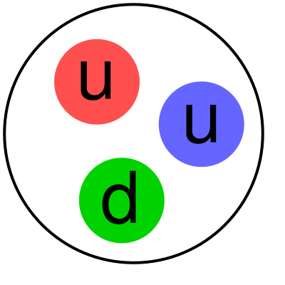

Introduction
OBSERVATION
Experiment
Theory
ATOMIC NUCLEUS
Many Body Quantum System
bound by the nuclear force
d
PREDICTION
PROTON
NEUTRON
COMPLEXITY OF THE SYSTEM
QUARKS and GLUONS are the building blocks of nucleons, while nucleons are the building blocks of nuclei
No a priori theory for
nuclear interaction!
Until the nucleon-nucleon interaction can be derived from more fundamental theory such as Quantum Chromodynamics we have to use various parametrizations for different purposes.
COMPLEXITY OF THE NUCLEAR FORCE
nuclear force acting between nucleons arises from the residual force acting between quarks in different nucleons

Slide 4
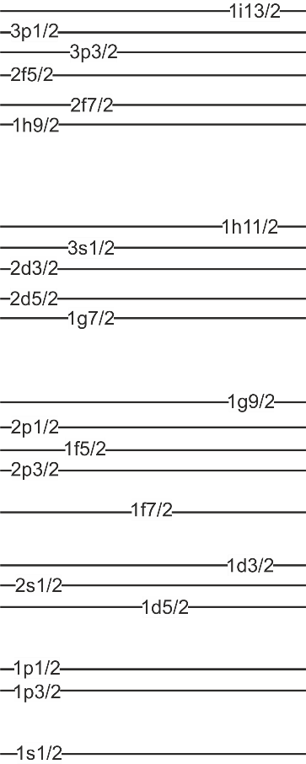
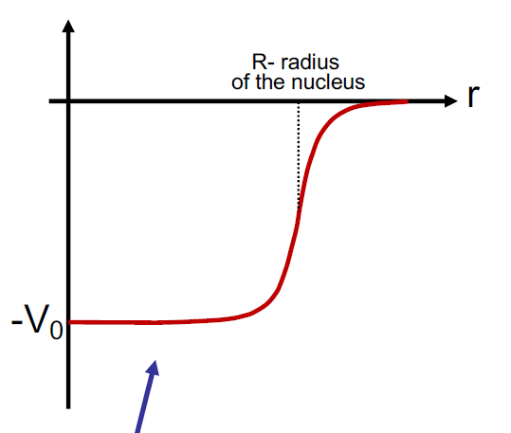
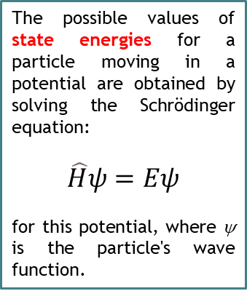


Introduction - Shell Model
126
Energy
Quantum states in the nuclear mean field
The primary assumption of the nuclear shell model is that the movement of nucleons can be to a good approximation treated as the movement of independent particles in a potential that represents the average interaction with the other nucleons.
82
The possible values of state energies for a particle moving in a potential are obtained by solving the Schrödinger equation:
$$\hat{H}ψ=Eψ$$
for this potential, where ψ is the particle's wave function.
50
28
20
8
2
$$V_{mean}\left(r\right)+A(r)\hat{L}∙\hat{S}$$
n$ℓ$j
Number of nucleons

Slide 5
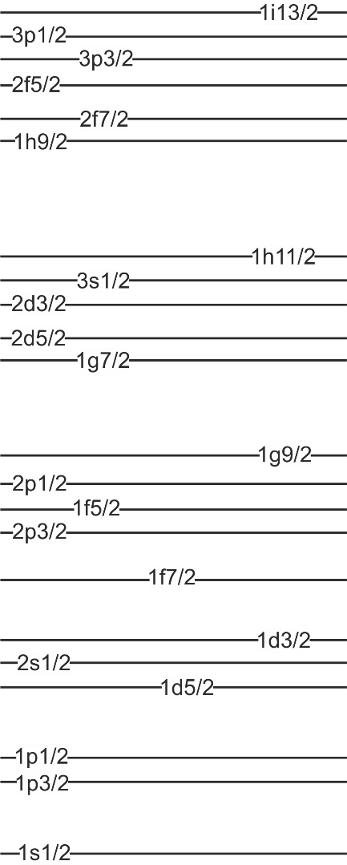
Stretched states
Such states are dominated by a single particle-hole component
for which the excited particle and the residual hole couple to
the maximal possible spin value:
J_{max} = j_{p} (max) + j_{h} (max)
M12
J = 5/2 + 3/2 = 4
M10
M8
M6
M4
PROTONS NEUTRONS
¹⁶O

Slide 6
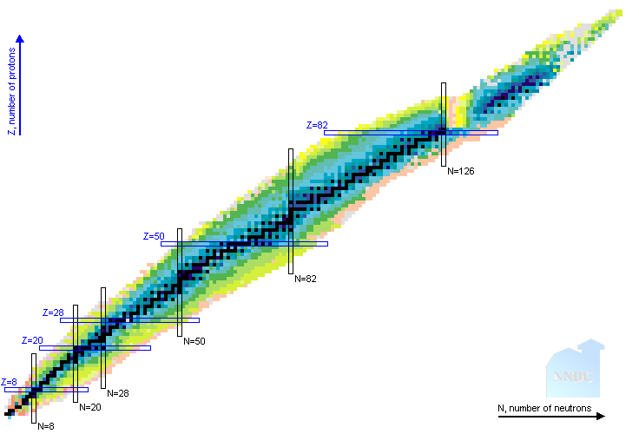
Stretched states
Such states are dominated by a single particle-hole component
for which the excited particle and the residual hole couple to
the maximal possible spin value:
J_{max} = j_{p} (max) + j_{h} (max)
M12
REPORTED STRETCHED STATES
M10
h_{11/2}  i_{13/2} M12 transitions
i_{13/2}  j_{15/2} M14 transitions
²⁰⁸Pb
M8
f_{7/2}  g_{9/2} M8 transitions
⁵²Cr, ⁵⁴Fe, ⁵⁶Fe, ⁵⁸Ni ⁶⁰Ni
M6
d_{5/2}  f_{7/2} M6 transitions
²⁴Mg, ²⁸Si
M4
p_{3/2}  d_{3/2} M4 transitions
¹¹B, ^{12,13,14}C, ^{14,15}N, ¹⁶O

Slide 7
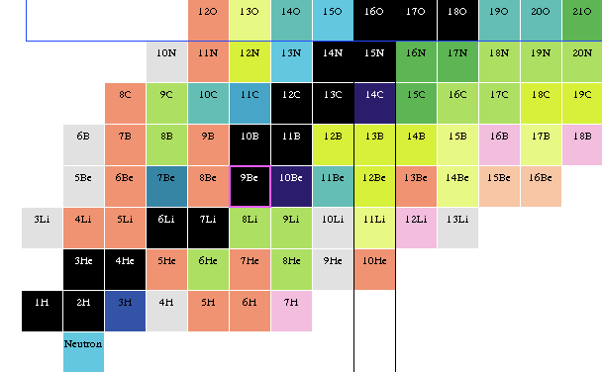
Stretched states in light nuclei – continuum region
CONFIGURATIONAL PURITY
ones of the simplest known
nuclear excitations
TESTING GROUND FOR THEORETICAL CALCULATIONS
properties of stretched states (decay patterns e.g.) used as
demanding test of state-of-the-art theory approaches
(Gamow Shell Model e.g.)
REPORTED STRETCHED STATES
In light nuclei reached by p_{3/2}  d_{3/2} M4 transitions
Populated in inelastic scattering of protons,
electrons or pions (experiments in the 80’s)
1d_{5/2}
M4 STATES
IN CONTINUUM
UNBOUND STATES
1p_{1/2}
¹⁶O
PARTICLE
SEPARATION
ENERGY
¹⁴N
¹⁵N
¹²C
¹³C
¹⁴C
1p_{3/2}
¹¹B
NO DATA ON M4 RESONANCES DECAY!
BOUND STATES
1s_{1/2}
PROTONS NEUTRONS
¹³C
1s_{1/2}
1p_{3/2}
1p_{1/2}
1d_{5/2}

Slide 8
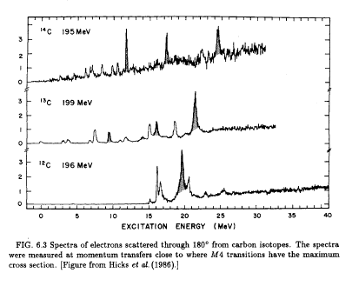
Stretched M4 resonances in light nuclei
¹³C is a perfect case to start:
strong M4 excitation
well isolated peak
quite easy preparation of target
REPORTED STRETCHED STATES
In light nuclei reached by p_{3/2}  d_{3/2} M4 transitions
Populated in inelastic scattering of protons,
electrons or pions (experiments in the 80’s)
1d_{5/2}
INELASTIC ELECTRON SCATTERING EXPERIMENTS
¹⁴C
11.7
17.3
24.3
RADIOACTIVE
TARGET
1p_{1/2}
¹⁶O
¹⁴N
¹⁵N
21.47
¹²C
¹³C
¹⁴C
¹³C
1p_{3/2}
¹¹B
16.08
9.5
19.5
Mixed with other
multipolarities - COMPLEX CASE
NO DATA ON M4 RESONANCES DECAY!
¹²C
1s_{1/2}
R.S. Hicks et al., PRC34, 1161(1986)
1s_{1/2}
1p_{3/2}
1p_{1/2}
1d_{5/2}

Slide 9

Previous studies of M4 resonances in ¹³C
The aim of the present investigations is to identify the decay of the 21.5-MeV
1p_{3/2} → 1d_{5/2} resonance in ¹³C
INELASTIC ELECTRON SCATTERING
¹³C(e,e’)
INELASTIC PION SCATTERING ¹³C(π,π’)
R.S. Hicks et al., PRC34, 1161(1986)
21.47
π⁻
D. Dehnhard et al., PRL43,1091(1979)
16.08
9.5
21.47 MeV
9.5
21.47
16.08
S_{p} = 17.5 MeV
16.08 MeV
INELASTIC PROTON SCATTERING
¹³C(p,p’)
S.F.Collins et al., Nuc. Phys. A481,494(1988)
9.5
π⁺
UNBOUND
STATES
21.47
16.08
9.50 MeV
π⁻−π⁺
EXCITATION ENERGY (MeV)
S_{n} = 4.9 MeV
From ¹³C(π,π’) scattering:
9.5 MeV is 9/2⁺: pure neutron excitation
16.08 MeV is 7/2⁺: mainly proton excitation
21.47 MeV is (7/2⁺,9/2⁺) proton and neutron excitations
BOUND
STATES
¹³C

Slide 10
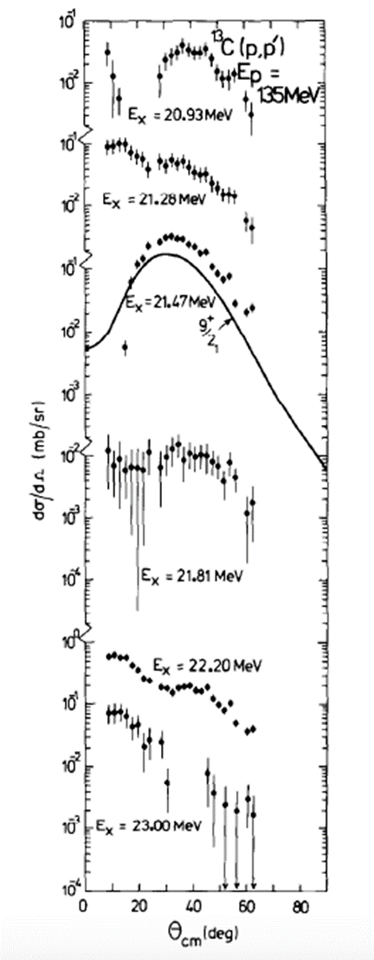
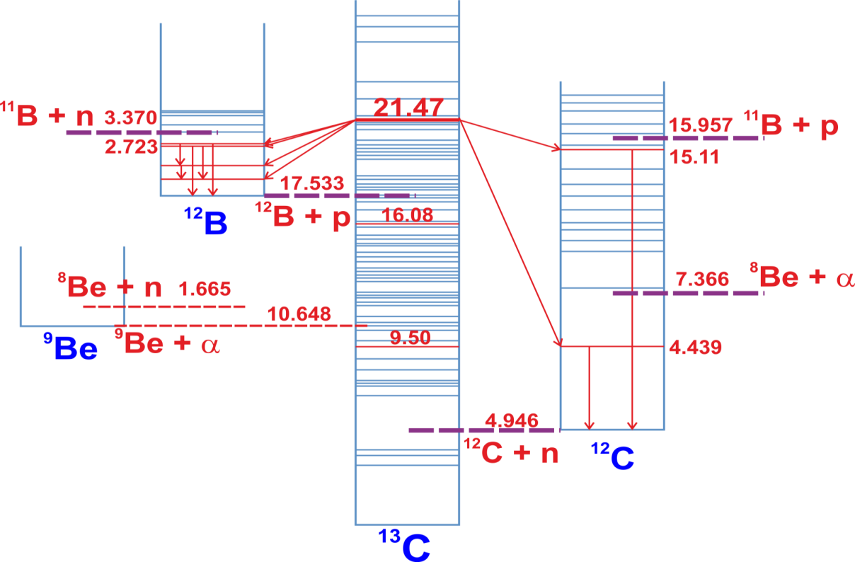
Previous studies of stretched states in ¹³C
INELASTIC PROTON SCATTERING ON ¹³C
S.F. Collins et al., Nuc. Phys. A481, 494(1988)
(Indiana University Cyclotron Facility Magnetic Spectrograph)
E_{p} = 135 MeV
21.47
The M4 resonance
at 21.47 MeV in ¹³C
is peaked at 30°
GATE ON SCATTERED PROTONS
EXCITATION ENERGY [MeV]
Strongest expected γ rays: ¹²B: 953, 1668, 1674, 2723 keV
¹²C: 4439, 15110 keV
30°

Slide 11
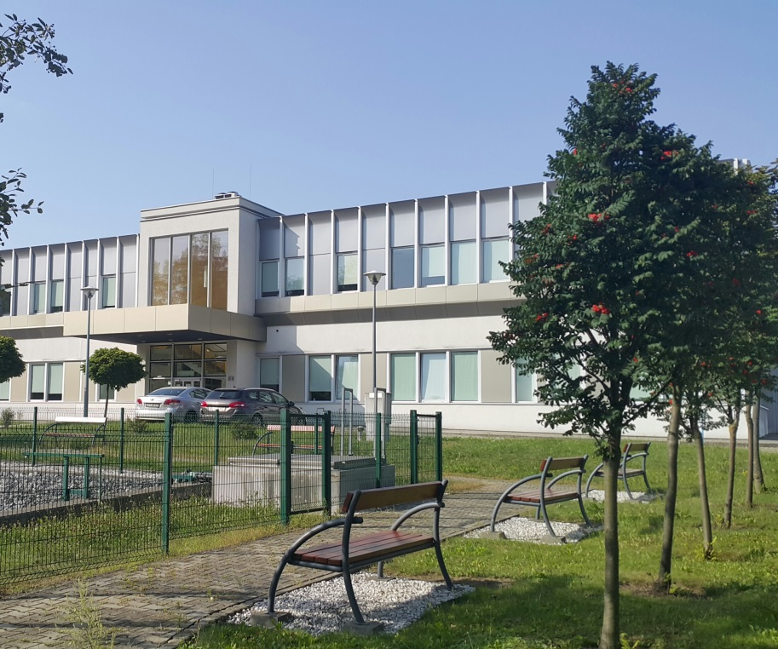

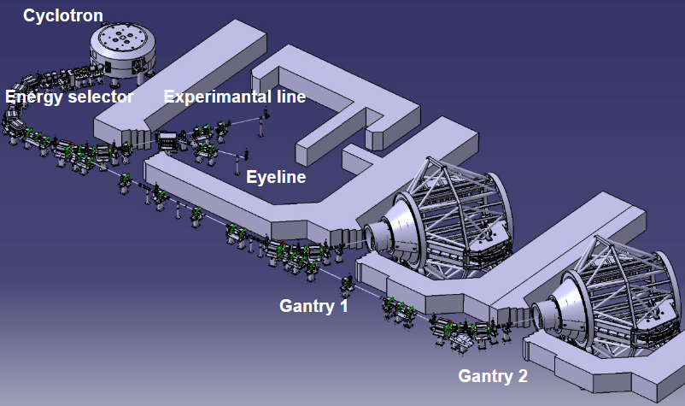

Experimental setup – Cyclotron Centre Bronowice (Kraków, Poland)
Experiment: „STUDY OF M4 STRETCHED CONFIGURATION DECAY IN ¹³C”
Spokespersons: B. Fornal (IFJ PAN), S. Leoni (INFN and Univ. Milano), M. Ciemała (IFJ PAN)
Proteus C-235

Slide 12
Experimental setup – Cyclotron Centre Bronowice (Kraków, Poland)
Experiment: „STUDY OF M4 STRETCHED CONFIGURATION DECAY IN ¹³C”
Spokespersons: B. Fornal (IFJ PAN), S. Leoni (INFN and Univ. Milano), M. Ciemała (IFJ PAN)
Proteus C-235
13C
TARGET
PROTON BEAM
GAMMA RAYS

Slide 13
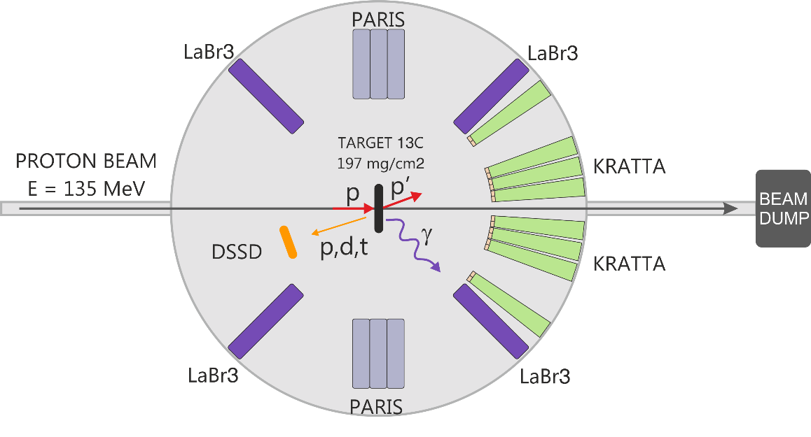
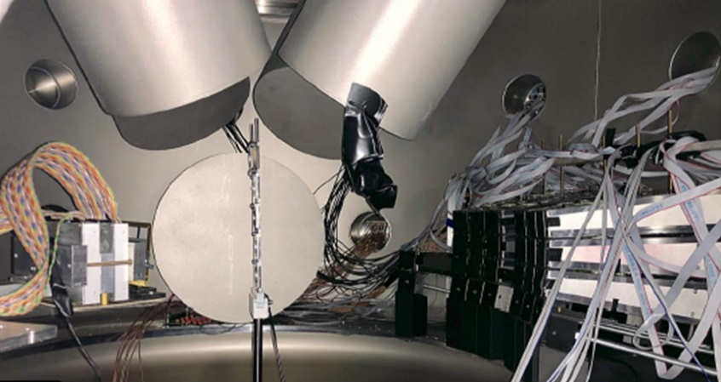
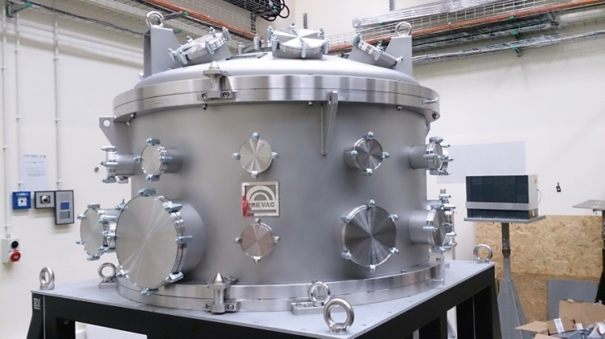
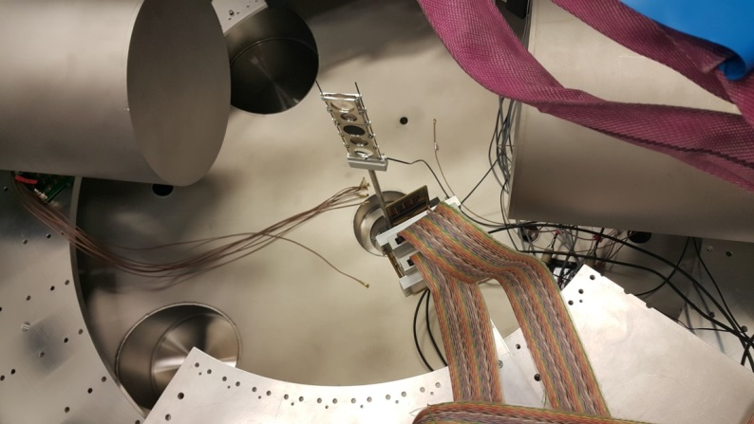
Experimental setup – measurements with thick and thin targets
LABR
LABR
PARIS
DSSD
KRATTA
PARIS
PARIS
1) Scattered protons measurement: KRATTA telescope array
2) γ-ray detection:
  four LaBr₃ detectors (3”x3”)
  two clusters of the PARIS scintillator array
3) Measurement of light charged particles produced in the reaction: a thick position-sensitive Si detector
DSSD
BEAM

Slide 14

Experimental setup – measurements with thick and thin targets
LABR
LABR
PARIS
DSSD
KRATTA
THICK ¹³C TARGET 197 mg/cm²: May-June 2019
126 hours of measurement + 17 hours for calibration + 24 hours for tests
6 KRATTA modules at ~36°
1) Scattered protons measurement: KRATTA telescope array
2) γ-ray detection:
  four LaBr₃ detectors (3”x3”)
  two clusters of the PARIS scintillator array
3) Measurement of light charged particles produced in the reaction: a thick position-sensitive Si detector
THIN ¹³C TARGET 1 mg/cm²: December 2019, March and June 2020
98 hours of measurement + 2 hours for calibration + 9 shifts for tests
30 KRATTA modules at ~36° (angular coverage: 30° -43°)

Slide 15
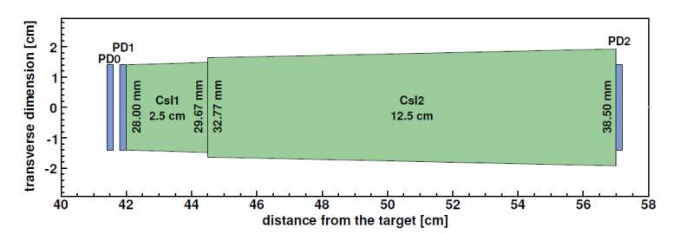

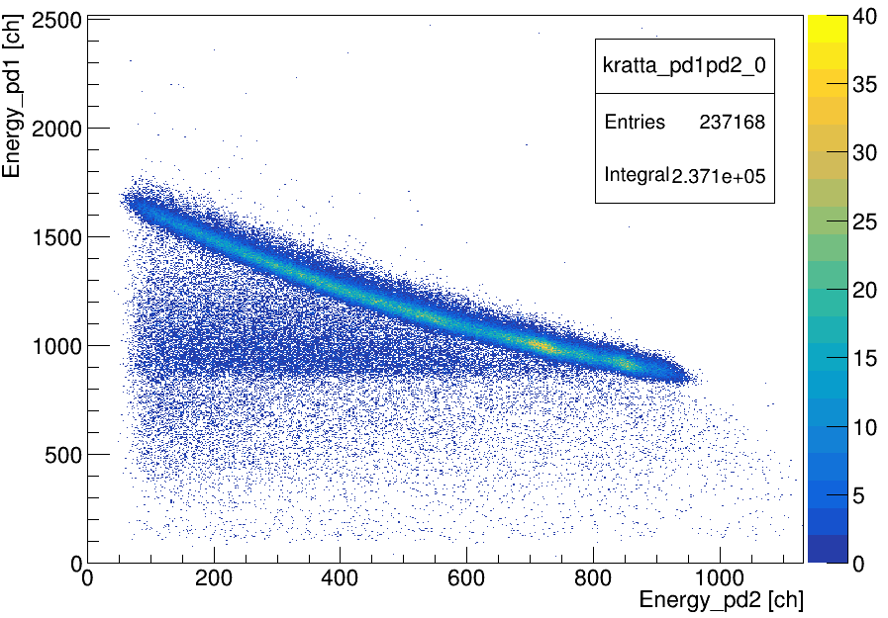
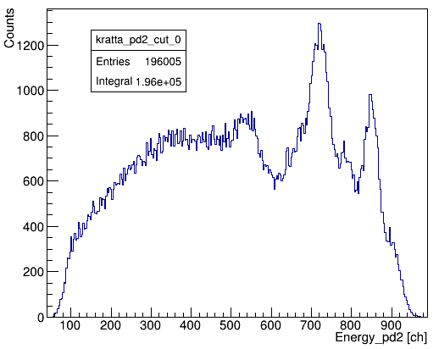
Measurement of the scattered protons: KRATTA telescope array
scattered protons
Other sorting conditions:
Plastic multiplicity = 1
Coincidence with corresponding plastic
Gates on time in PD1 and PD2
J. Lukasik et al., NIM A709, 120(2013)
PROTON IDENTIFICATION MATRIX PD1-PD2
PROTON ENERGY SPECTRUM IN PD2
protons
PROJECTION ON PD2 AXIS

Slide 16
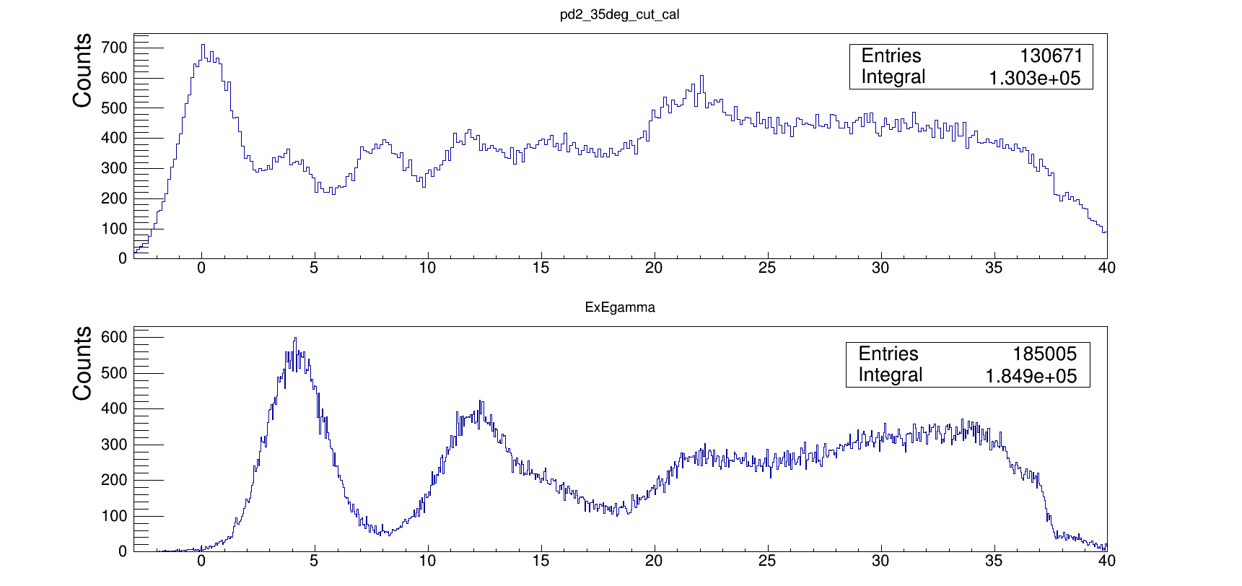
KRATTA – excitation energy spectra
13C(p,p’) @ 135 MeV
REFERENCE
SPECTRUM
Excitation energy spectra measured at ~36° corresponding to the excitations in the ¹³C target nucleus measured as:
S.F.Collins et al., Nuc. Phys. A481,494(1988)
Counts
EXCITATION ENERGY[MeV]
21.5
PROTON SINGLES
(only scattered proton required)
SINGLES (only scattered proton required)
11.9
decay to
4.4 MeV (¹²C)
15.1
3.7
7.6
16.1
g.s.
EXCITATION ENERGY[MeV]
EXCITATION ENERGY[MeV]

Slide 17
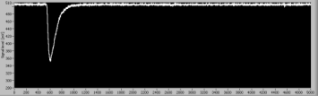
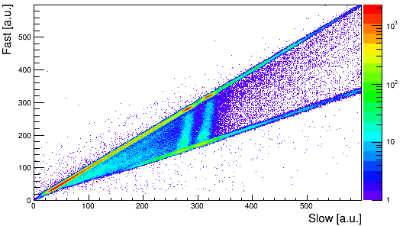
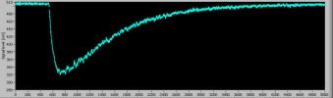
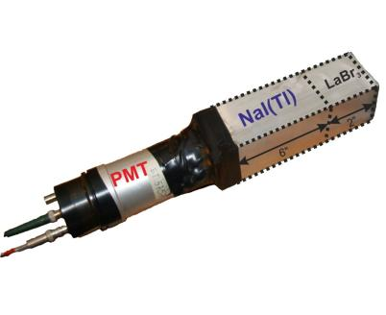
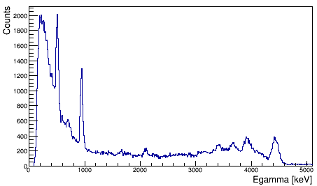
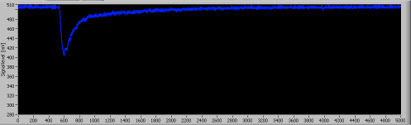
KRATTA – excitation energy spectra
Excitation energy spectra measured at ~36° corresponding to the excitations in the ¹³C target nucleus measured as:
IN COINCIDENCE WITH γ RAYS
(4 big LaBr₃ detectors + 18 modules of PARIS)
21.5
PROTON SINGLES
(only scattered proton required)
SINGLES (only scattered proton required)
11.9
decay to
4.4 MeV (¹²C)
15.1
SINGLE PULSE
3.7
7.6
16.1
g.s.
PROTON-GAMMA COINCIDENCES
SINGLE PULSE
The PARIS PHOSWICH
EXCITATION ENERGY[MeV]
GAMMA-RAY SPECTRUM
(PARIS „fast” part)
EXCITATION ENERGY[MeV]
A. Maj et al., Acta Phys. Pol. B40, 565(2009) and http://paris.ifj.edu.pl
MIXED SIGNAL
EXCITATION ENERGY[MeV]

Slide 18
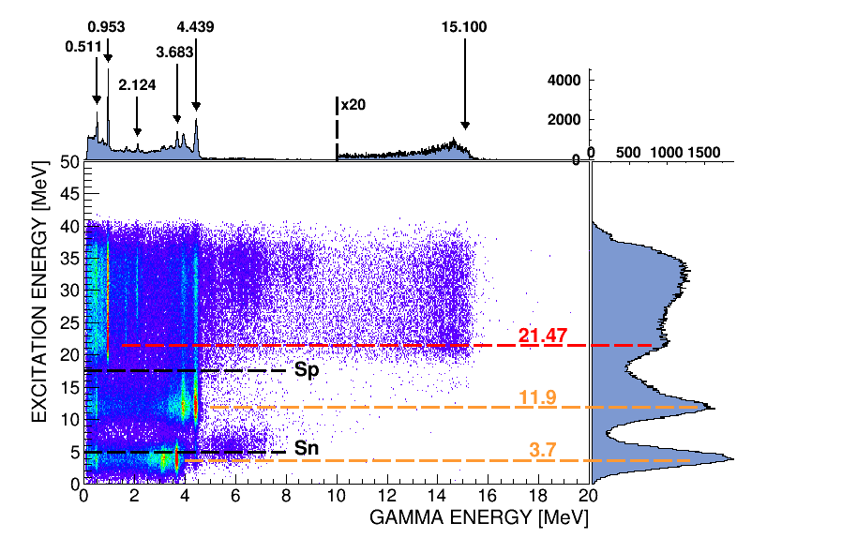
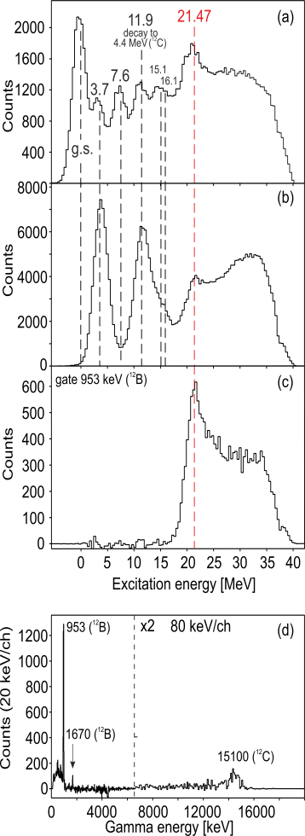
Experimental results: proton-gamma coincidence measurement
GATE 21.47 MeV (¹³C)

Slide 19
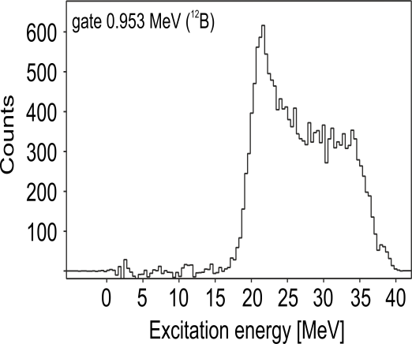
Experimental results: proton-gamma coincidence measurement
¹²B
GATE 953 keV
(¹²B)
GATE 21.47 MeV (¹³C)
21.47

Slide 20
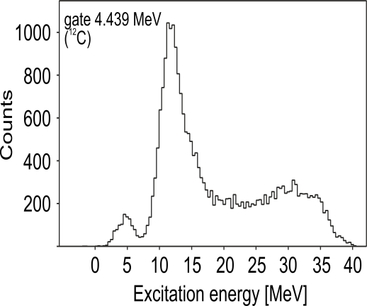
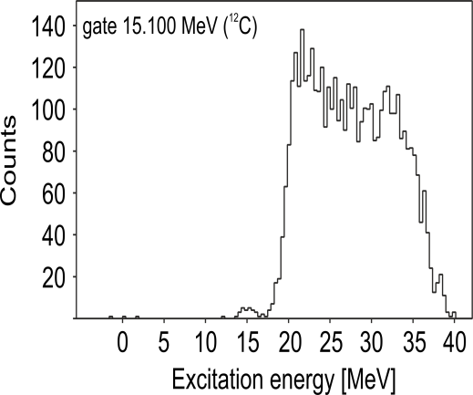
Experimental results: proton-gamma coincidence measurement
¹²C
GATE 953 keV
(¹²B)
GATE 21.47 MeV (¹³C)
21.47
GATE 4.4 MeV
(¹²C)
GATE 15.1 MeV
(¹²C)
21.47

Slide 21
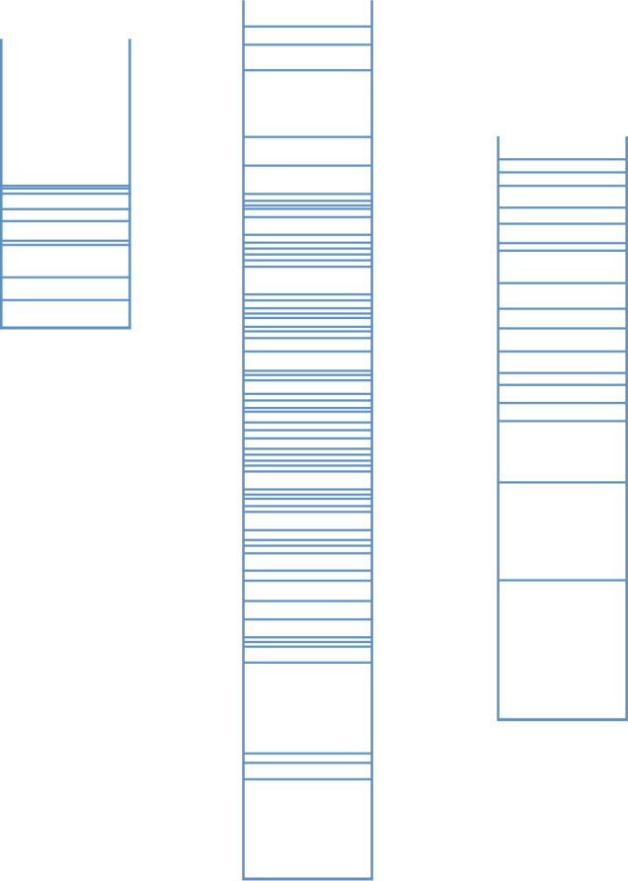
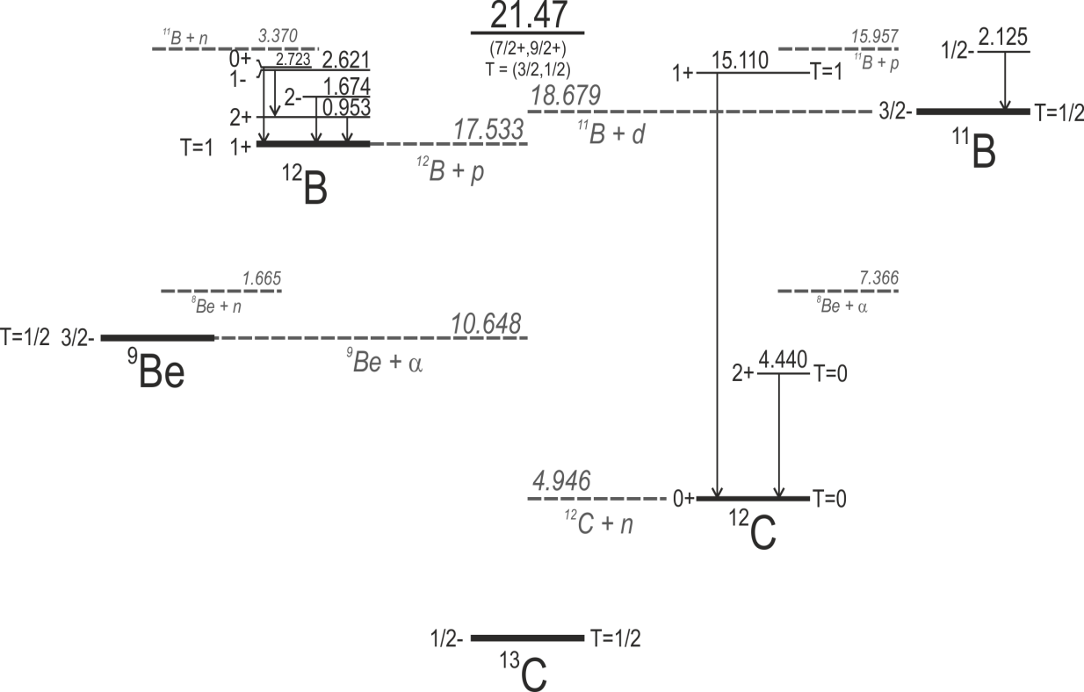
Experimental results: proton-gamma coincidence measurement
PROTON DECAY TO ¹²B
NEUTRON DECAY TO ¹²C
7(2)
24(5)
69(6)
Decay to ¹²B g.s. ?

Slide 22
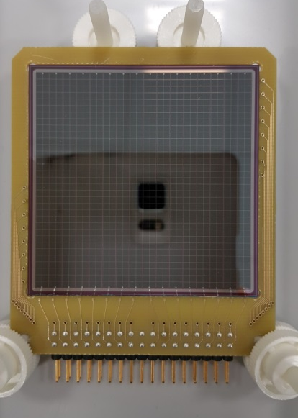
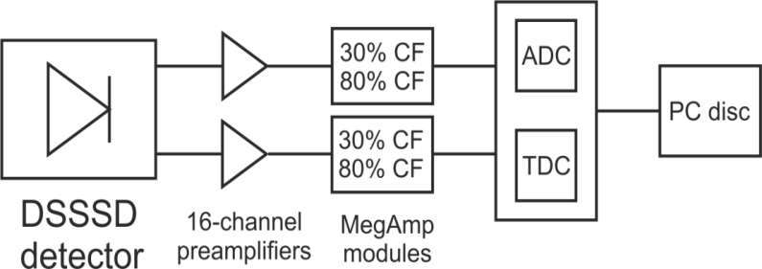
PERFORMANCE OF DSSSD (FROM THICK ¹³C TARGET EXPERIMENT)
Double Sided Silicon Strip Detector
(Micron Semiconductor Ltd)
Active area: No. of strips:
Thickness:
50mm x 50mm
32 (16 per side) 1.5 mm
13C
TARGET
PROTON BEAM
LIGHT CHARGED PARTICLES
SCHEME OF ACQUISITION LINE
MegAmp Pulse Shape Amplifier
(C. Boiano, S. Brambilla, INFN Milano)
Information on the energy
and rise time allowing for
light particle identification

Slide 23
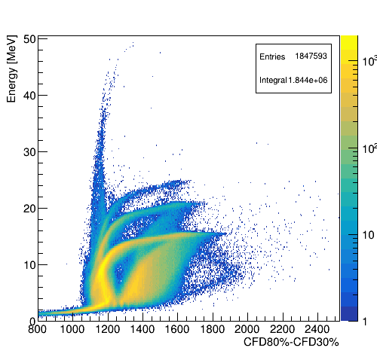
PERFORMANCE OF DSSSD (FROM THICK ¹³C TARGET EXPERIMENT)
PARTICLE IDENTIFICATION MATRIX
(for one strip, representative example)
Double Sided Silicon Strip Detector
(Micron Semiconductor Ltd)
Active area: No. of strips:
Thickness:
50mm x 50mm
32 (16 per side) 1.5 mm
13C
TARGET
Particle energy [MeV]
24.7
triton
20.9
deuteron
PROTON BEAM
15.5
proton
LIGHT CHARGED PARTICLES
SCHEME OF ACQUISITION LINE
~Rise time [a.u.]
MegAmp Pulse Shape Amplifier
(C. Boiano, S. Brambilla, INFN Milano)
Information on the energy
and rise time allowing for
light particle identification

Slide 24
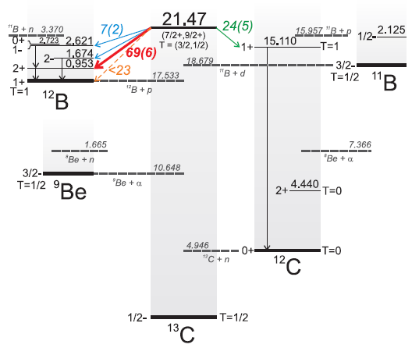
PERFORMANCE OF DSSSD (FROM THICK ¹³C TARGET EXPERIMENT)
PARTICLE IDENTIFICATION MATRIX
(for one strip, representative example)
Double Sided Silicon Strip Detector
(Micron Semiconductor Ltd)
Active area: No. of strips:
Thickness:
50mm x 50mm
32 (16 per side) 1.5 mm
Particle energy [MeV]
24.7
triton
20.9
deuteron
15.5
proton
~Rise time [a.u.]
Why another experiment?
Expected energies of emitted protons are
below 4 MeV so protons will stuck in the thick target
Excit.Energy in ¹²B [MeV] | E_{proton} [MeV]
2.723 | 1.214
2.621 | 1.316
1.674 | 2.263
0.953 | 2.984
0.0 | 3.937
THIN TARGET NEEDED
FOR LOW-ENERGY PROTONS!

Slide 25
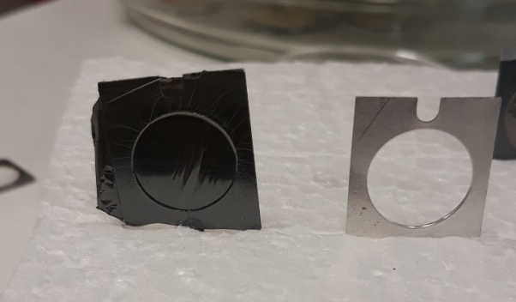
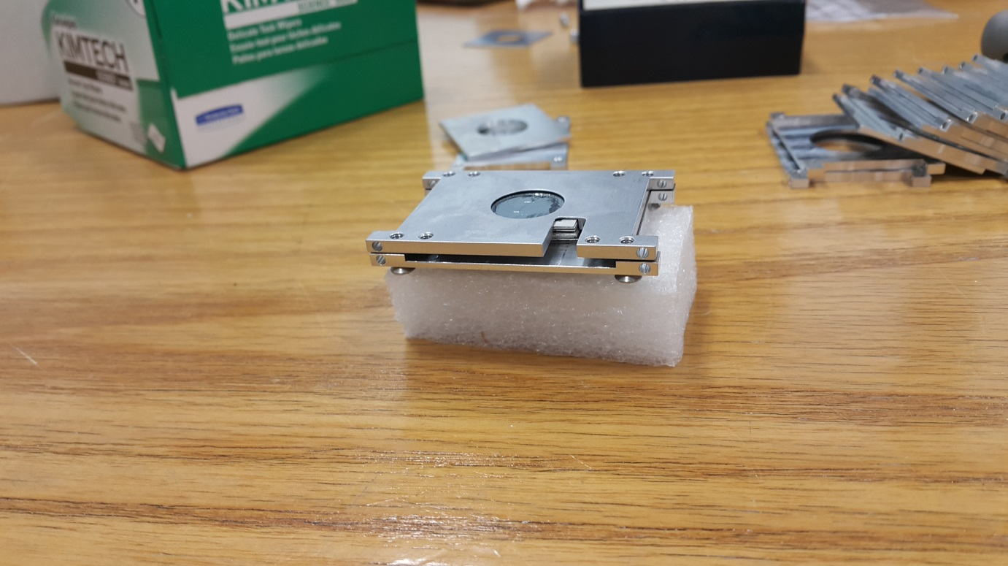
Thin 1 mg/cm² ¹³C target experiment
Double Sided Silicon Strip Detector
(Micron Semiconductor Ltd)
Active area: 50mm x 50mm
No. of strips: 32 (16 per side)
Thickness: 1.5 mm
Information on the energy and rise time
allowing for light particle identification
¹³C target made of 10 foils in separate frames,
total thickness 1 mg/cm²
(Nicoleta Florea, Nicu Marginean IFIN-HH, Bucharest, Romania)
Why another experiment?
Expected energies of emitted protons are
below 4 MeV so protons will stuck in the thick target
Excit.Energy in ¹²B [MeV] | E_{proton} [MeV]
2.723 | 1.214
2.621 | 1.316
1.674 | 2.263
0.953 | 2.984
0.0 | 3.937
THIN TARGET NEEDED
FOR LOW-ENERGY PROTONS!

Slide 26

Thin 1 mg/cm² ¹³C target preparation
¹³C target made of 10 foils in separate frames,
total thickness 1 mg/cm²
(Nicoleta Florea, Nicu Marginean IFIN-HH, Bucharest, Romania)

Slide 27
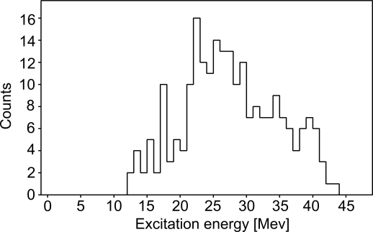
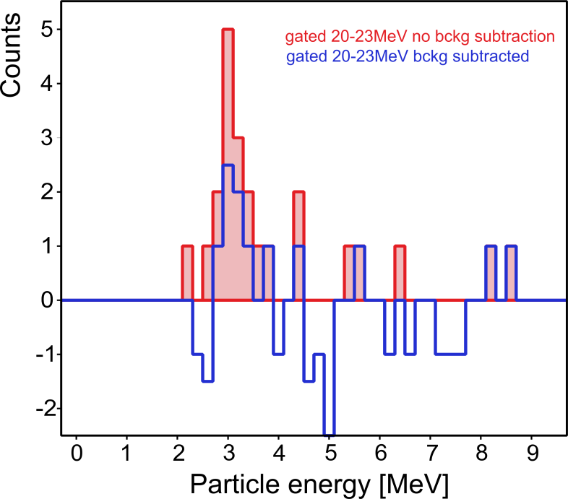
Scattered proton – light charged particle coincidences
Sorting conditions:
gate on protons in KRATTA
gate on times in KRATTA
plastic mult = 1
plastic ID corresponding to KRATTA ID
3.0 MeV
Projection of the excitation energy vs. particle energy matrix
GATE
BACKGROUND
NO BACKGROUNG SUBTRACTION
WITH BACKGROUND SUBTRACTION
+ KINEMATIC CORRECTION (by M. Ciemała)
Kinetic energy of proton in DSSD was reconstructed, that is, corrected on the energy of ¹³C recoil (all angles of Plastics and DSSD pixels included)
Energy loss of the particle in the middle of the target was included
Energy of ¹²B recoil was added
~4 counts
GATE
Excit.Energy in ¹²B [MeV] | E_{proton} [MeV]
2.723 | 1.214
2.621 | 1.316
1.674 | 2.263
0.953 | 2.984
0.0 | 3.937

Slide 28
Decay of the 21.47-MeV stretched state in ¹³C: first experimental information
Fraction of the decay
with gamma-ray emission from daughter nucleus: 46(10)%

Slide 29
Stretched states in the continuum – Gamow Shell Model calculations
Calculations by Y. Jaganathen (IFJ PAN) and M. Płoszajczak (GANIL)
The Gamow Shell Model is an open-quantum system extension
of the traditional Shell Model, which provides:
a rigorous treatment of bound and unbound nuclear excitations, including coupling to a continuum of non-resonant particles
a fully consistent calculation of the resonance energy and width and their mutual relation
FOR THE FIRST TIME GSM CALCULATIONS WERE PERFORMED FOR SUCH „HEAVY” SYSTEM

Slide 30
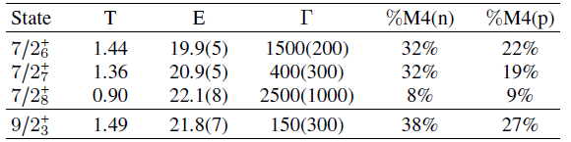
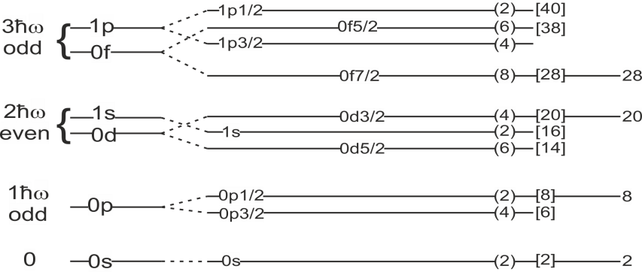
Stretched states in the continuum – Gamow Shell Model calculations
Calculations by Y. Jaganathen (IFJ PAN) and M. Płoszajczak (GANIL)
CANDIDATES FOR THE 21.5-MeV M4 RESONANCE IN ¹³C:
Mostly decays to the 1⁺ states of
¹²B and ¹²C
Small percentage of a particle-hole excitation between the p_{3/2}
and the d_{5/2} orbitals
M4
Does not decay to the 1⁺ state at 15.11 MeV in ¹²C or to the negative parity states in ¹²B
PROTONS NEUTRONS
¹³C

Slide 31
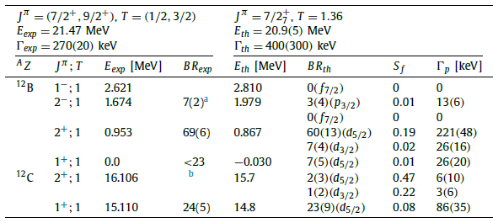
Stretched states in the continuum – Gamow Shell Model calculations
(by Y. Jaganathen (IFJ PAN) and M. Płoszajczak (GANIL))

Slide 32
Summary
EXPERIMENT
The first information on the decay branching
of the 21.47-MeV stretched state in ¹³C nucleus
was obtained from proton-gamma coincidence measurements.
GAMOW SHELL MODEL CALCULATIONS
Performed for the first time for such „heavy” system.
Successful comparison with experiment in terms of
state energy, width and decay branchings proves the high quality and precision of the GSM wave-function calculations
BETTER UNDERSTANDING
OF THE DECAY PATTERN!
This newly developed approach will be crucial in predicting structures in the continuum in other nuclei in this key region of nuclear chart.

Slide 33
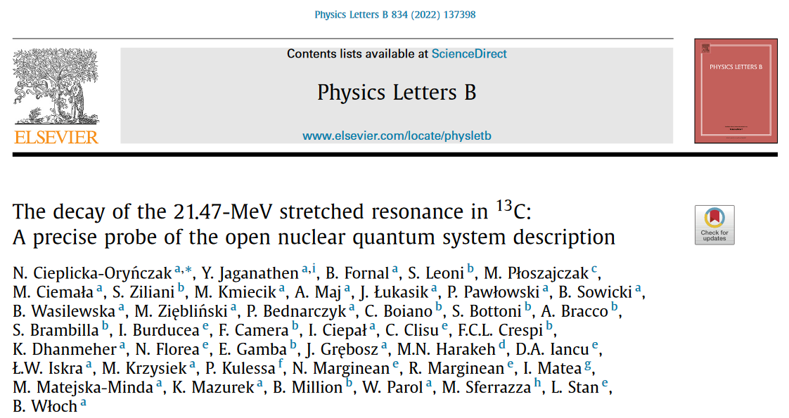
Thank you for your attention!

