Slide 1
Overview of the PIP-II RF Systems: Design and Delivery
Jeremiah Holzbauer, PIP-II Accelerator Systems L2 Manager
SPAS 2024
October 21st, 2024

Slide 2
Outline
PIP-II Mission & Scope
Project Overview and Status
  International Partners
Technical progress
  SRF Scope, Cavity, Cryomodules
  Cryoplant and CDS
  PIP2IT: Test bed and Teststand
  RF Systems
  Upgrades to the RF Systems of the Existing Complex Upgrades
Challenges and Path Forward
Summary

Slide 3
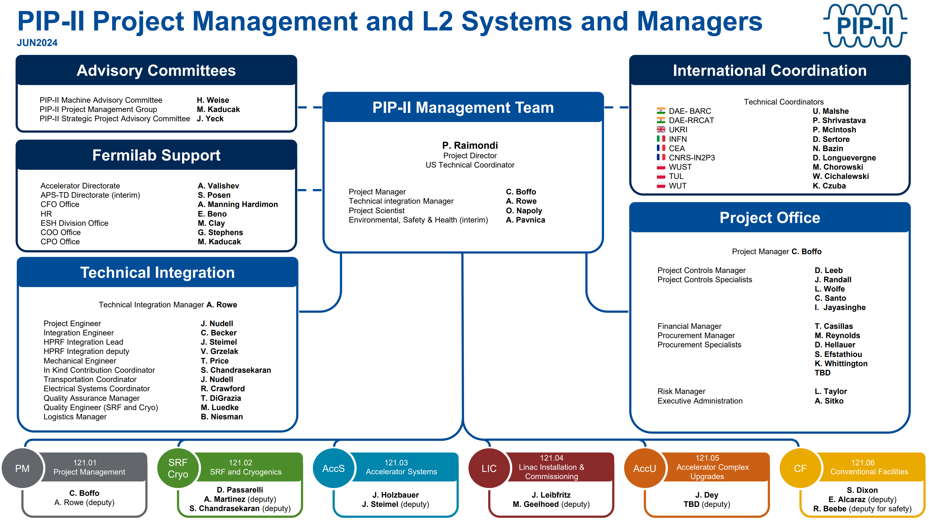
Collaborative Talk on behalf of larger PIP-II Team

Slide 4
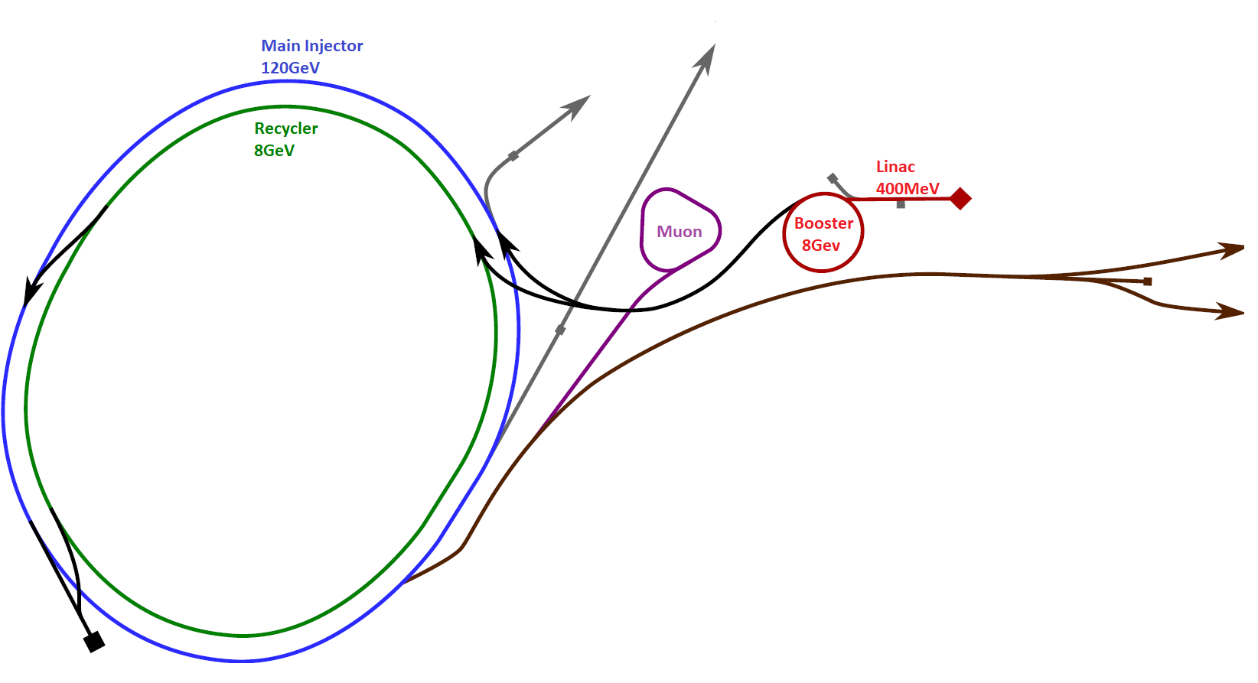
Present FNAL Accelerator Complex
 | Kinetic Energy
RIL | 750 | KeV
Linac | 400 | MeV
Booster | 8 | GeV
Recycler | 8 | GeV
Main Injector | 120 | GeV

Slide 5
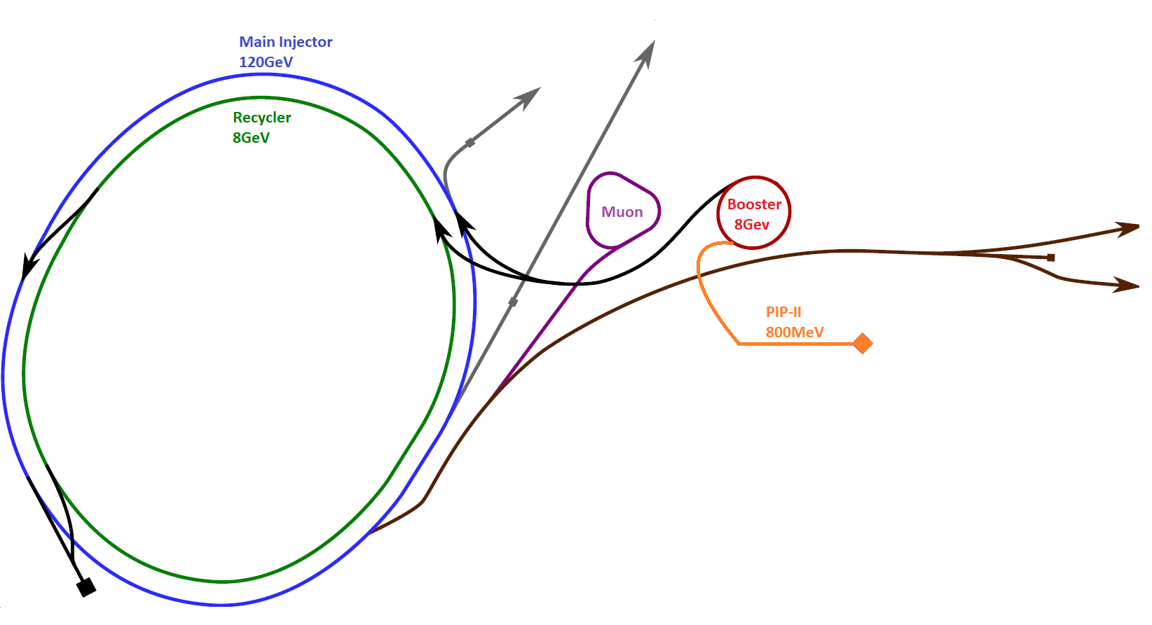
PIP-II Era Accelerator Complex
Expected Project Complete: Late 2029
 | Kinetic Energy
WFE | 2.1 | MeV
PIP-II SRF Linac | 800 | MeV
Booster | 8 | GeV
Recycler | 8 | GeV
Main Injector | 120 | GeV

Slide 6
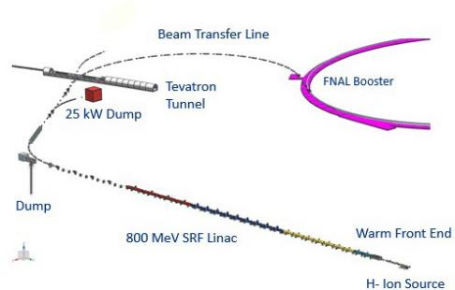
PIP-II Mission
PIP-II is an essential upgrade to Fermilab accelerator complex to enable the world’s most intense beam of neutrinos to LBNF/DUNE, and a broad physics research program for decades to come.
PIP-II Capabilities
Beam Power
PIP-II Scope
800 MeV H− SRF linac CW RF Operations
Linac-to-Booster transfer line Accelerator Complex Upgrades
Booster Recycler Main Injector
Conventional Facilities
Space reserved for two CMs for 1 GeV Upgrade
1.2 MW proton beam
Upgradeable to multi-MW
Flexibility, multi-user capability
CW-compatible
Customized beams
Multi-user delivery
Reliability
Modernizes Fermilab accel complex
The PIP-II scope enables the accelerator complex to reach 1.2 MW proton beam on LBNF target

Slide 7
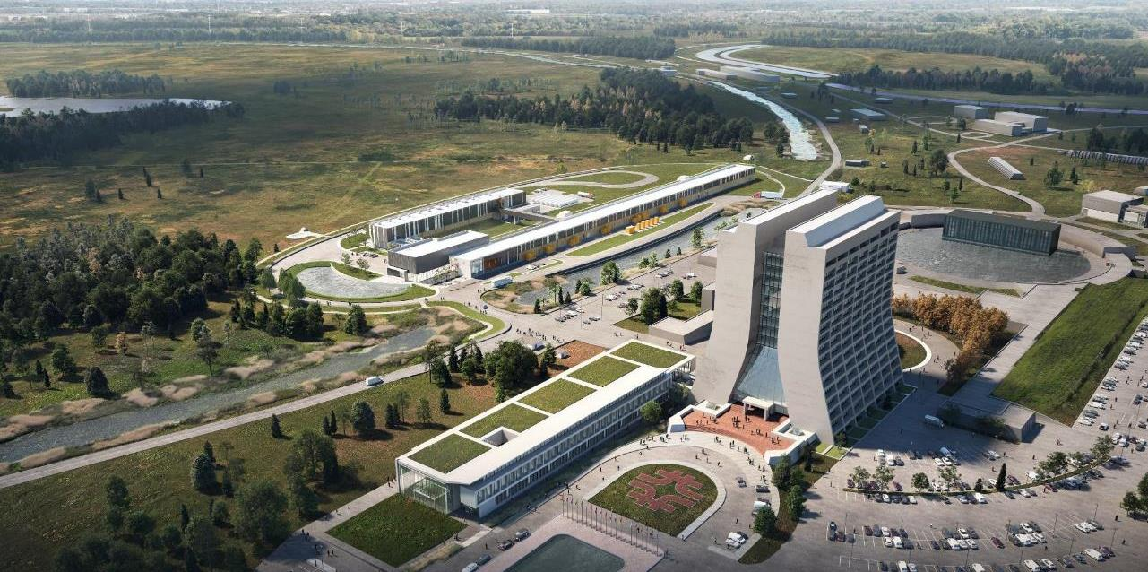












Main Injector
Transfer Line
PIP-II
SRF Linac
Booster
PIP-II will provide a highly capable, reliable, upgradeable and expandable scientific infrastructure with significant savings to DOE

Slide 8
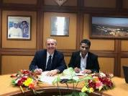






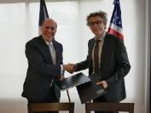

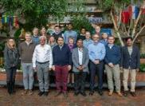



PIP-II International Partners, Expertise and Capabilities
India, Department of Atomic Energy (DAE) (started 2009) BARC, RRCAT, VECC; and IUAC
Substantial engineering / manufacturing experience; Superconducting magnets for LHC; 2 GeV synch light source
Italy, INFN (started 2016)
Internationally recognized leader in superconducting RF technologies SRF cavity and cryomodule fabrication for XFEL; SRF cavities for ESS
UK, STFC UKRI (started 2017)
Substantial engineering and manufacturing experience; Construction, operation of synch light & neutron sources SRF cavity processing and testing for ESS
France, CEA, CNRS/IN2P3 (started 2017)
Internationally recognized leader in large-scale CM assembly
CM assembly for European XFEL and ESS; SSR2 cavities and couplers for ESS
Poland, WUST, WUT, TUL (started 2018)
Substantial engineering / manufacturing experience; CDS, LLRF, QC for XFEL, ESS
PIP-II is the U.S. first accelerator project to be built with major international contributions; benefits from world-leading expertise, capabilities
3/1/2022 Lia Merminga | PIP-II Overview | PIP-II DOE CD-3 Review Plenary

Slide 9



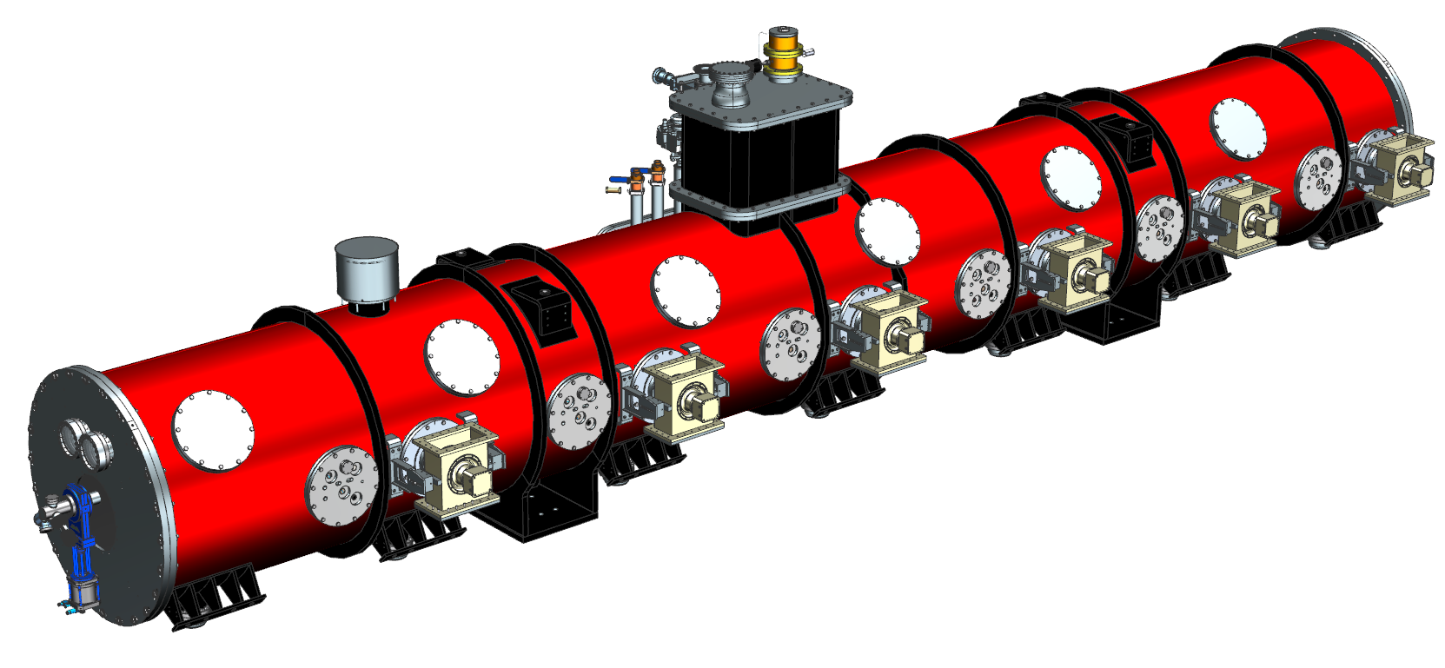




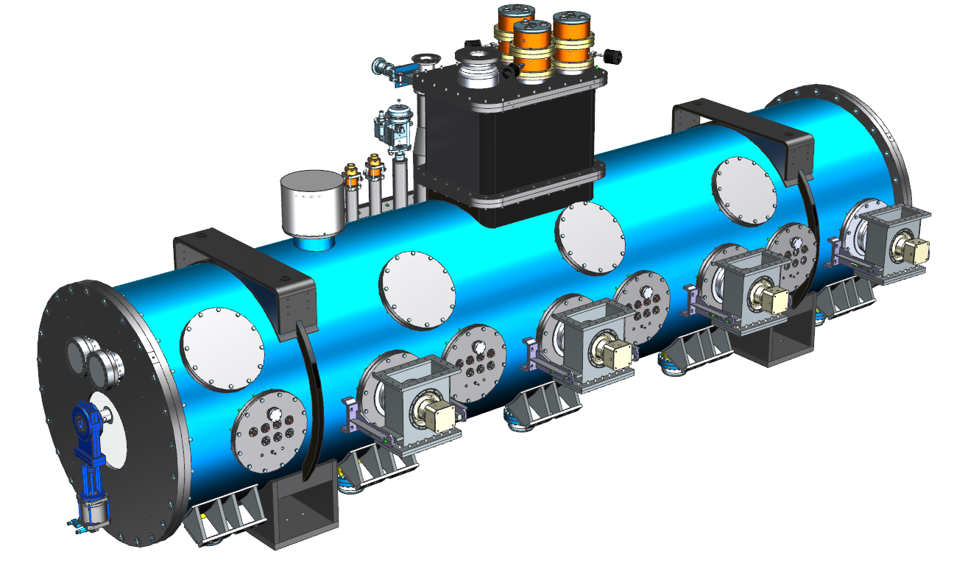



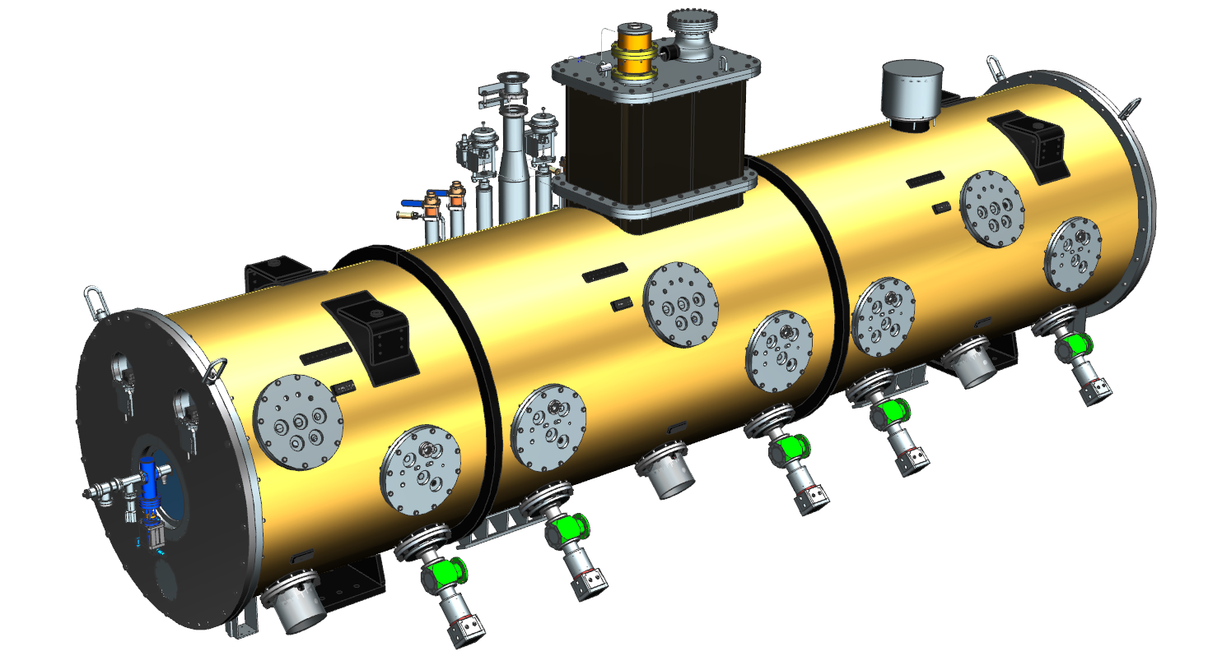
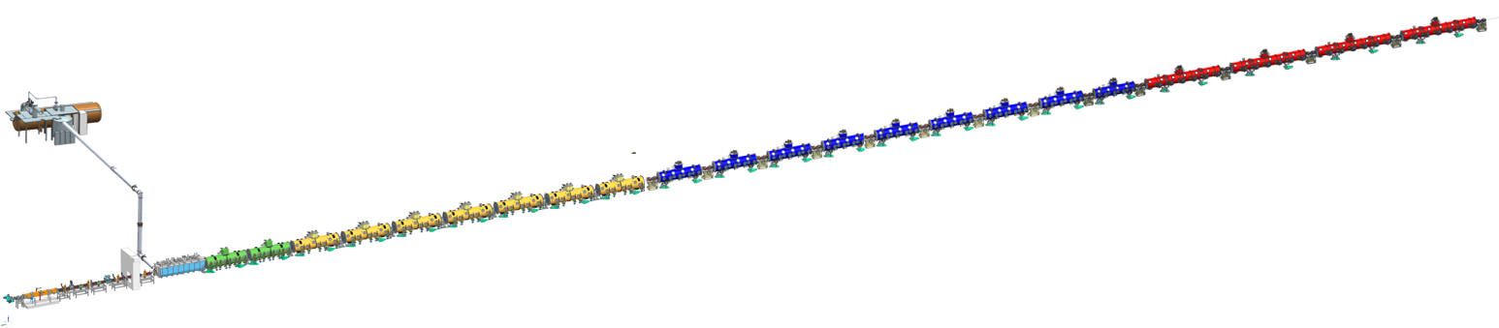
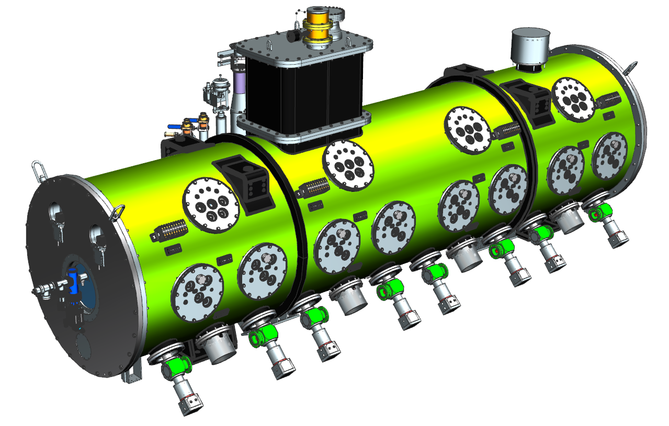





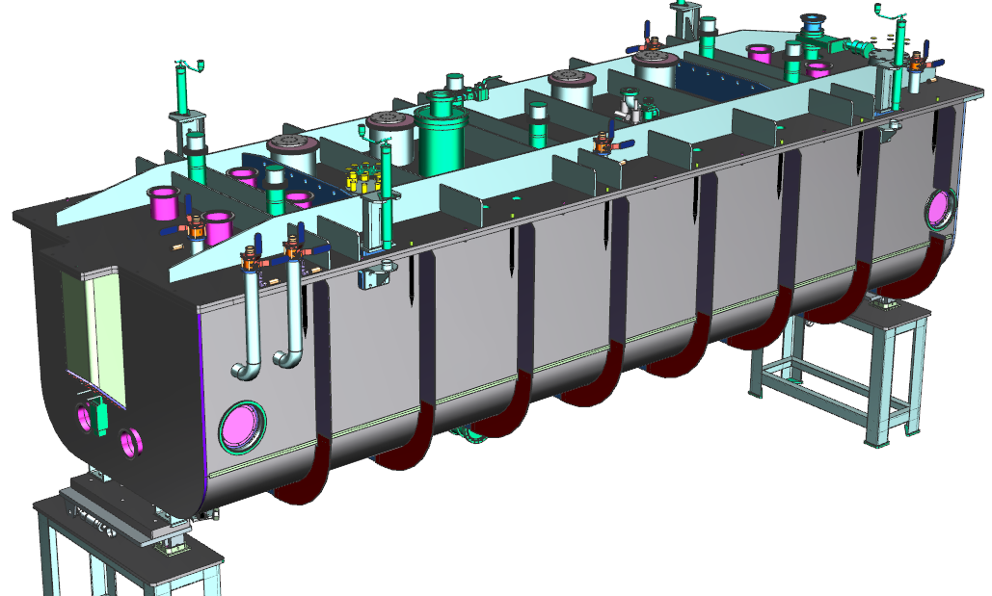

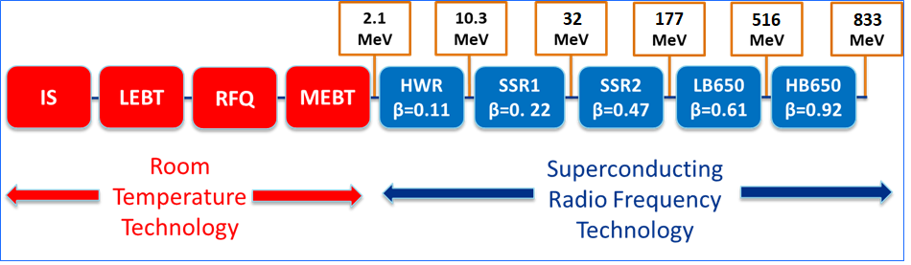





Superconducting Linac Scope
Management, design, procurement, fabrication, and testing of:
Superconducting Radio Frequency (SRF) cryomodules
Cryogenic Plant (CP)
Cryogenic Distribution System (CDS)
Elliptical
HB650 x (1 + 4)
650 MHz
Elliptical
LB650 x (1 + 9)
650 MHz
Single Spoke 2
SSR2 x (1 + 7)
325 MHz
Single Spoke 1
SSR1 x (1 + 2)
325 MHz
Cryoplant
2.5kW @ 2K
HWR
162.5 MHz
833 MeV $β$=0.92
516 MeV $β$=0.61
177 MeV $β$=0.47
SRF technology
10
CDS
32 MeV $β$=0.22
The in-kind contribution (IKC) from our international partners is substantial.
10 MeV $β$=0.11
RT technology *
PIP-II technology map

Slide 10
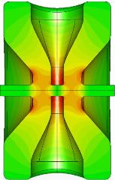
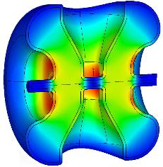



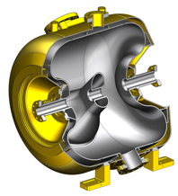
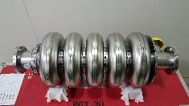
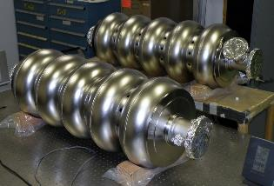
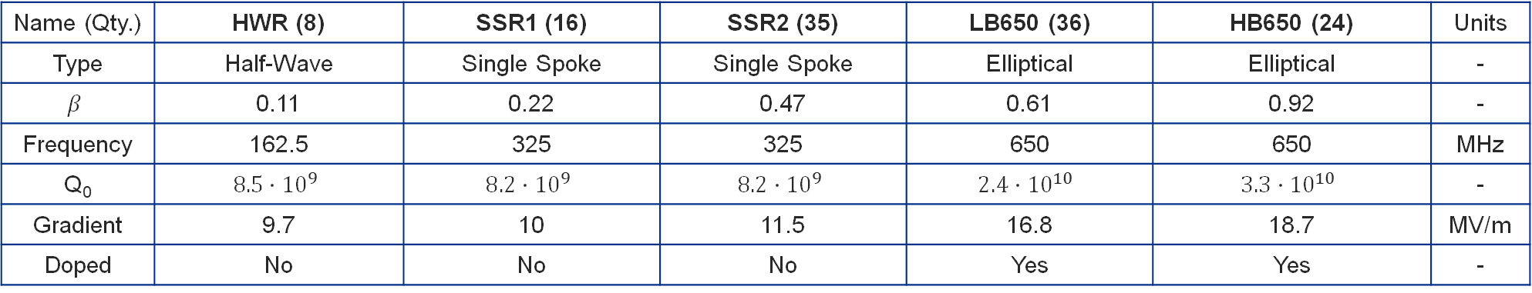
PIP-II Cavity Development
Name (Qty.) | HWR (8) | SSR1 (16) | SSR2 (35) | LB650 (36) | HB650 (24) | Units
Type | Half-Wave | Single Spoke | Single Spoke | Elliptical | Elliptical | -
$$β$$ | 0.11 | 0.22 | 0.47 | 0.61 | 0.92 | -
Frequency | 162.5 | 325 | 325 | 650 | 650 | MHz
Q₀ | $$8.5∙{10}^{9}$$ | $$8.2∙{10}^{9}$$ | $$8.2∙{10}^{9}$$ | $$2.4∙{10}^{10}$$ | $$3.3∙{10}^{10}$$ | -
Gradient | 9.7 | 10 | 11.5 | 16.8 | 18.7 | MV/m
Doped | No | No | No | Yes | Yes | -
Prototypes validated

Slide 11
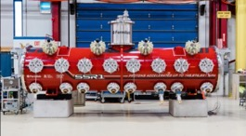
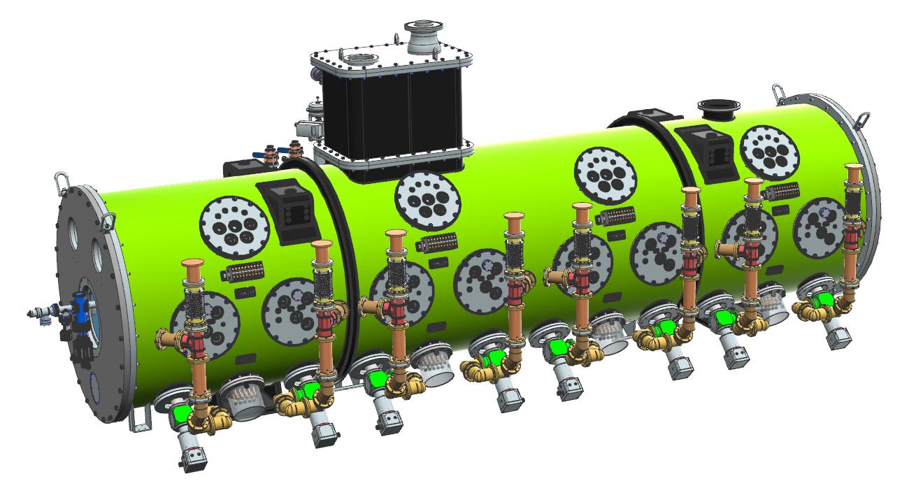
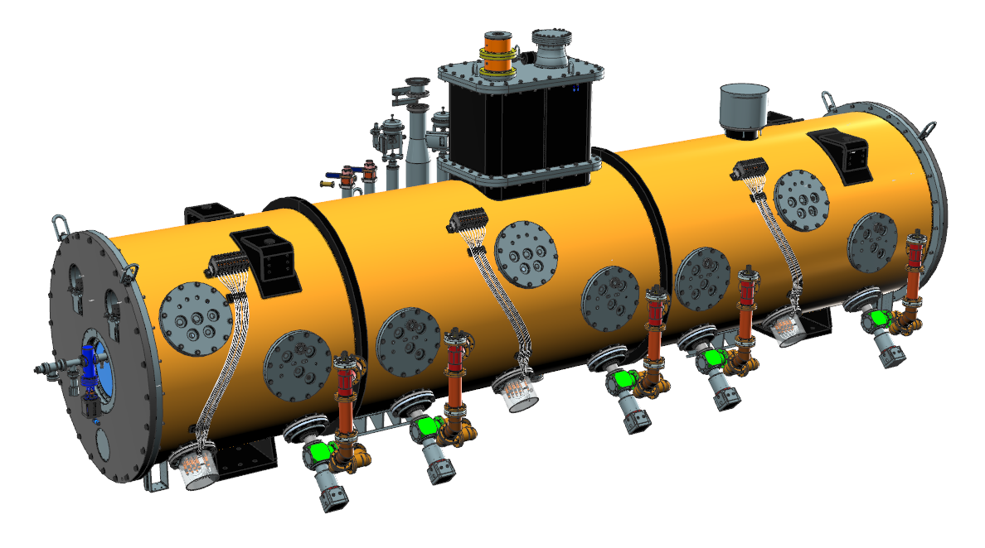
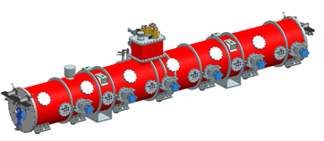
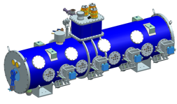
SRF technology map
2022
Timeline
PIP2IT
SSR1
2024
SSR2
Cryomodules
2025
2023
HB650
pCM rebuilt
2025
Prototype
Production
LB650
The development of prototype and pre-production units is instrumental in validating the Fermilab-style cryomodule design.

Slide 12
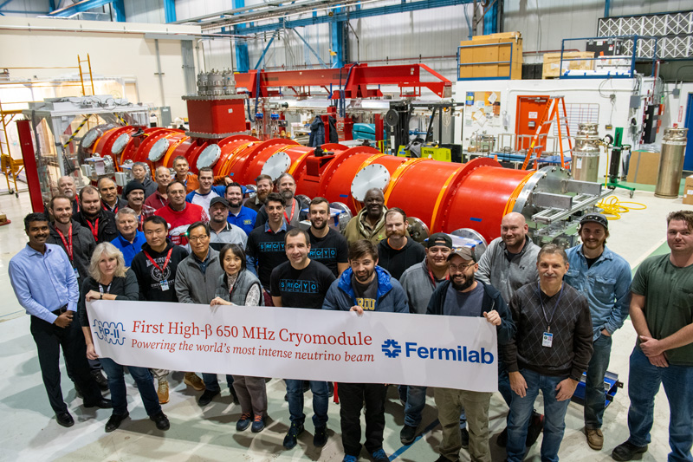
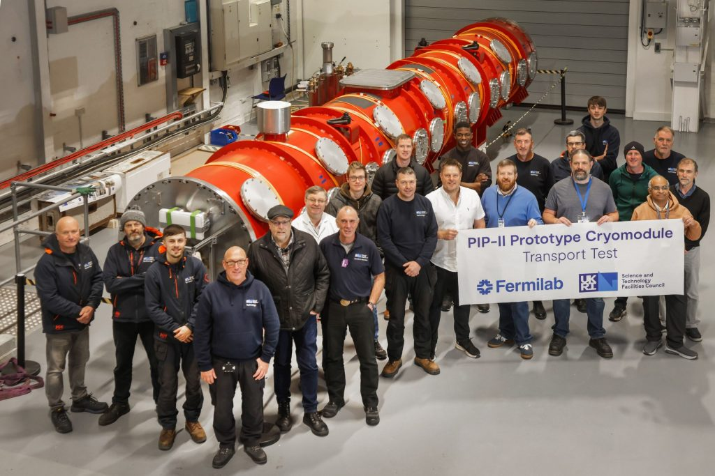
Prototype HB650
Completed two phases of 2K RF testing of prototype HB650 cryomodule at PIP2IT.
  First set of 2K tests verified.
  All six cavities experienced significantly increased FE during cryomodule (CM) operation compared to vertical test.
  Higher than expected heat loads led to design changes to optimize thermal performance for production CMs (HB & LB)
Successfully transported cryomodule to UK and back.
  The plan for the international transportation of cryomodules was verified, and thus the residual risk associated to this activity is now lower.
  Cryomodule performance reverified after transport at PIP2IT.
HB650 prototype CM to be re-built by partners in UK to improve performance for Linac installation.

Slide 13
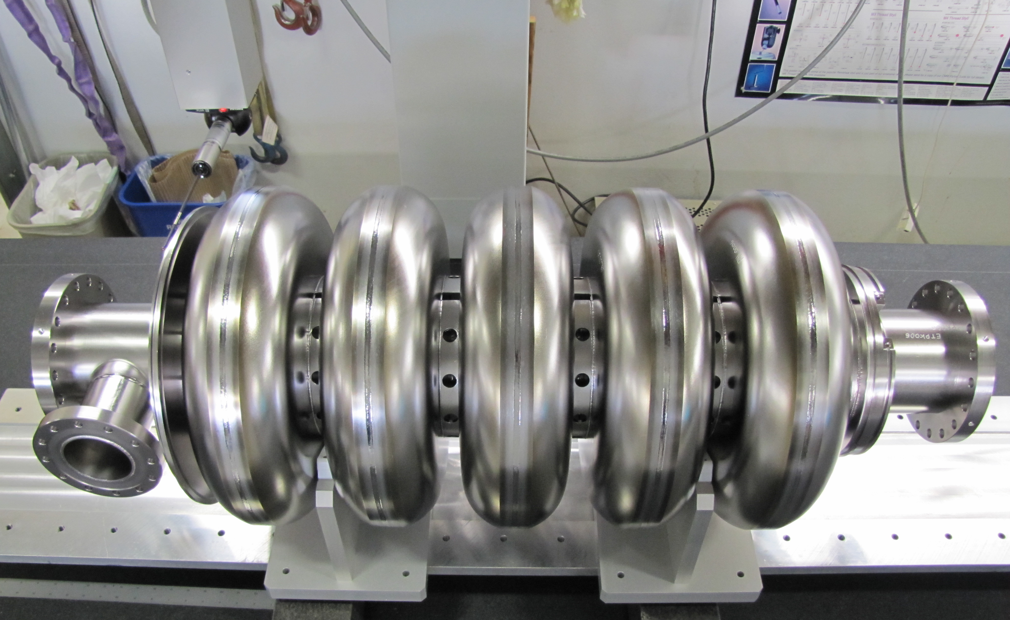
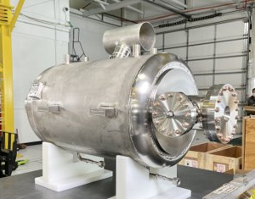

Pre-production LB650
Cavity
FNAL and INFN are processing, testing, jacketing, and qualifying 6 cavities. 4 of these cavities for use in the pre-production LB CM to be assembled at CEA/Saclay.
  Completed the jacketing of 2 cavities
  Field emission LB cavities is currently limiting performance. Investigating sources of field emission during vertical test preparation.
  Mitigation plan developed and being actively pursued.
Cryomodule
CEA completed the design of the pre-production CM.
  Lessons learnt from pCM
  HB650 were incorporated.
CEA and FNAL started the
procurement of cryomodule components.
CM assembly starts in FY25 at CEA.
Bare LB650 cavity
Jacketed LB650 cavity
pre-production LB650 CM

Slide 14
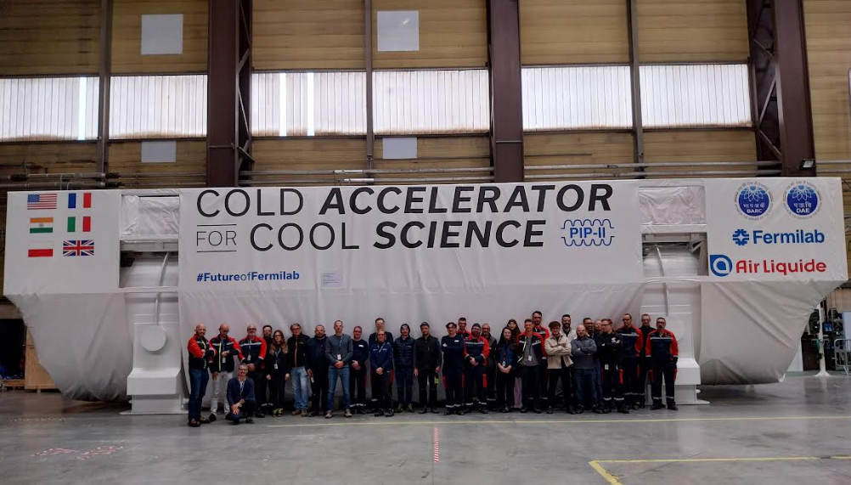
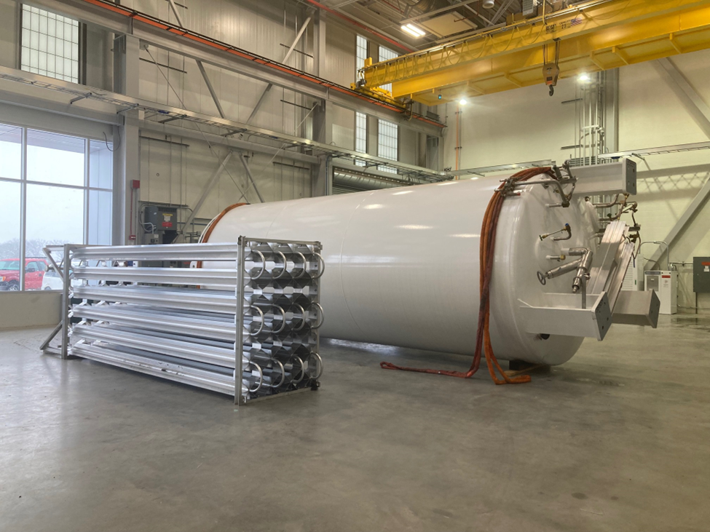
Cryoplant
Cryoplant - Coldbox
The Cryoplant design and fabrication are complete.
  International transportation contract awarded in March 2024.
  Coldbox departed vendor, due at FNAL in late November 2024.
  Compressors due at FNAL in early December 2024
  Commissioning to start by end of 2025
Cryoplant Recovery System transitioned to installation phase.
  Recovery System piping contract has been awarded
  All piping materials have been purchased and staged in preparation for the installation contract.
  LN2 Dewar was delivered in January 2024.
  Purifier fabrication underway with delivery expected in March 2024.
LN2 Dewar and Vaporizer

Slide 15
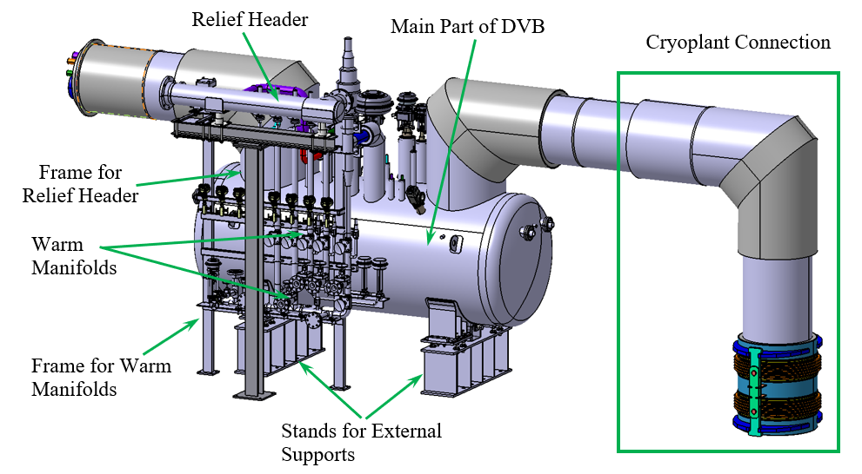
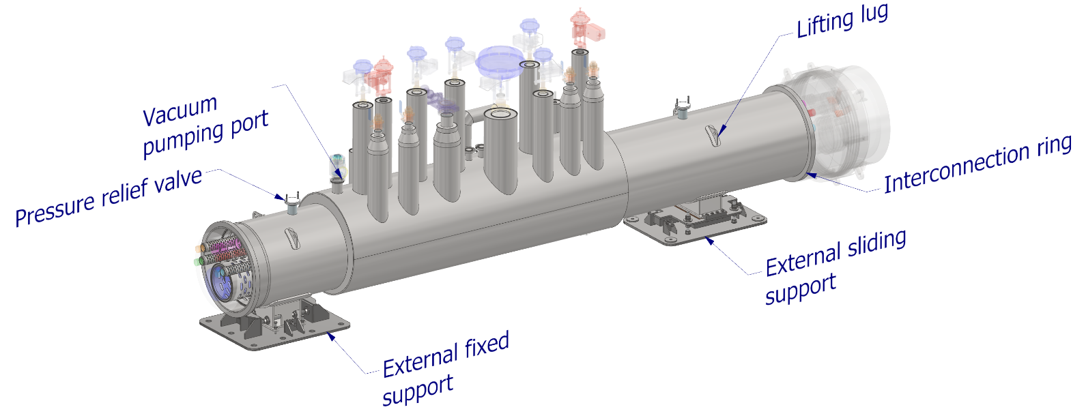
Cryogenics Distribution System
WUST preliminary designs of DVB and TTL have been completed.
  PRR completed in Feb 2024
  Vendor final design expected to complete Dec 2024
Started procurement of Intermediate Transfer Line.
Cryogenic Controls Hardware
  Final Design Review (FDR) was completed in April 2023.
  Multiple procurements are underway and expected to be awarded in FY24
Female bayonets for Tunnel Transfer Line (TTL)
  Fabrication, leak checks, and weld qualification of >100 female bayonets were completed in Q2FY24.
Distribution Valve Box module
Tunnel Transfer Line module

Slide 16
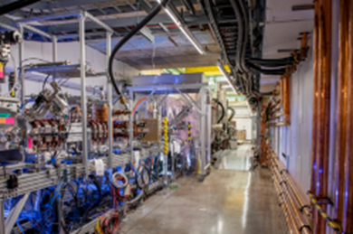


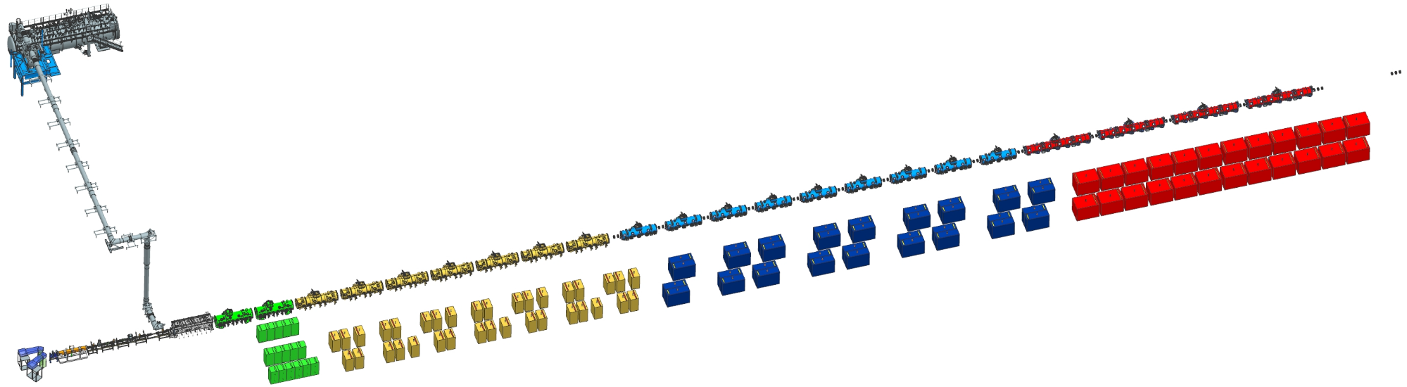



Linac Scope
PIP2IT successfully demonstrated 17 MeV beam with parameters required for LBNF/DUNE operations
Cryoplant
2.5 kW, 2 K
HB650
650 MHz
(1+4)
Magnets
LB650
650 MHz
(1+9)
CDS
DVB/ITL/TTL
SSR2
325 MHz
(1+7)
SSR1
325 MHz
(1+2)
Superconducting
SSA
70 kW, 650 MHz
(24+)
Normal Conducting
SSA
40 kW, 650 MHz
(36+)
SSA
20 kW, 325 MHz
(35+)
HWR
162.5 MHz
SSA
7 kW, 325 MHz
(16+)

Slide 17
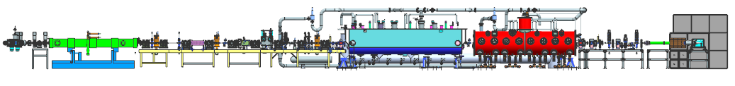
PIP2IT - PIP-II Injector Test
Beam facility used to mitigate risks related to the critical technology roadmap
Allowed for validation of cryomodules, cavities, tuners, LLRF, beam dynamics and much more
2mA proton beam current, 550us at 20Hz rep rate
Tested with proton beam up to 10MeV,
All RF cavities, amplifiers and circulators to be re-used in PIP-II
RFQ
2.1MeV
HWR
10MeV
SSR1
22MeV

Slide 18
PIP2IT PIP-II Injector Test
HWR was able to achieve the required gradients
Cavities 1-2 were off resonance, and out of the range of tuners
RFPI failure on bias current caused sputtering on window of Cavity 3
RF leaks on coupler bias connection corrected with design change
pSSR1 was able to achieve the required gradients
  pSSR1 to be used in PIP-II
Additional RFPI antennas added to design
Additional QC steps added to checkout
Data courtesy of Joe Ozelis and Sasha Sukhanov

Slide 19
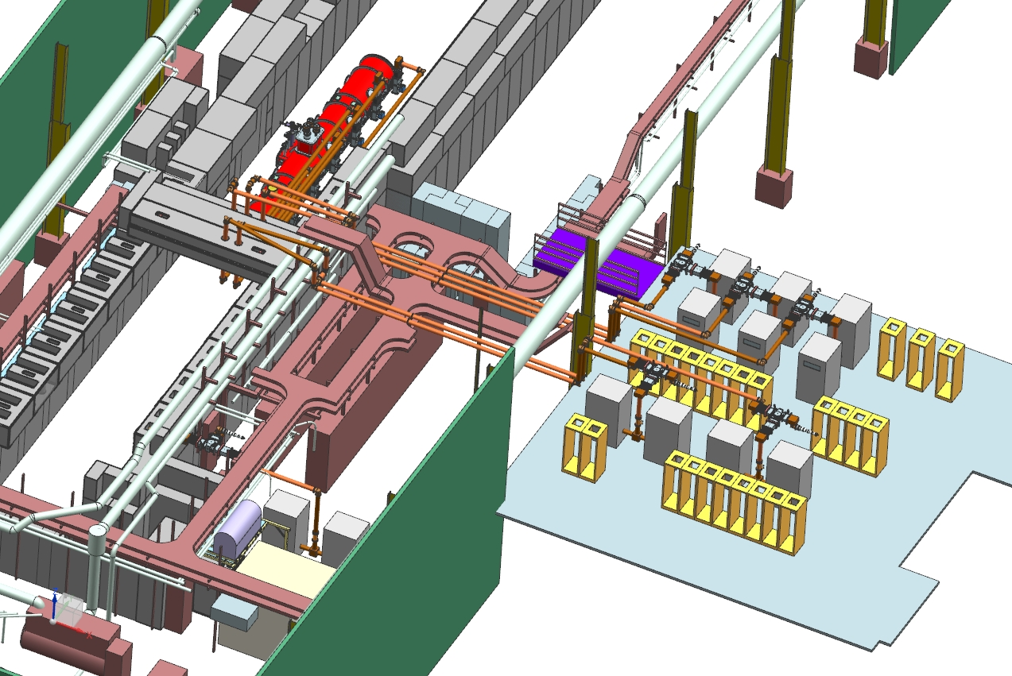
PIP2IT – Expansion of new amplifiers for CM testing
Testing of HB650 pCM done with single 40 kW 650 MHz SSA from DAE
  Additional amplifiers are being procured so full cryomodule characterization can be completed
Concurrent cavity testing is required for accurate heatload and RF characterization
New facility will be used to test all* SSR1, SSR2, LB650 and HB650 cryomodules before their installation into the machine

Slide 20
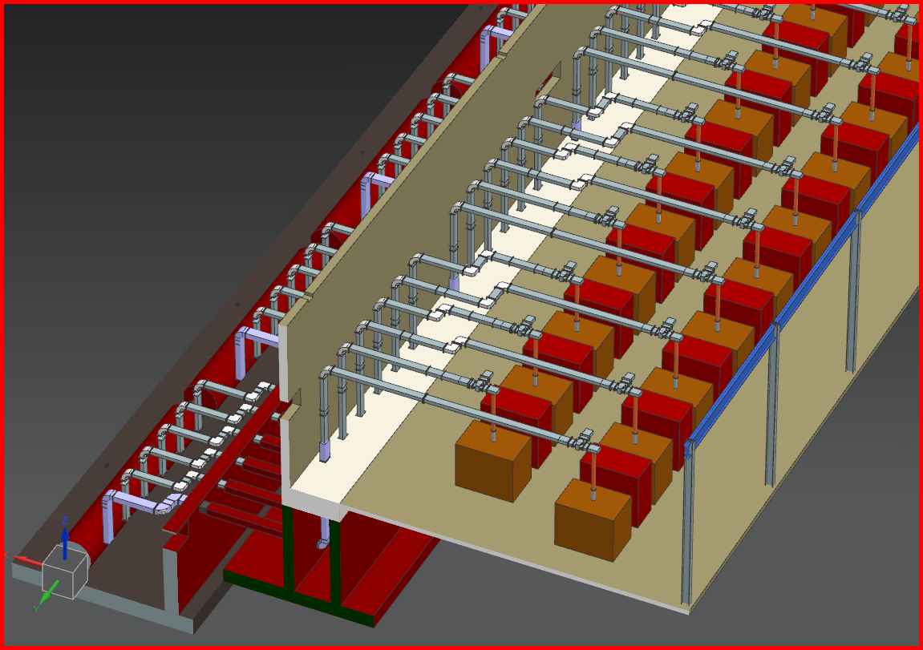
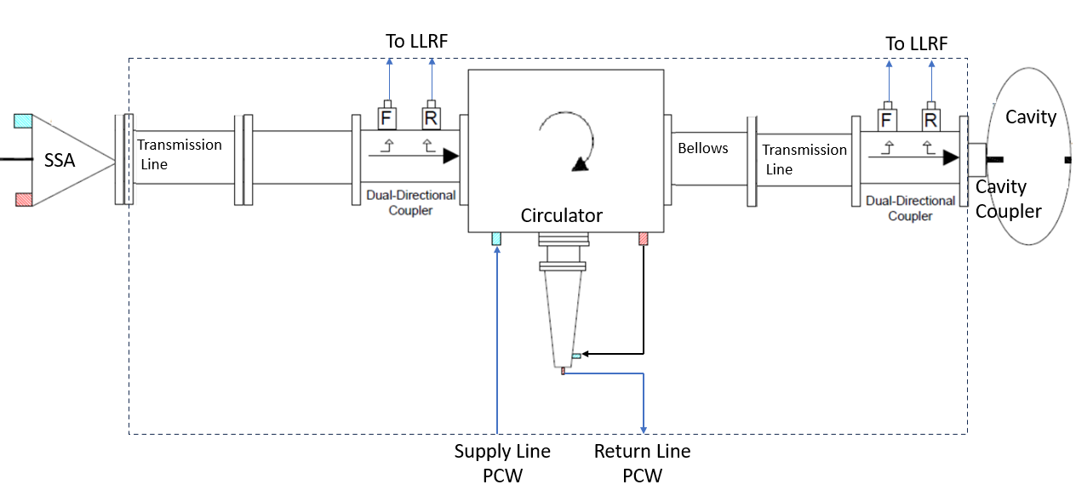
PIP-II Linac
PIP-II will be adding 125 RF Stations
125 SSA, most coming from partners in India
Roughly 15,000 RF transistors
125 Circulators and loads
250 Directional couplers
65 LLRF controllers

Slide 21
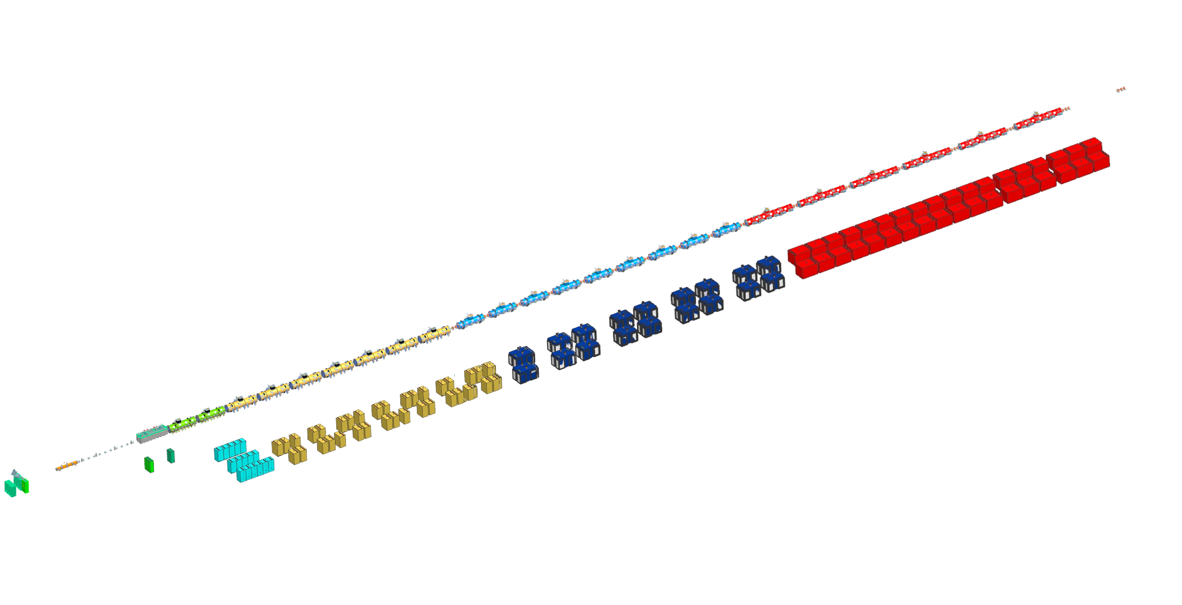
PIP-II Linac
 | Quantity | Frequency | Power | RF Pallets per Unit | Transistors per Pallet | Total Transistors
RFQ | 2 | 162.5MHz | 75kW | 16 | 8 | 256
Buncher | 4 | 162.5MHz | 3kW | 1 | 4 | 16
Half Wave Resonator (HWR) | 8 | 162.5MHz | 7kW | 1 | 8 | 64
Single Spoke Resonator (SSR1) | 16 | 325MHz | 7kW | 8 | 1 | 128
Single Spoke Resonator (SSR2) | 35 | 325MHz | 20kW | 24 | 1 | 840
Low Beta Elliptical Cavity (LB650) | 36 | 650MHz | 40kW | 32 | 4 | 4608
High Beta Elliptical Cavity (HB650) | 24(+12) | 650MHz | 70kW | 64 | 4 | 6144 (9216)

Slide 22
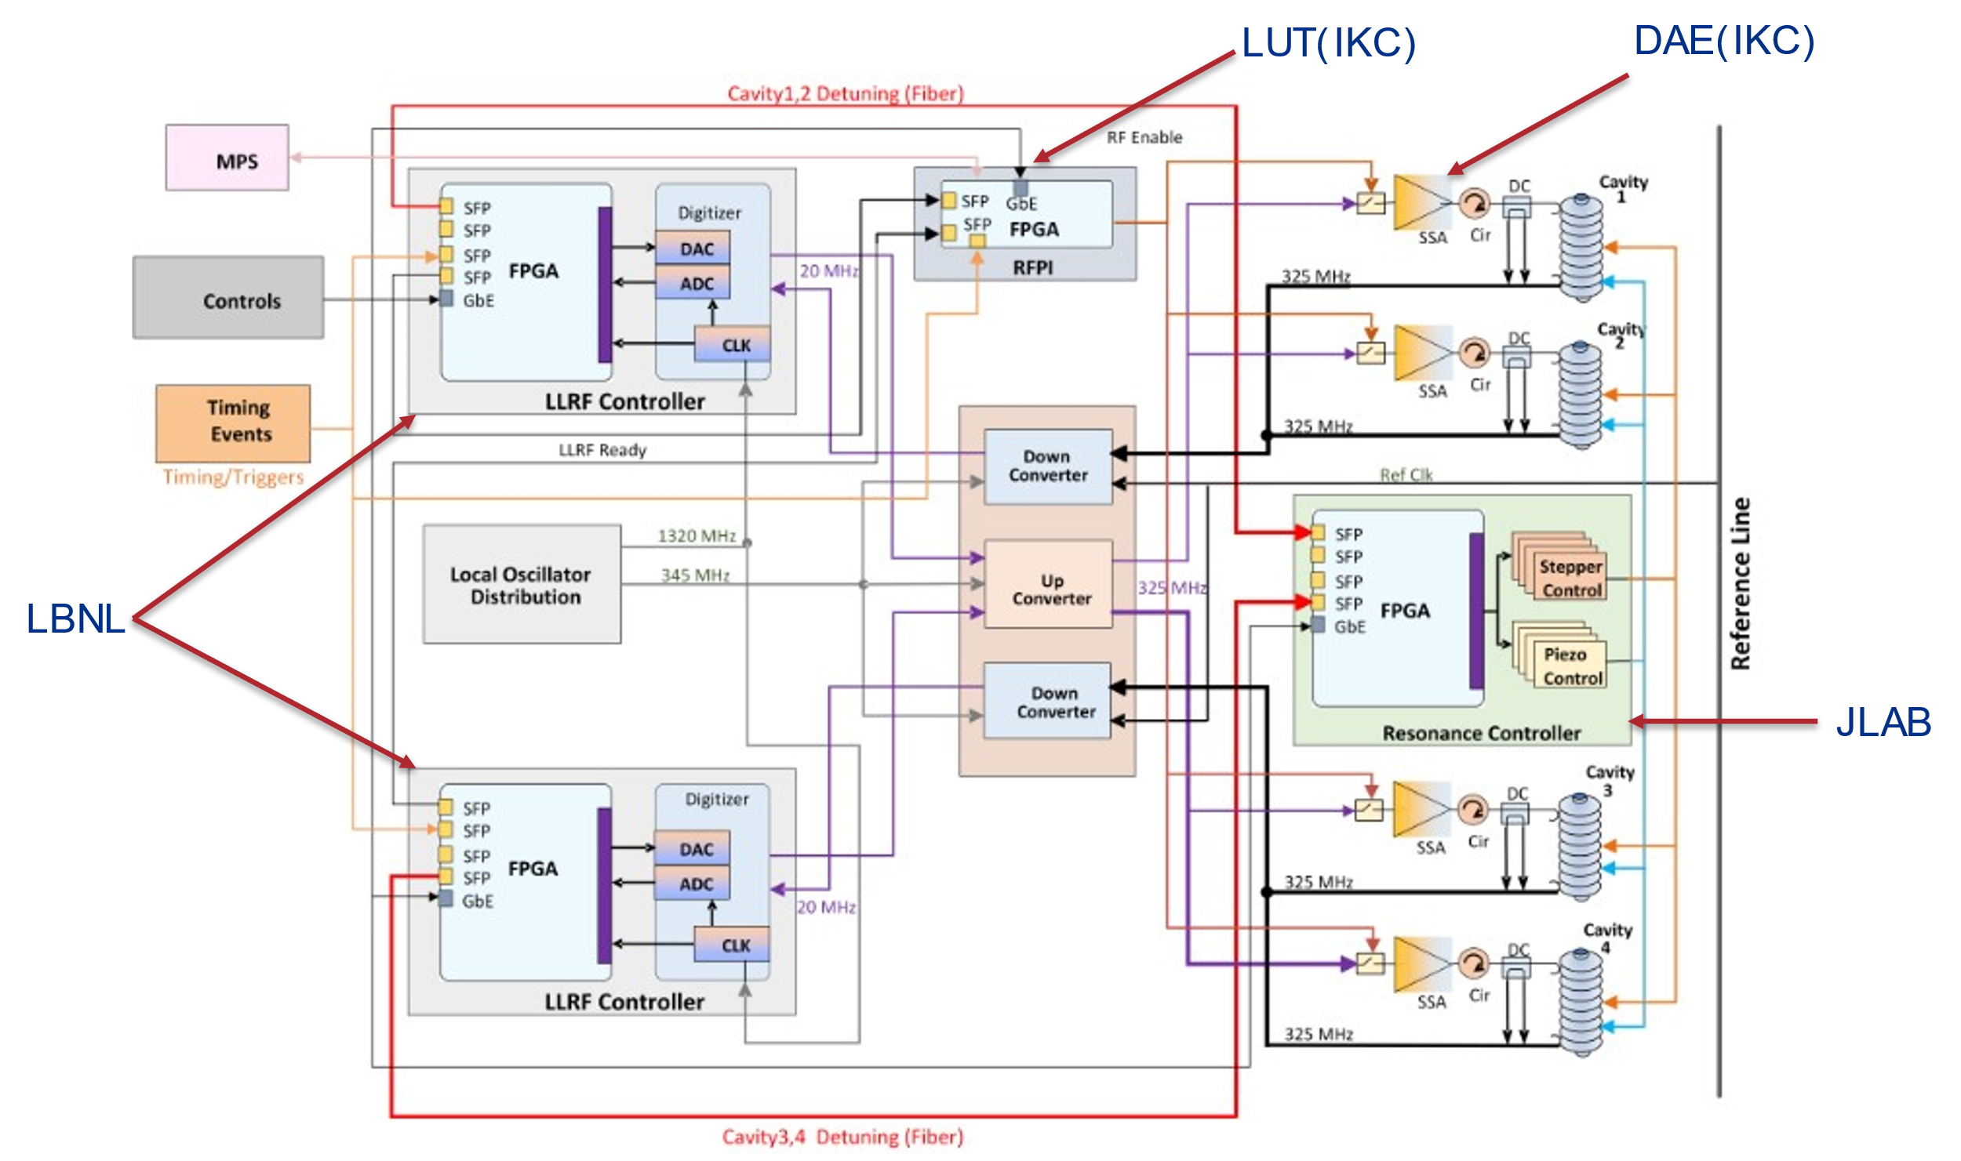
LLRF System Overview
Leveraging collaboration on LCLS-II, hardware and firmware
Prototype units in hand and testing on all cavity types complete
Further integrated testing during CM testing ongoing
Final designs complete, moving to production

Slide 23
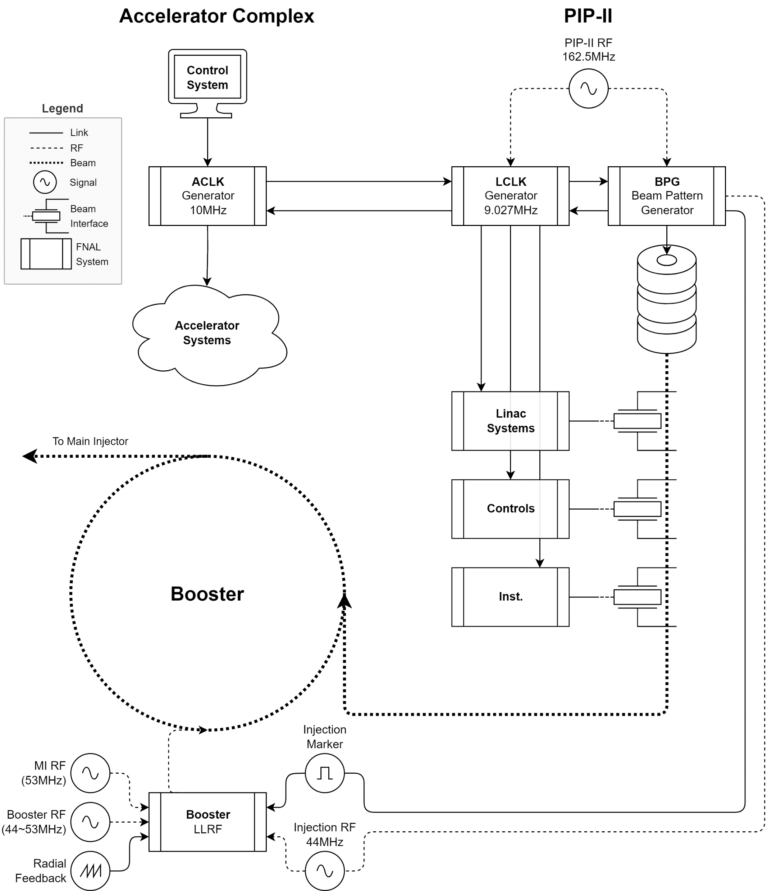
PIP-II Injection into Booster
PIP-II and Booster are non-harmonic, necessitating careful coordination for injection
The ACLK Generator will generate a Start of Beam event at 20Hz (Both to PIP-II and existing Complex)
The LCLK Generator will receive the event and lock to the Beam Pattern Generator (BPG)
  Also broadcast a pre-trigger event to downstream systems.
The BPG will coordinate PIP-II systems:
  Timing of bunch generation
  Beam chopper to generate bunch pattern
  ‘Tone On’ to Booster at Start of Beam
Booster LLRF systems will lock to PIP-II RF and coordinate injection with the gradient magnet sweep.

Slide 24
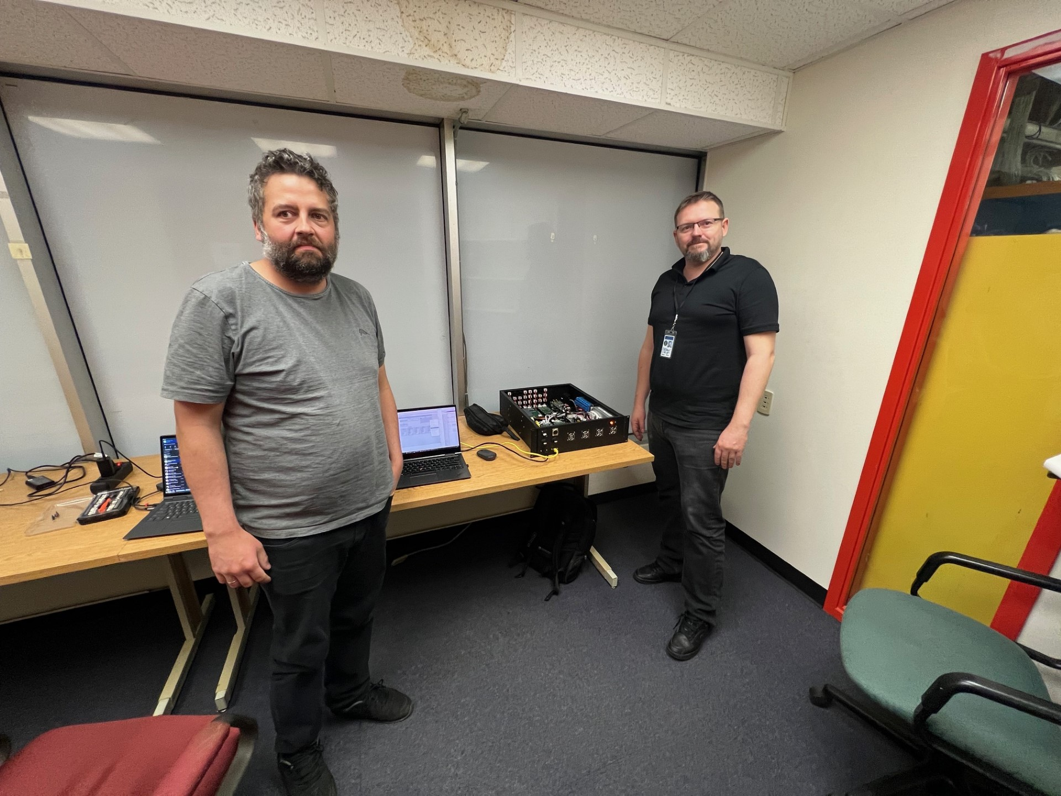
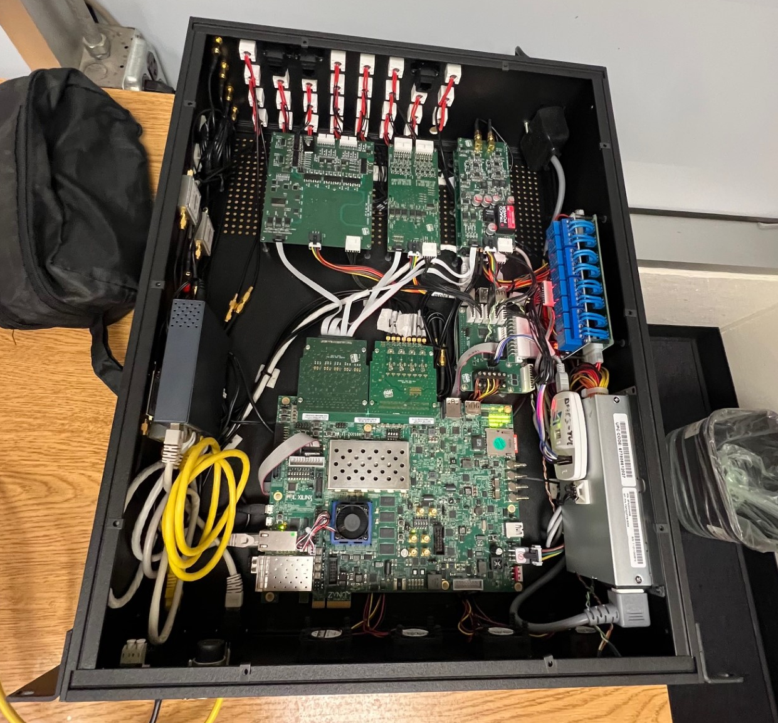
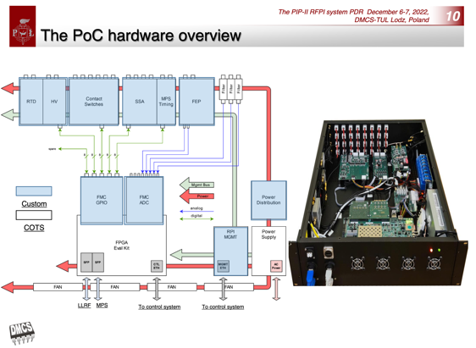
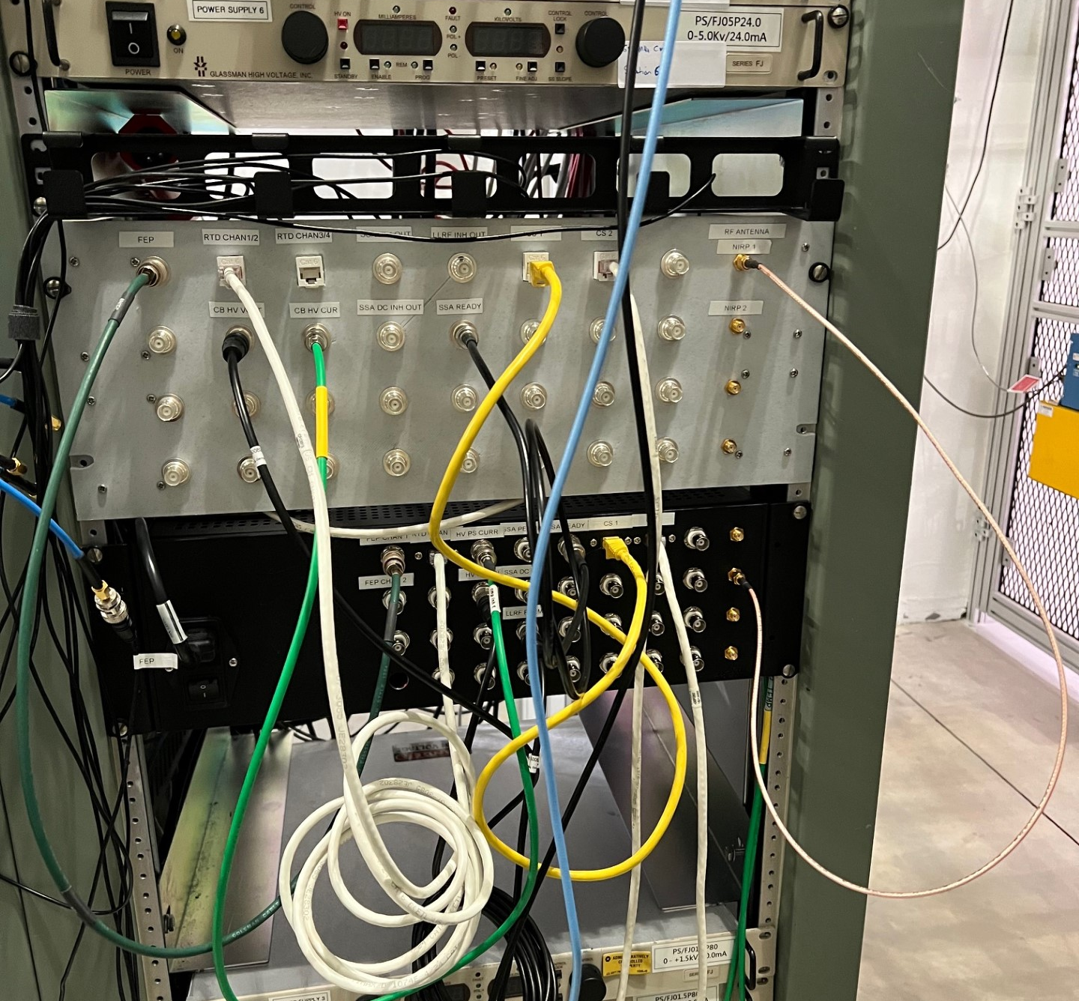



LLRF Collaboration with Poland
Warsaw University of Technology/Institute of Electronic Systems
  Beam Instrumentation Reference Line including design, fabrication, and installation
  Build on XFEL/ESS technologies
Lodz University of Technology/DMCS
  Subcontract for LLRF RF Interlocks Design
    Prototype RFPI hardware successfully used during pHB650 testing at PIP2IT
    Moving to Production shortly
  Contracting for coupler HV bias supplies design and production
Helping to modernize our EPICS integration
Proof of Concept
RFPI chassis (TUL)

Slide 25
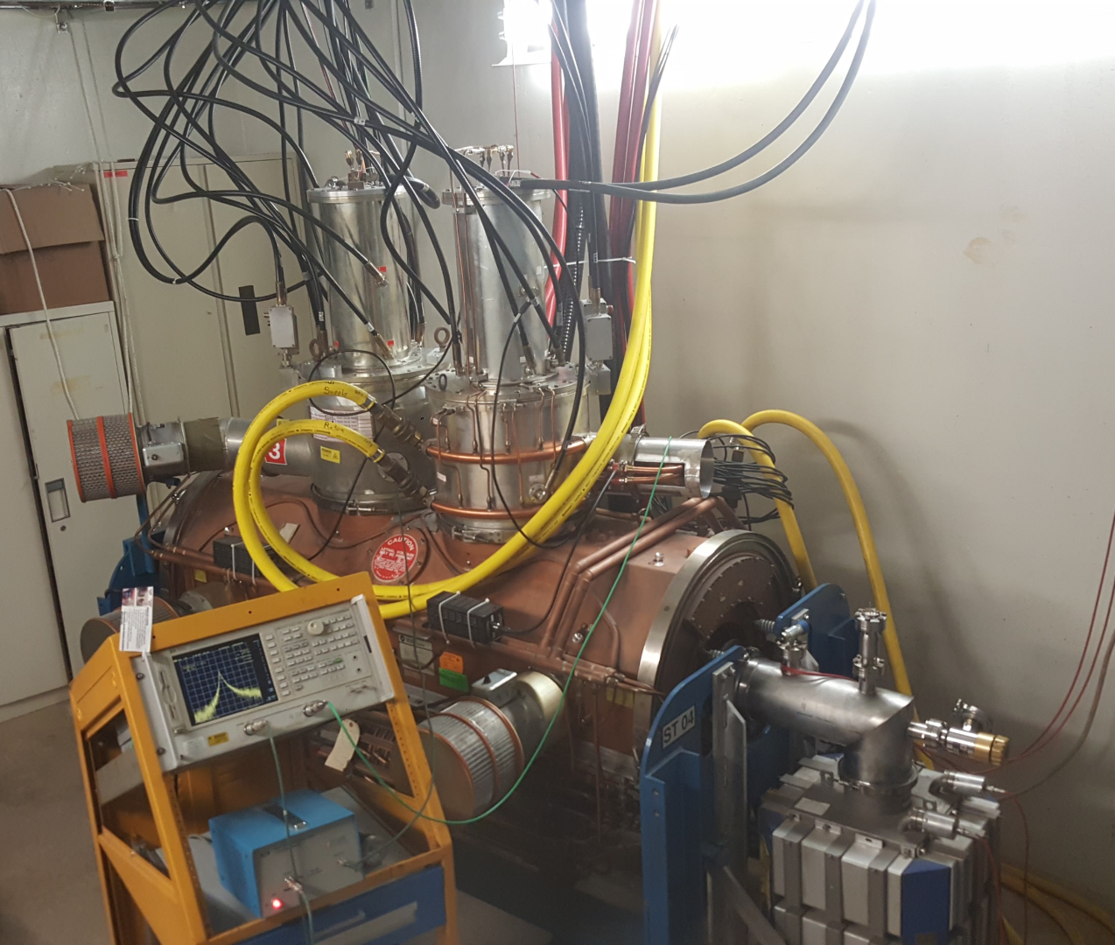
PIP-II Accelerator Upgrades
Booster RF – 44.7 to 52.8MHz
  Replacing 6 cavities with larger aperture equivalents
MI RF – 52.8 to 53.1 MHz
  Upgrading to dual tetrode tube on all 20 stations
  Upgrading to dual switch tube on all 20 modulators
  Adding 20 SSA, 8kW to 16kW per station
RR - 52.808MHz ± 1kHz for slip stacking
  Replacing 3 cavities (R/Q of 45, currently 13)
 | Quantity | Frequency | Power | Amplifier | Total RF Power
Booster | 22 | 44-52.8MHz | 150KW | Tetrode | 3.3MW
Recycler – 2.5MHz | 8 | 2.5MHz | 8KW | Solid State | 64kW
Recycler – 53MHz | 3 | 53MHz | 150KW | Tetrode | 450kW
Main Injector | 20 | 52.8-53.1MHz | 300KW | Tetrode | 6MW

Slide 26
Challenges and Path Forward
Five unique cryomodule flavors, prototypes of three are built and tested, with two coming in the next 18 months
  Convergent design between modules, but completing successful first articles will be a major milestone for the project
Cryoplant hardware coming in the door shortly
  Largest new cryoplant at FNAL in very long time, significant test of installation, integration, and operations planning
Production at scale with diverse partnership network requires intense focus on documentation and communication
  INFN, RRCAT, BARC, CEA, STFC-UKRI, IJC-LAB, WUST, TUL, WUT, LBNL, SLAC, JLab
  Strong documentation practices have been developed and exercised, and many established relationships/meetings, but constant effort and communication will be required
  Note: a similar strong effort is required to integrate PIP-II into the existing FNAL Complex!

Slide 27
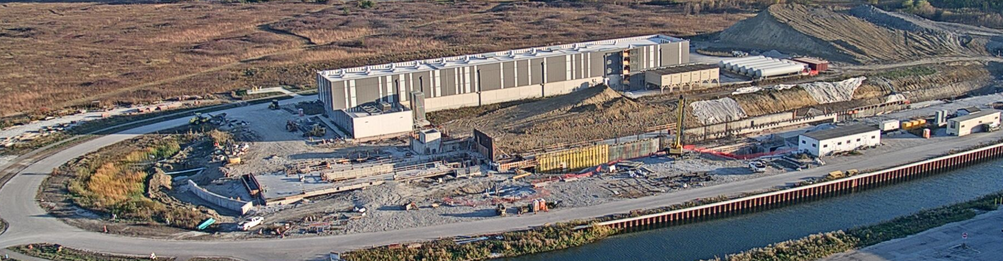
Summary
PIP-II is a critical modernization effort at FNAL and a platform to build the coming decades of science upon
Leveraging both in-house and international SRF and accelerator experience, building strong partnerships which are essential for the success of the Project
  We could not do PIP-II without our partners
We are at a critical stage, transitioning from design and prototyping to fabrication
Look forward to an exciting update at the next SPAS!
2024-10-20

Slide 28
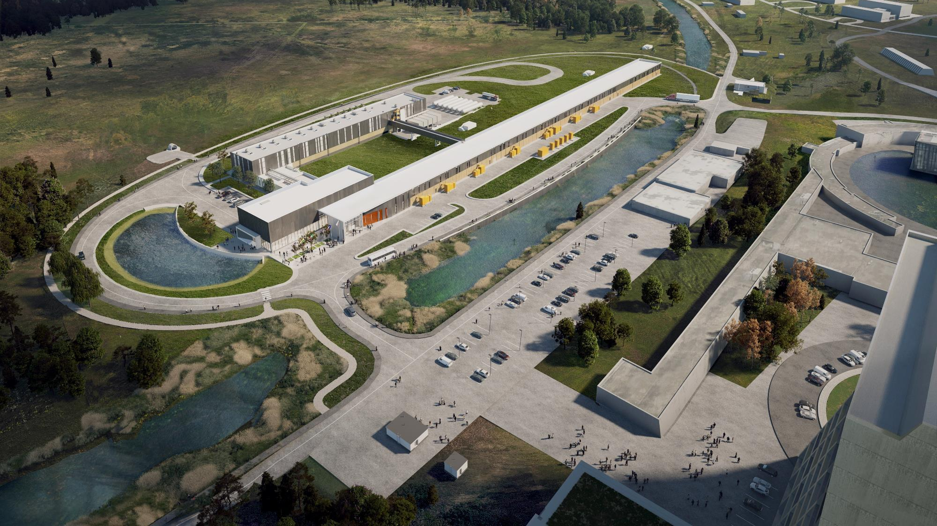



THE FUTURE OF FERMILAB
Follow us:
http://pip2.fnal.gov/
@PIP2accelerator
/showcase/pip-ii/

