Slide 1
Commissioning of the first HELIAC cryomodule CM1
“Advanced Demonstrator”
Maksym Miski-Oglu

Slide 2
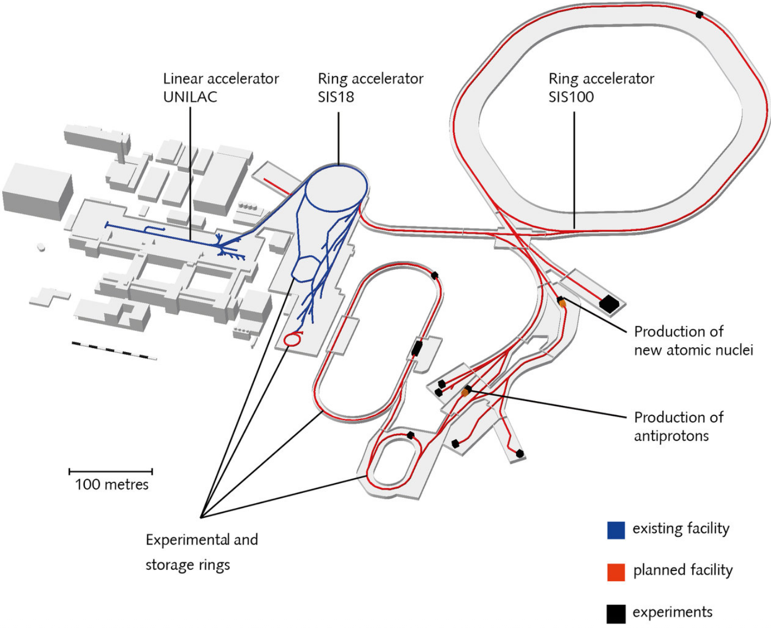
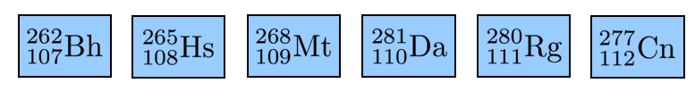
Existing GSI facility and future FAIR complex
Existing facility
Future facility
Experiments
UNILAC will serves as injector for FAIR
Super Heavy Element (SHE) program and material research requires a new LINAC
Word wide quest for synthesis of element 120

Slide 3
HELIAC* Layout
HELIAC has been optimized for the needs of SHE & materials research and could be used as SIS18-injector for medium intensities!
*HelmoltzLinearAccelerator – HELIAC
Advanced Demonstrator (Project at GSI)
Normal-Conducting Injector
Superconducting Accelerator @ 4K
Source
Parameter | Unit | Value
Output energy | MeV/u | 1.4
RF Cavities |  | 6
Operation mode |  | cw
A/Z |  | ≤ 6
Parameter | Unit | Value
Output energy | MeV/u | 3.5 – 7.3
Beam current | mA | ≤ 1
Operation mode |  | cw
A/Z |  | ≤ 6
RF Cavities | # | 12
Frequency | MHz | 216.8
RF Bunchers | # | 4
Transversal Focussing | 2 Solenoids per Cryom.
Parameter | Unit
Type | ECR
Frequency | 18 GHz

Slide 4
Cryomodule Layout for HELIAC
Standard Cryomodule Layout
CH
S
B
CH
CH
S
4.8 m
B
Buncher cavity – Single Spoke Resonator
CH
Accelerator cavity – Crossbar H-mode cavity
S
9.5 Tesla sc-Solenoid with integrated XY-stearing coils
Operated with 4.2K LHe at atmospheric pressure

Slide 5

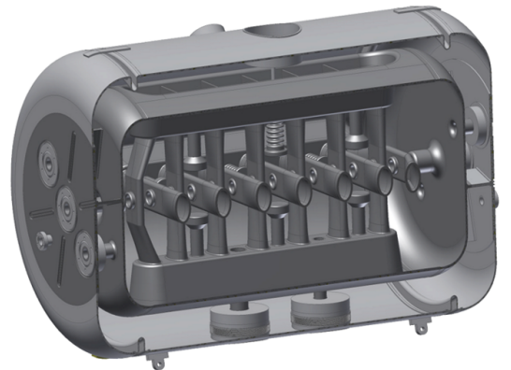
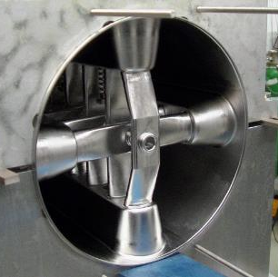
CH Cavity for HELIAC I
Designed by IAP
800mm
CH0 Cavity | Unit | Value
Cavity type |  | CH
β (v/c) |  | 0.059
Frequency | MHz | 216.8
Diameter | mm | 409
E_{a} (design) | MV/m | 5.5
E_{p}/E_{a} |  | 6.3
B_{p}/E_{a} | mT/(MV/m) | 5.7
Source
Stam with
drift tube nose
4mm Nb
cavity wall
Titanium
Helium vessel

Slide 6
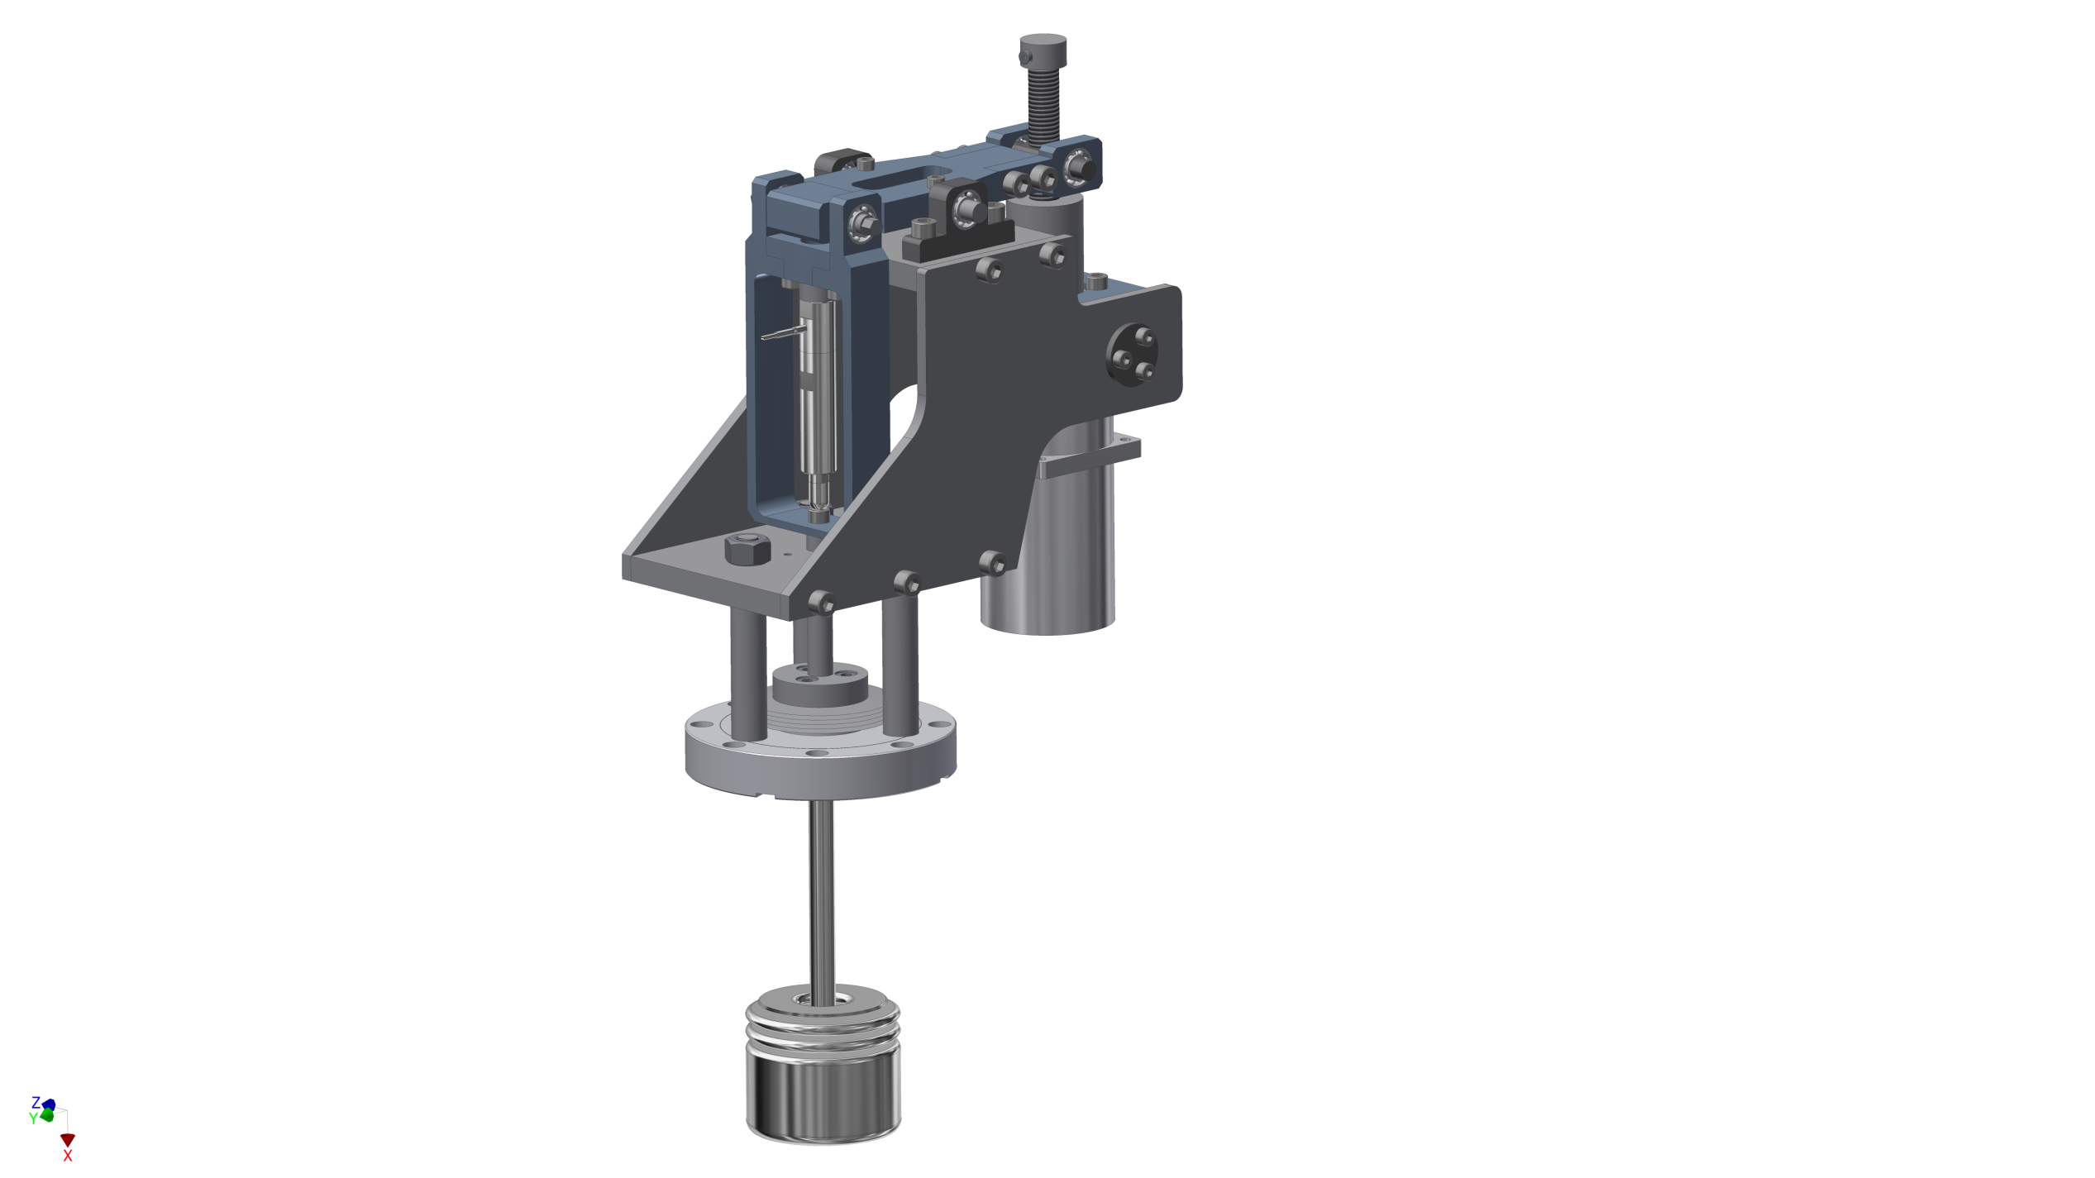
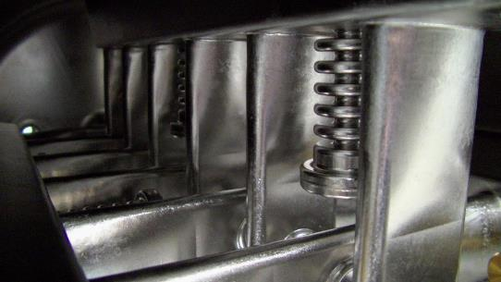
CH Cavity for HELIAC II
Main properties of the tuning system:
Capacitive bellow tuner
Enables slow & fast frequency adjustment
Max. mechanical displacement ±1 mm (≈ ±60 kHz)
Lever with pivot point ratio ≈ 2:1
Gear reduction ratio 50:1
Piezo actuator ‚connected in series‘ with slow tuning unit
Achieved displacement of piezo ±5 µm (≈ ±300 Hz)
Required force < 800 N
Compact, simple and durable mechanics
Rotation axis
Spindle
Lever
Piezo
actuator
Stepping motor
Source
Bellow tuner

Slide 7
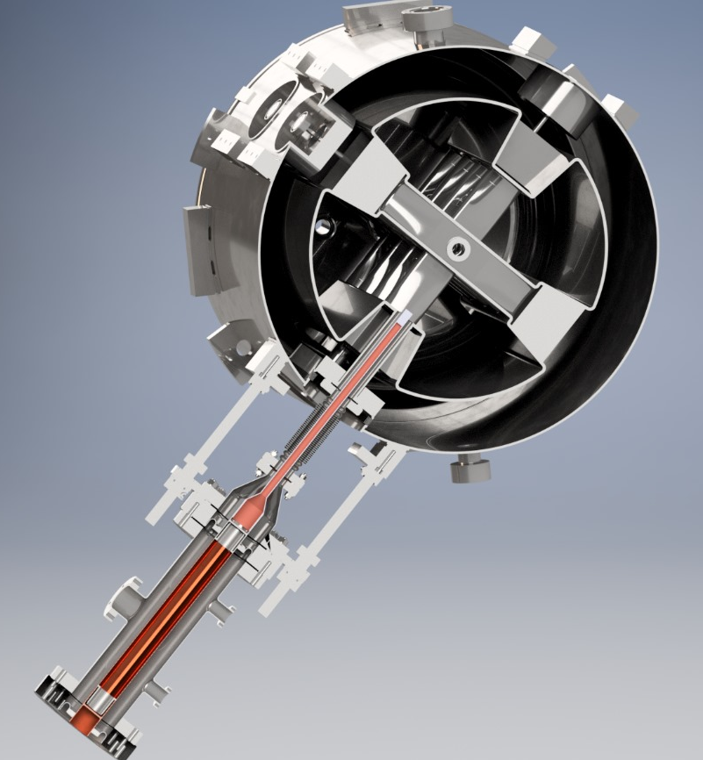
CH Cavity for HELIAC III
He-Outlet
Stems oriented 45° to horizon
LHe flowing through hollow stems
3kW cw fundamental power coupler
2 windows: 300K and 60K
Cold window unit assembled in clean room
Cold window unit slides on guiding roads
Variable coupling, penetration depth ±10mm
Warm window unit assembled after integration
with cryostat
guiding
road
He-Inlet
Cold window unit

Slide 8
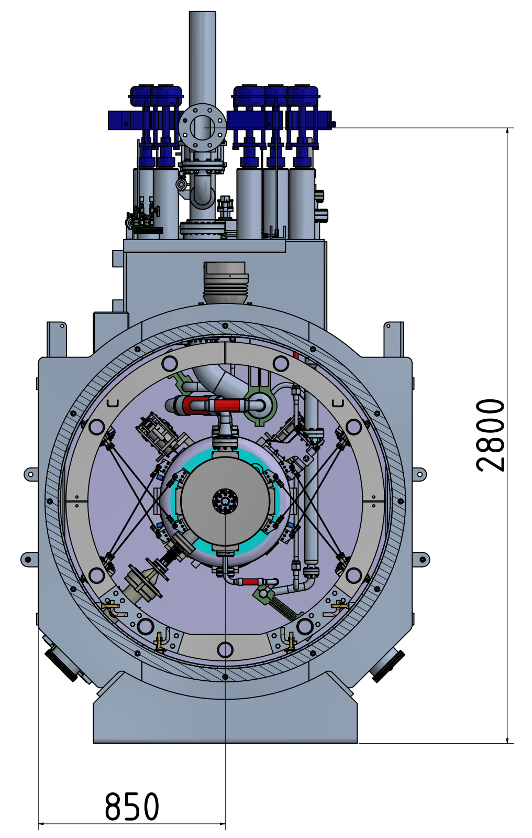
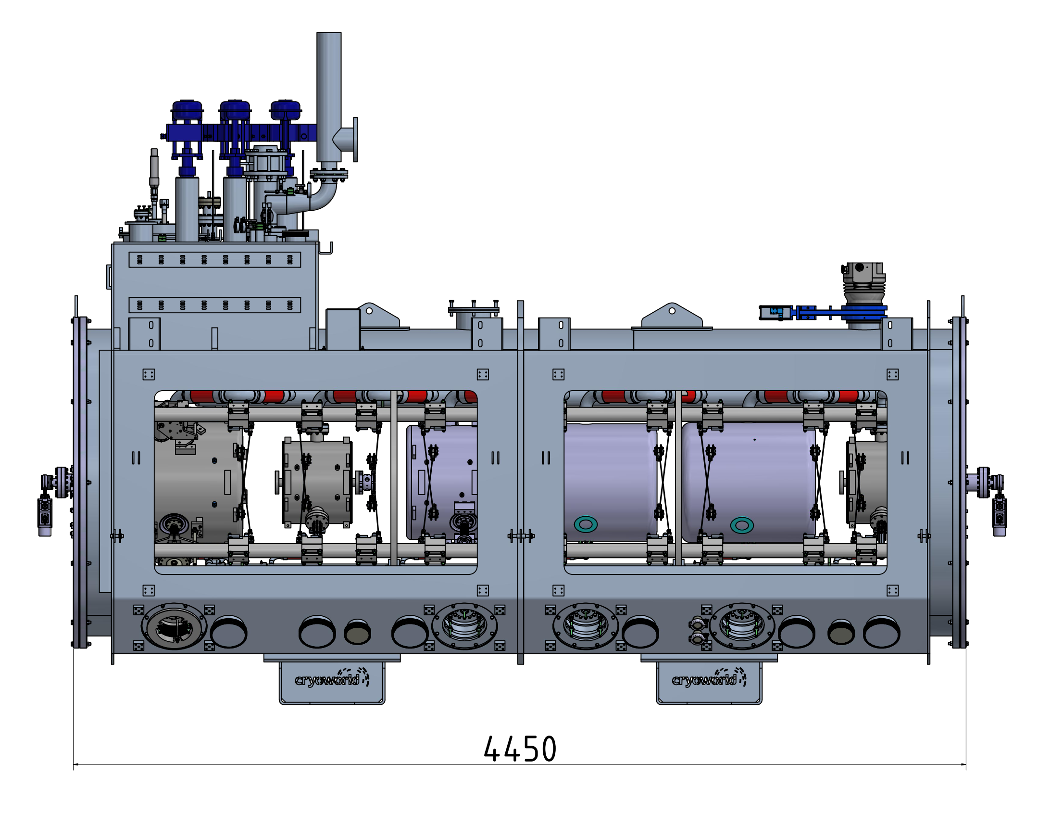
Design requirements & solutions for Cryostat
On site alignment of each component with a laser tracker
Assembly of RF power couplers and solenoid current leads after integration of string into the cryostat
2 rectangular service doors on each side
Trans. position of each component will be preserved within
± 0.1 mm during cool down
Nuclotron suspension of single components
Segmented support frame, mechanically and thermally coupled to outer tank (300 K)
Segmented frame standing on dedicated points of the bottom of the cryostat
Deformations of outer vessel during evacuation do not affect the position of the segented frame
Thermal shield suspended inside of support frame
Maintenance of auxiliary components (tuner, coupler etc….)

Slide 9
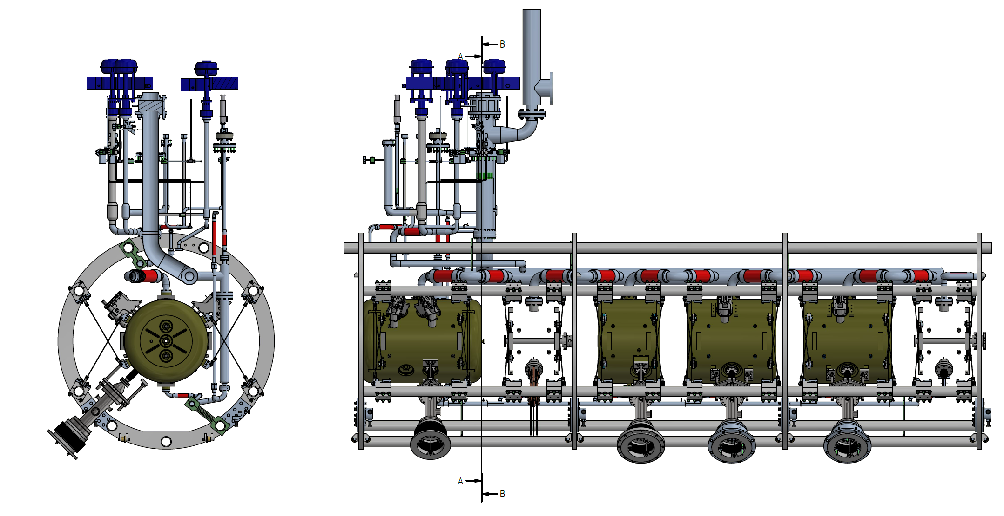

Nuclotron Suspension
Designed and manufactured by
Segmented Frame

Slide 10
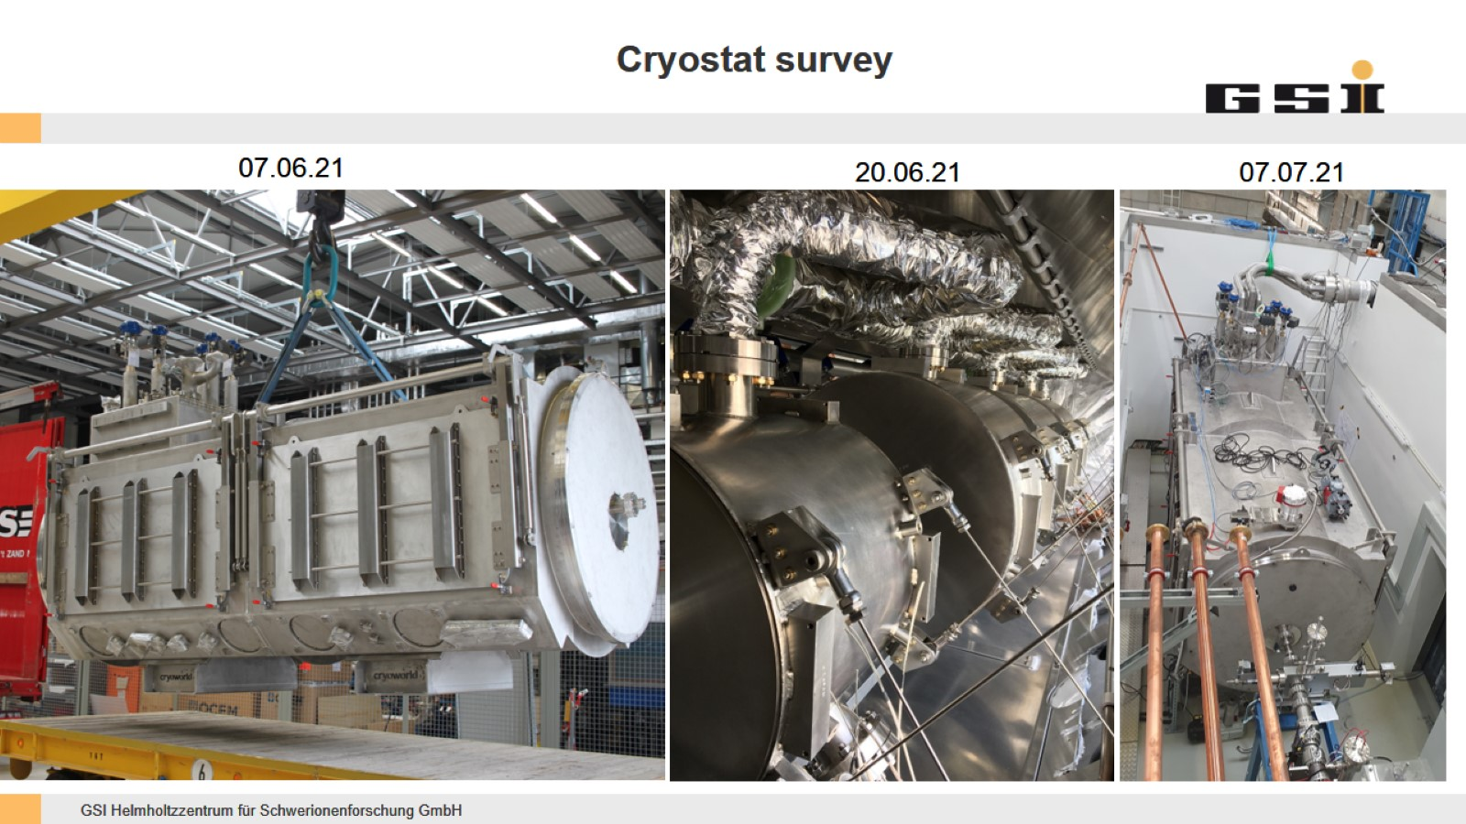
Delivery of Cryostat in June 2021
Cryostat equipped with cavity dummies and real solenoids

Slide 11
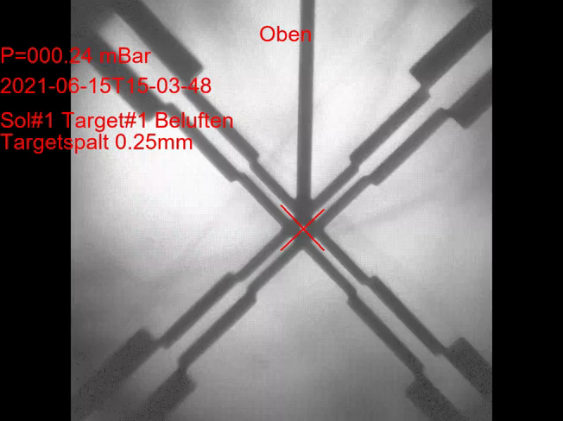
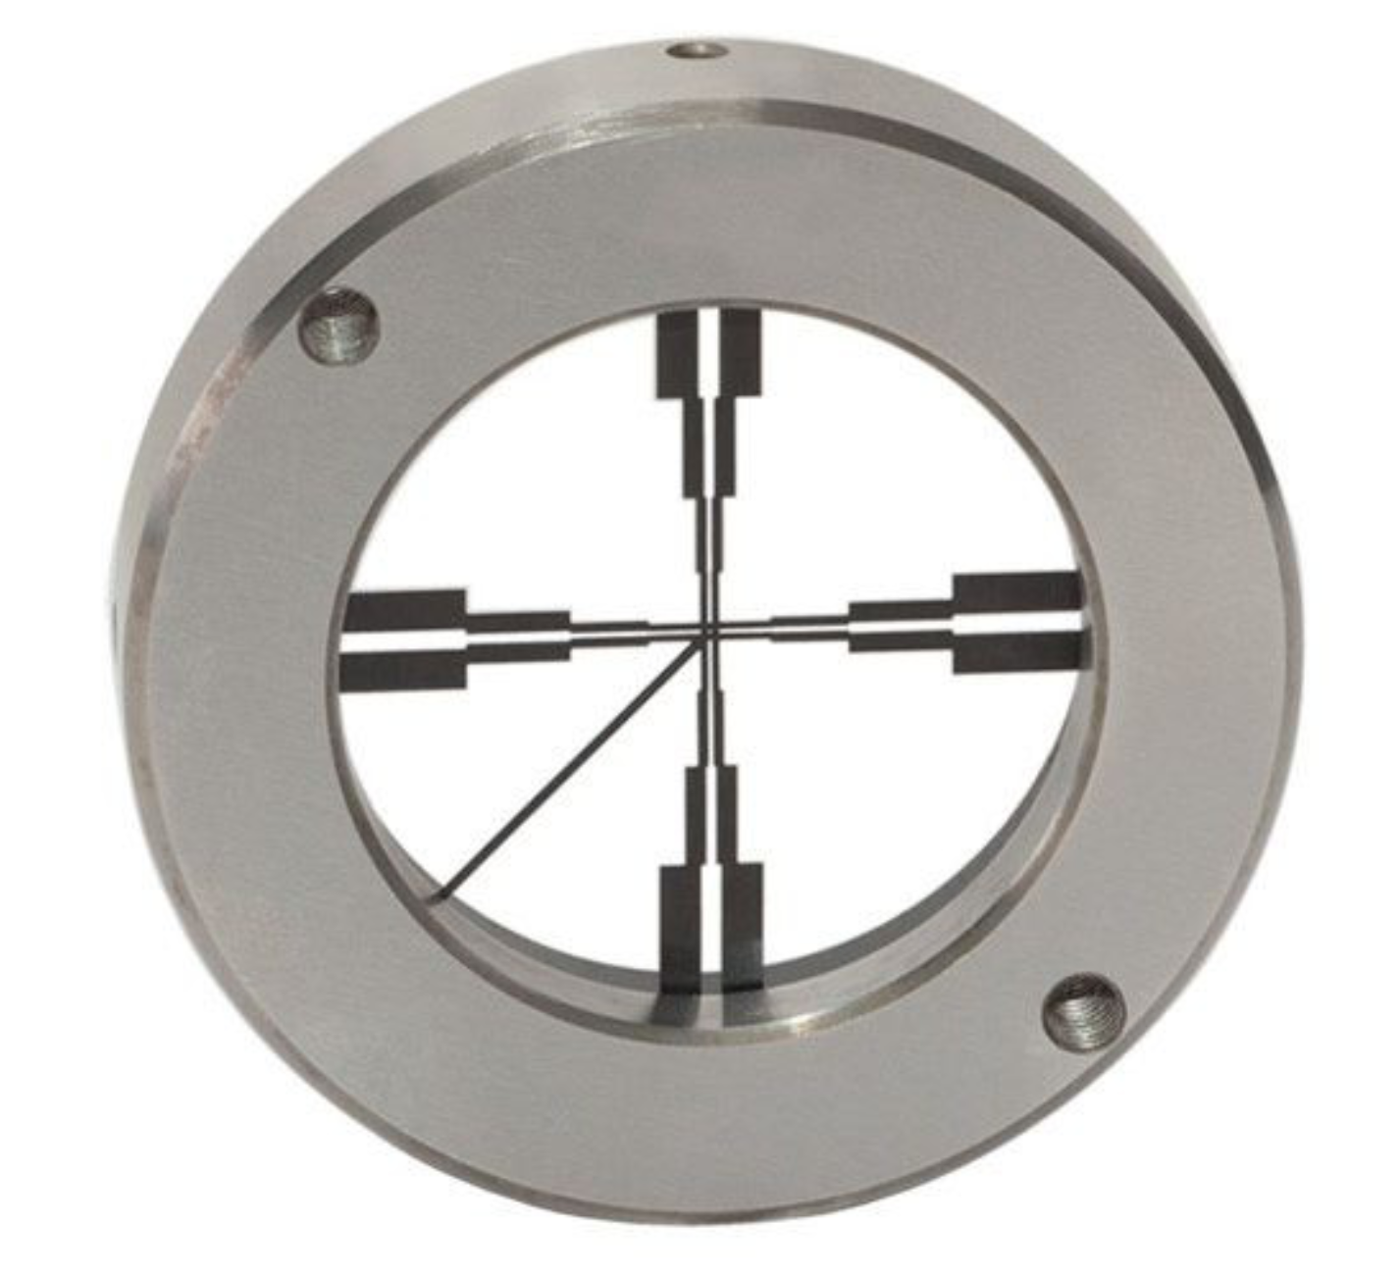
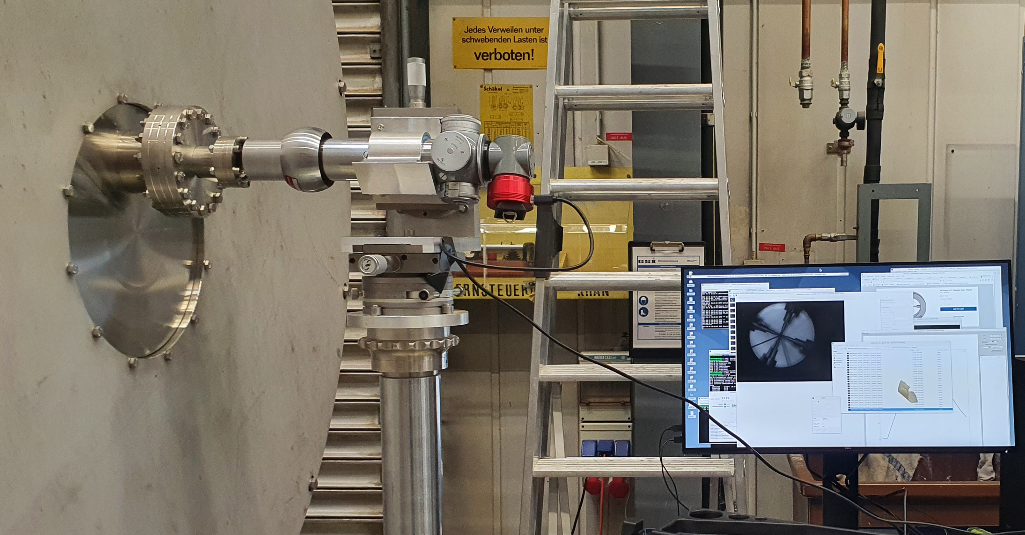
SAT in 2021
Transversal Positioning Fidelety
Open target mounted on flange of solenoid
Vacuum window at beam ports of cryostat
Taylor-Hobson micro alignment telescope
CMOS Camera
Measurement during evacuation/venting
∼0.15mm displacement
0.25 mm

Slide 12
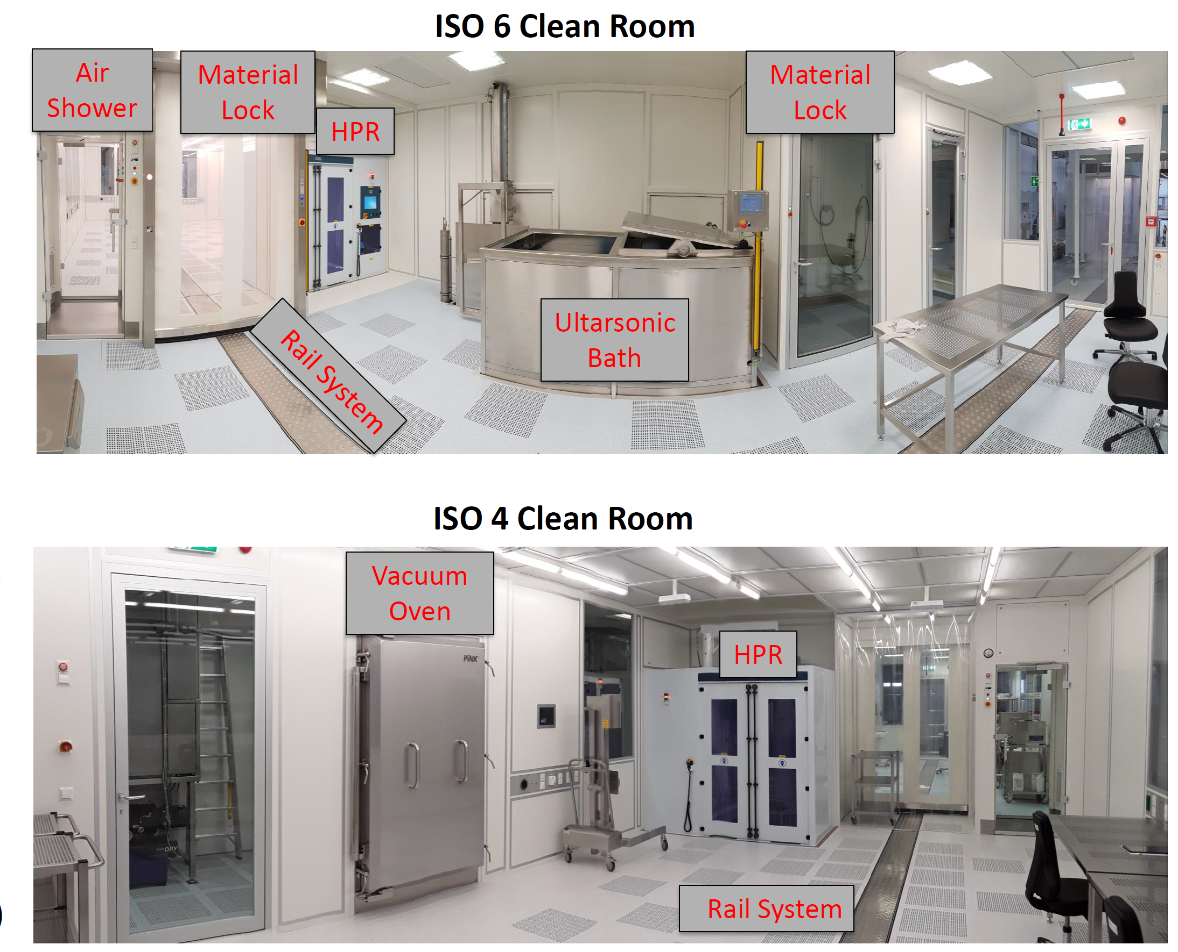
Cryo Module Assembly in Clean Room @ HIM
Unique infrastructure for SRF R&D
Two interconnected clean rooms
42m² (ISO6)+42m² (ISO4)
Rail system in floor
Ultra high purity water supply (18MΩ/cm)
Ultrasonic bath and conductance rinse
outer surfaces of everything must be grease free..
High Pressure Rinse (HPR) with 100Bar
removal of particulates & contamination from inner surfaces of vacuum bellows, cavities, solenoids …..
Weekly cleaning by external company every Friday

Slide 13
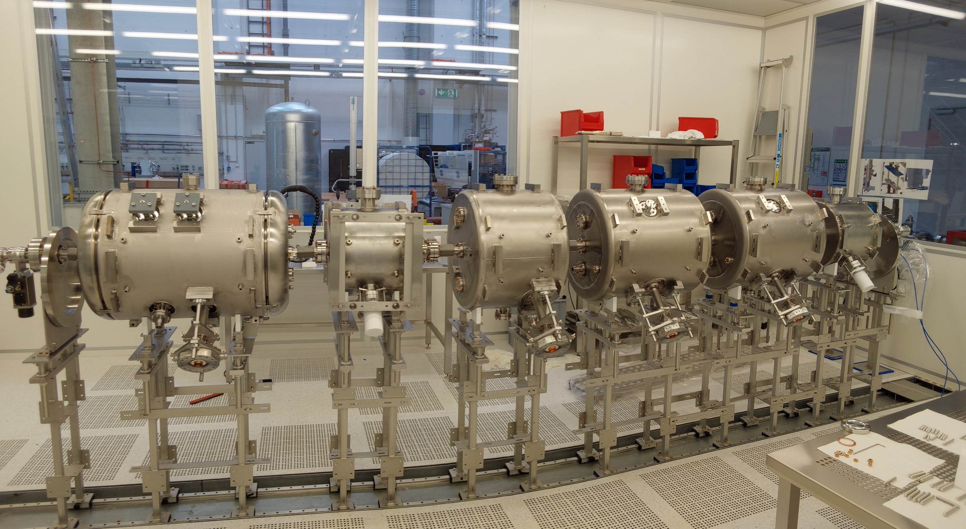
After 6 month of heavy work
String is ready
07.02.2023

Slide 14
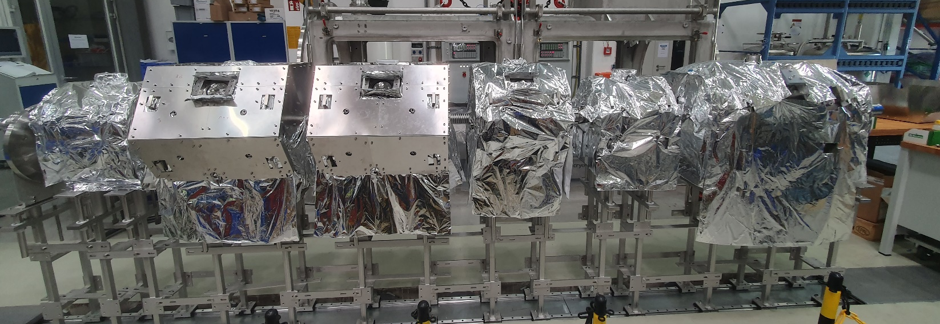
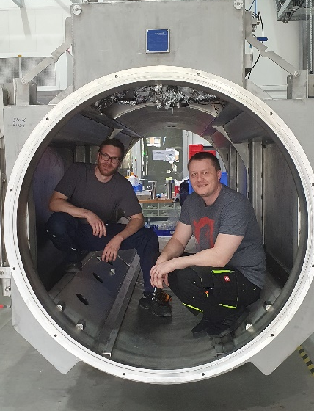
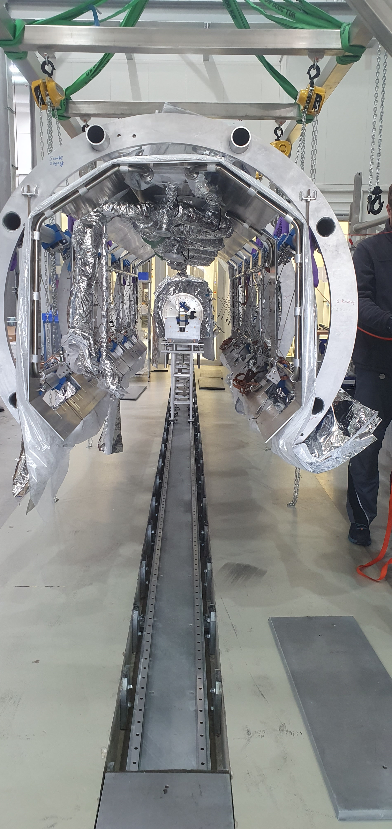
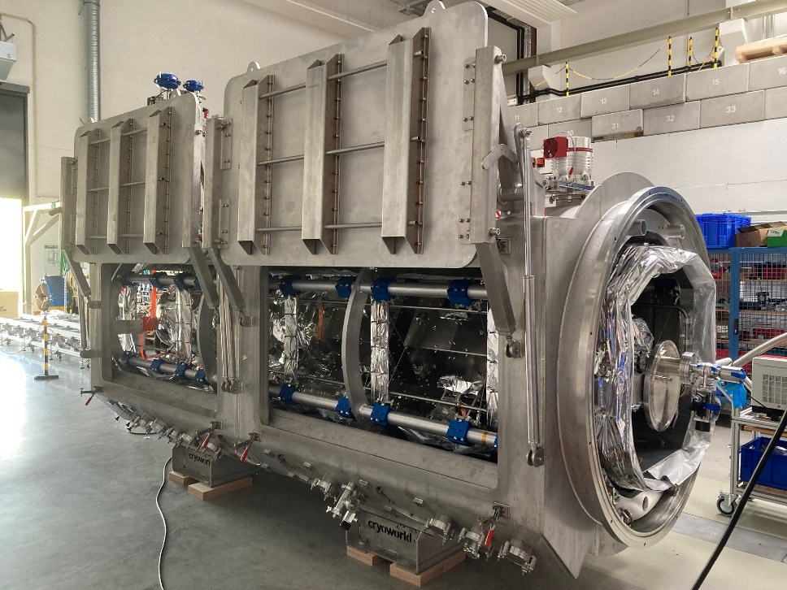
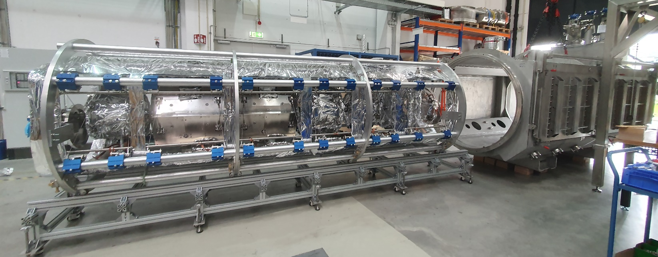
Integaration of CM1 cold string with cryostat
27.03.2023
18.04.2023
21.04.2023

Slide 15
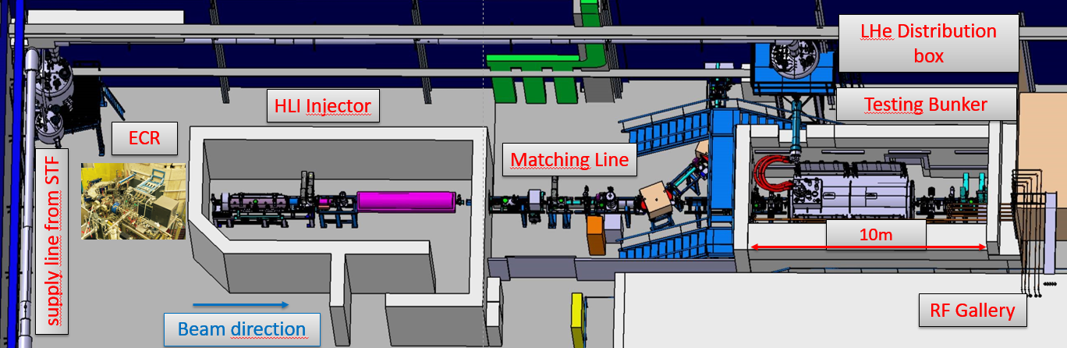
Testing Area @GSI for “Advanced Demonstrator”
Dedicated radiation protection shelter for cryogenic modules (in operation since 2020)
HLI injector provide with beam from H to Xe A/Z<6
Matching beam line and beam diagnostic bench in operation since 2020
Automated He-Distribution system for cryogenic modules of HELIAC
In total 80 meter of 4-fold transfer lines

Slide 16
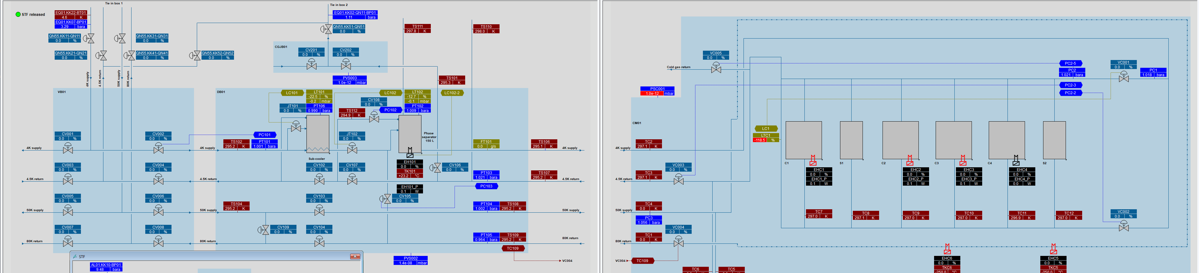
Local Cryogenic at Testing Area
STF
Series Test Facility(STF) for SIS100 dipole/quadrupole
50K He-Circuit with 2 kW@ 10Bar
4K He-Circuit with 700W@ 3Bar
J-T expansion into 150 L phase separator
Cool down line
50K cool down of the shield+ distribution (2 days)
4K cool down of distribution +LHe in phase separator (5 h)
Cold mass in cryostat is @250K due to radiation heat exchange
Danger of Q-Deseas, not all cavities are backed at 600 °C
Fast cool down of cryostat to 4K with rate 1K/min)

Slide 17
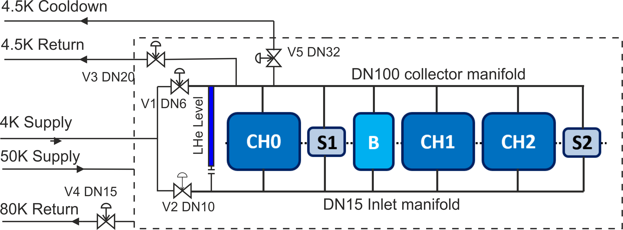
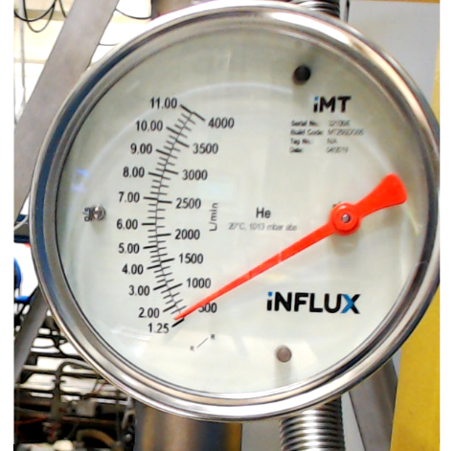
P&ID of Cryostat
50K @ 10Bar for radiation shield, V4 regulate He-flow
4K cool down via V2 “Inlet manifold” from bottom of cavity
4K supply with LHe via V1 for operation into collector manifold
Separate cool down line to the He-balloon (design pressure of cavity <0.5Barg)
4.5K return line with V3 for slow pressure control
Superconducting LHe-Level sensor in “appendix” with 3 mm orifice to inlet manifold
Design: 20W static losses for cryostat
measured 1.25g/s →28W
Total static losses of module 1.5 g/s → 35W
Subject of further improvement

Slide 18
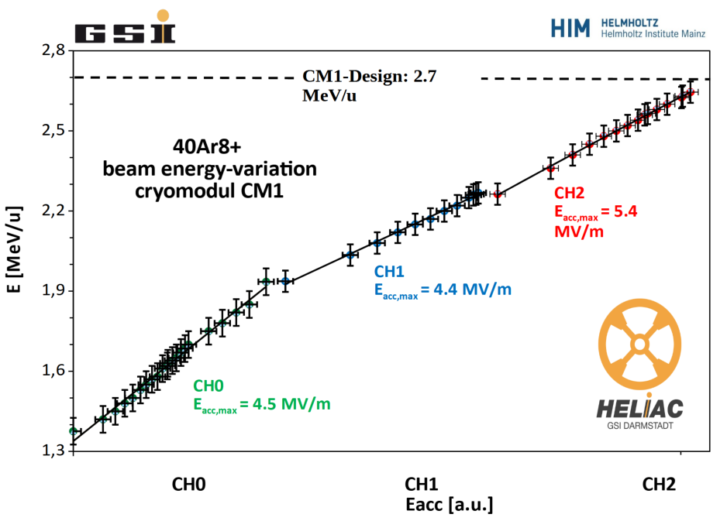
Lesson Learned Beam Campaign
Design W_{kin}=2.7 MeV/u reached
Transmission of 80% due to longitudinal mismatch of injector beam
UNILAC LLRF system from 1995
Cavity bandwidth less than 120Hz leads to instabilities of LLRF control loop
Modern digital LLRF is required!

Slide 19
Summary & Outlook
5 cold campaigns since November 2023
Local cryogenic infrastructure works well (except LHe sensor during cool down)
RF-control not stable yet for durable operation
Reasons for instabilities not yet understood
  Strong coupling of mechanical and electromagnetic modes
  He-gas blowing
  Damping of tuner compression mode
Optimisation of HLI Injector for smallest possible longitudinal and transversal emittance
Further cold campaigns scheduled!
Transition from R&D to TDR phase

Slide 20
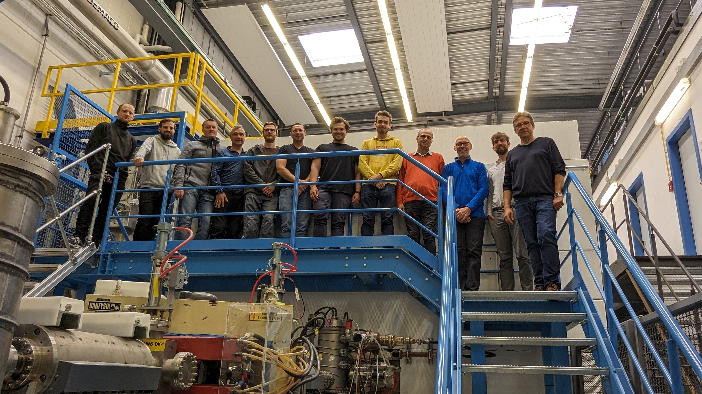
LINAC Team

