Slide 1
The Electron Ion Collider at Brookhaven National Laboratory
Kraków Epiphany Conference
Kraków, January 16-19, 2023
F. Willeke, BNL

Slide 2
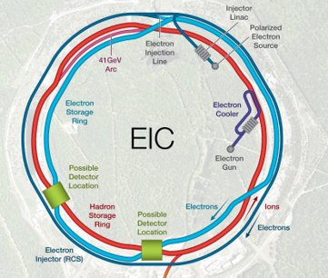
Outline
The EIC Physics Case
EIC Requirements
EIC Design
EIC Accelerator Challenges
  - High Luminosity
  Beam Polarization
  - Superconducting RF systems
  High beam Intensity
  - Collective Effects
  - High Energy Hadron Beam Cooling
EIC Schedule
EIC international Collaboration
Summary

Slide 3
Electron Ion Collider Physics
Nuclear Physics Community compiled an EIC WHITE PAPER^{*)} (2014/5):
How are quarks, gluons & their spins distributed in space & momentum in nucleus?
How do nucleon properties emerge from quarks and gluons and their interactions?
How do color-charged quarks, gluons & colorless jets, interact with a nuclear medium
How do confined hadronic states emerge from quarks & gluons
How do the quark-gluon interactions create nuclear binding?
How does dense nuclear environment affect the quarks-gluons correlations & interactions?
Does gluon density in nuclei saturate @ high energy
result in gluonic matter with universal properties?
*) A. Accardi et al, Eur. Phys. J. A529:268 (2016)

Slide 4

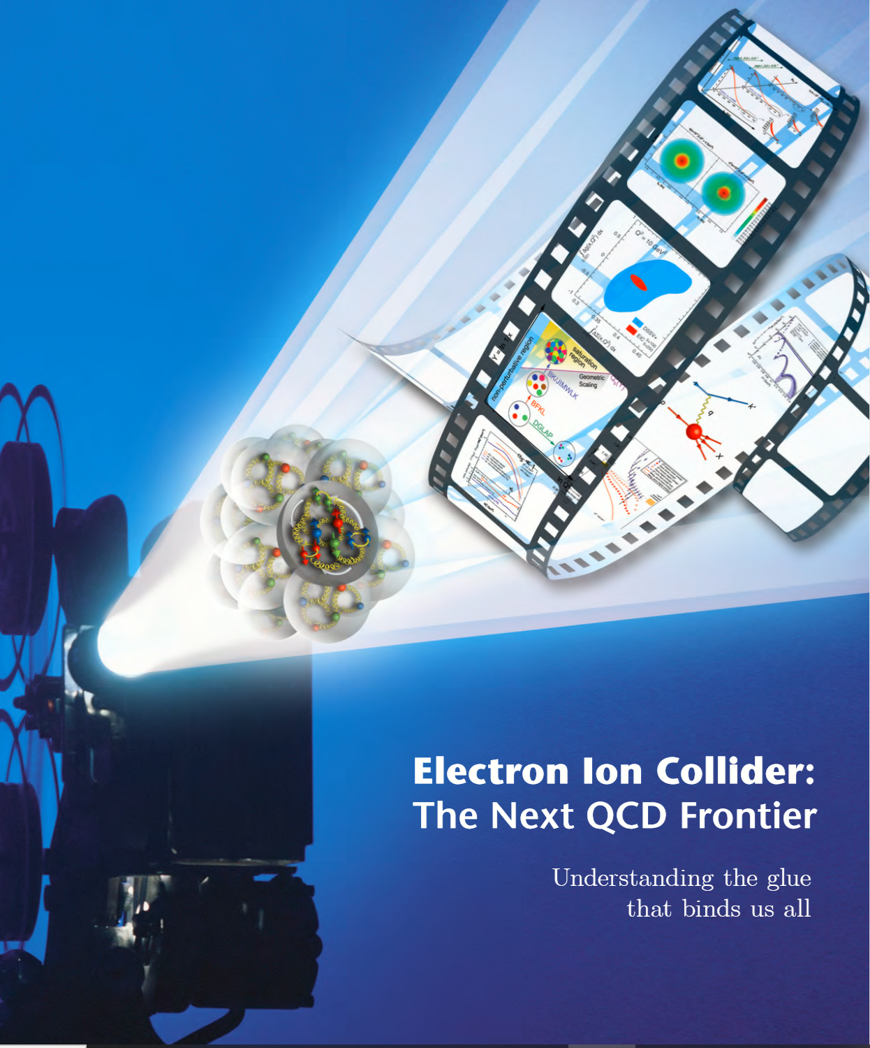
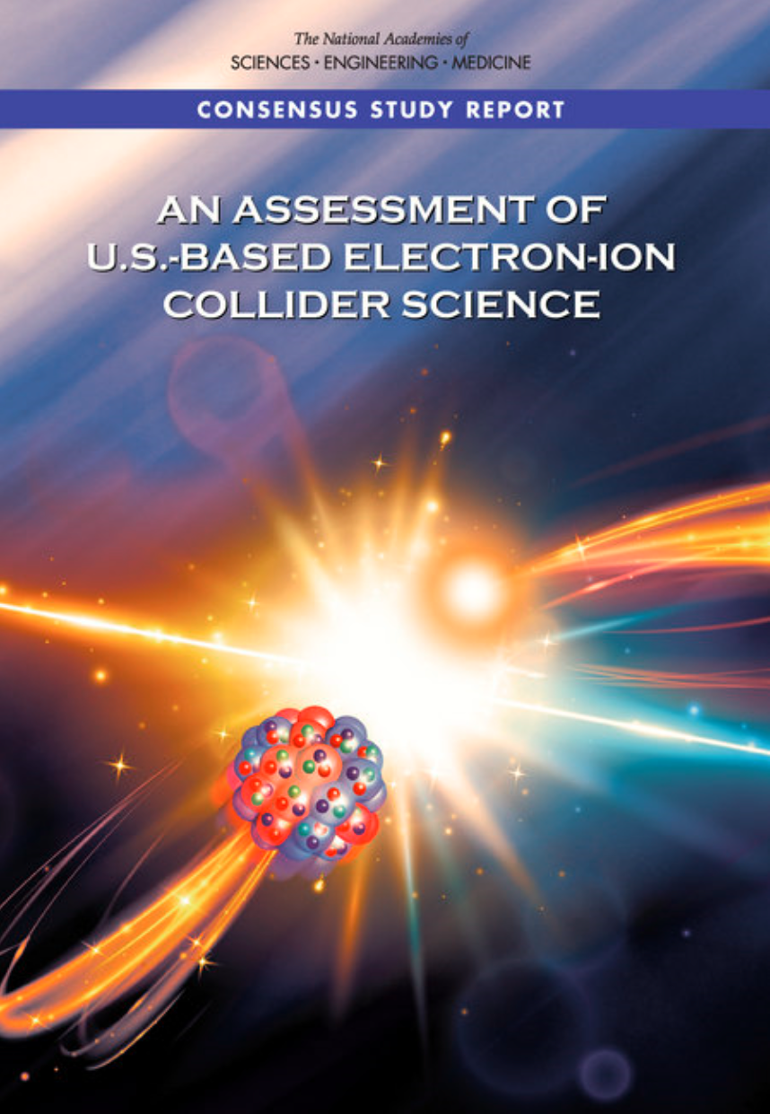
Requirements
EIC Design Goals
  High Luminosity: L=(0.1-1)∙10³⁴cm⁻²sec⁻¹, need 10 -100 fb⁻¹
  Collisions of highly polarized e and p (& light ion) beams with flexible bunch by bunch spin patterns : 70%
  Large range of center of mass energies: E_{cm} = (20-140) GeV
  Large range of Ion Species: Protons – Uranium
  Ensure Accommodation of a second IR
  Large detector acceptance
  Good background conditions (hadron particle loss and synchrotron radiation in the IR)
Goals match or exceed requirements of Long-Range Plan & EIC White Paper, endorsed by NAS
EIC Design meets or exceeds goals and requirements

Slide 5
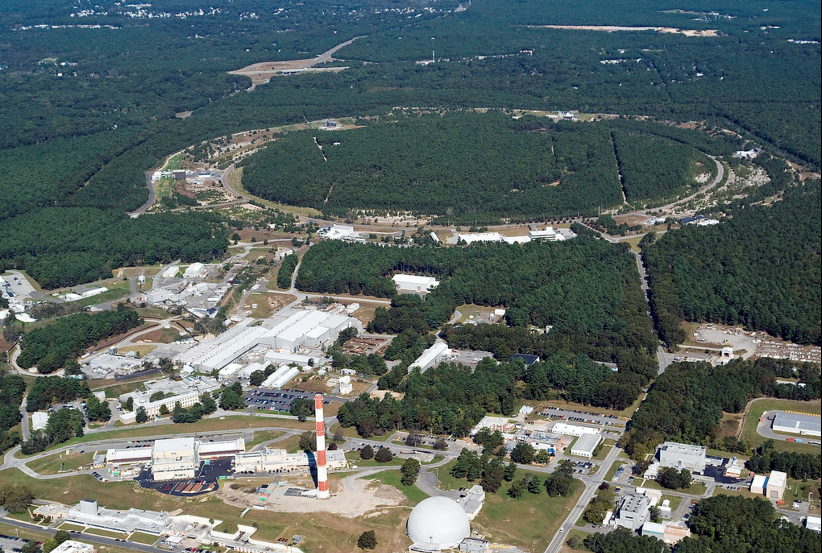

EIC Design Overview
Design based on existing RHIC Complex
RHIC is well maintained, operating at its peak
RHIC accelerator chain will provide EIC Hadrons
EIC constructed in Collaboration with JLab
Hadron storage Ring (RHIC Rings) 40-275 GeV
  Superconducting magnets (existing)
  1160 bunches, 1A beam current (3x RHIC)
  bright vertical beam emittance 1.5 nm
  strong cooling (coherent electron cooling)
Electron storage ring 2.5–18 GeV
  many bunches,
  large beam current, 2.5 A ➔ 9 MW S.R. power
  S.C. RF cavities
  Need to inject polarized bunches
Electron rapid cycling synchrotron 0.4- 18GeV
  1-2 Hz
  Spin transparent due to high periodicity
High luminosity interaction region(s)
  L = 10³⁴cm⁻²s⁻¹
  Superconducting magnets
  25 mrad Crossing angle with crab cavities
  Spin Rotators (longitudinal spin)
  Forward hadron instrumentation
EIC

Slide 6
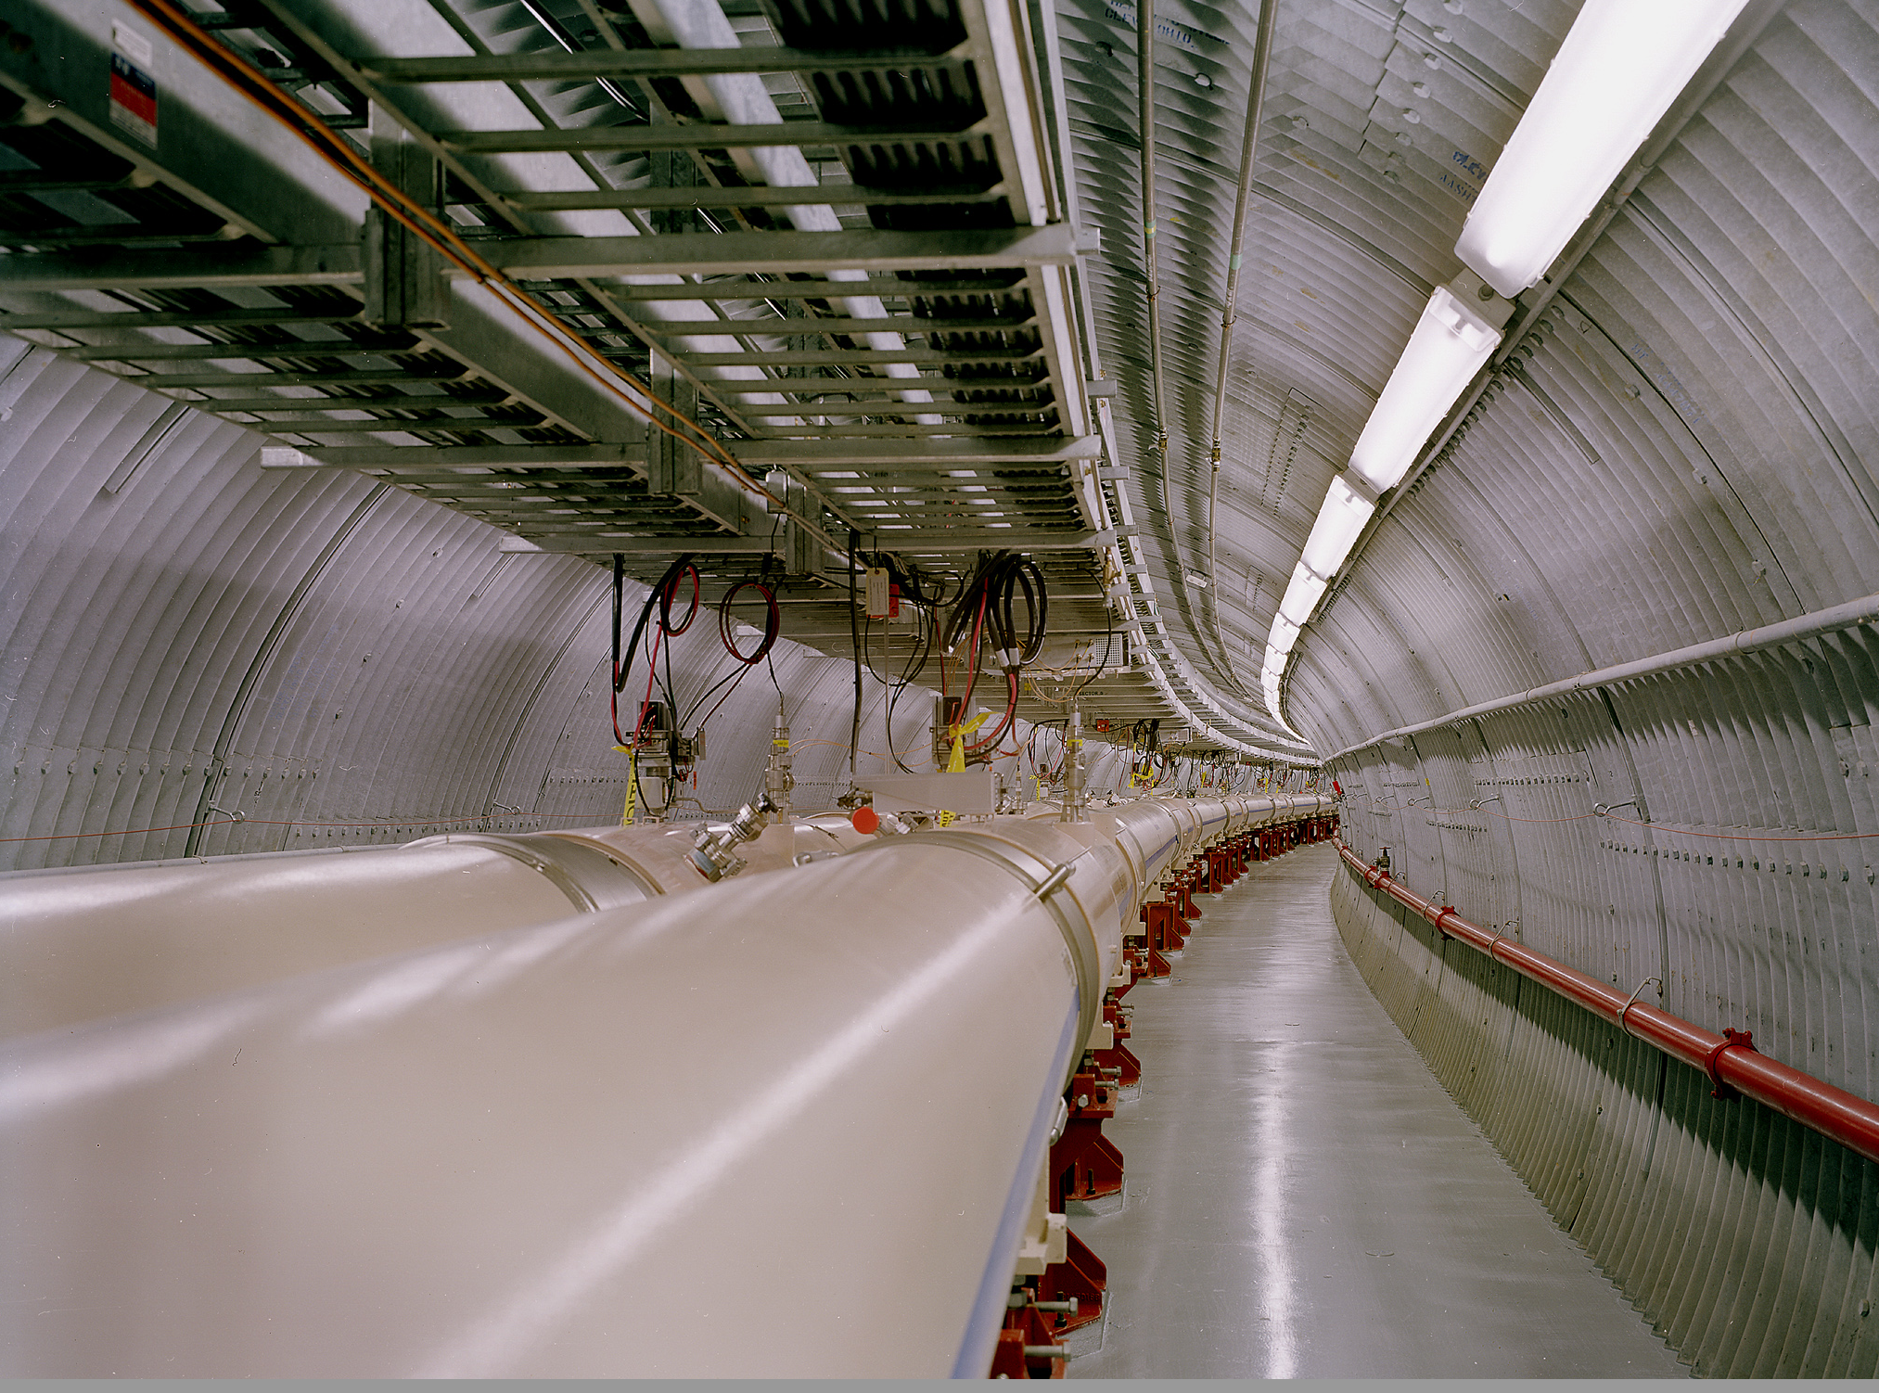
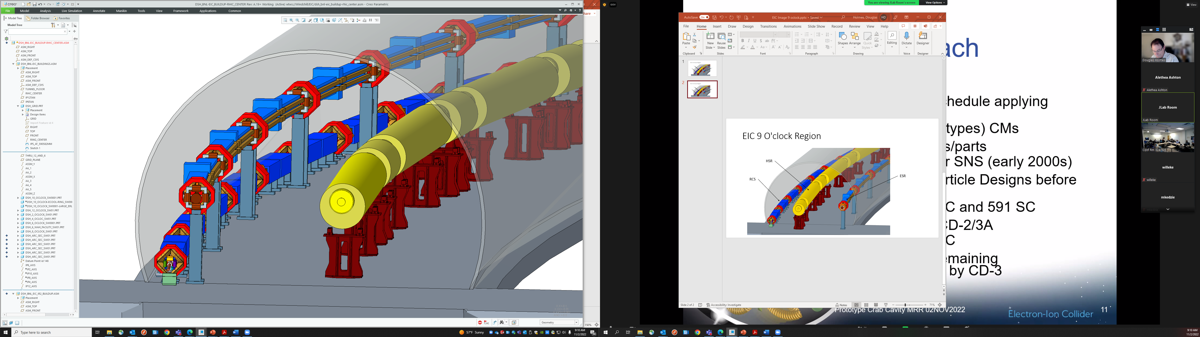
RHIC to EIC
TYPICAL ARC SECTION RENDERING
Electron Ring
Hadron Ring
Electron
Booster

Slide 7
Parameter Optimization for High Luminosity
Luminosity will always benefit from large beam currents ➔ maximize beam currents
EIC luminosity benefits from reducing hadron emittance by “cooling” to maximize luminosity as normalized emittance from source is too large
Minimizing number of bunches (1060, still a large number) will
  Reduce demand on beam cooling (since cooling is hard)
  Is detector friendly because bunch spacing is relatively large (12 ns)
  Results in smaller beam divergence at IP ➔ helps with p_{T} acceptance

Slide 8
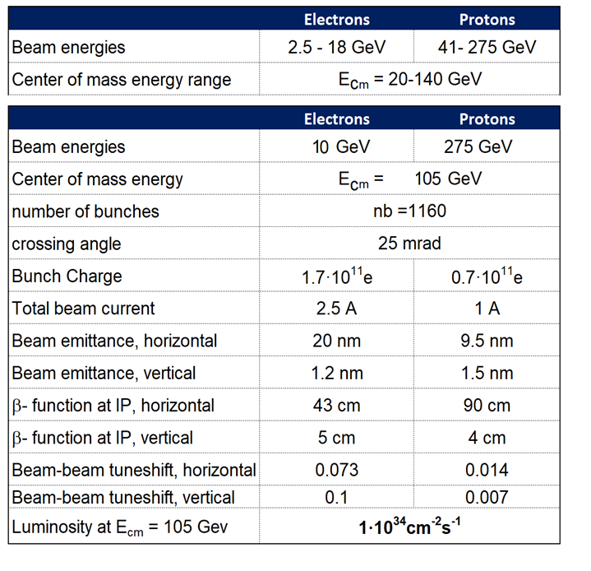
EIC CDR Parameters for E_{cm} and Luminosity

Slide 9
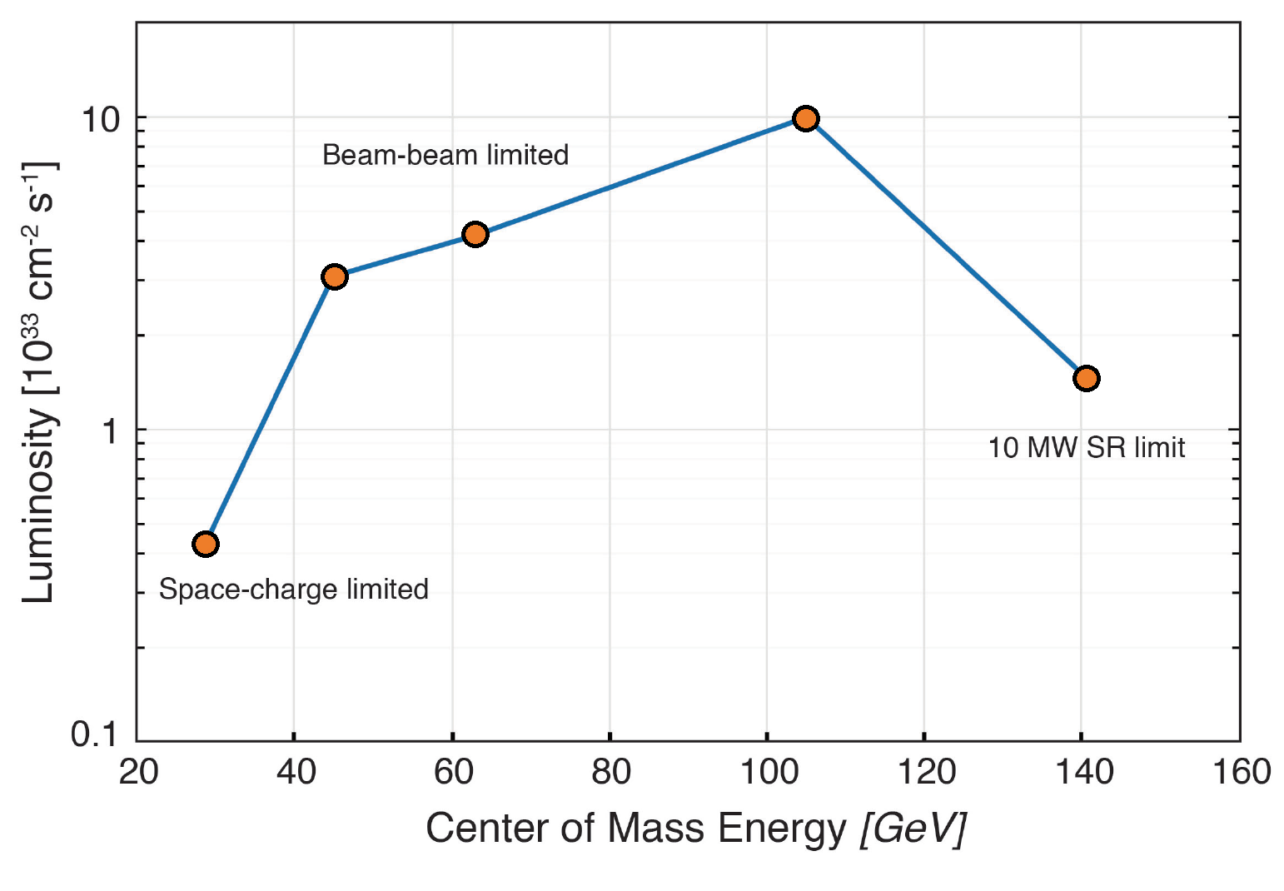
Luminosity vs. CM Energy
Parameter and IR optimization at 105 GeV center-of-mass energy
Optimization yields ${10}^{34}{cm}^{−2}\sec^{−1}$luminosity at 105 GeV

Slide 10
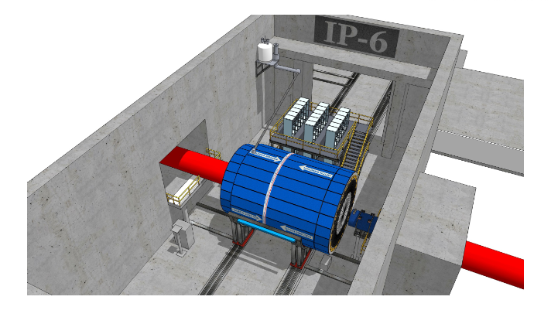
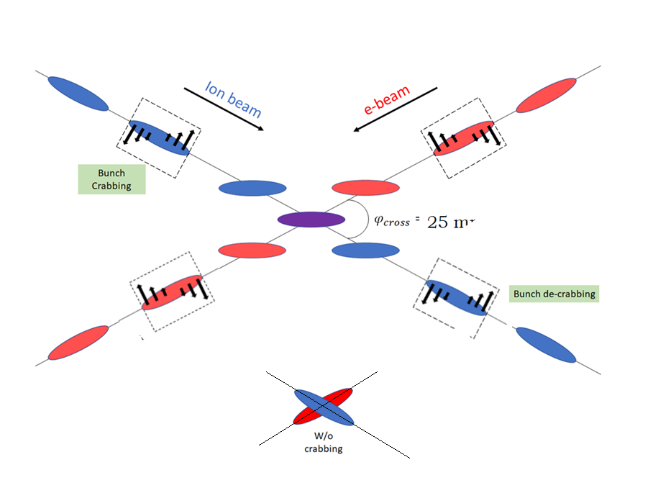
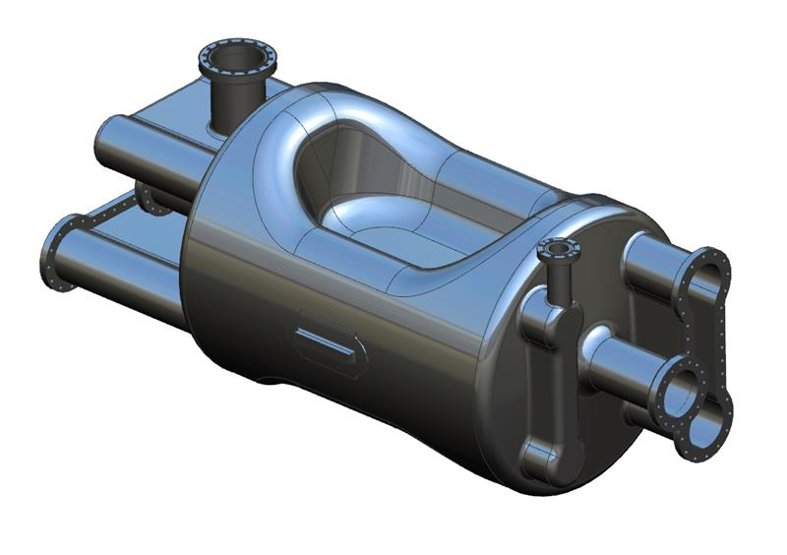
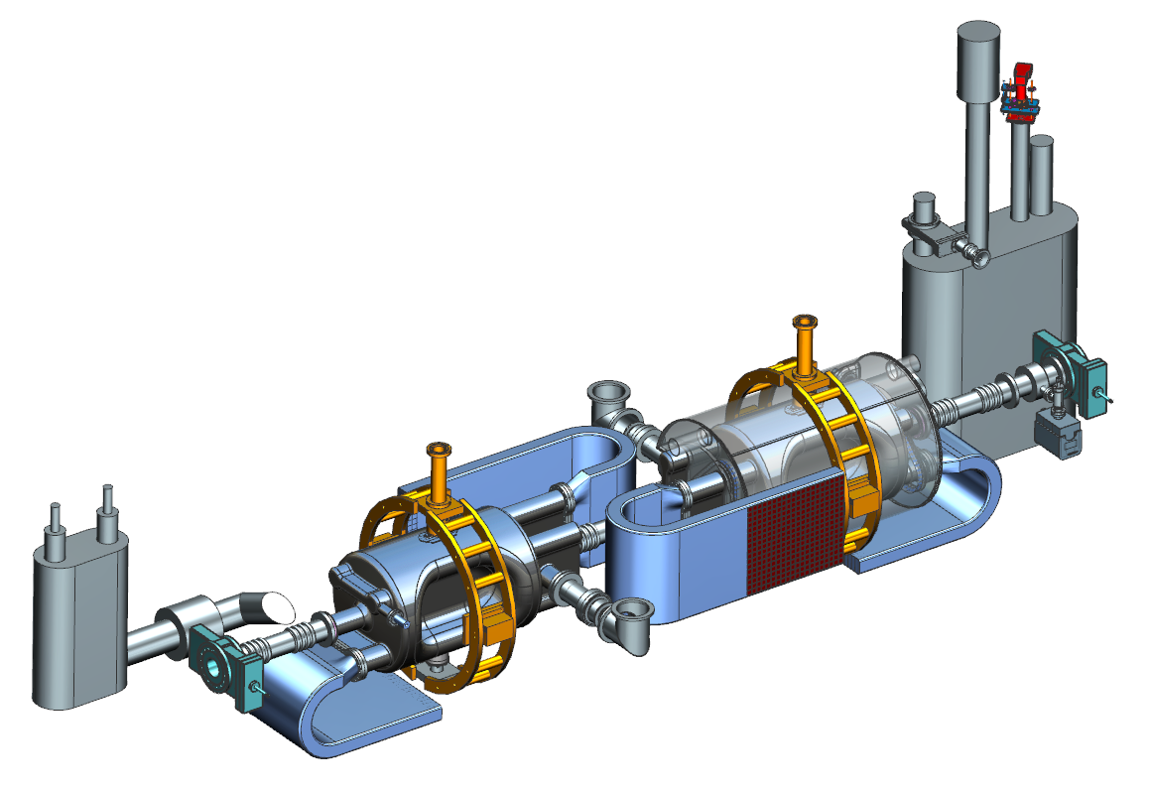
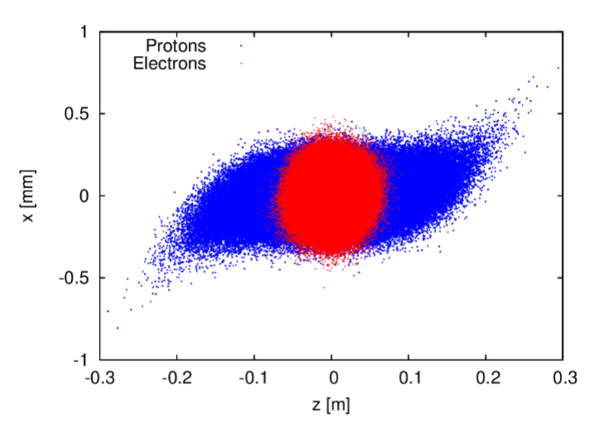
Interaction Region
12 ns bunch spacing ➔ 25 mrad crossing angle
Superconducting final focus magnets
Need compensate crossing angle effects ➔Crab cavities
Spin rotators
Large acceptance for forward scattered hadrons
Crabbing Complicates beam-beam interaction, source of hadron emittance blow-up
Once hadron beam size is blown up, electron re-shrink and the blow-up accelerated (mismatch)
Crab Phase noise: Fluctuating beam-beam offset causes rapid emittance growth many ➔ extremely small tolerances
10

Slide 11
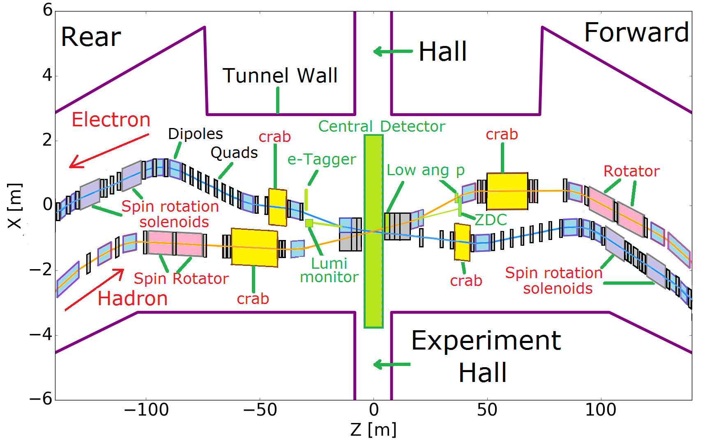
Interaction Region
Tightly Superconducting final focus magnets,
Aggressive focusing
Crab cavities optical conditions
Spin rotators
Large acceptance for forward scattered hadrons (conflicts aggressive focus)
11

Slide 12
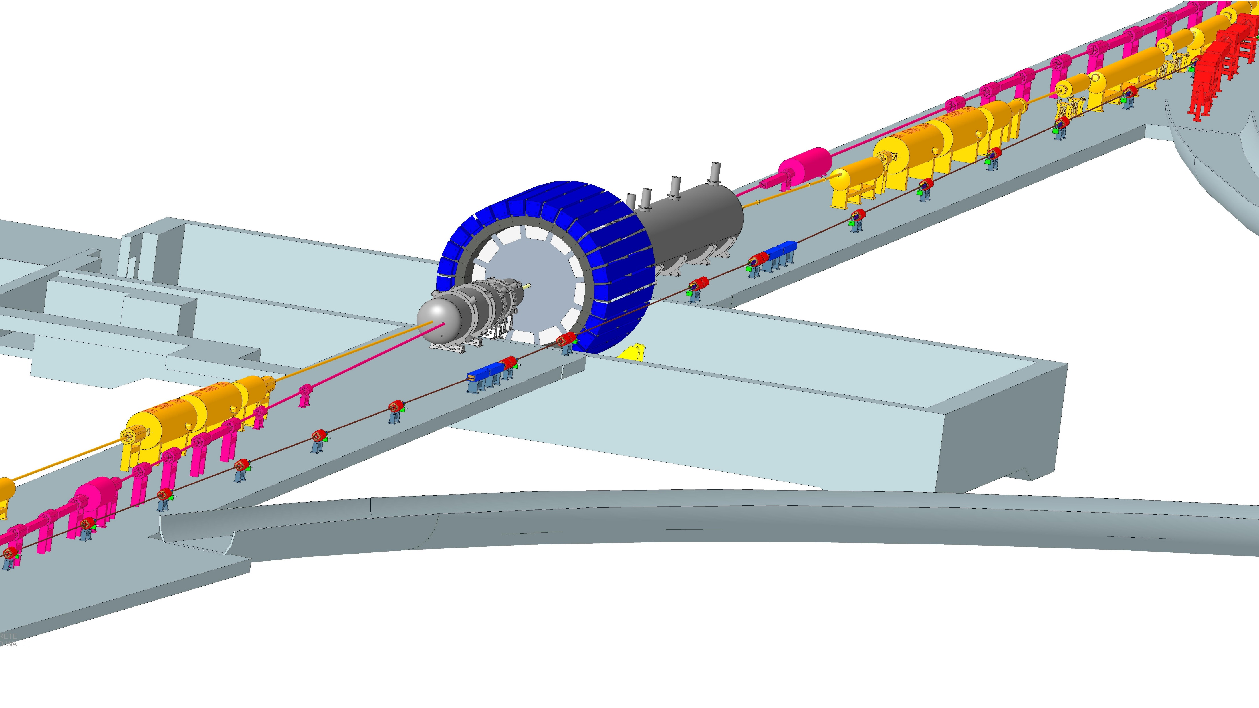
IR-6
Forward Side
SC Magnet Cryostat
ESR Forward side
Central Detector
Rear Side
SC Magnet Cryostat
HSR Injection Line
HSR Forward Side
HSR Rear Side
ESR Rear side
RCS
With Detector Bypass

Slide 13
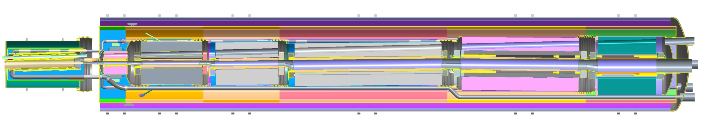
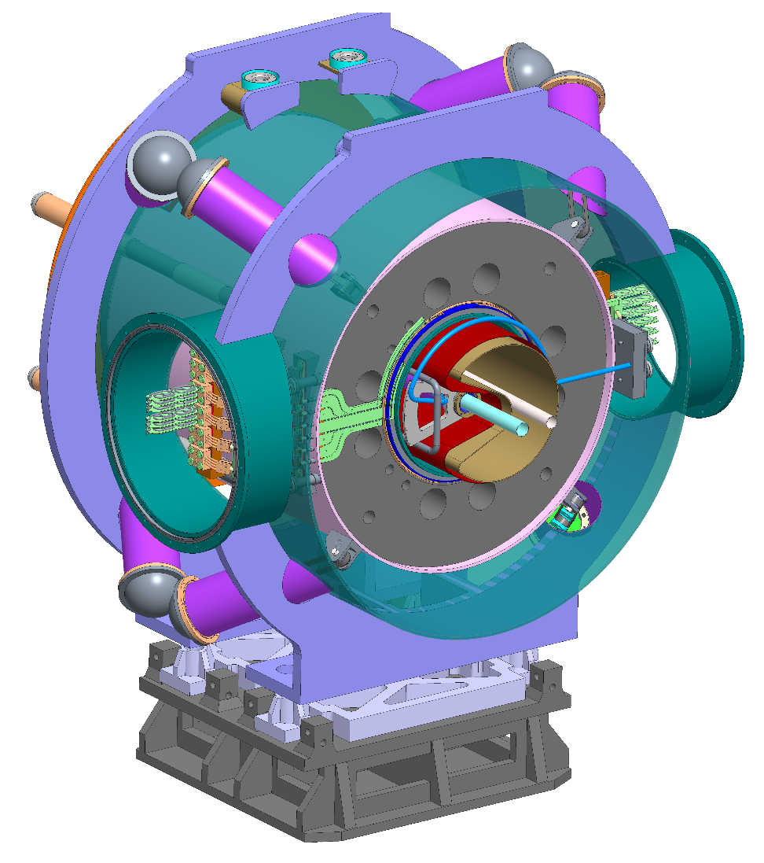
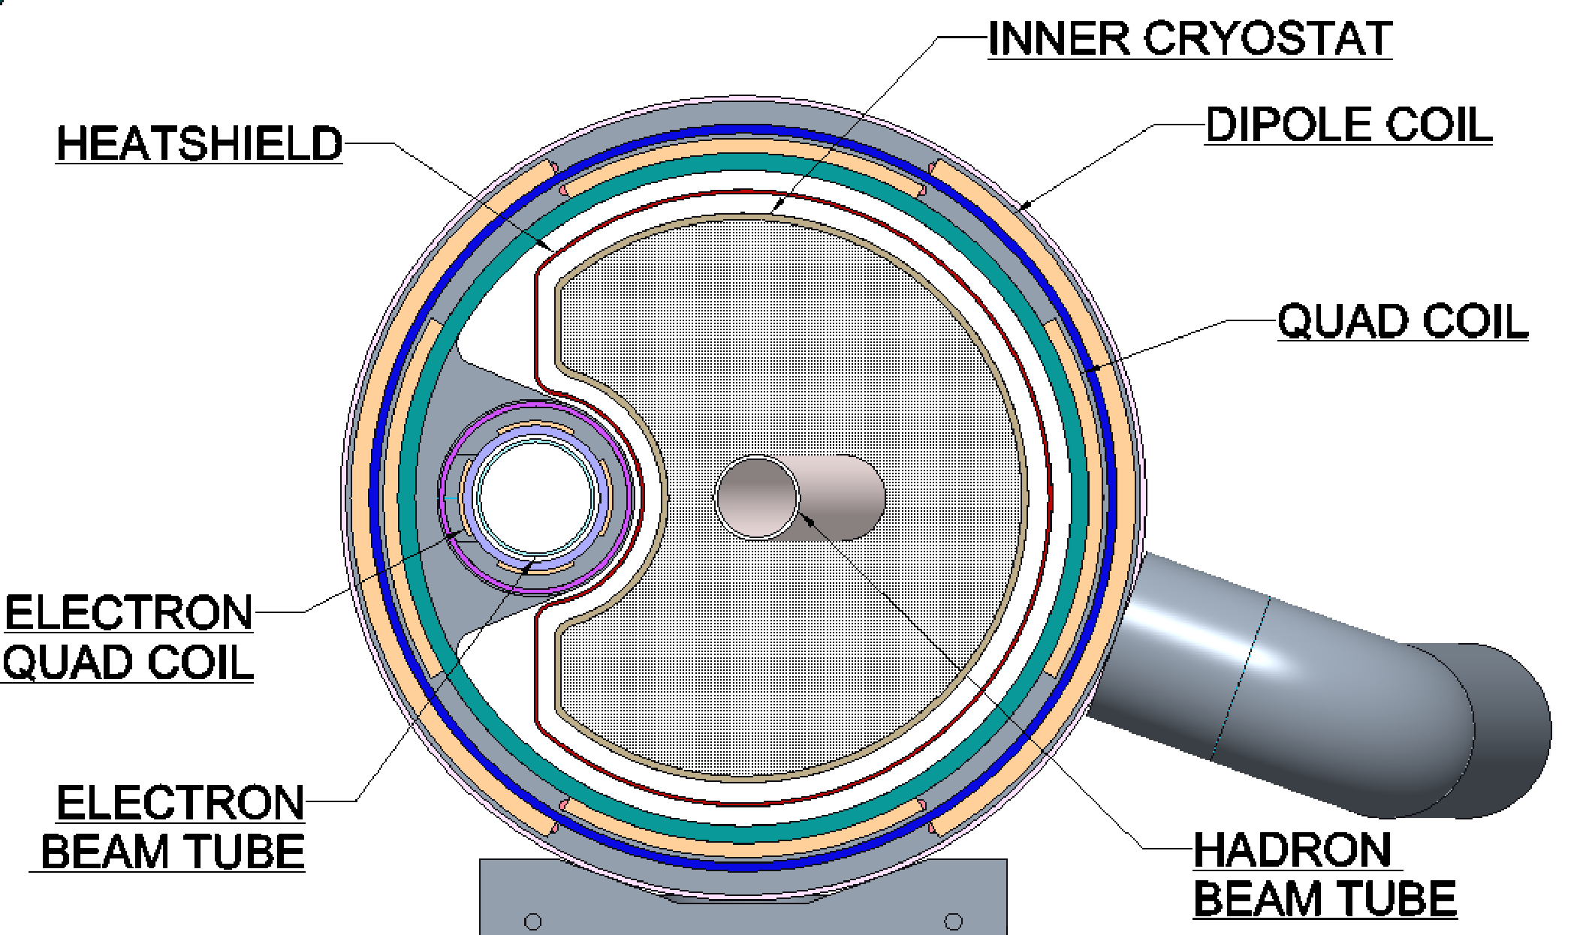
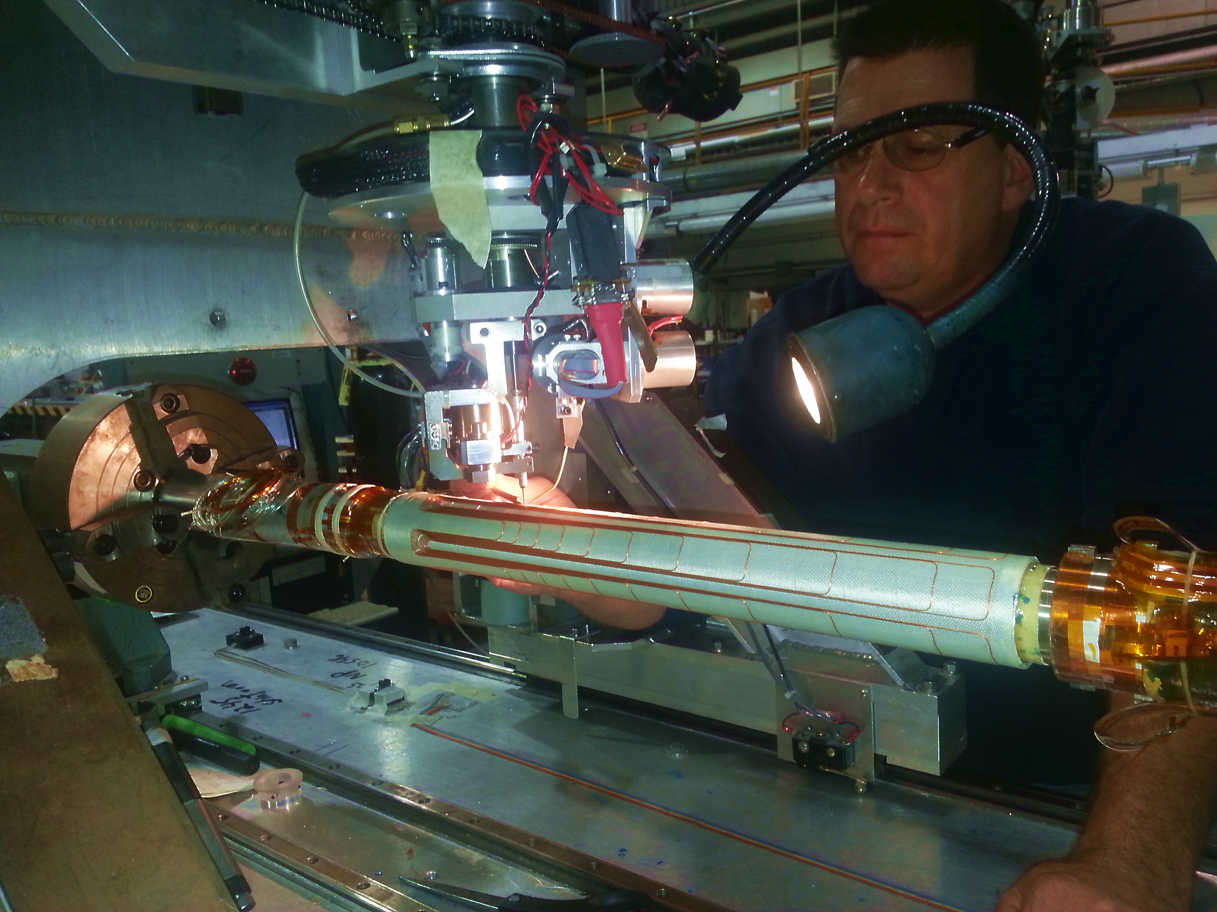
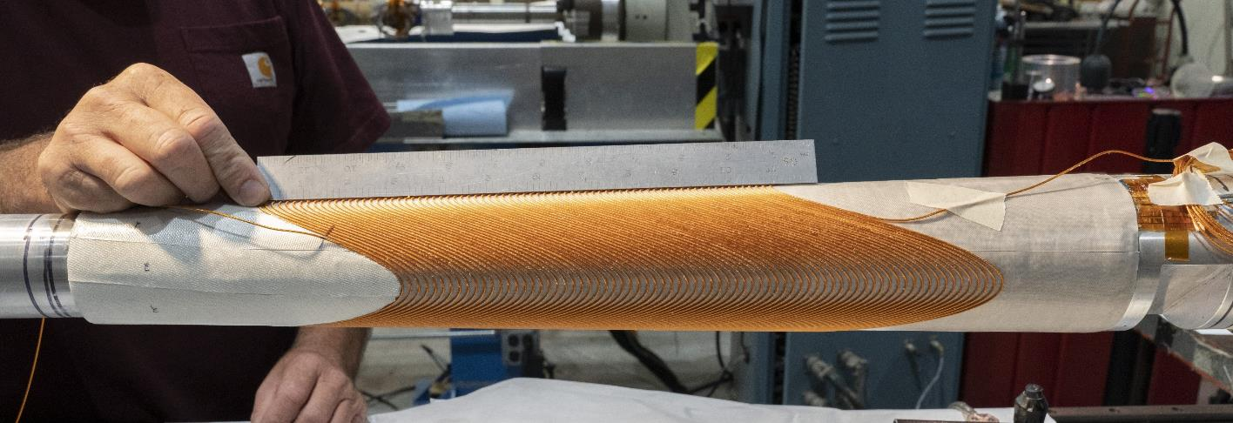
IR Superconducting Magnets
Highly integrated superconducting hadron and electron magnets, some operated at 2K
Spectrometer magnet including hadron and electron beam pipe
Direct wind technology

Slide 14
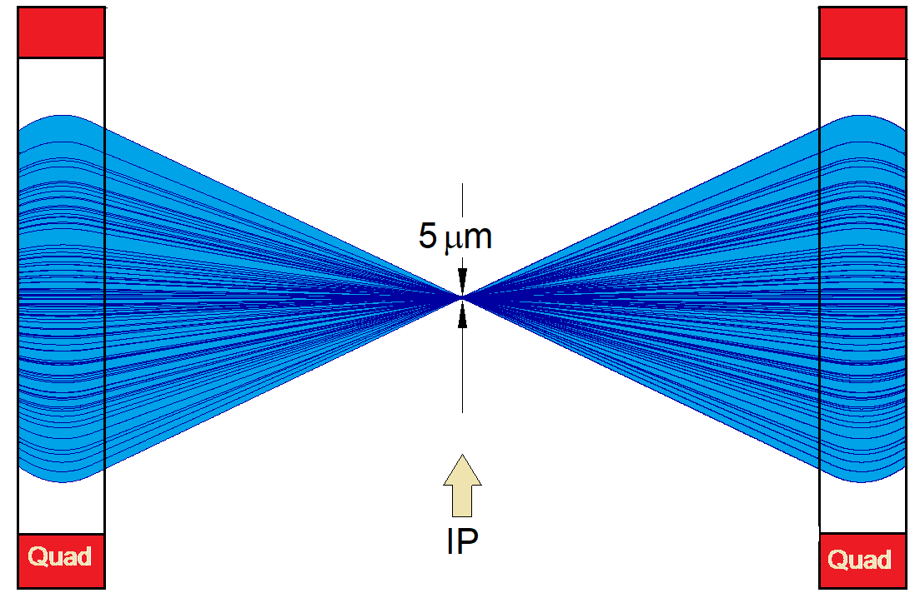
Dynamic Aperture
Luminosity requires small beam size at collision point, implies large beam divergence
Particles with slightly different beam energies experience weaker/stronger focusing (“chromaticity”) ➔beam optics distortions ➔must be corrected to store beam
Need compensation by nonlinear sextupole magnets in the arcs
Contributions from IR where beam size is large and final focus quadrupoles a strong dominate➔ strong nonlinear sextupoles
Strong nonlinear sextupoles limit betatron oscillations amplitudes (@beam size)
As the electrons beam size generated by from synchrotron radiation effects we must
  limit the focusing (affects beam size at IP and luminosity)
  Optimize distribution of nonlinear sextupole fields around the machine to keep the beam stable.
➔ sophisticated linear and nonlinear lattice design

Slide 15
High Luminosity: High Beam Intensity
Large amount of synchrotron radiation from the electron beam: 9 MW, need 64 MV for 18 GeV electrons
superconducting cavities driven by solid state RF amplifiers
High electron Bunch Charge 28 nC, careful low impedance vacuum design (tapers, shielded bellow, single-mode cavity design, effective higher order mode damping by SiC beampipe HOM absorbers)
RHIC cold beam pipe is stainless steel, large resistive heating due to 1 A beam current
Hadron beam suffers from clouds of electrons produced by ionization of rest-gas and amplified by secondary emissions
Need to insert a Cu and aC coated screen to reduce cryogenic load and suppress electron cloud by low SEY

Slide 16
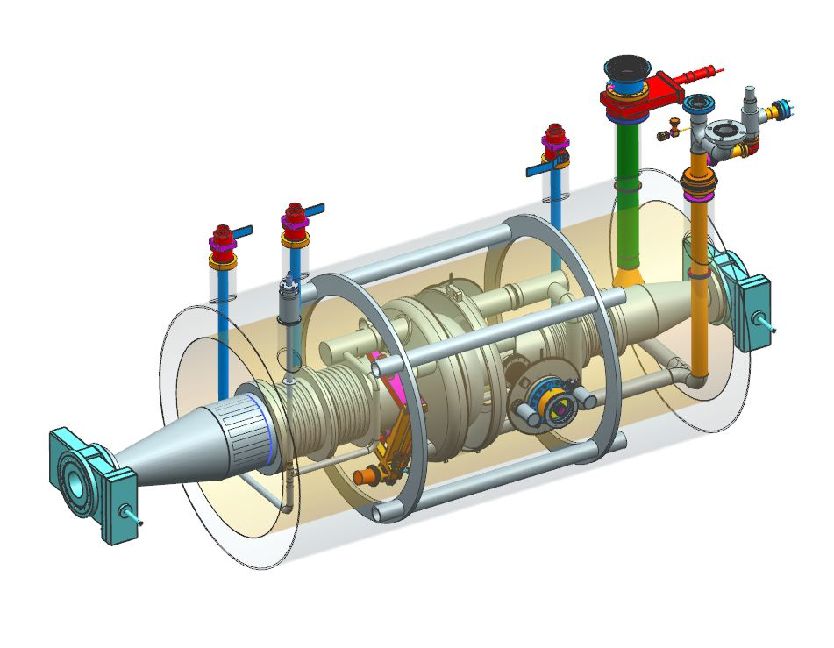
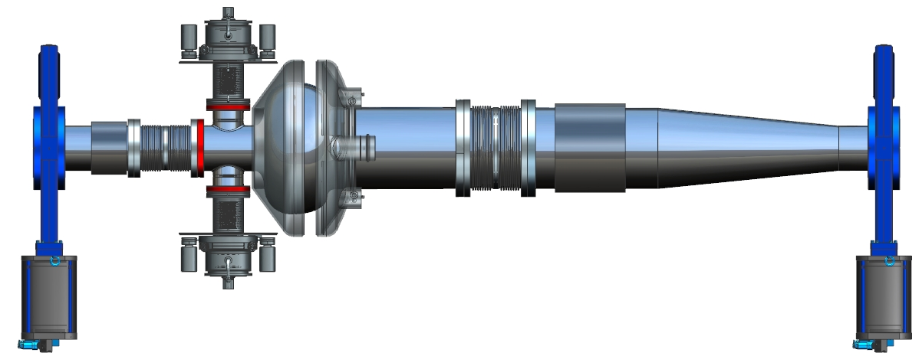
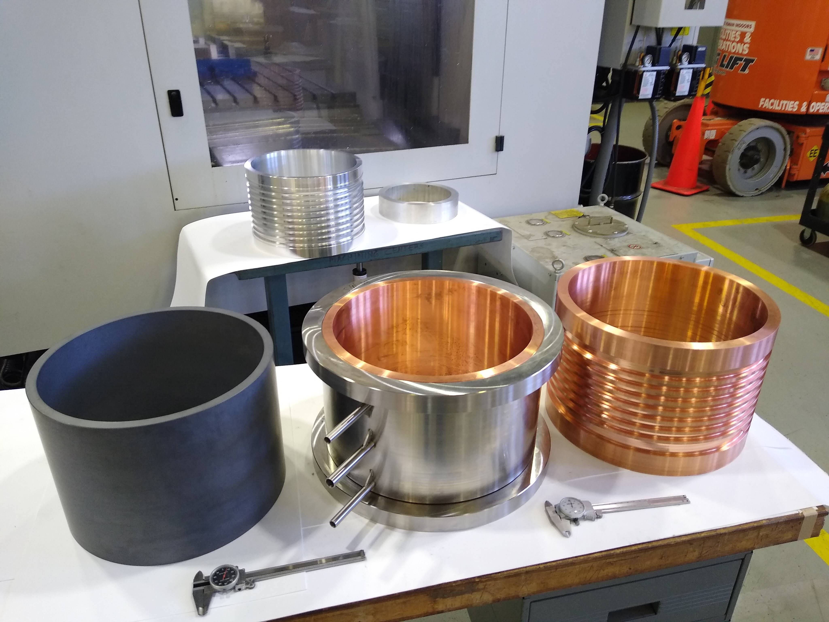
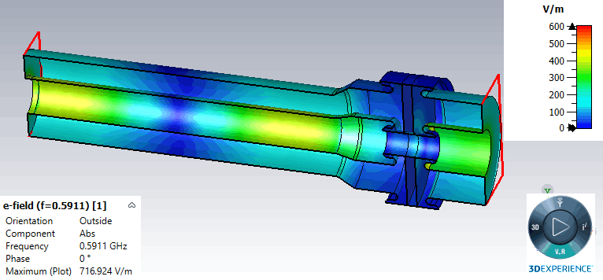
Electron Beam RF System R&D
SCOPE
18 single cell “single mode” superconducting cavities provide 64MV @15MV/m for 18GeV
SiC higher order mode absorbers integrated in the warm beam pipe
Each with two 400 kW forward power couplers with variable coupling
Each powered by an 800 kW two stage solid state RF amplifier
ESR Single cell 591 MHz s.c. cavity
HSR 196 MHz Crab cavity
R&D
- HOM damping
- FPC
FPC
Pick Up
VHOM
Dogbone
HHOM
Dogbone

Slide 17
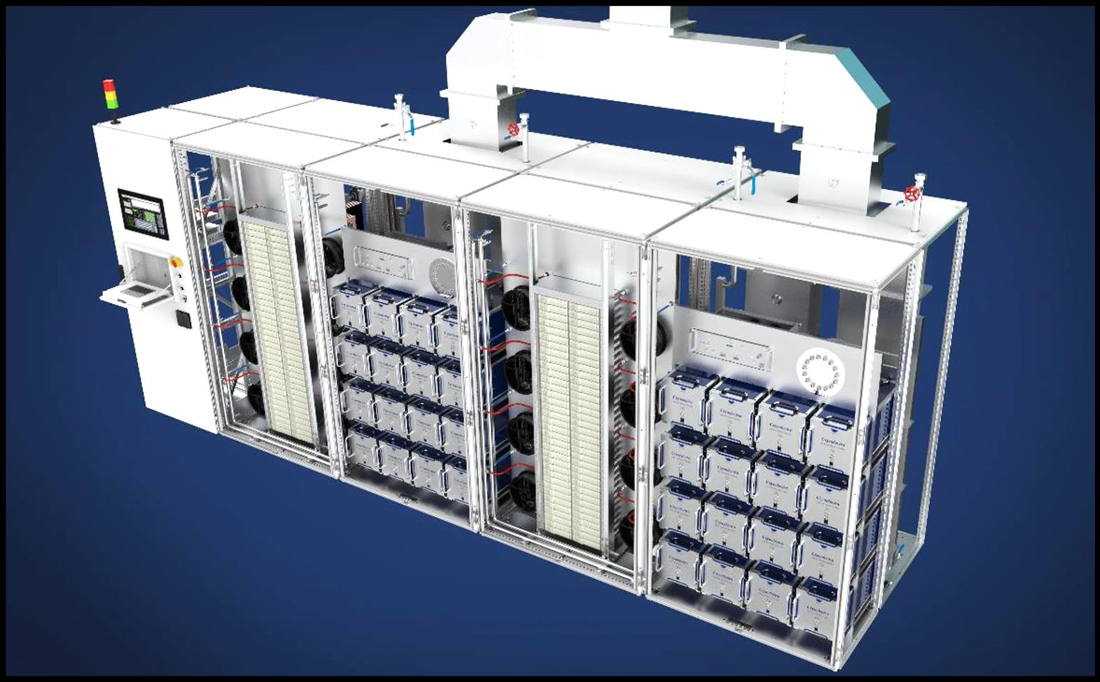
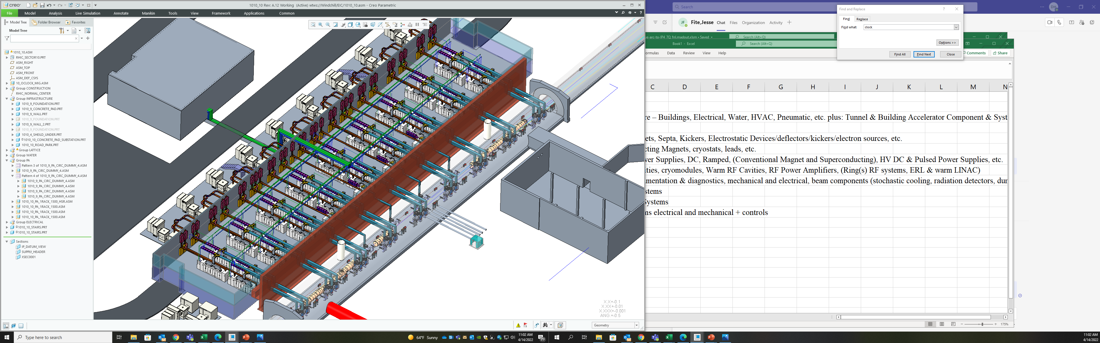
RF Power
ESR requires 12 MW of RF power to balance 9MW of synchrotron radiation power loss of the 2.5A beam at 10 GeV.
Considering technical performance, cost, safety and availability, solid state RF power technology has been chosen for the RF power sources

Slide 18
Electron Beam RF System
18 single cell “single mode” superconducting cavities
SiC higher order mode absorbers integrated in the beam pipe
Each with two 400 kW forward power couplers with variable coupling
Each powered by a 800 kW two stage solid state RF amplifier

Slide 19
RF Power
ESR requires 12 MW of RF power to balance 9MW of synchrotron radiation power loss of the 2.5A beam at 10 GeV.
Considering technical performance, cost, safety and availability, solid state RF power technology has been chosen for the RF power sources

Slide 20
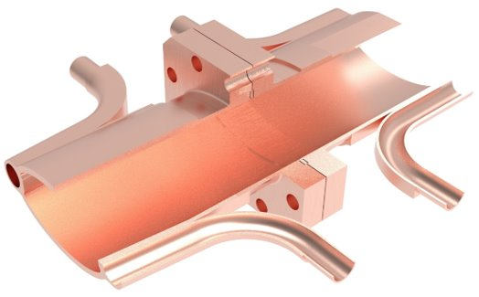
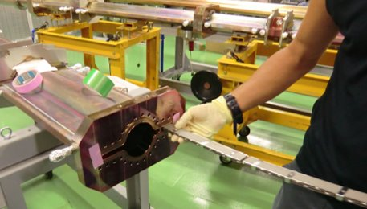
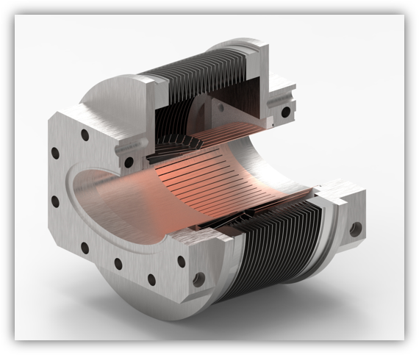
Electron Ring Vacuum system
Vacuum chamber design optimized to improve manufacturability
OFE Cu beam pipe with integrated NEG pumping (NEG stripes)
Carefully optimized shielded bellow derived from NSLS-II design
ESR vacuum chamber with flange and cooling
channels
ESR vacuum chamber with self supporting NEG strips
RF shielded bellow

Slide 21
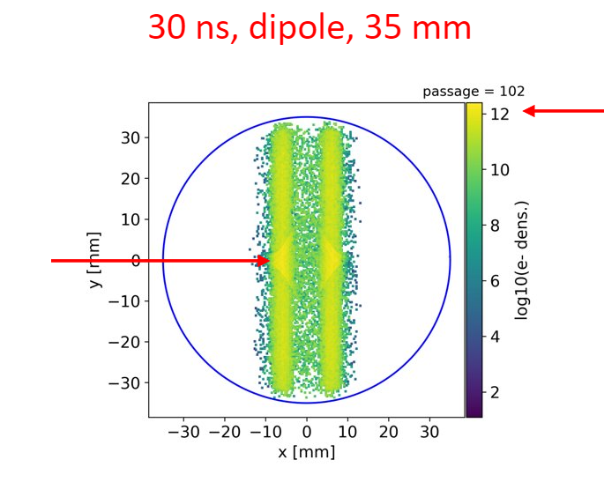
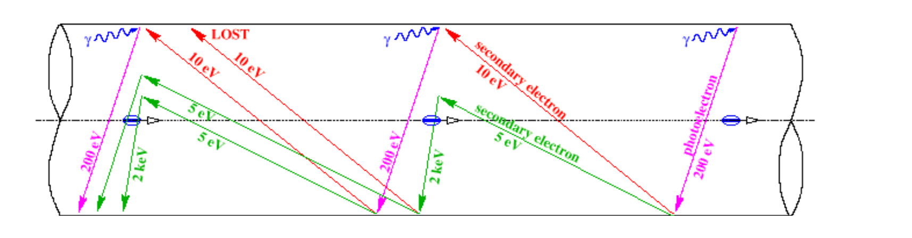
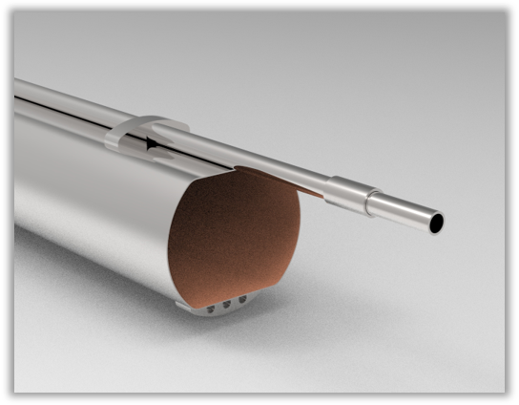
HSR Vacuum Cu/aC Coated Beam Screen
The resistive losses of the 1A proton beam current leads to an unacceptable cryogenic load ➔ need a Cu coated surface
Build up of electron cloud by ionization of rest gas amplified by secondary emission from stainless steel beam pipe
Need increase conductivity of RHIC cold SS beampipe, suppress electron cloud with SEY ~1
➔In situ insertion of a Cu and aC coated screen
An actively gas cooled screen is the only feasible solution (unfortunately also the most expensive one

Slide 22
Electron Polarization
In ESR, synchrotron radiation would help building up polarization slowly
but there are counteracting effects that destroy polarization
➔ Equilibrium polarization is only 30%-60% in ESR, but need 70-80%
Buildup would work only for spin up direction but need spin down also
➔ Electron polarization electrons created by polarized source
and preserved during acceleration in the RCS (quite tricky)
In ESR, long list of effects that destroy injected polarization
➔ need
  Extremely careful orbit control (microns)
  Extremely careful compensation of coupling between transverse planes of oscillations
  Very careful choice of tunes: horizontal, vertical, longitudinal, and spin
  Careful compensation of detector solenoid by rotated quadrupoles

Slide 23
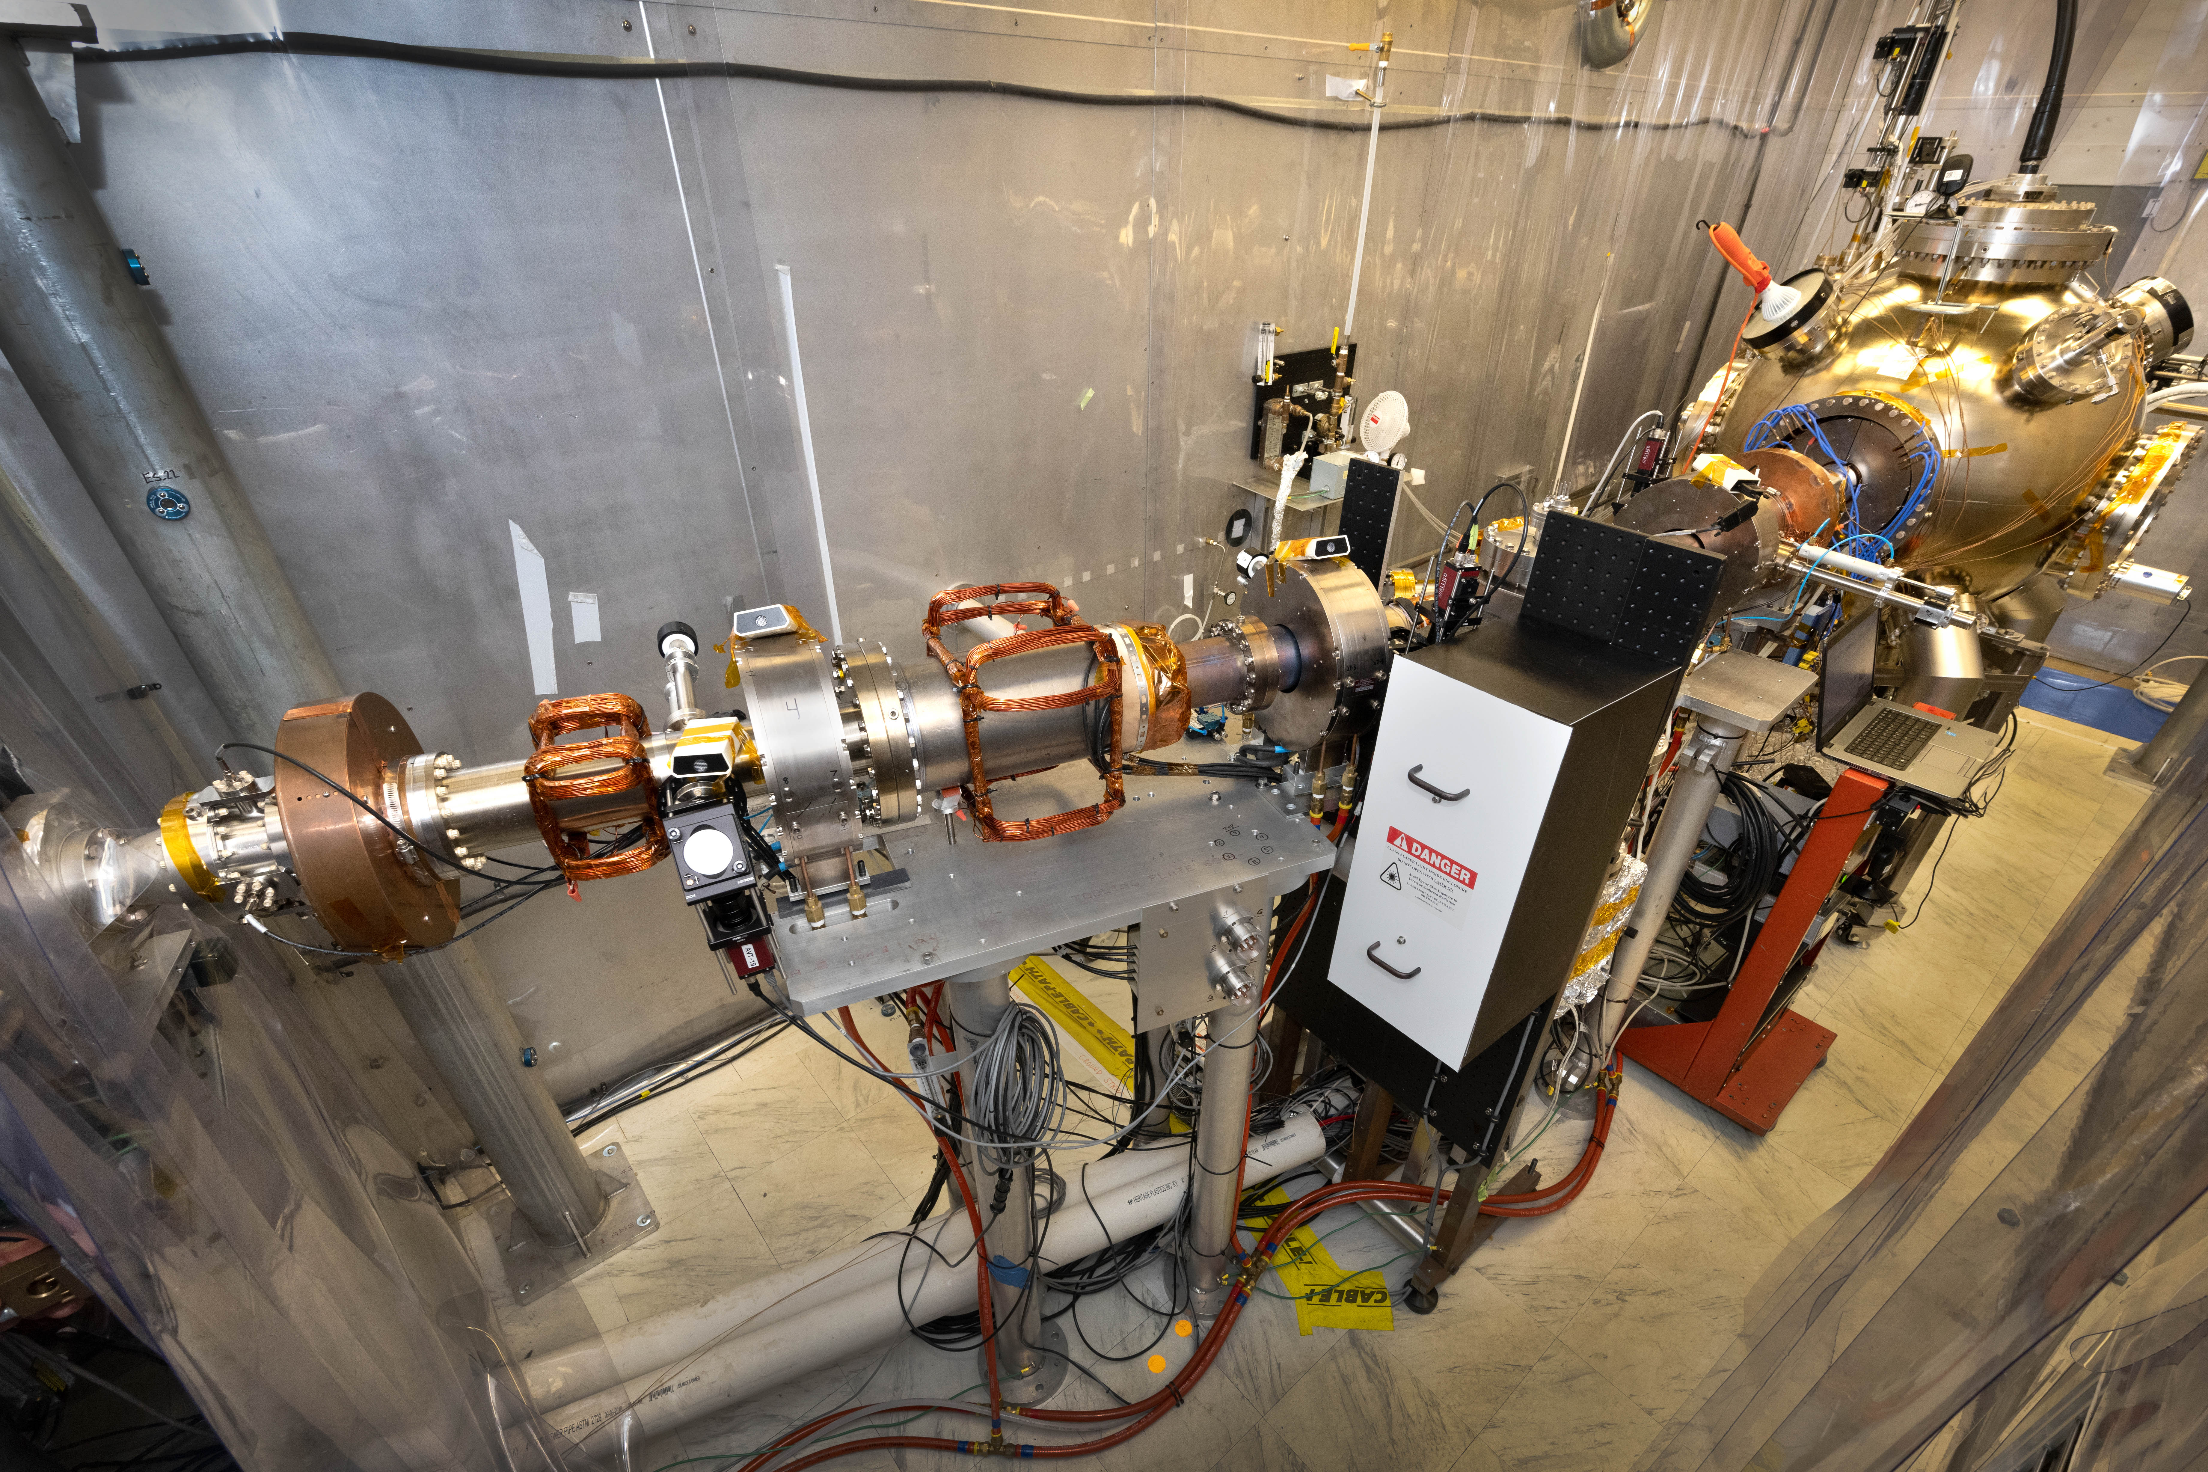
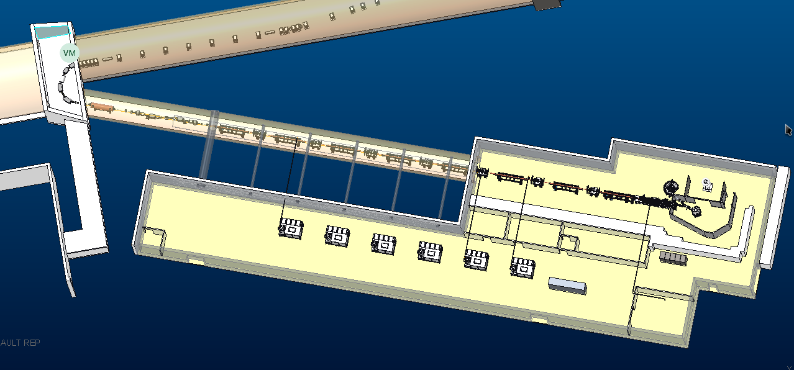
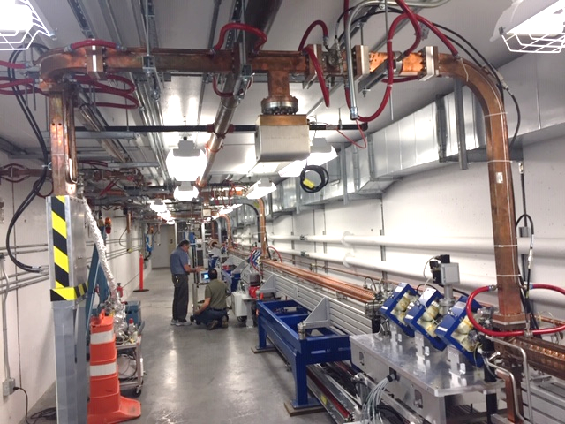
Electron-Injector Complex
Polarized electron source (constructed pre-project) has demonstrated EIC performance parameter with significant margin
Electron 400 MeV injector linac: Layout and parameters as well as performance. Requirements consolidated; planned as turn-key procurement from experienced vendors, performance confirmed by simulations based on detailed design and existing, similar linacs.
Critical long lead procurement, needs a CD3-a early procurement authorization
Is planned to be sufficiently defined for procurement by fall 2023
The polarized electron gun has produced beam with EIC intensity
The critical cathode lifetime achieved
@ > 1 year of operating
91% polarization with measured using strained GaAs cathodes
NSLS2 LINAC

Slide 24
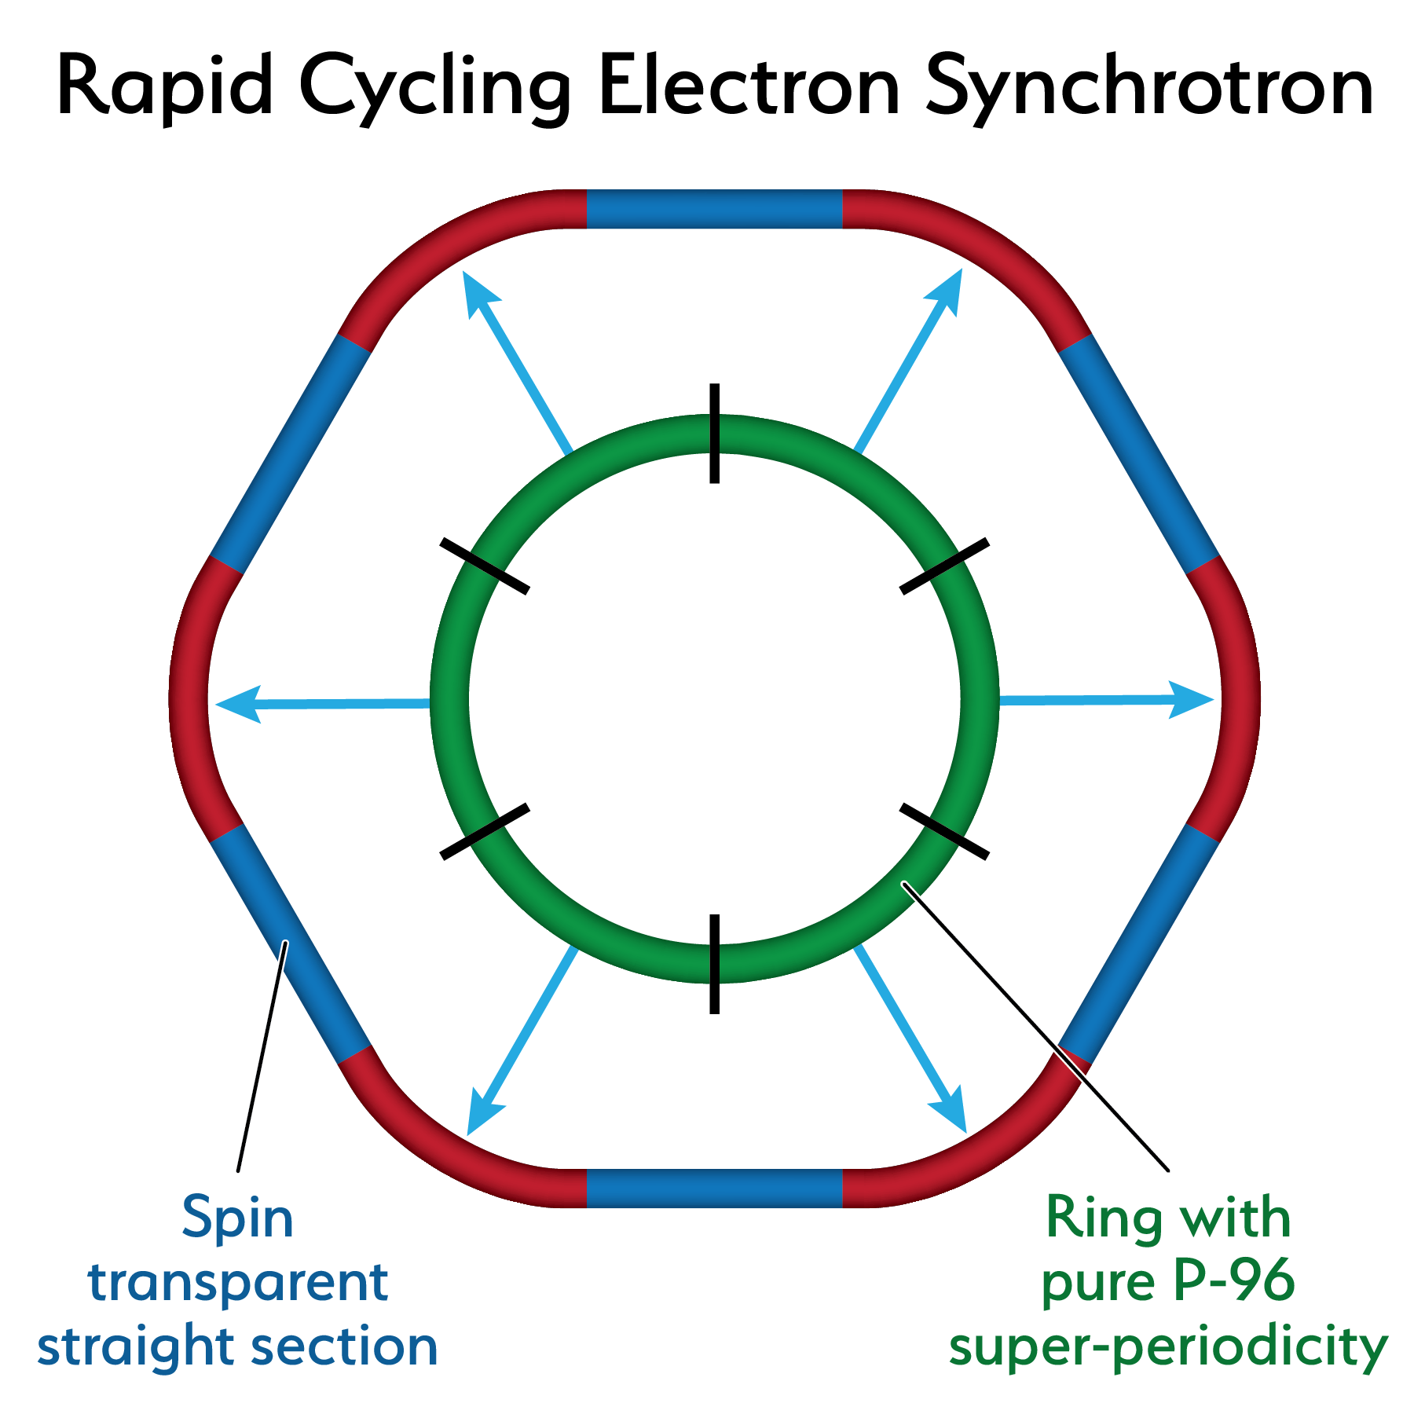
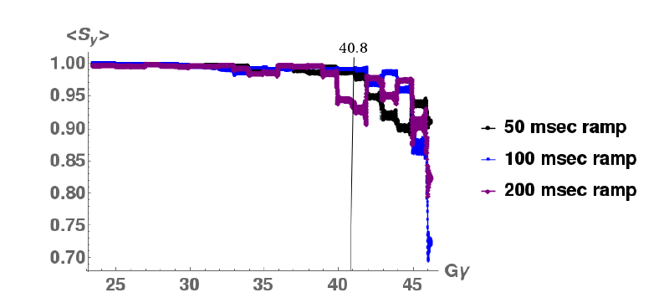
18 GeV Rapid Cycling Synchrotron enables high electron polarization in the electron storage ring
AGS experience confirms depolarization suppressed by lattice periodicity
Ingenious optical design with high quasi-periodicity arcs and unity transformations in the straights suppresses all systematic depolarizing resonances up to E >18 GeV
Good orbit control y_{cl.o.}< 0.5 mm; good reproducibility suppresses depolarization by imperfection resonances.
➔ No depolarizing resonances during acceleration 0.4-18 GeV
no loss of polarization on the entire ramp up to 18 GeV (100 ms ramp time, 2 Hz)
RCS Design
RCS Polarization Performance confirmed by extensive simulations

Slide 25
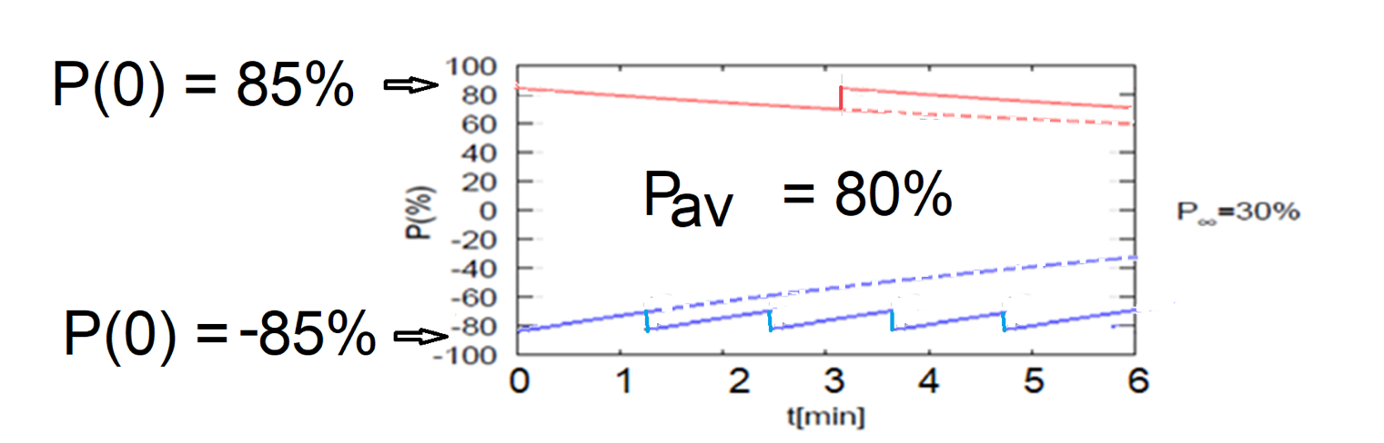
High average polarization at electron storage ring of 80% by
Frequent injection of bunches on energy with high initial polarization of 85%
Initial polarization decays towards P∞ < ~50% (equilibrium of self-polarization and stochastic excitation)
At 18 GeV, every bunch is refreshed within minutes with RCS cycling rate of 2Hz.
Need both polarization directions present at the same time
B P
Refilled every 1.2 minutes
B P
Refilled every 3.2 minutes
Re-injection
P_{av}=80%
P∞= 30%
(conservative)
P_{av}=80%
Re-injections

Slide 26
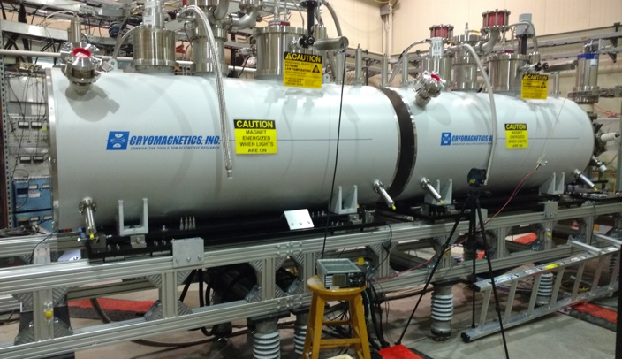
EIC Hadron Polarization
Existing p Polarization in RHIC achieved with “Siberian snakes”.
Near term improvements will increase proton polarization in RHIC from 60% to 80%.
³He polarization of >80% measured in source
80% polarized ³He in EIC will be achieved with six “snakes”,
Acceleration of polarized Deuterons in EIC 100% spin transparent
Need tune jumps in the hadron booster synchrotron
Electron beam ion source EBIS with polarized ³He extension

Slide 27
Hadron Cooling
Maximum luminosity requires hadron emittance smaller than can be provide by proton and ion sources
Need “Cooling”
Concept:
Precooling at injection energy with bunched beam electron cooling
Maintaining high beam brightness counteracting intra beam scattering by cooling at high energy: “Strong Hadron Cooling”

Slide 28
Strong Hadron Cooling Design
Method: Coherent Electron cooling, a cousin of stochastic cooling, detecting fluctuations of the hadron density along the bunch with high band width using an electron beam as a detector and kicker
H⁺
Modulator
E<E₀
Kicker
E>E₀
R₅₆
R₅₆
R₅₆
e⁻
Coherent electron cooling with microbunching amplification
Cooling process and amplification process supported by extensive simulations 1-D and 3-D simulations show slightly reduced cooling rates
Challenging beam diagnostic tasks: beams have to remain synchronous across the cooling section on the micron level
Pre-cooling at injection energy integrated into strong hadron cooling sharing many hardware components.

Slide 29
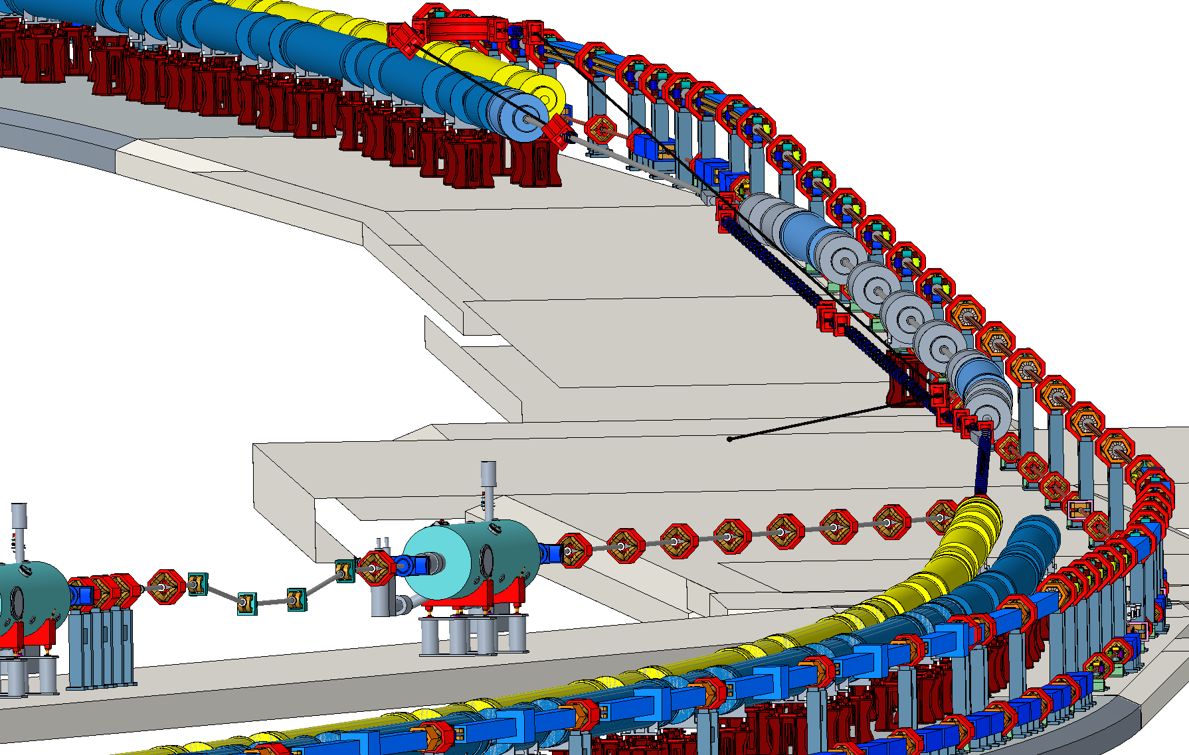
Improved cooling facility layout
“Kicker”-Section
“Modulator”-Section
“Amplification”-Section
Hadrons
Electron Return
s.c.
ERL
Many improvements on beam param’s based on better understanding of cooling process
Longer straight section, kicker & amplifier make up for reduced cooling rate due to recently assessed 3-d effect

Slide 30
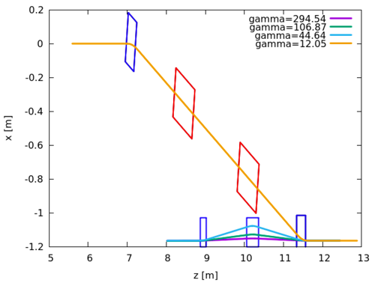
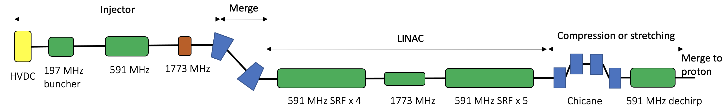
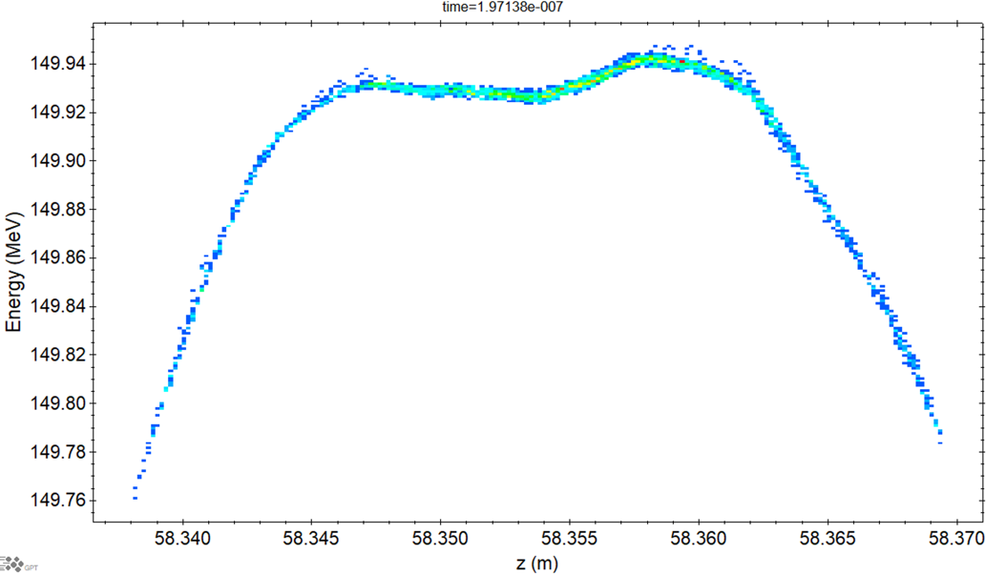
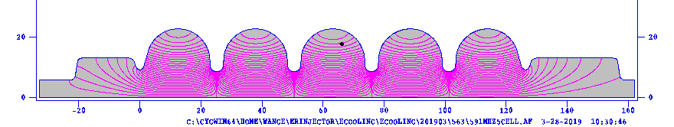
e-beam quality before entering cooling section
 | parameter
Bunch charge | 1 nC
Peak current | 8.5-34 A
RMS Bunch length | 14-3.4 mm
RMS Normalized emittance | 3 mm-mrad
Energy | 150 MeV
RMS dp/p | <1 e-4
Rms dp/p=1e-4
Sliced dp/p=4e-5
Injector and Linac up to cooling section are simulated by advanced 3D space charge code GPT 3.4, including CSR (Wakefield yet to be included).
See detail in S.Benson’s talk

Slide 31
γ= 25.4
Pre-Cooling
Achieving required beam parameters quickly requires pre-cooling of hadron at injection energy using bunched beam (incoherent) electron cooling.
The low energy cooler shares electron source, pre-injector and beam transport with the Strong Hadron Cooler and is highly integrated into the SHC facility
400 kV DC gun
2X197 MHz cavities ~3 MV
591 MHz cavity -11%
Merge to the197MHz LINAC
2X197 MHz cavities
~5 MV
2X197 MHz cavities
~5 MV
13 MeV
3 MeV
591 MHz cavity -11%
Compensation chicane magnets
3 MeV
Zoom in
13 MeV
Beam dump

Slide 32
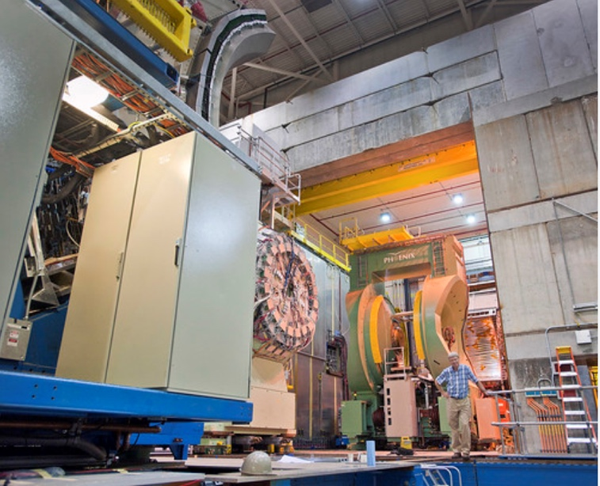
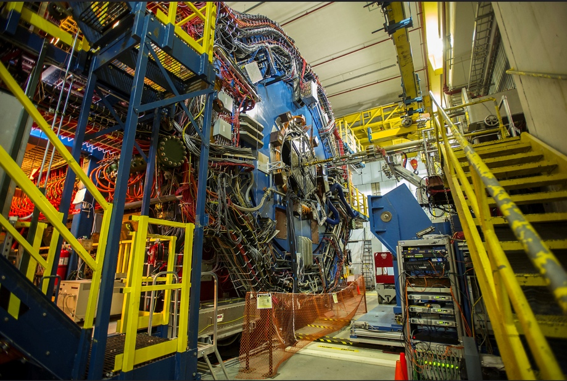
The EIC will benefit from two large existing detector halls in IR 6 and IR 8
Both halls are large and fully equipped with infrastructure such as power, water, overhead crane, ….
32
32
IR 8 detector hall with PHENIX detector (transitioning to sPHENIX)
IR 6 detector hall with STAR detector
Both IRs can be implemented simultaneously in the EIC lattice and be accommodated within beam dynamics envelope
2 IR’s: laid out identically or optimized for maximum luminosity at different E_{CM}

Slide 33
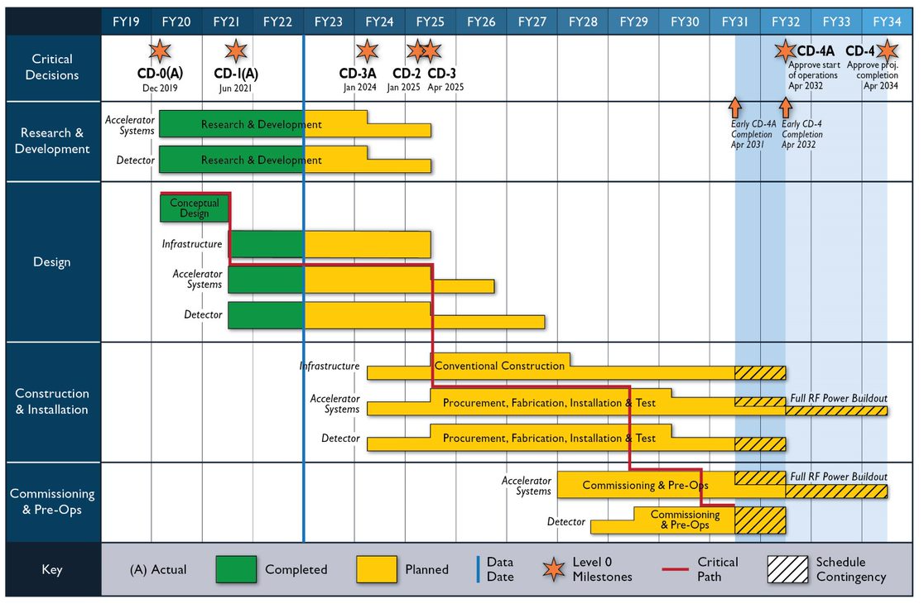
EIC Schedule

Slide 34
Collaboration with other Laboratories
SLAC: - Beam Dynamics and IR design ongoing
LBNL: - Beam dynamics Simulations, ongoing
- s.c. cable production MOU in preparation
- design of superconducting “matching” magnets MOU in preparation
ANL: - Design of RCS Quadrupole magnets in progress
- Design of RCS Sextupole Magnets MOU in preparation
- Beam dynamics (strong hadron cooling) ongoing
FERMILAB: - Beam dynamics (e-Polarization) ongoing
- Design of RCS dipole magnets in progress
- S.C. IR magnet quench Protection MOU in preparation
Collaboration with universities: Stony Brook, Cornell, MSU, UCLA, ODU
International collaboration and potential in-kind contributions (accelerator)
Crab cavities TRIUMF,
beam-screen development, INFN,
s.c 1775 MHz cavity, UK
Beam dynamics CERN

Slide 35
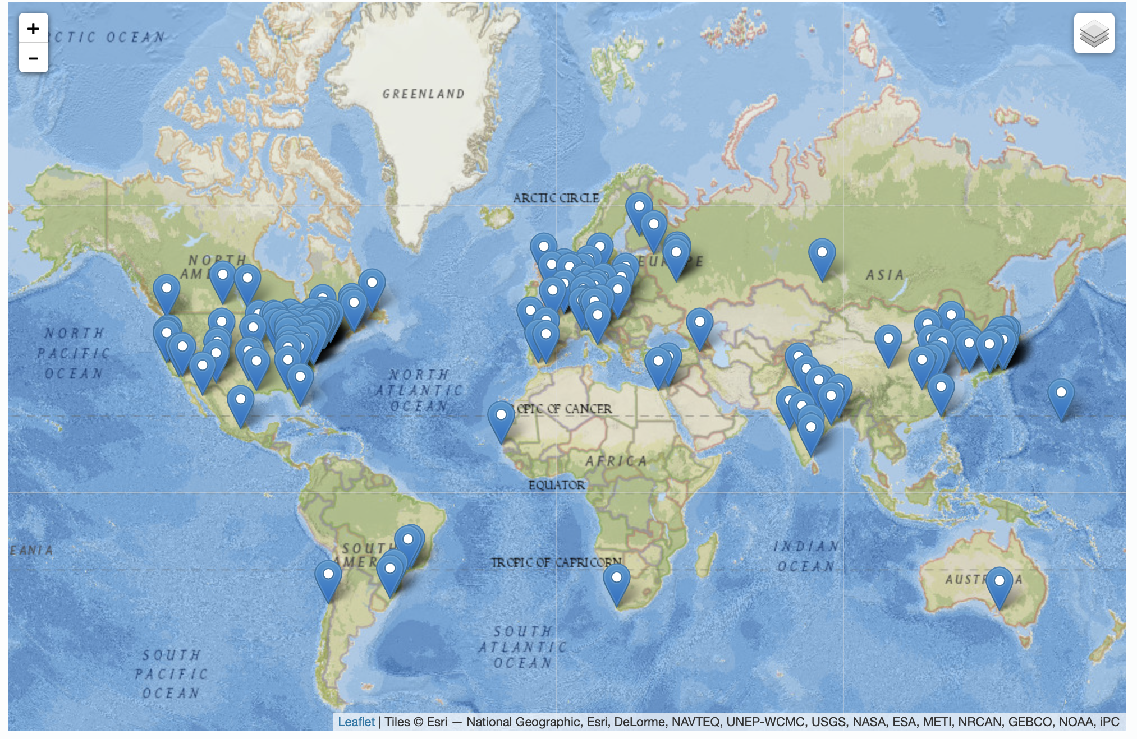
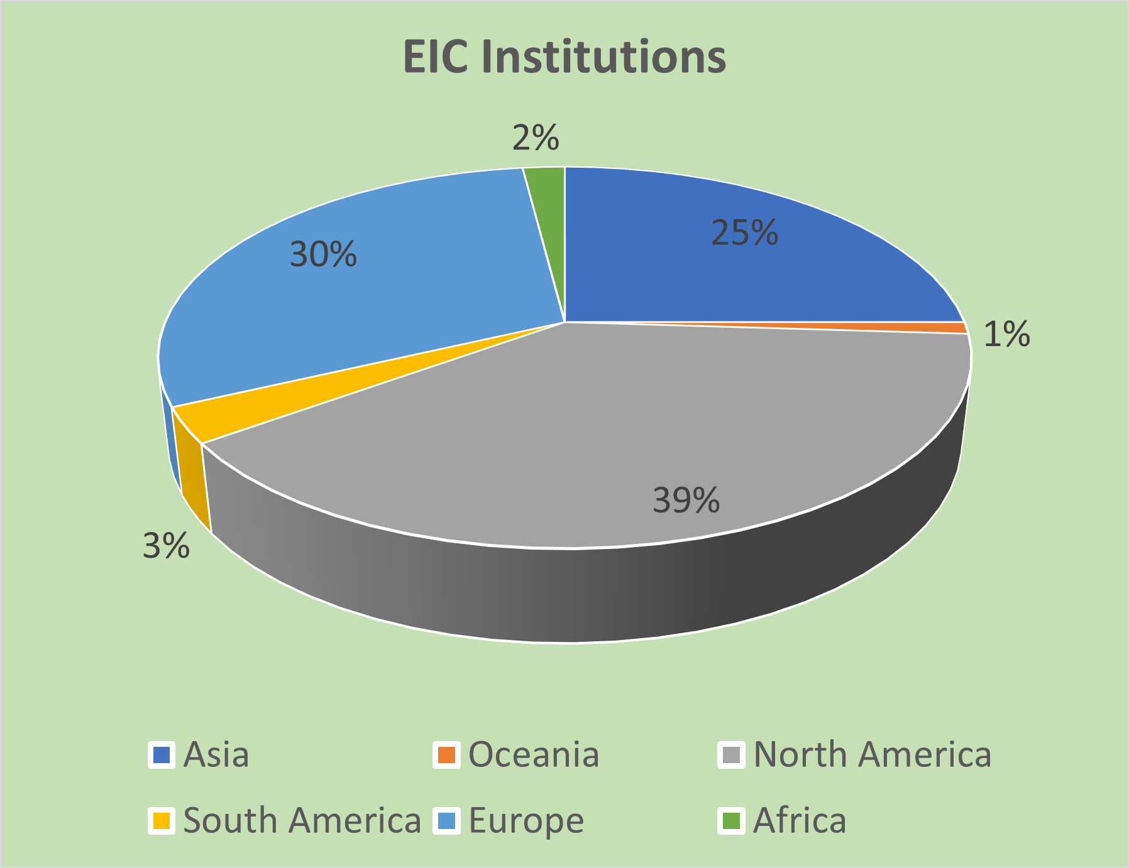
Worldwide Interest in EIC
The EIC Users Group: https://eicug.github.io/
Map of institution’s locations
Formed 2016 –
1331 collaborators,
36 countries,
266 institutions as of June 07, 2022.
Strong and Growing International Participation.
Annual EICUG meeting
2016 UC Berkeley, CA
2016 Argonne, IL
2017 Trieste, Italy
2018 Washington, DC
2019 Paris, France
2020 Miami, FL
2021 VUU, VA & UCR, CA
2022 Stony Brook U, NY
2023 Warsaw, Poland

Slide 36
Summary
The EIC is one of the most complex colliders because of several performance requirements that all are require reaching at or beyond state of the art
The challenging accelerator science questions of the EIC have all been addressed and remaining open question will only have a minor impact of EIC performance
Accelerator global design is close to be completed and designs are now stable to serve a base for engineering design
R&D made good progress in all areas that did not require large material expenses
Engineering of components is well underway
The project will collaborate with scientists and science institutions world-wide
Scientists and Engineers contributing to EIC are developing into a strong competent team that will deliver the EIC project.

Slide 37

Large Detector Acceptance & Low Backgrounds
Large accelerator component–free space around IP: -4m to + 5.5 m➔ challenge for beam focusing
Large aperture of hadron magnets on the forward side to provide acceptance for scattered low-p_{T} particles to be detected by roman plots along the outgoing hadron beam-pipe
Neutron spectrometer in the forward hadron direction (need strong hadron orbit bend)
Very good vacuum <1ntorr despite presence of SR around the IR to prevent scattering of hadrons in the IR (use NEG, ion, TSP, turbo pumping)
Straight electron orbit, synchrotron masking and Au coating of Be detector beam prevent/mitigate direct hits

Slide 38

Polarization
Spin: fundamental parameter of elementary particles associated with a magnetic moment
Polarization of beam means most of spins are oriented in the same direction
EIC physics requires collisions of highly polarized hadron and electron beam with polarization in two opposite directions
In the arcs, the polarization processes around the direction of the bending field (vertical)
In the IP, polarization needs to be in the direction of the beam motion
➔ Need spin rotator magnets to turn polarization into longitudinal direction(s)
For hadrons this was already accomplished in RHIC, requires only minor improvements
EIC polarized gun

Slide 39

Luminosity Optimization
Luminosity = f_{rev} ∙ n_{b} ∙ N_{eb} ∙ N_{hb} / ( 4π ∙ σ_{x}∙σ_{y} )
= I_{h} ∙ I_{e} / ( 4π ∙ e² ∙ f_{rev} ∙ n_{b}∙ σ_{x}∙σ_{y} ) $σ_{y,y}=\sqrt{ε_{x,y}β_{x,y}}$
However, stronger bunches means strong beam-beam interaction
Beam-beam interaction strength ξ_{h,e}~ N_{h,e} / ( ε_{h,e}∙(σ_{x}+σ_{y}))
Thus, with high N_{h,e} thus small n_{b}, need to increase emittances,
and the luminosity is unchanged
What is the advantage?
Emittance can be relatively large and that reduces the demand on keeping it small by strong hadron, which is more than desirable
Beam currents limited (SR, Cryo load) always make s large as possible
Minimize number of bunches to the extent beam dynamics allows

Slide 40

Superconducting IR Magnets

Slide 41

Accelerator R&D
Note: RF R&D captured by 6.08
Polarized Electron source prototype comfortably achieved EIC design parameters.
IR Magnet Prototyping design now based on 2K lq He cooling.
Vacuum Chamber upgrade is now based on actively cooled beam screen.
Good progress and refinement of HSR fast kicker design.
ESR Vacuum design: simplified vacuum chamber profile to ensure manufacturability.

Slide 42
IR-10
RF Power Supply Building
IR10 Tunnel

Slide 43
IR-2
Renderings by Doug Holmes and the design room
RCS
HSR
Blue inner ring
HSR Chicane
SHC Kicker Section
ESR
ERL Bates Bent turnaround
SHC Amplifier Section
RCS
SHC Modulator Section
ERL Return Beam
SHC
Energy Recovery Linac
ERL Input Beam
HSR
Yellow inner ring

Slide 44




Matching Dipole
Harmonics for different excitations
Harmonics in ends
3D end optimization

Slide 45





SC IR Magnet R&D
Q2pF
Q1ApF
Q1BpF
B1ApF, end harmonic
optimization
B1ApF, 3D
B1pF

Slide 46




HOM damper R&D status
First outgassing test were completed with solid SiC HOM damper.
Low power measurement on solid SiC HOM damper, result is close to expectation.
SiC samples were ordered and RF properties measurements ares ongoing
Back up segmented design being developed via SBIR
46

Slide 47

Progress in PED and R&D
ESR and RCS Magnets
Value engineering efforts: Single turn coils changed to multi-turn coils (change request pending), RCS dipoles split into two (cost saving and manufacturing simplification)
  Specifications for RFI developed, RFI published, 16 of 24 vendors responded positively.
ESR Vacuum
  Cu Vacuum chamber profile optimized for better manufacturability
  Shielded bellows: Fabrication of prototype in progress.
  Novel self-supporting NEG strip design, greatly simplifies installation and activation

Slide 48

Superconducting IR Magnets
Forward site s.c. magnet integration
Multiple function spectrometer magnet at the forward hadron side

Slide 49

The existing RHIC ion sources & ion acceleration chain provide already today all ions needed for EIC
Ions from He to U have been already generated in the Electron-Beam-Ion-Source ion source (EBIS), accelerated and collided in RHIC
EBIS can generate any ion beam from ³He to U for the BNL EIC
Existing EBIS provides the entire range of ion species from He to U in sufficient quality and quantity for the EIC
Ion Pairs
in the RHIC Complex
Zr-Zr, Ru-Ru (2018)
Au-Au (2016)
d-Au (2016)
p-Al (2015)
h-Au (2015)
p-Au (2015)
Cu-Au (2012)
U-U (2012)
Cu-Cu (2012)
D-Au (2008)
Cu-Cu (2005)
Ion-Ion Luminosity Runs in RHIC 2005-2018
Accumulated Luminosity [pb⁻¹]
Enormous
versatility!
is a unique capability!
Operation Time [weeks]

Slide 50
Progress on Accelerator Design
The time since CD-1 and the last OPA review with limited PED funds was well used to advance and mature the accelerator lattices and resolve corresponding design issues.
Designs are now very robust and provide a solid base for the engineering design of accelerator hardware components.
Updated design and R&D plans posted on review site; accelerator lattices now stable
Electron Injection Moved from IR-2 to IR-12
Electron injection into ESR modified: Eliminated slow bumps (because residuals affect the entire fill every second). Now fast kickers are stronger (1 mrad). We are also looking into nonlinear injection (for example a sextupole in the injection trajectory.
Strong Hadron Cooling ERL moved from ring outside to ring inside
The bypass for low energy hadron storage was moved from sector 2-12 to sector 12-10, now use 4 sextants from the yellow ring and two sextants from the blue ring for the HSR
Hadron straight sections: beam transport uses now normal conducting dipoles instead of superconducting dipoles
ESR accelerator lattice design is (nearly) complete
RCS accelerator design complete
Interaction region further matured, lattice stable, synchrotron radiation masking laid out, collimation in progress
Many details on HSR lattice resolved …

Slide 51

R&D on High power FPC Status
A high power ( CW 500 kW standing wave) alumina window FPC was designed for EIC ESR SRF cavity.
The design was reviewed by an international technical review committee in June 2021.
The review committee stated their “support moving forward with this design into prototype stage”.
Detailed engineering design for window and vacuum side has been finalized and in the process of prototyping.
FPC airside is almost finalized and getting ready to purchase materials for fabrication.
FPCs
Preliminary Cryomodule Design

Slide 52




ESR Vacuum: Shielded Bellows
Prototype Design
Manufactured parts for a prototype
Plans for lifetime testing

Slide 53



197 MHz Crab Cavity Status
197 MHz HSR crab cavity is one of the cavities that will be prototyped first
Bare cavity rf design is complete
  Including HOM damping, FPC design
  Two possible HOM damping schemes: Waveguide loaded and coaxial couplers
  Waiting for final rf multipole specifications and are not considered in the current design
Stress analysis is near completion
Preliminary fabrication plan is completed
Preliminary Cryomodule Design
Stiffeners
RF Design

Slide 54

Accelerator R&D Overview
EIC R&D is prototyping of novel, challenging, or critical components to obtain confidence for final design and production of the components in industry or in-house
ESR
Vacuum R&D
Electron Fast Kicker
Hadron Polarimetry
Cooler Electron Source
ESR Cavity
Prototype
HSR Vacuum Upgrade
ESR RF 500kW FPC
Polarized e⁻ Source
Proton Injection Fast Kicker
ESR RF HOM Damper
Crab Cavity
Prototype
IR Design and Magnet Prototyping
IR
Vacuum Chamber

Slide 55



Polarized Electron Source
Final assembled
 | EIC | Achieved in stable operation | R&D deliverable
Bunch charge [nC] | 7 | 7.5 (12) | Y
Peak current [A] | 3.8 | 4.8 (No SCL) | Y
Frequency [Hz] | 1 (8 bunches) | 1 (9000 bunches) | Y/N*
Voltage [kV] | 300 | 300 | Y
Average Current | 56 nA | 76.5 uA | Y
Polarization [%] | > 85% | Bulk (~35%) | Y/N**
85% polarization will be achieved with strained lattice GaAs cathode

Slide 56
Schematic Layout of the cooling facility
“Kicker”-Section
“Modulator”-Section
“Amplification”-Section
Hadrons
Electron Return
s.c.
ERL

Slide 57
Electron Ring Vacuum system
OFE Cu beam pipe with integrated NEG pumping (NEG stripes)
Carefully optimized shielded bellow derived from NSLS-II design

Slide 58
Beam-Beam Interactions & Crossing Angle
1160 bunches & beams must collide only at the IP
➔ need 25 mrad crossing angle
Uncompensated, crossing angle dramatically reduces luminosity
➔ need “crab” rf deflectors parallel beam ……. .orientation
Complicates beam-beam interaction, source of hadron emittance blow-up
Once hadron beam size is blown up, electron re-shrink and the blow-up accelerated (mismatch)
Crab Phase noise: Fluctuating beam-beam offset causes rapid emittance growth many ➔ extremely small tolerances

