Slide 1
Overview of IFJ PAN involvement in international projects
D. Bocian
IFJ PAN - ESS technical meeting
Kraków, 24th March 2014

Slide 2
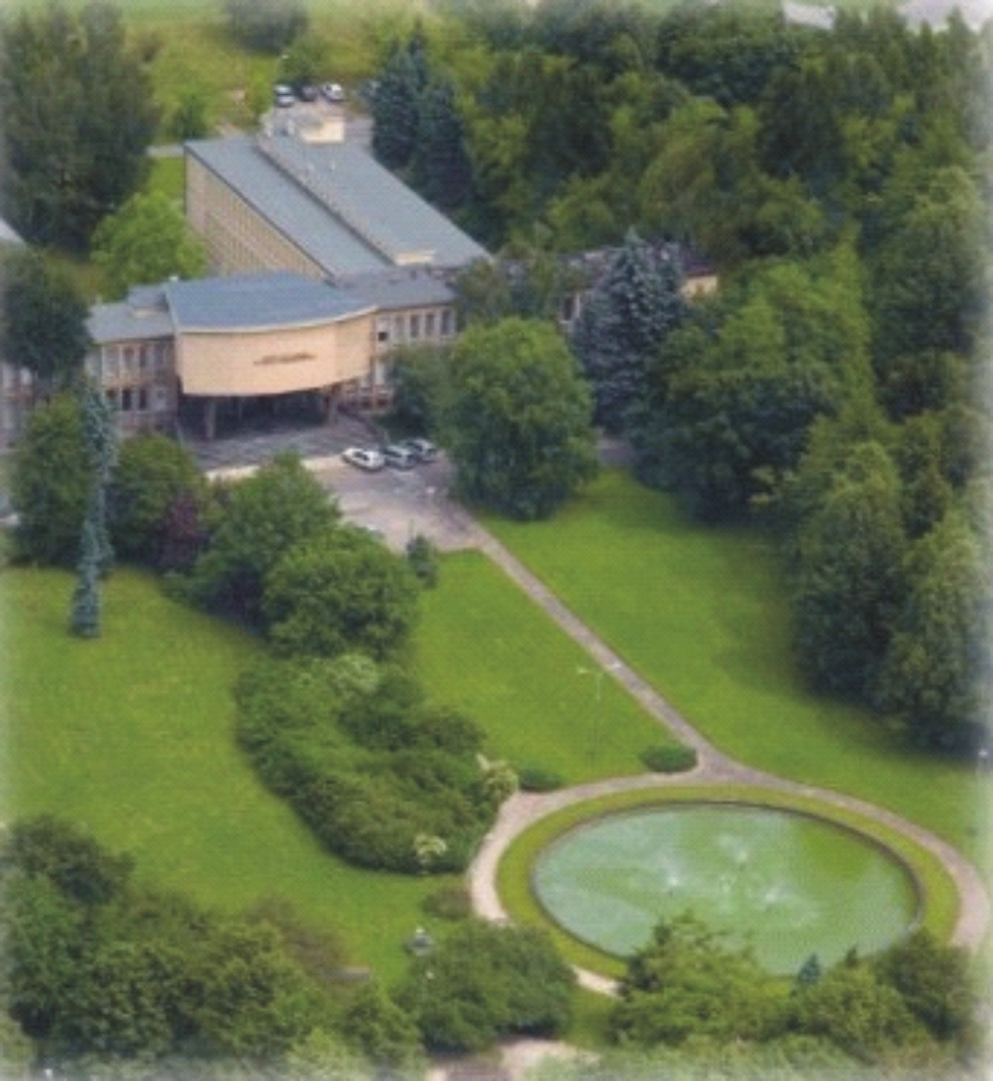
Outline
General information
Accelerator activities at IFJ
IFJ PAN and selected projects
European XFEL
LHC consolidation and upgrade
Wendelstein 7X
Scientific equipment construction
Summary

Slide 3
General information
530 personnel
Prof. 39, Assoc. Prof. 52, Ph.D. 108
PhD studies – 61 students
Interdisciplinary PhD studies
6 divisions: 28 departments
centre of excellence
centre of advanced technology
4 accredited laboratories
Equipment and Scientific Infrastructure Construction Division (DAI)

Slide 4
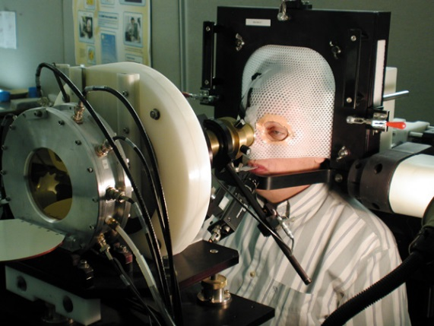
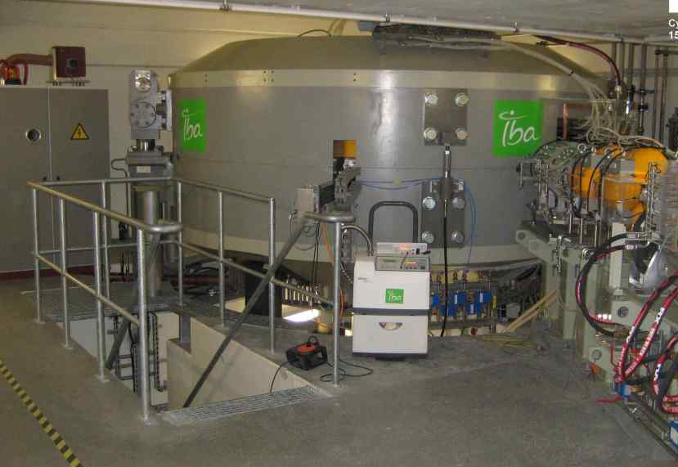
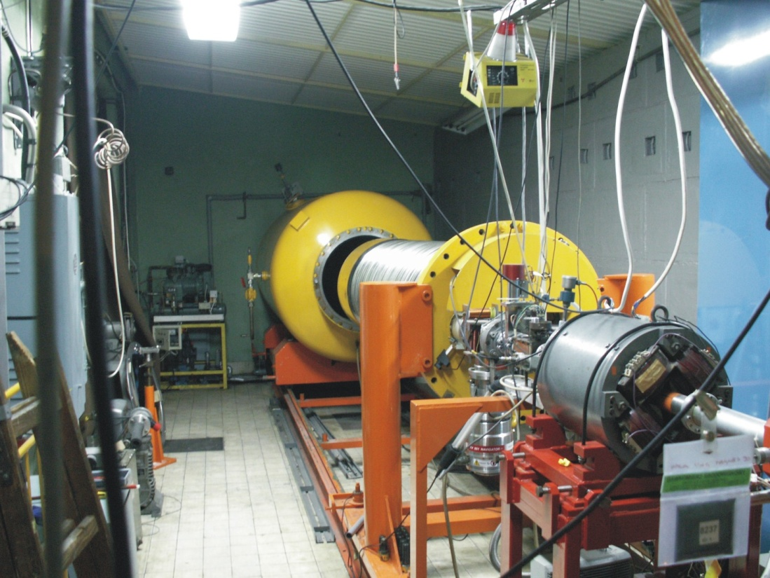
Accelerator activities at IFJ
cyclotron AIC-144 - proton beam energy: 60 MeV - Proton Radiotherapy of Eye Melanoma
Cyclotron Proteus C-235
National Centre for Hadron Radiotherapy
under construction (2013)
neutron generator
14 MeV
VdG high stability
2.5 MeV

Slide 5
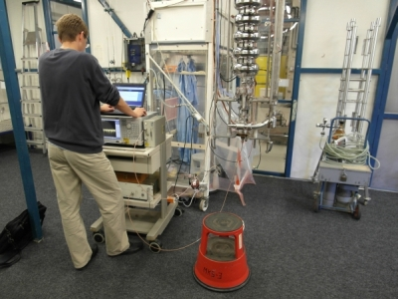
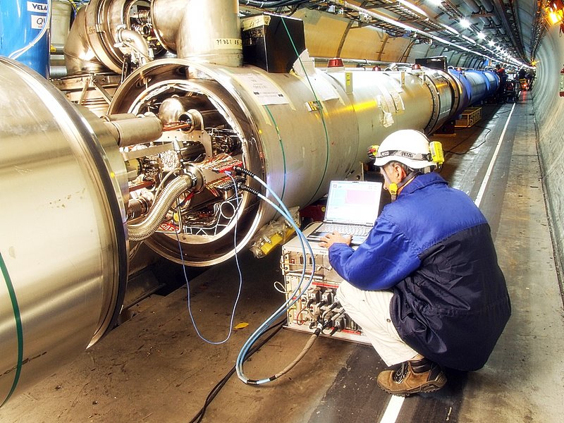
IFJ PAN and international projects
Running projects:
XFEL, DESY, Hamburg, 2009 – 2015
LHC, CERN, Geneva, 2013 – 2014
ITER, Cadarache, 2010-2015
Cherenkov Telescope Array (CTA), 2008 – 2013
Completed projects
LHC, CERN Geneva, 2005 – 2012
Wendelstein 7X, IPP Greifswald, 2007 – 2012
ATLAS, CERN Geneva, 2004 - 2012
T2K, J-PARC Tokai, Krakow/J-PARC, 2007 – 2009

Slide 6
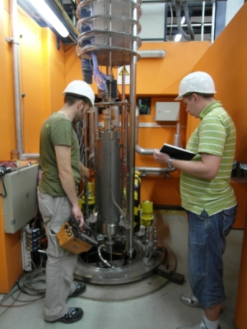
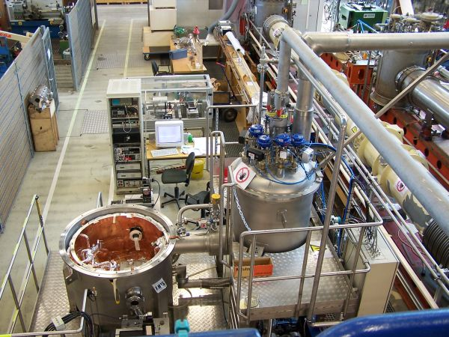
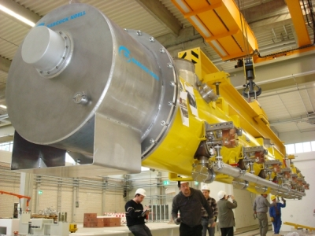
IFJ PAN in-kind contribution to XFEL construction (2009 - 2015)
Performance of acceptance tests of cavities for a series of 840 units on DESY infrastructure and delivering the corresponding test reports
Performance of acceptance tests of cryomodules for a series of 103 units on DESY infrastructure and delivering the corresponding test reports
Performance of acceptance tests of cold magnets for a series of 103 units on DESY infrastructure and delivering the corresponding tests reports – common effort with DESY
XFEL RF cavities tests
XFEL quadrupole magnets tests
XFEL cryomodules tests

Slide 7
IFJ PAN in-kind contribution to XFEL construction IFJ PAN tasks
Tests of cavities and cryomodules in the AMTF Hall
Tests of cold magnets
Each IFJ PAN task is split in two phases:
Preparatory phase
Knowledge acquiring (learning, trainings, meetings with DESY experts);
Procedures writing;
Software preparation;
Performance of preseries tests:
(3 cold magnets and 3 CL,
24 cavities and 3 cryomodules).
Serial tests phase
Performance of serial tests:
Cold magnets – 100
Current leads – 100
Cavities – 816
Cryomodules – 100
Data analysis and reporting;
Software upgrade.

Slide 8
IFJ PAN in-kind contribution to XFEL construction IFJ PAN team structure
IFJ PAN Team
(Management)
Teams of cold magnets tests
(Technical Coordinator)
Measurement
Data Base and Software Development
Teams of cavities and cryomodules tests
(Technical Coordinator)
Mechanic
Vacuum
Cryogenic
RF Measurement
Software Development
Safety officer
Team:
Dr Engineers – 4
Engineers – 23
Technicians – 23
(currently at DESY
35 people)
Expertise:
Mechanics
Electronics / Electrics
Automatics / Robotics
Software engineering
Physics
Computer science

Slide 9
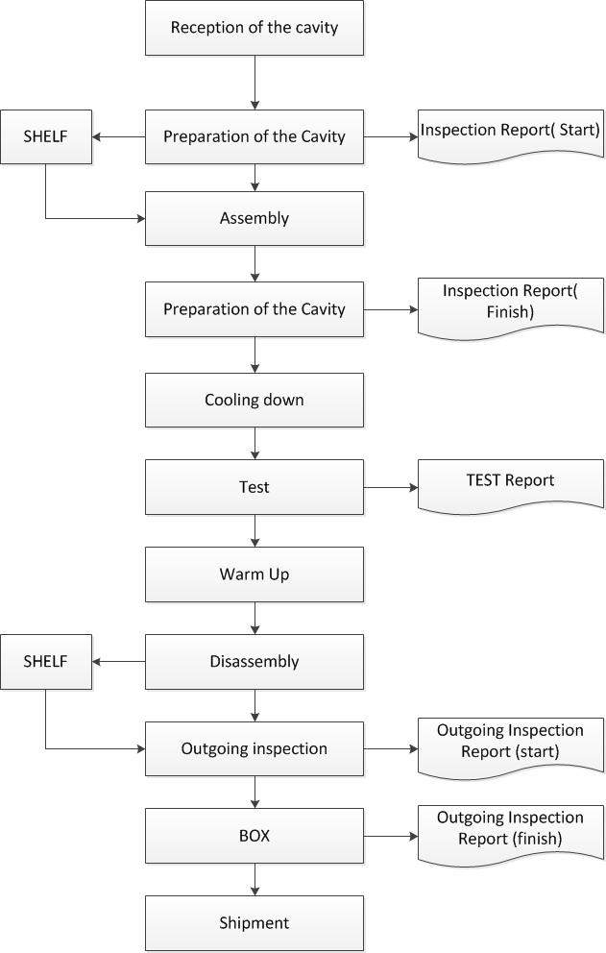
IFJ PAN in-kind contribution to XFEL construction Cavity Test Flow chart
We create 3 reports from each test and upload them to the EDMS:
Incoming inspection report
Final test report
Outgoing inspection report

Slide 10
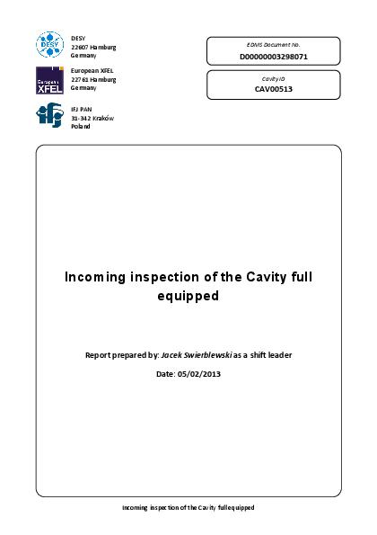
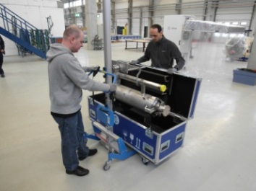
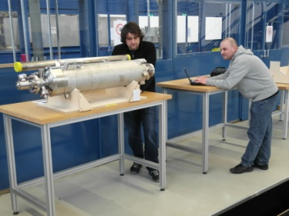
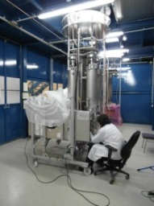
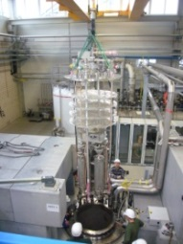
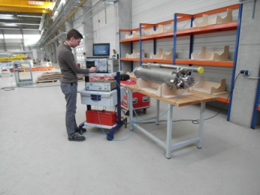
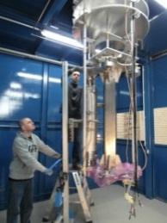
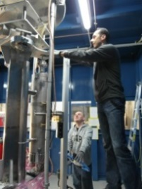
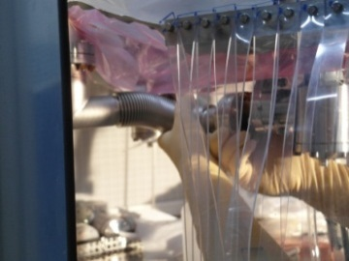
IFJ PAN in-kind contribution to XFEL construction Cavity test: Incoming inspection & preparation for test
Main tasks:
Incoming Report
Mechanical check of the cavity
Vaccum check
Electrical check
Cavity spectrum check & HOM tuning
Assembling cavity to the insert
Connecting cavity to the vacuum line (in cleanroom conditions)
Cables connection with TDR
Leak check of the cavity
Transport of the insert to the cryostat
Connecting of the insert to the vacuum line

Slide 11
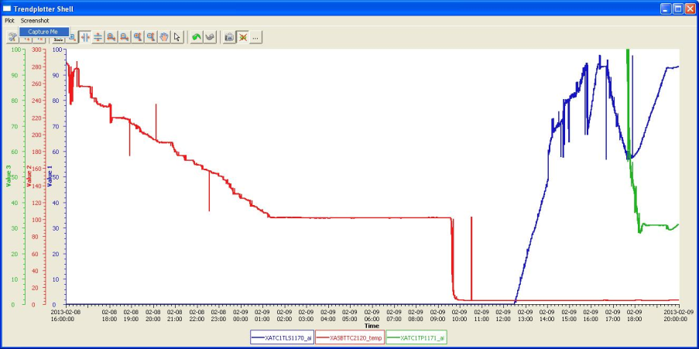
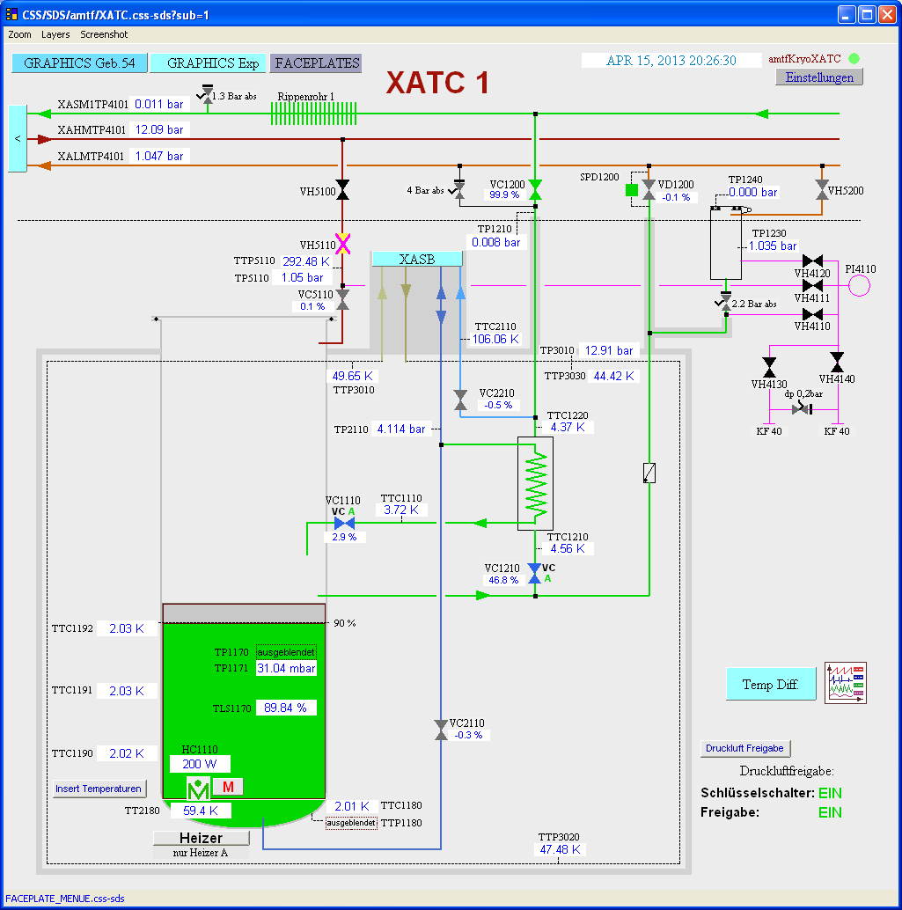
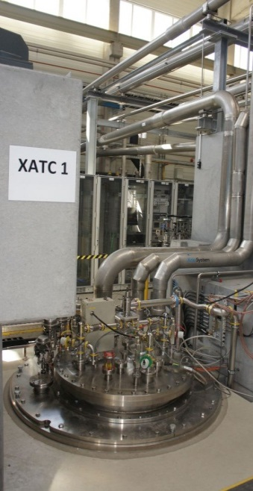
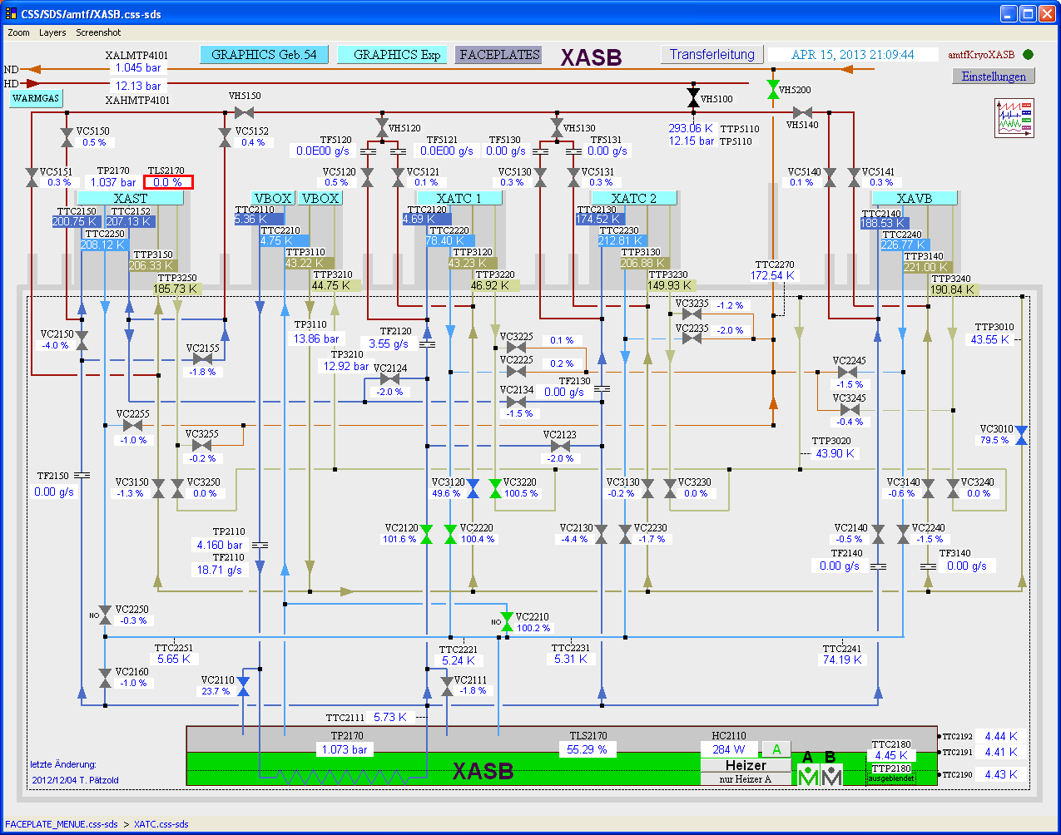
IFJ PAN in-kind contribution to XFEL construction Cavity test: Cryogenic operation
Cryogenic activities at AMTF:
Cool down
Maintenance during the test
Warm up
Cool down process from 300 K to 2 K
Cryogenics operator’s control panel for test cryostat (left) and subcooler box (right) at AMTF.
Cavity cryostat at AMTF

Slide 12
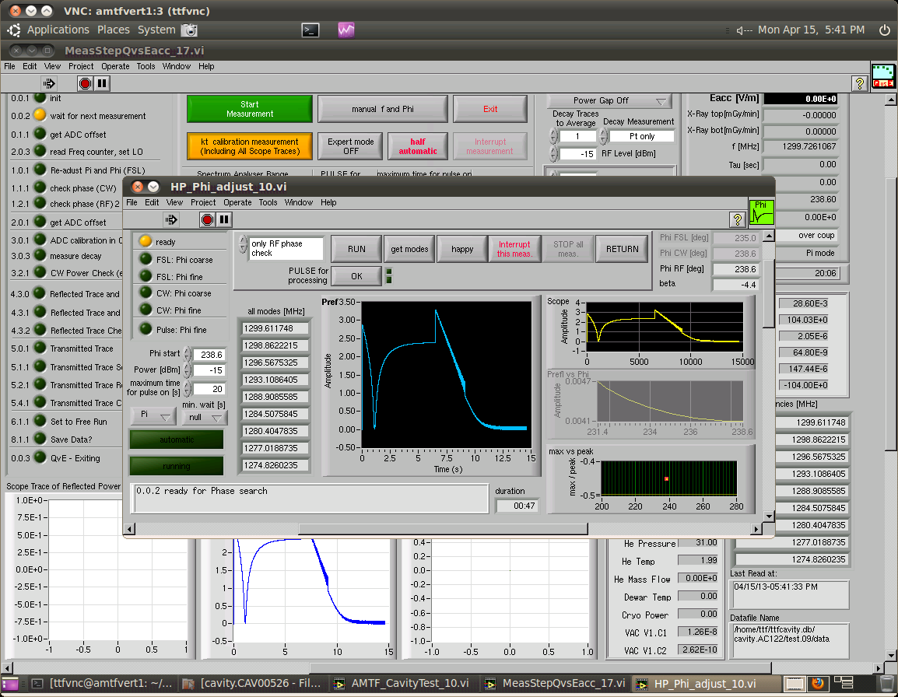
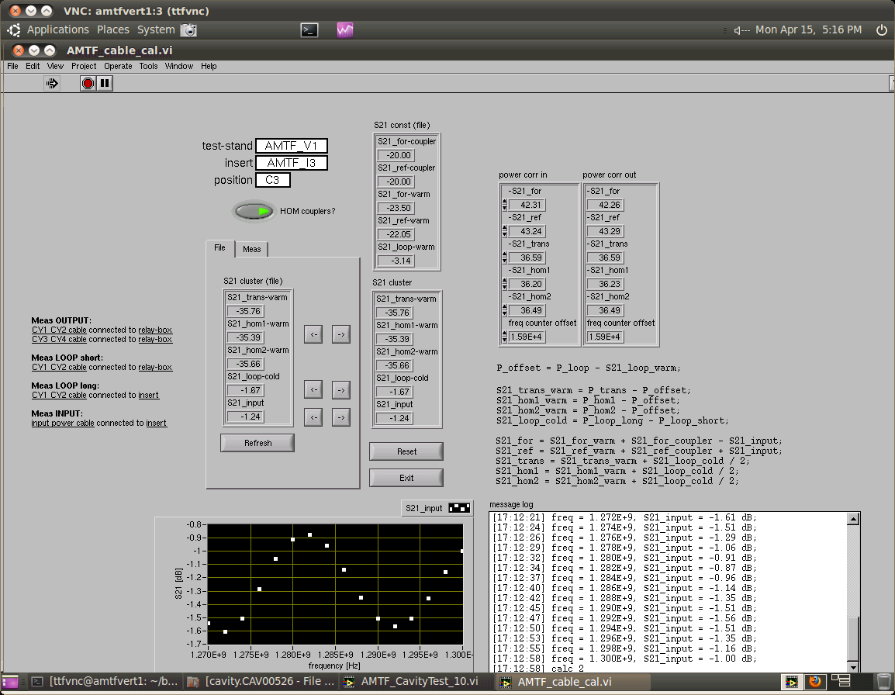
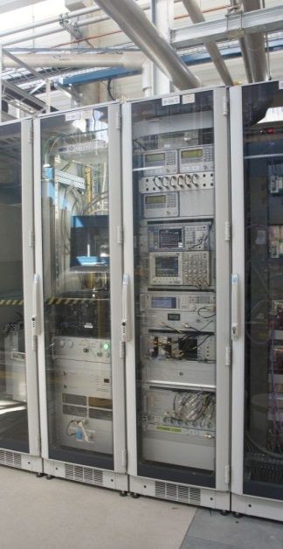
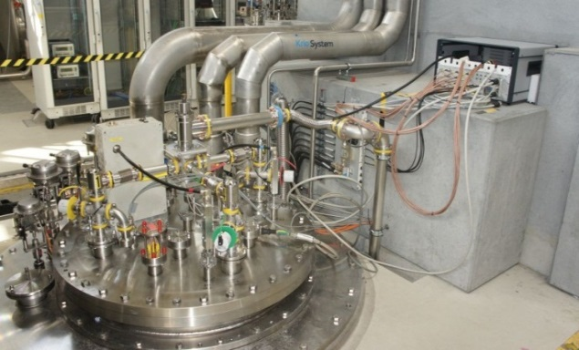
IFJ PAN in-kind contribution to XFEL construction Cavity test in vertical cryostat at 2K
Part of software written
by IFJ PAN engineers
Q vs E measurement
Vertical measurements application
Cable calibration application
Cavity test-stand, cryostat (left) and electronic racks (right)

Slide 13
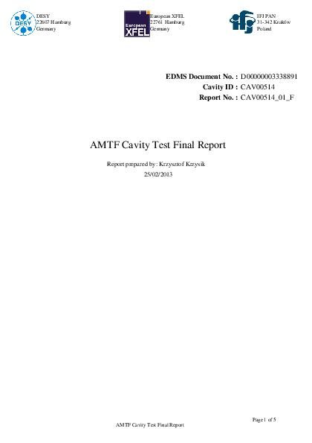
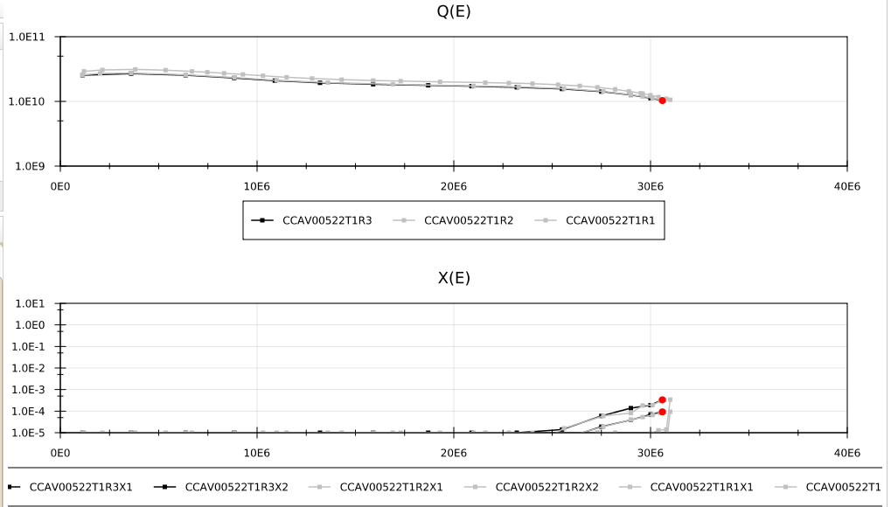
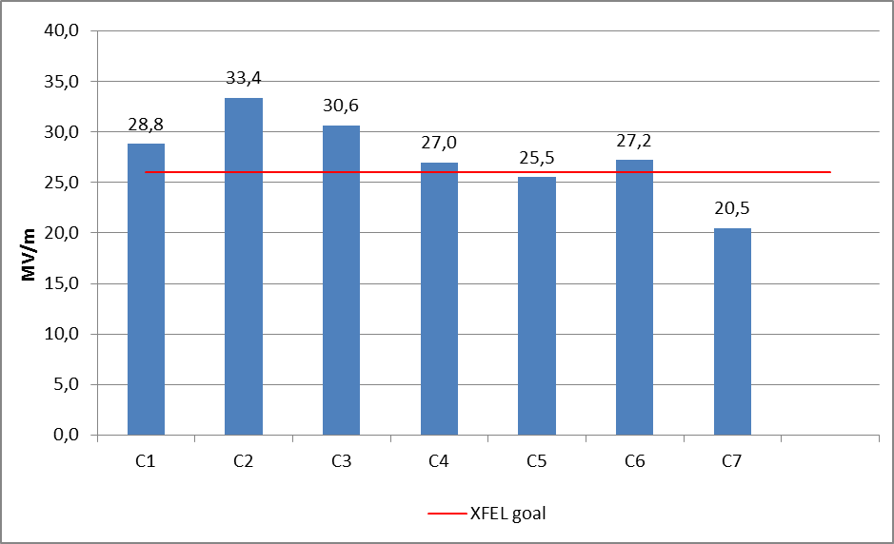
IFJ PAN in-kind contribution to XFEL construction Cavity test in vertical cryostat at 2K
Maximal E_{acc} (> 26 MV/m)
Q₀ factor vs. E_{acc} (>10¹⁰)
Radiation vs. E_{acc} (<10⁻² mGy/min)
Results overview from IFJ PAN cavitiy database
Example of series cavities test results

Slide 14
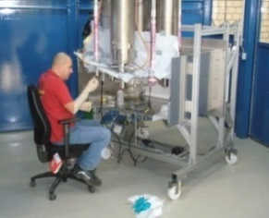
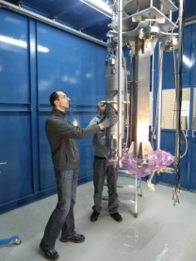
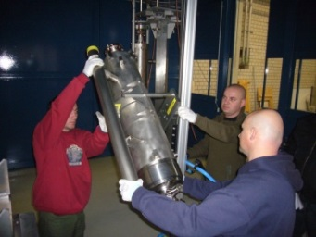
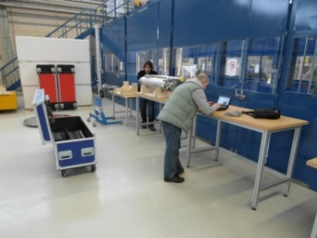
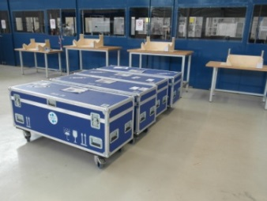
IFJ PAN in-kind contribution to XFEL construction Cavity test: Disassembling and outgoing
Main tasks
Disconnecting of the insert from the vacuum line
Transport of the insert to the preparation area
Leak check of the cavity
Disconnecting cavity from the vacuum line (in cleanroom conditions)
Disassembling cavity from the insert
Outgoing check
Mechanical check of the cavity
Vacuum check
Electrical check
Cavity spectrum check
Preparation for shipment

Slide 15
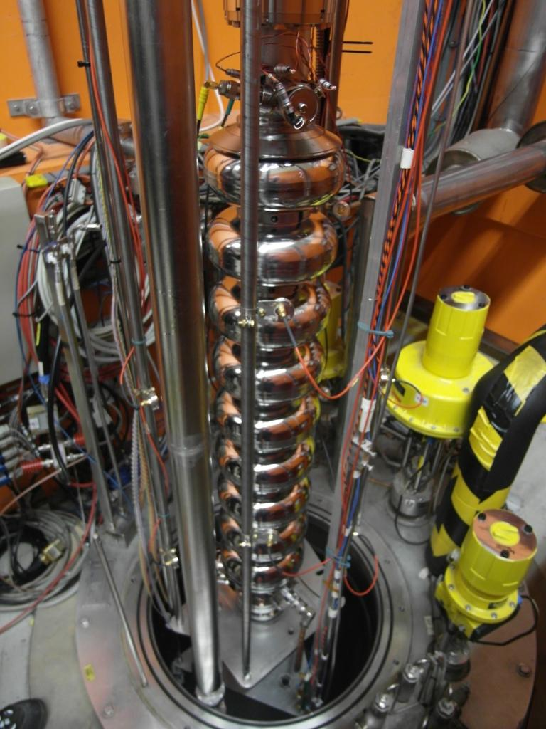
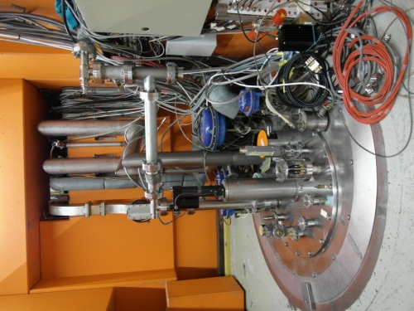
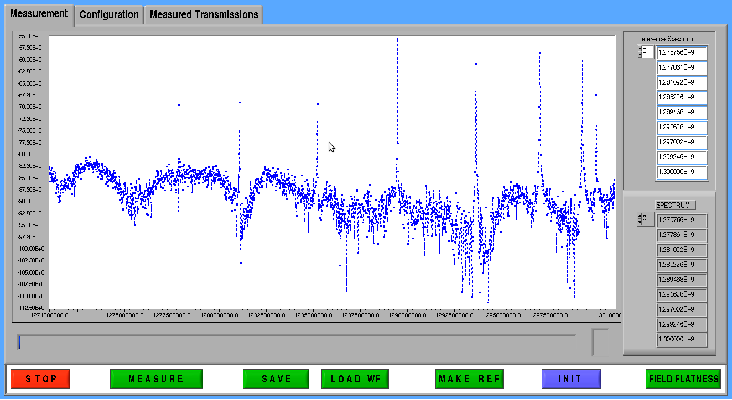
IFJ PAN in-kind contribution to XFEL construction Cavity test: Summary
60 prototype and pre-series cavities – tested
800 production cavities - ~20% tested (end 2013)
Insertion of the cavity into the vertical cryostat
Results of RF cavity measurement
Measurement of the cavity fundamental mode spectra

Slide 16
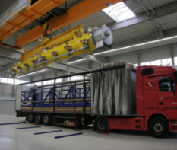
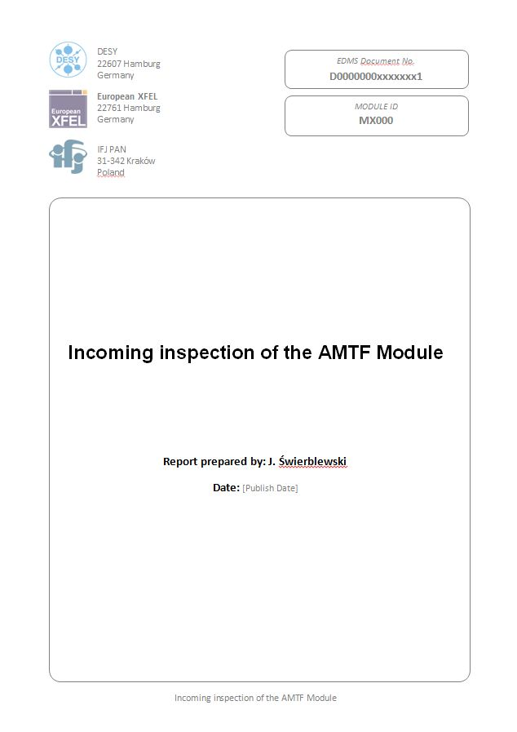
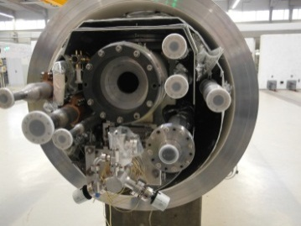
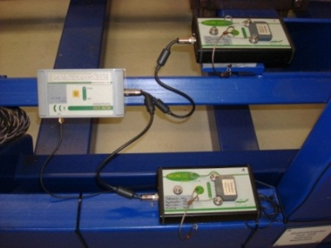
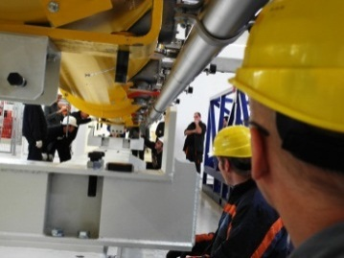
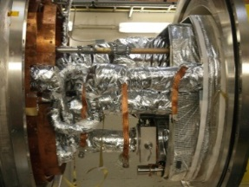
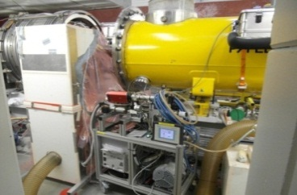
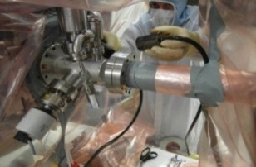
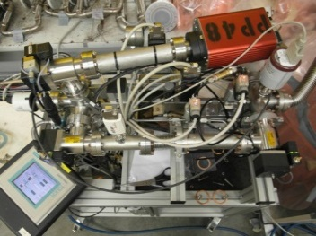
IFJ PAN in-kind contribution to XFEL construction Cryomodule test: Incoming inspection and preparation for cold test
Incoming checks
Mechanical check
Vacuum check
Check of the cavities fundamental mode spectra
Electrical check
Cavities tuner check
Shock loggers readout
Load the cryomodule to the movable support
Assembling cryomodule at the test stand
Connecting cryomodule beam line to the test stand under clean room conditions
Leak check of beam line interconnections and mass spectroscopy of the beam line
Connecting of the waveguides and electrical cables
Connect of all cryomodule process pipes to the test stands
Leak check of cryomodule vessel (ISO-VAC) and cryogenic valves
Assembly and isolating thermal shields
Pumping down of vacuum insulation

Slide 17
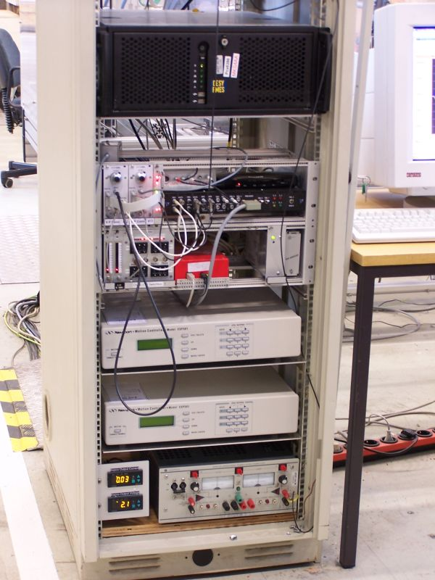
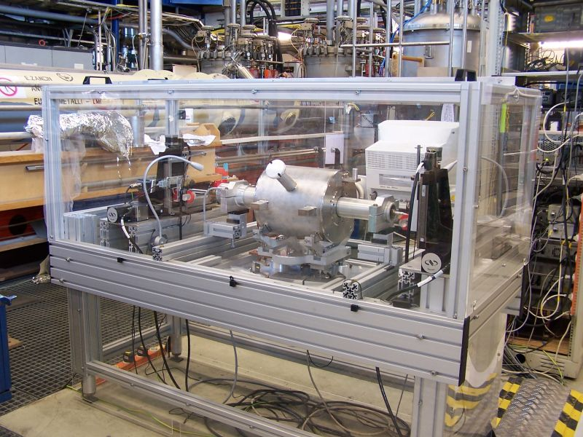
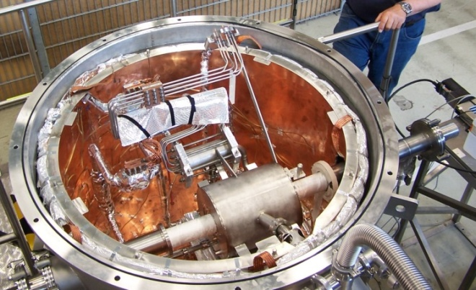
IFJ PAN in-kind contribution to XFEL construction Cold magnet test: Test-stand
Test stand for magnet tests at warm (top) and electronic rack (left).
Hall 55 with cryogenic infrastructure for magnet tests
Test stand for magnet tests at cold (top) and electronic racks (right)
CL electrical check test-stand

Slide 18
IFJ PAN in-kind contribution to XFEL construction Cold magnet test: Preparation and cold test
Electrical check of current leads connections
Magnet with CL installation in cryostat XMTS
Thermal insulation CL and magnet
Stretched wire test at 2K
Results of stretched wire test at 2K

Slide 19
IFJ PAN effort to XFEL construction
Total number of FTE’s over 7 years ~150
Total number of trained IFJ PAN staff ~ 60

Slide 20
IFJ PAN and LHC (2005-2014)
design & construction of measuring/testing devices
preparation of necessary software and data bases
manufacturing of superconducting N-lines
development of measuring/testing methods
organization, performance & documentation of electrical measurements /tests
organization, performance & documentation of interconnection inspection
Mobil test stations in LHC tunnel
User interface
Damaged PIM (Plug-In Module)

Slide 21
IFJ PAN and LHC Summary
Just recently group of 25 people (engineers and technicians) from the IFJ-PAN was performing the reference measurements before consolidation of the LHC superconducting circuits during Long Shutdown 1. The measurements are now completed.
Exactly the same tests will be performed before machine start-up.
Currently we are monitoring to the circuits’ health during the consolidation.
Part of the team is working on investigation and solving of the nonconformities revealed during standard measurements: short circuits caused by thermal cycle, abnormal resistances, etc.
Total number of FTEs over 8 years: ~160
Total number of trained IFJ PAN staff: ~50

Slide 22
IFJ PAN contribution to W7-X construction (2007 – 2012)
IFJ PAN was responsible for the assembly of the bus bar system powering 70 superconducting coils on five modules of the stellarator.
The bus bars are made of the NbTi superconductors in an aluminium jacket.
There are 24 bus bars on each module.
Bus bar cross section
Total number of FTE over 6 years > 160
Total number of trained IFJ PAN staff > 50
Example of bus bars routing on one module

Slide 23
IFJ PAN contribution to W7-X construction Joints assembly
Mechanical and electrical connection of the superconductors
Electrical connection of 81 triplets
Connected triplets squizzed with clamps and covered by stainless steel caps

Slide 24
IFJ PAN contribution to W7-X construction Electrical insulation of joints (wet wrapping)
Electrical insulation of the assembled joints (divided into three steps)
All joints (184) passed successfully tightness and HV tests
Installation of 24 bus bars on the module
and final shaping of the bus bar ends
Module Separation Plane
set of six joints painted and clamped

Slide 25
Scientific equipment construction Cherenkov Telescope Array (CTA)
Small Size Telescope Structure - prototype to be built by end 2013
dish diameter 4 m; focal length 9.6 m; weight 8.8 t
3-D model based on the technical documentation

Slide 26
Scientific equipment construction Cherenkov Telescope Array (CTA)
Open structure mirrors for Medium Size Telescope – 10 prototypes under tests
hexagonal shape 1.2 m f-t-f, curvature radius 32 m, weight 35 kg
Front (left) and rear (right) view of the prototype mirrors

Slide 27
Medical equipment construction Proton radiotherapy at IFJ PAN
Components of eye melanoma setup – to be finished in 2013
Device for immediate proton beam cut-off, so called shutter
Supports for the end of beam line
Adjustable supports for x-ray lamps
range discriminators and beam collimators
Holders for digital x-ray recorders

Slide 28
Scientific equipment construction Finger detector at GSI Darmstadt
Mechanics for one detector – completed in 2012

Slide 29
Scientific equipment construction Stellarator W7 - X
Mechanics for 30 sets of polychromators – completed in 2011

Slide 30
Scientific equipment construction ATLAS Assembly
Aluminium frame to install Muon Chambers – completed in 2006
The frame used during installation in the ATLAS cavern
The frame at IFJ PAN

Slide 31
Conclusions
Expertise:
XFEL (construction)
LHC (construction, consolidation, upgrade)
W7-X (construction)
AIC-144 (construction, medical applications)
Proteus C235 (medical applications, research)
Team:
Scientists: 5
Engineers: 34
Technicians: 65
IFJ PAN groups contribute to major world experiments in particle physics, astrophysics and nuclear physics.
IFJ PAN contributes to XFEL and LHC
IFJ PAN is involved in fusion projects (W7X, ITER)

