Slide 1
Analog to Digital Alice, triger
Ernest Jamro

Slide 2
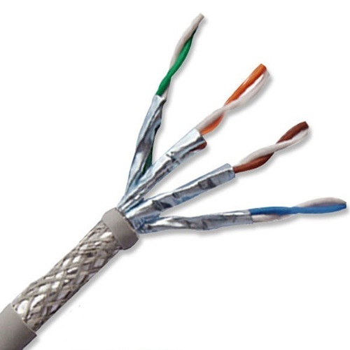
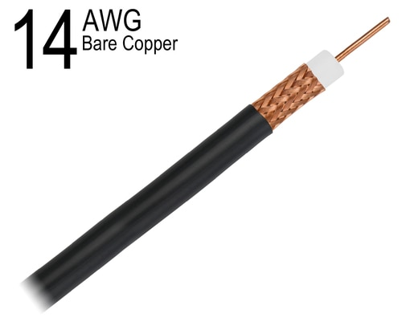
BNC (coaxial) vs twisted shielded
better high frequency characteristic vs better noise suppression

Slide 3
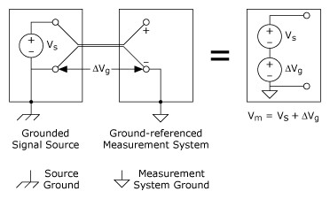
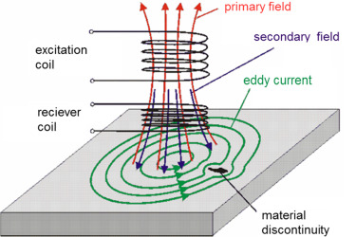
Grounded Signal Sources
Much better is differential signalling
( - signal should not be connected to the ground)
Cut to eliminate noise $∆Vg$
https://www.ni.com/pl-pl/support/documentation/supplemental/06/field-wiring-and-noise-considerations-for-analog-signals.html

Slide 4
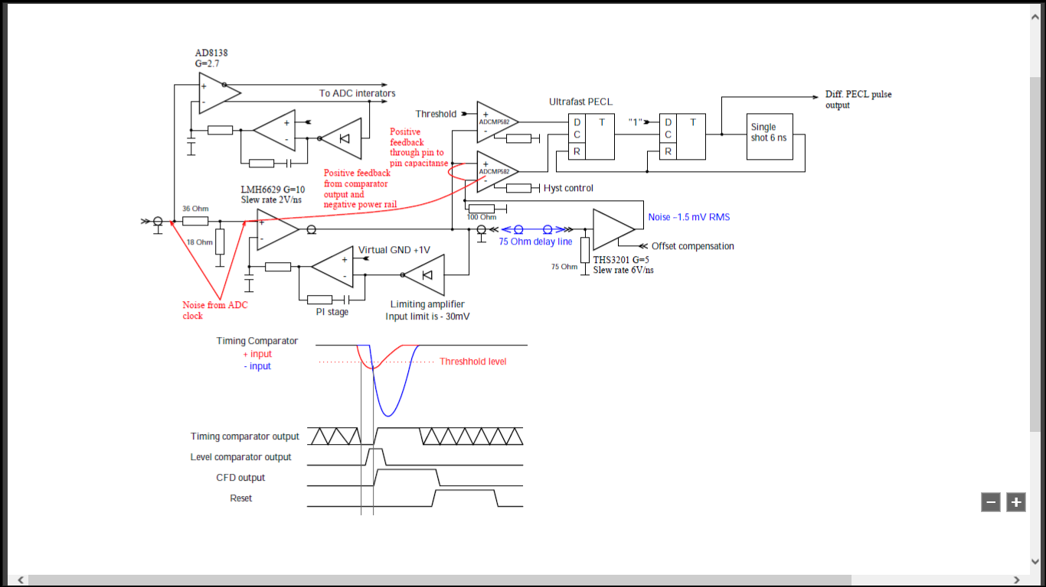

Slide 5
Analog to digital converter
How do you manage not known integration time (aperture time) which is about 20ns +/- 2ns. Aperture time noise (jiter) should be treated as the same kind of noise as signal noise - so noise (or uncurtainty) is +/- 10%!!! So why do you use 12-bit ADC (analog to digital converter) if aperture jiter is up to 10%? Same problem: crosstalk (parasitic cap.) between gate source and drain of the discharge transistor? Don't you want the aperture time to be 25ns, otherwise it is a dead 25ns- 20 ns = 5ns time? I suppose that the reason of this is that integrator discharge time must be 25 ns?
ADC has 7 clocks cycles pipline latency, is it O.K.?

Slide 6
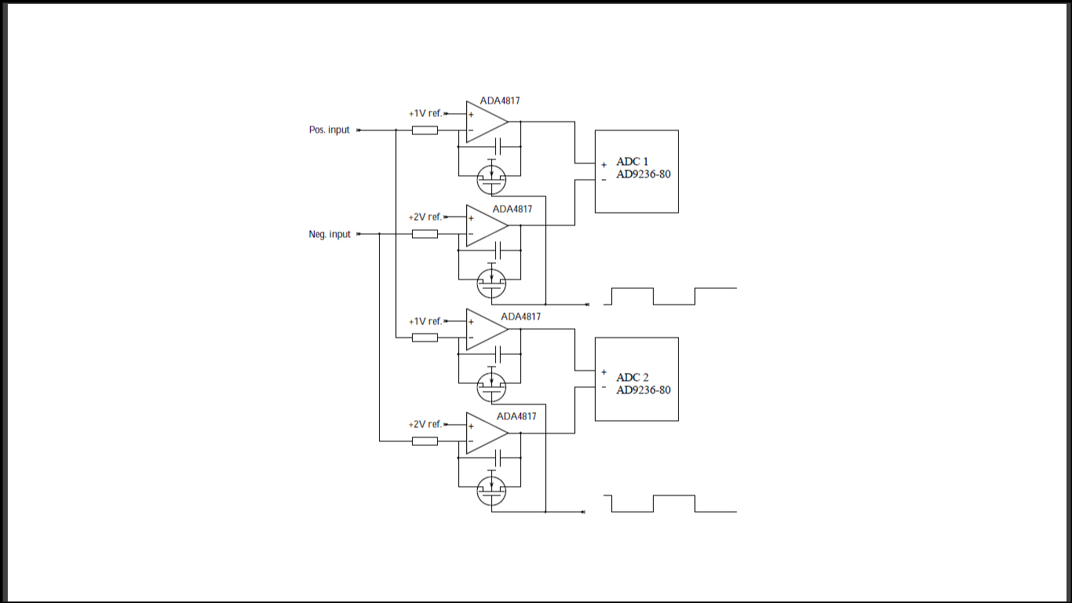

Slide 7
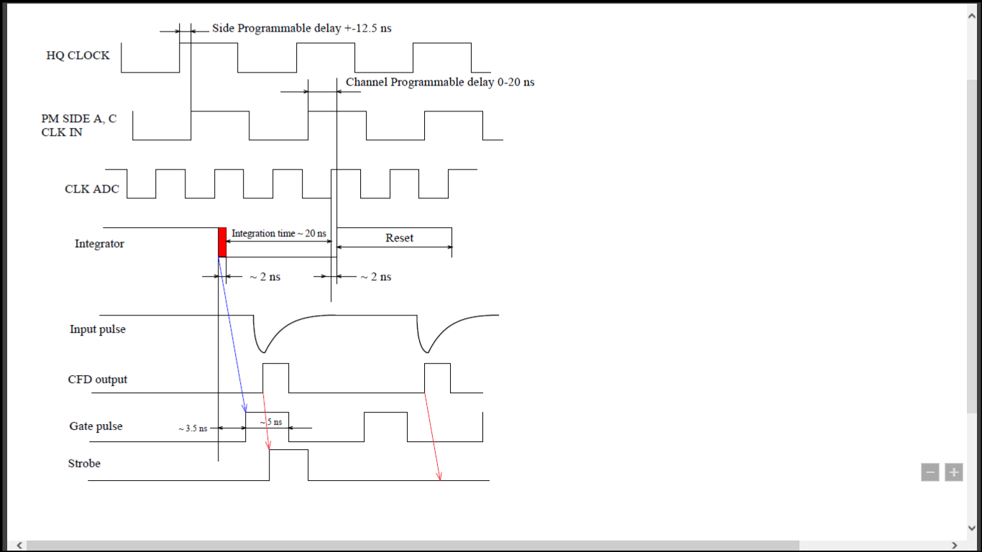

Slide 8
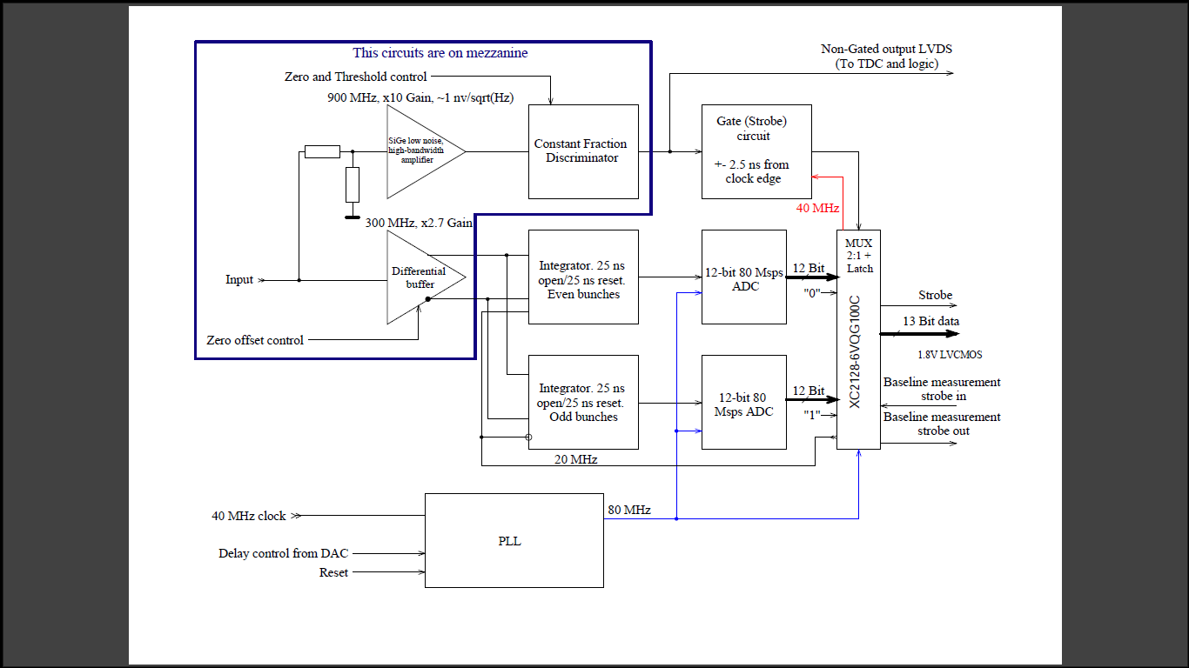

Slide 9
Solution
A) discharge time must not overlap with the sample time (change only in CPLD) Integral[t2 - t0]= Integral[t1 - t0] + Integral[t2 - t1] so the integrator need not be fully discharged - just we need to know the initial value for the integrator - subtract samples to get the proper value - change only in CPLD

Slide 10
Solution B (requires significant changes)
circuit similar to sigma-delta ADC - discharge the integrator with the known current (small change in the analog PCB board - replace transistor with a resistor?). In this case there is no discharge dead time - so sampling frequency can be doubled to 160 MS/s - employing integrators and sampling ADC one for rising another for falling clock edge.

