Slide 1
CREDO Visegrád Workshop 2019
Opava | 22nd. of November, 2019
LOBA Introduction

Slide 2
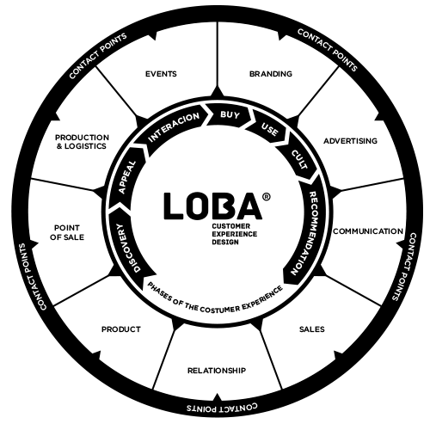
ABOUT LOBA
LOBA - Customer Experience Design: Solutions for promotion, communication, relationships and interaction with customers
Our mission: To provide excellent customer experiences to our clients’ customers.
Dissemination and Communication Services:
Branding and project identity,
Marketing activities,
Dissemination and exploitation of results,
Communication activities (i.e. events, workshops…),
Design and production of promotional material (i.e. brochure, posters, roll-ups) and merchandising,
Video production
Social Media management,
SEO and SEM management and
PR management (i.e. press releases, newsletters).

Slide 3
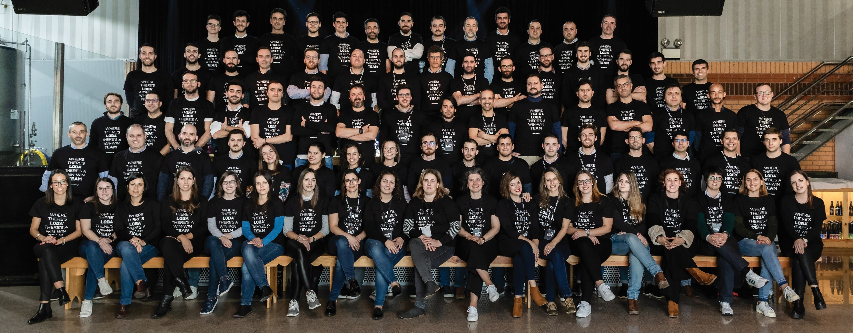
LOBAcx TEAM – Aveiro, Porto, Guarda & Lisbon

Slide 4
EU PROJECTS - HOW WE DO:
Dissemination and Communication Protokols = Planning – Targeting – Executing (Translate research to actionable knowledge-visually attractive Infographs, materials)
EU projects since 2010 (network capacity, experience, FP7, H2020, COSME)
Provide professional service to our Consortium Partners
Let us serve your communication during the project. Ask for help anytime!
A SUCCESSFUL COMMUNICATION AND DISSEMINATION OF THE PROJECT RESULTS AND ACTIVITIES NEEDS EFFORTS FROM ALL PARTNERS!

Slide 6
...Collecting from the Sky
Delivering from the bottom....

Slide 7
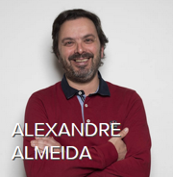
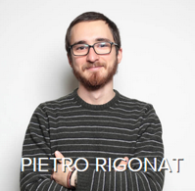
EU EU Project Team

Slide 8
Thank you for your attention!
Szabolcs Jakab – szabolcs@loba.pt

