Slide 1
Ultra High Energy Cosmic Rays produced by compact star mergers and pulsars
David E. Álvarez Castillo
Joint Institute for Nuclear Research
Dubna, Russia
CREDO Visegrad Workshop 2019
November 22, 2019

Slide 2
Outline
Introduction to astrophysical sources of cosmic rays.
Overview of the multi-messenger astronomy.
Cosmic rays generated by neutron stars, pulsars and black holes
Potential of detection of CREDO
Scientific CREDO development and perspectives.

Slide 3
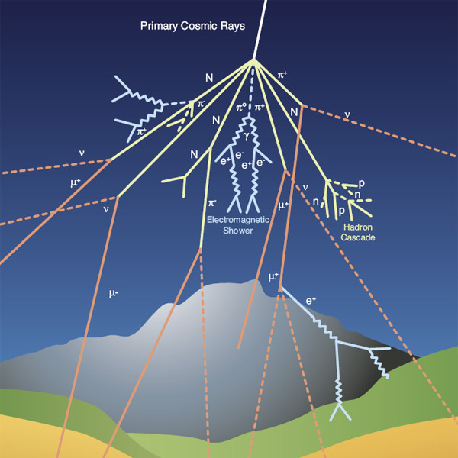
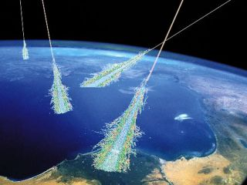
Cosmic Rays Content
Primary Particles
Proton
Alpha Particles
Heavy Nuclei
Secondary Particles
Pions, Kaons, Protons,
Electrons, Photons, γ

Slide 4
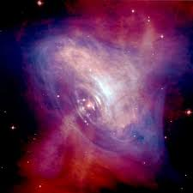
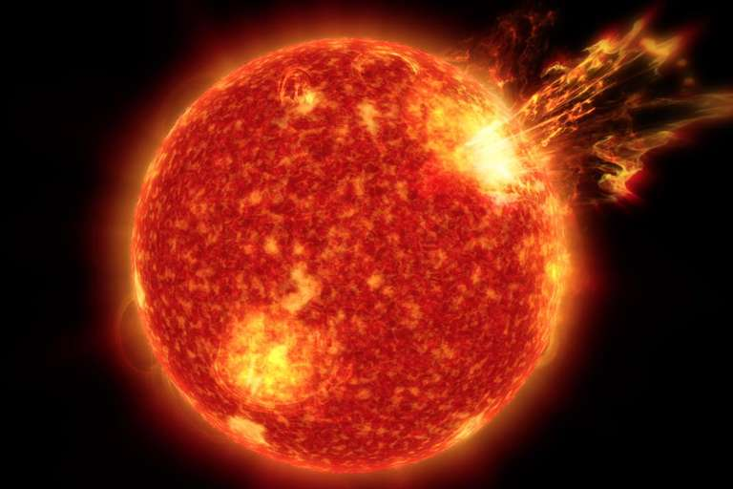
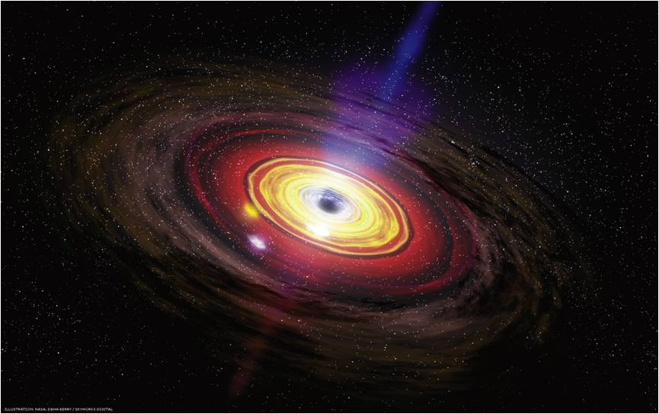
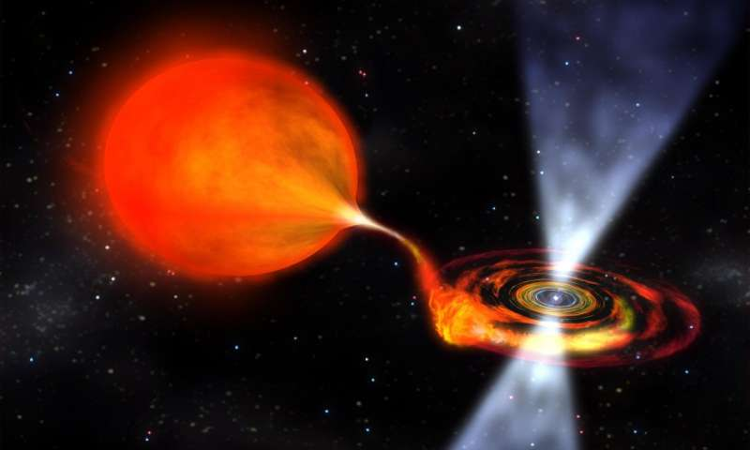
Cosmic Rays Sources
Solar Activity
Super Nova
Explosions
Pulsars
Rotating Black Holes
Active Galactic Nuclei

Slide 5
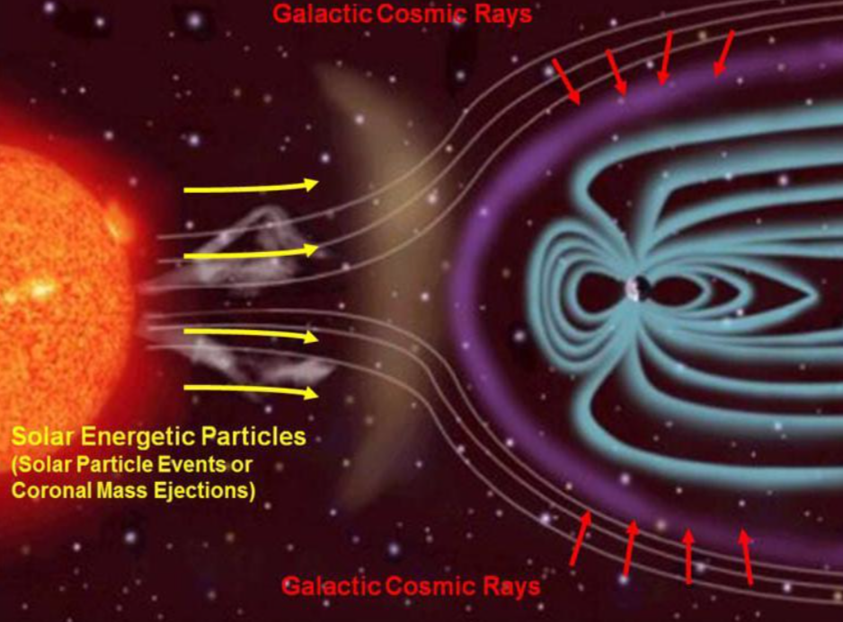

Slide 6
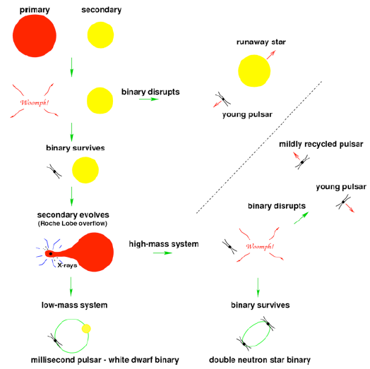
Double Neutron Stars and Millisecond Pulsars

Slide 7
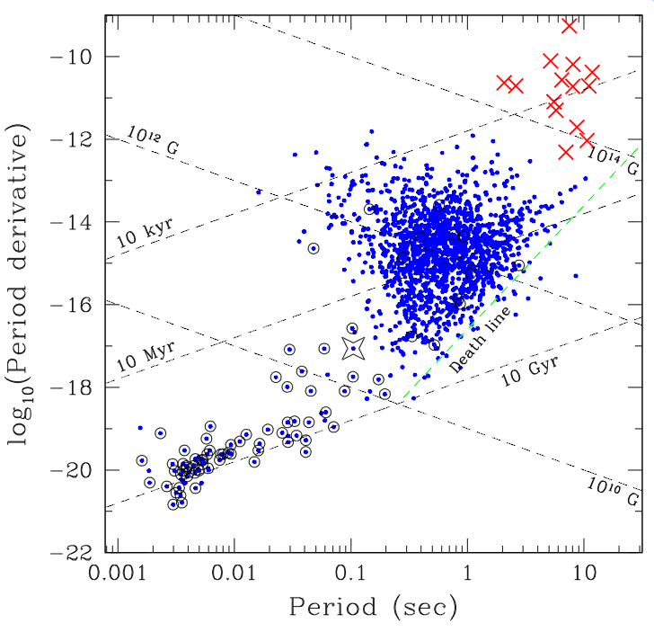
Statistics of Pulsars
Magnetars:
B > 10¹⁵ Gauss
Young pulsars:
P < 1 sec
B ~ 10¹² Gauss
Recycled (old) Pulsars:
P ~ few milliseconds
B ~ 10⁸ Gauss

Slide 8
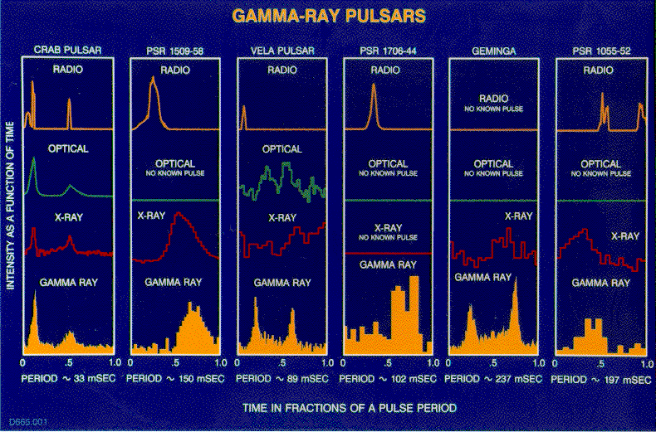
Pulse shapes and el.-magn. spectrum

Slide 9
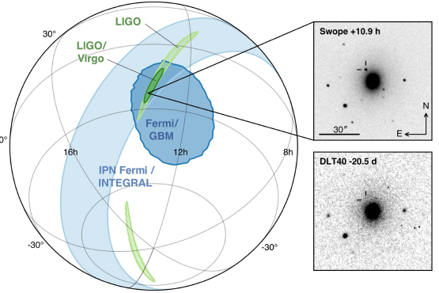
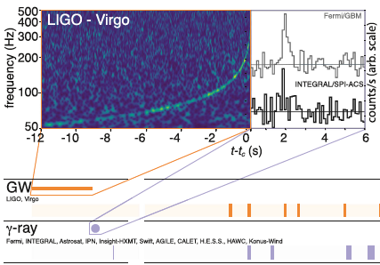
Compact star mergers
GW170817A , announced 16.10.2017 *)
*) B.P. Abbott et al. [LIGO/Virgo Collab.], PRL 119, 161101 (2017); ApJLett 848, L12 (2017)

Slide 10
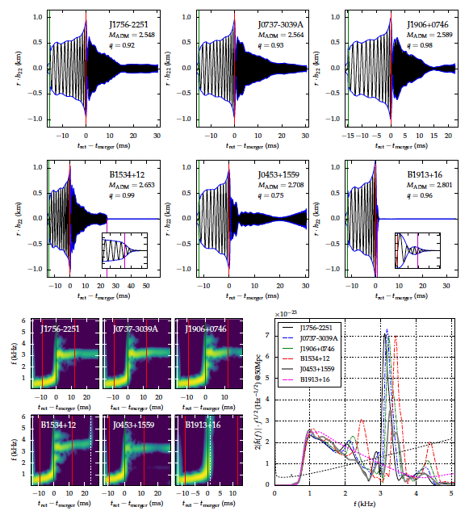
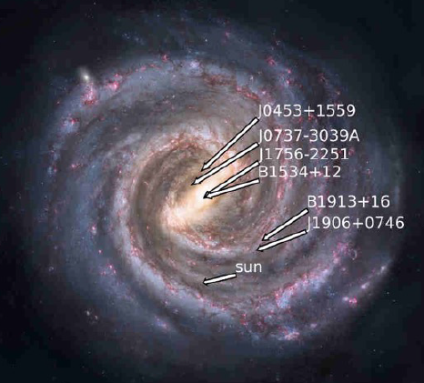
Neutron star mergers
Simulated NS-NS merger events *)
--> Sensitivity to the NS equation of state!
Expected rate ~ 0.2 – 200 events/year for
LIGO/Virgo Collaboration in 2016 - 2019
*) A. Feo, R. DePietri & F. Maione, Class. Quant. Grav. 34 (2017) 034001

Slide 11
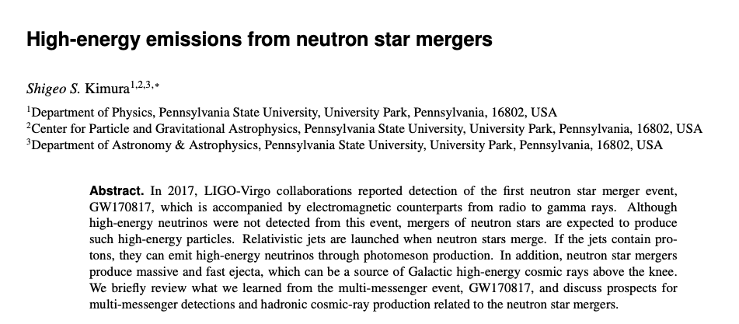
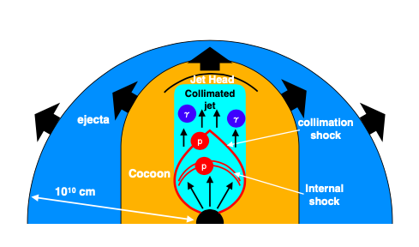
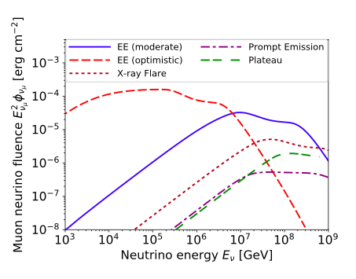
Neutron star mergers

Slide 12
UHECRs origination from Neutron Stars
MHD wind acceleration of iron nuclei remaining from the supernova.
Strange quark matter hypothesis: neutron star combustión resulting into large amplitude electromagnetic waves that accelerate light ion remnants from the supernova to UHECR energies.
Centrifugal mechanism of acceleration in the magnetospheres of the Crab-like Pulsars: 100 TeV cosmic rays coming from the Crab Nebula

Slide 13
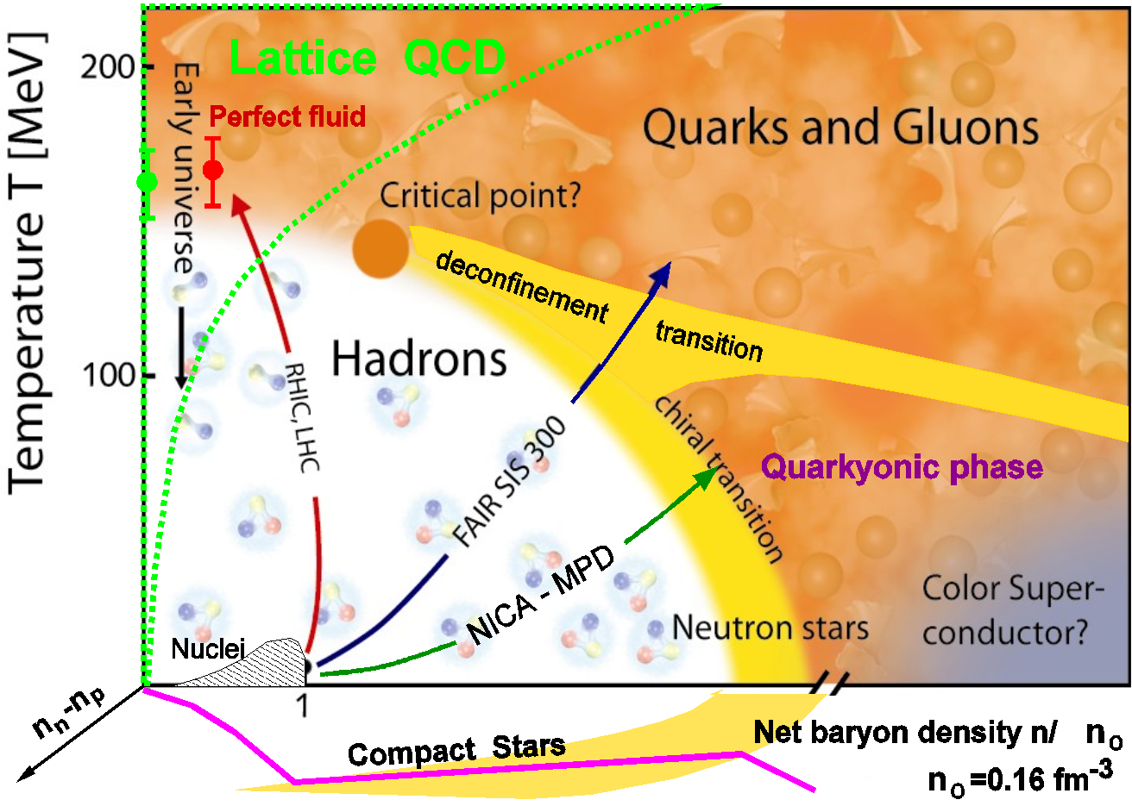
Critical Endpoint in QCD

Slide 14
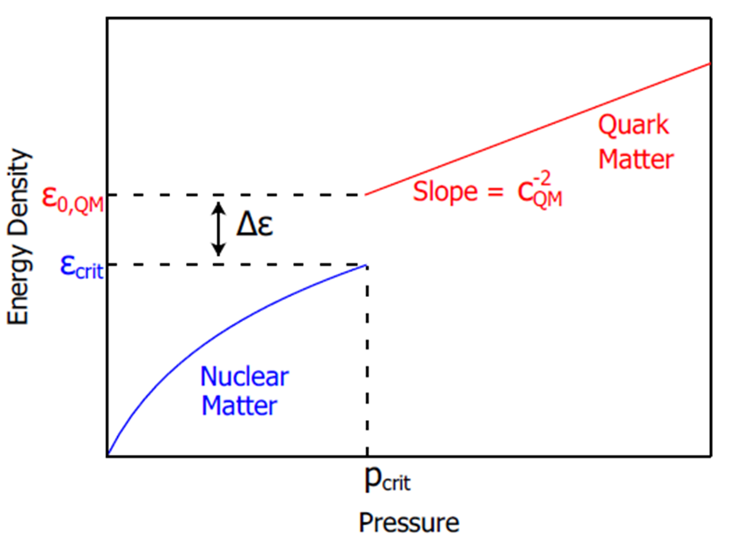
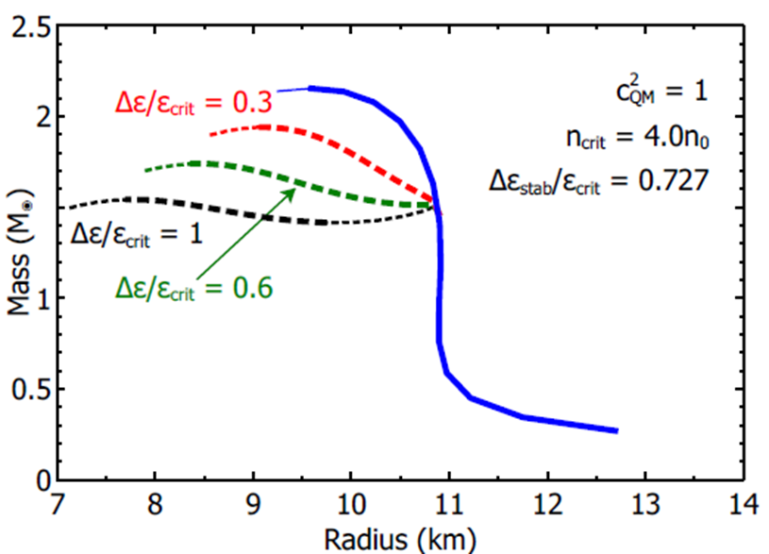
Compact Star Mass Twins and the AHP scheme
First order PT can lead to a stable branch of hybrid stars with quark matter cores which, depending on the size of the “latent heat” (jump in energy density), can even be disconnected from the hadronic one by an unstable branch → “third family of CS”.
Measuring two disconnected populations of compact stars in the M-R diagram would represent the detection of a first order phase transition in compact star matter and thus the indirect proof for the existence of a critical endpoint (CEP) in the QCD phase diagram!
Alford, Han, Prakash,
Phys. Rev. D 88, 083013 (2013)
arxiv:1302.4732

Slide 15
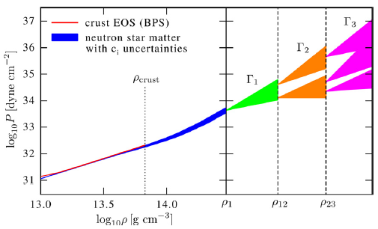
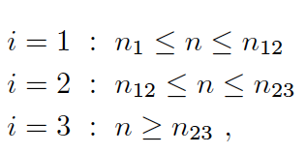
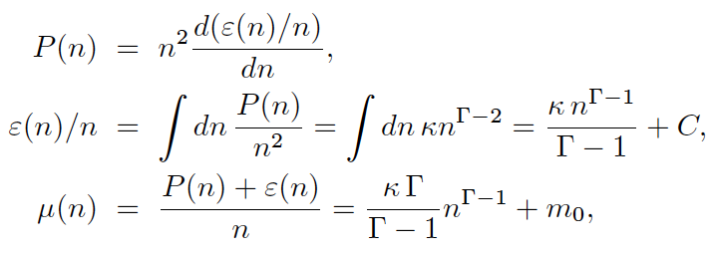
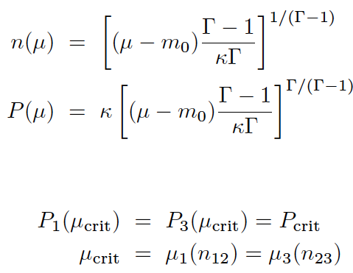
Piecewise polytrope EoS
Hebeler et al., ApJ 773, 11 (2013)
Here, 1st order PT in region 2:
Maxwell construction:
Seidov criterion for instability:

Slide 16
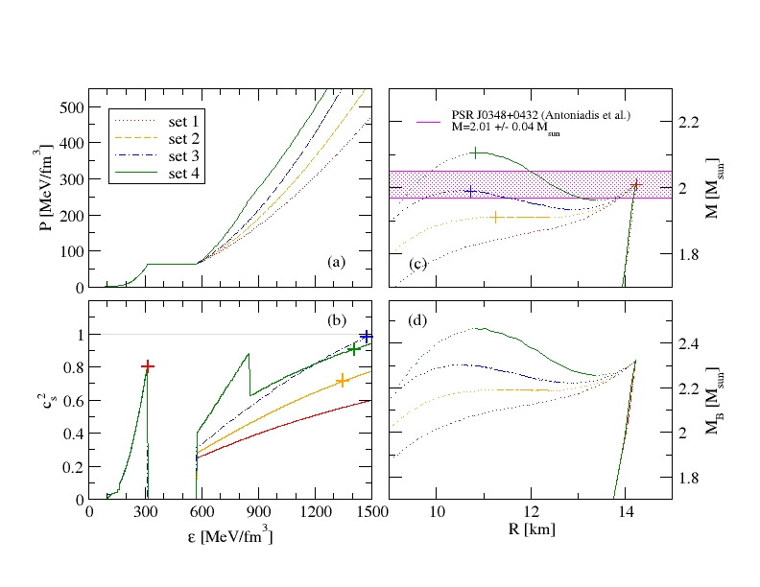
Compact Star Twins
Alvarez-Castillo, Blaschke (2017)
High mass twins from multi-polytrope equations of state
arXiv: 1703.02681v2, Phys. Rev. C 96, 045809 (2017)

Slide 17
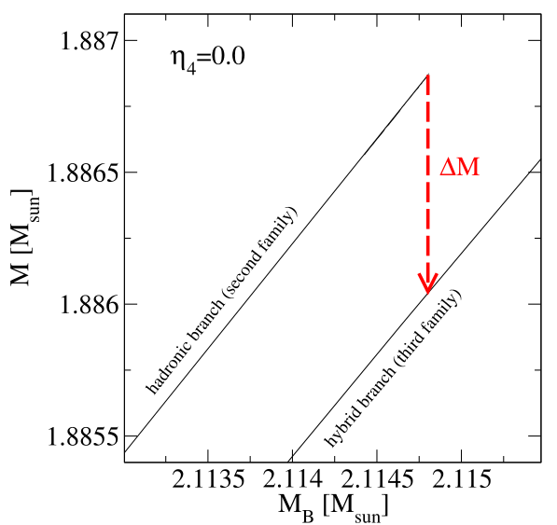
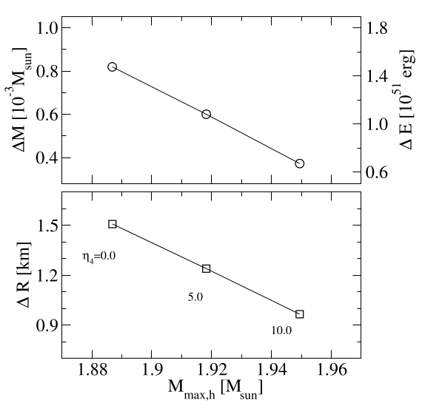
Energy bursts from deconfinement
Alvarez-Castillo, Bejger, Blaschke, Haensel, Zdunik (2015), arXiv:1401.5380

Slide 18
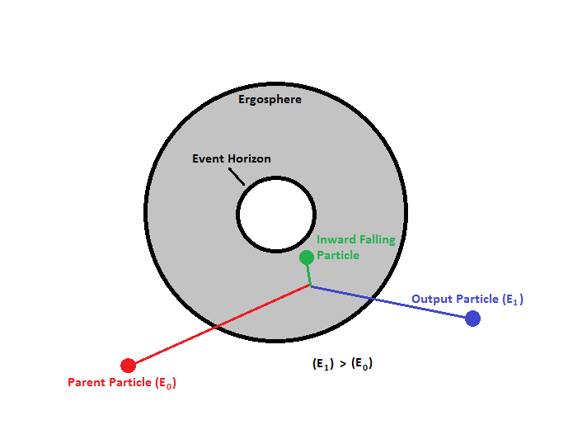
Magnetic Penrose Process
Naresh Dadhich, Arman Tursunov, Bobomurat Ahmedov, Zdeněk Stuchlík, The distinguishing signature of magnetic Penrose process, Monthly Notices of the Royal Astronomical Society: Letters, Volume 478, Issue 1, July 2018, Pages L89–L94

Slide 19
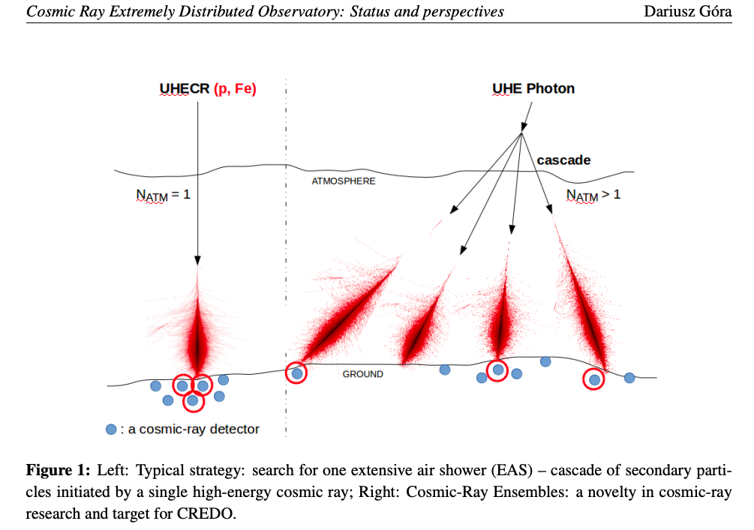
Cosmic Ray Ensembles
Cosmic Ray Extremely Distributed Observatory: Status and Perspectives of a Global Cosmic Ray Detection Framework. D. Gora et al., Proceedings of 36th International Cosmic Ray Conference - ICRC2019, arXiv:1908.04139

Slide 20
Perspectives
Inclusion of Multi-Messenger Astronomy as a tool for the study of the nature of cosmic rays, implying networking for CREDO.
Model and simulation of selected astrophysical scenarios: supernova explosions, neutrón star mergers and pulsars, rotating black holes, and cosmological processes.
Use of terrestrial laboratories as a complementary tool.
Numerical simulations of cosmic rays creation and interactions: cosmic rays ensembles.
Full support for the extensión of the CREDO detector network.

