Slide 1
Heterogeneous computing platform HybriLIT
Alexander Ayriyan (JINR & AANL)
on behalf of the HybriLIT team
Special thanks D. Podgainy, O. Streltsova, M. Zuev
CREDO Visegrad Workshop 2019
November 20-23, 2019

Slide 2
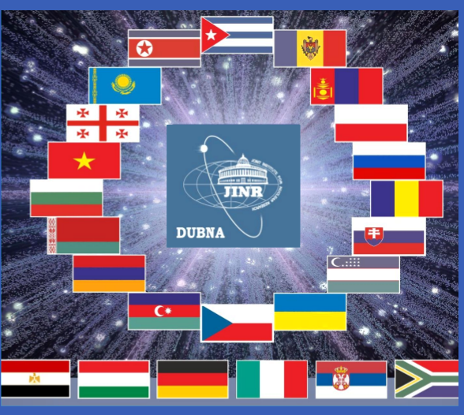
Joint Institute for Nuclear Research
Armenia
Azerbaijan
Belarus
Bulgaria
Cuba
Czech Republic
Georgia
Kazakhstan
DPR of Korea
Moldova
Mongolia
Poland
Romania
Russian Federation
Slovakia
Ukraine
Uzbekistan
Vietnam
Participation of Egypt, Germany, Hungary, Italy, South Africa and Serbia in JINR is based on bilateral agreements singed on the governmental level.

Slide 3
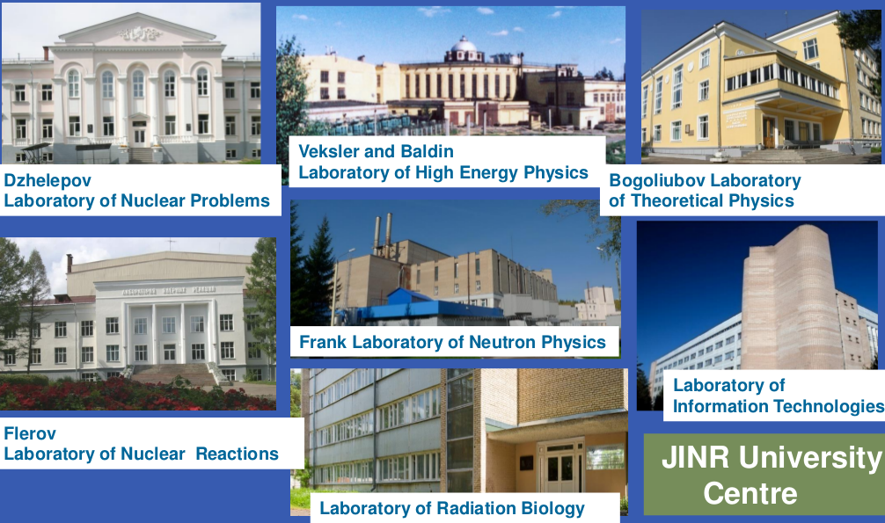
JINR Scientific Laboratories
JINR comprises seven scientific Laboratories, each being comparable with a large institute in the scale and scope of investigation performed

Slide 4
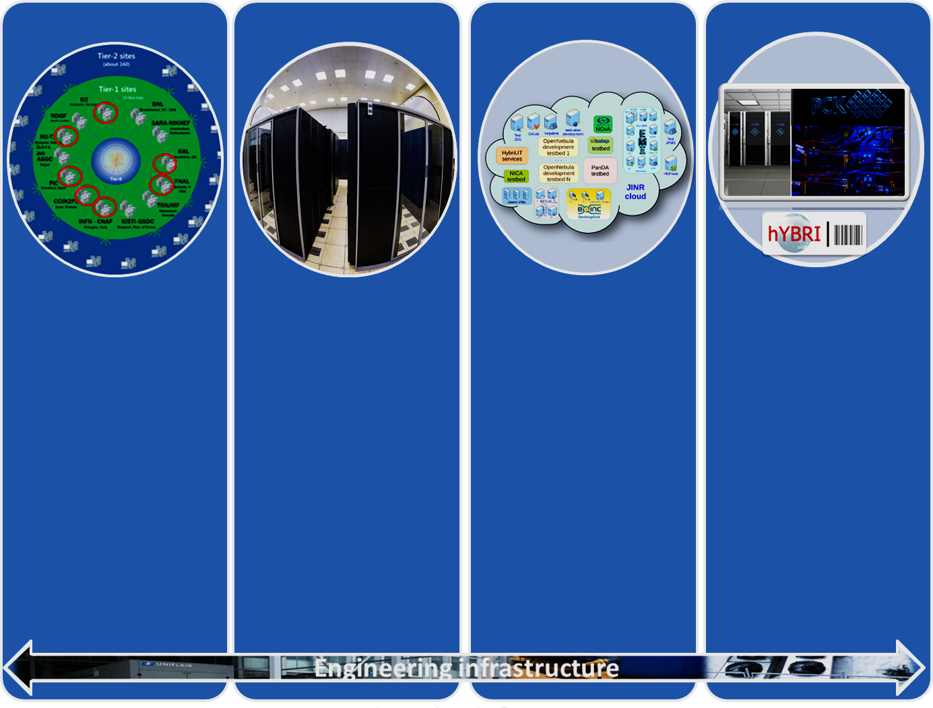
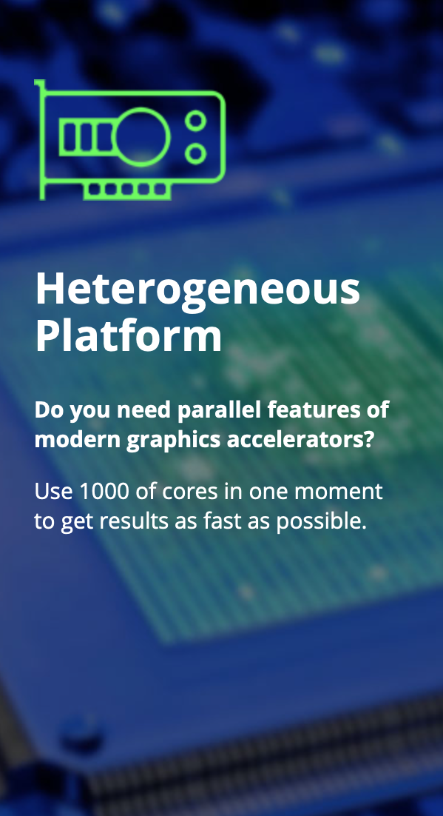


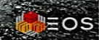

Multifunctional Information and Computing Complex
Grid-Tier1:
10688 cores
8.3 PB disk
11 PB tape
Grid-Tier2
CICC:
4128 cores
2.7 PB disk
Cloud:
1572 CPU
8.142 TB RAM
1.1 PВ disk
HPC Govorun
Peak ~0.5 Pflops
HybriLIT:
Peak ~70 Tflops
DATALAKE
3740TB
DATALAKE

Slide 5


Heterogeneous computing platform HybriLIT
Education, scientific and testing polygon HybriLIT
Supercomputer GOVORUN
CPU-component
Intel Skylake
Intel
Xeon
Intel
Xeon Phi
40 nodes
Intel Omni-Path
CPU-component
Intel Xeon Phi (KNL)
21 nodes
NVIDIA Tesla K20
NVIDIA Tesla K40
NVIDIA Tesla K80
GPU-component
GPU DGX-1 Volta
(NVIDIA Tesla V100)
5 nodes
10 computation nodes

Slide 6
Heterogeneous computing platform HybriLIT
SLURM

Slide 7
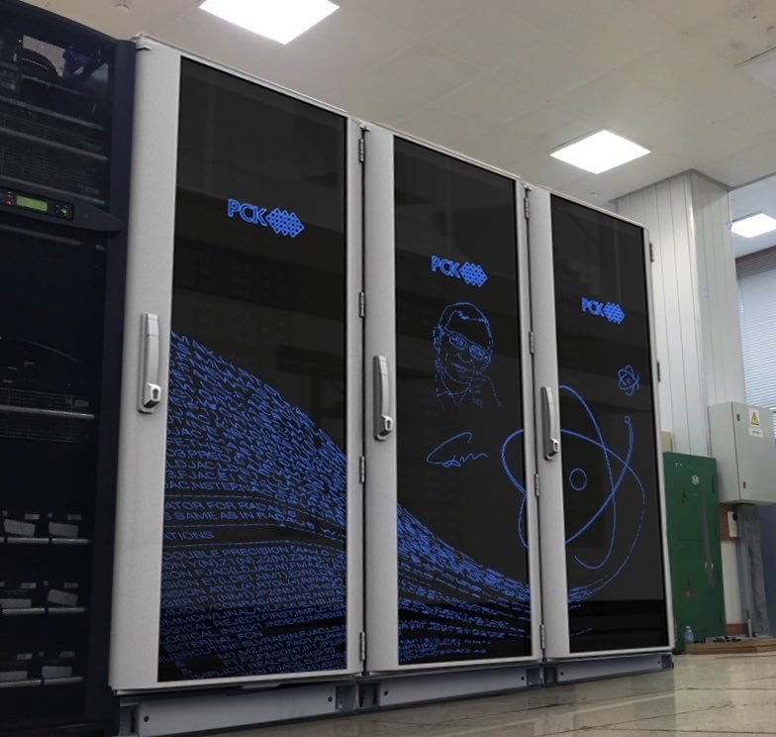
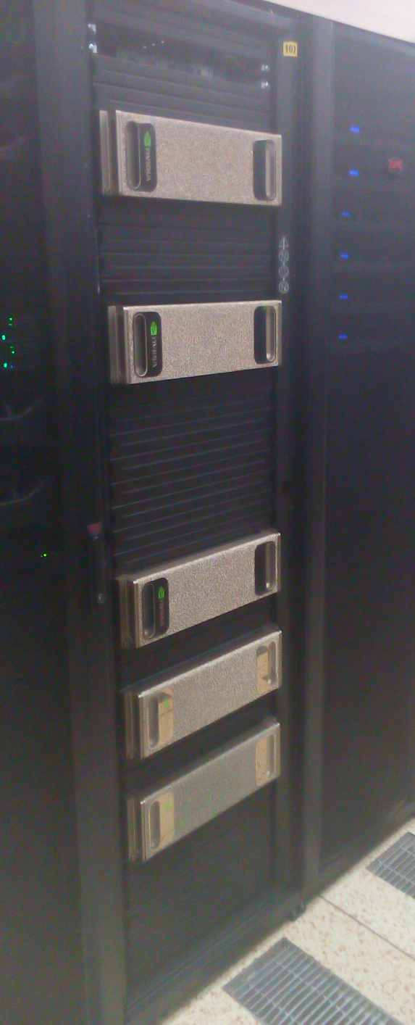
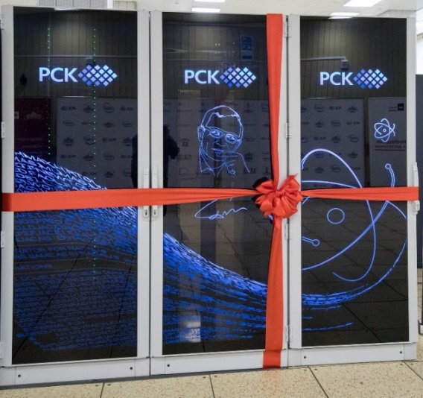
Supercomputer “Govorun”
Update
#10 в Top50
Peak performance in 2018:
1000 TFlops for single precision
500 TFlops for double precision
Peak performance in 2019:
1700 TFlops for single precision
860 TFlops for double precision

Slide 8

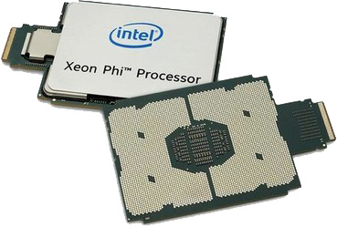
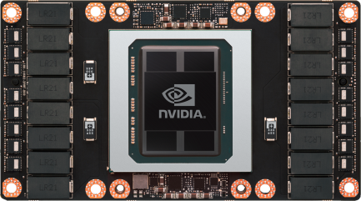

Main computational components of Govorun
2018
2019
Intel Xeon Gold 6154
Intel Xeon Phi 7290F
80x
18 cores
36 threads
3.0 GHz
Intel® AVX-512
Nvidia Tesla V100
Intel® AVX-512
2.9 GHz
48 threads
24 cores
208x
21x
72 cores
288 threads
1.5 GHz
16 GB RAM
Intel® AVX-512
40x
5120 GPU cores
80 Streaming Multiprocessor
1.25 GHz
16 GB RAM
Intel Xeon Platinum 8268

Slide 9
Govorun hyperconverged system
DRAM
Intel OPTANE
Very hot tier
Intel OPTANE+NVMe SSD
hot tier
INTEL NVMe SSD
warm tier
HDD + TAPE
cold tier

Slide 10
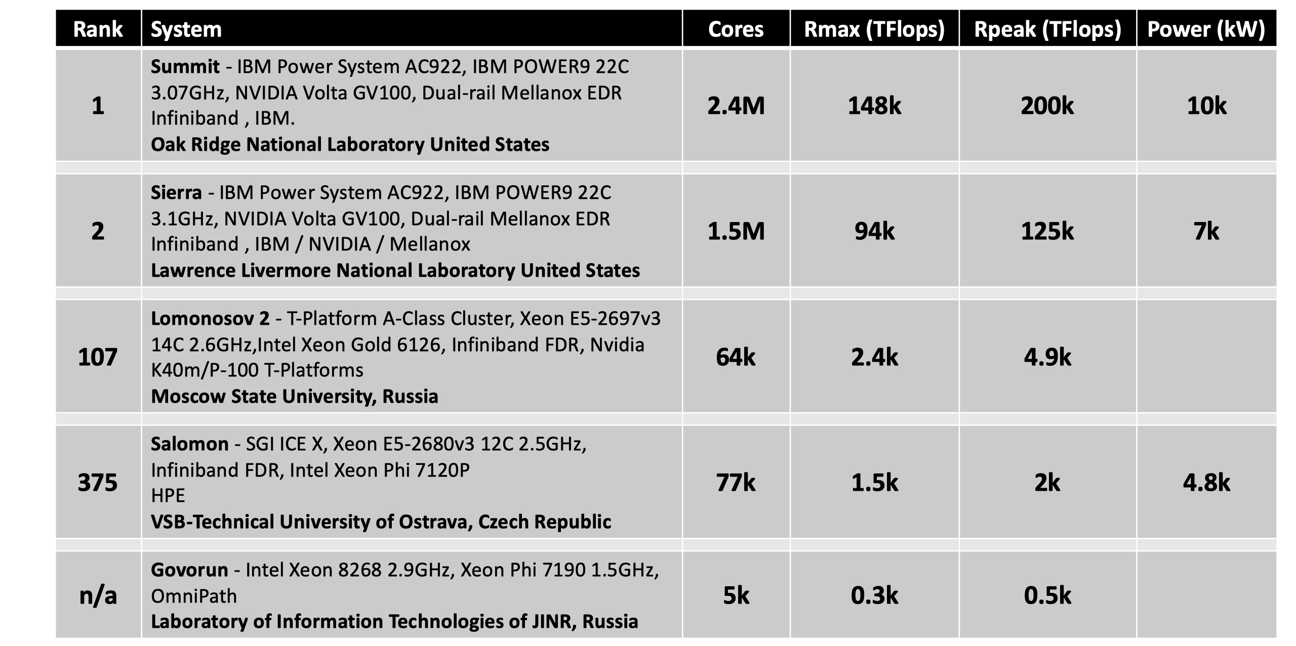
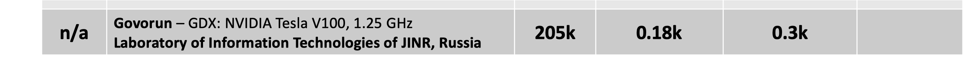
Main computational components of Govorun
#10
TOP50 CIS
#17

Slide 11

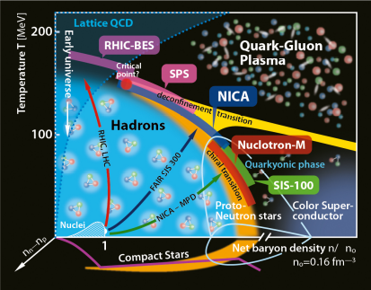
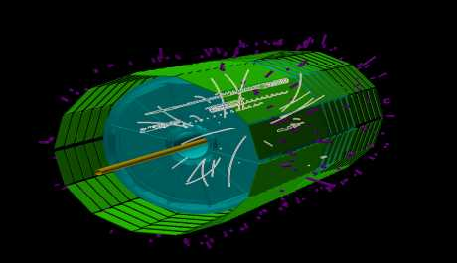
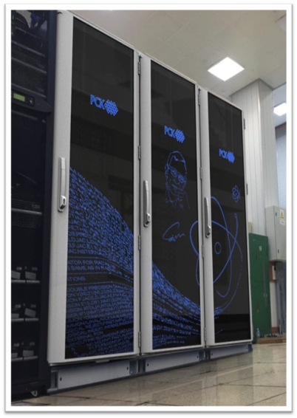
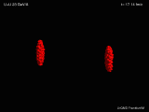
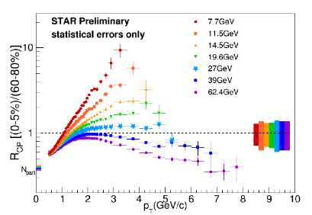
The main Govorun missions
GOVORUN
QCD phase diagram
Events reconstruction
Simulations
Physics analysis

Slide 12
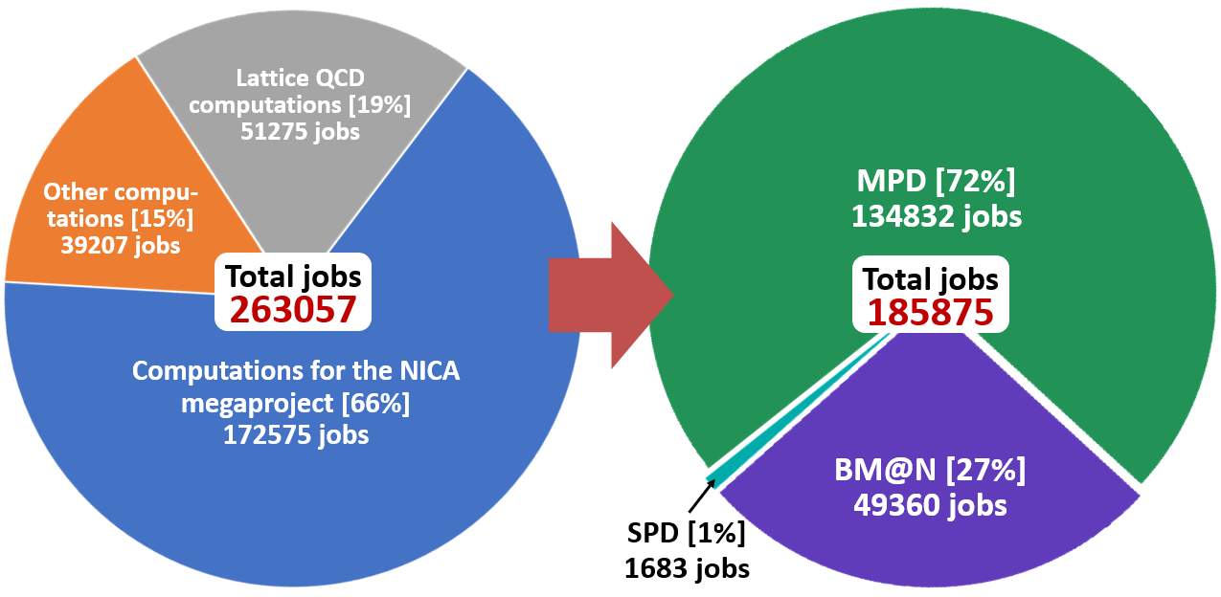
The main Govorun missions

Slide 13
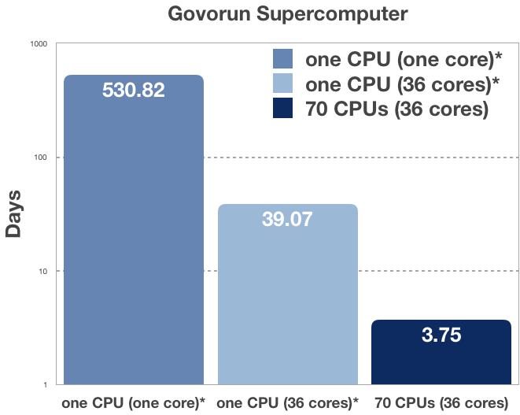
My experience with Govorun
1000
~ 1.5 years
A hybrid algorithm MPI+OpenMP has been developed for solving optimization problem for nonlinear unsteady heat equation. The optimization problem has been formulated in order to improve design of the so-called “temperature valves” technique for the pulse injection (in the millisecond range) of working gases into the multiply charged ion source ionization chamber.
100
10
141 times
1
A. Ayriyan, J. Busa Jr. Parallel Algorithm for Numerical Solution of Heat Equation in Complex Cylindrical Domain // Discrete and Continuous Models and Applied Computational Science, vol. 27(1), pp. 21–32 (2019). DOI: 10.22363/2658- 4670-2019-27-1-21-32
A. Ayriyan, J. Busa Jr., H. Grigorian, E. E. Donets. Solving the Optimization Problem for Designing a Pulsed Cryogenic Cell. Physics of Particles and Nuclei Letters, 2019, Vol. 16, No. 3,
pp. 300-309, doi: 10.1134/S1547477119030026

Slide 14
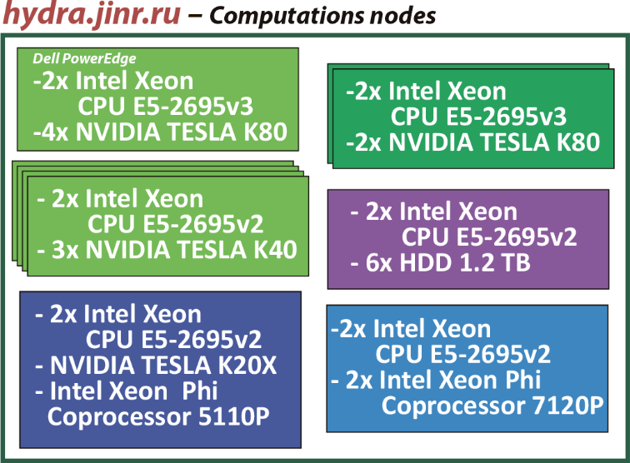

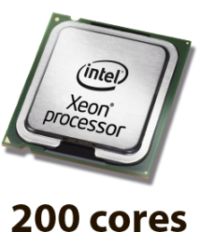
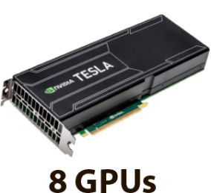
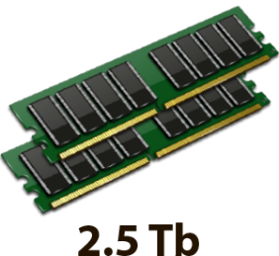
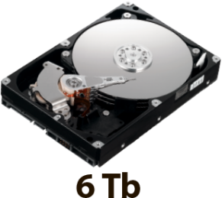
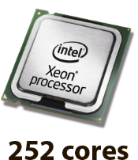
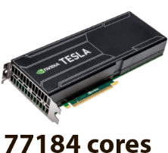
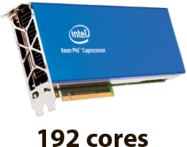

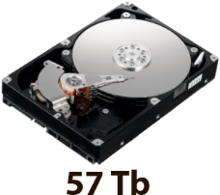
Educational, scientific and testing polygon “HybriLIT”
Performance
Single precision 142 TFLOPS
Double precision 50 TFLOPS

Slide 15
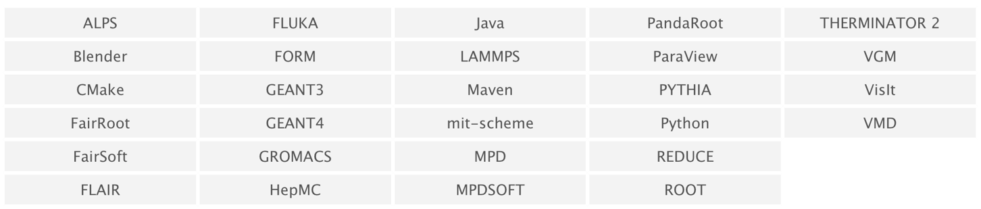
HybriLIT Software

Slide 16

HybriLIT Services
System Level
SLURM
(workload manager)
Scientific
Linux 7.5
xCAT
Software for parallel computing
OpenMPI 1.8.8, 2.1.2
CUDA 7.0, 8.0, 9.0, 9.1
OpenCV 2.4.9
GNU 4.8.5, 4.9.3, 6.2.0
Intel Parallel Studio 2018
Licensed math. software
COMSOL 5.3а
MATLAB R2017b
Mathematica 11.2
Maple 2017.3
NFS
(file system)
EOS
(file system)
HybriLIT
Software and Information Environment
CernVM-FS
(Virtual Software Appliance)
ZFS
(file system)
FreeIPA
(identity manager solution)
MODULES
HybriLIT web-site
http://hybrilit.jinr.ru/
User level
GitLab
https://gitlab-hybrilit.jinr.ru
Indico
http://indico-hybrilit.jinr.ru
HybriLIT user support
https://pm.jinr.ru/projects/hybrilit-user-support

Slide 17
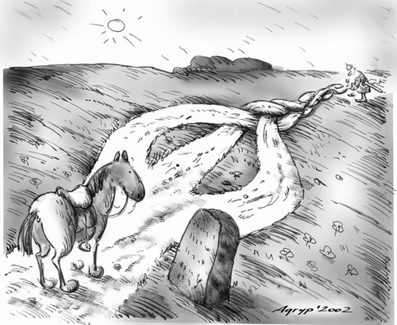
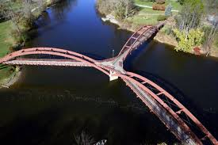
Ecosystem for parallel computations
MPI
OpenMP
OpenCL
CUDA
Distributed memory
Shared memory

Slide 18
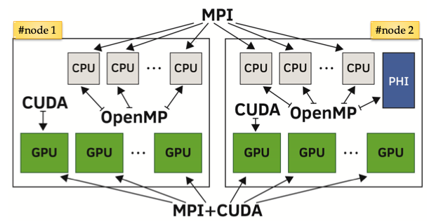
Ecosystem for parallel computations

Slide 19
Ecosystem for parallel computations
Intel Inspector
Memory and Threading Checking
Intel Vtune Amplifier
Performance Profiler
Intel Advisor
Vectorization Optimization and Thread Prototyping
Intel Math Kernel Library
Optimized Routines for Science, Engineering, and Financial
Intel Data Analytics Acceleration Library
Optimized for Data Analytics & Machine Learning
Intel Integrated Performance Primitives
Image, Signal, and Compression Routines
Intel Threading
Building Blocks
Task-Based Parallel C++ Template Library

Slide 20

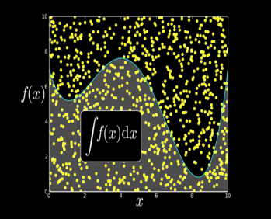
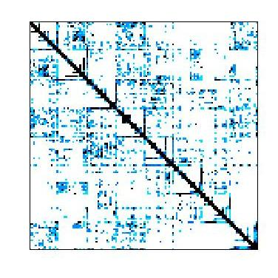


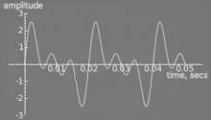







Ecosystem for parallel computations
NVIDIA cuBLAS
NVIDIA cuRAND
NVIDIA cuSPARSE
NVIDIA NPP
Vector Signal Image Processing
Matrix Algebra on GPU and Multicore
GPU Accelerated
Linear Algebra
NVIDIA cuFFT
ArrayFire Matrix Computations
Sparse Linear Algebra
C++ STL Features for CUDA
IMSL Library
GPU-accelerated Libraries

Slide 21
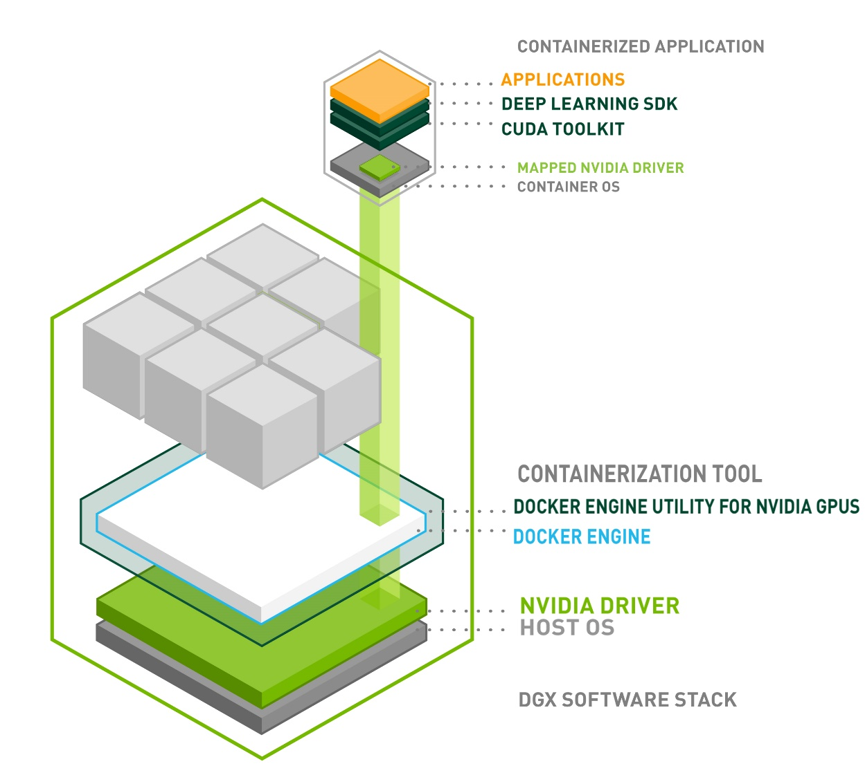






Ecosystem for tasks of ML/DL and data analysis
Machine Learning frameworks optimized by NVIDIA

Slide 22
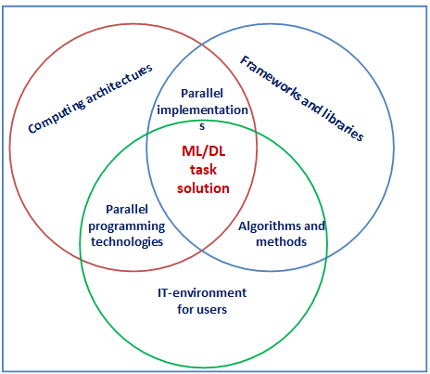
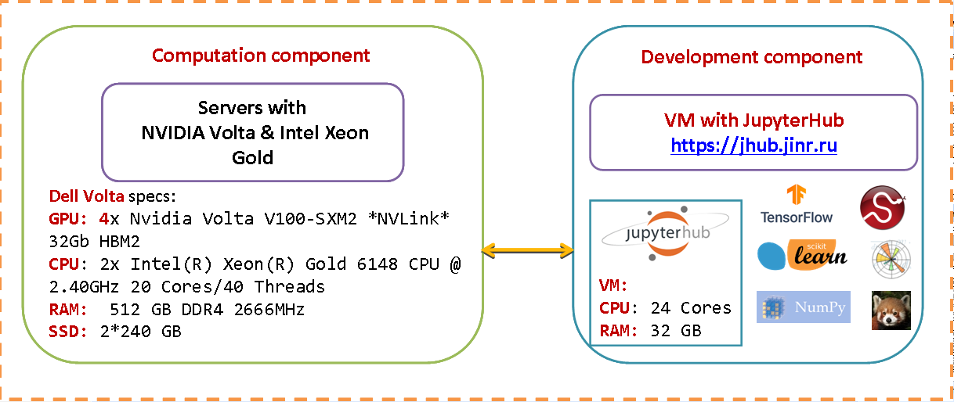
Ecosystem for tasks of ML/DL and data analysis
The ecosystem has two main components:
the computing component: 5x DGX stations [2xIntel Xeon E5-2698v4, 512 GB RAM; 8xNVIDIA Tesla V100];
the component for the development of models and algorithms: JupyterHub, Jupyter Notebook (known as IPython); DeepLerning libraries and frameworks.

Slide 23
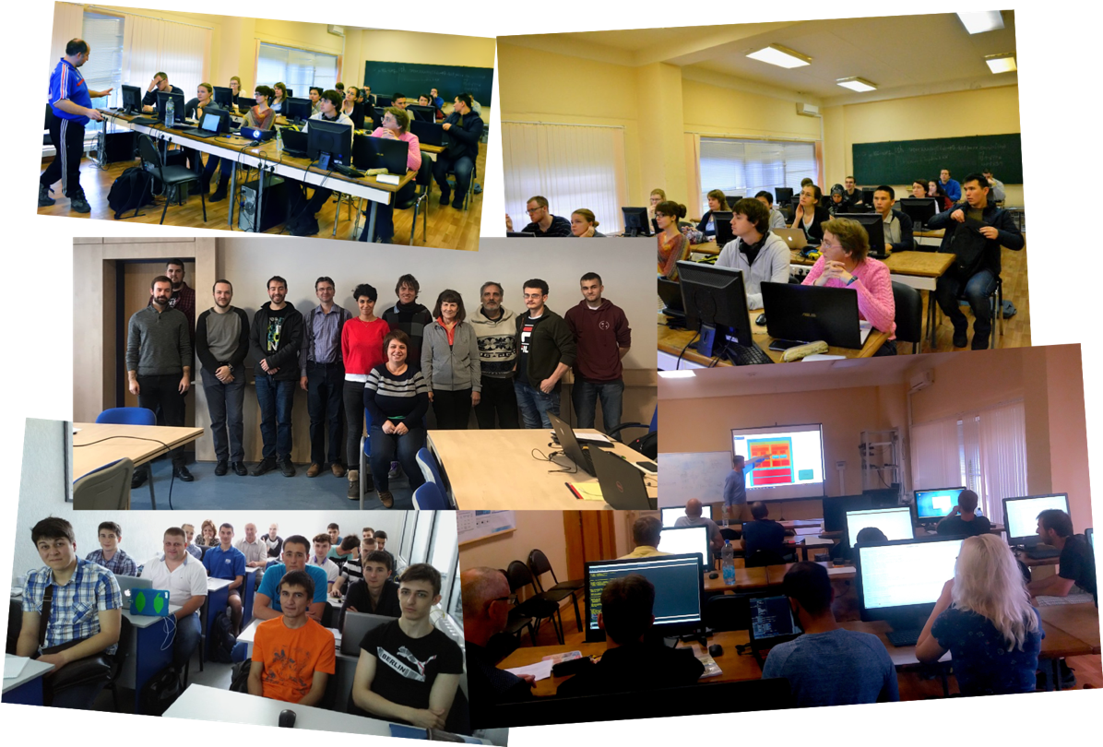
HybriLIT Lectures and Tutorials
Within the framework of international cooperation of JINR, lectures on parallel programming technologies was given at the Academy of Sciences of Belarus, at the Institute of Physics of ANAS (Azerbaijan), at Sofia University in Bulgaria and Mongolian State University.
IT School for Young Scientists “Modern IT Technologies for Solving Scientific Problems” (27-28 May 2019, North Ossetian State University)
Parallel programming technologies and high performance computing within the HybriLIT computing platform. (2 Apr 2019, Tver State University)
Tools and libraries for data analysis and machine learning tasks (14 May, Tver State University)
Workshop on parallel programming technologies (26-30 November 2018, at Pilsen and Prague)
The 2nd International School on Heterogeneous Computing Infrastructure NEC’2017 (25-29 September 2017, Montenegro)
More than 50 tutorials and lectures on parallel programming technologies were held in 2014-2019 yy. Total number of participants comprises over 500 people from different universities and scientific centers.

Slide 24
HybriLIT Lectures and Tutorials
The following lectures and workshops are held among the basic activities:
OpenMP parallel programming technology;
MPI parallel programming technology;
CUDA parallel programming technology;
OpenCL parallel programming technology;
Hybrid OpenMP and CUDA parallel programming on multiple GPU computation systems;
OpenMP Programming on Intel Xeon Phi coprocessors;
Hybrid MPI and OpenMP parallel programming on multiprocessor and multicore systems;
Deep Learning and Machine Learning at HybriLIT;
etc.

Slide 25
Děkuji vám za pozornost!
Thank you for your attention!
Dziękuję za uwagę!
Welcome to HybriLIT!
http://hlit.jinr.ru/en/

