Slide 1
European Spallation Source ERIC Procurement Overview
Mirko Menninga
Head of Supply, Procurement & Logistics Division
www.europeanspallationsource.se
30 November 2018

Slide 2
Opportunities for doing business with ESS
Skanska for civil construction
Contract in place with Skanska for conventional facilities, Skanska conducting procurement for sub-contractors for materials and works
ESS Procurement for goods and services from ESS budget
European Spallation Source ERIC public procurement rules
In-kind contributions (IKCs) from partner institutions in ESS member countries
A non-cash contribution in labor or material to ESS
Opportunities through IKCs from partner institutes in member countries

Slide 3
Financing includes cash and deliverables
Construction budget: 1843 M€ (2013) => As of November 2018: 52% complete
Steady state operations budget: 140 M€ / year (2026-2065)
Host Countries Sweden and Denmark
Construction 47.5% Cash Investment ~ 97%
Operations 15%
Non Host Member Countries
Construction 52.5% In-kind Deliverables ~ 70%
Operations 85%
15 European Member and Observer Countries

Slide 4
ESS In-Kind Goals
Construction cost: € 1,84 Billion
In-Kind: € 747.5 Million
€ 510 M
40.5%
€ 350 M
75%
65%
€ 155 M
€ 73 M
65%
50%
Controls
Target
Instruments (NSS)
Accelerator

Slide 5
ESS In-Kind Partners
Aarhus University
Atomki - Institute for Nuclear Research
Bergen University
CEA Saclay, Paris
Centre for Energy Research, Budapest
Centre for Nuclear Research, Poland, (NCBJ)
CNR, Rome
CNRS Orsay, Paris
Cockcroft Institute, Daresbury
Elettra – Sincrotrone Trieste
ESS Bilbao
Forschungszentrum Jülich
Helmholtz-Zentrum Geesthacht
Huddersfield University
IFJ PAN, Krakow
INFN, Catania
INFN, Legnaro
INFN, Milan
Institute for Energy Research (IFE)
ISIS - Rutherford-Appleton Laboratory, Oxford
Laboratoire Léon Brilouin (LLB)
Lund University
Nuclear Physics Institute of the ASCR
Oslo University
Paul Scherrer Institute (PSI)
Polish Electronic Group (PEG)
Roskilde University
Tallinn Technical University
Technical University of Denmark (DTU)
Technical University Munich (TUM)
Science and Technology Facilities Council
University of Copenhagen (KU)
University of Tartu
Uppsala University
Wigner Research Centre for Physics
Wroclaw University of Technology
Warsaw University of Technology
Zurich University of Applied Sciences (ZHAW)

Slide 6
Functions covered in SPL Division
Logistics
Procurement and Contracting
Travel
Plan and execute
Transportation
Loading/Unloading
Storage
Act on requested services
in the ESSnow portal
Support In-kind & suppliers
with logistic issues
Operate Receipt, Acceptance, Test and Storage (RATS) facility
Operate the logistics-
building (F03) once ready
Purchasing
ERP module
Purchase orders
Material master
Electronic catalogues
Supplier mgmt
Tendering
Call for tenders
E-procurement tool
Contracting*: - supply- and service agreements - consultancies, secondments and other external personnel - lease- and real estate
- Collaboration agreements
- Support contract management
Any other legal matters related to different types of agreements
ESS Rules for Travel
Travel Authorization
Travel Agency (Egencia)
Hotels
Taxi
Car rental
Visa
Contract management
*Legal Division dissolved in autumn 2017 and integrated into SPL and In-Kind

Slide 7
ERIC Procurement Rules
ESS procurement governed by the European Spallation Source ERIC procurement rules (as of 1 October 2015, before that ESS AB following LOU)
Purpose
To explain how ESS ERIC conducts procurement
Apply to all procurement from ESS cash budget
Principles and objectives
Following the EU treaty principles of:
Transparency, proportionality, mutual recognition, equal treatment and non-discrimination
Promoting the objectives of:
Value for money, publicity, integrity, innovation, sustainability
Revision done in April 2017
Increase of low-value threshold from EUR5K to EUR10K
Providing a process for appeal, internal process that protects ESS from court proceedings (no new appeals received in 2018 so far). Malmö court has confirmed on three occasions that ESS does not fall under their jurisdiction.
Available at https://europeanspallationsource.se/procurement
7

Slide 8
ERIC Procurement Rules – Overview of Procurement Procedures*
Value Threshold | Publication | Procurement procedure | Minimum timing | Variations in Timing | Standstill Period
>200.000 EUR | Publication on ESS website. Other media depending on subject matter and value. | Open procedure | 30 days | (+) 5 days if not available by internet (-) 3 days if receip of tenders electronically (-10) days if SAN published 30 days - 12 months in advance | 10 days
 |  | Restricted procedure | 25 days + 25 days
 |  | Competitive procedure with negotiation, with or without initial tender | 25 days / 30 days
50.000 - 200.000 EUR | Publication on ESS website. Other media depending on subject matter and value. | Open procedure | 20 days | (+) 5 days if documents not available by internet (-) 3 days if receipt of tenders electronically | 10 days (optional)
 |  | Restricted procedure | 15 days + 15 days
 |  | Competitive procedure with negotiation, with or without initial tender | 15 days / 20 days
10.000 - 49.999 EUR | Optional on ESS website. | Request For Quotation on website (optional) or directly to minimum 3 suppliers | -- | -- | --
<10.000 EUR | -- | Request For Quotation or price comparison with limited competition | -- | -- | --
<300 EUR | -- | Established ESS shop accounts for immediate needs | -- | -- | --
*Minimum procedure applicable by value
**Minimum timing does not include time required for preparation and evaluation**
Transparency: publication of awarded contracts (>50K EUR) on website

Slide 9
Results of the procurement process: Suppliers and contracts
ESS aims to works with a diverse group of suppliers
Opportunities for SMEs, for example
Procurements <200K EUR => simplified selection of companies
Contracts (including framework agreements) may be divided into lots
Types of commercial contracts
Framework agreements for goods and/or services
eg, vacuum components, technical consultants and services
Supply and service agreements
eg, one-off sourcing of technical systems (klystrons, modulators, cryoplants, etc)
Sevice agreements
eg, outsourcing of various functions (travel, logistics, etc)
Services + materials agreements
eg, installation related contracts
Purchase orders
Specific contracts under framework agreements

Slide 10
ESS & innovation
ESS statutes
“…contribute to top-level research, technological development, innovation and societal challenges...”
ESS Mission
“…Develops innovative ways of working, new technologies, and upgrades to capabilities needed to remain at the cutting edge…”
ESS Policy for Innovation
Promoting Open Innovation
Employees as a key source of innovation, plus importance of external partners (including industry) and R&D activities
Innovation Strategy
Provides guidelines on how to implement the Policy
A dynamic document that will adjust to the needs presented by the different stages of building and operating ESS
In procurement
Innovation => one of the ESS procurement objectives
Direct contracts to industry for delivery of innovative solutions based on ESS R&D (design, engineering, proto-typing, manufacturing)
Public procurement of innovation activities (PCP / PPI projects) under Brightness
One framework agreement signed for innovation related activities

Slide 11
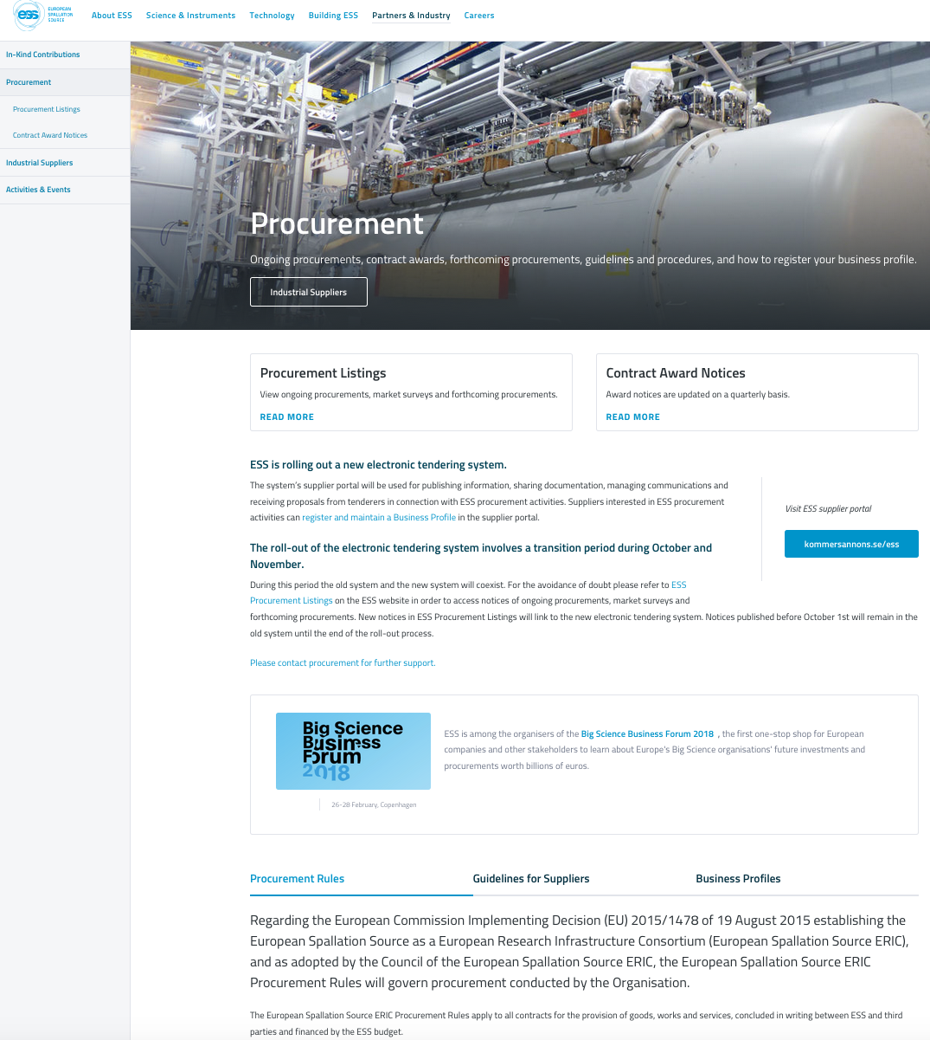
ESS procurement information
ESS Website
(http://europeanspallationsource.se/procurement)
Procurement Listings
Contract Notices >50,000 EUR
Market Surveys / Requests for Information
Forthcoming Procurement
Indicative information published to give greater visibility to industry on ESS’ procurement plans.
Contract Award Notices
For procurements published on the website, published by month of contract signature, updated quarterly
Guidelines for Suppliers on ESS procurement
Official Journal of the European Union
May be used for contract notices >200,000 EUR
Pre-Commercial Procurements and/or Public Procurement of Innovation
Industrial Liaison Offices (ILOs)
Via weekly email and notifications of new call for tenders

Slide 12
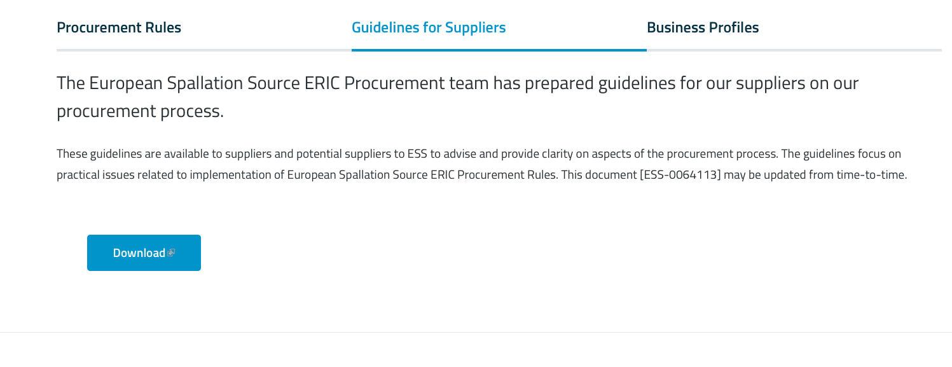
Guidelines for Suppliers
https://europeanspallationsource.se/procurement#guidelines-suppliers

Slide 13
Guideline for Communicating with Current and/or Potential Suppliers (ESS-0064128)
Responsibility of all staff to treat suppliers fairly, transparently and with the highest standards of business ethics
Defines when, how and what information can be communicated with suppliers
For example:
Presentation of ESS for companies – ok, but recommended participation of procurement
Cannot share information that would give one supplier a competitive advantage over another, based on professional judgement
Solicitation of indicative pricing / technical information – formal involvement of procurement
Communication during the course of contracts management – ok, but ensuring non-disclosure of information regarding future procurements
Communication during a procurement process (including preparation of specifications) controlled. Formal involvement of procurement
No communication with a supplier when the procurement process is open
Applies to all staff and third parties (consultants) working on behalf of ESS
It is the responsibility of the ESS staff member engaging the third party to ensure they are aware and follow these guidelines.
Reviewed and Approved by the Strategic Procurement Board

Slide 14
E-Procurement Tool
Rolled-out 1 October 2017
Used for publishing information, sharing documentation, managing communications and receiving proposals
Interested suppliers can register and maintain a business profile in the tool and configure notifications for new tenders

Slide 15
Procurement activities currently ongoing
Procurement planning
Bi-weekly coordination meetings with heads of divisions and bi-monthly prioritization list for high-value procurements
Quarterly Strategic Procurement Board with directors for elevation of prioritization needs, strategic decisions and to keep directors informed
Legal function related to procurement and contracting integrated into procurement
Complete process from tendering to contract signature in one function
Streamlined process and closer collaboration ensuring consistency in tenders and contractual agreements

Slide 16
Procurement activities currently ongoing
High-value procurements
E-tendering tool used, including supplier database, handling of entire tendering process with communication between ESS procurement and tenderers (90 procedures in 1st year of using e-tendering tool)
Focus currently on target shielding and neutron beam extraction systems (NBEX), accelerator high-beta klystrons and modulators, installation related framework agreements and science beamline related packages
Low-value procurements
Constant improvements to increase efficiency. As of Nov-18 there are 18 punch-out connections, 10 electronic catalogues and 66 connections to suppliers for electronic order sending
30-45% of incoming requests handled via punch-out or catalogues, resulting in significantly shortened processing time, reduction of issues and possibility to handle a larger number of requests with the same number of staff

Slide 17
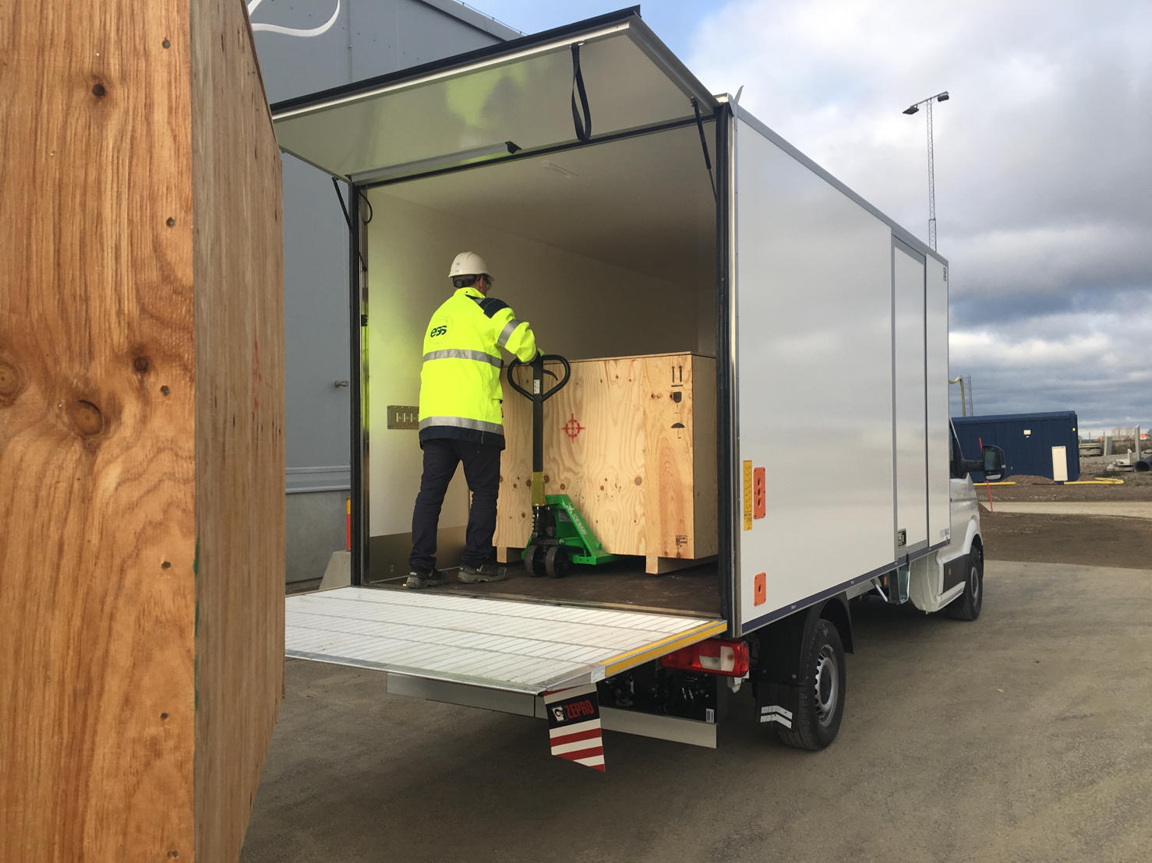
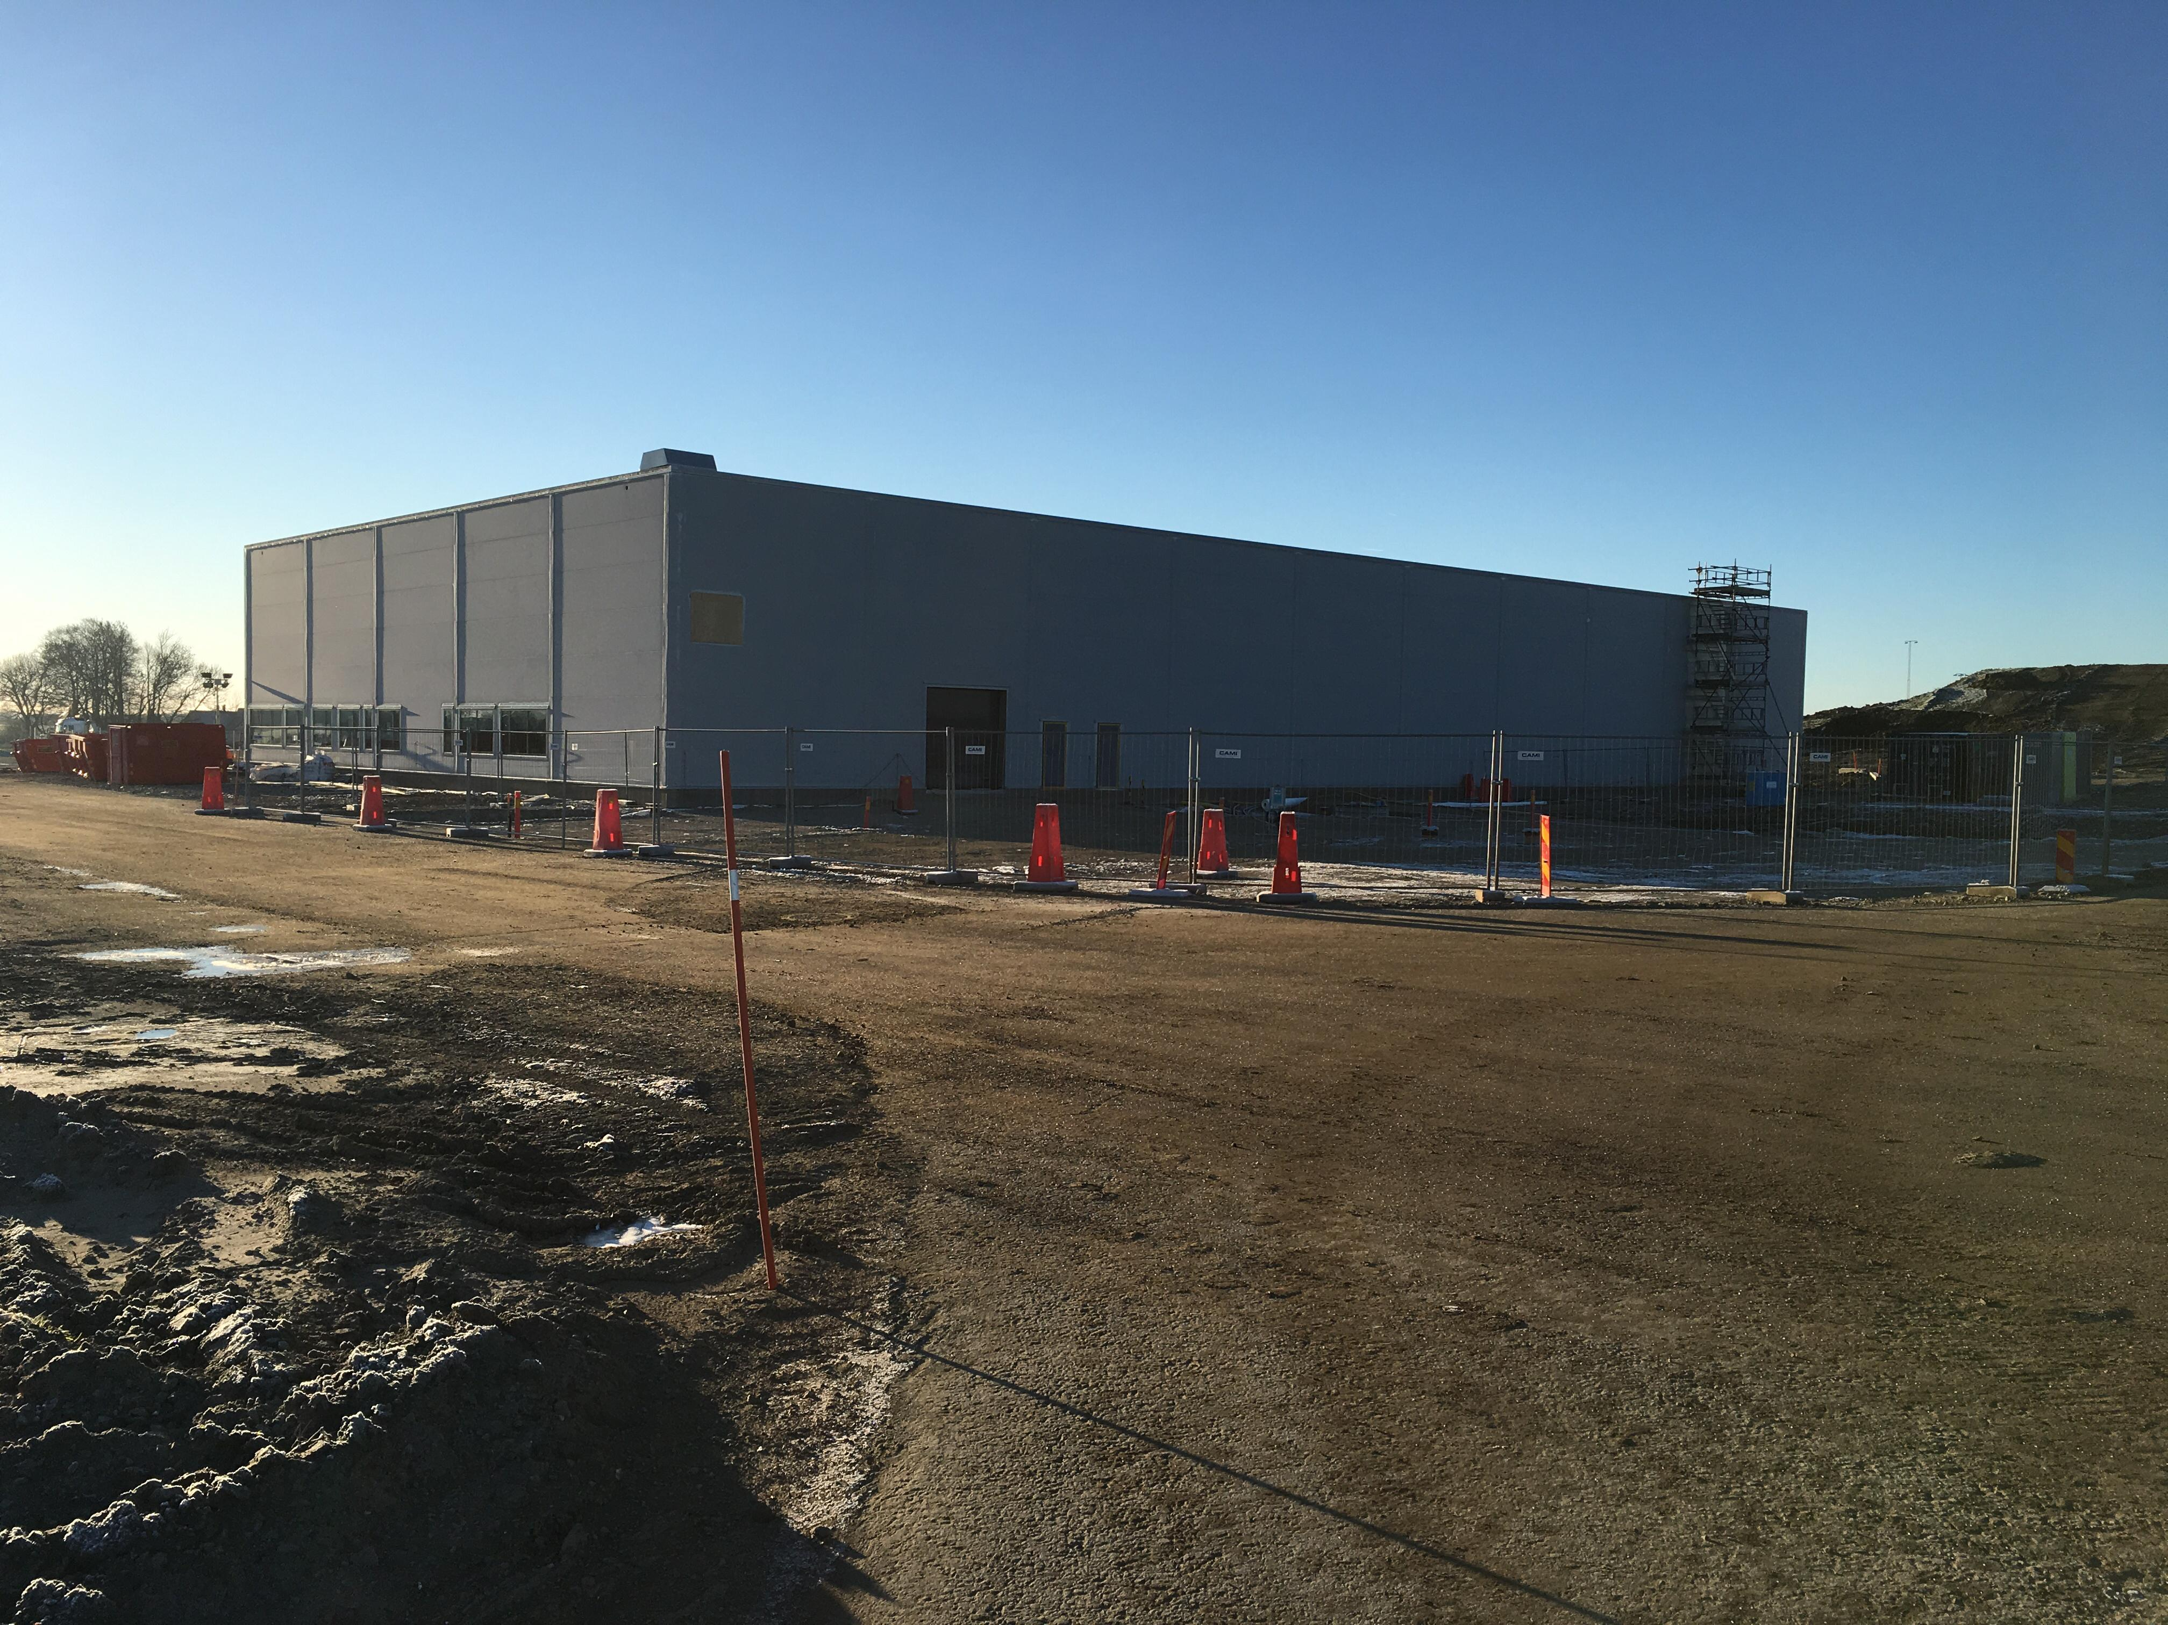
Procurement activities currently ongoing
Logistics function
Electronic booking tool for services for in- and out-bound transports, recently extended by lifting and rigging services
Since October 2018 handling transports on site, resulting in savings for projects
Logistics building (F03) under construction, expected to be operational Aug-19

Slide 18
Resourcing – October 2018

Slide 19
Thank you for your attention

