Slide 1
CREDO Detector
and other mobile applications
Aleksander Ćwikła

Slide 2
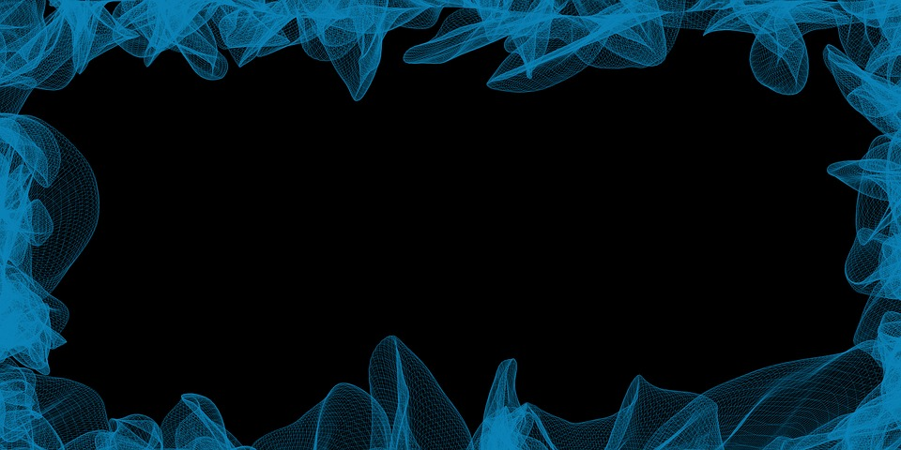
Plan
Introduce
Features
Other applications
Development

Slide 3
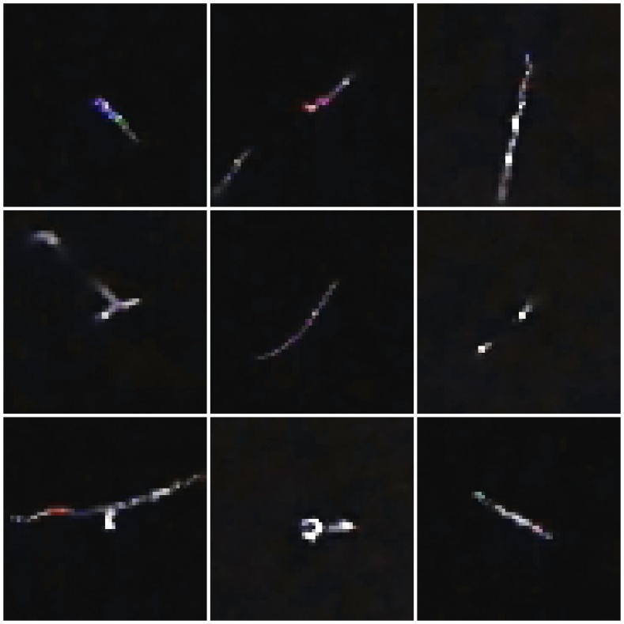
Introduce
The application uses the smartphone camera to capture particles that fall through the camera lens. If everything go well we can see something like this:

Slide 4
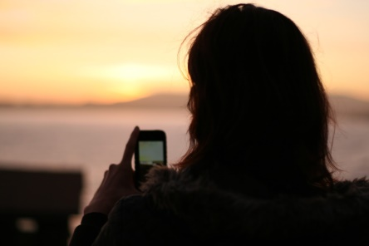
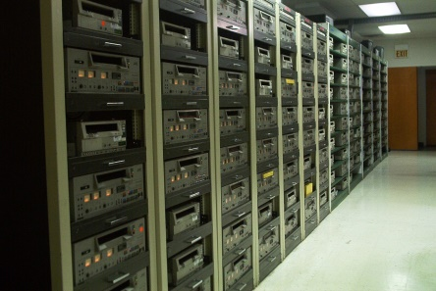
Introduce
We take picture only when that trace occurs, which tells us that probably the particle hit into our matrix.
Then we send this picture to the server where we can collect and analyze the data.

Slide 5
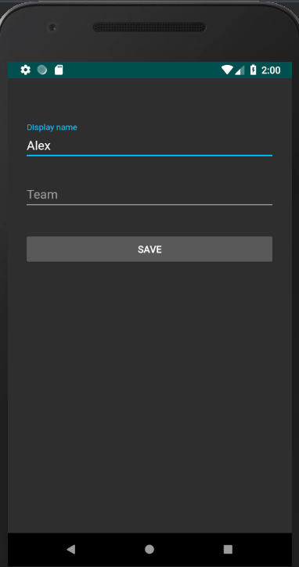
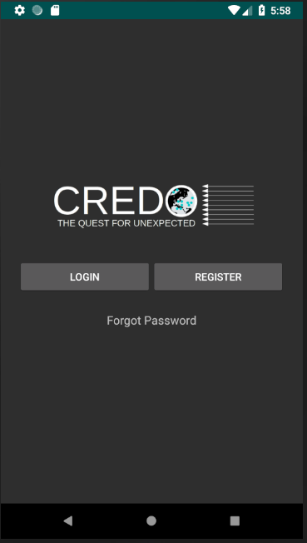
Login / Register
We need to register to use the app.
We can change our display name later in Menu.
Best friend button for most of us

Slide 6
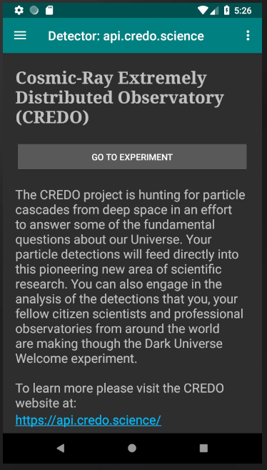
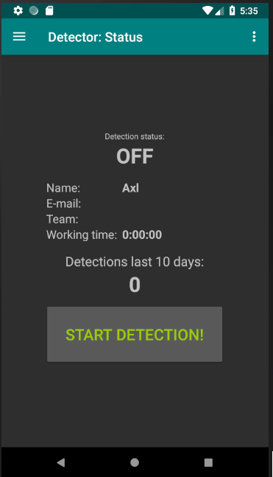
Simple GUI
Even if you are not expert in IT or nuclear physics, you know how to launch app.
In this app we don’t want to change easy thing into hard. A lot of data and information can be overwhelming for new users.

Slide 7
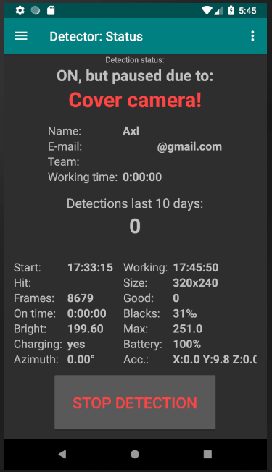
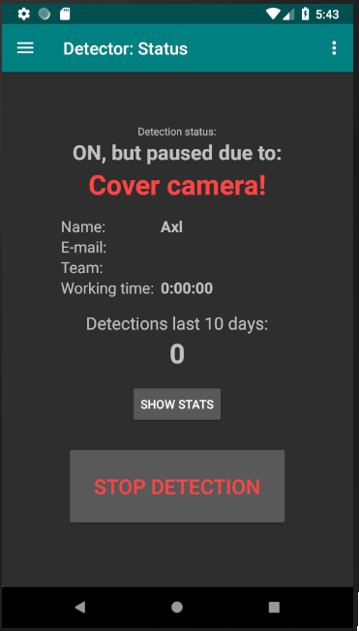
Clear information
But… we have stats for nerd too
If something go wrong, we will inform user about it with clear short information.
Just click “show stats” and app show parameters of work

Slide 8
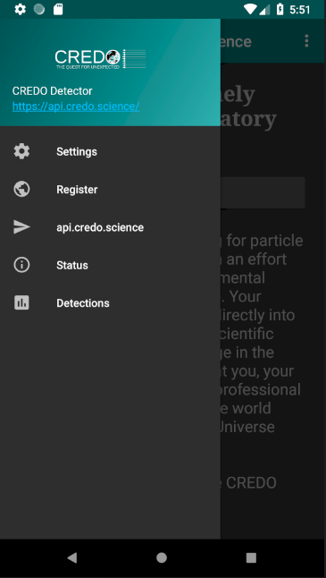
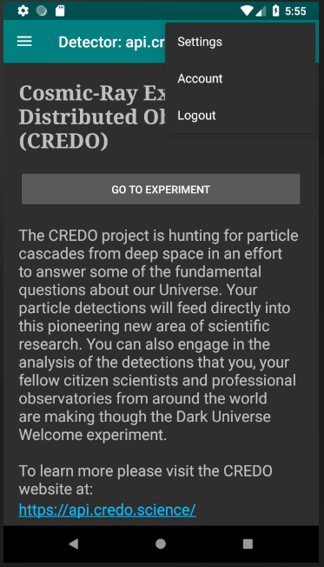
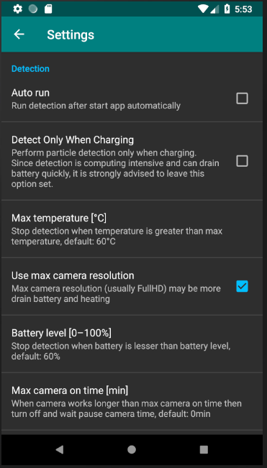
Navigation
This is still a normal app, so we have things like sliding menu and settings.
Big things can look casual.

Slide 9
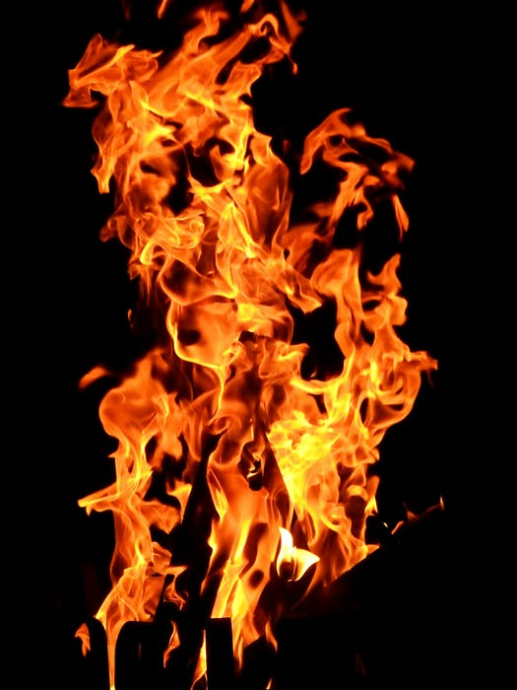
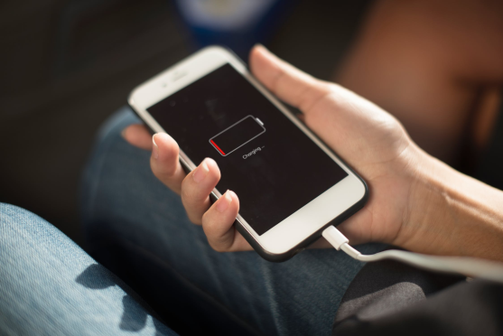
Does it make it difficult to use your smartphone?
Every action in smartphone generate heat, so detection will stop when temperature reach sp limit. Of course user can modify this in settings.
And if everything go great, temperature is perfect, user want use smartphone and … no battery? Not in this app! Detection is going to work only if we have more than battery level limit we set in settings.

Slide 10
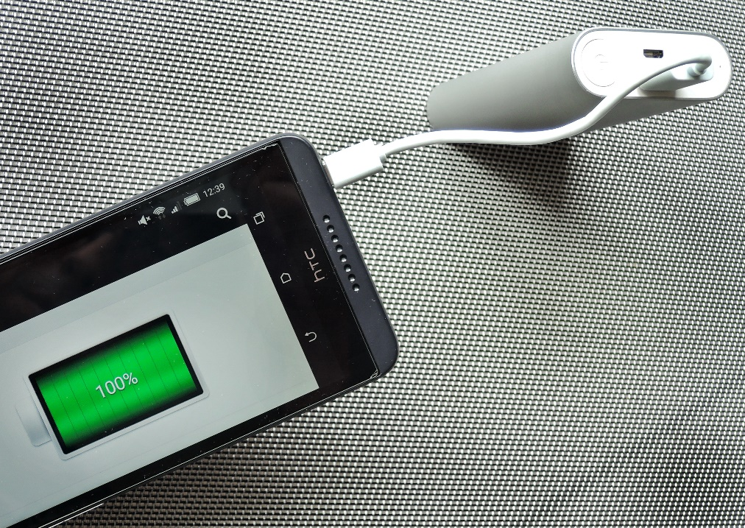
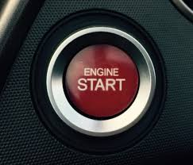
Does it make it difficult to use your smartphone?
App can work in the background and we have plenty of option to personalise when it should work:
Auto start when the smartphone is charging
Auto start after launching app
Turn on/off detection after certain amount of time
User can also manually start and stop

Slide 11
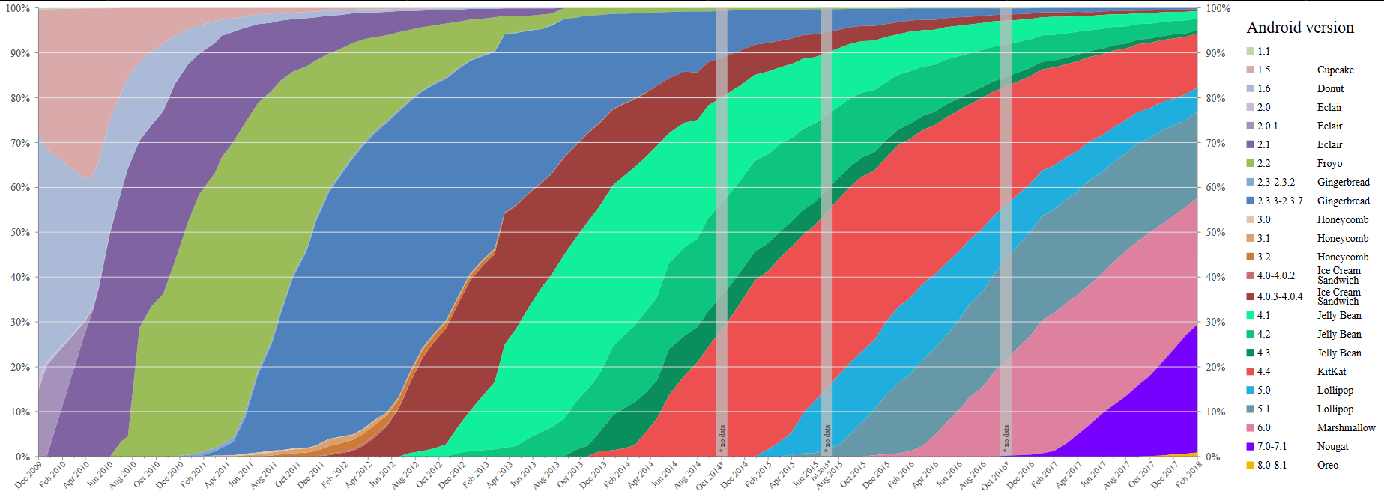
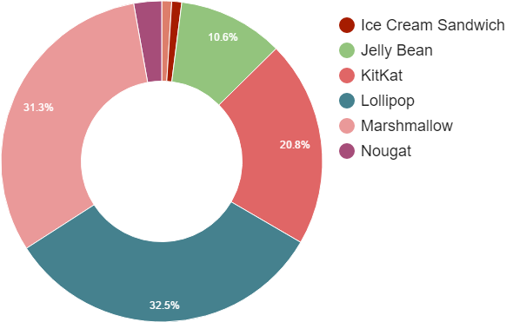
What if I have an old smartphone?
Our application can be run on android version 4.0 (Ice cream sandwich) or higher. Today it means that almost 100% of device can run it.

Slide 12
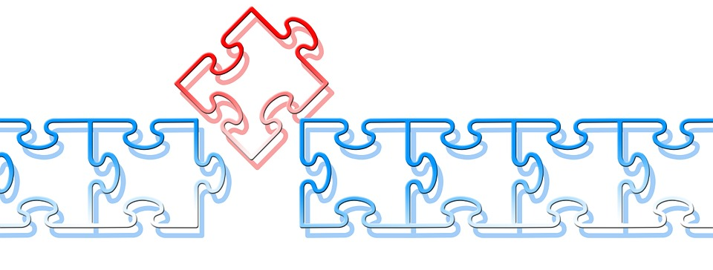
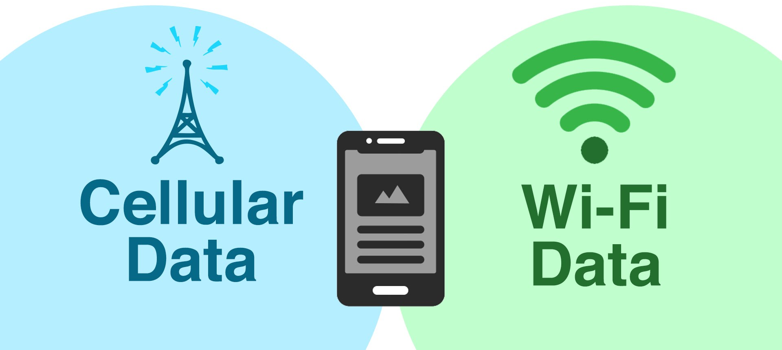
Internet cost, little space in memory…
Despite of the development of technology, there will always be someone who complain and search for cons. For that reason we optimized our application. Now when hit occur, we cut only little fragment from photo. By this trick we decrease the amount of transferred data .
For more comfort of using application, we give options to choose the way of connecting to the server.
WiFi + Cellular network
WiFi only

Slide 13
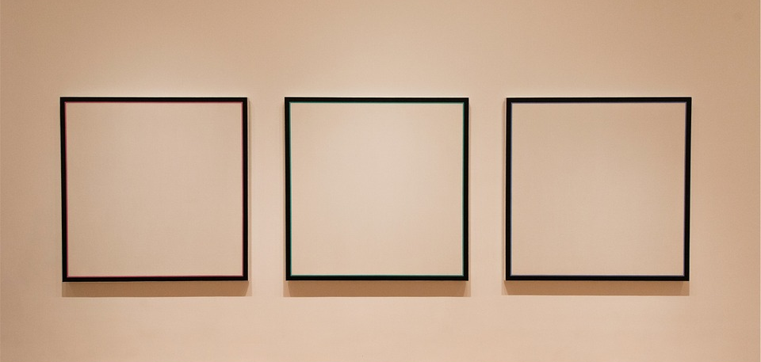
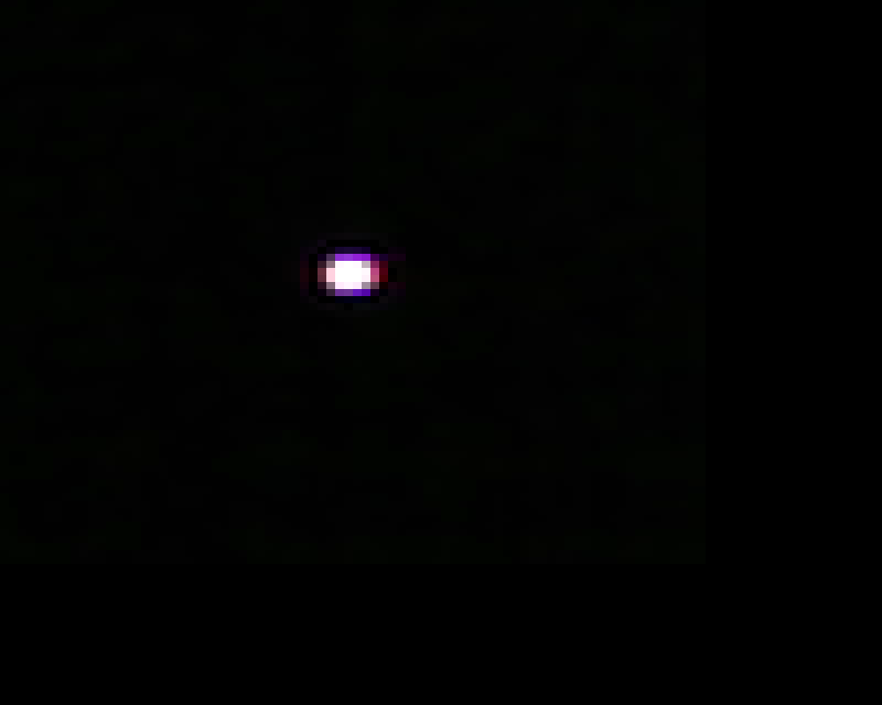
False positive
We set restrictions for amount of light. If photo is too bright, we will not take it under consideration.
Gallery
Captured particles can be looked through in gallery.

Slide 14
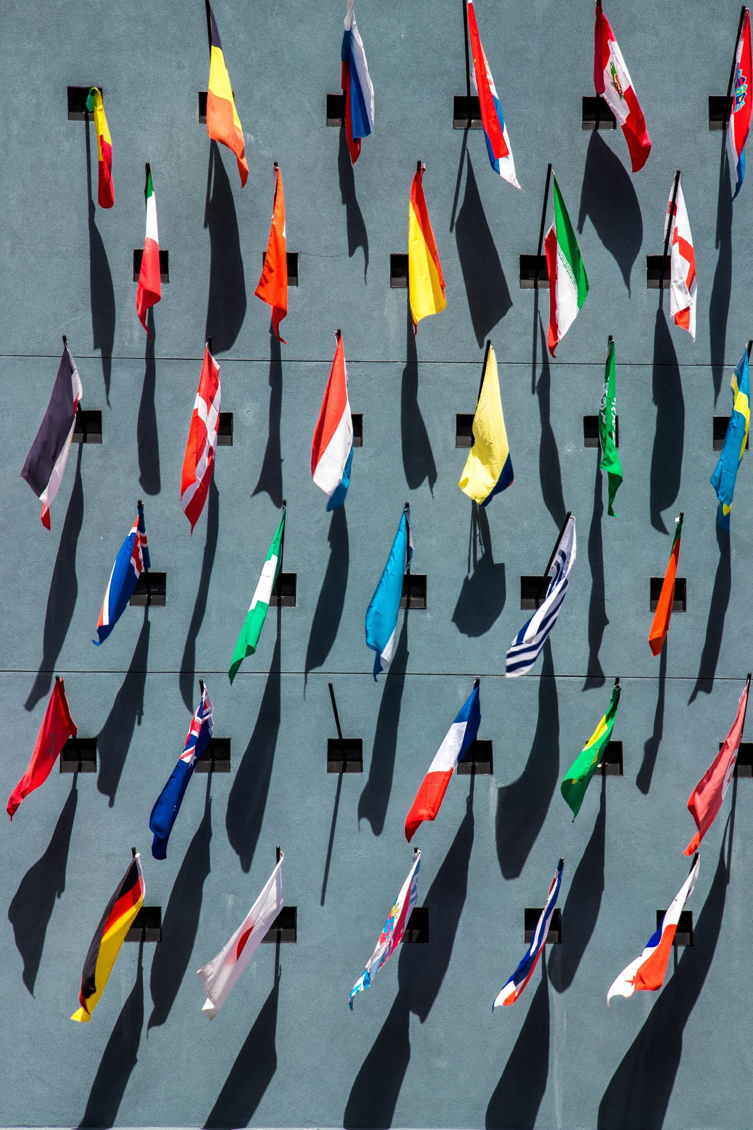
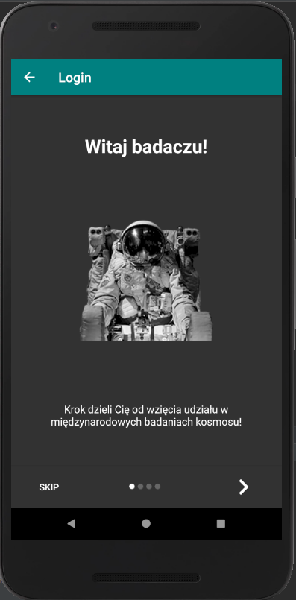
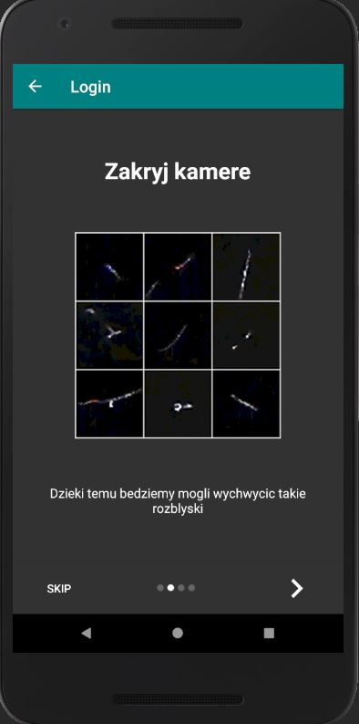
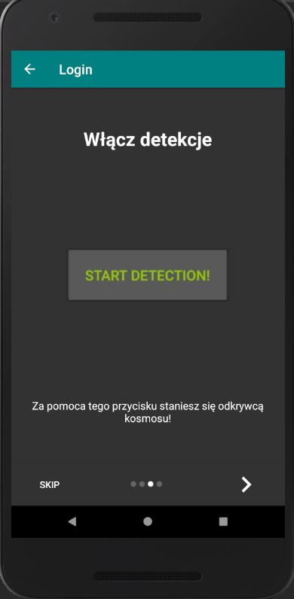
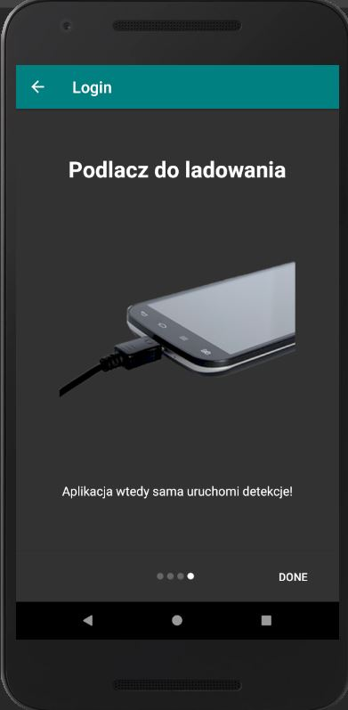
Multiple language
Jesteśmy dostępni w kilku językach!
We are available in several language!
Nous sommes disponibles dans plusieurs langues!
Log.d("Credo",”Android");
Beta team
Our team test every release so if this version need a fix, we can do this without interrupting all devices.

Slide 15
Other Applications
 | CREDO (The Cosmic Ray Extremely Distributed Observatory) | DECO (Distributed Electronic Cosmic-ray Observatory) | CRAYFIS | Cosmic Ray App
System: | Android Available on Google Play Store | Android Beta (available only on site) iOS In closed test | Android Closed Beta, available only on site (now they don't accept new beta-testers) iOS Coming soon for closed beta-testers | iOS Available on Apple App Store
Detection: | Checks bright on camera preview, if it`s go above limit, we take pictures. | Record camera image every 1-2s and analyze it to determine bright pixels. | No available date | Takes long exposure pictures periodically ~2 per second.
Gallery | Gallery in app and on website | On website | No available date | On website
Others |  | To work properly you need two application DECO app and Deco the data logger.

Slide 16
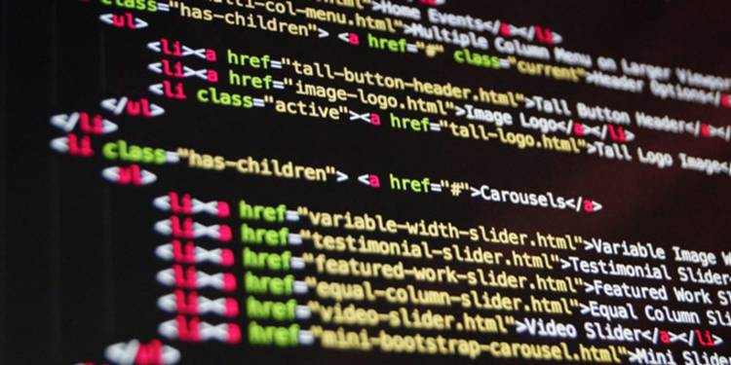
Team
After creating account, user can join in to the team.
On our page - api.credo.science – you can find the last caught particle and enjoy rankings.
Development
In the future for better encouragement of the users, we can make ranks and prize for some milestone. For example:
Best person get title „Albert Einstein”
Benefit in other app

Slide 17
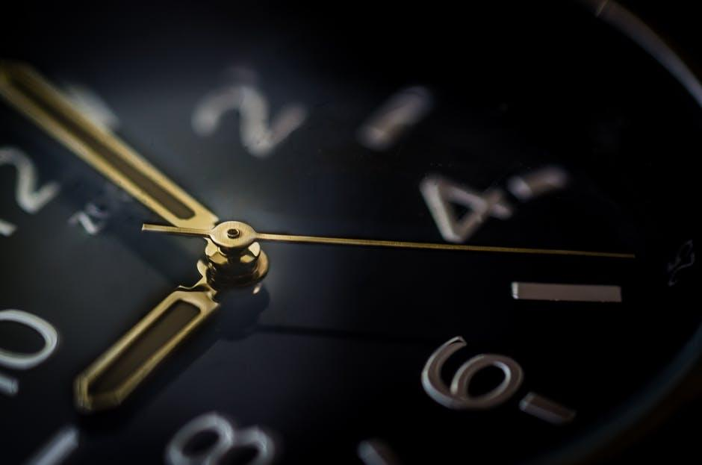
Development
Many people stop using the phone at a particular time of a day and for most of us, the day is cyclical. We can use it to create more universal tool.
We want to add a new option to automate application.
Scanning during inactivity
Automatic scanning at a given time

Slide 18
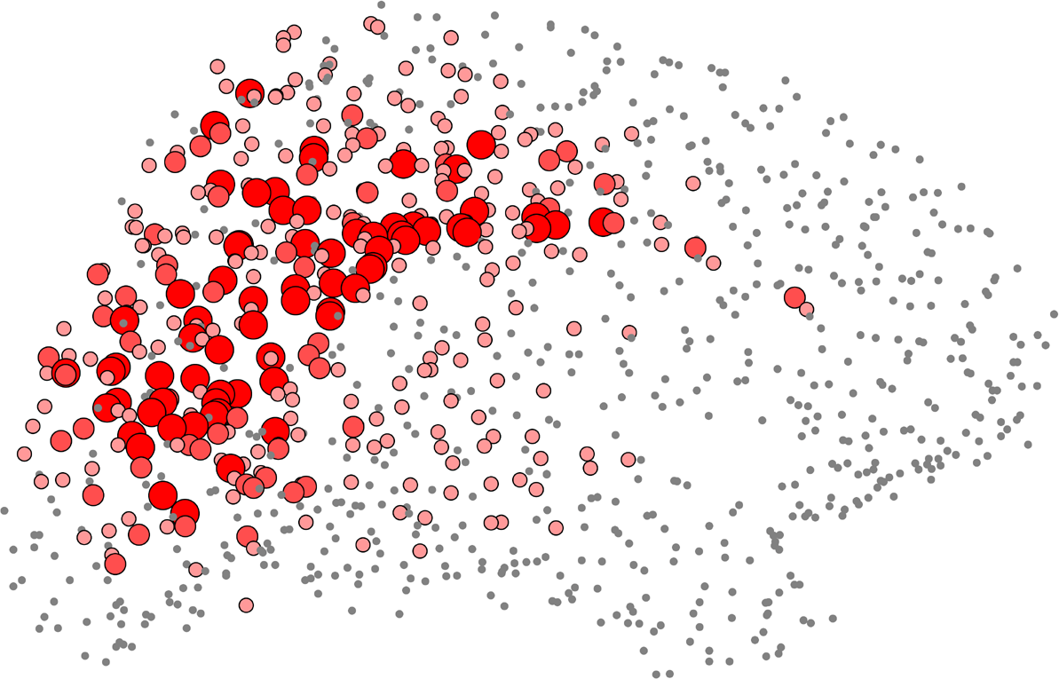
Development
2/3D Map with the density of hits
Skins for user
Application for other mobile systems
We have many ideas about this project and a lot of it are waiting for the invention.

Slide 19
THANK YOU FOR YOUR ATTENTION

