Slide 1


Connecting d and d
Hendrik Borras,
Heidelberg University

Slide 2

Cosmicpi: Goals
Build a globally distributed cosmic ray telescope
Low-cost detector unit
Easy to use
100% Open source (Hardware + Software) goal
Making high energy physics more accessible, for education and citizen scientists.

Slide 3
Cosmicpi: Who?
Based at CERN
Very multicultural team composed of summer students and volunteers form CERN
Volunteers interested in building a detector from the ground up, with state of the art technologies

Slide 4
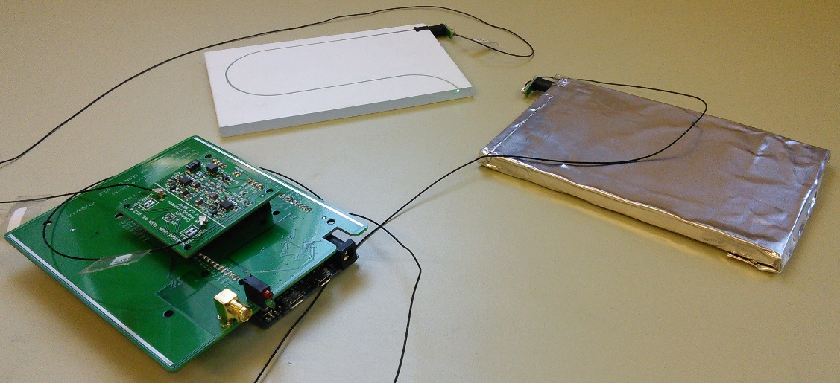
Details about the detector
Scintillator and SiPM-based design
Latest shipped version: 1.5
  2x10cm x 20cm plastic scintillators
  Time resolution: ~65ns (first event/second)
  Multiple sensors: GPS, Accelerometer, Magnetometer, Temperature
  Arduino DUE for sensor readout
  User interface provided by a Raspberry Pi
Version 2 in development
  New scintillator mounting
  Improved hardware layout
  Switch from Arduino to STM32
Version 1.5 unit during development
Notes:
V1.5, is a finished product in many ways – it works.
However it has some ‘closed source’ parts – in particular the scintillator/SiPM coupling, which is done using some spares from a ‘real’ physics experiment, and the scintillators which were prototypes for this experiment. Our V2 is all about getting the design to a 100% open source state; and escaping the Arduino DUE, which is technically obsolete. We’re also (right now) in the process of migrating from eagle cad to KiCad, so we will have a fully open source toolchain too.

Slide 5
Details about the detector
Scintillators
SiPMs
Analog frontend (amplifier)
Arduino DUE
Digital mainboard
Version 1.5 unit during development

Slide 6
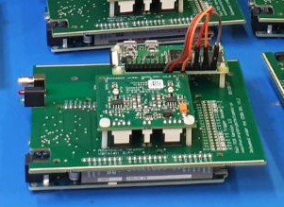
Details about the detector
Raspberry Pi Zero W
Analog frontend (amplifier)
Digital mainboard
Arduino DUE
V 1.5 unit, without scintillators; Notice how the unit is a stack of: Arduino DUE, mainboard, analogue board, Raspberry Pi Zero W

Slide 7
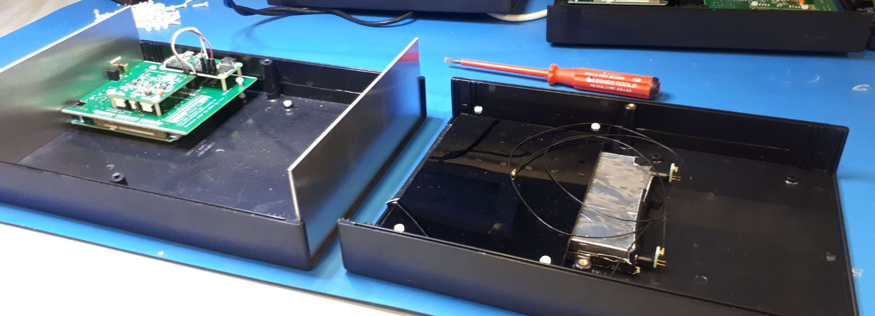
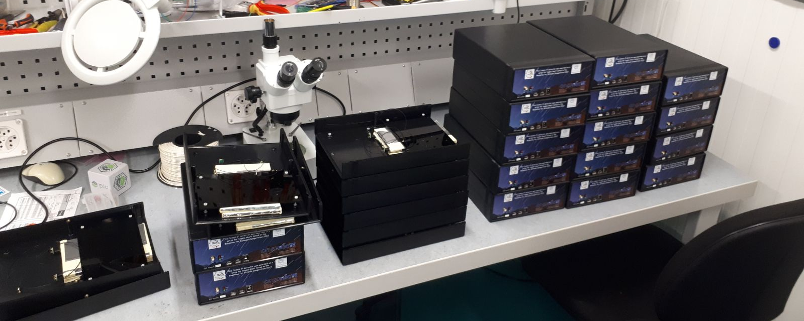
Details about the detector
Open V1.5 unit; On the left: Lower part with electronics; On the right: Upper part with the scintillators and SiPMs
Stack of V1.5 units; Partially open;

Slide 8
High level software
Runs on Raspberry Pi (Versions: 3 and Zero W)
Stores events locally in a SQLite database
Publishes events via MQTT
Provides a user interface via HTTP
  Exposes data via REST API
  User interface itself is written with node.js
  Displays basic information
  Allows export of local data
  Controls basic network settings
Code managed via GitHub: https://github.com/CosmicPi/cosmicpi-rpi_V1.5

Slide 9
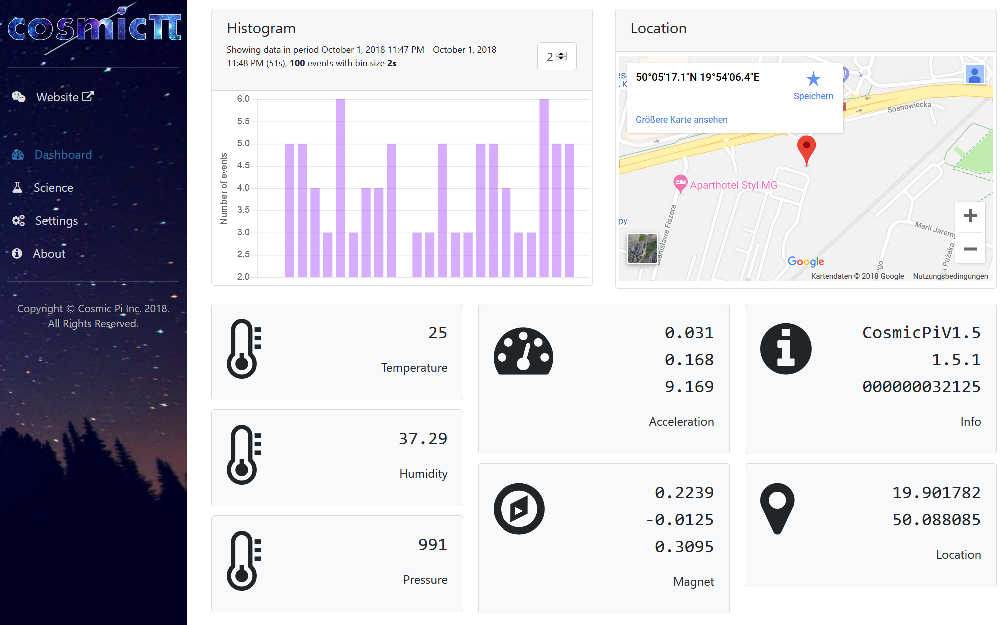
User interface screenshot
Dashboard
Basic information
Visible when connecting
Histogram updates itself automatically

Slide 10
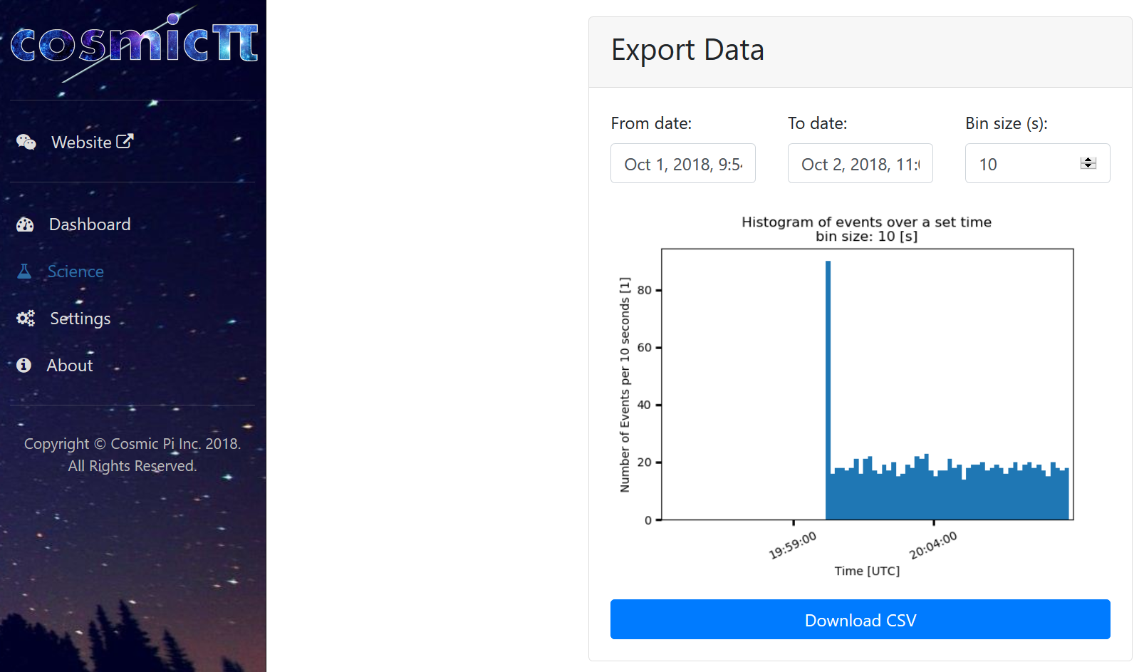
User interface screenshot
Science page
Create custom histograms via matplotlib
Export local database as CSV

Slide 11
Architecture
Detector readout
Hardware UART
UI via HTTP
Database maintenance
SQLite
Database (file based)
WiFi
Starts & keeps programs alive
Boot
systemd
MQTT
Publisher

Slide 12
Architecture
Communication
with µC
Detector readout
Hardware UART
UI via HTTP
Displays data
And controls WiFi
Saves new events
Access Point
Database maintenance
SQLite
Database (file based)
Reads events
Deletes old events
WiFi
Serves either
Network connection
Queries for recent
MQTT
Publisher
Publishes recent events
MQTT
Broker

Slide 13
How can we integrate with credo?

Slide 14
Architecture
Communication
with µC
Detector readout
Hardware UART
UI via HTTP
Displays data
And controls WiFi
Saves new events
Access Point
Database maintenance
SQLite
Database (file based)
Reads events
Deletes old events
WiFi
Serves either
Network connection
Queries for recent
Here or here?
MQTT
Publisher
Publishes recent events
MQTT
Broker

Slide 15
Architecture
Communication
with µC
Detector readout
Hardware UART
UI via HTTP
Displays data
And controls WiFi
Saves new events
Access Point
Database maintenance
SQLite
Database (file based)
Reads events
Deletes old events
WiFi
Serves either
Network connection
Queries for recent
Here or here?
MQTT
Publisher
Publishes recent events
MQTT
Broker

Slide 16
Integration with credo
Current development
  Contact with credo via the CREDO V2 REST-API
  Added publisher to the MQTT publisher on the CosmicPi
  Currently: Publishes to a default account
  Planned: Users can log into their own account via the UI

Slide 17
Integration with credo
Current development
  Contact with credo via the CREDO V2 REST-API
  Added publisher to the MQTT publisher on the CosmicPi
  Currently: Publishes to a default account
  Planned: Users can log into their own account via the UI
Open questions
  Should other data be pushed to CREDO as well?
    We have a lot of auxiliary sensors: Orientation, magnetic field, temperature
  Can we submit timestamps of a higher precision than [ms]?
  How fast should we submit events?
    Detector rate: ~3Hz
    Maybe we submit via our MQTT broker instead and it’s request limit get’s lifted?

Slide 18
Demo of the Cosmicpi ui
You can take a look at the CosmicPi UI yourself!
Connect to the hotspot “CosmicPi”, password: 12345678
Type 192.168.137.1 into your browsers address bar
Settings page login:
  username = cosmicpi
  password = MuonsFROMSp8ce
Disclaimer:
  The demo is running on my development system for high level software
  This means that the events shown are simulated by the Arduino DUE and the WiFi settings cannot be changed

