Slide 1
CREDO and philosophy of science – non-specific observations and discovery of new phenomena
Łukasz Lamża
Jagiellonian University
CREDO Week, Kraków, 4th OCt 2018

Slide 2
Two types of observational campaigns (end-members)
type A | type B
high specificity (carefully selected individual object of study) | low specificity (generic object of study)
requires specialist, sometimes individually crafted observational tools | done using off-the-shelf observational tools
difficult to get, easy to analyze | easy to get, difficult to analyze
better understanding of known phenomena | discovery of completely new phenomena

Slide 3
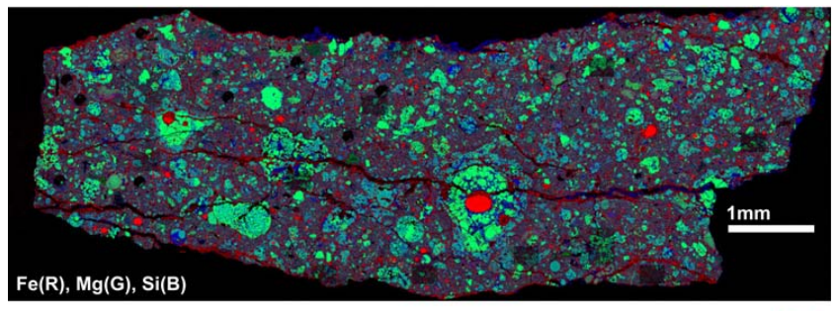
Example 1
Bland, P. A., Stadermann, F. J., Floss, C., Rost, D., Vicenzi, E. P., Kearsley, A. T., & Benedix, G. K. (2007). A cornucopia of presolar and early solar system materials at the micrometer size range in primitive chondrite matrix. Meteoritics & Planetary Science, 42(7-8), 1417-1427.

Slide 4
Example 1
Bland, P. A., Stadermann, F. J., Floss, C., Rost, D., Vicenzi, E. P., Kearsley, A. T., & Benedix, G. K. (2007). A cornucopia of presolar and early solar system materials at the micrometer size range in primitive chondrite matrix. Meteoritics & Planetary Science, 42(7-8), 1417-1427.

Slide 5
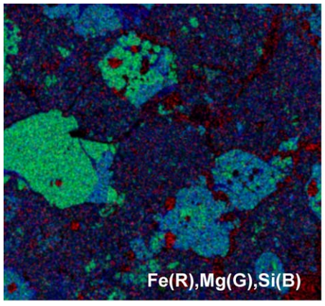
Example 1
Bland, P. A., Stadermann, F. J., Floss, C., Rost, D., Vicenzi, E. P., Kearsley, A. T., & Benedix, G. K. (2007). A cornucopia of presolar and early solar system materials at the micrometer size range in primitive chondrite matrix. Meteoritics & Planetary Science, 42(7-8), 1417-1427.

Slide 6
Example 1
Bland, P. A., Stadermann, F. J., Floss, C., Rost, D., Vicenzi, E. P., Kearsley, A. T., & Benedix, G. K. (2007). A cornucopia of presolar and early solar system materials at the micrometer size range in primitive chondrite matrix. Meteoritics & Planetary Science, 42(7-8), 1417-1427.

Slide 7
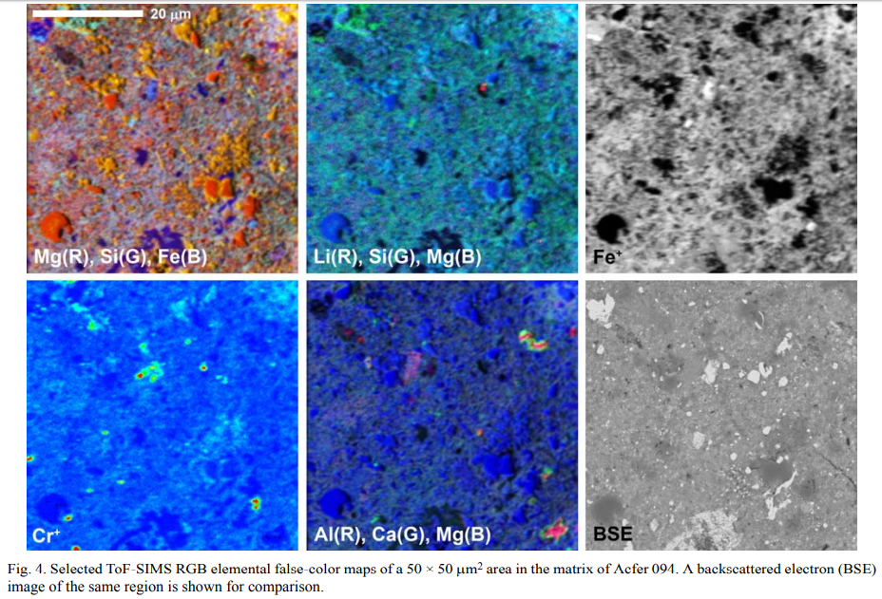
Example 1
Bland, P. A., Stadermann, F. J., Floss, C., Rost, D., Vicenzi, E. P., Kearsley, A. T., & Benedix, G. K. (2007). A cornucopia of presolar and early solar system materials at the micrometer size range in primitive chondrite matrix. Meteoritics & Planetary Science, 42(7-8), 1417-1427.

Slide 8
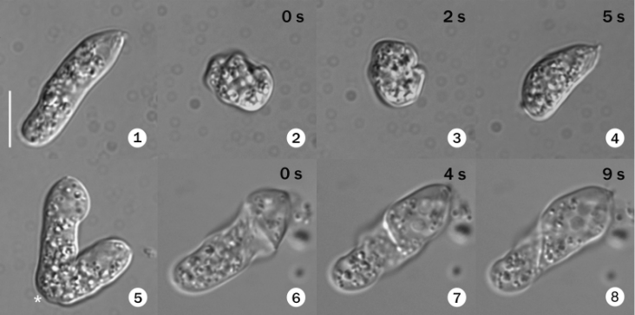
Example 2
Roy, J., Faktorova, D., Benada, O., Lukeš, J., & Burger, G. (2007). Description of Rhynchopus euleeides n. sp. (Diplonemea), a free‐living marine euglenozoan. Journal of eukaryotic microbiology, 54(2), 137-145.

Slide 9
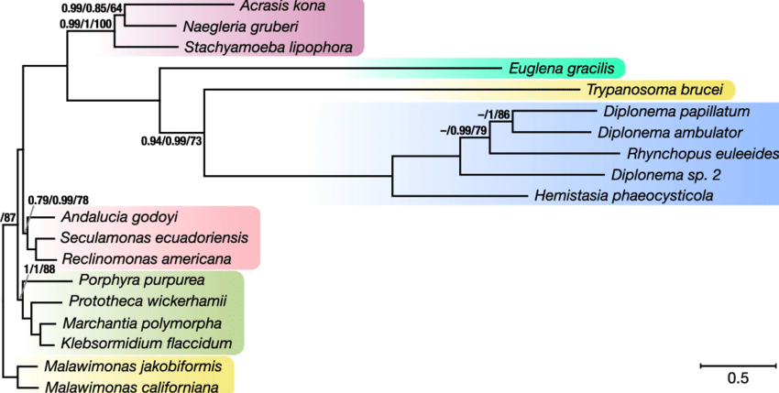
Example 2

Slide 10
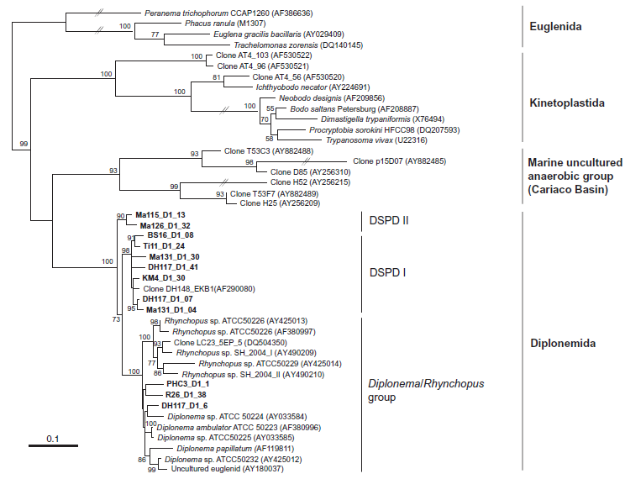
Example 2
Lara, E., Moreira, D., Vereshchaka, A., & López‐García, P. (2009). Pan‐oceanic distribution of new highly diverse clades of deep‐sea diplonemids. Environmental microbiology, 11(1), 47-55.

Slide 11
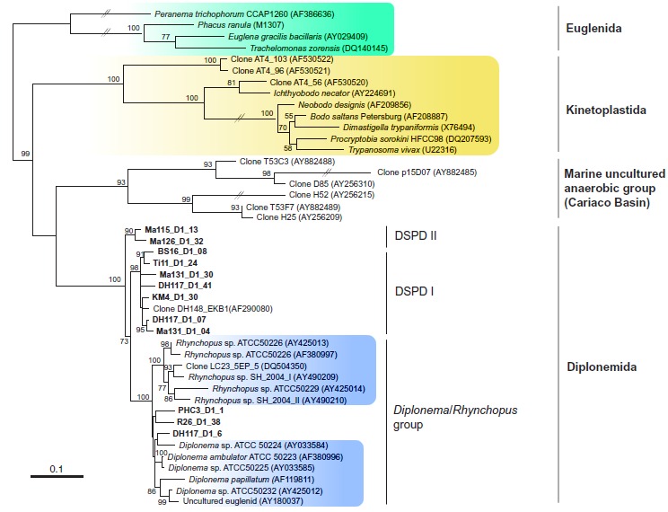
Example 2
Lara, E., Moreira, D., Vereshchaka, A., & López‐García, P. (2009). Pan‐oceanic distribution of new highly diverse clades of deep‐sea diplonemids. Environmental microbiology, 11(1), 47-55.

Slide 12
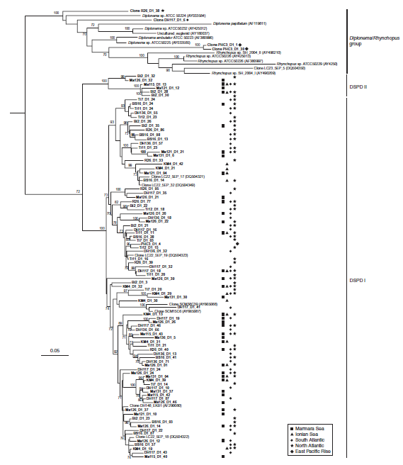
Example 2
Lara, E., Moreira, D., Vereshchaka, A., & López‐García, P. (2009). Pan‐oceanic distribution of new highly diverse clades of deep‐sea diplonemids. Environmental microbiology, 11(1), 47-55.

Slide 13
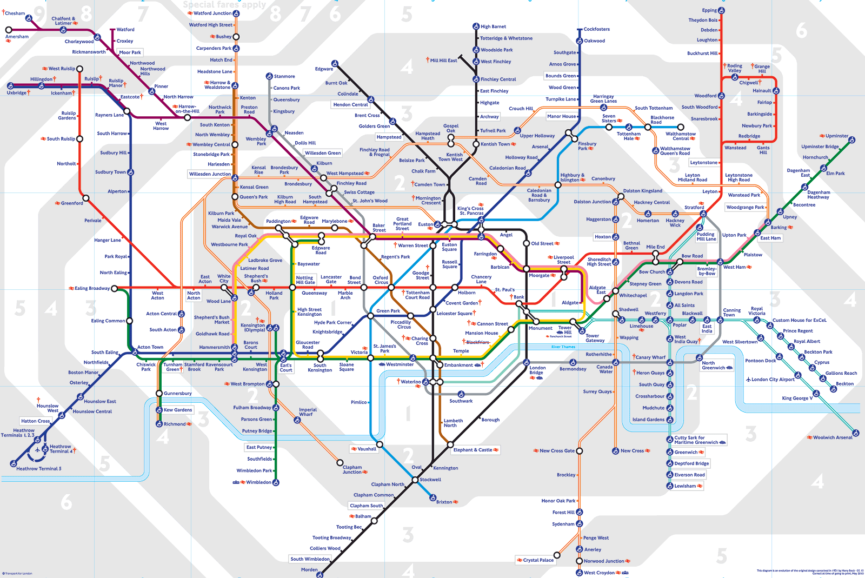
Example 3

Slide 14
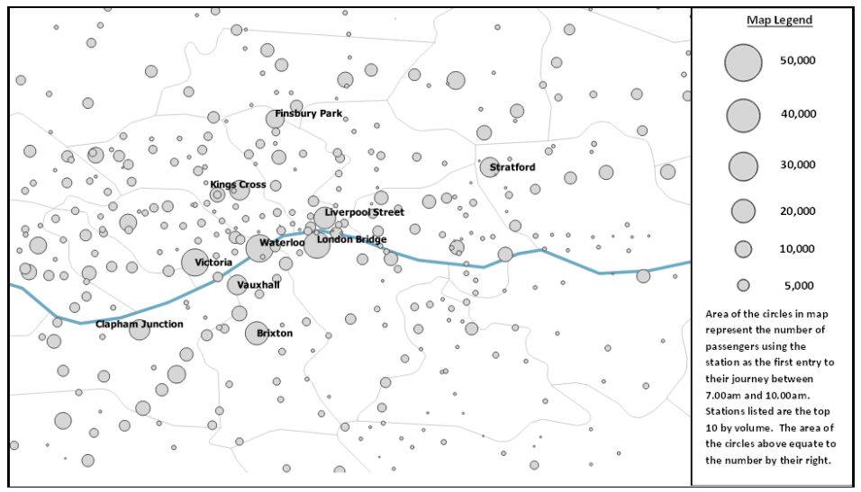
Example 3
Larcom, S., Rauch, F., & Willems, T. (2017). The benefits of forced experimentation: striking evidence from the London underground network. The Quarterly Journal of Economics, 132(4), 2019-2055.

Slide 15
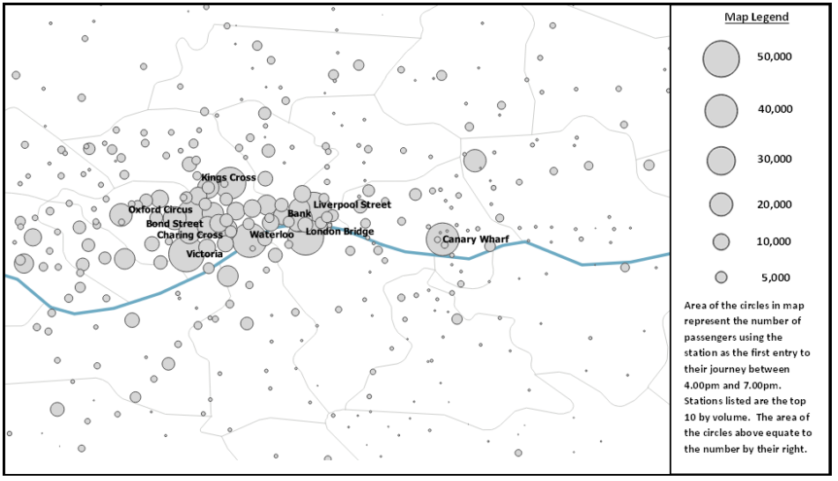
Example 3
Larcom, S., Rauch, F., & Willems, T. (2017). The benefits of forced experimentation: striking evidence from the London underground network. The Quarterly Journal of Economics, 132(4), 2019-2055.

Slide 16
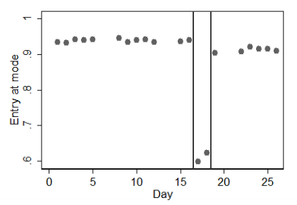
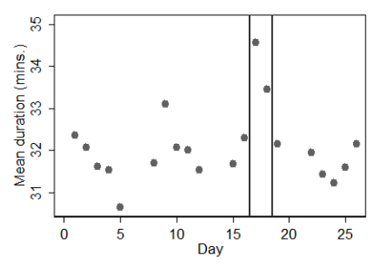
Example 3
Larcom, S., Rauch, F., & Willems, T. (2017). The benefits of forced experimentation: striking evidence from the London underground network. The Quarterly Journal of Economics, 132(4), 2019-2055.

Slide 17
Example 3
„On average, the treatment group seems to cut their journey time by about 1% more. Given that the average journey in our sample lasts approximately 32 minutes, this amounts to an ex-ante average time-gain of about 20 seconds on a one-way commute for those who were treated by our preferred treatment measure. Since about 5% of treated commuters switch permanently, the measured average time gain for those commuters who actually switch is around 400 seconds (20 times 20).”
Larcom, S., Rauch, F., & Willems, T. (2017). The benefits of forced experimentation: striking evidence from the London underground network. The Quarterly Journal of Economics, 132(4), 2019-2055.

Slide 18
Lessons to be learned from Examples 1-3 for Type B observational projects
analyze the „noise”
start with the known to find the unknown
you may need a lot of data

Slide 19
Thank you!
Łukasz Lamża
Jagiellonian University
CREDO Week, Kraków, 4th OCt 2018

