Slide 1
EAS impact on biological systems
By: Dmitriy Beznosko
Bard College
New Orleans, LA, USA

Slide 2
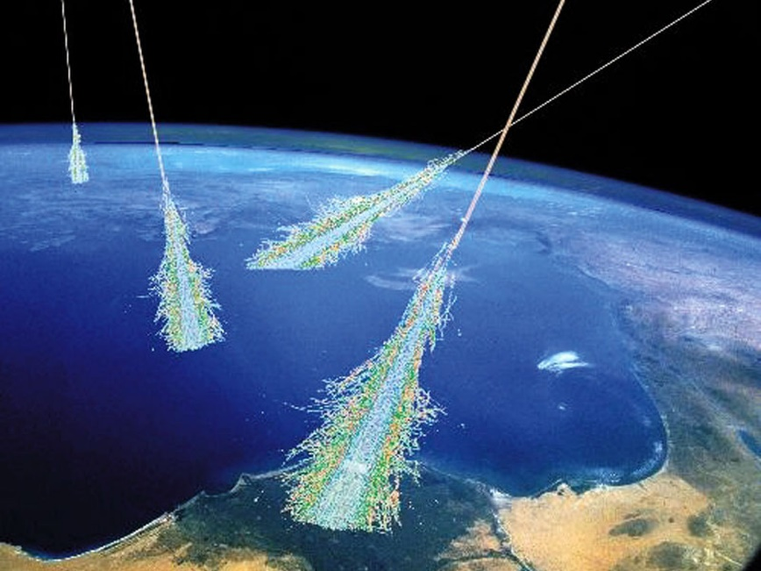
Health and radiation dose
Normally small dose of radiation is considered harmless
But what is ‘small’?
According to
https://www.sciencedaily.com/releases/2018/07/180719085337.htm
A CT (computed tomography) scan can increase the risk of brain cancer 1.5 times when delivering ~40 mGy overall dose (https://doi.org/10.1093/jnci/djy158)
We would like to examine the EAS phenomenon to see if it can deliver the same exposure and how often will that occur
https://www.space.com/32644-cosmic-rays.html

Slide 3
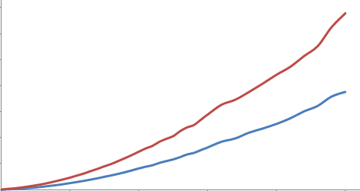
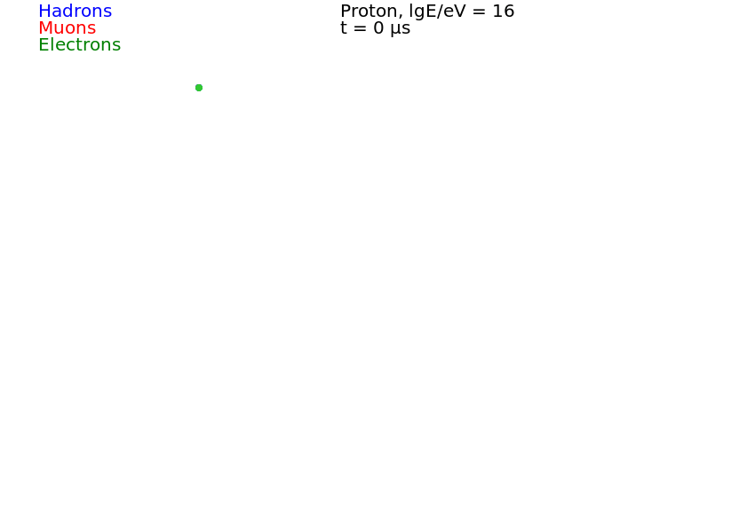
What is EAS
A particle with ultra-high energy arrives from outer space and enters atmosphere
In interactions, billions of secondary particles are born
They form two parts:
Core – 1-2 meters wide central area, very dense
Extended Air Shower (EAS) – disk of up to few km
Time, ns
Distance from core, m
Observation level with detectors

Slide 4
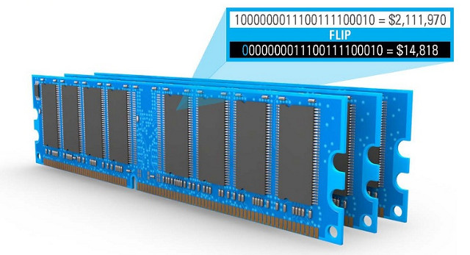
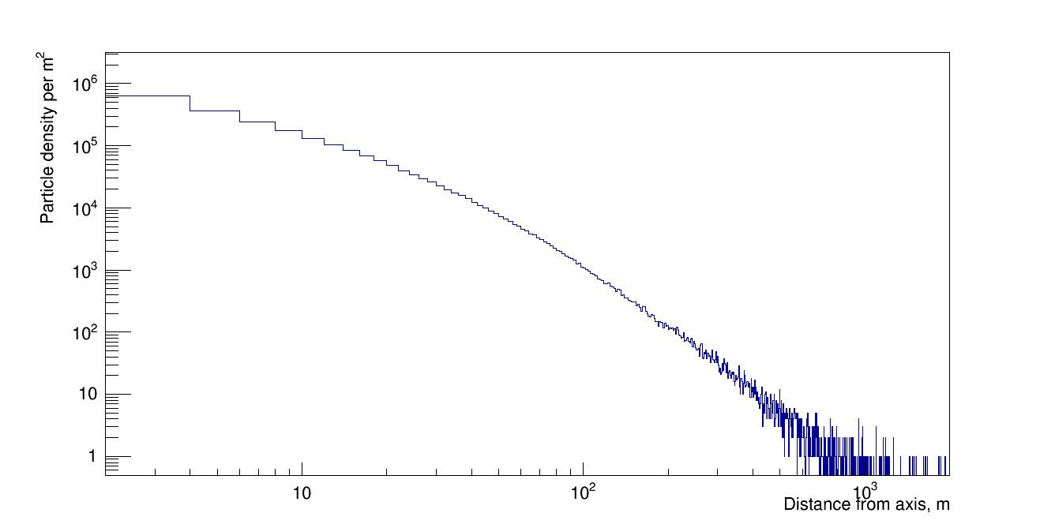
EAS Core
EAS Core is very dense with very energetic hadronic (those found in a nucleus) particles
Together, they give lots of radiation to any object they hit
Error-correcting code memory (ECC memory) for computers was invented to correct errors mostly from cosmic rays – small storage cells can flip their value with cosmic rays passage
If core passes – massive data failure. Can affect Hard drives too in a same way. CREDO as monitor of risk areas.
Particle density vs. distance from EAS axis
(primary is proton with energy of 10¹⁷ eV)
https://www.makeuseof.com/tag/data-corruption-prevent/

Slide 5
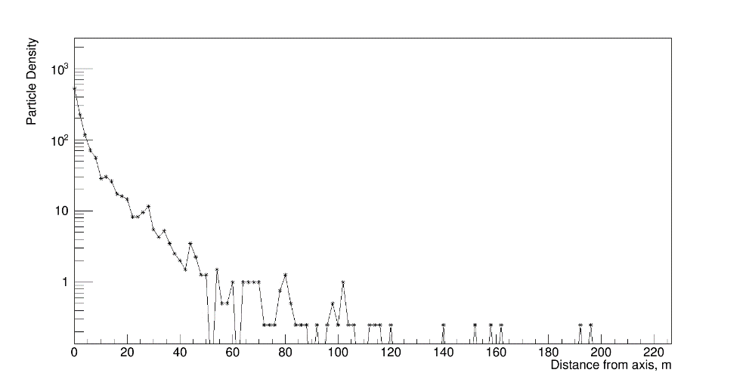
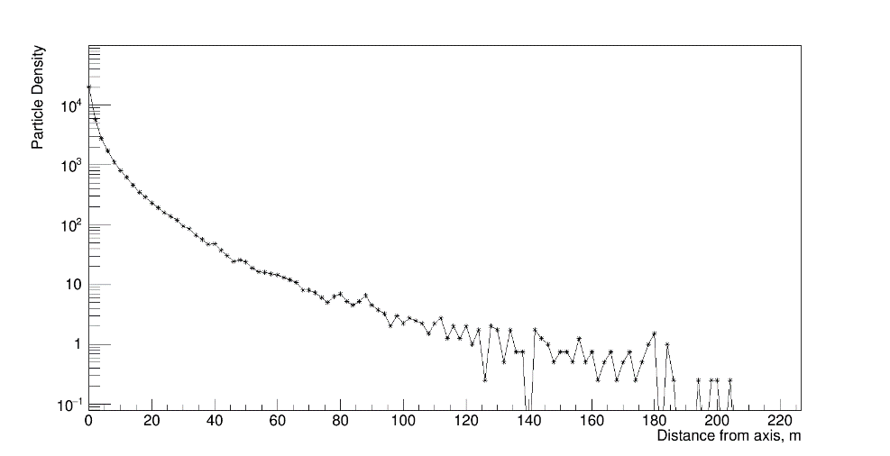
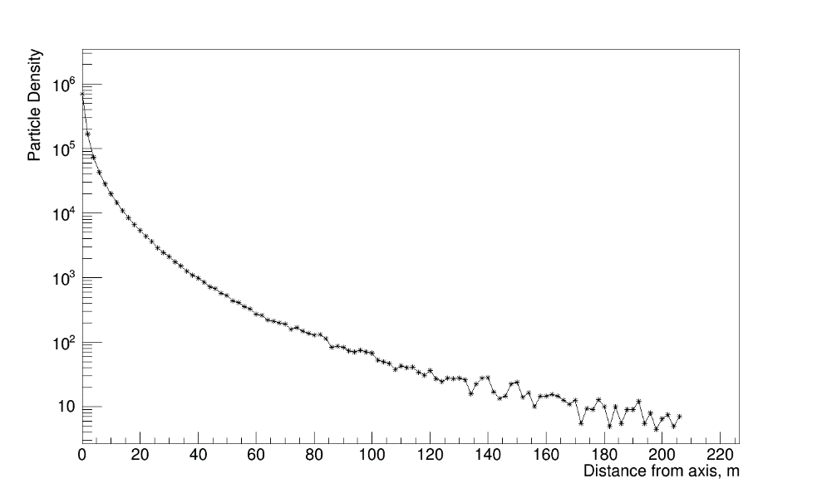
Particle density and radiation dose
A quick estimate using just electrons (and remembering the gamma components of EAS) using http://www.radprocalculator.com/Beta.aspx gives that we need particle density of about 10⁶ particles/m² to achieve ~40 mGy overall dose for an average-sized adult
Only EAS from primary with E>=10¹⁷ eV has this density in core at the sea level according to simulation (CORSIKA)
10¹⁵ eV primary
10¹⁶ eV primary
10¹⁷ eV primary

Slide 6
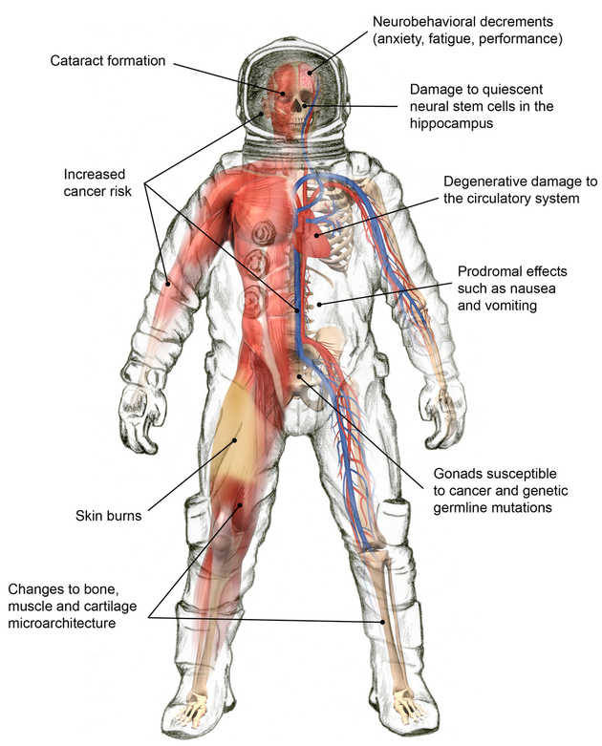
EAS and Health risks
EAS with energy above 10¹⁷ eV arrive ~ 2/hour per km². Core area is ~10m².
In Krakow, population density is 2,327.7/km² according to wiki. If a person has ~1m² cross-section, a chance is only 1 in 43 that part of the core will hit one person per EAS.
With Krakow area 326.8 km², about 17 people per hour are hit by the core with particle density near or exceeding 10⁶ particles/m².
Higher number for larger/denser cities.
Global monitoring (CREDO) and correlation between high energy events and medical database can uncover these correlations, provide doctors information on EAS and on average dose per person if cell phone was used – can be a potential dosimeter/EAS detector.
https://scienceaid.net/Space_Radiation

