Slide 1
Discovering new physics in EAS, or communal resistance to new approaches
By: Dmitriy Beznosko
Bard College
New Orleans, USA

Slide 2
A path to discovery – who and how
Often a new discovery gets a push-back from a community. Some reasons can be:
Political/Financial
Social inertia
Too radical idea/change
Very large changes are required in retrospective
Many others…
As we are in Cosmic Rays, let’s see some examples that are connected with cosmic rays and EAS…

Slide 3
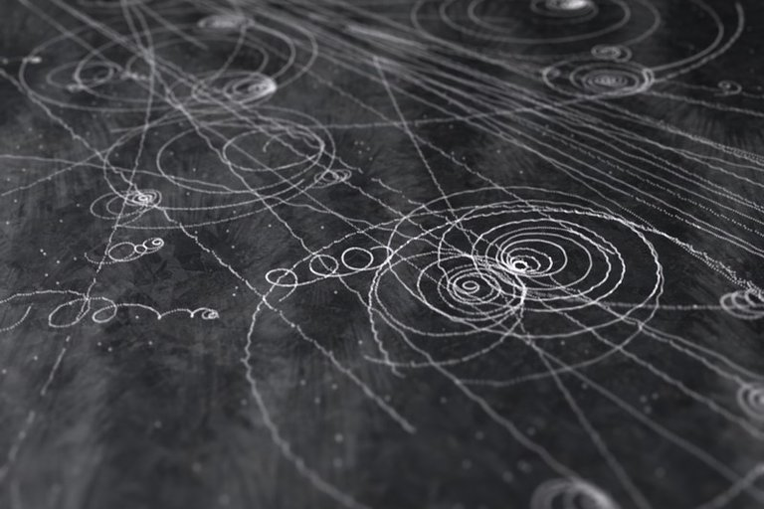
Discovery of EAS
https://www.seeker.com/cloud-chamber-tracks-make-beautiful-music-1765169524.html
In 1927-1929, Dmitri Vladimirovich Skobeltsyn (Russian: Дмитрий Владимирович Скобельцын) who was a Soviet physicist, academician of the Soviet Academy of Sciences, was observing cosmic rays by placing Wilson chamber (e.g. cloud chamber) in B-field.
Two things he noted: particles not only pass as single muons from cosmic background (as we know today) but sometimes as a group. The tracks for such groups would be ~straight lines so he called such spurs the showers of cosmic particles and concluded that they have very high energy.

Slide 4
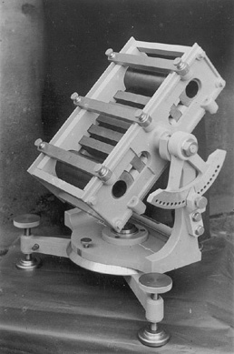
Discovery of EAS
https://en.wikipedia.org/wiki/Bruno_Rossi
In 1933, famous Italian scientist Bruno Rossi, using his new improved coincidence trigger, was observing coincidences in several cosmic rays detectors that were separated by up to 100 m.
In 1938-39, the works by Skobeltsyn and Rossi were repeated and proved by Pierre Auger.
Note that today Wikipedia only lists Auger as a person who did the discovery:
“In his work with cosmic rays, he found that the cosmic radiation events were coincident in time meaning that they were associated with a single event, an air shower. He estimated that the energy of the incoming particle that creates large air showers must be at least 10¹⁵ electronvolts (eV) = 10⁶ particles of 10⁸ eV (critical energy in air) and a factor of ten for energy loss from traversing the atmosphere (Auger et al., 1939)”
Often people call EAS an Auger showers, so other work was politically swept under the rug.

Slide 5
Discovery in EAS
Cosmic rays and EAS have been a source of many discoveries:
Positron
Muon + lifetime
Pion
Several hadronic processes and cross-sections
New physics to follow?
Delayed particles?

Slide 6
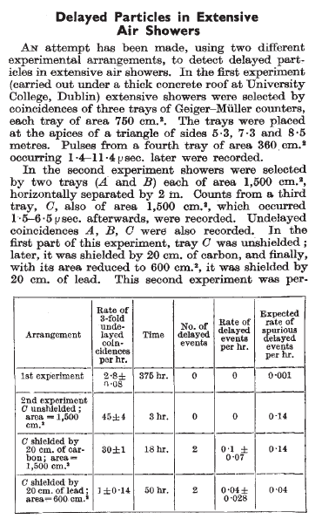
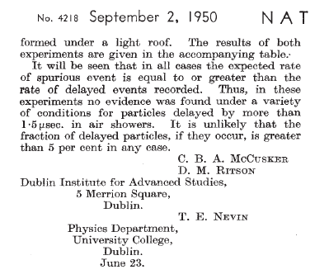
Delayed Particles in EAS
This is the first mention of delayed particles I found in google, may be there are earlier ones.

Slide 7
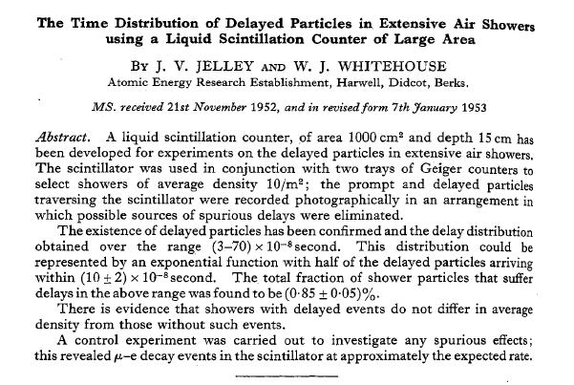
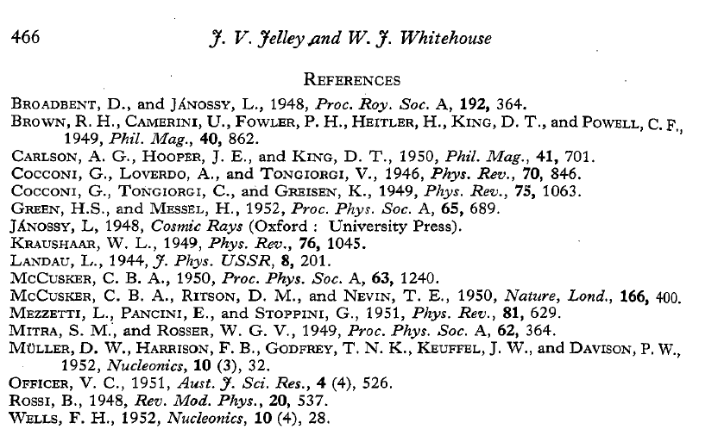
Delayed Particles in EAS
The typical reference is for (J V Jelley and W J Whitehouse 1953 Proc. Phys. Soc. A 66 454) for confirmation of the existence of delayed particles. Note that he does reference the previous article.

Slide 8
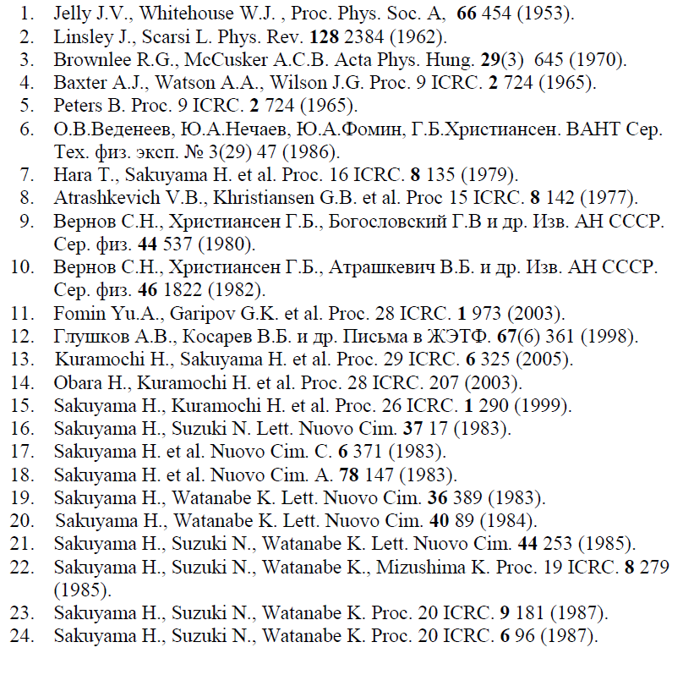
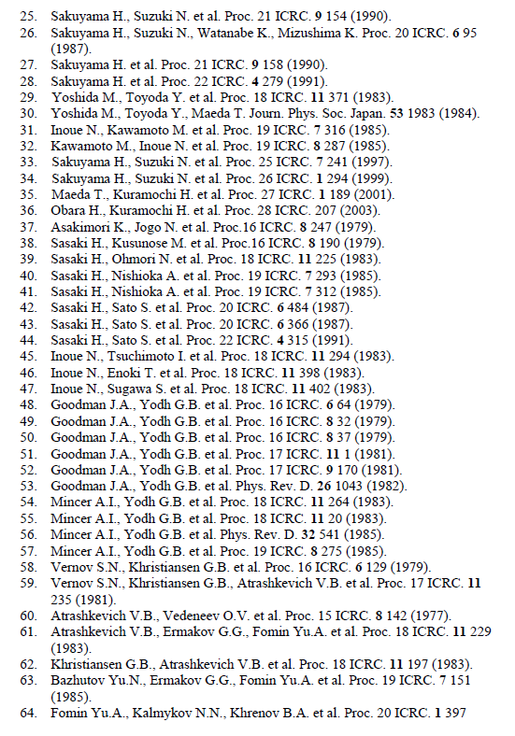
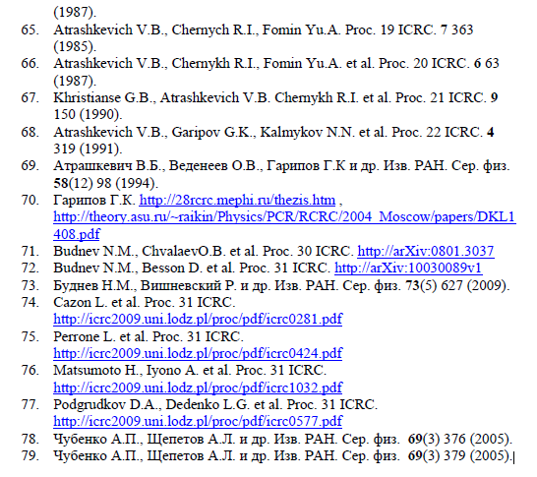
Delayed Particles in EAS
Since 1950-es, lost of work done on delayed particles…

Slide 9
Delayed Particles in EAS
All this work (there may be more recent publications I didn’t include here) did not shed any light on what causes the delayed particle effect, what are the particles, what is the mechanism of this double pulse formation, etc…
It became clear that old EAS analysis methods developed at Pamir by Skobeltsyn group in 1942 that are still being used (particle distribution, ρ(600) – ρ(1000) methods) are yielding no results for analysis of delayed particles and new approaches may be needed.
Yet community resists with very slow change if any
Some possible changes:
Record and analyze waveform, not just total charge
Go to few ns-level resolution of the pulse, best at current – 100 to 50ns
Start developing new analysis methods of the collected data using old ones as the base
Resistance to start this change (its politics, money, effort and social inertia combined) also produces resistance to acknowledge new data or rejection of papers with comments like: ‘this phenomena is already well explained by CORSIKA’ (really? It’s the most standard EAS simulated there! this is an actual comment…), or: why are you not using the same 1942 methods (not a direct quote but that was a meaning behind the comment)

Slide 10
Conclusion
Need to introduce new hardware/new analysis methods
More visibility and stay united to overcome social inertia
Higher visibility/outreach
More and more of new projects to give weight to newest approaches and new data!
GO CREDO ☺

Slide 11
Additional materials on multi-modal events follow

Slide 12
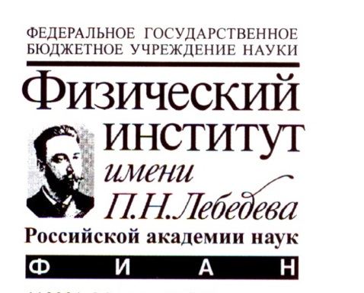
Extensive Air Showers with Unusual Spatial and Temporal Structure
By: Dmitriy Beznosko
For Horizon-t group
Talk given at ISVHECRI2018 conference
Notes:
Possible text: Hello everyone, my name is **** I will give this presentation on behalf of Dr. Beznosko who couldn’t attend today. This presentation is about the unusual structure of some EAS events detected by Horizon-T experiment.
//these are comments

Slide 13
Horizon-T Group
R. U. Beisembaev, E. A. Beisembaeva, O. D. Dalkarov, V. A. Ryabov, S. B. Shaulov, M. I. Vildanova, V. V. Zhukov
P. N. Lebedev Physical Institute of the Russian Academy of Sciences, Moscow, Russia
K. A. Baigarin, A. Batyrkhanov, T. Uakhitov
Nazarbayev University, Astana, Kazakhstan
T. X. Sadykov
LLP “Institute of Physics and Technology”, Almaty, Kazakhstan
D. Beznosko, A. Iakovlev
Bard College, New Orleans, USA

Slide 14
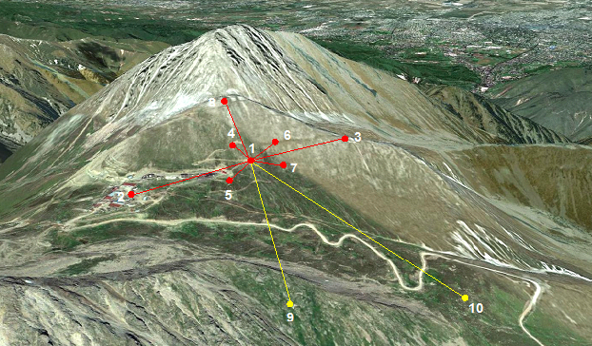
Horizon-10T (HT) Detector System [1, 2, 3]
An innovative detector system
pulse shape -> disk width information
2 ns resolution
EAS E> 10¹⁶ eV ; Zenith angles (0º - 85º).
At Tien Shan high-altitude Science Station ~3340 meters above the sea level
TEN (points 9 and 10 are recent upgrade) charged particle detection points [8]
separated by the distance up to 1.3 kilometer
Hardware trigger points 5+6
Optical detector subsystem
to view the Vavilov-Cherenkov light from the EAS
Station name | Center | Yastrebov | Stone Flower | Left | Kurashkin | Right | Bottom | Upper | Cher | 600m | Bunker
Station # | 1 | 2 | 3 | 4 | 5 | 6 | 7 | 8 | VCD | 9 | 10
Notes:
Detector description:
The Horizon-10T (HT) detector is the upgraded version of the Horizon-T with now 10 detector points. Detector includes near periphery detectors – points 1, 4-7, and far periphery – detection points 2, 3, 8-10. The spatial separation between two farthest detectors is just less then 1.3 km. Each point is assigned both name and a number, the correspondence is in the table. The system hardware trigger is the double coincidence between detection points 5&6 (logical AND) with the threshold of about 5 MIP (minimally ionizing particles) for each.

Slide 15
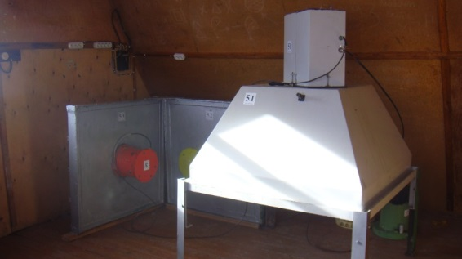
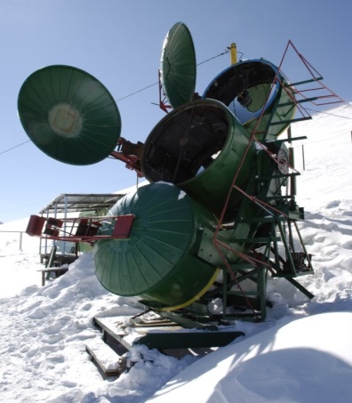
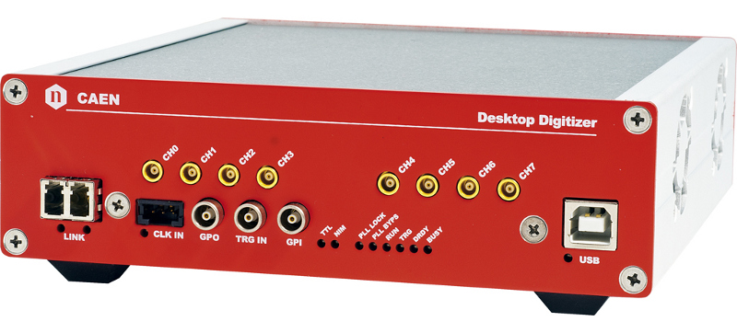
Horizon-T (HT) Detector System
Z plane detectors
R7723 Hamamtsu [6] PMT (1.2 ns resolution) at points 1-8
H6527 Hamamatsu PMT at points 9-10
5-12 m² at far points planned [8]
500 MHz digitization CAEN [9] DT5730 ADC
Cherenkov-Vavilov light detector
with Hamamtsu H6527 PMTs
All channels MIP/cable/linear range calibrated
Two physics runs: 2016-2017 and 2017-2018
R7723 PMT with glass gives pulse front resolution of ~2.2ns
Scintillator additional contribution ~5ns
Notes:
Each detection point has 1m^2 scintillator detector with fast Hamamatsu PMT. All near points are also equipped with glass detectors with fast 2.2ns response (this is rise time). Scintillator adds another 5ns for a total of ~7-8ns. Far points upgrade to 5 and more m^2 is planned. The Data acquisition system is based on 3 CAEN desktop ADC modules with 500MHz digitization rate. Two physics runs have been completed.

Slide 16
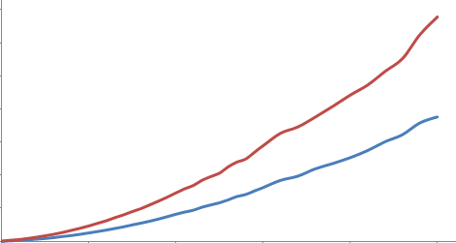
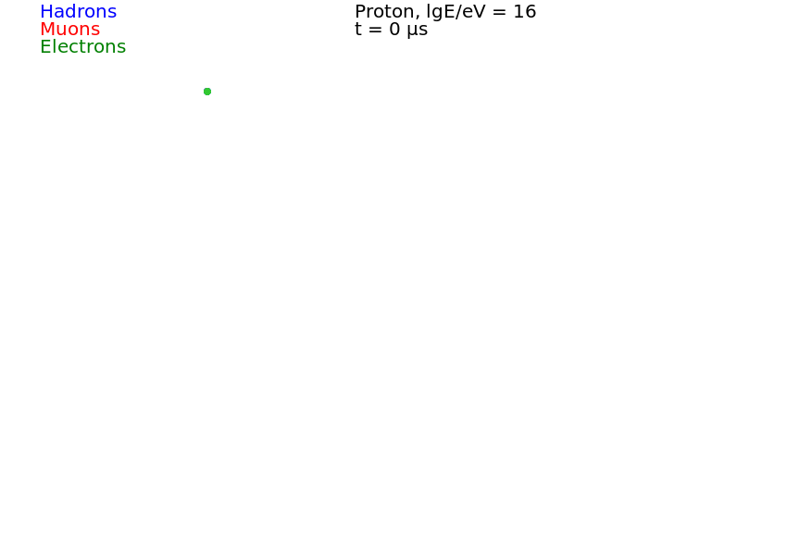
Typical methods of CR physics
Time, ns
Can reconstruct using particle density distribution
Need to calibrate detection points to obtain equivalent MIP number
If know time and width, additional methods can be used (CORSIKA) [5]
Distance from core, m
Observation level with detectors
Notes:
The Extensive Air Shower (EAS) disk has a curved shape with width increasing with distance from the axis and density decreasing. With each detector calibrated, can get particle density in MIP equivalents and reconstruct using particle density distribution. However, if can measure width (as HT does), can also use it for reconstruction. Parameter dependencies are studied using CORSIKA (shown on next slide)
//note that the animation on this slide will not work in pdf file!

Slide 17
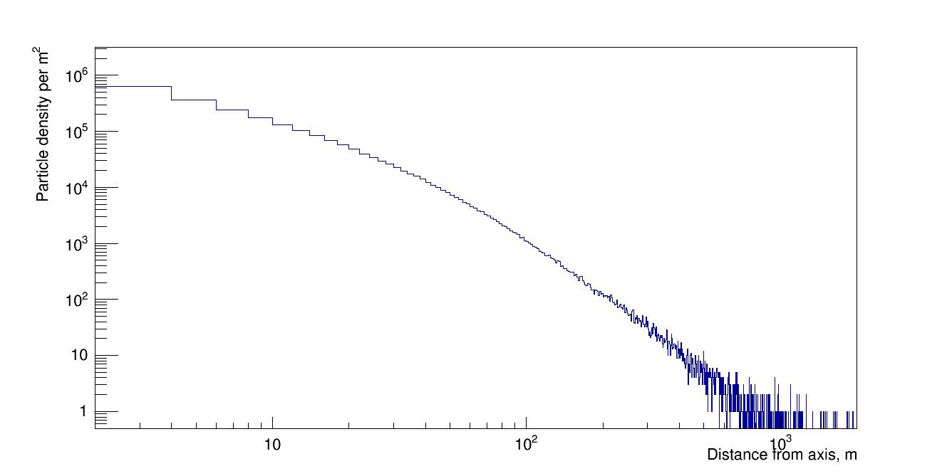
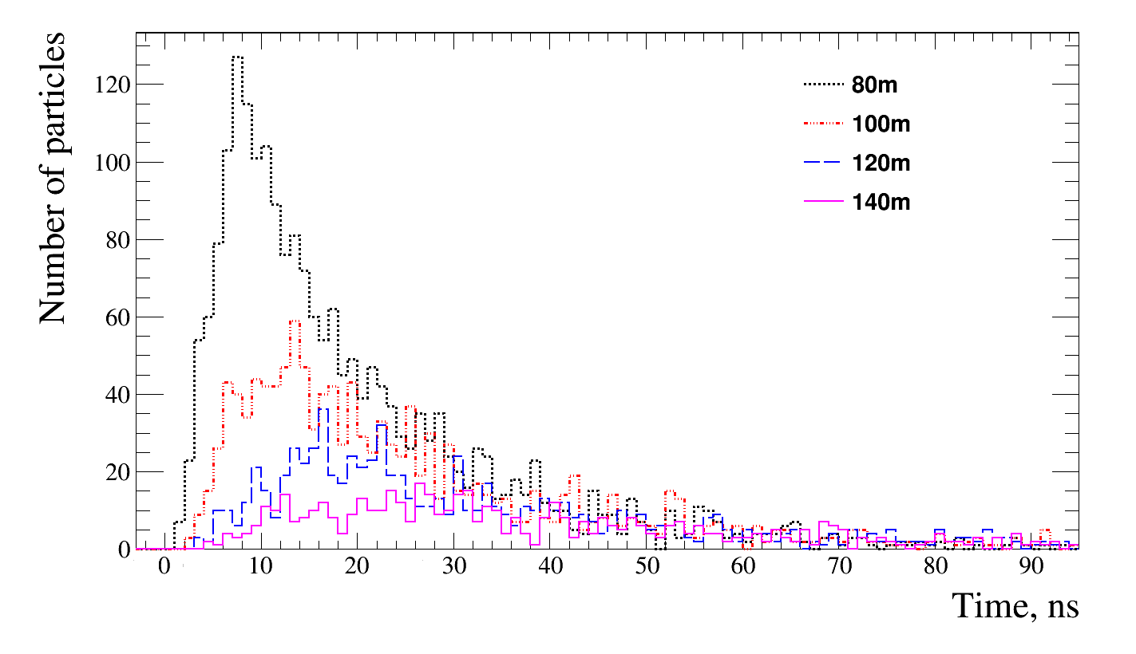
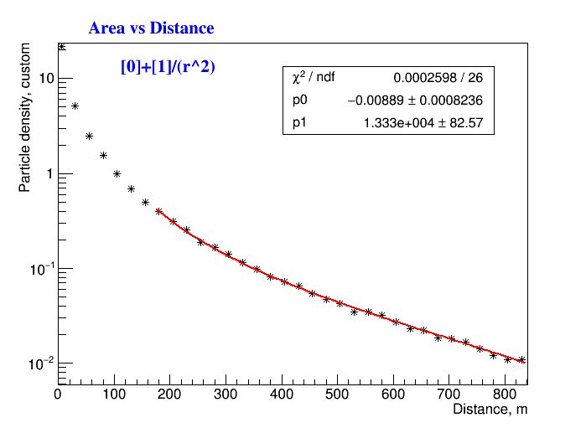
Standard EAS Definition
Particle density vs. distance from EAS axis
Number of particles arrival in time at different distances from EAS axis.
CORSIKA* simulation software is based on our understanding of HEP, thus simulating a ‘standard’ shower.
Plots are for E=10¹⁷ eV proton.
At observation level, such EAS has a single disk with particle density decreasing as ~1/r² (far) from the axis
* D. Heck, J. Knapp, J.N. Capdevielle, G. Schatz, T. Thouw. CORSIKA: A Monte Carlo Code to Simulate Extensive Air Showers, Forschungszentrum Karlsruhe Report FZKA (6019)
Notes:
From CORSIKA, we can see that particle density drops rapidly with distance from EAS axis. For the most of the disk, the dependence is ~1/(r^2) and is more rapid near to the axis.
//top left figure is log-log plot of particle density in the EAS disk, top right is particle distribution in time at different distances, bottom right – fitted 1 over r_squared dependence.

Slide 18
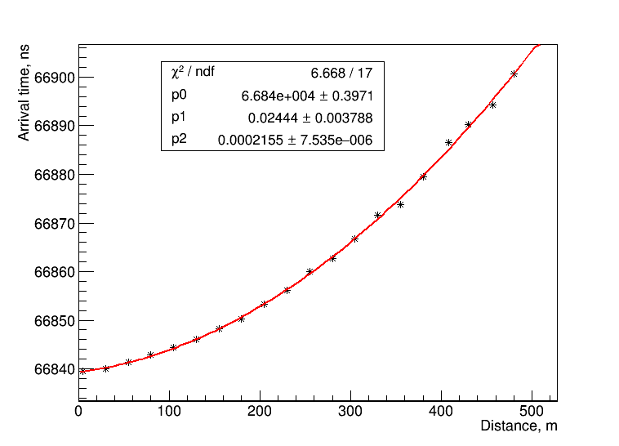
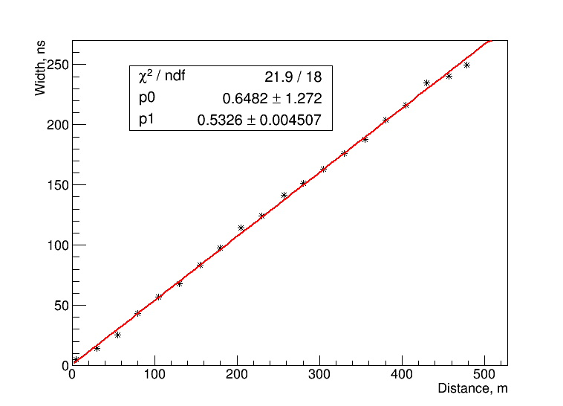
Standard EAS characteristics
Disk arrival time ~r² (used for arrival direction determination)
Disk passage time (e.g. width) is growing with ~r
Can use particle density and pulse width additional information from each detection point
Need time resolution <10ns
Notes:
The arrival time of the disk (taken as time of the 10% of total particles at each detector location) is parabolic but this parameter can not be measured in the experiment directly. However, disk width at each detector location can be recorded, and this width grows ~linearly with distance from the axis. Note that at far distances particle density is very low and is not possible to assess disk width accurately.
//this is all from simulation
//how we define start, center and pulse end: total pulse area is integrated, center is the median (50%), the start is taken as 10% of the area and end as 90%
//top plot: this is the time of 10% of simulated pulse at each virtual ‘detector’, fitted with 2nd order polynomial
/bottom plot: disk width at each virtual detector distance from axis as time between 10% and 50%. Grows linearly with distance.

Slide 19
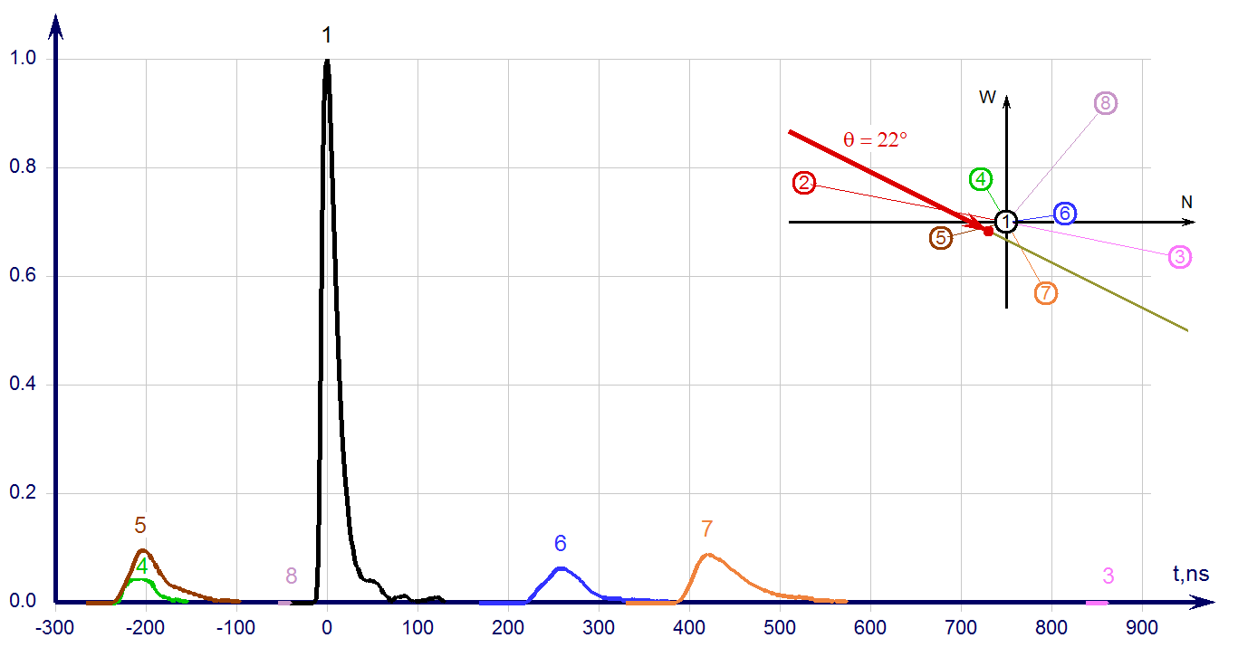
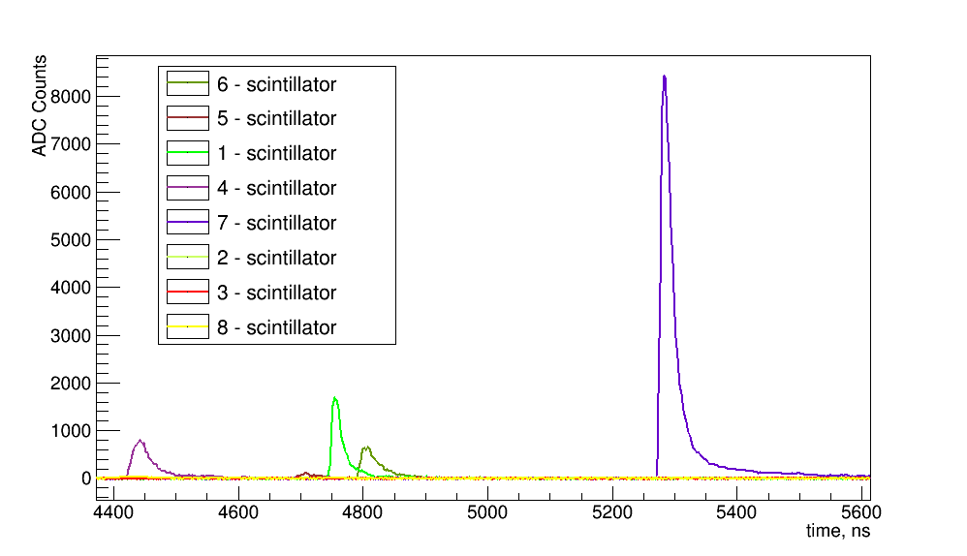
Data examples for Standard EAS
Standard EAS signal from each HT detector
Corresponds to simulation
Estimated Energy:
~10¹⁶ eV (top) at low angle
~2·10¹⁶ eV (left) high zenith angle
Notes:
So we establish ‘standard’ EAS as simulated on average by CORSIKA. This slide shows two examples from HT data of standard events.
//plots are self evident from description

Slide 20
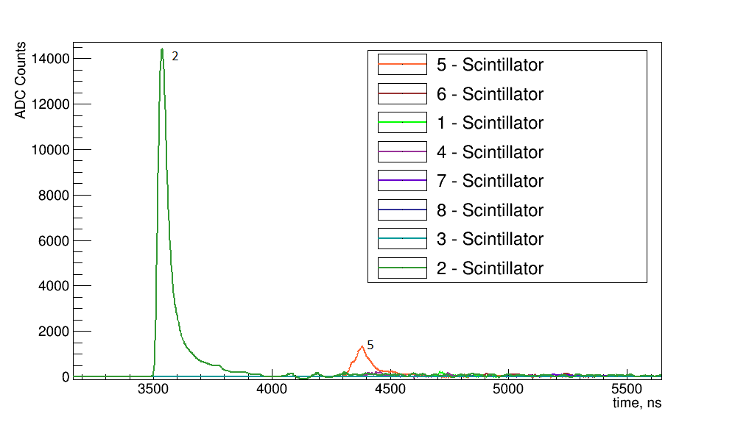
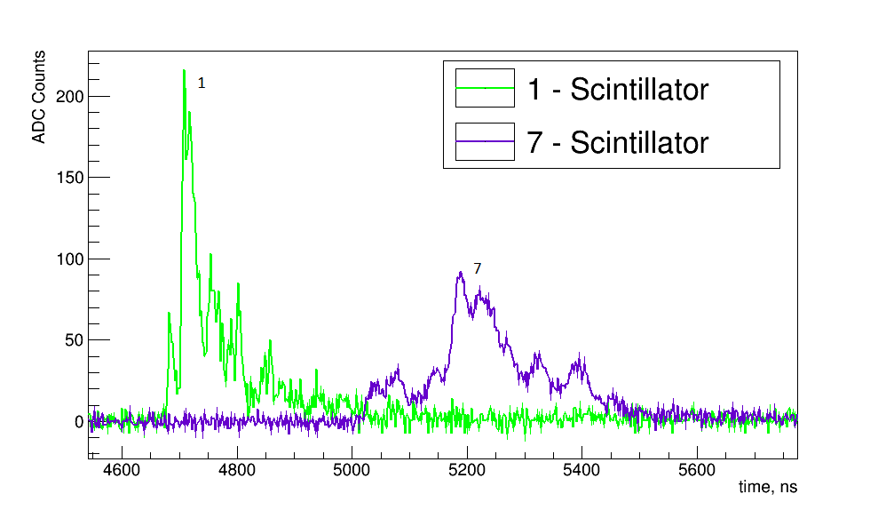
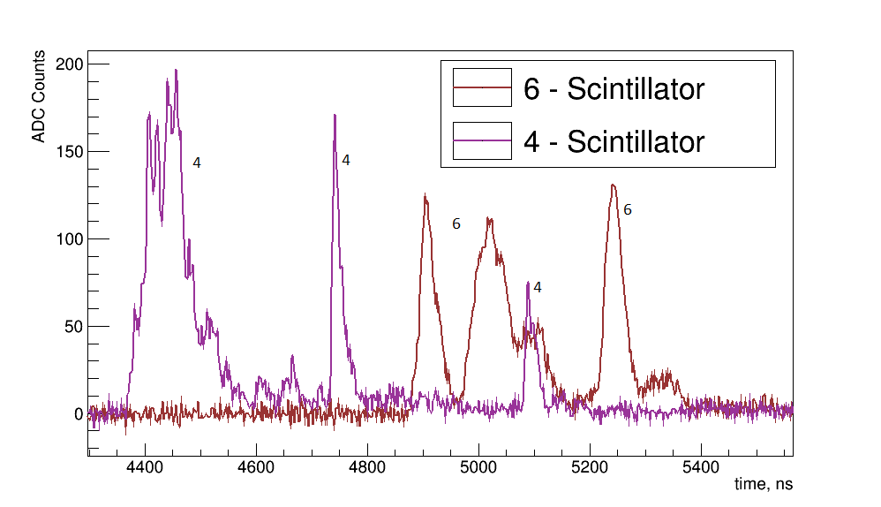
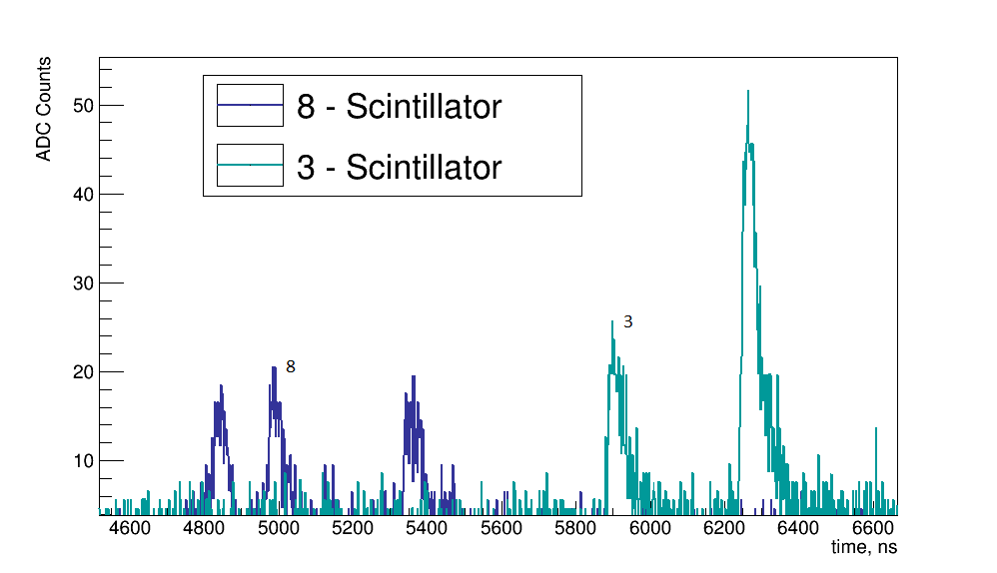
Unusual EAS at HT example [4]
Event of Jan26 ’16.
Notes:
This slide shows clear example of the unusual event from HT detector. Note that closer to the axis (top left) the smaller peak has a shape with steps, then farther from axis peaks (top right) appear to be composed of many smaller peaks, and farther from the axis (bottom left, about 300m) peaks separate completely. This separation is very clear at even further distances (bottom right plot, about 400m for blue and 600m for green). This is a typical appearance for the ‘unusual’ event
//plots are different zoom views of the same event . HT had only 8 detector. at the time
//if anyone asks – this can not be Poisson noise. In bottom left plot – each peak has at least 12-15 MIP particle equivalent from calibration data. Much more particles in other plots, many tens to hundreds…

Slide 21
Modeling attempt at unusual events by Combining Simulated disks
To approximate response of a detector from arrival of two disks separated in time and space, two simulated disks are overlaid.
Following cases were simulated:
Two disks of the same energy falling with delay at the same distance from their centers (time delay)
Two disks of the same energy falling at the same time at different distances from their centers (spatial separation)
Two disks of different energies falling at the same time at different distances from their centers
Notes:
CORSIKA gives us a simulated disk. We can try to use this disk to form simple combinations to try and re-create the unusual event structure.
Simple ways to combine: one disk is delayed in time behind another-or time delay, one disk axis is displaced with respect to another – spatial separation; two disks can be either of same energy or different (scaled)

Slide 22
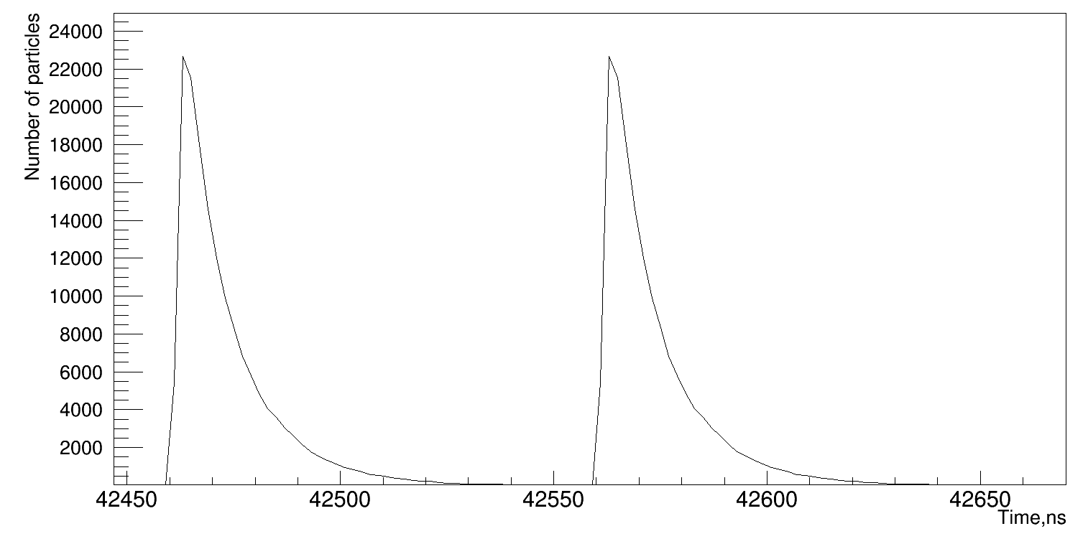
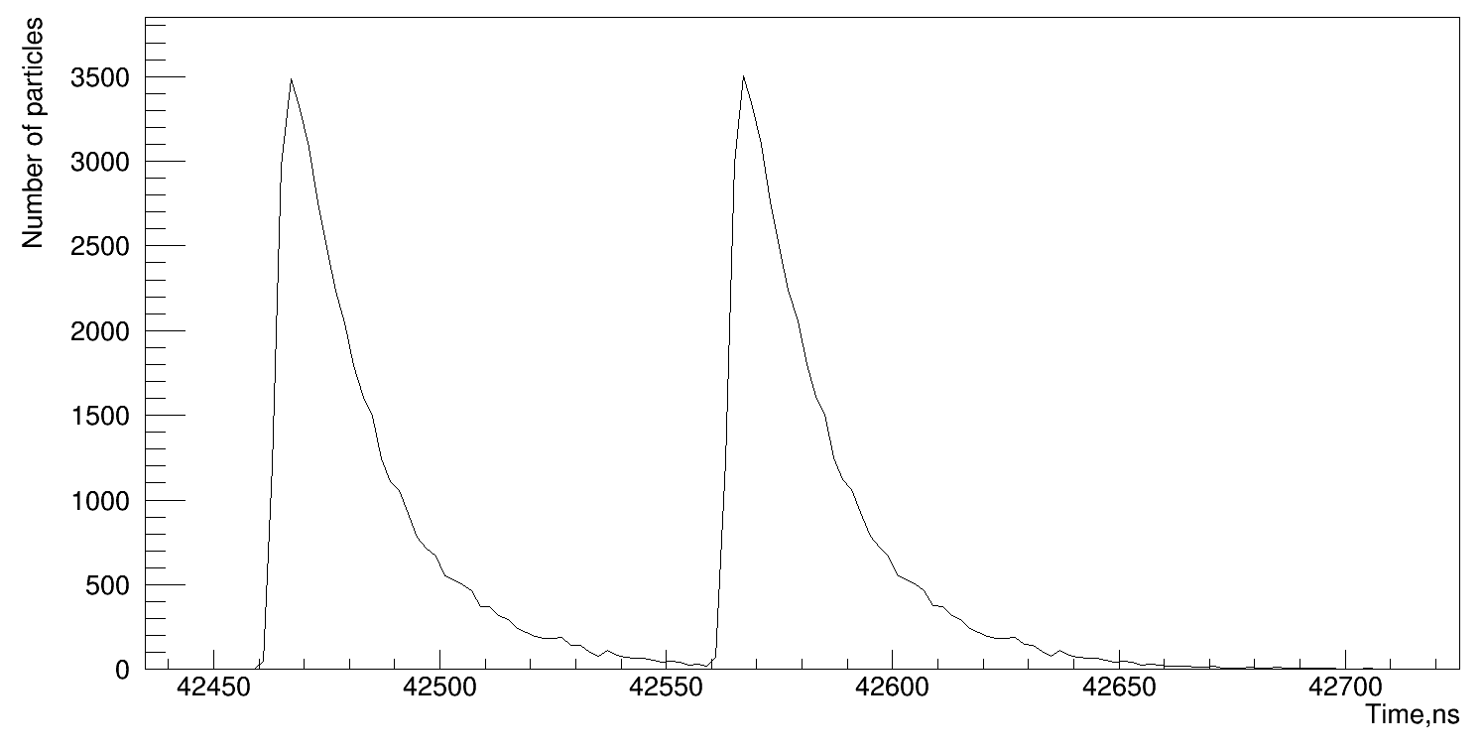
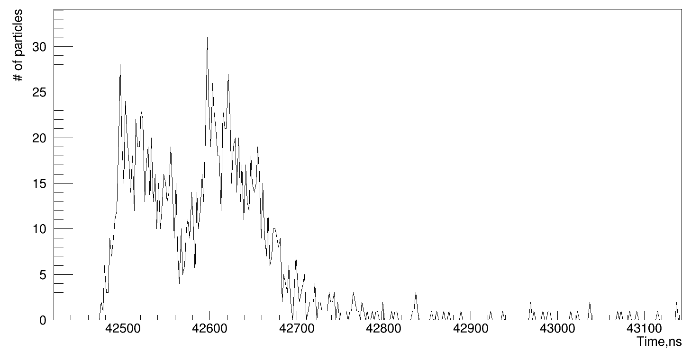
Combining Simulated disks: Time delay
50 m
30 m
Time delay between disks centers - 100 ns.
Energy of each primary – 10¹⁷ eV
Farther from the EAS axis the disks become wider, so combining two pulses results in overlapping of the shower fronts.
170 m
Close to the center, each disk signal could be differentiated easily. However, hardly distinguishable multipeak event can occur far from the center
Notes:
Results from the time delay (both disks are the same): disk centers are separated by 100ns. Note the overall picture: near the axis, where disk is narrow, two high amplitude pulses (corresponding to high particle density) are clearly separated. As we go further from the axis, pulses become wider and shallow – separation becomes less and less apparent (continued on next slide)

Slide 23
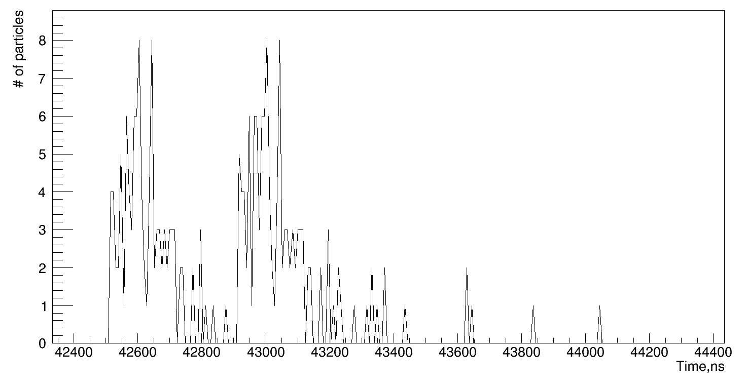
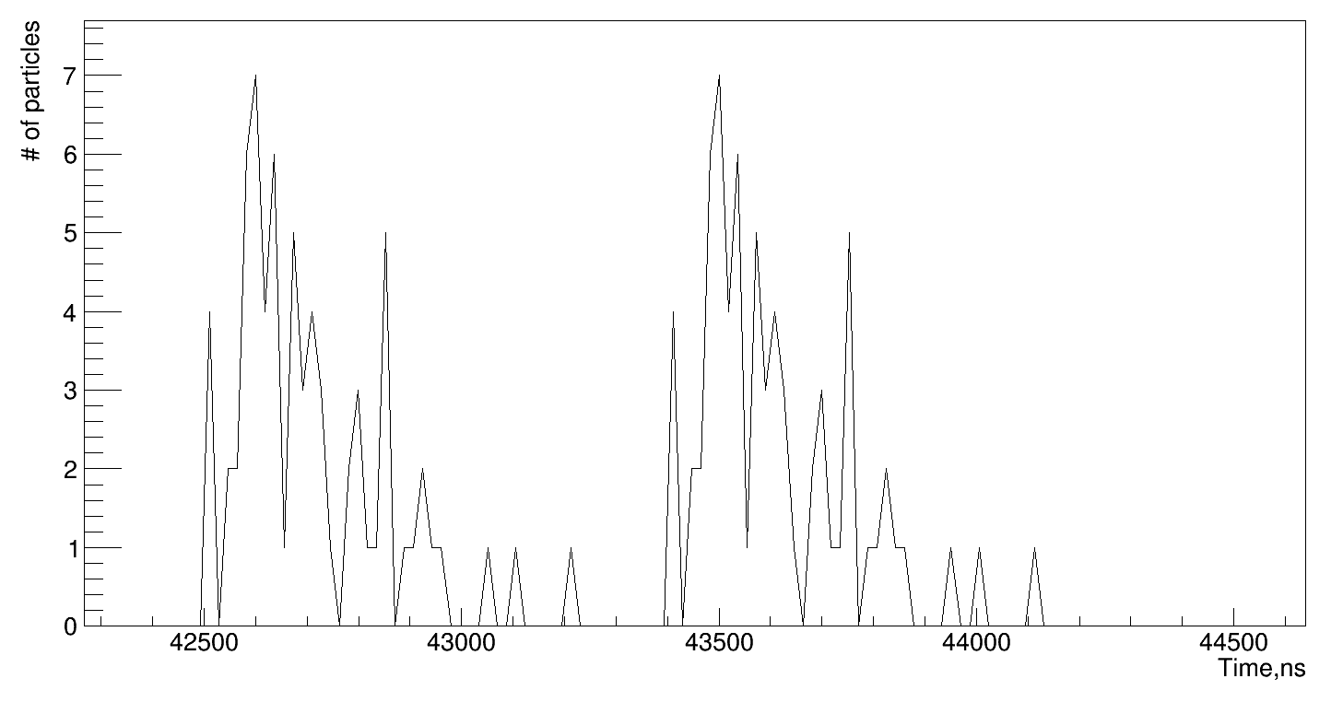
Combining Simulated disks: Time delay 2
170 m
290 m
Although at even larger distances from the center of the shower (>300 meters) signals become separated clearer, it happens because of low density of particles in the shower disk. Still, wide particle distributions are observed as expected from disk width.
350 m
Notes:
At even farther distances (170m) separation is barely there, then it comes back mostly due to the lack to particles in that region – we see only most dense parts of the disk.
So delayed disk gives the following event: two clearly separated pulses in detectors near the axis with high amplitude pulses, and much shallower separation at larger distances and small wide! pulses. However, there are no events in data that have the same appearance.

Slide 24
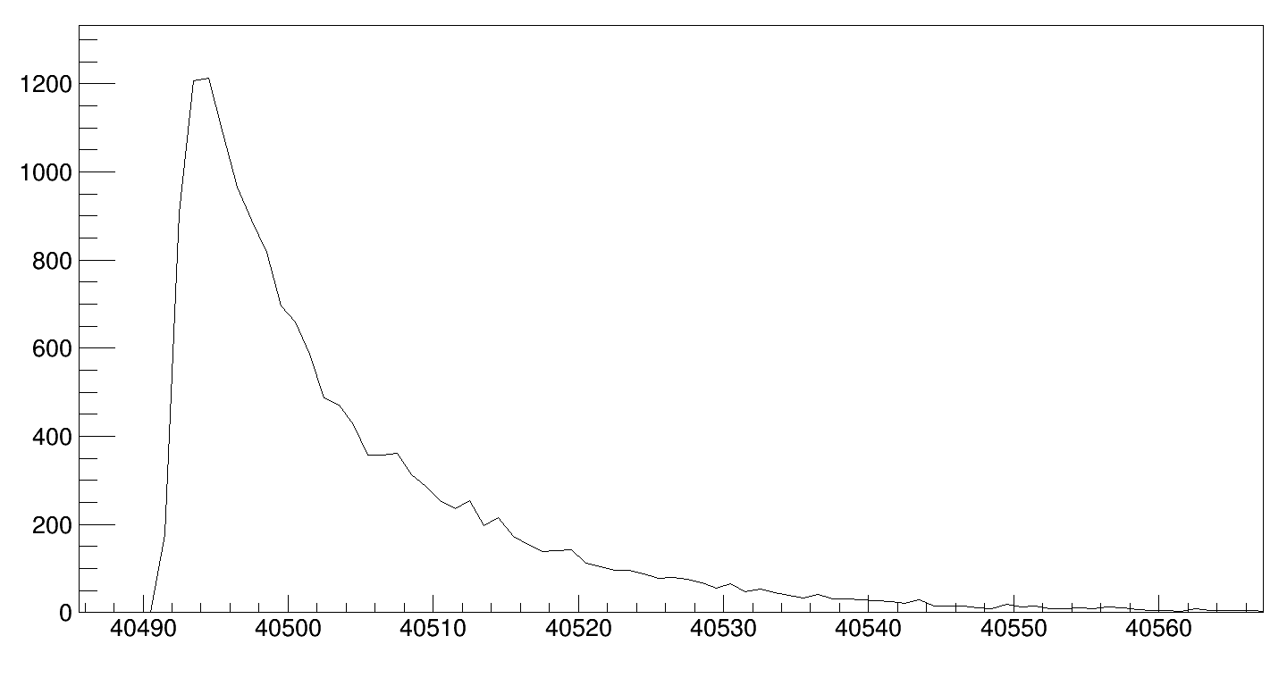
Combining Simulated disks: spatial separation
Number of particles
30 m + 50 m
Energy – 10^16 eV
The particle density so much higher closer to the axis that contribution of the second disk is not clearly visible
Each figure shows distances from the disk axis on the left then from the axis on the right
30 m + 110 m
Number of particles
Notes:
Here we try to overlap two disks that that fall vertically without any time delay, but their axis are separated. Because the particle density falls very rapidly, if we take virtual detector position in a position very different from one axis then another, then we don’t see one of the signals in comparison (bottom plot – one axis is 30m away, one is 110m). But even if we take closer distances (top plot), we still see no peak separation. (continued on the next slide)

Slide 25
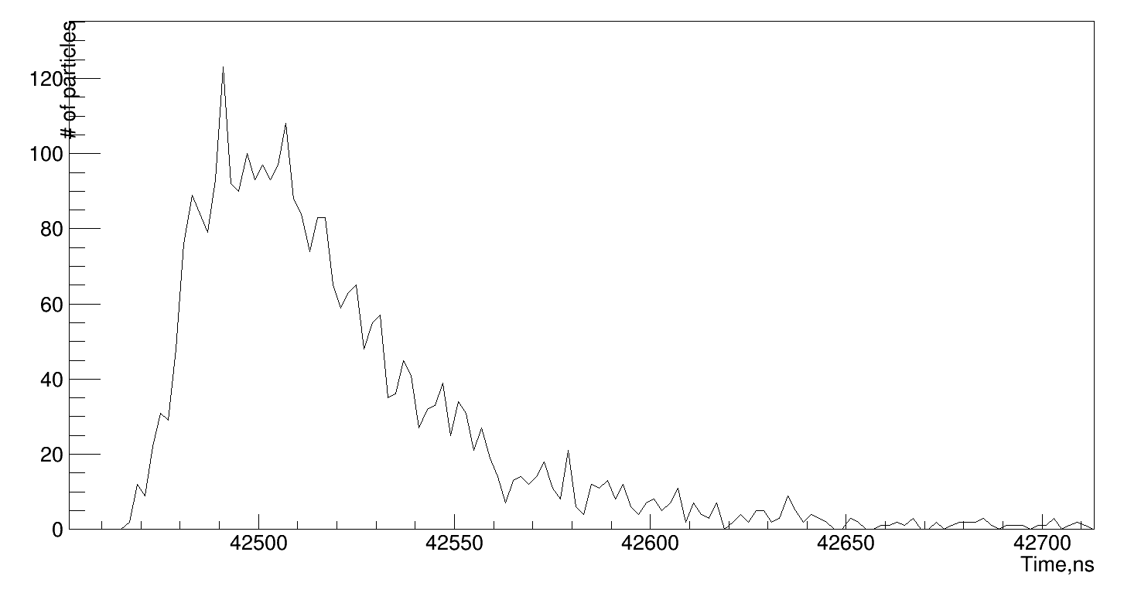
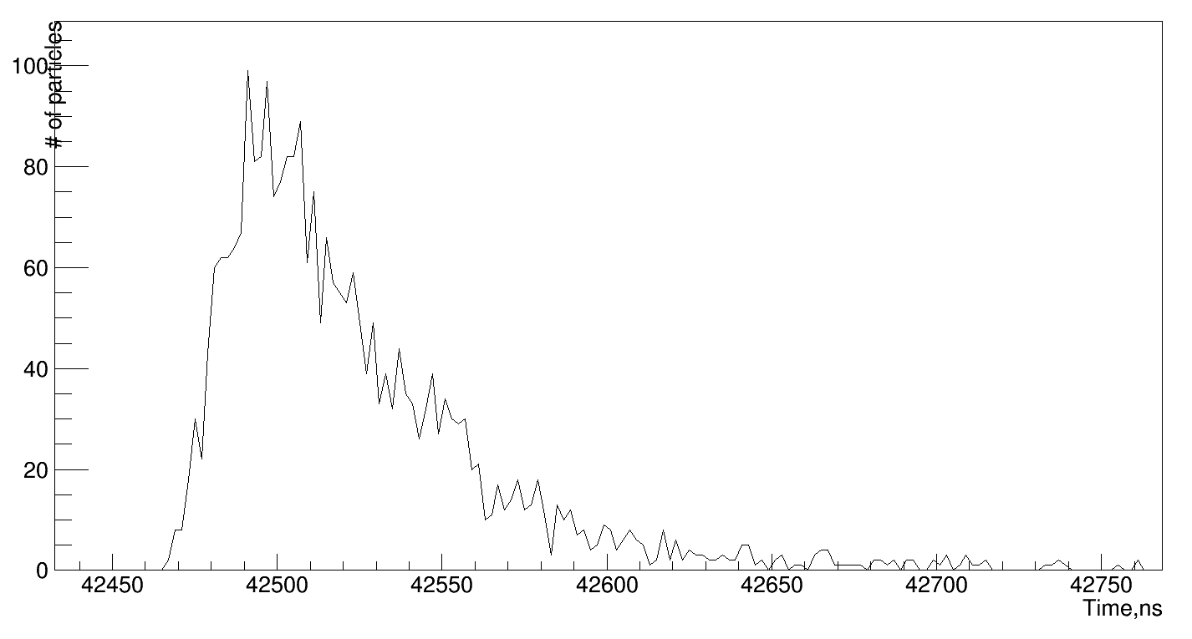
Combining Simulated disks: spatial separation
Number of particles
130 m + 150 m
Energy – 10^17 eV
Even far from the center of the shower combination does not give any distinguishable peaks
Thus, no multi-peak behavior can be seen in this case
Number of particles
130 m + 170 m
Notes:
Here virtual detector is located at comparable but larger distances from both axes. We still see that no multi-peak signal is detected. So, simple combinations of the EAS disks don’t give the same event as is observed by the HT detector.

Slide 26
Conclusion
In HT data, ‘unusual’ events have been identified
Simple combination of simulated disks doesn’t give similar picture
The data analysis continues and more physics runs are planned
Far periphery detectors upgrade to larger areas is planned
Notes:
//No comments – just reading slide will work

Slide 27
references
[1] RU Beisembaev, EA Beisembaeva, OD Dalkarov, VA Ryabov, AV Stepanov, NG Vildanov, MI Vildanova, VV Zhukov, KA Baigarin, D Beznosko, TX Sadykov, NS Suleymenov, "The 'Horizon-T' Experiment: Extensive Air Showers Detection," arXiv:1605.05179 [physics.ins-det], May 17 2016.
[2] Rashid Beisembaev, Dmitriy Beznosko, Kanat Baigarin, Elena Beisembaeva, Oleg Dalkarov, Vladimi Ryabov, Turlan Sadykov, Sergei Shaulov, Aleksei Stepanov, Marina Vildanova, Nikolay Vildanov, Valeriy Zhukov. "Horizon-T experiment status." EPJ Web Conf. 145 11004 (2017). DOI: 10.1051/epjconf/201614511004
[3] Rashid Beisembaev, Dmitriy Beznosko, Kanat Baigarin, Elena Beisembaeva, Oleg Dalkarov, Vladimir Ryabov, Turlan Sadykov, Sergei Shaulov, Aleksei Stepanov, Marina Vildanova, Nikolay Vildanov, Valeriy Zhukov. " Extensive Air Showers with unusual structure." EPJ Web Conf. 145 14001 (2017). DOI: 10.1051/epjconf/201614514001 ISVHECRI
[4] R U Beisembaev, D Beznosko, K A Baigarin, A Batyrkhanov, E A Beisembaeva, T. Beremkulov, O D Dalkarov, A Iakovlev, V A Ryabov, N S Suleimenov, T Kh Sadykov, Z Tagay, T Uakhitov, M I Vildanova and V V Zhukov. "Horizon-T experiment and detection of Extensive air showers with unusual structure", accepted to Journal of Physics: Conference series, 2018
[5]. D. Heck, J. Knapp, J.N. Capdevielle, G. Schatz, T. Thouw. CORSIKA: A Monte Carlo Code to Simulate Extensive Air Showers, Forschungszentrum Karlsruhe Report FZKA (6019).
[6]. HAMAMATSU PHOTONICS K.K., Electron Tube Division, 314-5, Shimokanzo, Iwata City, Shizuoka Pref., 438-0193, Japan, http://www.hamamatsu.com
[7] R.U. Beisembaev, D. Beznosko, E.A. Beisembaeva, A. Duspayev, A. Iakovlev, T.X. Sadykov, T. Uakhitov, M.I. Vildanova, M. Yessenov and V.V. Zhukov, "Fast and simple glass-based charged particles detector with large linear detection range," Journal of Instrumentation, vol. 12, no. T07008, 2017.
[8] D. Beznosko, T. Beremkulov, A. Iakovlev, S. Jakupov, D. Turganov, A. Tussipzhan, T. Uakhitov, M.I. Vildanova, A. Yeltokov, V.V. Zhukov."Horizon-T Experiment Upgrade and Calibration of New Detection Points", arXiv:1803.08309 [physics.ins-det], Mar 22, 2018.
[9].CAEN S.p.A. Via della Vetraia, 11, 55049 Viareggio Lucca, Italy. http://caen.it.

