Slide 1
Institute of Nuclear Physics
Polish Academy of Sciences
Dariusz Bocian
Low and High Temperature Superconductors Workshop #02
March 22, 2018

Slide 2
Welcome to LHTSW #02 Low and High Temperature Superconductors Workshop Research and Applications

Slide 3
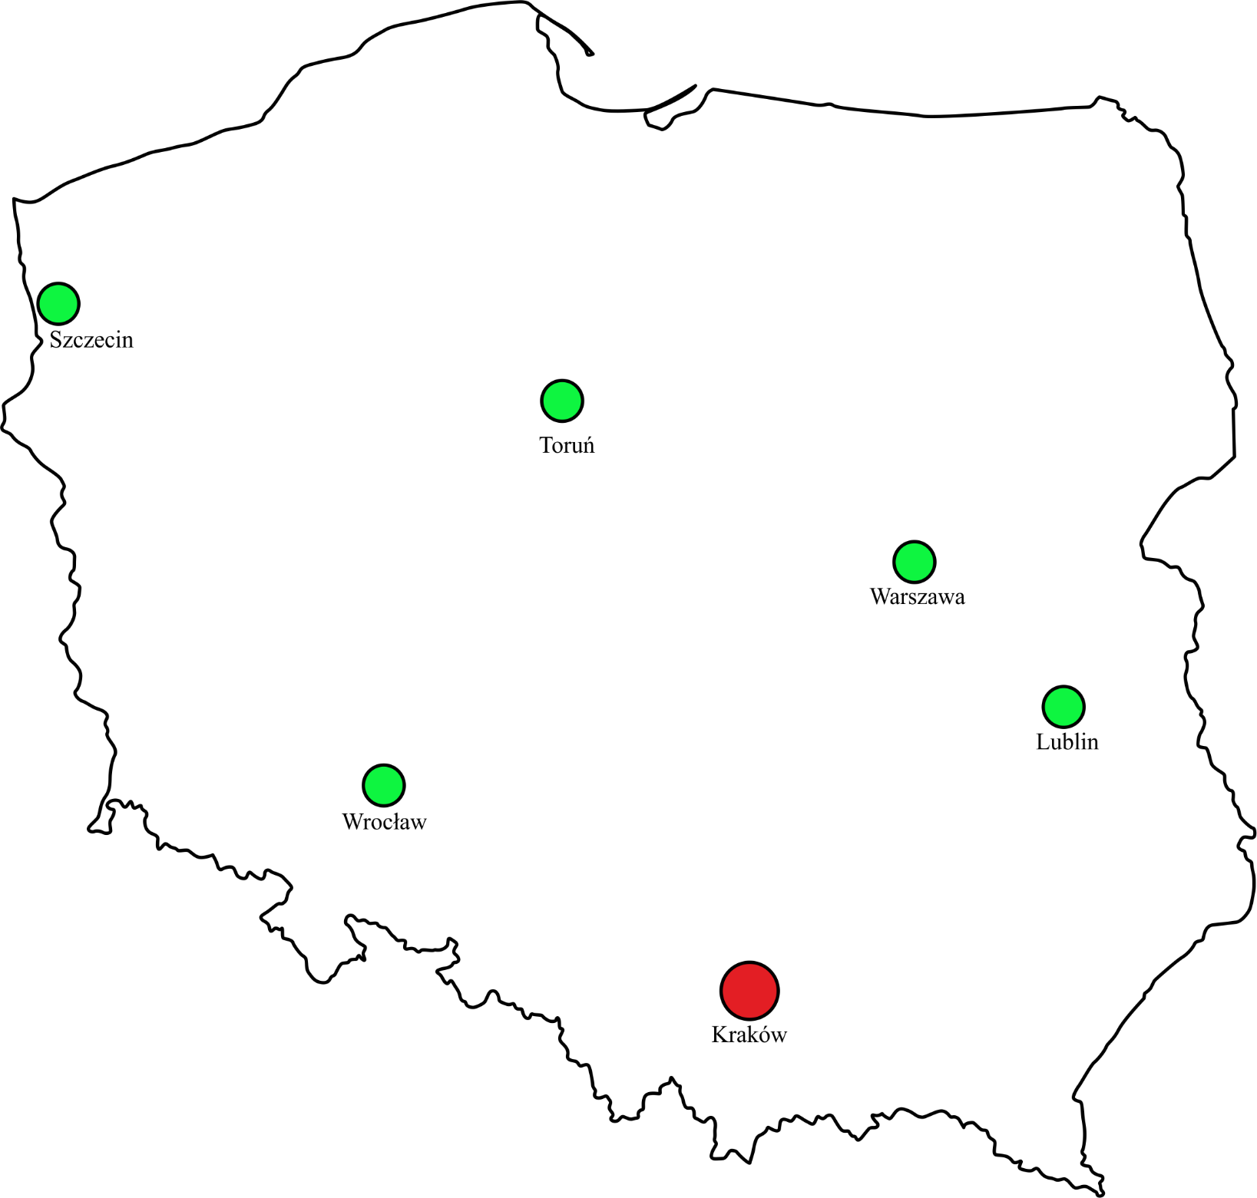
LHTSW #02 participants
scientific institutions
11
companies
ZUT
4
FrakoTerm
ICiMB
IEL
ITE
IWC PAN
INTiBS
PL
KRIOSYSTEM
AGH
25
IFJ PAN
WIT-Composites
Registered participants
PK
SOUL-Kozak
ITE
Presentations and discussion

Slide 4
Workshop Program
LHTSW #02
Session I Consortium Agreement
Session II Grant: primary workpackages presentation
- general workpackages
- technical workpackages
Session III Discussion Panel

