Slide 1
A New Correlator to Detect and Characterize the Chiral Magnetic Effect (CME)
Roy A. Lacey
Stony Brook University
The search for CME-driven charge separation is a major research theme especially at RHIC!
The isobar run is currently in progress
Outline
Introduction
  CME & Charge separation
  Prior measurements & challenges
New Correlator
  Correlator essentials
  Correlator details
  Signal Quantification
Correlator response
  Response to background
  Response to signal + background
  Example measurements
Summary

Slide 2

Anomalous Transport in the QGP
Chiral Magnetic Effect (CME)
Electric
Current
Chiral Magnetic
Conductivity
B
Chiral Chemical
potential
Reaction
Plane $Ψ_{n}$
Kharzeev
hep-ph/0406125
y
x
Why CME?
CME detection & characterization could provide crucial insights on;
  anomalous transport
  the interplay of chiral symmetry restoration, axial anomaly, and gluonic topology in the QGP
The Chiral Magnetic Effect (CME) results from anomalous chiral transport of the chiral fermions in the QGP, leading to the generation of an electric current along the magnetic field generated in the collision:
Leads to charge separation along
the B-field

Slide 3
Measuring Charge separation
B
Reaction
Plane $Ψ_{n}$
y
x
CME-driven charge separation leads to a dipole term in the azimuthal distribution of the produced charged hadrons:
Objective: identify & characterize this “dipole moment”
The Gamma correlator and its variants, have been used extensively
for experimental measurements

Slide 4

Gamma correlator & its Response
Ma, Zhang
Phys.Lett. B700 (2011) 39-43
Results from AMPT
$$Ψ_{Rxn}$$
Tested with Input
charge separation in AMPT
The Gamma Correlator’s response is similar for signal and background
  Background-driven correlations complicate CME-driven signal extraction?
    Background can account for a part, or all of the observed charge separation signal?
switch the p_{y} values of a fraction of each set

Slide 5

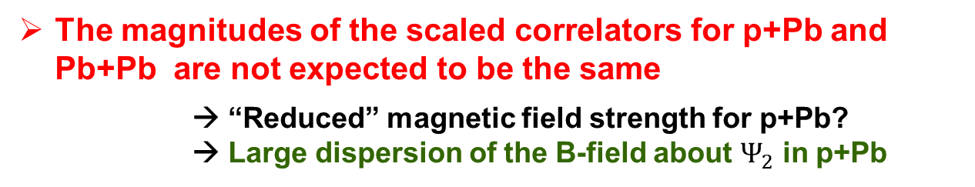


Gamma correlator status quo & measurements
Recent CMS measurements for p+Pb and Pb+Pb
at the LHC gives cause for pause!
Pb+Pb
B
$Ψ_{2}$ plane
B and $Ψ_{2}$ correlated
p+Pb
plane
B and $Ψ_{2}$ ~ uncorrelated
The magnitudes of the scaled correlators for p+Pb and Pb+Pb are not expected to be the same
      → “Reduced” magnetic field strength for p+Pb?
      → Large dispersion of the B-field about $Ψ_{2}$ in p+Pb

Slide 6

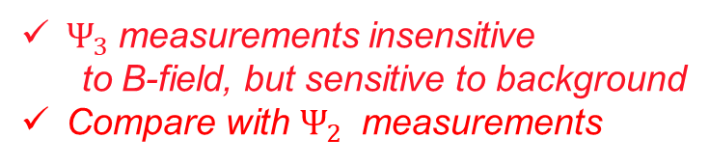




Why a new correlator?
Leverage Small systems
To have better control over signal and background
p+Pb
Correlator essentials
CME-driven + Background-driven
charge separation
plane
B and $Ψ_{2}$ ~ uncorrelated
B
B
Measurement insensitive
to B-field → “no signal”
Excellent bench mark
Reaction
Plane $Ψ_{n}$
Reaction
Plane $Ψ_{2}$
Background-driven
charge separation
only
y
$${Leverage Ψ}_{3} measurements$$
x
Measure separately;
CME-driven + Background-driven
charge separation
Background-driven
charge separation
Then compare them
B
$$Ψ_{3}$$
B and $Ψ_{3}$ ~ uncorrelated
$Ψ_{3}$ measurements insensitive
to B-field, but sensitive to background
Compare with $Ψ_{2}$ measurements

Slide 7
The “New” Correlator
The correlator is constructed for each event plane
N. Magdy et al.
arXiv: 1710.01717
via a ratio of two correlation functions
quantifies charge separation
along the B-field
B
Reaction
Plane $Ψ_{n}$
quantifies charge separation
perpendicular to the B-field
(measures only background)
y
x
The correlator measures the magnitude of charge separation parallel to
the B-field, relative to that for charge separation perpendicular to the B-field
Note
and
are both insensitive to CME-driven charge separation
(they measure only background)

Slide 8


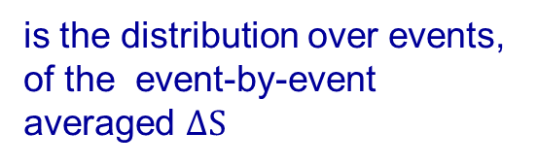
The “New” Correlator – Correlation Functions
N. Magdy et al.
arXiv: 1710.01717
Correlation functions are constructed from the ratio of two distributions
is the distribution over events, of the event-by-event averaged $ΔS$
B
p = # $h^{+}$
n = # $h^{−}$
Reaction
Plane $Ψ_{n}$
measures charge separation
is obtained from the same events, following random reassignment (shuffling) of
only the charge of each
particle in an event
y
x
contributions from CME-driven charge separation, vanish for this
correlation function

Slide 9
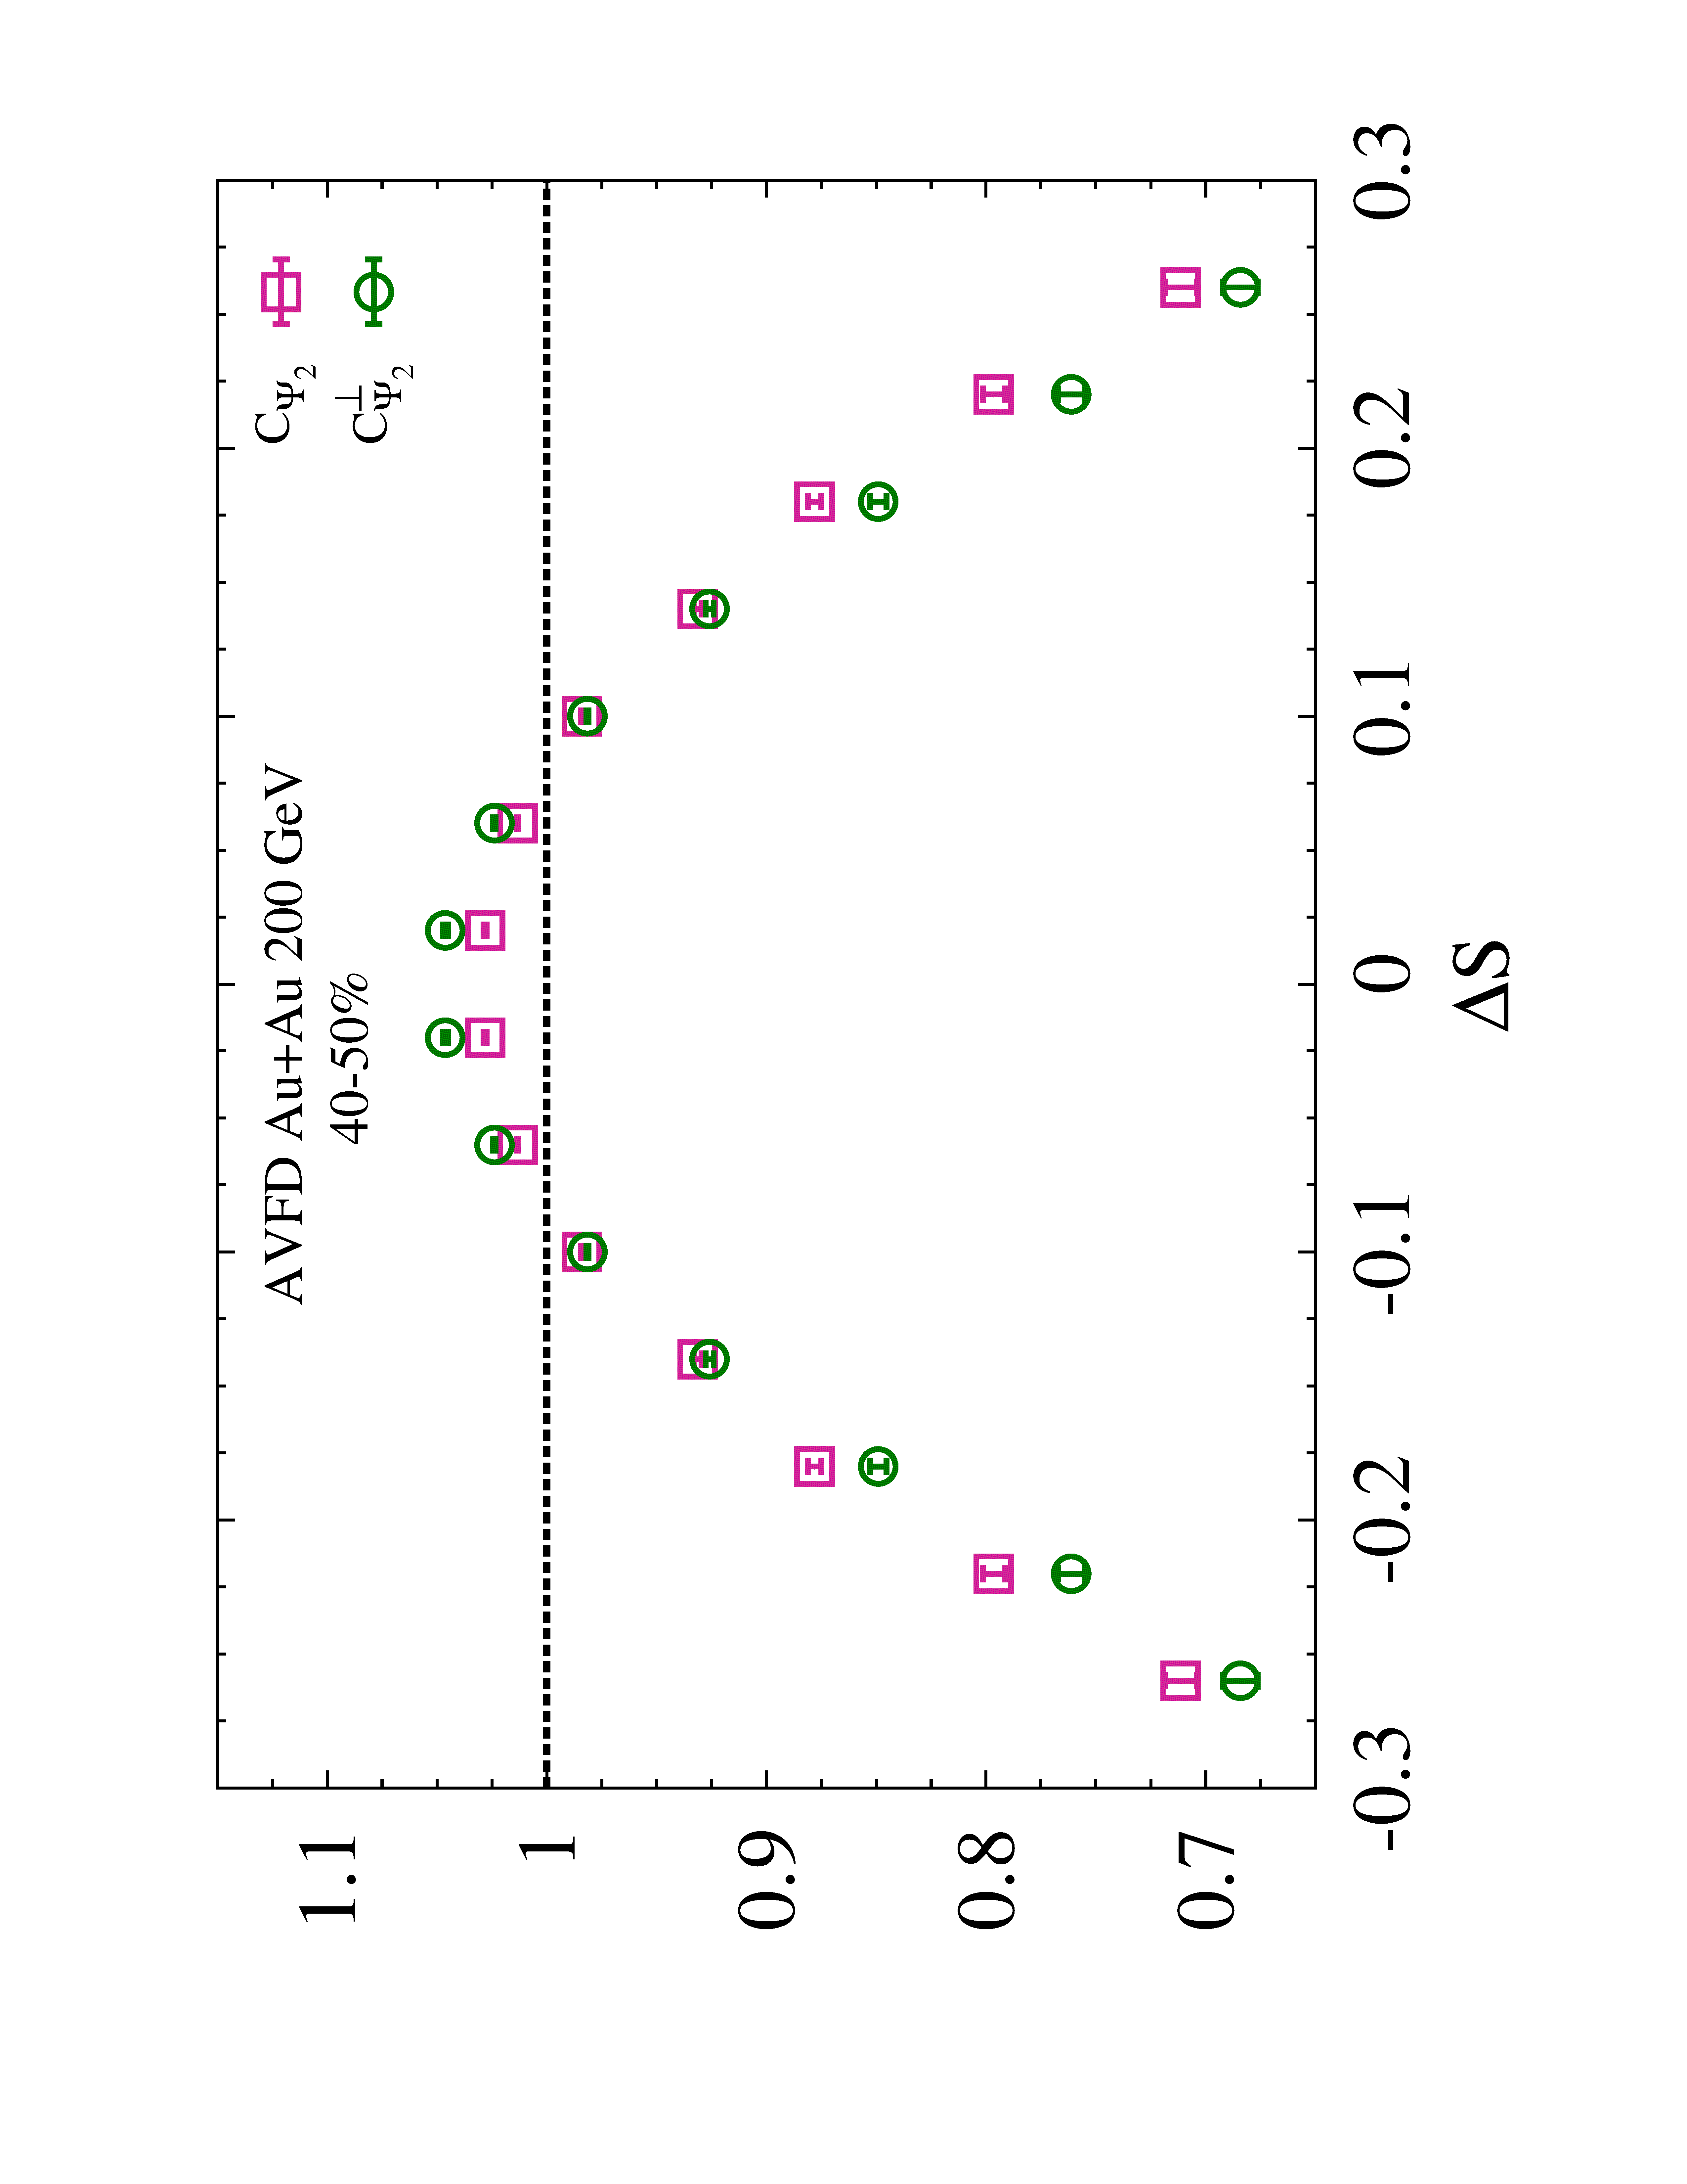
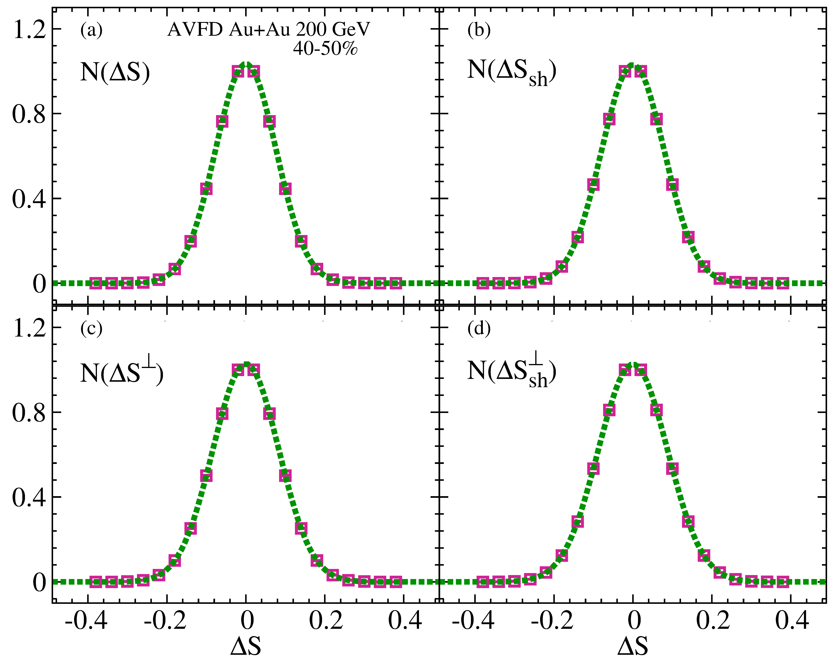
The “New” Correlator & Correlation Functions
Correlation functions are constructed
from Gaussian shaped distributions
B
Reaction
Plane $Ψ_{n}$
y
x

Slide 10
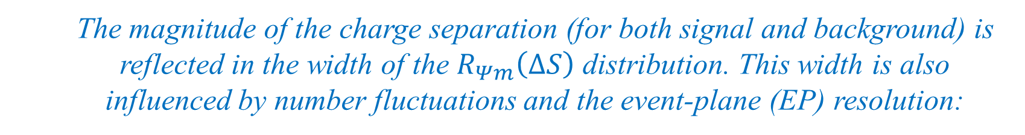

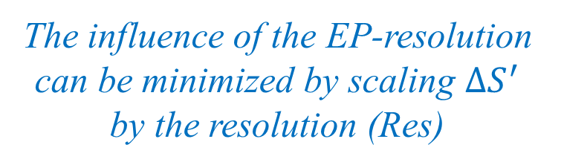

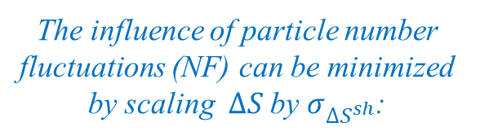
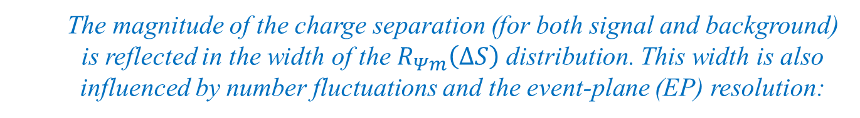
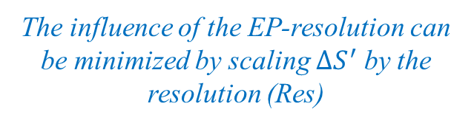
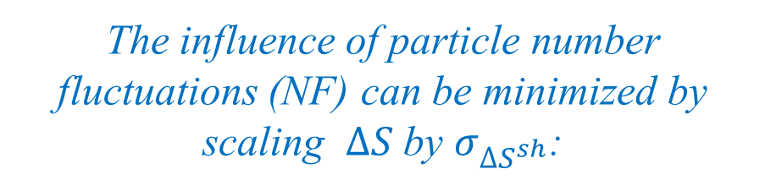

Correlator Response
  The magnitude of the charge separation (for both signal and background) is reflected in the width of the $R_{Ψm}\left(∆S\right)$ distribution. This width is also influenced by number fluctuations and the event-plane (EP) resolution:
$a_{1}$=0
$$∆S^{′}=∆S/σ_{∆S^{sh}}$$
$∆S^{”}=∆S^{′}/$Res
The influence of particle number fluctuations (NF) can be minimized by scaling $∆S$by $σ_{∆S^{sh}}$:
The influence of the EP-resolution can be minimized by scaling $∆S^{′}$ by the resolution (Res)
  The magnitude of the charge separation (for both signal and background) is reflected in the width of the $R_{Ψm}\left(∆S\right)$ distribution. This width is also influenced by number fluctuations and the event-plane (EP) resolution:
  Number fluctuations
  EP-resolution
The influence of particle number fluctuations (NF) can be minimized by scaling $∆S$by $σ_{∆S^{sh}}$:
The influence of the EP-resolution can be minimized by scaling $∆S^{′}$ by the resolution (Res)

Slide 11

Correlator Response – background models
N. Magdy et al.
arXiv: 1710.01717
$a_{1}$=0
Validation of the expected similarity between the patterns
for and for background-driven charge separation
A discernible difference in the response for signal and background
( and ) is a crucial and necessary requirement for unambiguous identification and characterization of CME-driven
charge separation.

Slide 12
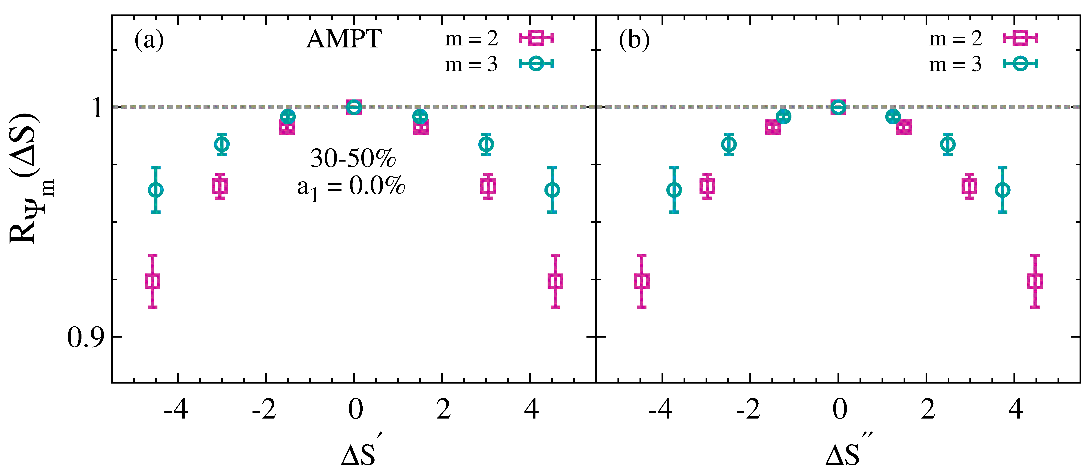
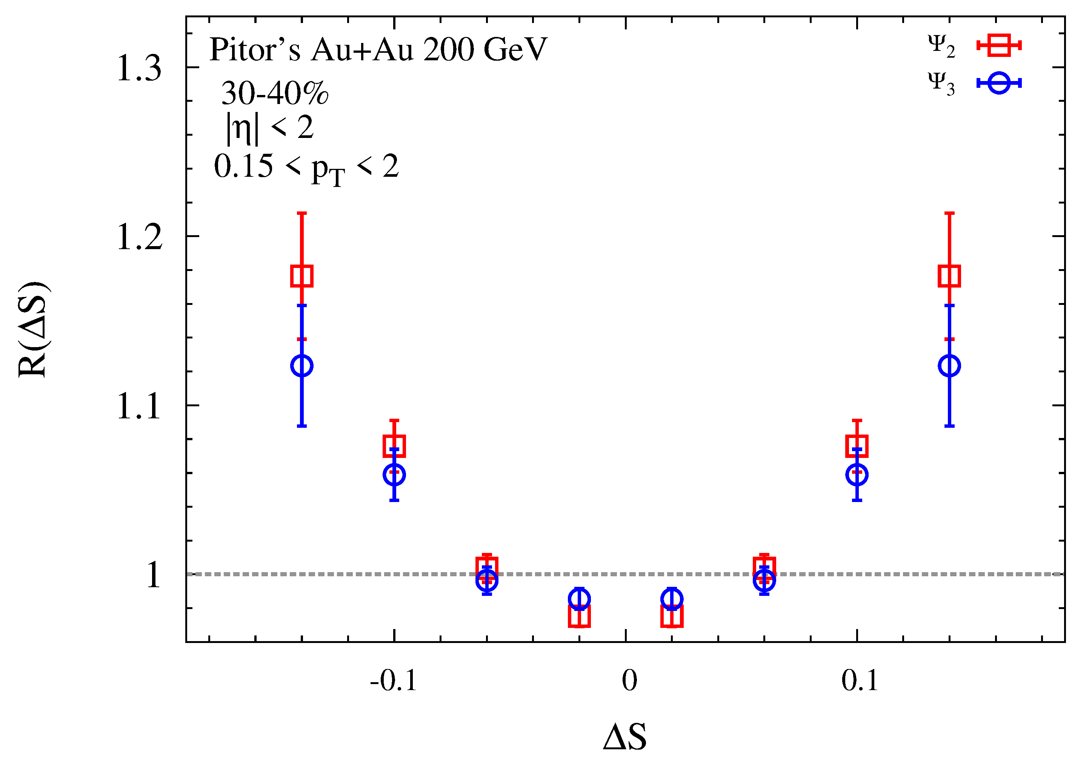
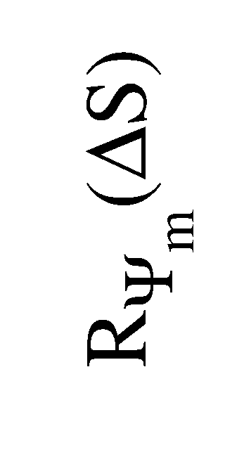
Correlator Response – background models
N. Magdy et al.
arXiv: 1710.01717
a₁=0.0%
Validation of the expected similarity between the patterns
for and for background-driven charge separation
A discernible difference in the response for signal and background
( and ) is a crucial and necessary requirement for unambiguous identification and characterization of CME-driven
charge separation.

Slide 13
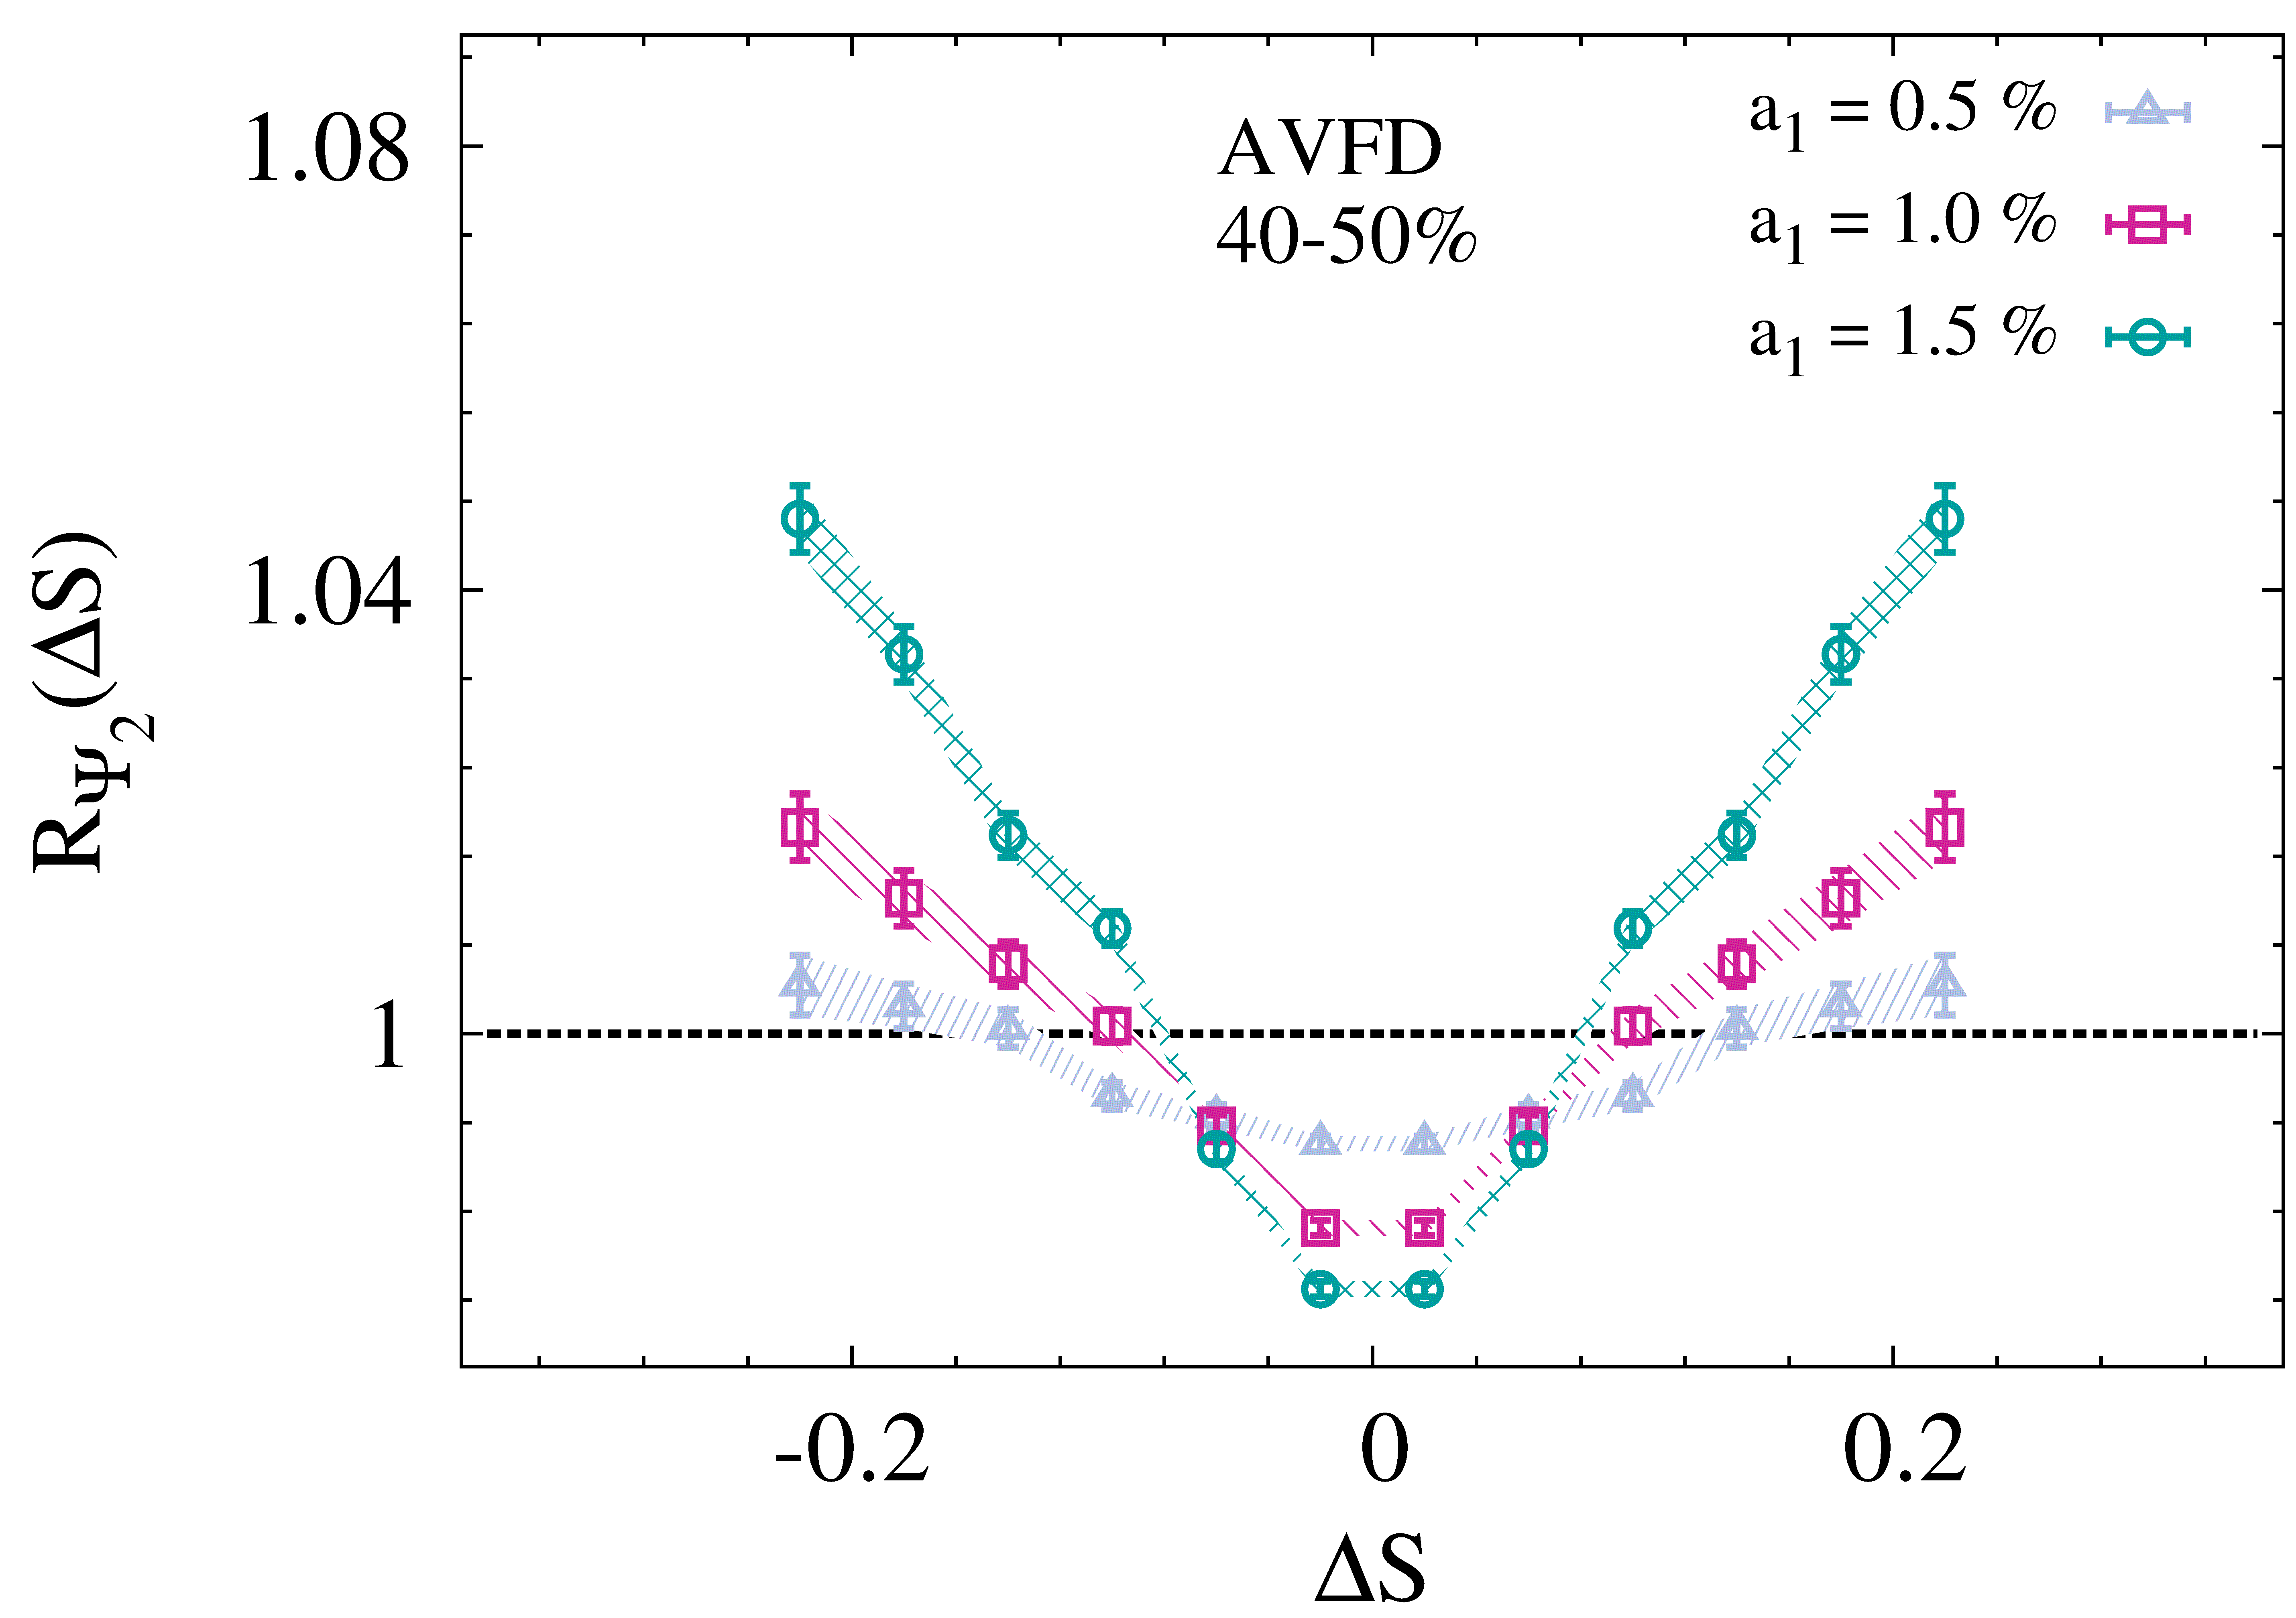
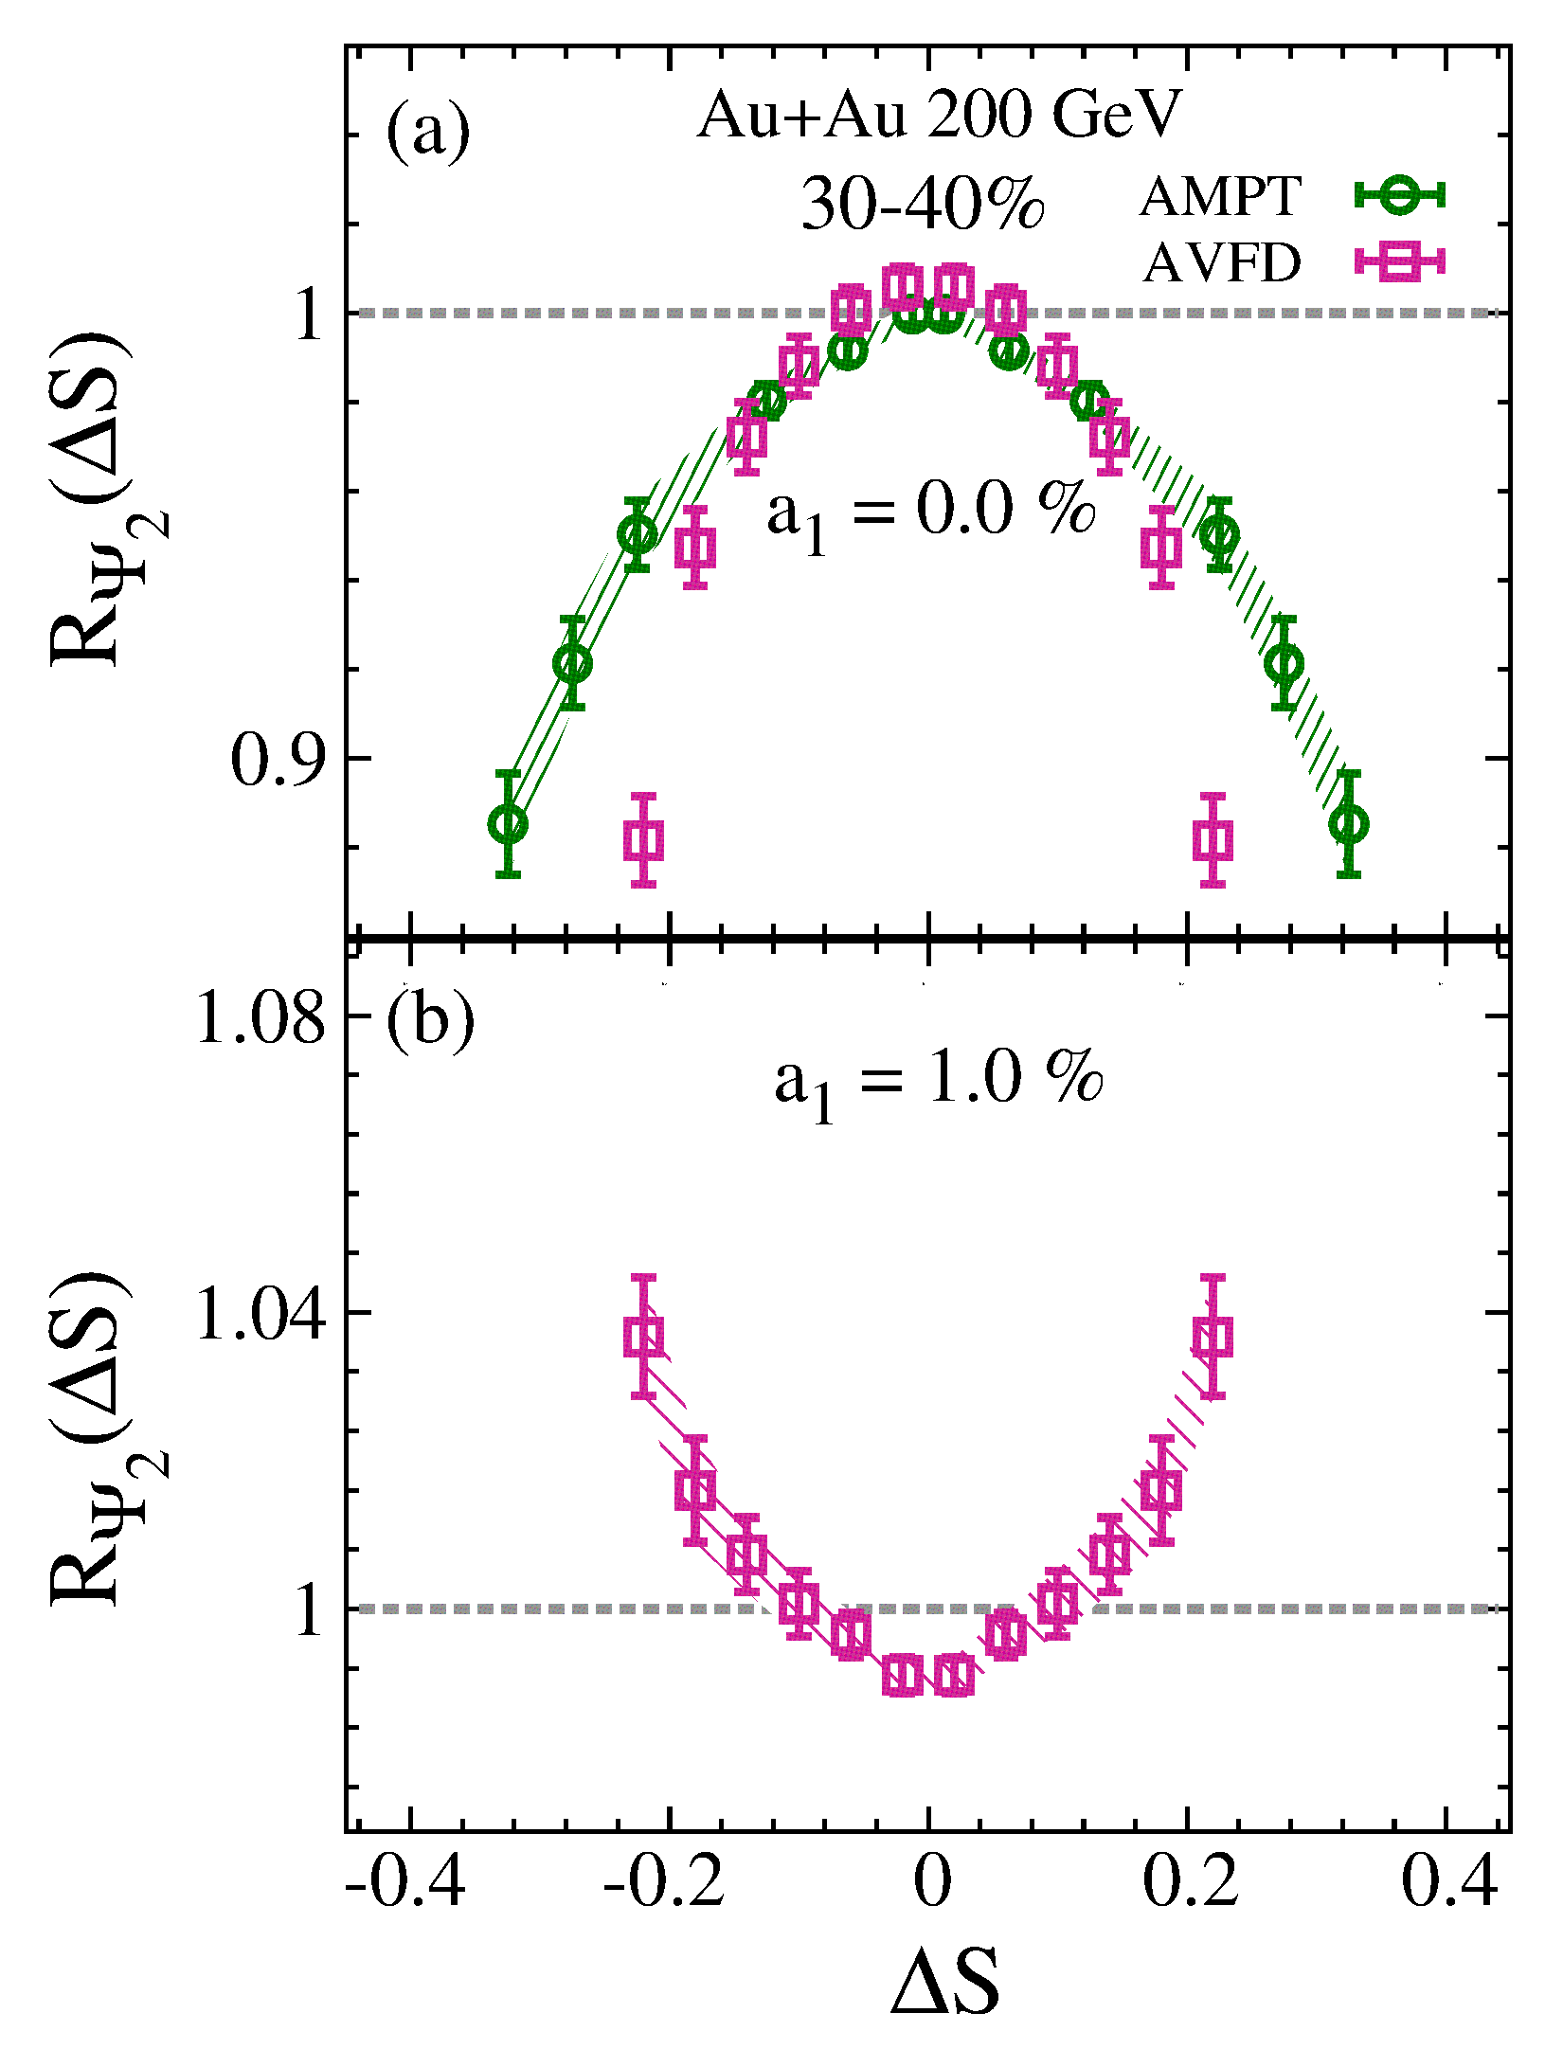
New Correlator Response – Signal + background
N. Magdy et al.
arXiv: 1710.01717
Signal magnitude reflected in the
widths of the distributions
  Smaller widths for larger input signal
Validation of the expected concave-shaped
response of to CME-driven
charge separation input in AVFD events.
Concaved-shape distribution
for input charge separation

Slide 14
New Correlator Response
N. Magdy et al.
arXiv: 1710.01717
Validation of the expected centrality dependence of
to CME-driven charge separation input in AVFD events.

Slide 15


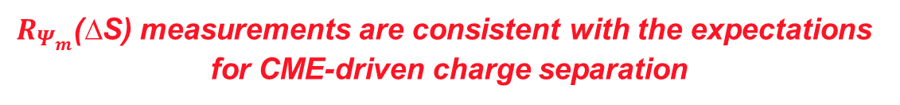

New Correlator Response – Data teaser
Au+Au
B
$Ψ_{2}$ plane
$Ψ_{B}$ and $Ψ_{2}$ correlated
plane
$Ψ_{B}$ and $Ψ_{2}$ ~ uncorrelated
STAR Preliminary
A decidedly “concave-shaped” distribution for peripheral Au+Au collisions
In contrast, an essentially flat distribution for p(d)+Au
  Validates the
    “reduced magnetic field strength”
    random B-field orientations
  in these collisions
Consistent with a CME-driven charge separation contribution in these collisions
$R_{Ψ_{m}}$(∆S) measurements are consistent with the expectations
for CME-driven charge separation

Slide 16
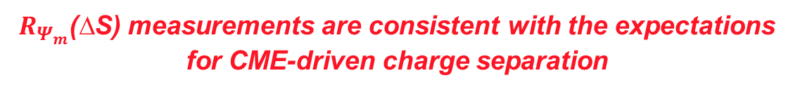
New Correlator Response – Data teaser
Au+Au
B
$Ψ_{2}$ plane
$Ψ_{B}$ and $Ψ_{2}$ correlated
$R_{Ψ_{m}}$(∆S) measurements are consistent with the expectations
for CME-driven charge separation

Slide 17
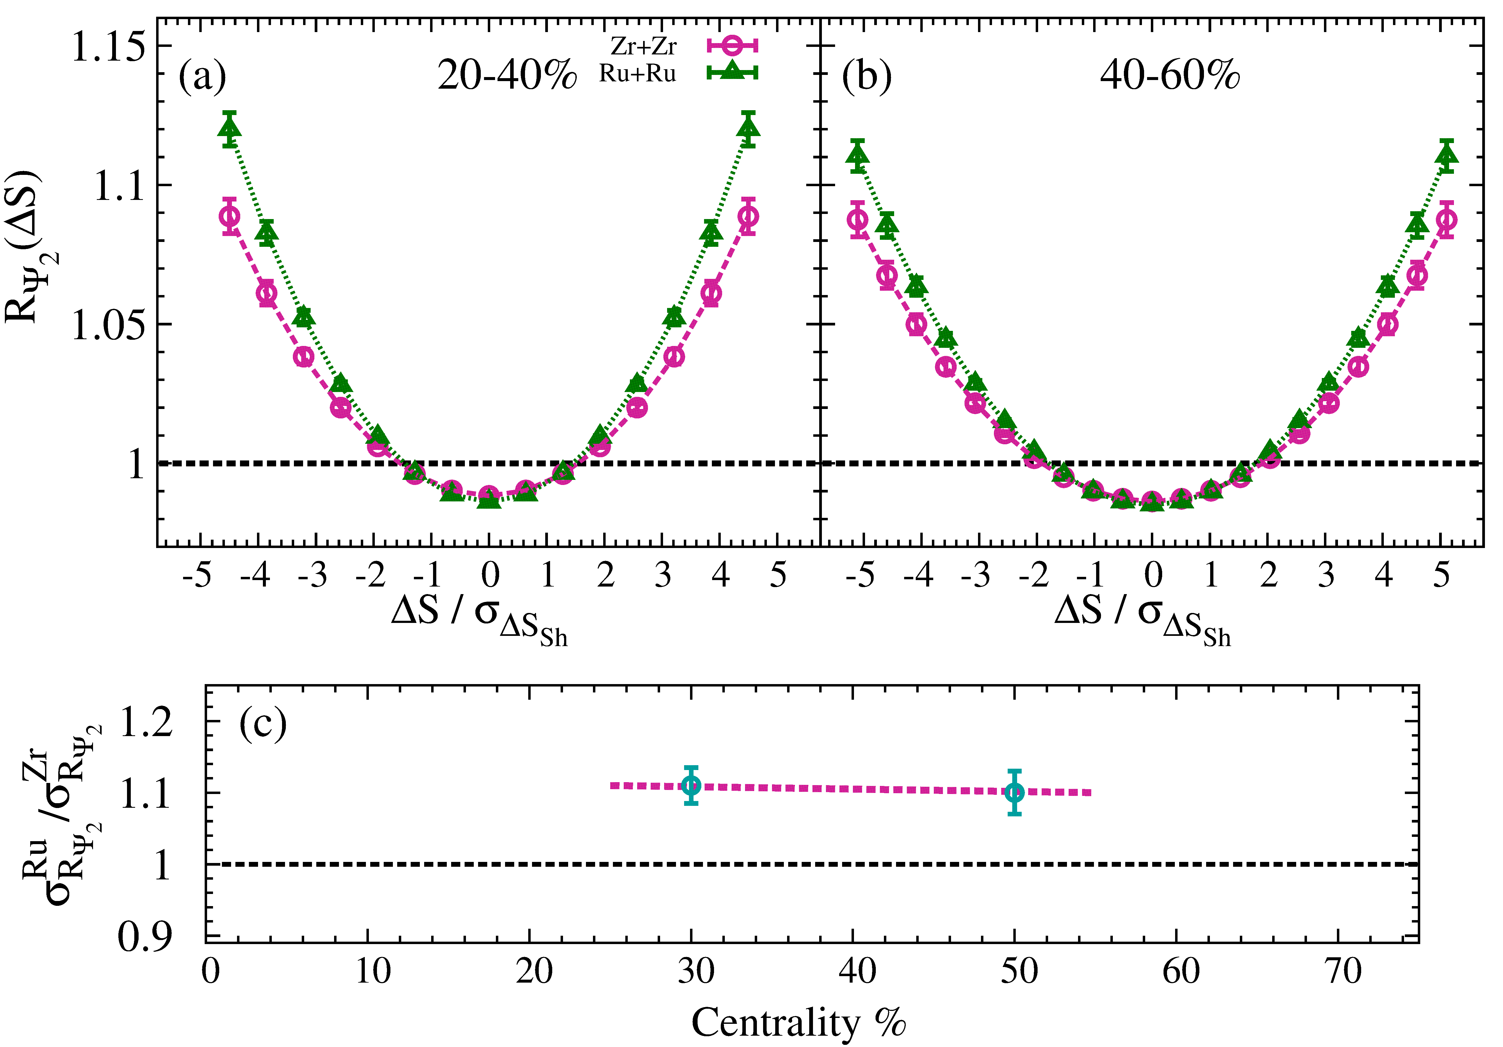
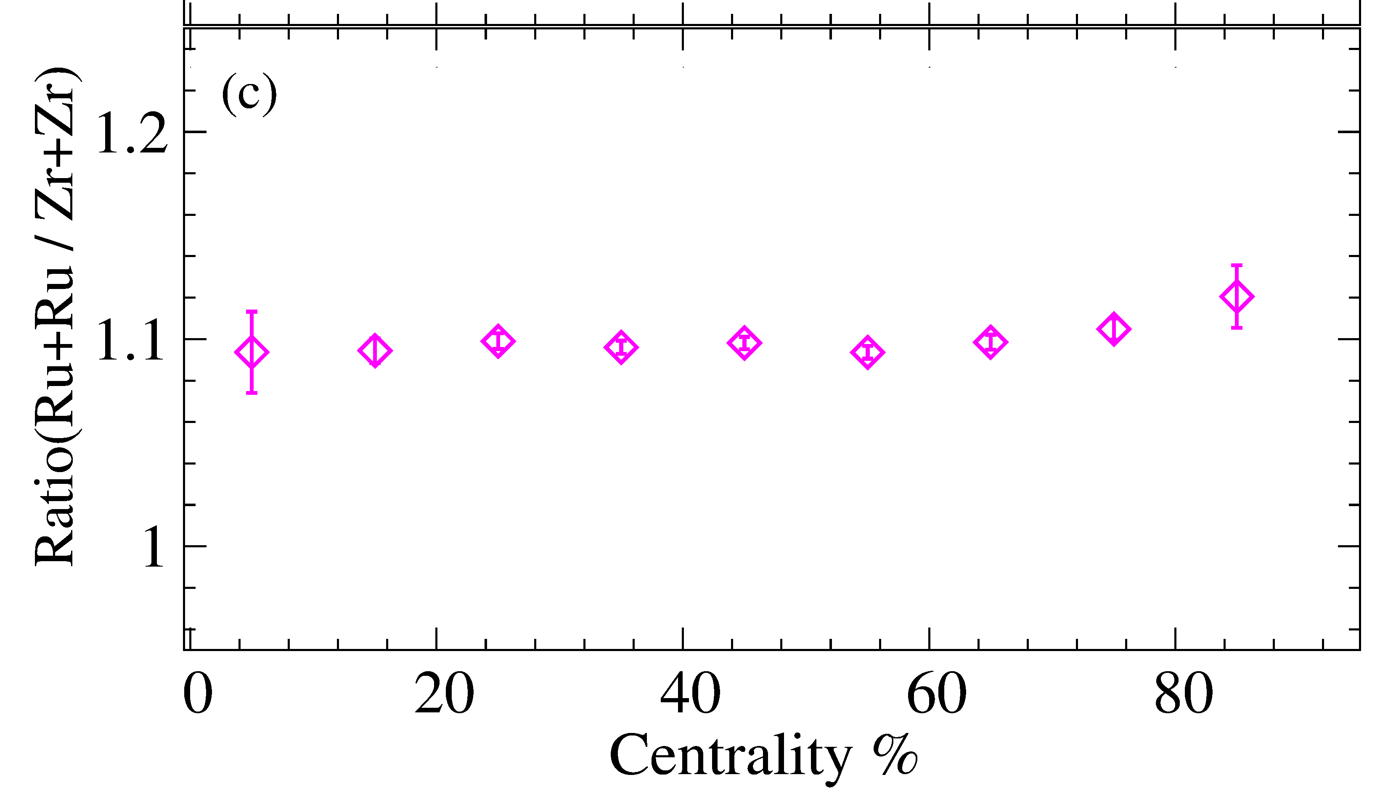
New Correlator Response
AVFD predictions for the Ru+Ru and Zr+Zr
isobaric systems
B-field difference
But similar background
for isobars
Validation of the expected
isobaric dependence of to
CME-driven charge separation
input in AVFD events.

Slide 18
New Correlator Response
AVFD predictions for the Ru+Ru and Zr+Zr
isobaric systems
B-field difference
But similar background
for isobars
B
B
Reaction
Plane $Ψ_{n}$
Reaction
Plane $Ψ_{2}$
y
x
Isobaric ratios of the correlation function can be used to characterize both signal and background – crucial for isobar run!

Slide 19
Summary
New charge-sensitive correlators have been developed to identify and characterize CME-driven charge separation
  This correlator suppresses, as well as measures the well known background contributions to the CME-driven charge separation signal
Validation tests, performed with several models, indicate that the correlators can give;
  discernible responses for background- and CME-driven charge separation which allows unambiguous identification and characterization of the CME
  Crucial information to characterize both signal and background in the isobar data
The experimentally measured correlators (to date) suggests the presence of a CME-driven charge separation in Au+Au collisions.

Slide 20
End

Slide 21

Chiral Magnetic Effect
Jiang et al., arXiv:1611.04586
B
Electric
Current
Chiral Magnetic
Conductivity
Reaction
Plane $Ψ_{n}$
Chiral Chemical
potential
y
x
Non-zero
Topological charge
Kharzeev
hep-ph/0406125
The Chiral Magnetic Effect (CME) results from anomalous chiral transport of the chiral fermions in the QGP, leading to the generation of an electric current along the magnetic field generated in the collision:
→ Leads to charge separation about the event plane
Charge separation leads to a dipole term in the azimuthal distribution of the produced charged hadrons:
Objective: identify & characterize this “dipole moment”

Slide 22


CME correlator status quo
Several measurements performed at RHIC and the LHC with the so-called Gamma Correlator;
Second order event plane
$Ψ_{B}$ =${ Ψ}_{RP}$
$$Ψ_{B}$$

Slide 23
Gamma correlator status quo & measurements
Local charge conservation is an especially important background
    Background-driven correlations can account for a part, or all of the observed charge separation signal?

