Slide 1
Elektronika i Akwizycja Danych w NZ22
Prof. Piotr Bednarczyk
Bieżące eksperymenty w CCB
Systemy akwizycji danych- DAQ
R&D dot. Detektorów scyntylacyjnych i ich FEE

Slide 2


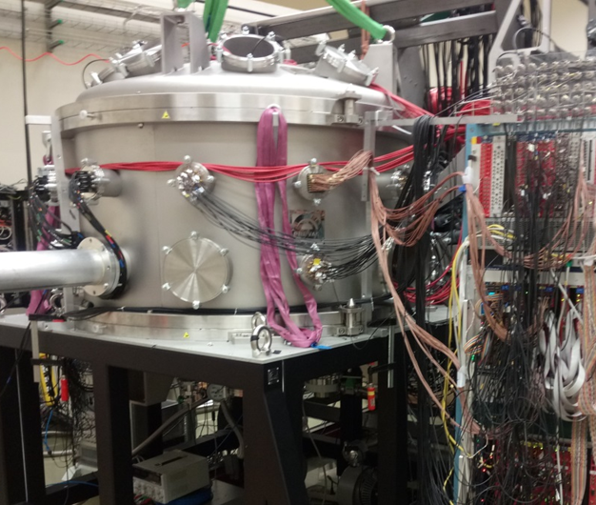
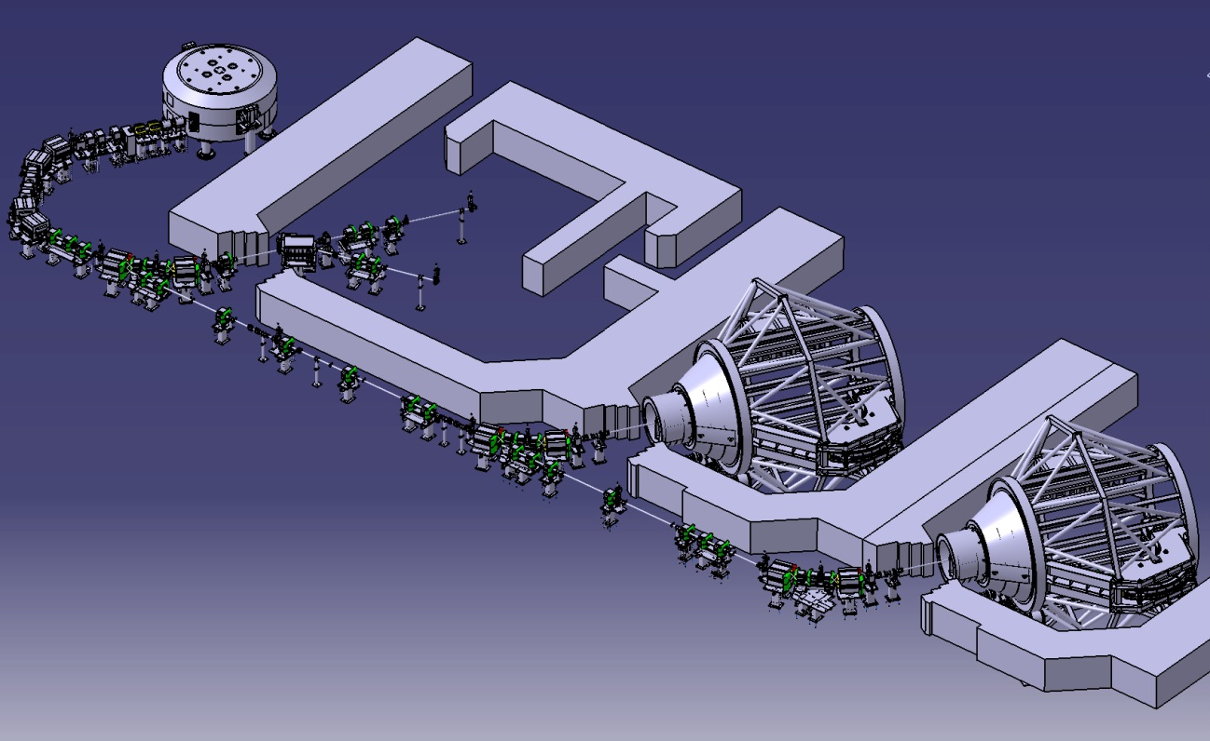
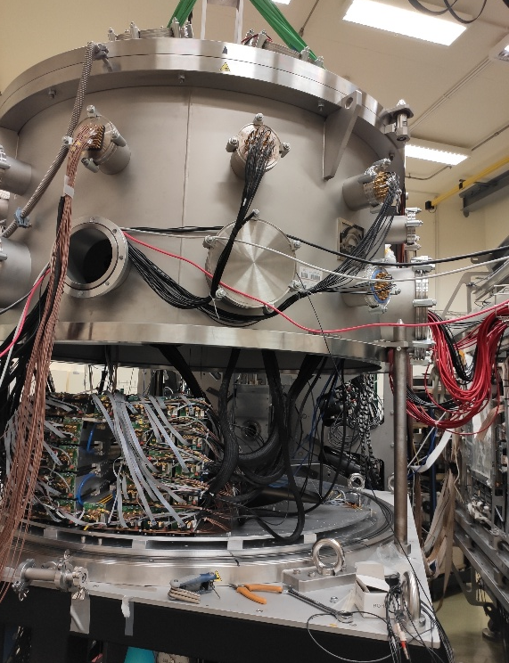
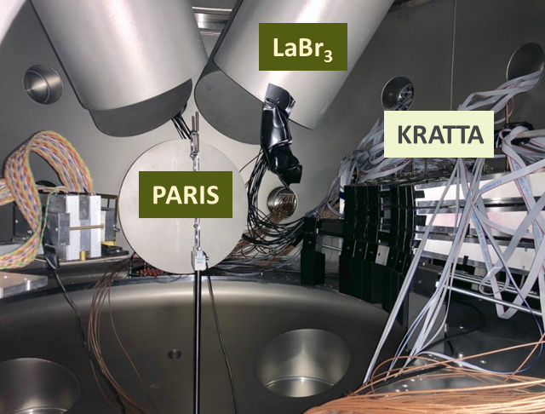
NZ22
Cyclotron (IBA) – protons E = 230 MeV
Energy Selector
(70-230 MeV Δp/p<0.7%)
Eye therapy
Exp. hall for NP. experiments
dynamics of a few-nucleon systems (BINA)
Collective and high-energy excitations in nuclei e.g., giant nuclear resonances, continuum coupling,… (PARIS, KRATTA, SSD,…)
gamma-ray spectroscopy of nuclei produced in the process of proton-induced fission and spallation,
tests of detectors for the large scale nuclear physics facilities (SPIRAL2, FAIR).

Slide 3
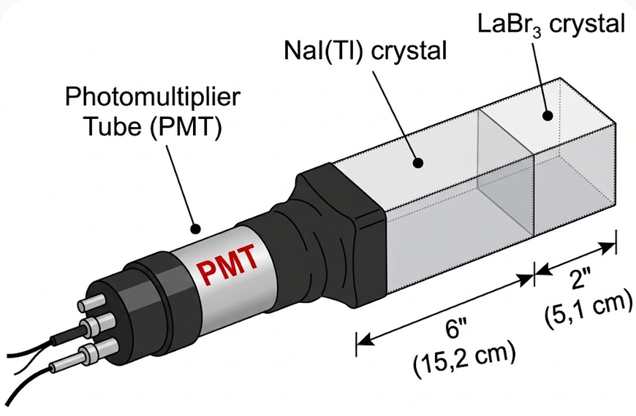
Detektory, utrzymanie, rozwój, prototypowanie
Bieżące utrzymanie sprawności detektorów: scyntylatory LaBr₃:NaI, CeBr₃:Nai, LaBr₃, BaF₂, moduły krzemowe DSSD, układ KRATTA (plastik, krzem, krzem, CsI, CsI), planowane detektory gazowe THGEM i inne (na przykład ciekłe scyntylatory – neutrony)
Testy detektorów na wiązce protonów CCB. Prototypowanie nowych detektorów na przykład FINGER dla GSI/FAIR. Nowe metody odczytu scyntylatorów – SiPM i układ FERS.
Duże zapotrzebowanie na dobrze wyposażone laboratorium detektorowe z podstawową działalnością elektroniczną (proste projekty płytek itp.).

Slide 4
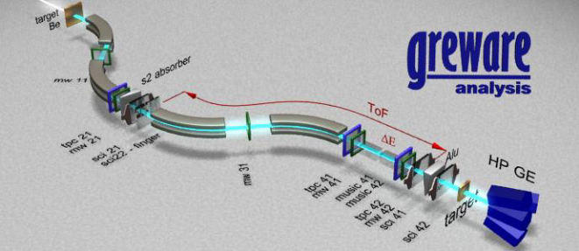
DAQ LOGIC
So far CCB DAQ based on VME oriented MBS (Multi Branch System, GSI)
New type of digitizers (CAEN)
Typical data streams: KRATTA – V1724 (traces); scintillators (LaBr, PARIS) V1730 (DPP-PSD ), DSSD V2740 (currently traces), THGEM gas detectors V1730.
FERS (Front-End Readout System) dedicated for large matrices of SiPM (FINGER-FAIR, RFD).
Synchronisation using timestamps.
Validation to select interesting data to be acquired.
Online data visualisation and analysis (GreWare, IFJ PAN).
J.Grebosz

Slide 5
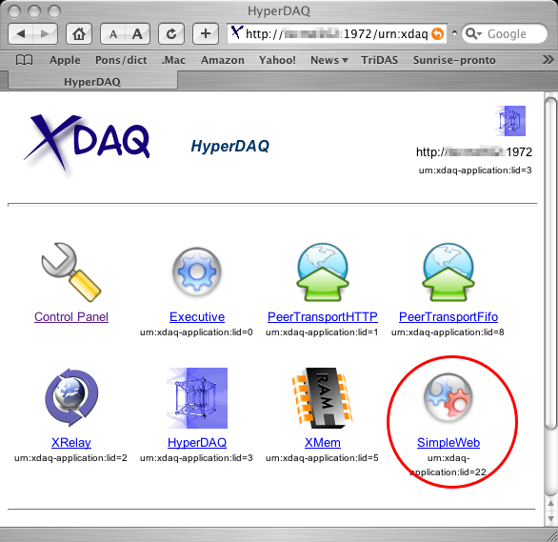
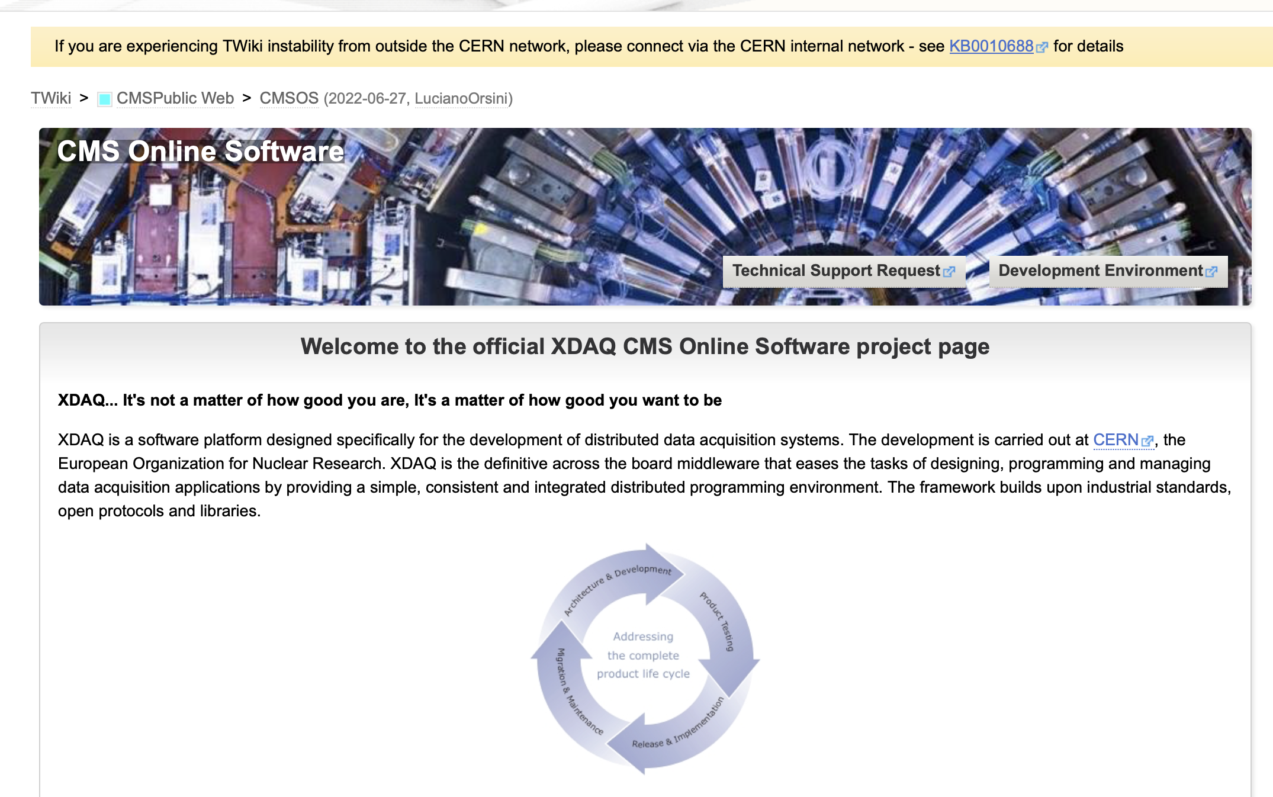
XDAQ for nuclear physics
Software platform developed at CERN and design specifically for the development of distributed DAQ
Standard DAQ framework for CMS experiment
XDAQ provides:
  Platform independent services
  Peer-to-peer communication between DAQ blocks
  SOAP messaging for configuration/control/monitoring
Main Features:
  Device access
  Configuration, control and monitoring
  Maintainability and portability
  Scalability
Long standing experience at LNL:
  GASP spectrometer
  PRISMA/PISOLO,EXOTIC spectrometers
  GALILEO spectrometer
  AGATA ancillaries
N. Toniolo, INFN LNL

Slide 6

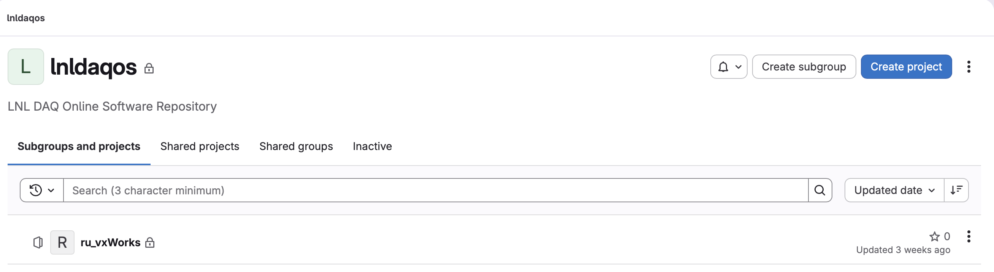
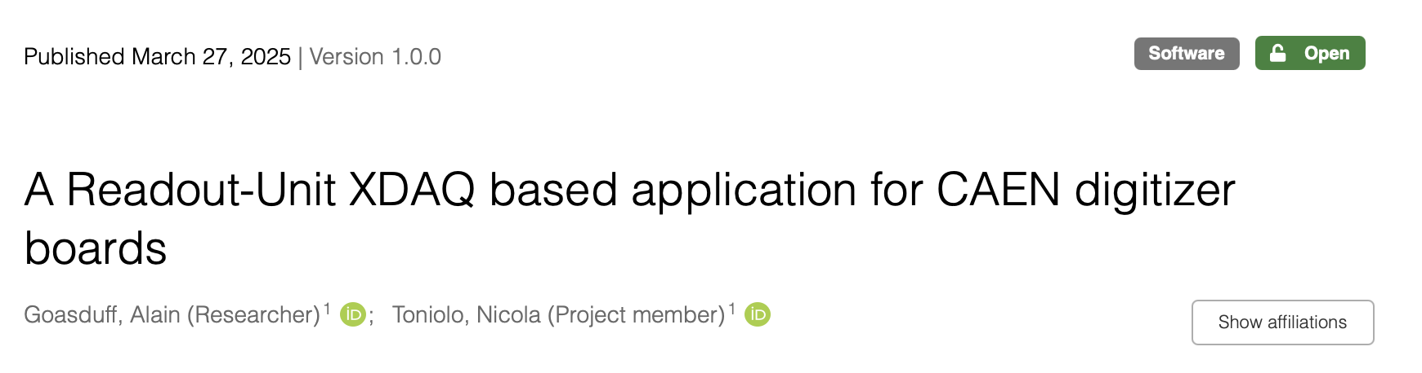
XDAQ for nuclear physics (implementation at LNL Legnaro)
Synchronized starts:
CAEN VME controllers
Arduino
Readout systems:
Digitizers V1:
  V1725/V1730 (used at LNL, PARIS, HIL, LUNA)
Digitizers V2:
  V2740 (used for AGATA test bench / Silicon detectors)
New digital peak-sensing ADC:
  V1741 (tested on PRISMA, used for EXOTIC/DANTE)
Compatible with the old ADC/TDC readout:
  V778 (ADCs) / V775 (TDCs)
N. Toniolo, INFN LNL
https://zenodo.org/records/15095314

Slide 7
Modular structure
CAEN
Electronics
Readout Server
DAQ topology described in XML files
Configurable outputs:
  SPY: complete or partial data quality monitoring (depending on the load)
  DISK: writing all data on disk
  Network: Passing all data to the next DAQ actor.
Chain can be cut at any level
Actors can be added to the chain to perform specific operation on the data
Readout Unit
Data Filtering
Event Builder
Software trigger?
N. Toniolo, INFN LNL

Slide 8
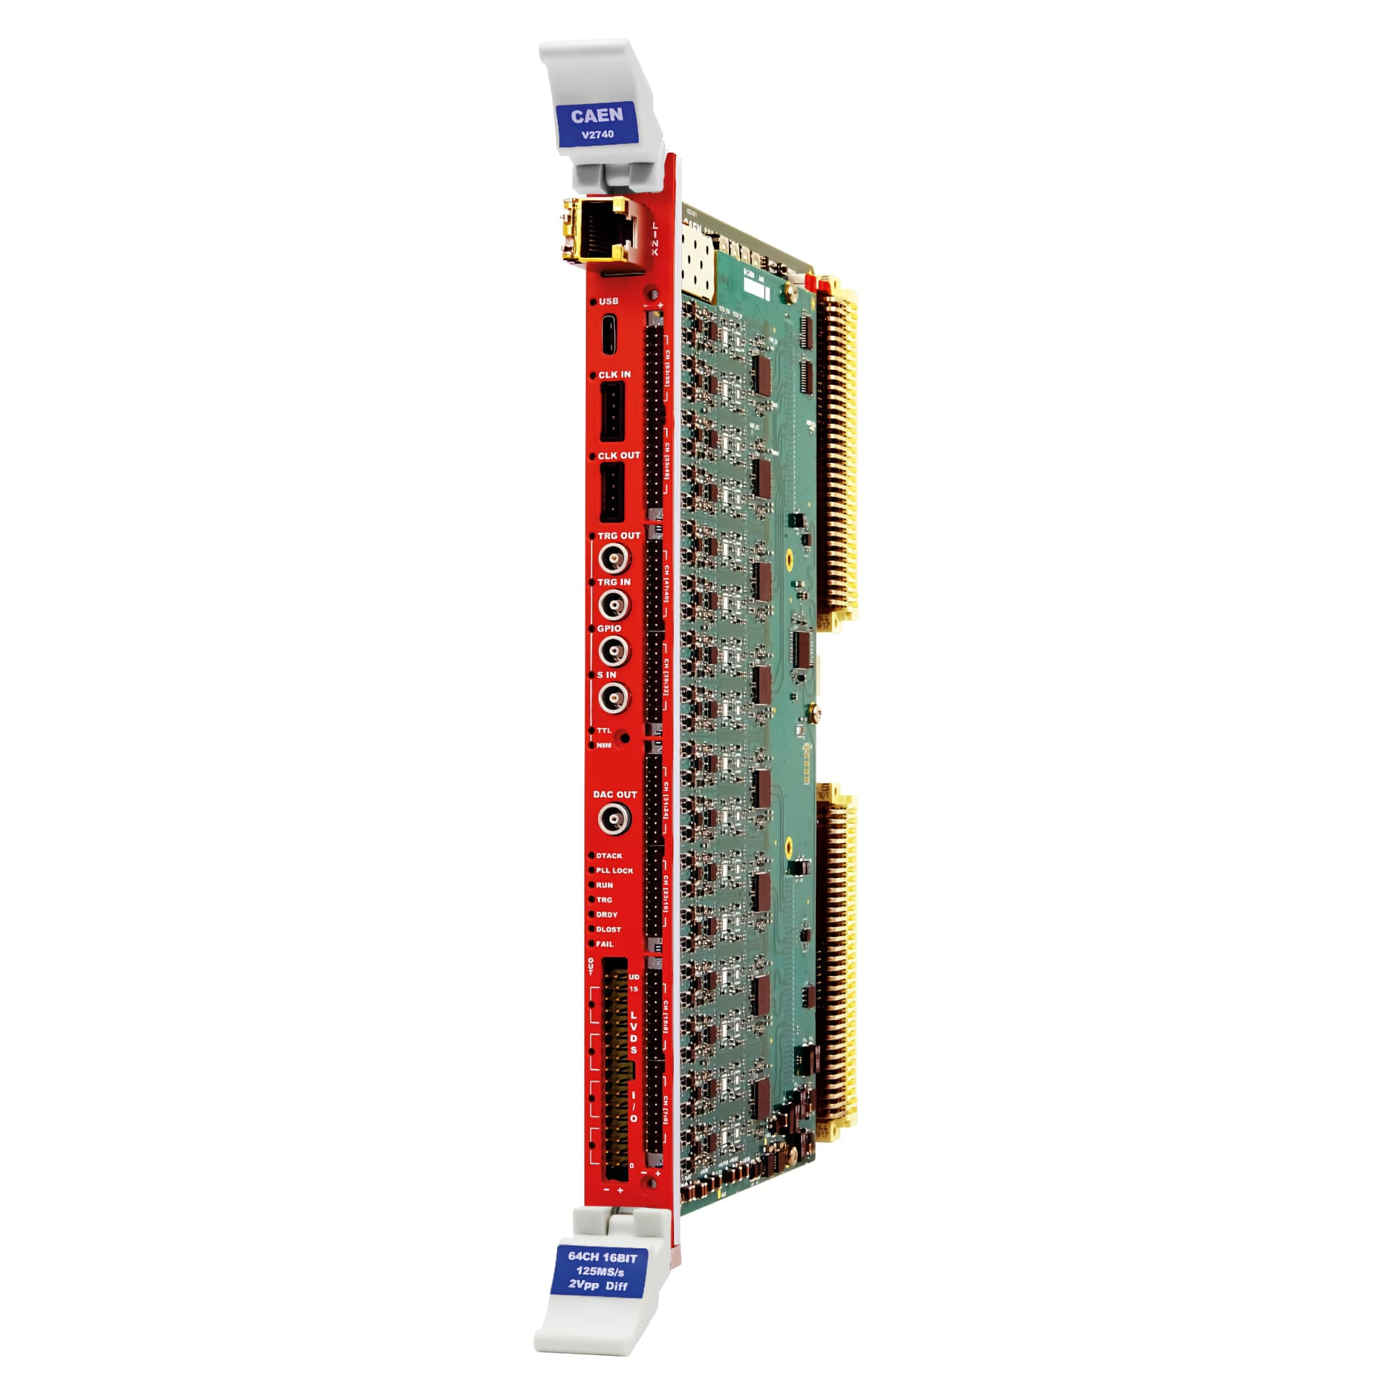
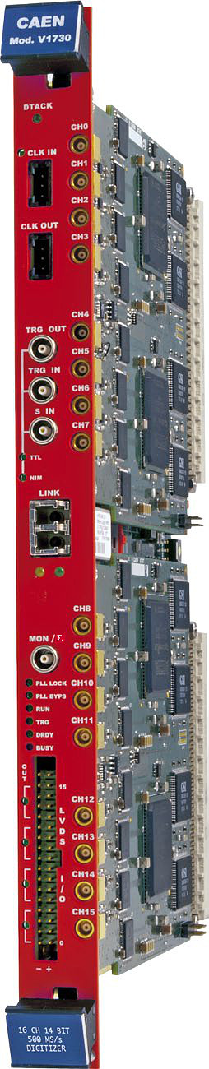
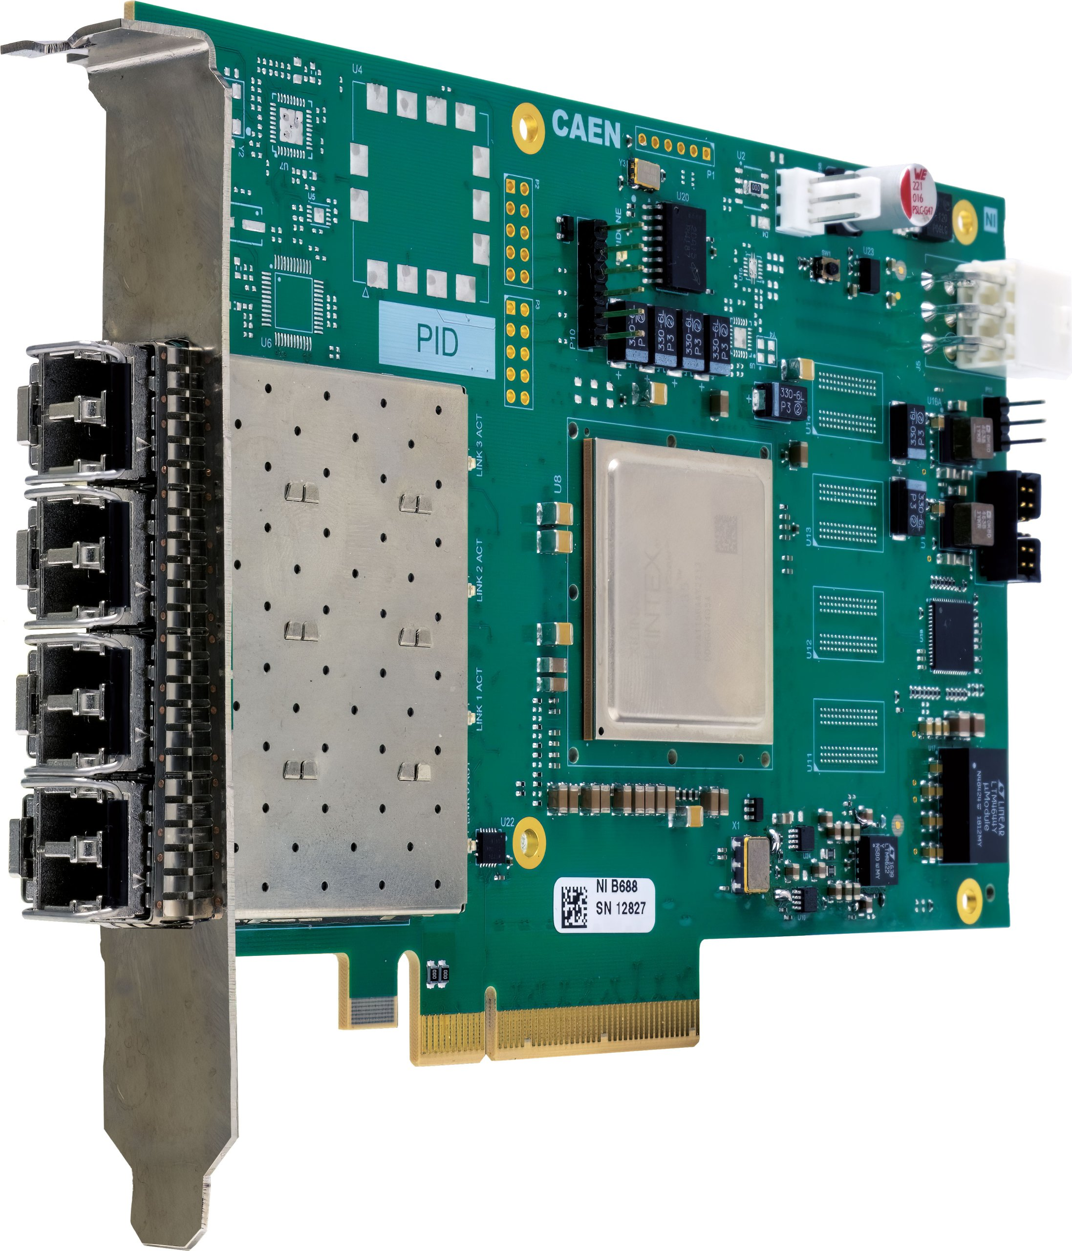
Electronics boards to be serviced (currently considered)
CAEN digitizers: V1730, V1724, V2740, V27XX family (in the near future), as well as the V4718 VME bridge.
PCI Cards with optical links :
2 x CAEN A5818 (4 port),
1 x CAEN A3818 (2 port).
Hardware: dedicated server.

Slide 9
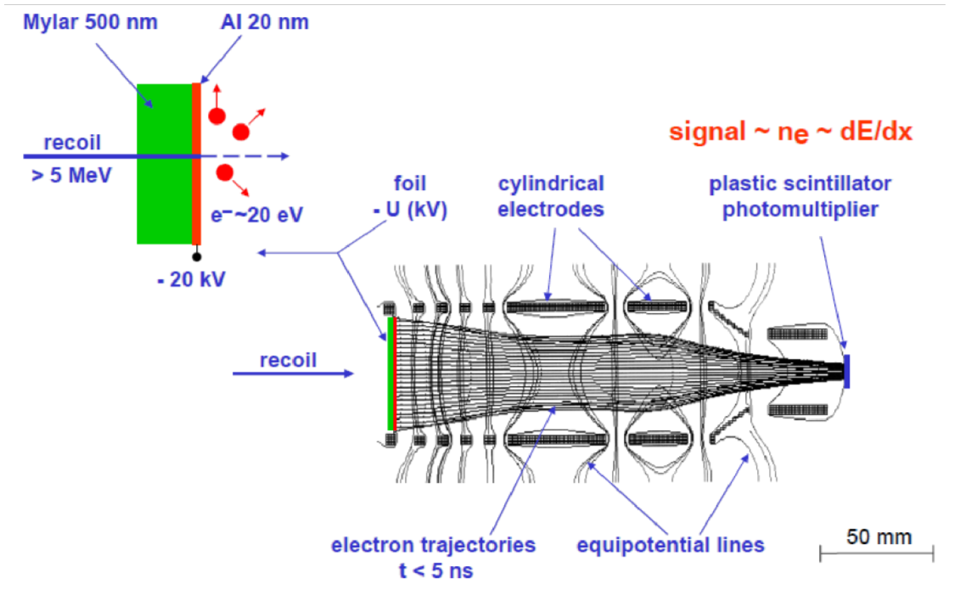
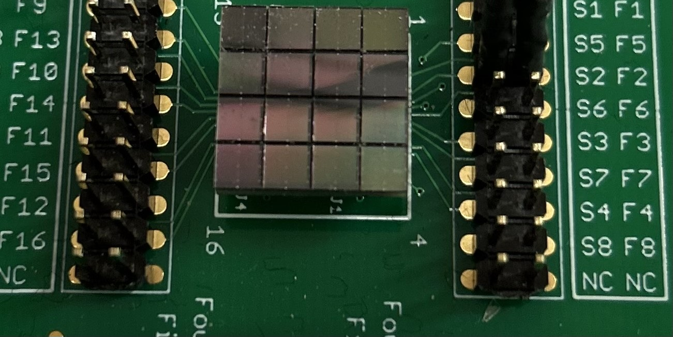
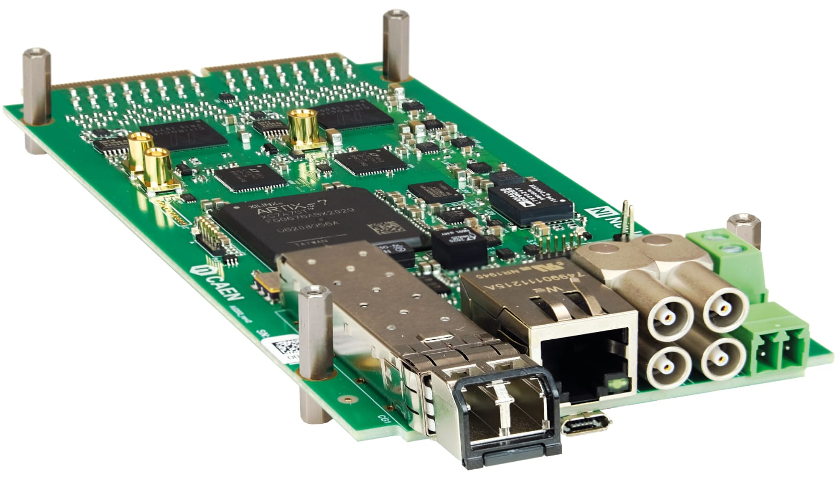
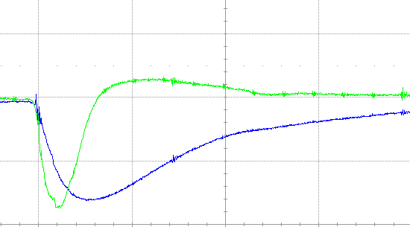
RFD Upgrade
Active elements modernization:
1) Scintillators, isolators, Mylar foil, resistors
2) New generation of PMTs - Silicon PhotoMultipliers (SiPM)
Many more readout channels (from 18 up to 288)
higher segmentation (lower rate/load per channel, previously ~1MHz/channel)
higher counting rate capabilities
Heavy ion detection unit (one of 18)
Mylar foil
Scintillator+PMT
recoil
secondary electrons
Each SiPM:
Slow output
Fast output
HV~26-29V
New fast digital data readout
CAEN solutions dedicated to SiPM (A5202/A5204)
No hardware filtering (no external logic for trigger)
Reduced deadtime
fast output
standard output
This improvement will significantly boost the RFD efficiency
Timebase = 100 ns/div
<number>

Slide 10


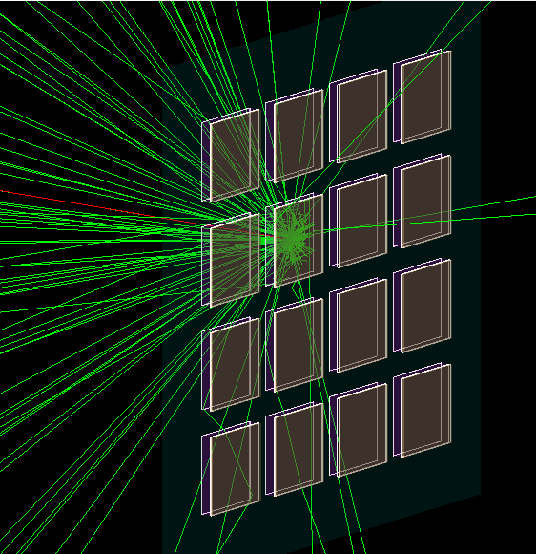
Light propagation - simulations
Geant4 simulations
Blue : 2mm plastic. Purple : glass cap. Red : electron 20 keV.
Green : optical photons.
10um plastic

Slide 11
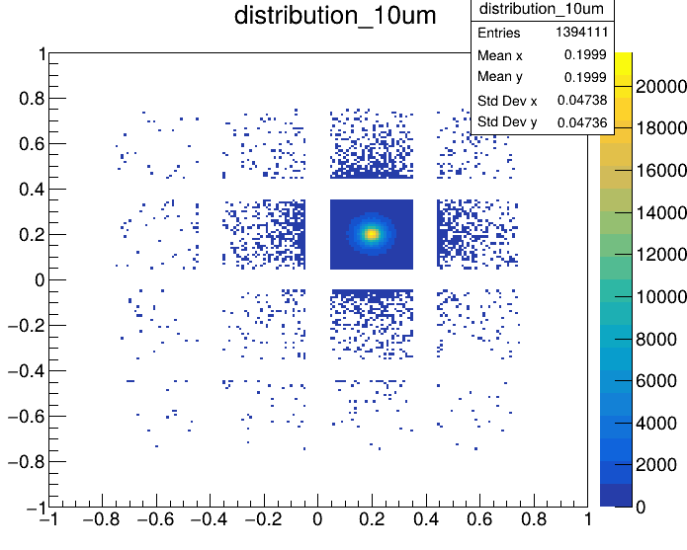
Light propagation - simulations
Geant4 simulations
cm
cm

Slide 12
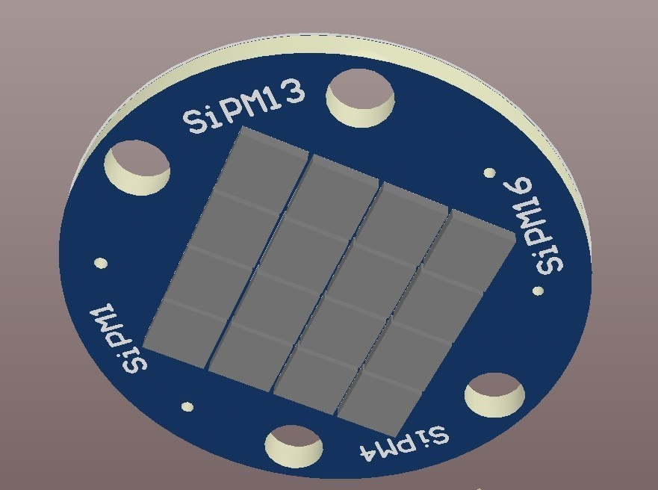
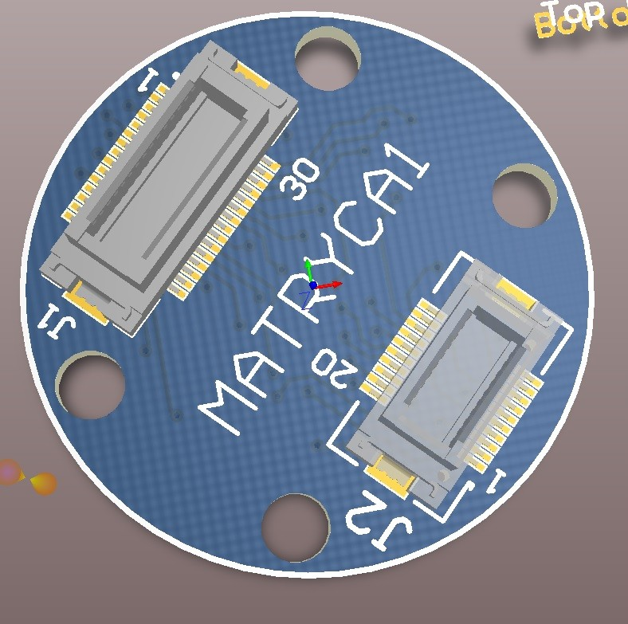
RFD Upgrade – in-house matrix design
J−30035 SiPM sensors – same as in Onsemi Matrix
48 channels (sow, fast, HV – x 16)
2 spare channels
6 pieces ordered - delivery on June 6
11

Slide 13
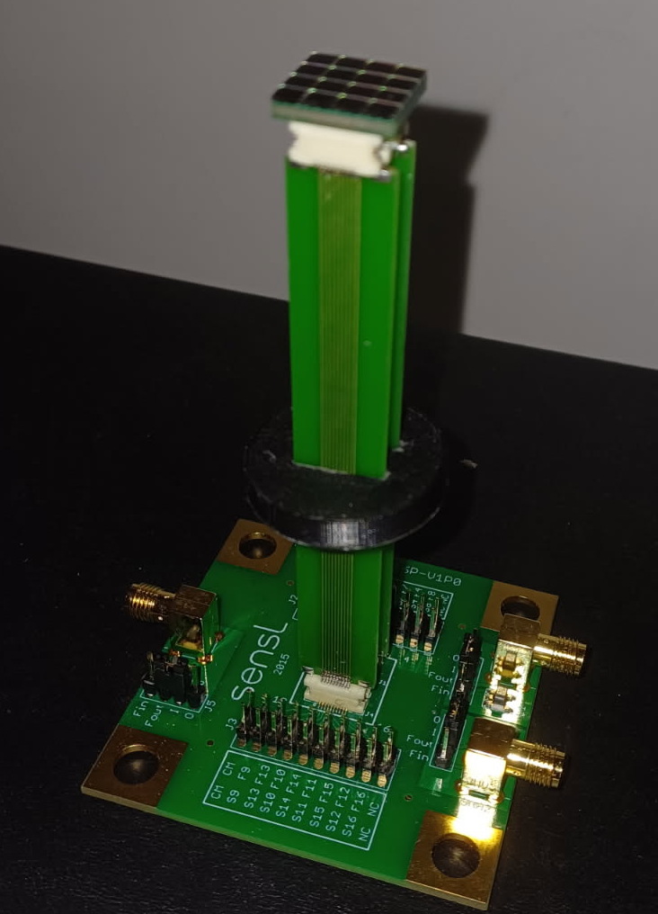
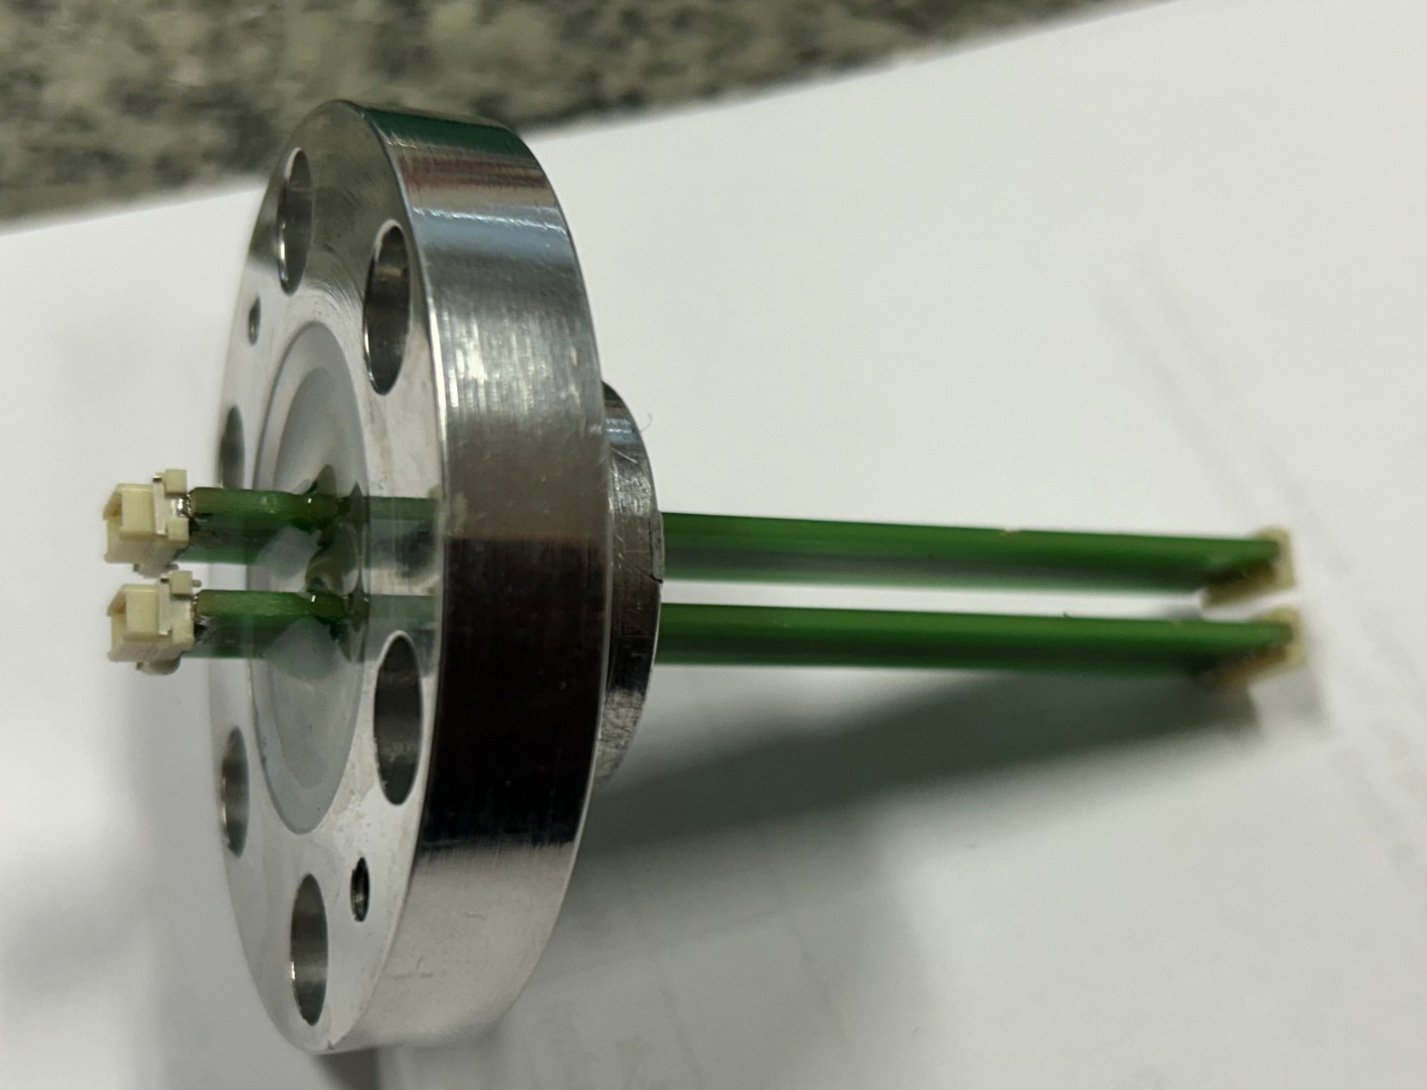
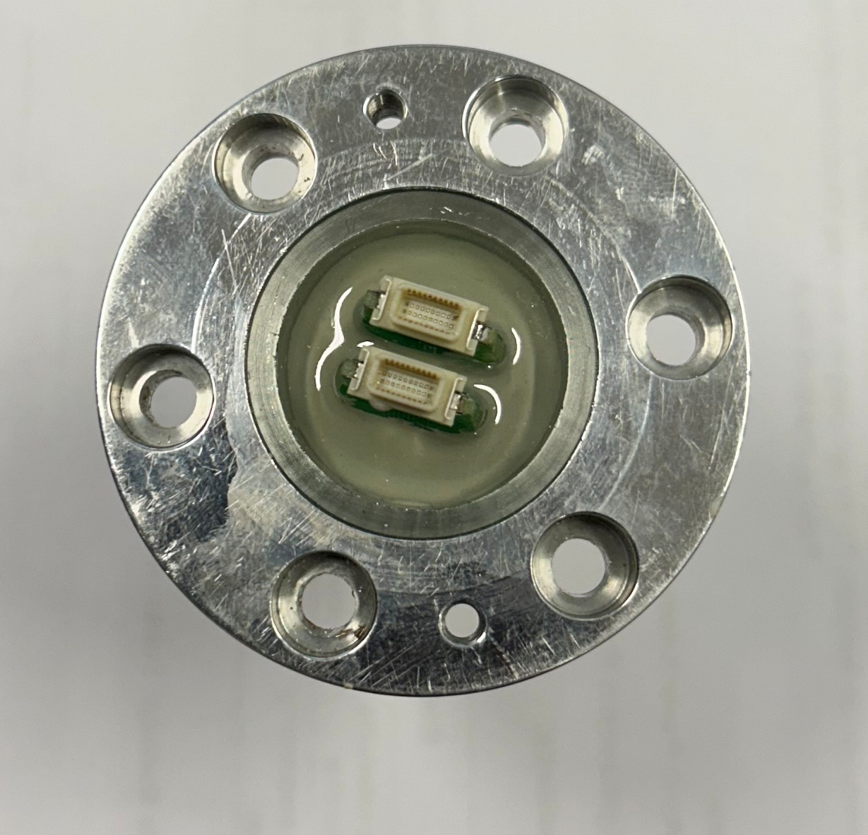
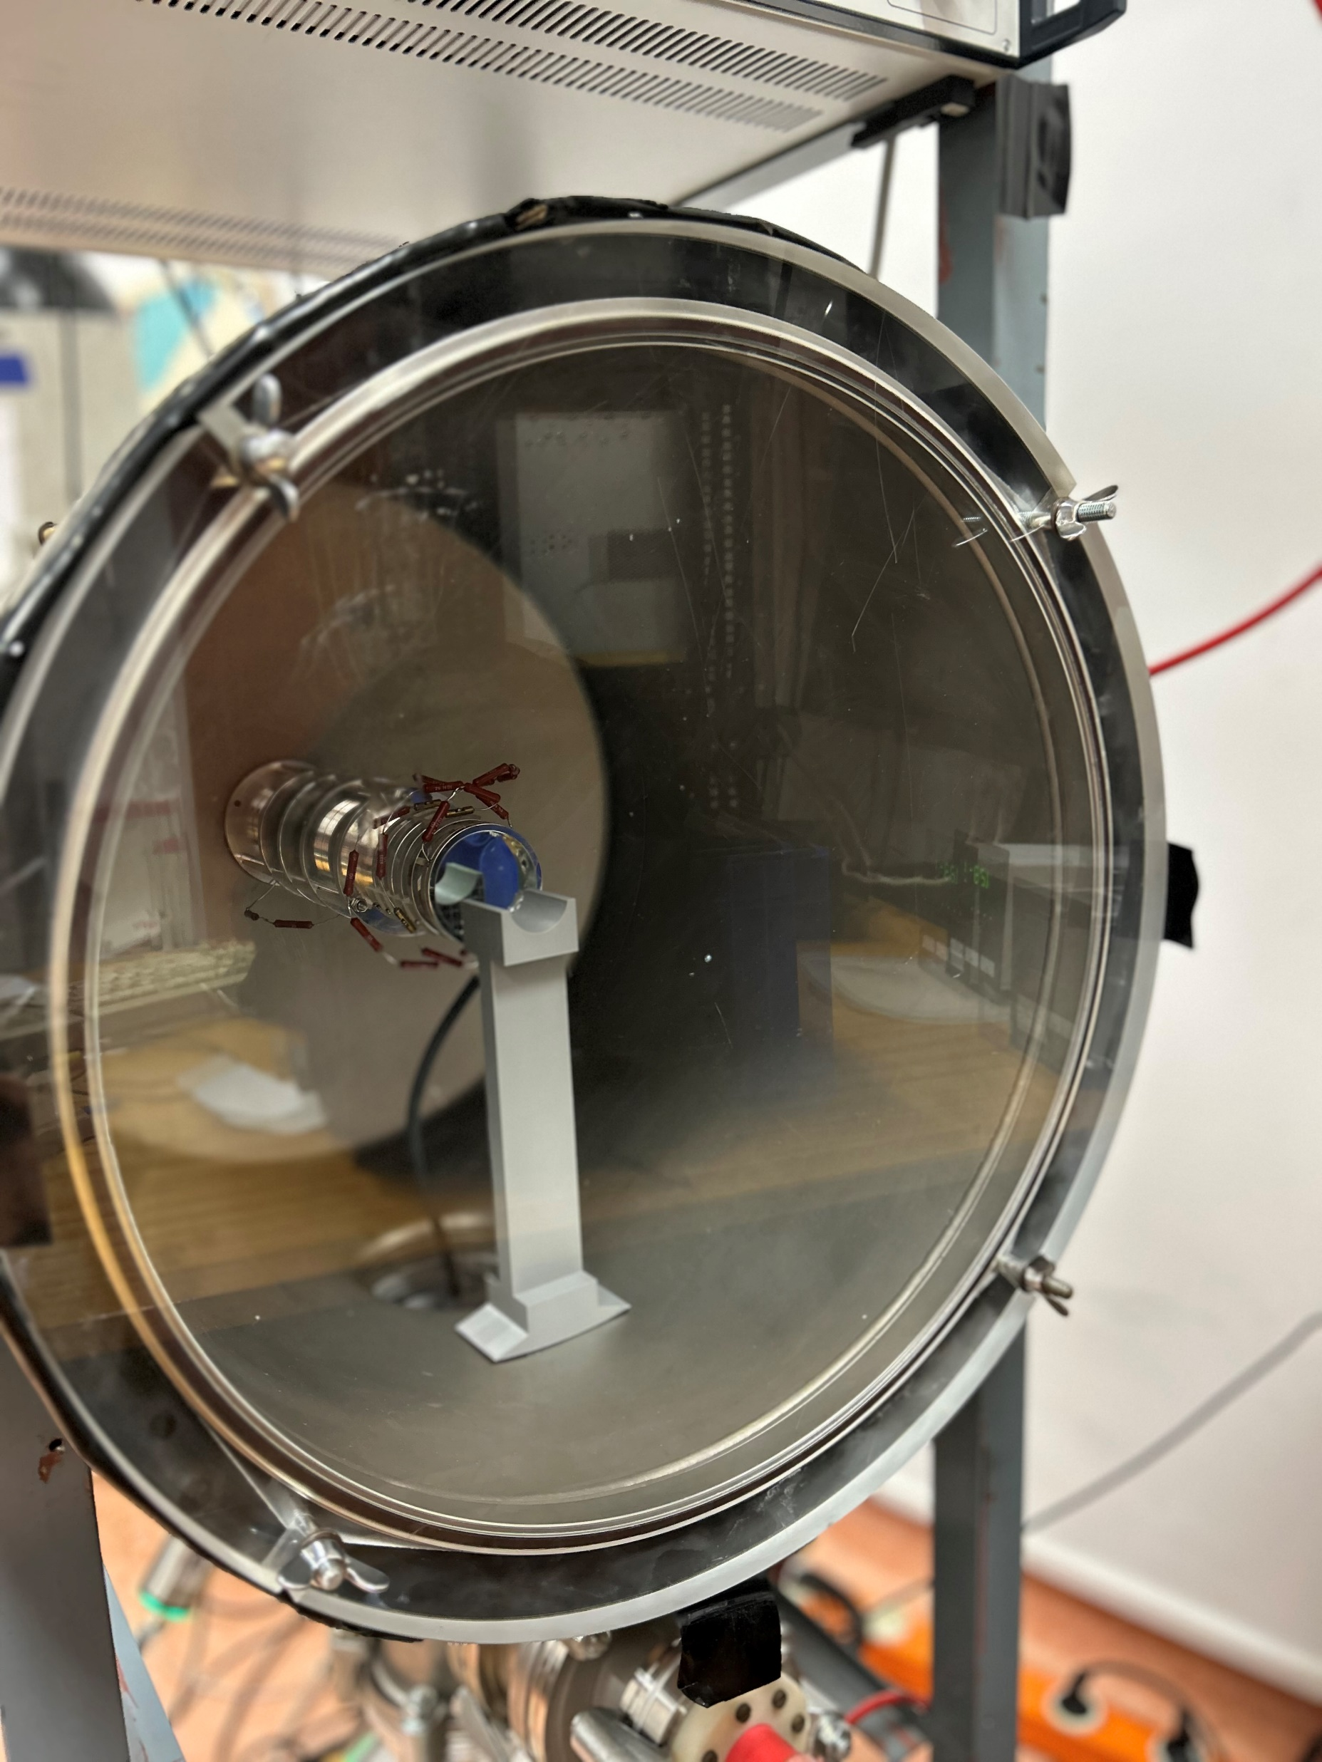
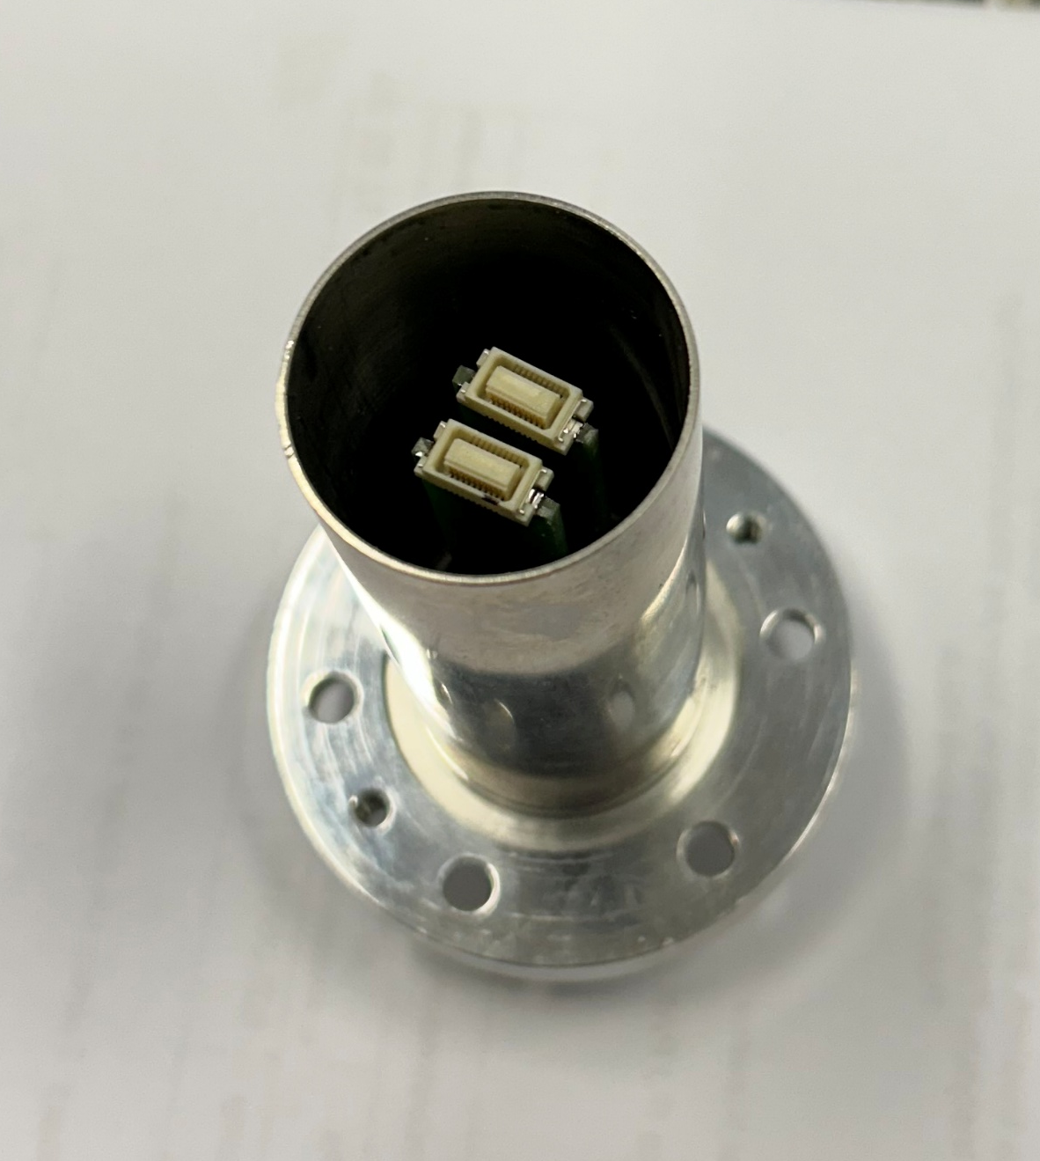
RFD Upgrade – Vacuum passage
We tested this solution in the vacuum chamber, and it is leak-proof
Our newly designed matrix has more channels, one socket is larger

Slide 14
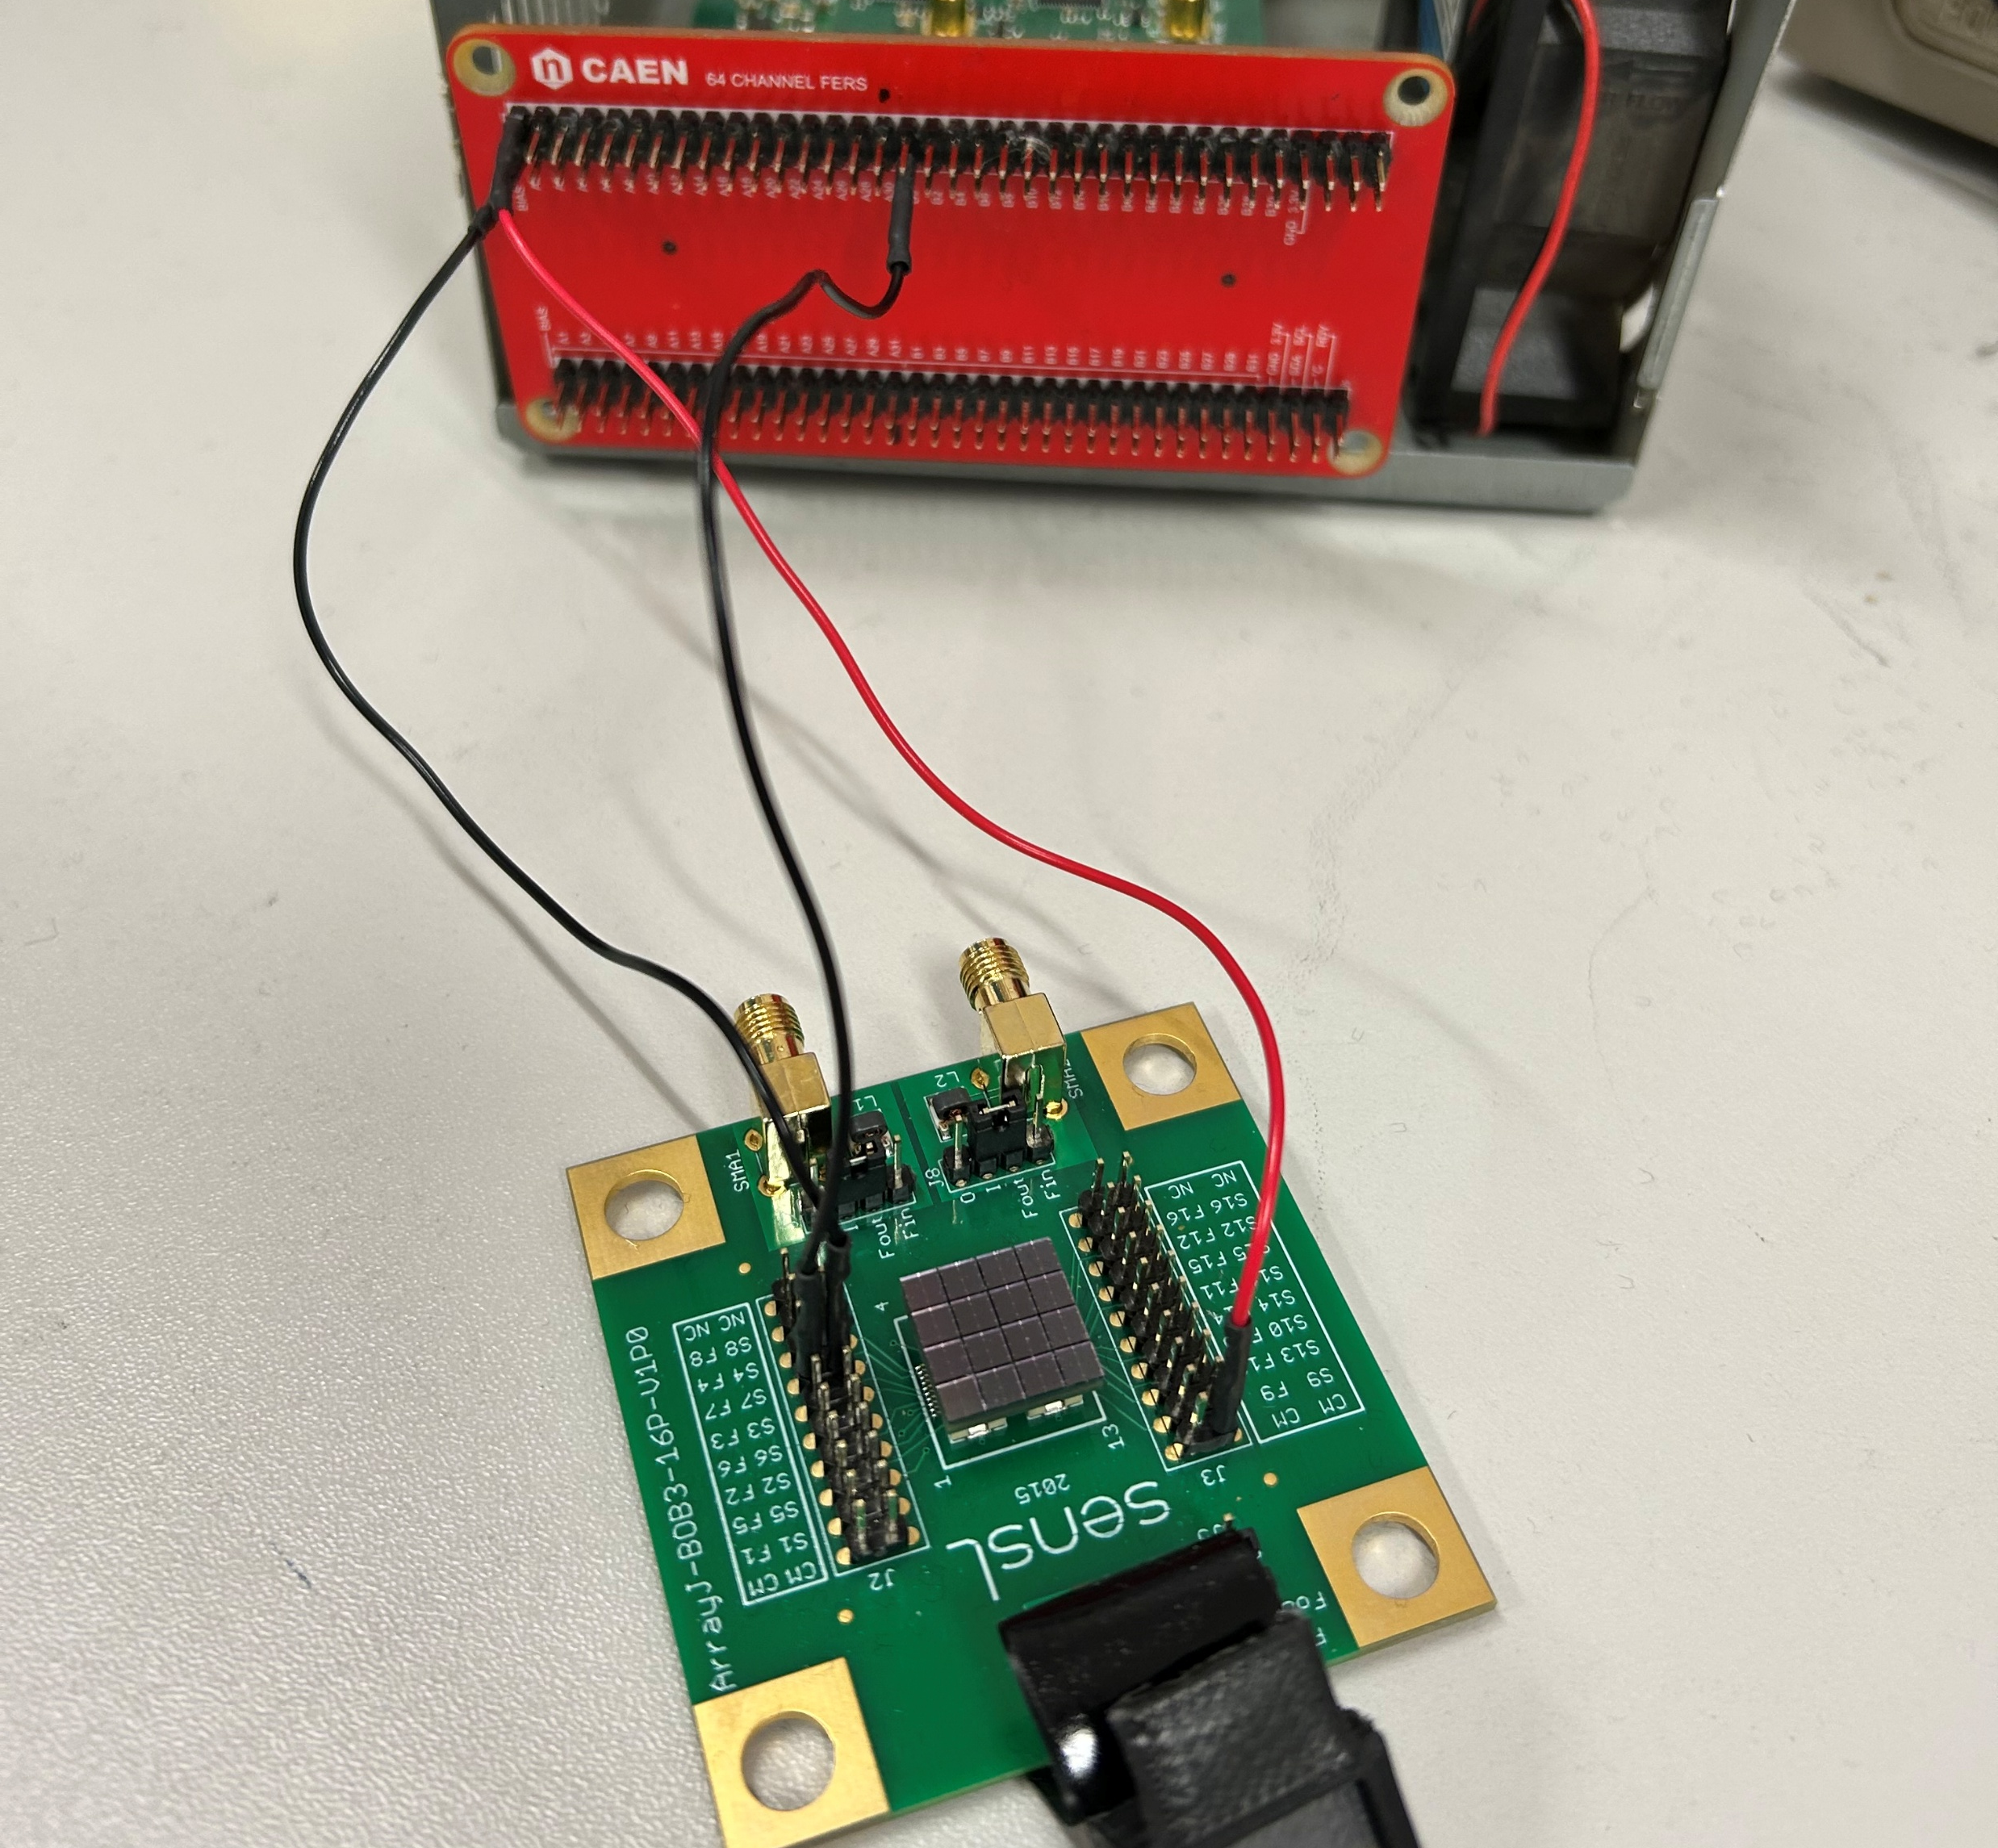
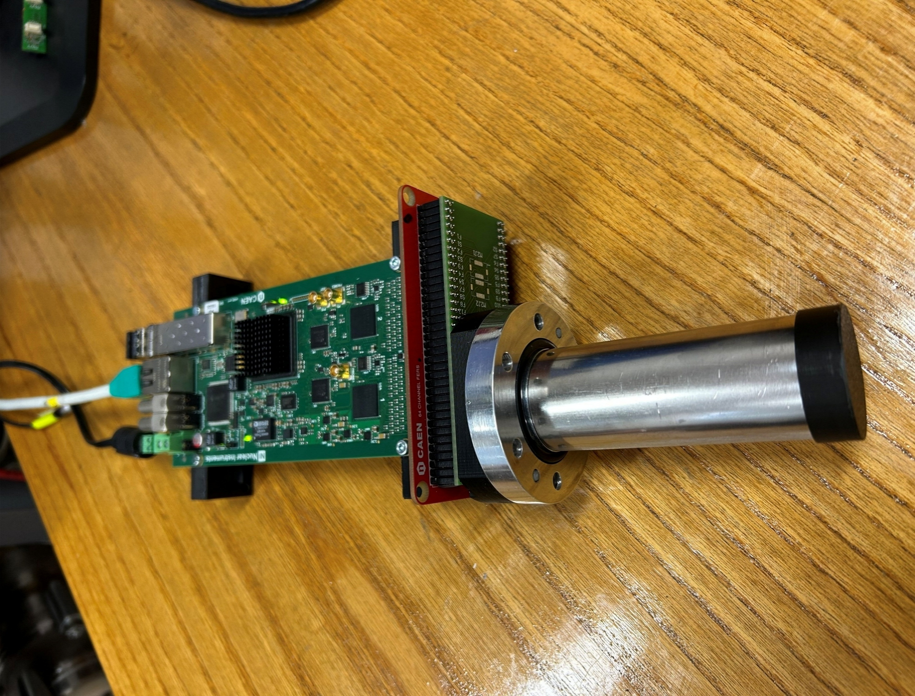
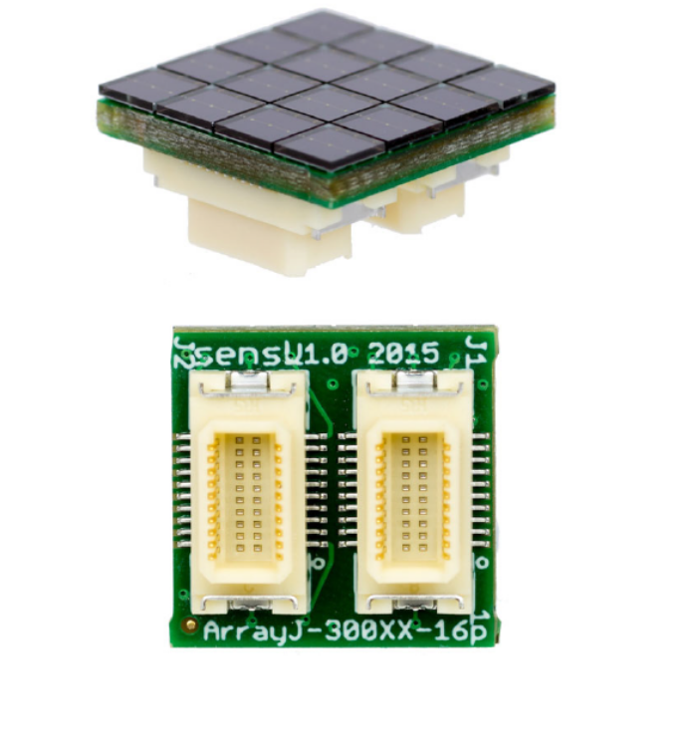
RFD Upgrade – SiPM
Onsemi - ARRAYJ−30035−16P
A5202 card borrowed from CAEN
Test with/without alpha source, CAEN adapter, sensl board
16 slow channels, 3 fast signals are missing
Connection/type of cables/adapters – is crucial
With a “bad” cable, we have a:
  strong signal attenuation effect (increasing the voltage sometimes helps)
  significantly greater noise
  lack of sensitivity to voltage change
  an appearance of additional structures on the spectrum (peak between the dark current and the signal from the source)
<number>

Slide 15
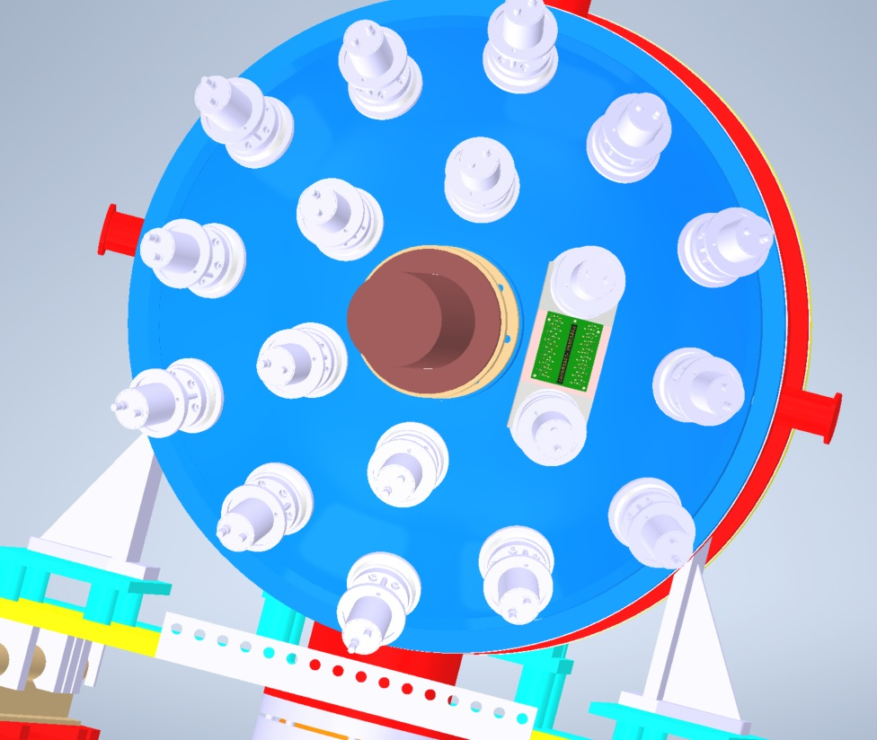
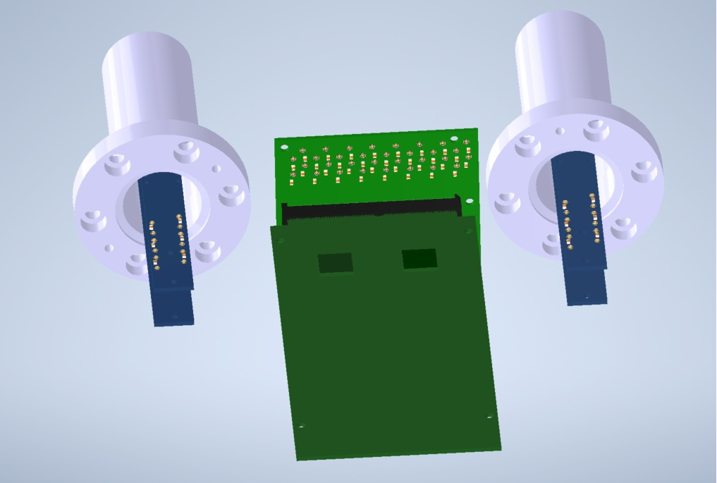
RFD Upgrade – connecting the signal output to the card
9 CAEN cards, each 64-channel
Connection with cables of ~10cm length
<number>

Slide 16
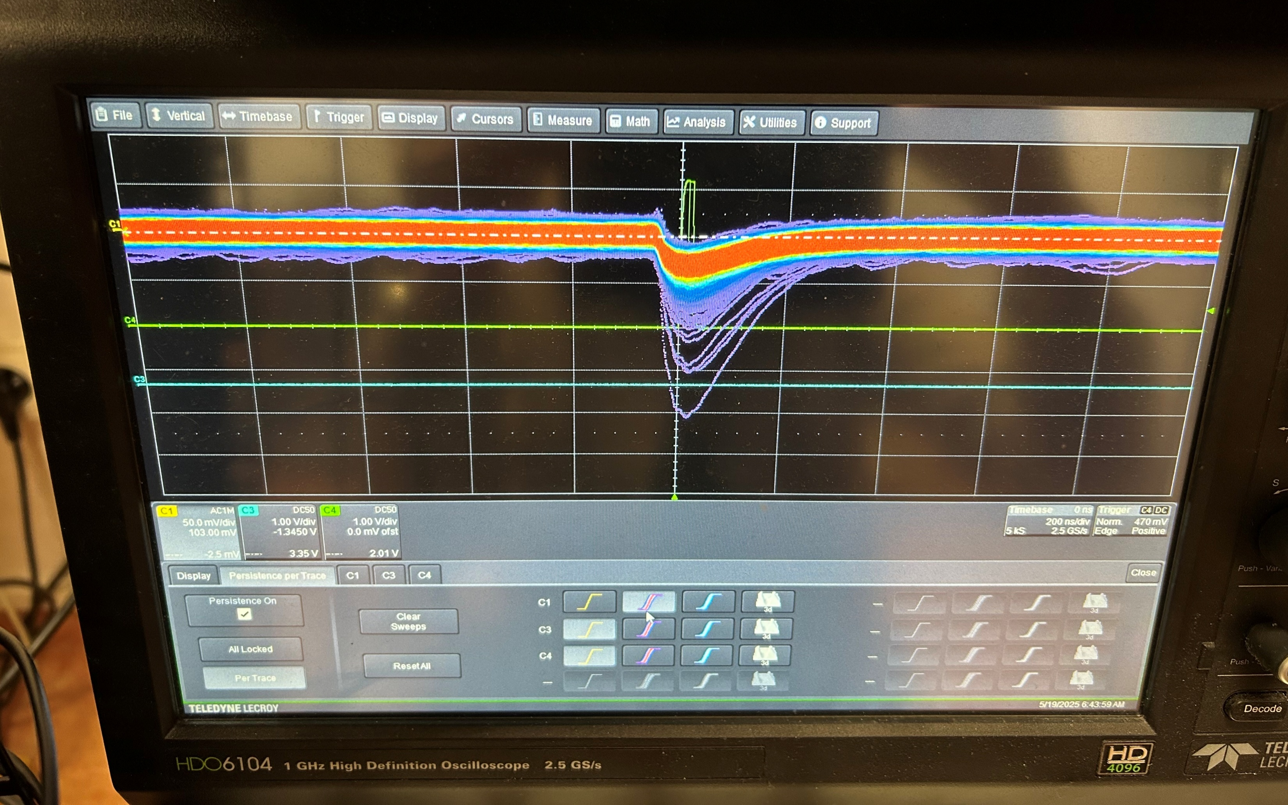
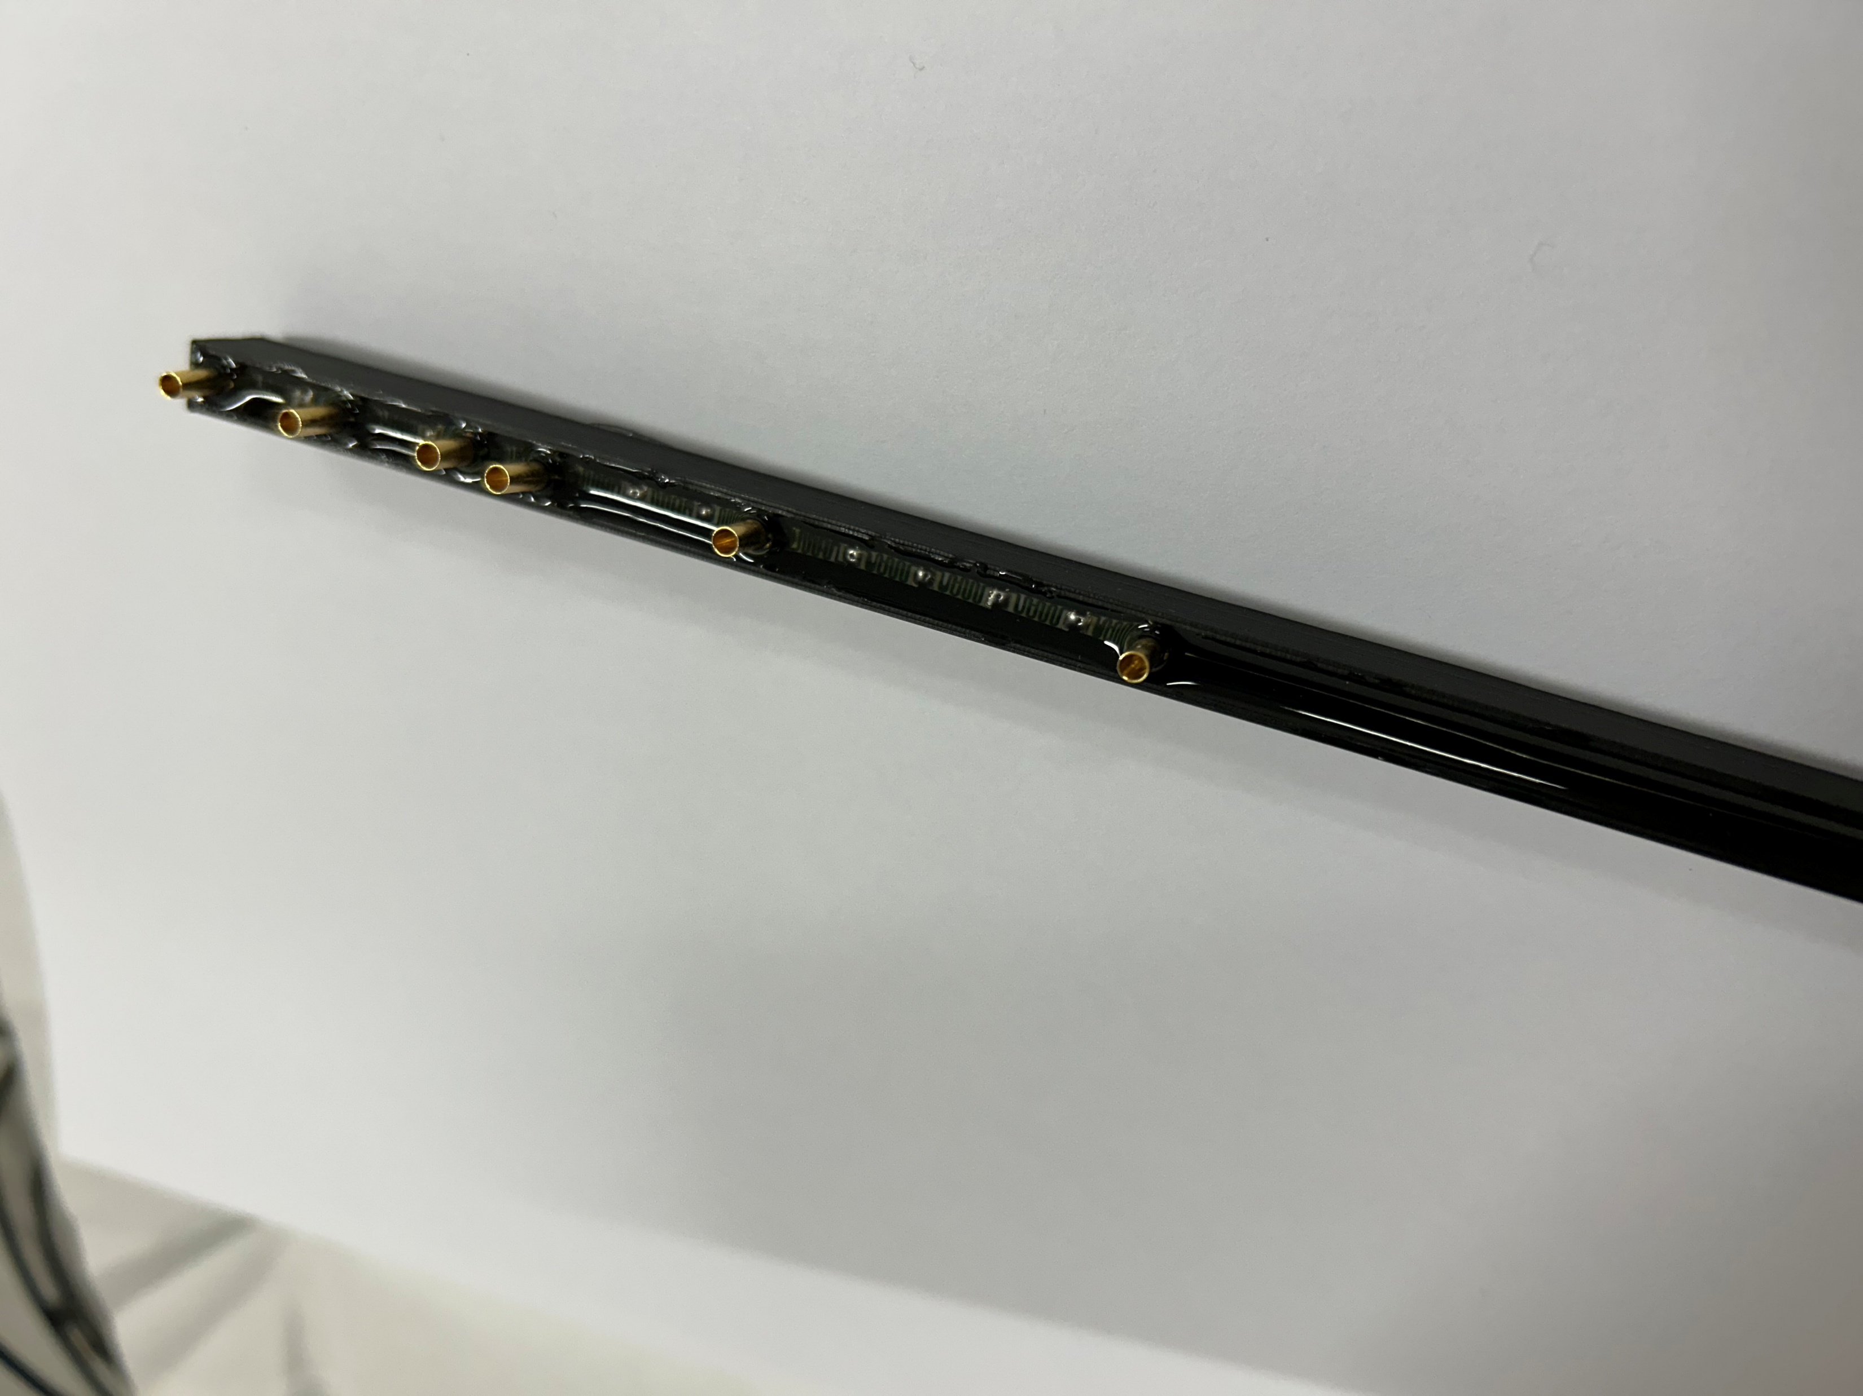
RFD Upgrade – current status
HV issues:
Switching on high voltage generates additional counts in low channels; it was also the issue with the old PMTs
Under investigation
Vacuum Testing Chamber - 10⁻⁷ mbar
To eliminate sharp edges:
A new voltage divider – using SMD resistors
New isolators
Cylindrical rings (torus-like)
<number>
Notes:
This improvement will significantly boost the efficiency of the device.

Slide 17
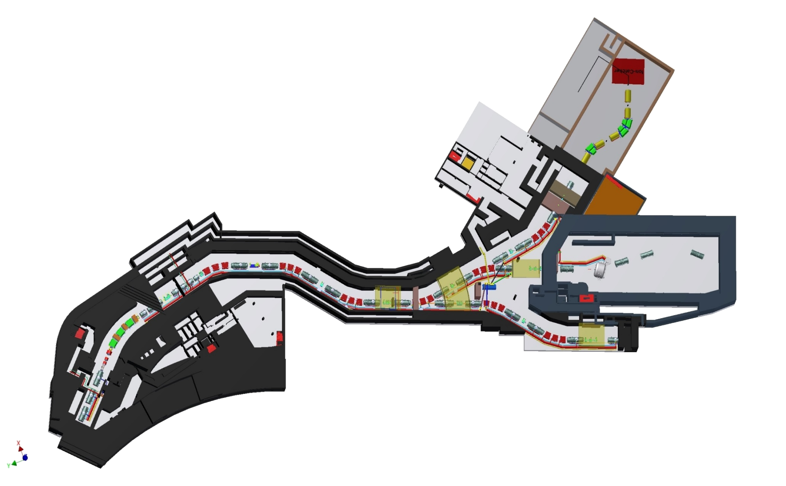
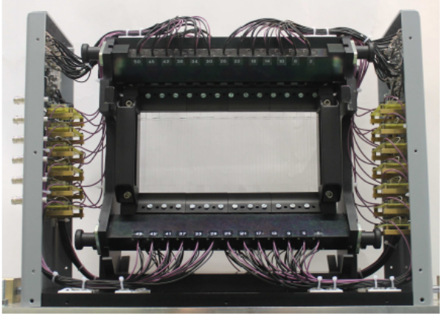
FINGER NUSTAR/FAIR
Strips 51x4.4 mm
Projectile ToF
LEB
Low Energy Branch
Prototype, tested in-beam, 2014
High Energy Branch
MF2
large area ~400x100 mm²
segmented scintillator
Δt (<50 ps)
high rate (10⁶/s)
easy and quick exchange

Slide 18
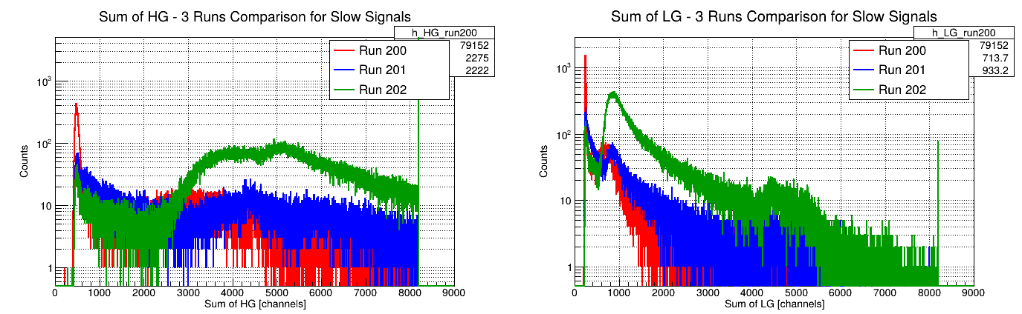
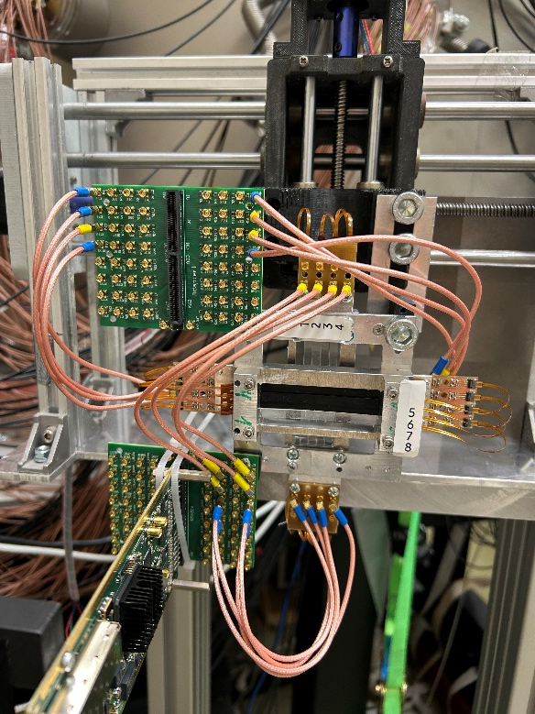
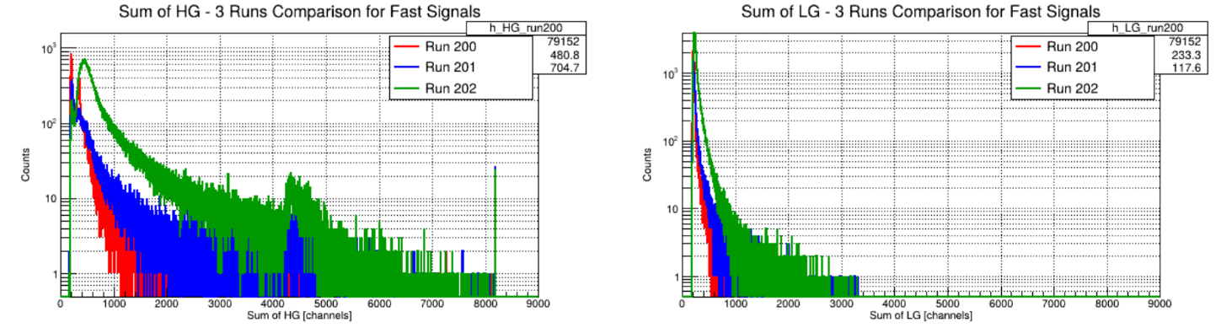
FINGER tests at CCB
SiPM fast and slow outputs with for two gain paths in the FERS system (low gain-LG and high gain-HG)

Slide 19
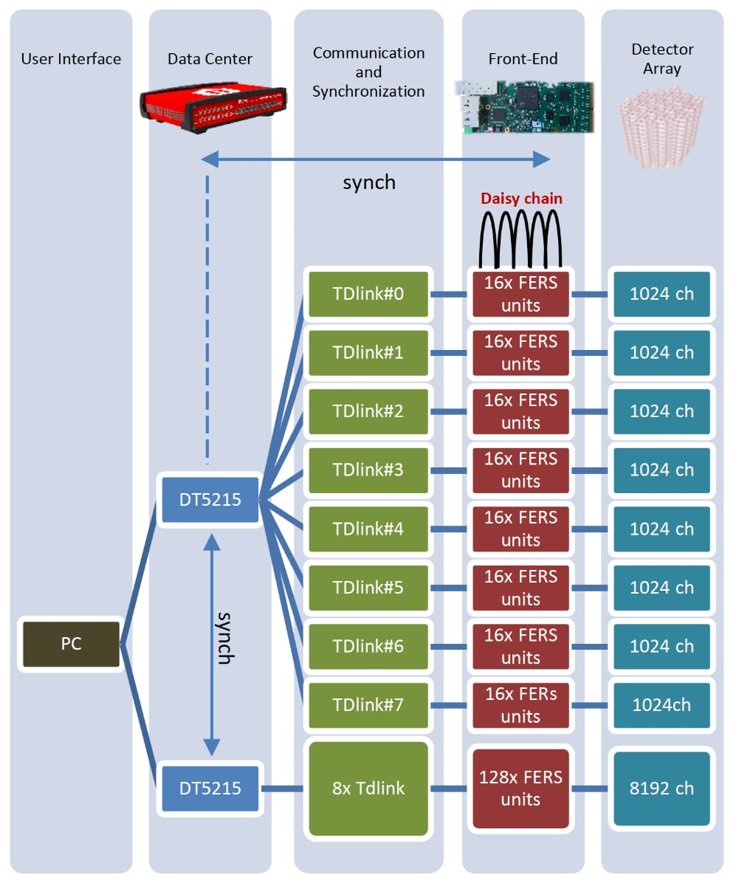
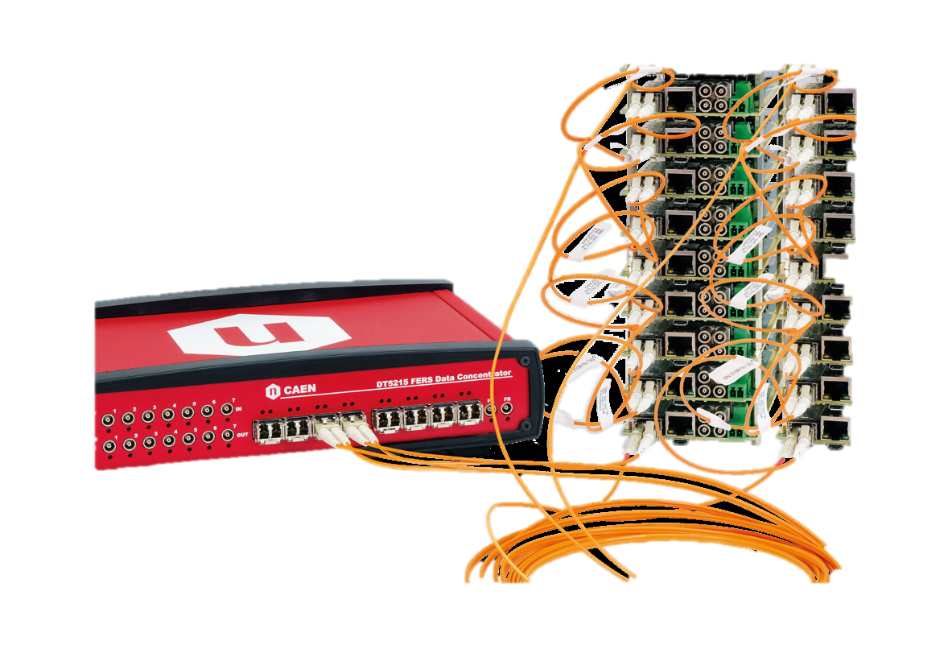
DAQ and FEE
A5204 - 64-channel frontend unit for SiPM readout and high-resolution timing
SiPM readout and bias for FERS 5200 Family
• High energy resolution and excellent ToA/ToT performances with Radioroc (produced by Weeroc) and CERN picoTDC
• Better than 55 ps FWHM on single photo-electron
• Photon counting @ 100 MHz
• Wide shaping time range [20 ns - 2 us] enabling Pulse shape discrimination technique
Concentrator Board
for FERS-5200
Upgraded RFD - 288 channels
6 A5204 cards
Janus open source software for the board configuration and DAQ control
Or homemade software?

Slide 20
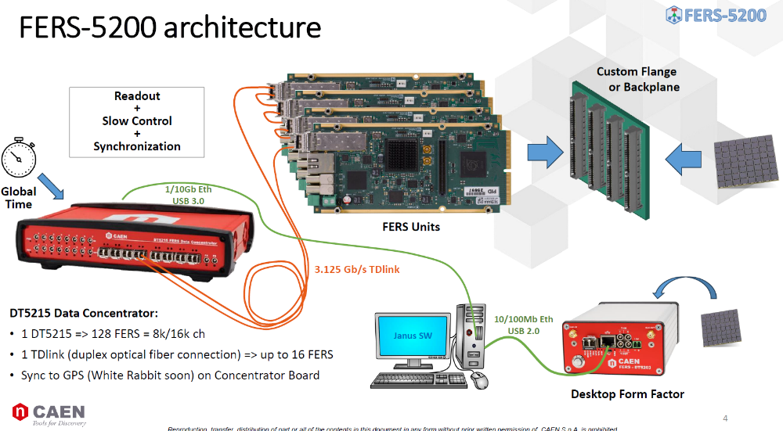
Synchronization
M. Matejska-Minda (IFJ PAN)

Slide 21
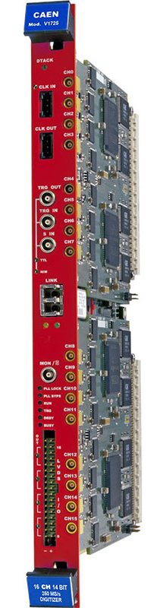

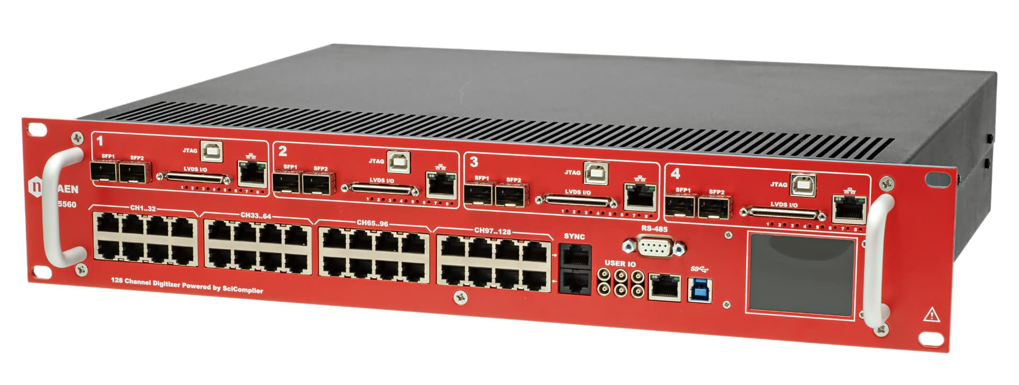
Synchronization
V1725 for EAGLE
14-bit 250 MS/s Digitizer
FERS 5200 for RFD
5560 digitizer for DIAMANT
128 Channel 14-bit 125 MS/s Open FPGA Digitizer
M. Matejska-Minda (IFJ PAN)

