Slide 1
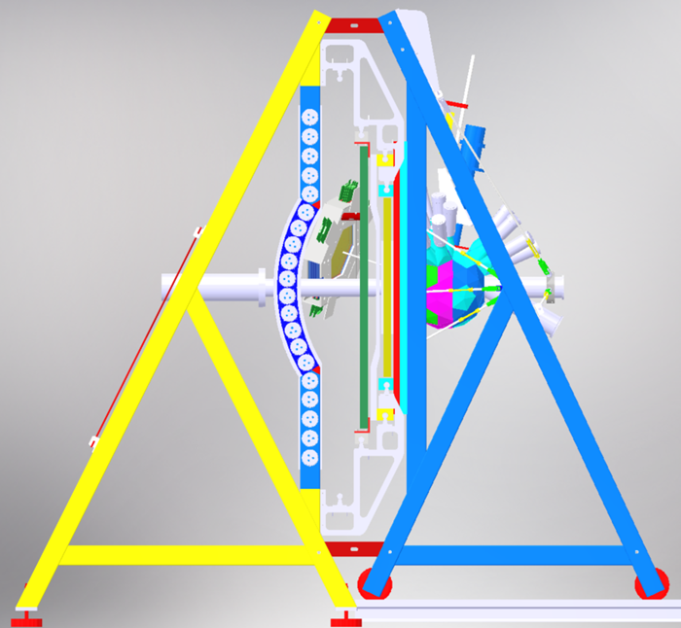
Proton polarization induced
in the ²H(p,pp)n breakup reaction
BINA@CCB
E. Stephan, A. Kozela
University of Silesia in Katowice
Institute of Nuclear Physics, Kraków
Jagiellonian University, Kraków
Warsaw University
University of Gdańsk
University of Groningen
TIFR Mumbai
Tokyo Institute of Technology

Slide 2
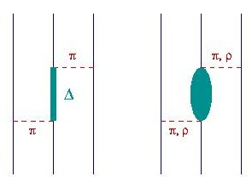
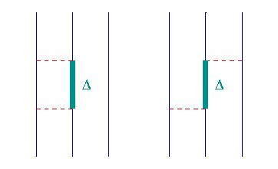
Goal: studies of nuclear interactions
in 3N scattering
NN interactions are well modelled by realistic potentials.
3NF is added to describe the genuine 3N system dynamics:
  Tucson-Melbourne TM99. Explicit treatment of the Δ isobar
  Urbana IX – Illinois.
3NF improves the description of pd elastic scattering and breakup cross sections, but certain discrepancies are observed, in particular in polarization observables.
In the deuteron breakup in collision with proton Coulomb interactions are playing important role in cross section.

Slide 3
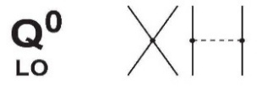
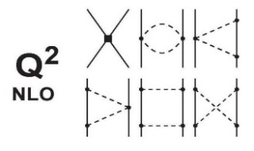
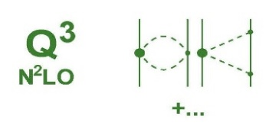
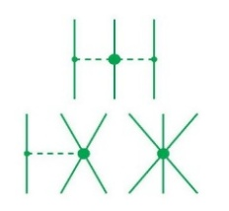
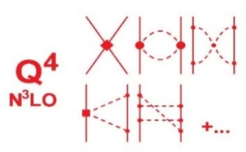
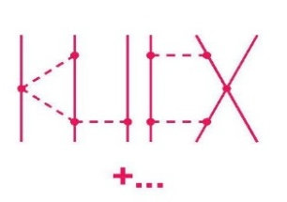
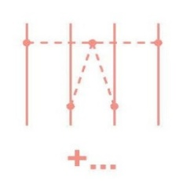
Goal: studies of nuclear interactions
in 3N scattering
Modern approach: Chiral Effective Field Theory
  very succesfull in determining binding energies and excited states of light nuclei;
  many difficulties when applied to 3N scattering;
  significant progress has been made recently: complete N3LO calculations are in reach.
3N scattering data are considered very important to fit LEC’s for 3NF.
2N forces
3N forces
4N forces
Experimental data needed for fitting certain 3NF LECs !

Slide 4
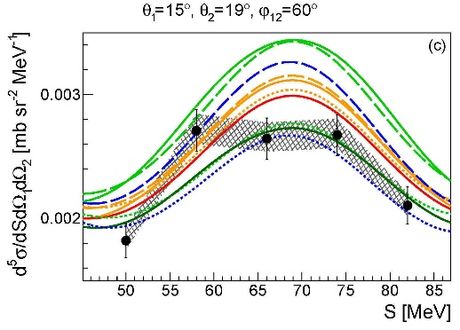
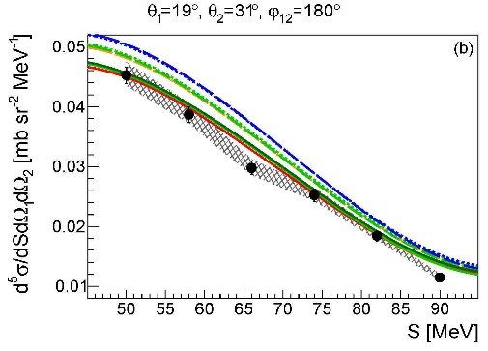
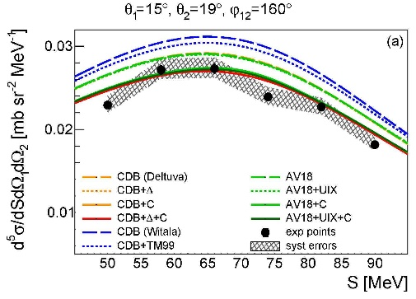
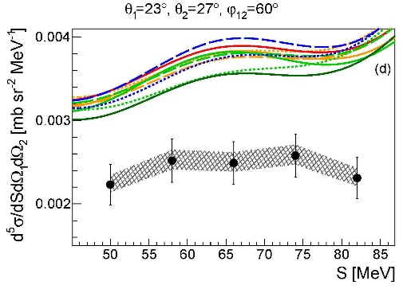
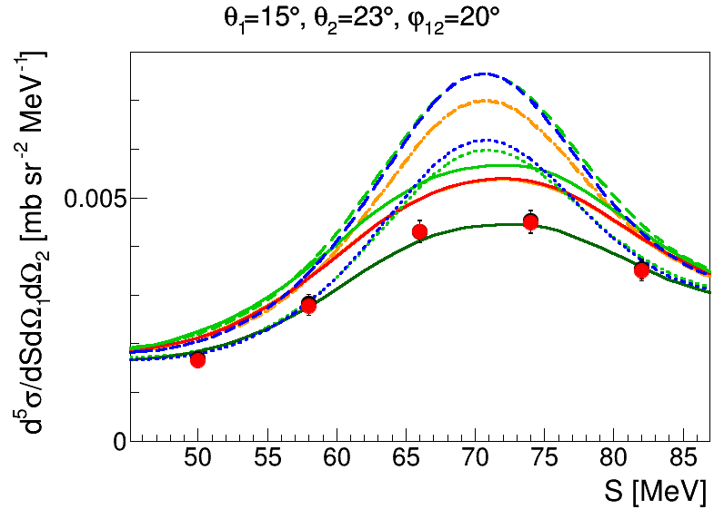
Differential cross section for ²H(p,pp)n breakup
at 108 MeV measured with BINA@CCB
Coulomb
discrepancy
3NF
Coulomb
Example of the recent results for the smallest φ₁₂ angles
Coulomb plays a very important role
Av18+Coulomb
Av18+Coulomb+Δ 3NF
sensitivity to the 3NF model (UIX, Δ)
Av18+Coulomb+UIX 3NF

Slide 5
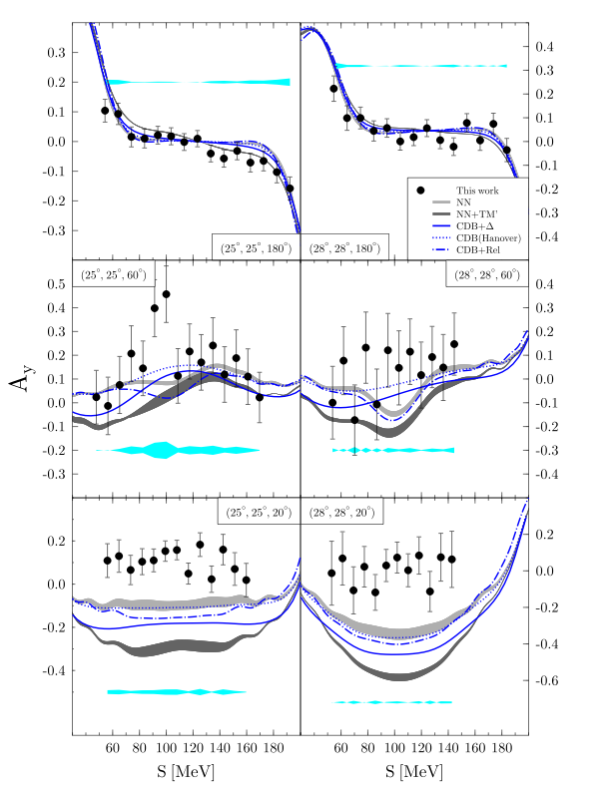
Polarization observables in ²H(p,pp)n breakup
190 MeV, H. Mardanpour et al.
There are more independent observables describing the breakup reaction (than in the case of the elastic scattering).
Yet, fewer of them were measured, and for small number of energies only.
Polarization observables for protons in breakup reaction are sensitive to details of the 3NF models.
Large discrepancies are observed for analyzing powers at certain configurations.
Coulomb effects are practically negligible.
Polarization observables are very good candidates to test the ChEFT predictions (even before these calculations include Coulomb interactions).
large discrepancy
(even opposite signs)
sensitivity to the 3NF model (TM99, Δ)

Slide 6
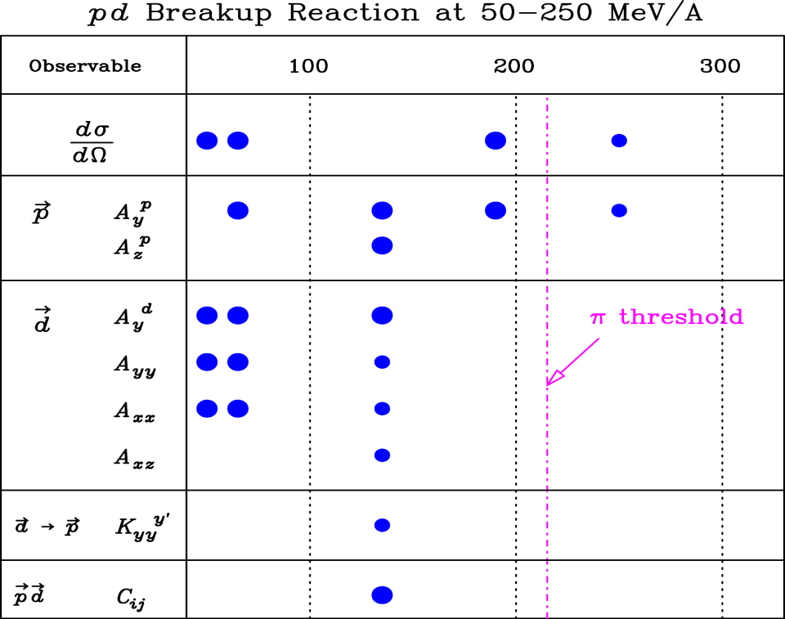
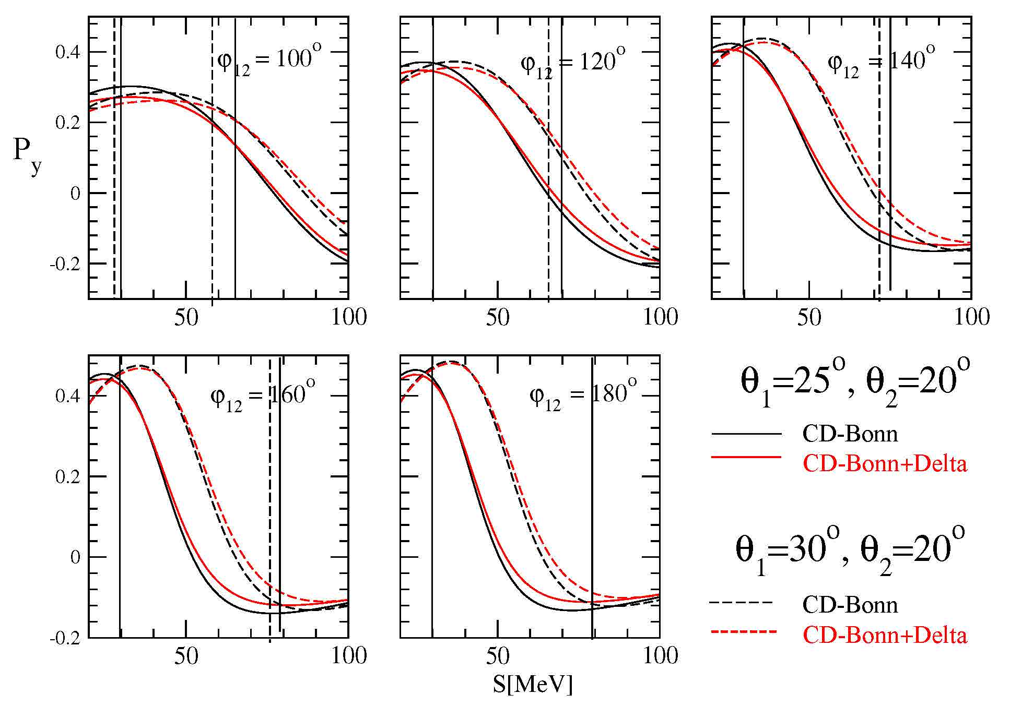
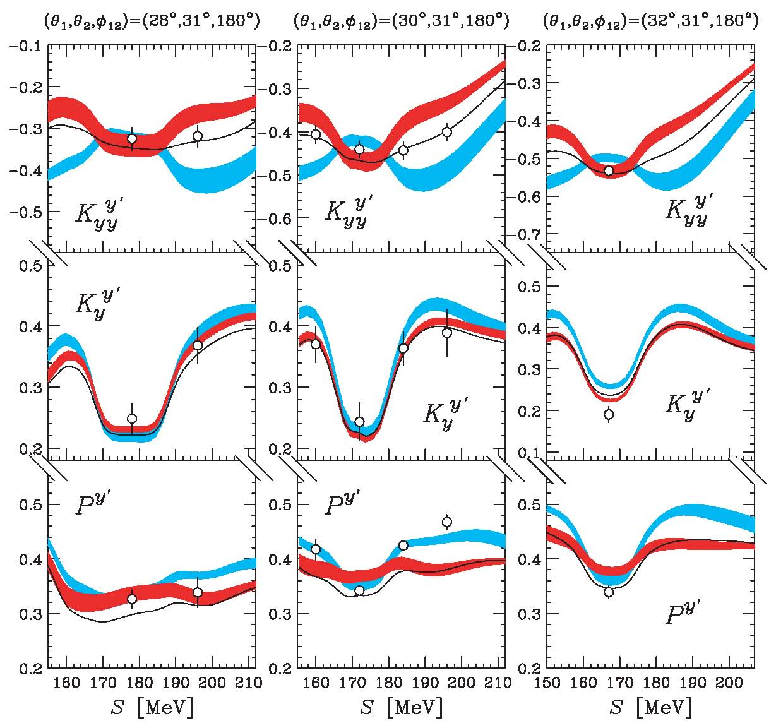

Polarization observables in ²H(p,pp)n breakup
Interesting results were found but...
... the data base available for comparisons with theories is very limited.
Induced polarization is the least known of the first order polarization observables.
We propose to measure P^{y} for a numer of nearly-coplanar configurations of ²H(p,pp)n breakup reaction at the beam energy of 160 MeV.
WASA
CCB
Theoretical calculations by Deltuva (150 MeV)
$$\overset{→}{p}$$ | $$P^{y}$$
135 MeV
K. Sekiguchi et al.,
PRC 78 (2009) 054008
region of both proton energies over thresholds

Slide 7
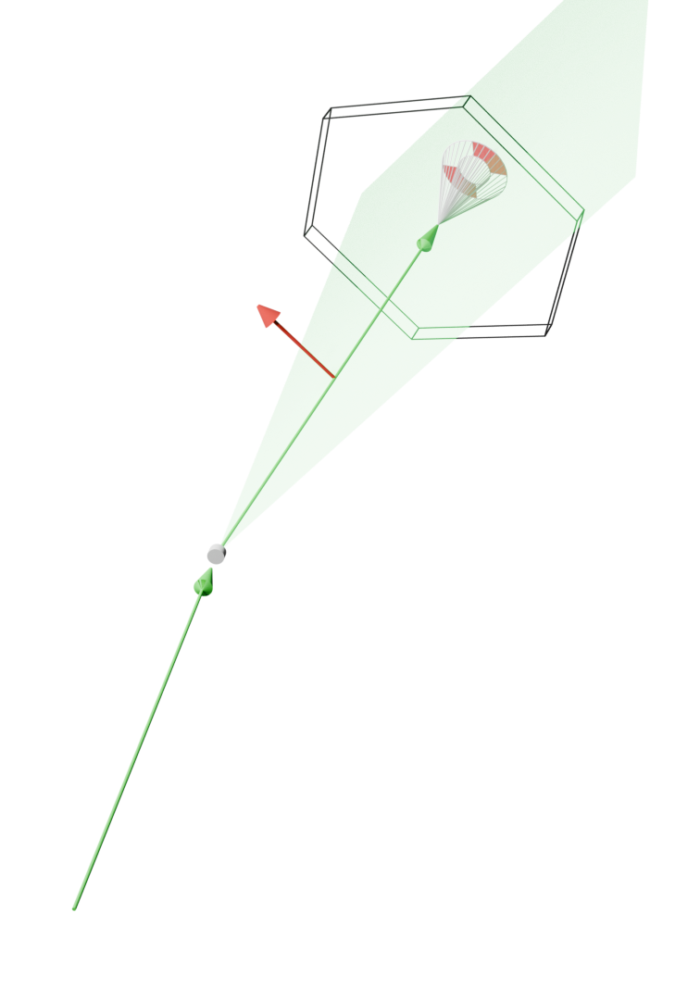
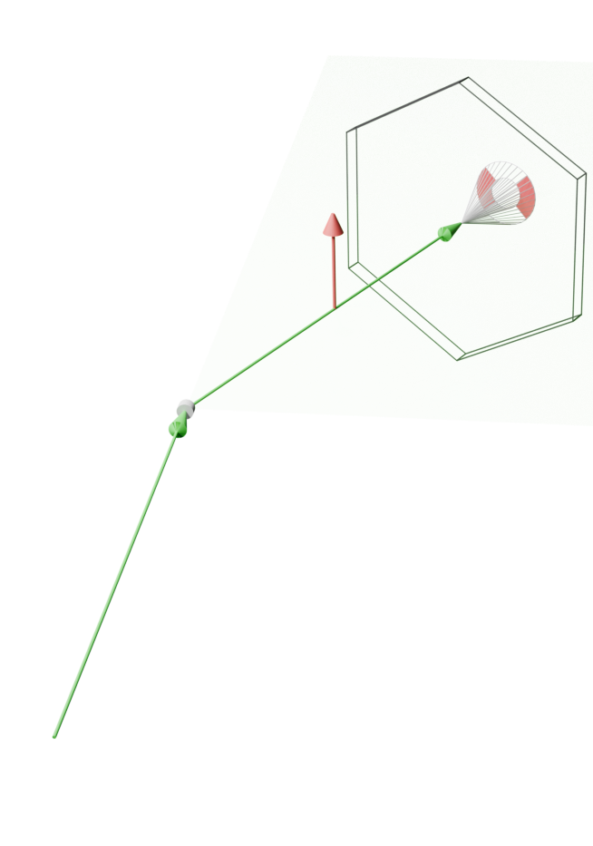
PROPOSAL: BINA equipped with polarimeter
BINAPol to measure the induced polarization
R
L
BINAPol
P_{Y}
graphite
P_{Y} II (p_{beam} x p₁)
is parity even:
P_{Y}(ξ,ϕ₁₂)= P_{Y} (ξ,-ϕ ₁₂)
P_{x} is parity odd:
P_{x}(ξ,ϕ₁₂)= -P_{x} (ξ,-ϕ ₁₂),
thus vanishes for elastic scattering and any coplanar breakup configuration
← p beam
p₁
LD₂
E
target
ΔE
MWPC
First scattering: proton beam on deuteron target, outgoing proton tracked in MWPC
  pd elastic scattering on CD₂ target for polarimeter calibration (single proton in Wall)
  pd breakup on LD₂ target (coincidence of two protons, polarization of one proton analysed)
Second scattering: proton on Carbon, scattered proton tracked in MWDC
p_{beam}

Slide 8
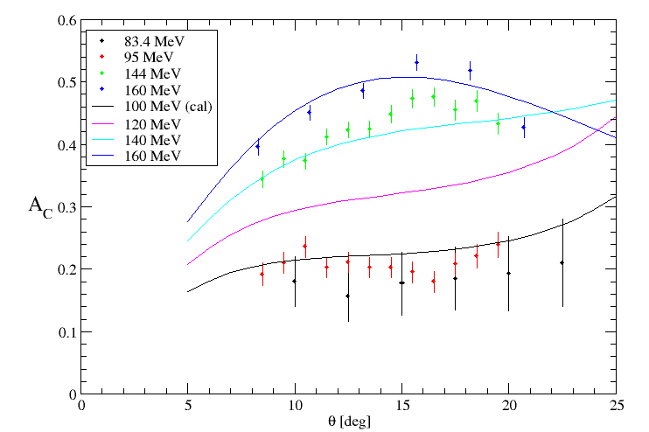
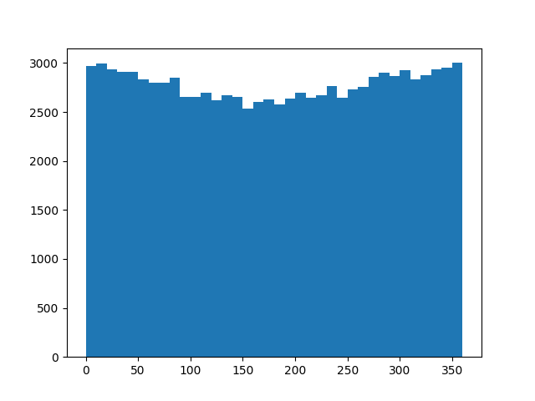
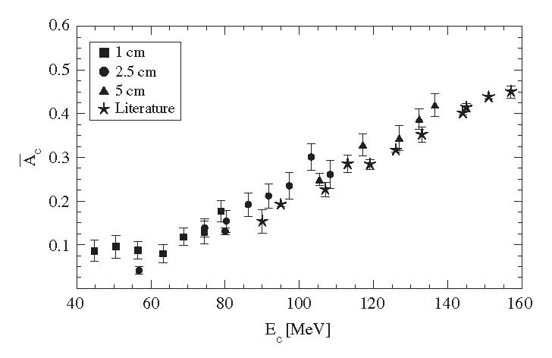

Polarimeter calibration: effective analyzing power A_{C}
Polarimetry based on proton-Carbon scattering: the rate of polarized protons changes with cosine of azimuthal angle with an amplitude of variations =P*A_{C} .
Therefore precision of determining the polarization P depens on accurate knowledge of A_{C} .
$$N=N_{0}(1+PA_{C }\cos{φ})$$
Energy region of interest
In the range of scattering angles between 8º and 20º, effective A_{C} is almost independent of the scatterer thickness.
averaging: between 8 and 20º ; E_{c} - proton energy at the center of the graphite scatterer
H.R. Amir-Ahmadi et al., NIM A 562, 338 (2006)

Slide 9
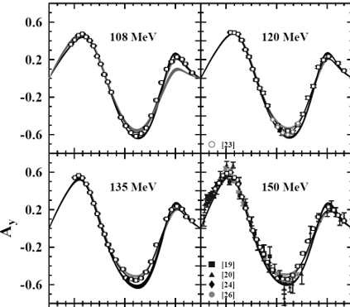
Polarimeter calibration: effective analyzing power A_{C}
Time-reversal symmetry of proton-deuteron elastic scattering impose relation between induced polarization and analyzing power: P^{y} = - A_{y} .
The analyzing power was measured at KVI for a numer of beam energies. In the region of angles covered by BINAPol A_{y} is high.
Protons elastically scattered from deuterons will have high and precisely known polarization. They can be used for determination/check of A_{C}.
BINAPol
30 90 150 30 90 150
θ_{cm}
K. Ermisch et al., Phys. Rev. C 71, 064004 (2005)

Slide 10
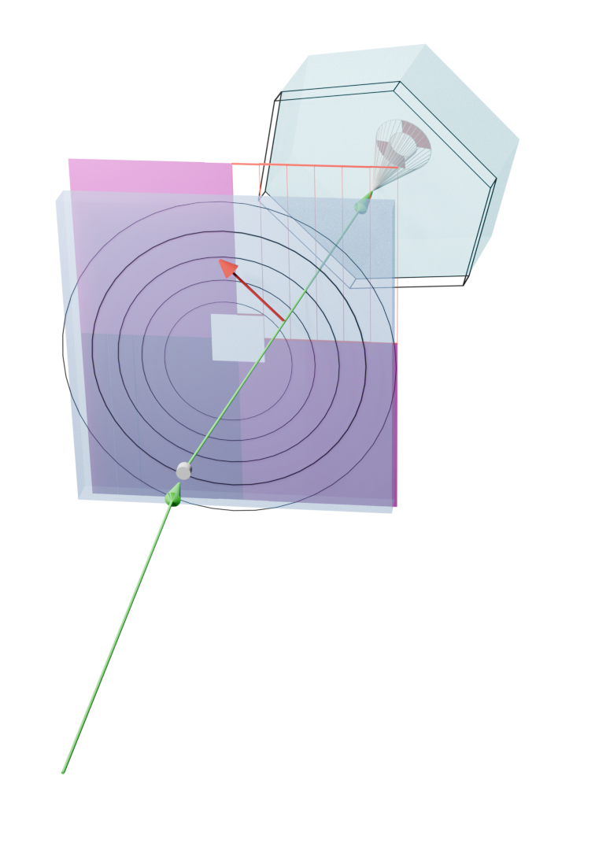
Polarimeter calibration with elastic scattering
Two types of processes are considered, both measured with the use of solid targets and BINA setup.
pd elastic scattering with the use of CD₂ target:
  single proton registered in BINAPol (deuteron in Ball below the threshold);
  high induced polarization known for a number of beam energies and the whole range of polar angles covered by BINAPol.
pp elastic scattering with the use of CH₂ target:
  clean events: one proton registered in BINAPol, second proton in backward Ball (near the threshold);
  high polarization for specific energy and angle.
Important advantage: the same acceptance and detection efficiency for the polarized proton from elastic scattering and for the proton from the breakup reaction.
The requested beam time was accepted by IAC but not yet scheduled.
R
L
P_{Y}
graphite
p₁
CD₂
p_{beam}

Slide 11
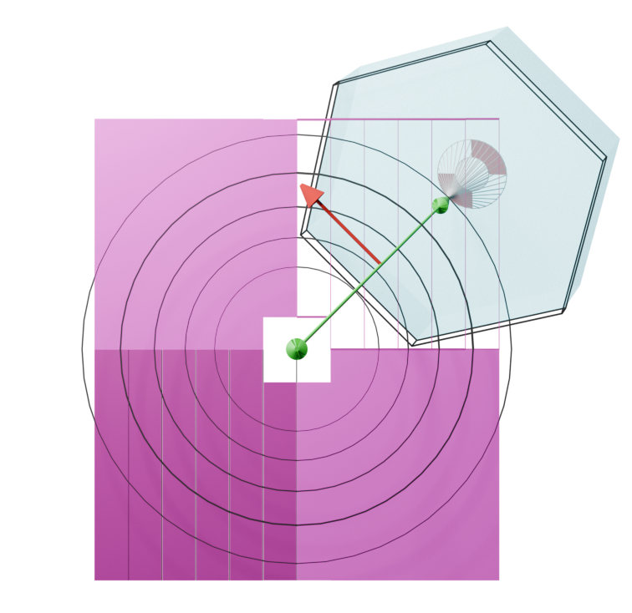

Measurement of P^{y} in ²H(p,pp)n breakup reaction in nearly coplanar configurations
Coincidence of two protons registered in diagonal sectors of the BINA Wall:
first proton in the BINAPol
(after pC scattering, both L and R segments are within the BINAPol acceptance)
second proton – in the diagonal sector
R
L
p₁
ϕ₁₂
$$ASY=\frac{N_{L}−N_{R}}{N_{L}+N_{R}}=P^{Y}A_{C}\cos{φ}$$
θ₁=20-30º
Δϕ₁≈36º
E₁> 80 MeV
θ₂=14-26º
E₂> 20 MeV
ϕ₁₂=180º+/-20º
p₂
θ=15º
20º
25º
30º
35º

Slide 12
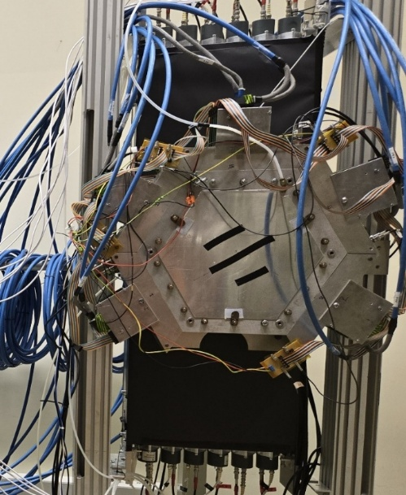
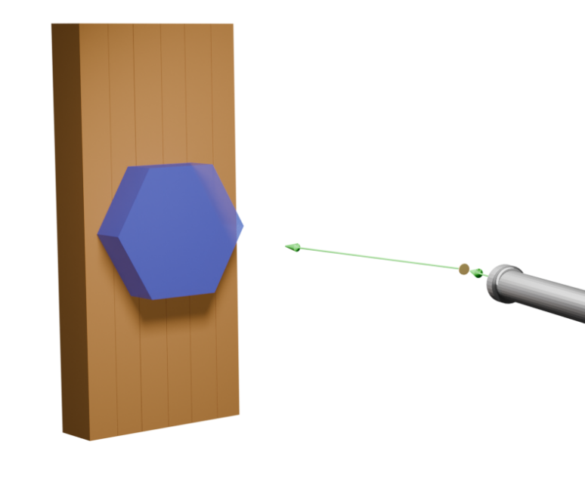
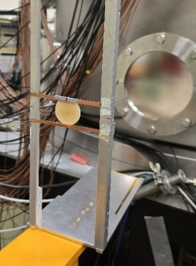
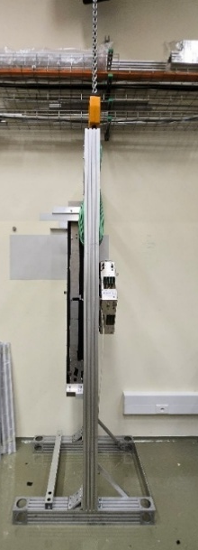
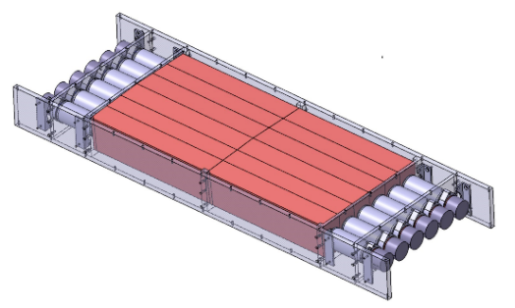
MWDC and DAQ commissioning
(test run without BINA)
distance from CD₂: 273 cm
angle: 21 deg
CD₂
CD₂
beam
MWDC
MWDC – commissioned.
CD₂ target, 2 mm thick
  simple, a few types of characteristic events were collected;
  runs without the target were also conducted.
Plastic Scintillator Hodoscope made of 6 scintillators with two-side readout was used for:
  trigger,
  time reference for Drift Time,
  collecting the energy spectra.
Notes:
12

Slide 13
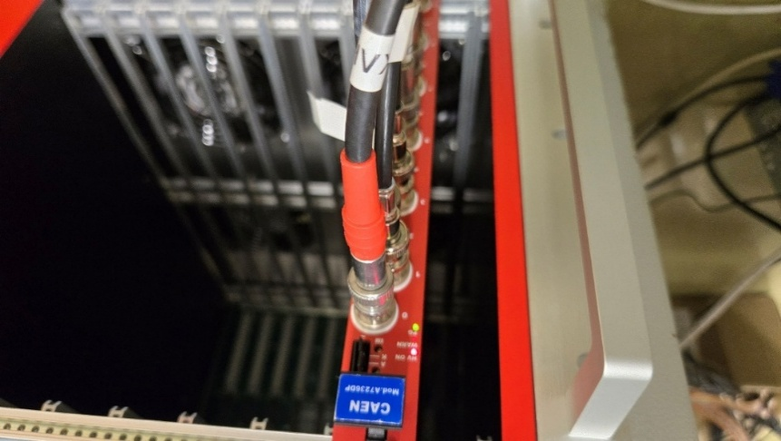
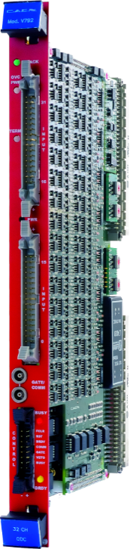
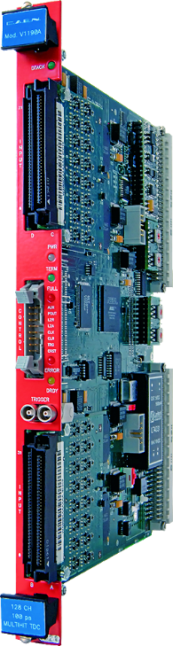
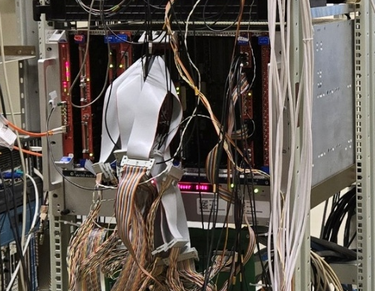
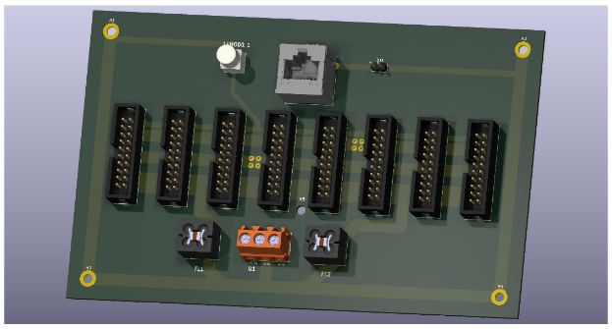
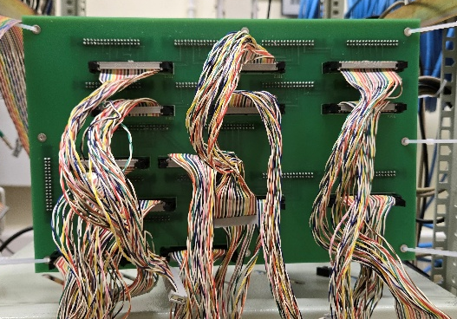
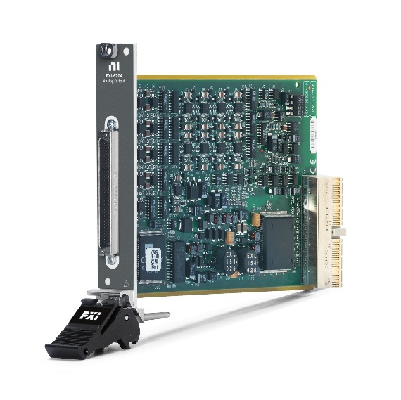
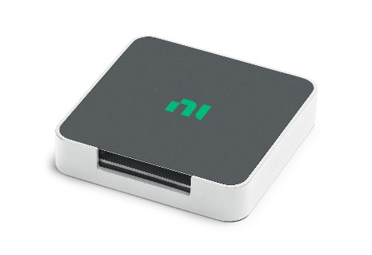
Electronics & DAQ
Migration to DAQ based on VME modules, optical link bridge,
HV for MWDC
Low Voltage & Thresholds
for MWDC electronics
Test setup:
1 ADC (12#) + 2 TDC’s (220#)
Throughput : 2.7 Mbytes/s
Full setup:
3 ADC’s (60#) + 6 TDC’s (780#)

Slide 14
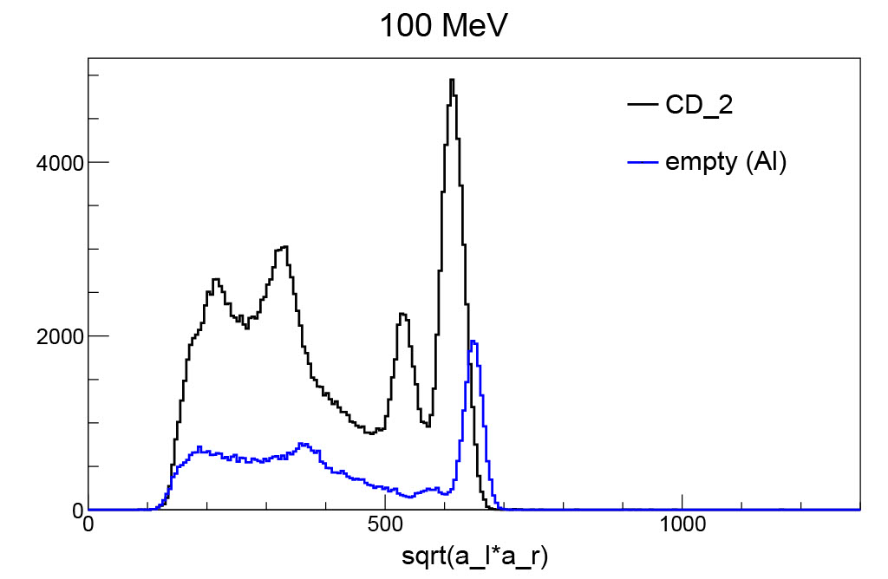


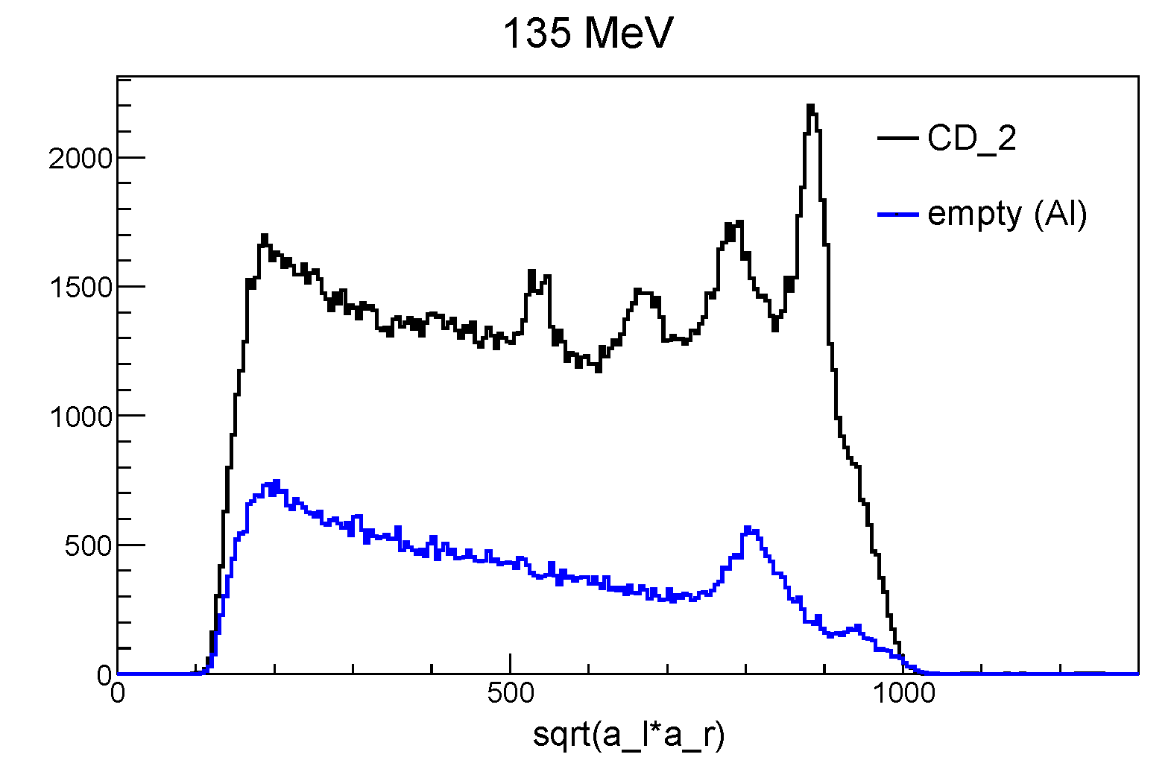
Test Measurement Hodoscope Spectra
C/Ti(p,p)
Main peaks in energy spectra: :
protons and deuterons from pd elastic scattering (CD₂ target)
protons from elastic scattering on heavy targets (C, Ti, air)
Beam energies:
100 MeV – all particles stopped in the hodoscope
135 MeV – protons scattered on heavy targets punch through
160 MeV – all elastically scattered protons punch through
d
D(p,p)d
Ti(p,p)
D(p,p)d
C/Ti(p,p)
punch
through
d
Max proton energy
deposit in scintillator
Ti(p,p)
punch
through

Slide 15
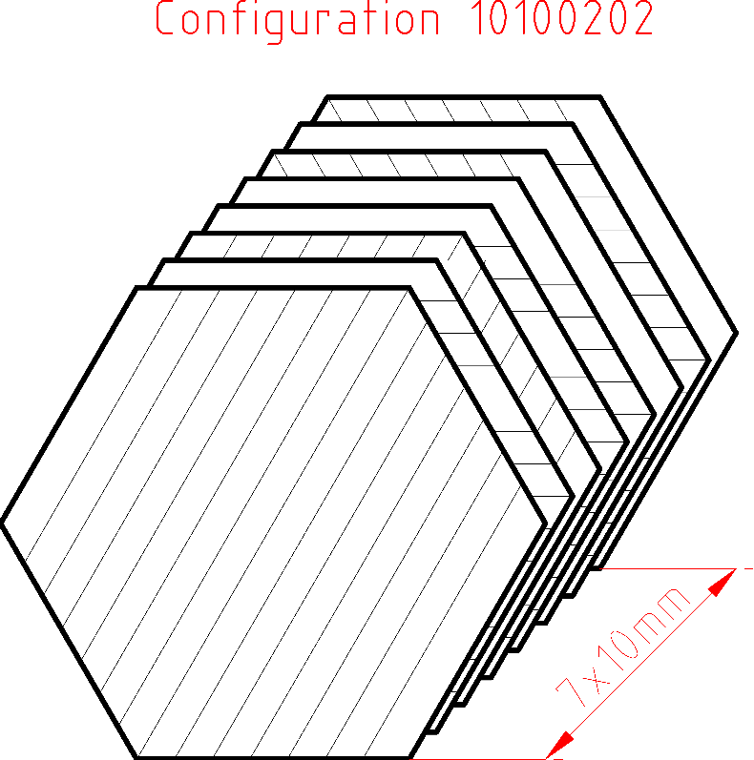
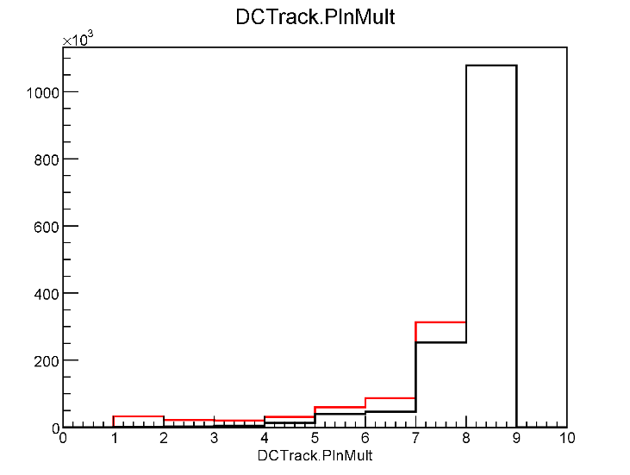
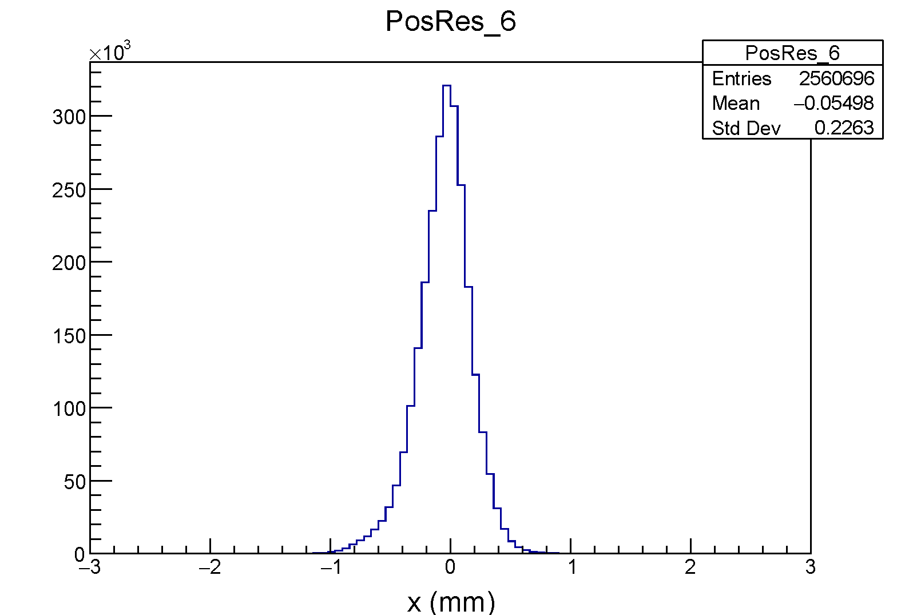
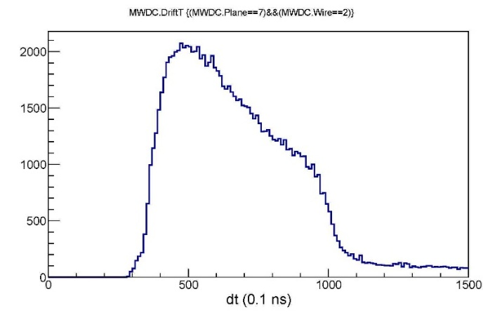
Test Measurement: MWDC spectra
Plane Multiplicity
It was necessary to reduce the noise (shielding, imroving contacts, modifications of low voltage cables etc.).
After this step, efficiency looked good.
Detail study show problems with few channels, repair is planned.
----- all events
----- hit in last plane required
High efficiency
hits in all planes
complete position
information
Position Resolution (Plane 6)
Drift Time spectrum
Individual calibration of the planes is currently underway.
In future, certain electronic cards will be modified to obtain similar time characteristics for all channels what will simplify analysis of the MWDC data.
RMS = 0.22 mm
High resolution

Slide 16
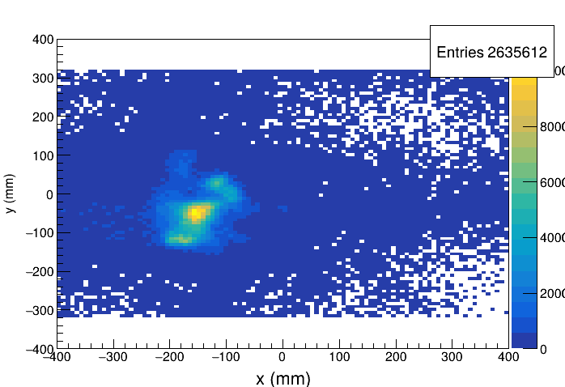
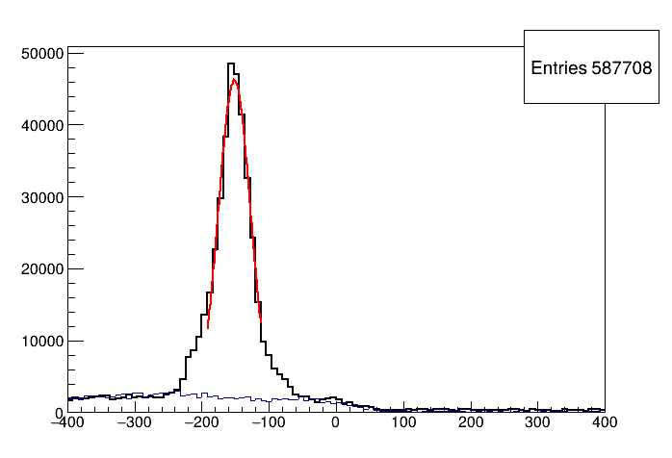
Test Measurement
MWDC – reconstructed source image
Summary
Reconstructed image of beam on CD₂ target
Our standard MWPC mixture works well for MWDC.
Effective noise reduction enabled stable measurements;
  a few additional changes will make the system more robust and allow for the individual adjustment of thresholds.
Events originating from the target can be well identified.
A preliminary analysis indicates that the MWDC meets expectations regarding the parameters relevant to polarization measurement;
  planned improvement of electronic cards: repair of channels, obtaining uniform Drift Time spectra.
DAQ succefully tested.
Y [mm]
RMS=24 mm
X [mm]

Slide 17
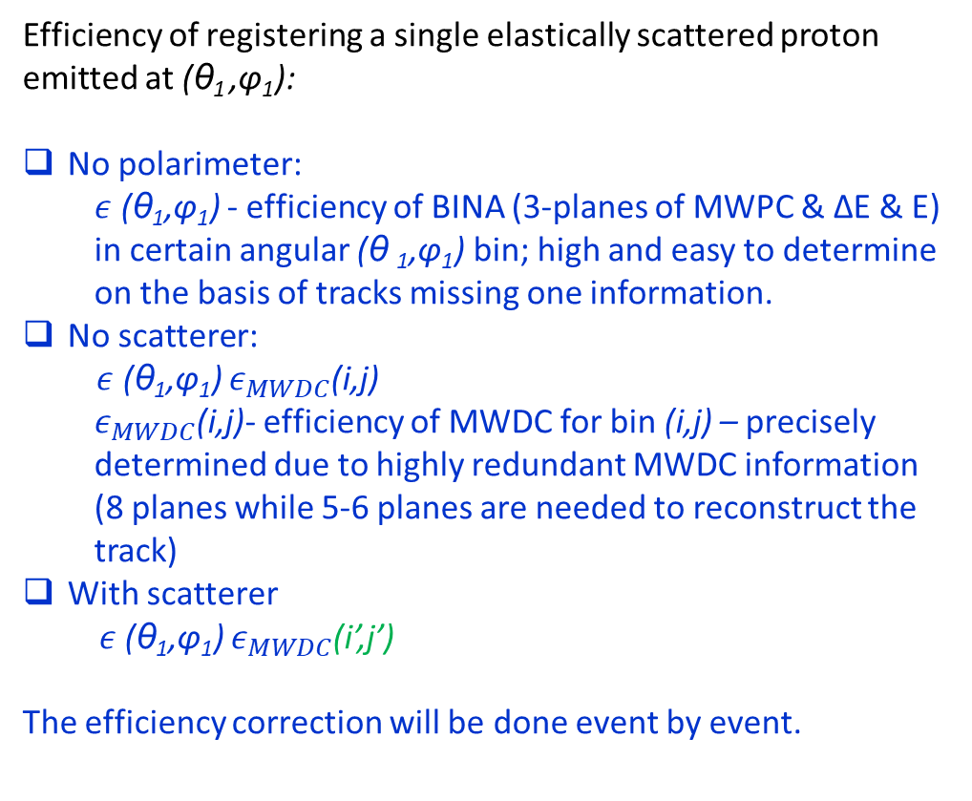
Efficiency studies with elastic scattering protons
Efficiency of registering a single elastically scattered proton emitted at (θ₁ ,φ₁):
No polarimeter:
  $ε$ (θ₁,φ₁) - efficiency of BINA (3-planes of MWPC & ΔE & E) in certain angular (θ ₁,φ₁) bin; high and easy to determine on the basis of tracks missing one information.
No scatterer:
$ε$ (θ₁,φ₁) $ε_{MWDC}$(i,j)
  $ε_{MWDC}$(i,j)- efficiency of MWDC for bin (i,j) – precisely determined due to highly redundant MWDC information (8 planes while 5-6 planes are needed to reconstruct the track)
With scatterer
$ε$ (θ₁,φ₁) $ε_{MWDC}$(i’,j’)
The efficiency correction will be done event by event.
R
L
P_{Y}
graphite
p₁
LD₂
p_{beam}

Slide 18
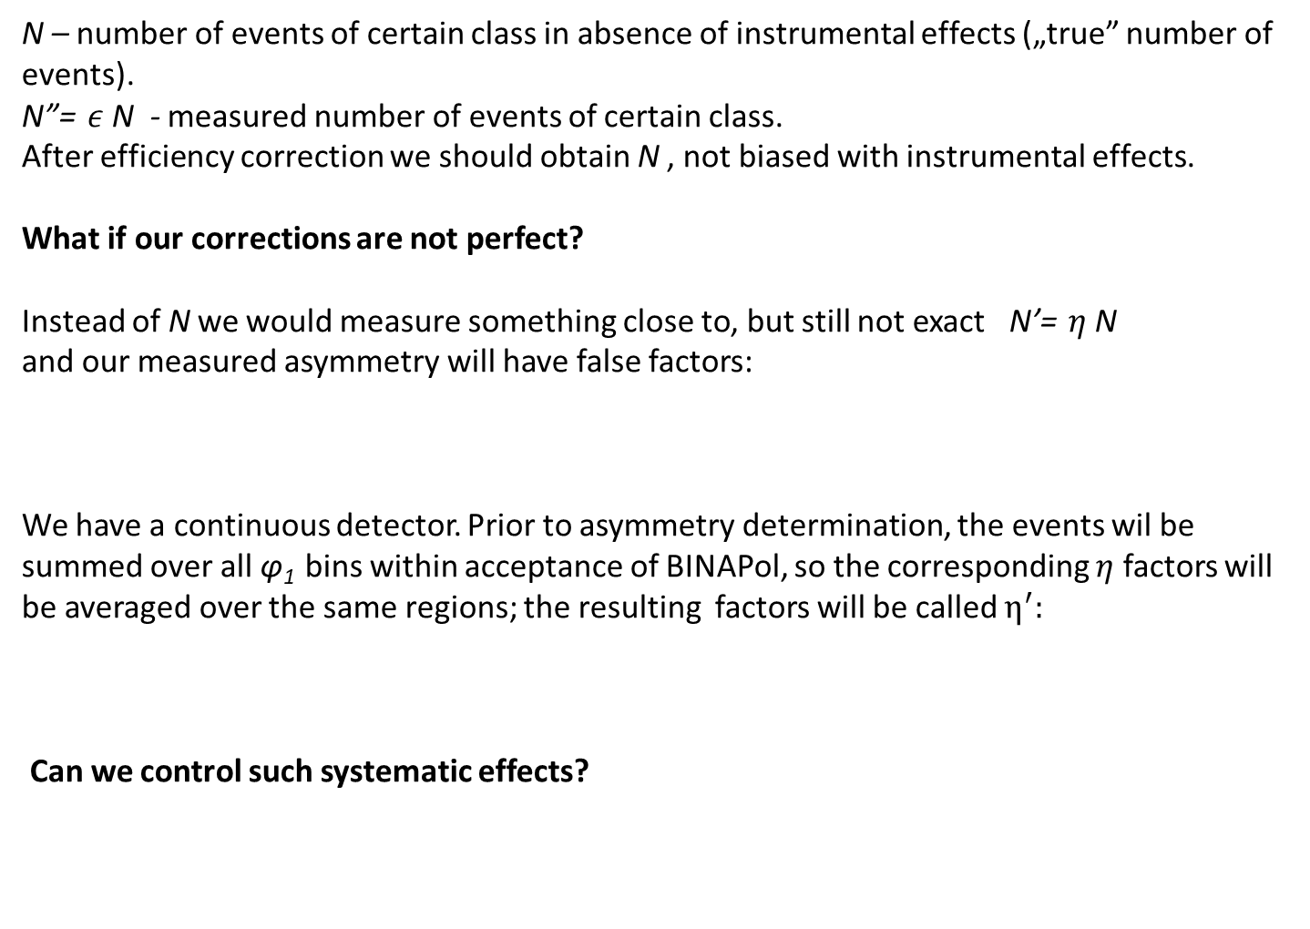

Efficiency studies with elastic scattering
N – number of events of certain class in absence of instrumental effects („true” number of events).
N”= $ε$N - measured number of events of certain class.
After efficiency correction we should obtain N , not biased with instrumental effects.
What if our corrections are not perfect?
Instead of N we would measure something close to, but still not exact N’= $η$N
and our measured asymmetry will have false factors:
We have a continuous detector. Prior to asymmetry determination, the events wil be summed over all φ₁ bins within acceptance of BINAPol, so the corresponding $η$ factors will be averaged over the same regions; the resulting factors will be called $η^{′}:$
Can we control such systematic effects?
$$ASY\text{(}\text{θ}\text{1}\text{,}\text{φ}\text{1}\text{)}=\frac{{η\text{(}\text{θ}\text{1}\text{,}\text{φ}\text{1}\text{)}η_{MWDC}\text{(}\text{L}\text{)}N}_{L}−{η\text{(}\text{θ}\text{1}\text{,}\text{φ}\text{1}\text{)}η_{MWDC}\text{(}\text{R}\text{)} N}_{R} }{η\text{(}\text{θ}\text{1}\text{,}\text{φ}\text{1}\text{)}{η_{MWDC}\text{(}\text{L}\text{)}N}_{L}+{η\text{(}\text{θ}\text{1}\text{,}\text{φ}\text{1}\text{)}η_{MWDC}\text{(}\text{R}\text{)} N}_{R}}=\frac{{η_{MWDC}\text{(}\text{L}\text{)}N}_{L}−{η_{MWDC}\text{(}\text{R}\text{)}N}_{R}}{{η_{MWDC}\text{(}\text{L}\text{)} N}_{L}+{η_{MWDC}\text{(}\text{R}\text{)} N}_{R}}$$
$$ASY\text{(}\text{θ}\text{1}\text{)}= \frac{{{η′}_{MWDC}\text{(}\text{L}\text{)}N}_{L}−{{η′}_{MWDC}\text{(}\text{R}\text{)}N}_{R}}{{{η′}_{MWDC}\text{(}\text{L}\text{)} N}_{L}+{{η′}_{MWDC}\text{(}\text{R}\text{)} N}_{R}}$$

Slide 19






Efficiency studies with elastic scattering
We have regions where asymmetries related to polarization are averaged out,
They will be our control regions (up, down).
First check concerns control regions : ${η′(u)N}_{u}={η′(d)N}_{d}$ ?
Than we can construct asymmetries with respect to these regions
Second check : ${ASY}_{L}\text{(}\text{θ}\text{1}\text{)}=− {ASY}_{R}\text{(}\text{θ}\text{1}\text{)}$?
Other consistency checks:
Control regions at certain $\text{θ}$angles correspond to left or right sectors at other $\text{θ}$angles.
If the statistics allow it, the two halves of the MWDC can be analyzed separately, and the results should match.
$${ASY}_{L}\text{(}\text{θ}\text{1}\text{)}= \frac{{η′(\text{L})N}_{L}−\frac{{η′(u)N}_{u}+{η′(d)N}_{d}}{2} }{{η′(\text{L})N}_{L}+\frac{{η′(u)N}_{u}+{η′(d)N}_{d}}{2} }$$
R
L
$${ASY}_{R}\text{(}\text{θ}\text{1}\text{)}= \frac{{η′(\text{R})N}_{R}−\frac{{η′(u)N}_{u}+{η′(d)N}_{d}}{2} }{{η′(\text{R})N}_{R}+\frac{{η′(u)N}_{u}+{η′(d)N}_{d}}{2} }$$
L
R
L
φ

Slide 20

Measurement of P^{y} in ²H(p,pp)n breakup reaction comment on efficiency effects
Efficiency for coincidence of two protons, :
1st proton in polarimeter (θ₁,φ₁), 2nd proton in diagonal sector of the BINA Wall (θ₂,φ₂):
$ε$ (θ₁,φ₁) $ε\text{(}\text{θ}\text{2}\text{,}\text{φ}\text{2}\text{)}ε_{MWDC}(i′,j′)$
where:
$ε$ - efficiencies of BINA (MWPC & ΔE & E) for certain angular (θ,φ) bins;
they will be corrected for, but they are anyway cancelled out in asymmetries.
After correcting for MWDC efficiencies, any remnant effects, if present, will be exactly the same as for elastically scattered protons.
R
L
p₁
ϕ₁₂
θ₁=20-30º
Δϕ₁≈36º
E₁> 80 MeV
θ₂=14-26º
E₂> 20 MeV
ϕ₁₂=180º+/-20º
p₂
θ=15º
20º
25º
30º
35º

Slide 21
Beam time request
To schedule
  Polarization calibration run with BINA and solid targets
    12 UT’s approved by IAC;
    Includes commissioning of BINAPol integrated with BINA, test of full DAQ and verification of data rates;
    Optimization of trigger for breakup events.
  - INTERVAL FOR PRELIMINARY ANALYSIS AND IMPROVEMENTS -
  New beam time request
  Measurement of induced polarization in breakup reaction for nearly complanar configurations with the use of BINA, BINAPol and the LD₂ target:
  requested 38 UT’s in two well separated runs
Each run (provided it is taken after the Bina has been dismantled) requires 3 weeks of preparations

Slide 22





R
L
L
R
L

Slide 23



Slide 24


