Slide 1


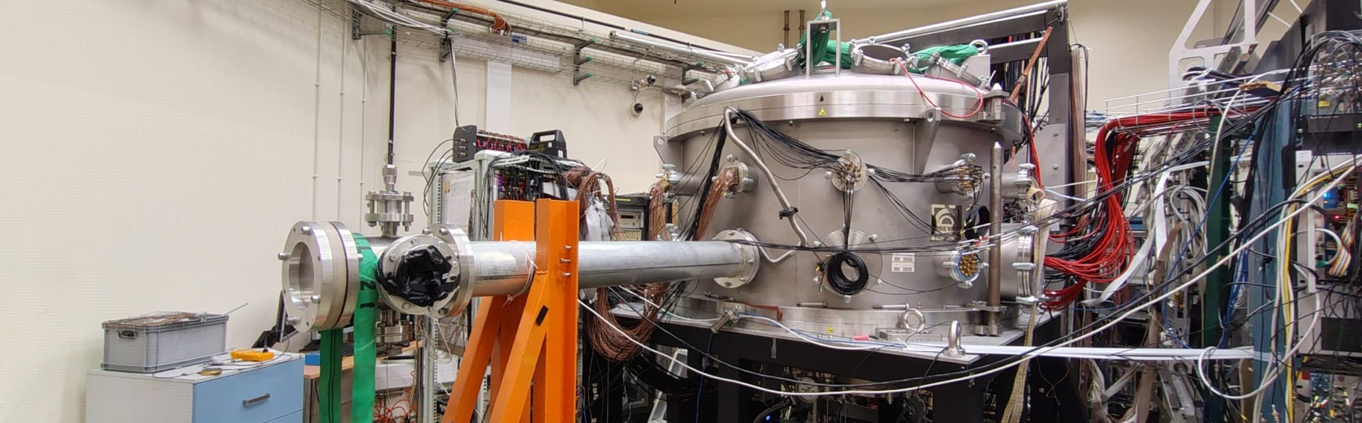
Investigation of the Pygmy Dipole Resonance in the Deformed Nucleus ⁶⁶Zn within the Systematic Study of the A ≈ 60 Mass Region
Spokepersons: A. Giaz, M. Ciemała

Slide 2
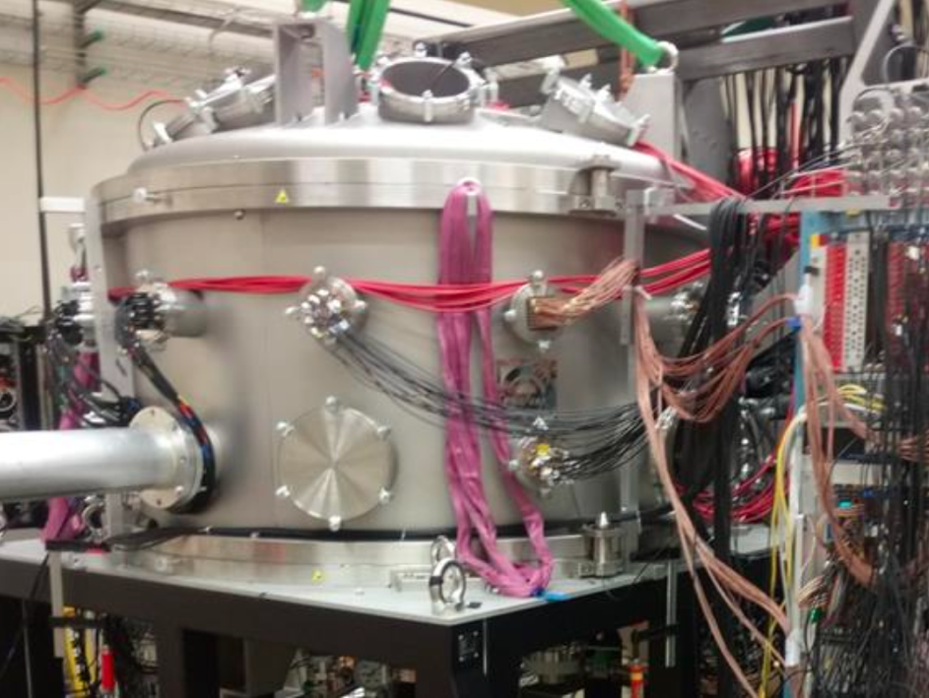
Outline
Motivations
PDR in A = 60 mass region: Ni chain and ⁶⁴Zn and ⁶⁶Zn
Experimental setup & the experimental techniques
Previous experimental results
Beam time estimations
Summary
2

Slide 3
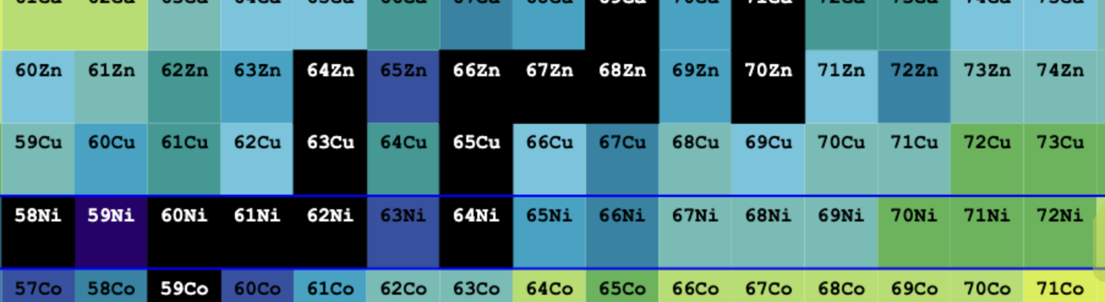
Motivations: PDR IN A=60 MASS REGION
New Proposal: ⁶⁶Zn
3

Slide 4
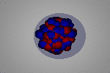
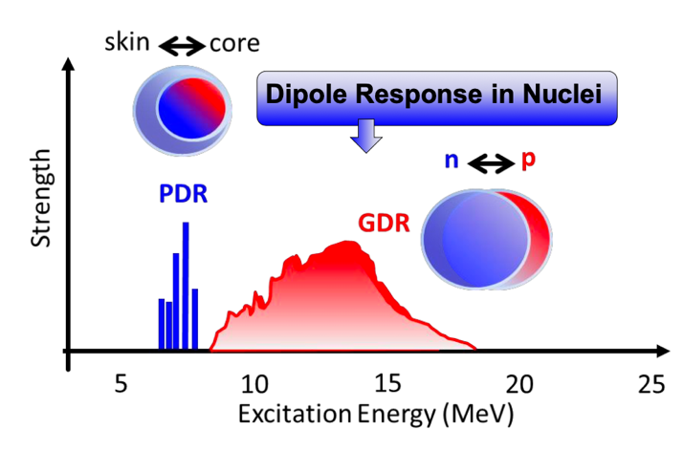
Motivation: Pygmy resonance
PDR has been mostly interpreted as collective oscillation of neutron skin against the core
Manifests itself as
E1 strength concentration around the particle binding energy
4

Slide 5
Motivation: Pygmy resonance
PDR has been mostly interpreted as collective oscillation of neutron skin against the core
Manifests itself as
E1 strength concentration around the particle binding energy
Theory: Different approaches give varied predictions in terms of collectivity, strength and line-shape of the PDR
A broad systematic study it is necessary using complementary approaches.
4

Slide 6
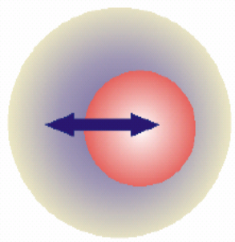
Importance of pygmy resonance
Implications beyond nuclear structure of the low-lying E1strength
Neutron rich nuclei
5

Slide 7
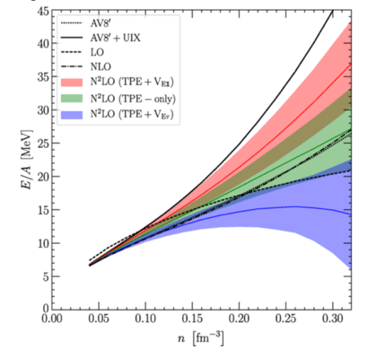
Importance of pygmy resonance
Implications beyond nuclear structure of the low-lying E1strength
Neutron rich nuclei
related to determination of nuclear symmetry energy
(n rich matter)
5

Slide 8
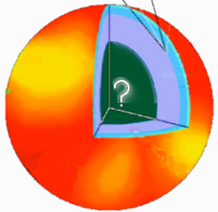
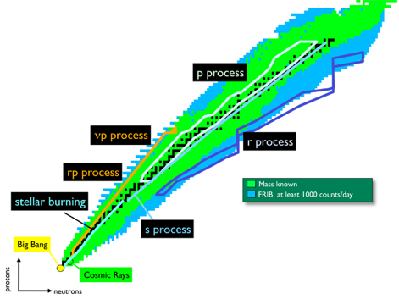
Importance of pygmy resonance
Implications beyond nuclear structure of the low-lying E1strength
can be used for neutron skin thickness determination (neutron stars radius)
Possible impact on the
r-process nucleosynthesis
Neutron rich nuclei
related to determination of nuclear symmetry energy
(n rich matter)
5

Slide 9
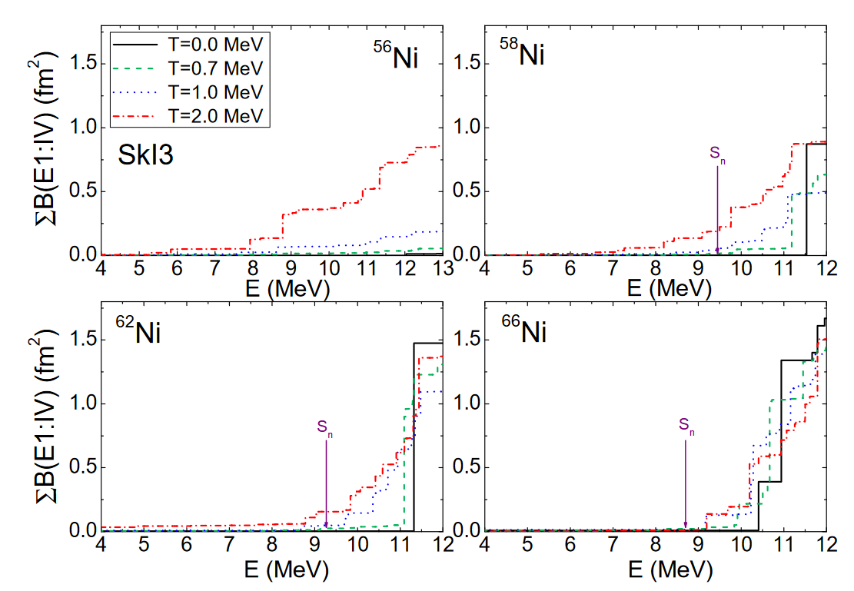
The Previuos experiment: Pygmy in Nickel Chain
Why Ni chain?
PDR strength and position change as a function of the N/Z ratio
A lot of Ni isotopes are experimental available
Ni is part of the r-process
E. Yüksel et al., Eur. Phys. J. A (2019) 55: 230
6

Slide 10
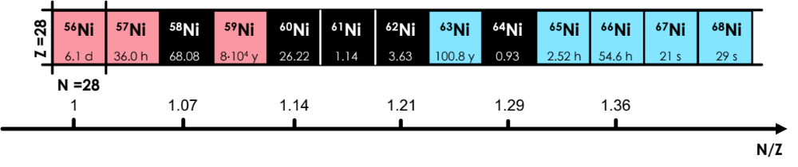
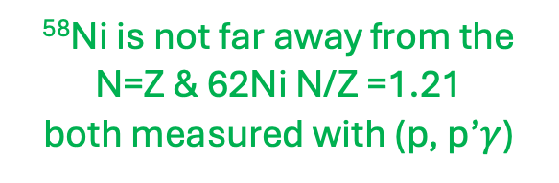
The Previuos experiment: Pygmy in Nickel Chain
Why Ni chain?
PDR strength and position change as a function of the N/Z ratio
A lot of Ni isotopes are experimental available
Ni is part of the r-process
March- June 2024
N/Z
⁵⁸Ni is not far away from the N=Z & 62Ni N/Z =1.21
both measured with (p, p’$γ$)
E. Yüksel et al., Eur. Phys. J. A (2019) 55: 230
6

Slide 11
The Previuos experiment: Pygmy in Nickel Chain
Why Ni chain?
PDR strength and position change as a function of the N/Z ratio
A lot of Ni isotopes are experimental available
Ni is part of the r-process
March- June 2024
2025
N/Z
⁵⁸Ni is not far away from the N=Z & 62Ni N/Z =1.21
both measured with (p, p’$γ$)
⁶⁴Ni has the highest N/Z among stable nuclei
E. Yüksel et al., Eur. Phys. J. A (2019) 55: 230
6

Slide 12
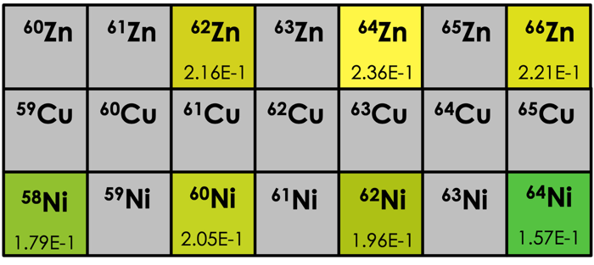
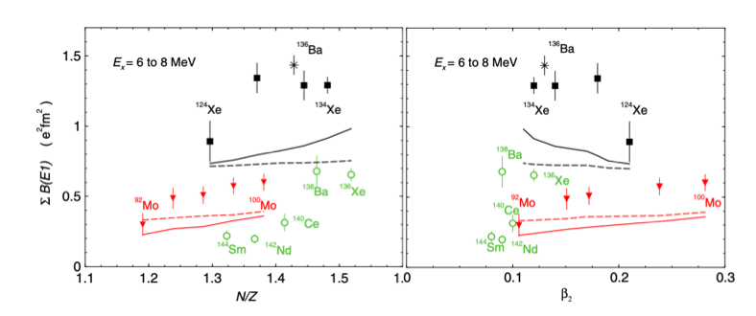
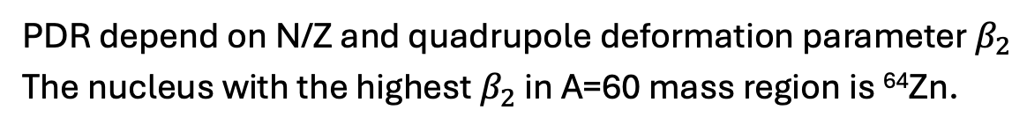
ONGOING: PDR in ⁶⁴Zn
Why ⁶⁴Zn?
PDR depend on N/Z and quadrupole deformation parameter $β_{2}$
The nucleus with the highest $β_{2}$ in A=60 mass region is ⁶⁴Zn.
The ongoing experiment
R. Massarczyk et al. Phys. Rev. Lett. 112, 072501 (2014)
7

Slide 13
ONGOING: PDR in ⁶⁴Zn
Why ⁶⁴Zn?
PDR depend on N/Z and quadrupole deformation parameter $β_{2}$
The nucleus with the highest $β_{2}$ in A=60 mass region is ⁶⁴Zn.
The ongoing experiment
R. Massarczyk et al. Phys. Rev. Lett. 112, 072501 (2014)
7

Slide 14
ONGOING: PDR in ⁶⁴Zn
Why ⁶⁴Zn?
PDR depend on N/Z and quadrupole deformation parameter $β_{2}$
The nucleus with the highest $β_{2}$ in A=60 mass region is ⁶⁴Zn.
The ongoing experiment
R. Massarczyk et al. Phys. Rev. Lett. 112, 072501 (2014)
7

Slide 15
ONGOING: PDR in ⁶⁴Zn
Why ⁶⁴Zn?
PDR depend on N/Z and quadrupole deformation parameter $β_{2}$
The nucleus with the highest $β_{2}$ in A=60 mass region is ⁶⁴Zn.
The ongoing experiment
In Zn isotopes case, too, a complementary experiment on HOT-PDR will be proposed at the IFIN-HH tandem.
R. Massarczyk et al. Phys. Rev. Lett. 112, 072501 (2014)
7

Slide 16
The NEW PROPOSAL: PDR in ⁶⁶Zn
Why ⁶⁶Zn?
PDR strength depends on both the N/Z ratio and the quadrupole deformation parameter β₂​.
⁶⁶Zn is deformed, similarly to ⁶⁴Zn.
⁶⁶Zn and ⁶²Ni have the same N/Z ratios.
This proposal
8

Slide 17
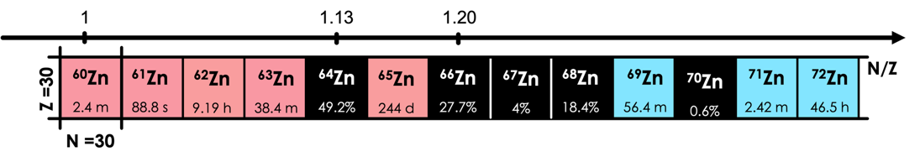
The NEW PROPOSAL: PDR in ⁶⁶Zn
Why ⁶⁶Zn?
PDR strength depends on both the N/Z ratio and the quadrupole deformation parameter β₂​.
⁶⁶Zn is deformed, similarly to ⁶⁴Zn.
⁶⁶Zn and ⁶²Ni have the same N/Z ratios.
Comparison with ⁶²Ni allows us to disentangle N/Z and deformation effects on the PDR.
This proposal

Slide 18
The NEW PROPOSAL: PDR in ⁶⁶Zn
Why ⁶⁶Zn?
PDR strength depends on both the N/Z ratio and the quadrupole deformation parameter β₂​.
⁶⁶Zn is deformed, similarly to ⁶⁴Zn.
⁶⁶Zn and ⁶²Ni have the same N/Z ratios.
Comparison with ⁶²Ni allows us to disentangle N/Z and deformation effects on the PDR.
This proposal
8

Slide 19
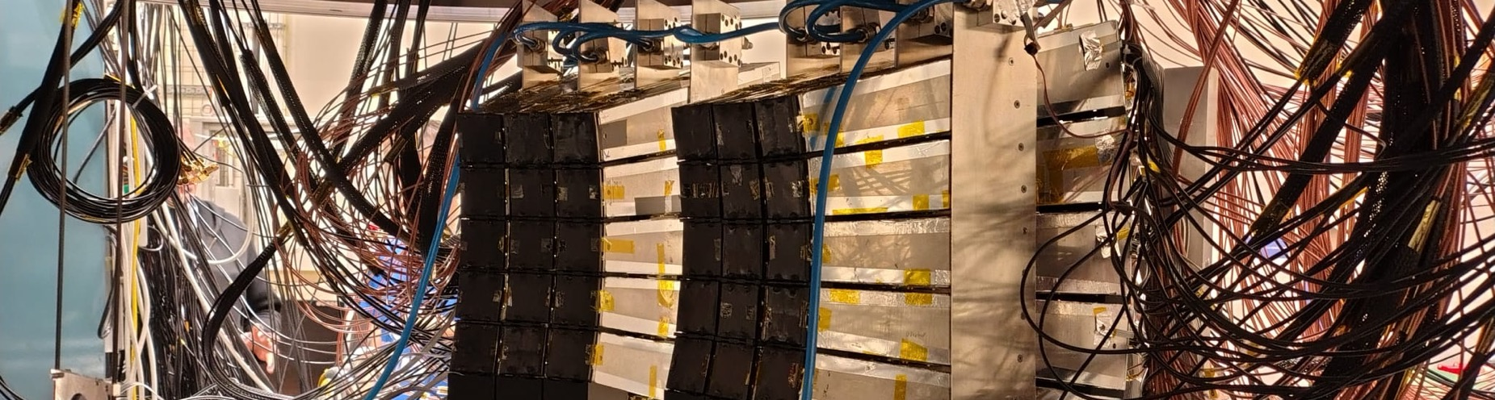
ExPERIMENTAL SETUP & EXPERIMEntal tecnique
PDR Via (p,p’) Inelastic scattering
9

Slide 20
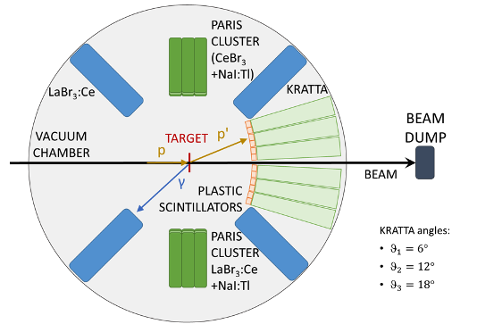
Used and Requested Experimental SETUP
TARGETs:
⁶⁴Ni 30 mg/cm² ⁶²Ni 100 mg/cm²
⁵⁸Ni 200 mg/cm²
⁶⁴Zn 50 mg/cm²
⁶⁶Zn 23 mg/cm²
PROTON BEAM:
180 MeV
0.4 nA
10

Slide 21
Used and Requested Experimental SETUP
TARGETs:
⁶⁴Ni 30 mg/cm² ⁶²Ni 100 mg/cm²
⁵⁸Ni 200 mg/cm²
⁶⁴Zn 50 mg/cm²
⁶⁶Zn 23 mg/cm²
PROTON BEAM:
180 MeV
0.4 nA
32 KRATTA TELESCOPES:
6 column of 5 detectos each
Resolution:
2 MeV (FWHM)
Angular resolution: 0.8°
10

Slide 22
Used and Requested Experimental SETUP
TARGETs:
⁶⁴Ni 30 mg/cm² ⁶²Ni 100 mg/cm²
⁵⁸Ni 200 mg/cm²
⁶⁴Zn 50 mg/cm²
⁶⁶Zn 23 mg/cm²
PROTON BEAM:
180 MeV
0.4 nA
32 KRATTA TELESCOPES:
6 column of 5 detectos each
Resolution:
2 MeV (FWHM)
Angular resolution: 0.8°
PARIS DETECTORS:
Phoswich
CeBr₃ or LaBr₃:Ce + NaI
Energy range up to 20 MeV.
4 LaBr₃:Ce
Size: 3.5” x 8”
10

Slide 23
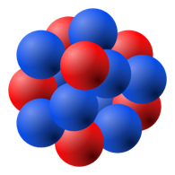


The experimental technique
p’
p
⁵⁸Ni - ⁶²Ni - ⁶⁴Ni
⁶⁴Zn - ⁶⁶Zn
$$γ$$
11

Slide 24
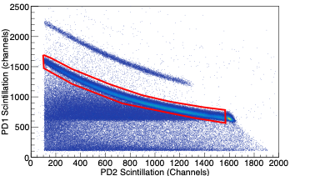

The experimental technique
KRATTTA
p’
p
⁵⁸Ni - ⁶²Ni - ⁶⁴Ni
⁶⁴Zn - ⁶⁶Zn
Proton gate → E_{p’}
$$γ$$
11

Slide 25
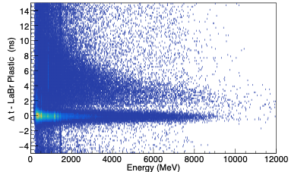

The experimental technique
KRATTTA
p’
p
⁵⁸Ni - ⁶²Ni - ⁶⁴Ni
⁶⁴Zn - ⁶⁶Zn
Proton gate → E_{p’}
$$γ$$
Large-volume
LaBr₃:Ce
$γ$ prompt
11

Slide 26
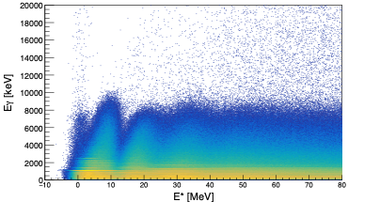

The experimental technique
KRATTTA
p’
p
⁵⁸Ni - ⁶²Ni - ⁶⁴Ni
⁶⁴Zn - ⁶⁶Zn
Proton gate → E_{p’}
$$γ$$
Large-volume
LaBr₃:Ce
$γ$ prompt
E* = E_{beam} - E_{p’}
11

Slide 27
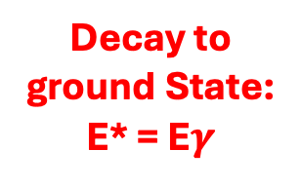
The experimental technique
KRATTTA
p’
p
⁵⁸Ni - ⁶²Ni - ⁶⁴Ni
⁶⁴Zn - ⁶⁶Zn
Proton gate → E_{p’}
$$γ$$
Large-volume
LaBr₃:Ce
Decay to ground State:
E* = E$γ$
$γ$ prompt
E* = E_{beam} - E_{p’}
11

Slide 28
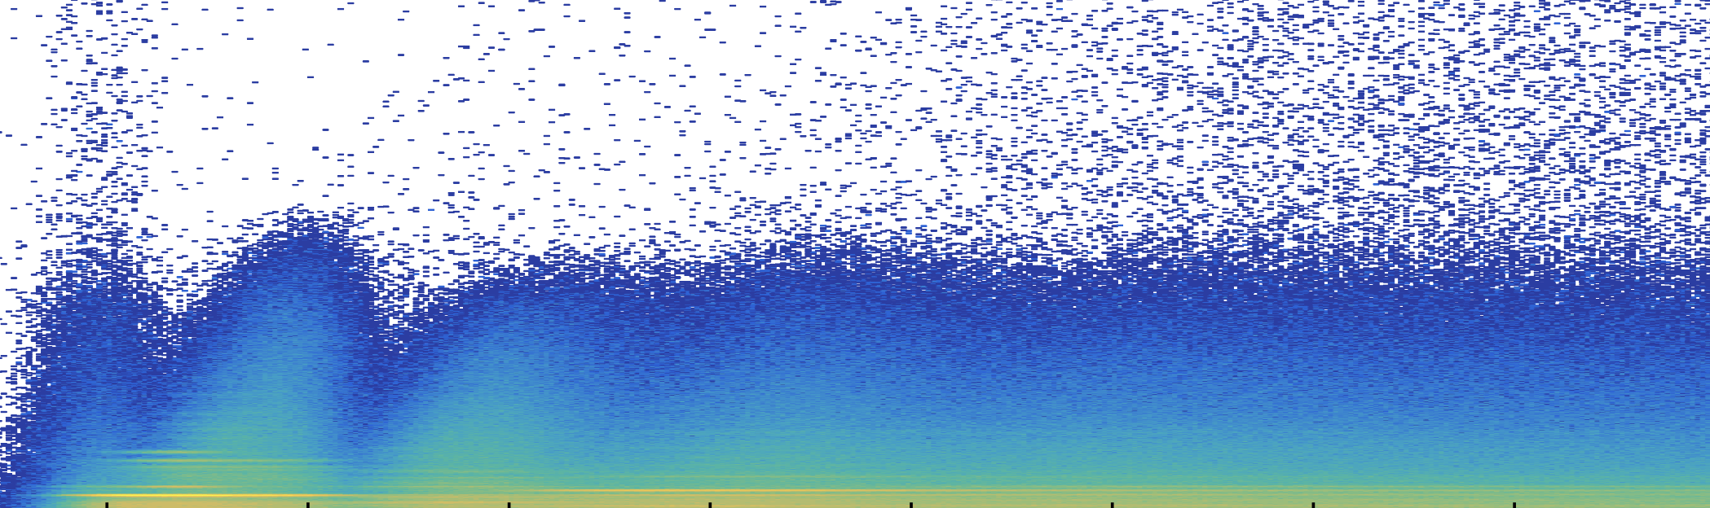
Previuous measumerements results
preliminary results: ⁵⁸Ni, ⁶²Ni & ⁶⁴Ni
12

Slide 29
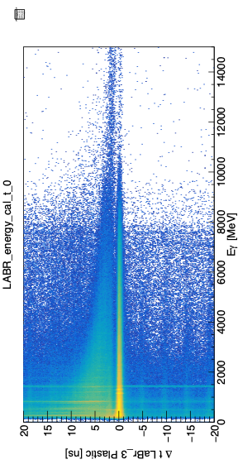
⁶²Ni & ⁵⁸Ni DATA ANALYSis: Time selection
Plastic vs
LaBr₃:Ce
13

Slide 30
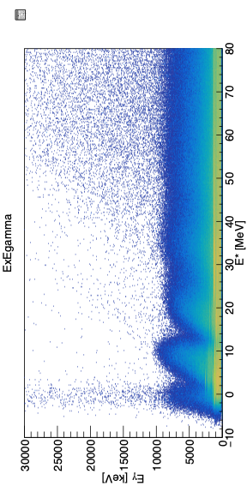

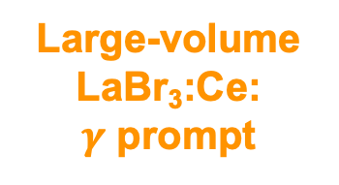
⁶²Ni & ⁵⁸Ni DATA ANALYSis: Time selection
⁶²Ni
Large-volume
LaBr₃:Ce:
$γ$ prompt
Time resolution Plastic vs LaBr₃:Ce is about an 0.9 ns FWHM
Plastic vs
LaBr₃:Ce
$γ$ prompt
13

Slide 31
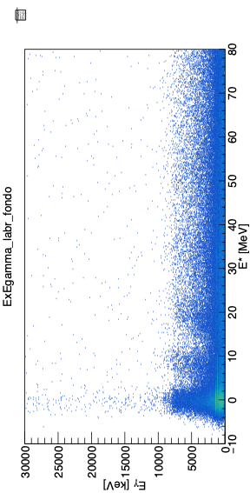
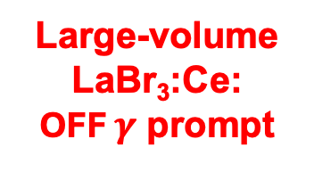
⁶²Ni & ⁵⁸Ni DATA ANALYSis: Time selection
⁶²Ni
Large-volume
LaBr₃:Ce:
$γ$ prompt
⁶²Ni
Large-volume
LaBr₃:Ce:
OFF $γ$ prompt
Time resolution Plastic vs LaBr₃:Ce is about an 0.9 ns FWHM
Plastic vs
LaBr₃:Ce
Background events shoud be subtracted from the data
$γ$ prompt
13

Slide 32
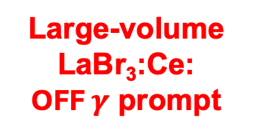

⁶²Ni & ⁵⁸Ni DATA ANALYSis: DECAY to the ground state
⁶²Ni
Large-volume
LaBr₃:Ce:
$γ$ prompt
⁶²Ni
Large-volume
LaBr₃:Ce:
OFF $γ$ prompt
14

Slide 33
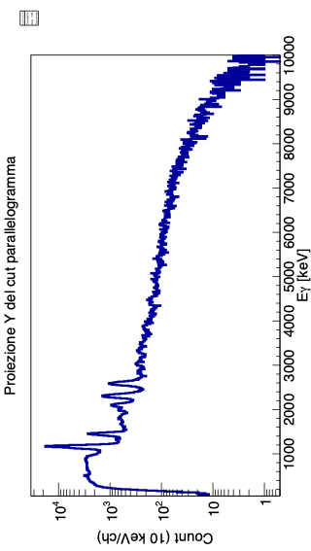
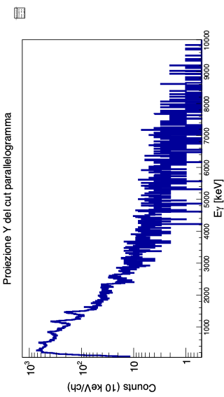
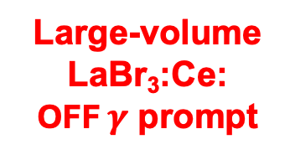
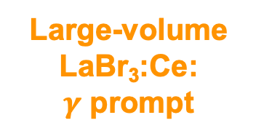
⁶²Ni & ⁵⁸Ni DATA ANALYSis: DECAY to the ground state
⁶²Ni
Large-volume
LaBr₃:Ce:
$γ$ prompt
Large-volume
LaBr₃:Ce:
$γ$ prompt
y-axis projection to extract the γ decay to the ground state
⁶²Ni
Large-volume
LaBr₃:Ce:
OFF $γ$ prompt
Large-volume
LaBr₃:Ce:
OFF $γ$ prompt
14

Slide 34
⁶²Ni & ⁵⁸Ni DATA ANALYSis: DECAY to the ground state
⁶²Ni
Large-volume
LaBr₃:Ce:
$γ$ prompt
Large-volume
LaBr₃:Ce:
$γ$ prompt
y-axis projection to extract the γ decay to the ground state
⁶²Ni
Large-volume
LaBr₃:Ce:
OFF $γ$ prompt
Large-volume
LaBr₃:Ce:
OFF $γ$ prompt
LaBr₃:Ce: $γ$ prompt – LaBr3:Ce: OFF $γ$ prompt
14

Slide 35
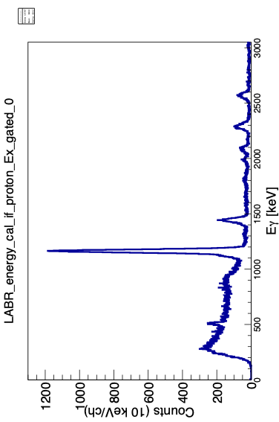
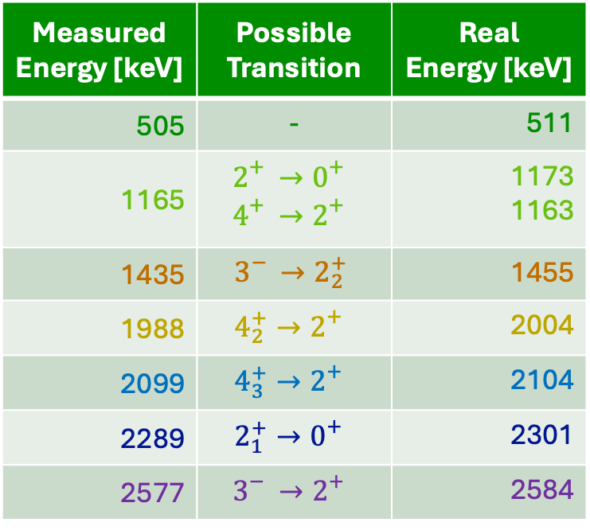
LaBr₃:ce: ⁶²Ni LOW ENERGY TRANSITIONS
The calibration need to be refined
Measured Energy [keV] | Possible Transition | Real Energy [keV]
505 | - | 511
1165 | $$2_{}^{+}→0_{}^{+}$$ $$4_{}^{+}→2_{}^{+}$$ | 1173 1163
1435 | $$3_{}^{−}→2_{2}^{+}$$ | 1455
1988 | $$4_{2}^{+}→2_{}^{+}$$ | 2004
2099 | $$4_{3}^{+}→2_{}^{+}$$ | 2104
2289 | $$2_{1}^{+}→0_{}^{+}$$ | 2301
2577 | $$3_{}^{−}→2_{}^{+}$$ | 2584
1173 keV
1163 keV
PRELIMINARY
2099 keV
2584 keV
511 keV
1455 keV
2099 keV
1988 keV
15

Slide 36
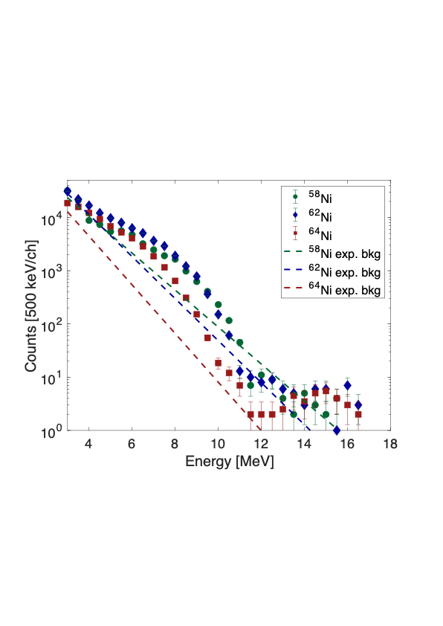
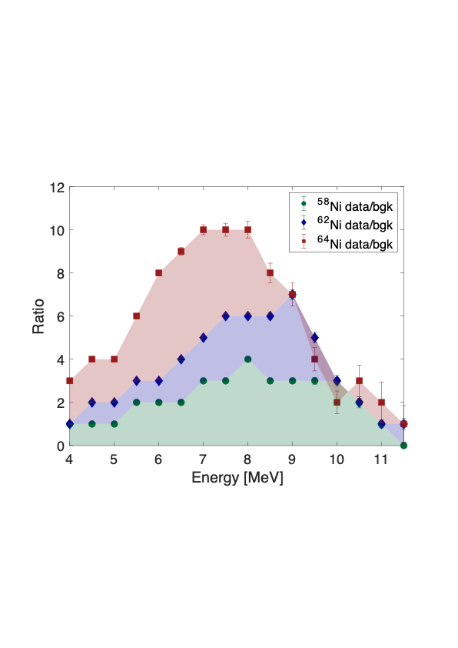
PDR in Ni Isotopes
⁶²Ni & ⁶⁴Ni
N/Z = 1.21
N/Z = 1.29
Pygmy expected
Preliminary
⁵⁸Ni
N/Z = 1.07
No Pygmy or negligible Pygmy expected
Preliminary
The data for ⁶⁴Ni are based on a semi-online analysis.
16

Slide 37
PDR in Ni Isotopes
⁶²Ni & ⁶⁴Ni
N/Z = 1.21
N/Z = 1.29
Pygmy expected
Preliminary
Maurizio Giunta’s Bachelor and Master
&
Kacper
Proszowski’s
Master
⁵⁸Ni
N/Z = 1.07
No Pygmy or negligible Pygmy expected
Preliminary
The data for ⁶⁴Ni are based on a semi-online analysis.
16

Slide 38

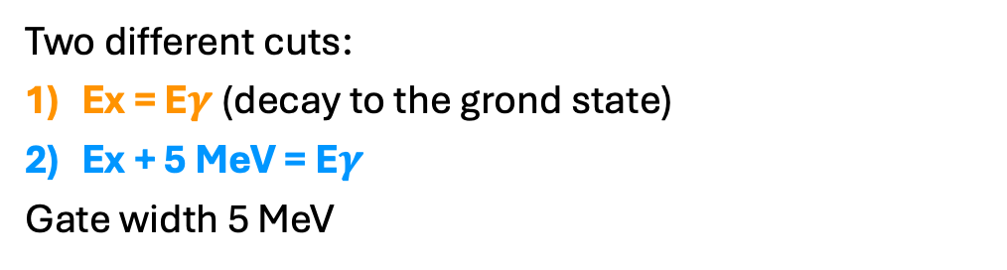
PDR DECAY to Ground state IN ⁶²Ni
⁶²Ni
Large-volume
LaBr₃:Ce:
$γ$ prompt
Two different cuts:
Ex = E$γ$ (decay to the grond state)
Ex + 5 MeV = E$γ$
Gate width 5 MeV
17

Slide 39
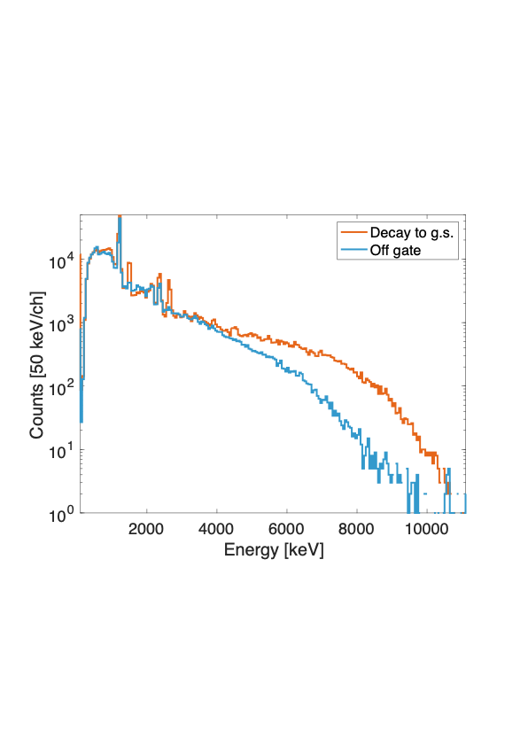
PDR DECAY to Ground state IN ⁶²Ni
⁶²Ni
Large-volume
LaBr₃:Ce:
$γ$ prompt
Preliminary
Two different cuts:
Ex = E$γ$ (decay to the grond state)
Ex + 5 MeV = E$γ$
Gate width 5 MeV
PDR decays to the ground state
17

Slide 40
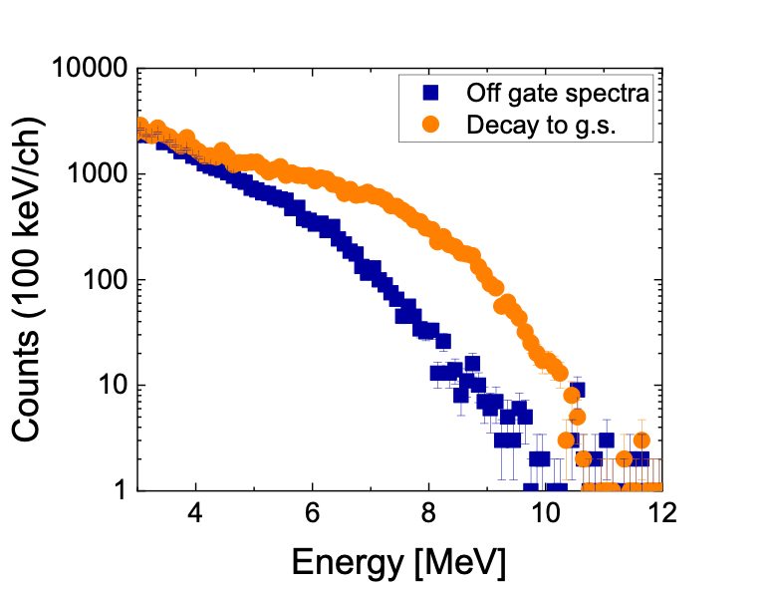
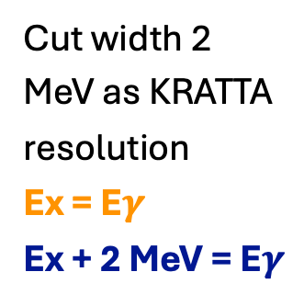
PDR IN ⁶²Ni
Cut width 2 MeV as KRATTA resolution
Ex = E$γ$
Ex + 2 MeV = E$γ$
Preliminary
18

Slide 41
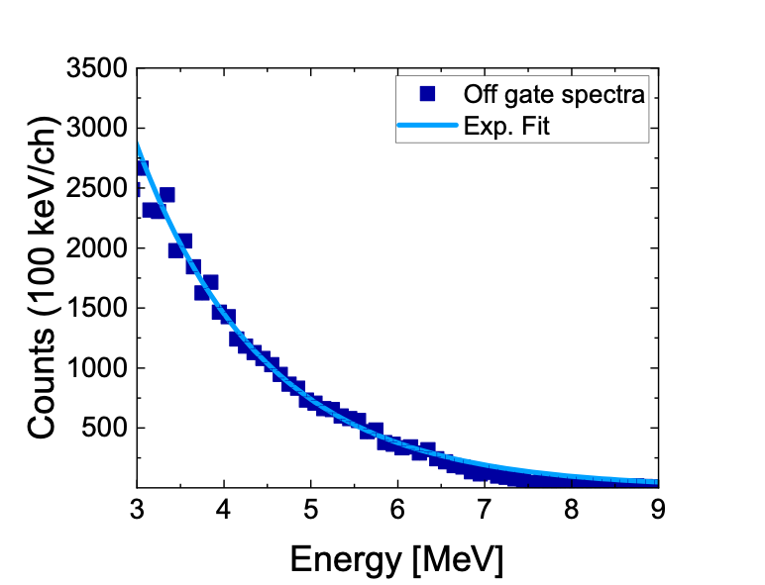
PDR IN ⁶²Ni
Cut width 2 MeV as KRATTA resolution
Ex = E$γ$
Ex + 2 MeV = E$γ$
Preliminary
Off gate spectra fitted with an exponetial
Exponential fit subtracted to the data
Preliminary
18

Slide 42
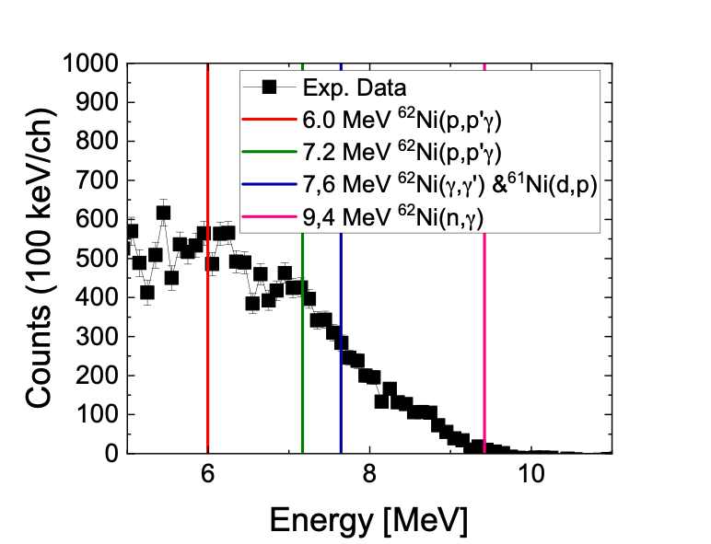
PDR IN ⁶²Ni
The calibration need to be refined
Cut width 2 MeV as KRATTA resolution
Ex = E$γ$
Ex + 2 MeV = E$γ$
Preliminary
Preliminary
Off gate spectra fitted with an exponetial
Exponential fit subtracted to the data
Preliminary
18

Slide 43
PDR IN ⁶²Ni
The calibration need to be refined
Cut width 2 MeV as KRATTA resolution
Ex = E$γ$
Ex + 2 MeV = E$γ$
Preliminary
Preliminary
Off gate spectra fitted with an exponetial
Exponential fit subtracted to the data
Preliminary
Final goal : extraction of the PDR cross section
18

Slide 44
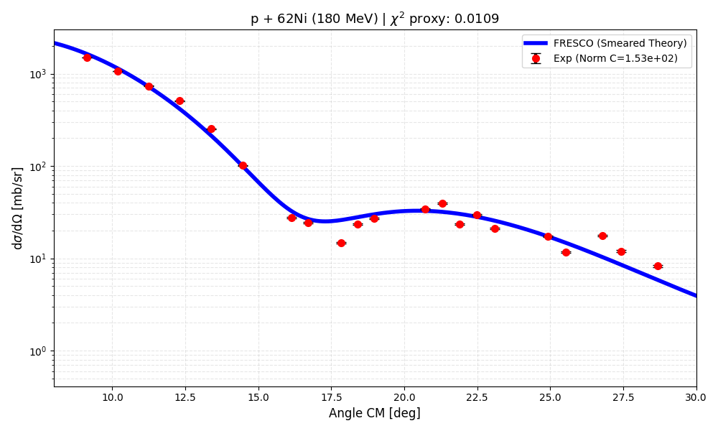
Elastic cross section: ⁶²Ni
By using plastic angles, the elastic cross section can be reproduced over the angular range from 8° to 30°.
Preliminary
Courtesy of M. Ciemała
19

Slide 45
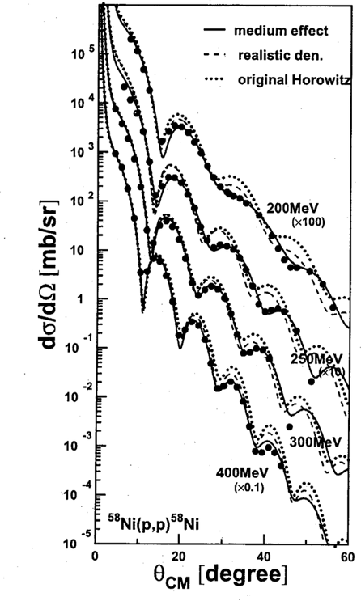
Elastic cross section: ⁶²Ni
By using plastic angles, the elastic cross section can be reproduced over the angular range from 8° to 30°.
It was previously measured in Osaka for ⁵⁸Ni at 200 MeV. We can compare our data with those results.
Preliminary
Courtesy of M. Ciemała
Y. Takeda, Mem. Fac. Sci. Kyoto Univ., Ser. Phys., 44, 1, (2003)
19

Slide 46
Elastic cross section: ⁶²Ni
By using plastic angles, the elastic cross section can be reproduced over the angular range from 8° to 30°.
It was previously measured in Osaka for ⁵⁸Ni at 200 MeV. We can compare our data with those results.
Preliminary
Courtesy of M. Ciemała
Y. Takeda, Mem. Fac. Sci. Kyoto Univ., Ser. Phys., 44, 1, (2003)
19

Slide 47
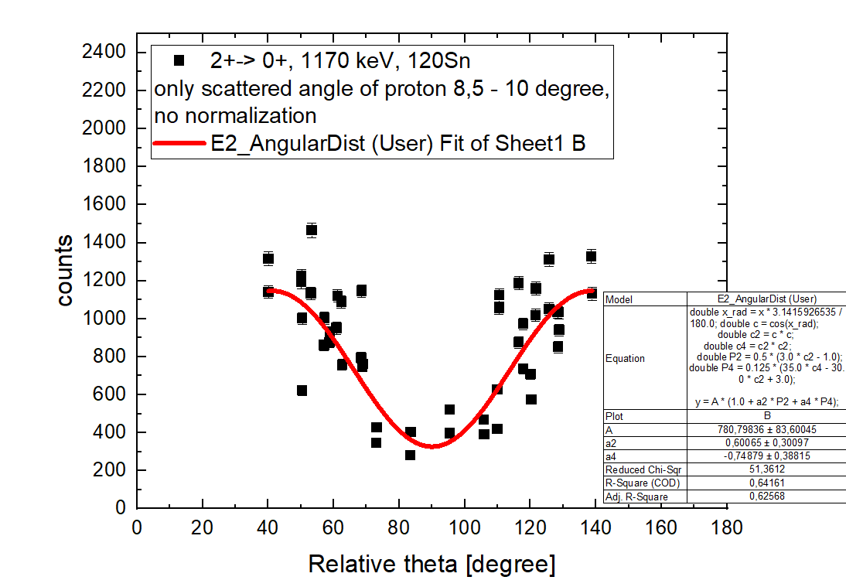
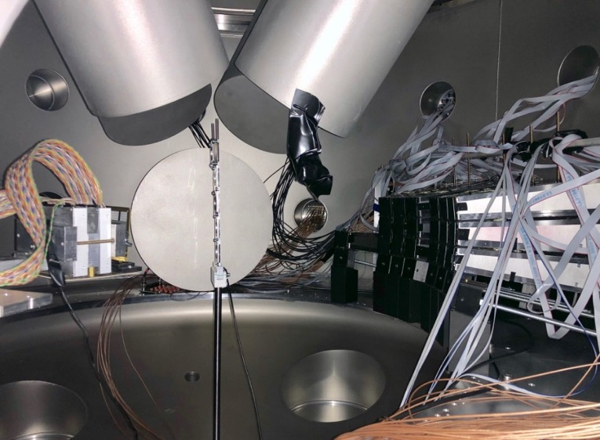



γ-ray angular distribution
The plaastic detector granularity allows us to extract the angular distribution (transition character).
$$γ$$
Preliminary
$$θ$$
p
p’
Courtesy of M. Ciemała
20

Slide 48
γ-ray angular distribution
The plaastic detector granularity allows us to extract the angular distribution (transition character).
$$γ$$
Preliminary
$$θ$$
p
p’
Ongoing work: extraction of angular distributions in Ni data
Courtesy of M. Ciemała
20

Slide 49
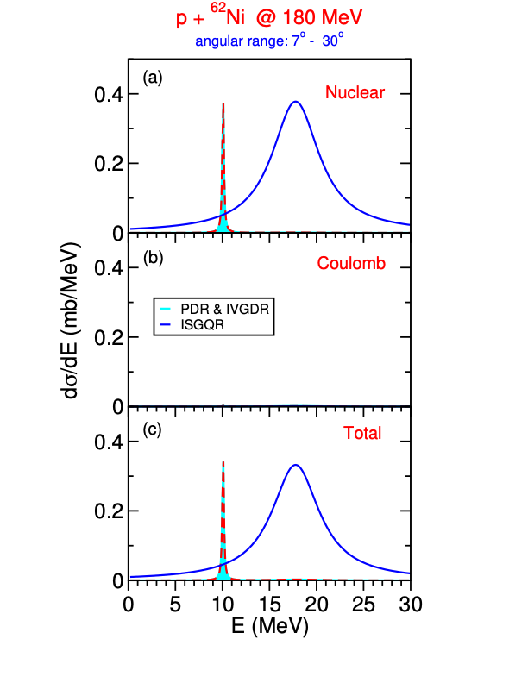
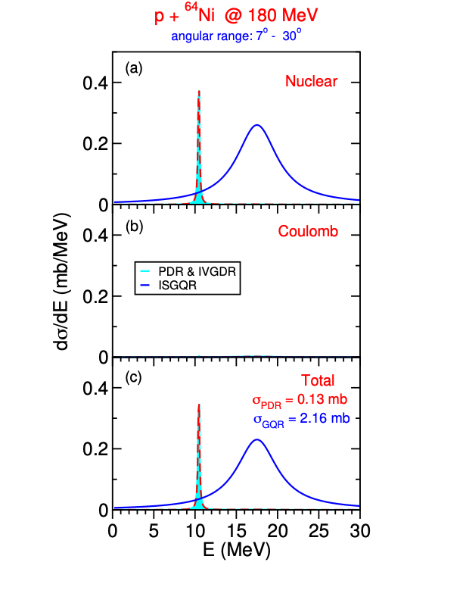

Theoretical Predictions
Calculations by E. Lanza:
PDR, ISGQR, and IVGDR contributions
Separate evaluation of nuclear and Coulomb excitation
Indication that the observed strength is with nuclear excitation.
⁶²Ni
⁶⁴Ni
⁶²Ni
Courtesy of E. Lanza
21

Slide 50

Previuous measumerements results
ONLINE results: ⁶⁴Zn
22

Slide 51



ONGOING: PDR in ⁶⁴Zn
⁶²Ni
The same analysis procedure was applied to the just acquired ⁶⁴Zn data to investigate the presence of the PDR.
ONLINE datA
992 keV
2+ → 0+
1315 keV
4+ → 2+
2007 keV
3- → 2+
ONLINE datA
ONLINE datA
23

Slide 52
ONGOING: PDR in ⁶⁴Zn
⁶²Ni
The same analysis procedure was applied to the just acquired ⁶⁴Zn data to investigate the presence of the PDR.
ONLINE datA
Evidence of PDR in ⁶⁴Zn
992 keV
2+ → 0+
1315 keV
4+ → 2+
2007 keV
3- → 2+
ONLINE datA
ONLINE datA
23

Slide 53
ONGOING: PDR in ⁶⁴Zn
⁶²Ni
The same analysis procedure was applied to the just acquired ⁶⁴Zn data to investigate the presence of the PDR.
ONLINE datA
Francesco Apa’s Master
Evidence of PDR in ⁶⁴Zn
992 keV
2+ → 0+
1315 keV
4+ → 2+
2007 keV
3- → 2+
ONLINE datA
ONLINE datA
23

Slide 54

The Proposed experiment
Beam Time Extimations
24

Slide 55


Beam Time Estimations
We based our estimation on previuos Ni isotope meauserements.
 | Previous Experiment: ⁶⁴Ni | Proposed Experiment: ⁶⁶Zn
BEAM ENERGY | 180 MeV | 180 MeV
BEAM CURRENT | 0.4 nA | 0.4 nA
CROSS SECTION | ⁶⁴Ni $≈$ ⁶⁶Zn | ⁶⁴Ni $≈$ ⁶⁶Zn
DEAD TIME | 50% | 20 %
TARGET THICKNESS | 30 mg/cm² | 23 mg/cm²
BEAM TIME | 50 UTs | 47 UTs
We scale for the target thickness and the dead time reduction.
47 UTs + 1 UT for KRATTA calibration = 48 UTs
$\sim$8 weekends
25

Slide 56
Beam Time Estimations
We based our estimation on previuos Ni isotope meauserements.
 | Previous Experiment: ⁶⁴Ni | Proposed Experiment: ⁶⁶Zn
BEAM ENERGY | 180 MeV | 180 MeV
BEAM CURRENT | 0.4 nA | 0.4 nA
CROSS SECTION | ⁶⁴Ni $≈$ ⁶⁶Zn | ⁶⁴Ni $≈$ ⁶⁶Zn
DEAD TIME | 50% | 20 %
TARGET THICKNESS | 30 mg/cm² | 23 mg/cm²
BEAM TIME | 50 UTs | 47 UTs
We scale for the target thickness and the dead time reduction.
47 UTs + 1 UT for KRATTA calibration = 48 UTs
$\sim$8 weekends
TARGET:
Target material purchased by INFN
Target successfully manufactured by LNL-INFN
Target already available at the Kraków laboratory ready for the experiment
25

Slide 57

Summary
We propose to measure PDR in the deformed isotope ⁶⁶Zn to disentangle N/Z and deformation effects
It is sequel of a previous experiment on PDR in Ni & Zn isotopes
Experimental set up: KRATTTA + large-volume LaBr₃:Ce + PARIS
Considering target thickness (⁶⁴Ni $\sim$ 30 mg/cm² while ⁶⁶Zn $\sim$ 23 mg/cm²) and dead time reduction we ask for 47 UTs for ⁶⁶Zn measurement and 1 UTs for KRATTA calibration
Total beam request: 48 UTs corresponding to 8 weekends
26

Slide 58


Experiment Partecipants
INFN and Uni Milano (Italy): A. Giaz, O. Wieland,
F. Apa, G. Benzoni, S. Bottoni, A. Bracco, S. Brambilla,
F. Camera, F. Conca, F. Crespi, D. Genna, M. Giunta, S. Leoni,
M. Luciani, B. Million,
IFJ PAN Krakow (Poland): M. Ciemała, M. Kmiecik,
P. Bednarczyk, N. Cieplicka-Orynczak, B. Fornal,
K. Gajewska, J. Grębosz, P. Kulessa J. Łukasik, A. Maj,
M. Matejska-Minda, K. Mazurek, S. Panwar, K. Proszowski,
P. Pawłowski, M. Ziębliński,
University of Groningen (The Netherlands):
M.N. Harakeh,
INFN LNL e Uni Padova (Italy): M. Balogh,
D. Stramaccioni, J.J. Valiente-Dobon
GANIL (France): M. Lewitowicz,
IJCLab Orsay (France): A. Dey, I. Matea, J. Wilson,
CEA Saclay (France): P. Miriot-Jaubert, M. Vandebrouck,
SLCJ UW (Poland): K. Hadyńska-Klęk, C. Hiver, P. Napiorkowski,
USTHB Algiers (Algeria): N. Benouaret,
Ithemba (South Africa): R. Neveling, L. Pellegri,
IFJ PAN Krakow (Poland) & IPHC Strasburg (France):
C. Schmitt,
ELI-NP Bucharest: D. Balabanski, A. Kusoglu,
P-A Söderström, R. S. Ban.
INFN Catania: E. Lanza
27

Slide 59

Thank you for the attention!

Slide 60

Backup Slides

Slide 61




$64Ni$ Trigger improvment
LaBr₃:Ce + PARIS
KRATTA TELESCOPES
+ PLASTIC Scintillators
Plastic
$$γ$$
p’
p
⁶⁴Ni
We compensate the reduction in the target thickness (from 30 to 23 mg/cm²).
OLD TRIGGER: PARIS & PLASTIC
NEW TRIGGER: PARIS & PLASTIC & KRATTA
Dead time reduction from 50% to 20% - Good events increasement
29

Slide 62





Polarization measurements with PARIS
//PARIS
$⊥$PARIS
Parity distinction:
On basis of scattering ratio vertical ($⊥$PARIS) horizontal ($∥$PARIS)
Paris Cluster 1
Paris Cluster 2
30

Slide 63


PARIS LaBr₃:ce & CeBr₃ Detector Issues
CLUSTER I1: detector from 13 - 25
1 detector with wrong calibration: det 17
I detector with low statistics: det 22
I detector with a sligthty wrong calibration: 19
CLUSTER 1: detector from 0 - 12
2 detectors with wrong calibration: det 4 & 7
2 detector with low statistics: det 10 & 12
31

Slide 64




PARIS LaBr₃:ce & CeBr₃ Detector Issues: CLUSTER II
Detectors with bad calibration low
statistics are not stable.
Detectors with bad calibration low
statistics are not stable.
Detectors with good calibration are stable.
32

