Slide 1

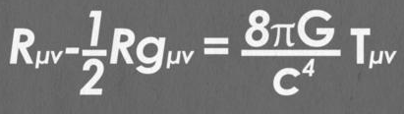
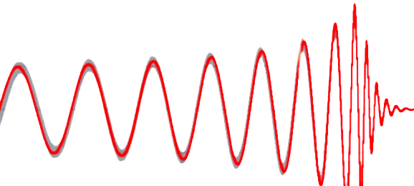
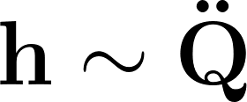
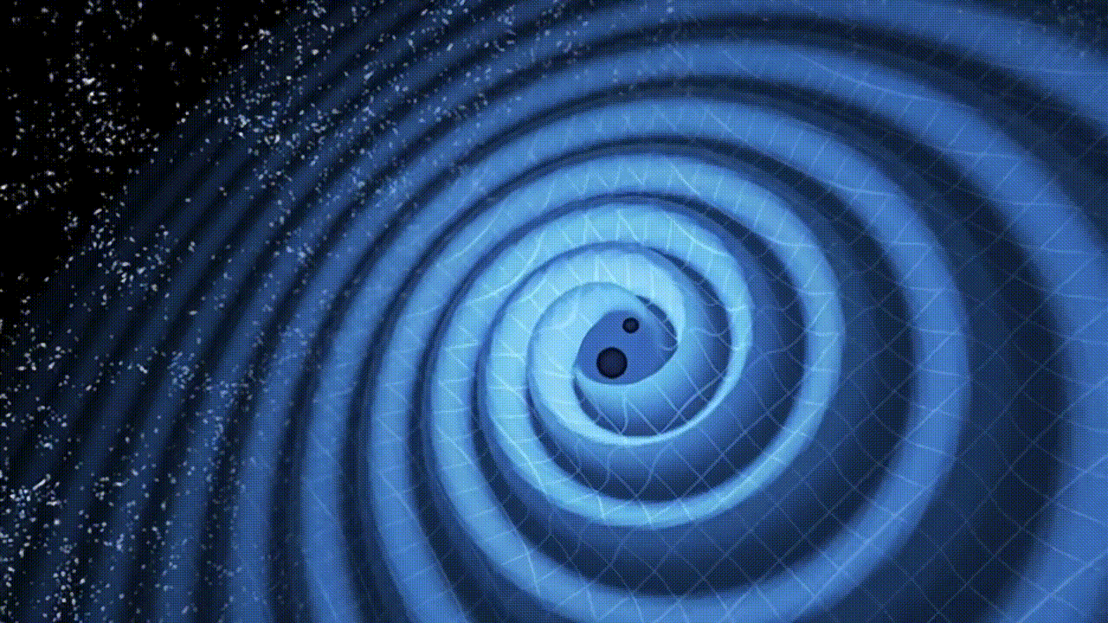
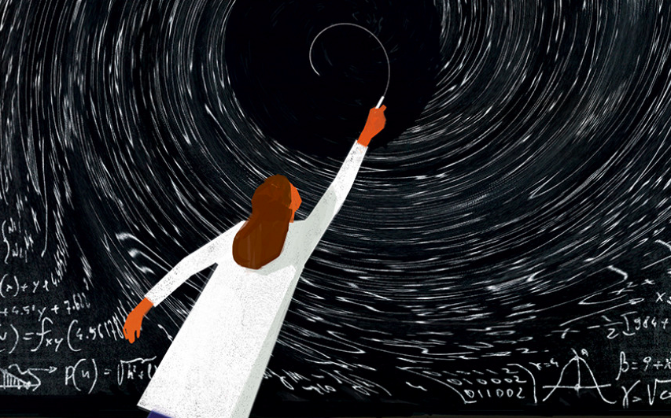
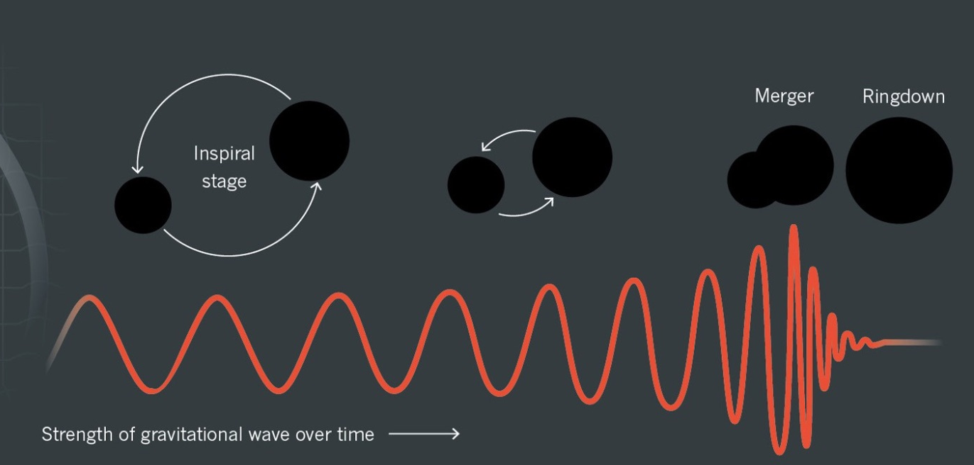

Basics of Gravitational Wave Physics:
Connecting Theory to Data
Syed Naqvi, Post-Doc, NZ-15
Einstein Telescope member (David E. Alvarez group)
Einstein’s famous quadrupole formula

Slide 2
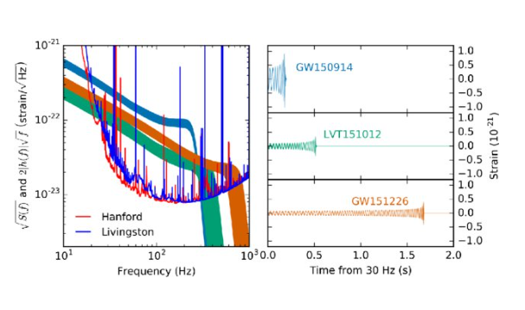
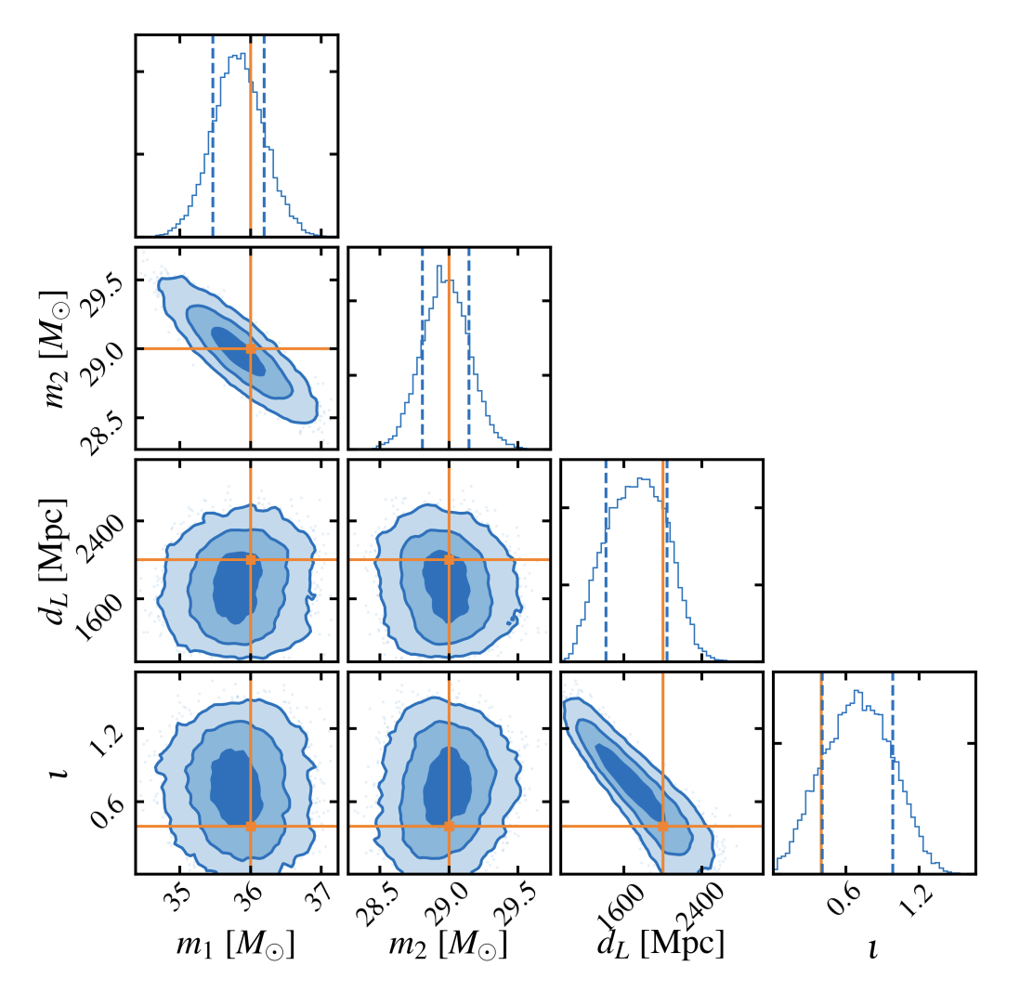

Basics of Gravitational Wave Physics:
Connecting Theory to Data
Syed Naqvi, Post-Doc, NZ-15
Einstein Telescope member (David E. Alvarez group)
Gravitational Waves: signal + noise

Slide 3
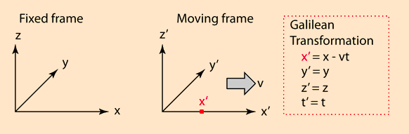
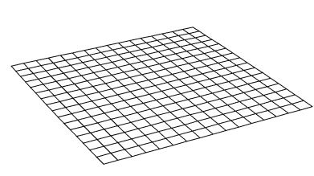
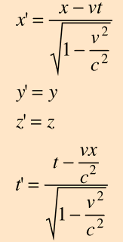
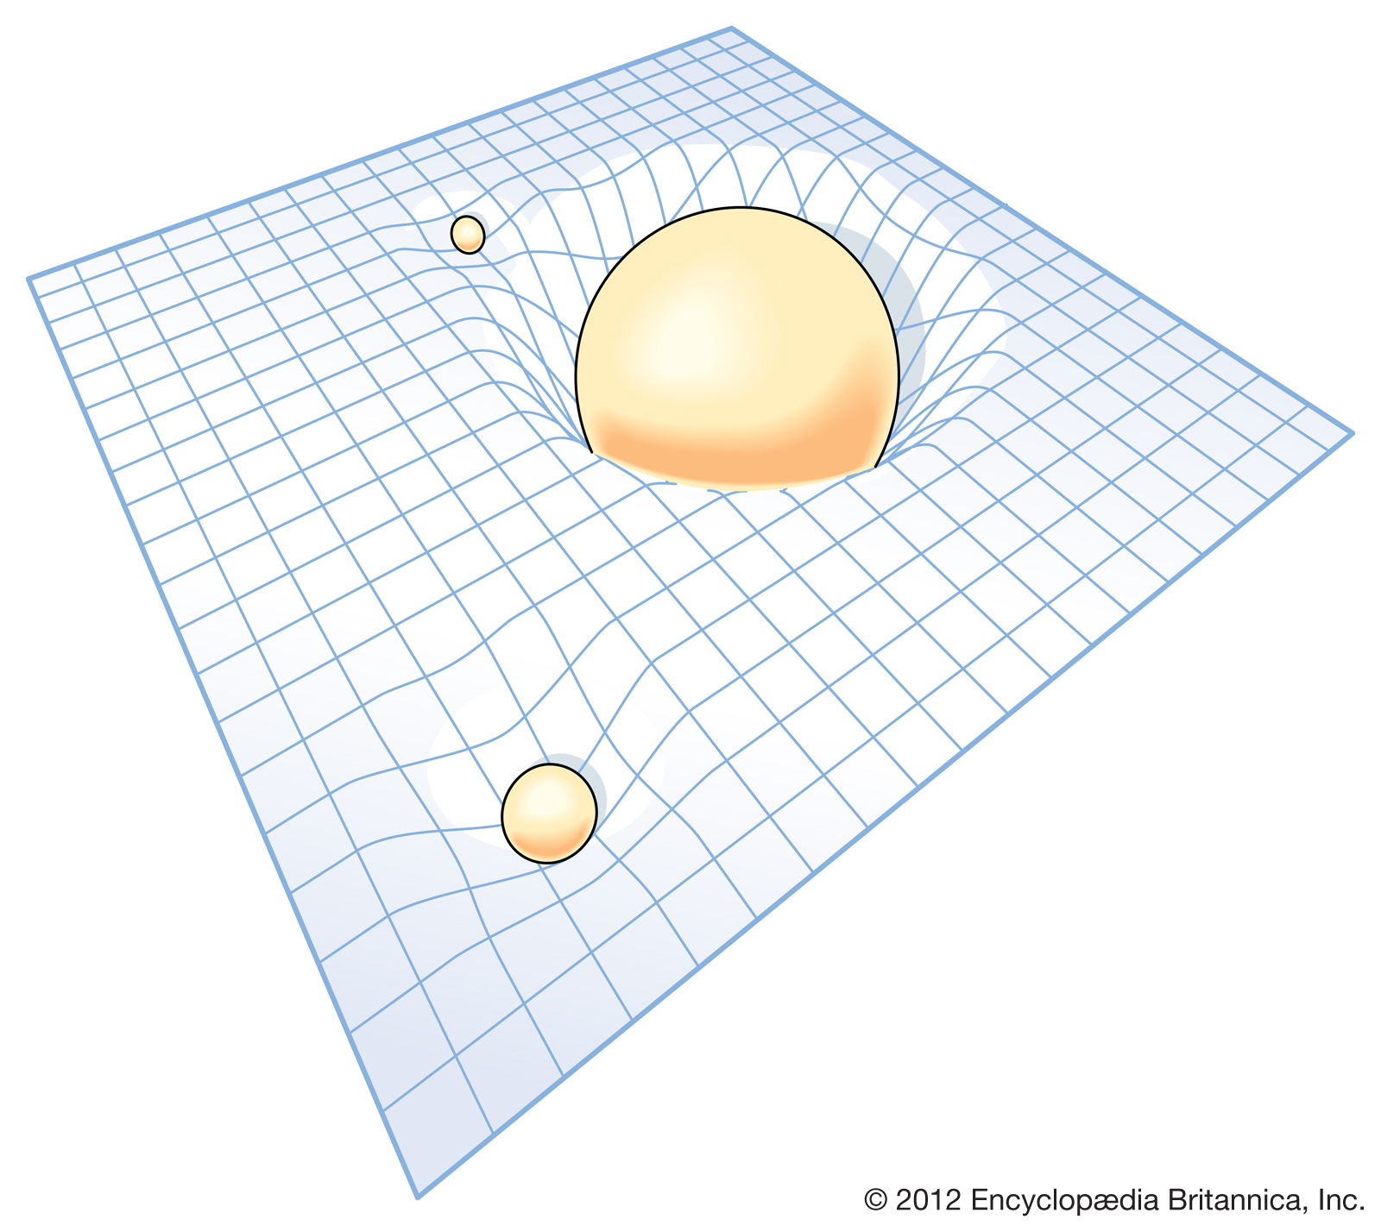

Newtonian Era
Space and Time becomes SpaceTime
Lorentz Transformation
General Relativity
Spacetime metric:

Slide 4


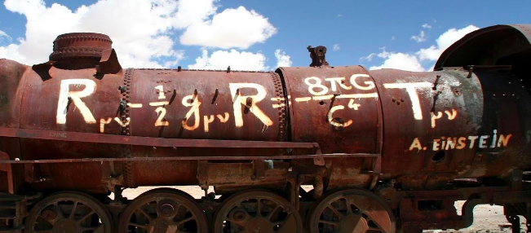
Einstein Field Equations : Meme Version
Czasoprzestrzeń mówi materii jak się poruszać...
...materia mówi czasoprzestrzeni, jak się zakrzywiać
Non-linear nature, many types of spacetimes(compact objects, universe expanding etc . . .)

Slide 5
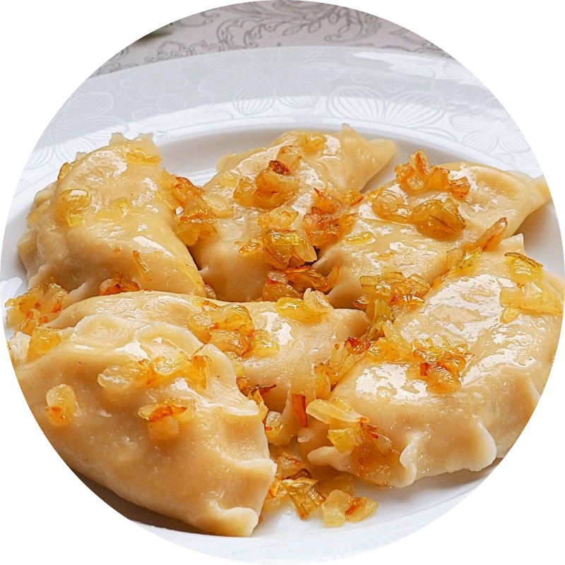

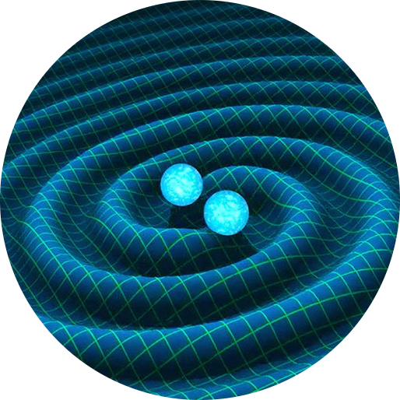
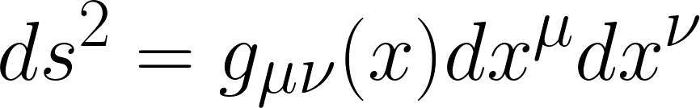
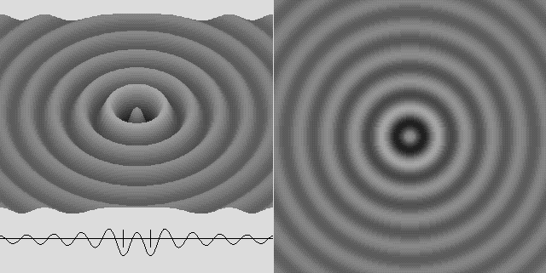
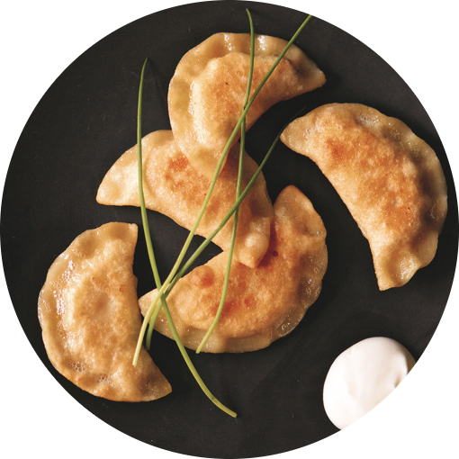
Different spacetimes represent different settings…
Pierogi Ruskie: Spacetimes of heavy objects Black Holes, NS etc….
Pierogi ze szpinakiem i serem feta: Spacetimes having radiation/Grav Waves from astrophysical sources
.
.
.
.
.
.
Indyjskie pierogi: Spacetimes having
Standing Grav. Waves

Slide 6

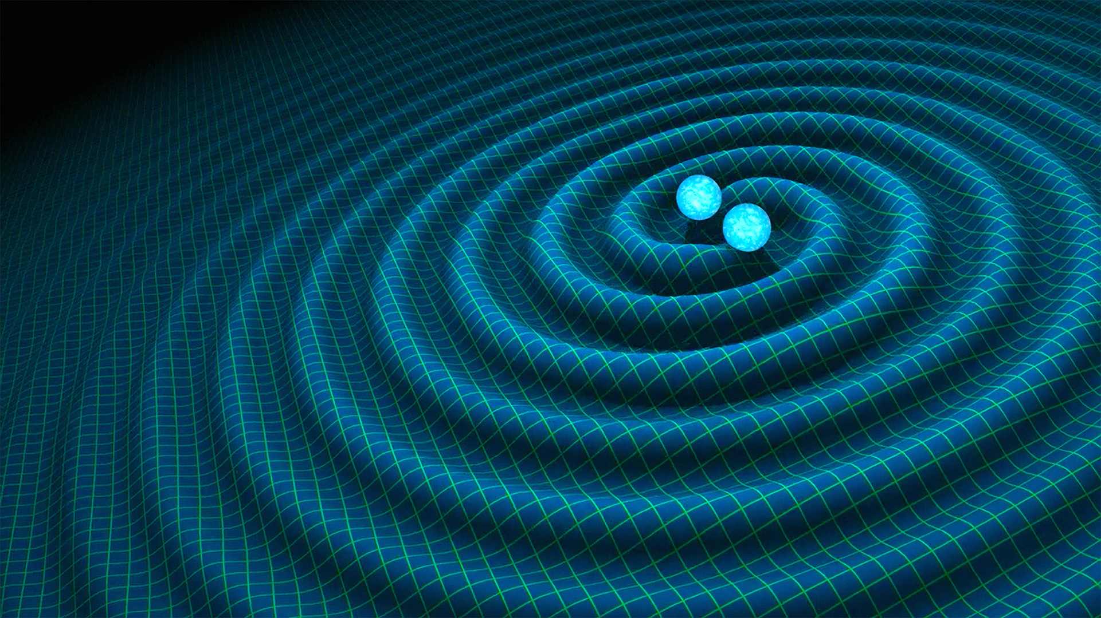

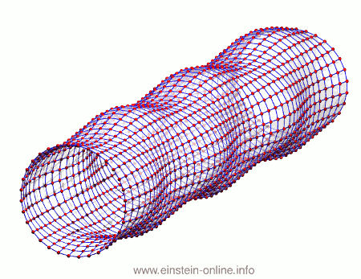

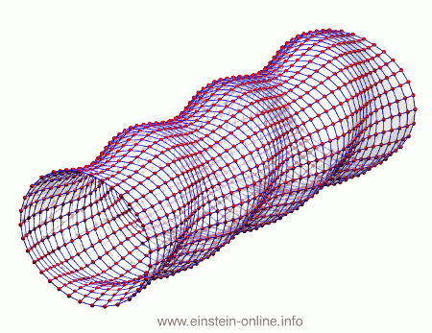
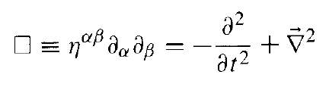
GWs = Ripples of spacetime = Perturbations
Einstein Field Equations in LINEARIZED form : weak field
Metric Perturbations
Wave Equation
Effect on test masses
d’Alembertian

Slide 7
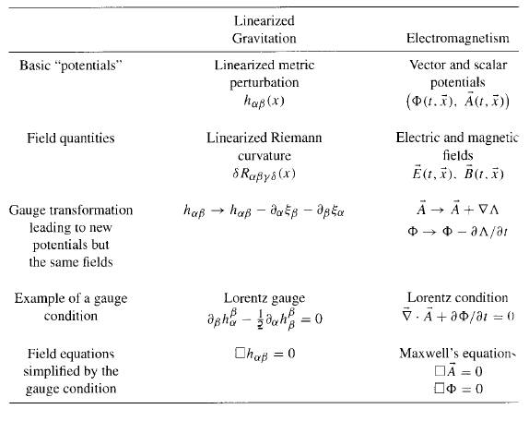
Hartle Book: Rough GW and EM analogy

Slide 8
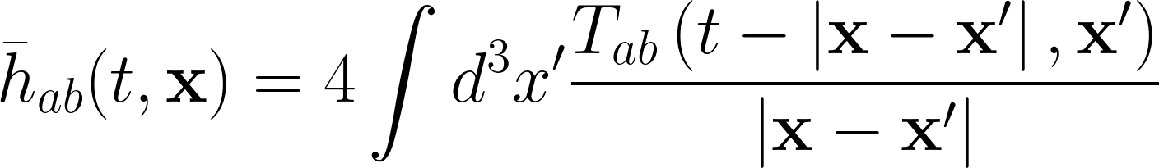
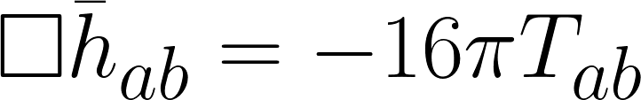
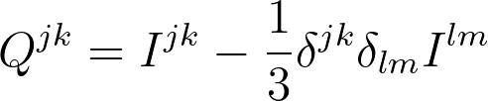

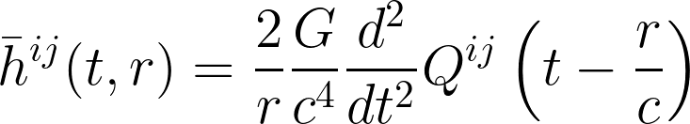
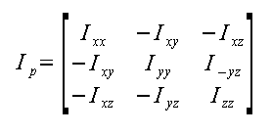
Generation of G.Ws = Quadrupole radiation
Including matter source term
Quadrupole Formula
(in units c,G)
Stretching and squeezing due to asymmetric mass distribution !
Moment of Inertia tensor
Reduced Quadrupole Moment

Slide 9
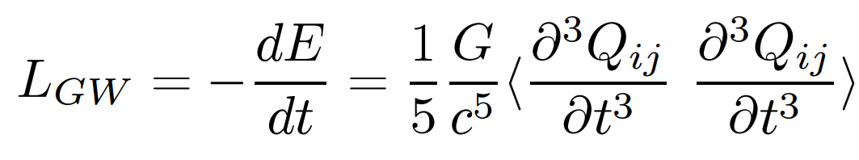
Generation of G.Ws = Quadrupole radiation
Including matter source term
Quadrupole Formula
(in units c,G)
GW Luminosity
Energy carried away by GWs per second ~ Peak luminosity @ BH merger : 10⁵⁰ watts!!!

Slide 10

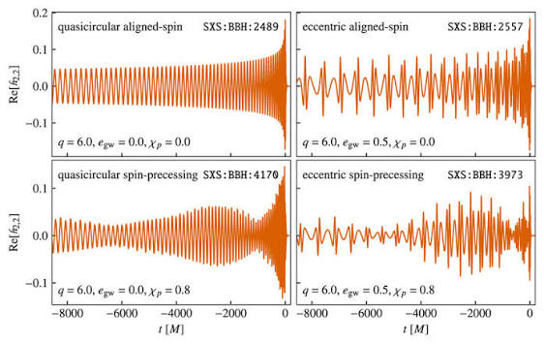
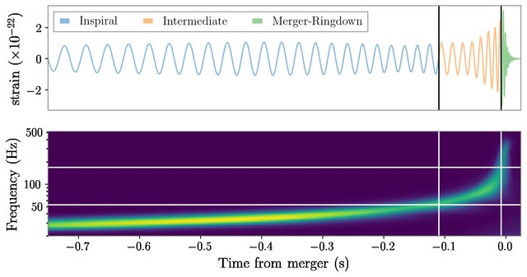
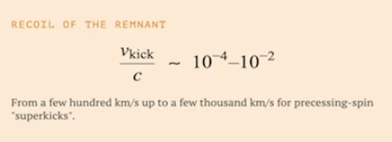
Gravitational Waveform: Time Domain vs Freq Domain
Diff types of GW signals:
Eccentric, Precessing…
“Chirp/ćwierkanie” Signal
After merger:
Kick !

Slide 11
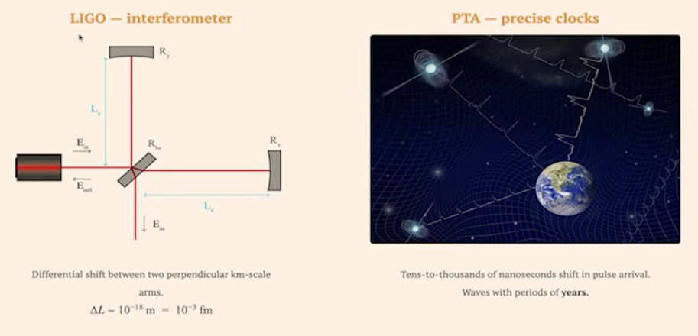
Detecting Gravitational Waves

Slide 12
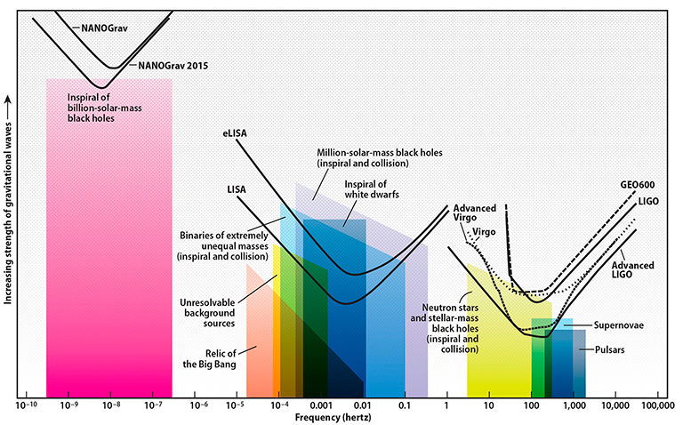
Future of GWs : A new window to the universe
Future GW detectors -
Einstein Telescope

Slide 13
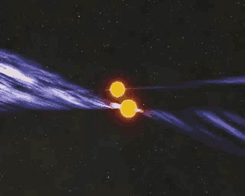
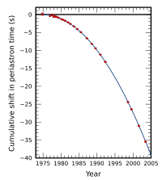



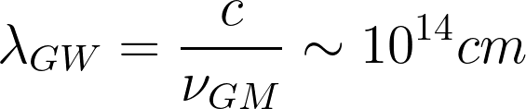
First Indirect GW detection:
Hulse–Taylor binary pulsar (PSR 1913+16)
Discovered in 1974; binary neutron-star system: one star is a millisecond pulsar
Orbital period: ~7.75 hours
Eccentric orbit → strong relativistic effects
Provided the first evidence that gravitational waves carry energy
PSR 1913+16
(slow-motion approximation,
on which the quadrupole formalism is based)

Slide 14
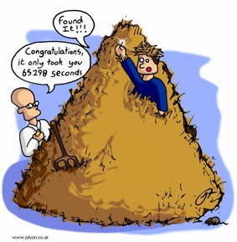
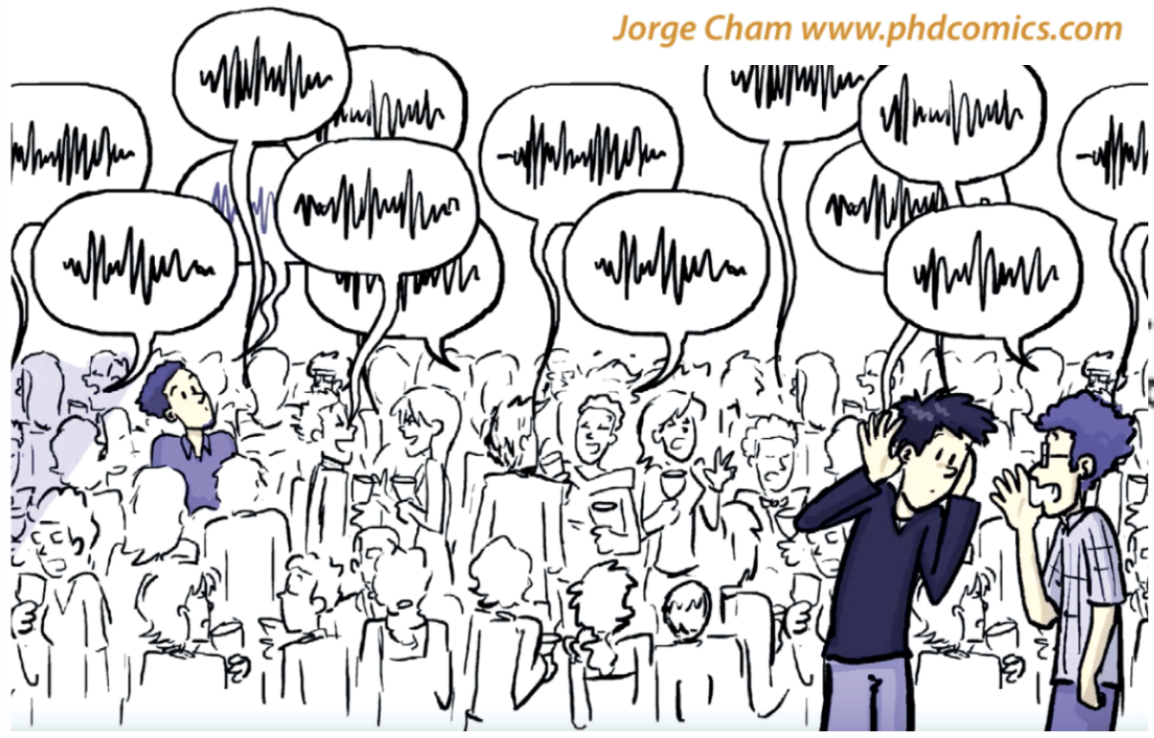
Gravitational Waves: Template banks + Parameter Estimation
Parameter
Estimation
Theory:
Data:

Slide 15
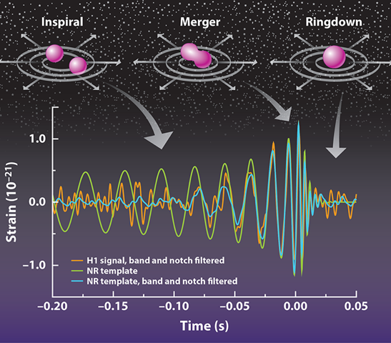

GWs : Methods to compute templates
Theory:
BH Perturbation Theory
Numerical Rel.
Post-Newtonian
Theory
Many templates ~ O(millions)
Eccentricity, precession, Env effects . . .
=> correct template/needle!

Slide 16
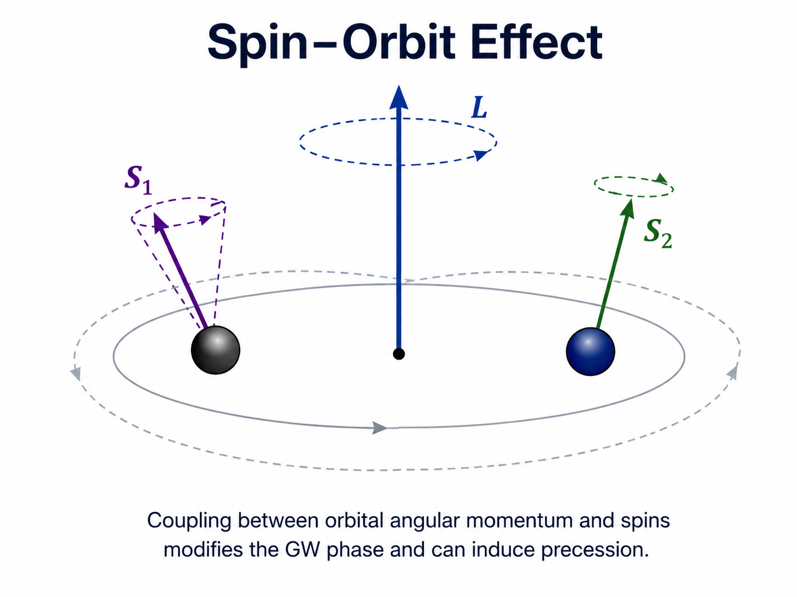
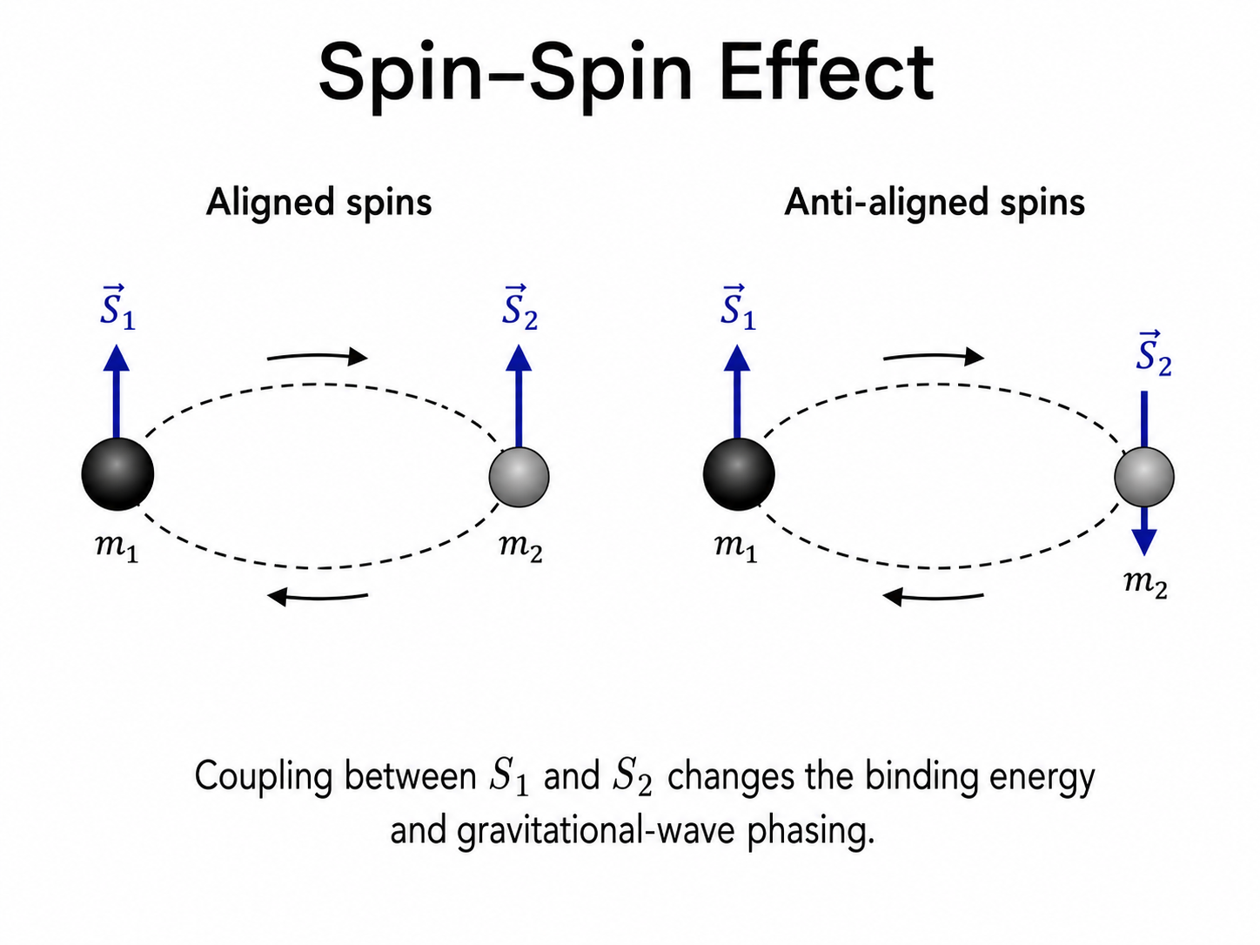
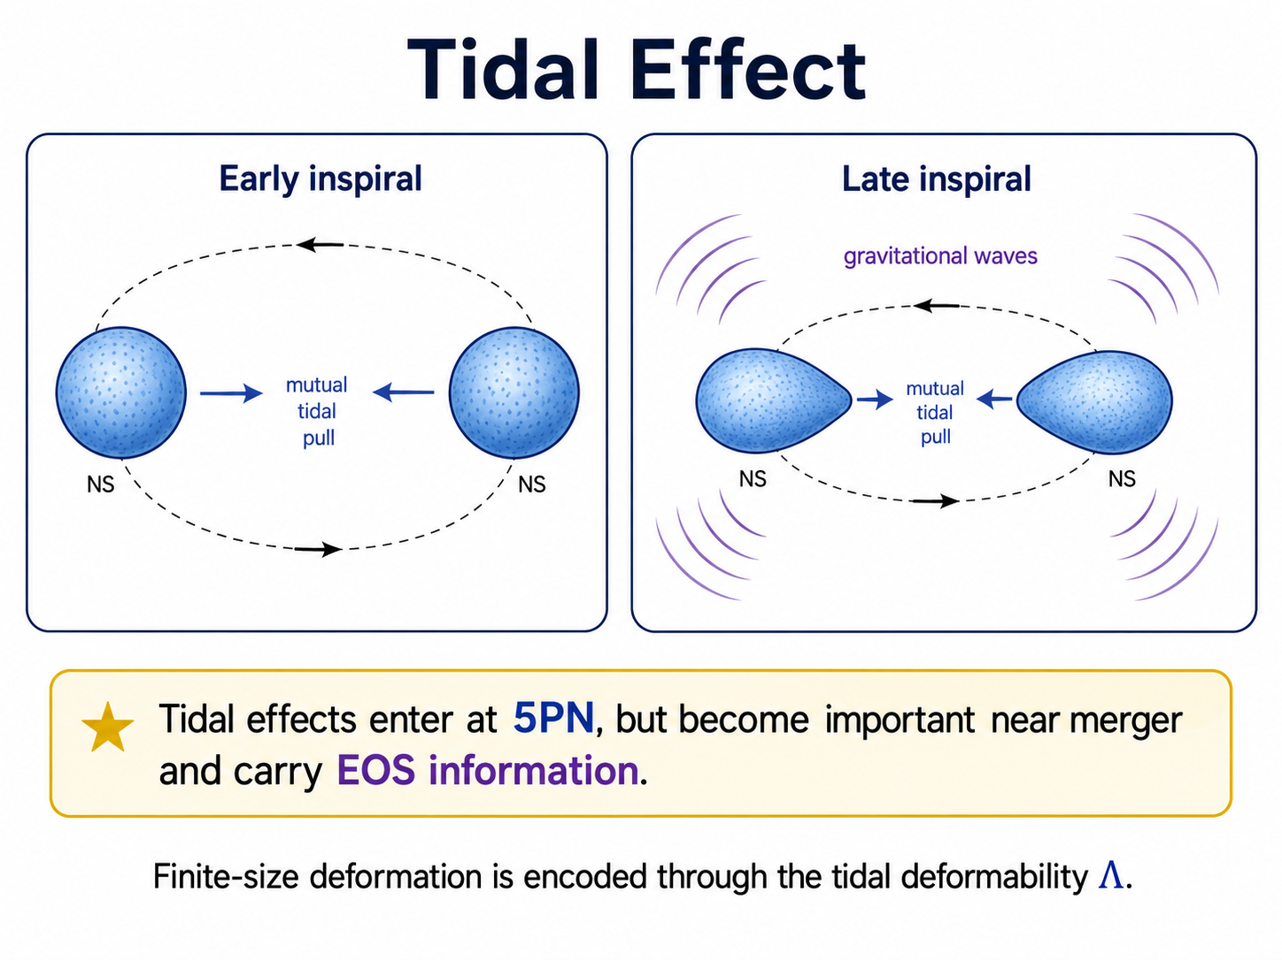
Theory:
Physical effects entering the GW phase
L . S₁/L. S₂
S₁ . S₂
Λ ~ Equation of State

Slide 17
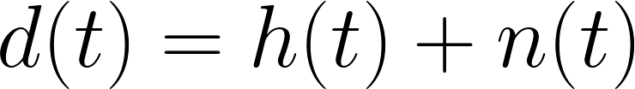
Data:
GW Data-analysis => Matched Filtering

Slide 18
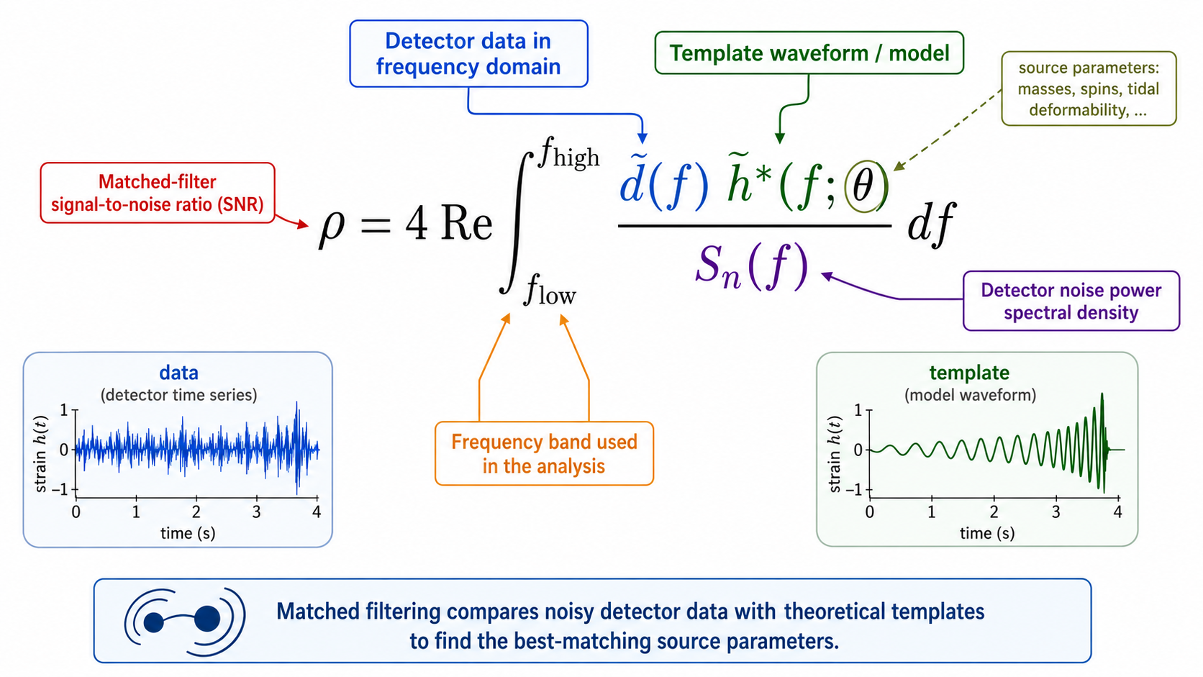
Data:
GW Data-analysis => Matched Filtering
Inner product: (d,h)
GW Parameter Estimation: How likely was the data generated by signal?

Slide 19
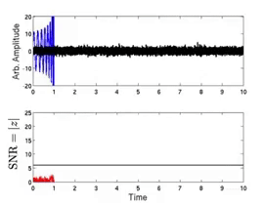
Data:
GW Data-analysis => Matched Filtering
Cross–correlate with detector data: d(t) using the noise-weighted inner product → Signal-to-Noise Ratio (SNR)
Template bank: Covers a grid of masses, spins, orientations Search = “scan over templates” to find the best match
Noise is non-Gaussian and non-stationary
GW Parameter Estimation: How likely was the data generated by signal?

Slide 20
GW
Parameter Estimation
Bayesian Analysis:
Comprehensive, reliable for realistic data, especially when the likelihood is non-Gaussian.
Given the detector data,:
What is the probability that the observed strain was produced by an astrophysical signal rather than by noise?
Fisher Analysis:
Quick, approximate, best for high SNR and gaussian noise
*References:
Post-Newtonian theory for gravitational waves, Living Reviews in Relativity, Luc Blanchet 2024
Sources of Gravitational Waves: Theory and Observations, Alessandra Buonanno and B.S. Sathyaprakash

Slide 21
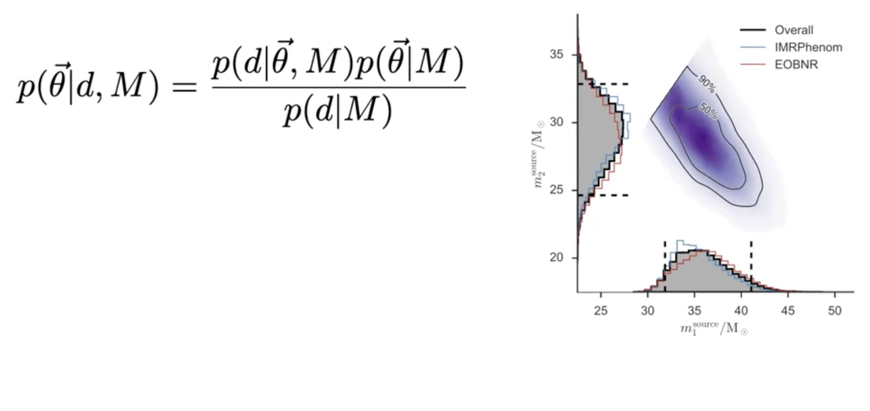
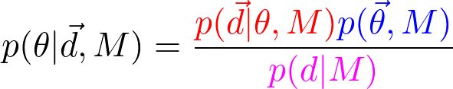


Bayesian Analysis: Given the data, inferring parameters
Posterior: prob. distn. of param (𝝷)
Waveform models
Likelihood: measures how well the data fits param
Prior: encodes our knowledge about param
Evidence: normalization

Slide 22
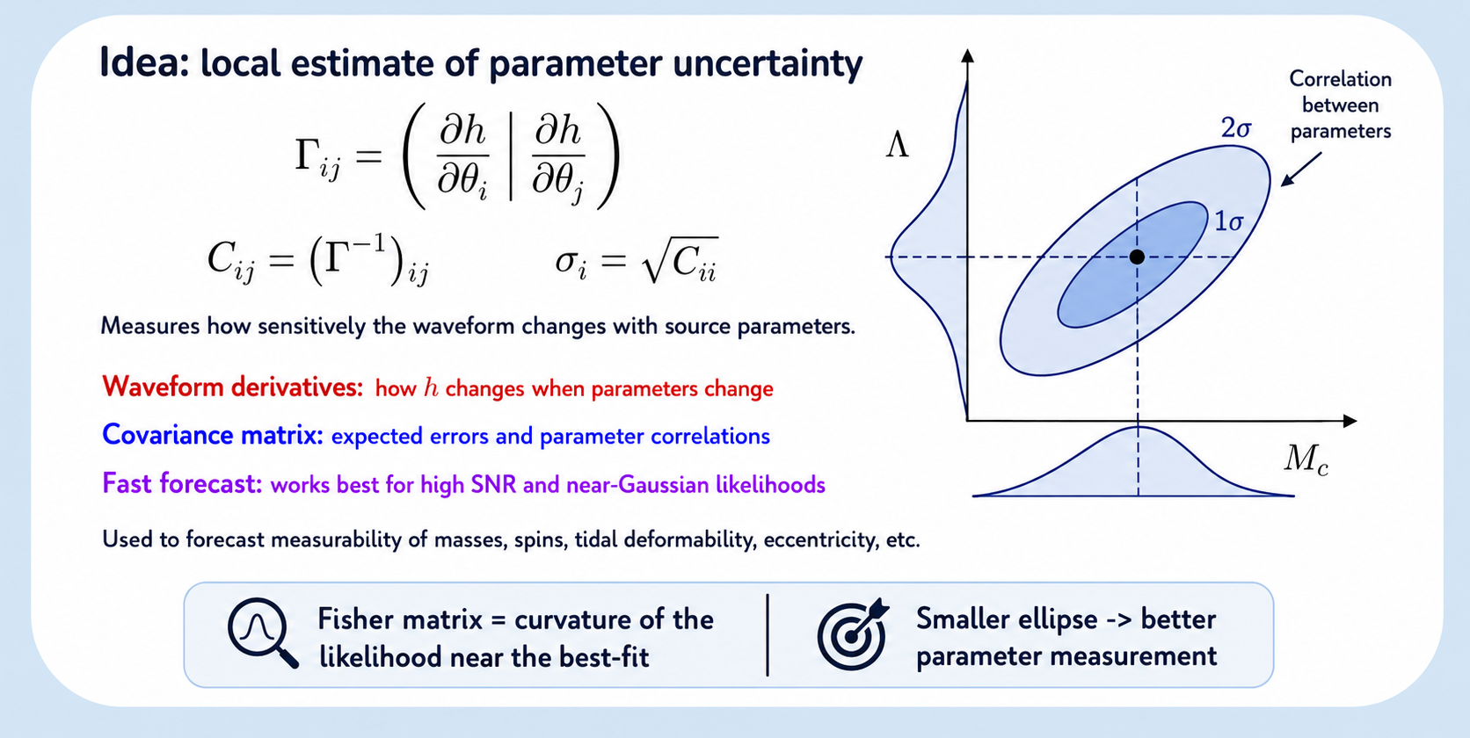
Fisher Analysis: Estimating 1-𝝈 errors

Slide 23
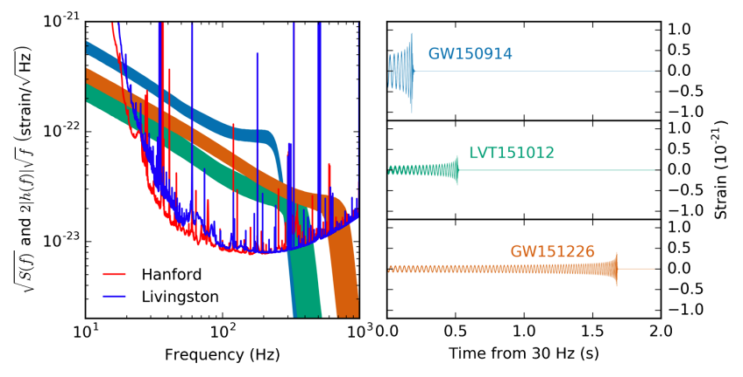
The First Detections:

Slide 24


The First Detections:

Slide 25


The New Detections: Puzzle…
Q1: Why the kink
Q2: What about lower mass
Q3: What about polarisation?

Slide 26


Slide 27


Slide 28

In June 2023, NANOGrav, EPTA, PPTA, and InPTA announced that they found evidence for a gravitational wave background. NANOGrav's 15-year data on 68 pulsars provided a measurement of the distinctive Hellings-Downs curve, a tell-tale quadrupolar signature of gravitational waves.
Plot of correlation between pulsars observed by NANOGrav (2023) vs angular separation between pulsars, compared with a theoretical model (dashed purple, or Hellings-Downs curve) and if there were no gravitational wave background (solid green)

Slide 29



$

Slide 30
$

Slide 31

$

Slide 32

$
Test fundamental physics
Black Hole Spin-induced Quadrupole Moment
Define 𝜅₁ = 1 + δ𝜅₁ and 𝜅₂ = 1 + δ𝜅₂ as the spin-induced quadrupole coefficients of each compact object in GW241011’s source binary.
Repeat parameter estimation with a modified IMRPhenomXPHM waveform model allowing for nonzero δ𝜅1 and δ𝜅2

Slide 33

Conclusion
➤ SIQM-Ecc Fisher analysis:
Single-event studies → Ecc improves constraints for low mass syste,s
Population level → Improved CDF of kappa and ecc from the updated waveform
SIQM
Eccentric
➤ SIQM-Ecc e0² : Bayesian Analysis
Terms coded in LALSuite => injection and recovery study
Are 𝜅𝑠 - 𝑒0 degenerate?
Does eccentricity broaden the 𝜅𝑠 posterior?
cWB ( Marek Szczepanczyk UW, Shubhata, IITB )

Slide 34
Conclusion
DM
Admixed
NS
➤ DM Admixed Neutron stars:
Single-event studies → ET and Deci-Hz
Population level → To perform Fisher population analysis
➤ Primordial BH vs Astrophysics BH population analysis
Develop a Population Fisher Matrix (PFM)=> combines waveform-level parameter estimation (including eccentric and spin effects) with mixed primordial black hole (PBH) and astrophysical black hole (ABH) population models.
Incorporate StarTrack-based ABH population uncertainties (e.g. common-envelope efficiency, mass spectrum, redshift evolution, spin distributions) into the PFM to quantify PBH–ABH confusion and assess how astrophysical modeling systematics impact future PBH searches and tests of black-hole nature.
D.Alvarez,
Iwona Kotko

Slide 35


Conclusion
GW241011: Heisenberg “what we observe is not nature itself, but nature exposed to our method of questioning”—Analysis tests for one specific finite-size effect relating to SIQMs, and by construction does not account for other possible effects, such as tidal deformability…

Slide 36

This latest catalog update, together with the previous one GWTC-4, covering events collected between May 2023 and January 2024, contains 75% of all gravitational wave events observed so far since the first detection in 2015.
Evidence for Multiple Black Hole Subpopulations
Mass Distribution Features and Possible Hierarchical Mergers
Spin Distribution Evolves with Mass Ratio and Redshift
Total number of gravitational wave signals detected to date to 390.

Slide 37

Conclusion
Numerical relativity simulations of the black hole mergers provided by the Simulations of Extreme Spacetimes (SXS) waveform database

Slide 38

Recent Results:
GW230518: BIG
GW231114: Two unequal black holes
GW231028: Neutron star-black hole

Slide 39


Slide 40



Slide 41


Slide 42






Post-Newtonian (PN) Theory: Small Intro
Rewrite Einstein Equations in terms of flat-space wave eqn:
(least quadratic in h and its space-time derivatives)
Expand quantities in terms of small parameter ε
Each PN order folds in successively smaller (v/c)^n corrections:
0 PN → Newtonian gravity, 1 PN → relativistic precession, 1.5 PN → GW energy loss,
2 PN → spin-orbit forces, 2.5 PN → GW back-reaction, 3 PN+ → spin-spin & tail effects

Slide 43


Slide 44

Backup: GW230529

Slide 45

arxiv:2511.17341
(Krishnendu et al.) Consider GW241011 posterior from paper $
Question: Given this event, what does it imply for rotating exotic compact objects?
It maps the 𝜅 measurement onto ECO model space and derives the compactness bounds.

Slide 46
arxiv:2511.17341
GW241011 is an ideal ECO laboratory: highly spinning primary (χ₁ ~ 0.78) with a 3:1 mass ratio, giving strong SIQM sensitivity — the 𝜅 measurement is among the tightest from any single event.

Slide 47

arxiv:2511.17341
Slide: Paolo Pani talk

Slide 48
arxiv:2511.17341
𝜅 probes only compactness — the spin-induced quadrupole moment is sensitive to how concentrated the mass is (C = M/R)
GW241011 sets a compactness threshold — the 𝜅₁ measurement places a lower bound C ≳ 0.24.
A compact ECO with C ≳ 0.24 — whether a gravastar or a thin-wall solitonic star — remains viable.
Not all boson stars are equal — whether a boson star survives depends entirely on its potential: some are fully excluded, some partially.
Slide: Paolo Pani talk

Slide 49

Backup: GW231123

Slide 50

Backup: Harmonics in Ecc

