Slide 1
Gamma-ray Astrophysics
Suvendu Giri , IFJ PAN

Slide 2
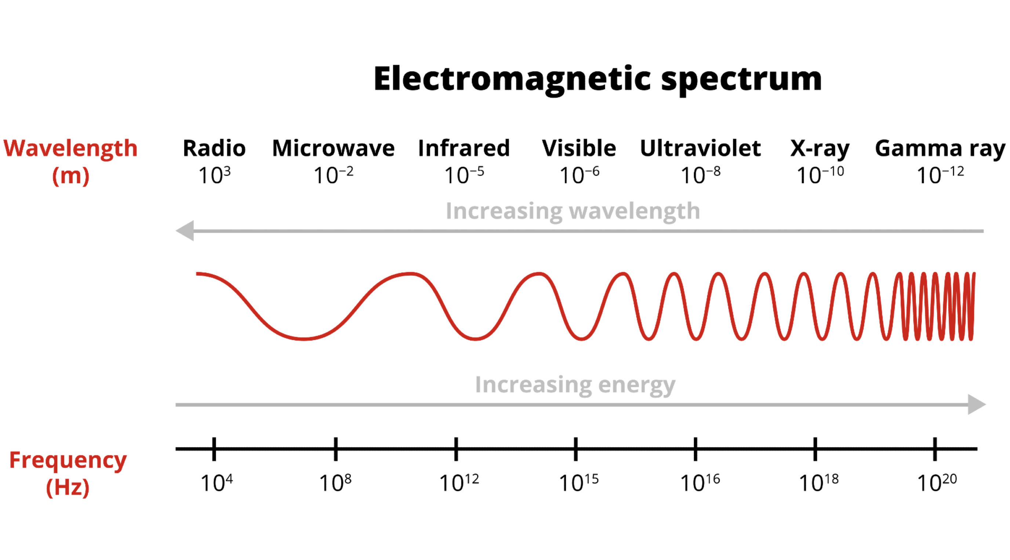
1
What is gamma-ray?
Gamma-rays are highest energy form of electro-magnetic radiation in the universe . ( start around 100 KeV, no upper Bound)
LE , < 30 MeV
HE , 30 MeV $≤$ E $<$30 GeV
VHE , 30 GeV $≤$ E < 30 TeV
UHE , 30 TeV $≤$ E < 30 PeV
EHE , $≥$ 30 PeV
Wavelength and frequency range of various type of EM waves

Slide 3
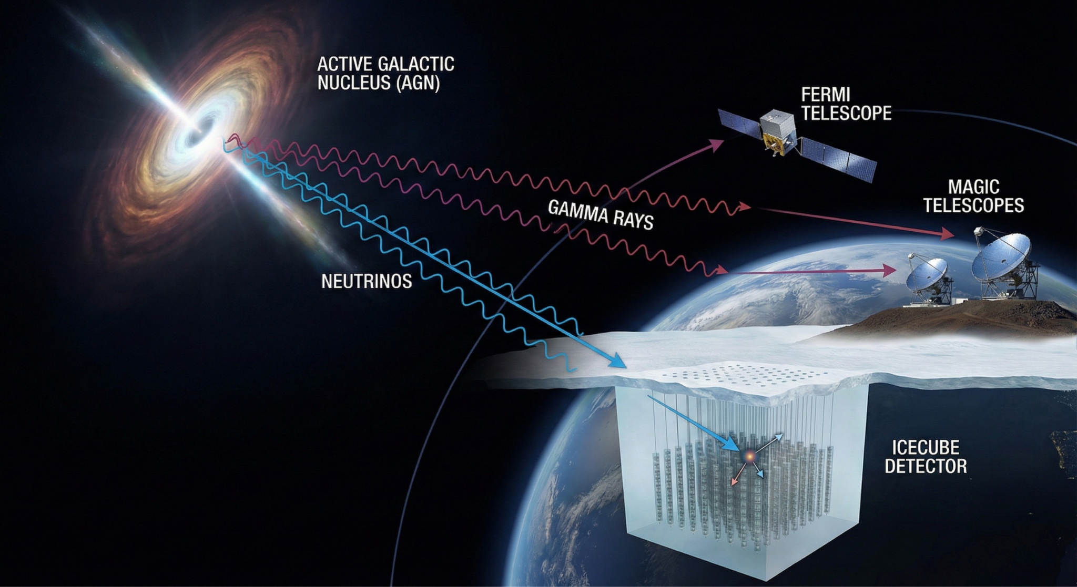
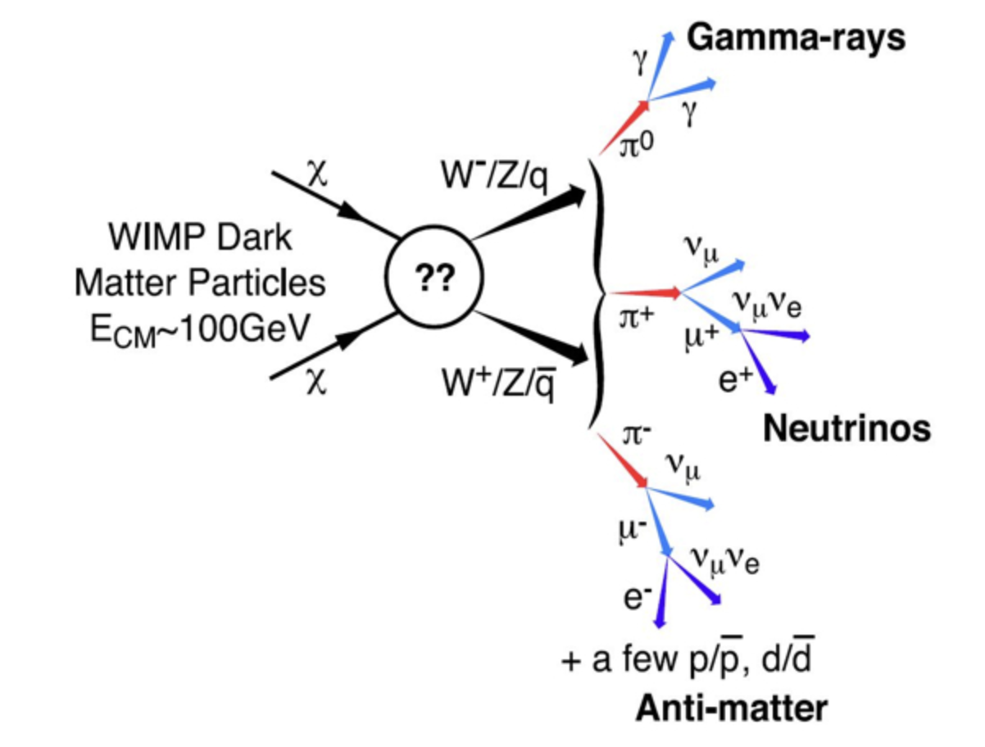
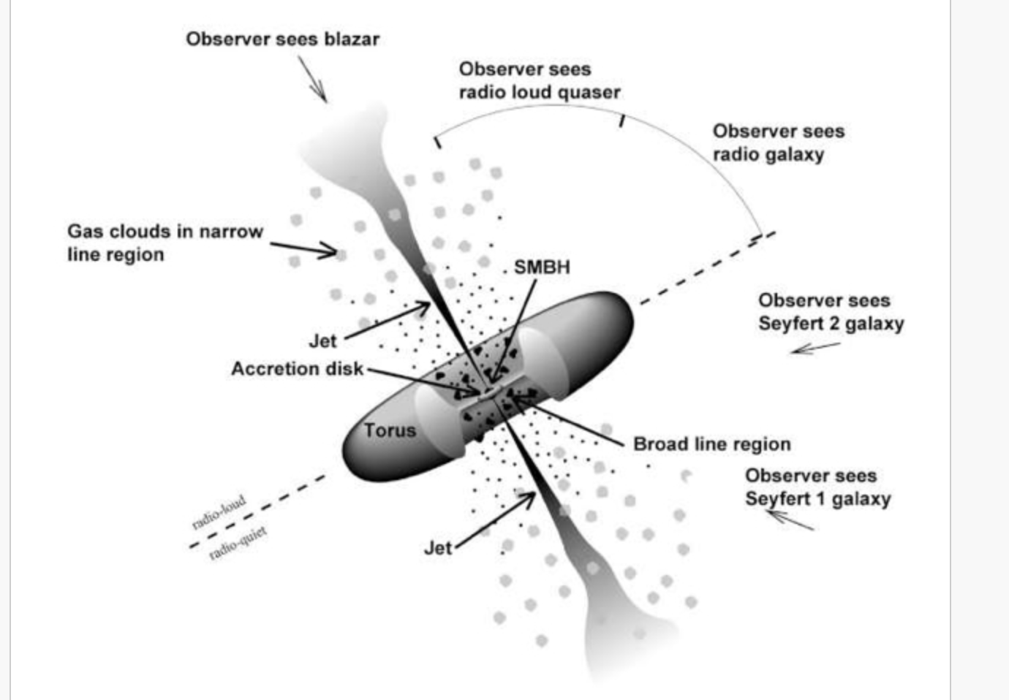
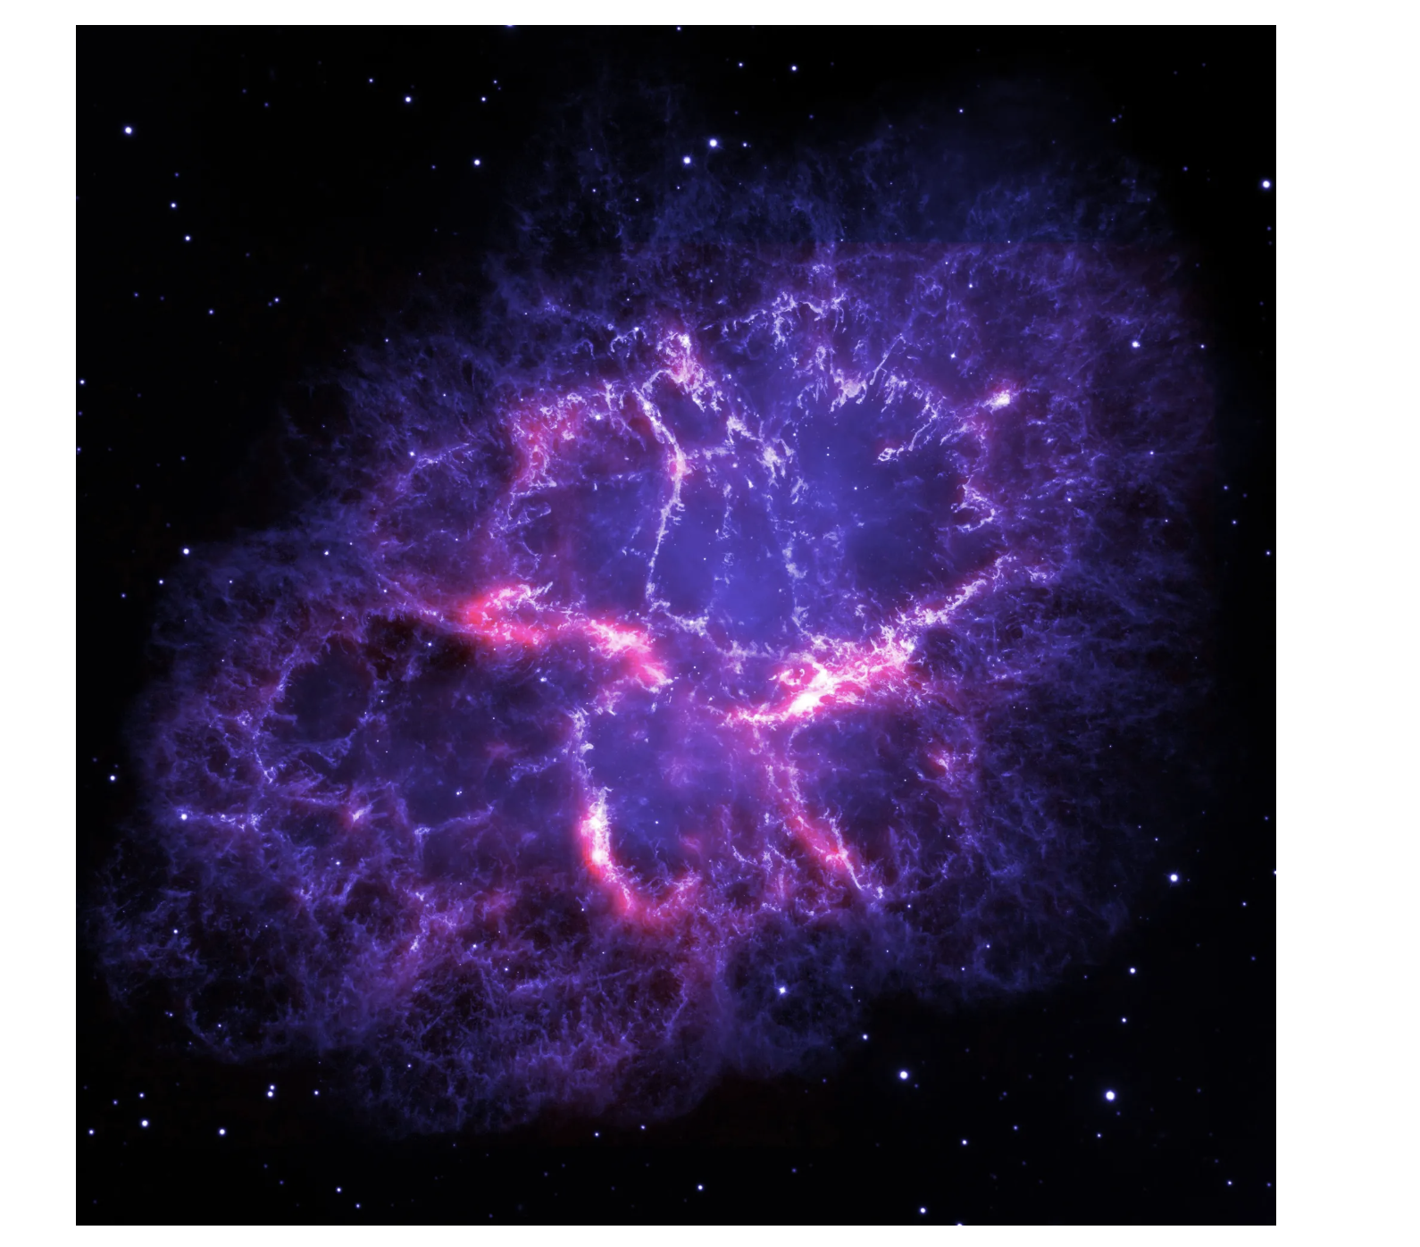
2
The Source Zoo
Galactic ( SNR, Pulsars, X-ray Binaries …)
Extragalactic ( AGN, GRBs … )
Theoretical Source ( Like - Dark Matter annihilation )
Radio-active decay
Axion-Axion interaction
Blazer
SNR

Slide 4
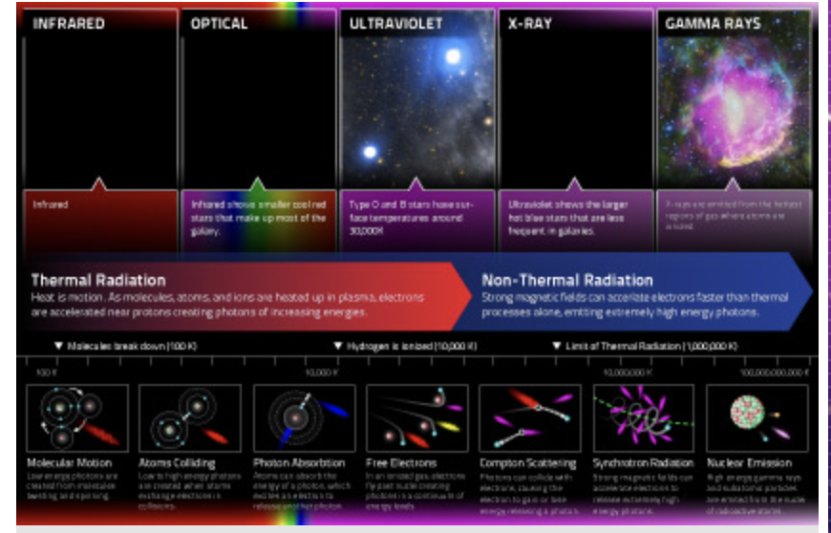
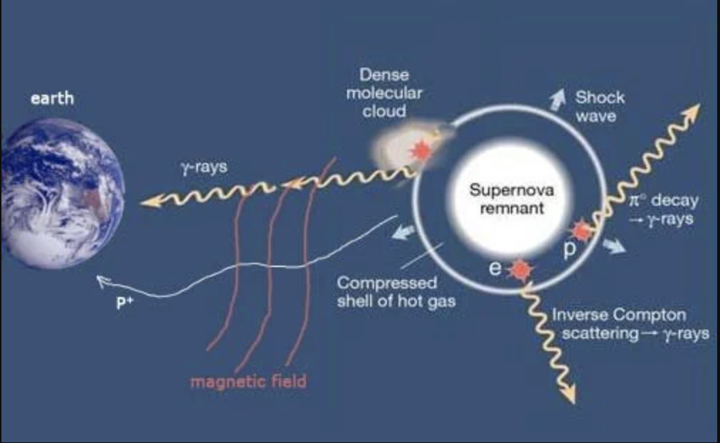
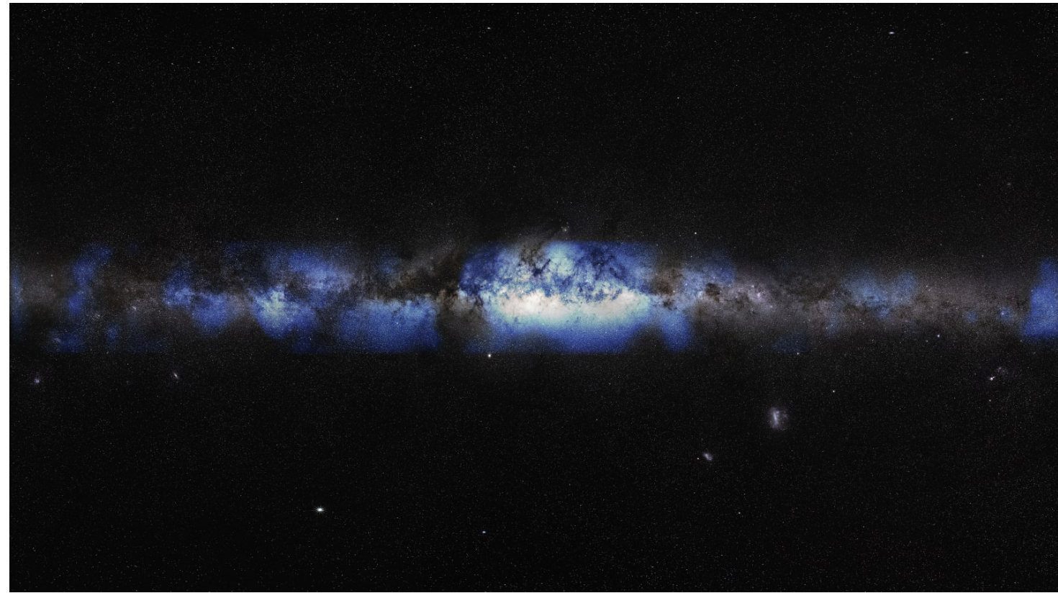
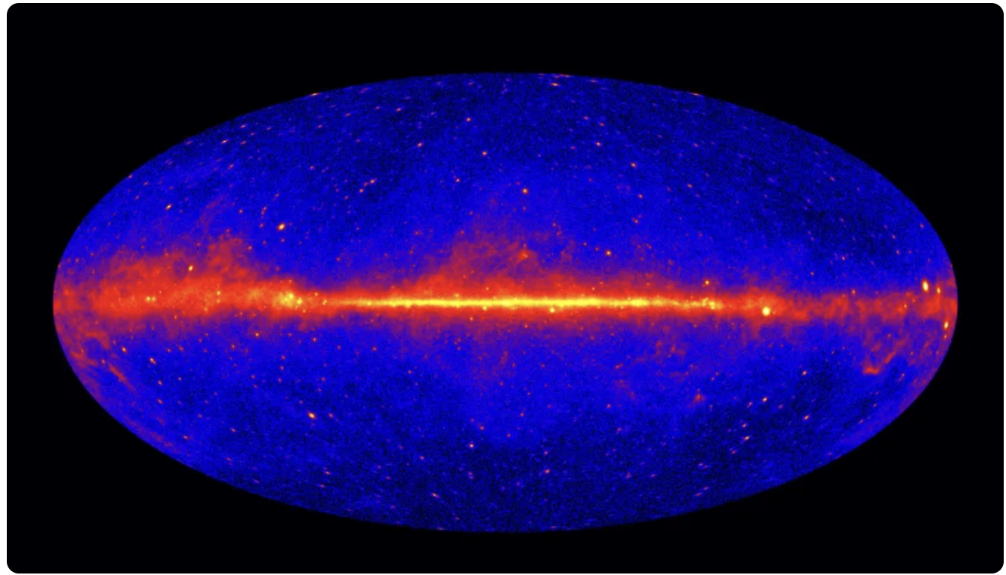
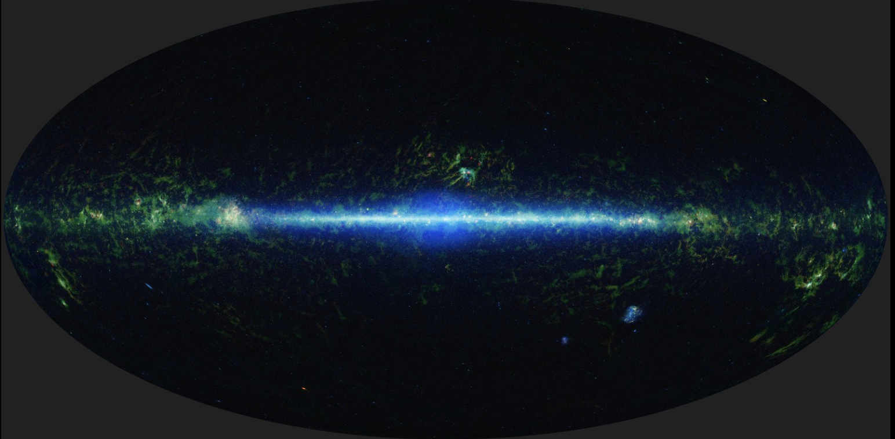
3
Why Gamma-rays ?
Thermal vs Non-Thermal Universe
Neutral ( no Lorentz-force )
Hadronic Acceleration
Multi-Messenger Astronomy
Thermal vs Non-thermal radiation
Neutrino vs Gamma vs infrared rays
Path of Messenger Particle

Slide 5
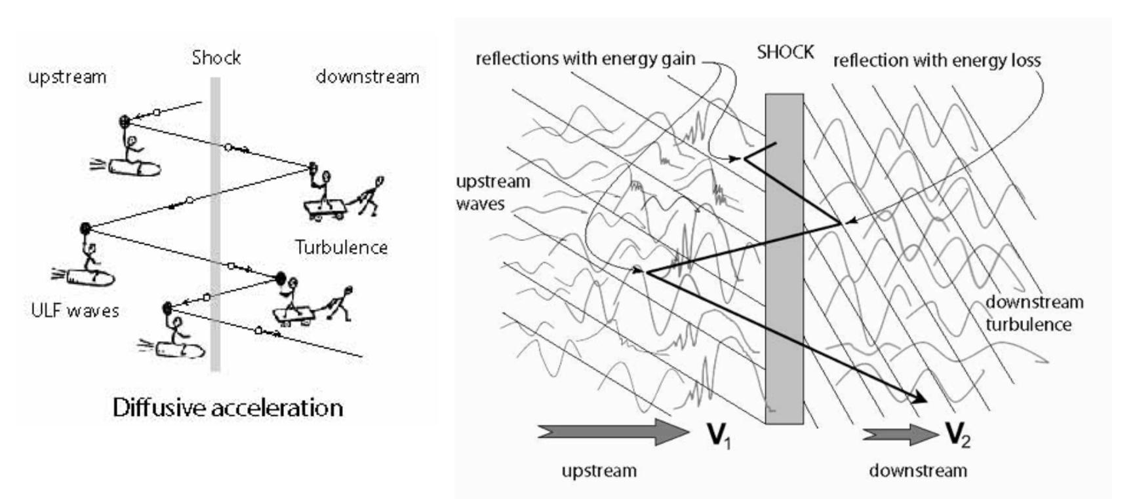
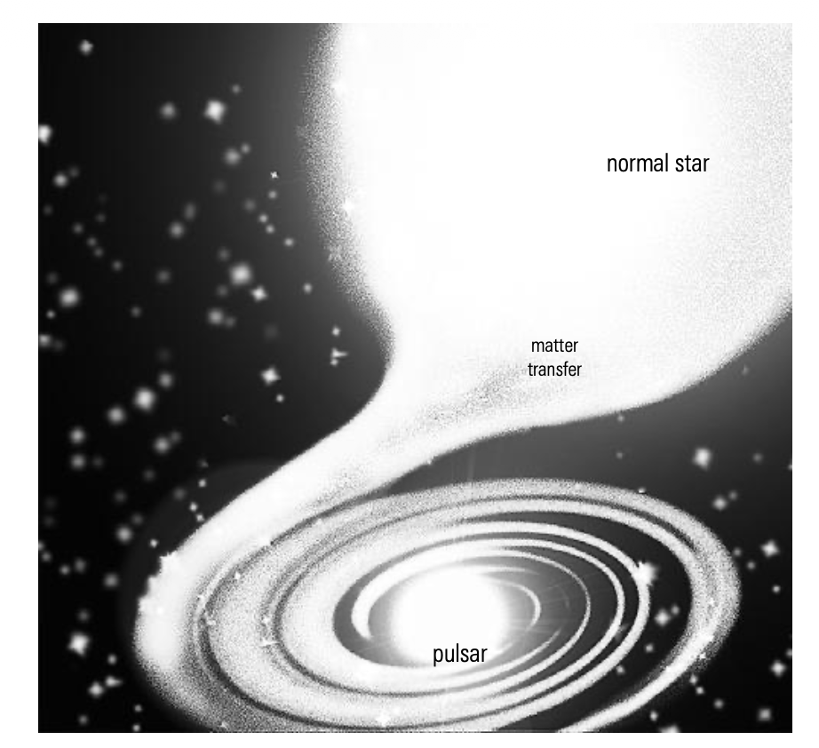
4
Production of gamma rays
Particle Accelerator -> Interaction and emissions Target
+ Absorption
Cosmic Accelerator
Diffusive Shock Acceleration (TeV to PeV)
Magnetic Reconnection ( MeV to GeV )
Pulsar dynamos ( Pushes electron to Gev, before crash into radiation field )
Shock wave and acceleration of particle
Accretion of particle

Slide 6
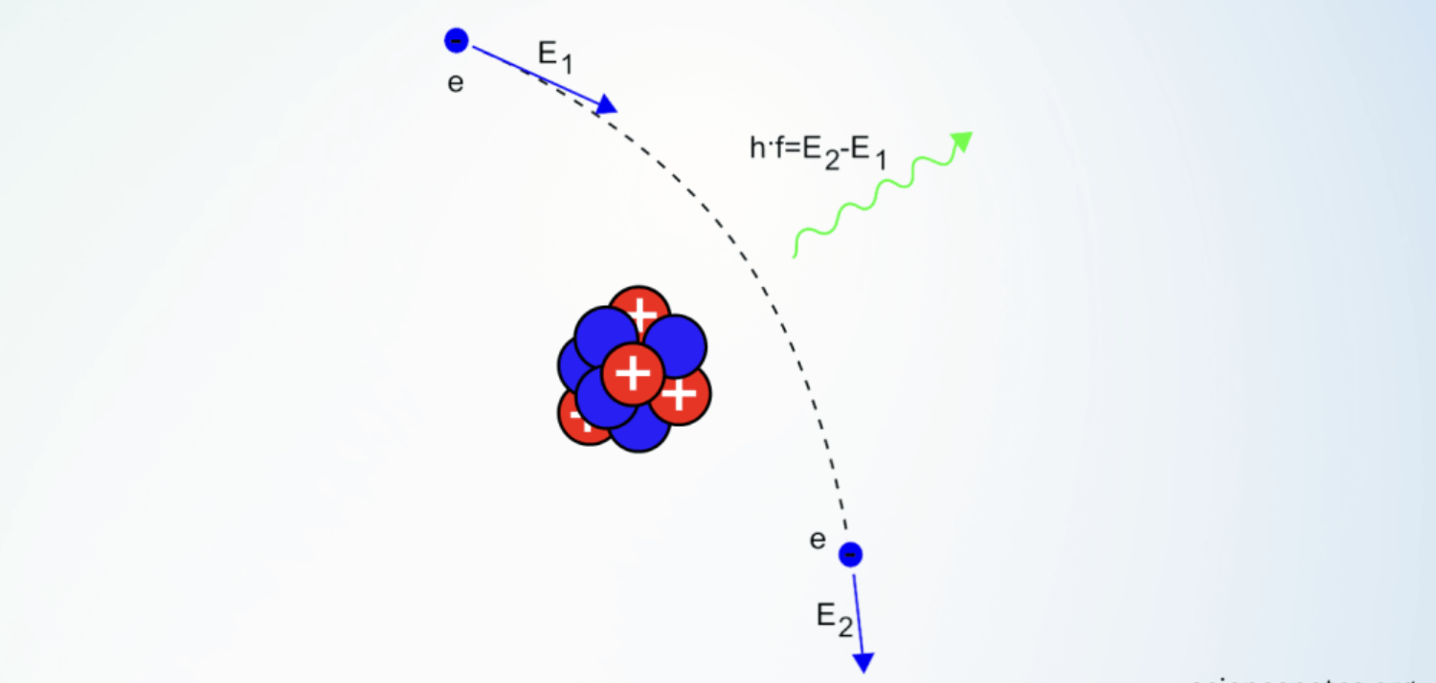
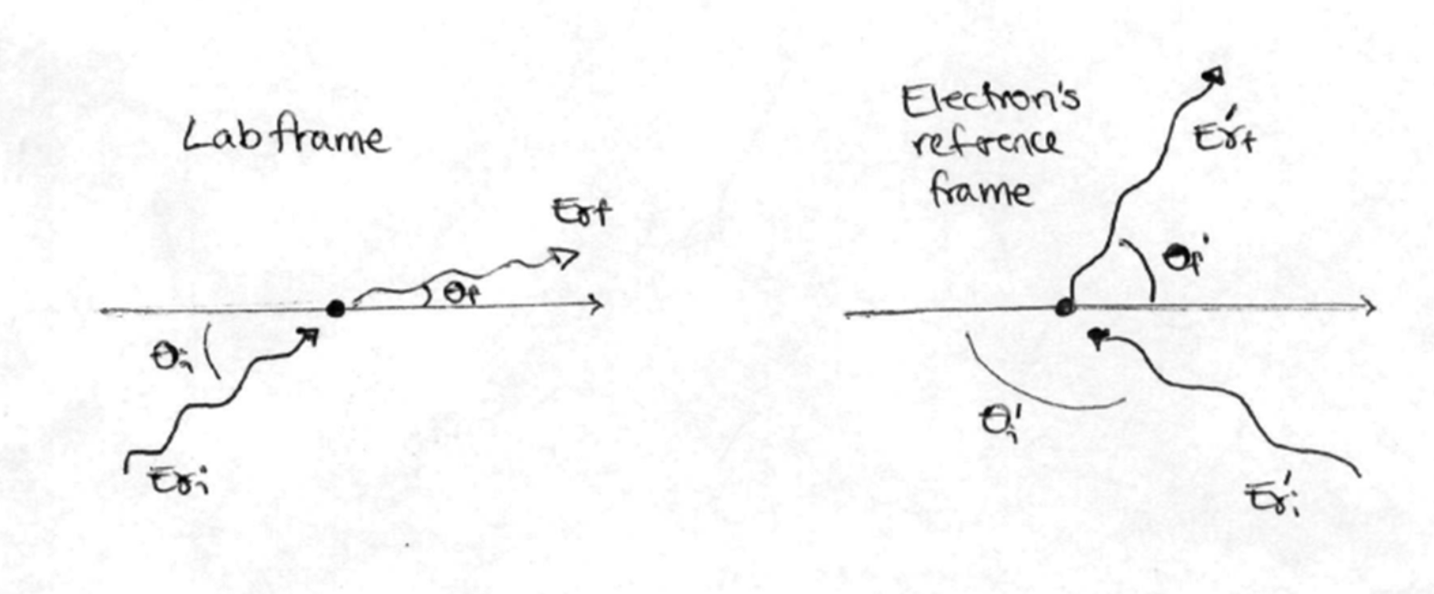
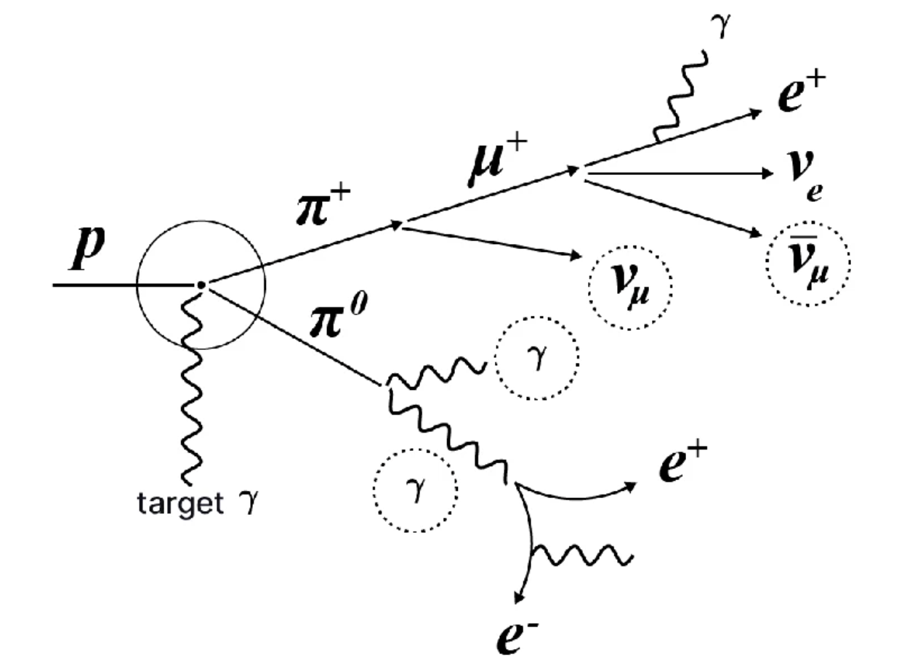
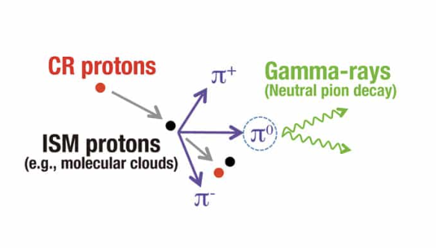
5
Interaction and Emission Mechanisms
Leptonic:
Inverse Compton
Bremsstrahlung
- SSC
IC
Bremsstrahlung
Hadronic:
p-p interaction ( Pion decay )
Photo-hadronic ( p-$γ$ )
Absorption Mechanisms
- $γ-γ$ absorption and Pair Production
Pion Decay
Photo-Pion

Slide 7
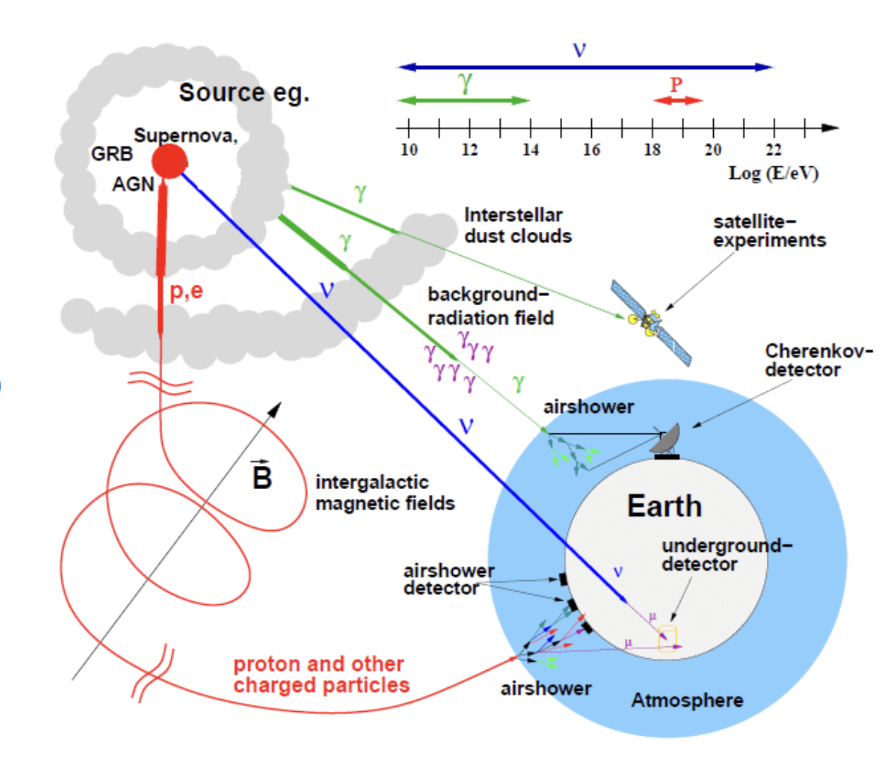
6
How to detect :
Our Earth’s Atmosphere behave as opaque to Gamma-rays
Space Based detection :
Fermi-LAT, AGILE …
- Ground Based Detection :
H.E.S.S , HAWC , MAGIC, LHAASO , CTAO etc.
Via Indirect detection …
Pictorial representation of source, gamma-ray, space and ground base telescope

Slide 8
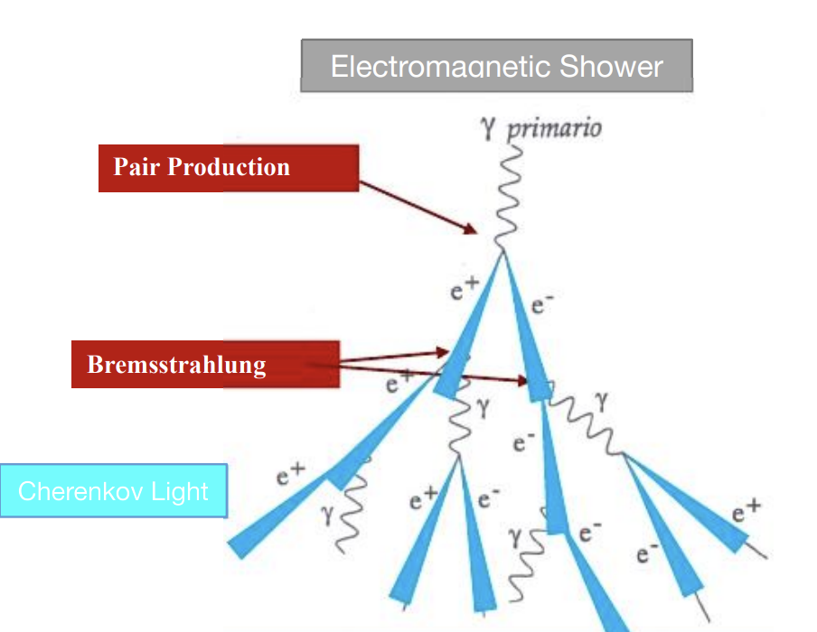
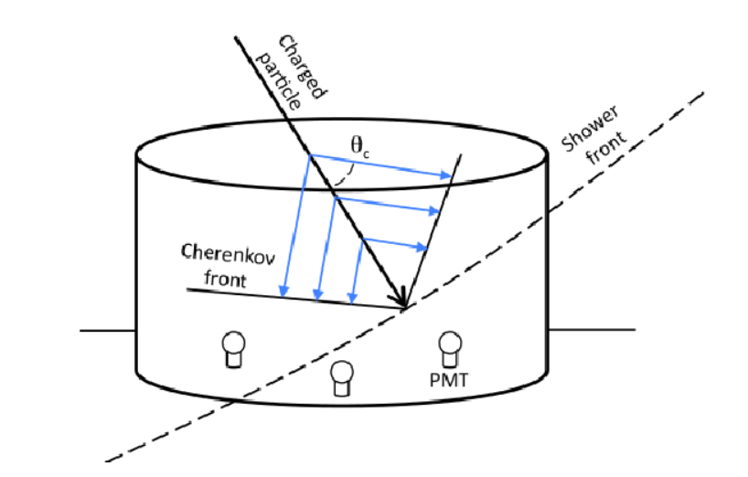
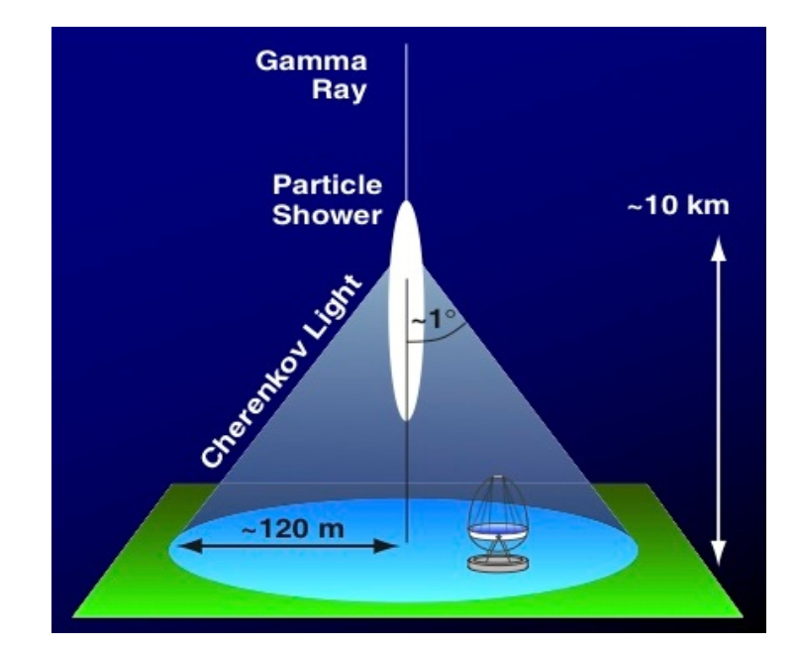
7
Ground-Based Observation :
Technique
- Atmospheric Cherenkov telescopes
- Air shower Particle Detector ( water Cherenkov Technique )
Water cherenkov technique
Principle of atmospheric Cherenkov technique

Slide 9
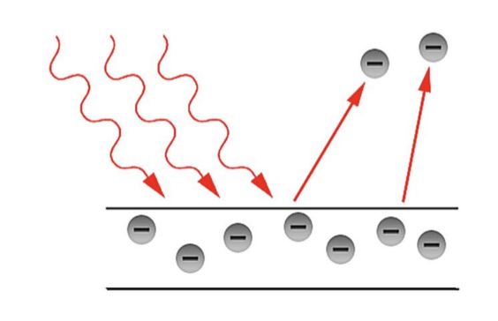
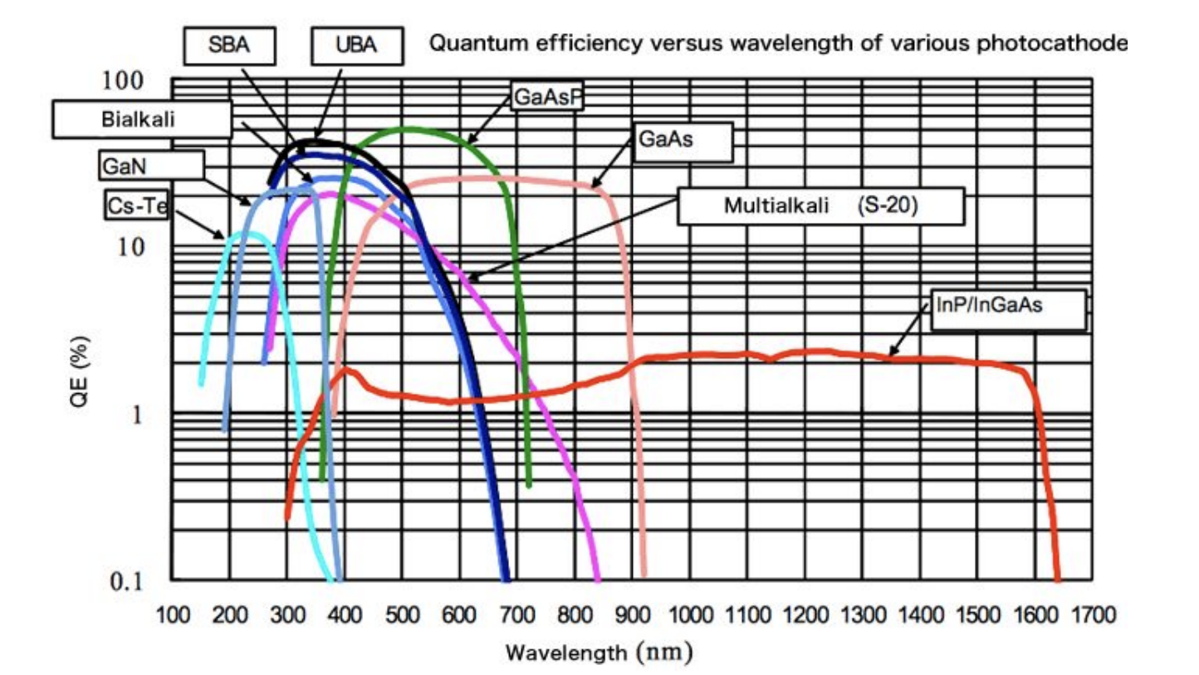
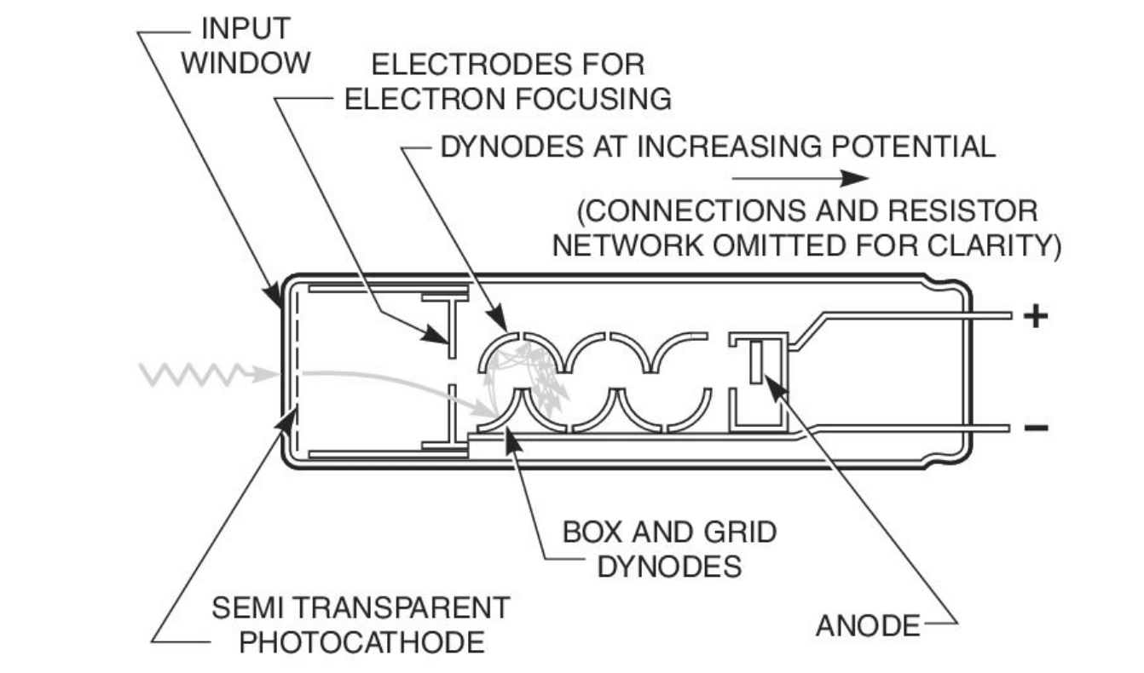
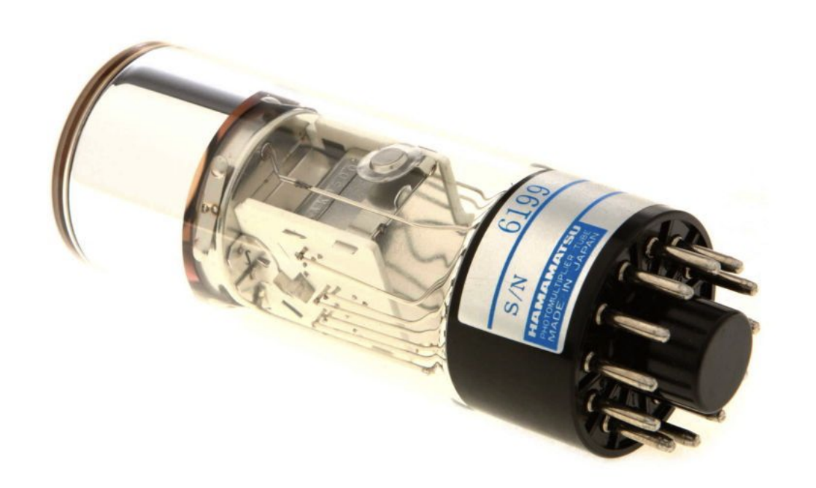
8
PMT
Photo Electric effect
Efficiency of different material wrt wavelength
PMT
Photon detection in PMT

Slide 10
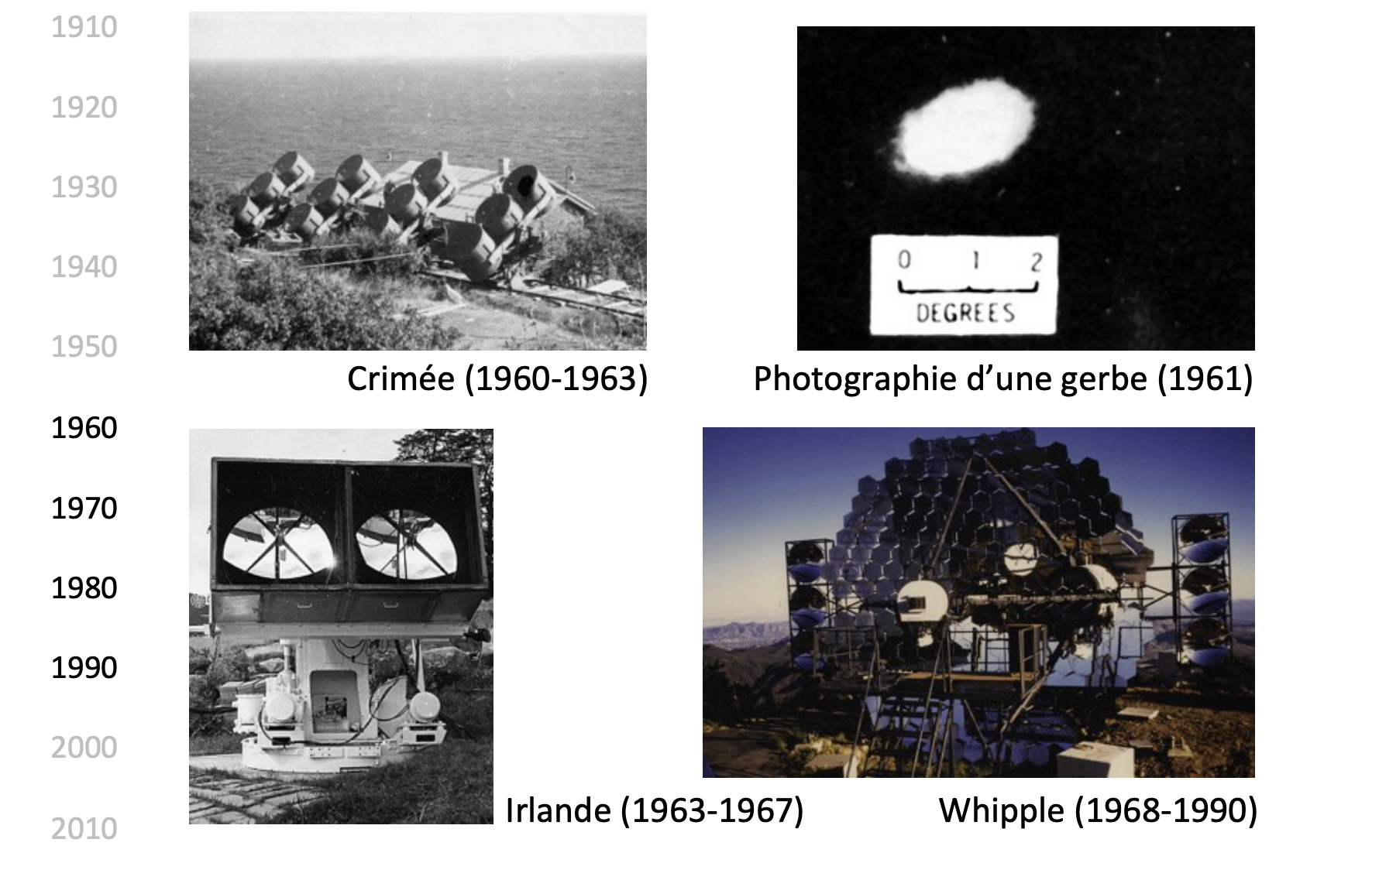
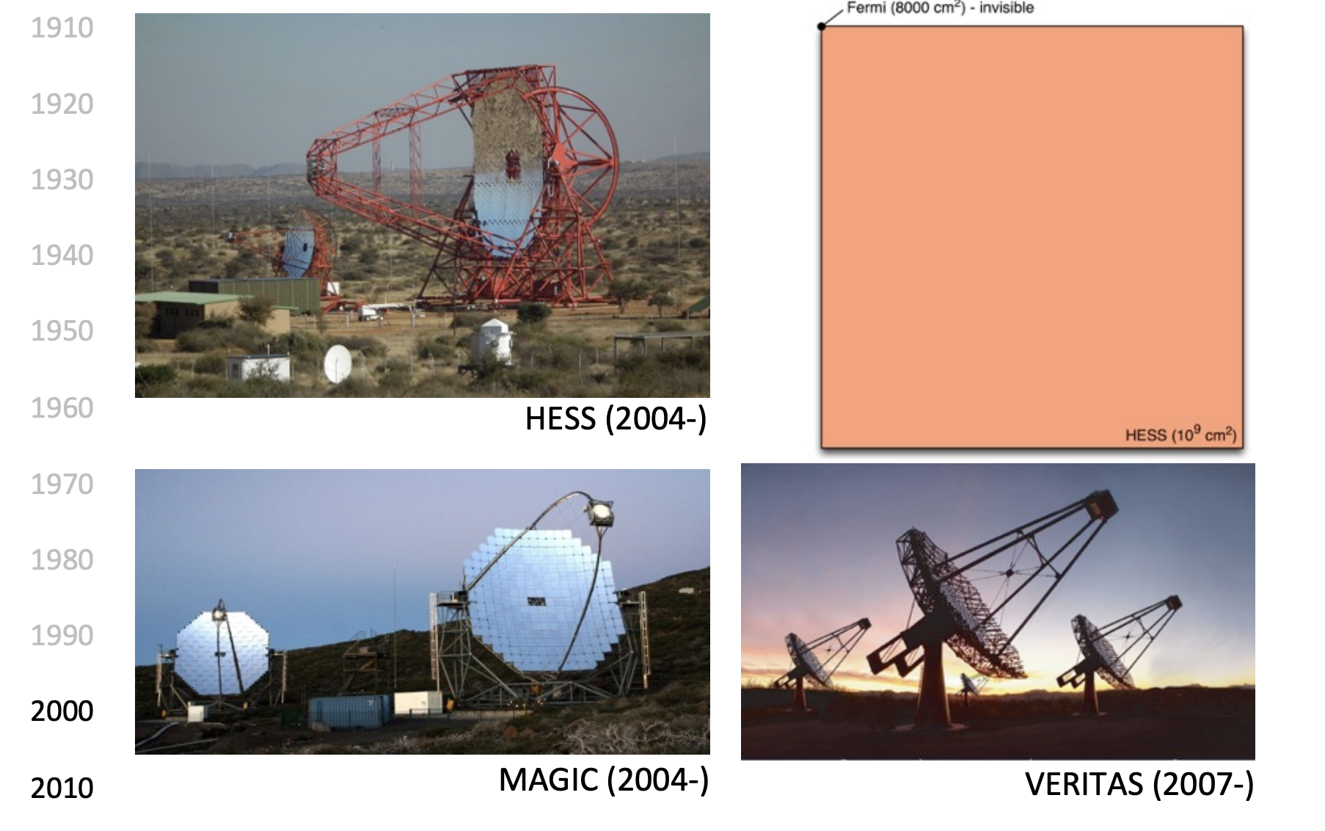
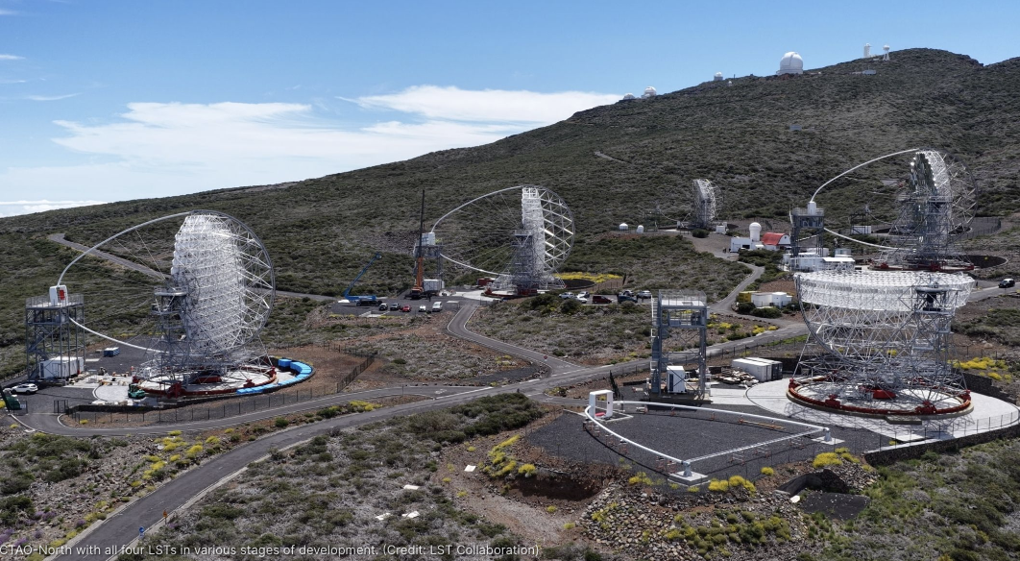

9
Observing from the Ground
CTAO
CTAO

Slide 11
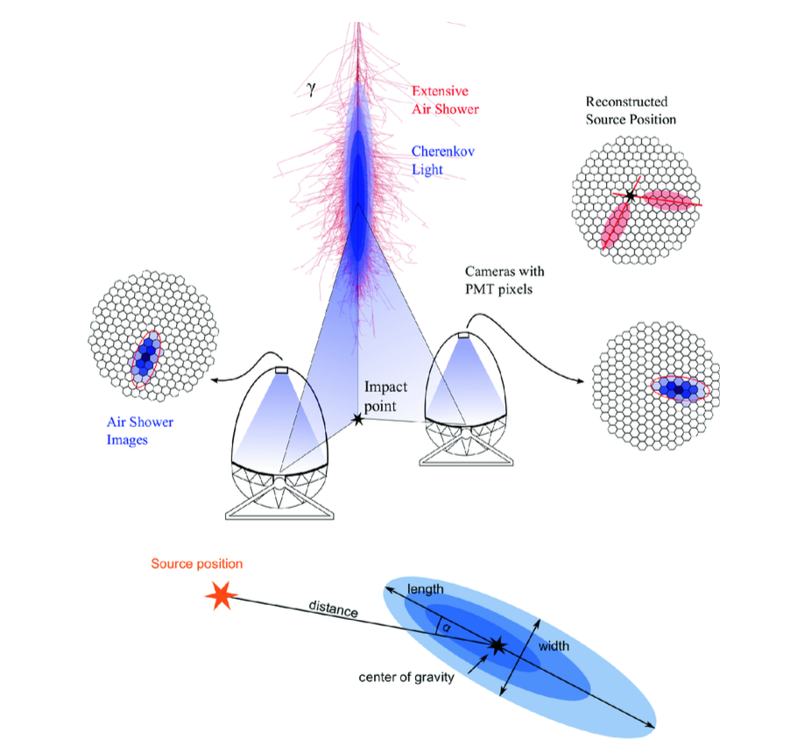
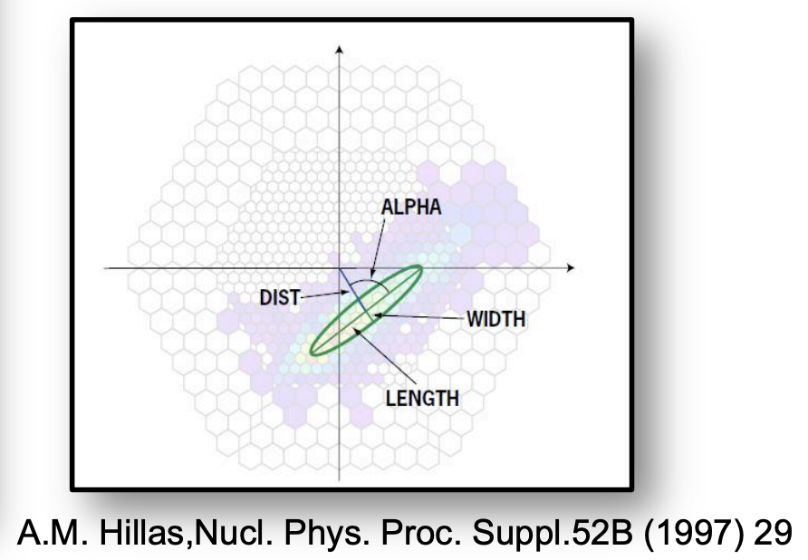
10
Imaging Atmospheric Cherenkov telescopes (IACT) :
1970s and 1980s some advanced made …
An array of PMTs in the focal plane of the mirror capable of
resolving the, cherenkov image of EAS
- Look like a ellipse
- Improvement of angular resolution
- 1989 , discovery of Crab Nebula in TeV gamma rays
( Whipple Telescope )
A schematic view of stereoscopic observations of imaging telescopes.

Slide 12
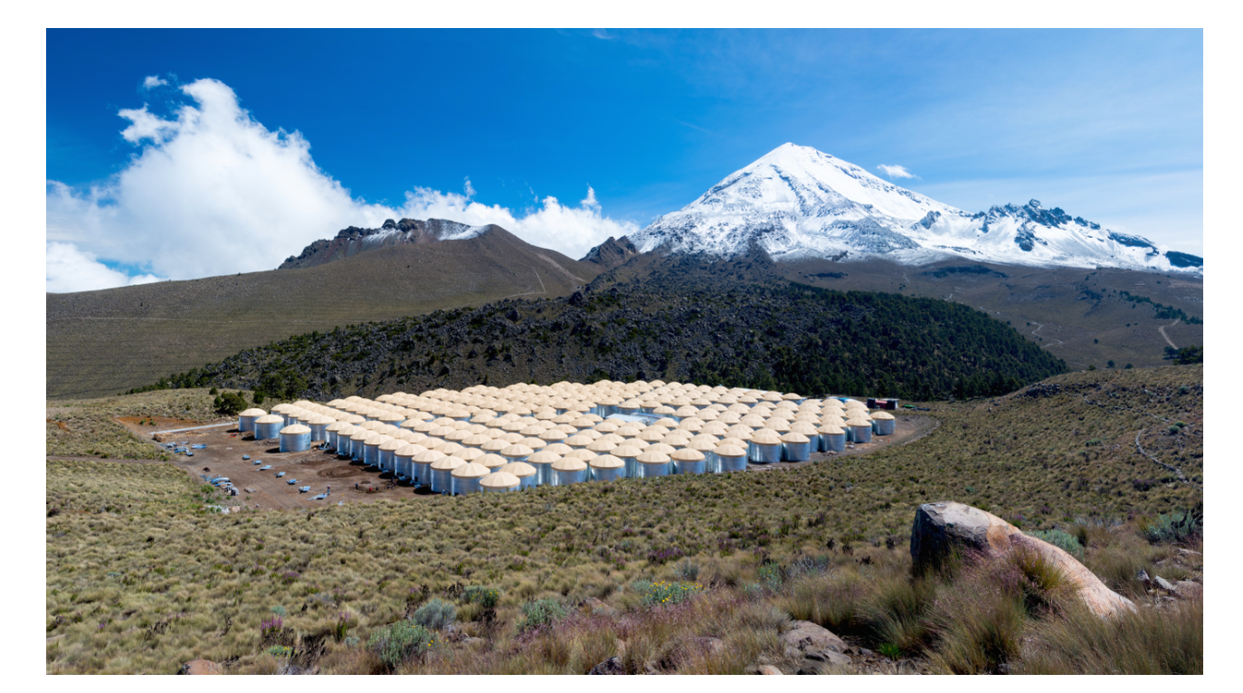
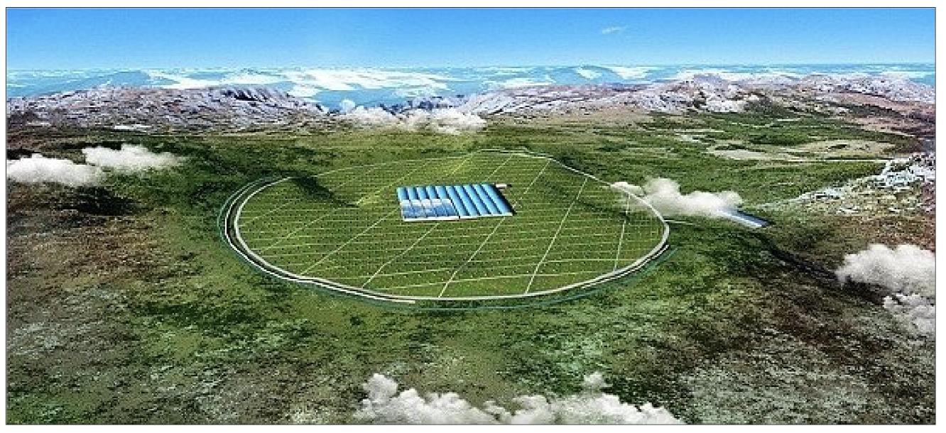
11
EAS Array
- the primary particle is determined by measuring the relative arrival time of the EAS
- to reconstruct the direction and energy of the primary particle the shower core should be contained within the complete detector and many measurements of the pulse height and arrival time should be made across the EAS.
- leads concept of the EAS array
- Individual detectors may be wire chambers, scintillation detectors or water Cherenkov detectors.
HAWC
LHAASO

Slide 13
12
IACT vs EAS Array
IACTs have significantly better angular and energy resolutions than the EAS arrays
      the attenuation length of Cherenkov light in the atmosphere is much greater than the attenuation length of particles the energy threshold of IACTs is typically lower than that of an EAS array.
IACT arrays give excellent background rejection both at the hardware (trigger) level rejecting the ‘diffuse’ images of cosmic ray
showers as well as local muons and at the software level based on the analysis of image parameters from stereoscopic reproduction
For point sources, this gives a much higher significance per unit observing time ( $≥$30σ/ $\sqrt{h}r$ for HESS and VERITAS) compared with water Cherenkov experiments (∼0.3σ/ $\sqrt{h}r$ for HAWC)
  On the other hand, IACTs are optical instruments and therefore can operate better on clear moonless nights and they have relatively small field of view (∼few msr), while EAS arrays continuously view the entire overhead sky (>2 sr) with duty cycles in excess of 90%.

Slide 14
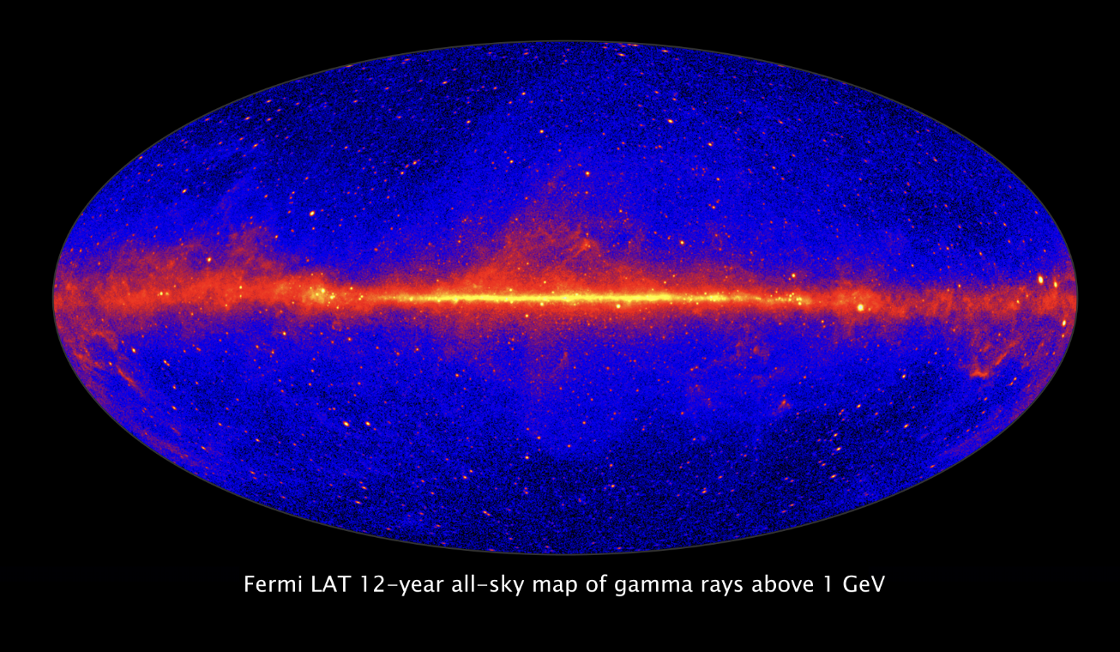
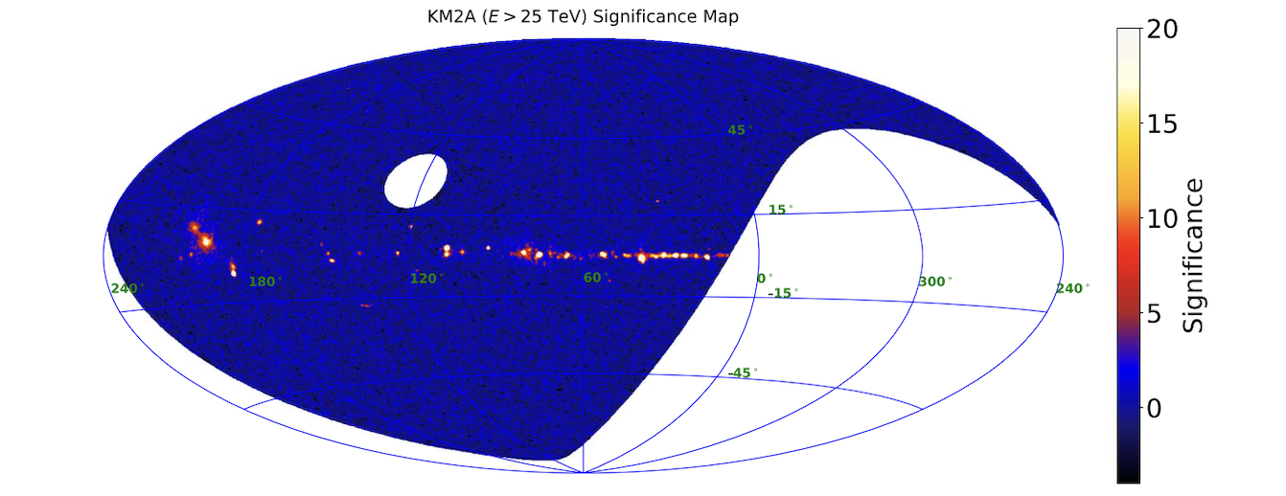
14
Fermi-Lat all sky map
LHAASO all sky map above 25 TeV

Slide 15
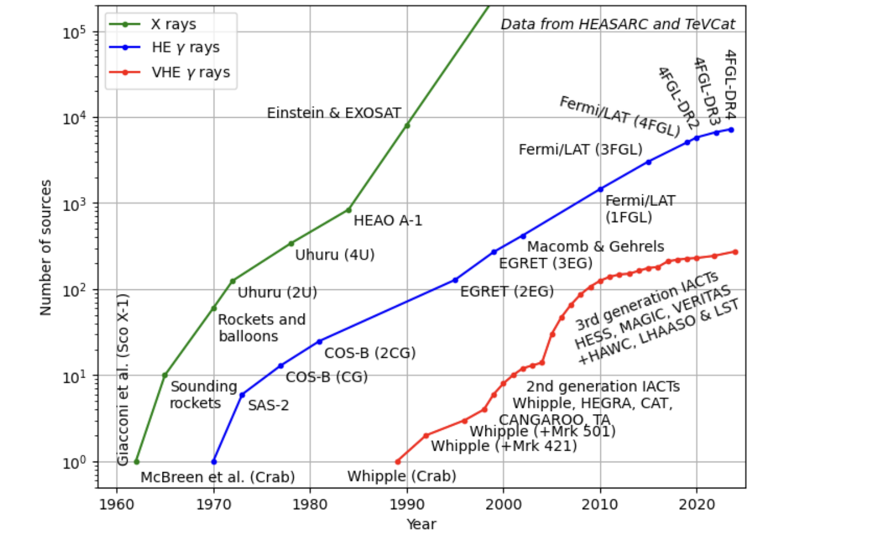
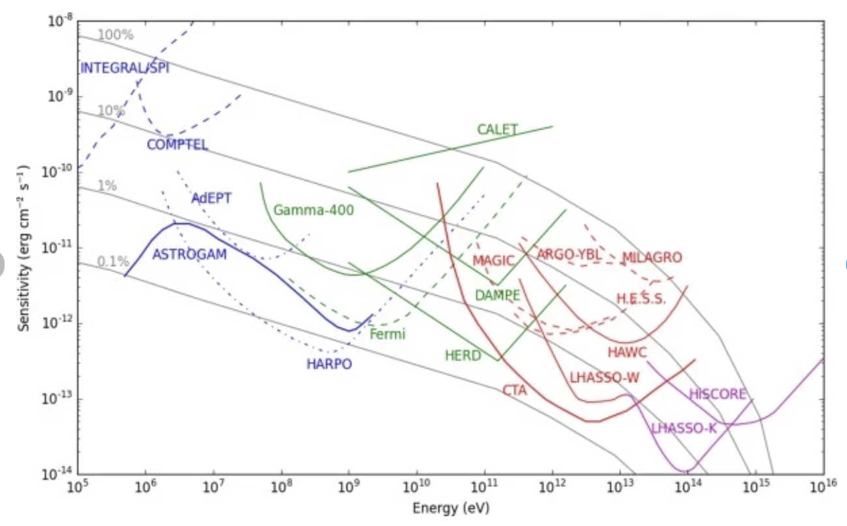
13
Sensitivity of current and Future Detector
discovery history of astronomical sources over time.

Slide 16
15
Conclusion
The domain of ground-based gamma-ray astrophysics has seen a revolution during the few last decades
- starting from a handful of sources we now know many very-high energy gamma-ray emitters
- from the initial quest for the Galactic source of cosmic rays, a new observational window allowing the study of the most extreme accelerators in the Universe
- Maybe, with the byproduct of probing the Universe and providing a new tool to unveil the dark matter of our Universe
Thanks !

Slide 17
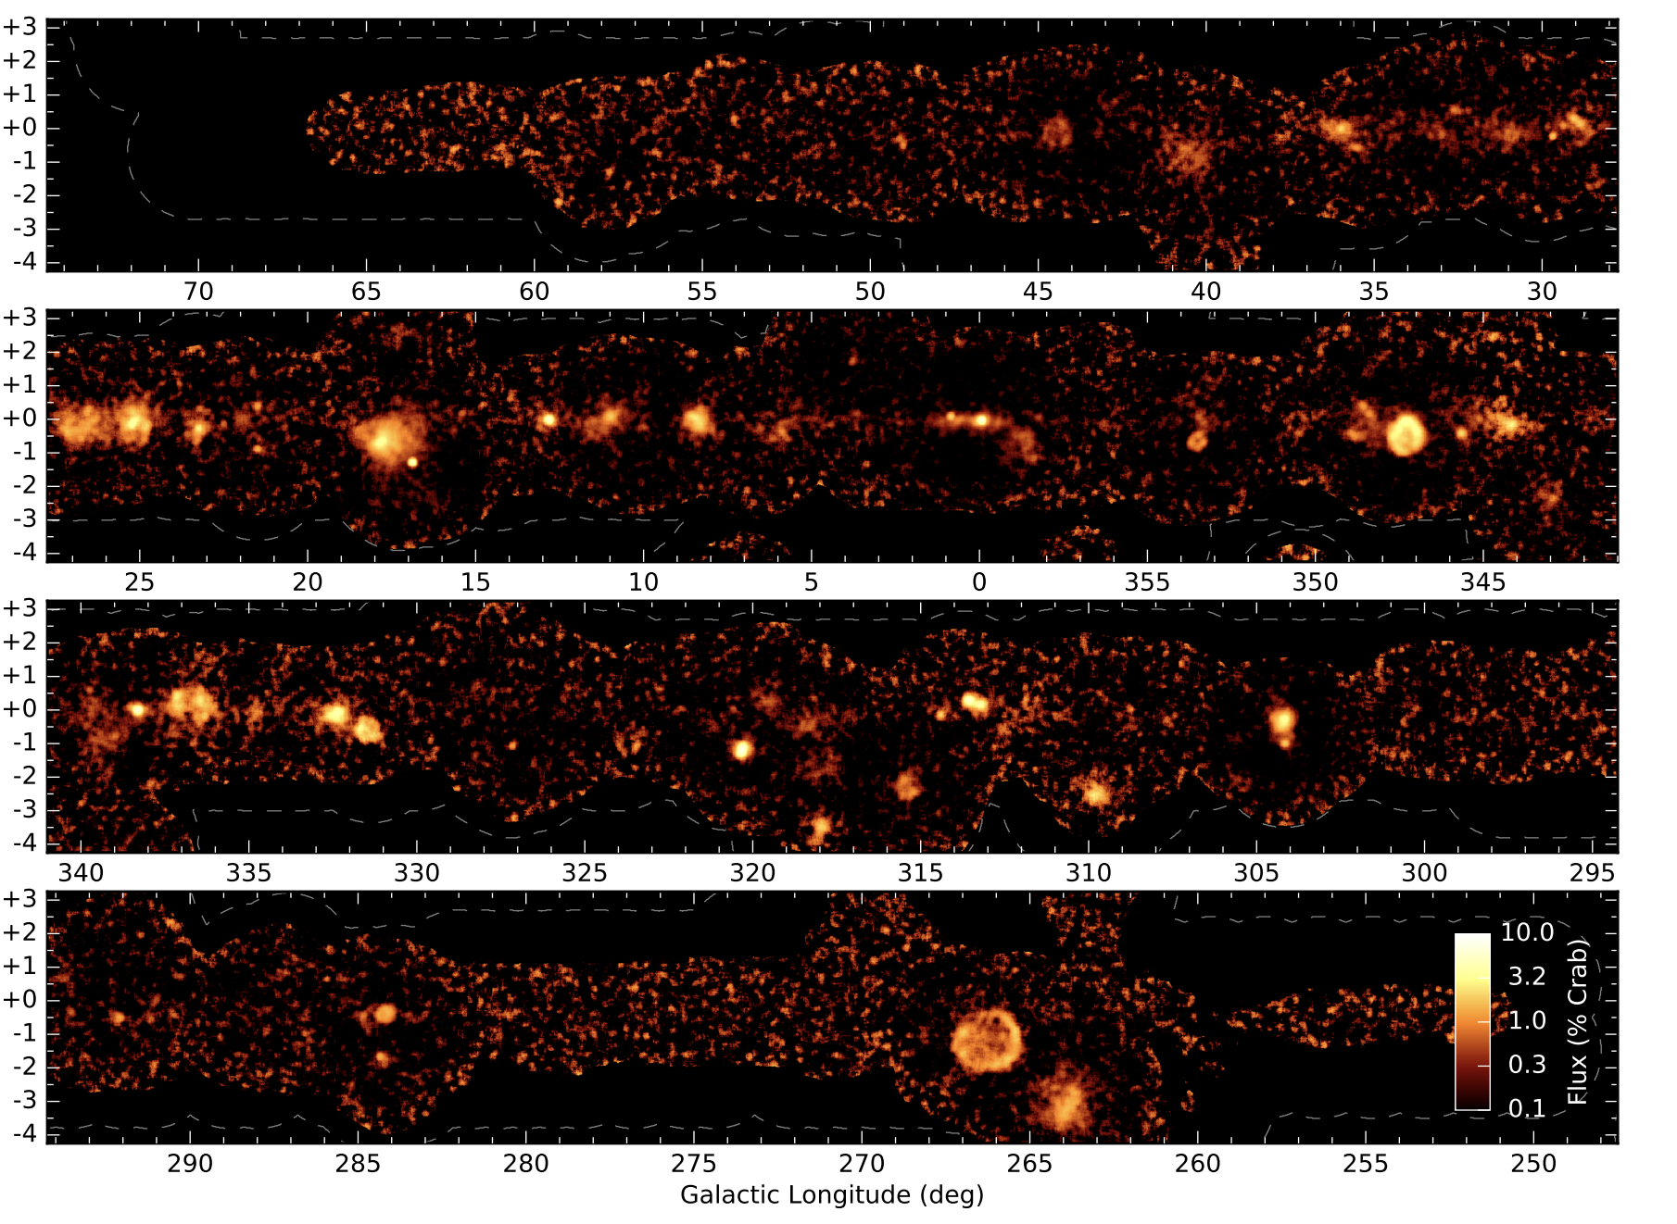
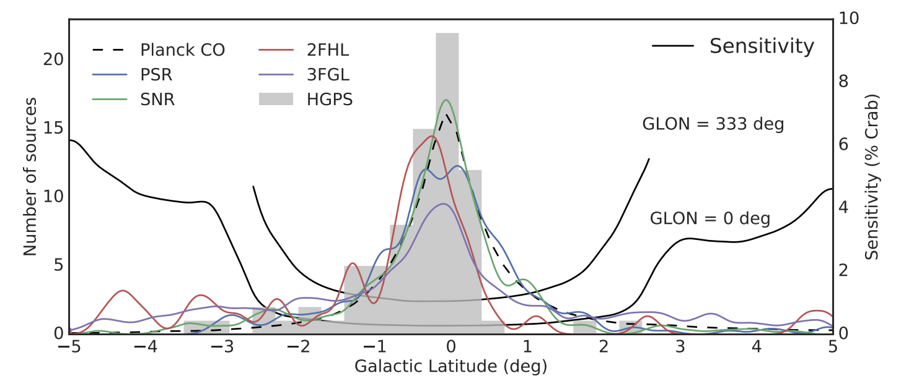
galactic latitude profile of H.E.S.S. galactic Plane Survey

Slide 18
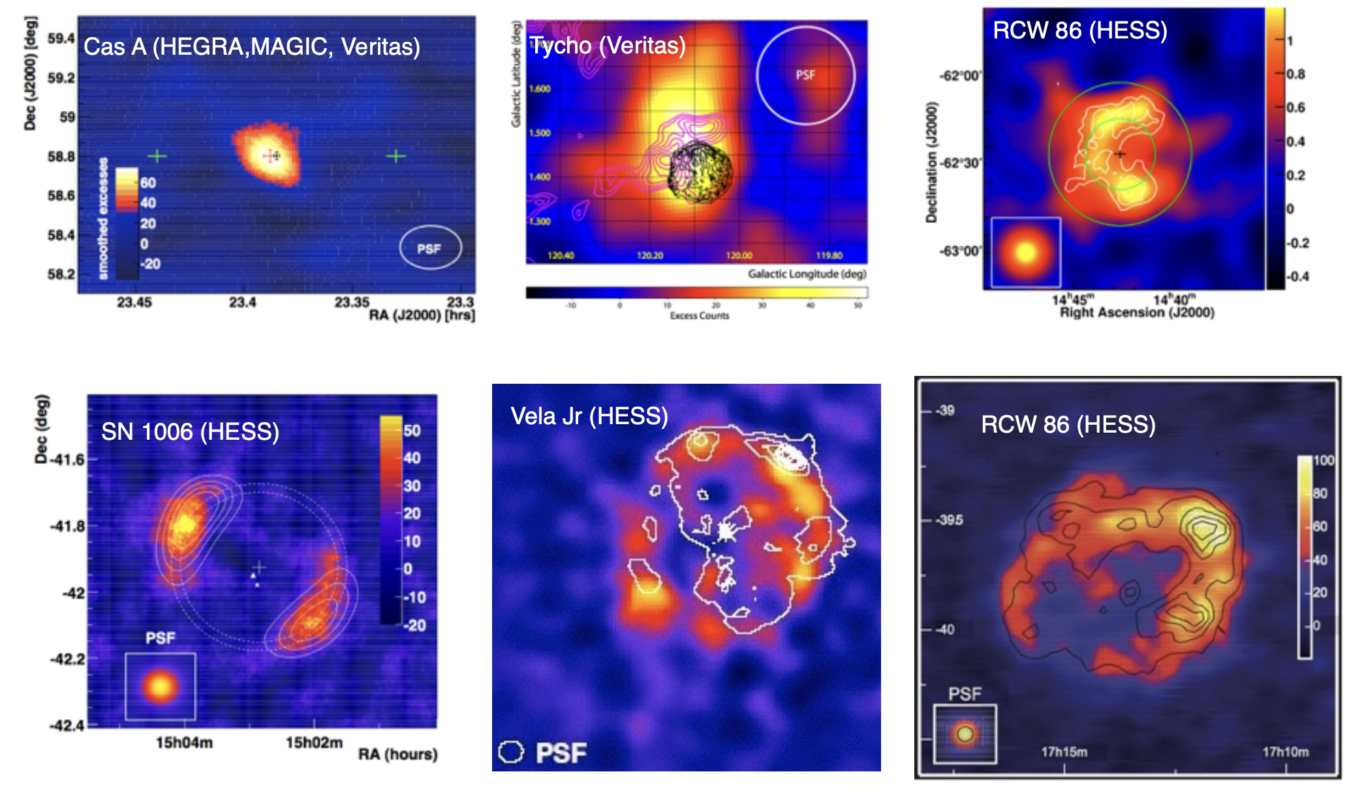
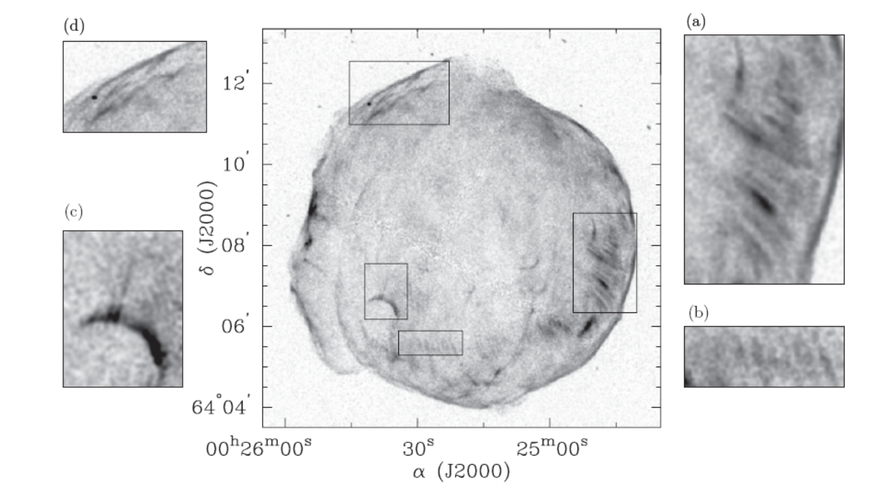
SNR AS Accelerator of CRs
Non thermal x-ray emission, evidence for electron accelerate ~ 100 TeV
Credit : Jürgen Knödlseder
Some SNR in TeV Gamma-rays

