Slide 1
Enabling controlled nuclear fusion – the role of magnetic diagnostics in tokamaks
André Torres
Prepared for the Seminar for Young Researchers
26th March 2026

Slide 2
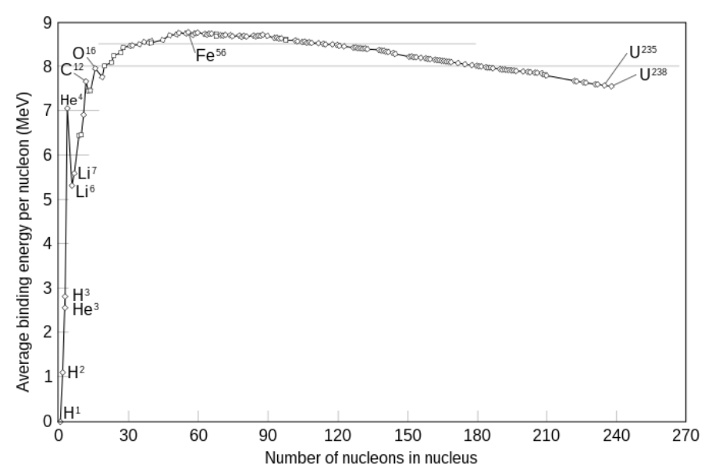
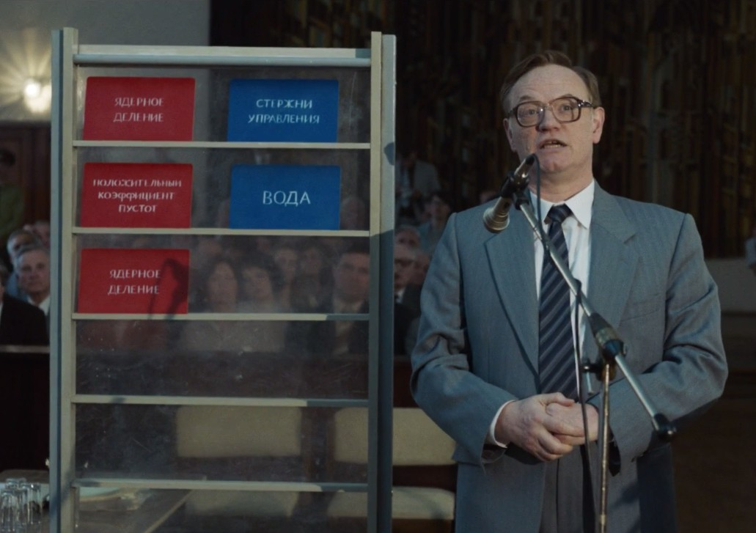

A fundamental difference…
Confinement
time
Nuclear fission
Chernobyl (2019, HBO)
Plasma temperature
Density
Nuclear fusion
‘triple product’
Nuclear fusion
Equilibrium
Stability
Magnetic confinement
“The reactivity that generates power either goes up [holds up a red card] or it goes down [holds up a blue card].”
In magnetic confinement nuclear fusion, the reaction does not occur naturally, we need to create – and maintain – the conditions for its existence.

Slide 3
In this presentation…
Principles of the tokamak
The magnetic diagnostic system
Types of sensors
What is their role?
Development of the diagnostic for COMPASS-U
Challenges and R&D
Sensors
Low drift signal integration for COMPASS-U
Real-time ELM detection for buffering
The magnetic diagnostic is intrinsically linked with the operation of the magnetic confinement device.
It is present since the early devices,
and a fundamental tool for plasma both physics research and for power-plant operation.

Slide 4
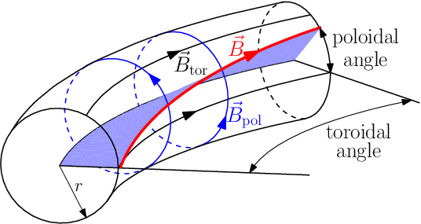
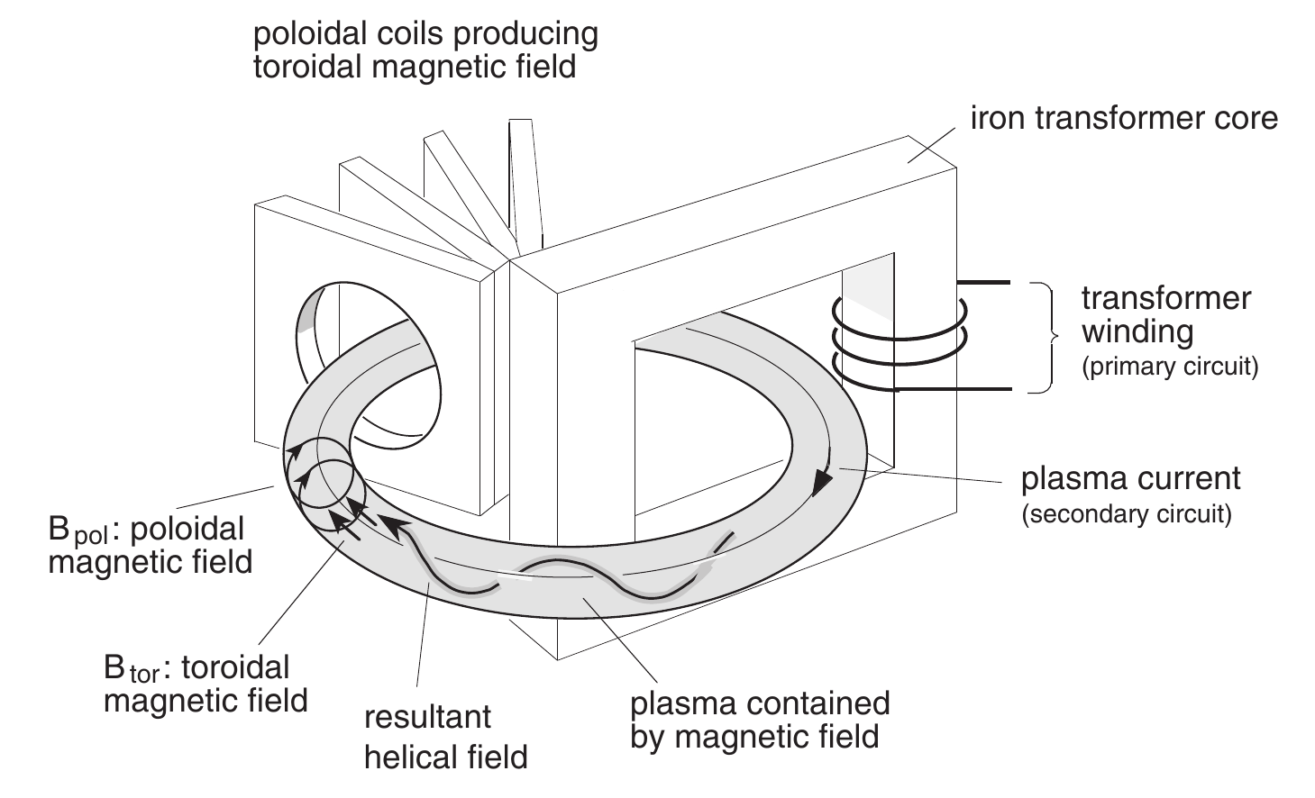
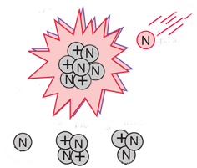
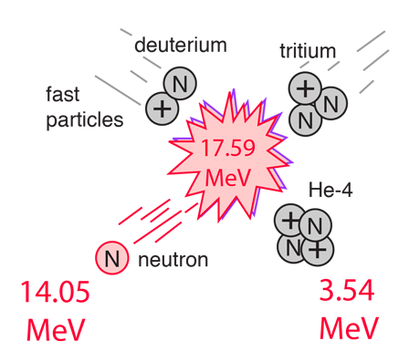
The vessel for magnetic confinement
Tokamak (from toroidalnaja kamiera s magnitnymi katuszkami)
Toroidal field coils create a strong toroidal field
Current is induced on the conductive plasma (secondary of a transformer)
The plasma current generates a poloidal field
The resulting field lines are helical, which compress the plasma
Balance between the kinetic and magnetic pressures → Equilibrium
Important definitions!
Witvoet, et al., Nuclear Fusion, 2009
Li-7
(fast) neutron
[2]
(slow) neutron
He-4
tritium
Breeding blanket
[1] J. P. H. Goedbloed and S. Poedts, Cambridge University Press, 2004
[2] Online: R. Nave, HyperPhysics, 2017
[1]

Slide 5
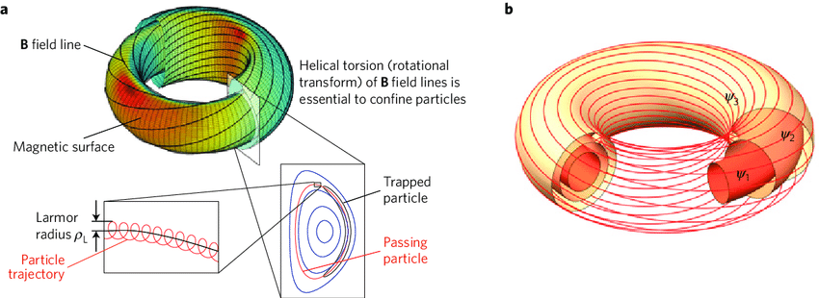
Where are the particles?
Particles follow the helical field lines, gyrating with a Larmor radius
They are confined along the flux surfaces, from the core to the Last Closed Flux Surface, where the field lines start being open
Magnetic surfaces of same poloidal (magnetic) flux - Ψ

Slide 6
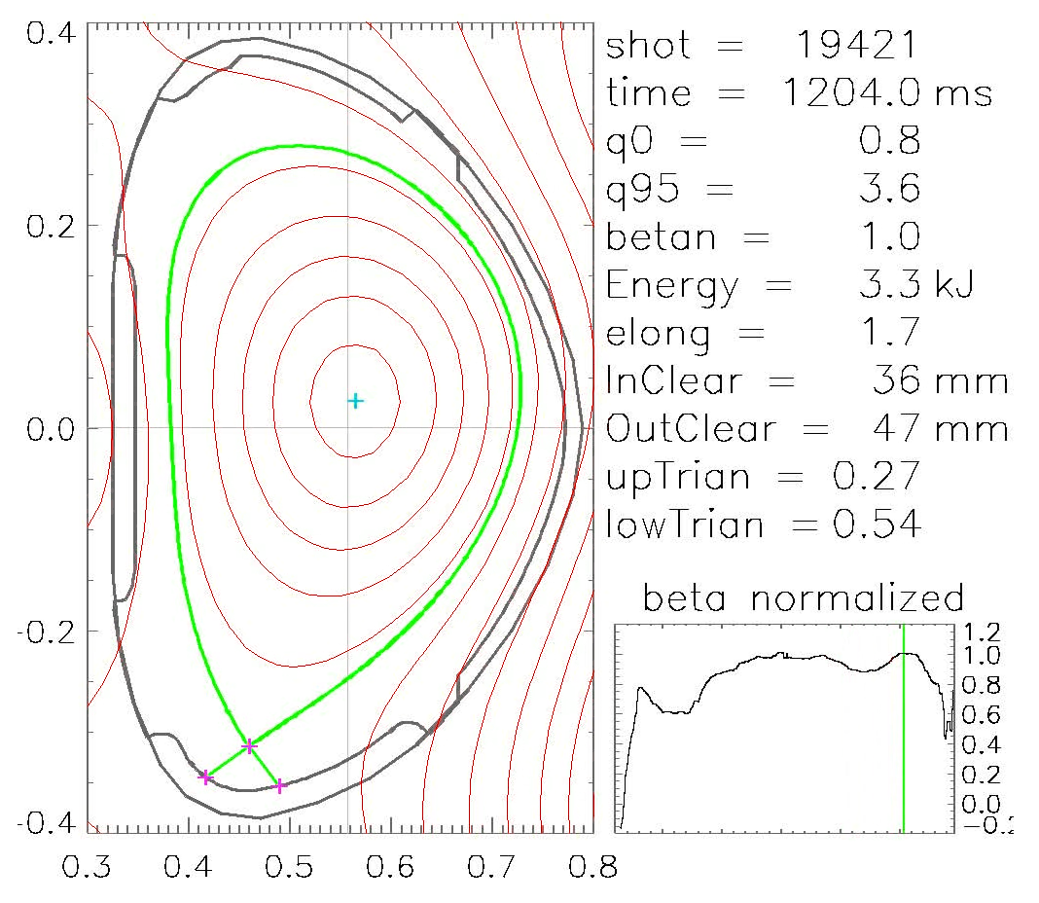

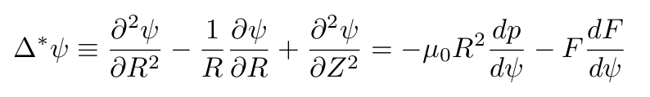
Magnetic equilibrium
Internal balance between the plasma pressure and the magnetic field forces. Gives rise to the shape and position of the plasma, controlled by the currents in the external coils.
Lorentz force compresses the plasma
Hot plasma tries to expand
Grad-Shafranov equation
Ψ is both the dependant and independent variable! Would be really convenient to measure it!
R, Z – 2D coordinates p(ψ) – pressure profile F(ψ) – toroidal field profile

Slide 7
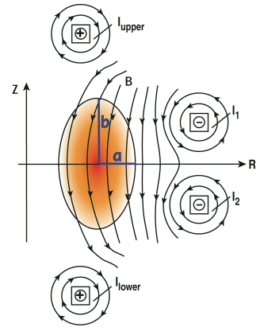
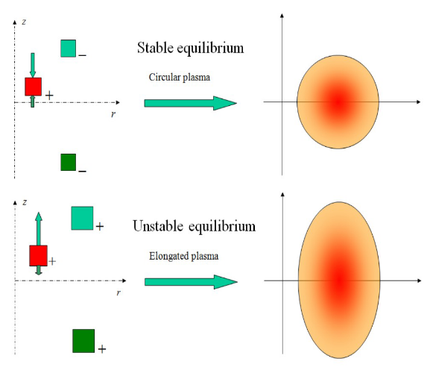

Optimizing the tokamak: elongation
We want to drive more current in the same volume, with a fixed major radius. Beyond a certain point, massive instabilities appear.
Elongation increases the cross section of the plasma allowing longer trapped particle paths.
$$κ=\frac{b}{a}$$
Problem: Elongated plasmas are vertically unstable!
Solutions:
Eddy currents on conductive structures
Real-time magnetic control
M. Walker, General Atomics
G.D. Tommasi, 2019

Slide 8
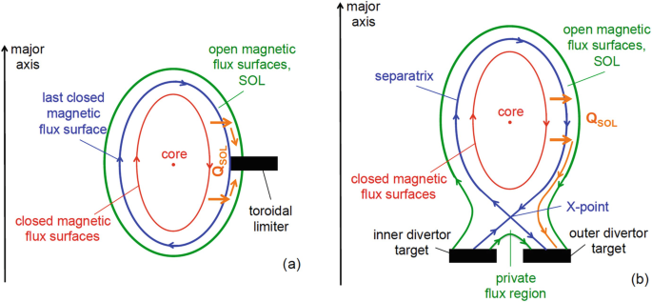
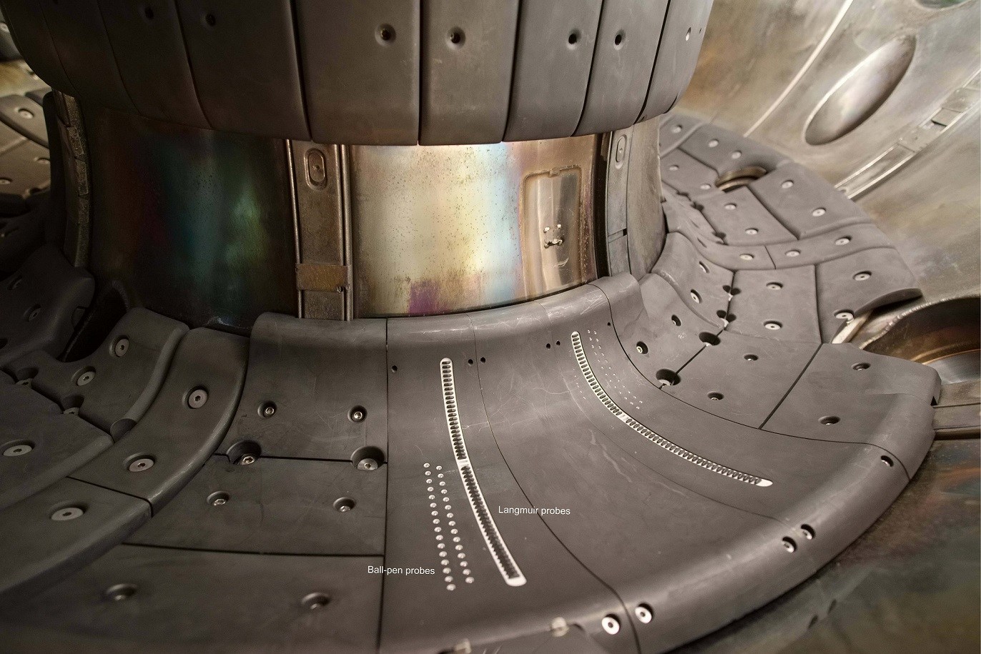
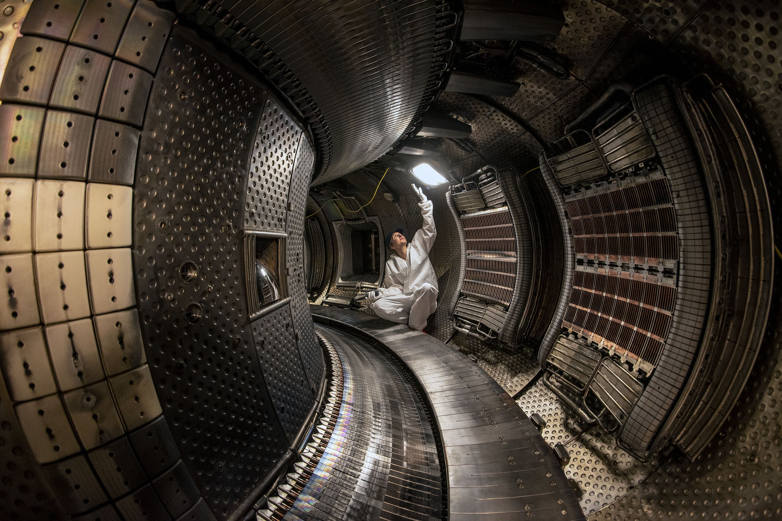
Optimizing the tokamak: the divertor
S. Krasheninnikov, A. Smolyakov & A. Kukushkin - Edge Plasma Issues in Magnetic Fusion Devices
Where does the plasma ‘end’?
The closest metallic structure will act as a limiter – closed field lines (confinement) inside, open field lines outside.
Problem: Plasma exhaust is concentrated on the limiter
Solution: Divertor
Withstands the high alpha particle heat flux
Away from the plasma core
Pumps out impurities
COMPASS – Carbon divertor
WEST – Tungsten divertor
Photos: IPP-CAS, CEA

Slide 9
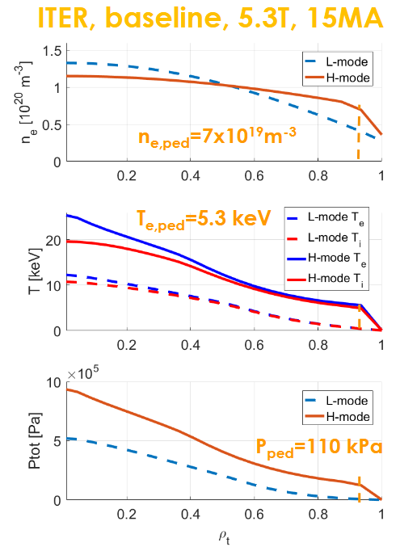
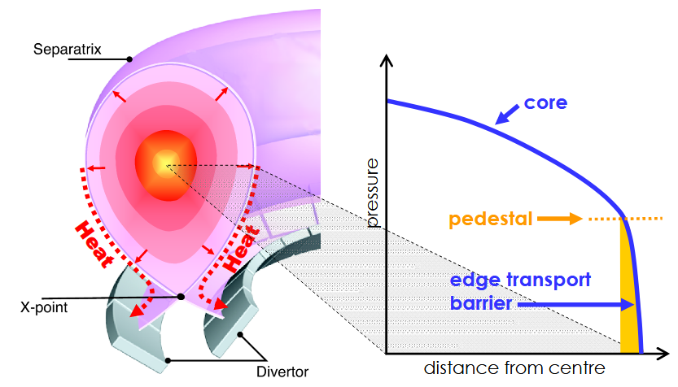
Optimizing the tokamak: H-mode
High confinement mode
H-mode is an operating regime with enhanced confinement (higher confinement time) reached through the addition of external heating. It is characterized by the formation of a transport barrier at the edge, appearing as a pedestal in the radial profiles.
J. W. Connor et al, AIP Conference Proceedings 1013, 174-190 (2008)
F. Jaulmes, et al., PhDiaFusion, 2021

Slide 10
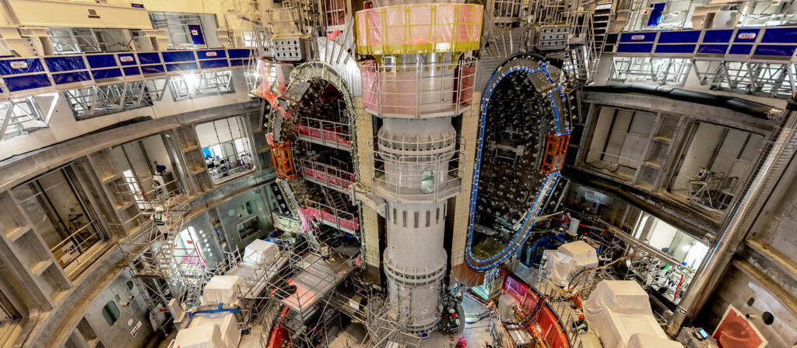

The modern tokamak
ITER
Under construction in France
~20 B EUR
In-kind contributions form 7 members
Aim of demonstration of net positive energy production with Q=10
Person

Slide 11
The magnetic diagnostic

Slide 12
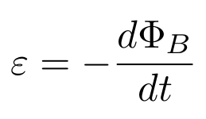
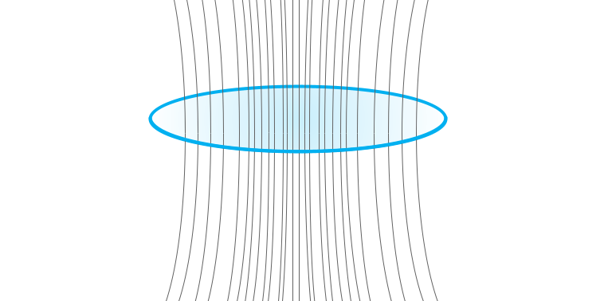
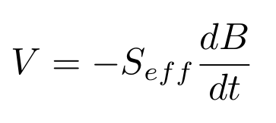
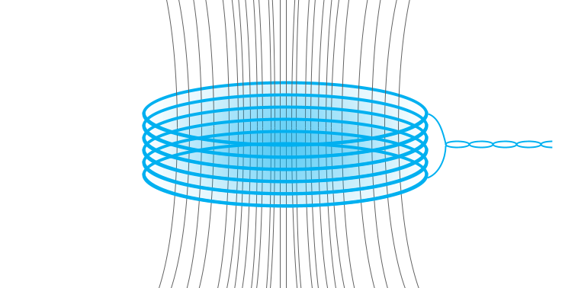

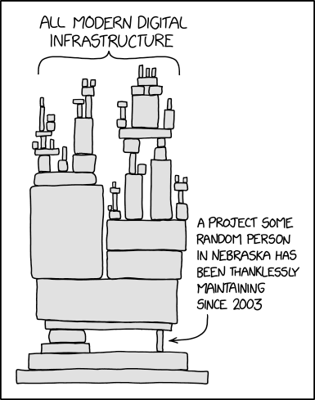
Magnetic diagnostic – Principle of operaton
Adapted from: J. Wesson, Oxford Univ. Press, 2011
Inductive magnetic sensors
Physics exploitation on tokamaks and stellarators
Magnetic probes (Mirnov coils) ➡ Local B Flux loops ➡ Loop voltage (V_{loop}), poloidal flux (ψ) Rogowski coil ➡ Plasma current (Ip) Diamagnetic loop ➡ Plasma energy (W) Saddle loops ➡ Radial Magnetic field B_{R}
Some wires around the device
Adapted from the XKCD comic
https://imgs.xkcd.com/comics/dependency.png

Slide 13
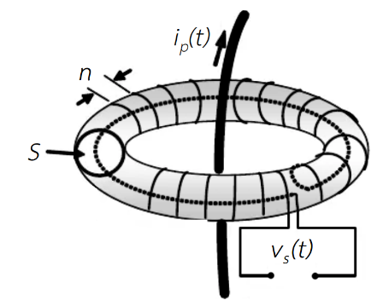
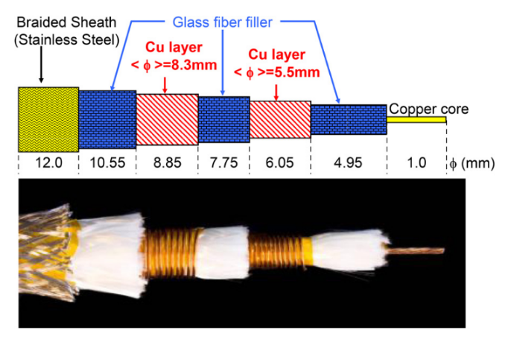
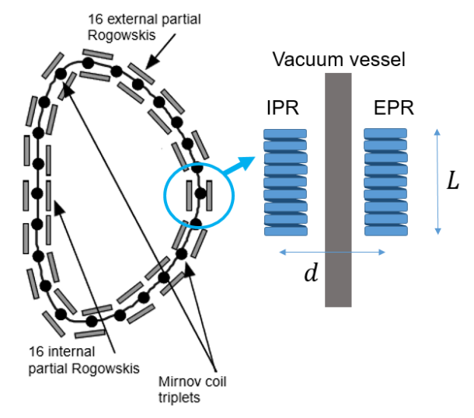



Rogowski coil
Main measurement for plasma current!
Essential for physics exploitation and control alike
In addition, used to measure other currents such as in the Vacuum Vessel
P. Moreau, et al., “Prototyping and testing of the continuous external rogowski ITER magnetic sensor,” 2013
E. Matveeva, 2019

Slide 14
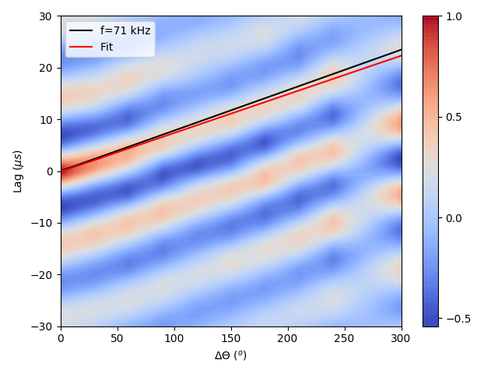
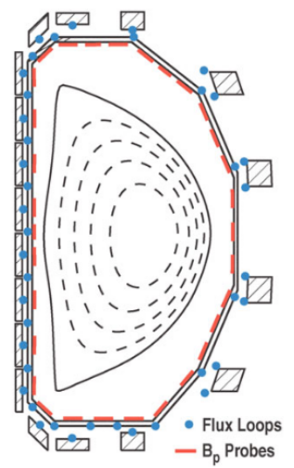
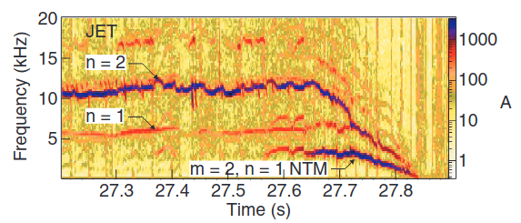
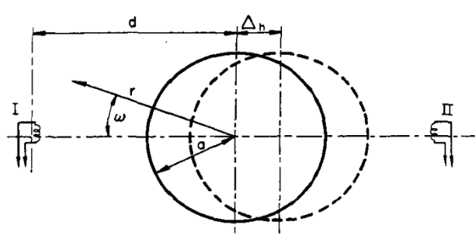
Magnetic probes (Mirnov coils)
Provide local B measurements
Main tool to study the Magneto-Hydro-Dynamics (MHD) of the plasma, i.e. deviations from the equilibrium state
In addition to physics, we can monitor and prevent the growth of instabilities that could lead to an abrupt termination of the discharge
Control plasma shape and position
m=2
Min
Max
Max
Min
T. Hender, et al., Nuclear Fusion, 2004.
TM-3 1964
DIII-D 1986
E. J. Strait, 2008

Slide 15
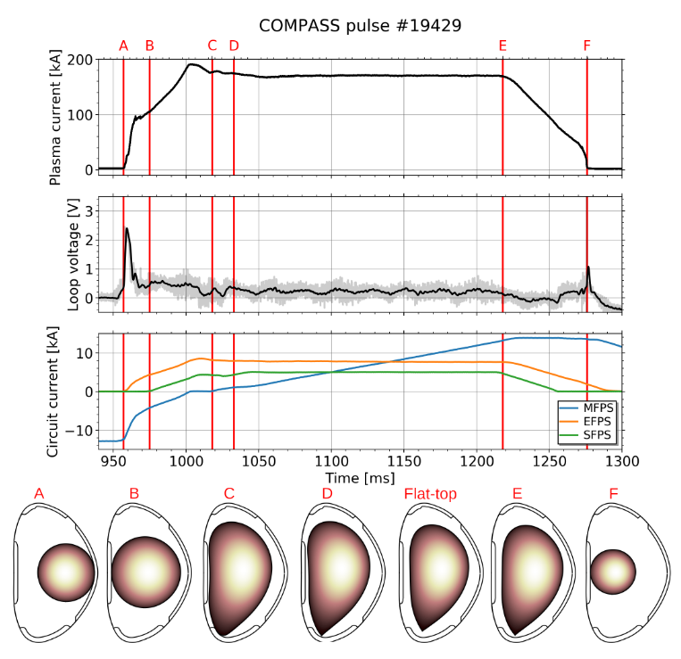
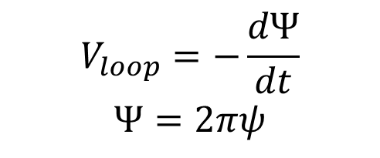
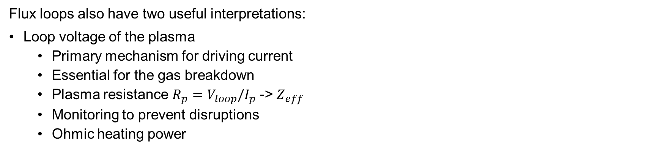
Flux loops
Flux loops also have two useful interpretations:
Loop voltage of the plasma
Primary mechanism for driving current
Essential for the gas breakdown
Plasma resistance ${R_{p}=V}_{loop}/I_{p}$ -> $Z_{eff}$
Monitoring to prevent disruptions
Ohmic heating power
$$V_{loop}=−\frac{dΨ}{dt}$$
$$Ψ=2πψ$$
Poloidal flux
With measurements outside the plasma we obtain the main plasma core parameters
X and divertor strike points

Slide 16
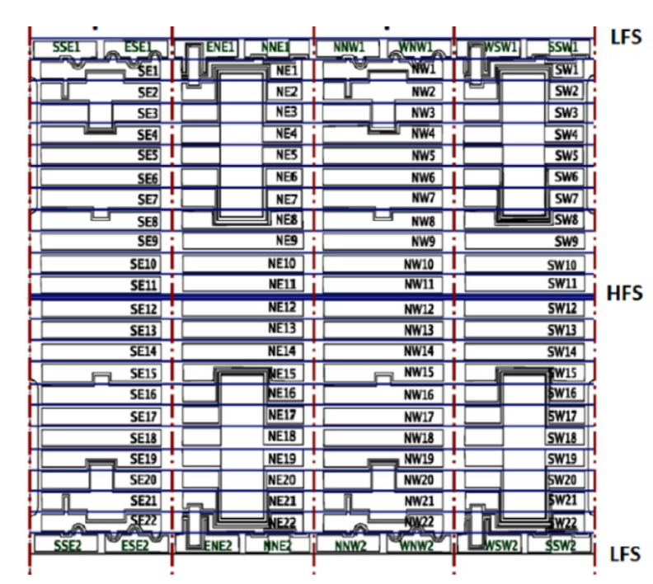


Saddle (siodło) loops
Shaped like a saddle because they sit on the surface of the VV, torus-shaped
Sensitive to radial flux, averaged over a large area
On a phi-theta map, they are a rectangle
The signal can be interpreted as:
φ1
φ2
Δϕ
Poloidal
Extremely important to detect low frequency MHD modes, specially non-axisymmetric non-rotating modes
Toroidal

Slide 17
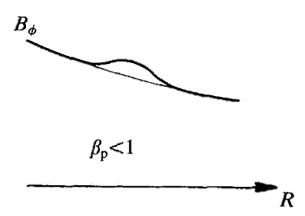
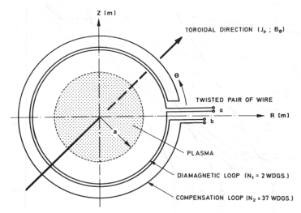
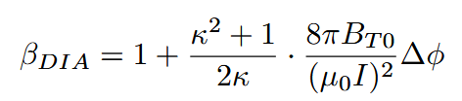


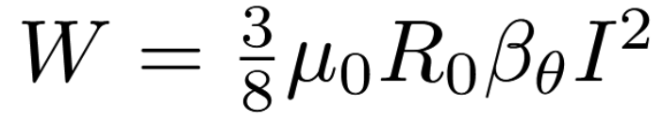
Diamagnetic loop
Main measurement of the plasma energy (W)
The diamagnetic flux is the difference between the total toroidal flux with plasma and that in the absence of plasma (vacuum flux).
The vacuum flux is determined either by measuring the current flowing in the toroidal field coils or, equivalently, the toroidal field outside plasma column.
Challenging measurement because the toroidal flux is several orders of magnitude larger than the diamagnetic flux
Approximation for elongated plasma
Gernhardt, et. al, Design and electronic compensation of a diamagnetic loop and its applications in the ASDEX tokamak, Tech. Rep., 1986

Slide 18
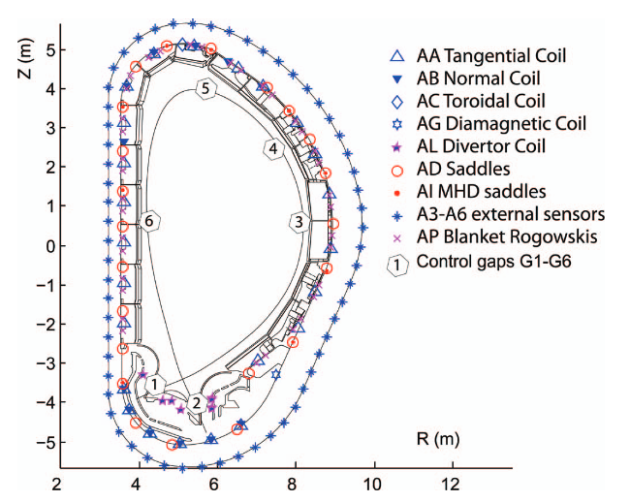
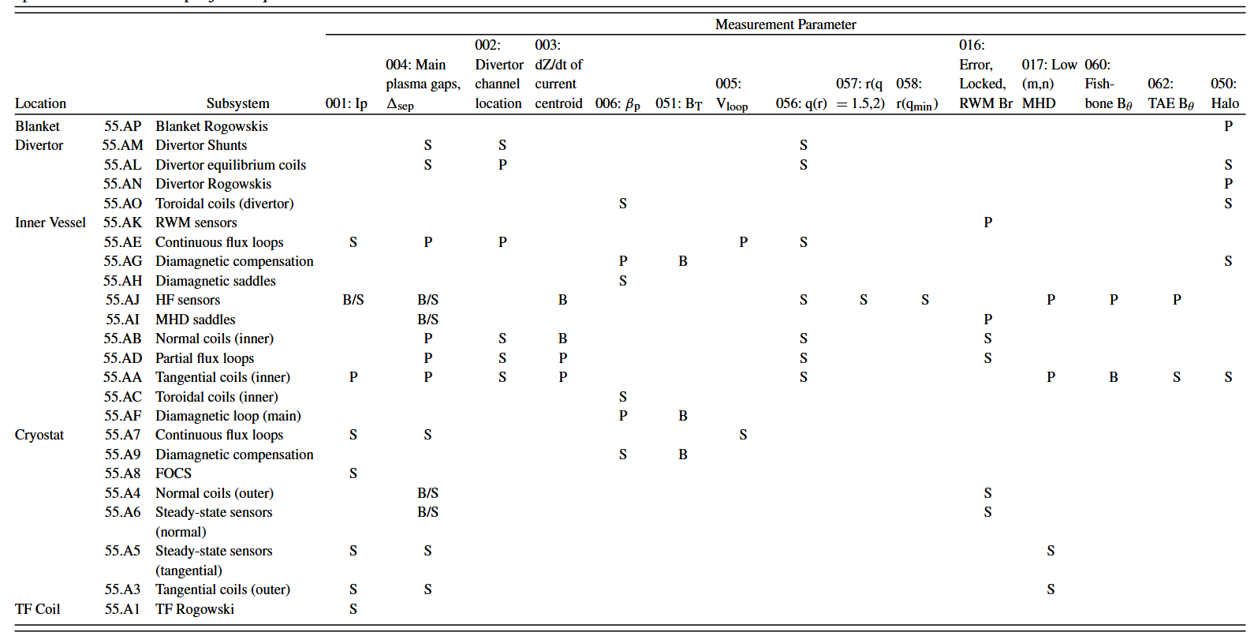
Applications (ITER)
Vayakis, 2012

Slide 19
Magnetics for COMPASS Upgrade

Slide 20
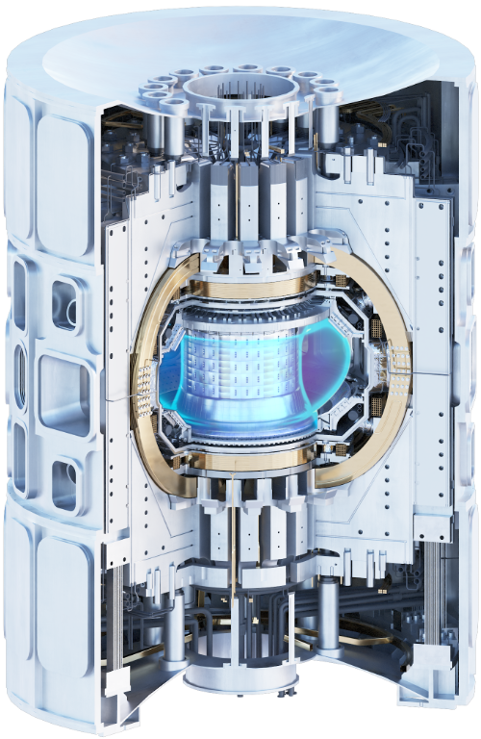
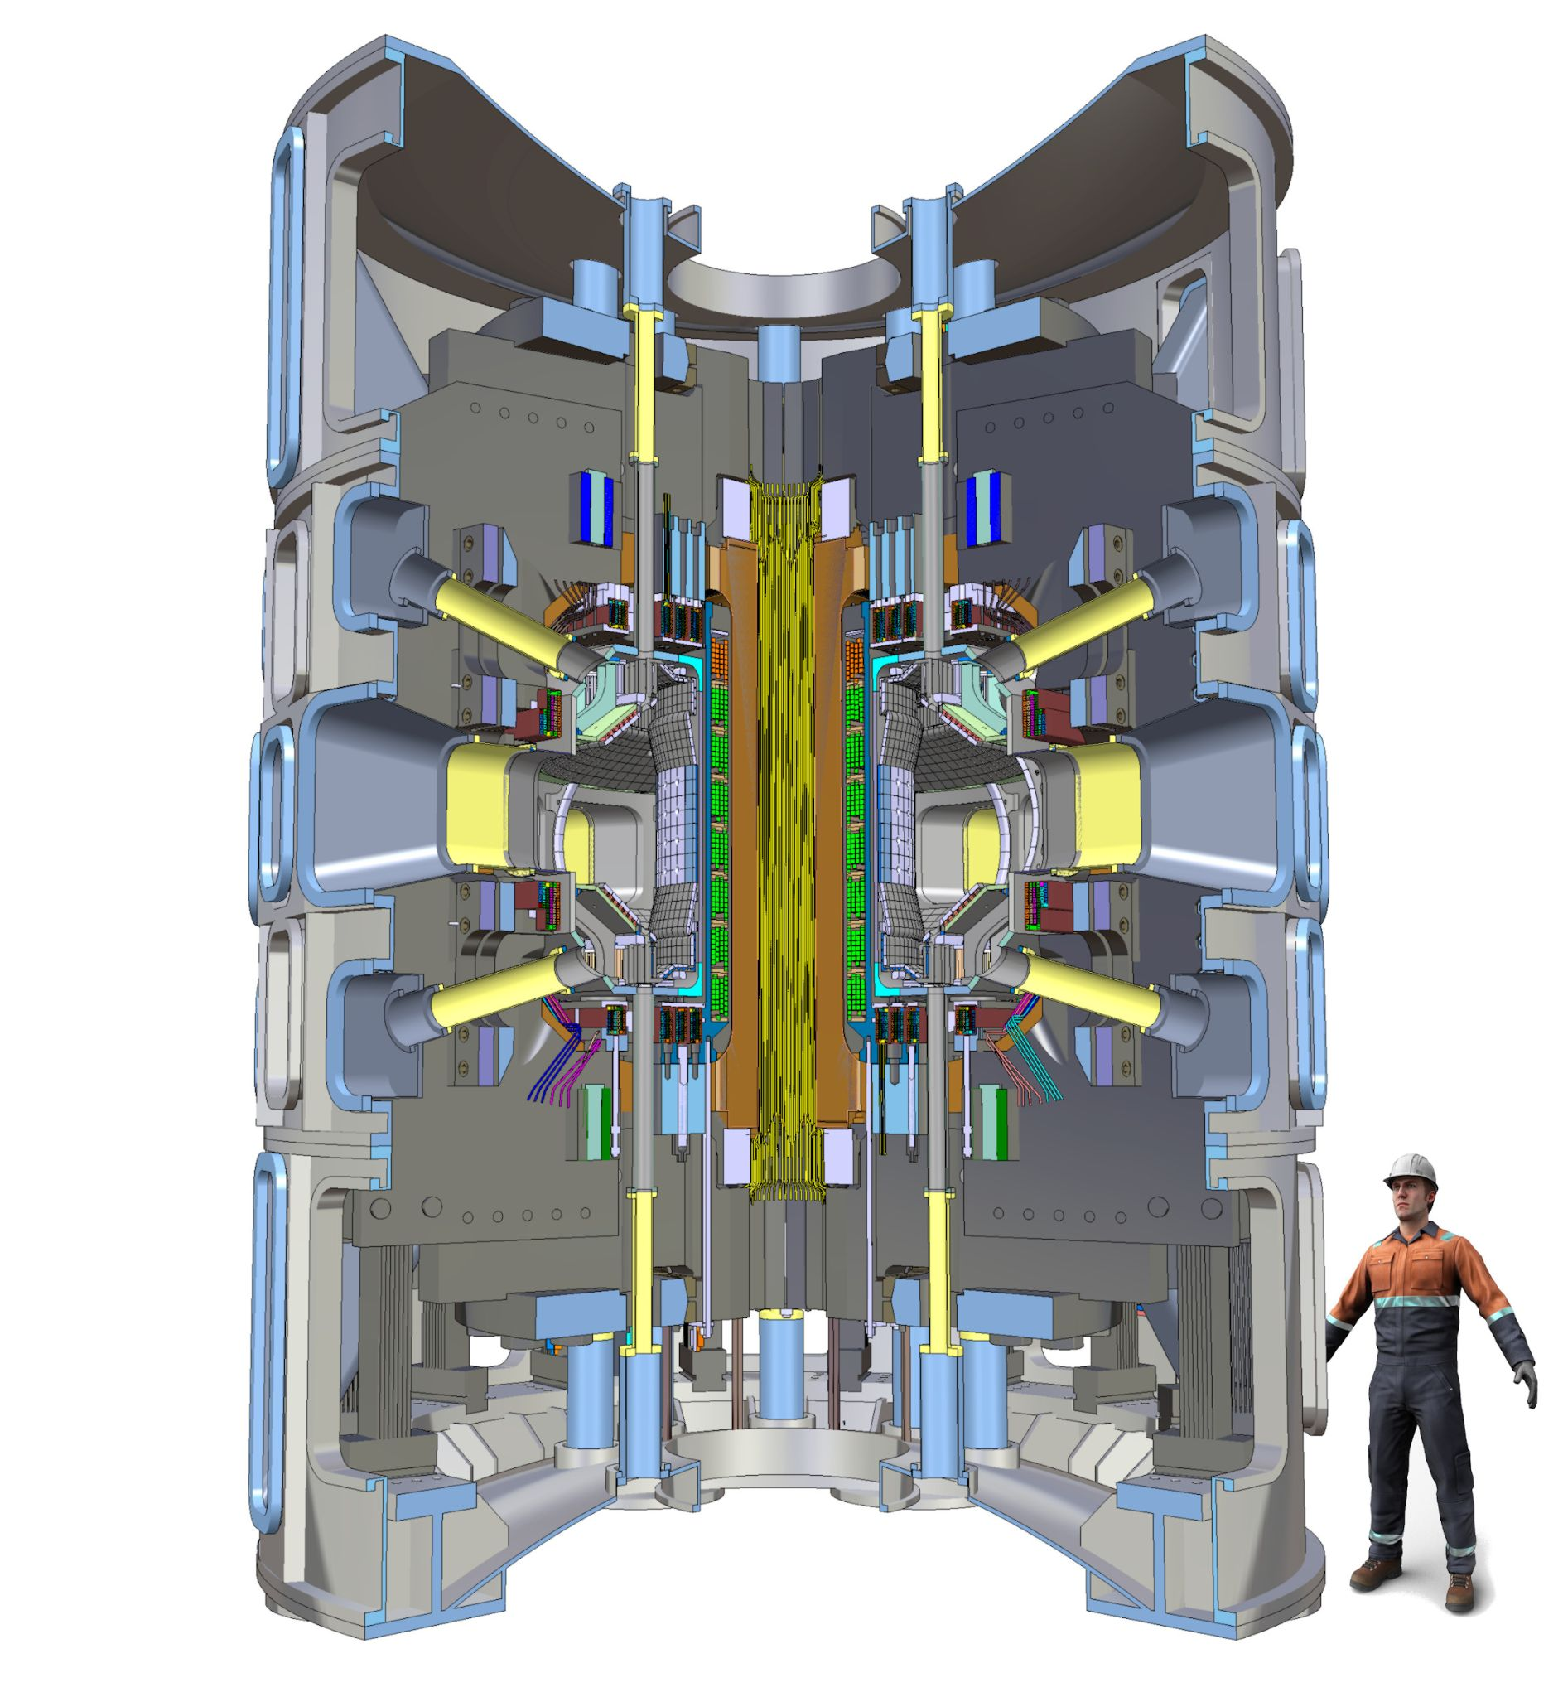
COMPASS Upgrade
COMPASS-U will be a compact and flexible device with a set of unique parameters to support the ITER operation and address key challenges of DEMO reactor design. In particular:
Power exhaust and liquid metal concepts
Alternative confinement modes and plasma shapes
“Hot-wall” operation: vacuum vessel can be heated up to 300 ºC and later 500 ºC
These are enabled by:
Cryogenically cooled copper coils
Metallic first wall (full metallic device)
Replaceable top and bottom divertors
High heat fluxes
NBI + ECRH heating
Main parameters:
Major radius R = 0.894 m
Minor radius a = 0.27 m
Aspect ratio A = 3.3
Triangularity δ ∈ 0.3-0.6
Tor. mag. field Bt ≤ 5 T
Plasma current Ip ≤ 2 MA
Elongation κ ≤ 1.8
Pulse length t ∈1-3 s
(11 s max.)
Vondracek, et. al, Preliminary design of the COMPASS upgrade tokamak, Fus. Eng. Des., 169, 2021

Slide 21
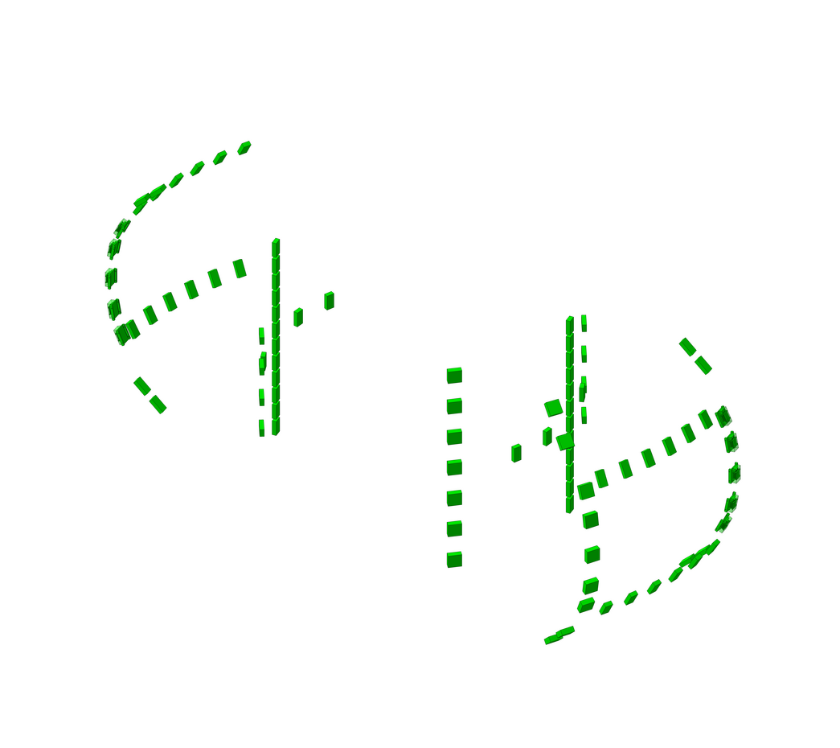
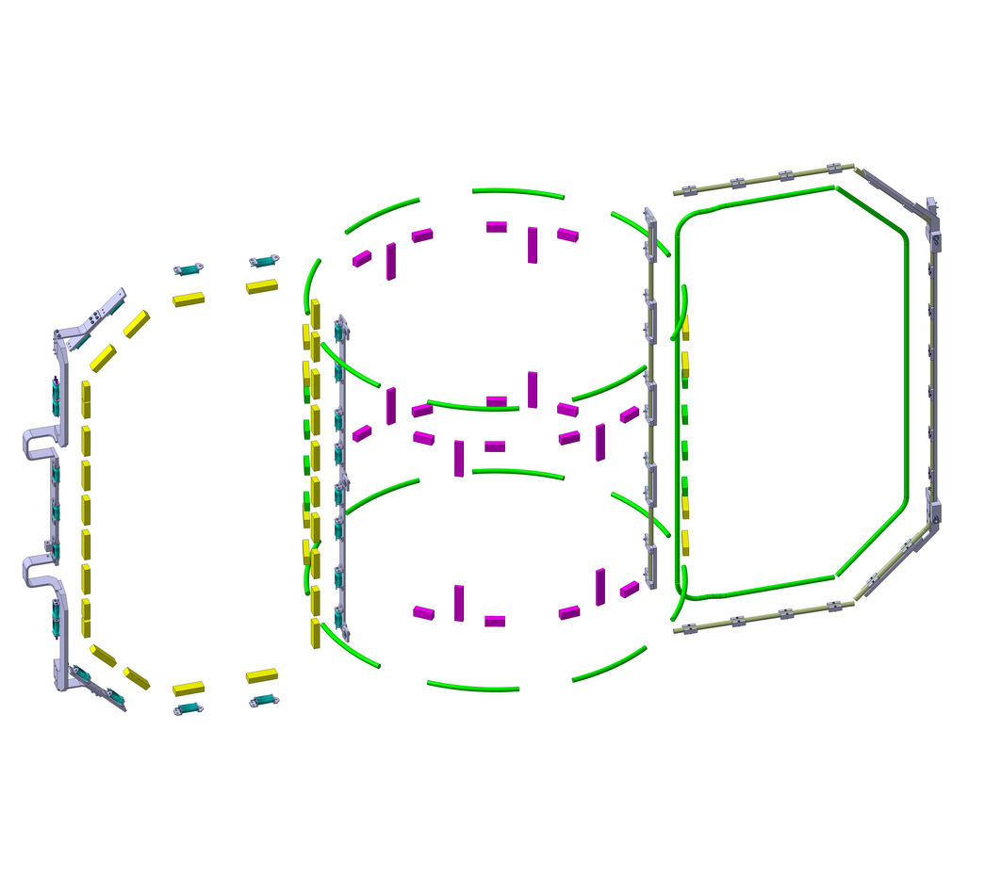
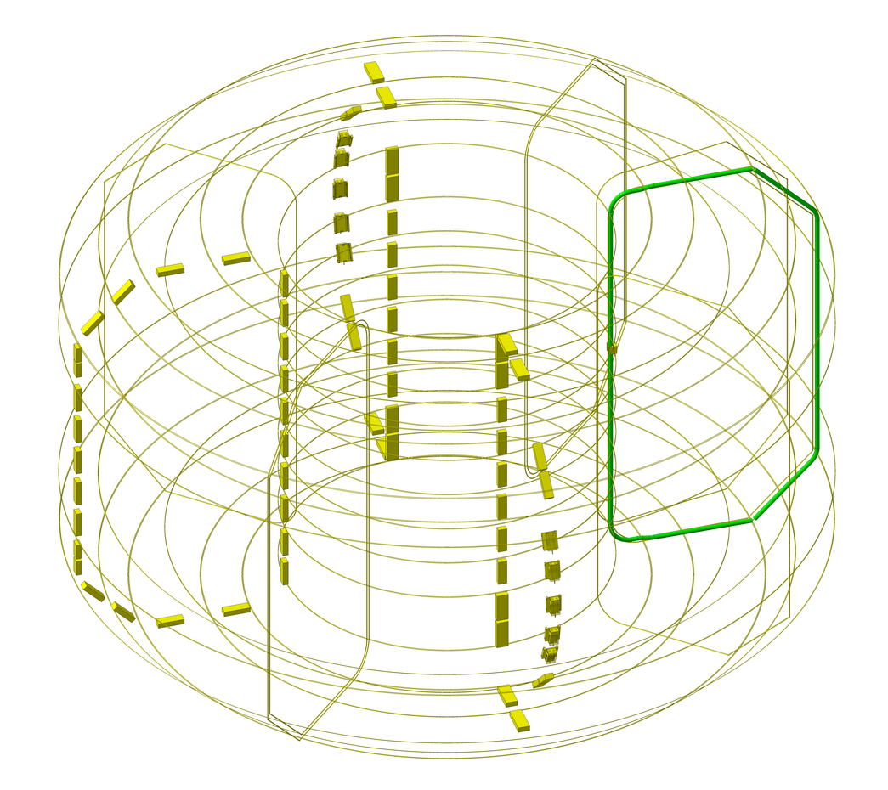
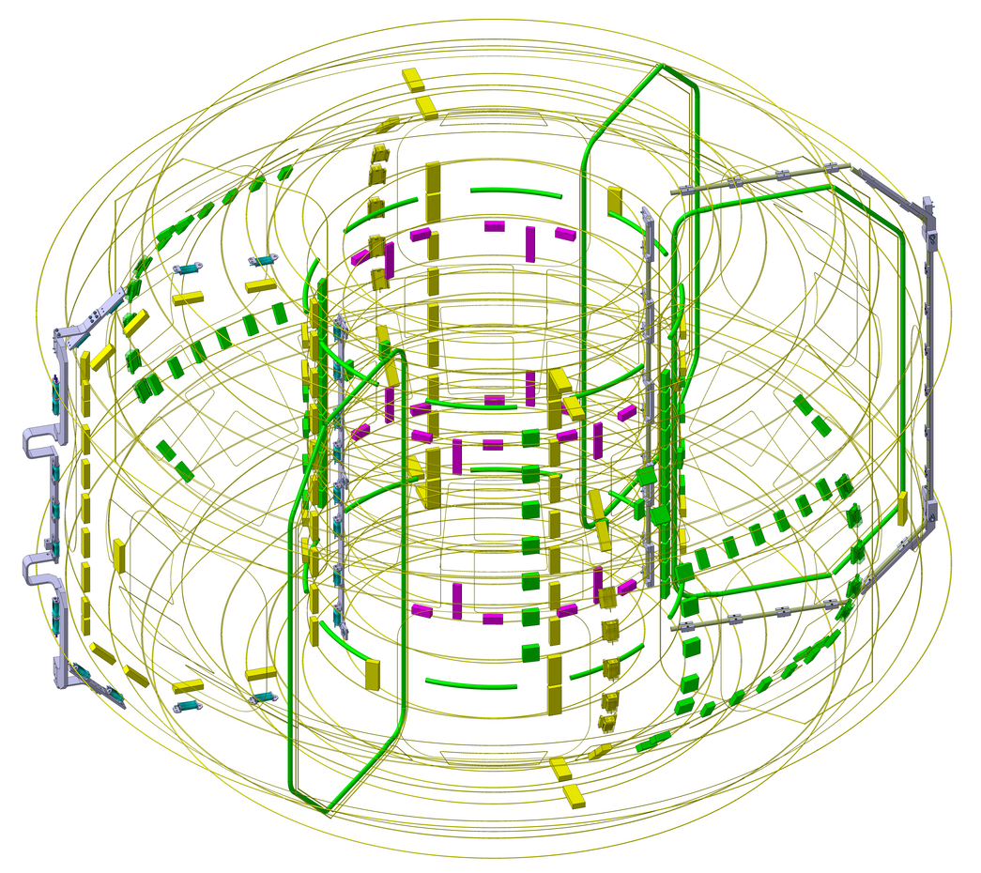
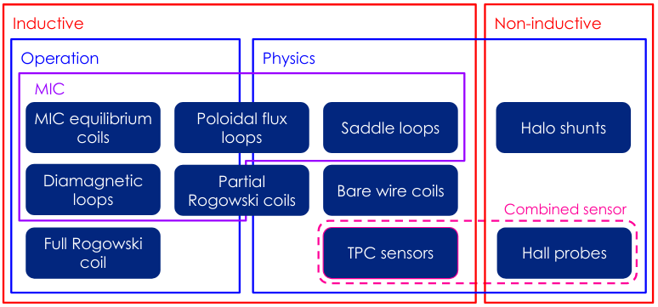
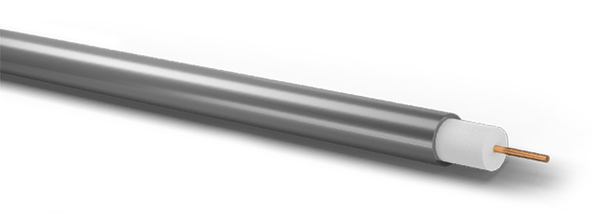
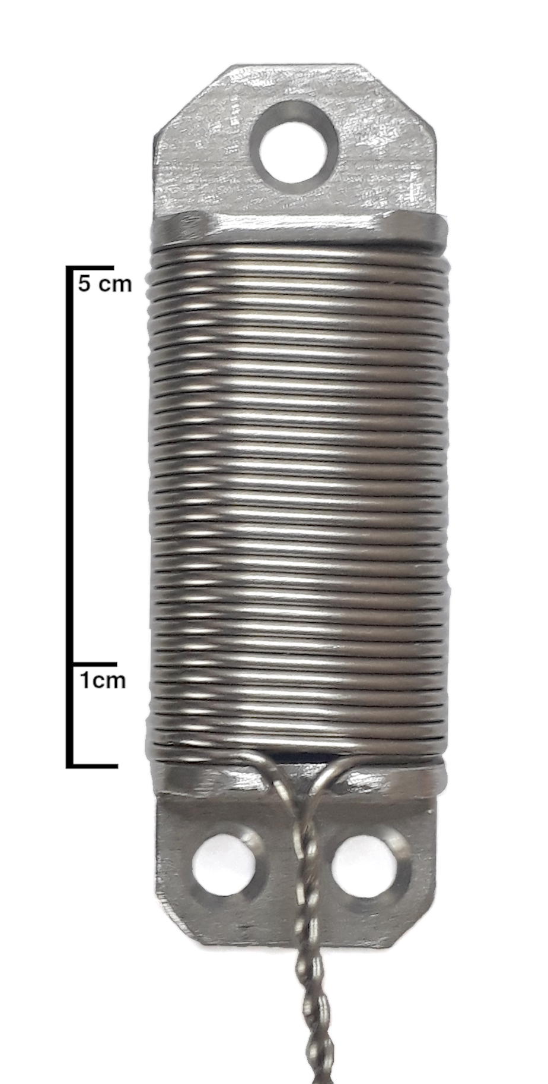
COMPASS-U magnetic sensors
Ceramic powder (MgO)
1D MIC Eq. coil
Measure vacuum vessel currents:
1 poloidal array Inner Partial Rogowski
1 poloidal array External partial Rogowski
1 internal full rogowski coil
1 external full rogowski coil
24 current shunts
2 segmented rogowski coils under PSP
Detect fast oscillations:
2 poloidal arrays
4 toroidal arrays LFS
2 toroidal arrays HFS
1 poloidal array TPC+Hall
Magnetic equilibrium:
2 poloidal arrays of MIC coils (1D, 2D)
4 Diamagnetic loops (two with compensation windings)
1 Full Rogowski
1 poloidal array of partial rogowski coils
30 poloidal flux loops
Image: nVent
Over 500 individual sensors planned, redundancy included. Approx. 3 km MIC
How much does the MIC attenuate the magnetic signal? At which frequencies?
Stainless steel sheath (SS316)
Conductor (Cu)
Mineral Insulated Cable (MIC)
Survivability of more than 700 ºC
Shields high-frequency signal

Slide 22
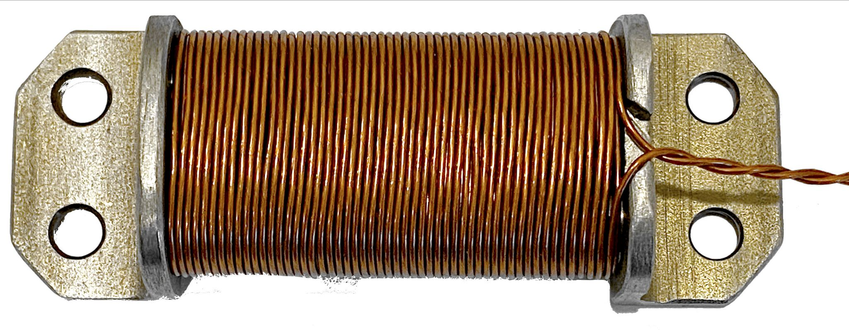
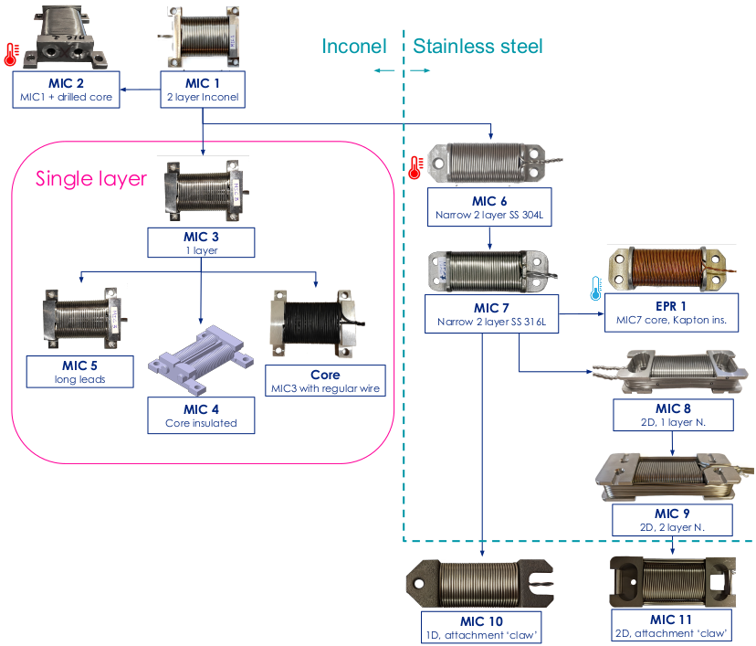


MIC sensor prototyping and optimization
non-MIC
MIC
A. Torres, et al., Mineral insulated cable assessment for inductive magnetic diagnostic sensors of a hot-wall tokamak, JINST, 2019
Torres, K. Kovarik et. al, Test bench for calibration of magnetic field sensor prototypes for COMPASS-U tokamak, Fus. Eng. Des., 168, 2021

Slide 23
Magnetics Data Acquisition Electronics

Slide 24



Magnetic diagnostic – integration
Inductive sensors require integration
Offline this is a simple process
Online it requires dedicated electronics
y=cos(x)
+ 0.03
It is extremely important to minimize integration drift!
… or avoid it completely.
Non-inductive magnetic sensors:
Current shunts ➡ Currents in passive structures Hall probes ➡ Local B FOCS¹ ➡ Plasma current (Ip) MSE² ➡ B pitch (q(r)) ¹ Fiber Optic Current Sensor ² Motional Stark Effect
∫ y dx=sin(x)
+ 0.03 x

Slide 25



Real-time signal integration
Electronic integrators are typically used for real-time integration of the magnetic signals.
These work well for short discharges < 10 s
For longer discharges, this configuration requires precision electronics, complex and frequent calibration procedures.
Adjustments to hundreds of integrators for peak performance!
Wendelstein 7-X – A digital integration approach
W7-X, a stellarator, intended to achieve pulses of 100s of seconds
Straight-up integration of sampled signal not feasible due to many DC offsets
But we can try to cancel them!
A. Werner, Rev. Sci. Inst., 2006

Slide 26

Digital integration with phase modulation
Periodic inversion of the coil signal before sampling
Elimination of the effect of drift inducing DC offsets added in the electronics chain
Enhanced long pulse performance due to low drift
Initially proposed for W7-X, adopted by ITER, implemented at ISTTOK, W7-X
A: Input signal
B: Chopper
C: Sampled
D: DC offset
Advantages
Low-drift integration
Mostly independent from precision analog electronics maintenance or ‘fidgeting’
Can be used as a normal DAS, by turning the switches off by software
Disadvantages
Demodulation artifacts
High dynamic range of magnetic signals
Requires strong filtering
E: Demodulated
F: Integrated
B
C
E
F
ADC module
Input filter
Chopper
Signal conditioning
ADC
FPGA
A
Demodulation
Integration
Decimation
Controller
Memory
D

Slide 27





New generation modules and carrier
Two main components: Module carrier
FPGA (demodulation, integration)
Power distribution
PCIe over fiber
ATCA standard
48 modules
Modules
Analogue signal processing
Modulation
Digitization
Galvanic isolation
2 separate channels
Signal conditioning
ADC 18bit @ 2 MSPS
Chopper
Isolated power supply
Input filter
Digital isolators
A. Torres, et al., “Data acquisition with real-time numerical integration for COMPASS-U magnetic diagnostics”, Fusion Engineering and Design 191, 113580, 2023
J Oliveira, A Torres, et al., Digitizer hardware for magnetic data acquisition on COMPASS-U, EPJ Web of Conferences 288, 03005, 2023
2-channel design

Slide 28


State-of-the-art drift performance
Requirement of 5 μVs/s for integrator drift on COMPASS-U
For comparison, the requirement for ITER is 500 μVs over 1h = 139 nV, 36 times more strict
Tests show a drift of |d| < 50 nVs/s for 90% of the cases (157 nVs/s max)
Great results not only on COMPASS-U timescales but also long pulses (>100 s)
While having high channel density, 20 kHz bandwidth, and modulation artifact reduction
CU
requirement
ITER
requirement
J. Oliveira, A. Torres, et al., " A real-time data acquisition system for the magnetic diagnostic of COMPASS-U" submitted to Plasma Physics and Controlled Fusion, 2026

Slide 29
ELM buffering real-time controller

Slide 30

Edge Localized Modes (ELMs)
MAST fast visible camera (A. Kirk, S. Lisgo, UKAEA)

Slide 31




Edge Localized Modes (ELMs)
J. W. Connor et al, 2008
1-1.5 MW/m²
Energy deposited at the divertor
Not sustainable for powerplant scenarios
Permanent damage of the divertor tiles
Image: UKEA

Slide 32

ELM buffering
ELM buffering:
Inject impurities to dissipate the ELM energy (radiation) before it reaches the divertor
Up to 3x reduction on energy deposited observed using Ar and N₂ seeding
Reference
N2+Ar seeding
Real-time Feedback System
Control the impurity ingress rate balancing power deposition and plasma performance.
N2 seeding
M. Komm, NF, 2023

Slide 33



How to detect ELM energy?
Light from the Balmer lines (Hα or Dα) are the most commonly used signals to detect ELMs. However in arbitrary units.
With the Diamagnetic loop we can measure the drop in the plasma energy associated with the ELM
It was shown that thermoelectric currents in the divertor tiles can be used to estimate the thermal flux
By measuring the current with shunts we obtain a proxy for ELM energy at the divertor
L. Giannone, 2024

Slide 34


Real-time ELM detection
Upgrade of the DAS to 1 MSPS with real-time processing capabilities
Development of a real-time compatible algorithm for fast ELM detection and energy estimation
Causal filter
Differentiation and triggering on derivative
Pre-trigger and debounce windows

Slide 35

Real-time ELM detection
Upgrade of the DAS to 1 MSPS with real-time processing capabilities
Development of a real-time compatible algorithm for fast ELM detection and energy estimation
Causal filter
Differentiation and triggering on derivative
Pre-trigger and debounce windows
Optimization of the detection parameters to minimize false positives and false negatives using independent statistical methods (Shapiro-Wilk test for normality)
Too low threshold, non-ELM events trigger
Too high threshold, many missed ELMs

Slide 36


Real-time ELM detection
Upgrade of the DAS to 1 MSPS with real-time processing capabilities
Development of a real-time compatible algorithm for fast ELM detection and energy estimation
Causal filter
Differentiation and triggering on derivative
Pre-trigger and debounce windows
Optimization of the detection parameters to minimize false positives and false negatives using independent statistical methods (Shapiro-Wilk test for normality)
Implementation on the Discharge Control System: the real-time distributed architecture at ASDEX-Upgrade in Munich
Work on the controller ongoing, with dedicated experiment planned for 2026
Image: B. Sieglin et al, Fus. Eng. Des., 146 (2019)
A. Torres, M. Komm, et al., "Real-time ELM energy estimation on ASDEX Upgrade", under preparation
Front-end electronics for shunts
MTCA crate with fast DAS and RT processing
‘Old’ DAS for offline data acquisition

Slide 37
Key Takeaways
Enabling controlled nuclear fusion – the role of magnetic diagnostics in tokamaks
Physics exploitation on tokamaks and stellarators
Despite extremely simple, the magnetic diagnostic provides vital important to the determination of the magnetic equilibrium, analysis of perturbations and control of the discharge
The magnetic diagnostic development for COMPASS-U was shaped by its unique challenges, specially high temperatures
Low drift integration is essential for future devices with longer discharges …
… in combination with non-inductive sensors
ELM mitigation is needed for high-power devices such as ITER and beyond
We are expanding the diagnostic capabilities of ASDEX-U, by having a real-time ELM energy monitor …
… that will be used for real-time ELM buffering control
Some wires around the device
Adapted from the XKCD comic
https://imgs.xkcd.com/comics/dependency.png
Thank you for your attention!

Slide 38
Backup slides

Slide 39






First some context
Problem: End losses
Solution: Circular symmetry (torus)
Problem: Grad-B separates charges, creates E
Solution(s): Create helical field lines to average the separation to 0
USA: 3D field configuration
Image: PPPL
Figure of 8
Helical field lines
Wendelstein 7-X (2015)
Image: IPP-MPG
Lyman Spitzer – Stellarator (1951)

Slide 40


The tokamak
Problem: Grad-B separates charges, creates E
Solution(s): Create helical field lines to average the separation to 0
USA: 3D field configuration
USSR: Add a poloidal field by driving current
Problem: Plasma current is also curved, so higher magnetic pressure on the inside pushes the plasma outwards
J. P. H. Goedbloed and S. Poedts, 2004
Solution: Vertical field -> J x B inward
Andrei Sakharov and Igor Tamm proposed the tokamak in 1950, in secret.
Only fully shared with the international community at the Second Atoms for
Peace Conference in 1958
A. White 2015
Tokamak T1 (1958)

Slide 41



Plasma magnetic control
Current Position Shape
G. D. Tommasi, Journal of Fusion Energy, 2019
Isoflux
Gap
DIII-D
JET
NSTX-U

Slide 42



Study of Mineral Insulated Cables
MIC from 0.5 to 3.2 mm diameter tested electrically and with induced fields.
Measurement of the attenuation of MIC flux loops against a non-MIC loop on COMPASS.
Data analysis: Spectrograms, power spectra through Welch method, fitting of first order filter.
Fit of first order filter.
Greyed areas ignored in fit
Higher bandwidth
Thinner sheath
A. Torres, et al., Mineral insulated cable assessment for inductive magnetic diagnostic sensors of a hot-wall tokamak, JINST, 2019

Slide 43



Calibration and measurement of frequency response
Effective area calibration – S_{eff}
Long solenoid
40 Hz – 1 kHz
A. Torres, et al., Mineral insulated cable assessment for inductive magnetic diagnostic sensors of a hot-wall tokamak, JINST, 2019
Torres, K. Kovarik et. al, Test bench for calibration of magnetic field sensor prototypes for COMPASS-U tokamak, Fus. Eng. Des., 168, 2021
Frequency response – g(f)
Helmholtz coil
<10 MHz (accurate to 1 MHz)
Fast oscillation sensors: Measurement and modeling of the resonances introduced by the cables connecting to DAQ
Equilibrium sensors:
Quantification of the attenuation and delay introduced by metallic structures
non-MIC
15m coax
MIC
cable element (x10)

Slide 44





Mirnov coils development
Mirnov coils
Intended to detect fast perturbations better than MIC equilibrium coils
Limiting factor is the resonance introduced by the long (~ 30 m) cables
Same alignment method
In-kind contribution from PPPL, developed from the model used in NSTX-U

Slide 45


MIC sensor prototyping and optimization
Signal simulation of COMPASS Mirnov coil with CU equilibrium coil response

Slide 46



Qualification tests on COMPASS
We can recover digitally the attenuated high frequencies, provided the resolution is sufficiently high
This method is real-time compatible or can be applied in post-processing (as was the case) if the raw data is saved.
Detail on high frequency events recovered
Amplification of noise that is not subject to the input filter
Results published in [2]
[1] E. J. Strait, et. al, A hybrid digital–analog long pulse integrator, Rev. Sci. Instrum. 68 (1), 1997
[2] A. Torres, et al., “Data acquisition with real-time numerical integration for COMPASS-U magnetic diagnostics”, Fusion Engineering and Design 191, 113580, 2023

Slide 47


Kirk, et al. PPCF, 2005

