Slide 1
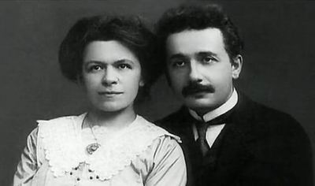
From Collaboration to Oblivion:
The Tragedy of Mileva Marić Einstein
Why was she forgotten?
Pauline Gagnon
1

Slide 2
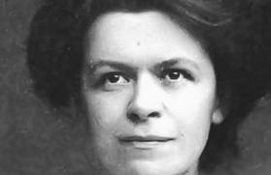
Plan
Examine their 20 year-long collaboration based on existing documents and testimonies
Take into account the historical context and her personal circumstances
The point is not to denigrate Albert Einstein, a flawed human being, but to pay justice to Mileva Marić

Slide 3
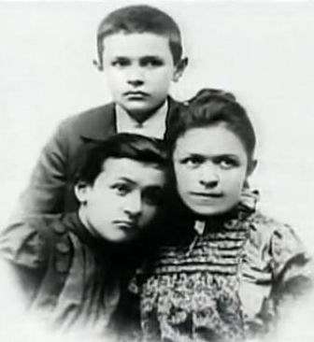
Mileva’s studies
1875: Born in Titel (now in Serbia)
Attended high school the last year girls were accepted
1892: Special authorization to attend physics lectures in Zagreb
1894: Completed her high school degree in Zurich
Miloš (9), Zorka (11) and Mileva (19) in 1894

Slide 4
Mileva’s temperament
Albert’s temperament
Brilliant but reserved
Not talkative
Persistent and determined
Kept going towards her goal
Got to the bottom of things
Inquisitive, bohemian and rebel
Not very disciplined, easily changed his mind
Insolent, sarcastic, mocking
Hated discipline in German schools
Ended his high school studies in Switzerland

Slide 5
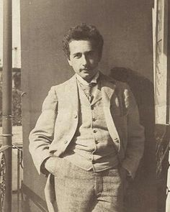
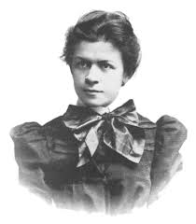
Students admitted to the physics-mathematics section at ETH Zurich in 1896
Albert Einstein (17.5 yrs)
Mileva Marić (21 yrs)
Marcel Grossman (18 yrs)
Louis Kollros (18 yrs)
Jakob Ehrat (20 yrs)
Zurich University was the first German-speaking university to admit women in Europe in 1867
ETH was founded in 1855; first woman in 1871
- same year in the Netherlands
- in 1900 in Baden, in Germany
Mileva was the 5th woman admitted in the math/physics section, first in physics
None had graduated

Slide 6
The beginning of their collaboration

Slide 7
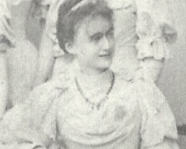
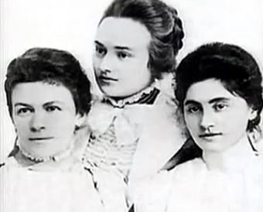
1896-1901 Studies in Zurich
Albert and Mileva shared a passion for physics, music and for each other
Milana and Helene spoke of Albert’s continuous presence at Mileva’s place
Helene Kaufler Savić
Mileva Marić, Milana Bota and Ružica Dražic in 1899

Slide 8

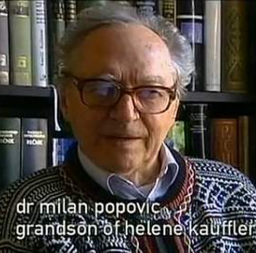
Mileva and Helene Kaufler Savić exchanged letters all their lives

Slide 9

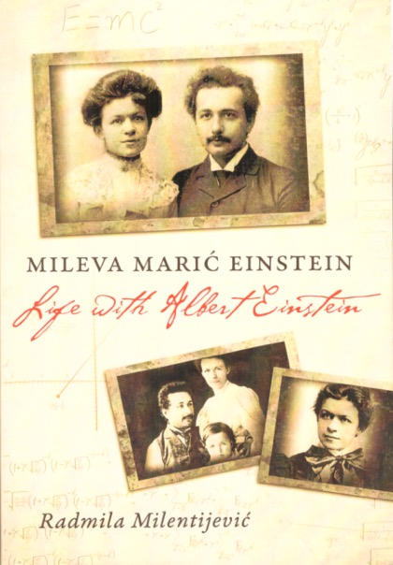
Correspondence from 1897-1903
43 letters from Albert to Mileva
11 letters from Mileva to Albert
Radmila Milentijević notes that Albert’s letters are peppered with terms such as « our new studies », « our research », «our viewpoint », « our theory », « our article », « our work on relative motion».
Renn and Schulmann
Albert Einstein / Mileva Marić
The Love Letters, 1992
Radmila Milentijević Mileva Marić Einstein:
Life with Albert Einstein
United World Press, 2015

Slide 10
Excerpts from Albert’s letters to Mileva
“For the investigation of the Thomson effect, I have again resorted to another method, which has some similarities with yours” – 30 Aug or 6 Sept. 1900
“What about the specific heat of glass …? … See whether you can find some litterature about that.” - 23 March 1901
His friend “Michele… is very interested in our research” - 4 April 1901
“I came up with a wonderful idea, that allows one to apply our theory of molecular forces to gas as well” – 15 April 1901

Slide 11
Excerpts from Albert’s letters to Mileva
“… there is enough empirical material for our investigation in the O. E. Meyer. … I am very curious to see whether our conservative molecular forces will hold true for gases as well… In any case, we will get a quite rigourous test of our view.” – 30 April 1901
“…I gave him our paper.” (his first article on capillarity) - May 1901
“…how lovely it will be when we are able to work again completely undisturbed… Weber once did theoretical work on the motion of heat in metal cylinders... See if you can use the table on this basis. – 4 June 1901
“…according to our theory of molecular forces, ... there must be an approximate proportionality between our constants Σc⍺ and the molecular volumes of the liquids. – 12 Dec 1901

Slide 12
Mileva and Albert always studied together
« When I read Helmholtz for the first time, it seemed inconceivable that you were not with me and now, it is not much better. I find the collaboration very good, curative and also less desicating.» Letter from Albert to Mileva, August 1899
Renn and Schulmann
Albert Einstein / Mileva Marić
The Love Letters, 1992

Slide 13
Mileva was methodical and organized; she helped Albert focus
“… the climate here does not suit me at all, and while I miss work, I find myself filled with dark thoughts – in other words, I miss having you nearby to kindly keep me in check and prevent me from meandering”.
Letter from Albert to Mileva 28 September 1899

Slide 14
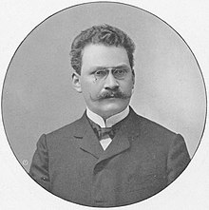
Oral exam - 27 July 1900
Their overall average (written exams):
Albert Einstein: 4,74
Mileva Marić: 4,75
Oral exam: Hermann Minkowski gave 11/12 to all except to Mileva who got 5/12
Albert got his degree but Mileva did not
At ETH in the physics & maths section:
Elizabeth Stephansen, 1st woman PhD in maths in 1902
PhD success rate, 1917-1924: 96,0%
% of women, 1917-1924: 2,7%
Overall grades
Louis Kollros | 5,45
Marcel Grossman | 5,23
Jakob Ehrat | 5,14
Albert Einstein | 4,91
Mileva Marić | 4,00

Slide 15
Albert is without a job July 1900 - June 1902
The 3 other students get an academic position
Albert sends applications all over Europe
He suspects that Prof. Weber is blocking him
Without a job, he refuses to marry Mileva
They give private lessons to make ends meet and « continue to live and work as before. »
Letter from Mileva to Helene Savić

Slide 16
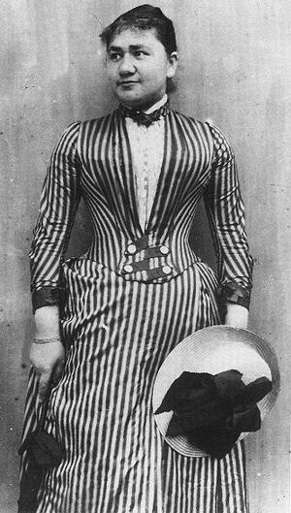
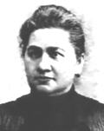
1900: Albert’s mother is opposed to their relationship
She finds Mileva too old:
“By the time you’re 30, she’ll already be an old hag!”
Letter from Albert to Mileva - 27 July 1900
« She cannot enter a respectable family »
Mileva is not Jewish, nor German
She has a limp and is too intellectual
Prejudice against Slavic people
Albert’s father also requests that his son finds work before getting married

Slide 17
Albert confirms their collaboration
« I look forward to resume our new common work. You must now continue with your research – how proud I will be to have a doctor for my spouse when I’ll only be an ordinary man. »
Letter from Albert to Mileva – mid-September 1900
Back to Zurich in October to complete their theses –
they resume their common studies

Slide 18
First article on capillarity submitted on 13 December 1900
“…we’ll try together to get some empirical data on this subject”
Letter from Albert to Mileva – 3 October 1900
“We also sent a copy to Boltzmann and we would like to know what he thinks of it; I hope he will write to us.”
Letter from Mileva to Helene Kaufler Savić – 20 December 1900
Albert’s friend Michele Besso“visited his uncle Prof. Jung on my behalf, one of the most influent physicists in Italy, and gave him a copy of our article.” Letter from Albert to Mileva – 4 April 1901

Slide 19
Why was this article signed by Albert alone?
Did Mileva wish to help promote Albert’s career?
Her own happiness depended on his success
Mileva did not have a degree. She had no credibility.
Krstić thinks that, since so few women published articles in Annalen der Physik, if she had signed it, it could have cast a shadow on his credibility
Dord Krstić: Mileva & Albert Einstein: Their Love and Scientific Collaboration, Didakta, 2004
Being raised in a very patriarchal family, she saw it as her duty to assist her husband
For Mileva, they were one unique entity
In reply to Conrad Habicht: « Warum? Wir beide sind nur ein Stein »,
(« Why? The two of us are just one stone », i.e. we are one unique entity).

Slide 20
Proof of their collaboration from Albert Einstein’s own hand
March 1901: Albert returns to Milan
« How happy and proud I will be when the two of us, together will have brought our work on relative motion to a victorious conclusion! »
Letter from Albert to Mileva – 27 March 1901

Slide 21
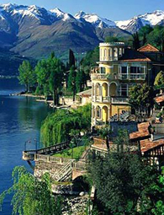
Mileva’s destiny changes
May 1901: love escapade in Lake Como
Mileva gets pregnant
Without a job, Albert refuses to marry her

Slide 22
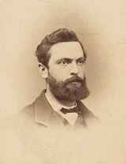
Second chance at the oral exam Summer 1901
Prof. Weber fails her
- Mileva must go back to Serbia
Comes to Bern twice to try to
convince Albert to marry her
Gave birth to Lieserl in January 1902
the child’s trace disappeared in 1903
Mileva will suffer from chronic depression
Prof. F. H. Webe
Prof. F. H. Weber

Slide 23
First job in sight
Albert mentions a post at the Patent Office in Bern, thanks to the intervention of his friend Marcel Grossmann’s father.
Letter from Albert to Mileva – 19 December 1901
« When you will be my little wife, we shall resume diligently our scientific work, such as to not become Philistines. »
Letter from Albert to Mileva – 28 December 1901
Starts work in June 1902.
No mention of marriage, no visit to Lieserl

Slide 24
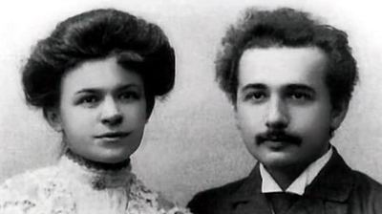
Bern – 1902
Marriage on 6 January 1903

Slide 25
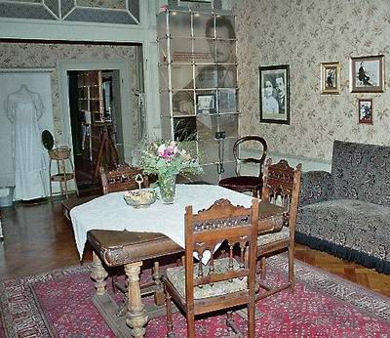
Married life in Bern
Albert works 8 hours a day, 6 days a week at the Patent Office
Mileva assumes the domestic tasks
They work together in the evenings, sometimes late in the night

Slide 26
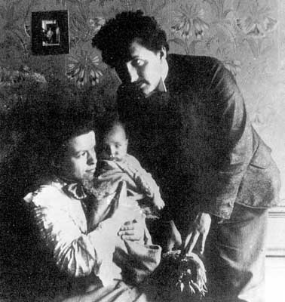
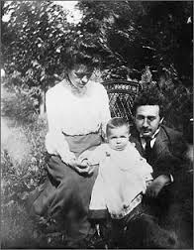
14 may 1904: birth of Hans-Albert

Slide 27
1905
The “miracle year”

Slide 28
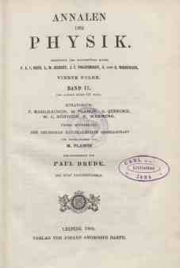
Publications in 1905
Albert signed 5 articles in the Annalen der Physik
Photoelectric effect – Nobel Prize 1921
2 papers on Brownian motion and existence of molecules
Special relativity
Equivalence mass and energy: E = mc²
Also commented on 19 scientific papers in Annalen der Physik
Submitted his doctoral thesis in April on the dimensions of molecules. Received his doctorate degree in July.

Slide 29
Birth of Special Relativity
Three years before his death, Albert Einstein told R. S. Shankland that his work on relativity « had been with him for more than 7 years », and the photoelectric effect, 5 years.
Shankland, Conversations with Albert Einstein, Am. J. Phys. 31, 47 (1963)
His thinking about relativity dates back to 1898, when he and Mileva spent all their time discussing and studying together

Slide 30
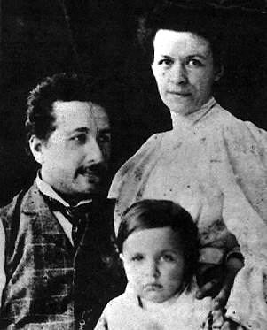
Peter Michelmore, Einstein’s biographer
Michelmore wrote that after having worked five weeks to complete the article containing the basis of special relativity, Albert
« spent two weeks in bed while Mileva read the article over and over before posting it ».

Slide 31
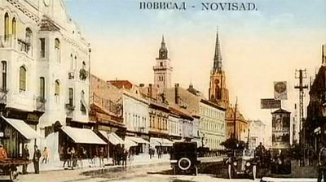
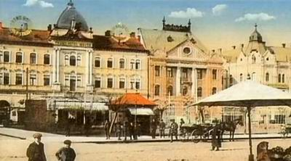
Visits to Novi Sad in 1905,1907 and 1913 Interacted with many people

Slide 32
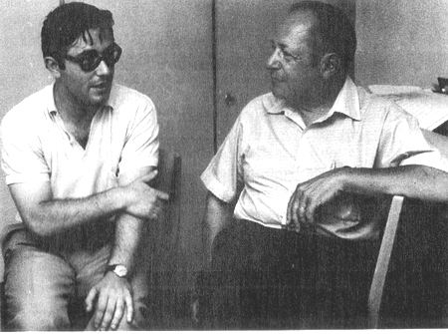
Dord Krstić collected testimonies in Serbia for 50 years
Hans-Albert “told me that this scientific collaboration continued into their marriage and that he remembered seeing his parents work together in the evenings at the same table.”
Dord Krstić with Hans-Albert Einstein in 1971

Slide 33
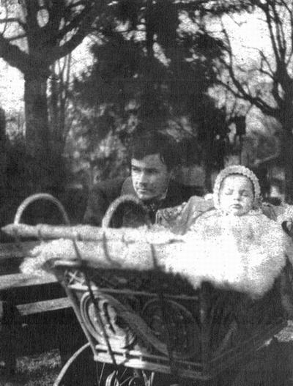
Miloš’ visits in 1904-1905
Dord Krstić writes:
Miloš Marić, who stayed with the Einstein family, had a chance to see close up exactly how Mileva and Albert lived and worked together.

Slide 34
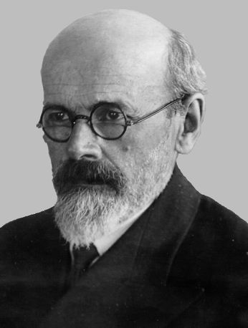
Reports from Miloš Marić Jr.
« He (Miloš) described how during the evenings and at night, when silence fell upon the town, the young married couple would sit together at the table and at the light of a kerosene lantern, they would work together on physics problems. Miloš Jr. spoke of how they calculated, wrote, read and debated. »
Miloš was known for his integrity
Stuck to facts instead of his own opinions
Dord Krstić heard this directly from
Sidonija Gajin in May 1955, then from
Sofija Galić Golubović in 1961.

Slide 35
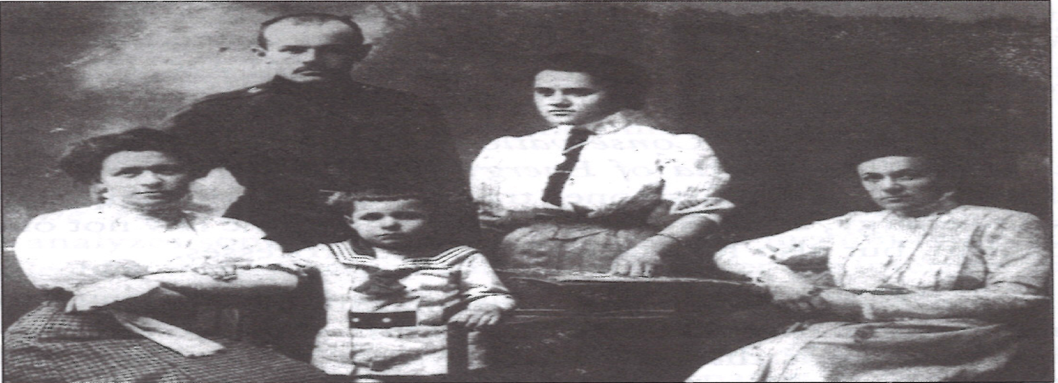
Other testimonies
« Before our departure, we finished an important scientific work which will make my husband known around the world.»
Mileva to her father during their visit to Novi Sad in 1905
Dord Krstić heard this in 1961 from Mileva’s cousin, Sofija Galić Golubović. She was present when Mileva told this to her father.
Simonija Gajin (1955) and Zarko Marić (1961)
reported the same to Krstić.
They had both heard it from Mileva’s father.
front: Mileva, Hans-Albert and Zorka
rear: brother Miloš and Sofija Galić in 1907

Slide 36
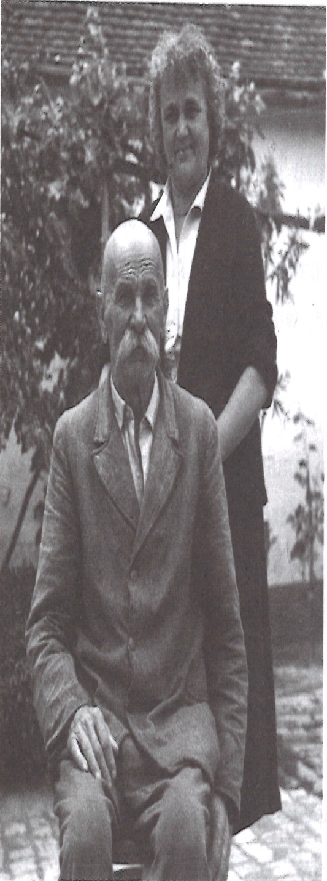
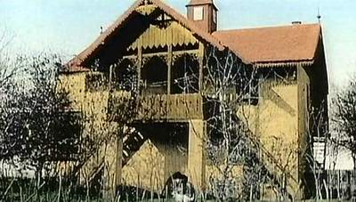
Zarko Marić lived in Villa Kula during both visits in 1905 and 1907
Mileva calculated, wrote and debated with Albert sitting in the shade
Harmony and mutual respect was visible
Zarko Marić and daughter Djurdjinka in 1961
Villa Kula (the tower) in Kać

Slide 37
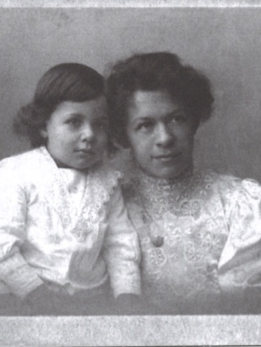
Other testimony
According to Mr. Tapavica, the mayor of Novi Sad, Albert Einstein said:
« I need my wife. She solves all my mathematical problems for me. »
Quoted by Živko Marković and Desanka Djurić-Trbuhović

Slide 38
Albert relies on Mileva’s help for mathematics
Easter 1908: Mileva visits in Serbia
Albert hired Jakob Laub to help him. Laub stayed with him.
“… but he’s doing the calculations, for which I would not have the time, and that’s good.”
Letter dated 17 avril 1908, CP, vol.5, doc. 96

Slide 39
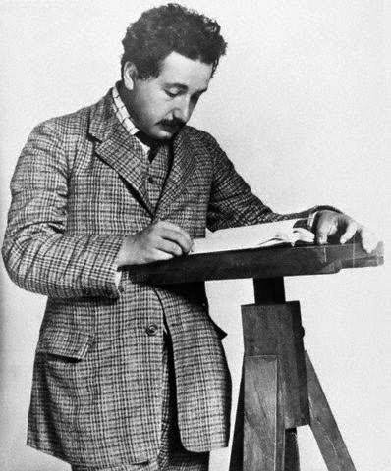
First academic position
Fall 1908: Unpaid lecturer position at Bern University
done after his office job
1909: Kleiner opened a post for him at University of Zurich
28 July 1910: Eduard’s birth
1910-1914: Academic positions in Prague, Zurich and Berlin

Slide 40
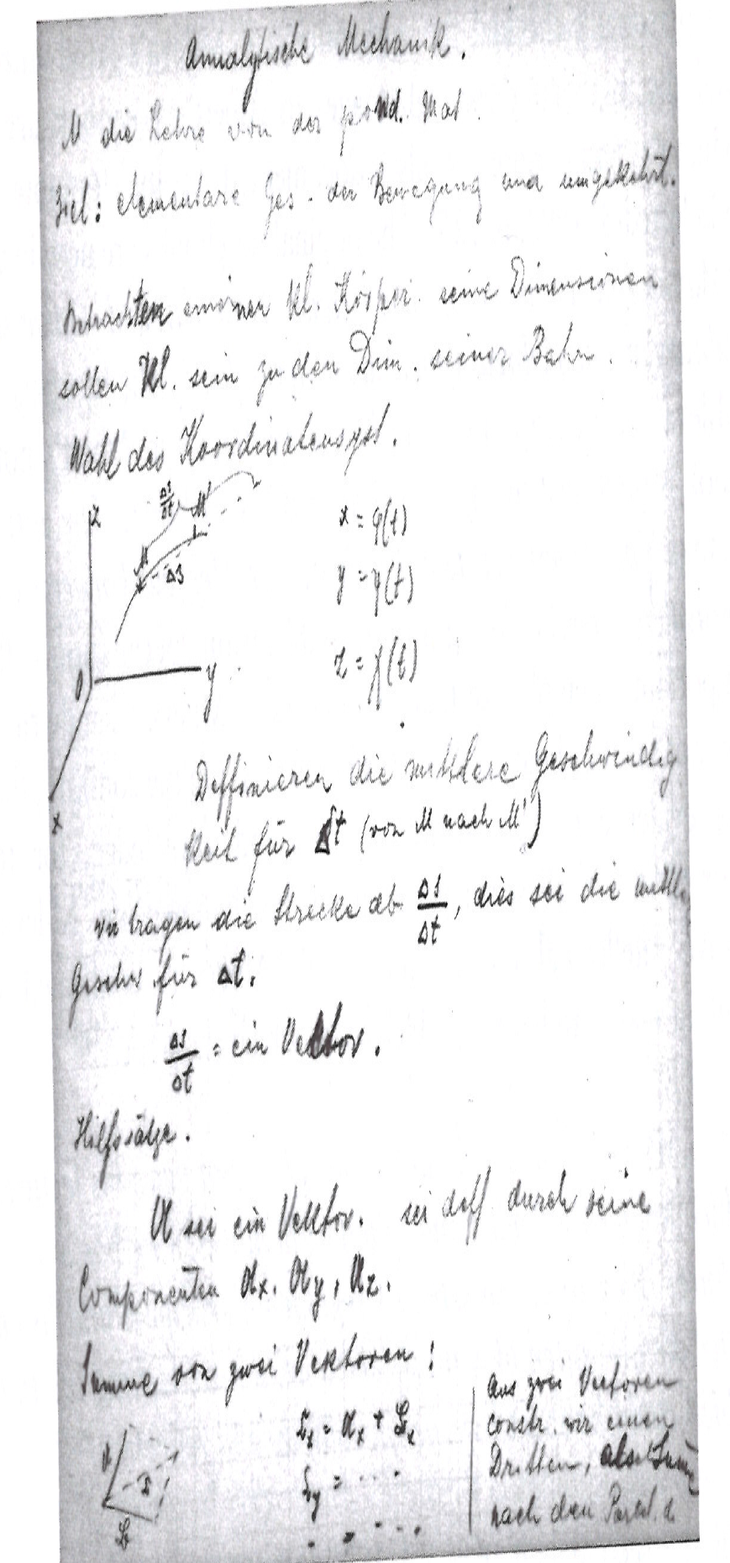
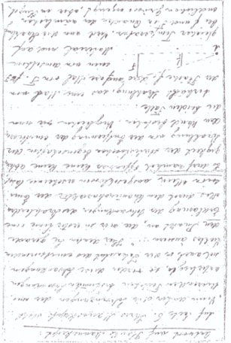
Mileva helps Albert with his first lectures
1909: Eight pages from Albert’s first lectures in Zurich are handwritten by Mileva
1910: Draft of a reply to Max Planck written by Mileva
Albert Einstein Archives of the
Hebraic University in Jerusalem

Slide 41
Success for Albert, worries for Mileva
« He is now regarded as the best of the German-speaking physicists, and they give him a lot of honours. I am very happy for his success, because he fully deserves it; I only hope and wish that fame does not have a harmful effect on his humanity. »
Letter from Mileva to Helene Savić – 3 September 1909
« With that kind of fame, he does not have much time left for his wife. […]But what can you do? One gets the pearl, the other the shell. »
Letter from Mileva to Helene Savić ca. December 1909

Slide 42
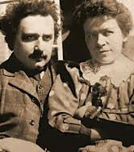
Einstein’s temperament changed
“Given his great discoveries, Einstein felt invulnerable”. His conversation could be “a combination of harmless jokes and hurtful comments”.
Philip Frank, colleague in Prague and biographer
“His growing success filled his soul with a feeling of superiority, and sometimes arrogance bordering hubris.”
David Reichenstein, Albert’s student, quoted by Highfield and Carter, p.127

Slide 43
Success and arrogance for Albert;
Depression and second place for Mileva

Slide 44
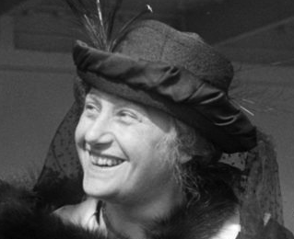
Their relationship crumbles
Up to 1911, Albert and Mileva still exchange affectionate postcards
April 1912: he begins an affair with his cousin Elsa Löwenthal during a visit in Berlin

Slide 45
Albert’s conditions in July 1914
You care:
That my clothes and linen are in good order and in good repair,
That I receive regularly three daily rations in my room,
That my bedroom and study room are properly tidy and also extra, that the writing table is available only for me.
You renounce all personal relations with me, with the exception of necessities owing to social reasons. Especially, you renounce:
From me sitting beside you at home,
To walk or travel together with me.
You are strictly obliged in your relations with me to take into account the following items:
You dare not reproach me that I do not show you tenderness but I also do not expect any from you at all,
You stop any conversation with me, if I do demand so,
You must at once leave my room or my working space upon request.
You will not humble me in front of the children

Slide 46
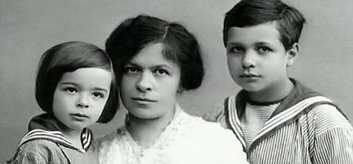
Separation and return to Zurich on 29 July 1914
Eduard, Mileva et Hans-Albert, 1914

Slide 47
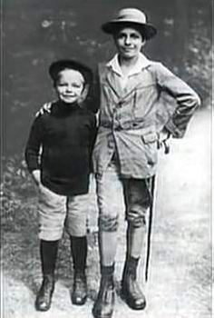
Three decades of misery
Several costly stays in the sanatorium for Eduard
Mileva also has serious health problems in 1916-17
Most of her life, she will struggle financially, except for a short period in the 1920s
Hans-Albert and Eduard ca. 1918

Slide 48
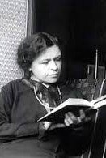
Divorce in 1919
One clause of the divorce agreement states that:
If Albert receives the Nobel Prize, Mileva would get all the money
He would keep the fame, but she could have the money

Slide 49
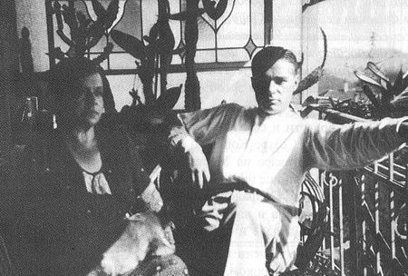
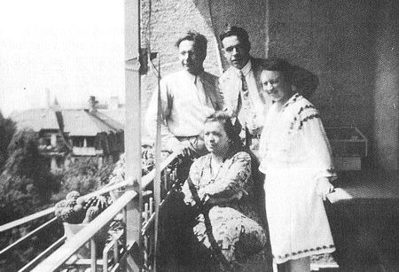
Eduard suffered from schizophrenia starting in his twenties
Often hospitalized all his life and at the end permanently

Slide 50
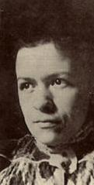
Mileva confided that she had always collaborated with Albert Einstein
To Milana Bota, her friend
reported in Politika in 1929
To Maja Shucan, her student
quoted by Highfield, p. 232
To her godparents, adding that Albert had ruined her life
according to Dord Krstić
To her son Hans-Albert, her mother and sister according to Dord Krstić

Slide 51
Attempt to claim her share
In 1925, Albert wrote in his will that the money from the Nobel Prize was his sons’ inheritance
Mileva strongly opposed this, stating this money was hers and may have considered proving she had contributed to his work.
«But you really gave me a good laugh when you started threatening me with your memories. Doesn’t it ever dawn upon you for even a single second that no one would pay the least attention at all to your rubbish if the man with whom you are dealing had not perchance accomplished something important? When a person is a nonentity, there’s nothing more to be said, but one should then be modest and shut up. I advise you to do so. »
« Not only children need a bit of thrashing but also grownups and especially women.»
Letter from Albert to Mileva – 24 October 1925
Quoted by Radmila Milentijević, AEA 75-634

Slide 52
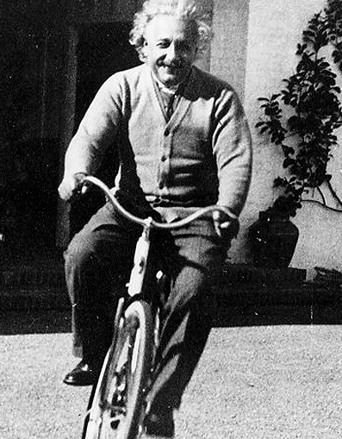
The Einstein Myth
Helen Dukas, Albert’s secretary (1928-55)
Otto Nathan, economist, friend and executor of Albert’s estate
Both tried to hide Mileva’s existence
Nathan « visited » Mileva’s apartment after her death
Prevented Hans-Albert from publishing his parents’ letters
Blocked it until their death
(1982 and 1987)

Slide 53
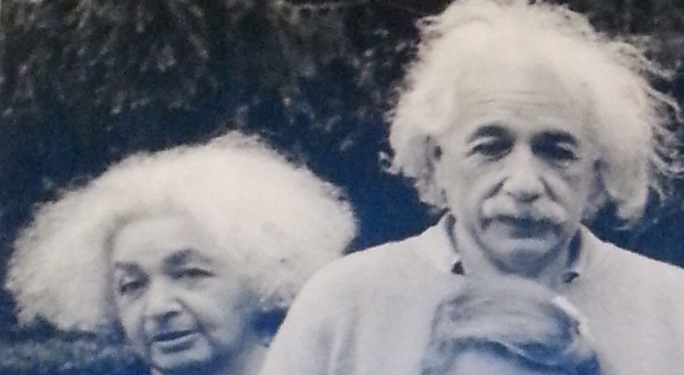
Another myth
Maja and Albert Einstein in 1953
53

Slide 54
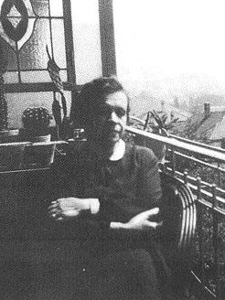
Fame for Albert
but
oblivion for Mileva

Slide 55
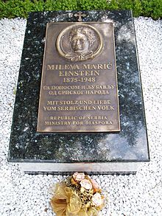
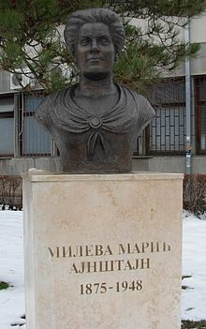
Mileva died on 4th Aug 1948 Memorials in Zurich and Novi Sad
With pride and love, the people of Serbia

Slide 56
Conclusion

Slide 57
Proofs of their collaboration
Clearest evidence comes from Albert’s own hand:
« our work on relative motion »
Looking at how they interacted and worked together:
by today’s standards, they would be scientific collaborators
Hand-written documents from Mileva’s hand:
letter to Planck, lectures note in Zurich
Numerous testimonies:
Hans-Albert, Milana Bota, Maja Shucan, friends and family in Novi Sad

Slide 58
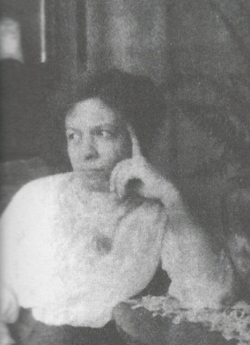
Indirect proofs
Nobel Prize money given to Mileva
Decline in Albert Einstein’s productivity and creativity after their separation

Slide 59
Albert’s bad conscience
«When the house is sold, when [Eduard] has a reliable tutor and when Mileva is no longer here, I'll be able to live in peace»
Letter from Albert to Dr Karl Zürcher - 29 July 1947

Slide 60
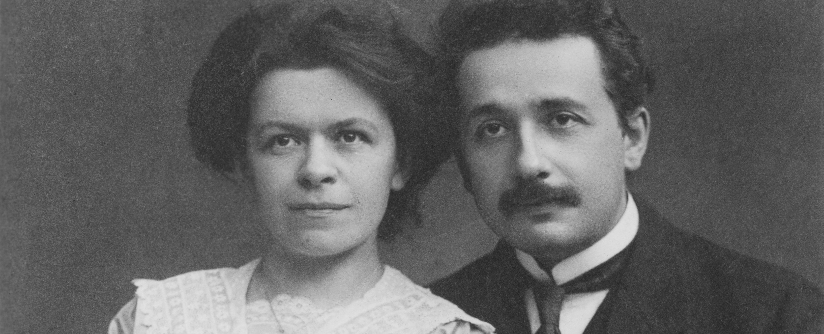
My opinion
Union based on love and respect
Together, they produced uncommon work
their individual contributions will never be known
Mileva was the first person to recognize Albert’s talent
Without her emotional and intellectual support, he would never have succeeded
Given her patriarchal upbringing, she merged her own aspirations with his, and saw his success as their shared success – they were ein Stein
The more it went on, the more he had to lose

Slide 61
Why did she remain silent?
Reserved
Not after honour and fame
It was her duty to support her husband
She always loved him
She had no degree
so no legitimacy

Slide 62
The lone genius A couple of genius
Eclipsed
Limited TV series on Mileva
Marić Einstein
and other women scientists

Slide 63
We cannot change history…
…but we can acknowledge the errors of the past and pay justice.
Following Gabriella Greison’s initiative, I also asked ETH to grant a posthumous degree to Mileva Marić Einstein and to the four other women who were denied a degree before 1902.
You too can write to the Rector at ETH:
guenther.dissertori@sl.ethz.ch

Slide 64
How can you help?
Put pressure on ETH to grant Mileva Marić a degree
guenther.dissertori@sl.ethz.ch
Name a lecture hall or a building after Mileva Marić
Tell your students, colleagues and friends about her
If you are organizing a conference, include a talk on Mileva Marić

Slide 65

Radmila Milentijević
wrote the
best biography of
Mileva Marić
Many ressources on
my web site:
https://paulinegagnon3.wixsite.com/boson-in-winter/mileva-maric-einstein

Slide 66
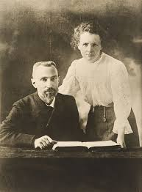
Maria Skłodowska-Curie
Maria was born in 1867, Mileva in 1875
1895:
Pierre and Marie married
Pierre got his PhD and a professor position
1898-1902:
32 papers jointly or separately
1903:
Marie got her PhD
Pierre insisted that if Marie did not receive the Nobel Prize with him, he would refuse the prize.

Slide 67
Main References
Radmila Milentijević:
Mileva Marić Einstein:
Life with Albert Einstein
United World Press, 2015
2. Renn and Schulmann
Albert Einstein / Mileva Marić
The Love Letters, 1992
3. The Collected Papers of Albert
Einstein, Princeton University, 1987
https://einsteinpapers.press.princeton.edu/
4. Dord Krstić: Mileva & Albert Einstein: Their Love and Scientific Collaboration, Didakta, 2004
5. Milan Popović:
In Albert’s Shadow, the Life
and Letters of Mileva Marić,
Einstein’s First Wife
2003, The John Hopkins
University Press
6. Desanka Trbuhović-Gjurić
Mileva Marić Einstein: In Albert Einstein’s shadow (Serbia, 1966). In German, 1982 and French, 1991).
Notes:
https://einsteinpapers.press.princeton.edu/

Slide 68
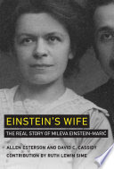
Recent attacks
Attack older and minor work; barely mention Radmila Milentijević (2013)
Claim that Mileva’s academic records were poor
Systematically reject all testimonies from Serbs but cite Einstein’s friends and family –clear ethnic bias
No mention of Helen Dukas and Otto Nathan
Distort the letters’ contents and facts
Pose as great defenders of women in science
Published by MIT Press with a huge publicity campaign

Slide 69
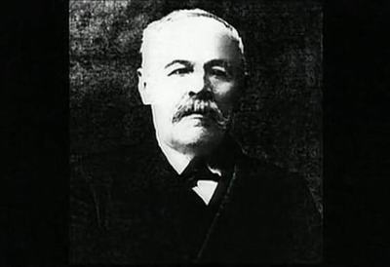


Mileva’s family
Miloš Marić
(1846-1922)
Marija Ruzić
(1846-1935)
Zorka
(1883-1938)
Miloš
(1885-1944)
Mileva
(1875-1948)

Slide 70


Albert’s family
Hermann Einstein
(1847-1902)
Pauline Koch
(1858-1920)
Père
Milos Marić
(1846-1922)
Mère
Marija Ruzić
(1846-1935)
Soeur
Zorka
(18XX-19XX)
Frère
Milos
(1885-1944)
Mileva
(1875-1948)
Maja
(1881-1951)
Albert
(1878-1955)

Slide 71
Academic records ETH (highest grade: 6)
1896-1897 | Mileva |  | Albert |  | 1898-1899 | Mileva |  | Albert
Calculus & diff. equations | 4,5 | 4,5 | 4,5 | 5 | Electrotechnical lab |  |  | 6
Analytic geometry | 4,5 |  | 5 |  | Physics practicum | 5 |  | 1
Descriptive geometry | 4,5 | 4 | 4,5 | 4 | Scient. Projects in physics lab |  | 5 |  | 5
Projective geometry |  | 3,5 |  | 4,5 | Determination of geographical location |  | 5 |  | 4,5
Mechanics |  | 4,5 |  | 5
1897-1898 | Mileva |  | Albert |  | 1899-1900 | Mileva |  | Albert
Differential equations |  |  | 5.0 |  | Scient. Projects in physics lab | 6 | 5 | 6 | 5
physics |  | 5 | 5,5 | 5 | Geometry of position | 5
Mechanics |  |  | 5,5
Projective geometry |  |  | 4 |  | Summer 1901 | Mileva |  | Albert
 |  |  |  |  | Determination of geographical location | 5
 |  |  |  |  | Scient. projects in physics lab | 5

Slide 72

Declaration from Milana Bota
Mileva was « the person to provide information about the genesis of [Einstein’s relativity] theory, since she herself participated in its creation.» Milana based her statement on what Mileva herself had told her “but in pain.”
Interview given by Milana Bota to a Serbian newspaper, Vreme, in 1929
as quoted by Radmila Milentijević, p. 127
« Such publications in newspapers do not suit my nature at all, but I believe that all that was for Milana’s joy, and that she probably thought that this would also be a joy for me, and I can only suppose that she wanted to help me receive some public rights with regard to Einstein.»
Letter from Mileva to Helene Savić – 13 June 1929

