Slide 1
Proposal for a multi-purpose light-ion linear accelerator for nuclear, medical, and applied research
Presenter: Lazar Nikitovic

Slide 2
Table of contents
1
Pre-Conceptual Design Report
2
Main Components of the Linear Accelerator
3
Research Programs
4
Future Developments and Opportunities

Slide 3
Pre-conceptual design report
Part 1

Slide 4
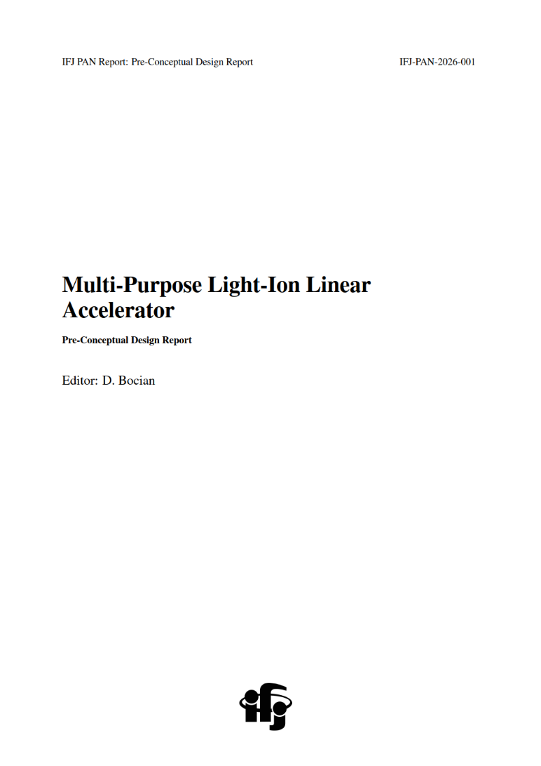

Pre-Conceptual Design Report
Preparation of the pre-Conceptual Design Report (pCDR) for a multi-purpose light-ion linear accelerator is underway;
First draft of the pCDR expected by November 2026.

Slide 5
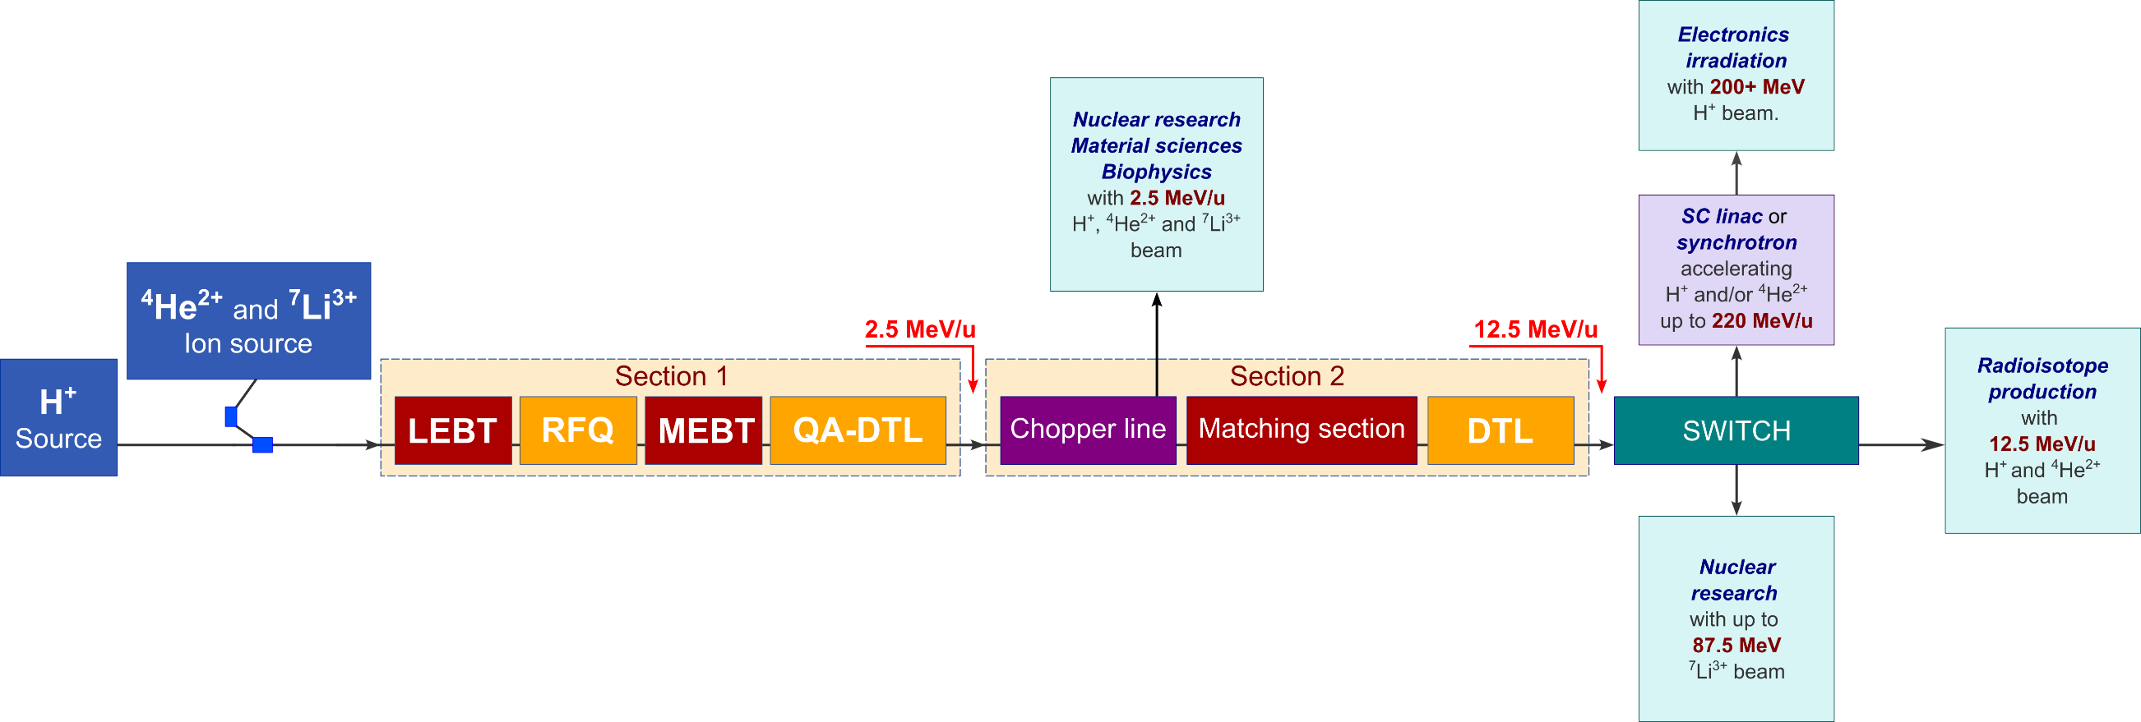
Proposed linac layout
Proposed layout (see Figure):
  Ion sources,
  Beam bunching and pre-acceleration section (Section 1),
  Chopper line and main accelerating section (Section 2), and
  Experimental halls for research programs.

Slide 6
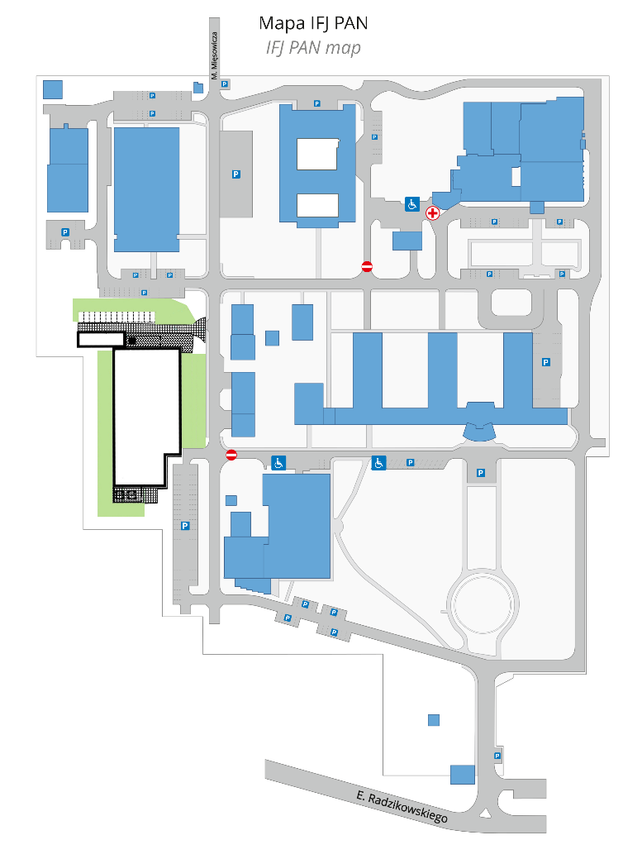
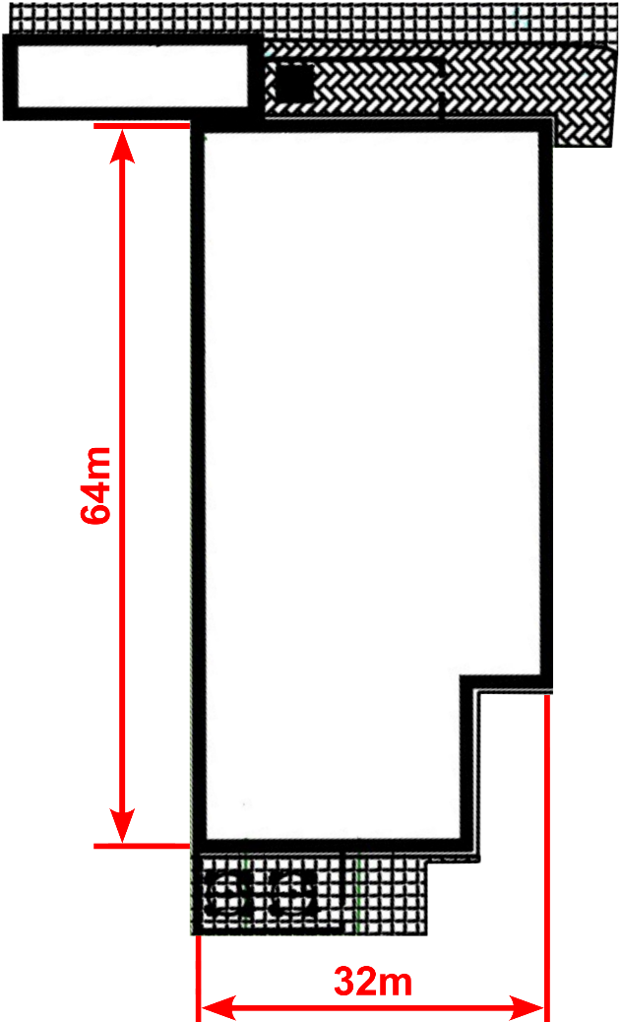
Available space for the linac at ifj pan
The complete linac is estimated to be under 30 m long;
A ~2000 m² site at IFJ PAN is available as a potential location for the facility.

Slide 7
Main components of the linear accelerator
Part 2

Slide 8
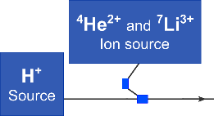
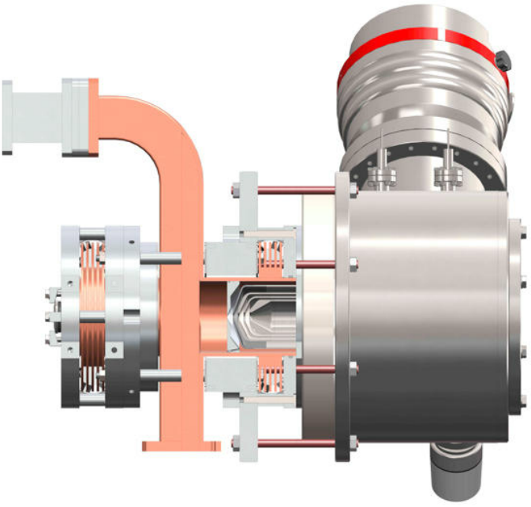
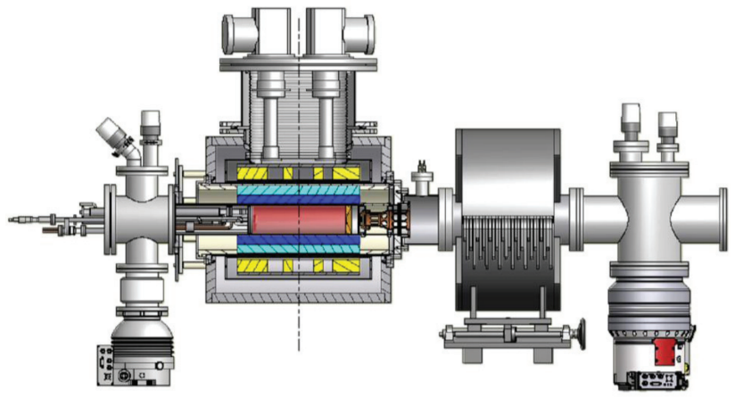
Ion sources
Monogan M-1000
AISHa
Pantechnik, France,
20 mA of protons,
0.2 π·mm·mrad.
INFN-Catania, Italy,
5.4 mA of alphas (⁴He²⁺),
0.42 π·mm·mrad.
0.2 mA of ⁷Li³⁺,
~0.1-0.2 π·mm·mrad.
* Geebee International, Monogan M-1000 – ECR ion source specifications, https://www.geebeeinternational.com/products/accelerator-systems/ion-sources/monogan-m-1000-specifications.html.
* L. Celona et al., Design of the AISHa Ion Source for Hadron Therapy Facilities (ECRIS2012, Sydney, Australia). Sep. 2012.

Slide 9
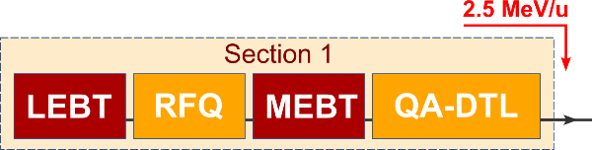
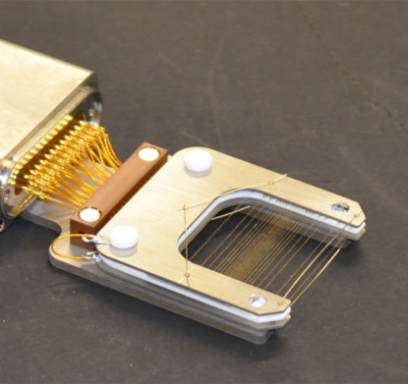
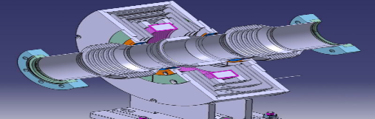
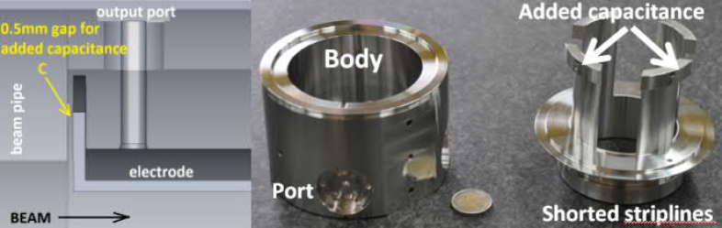
Beam Transfer lines – LEBT and MEBT
LEBT and MEBT will be equipped with beam diagnostics to monitor key parameters: intensity, position, transverse profile and emittance;
Purpose:
  Compare calculated and measured beam parameters during commissioning,
  Monitor and tune beam parameters during regular operation.
Considered instrumentation:
  Faraday cup – total beam current (destructive),
  Beam current transformer (BCT) – total beam current (non-destructive),
  Beam position monitor (BPM) – transverse beam position,
  Wire grid – transverse profile,
  Pepper-pot – transverse emittance.
(Wire grid, used for transverse profile measurements)
(Beam current transformer)
(Beam position monitor)
* M. Vretenar et al., Linac4 Design Report (CERN Yellow Reports: Monographs). Sep. 2020, vol. 6/2020.

Slide 10
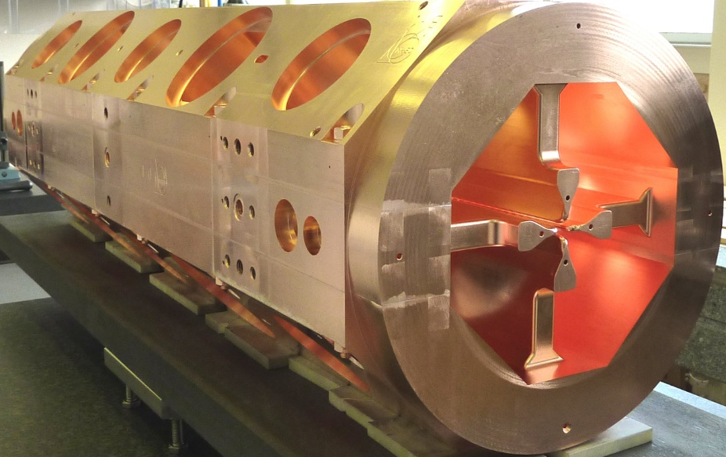
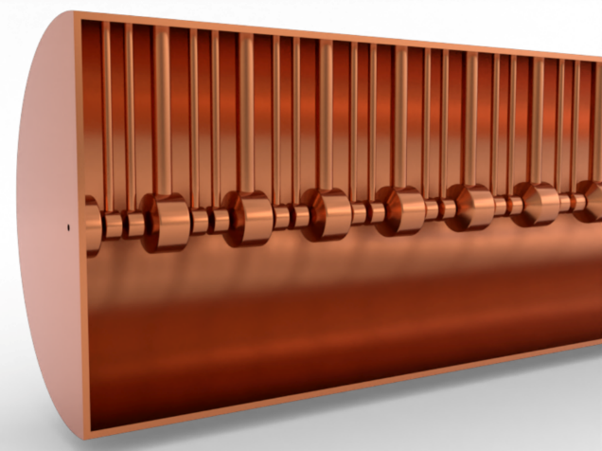
Section 1 – RFQ and QA-DTL
Radio-Frequency Quadrupole (RFQ)
Quasi-Alvarez Drift Tube Linac (QA-DTL)
Beam bunching,
Initial acceleration.
Acceleration of low-velocity ions,
Keeps the RFQ short → reduces cost.
* S. Mathot et al., Mechanical Design, Brazing and Assembly Procedures of the Linac4 RFQ (IPAC2010, Kyoto, Japan). May. 2010.

Slide 11
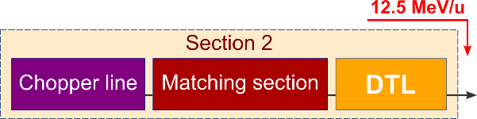
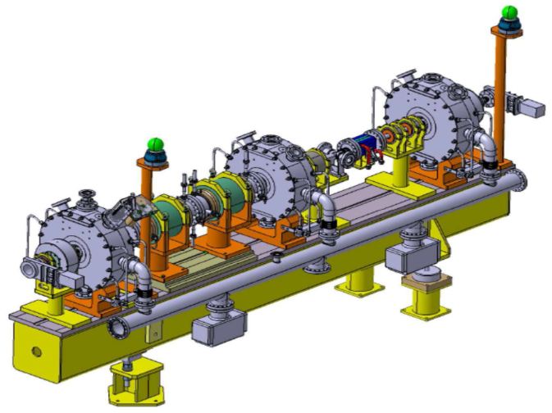
Section 2 – Chopper line & matching sections
Foreseen components of the chopper line and matching sections:
  Upstream matching section (4 quadrupoles & 1 bunching cavity),
  Beam chopper (2 quadrupoles with chopper plates),
  Transport line for chopped beam (bunching cavity, quadrupole & beam dump),
  Downstream matching section (4 quadrupoles & 1 bunching cavity).
* M. Vretenar et al., Linac4 Design Report (CERN Yellow Reports: Monographs). Sep. 2020, vol. 6/2020.

Slide 12
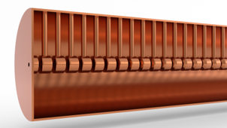
Section 2 – DTL
Alvarez Drift Tube Linac (DTL)
Main accelerating cavity;
Follows the chopper line;
Requires a matching section at its entrance;
Accelerates the desired particles (H⁺, ⁴He²⁺ and ⁷Li³⁺) up to 12.5 MeV/u;
Electromagnetic over permanent magnet quadrupoles → tunable focusing gradients during operation (required when switching between ion species).

Slide 13
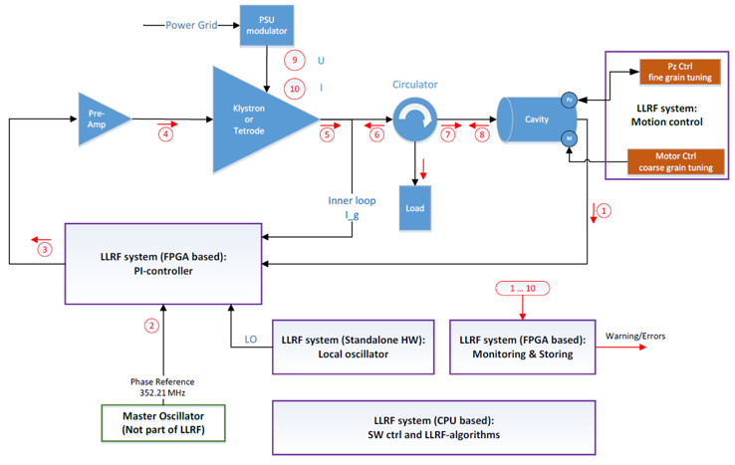
RF Power generation and Low-level RF system
* K. Klys et al., EPICS Based Tool for LLRF Operation Support and Testing (ICALEPCS2023, Cape Town, South Africa). Oct. 2023.

Slide 14
Research programs
Part 3

Slide 15
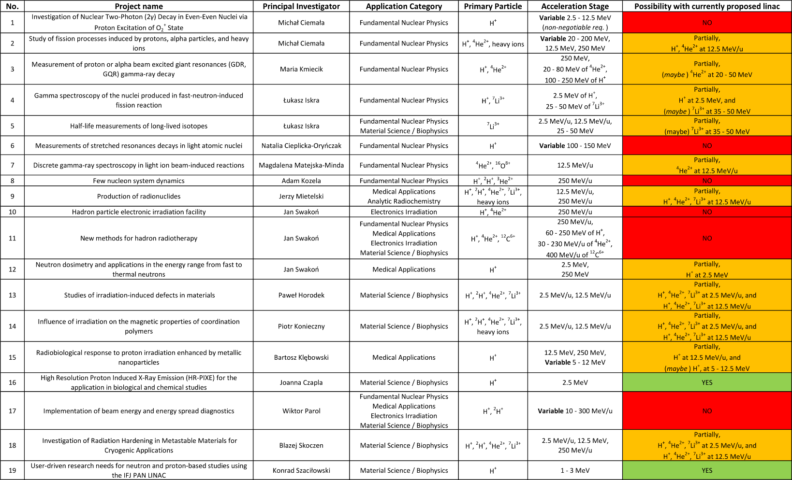
Research Proposals and their feasibility
A collection of 19 project proposals from 15 principal investigators at IFJ PAN, spanning fundamental nuclear physics, medical applications, materials science/biophysics, electronics irradiation, and radiochemistry!
Proposals cover all major research directions, confirming a need for a versatile light-ion facility;
13 of 19 proposals (~68%) are fully or partially feasible with the currently proposed linac (H⁺, ⁴He²⁺, ⁷Li³⁺ at 2.5 and 12.5 MeV/u);
Deuterons (²H⁺) recur across several proposals;
The 6 currently unfeasible projects require higher energies (~100-300 MeV), continuously variable energy, or additional ion species (e.g. ¹²C⁶⁺) → precisely the capabilities of the planned future upgrade.

Slide 16
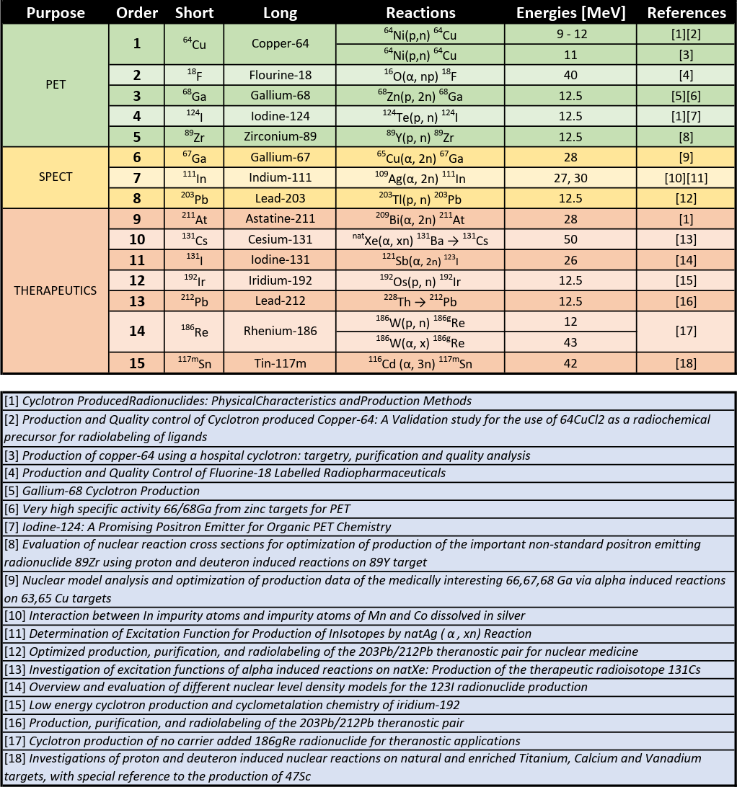
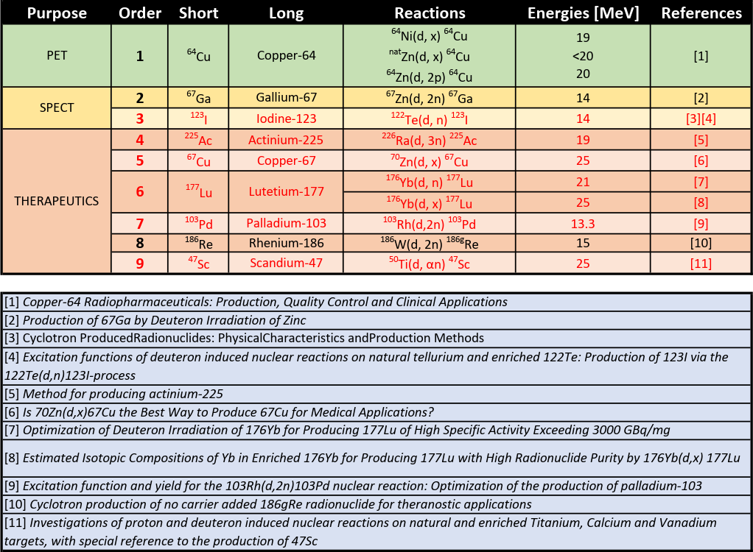
Radioisotope production (Medical application)
High-intensity H⁺ and ⁴He²⁺ beams cover the radioisotopes listed in the left table;
Adding a ²H⁺ source in the future would extend production to those marked in red (right table);
Both ²H⁺ and ⁴He²⁺ have the same q/m → no linac modification needed.

Slide 17
Future developments and opportunities
Part 4

Slide 18
Future Developments and Opportunities
Deuteron (²H⁺) acceleration → additional radioisotopes (same q/m as ⁴He²⁺ - no linac changes);
Facility upgrade via superconducting linac or synchrotron → accelerate H⁺, ⁴He²⁺ and ⁷Li³⁺ ions to higher energies (up to several hundred MeV);
Higher energies → broader research programs;
Neutron production station (12.5 MeV protons on Be or Li target) → Boron Neutron Capture Therapy (BNCT) or neutron-diffraction oriented research.

Slide 19
Conclusions
A compact (< 30 m), multi-purpose light-ion linac (delivering H⁺, ⁴He²⁺ and ⁷Li³⁺ up to 12.5 MeV/u) can be realized on the available site at IFJ PAN.;
The concept is demand-driven → it already addresses approximately two-thirds of the research proposals gathered across the institute, spanning nuclear, medical, and applied research;
A clear upgrade path (a deuteron source, and a superconducting linac or synchrotron reaching several hundred MeV) extends coverage to the remaining proposals without redesigning the baseline;
Next step → completion of the pre-Conceptual Design Report, with a first draft expected in November 2026;

Slide 20
Thank you for your attention!

