Slide 1
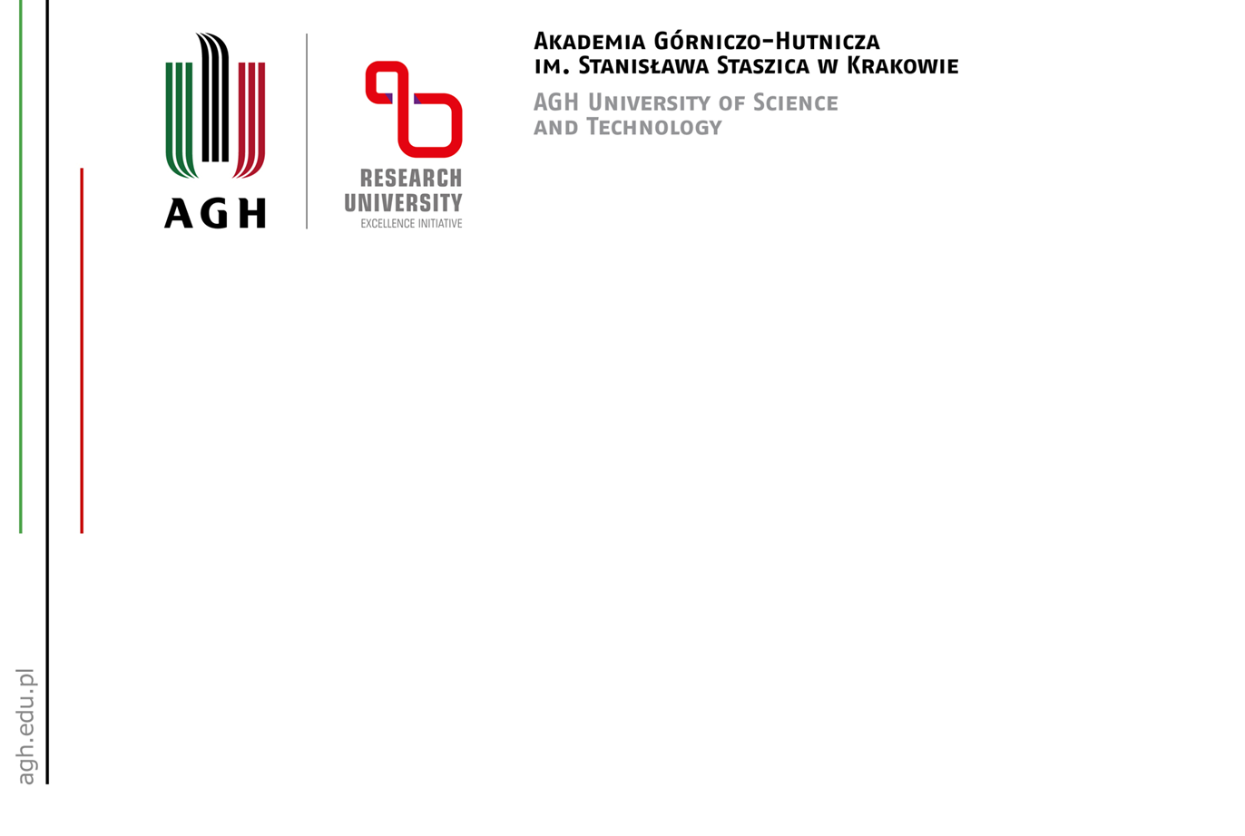

Reseach Programmen for Linear Accelerator:
Interests from the AGH University of Krakow
Marianna Marciszko-Wiąckowska
Konrad Szaciłowski
Academic Centre for Materials and Nanotechnology
AGH University of Krakow
May 27th, 2026

Slide 2
Main objects of study
Ceramic materials
Metals and metal alloys
Semiconductors
Superconductors
Topological insulators
Polymers
Nanoparticles/nanomaterials
Biomaterials & biological samples
Art and heritage objects

Slide 3
Principal technique of interest:
Thermal neutron powder diffraction
Key beamline for structural studies: thermal neutrons:
Wavelenght 1.0 – 3.7 Å (most commonly used λ ≈ 2.3 Å,
second harmonics (1.15 Å)
Beam intensity at sample: ~10⁵ n/(cm²·s) for λ = 2.3 Å

Slide 4
Principal technique of interest:
SANS + neutron imaging
Key beamline for structural studies: cold and thermal neutrons
Wavelenght:
λ ≈ 0.5 – 4 Å (for diffraction studies),
λ ≈ 2 – 20 Å (for SANS),
Beam intensity at sample: ~10⁵ n/(cm²·s) for λ = 2.3 Å
Scattering vector:
up to 25 Å⁻¹ for structural studies,
10⁻³ – 1 Å⁻¹ for SANS

Slide 5
Principal technique of interest:
SANS + neutron imaging
Potential applications in biological research:
SANS measurements to study the distribution of water in tissues (e.g., cartilage or brain sections);
neutron tomography and 3D imaging, enabling the analysis of hydration distribution as well as diffusion and water transport processes over time;
the possibility of investigating the organization of proteoglycans and changes in the collagen network.

Slide 6
Principal technique of interest:
Neutron spectroscopy
Key problems to be addressed:
Slow molecular dynamics (polymers, biological samples)
Phonon structure of solid state
Inelastic scattering and high excited states
Wavelenght:
λ ≈ 3 – 10 Å (slow dynamics),
λ ≈ 1 – 3 Å (phonon structure),
λ ≈ <1 Å (inelastic scattering, high energy excitations),
Beam intensity at sample: ~10⁸ – 10¹² n/(cm²·s)
Scattering vector:
up to 25 Å⁻¹ for structural studies,
10⁻³ – 1 Å⁻¹ for SANS

Slide 7
Principal technique of interest:
Particle‑Induced X‑ray Emission
Key problems to be addressed in micro-PIXE:
Ceramics: Determination of trace impurities, study of elemental homogeneity
Semiconductors: Measurement of dopant distribution, detection of ultra-trace impurities, thin film and layer composition analysis
Superconductors: Determination of stoichiometry, mapping of elemental inhomogeneities
Biomaterials & Biological Samples: Mapping of trace elements in tissues (e.g. Fe, Zn, Cu), study of metal distribution in cells and organs, analysis of implant-tissue intyeractions
Art and Heritage Objects: Non-destructive analysis of pigments and paints, authentication of artworks, provenance studies (origin of materials), analysis of ancient coins, glass, pottery

Slide 8
Principal technique of interest:
Particle‑Induced X‑ray Emission
Key beam parameters for micro-PIXE
Proton Energy 1 – 3 MeV
Beam current: 10 pA – 10 nA
Spot size: 1 – 10 µm
Proton flux: 10⁶ – 10⁹ protons/s

Slide 9


