Slide 1

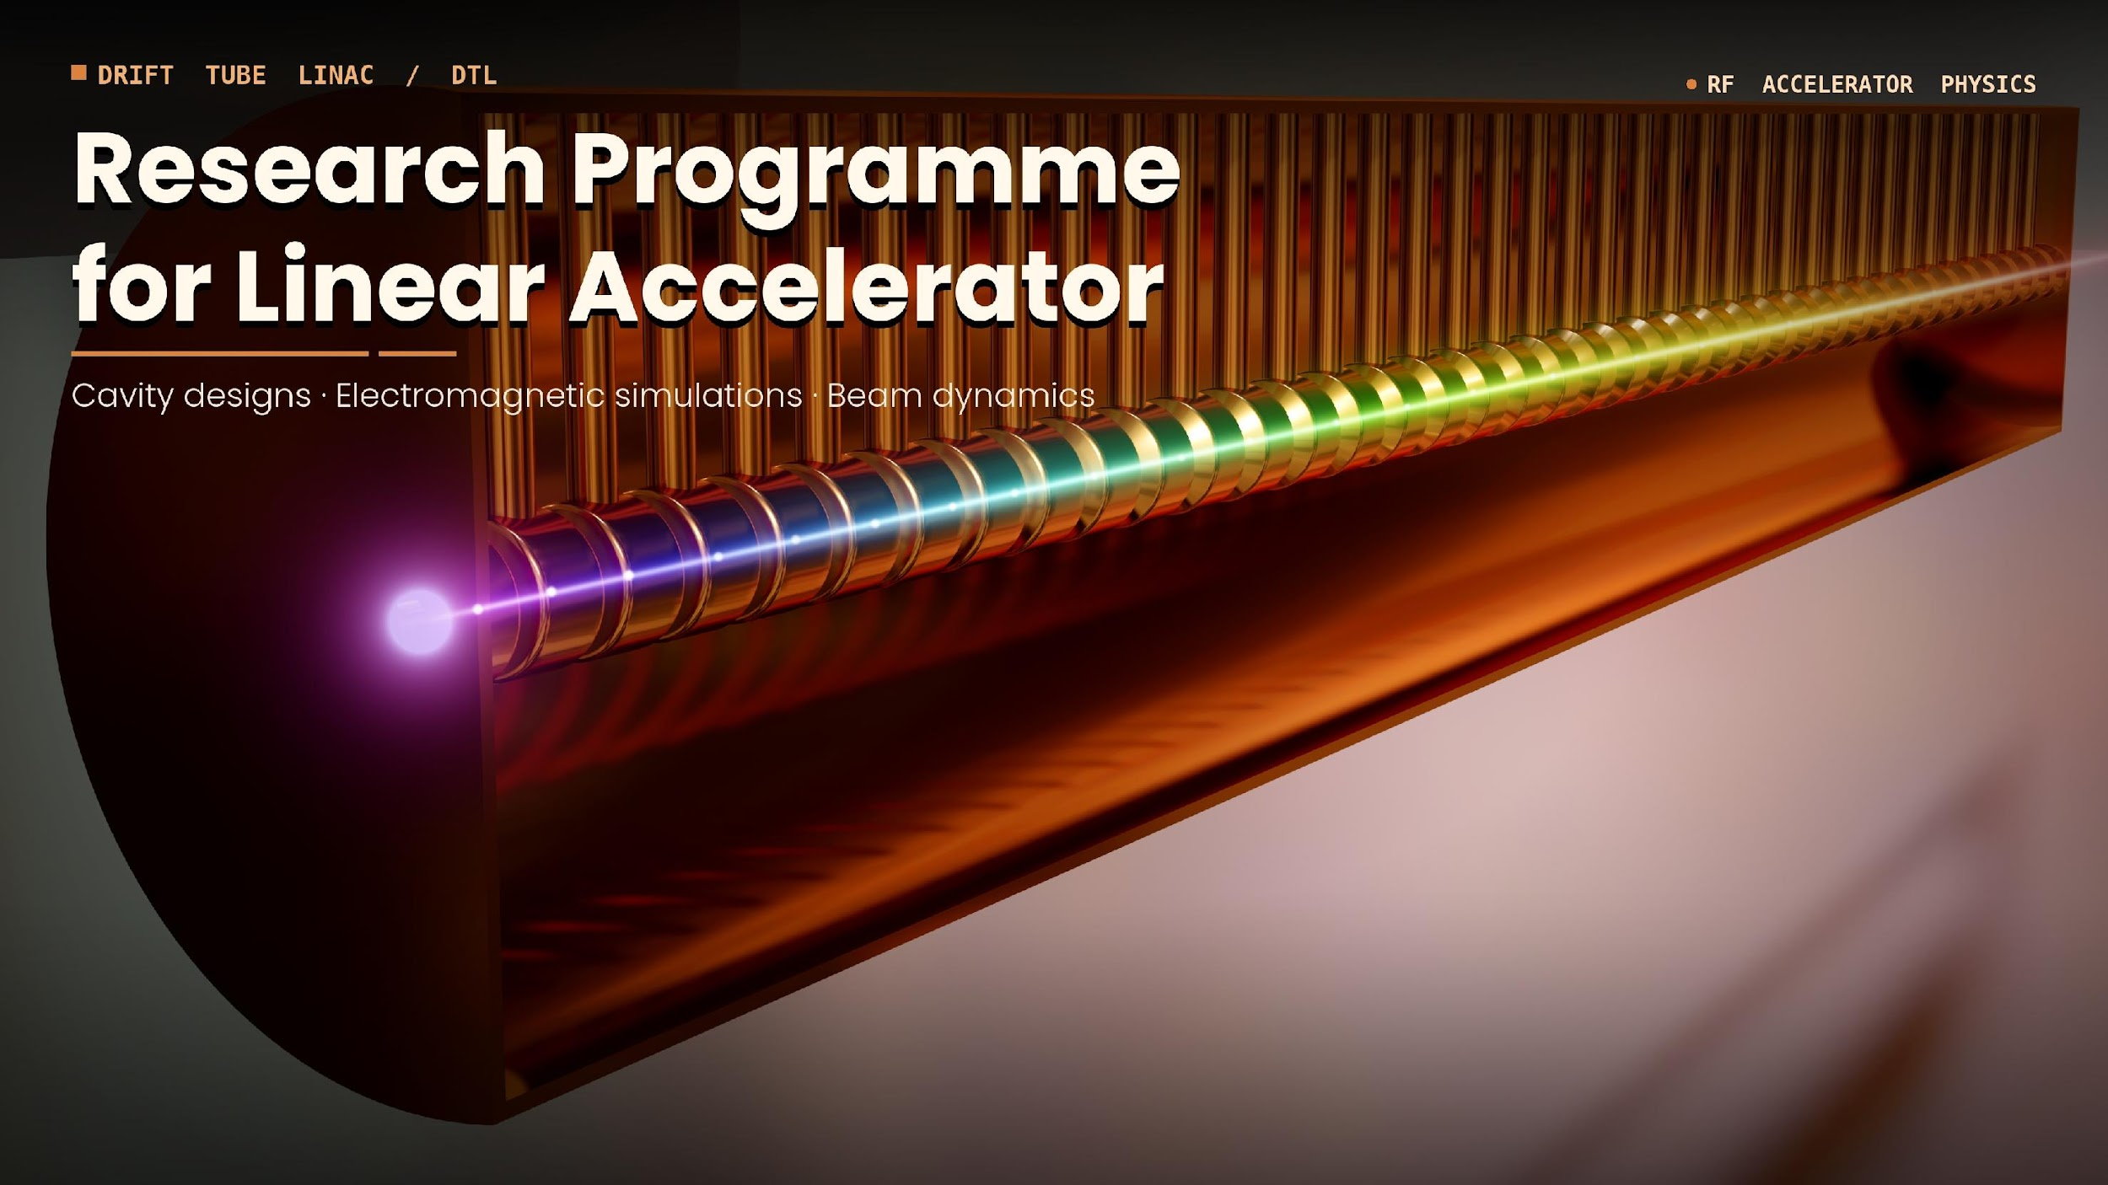
Implementation of beam energy and energy spread diagnostics
W. Parol, P. Kulessa, A. Kozela
2nd Workshop on Research & Innovation in Poland
IFJ PAN, Krakow, 26-27 May, 2026

Slide 2
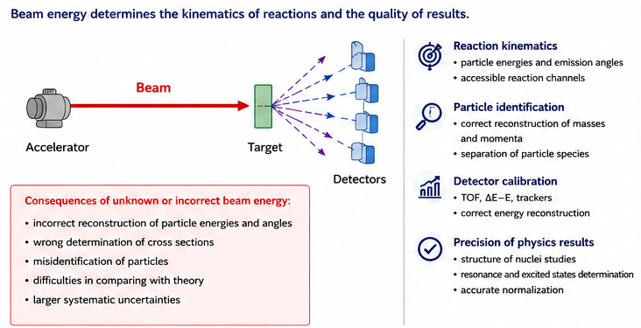
Motivation

Slide 3
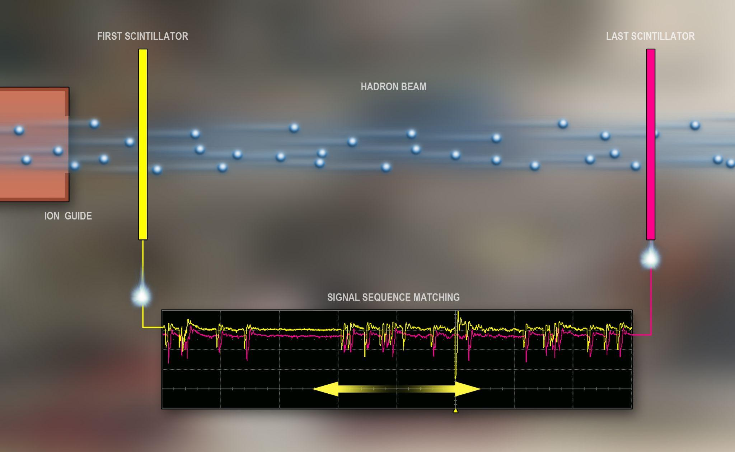
Waveform Pattern Alignment based on time-of-flight

Slide 4
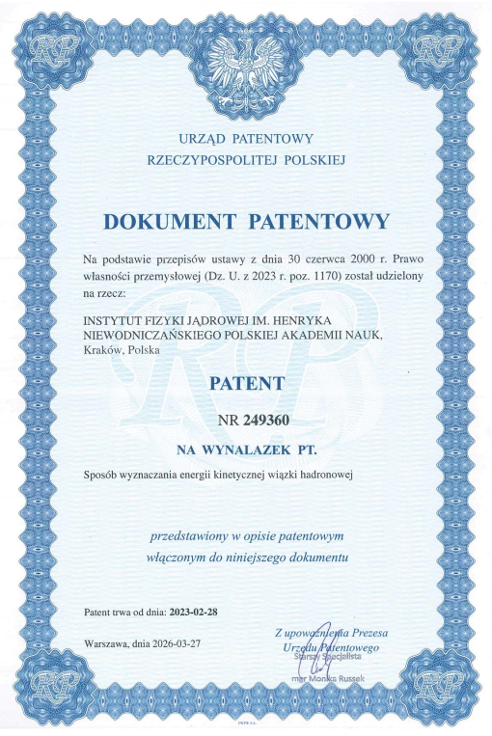
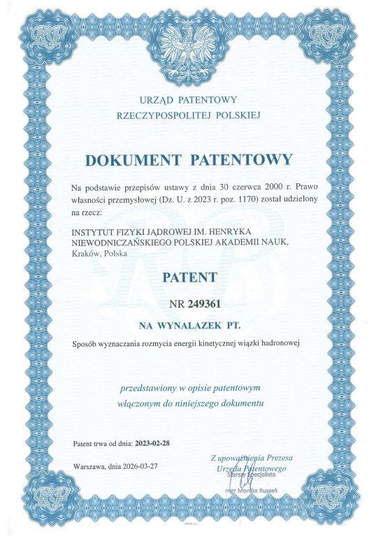
Feasibility

Slide 5



Validated Operating Conditions
Proton beams from cyclotrons COZY, AIC-144, C-230
70 – 200 MeV/u range, effective currents 5 - 500 pA,
TOF distance 3.611 m
60 MeV/u, currents 100-600 pA
TOF distance 2.149 m
1.96 GeV
TOF distance 7.89 m
Struggle to achieve measurement precision below 0.25%

Slide 6
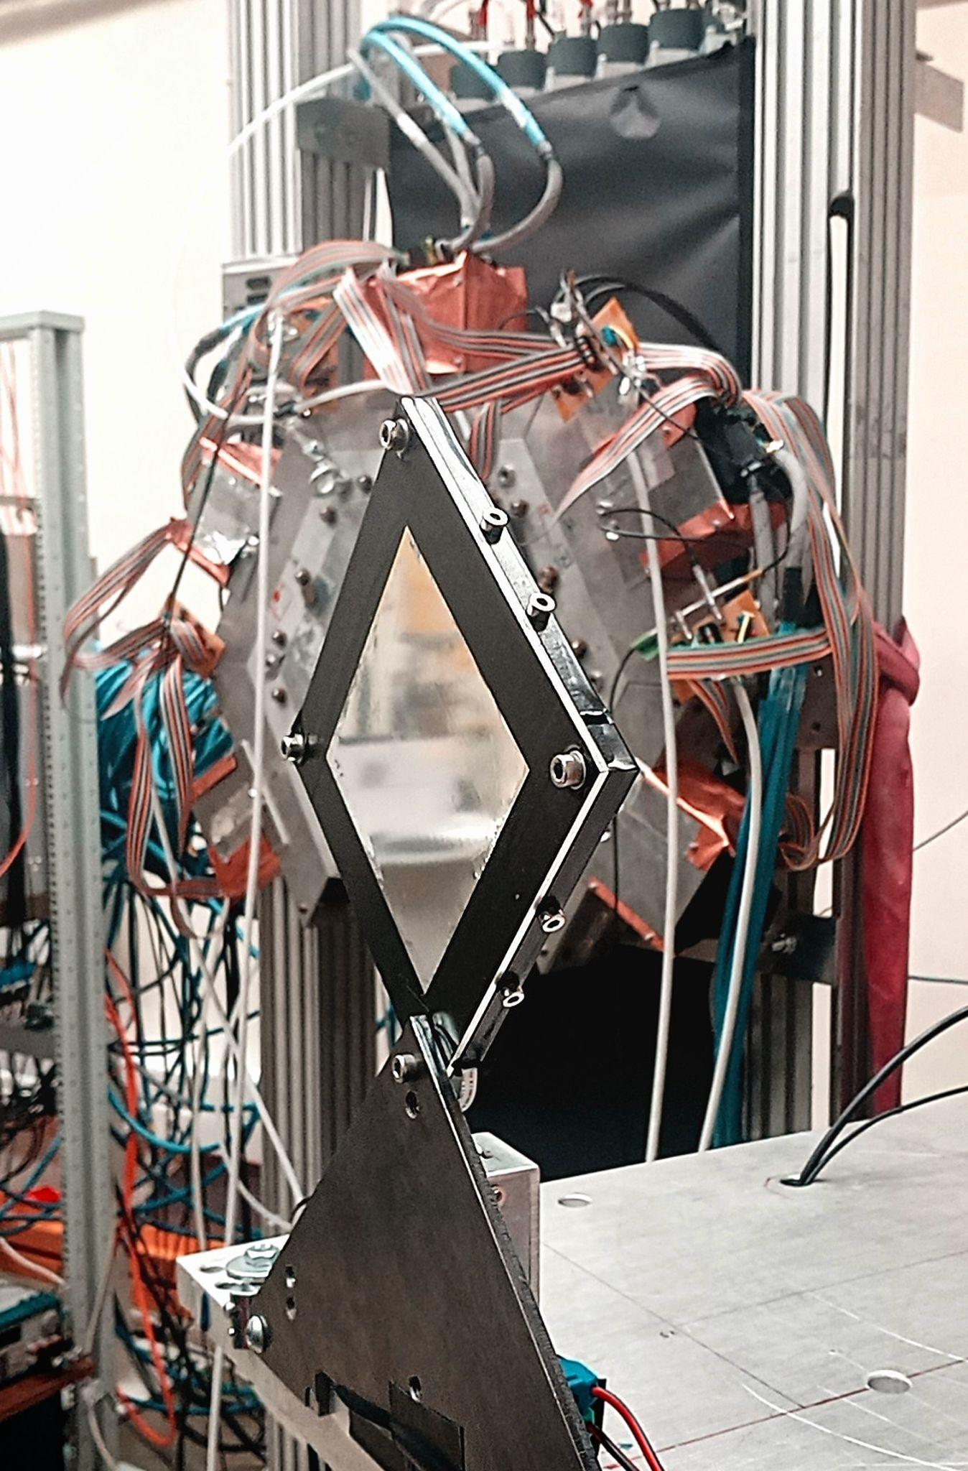
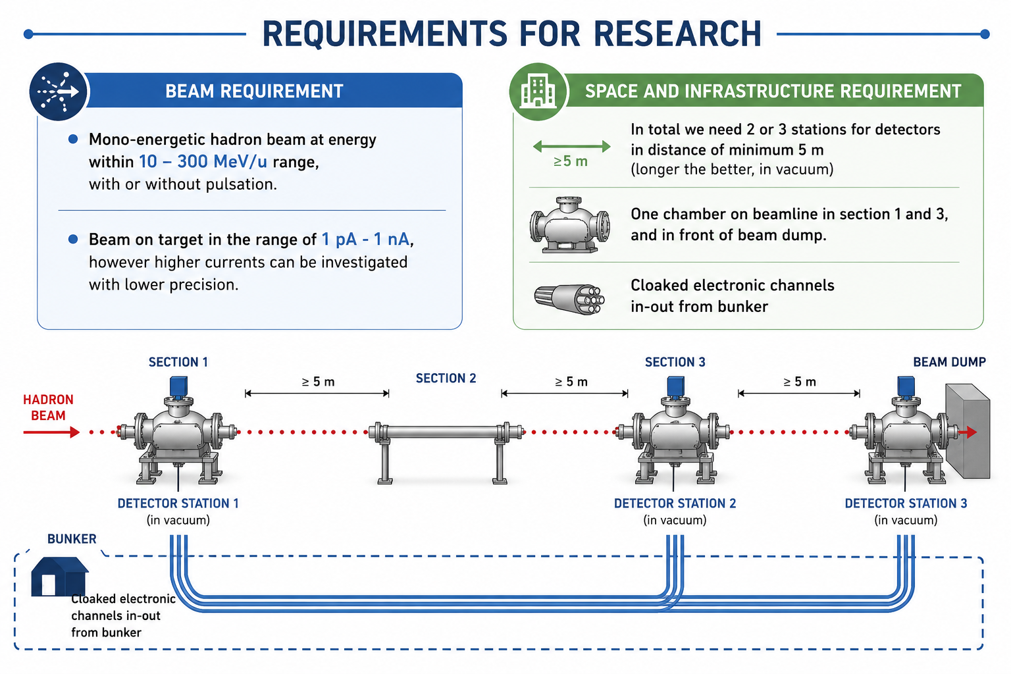

Slide 8
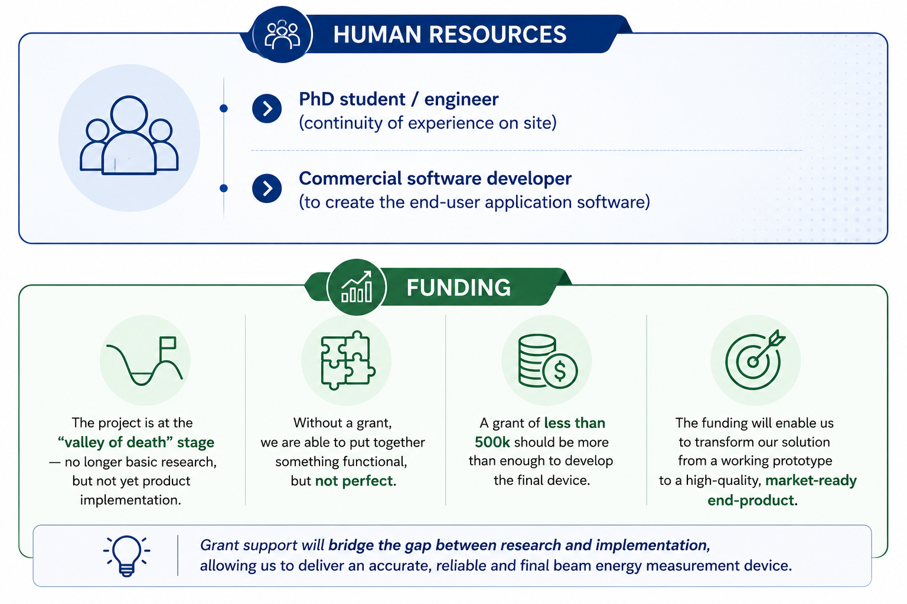

Slide 9
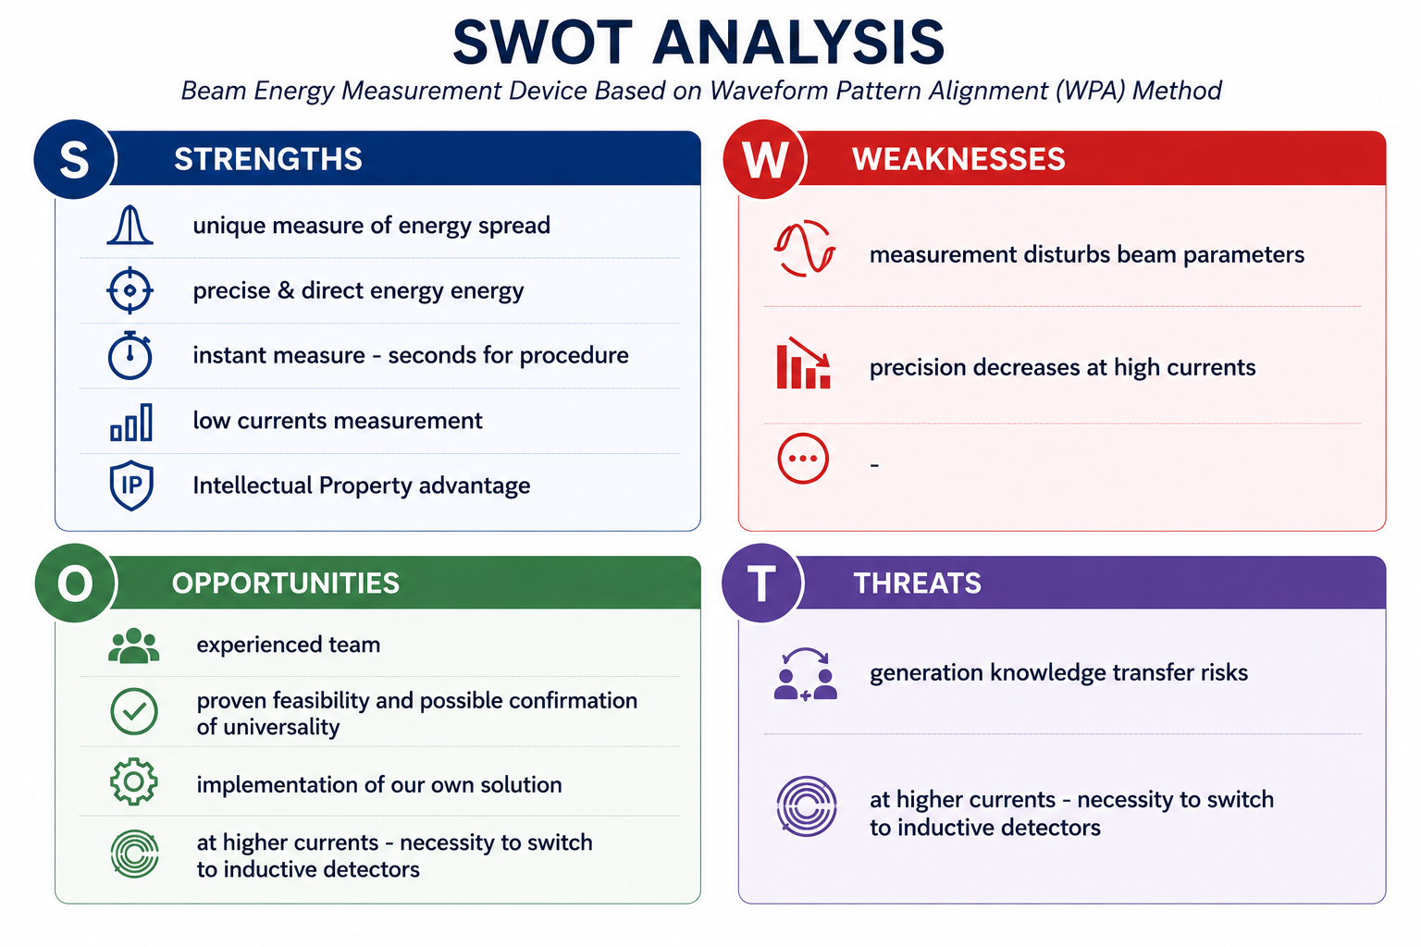

Slide 10
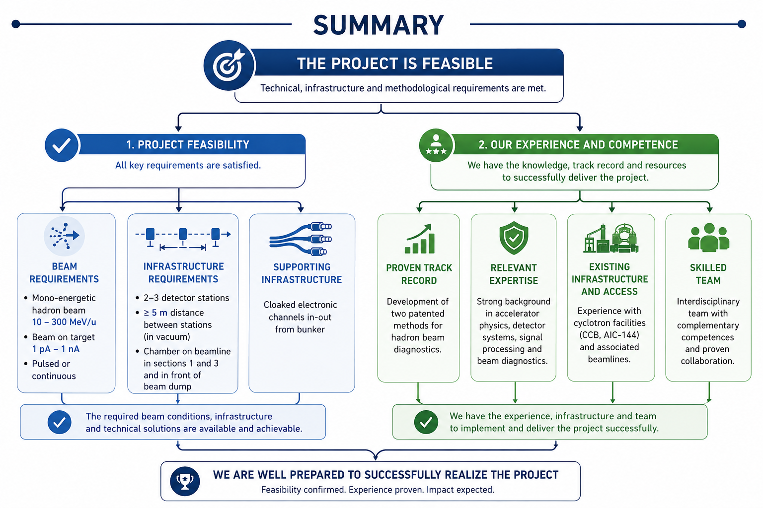

Slide 11
