Slide 1

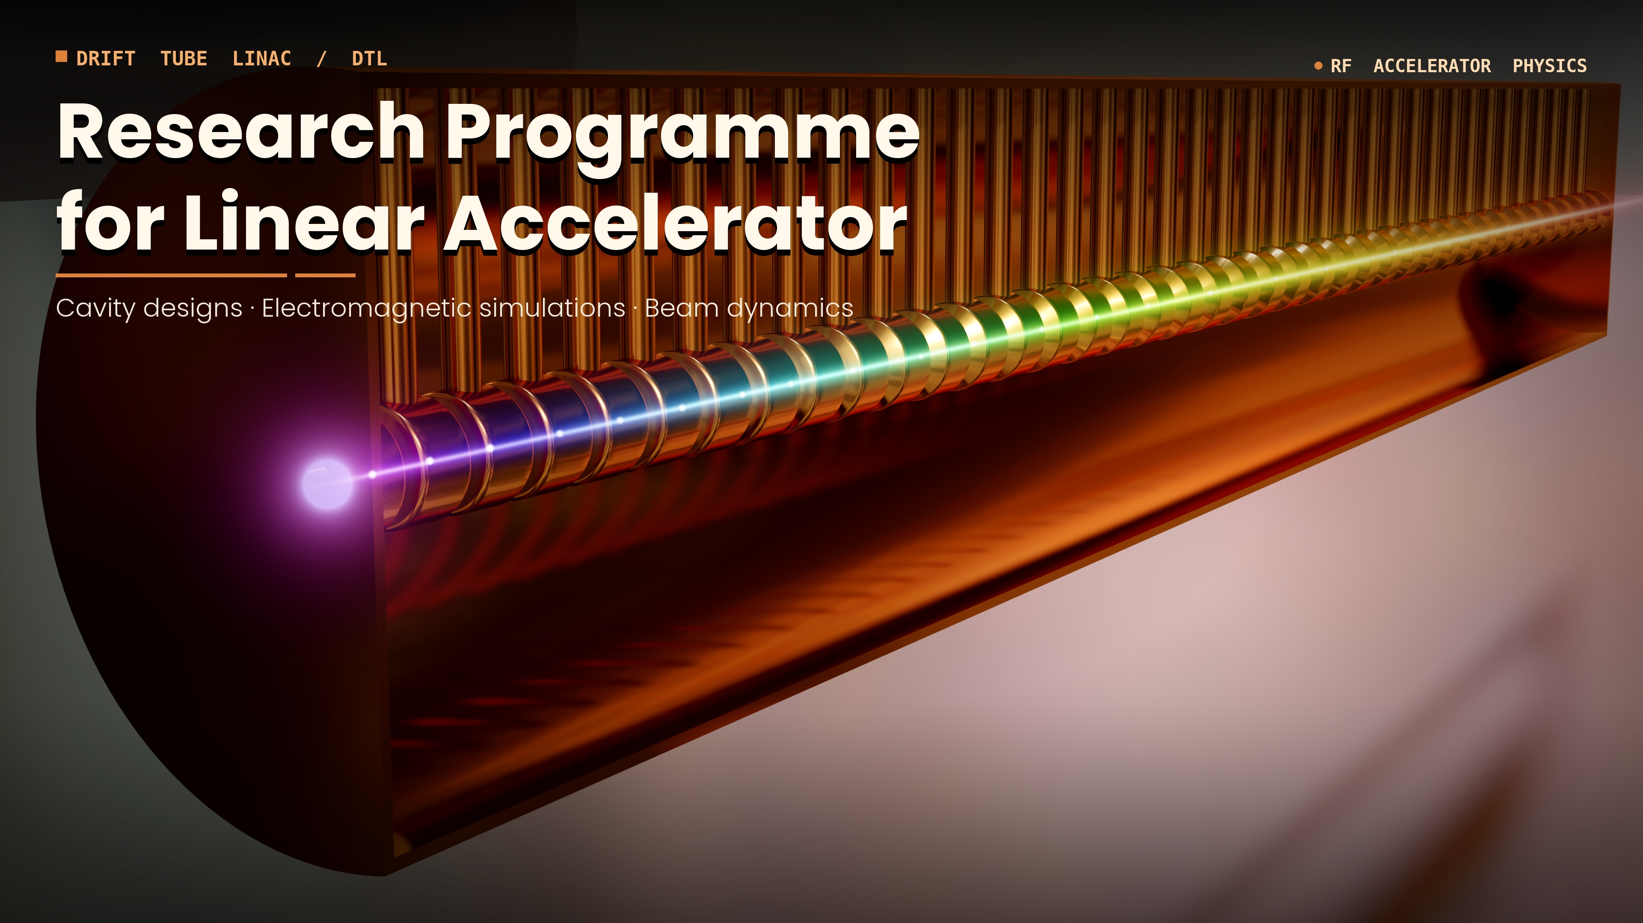
Influence of irradiation on the magnetic properties of coordination polymers
Piotr Konieczny, Dominik Czernia
2nd Workshop on Research & Innovation in Poland
IFJ PAN, Krakow, 26-27 May, 2026

Slide 2
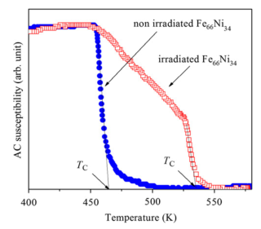
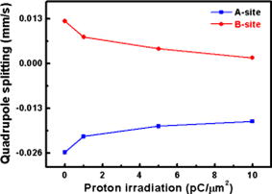
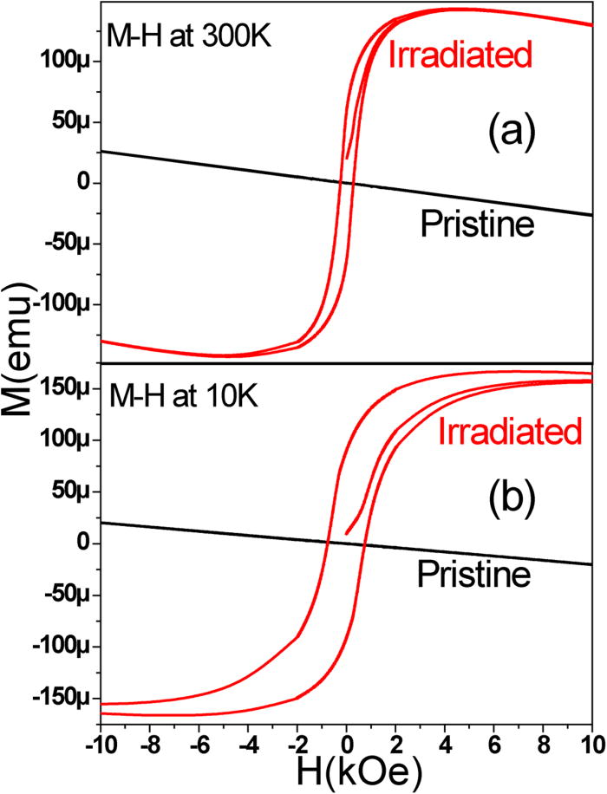
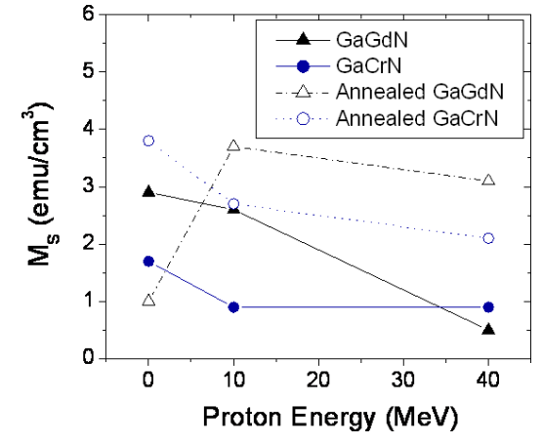
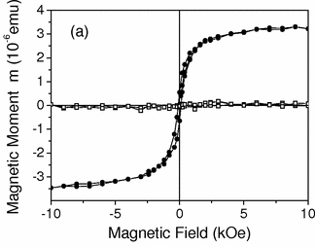
Magnetism and proton irradiation
Li_{0.5}Fe_{2.5}O₄
MoS₂
6.66 MeV
J. Appl. Phys. (2009)
50 keV
JMMM 333(2013)
Graphite
2 MeV
Appl. Phys. Lett. (2012)
10 and 40 MeV
New J. Phys. 10 (2008)
2.25 MeV
Phys. Rev. Lett. 91 (2003)

Slide 3

Influence of proton irradiation
on the magnetic properties of
2D Ni(II) molecular ferrimagnet

Slide 4

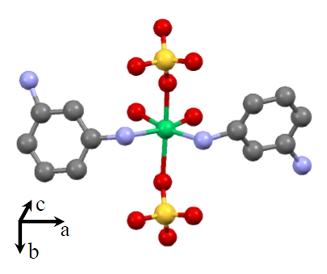

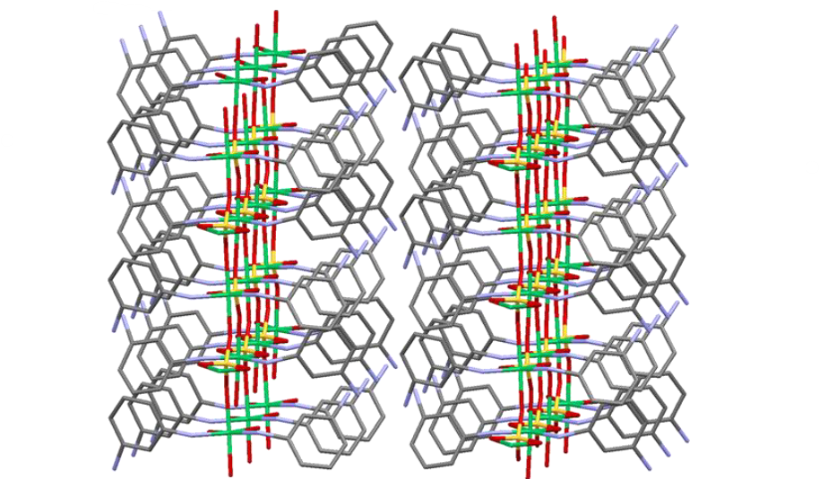
T_{c} = 24 K
PXRD, IR, DC
magnetometry
D. Czernia
Ni^{II}SO₄(1,3-phenylenediamine)₂
Sci Rep 13, 14032 (2023)

Slide 5
T_{c} = 24 K
PXRD, IR, DC
magnetometry
D. Czernia
Ni^{II}SO₄(1,3-phenylenediamine)₂
Van de Graaff accelerator
1.9 MeV protons
10 nA
Sci Rep 13, 14032 (2023)

Slide 6
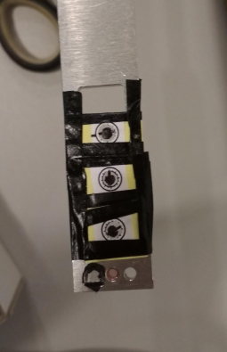
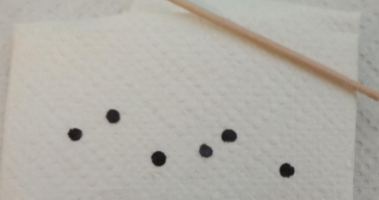
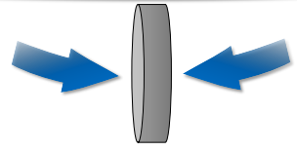
Sample preparation issue
Pellet thickness
> 100 μm
Sci Rep 13, 14032 (2023)

Slide 7
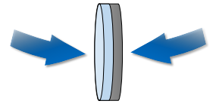
Sample preparation issue
Van de Graaff accelerator
1.9 MeV protons
10 nA
two phases!
Pellet thickness
> 100 μm
Sci Rep 13, 14032 (2023)

Slide 8
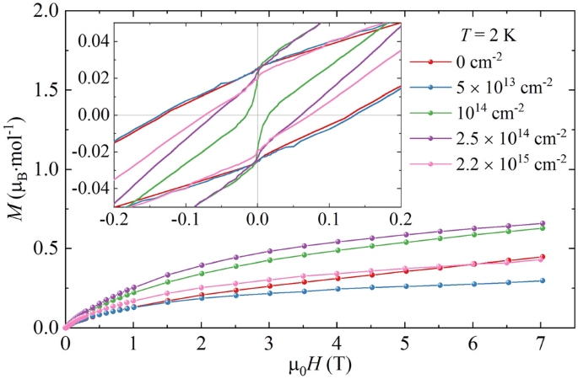
Powder layer thickness
≈ 30 μm
Sci Rep 13, 14032 (2023)

Slide 9
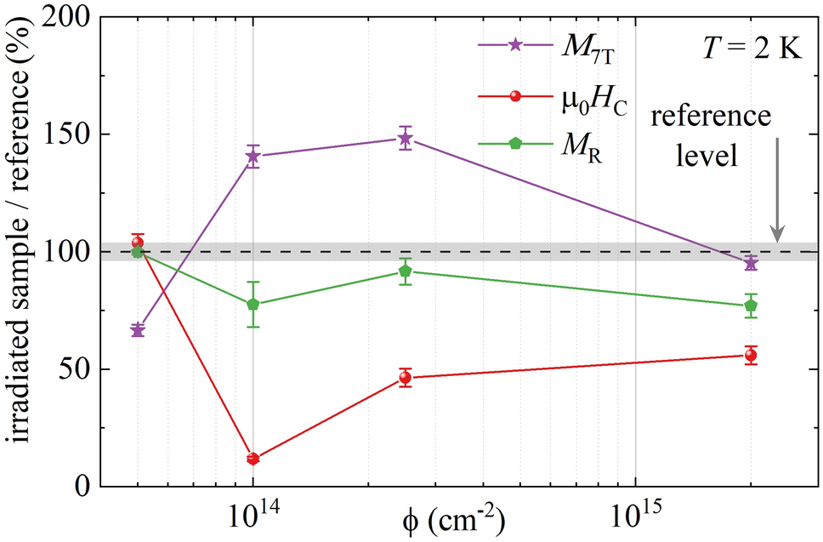
Powder layer thickness
≈ 30 μm
coercive field: reduction up to 90%
maximal magnetization (at 7T): 65% -150% of the reference sample
degree of irreversibility Δχ_{irr}: increase up to 40%
Temperature of phase transition: constant
Sci Rep 13, 14032 (2023)

Slide 10
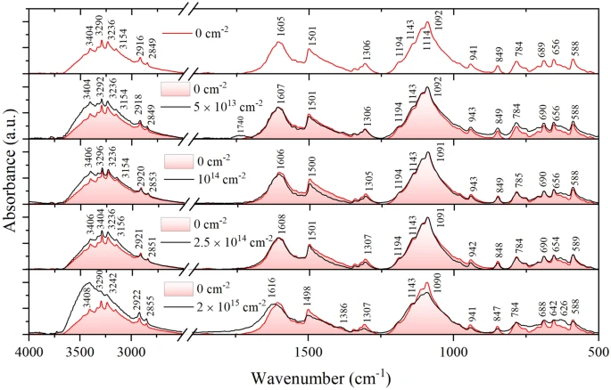
Infrared spectroscopy
Reference
5 x 10¹³ cm⁻²
10¹⁴ cm⁻²
2.5 x 10¹⁴ cm⁻²
2 x 10¹⁵ cm⁻²
coercive field: reduction up to 90%
maximal magnetization (at 7T): 65% -150% of the reference sample
degree of irreversibility Δχ_{irr}: increase up to 40%
Temperature of phase transition: constant
Sci Rep 13, 14032 (2023)

Slide 11
Which Section (1, 2 or 3)
Required beam: particle, energy nad properties
Section 1 and 2 – depending on investigated material
All available particles with variable energy
Beam current range: 1 nA - 20 nA – to limit sample degradation
No requirements about time structure of the beam

Slide 12
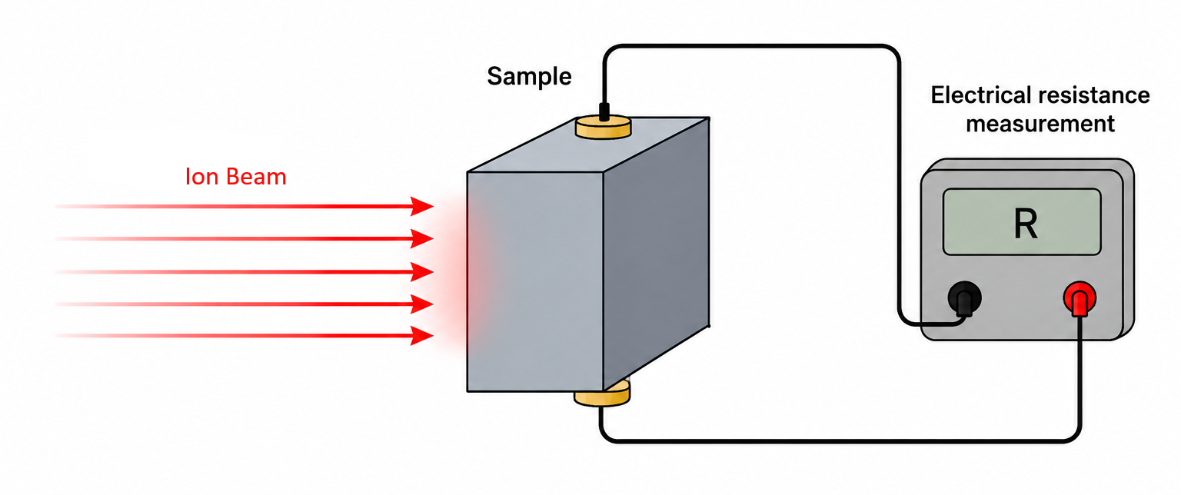
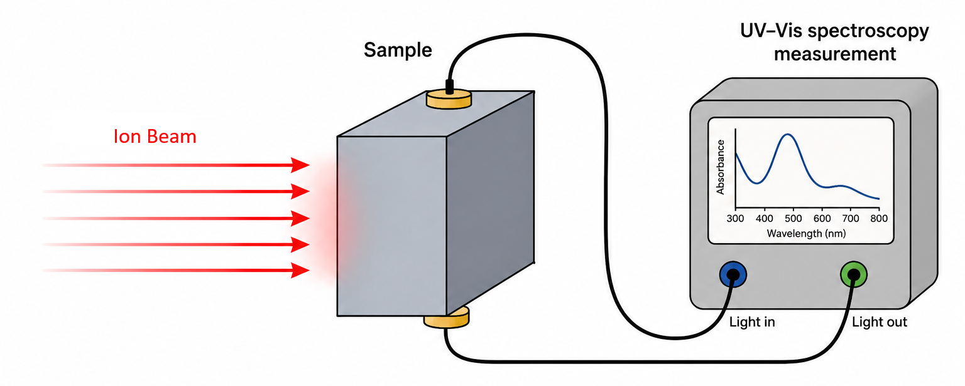
Other requirements (detection system, infrastructure)
Sample conditions:
scanning stage with cooling – to limit healing effect,
Energy degraded beam – uniform modification,
Real-Time Data: setup for electrical transport measurements and other techniques (magnetic, optic).

Slide 13
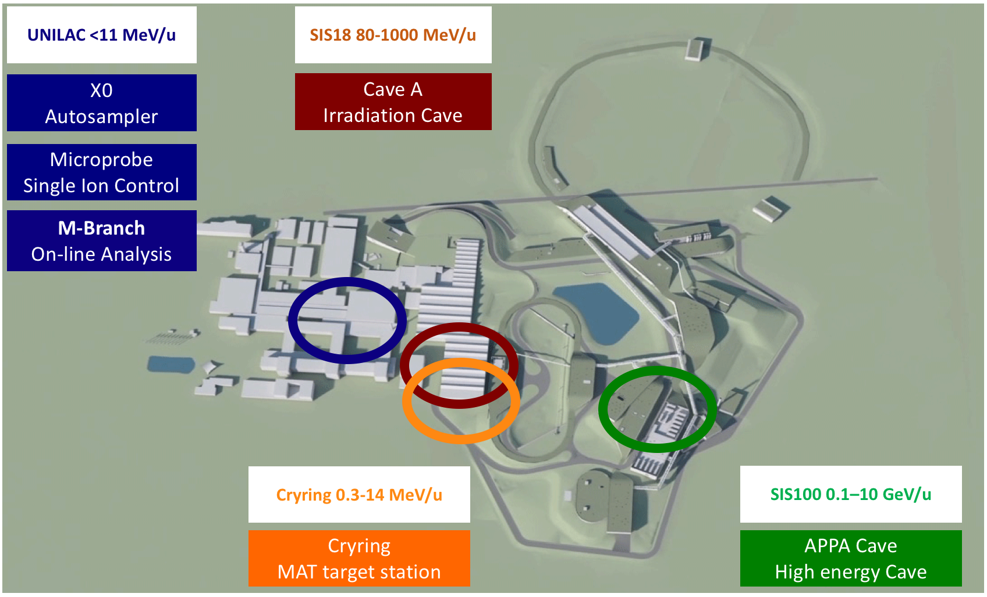
GSI
Helmholtzzentrum für Schwerionenforschung
Darmstadt

Slide 14
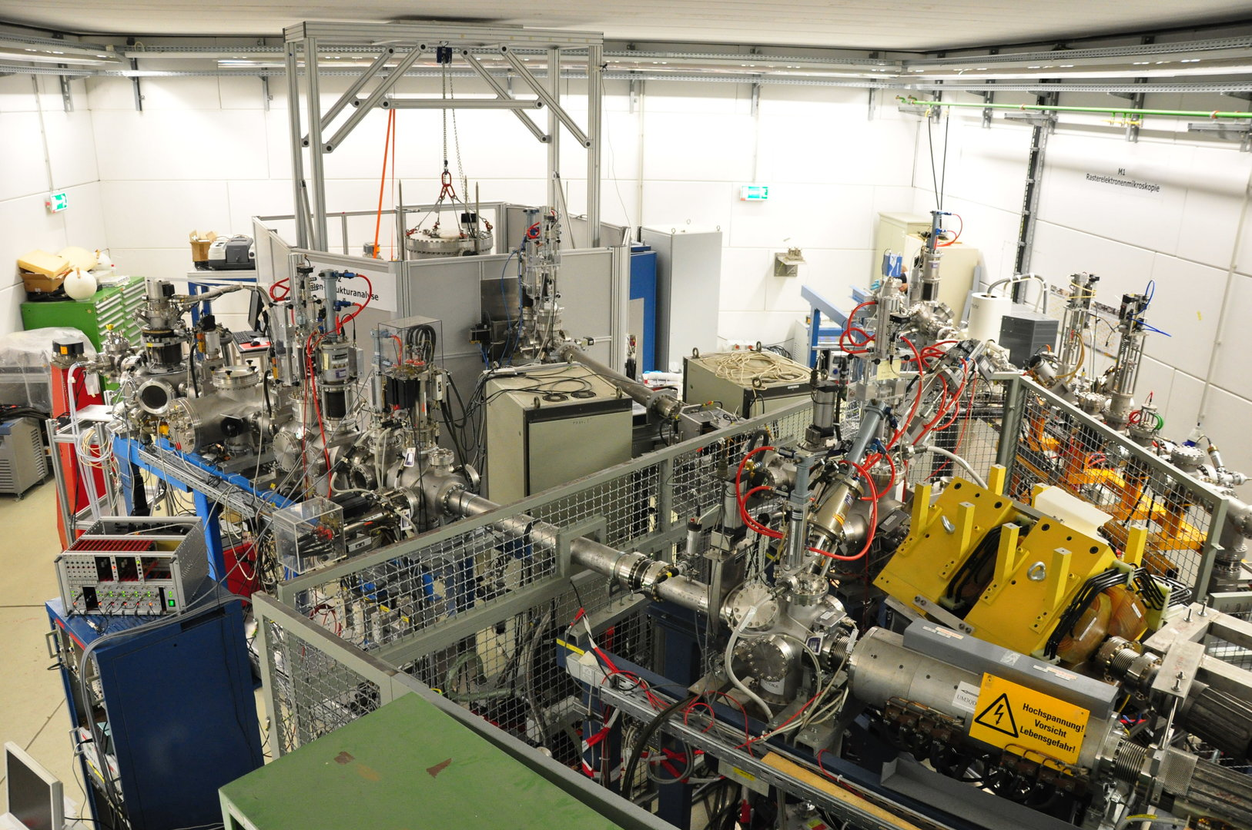
GSI
Helmholtzzentrum für Schwerionenforschung
Darmstadt
M1 Beamline – Scanning electron microscope and ToF-SIMS/SNMS
M2 Beamline – X-ray diffraction
M3 Beamline – In-situ spectroscopy and oven chamber

Slide 15
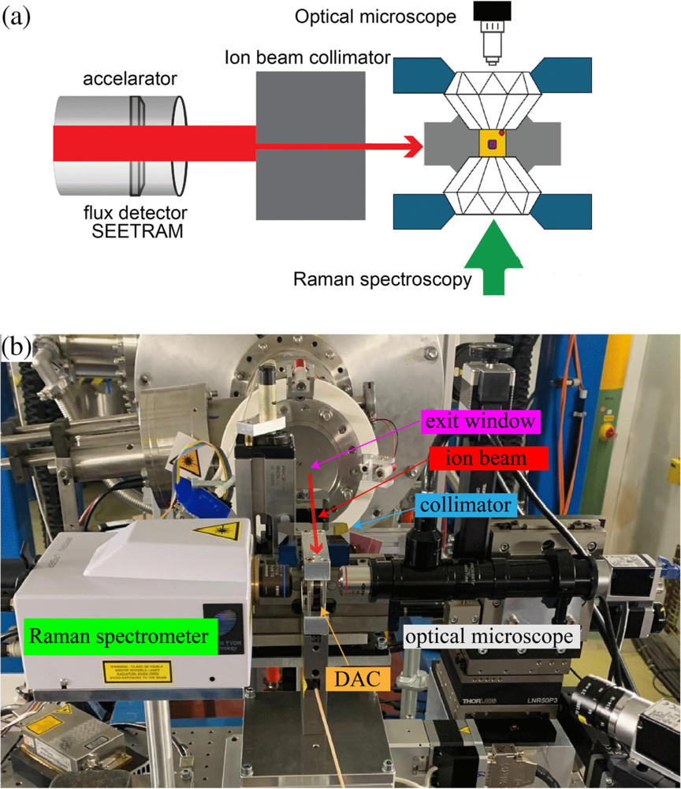
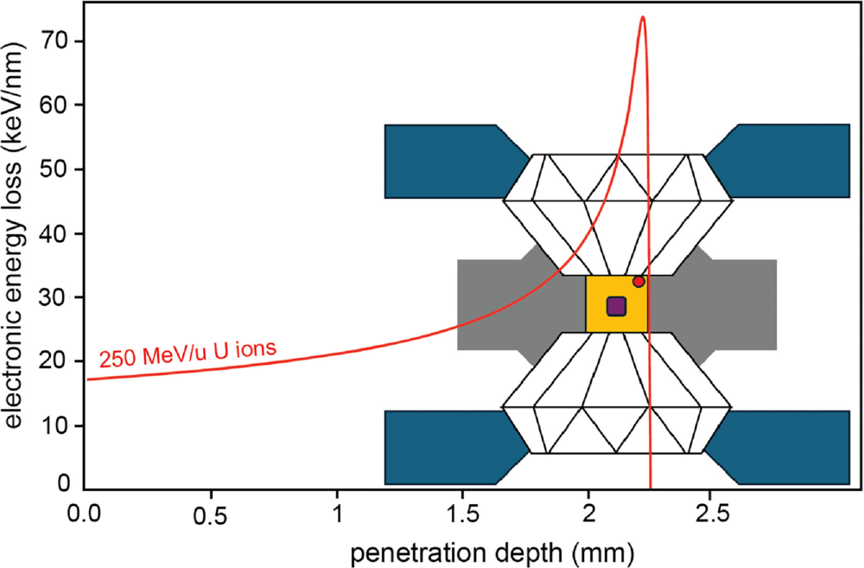
Phys. Rev. Research 8, 023054
Published 16 April, 2026

Slide 16
SWOT analysis for the project
Strengths
Builds on existing expertise in post-irradiation characterization.
Combines irradiation with real-time electrical transport and UV-VIS measurements,.
Creates a unique experimental capability in Poland and fills a clear infrastructure gap.
Weaknesses
Risk of sample degradation during irradiation, especially for sensitive materials.
Requires a highly flexible beamline: adjustable energy, current, and sample environment.
In situ experiments are technically demanding, e.g. complex integration of optical diagnostics.
Opportunities
Fits the growing concept of defect engineering in functional materials.
Strong relevance for advanced materials research, including radiation-tolerant and tunable systems.
Threats
Competing laboratories may develop similar in situ capabilities.
High investment and operating costs could constrain long-term sustainability.

Slide 17
Conclusions
Development of an in situ ion-irradiation beamline enabling
real-time electric transport and UV-VIS measurements
Direct insight into defect-driven modification of functional materials
Platform for interdisciplinary collaboration
Scalable concept with strong potential for application-oriented and industrial research

Slide 18
thank you for your attention

