Slide 1

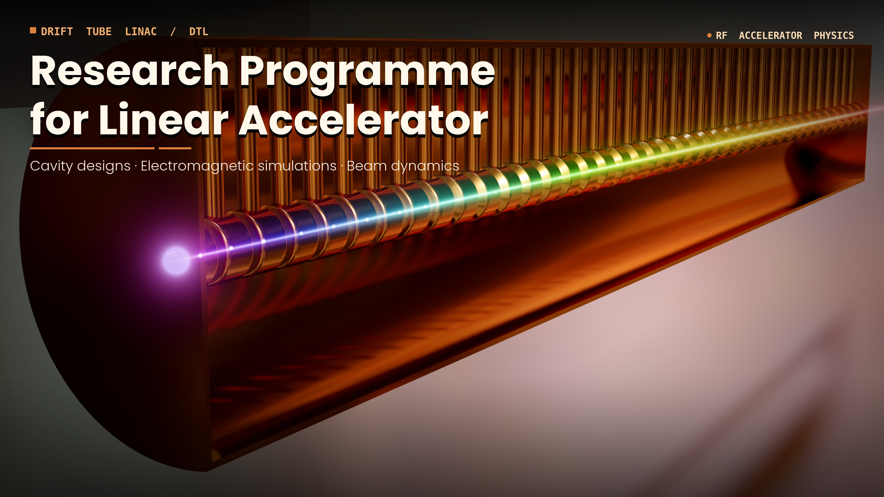
Space Lab, Ion Radiotherapy and Neutrons for Dual Use at the Bronowice Accelerator Centre
Jan Swakoń
2nd Workshop on Research & Innovation in Poland
IFJ PAN, Krakow, 26-27 May, 2026

Slide 2
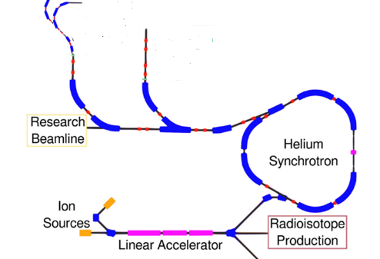
The idea of ​​the Facility
Space Lab
Neutron Hall
CCB+
Possibility of expanding the project as desired, e.g., adding a research component:
Nuclear Physics!
Hadrontherapy CCB+
doi:10.1088/1742-6596/2420/1/012103

Slide 3
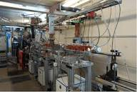
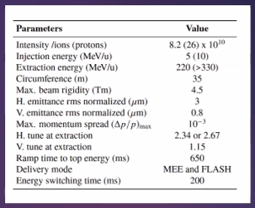
Linear accelerator as the first stage or injector of a synchrotron
The accelerators
https://www.kep.enea.it/images/sistemidagnosticamedicali/acceleratore-lineare-di-protoni-per-terapie-oncologiche.png
E.g. HeLICS –Helium and light ions compact synchrotron
doi:10.1088/1742-6596/2420/1/012103

Slide 4
Components:
The idea of ​​the Facility
Space Lab - Ion Beams for Testing Radiation Hardness in Space Research;

Slide 5
The idea of ​​the Facility
Space Lab
Neutron Hall
CCB+
Possibility of expanding the project as desired, e.g., adding a research component:
Nuclear Physics!
Hadrontherapy CCB+
doi:10.1088/1742-6596/2420/1/012103

Slide 6
Components:
The idea of ​​the Facility
Ion Beams for Testing Radiation Hardness in Space Research
Space Lab - Ion Beams for Radiation Hardness for Space Research;
New Methods for Ion Radiotherapy - CCB+;

Slide 7
The idea of ​​the Facility
Medical Component CCB+
Space Lab
Neutron Hall
CCB+
Possibility of expanding the project as desired, e.g., adding a research component:
Nuclear Physics!
Hadrontherapy CCB+
doi:10.1088/1742-6596/2420/1/012103

Slide 8
Components:
The idea of ​​the Facility
Ion Beams for Testing Radiation Hardness in Space Research
Space Lab - Ion Beams for Radiation Hardness for Space Research;
New Methods for Ion Radiotherapy - CCB+;
Neutrons for dual use;

Slide 9
The idea of ​​the Facility
Space lab
Neutron Hall
CCB+
Possibility of expanding the project as desired, e.g., adding a research component:
Nuclear Physics!
Hadrontherapy CCB+
doi:10.1088/1742-6596/2420/1/012103

Slide 10
Components:
The idea of ​​the Facility
Space Lab - Ion Beams for Testing Radiation Hardness in Space Research;
New Methods for Ion Radiotherapy - CCB+;
Neutrons for dual use;
defense
BNCT
nuclear physics

Slide 11
The idea of ​​the Facility
Space Lab
Neutron Hall
CCB+
Possibility of expanding the project as desired, e.g., adding a research component:
Nuclear Physics!
Hadrontherapy CCB+
doi:10.1088/1742-6596/2420/1/012103

Slide 12
Space Lab
Ion Beams for Testing Radiation Hardness in Space Research
Research Team: J. Swakoń and NZ62 Team,
J. Chwastowski and NZ13 Team,
E. Stanecka and NZ14 Team

Slide 13
Goals and objectives
Ion Beams for Testing Radiation Hardness in Space Research
The aim of the project is to build irradiation line that will enable the radiation hardness tests of electronics for the space industry and for tests of electronics and construction materials prepared for high-energy physics experiments.
The irradiation facility should meet the requirements established by ESA and NASA for various types of radiation hardness tests (e.g., SSE, SUE, etc. as well as total dose (TID)), and should enable the delivery of the fluence levels necessary to conduct electronic hardness tests on electronic components intended for exposure over the projected lifetime of high-energy facilities.

Slide 14
Primary particles/beam requirements
Space Lab
Proton (p+)
Minimum current: 1pA (1e3 proton/cm2s for broad beam);
up to 100nA for 60MeV proton beam;
up to 500 nA for 250 MeV proton beam;
Alpha (4He2+)
Minimum current: 1pA (1e3 proton/cm2s for broad beam);
1nA for 60MeV alpha particle beam;
100 nA for 250 MeV proton beam;
Time Structure: quasicontinous;
Beam Field Geometry:
Ability to form a wide radiation field of 10-12 cm diameter with 10% uniformity. A scanning beam or installed 2D moving table ensures a uniform radiation field of minimum dimensions of 30 cm x 40 cm.
ΔE requirement: 1MeV

Slide 15
Additional needs
Space Lab
The irradiation station should enable the delivery of the fluences in the range of 1e6 to 1e17 proton/cm2 during one max fluence irradiation or during one shift and the safe transfer of samples from the irradiation stations to a safe storage facility.
Due to the wide range of beam parameters required in this type of application, it will be necessary to build a dedicated beam forming and control and monitoring system.

Slide 16
New Methods for Ion Radiotherapy
CCB+
Research Team: J. Swakoń and NZ62 Team,
P. Bilski and NZ63 Team

Slide 17
Goals and objectives
New Methods for Ion Radiotherapy CCB+
Development of dosimetric methods for proton and hadron radiotherapy (He ions), possibly heavier ions including carbon and oxygen ions;
Irradiation of biological materials for radiobiology with helium beams and heavier ions;
Starting radiobiological research into FLASH and GRID radiotherapy;
Development of new detectors for applications in hadron radiotherapy, in particular dosimetry methods for fields with high and very high dose rates (FLASH hadron radiotherapy);
Development of research on MRI-guided proton/alpha radiotherapy and dose deposition by ion beams in magnetic fields;
Research into proton and alpha beam radiography;
Medical Component CCB+

Slide 18
Primary particles (also interesting for therapy in CCB+)
New Methods for Ion Radiotherapy CCB+
Proton (p+)
60 MeV -250 MeV, 1nA – 1uA;
Alpha (4He2+)
30 MeV – 230 MeV/u, 5nA – 1uA;
Carbon (12C6+)
400 MeV/u from 0.01nA to 1(10) nA;
Other ions (e.g. 16O8+)
Beam Spot Geometry:
- Desired spot size on target: 4-10 mm FWHM;
- Universal or scanning nozzle needed;

Slide 19
CCB+
New Methods for Ion Radiotherapy CCB+
From 2016 the CCB proton therapy facility treats patients and is used for research in nuclear physics, medical physics, and radiobiology. In addition, the proton beam is used for irradiation of electronics for space research.
In 2035, twenty years after the opening of CCB, the center may possibly end its medical activity due to the expiration of technical support and technological obsolescence. By 2035, many oncology centres in Poland are expected to operate their own small proton synchrocyclotrons.
It is therefore proposed that IFJ PAN purchase a 400 MeV/amu carbon ion synchrotron, currently offered by MedAustron and Hitachi, with medical device certification.
This would allow IFJ PAN to broaden its leadership in hadron therapy in Poland by offering treatments with protons, helium ions, and carbon ions.

Slide 20
Neutrons for Dual Use
Research Team: J. Swakoń and NZ62 Team,
U. Wiącek and NZ61 Team

Slide 21
Goals and objectives
Neutrons for Dual Use
The neutron beam irradiation station will be used to conduct research on various types of detectors and dosimeters, as well as to test and qualify neutron detectors for measurement systems used in neutron fields with equal time structures and a wide range of neutron energies (from thermal energies up to 200 MeV).

Slide 22
Primary beam requirements
Neutrons for Dual Use
Protons with variable energy within 2.5 – 250 MeV range;
Proton beam current from 1 nA to 1 mA;
> 1 mA for 2.5 MeV;
10 nA -1 uA for 250MeV ;
The ability to change the beam structure (continuous beam/pulse beam with varying duty cycles);

Slide 23
Planned research
Neutrons for Dual Use
tests of military equipment;
calibration and testing of various types of detectors and dosimeters;
testing and qualification of newly designed neutron monitors;
radiobiological research for medicine and radiotherapy, in particular on BNCT and neutron burst in proton therapy;
irradiation of electronics for radiation hardness tests for space applications;
irradiation of electronics for radiation hardness in high-energy physics and plasma physics;
qualification and development of new neutron detectors for thermonuclear plasma diagnostic systems (ITER, DONES);

Slide 24
Neutrons for Dual Use
Additional needs
Separate room approx. 50 m2;
Proton - neutron converter and moderators;
Equipment for neutron dosimetry;
High activation possible thanks to work with high-intensity neutron beams, high shielding of the hall required;

Slide 25
Summary
Requests for access to the research infrastructure presented in this presentation have already been submitted by teams from five departments of IFJ PAN (NZ13, NZ14, NZ61, NZ62, and NZ63). This is likely only a small fraction of the future user community.
The concept of the accelerator facility and the three major fields of activity envisioned for the proposed equipment were presented.
An accelerator offering a broad range of available beams is not sufficient on its own. Efficient utilization of such a facility requires appropriate infrastructure, including dedicated experimental halls, supporting equipment, and laboratory facilities.
Expanding the project to address the needs of the Cyclotron Centre Bronowice (CCB) would enable IFJ PAN to maintain its leading position in hadron therapy in Poland, with the capability to offer treatments using protons, helium ions, and carbon ions.

