Slide 1

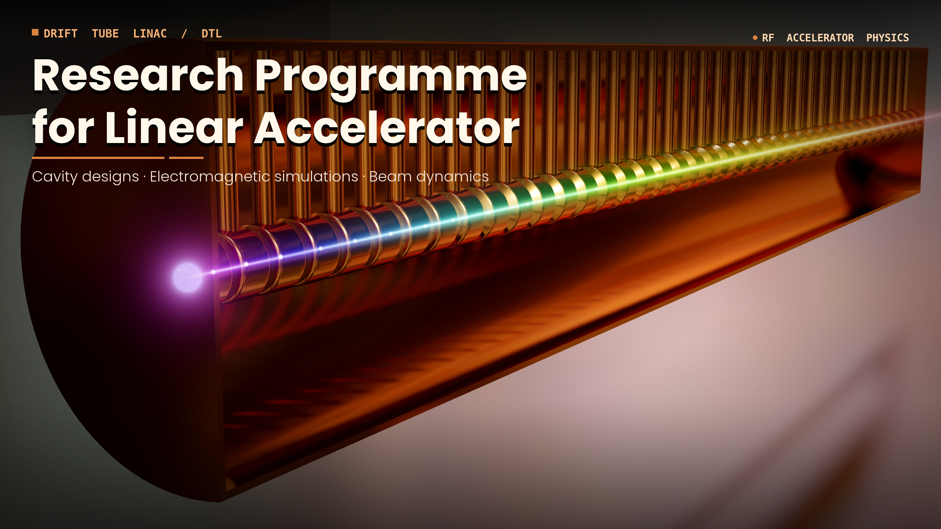
Radiobiological response to proton irradiation enhanced by metallic nanoparticles
Dr inż. Bartosz Klębowski
2nd Workshop on Research & Innovation in Poland
IFJ PAN, Krakow, 26-27 May, 2026

Slide 2
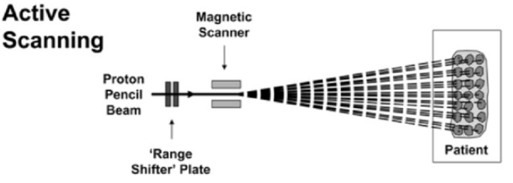
Proton radiotherapy
https://www.osaka-himak.or.jp/en/whats/merit/
KCE REP 235. D/2015/10.273/05

Slide 3
Interaction of ionizing irradiation with cells

Slide 4
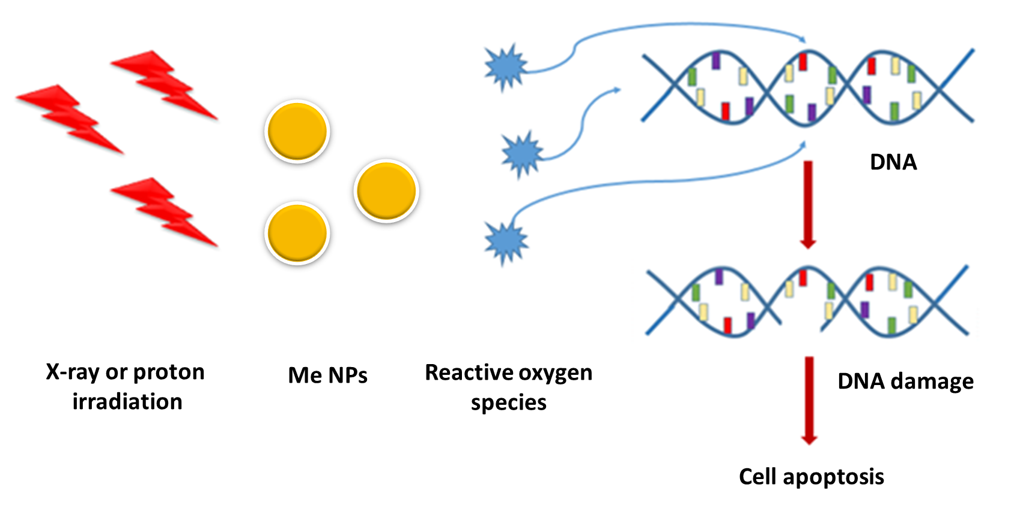
Metallic nanoparticles (Me NPs) as radiosensitizers
Radiosensitizers:
Small molecules
Macromolecules
Me NPs
(Me = Au, Pt, Pd, Ag, Zn, Zr, Hf, Gd, Bi)

Slide 5
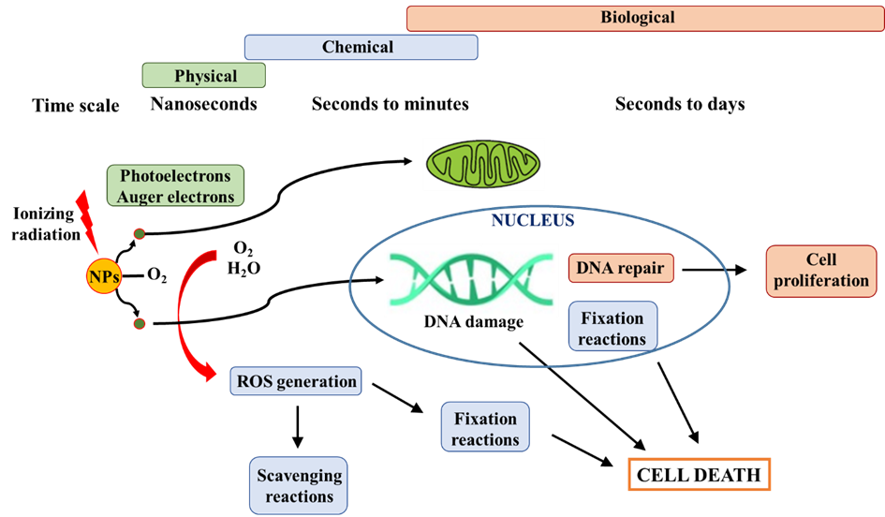
Mechanism od radiosensitization

Slide 6
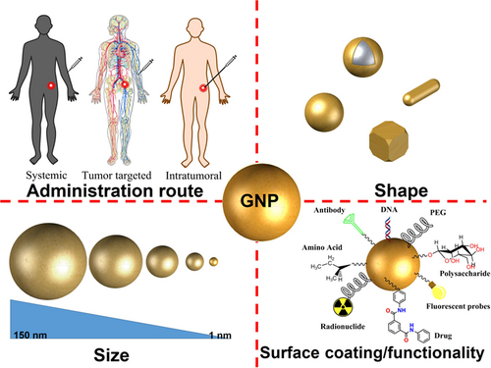
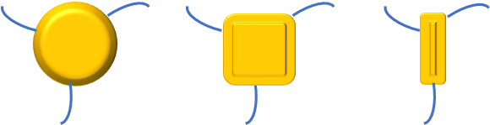


Which NPs parameters influence radiosensitization?
Chirality – a novel parameter?
L- or D-amino acids (cysteine, homocysteine or penicillamine)
Me NPs with
ligand-induced chirality
Me NPs with structural chirality
Moloudi et al. Critical parameters to translate gold nanoparticles as radiosensitizing agents into the clinic

Slide 7
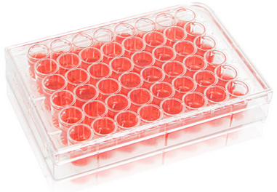
Experimental plan
Cell viability,
Clonogenic assay,
ROS detection,
Holotomographic analysis,
Spectroscopic methods
(FTIR, Raman, XANES)
.....
+
Cell culture with Me NPs
Proton irradiation
Pulse repetition rate – a key parameter?

Slide 8
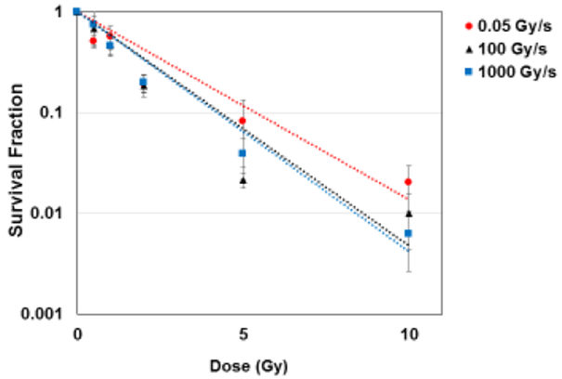
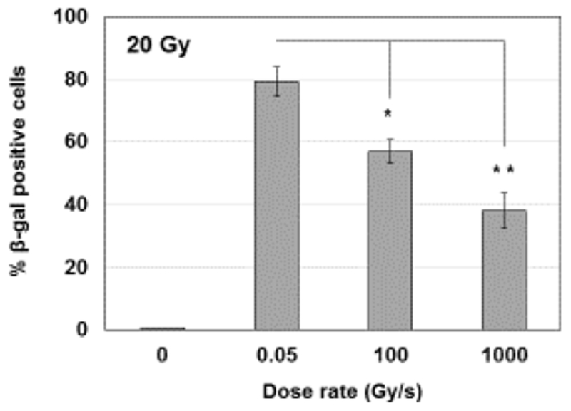
Dose rate effects on radiosensitization
Buonanno et al. Biological effects in normal cells exposed to FLASH dose rate protons

Slide 9
Required beam: particle, energy nad properties
Primary particle: proton (p⁺)
Section: 2 (12.5 MeV/u) and 3 (250 MeV/u)
Pulse repetition rate: flexible (user-selectable pulse repetition rate)
Beam spot geometry: 5 – 20 mm
Energy resolution: ΔE requirement < 1% preferred

Slide 10
SWOT analysis for the project
S (Strengths): Innovative combination of proton irradiation and Me NPs-based radiosensitization with adjustable pulse repetition rate.
W (Weaknesses): High technical requirements for dosimetry and biological reproducibility.
O (Opportunities): Development of a unique research platform for advanced radiobiology and international collaborations.
T (Threats): Long infrastructure development time and strong international competition in proton research.

Slide 11
Conclusions
Controlled proton pulse structure and advanced beam parameter modulation may open new possibilities in Me NPs-enhanced proton radiotherapy and mechanistic radiobiology studies.
The combination of proton irradiation with Me NPs – with special emphasis on the evaluation of chirality-dependent effects of Me NPs – represents a promising interdisciplinary research direction integrating accelerator physics, nanotechnology and cancer biology.
The proposed accelerator infrastructure could provide a unique experimental platform for investigating how beam parameters influence cell viability, proliferation, ROS generation, DNA damage and biological response at the nano–bio interface.

