Slide 1

Production of radionuclides at a future liniac
(NZ 64)
Jerzy W. Mietelski,
Arshiya Anees Ahmed, Tomasz M.Mróz
NZ-64 Nuclear Physical Chemistry (IFJPAN)

Slide 2
Dept. of Nuclear Physical Chemistry (NZ64)
Research on Radioactive Contamination of the Environment
Research on study of production of medical radionuclides, cyclotron targetry and radiochemical separation techniques

Slide 3
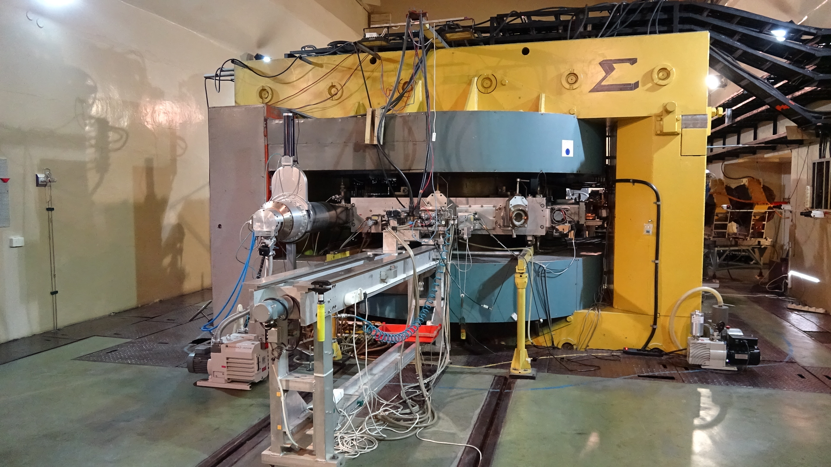
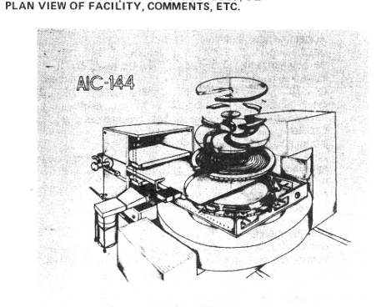
Current status of accelerator
Proton Beam parameters
Energy – 60 MeV
Current (@ shutter) < 60 nA
At target station max 40 nA
Cyclotron AIC-144

Slide 4
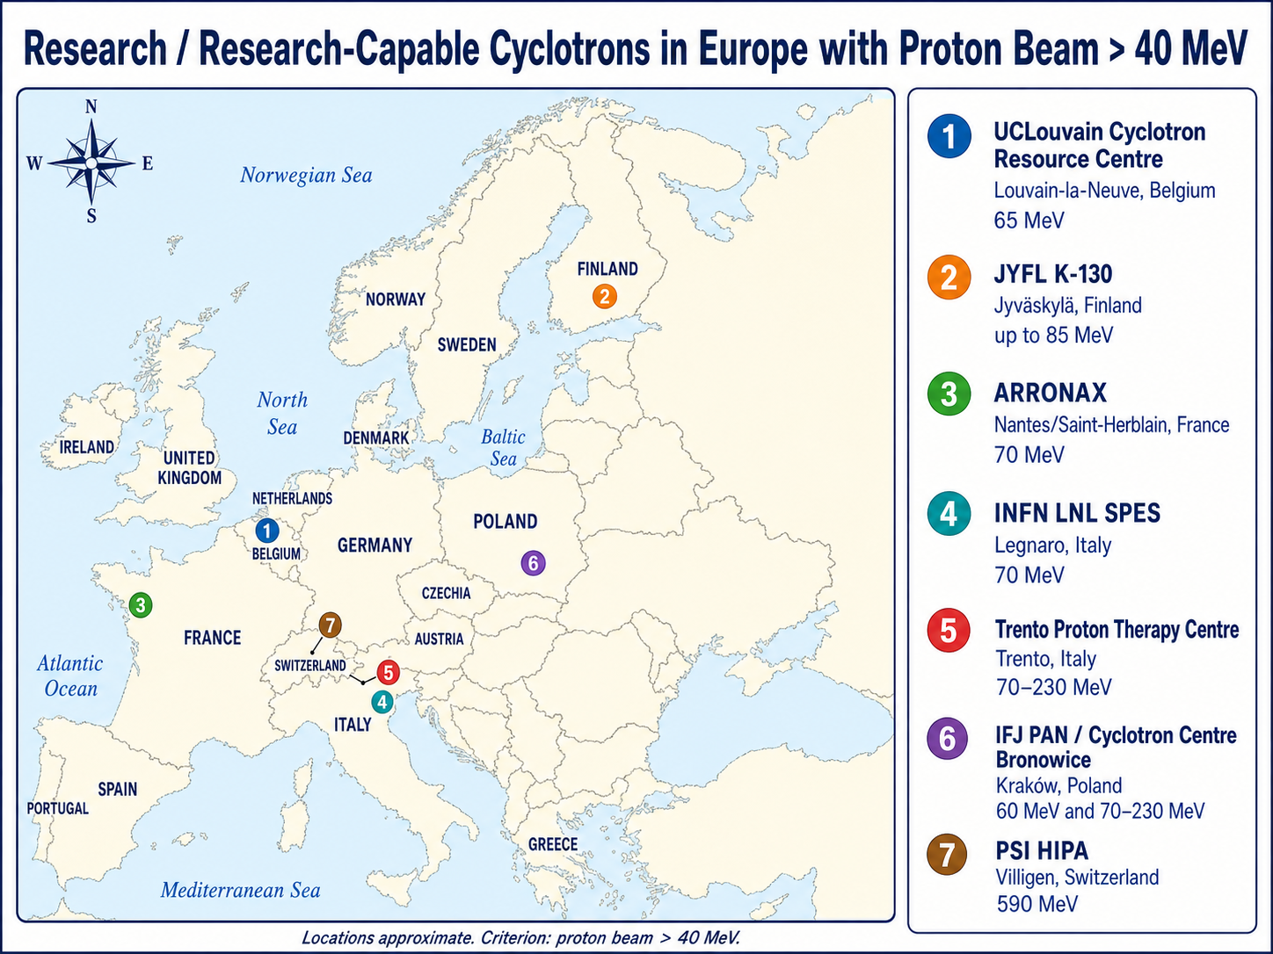

Slide 5
Research equipment
α, β, and γ spectrometers
Identification and quantification of radioactive material separated from irradiated targets
Qualitative and quantitative analysis of various radiochemicals
HPGe detectors and liquid Scintillation spectrometers
Radiochemical Laboratory (II class)
Ion exchange / extraction chromatography
Thermochromatography
Microwave digestion system
Radiochemical box with target transport system
Targetry equipment (hydraulic press etc.)
Laboratory and department Staff ready for operating with high activities – in future possible upgrade for GMP standard

Slide 6
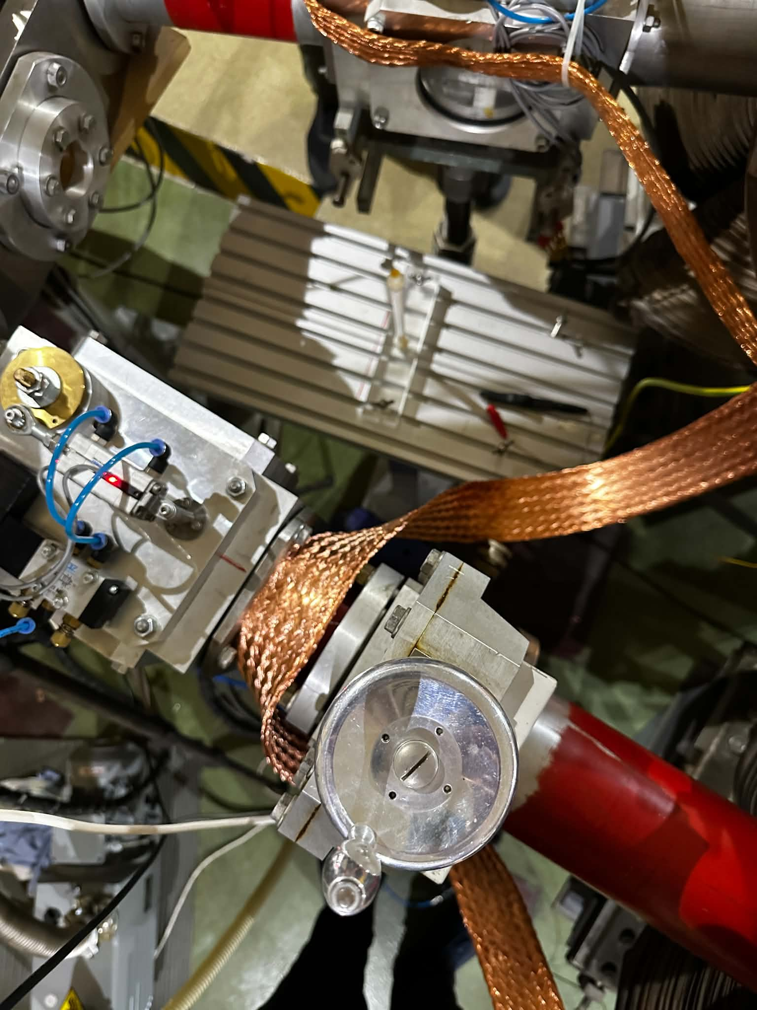
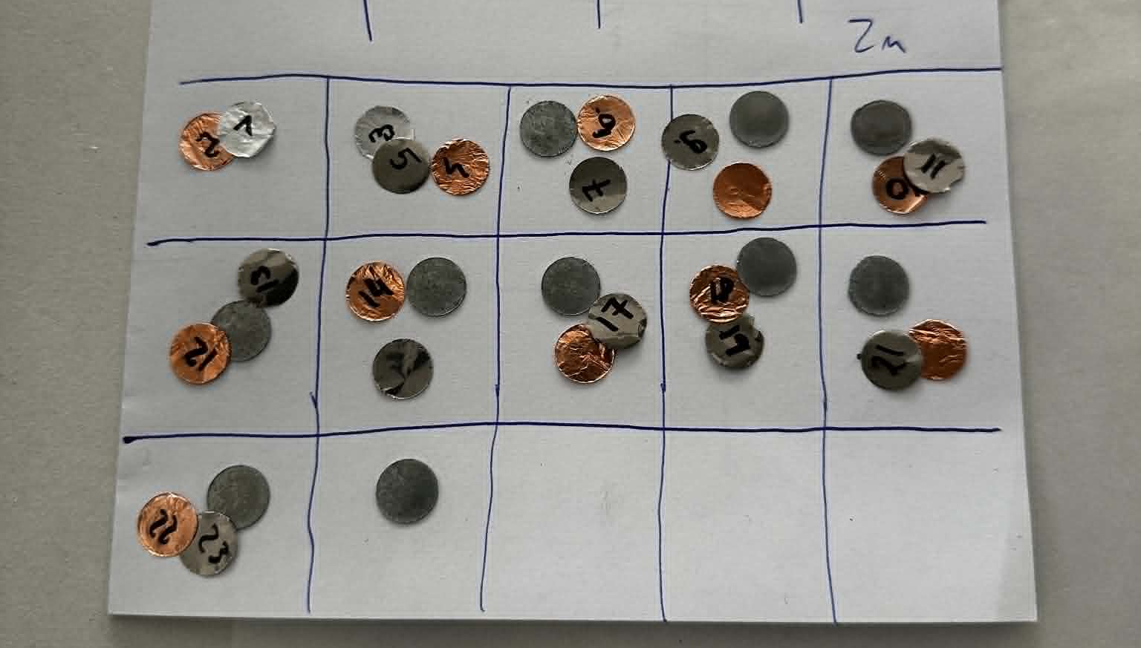
Typical irradiation routine for cross-section studies:
Stacked foils / tablets with beam current and energy monitors (Al, Cu, Ti)
Three irradiations per experiment to cover energy range up to ~60 MeV
Gamma ray spectrometry, radiochemical spearation for alpha or beta counting if required

Slide 7
Research (general overview)
Nuclear reaction cross-section measurements for radioisotopes production (T_{1/2} ≥ 3h up to several days)
Testing and development of radiochemical separations procedures
Studies on obtaining (activation and separation) of radioactive tracers (¹⁴⁸Gd, ²³⁵Np, ⁹⁷Tc….) as suport for environmental radioactivity monitoring and research

Slide 8
Recently completed projects
Beam monitoring
Testing of new materials for energy degradation
Study of proton induced excitation functions on ⁷⁰Ge
^{nat}Ge (p,x) reactions studying ⁶⁸Ge/⁶⁸Ga
^{nat}Pr (p,x) ¹⁴⁰Nd/¹⁴⁰Pr
^{nat}Zn (p,x) reactions cross sections

Slide 9
Current work and future plans
Study on production of medical radio-generators
⁷²Se(T1/2 = 8.4 d)/ ⁷²As(T1/2 = 1.08 d), (p,x) reaction on ^{nat}As up to 45 MeV
¹⁹⁴Hg(T1/2 = 444 y)/ ¹⁹⁴Au (T1/2 = 38 h), ^{nat}Au target up to 60MeV (a third year activation on a beam shutter )
¹⁷⁸W(T1/2 = 21.5 d)/ ^{178m}Ta (T1/2 = 9.3 min), 20-60 MeV range in ^{nat}Ta
²³⁵U (p,n) ²³⁵Np cross section study for production novel MS radiotracer
New degrader materials testing (low scattering and neutron emission – e.g. B₄C)
Study of ^{nat}Gd(p,x) ^{152,155}Tb excitation functions up to 60 MeV
Participation in future IAEA CRP for radioisotope production
Other research projects

Slide 10
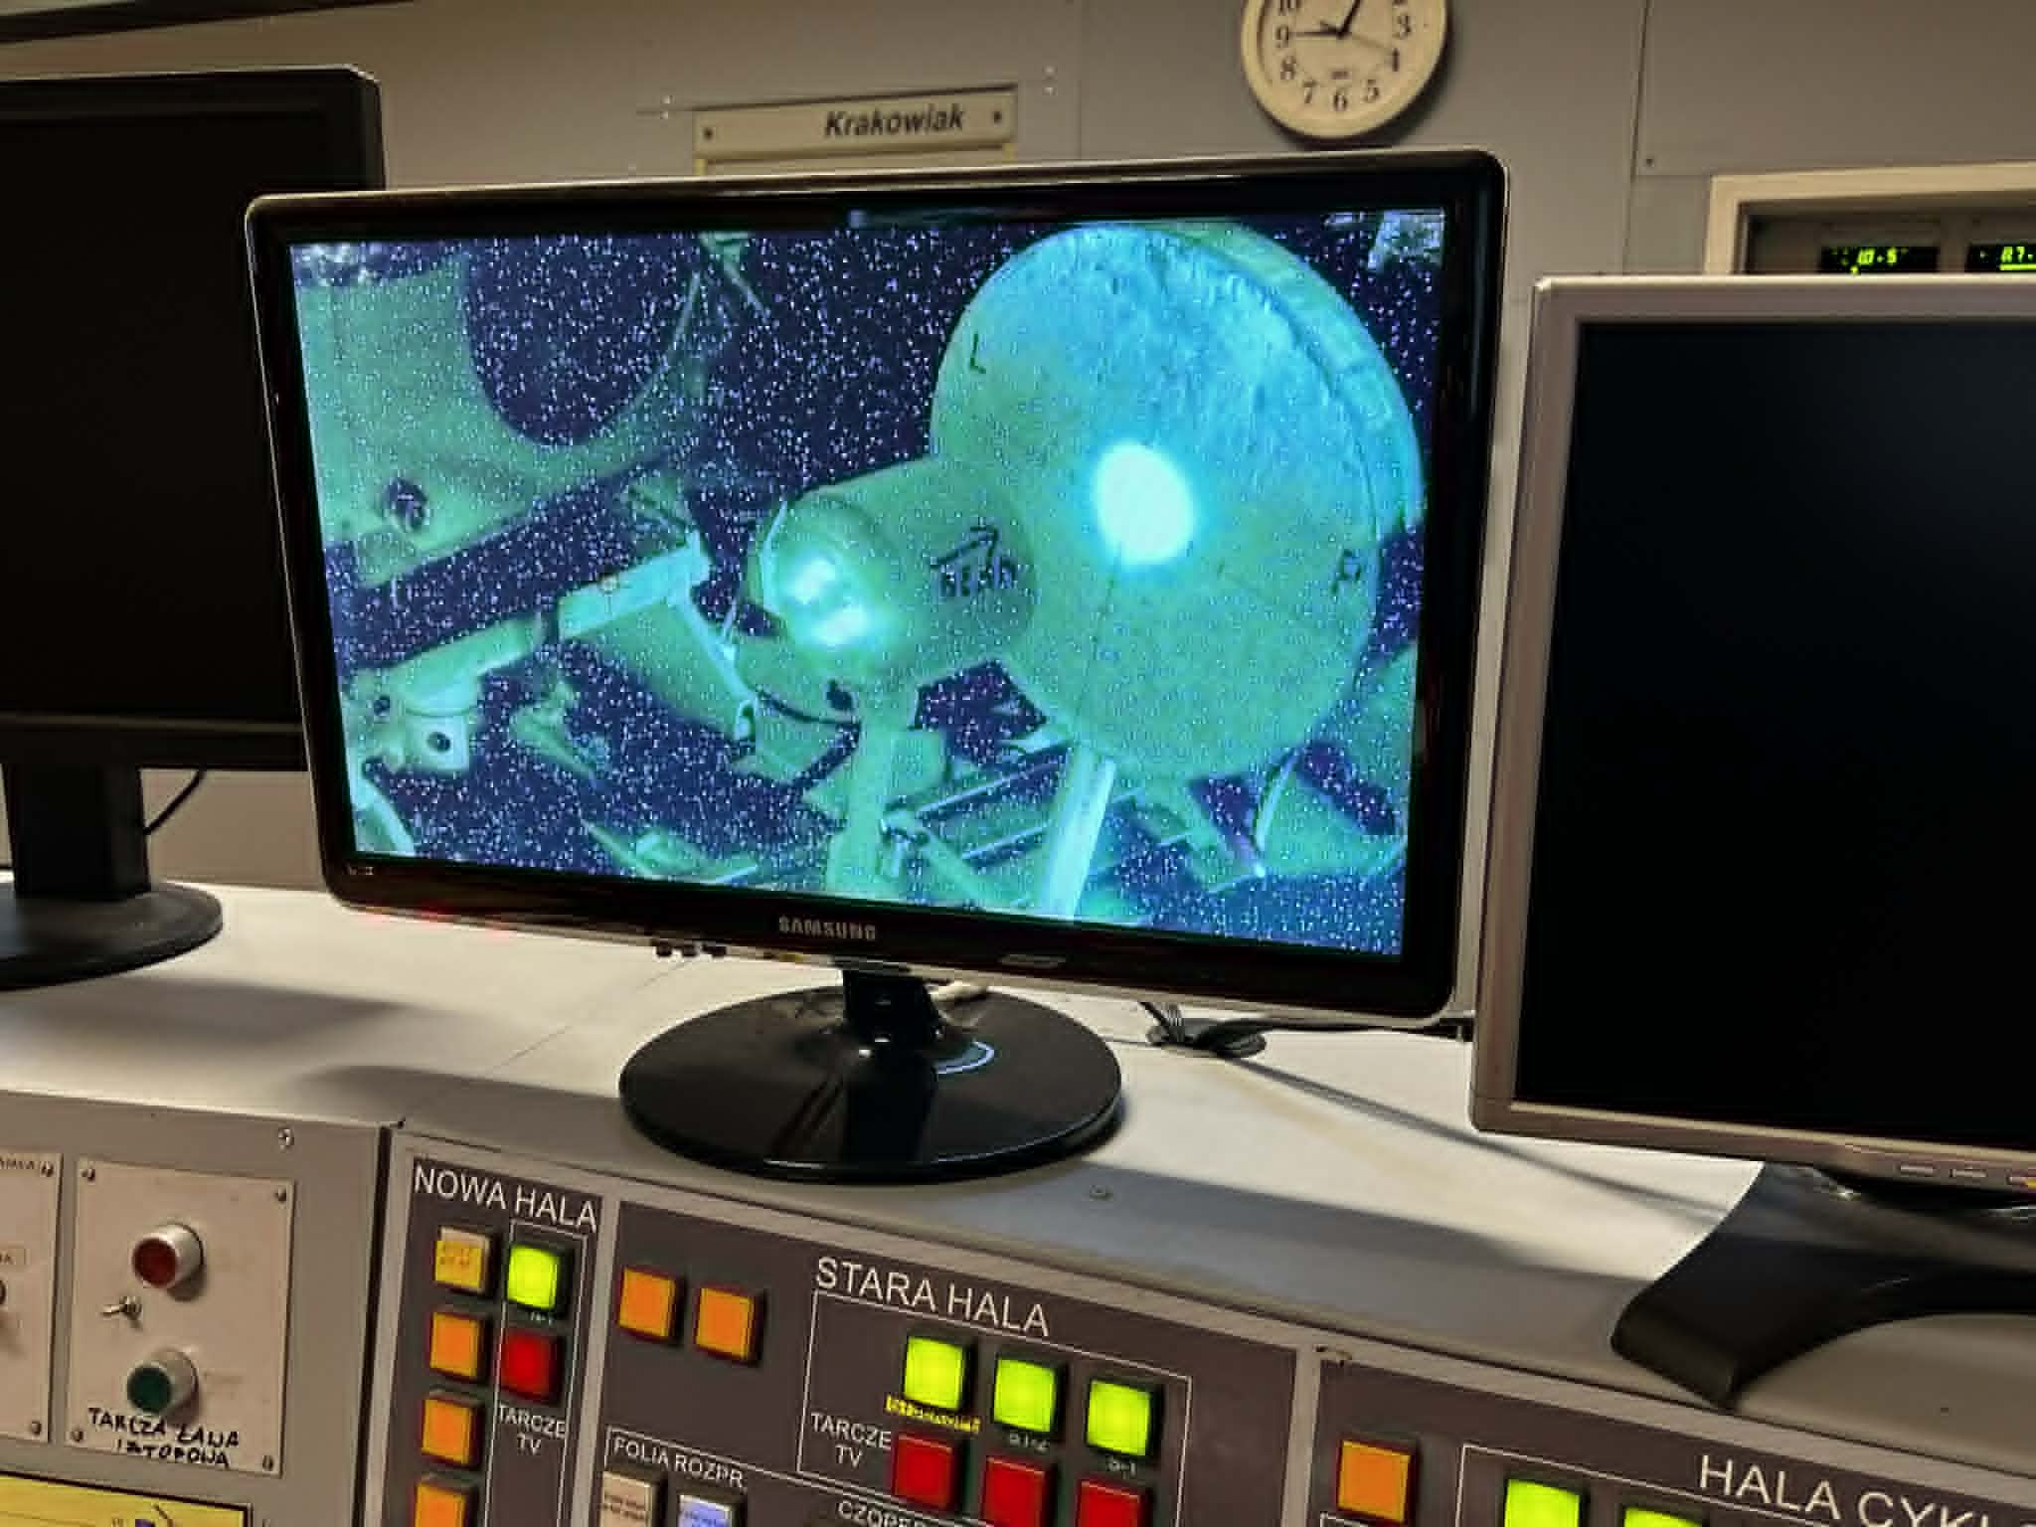
Desired beam ions
Primary Particle:
[x ] Proton (p+)
[x ] Deuteron (2H+ / d)
[x ] Alpha (4He2+)
[x ] Lithium-7 (7Li3+)
[x ] Other (e.g., 16O8+)

Slide 11
Energies
Acceleration Stage (Energy):
[ ] Section 1: 2.5 MeV/u
[ x] Section 2: 12.5 MeV/u
[ x] Section 3: 250 MeV/u (Future expansion / High energy)
[ ] Custom Energy: _________ MeV/u (Variable range within section limits)

Slide 12
More details
Intensity / Current:
Required current on target: 0.0001 – 0.1 mA
High intensity requirements (if applicable): _1 mA (in special cases)
Time Structure:
Pulse repetition rate: [ ] 100 ns | [ ] 200 ns | [ ] 400 ns | [ ] Other: n/a
Bunch width (Sigma/FWHM): < 0.5 ns
[ ] Requirement for zero dark current (no background between pulses)
Beam Spot Geometry:
Desired spot size on target: _10-15 mm or larger
[ ] Requirement for no beam halo
Energy Resolution:
ΔE requirement: ~ 0.5 MeV

Slide 13
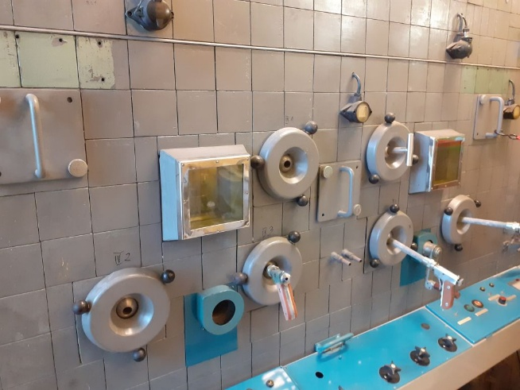
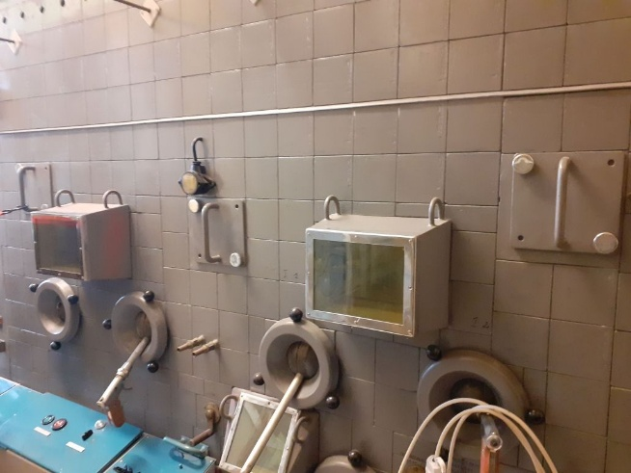
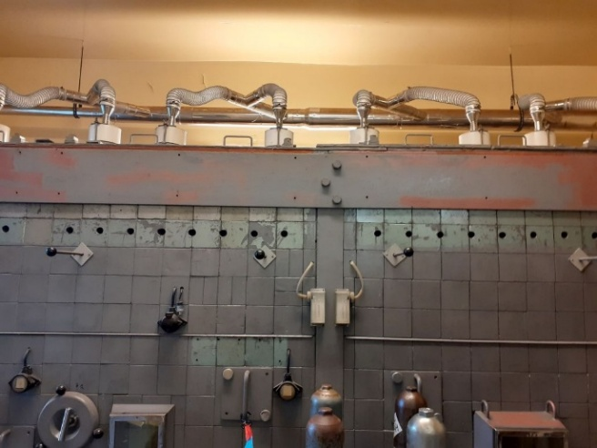
6. Additional Infrastructure Needs
Modification/upgrade of existing hot cell or construction of brand new lab for processing of irradiated targets, transport of targets to radiochemical lab together with targetry preparation bench/workshop:
Box renovation (new equipment, restoration and testing of target transport system, installation of area monitoring)
Glovebox stations for target preparation / separation in inert atmosphere
New targetry workbench for construction of cooled targets, gas targets etc.

Slide 14
CONCLUSIONS
Planned is obtaining various radionuclides for both medical application and tracers for radiochemical analyses. If routine work for medicine a special devoted team needed.
To obtain maximum flexibility in future studies a wide range of beam particles as well as energies are desired.
High current of beam would be the key feature enabling obtaining sufficient activities for medical applications.
The heavy ion beams are of the particular interest due to opening room for production of radioactive tracers not available in (p,xn) or (d,xn) reactions.
For production of tracers high currents are not necessary. High energy will open also opportunity to use spallation for radionuclide production, what sometime is a only one way of production of desired nuclide.
Therefore, for proposed here purpose a wide range of beam particles and also energies as well as high current are required.

