Slide 1


Discrete gamma-ray spectroscopy in light ion beam-induced reactions
M. Matejska-Minda, P. Bednarczyk, I. Dedes,
D. Duda (PhD student), et al.,
2nd Workshop on Research & Innovation in Poland
IFJ PAN, Krakow, 26-27 May, 2026

Slide 2
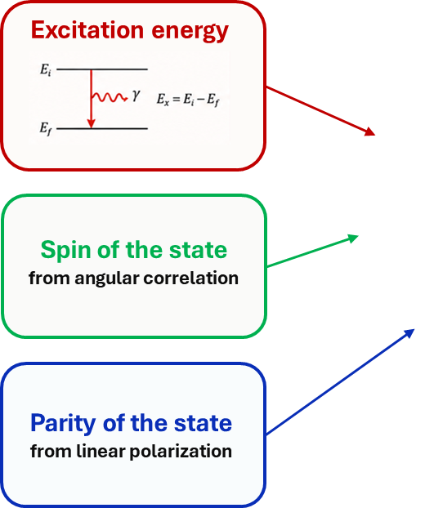
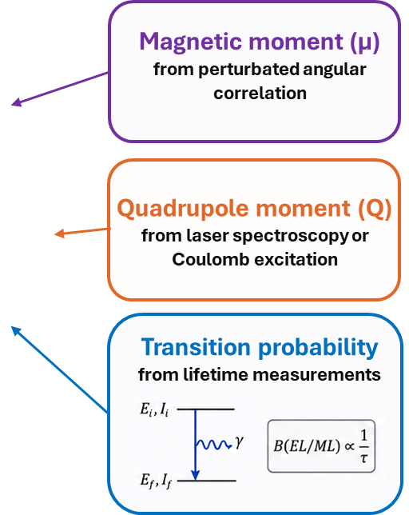
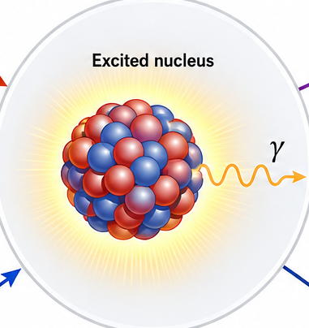
Discrete gamma-ray spectroscopy gives access to the most important observables of the excited nuclear states
enabling comparison with nuclear structure models

Slide 3
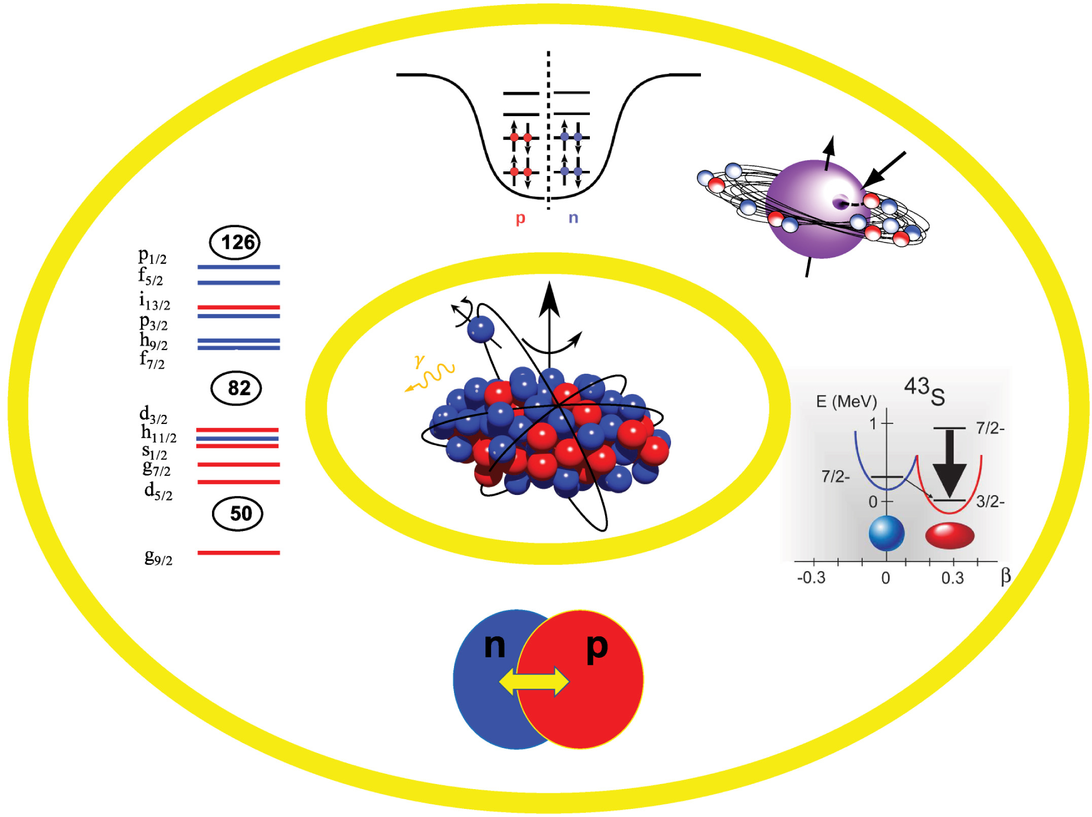
Key properties of the nuclear structure that can be studied using high-resolution γ -ray spectroscopy
Level filling with nucleons and the impact of their interactions
Complex configurations and isomerism
Shell structure and single-particle properties
Nuclear shapes and shape coexistence
Collective vibrations of nuclei
A. Bracco, G. Duchêne, Zs. Podolyák, P. Reiter - Progress in Particle and Nuclear Physics, 121 (2021) 103887

Slide 4

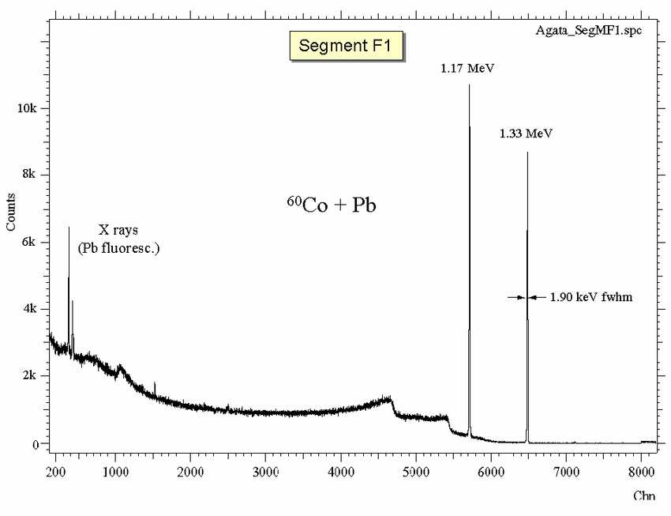
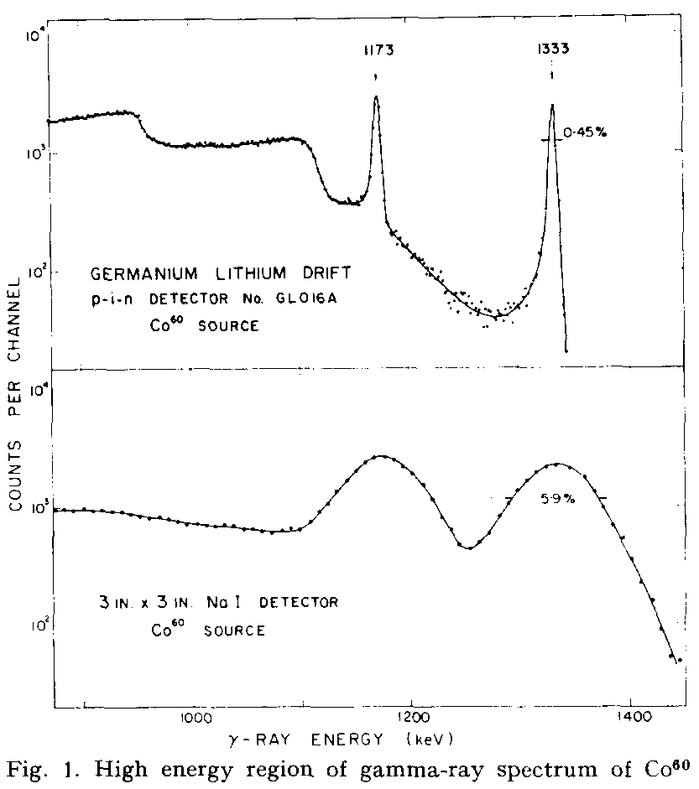
High-resolution measurement of discrete transitions a tool to study the structure of the atomic nucleus
Modern gamma-ray spectrometer

Slide 5
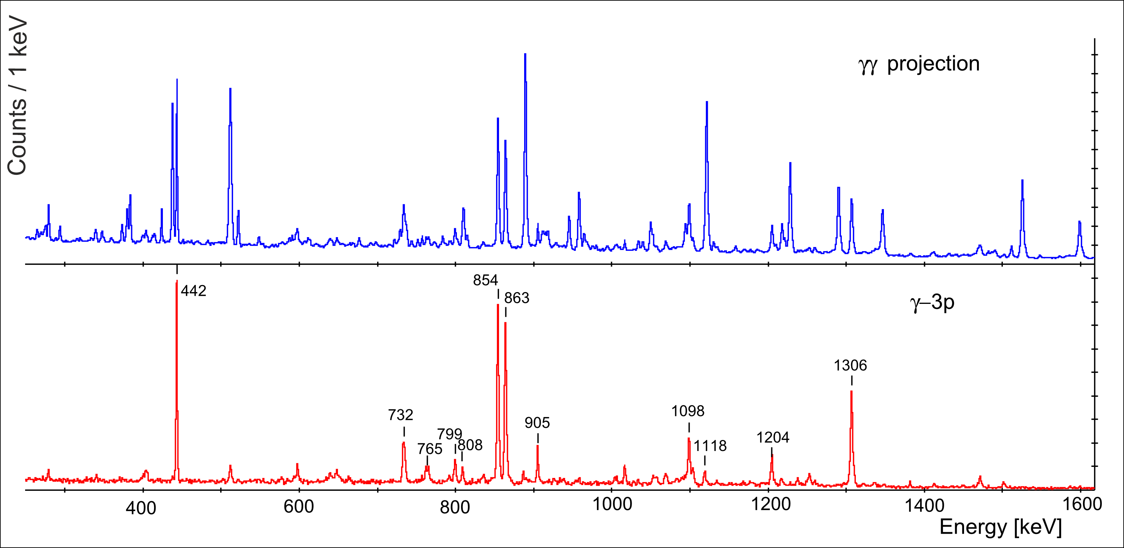
High-resolution measurement of discrete transitions a tool to study the structure of the atomic nucleus
EAGLE+NEDA+DIAMANT
³²S(86 MeV) + ⁴⁰Ca
D. Duda (PhD thesis, Acta Phys. Pol. B Proc. Suppl. 19, 1-A20 (2026))
Main experimental tools
  HPGe detectors
  Particle-gamma coincidence measurements

Slide 6
Gamma-ray spectroscopy on LINIAC beams at IFJ PAN
⁷Li beam The weakly bound cluster structure of ⁷Li makes it an ideal probe for transfer and fusion studies:
  Transfer reactions
    (⁷Li, alpha), (⁷Li, tritium), (⁷Li, ⁶Li), …
    Cluster structures in light nuclei
  Fusion reactions (⁷Li beam can be utilized with a wide variety of targets, including heavy radioactive materials)
    Fusion-evaporation as a standard approach
    Incomplete fusion - ICF (possible reduction of fission cross section for heavy nuclei?)

Slide 7
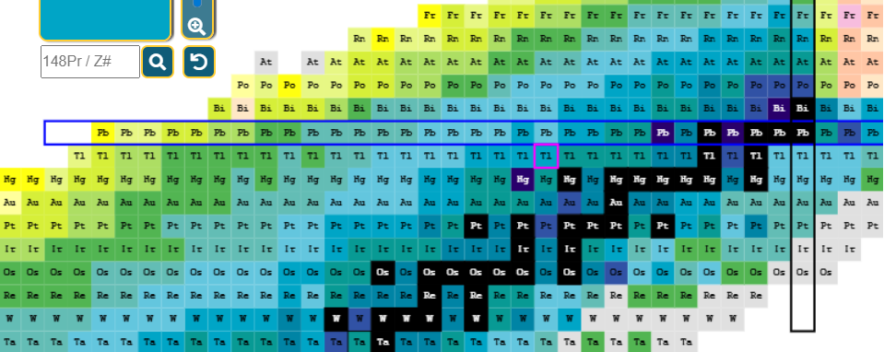
Spectroscopy of A~190 nuclei using ⁷Li beam
Neutron-deficient thallium (Z = 81) isotopes serve as a microscopic laboratory for nuclear physicists. They have just one proton less than the magic number for lead (Z = 82).
Z=82
N=126
A prolate-to-oblate shape transition is predicted to appear when moving towards the N = 126 shell closure, where the spherical shape should be restored.
Question of why prolate shapes dominate all over the chart of nuclei?
Subtle interplay between single-particle and collective degrees of freedom - related to the underlying NN interaction and its role in the microscopic origin of deformation.

Slide 8

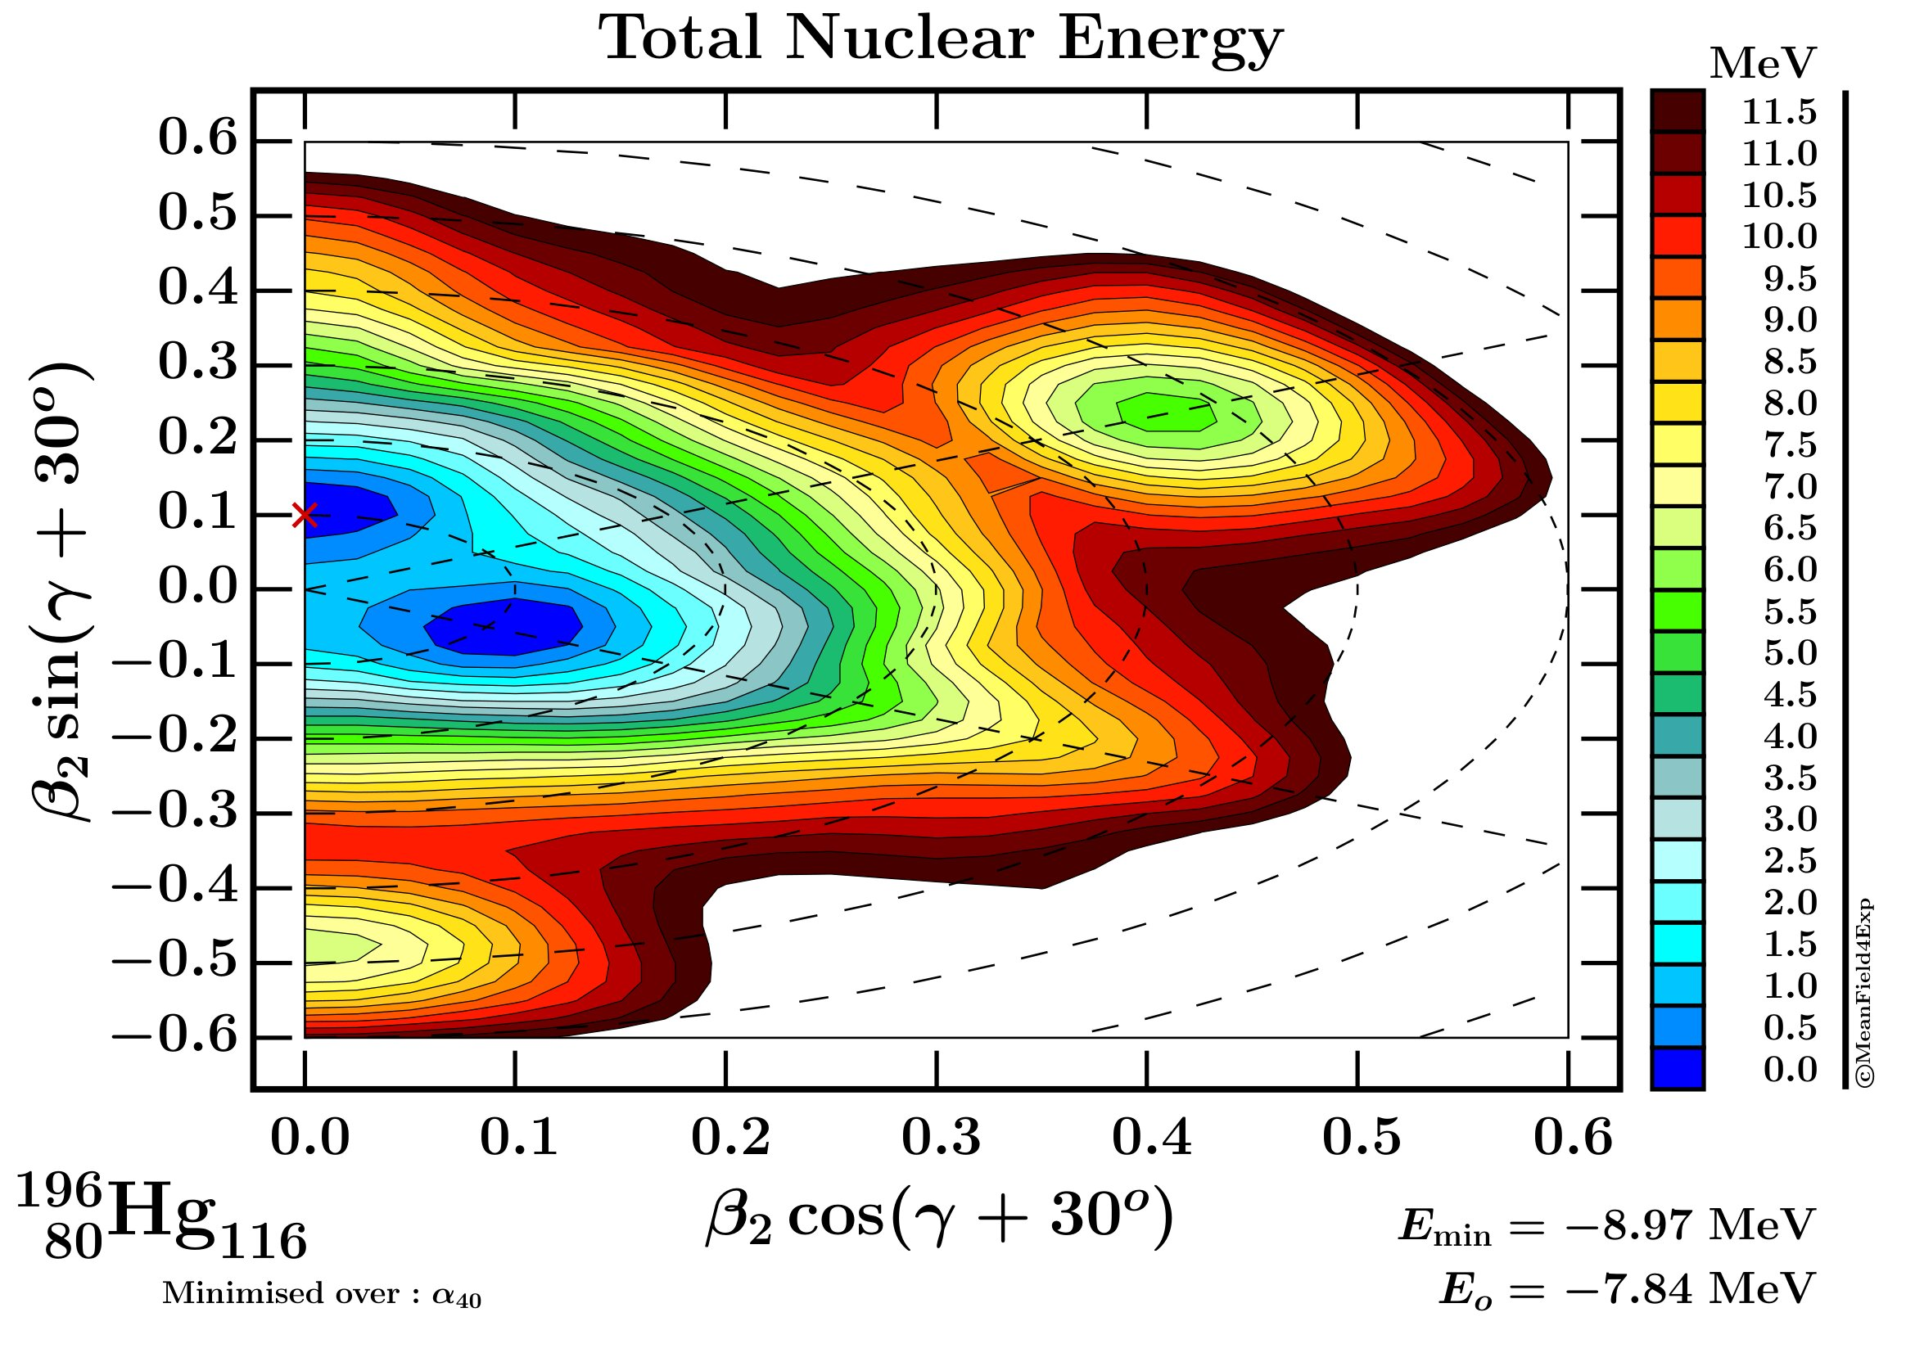
Spectroscopy of A~190 nuclei using ⁷Li beam
At low spin, the 1-quasiparticle configurations in ^{195,196}Tl prefer an oblate shape
As the nucleus is excited and neutrons align in the i_{13/2} orbital, calculations show that the system shifts toward triaxiality
Z=82
N=126
Potential energy surface as a function of the standard (beta, gamma) deformation, for ¹⁹⁶Hg, even-even neighbor of ¹⁹⁶Tl. In mean-field theory, it is a practical solution to refer to the even-even nucleus, since one expects similar results for the odd system concerned.

Slide 9
Spectroscopy of A~190 nuclei using ⁷Li beam
Previous studies - Tl nuclei were investigated using beams:
¹³C, 75 MeV, Physics Letters B 782 (2018) 768–772
¹⁸O ¹⁵N, ~90 MeV, Z. Phys. A-Hadrons and Nuclei 338,471-472 (1991)
⁴²Ca, 195 and 200 MeV - Phys. Rev. C 70, 064308 (2004)
Z=82
N=126
Example of proposed research using the future LINIAC at IFJ PAN:
⁷Li beam of E~6-10 MeV/n
Fusion-evaporation reactions
i.e., investigation of high-spin states in ¹⁹³⁻¹⁹⁶Tl
Measurement of the excited states’ lifetimes
Set-up: HPGe array + particle detectors

Slide 10
Which Section (1, 2 or 3)
Required beam: particle, energy and properties
Section 2
⁷Li beam with variable energy in the range of 2.5–12.5 MeV, with absolute suppression of dark current (off-pulse background) by a factor of at least 10⁶
Pulse structure required: 100 ns and its multiples
Beam current on target should reach up to ~500 nA
Beam energy resolution of approximately 10–20 keV is desirable

Slide 11
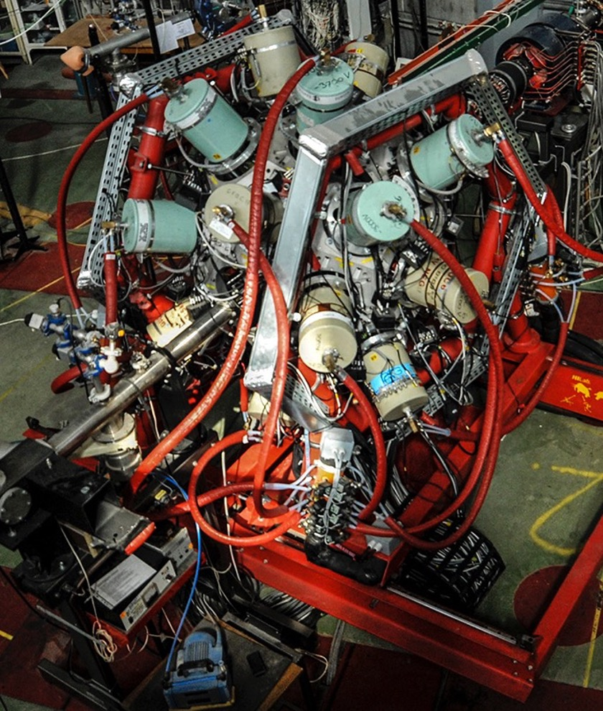
Required Infrastructure
For HPGe Detector Operation
  Nitrogen cooling installation
  Detector Service Laboratory
EAGLE @ HIL UW
During the design phase, ensure that the experimental hall is adapted to the nitrogen cooling system.
Allocate dedicated space for a detector servicing laboratory.
Particle detectors
  Particle detectors are available both in IFJ and among collaborations (light charge particles, neutrons, recoils)

Slide 12
SWOT analysis for the project
S (Strengths) Potential for internationally competitive measurements. Access to an intense ⁷Li beam (ensuring suitability for nuclear physics experiments), access to modern gamma-ray spectroscopy technologies, and availability of shared advanced detector systems for gamma spectroscopy.
W (Weakness) Very limited range of available ion beams and lack of existing infrastructure for high-resolution gamma-ray spectroscopy experiments.
O (Opportunities) Complementary nuclear structure studies using light-ion beams; development of technical and nuclear research competences at IFJ PAN and construction of a complete experimental setup. Opportunity to become an active member of the international community studying the structure of heavy and very heavy nuclei, and to establish IFJ PAN as an experimental site in this field.
T (Threats) Long timescale, which may lead to partial obsolescence of the research program. Insufficient funding for the experimental setup and the high cost of advanced gamma-ray spectrometers.

Slide 13
Conclusions
Gamma-ray spectroscopy is a powerful tool in nuclear structure investigations
Light-ion beams from the future LINAC accelerator at IFJ PAN will provide new opportunities to study nuclear structure and shape evolution, offering valuable insight into the underlying microscopic interactions
This requires the availability of an HPGe germanium array @ IFJ PAN
The future LINAC facility at IFJ PAN could establish a competitive program in nuclear spectroscopy

