Slide 1

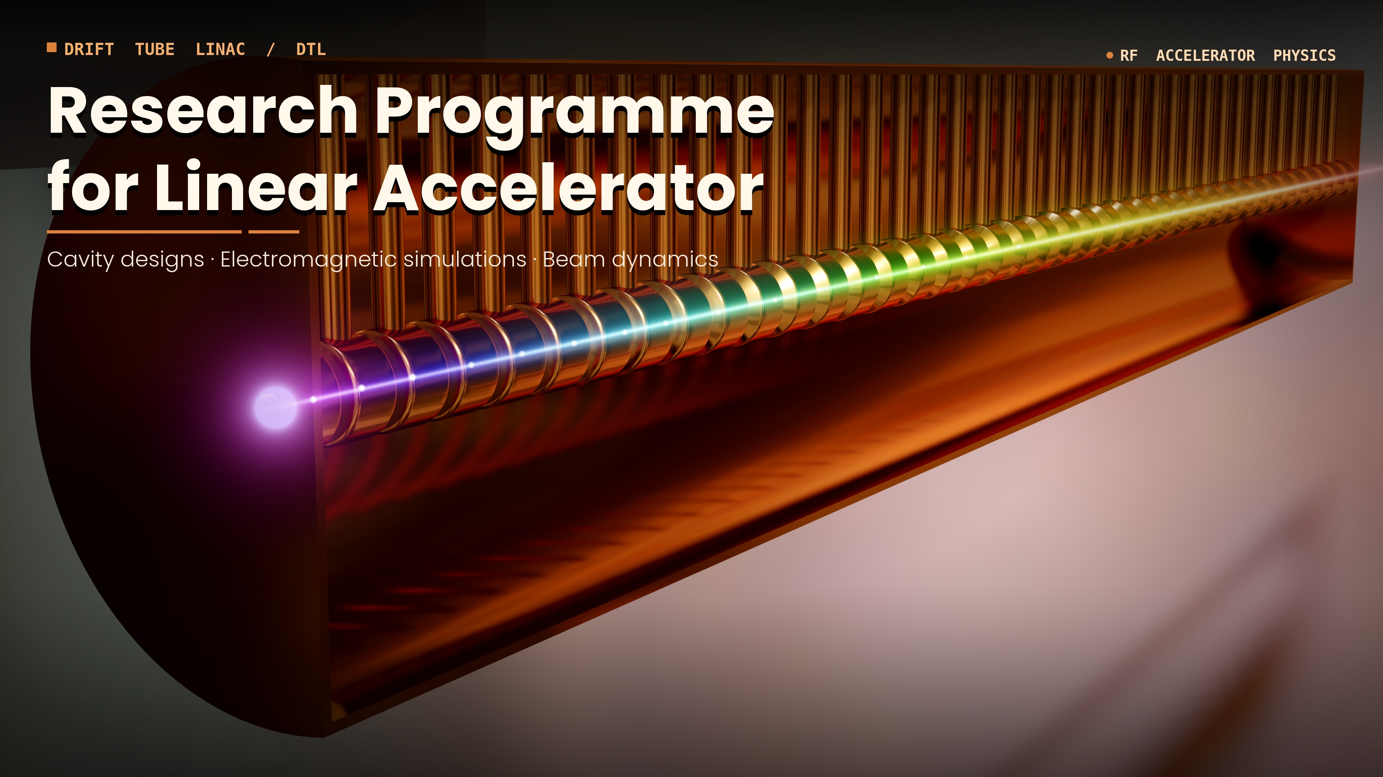
Measurements of stretched resonances decays in light atomic nuclei
Natalia Cieplicka-Oryńczak et al.
2nd Workshop on Research & Innovation in Poland
IFJ PAN, Krakow, 26-27 May, 2026

Slide 2








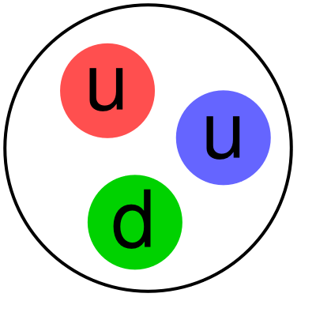

Introduction
OBSERVATION
Experiment
Theory
ATOMIC NUCLEUS
Many Body Quantum System
bound by the nuclear force
d
PREDICTION
PROTON
NEUTRON
COMPLEXITY OF THE SYSTEM
QUARKS and GLUONS are the building blocks of nucleons, while nucleons are the building blocks of nuclei
No a priori theory for
nuclear interaction!
Until the nucleon-nucleon interaction can be derived from more fundamental theory such as Quantum Chromodynamics we have to use various parametrizations for different purposes.
COMPLEXITY OF THE NUCLEAR FORCE
nuclear force acting between nucleons arises from the residual force acting between quarks in different nucleons

Slide 3
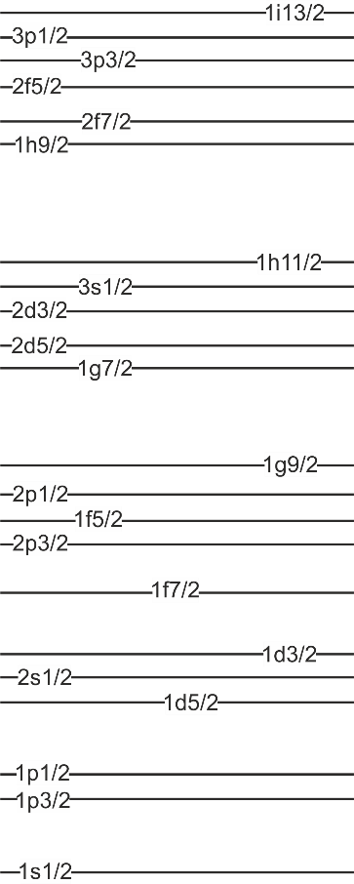
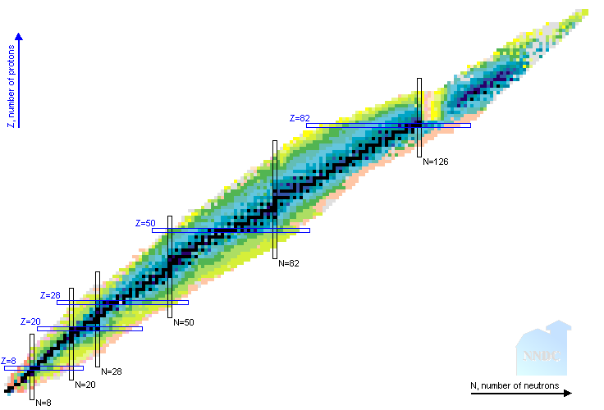
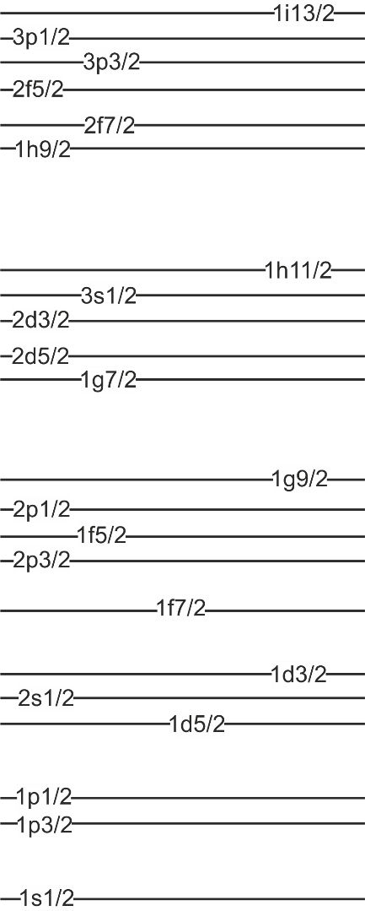
What is a „stretched” state?
Such states are dominated by a single particle-hole component for which
the excited particle and the residual hole couple to the maximal possible spin value:
J_{max} = j_{p} (max) + j_{h} (max)
M12
REPORTED STRETCHED STATES
M10
h_{11/2}  i_{13/2} M12 transitions
i_{13/2}  j_{15/2} M14 transitions
²⁰⁸Pb
J = 5/2 + 3/2 = 4
M8
f_{7/2}  g_{9/2} M8 transitions
⁵²Cr, ⁵⁴Fe, ⁵⁶Fe, ⁵⁸Ni ⁶⁰Ni
M6
d_{5/2}  f_{7/2} M6 transitions
²⁴Mg, ²⁸Si
M4
PROTONS NEUTRONS
p_{3/2}  d_{3/2} M4 transitions
¹¹B, ^{12,13,14}C, ^{14,15}N, ¹⁶O
¹⁶O
SHELL-MODEL ORBITALS

Slide 4
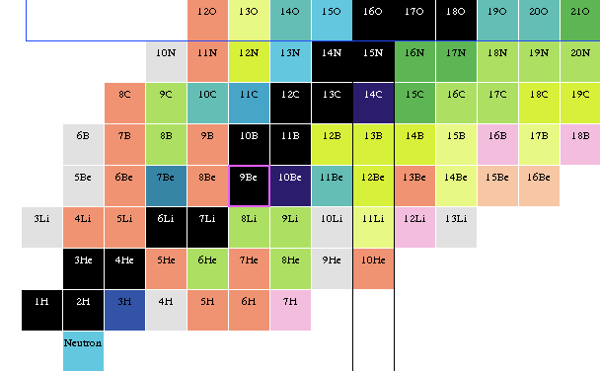
Stretched states in light nuclei – why are they interesting?
CONFIGURATIONAL PURITY
ones of the simplest known
nuclear excitations
TESTING GROUND FOR THEORETICAL CALCULATIONS
properties of stretched states (decay patterns e.g.) used as
demanding test of state-of-the-art theory approaches
(Gamow Shell Model e.g.)
1d_{5/2}
J = 5/2 + 3/2 = 4
M4 STATES
IN CONTINUUM
¹⁶O
¹⁷O
¹⁸O
UNBOUND STATES
1p_{1/2}
¹⁴N
¹⁵N
¹²C
PARTICLE
SEPARATION
ENERGY
¹³C
¹⁴C
1p_{3/2}
¹¹B
1s_{1/2}
BOUND STATES
PROTONS NEUTRONS
1s_{1/2}
1p_{3/2}
¹⁶O
1p_{1/2}
1d_{5/2}
Notes:
dodać slajd z listą reakcji, w których wzbudzane były rezonanse M4

Slide 5
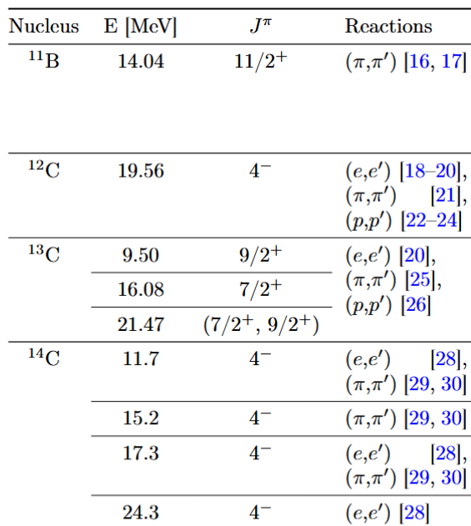
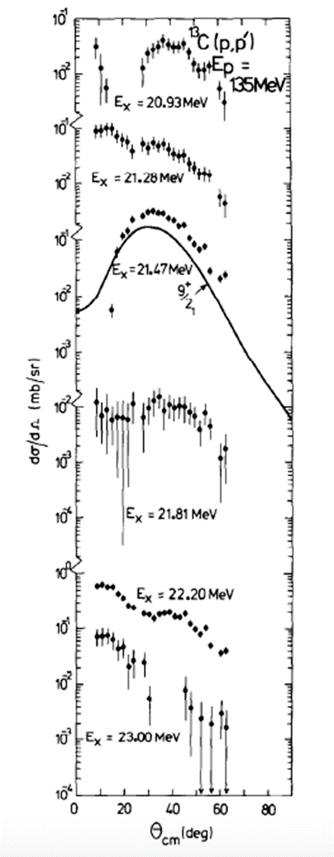
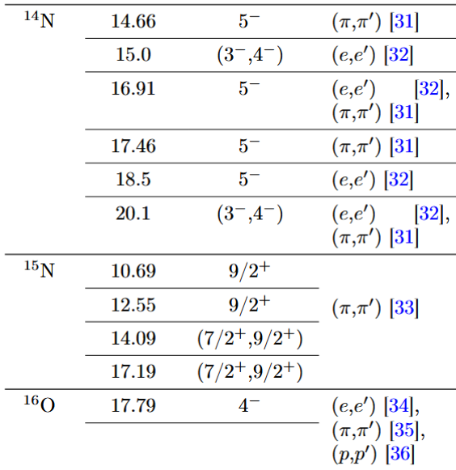
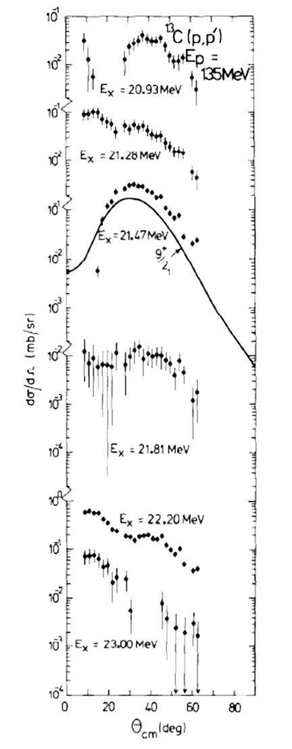

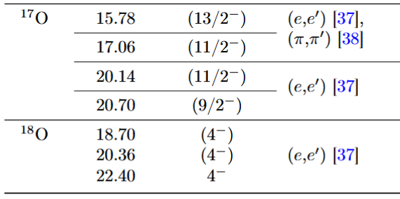
The ways to reach the stretched states in light nuclei
Preferentially populated in
inelastic scattering reactions
at large momentum transfer
Used probes:
protons
pions
electrons
1d_{5/2}
1p_{1/2}
¹⁶O
¹⁷O
¹⁸O
¹³C
¹⁴N
¹⁵N
¹²C
¹³C
¹⁴C
1p_{3/2}
¹¹B
ALMOST NO DATA ON M4 RESONANCES DECAY!
S.F. Collins et al.,
Nuc. Phys. A481, 494(1988)
1s_{1/2}
30°
The differential cross sections
for the stretched-states population
in (p,p’) reactions are peaked at ~30°
1s_{1/2}
1p_{3/2}
1p_{1/2}
1d_{5/2}

Slide 6
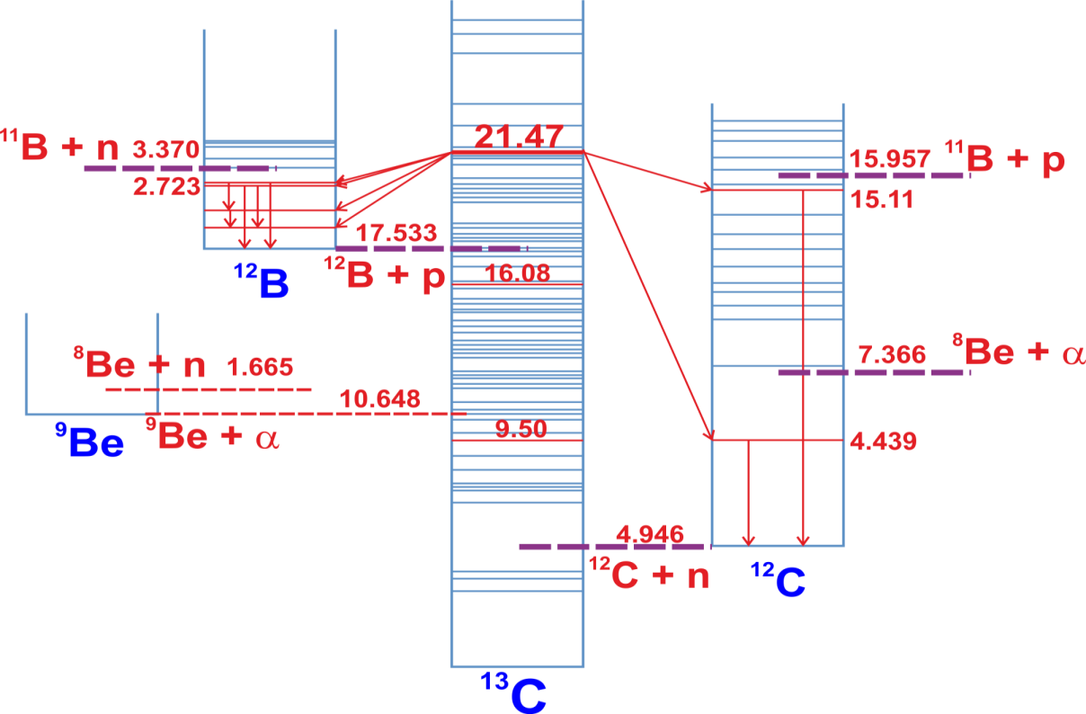
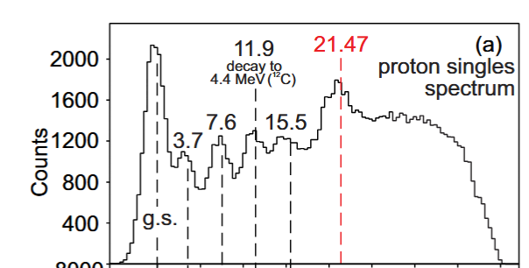

Experimental method: particle – gamma coincidence measurement
Experiment at CCB: STUDY OF M4 STRETCHED CONFIGURATION DECAY IN ¹³C
Spokespersons: B. Fornal (IFJ PAN), S. Leoni (INFN and Univ. Milano), M. Ciemała (IFJ PAN)
GAMMA RAYS
COINCIDENCE MEASUREMENT OF GAMMA RAYS
¹³C
TARGET
PROTON BEAM
135 MeV
Excitation to the 21.47-MeV state in proton inelastic scatering reaction
SETTING THE GATE ON THE RESONANCE
S.F. Collins et al.,
Nuc. Phys. A481, 494(1988)
30°

Slide 7
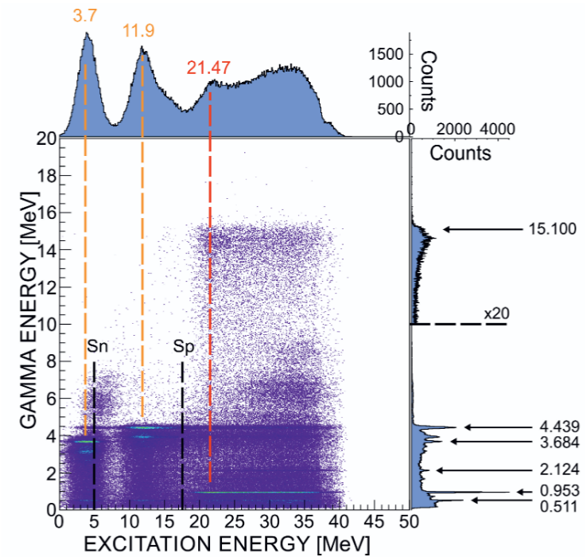
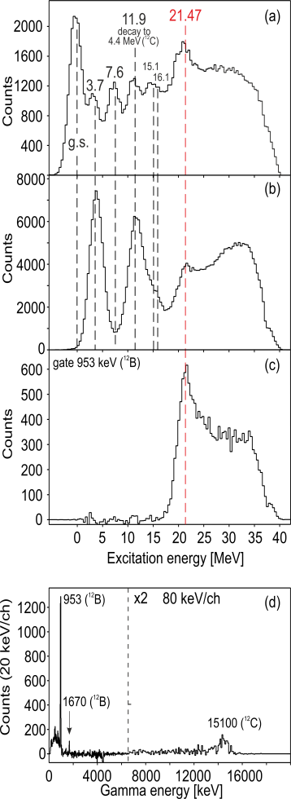
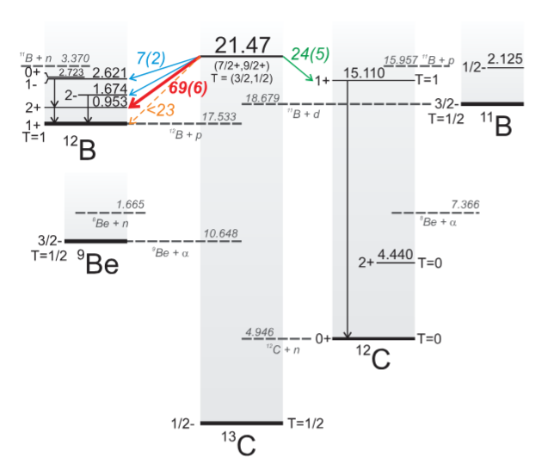
Experimental method: particle – gamma coincidence measurement
GATE 21.47 MeV (¹³C)

Slide 8
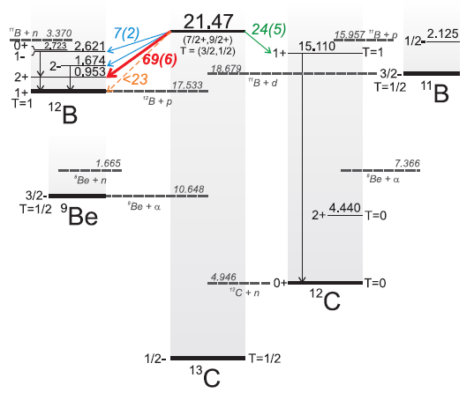
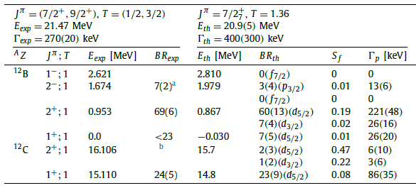
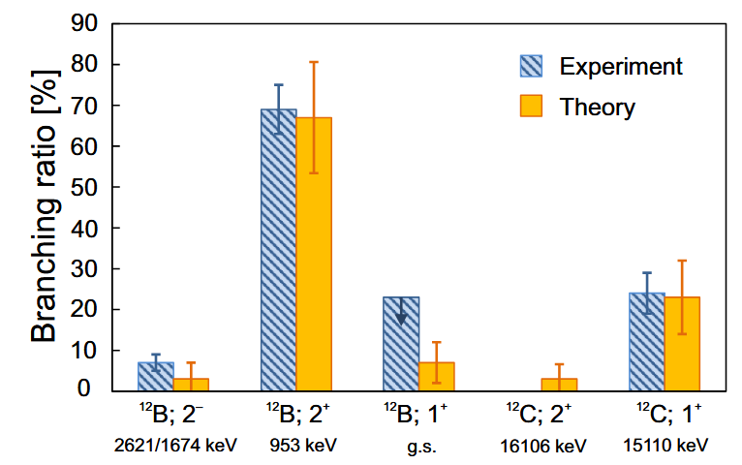
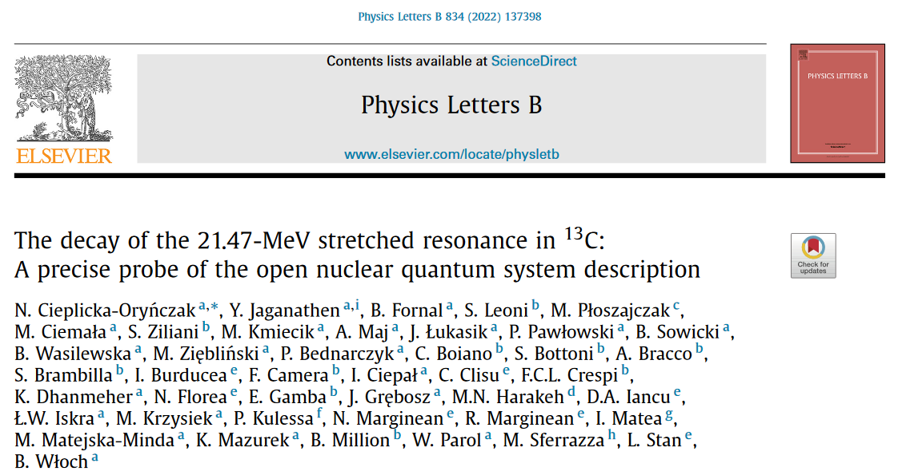
Comparison with theory describing open quantum systems
Experimental results
Gamow Shell Model calculations
(Y. Jaganathen (IFJ PAN) and M. Płoszajczak (GANIL))
PROTON DECAY
NEUTRON DECAY

Slide 9
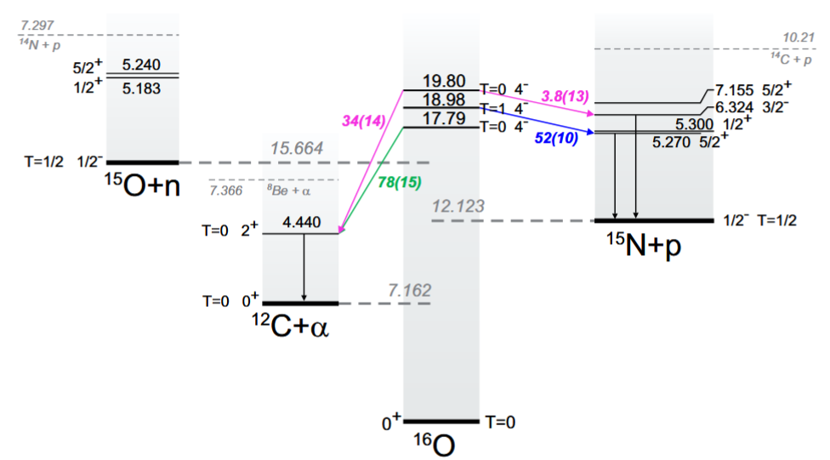

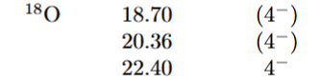
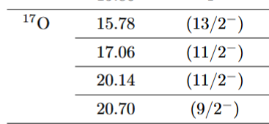
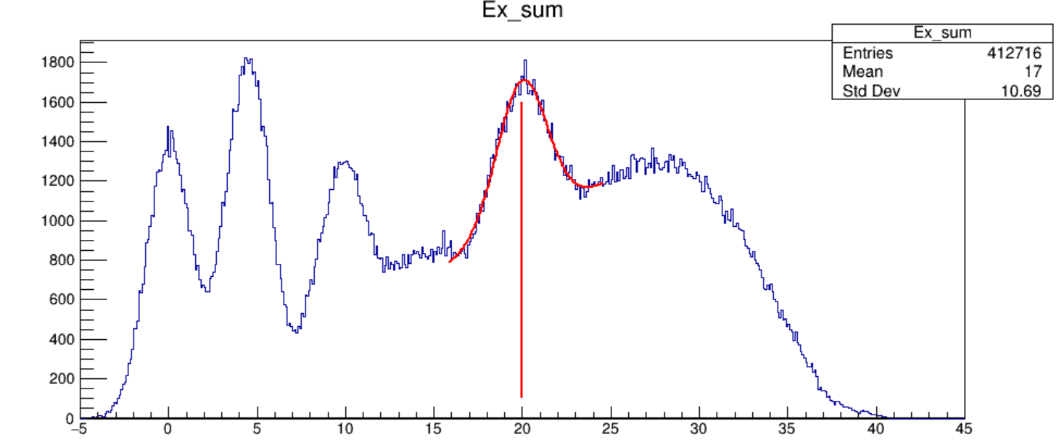
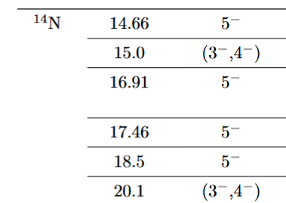
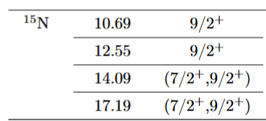
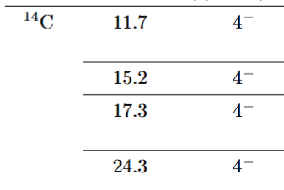

Already done
at CCB:
Not yet studied:
¹⁸O
¹⁷O
¹⁶O
Counts
1d_{5/2}
¹⁴N
¹²C – under analysis…
1p_{1/2}
¹⁶O
¹⁷O
¹⁸O
Excitation Energy [MeV]
¹⁴N
¹⁵N
¹²C
¹³C
¹⁴C
1p_{3/2}
¹¹B
¹⁵N
1s_{1/2}
¹⁴C
1s_{1/2}
1p_{3/2}
1p_{1/2}
1d_{5/2}
¹¹B
¹³C

Slide 10
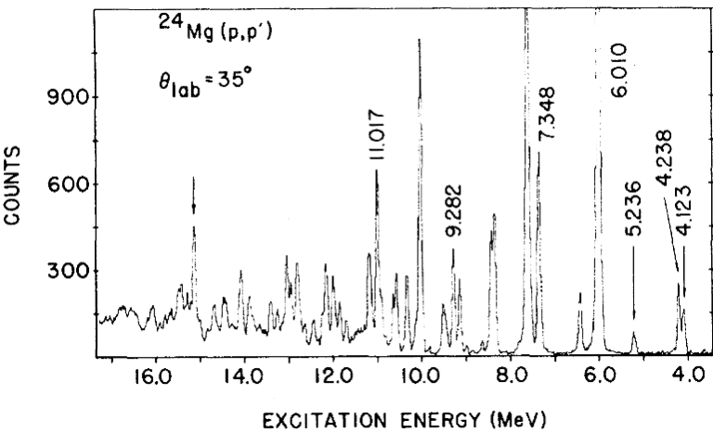
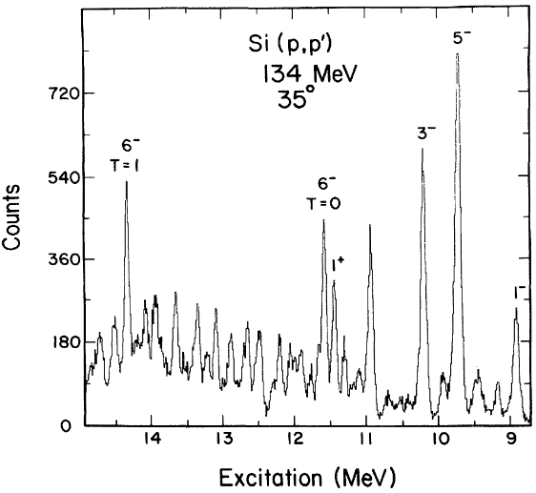
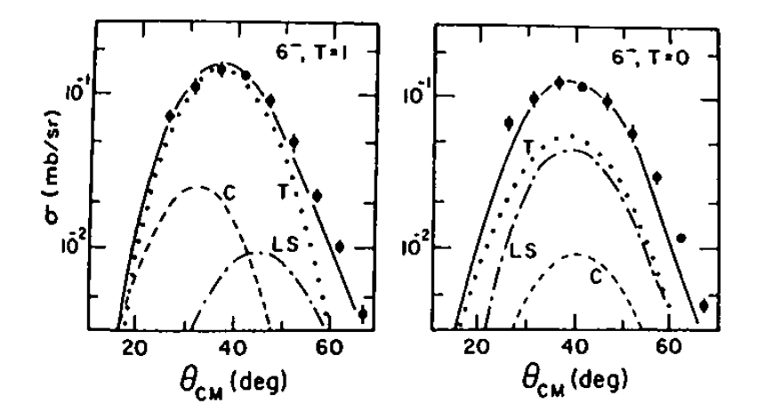
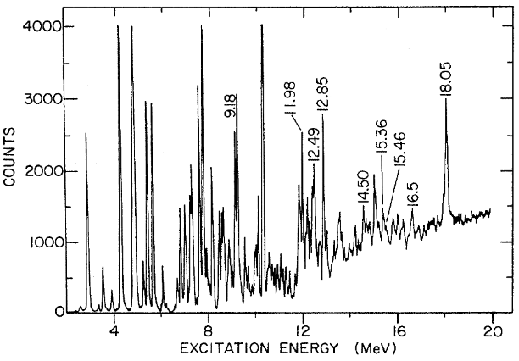
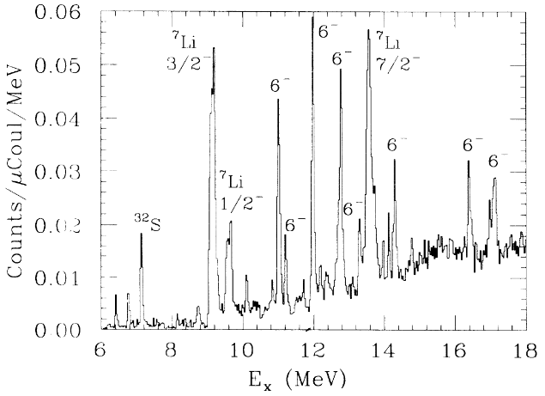
M6
Possible in future
G.S. Adams et al., Phys. Rev. Lett. 38, 1387 (1977)
C. Olmer et al., Phys. Rev. C 29, 361 (1984)
14.36
11.58
15.14
²⁴Mg
²⁸Si
d_{5/2}  f_{7/2}
M6 transitions
to J^{π}=6– states
(²⁴Mg, ²⁶Mg, ²⁸Si, ³²S, …)
R.E. Segel et al., Phys. Rev. C 39, 749 (1989)
B.L. Clausen et al., Phys. Rev. Lett. 65, 547 (1990)
²⁸Si
²⁶Mg(p,p’)
11.94
12.74
³²S(e,e’)
G.T. Emery, J. Phys. Colloques 45, C4-389 (1984)
18.05
10.98
11.98
12.85
14.29
16.43
17.16
15.36
15.46
11.17
13.26
14.5
16.5
²⁶Mg
³²S
Additional upgrades to the setup are required:
Mass spectrometer to improve excitation energy resolution
HPGe detectors for discrete gamma-ray spectroscopy

Slide 11
Required beam: particle, energy nad properties
Section 3
PROTONS with variable energy in the 100-150 MeV range
well-controlled energy of the beam: energy resolution <100 keV
beam intensity on target reaching tens of nA
substantially reduced halo: pencil-like beam with a well-defined interaction point on the target
beam pulsing with finely controlled timing and suppression of the background between the pulses would be an advantage

Slide 12
Other requirements (detection system, infrastructure)
These experiments, to achieve more accurate results for more complex cases with overlapping states, would greatly benefit from:
HPGe detectors
Neutron detectors
Mass spectrometer (large experimental hall needed)

Slide 13
Project SWOT analysis
Strengths
Beam parameters highly suitable for stretched resonances studies
Hybrid coincidence measurements provide unique sensitivity to decay mechanisms
Feasibility already demonstrated at CCB;
Existing infrastructure available: KRATTA, PARIS, DSSDs, scattering chamber
Potential for high-quality LINAC beam and long-term scientific program
Weaknesses
Technically demanding multi-detector coincidence setup
Additional detectors likely required (HPGe, neutron detectors, improved proton spectrometry)
Low absolute efficiency → long beam times
High demands on DAQ and synchronization systems, complex data analysis
Opportunities
Benchmark data for modern theories of unbound nuclear states → strong integration of experiment and theory
Development of local expertise and infrastructure in Poland
Potential to become an important European center for medium-energy proton spectroscopy
Possibility of building international research collaborations
Threats
Long-term timeline before the final LINAC beam capabilities become available → similar experiments may be performed earlier somewhere else
Beam parameters may not fully meet requirements
Insufficient funding for optimal detector development

Slide 14

Conclusions
The experimental program focused on investigations of stretched states decays would strongly benefit from a LINAC facility optimized for high-quality medium-energy proton beams with well-controlled beam properties.
The initial stages of the project would already provide valuable opportunities for the development of local expertise, detector systems and accelerator-related competences, however, the proposed research program would become feasible after implementation of the advanced LINAC capabilities (Section 3).
Hopefully, this sprouting idea will eventually bloom!
THANK YOU FOR YOUR ATTENTION

