Slide 1

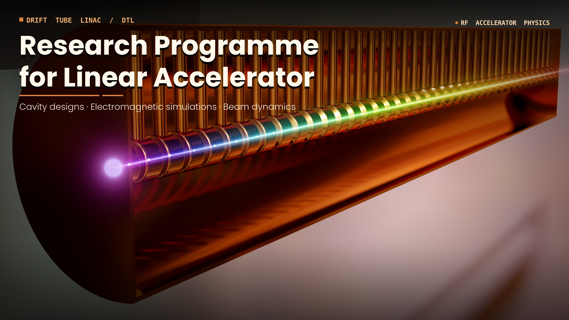
Introduction to the Workshop
Main goal: White Book on Reserach Programme for Linear Accelerator
Adam Maj, Dariusz Bocian, Michał Ciemała
2nd Workshop on Research & Innovation in Poland
IFJ PAN, Krakow, 26-27 May, 2026

Slide 2
The goal of this workshop is to present and discuss the possible physics cases to be conducted at linear accelerator, which will be the main chapter of the White Book

Slide 3
Programme Committee
(Editorial Board)
prof. dr hab. inż. Piotr Bała, AGH
dr hab. Dariusz Bocian, IFJ PAN
dr inż. Michał Ciemała, IFJ PAN
prof. dr hab. Bogdan Fornal, IFJ PAN
prof. dr hab. Stanisław Kistryn, UJ
prof. dr hab. Tadeusz Lesiak, IFJ PAN
prof. dr hab. Marek Lewitowicz, GANIL
prof. dr hab. Adam Maj, IFJ PAN
prof. dr hab. inż. Błażej Skoczeń, PK
dr Maurizio Vretenar, CERN

Slide 4
19 abstracts were submitted:
8 Nuclear Physics, 3 BioMed, 3 Irradiations, 5 applications
They will be presented today and tomorrow, and will be main part of the White Book
White Book organization:
Chapter 1: Idea and initial assumptions
Chapter 2: Physics cases
Chapter 3: Conclusions and Recommendations
Chapter 3 will be prepared by the Programme Committe (Editorial Board),
coordinated by Marek Lewitowicz and Maurizio Vretenar

Slide 5
Deadlines
Template for the contributions will be distributed until next week
Contributions (up to 4 pages per proposal) shall be send until June 30
Conclusions and Reccomedations – shall be ready until mid of September
White Book ready – first half of October
There is a possibility to publish the White Book (or parts of it) in European Physical Journal – Research Infrastructures

