Slide 1

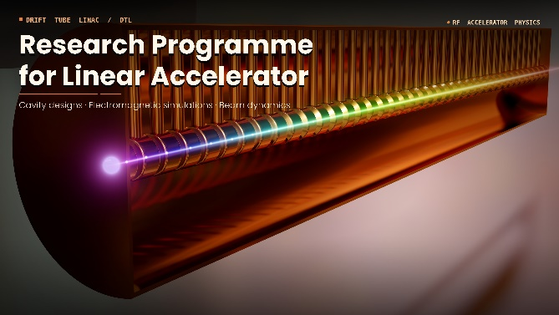
Production of fast neutrons using a LINAC
Gamma spectroscopy of the nuclei produced in
fast-neutron-induced fission reaction
Half-life measurements of long-lived isotopes
Ł. W. Iskra et al.
2nd Workshop on Research & Innovation in Poland
IFJ PAN, Krakow, 26-27 May, 2026

Slide 2
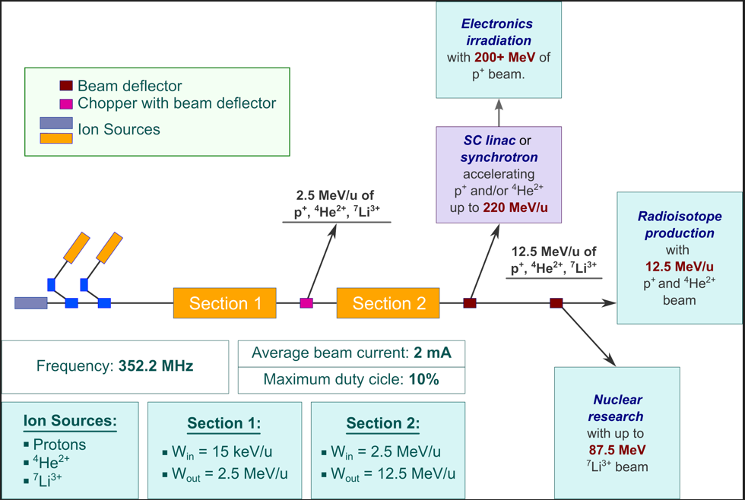
Production of fast neutrons using a LINAC
⁷Li³⁺
16 - 50 MeV

Slide 3
Production of fast neutrons using a LINAC
Standard neutron production reactions:
d(d,p)n
isotropic neutron production
less than 1% can be used in the experiment
⁷Li(p,n)⁷Be
Inverse kinematics with ⁷Li beam
p(⁷Li,n)⁷Be
directional beam
concept and technique developed at IJCLab
fast neutrons
LICORNE (Lithium Inverse Cinematiques ORsay NEutron source)
high intense beam
LIthium neutron Soure in KRAkow
M. Lebois et al., Nucl. Instrum. Methods Phys. Res. A 735, 145 (2014).
J.N. Wilson et al., Phys. Proc. 64, 107 (2015).

Slide 4
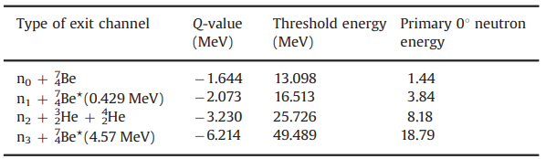
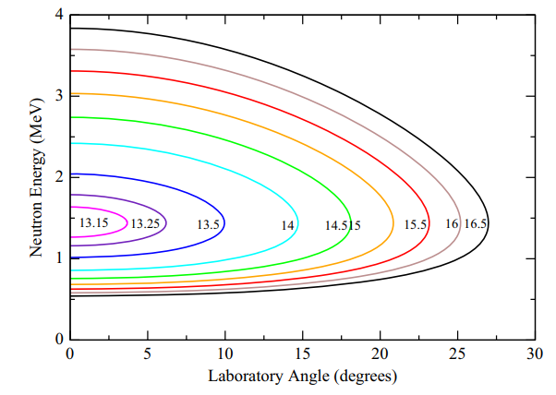
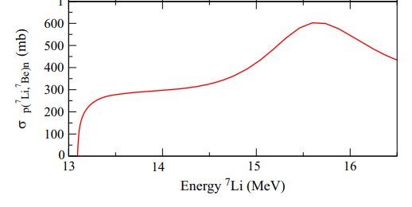
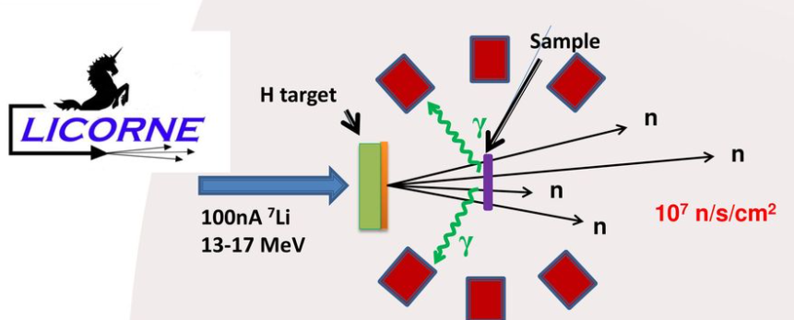
Production of fast neutrons using a LINAC
Beam energy
Neutron Energy 1.9 MeV
collimated beams and high neutron fluxes
at short distances
⁷Li³⁺ 16 - 50 MeV
Courtesy of J. Wilson
2 - 19 MeV neutrons

Slide 5
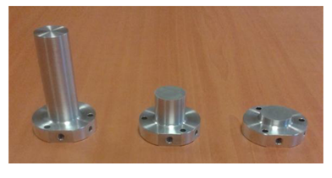
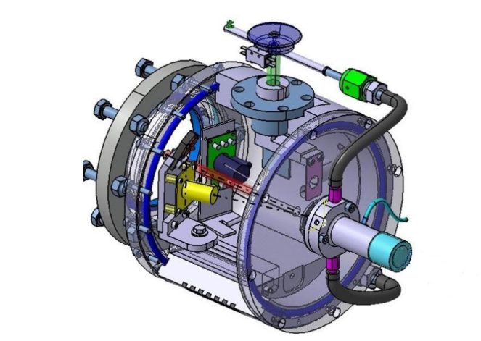
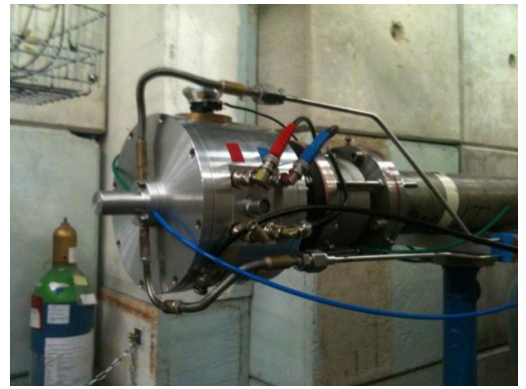
Production of fast neutrons using a LINAC
Target
H₂ gas target
- gas pressure – 1.5-2 atm
1.0×10²⁰ and 8.0×10²⁰ hydrogen atoms per cm²
Tantalum entrance window is 5mm in diameter and between 2μm and 4μm thick – for 2 atm. and 100 nA
The thicker the target the greater the neutron production rate, but the larger the degradation in energy resolution of the neutron beam as well.

Slide 6
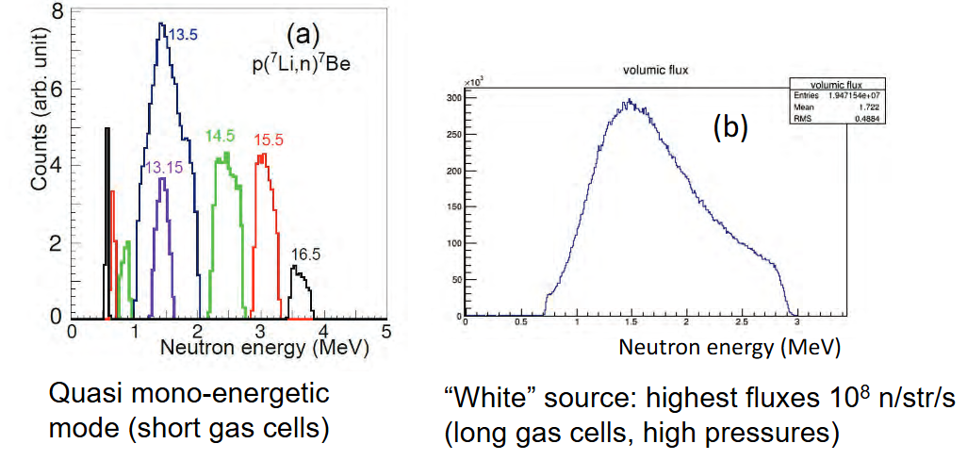
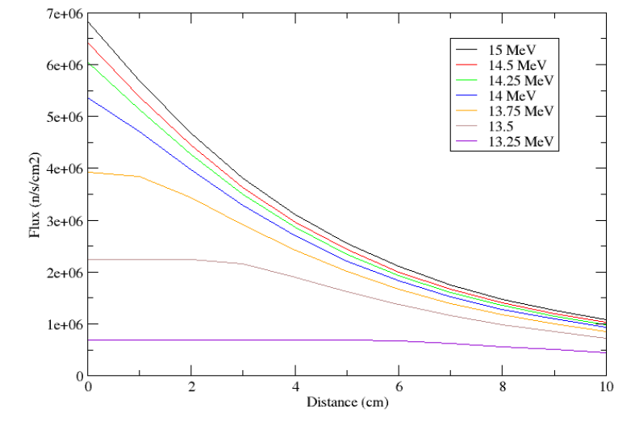
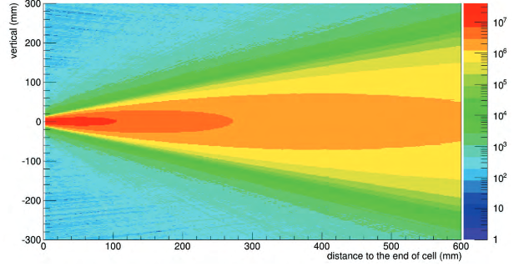
Production of fast neutrons using a LINAC
Neutron spectrum and flux
Safety :
hydrogen is evacuated outside the accelerator buildings to
prevent potentially explosive build-ups of gas
In the event of a rupture of the cell window, two safety
valves will close rapidly when sensors detect any minor
changes in pressure and the flow of hydrogen from the
gas bottle is cut off

Slide 7
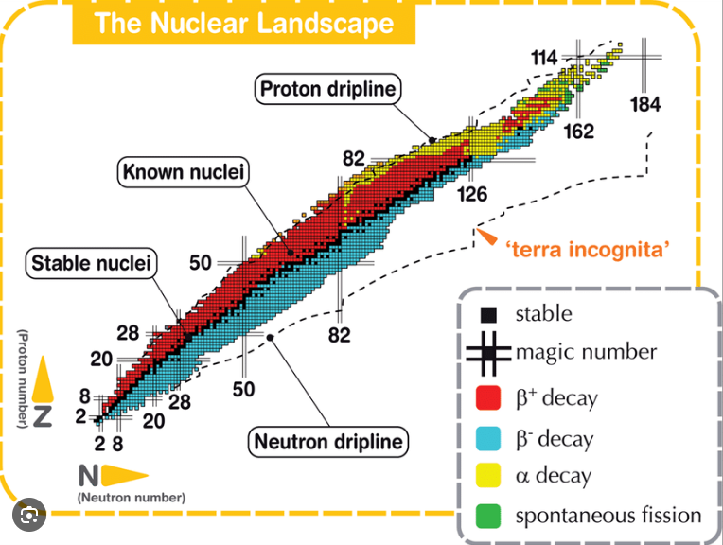
Gamma spectroscopy of the nuclei produced in
fast-neutron-induced fission reaction
300 stable nuclei
3000 known nuclei
7000 predicted nuclei
Mass
Half-life
Decay mode
Courtesy of Alessio Galata
Shapes
How protons and neutrons are arranged and
how they interact with each other

Slide 8
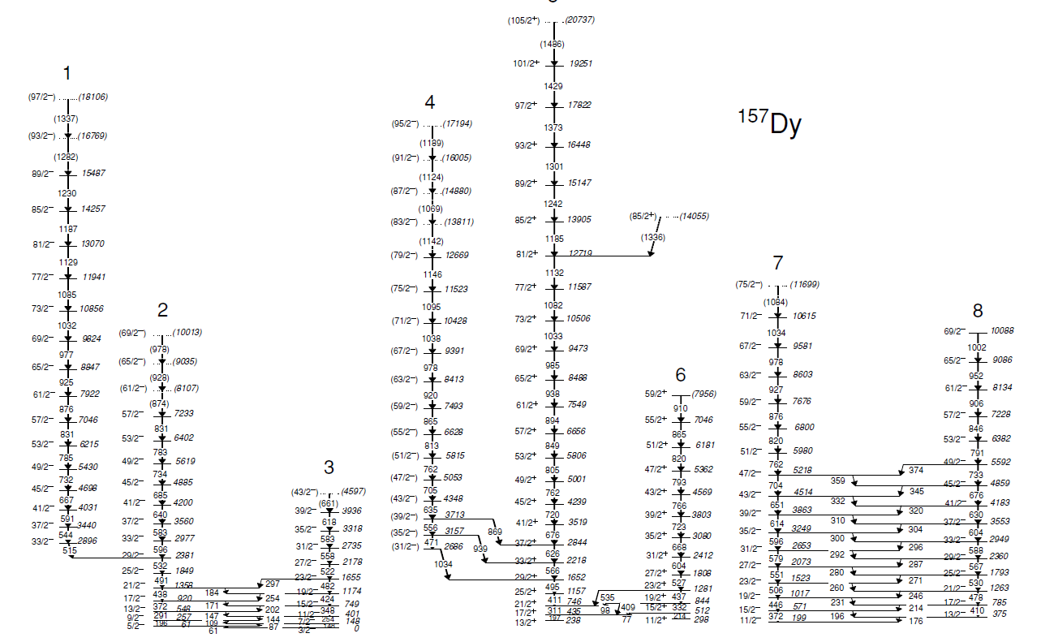
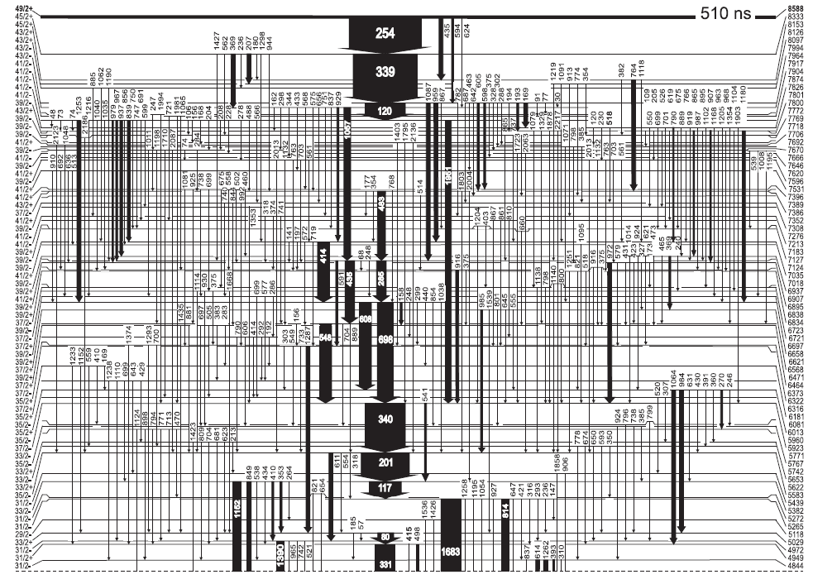
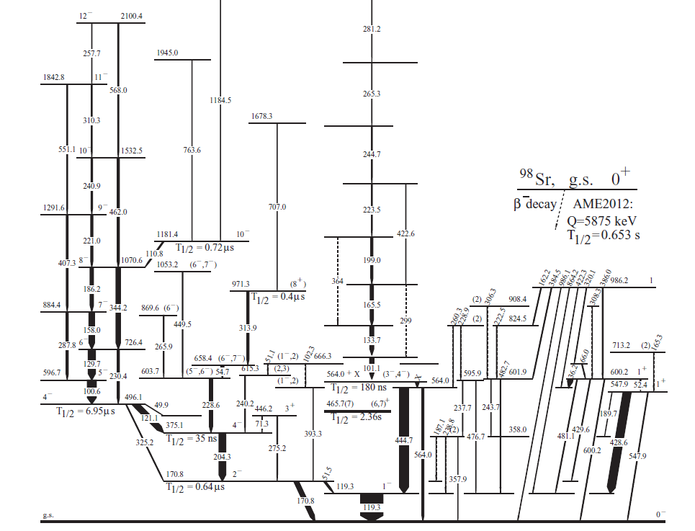
Gamma spectroscopy of the nuclei produced in
fast-neutron-induced fission reaction
A. Pipidis et al., PRC 72, 064307 (2015)
R. Broda et al., PRC 101, 064320 (2020)
⁹⁸Y
isomeric states T_{1/2} > few ns
W. Urban (Ł.W. Iskra) et al.., PRC 96, 044333 (2017)

Slide 9
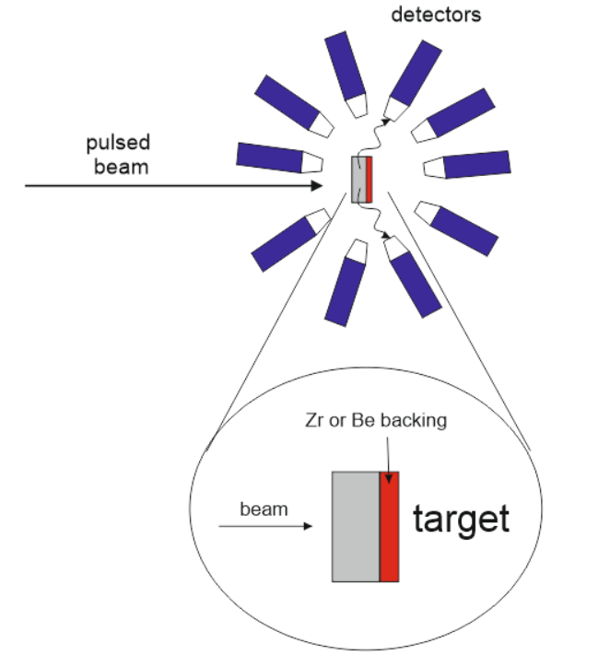
Gamma spectroscopy of the nuclei produced in
fast-neutron-induced fission reaction
Typical experimental setup and requirements
Pulsed beam ( few ns width; hundreds ns repetition time)
- reaction tag
Thick target (or backing) – doppler free detection
Detectors :
- HPGe – discrete gamma-ray spectroscopy
- LaBr₃ – lifetimes measurement

Slide 10
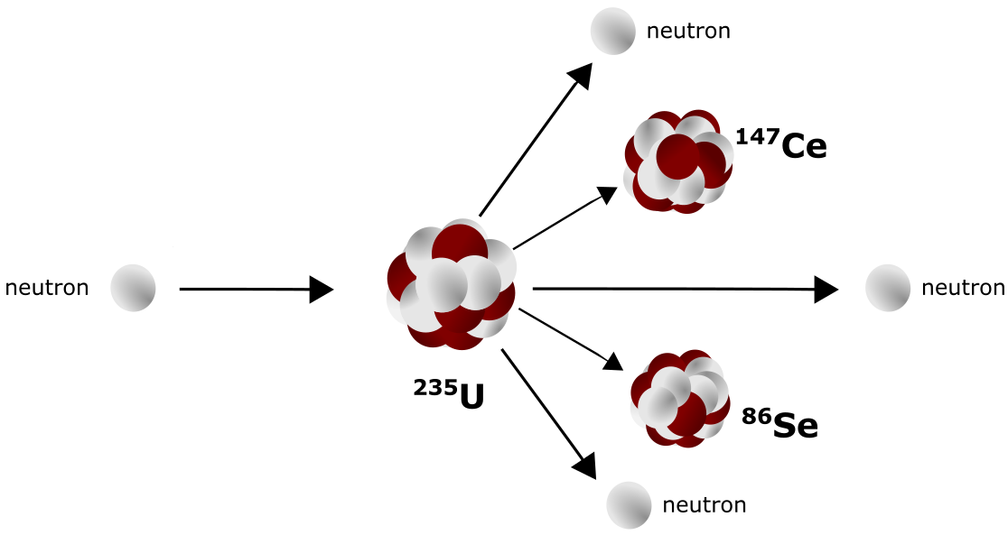
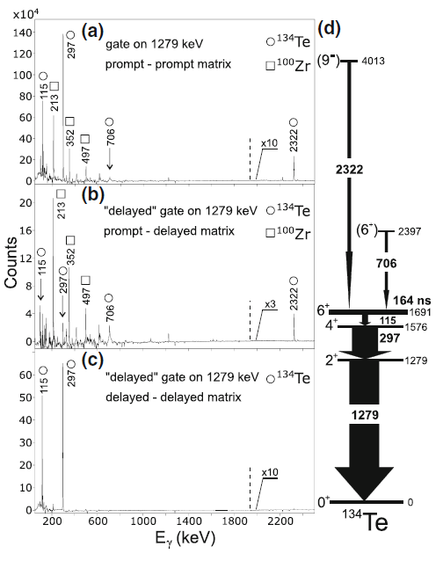
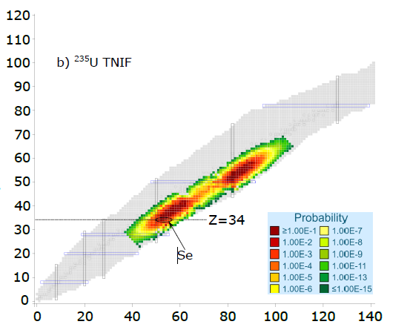
Gamma spectroscopy of the nuclei produced in
fast-neutron-induced fission reaction
Hundreds of different nuclei
produced in one experiment
High statistic data
- long duration of the experiment
- pawerfull detection system
Pulsed beam – fission tag

Slide 11
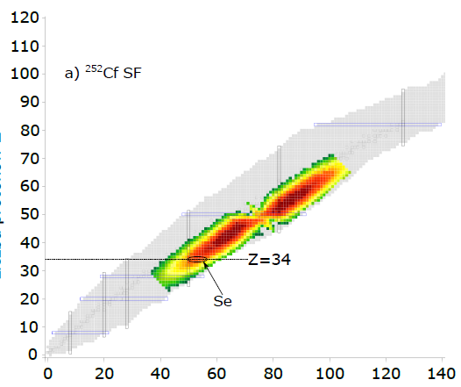
Gamma spectroscopy of the nuclei produced in
fast-neutron-induced fission reaction
Spontaneous fission – ²⁵²Cf and ²⁴⁸Cm
Gammasphere array of Ge detectors at
Argonne National Laboratory (US)
High statistic data
- long duration of the experiment
- powerful detection system
Pulsed beam – fission tag

Slide 12
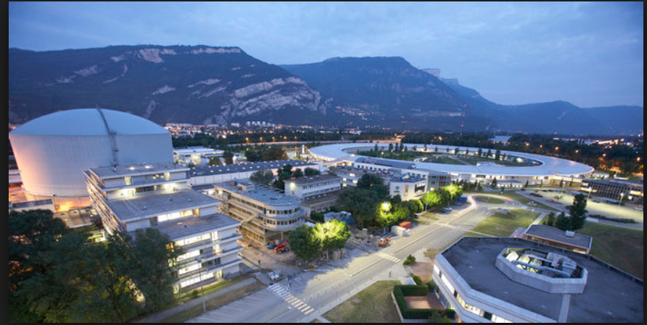
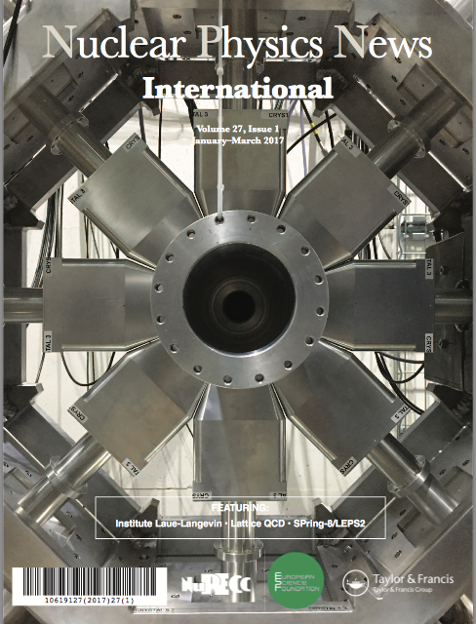
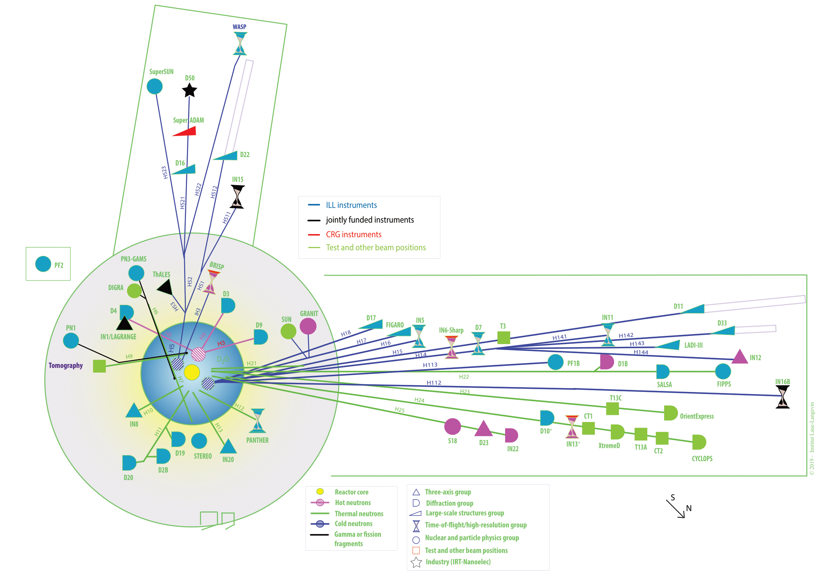
Gamma spectroscopy of the nuclei produced in
fast-neutron-induced fission reaction
Institut Laue-Langevin - ILL
FIPPS FIssion Product Prompt γ-ray Spectrometer
8 HPGe clover detectors
FIPPS
Neutron induced fission of on ²³³U, ²³⁵U, and, ²⁴¹Pu
²⁴⁵Cm (n,f) – co-spokeperson K. Gajewska (IFJ PAN) – 2027
(diamond wall and fission tag)
~50 days of measurements with each target
~10⁸ neutrons /s*cm² at the target position

Slide 13
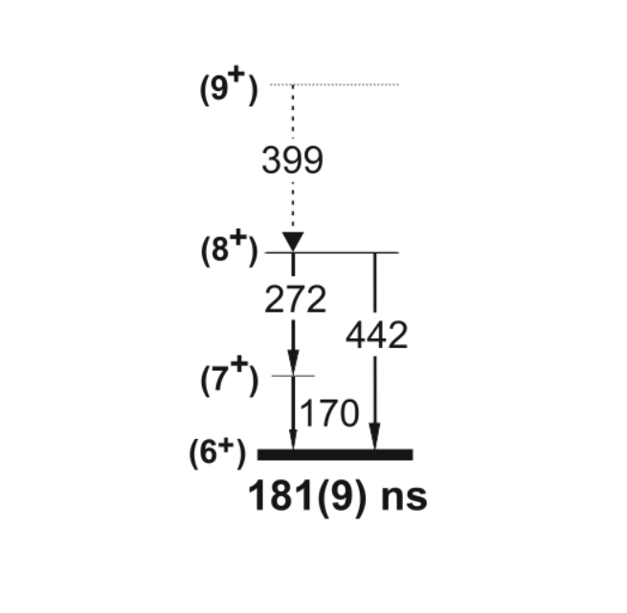
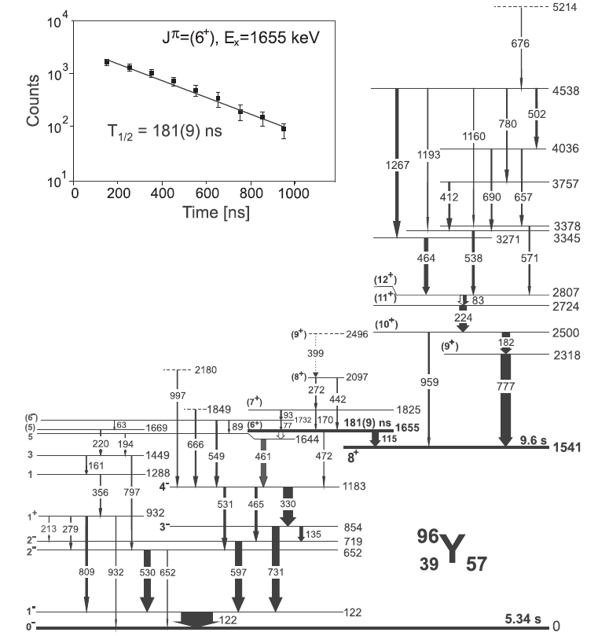
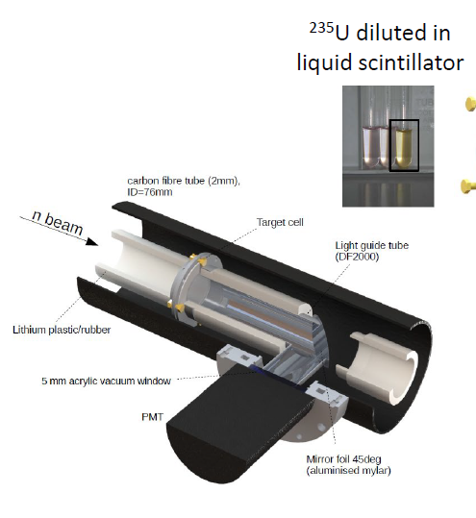
Gamma spectroscopy of the nuclei produced in
fast-neutron-induced fission reaction
High statistic data
- long duration of the experiment
- powerful detection system
Pulsed beam – fission tag
Ł. W. Iskra, S. Leoni, B. Fornal et al., PRC 102, 054324 (2020)
F. Kandzia (Ł. W . Iskra) et al., Eur. Phys. J. A 56, 207 (2020).

Slide 14

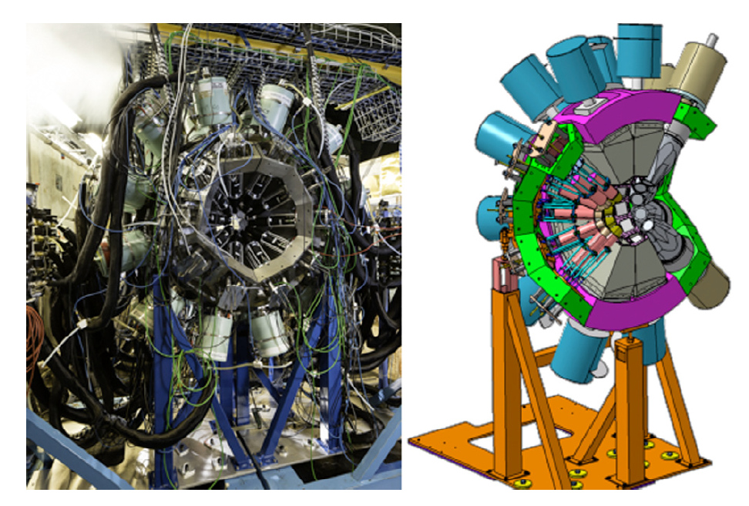
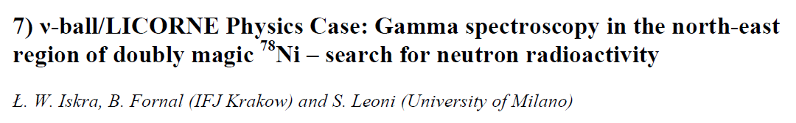
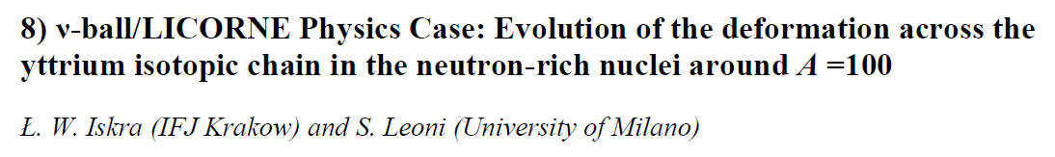
Gamma spectroscopy of the nuclei produced in
fast-neutron-induced fission reaction
Laboratoire de Physique des 2 infinis Irène Joliot-Curie - IJCLab
v-ball campaigns
Courtesy of J. Wilson
High statistic data
- long duration of the experiment
- powerful detection system
Pulsed beam – fission tag

Slide 15
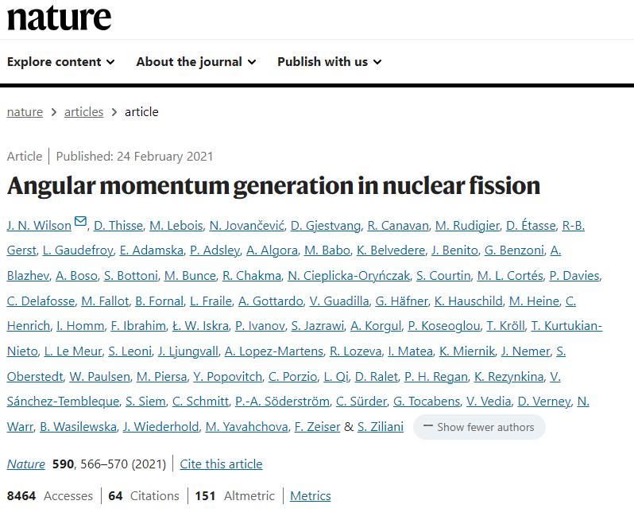
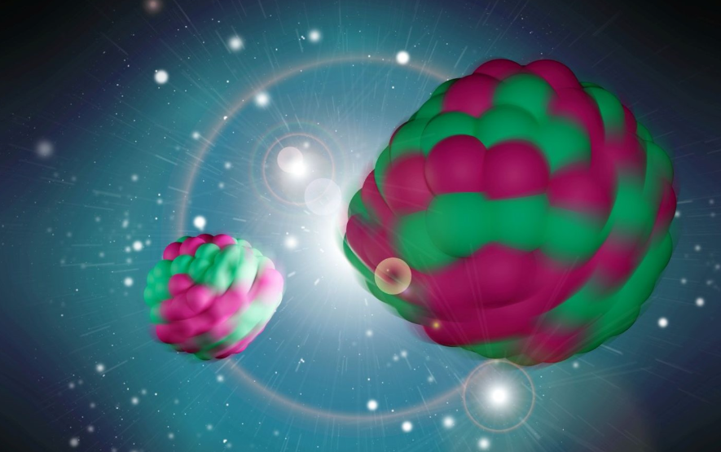
Gamma spectroscopy of the nuclei produced in
fast-neutron-induced fission reaction

Slide 16
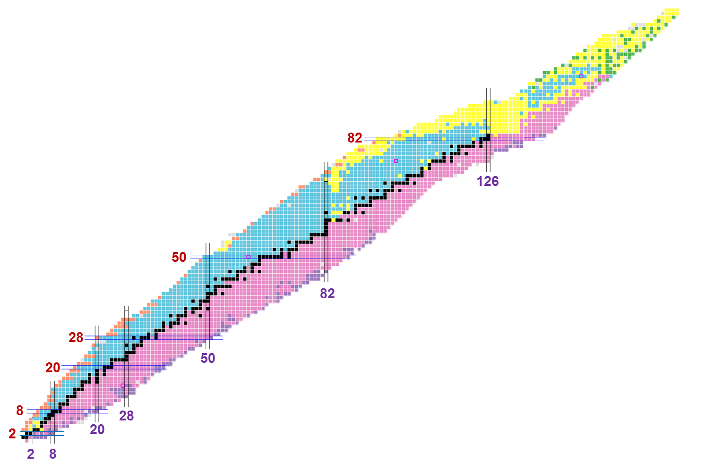


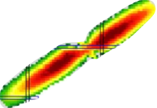
Gamma spectroscopy of the nuclei produced in
fast-neutron-induced fission reaction
²³²Th
²³⁵U
Yields of products
from the 14 MeV-neutron
induced fission of ²³²Th
n(14 MeV) + ²³²Th
Thermal neutron induced fission
of ²³⁵U
Spontaneous fission of ²⁴⁸Cm
Courtesy of B. Fornal

Slide 17
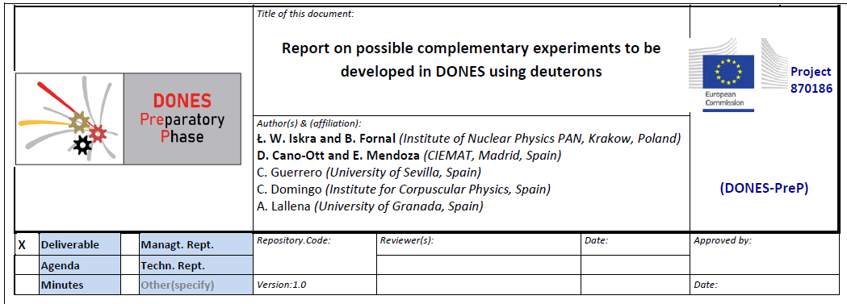
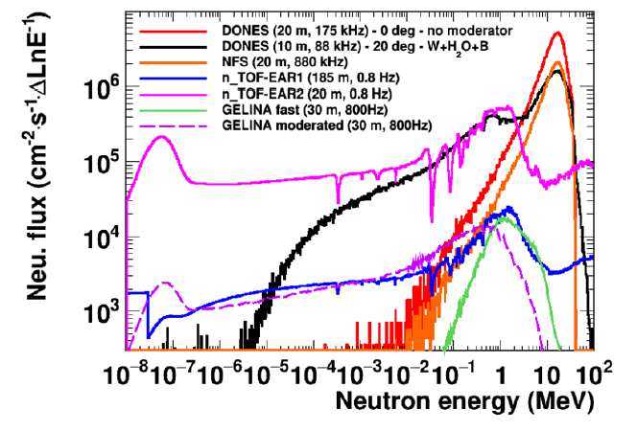
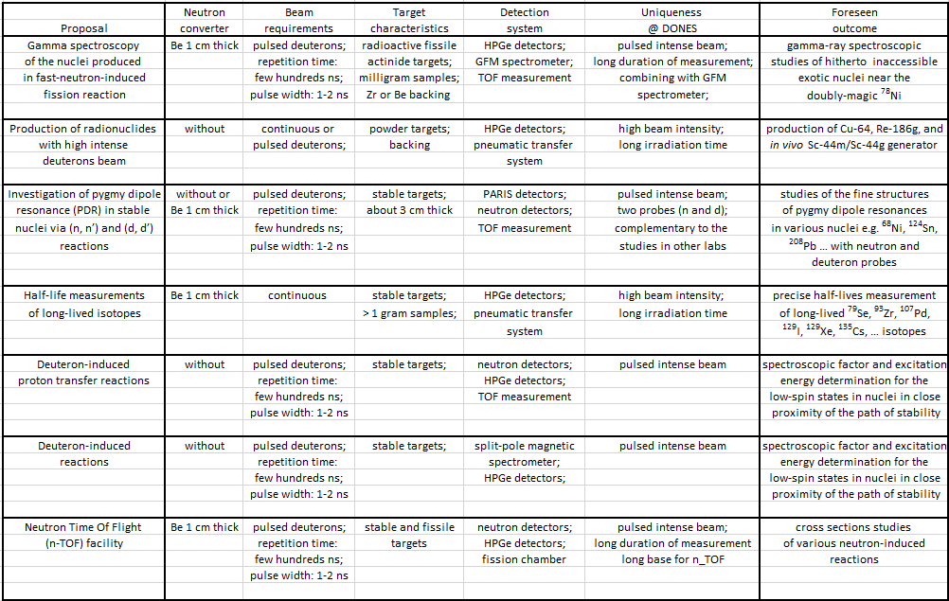
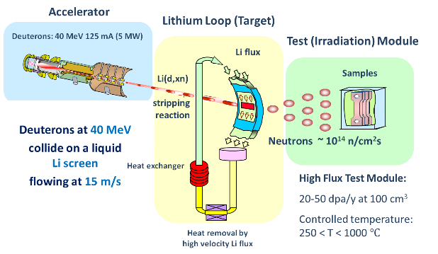
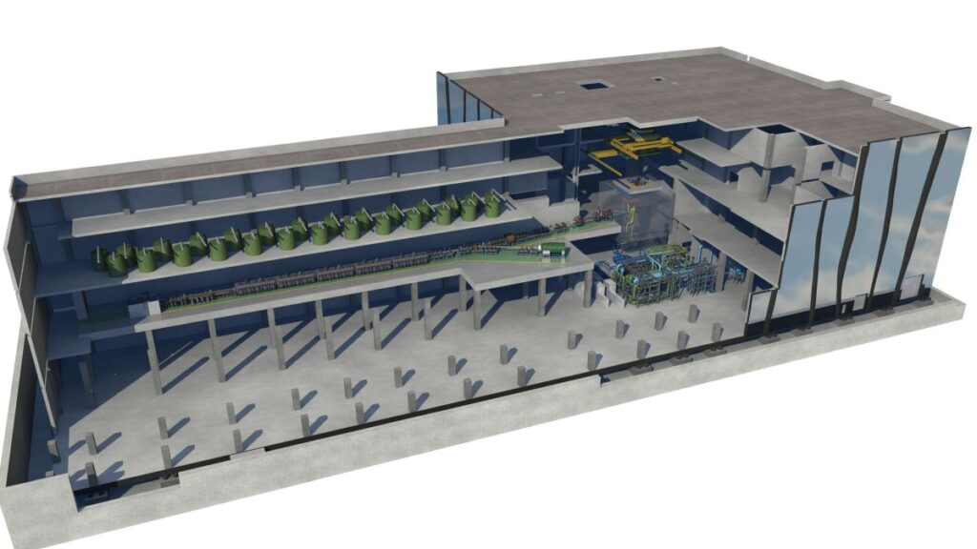
Gamma spectroscopy of the nuclei produced in
fast-neutron-induced fission reaction
Neutrons For Science (NFS)
GANIL Caen (France)
40 MeV d + Be
75 pages – 7 experimental programs
DONES (Demo Oriented NEutron Source)

Slide 18
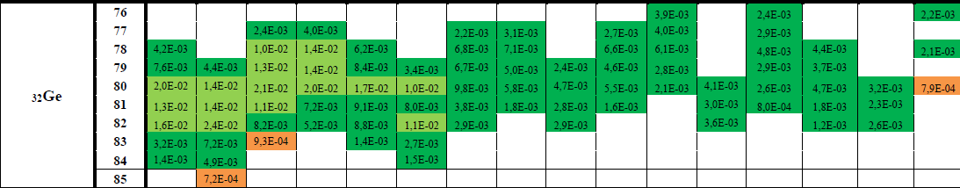
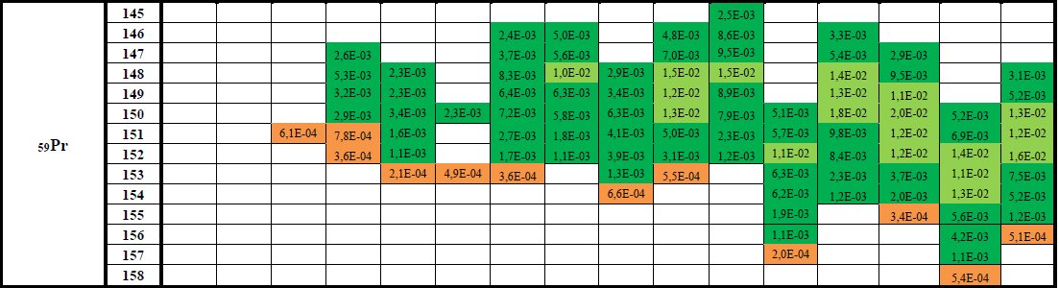
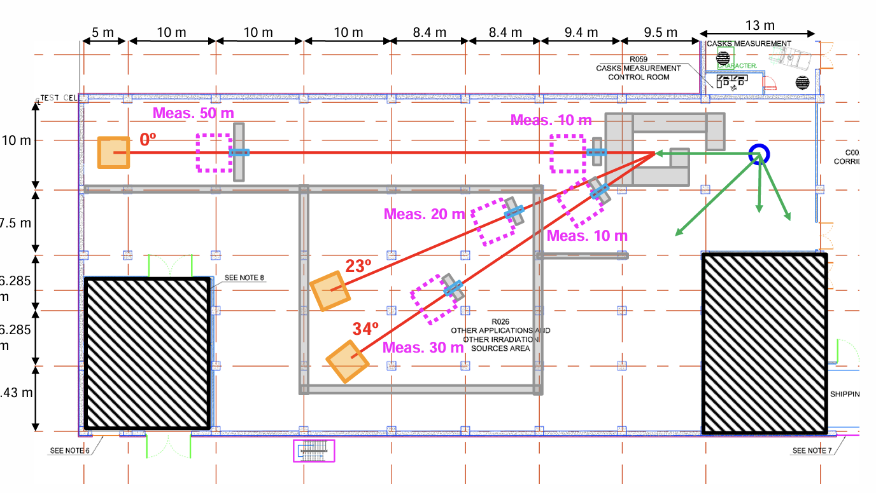
Gamma spectroscopy of the nuclei produced in
fast-neutron-induced fission reaction
Ł. W. Iskra et al., "Report … ," DONES-PreP WP8.2-1.

Slide 19
Required beam:
Gamma spectroscopy of the nuclei produced in
fast-neutron-induced fission reaction
Section 2
⁷Li with variable energy within 17 to 50 MeV range,
Required pulsation – around 400 ns repetition time and few ns pulse width
Beam on target around 10 µA

Slide 20
SWOT analysis for the project
Gamma spectroscopy of the nuclei produced in
fast-neutron-induced fission reaction
S (Strengths) – A fast neutron beam can be used in various nuclear physics experiments (and other fields). For study fission products - many targets can be exploited to provide spectroscopic data for a wide range of neutron-rich isotopes
W (Weaknesses) – The neutron production technique is well known for a 17 MeV ⁷Li beam, which produces neutrons of around 2 MeV. To produce more energetic neutrons, the ⁷Li beam must be increased up to 50 MeV, which opens new reaction channels and may change the direction of outgoing neutrons
O (Opportunities) – High-intensity, oriented fast neutron beams make LINAC very important facility in the global landscape of nuclear physics research. The study of fission products and the fission process is at the center of activity in this field.
T (Threats) – If neutron energies above 2 MeV are not accessible due to the influence of other reaction channels, the neutron spectrum will be similar to that of IJCLab but with a higher intensity (by about two orders of magnitude), which makes LINAC an important European-scale facility. Studies of fission products require a gamma detector array / a mass spectrometer.

Slide 21
Other requirements (detection system, infrastructure)
Gamma spectroscopy of the nuclei produced in
fast-neutron-induced fission reaction
H₂ gas target system
Gamma-Ray Detectors – HPGe and LaBr₃
mass spectrometer (e.g., BigBite, Gas-filled magnet) – large experimental hall

Slide 22
Half-life measurements of long-lived isotopes
⁹³Zr - important component of nuclear power plant waste
⁹³Zr – T_{1/2} ~ 10⁶ y
1.64(6) x 10⁶ y
1.13(11) x 10⁶ y
⁷⁹Se – T_{1/2} ~ 3 x 10⁵ y
More than half a million years of discrepancy
¹⁰⁷Pd – T_{1/2} ~ 7 x 10⁵ y
astrophysics or nuclear repository assessment
nuclear waste contributors
¹²⁹I – T_{1/2} ~ 2 x 10⁷ y
markers in geological and biological processes
Difficulties to measure half-lives longer than 10⁴ years
T_{1/2} ~
Activity
Total numbers of nuclei
Difficult to determine (large systematic uncertainties)

Slide 23
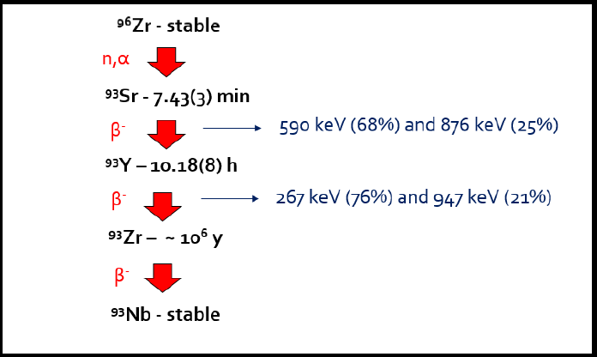
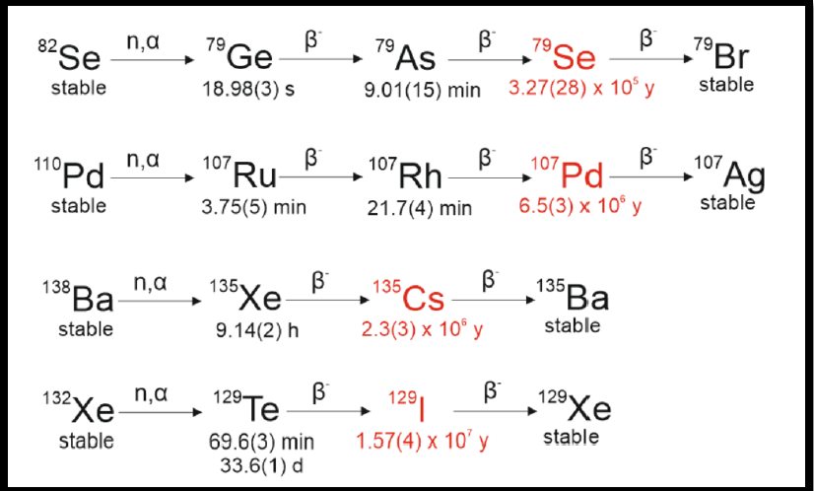
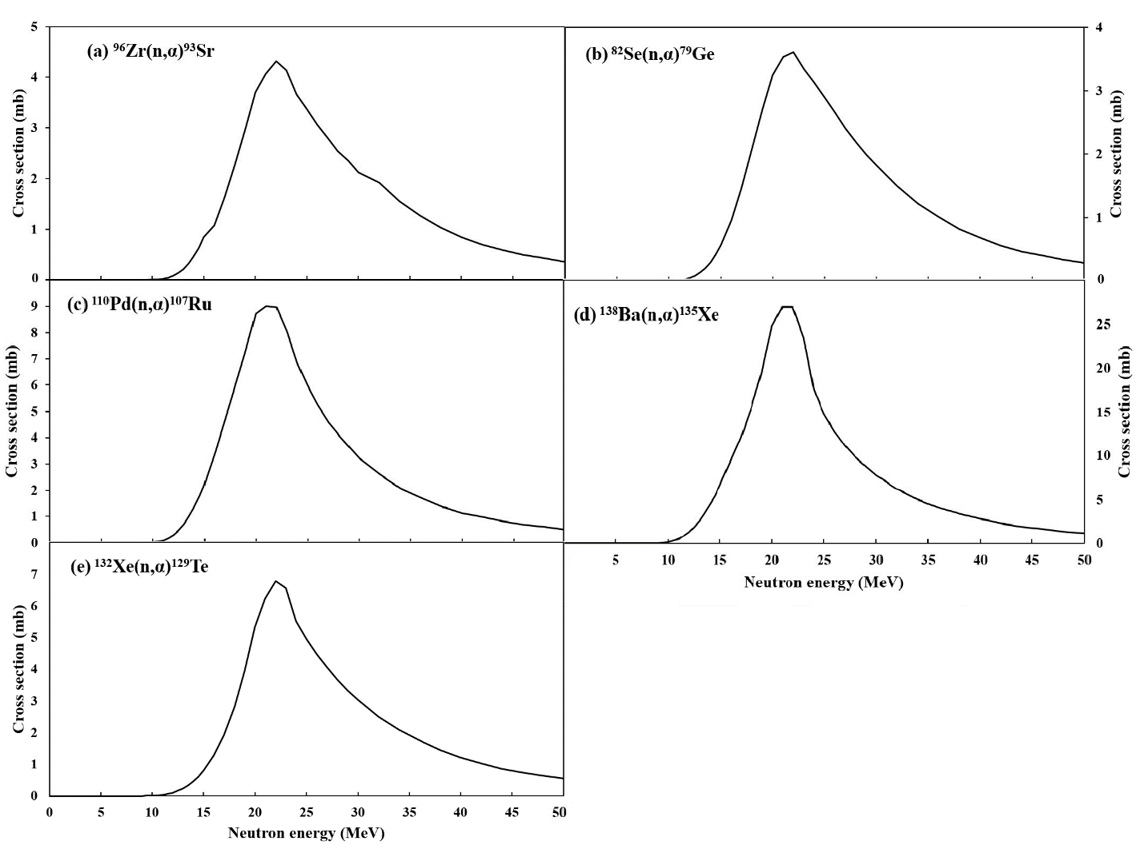
Half-life measurements of long-lived isotopes
Solution: Produce a short-lived isotope ((n, α) reaction), which decays to the long-lived isotope
1. Use of a stable ⁹⁶Zr target
2. Production of the ⁹³Sr isotope in the (n,α) reaction
3. Measurement of 267 and 947 keV gamma rays using
low-background detection systems
4. Measurement of electrons associated with the β decay
of the ⁹³Zr isotope (nucleus of interest)

Slide 24
Required beam
Half-life measurements of long-lived isotopes
Section 2
⁷Li with variable energy above 45 MeV ,
no pulsation requared
Beam on target around 1 mA (depending on the target)

Slide 25
SWOT analysis for the project
Half-life measurements of long-lived isotopes
S (Strengths) – A fast neutron beam can be used in various nuclear physics experiments (and other fields). Measurements of long-lived isotopes will provide very important information for astrophysics, nuclear waste management, etc.
W (Weaknesses) – The neutron production technique is well known for a 17 MeV ⁷Li beam, which produces neutrons of around 2 MeV. To produce more energetic neutrons, the ⁷Li beam must be increased up to 50 MeV, which opens new reaction channels and may change the direction of outgoing neutrons.
O (Opportunities) – High-intensity, oriented fast neutron beams make LINAC very important facility in the global landscape of nuclear physics Research. The new project has not been conducted elsewhere (unique).
T (Threats) – If neutron energies above 19 MeV are not accessible due to the influence of other reaction channels, the project cannot be performed. The activity of the samples must be measured in an ultra-low background environment. The project requires the development of a new technique.

Slide 26
Other requirements (detection system, infrastructure)
Half-life measurements of long-lived isotopes
H₂ gas target system
Gamma-Ray Detectors – HPGe
A low-background area is required to measure the activity of the samples

Slide 27
Thank you for the attention

