Slide 1

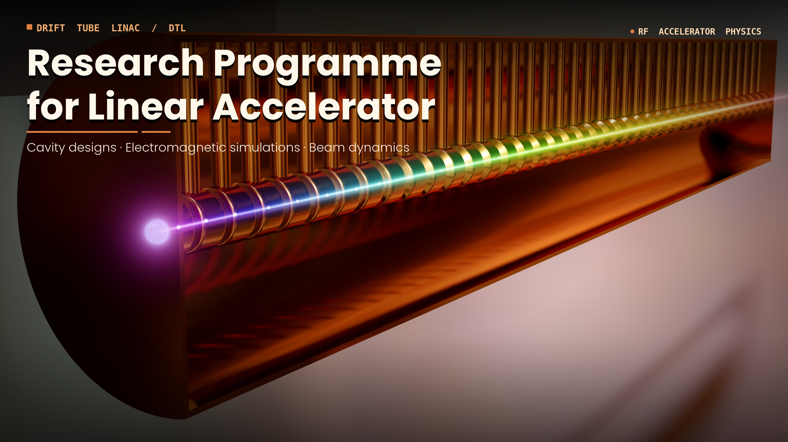
Gamma decay of giant resonances (GDR, GQR) excited by proton or alpha beam
M. Kmiecik, M . Ciemała, A. Maj et al..
2nd Workshop on Research & Innovation in Poland
IFJ PAN, Krakow, 26-27 May, 2026

Slide 2
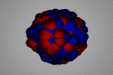
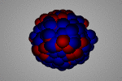
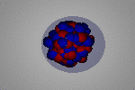
Introduction
E*
(excitation
energy)
main aim: γ decay
GDR
(IVGDR – Isovector Giant Dipole Resonance)
GQR
(ISGQR – Isoscalar Giant Quadrupole Resonance)
PDR
(Pygmy Dipole Resonance)
S_{n}
(neutron
separation
energy)
soft dipole mode, low-energy part of dipole strength
measurement of γ-rays emitted from the decay
(above neutron threshold hindered by neutron emission)
ground state - g. s.

Slide 3
Motivation – GDR γ–decay study
E1 response (GDR)
Well known properties.
Systematic studies done for years for wide range of atomic nuclei concerning collectivity, strength and line-shape (for GDR excited in ground state and in hot compound nucleus).
E*
Lack of the information on the gamma decay of GDR to the excited states.
Studies of gamma decay of GDR to ground state and excited states could be used
as an input for theoretical models to determine GDR wave functions, and the use of various probes could provide insights into the GDR excitation mechanism.

Slide 4
Motivation – PDR γ–decay study
E*
PDR – low-energy part of the E1 response (GDR)
below and above Sn (soft dipole mode)
Implications on the r-process nucleosynthesis
related to determination of nuclear symmetry energy (neutron rich matter)
can be used for neutron skin thickness determination (neutron stars)
Described by various theoretical approaches based on different models and giving different predictions in terms of collectivity, strength and line-shape
of the pygmy resonances
Studies with various probes will allow to learn on the structure of PDR states
and give an input for theoretical models verification

Slide 5
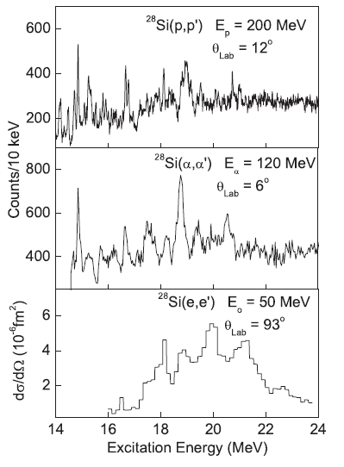
Motivation – GQR γ–decay study
E*
ISGQR evidenced in electron, alpha nad proton scattering reactions
I.T. Usman et al.,
Phys. Rev. C94, 024308 (2016)
K. van der Borg et al.,
Nucl. Phys. A341, 219 (1980)
A. Richter, Prog. Part.Nucl. Phys. 13, 1 (1985)
Using different probes
for the GQR excitation
various results obtained
GQR is not well known, only some excitation cross sections were measured.
The GQR structure, fragmented strength, and decay important to be investigated.
γ-decay to ground state and excited states is of particular ineterest – it could be used
to get the information about the resonance wave function

Slide 6
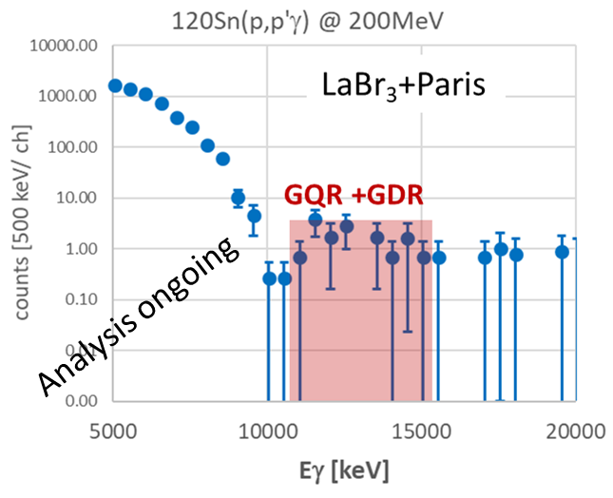
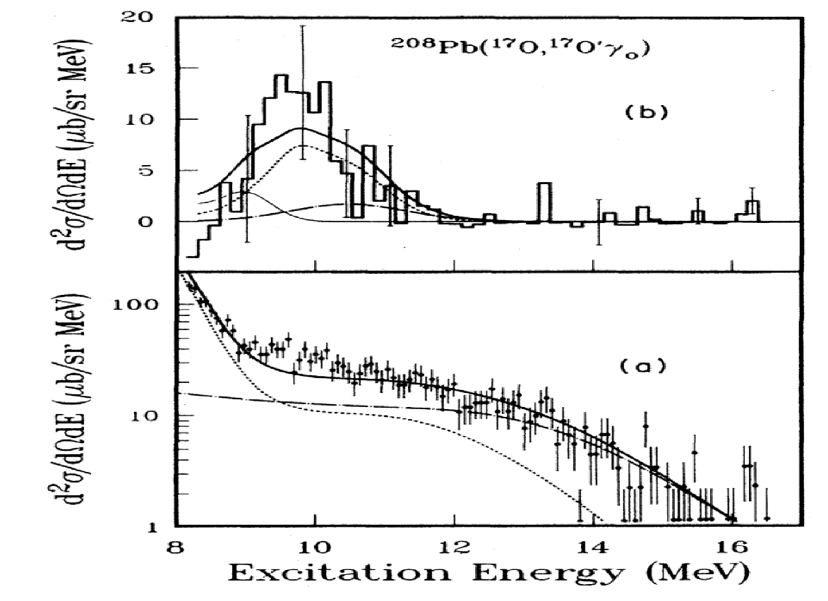
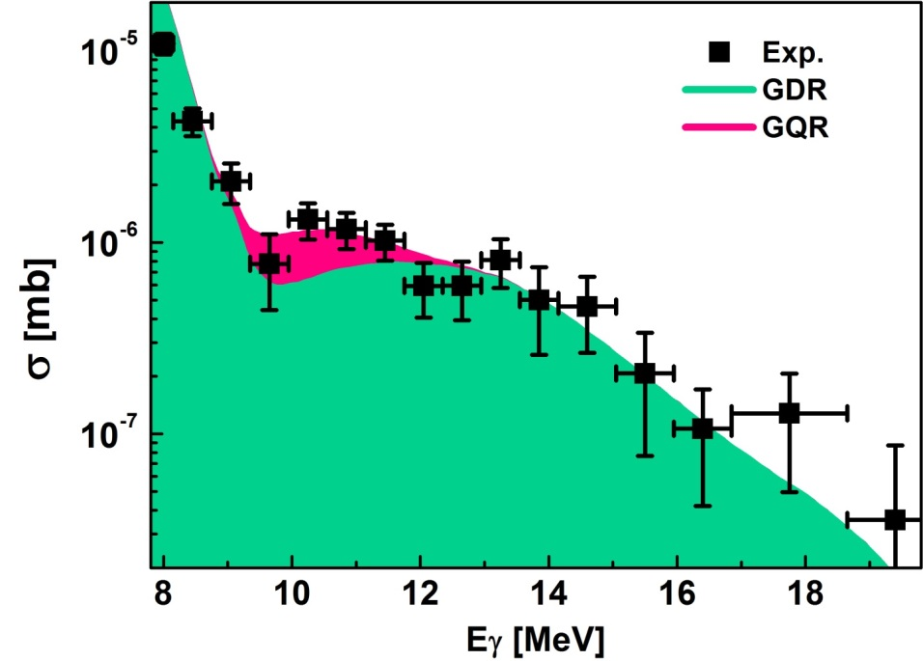
Motivation – GQR γ–decay study
E*
GQR γ–decay difficult to measure – very small probability (~10⁻⁴)
The ISGQR γ-decay observed
for the first time in 1980s
The ISGQR γ-decay confirmed and research program started
at IFJ PAN using proton inelastic scattering
²⁰⁸Pb (¹⁷O,¹⁷O’γ) @ 381 MeV
²⁰⁸Pb(p,p’γ) @ 85 MeV
¹²⁰Sn(p,p’γ) @ 200 MeV
J.Beene et al., PRC39, 1307 (1989)
B. Wasilewska al., PRC105, 014310 (2022)

Slide 7
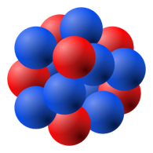
Method
proton or alpha particle inelastic scattering reaction – (p,p’γ); (α, α’γ)
detectors to measure energy
and angle of gamma rays
detectors to measure
energy and angles
of scattered particles
γ
P’
p
magnetic spectrometer
recommended - very good
energy resolution
beam
target
scattering
vaccuum chamber
coincidence measurement of gamma rays and scattered particles

Slide 8
Research plan
Use of charged particle beam with high energies to excite nuclei using the inelastic scattering reaction.
Measure energy of scattered particles (possible with high energy resolution) and gamma rays emitted from the decay of excited nuclei.
Obtain the excitation cross section (also it’s angular distribution).
Study of GQR, GDR and PDR gamma decay and determine the branching ratio of the decay to ground and (possibly) excited states.

Slide 9
LINIAC Stage: Section 3
Section 3: 250 MeV/u (Future expansion / High energy)
Custom Energy: approximately 20-80 MeV/u for alpha, approximately 100-250 MeV/u for proton (Variable range within section limits)
Protons with variable energy within 100 – 250 MeV range,
alphas (⁴He₂⁺) with variable energy within 20 – 80 MeV/u range (it would be possible to use Section 2 if its energy is increased up to 25 MeV/u)
with suppression of dark current – (off-pulse background)
Desired spot size on target: around 0.5 mm sigma, no beam halo
Required pulsation by 100 ns or 200 ns
Required current on target: 0.1 nA to 20 nA
Good beam energy resolution (of <100 keV) is required, but around 10-20 keV will be useful.

Slide 10
Other requirements
Gamma-ray detectors: scintillators with good efficincy for high-enegry gamma rays measurement and good time resolution and reasonable energy resolution. Example PARIS CeBr₃:NaI; LaBr₃:NaI phoswiches, as well as large volume LaBr₃ detectors.
Charged particle detectors for the measurement of scattered high energy protons and alpha particles with good time and energy resolution.
Mass spectrometer with the energy resolution < 10 keV is necessary to ensure highest quality measurements, in particular the study of decays to selected final states.
Large Vacuum Chamber, required to house the target and inner detector arrays.
Detector integration, support for the detector mounting and data acquisition.
Spatial requirements: a significantly large experimental hall is required to accommodate the planned mass spectrometer (e.g., BigBite).

Slide 11
SWOT analysis for the project (Example)
S (Strengths): Experience in conducting similar experiments (coincidence measurement of excitation energy and gamma rays emitted from the decay). PDR studies are corresponding to the research done at IFIN-HH. The GQR experiments are unique. The detectors for gamma rays and scattered particles measurement are existing at IFJ.
W (Weaknesses): Experiments requiring both good beam quality and detector properties.
O (Opportunities): Development of a highly specialized expert team; Strengthening of international research collaboration. Possibility of educating students.
T (Threats):
Risk of possible competitors (RIKEN, iTemba Labs) completing the similar research within the 10-year time, especially in the field of PDR studies, potentially neutralizing the project’s „first-in-the-world” advantage.

Slide 12
Conclusions
Using high energy proton and alpha particle beam will enable to broaden the research of GQR, GDR and PDR at IFJ PAN. The results obtained using various probes will provide more comprehensive information on the properties of studied excitations, which is a topic of the interest of many physicists.
The possibility of good quality research will enable to strengthen the international collaboration between IFJ PAN and other laboratories.

