Slide 1

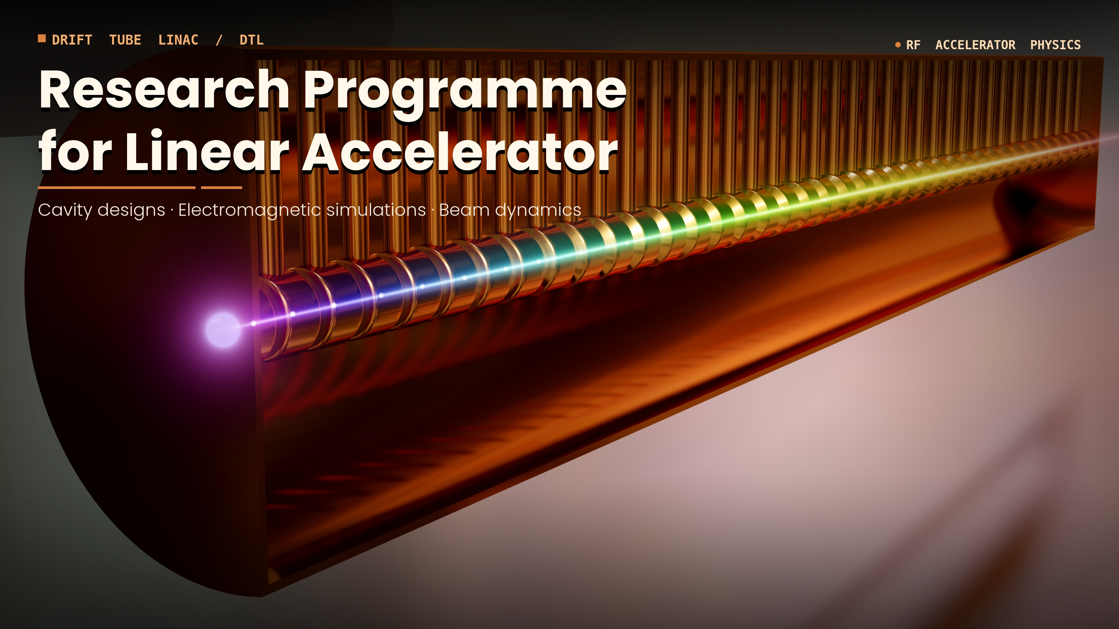
Study of fission processes induced by protons, alpha particles, and heavy ions
Michał Ciemała
2nd Workshop on Research & Innovation in Poland
IFJ PAN, Krakow, 26-27 May, 2026

Slide 2





Introduction and Motivation
Fission – almost 90 years from discovery
n
γ
A₂ v₂
γ
n
· Characterized by a dramatic rearrangement of nuclear structure;
· Important for fundamental and applications (energy, isotopes for medicine,…).
A v
γ
CN CN
A₁ v₁
n
γ
γ
n

Slide 3
Introduction and Motivation
Still a lot of open questions
What is the nature of the driving force in fission dynamics?
What is the mechanism that generates excitation energy and angular momentum along the way to scission?
How are excitation energy and angular momentum shared between the fragments?
What is the role of shell effects and pairing correlations?
How fast is the snapping of the neck at splitting?
How much are the fragments still entangled immediately after scission?

Slide 4
Possibilities
Use of charge particle with energies up to 200 MeV to induce fission and reconstruction of E* of fissioning system. Control the excitation energy of the compound nuclear system up to several tens of MeV.
• Study of the transition from asymmetric to symmetric fission modes as a function of excitation energy;
• Measurement of Prompt Fission Gamma-Ray Spectra;
• Study of possible collective excitations (PDR, GDR) in fission fragments;
• The high excitation energies will allow study of the fission of actinides as well as of sub-actinide nuclei such as ²⁰⁸Pb, ¹⁹⁷Au, ¹⁹⁶Pt, ¹⁸⁶W, etc. where fission barrier heights are around 25-30 MeV. Measure Prompt Fission Gamma-ray spectra as a function A and E* for each system.
Simultaneous measurement of neutron and gamma-ray FOLD and energies.

Slide 5
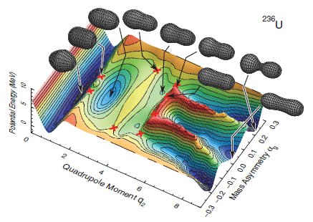
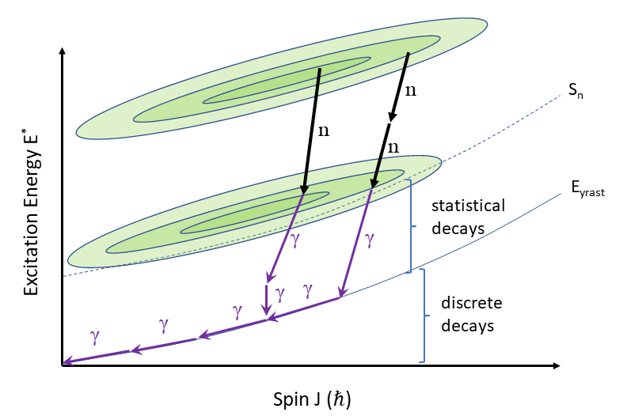
Possibilities
A’, Z’, v’,
E*’, L’
A, Z, v ,
E*, L
Ichikawa et al., PRC (2012)
PES topography (system A and Z) and E*_{ini}
Outcome depends on: Dynamics
Fragment entry point (E*, L)
Fundamental nuclear properties
Fragments A_{1,2} , Z_{1,2} , TKE=KE₁+KE₂
Possible observables in experiments: Neutrons M_{n} , E_{n}
γ-rays M_{γ} , E_{γ}

Slide 6
LINIAC at IFJ PAN requirements for studies of fission process, STAGE 2 and STAGE 3
Charged particles with variable energy within 2.5 – 200 MeV range.
Required pulsation by 200 ns or its multiplication, with beam pulse sigma better than 1 ns
Beam on target up to around 1 uA
Good beam spot on taget, better than 0.5 mm sigma be welcomed

Slide 7
Other requirements
Gamma-ray system basing on the scintillator and HPGe gamma-ray detectors with good time resolution and reasonable Energy resolution. Example PARIS CeBr₃:NaI phoswiches, as well as HPGe detectors.
Experimental setup requires detectors for fission fragments, including a gas system.
A neutron detector array would also be of great interest to provide a nearly complete measurement of the particles and gamma-rays created during the fission and from fragments de-excitation.
Also necessary detectors for the inelastically scattered particles, to extract E* of the fissioning system.

Slide 8

SWOT analysis for the project
S (Strengths): We are currently taking part in the research on fission process at foreign laboratories (GANIL – VAMOS, NFS; IJCLab NuBall; ILL GRENOBLE – FIPPS). Possible gain of knowledge from planned fission studies campaign at CCB (COFFEE project).
W (Weaknesses): High technical complexity in designing optimal setup. Limited initial core team size.

Slide 9
SWOT analysis for the project
O (Opportunities): Development of a competing in Europe, specialized expert team of experimental fission studies in Poland.
Possible synegries with other facilities with shared research programmes.
T (Threats):
Very high risk of competitors completing the research within the 10-year time, can be neutralized with use of the best possible detectors.

Slide 10
Conclusions
The use of charged particle induced fission will deliver high-value research outputs, firmly establishing IFJ PAN as a important hub for experimental fission research in Poland.
Thanks to active participation in leading international campaigns, the IFJ PAN research team is successfully expanding its competencies. This expertise is directly channeled into the upcoming proton-induced fission experiments planned at the CCB facility.
Equipped with a state-of-the-art experimental setup, the upcoming campaigns at the LINAC facility will produce very good datasets. This guarantees a highly competitivenes and unique scientific contributions even within a 10-year horizon.

