Slide 1

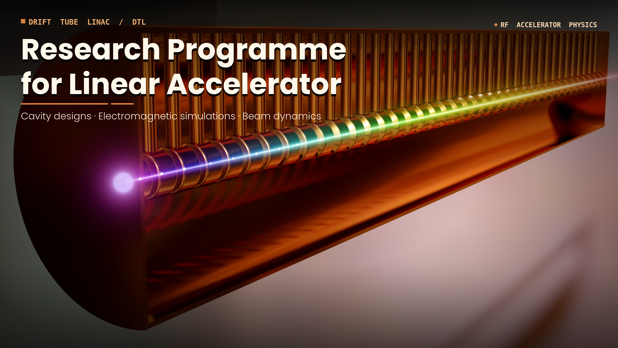
Investigation of nuclear two-photon (2γ) decay in even-even nuclei via proton excitation of 0₂⁺ states
Michał Ciemała
2nd Workshop on Research & Innovation in Poland
IFJ PAN, Krakow, 26-27 May, 2026

Slide 2
Introduction and Motivation
Double-gamma decay is a rare nuclear [second order] decay process, firstly investigated in 1930 by Maria Goeppert in her doctoral thesis.
In the double-gamma decay, an excited nuclear state decays to a lower-lying state and emits two photons simultaneously.
Sum energy of the two photons is equal to the transition energy.
Figure from E. Beardsworth et al., Phys. Rev. C, 8(1), 216 (1973)
Double gamma: branching ratio 10⁻⁴ to 10⁻⁶ compared to other decay modes.

Slide 3
Introduction and Motivation
Up to now 2gamma decay was observed in direct experiments:
¹³⁷Ba (competitive to single gamma-ray Decay), [W. Beusch, Helvetica Physica Acta 33 (1960) 363; C. Waltz et al., Nature 526 (2015) 406.]
From 0⁺ -> 0⁺ transitions:
¹⁶O, [B.A. Watson, et al., Phys. Rev. Lett. 35 (1975) 1333.; J. Kramp, et al., Nucl. Phys. A474, (1987) 412]
⁴⁰Ca, [E. Beardsworth et al., Phys. Rev. C, 8(1), 216 (1973); J. Schirmer, et al., Phys. Rev. Lett, 53(20), (1984), 1897]
⁹⁰Zr, [J. Schirmer, et al., Phys. Rev. Lett, 53(20), (1984), 1897]
Still not measured for stable or long living targets:
⁷²Ge (not direct), ⁹⁶Zr, ⁹⁸Mo

Slide 4
Introduction and Motivation
Recent indirect measurement for ⁷²Ge with use of storage ring and fully ionised ⁷²Ge (no internal conversion process)
Figure from: D. Freire-Fernández, W. Korten, et al., Phys. Rev. Lett 133, (2024) 022502

Slide 5
Introduction and Motivation
Measured half life with the survival method is too low compared to the systematic
Figure from: D. Freire-Fernández, W. Korten, et al., Phys. Rev. Lett 133, (2024) 022502
Precise measurement of direct 2gamma decay for ⁷²Ge as well as for ⁹⁸Mo, ⁹⁶Zr and re-measurement ¹⁶O, ⁴⁰Ca, ⁹⁰Zr is needed

Slide 6
Experiments idea
Systematic study of the 2gamma Decay process for
¹⁶O, ⁴⁰Ca, ⁷²Ge, ⁹⁰Zr, ⁹⁸Mo, ⁹⁶Zr isotopes.
Use of p,p’ reaction which will populate first excited 0⁺ state.
Use of gamma-ray detectors for direct measurements of the 2gamma decay process.
Use of charged particle detectors for the measurement of the excitation function and for measurement of the electrons coming from Internal Conversion and/or Internal Pair Creation.
Goal: Complete measurement of excitation and decay of the first excited 0⁺ state in nuclei of interet.

Slide 7
LINIAC at IFJ PAN requirements for the 2gamma measurements, STAGE 2
Protons with variable energy within 2.5 – 12.5 MeV range, with absolute suppression of dark current (which is off-pulse background) by factor of 10⁶ or better.
Required pulsation by 100 ns or its multiplication, with beam pulse sigma better than 1 ns
Beam on target up to around 500 nA
Good energy resolution, around 10-20 keV will be welcomed

Slide 8
Other requirements
For 2gamma measurements, gamma-ray system basing on the scintillator gamma-ray detectors with good time resolution and reasonable Energy resolution. Example PARIS CeBr₃:NaI phoswiches.
IFJ PAN posess currently knowledge in this area.
Detection system for the Internal Conversion Electrons and Internal Pair Creation, as well as for the detection of the scattered protons.

Slide 9
SWOT analysis for the project
S (Strengths): Thanks to long-term R&D within the PARIS collaboration, IFJ PAN possesses unique expertise in gamma-ray calorimetry and measurements using advanced scintillators. Existing infrastructure and data analysis adapted from previous PARIS experiments.
W (Weaknesses): High risk of failure due to low beam quality. High technical complexity in designing the dedicated 2gamma detection geometry. Limited initial core team size.

Slide 10
SWOT analysis for the project
O (Opportunities): Development of a world-class, highly specialized expert team in Poland; strong potential to attract the best international research collaborations; establishing IFJ PAN as the best center for 2gamma decay experiments.
T (Threats): Challenges in securing continuous long-term funding for the design, prototyping, and manufacturing of the detection system.
Risk of competitors completing the research within the 10-year time, potentially neutralizing the project’s „first-in-the-world” advantage.

Slide 11
Conclusions
The 2γ decay is an extremely rare and challenging process to observe. Presented fundamental research programme opens a unique window, giving IFJ PAN opportunity to explore locally scientific terra incognita.
Success in this high-risk, high-reward adventure is fully backed by solid foundation which is a decade of specialized R&D within the PARIS detectors and know-how in advanced scintillator measurements.
To secure "first-in-the-world" advantage within the 10-year window, the primary strategic priority is checking of technical risks and precise design of setup, combined with securing continuous, long-term funding.

