Slide 1
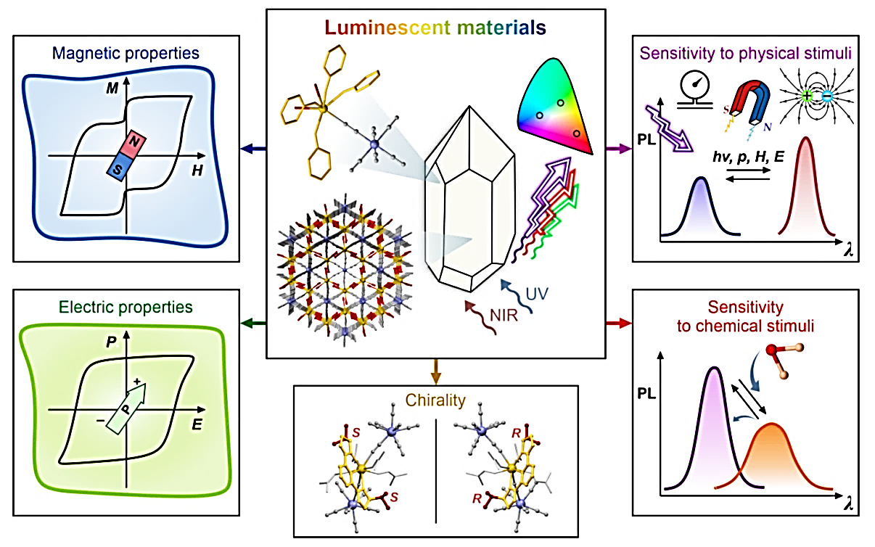
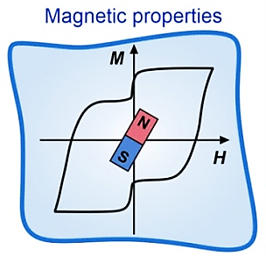
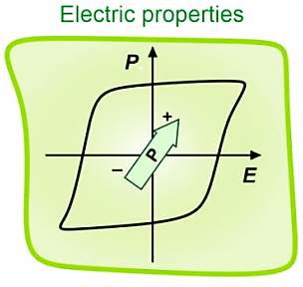
Multifunctional solid luminophores based on metal complexes:
from luminescent molecular magnets to luminescent molecular ferroelectrics
Szymon Chorazy
Multifunctional Luminescent Materials Group, Faculty of Chemistry, Jagiellonian University, Kraków, Poland
Institute of Nuclear Physics PAS, Institute Seminar, Kraków, February 26, 2026

Slide 2

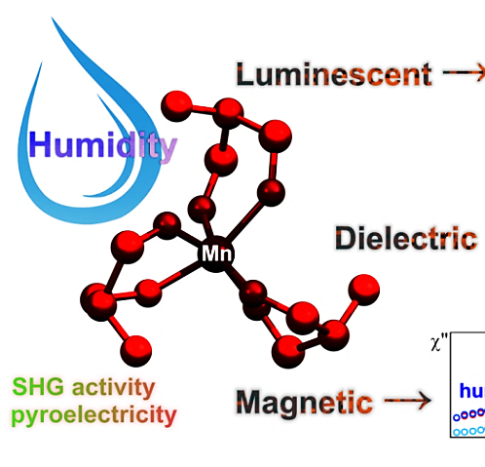
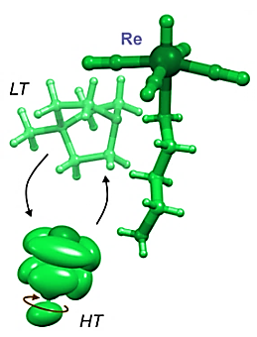
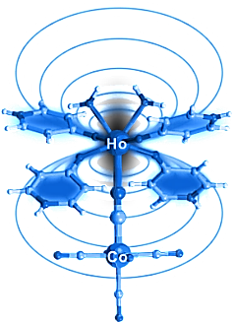
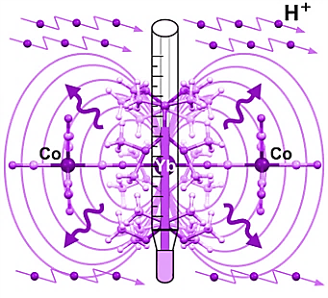
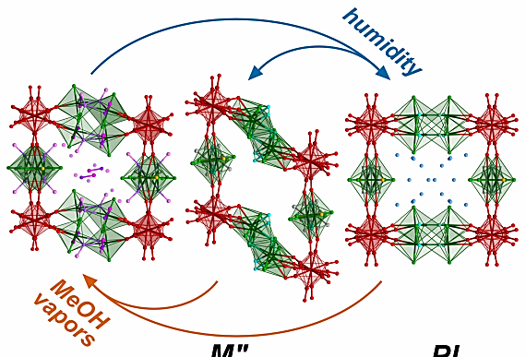
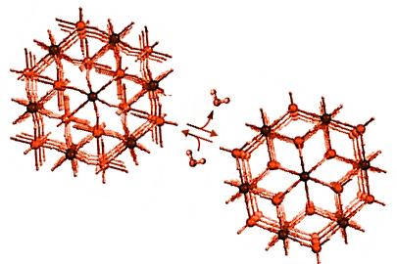
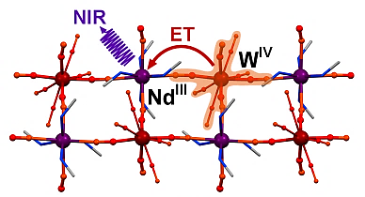
From basic science to application potential in memory devices, sensors, light-emitting diodes, and multifunctional devices.
(I)
Angew. Chem. Int. Ed. 2023, 62, e202308284
Chem. Sci. 2025, 16, 8979
(II)
J. Am. Chem. Soc. 2020, 142, 3970
Chem. Sci. 2021, 12, 730
Co^{III}
Review papers:
Chem. Soc. Rev. 2020, 49, 5945
Inorg. Chem. Front. 2021, 8, 452
Chem. Commun. 2023, 59, 5961
Chem. Rev. 2024, 124, 5930
(III)
U^{VI}
J. Am. Chem. Soc. 2019, 141, 18211;
Angew. Chem. Int. Ed. 2023, 62, e202306372
Angew. Chem. Int. Ed. 2025, 64, e202424651
Angew. Chem. Int. Ed. 2025, e202517109
Institute of Nuclear Physics PAS, Institute Seminar, Kraków, February 26, 2026

Slide 3
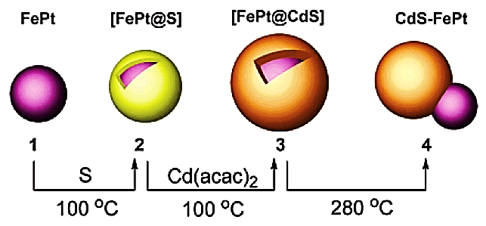
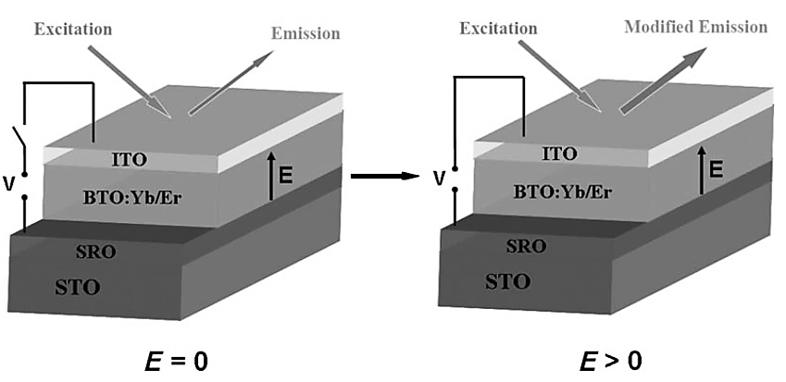
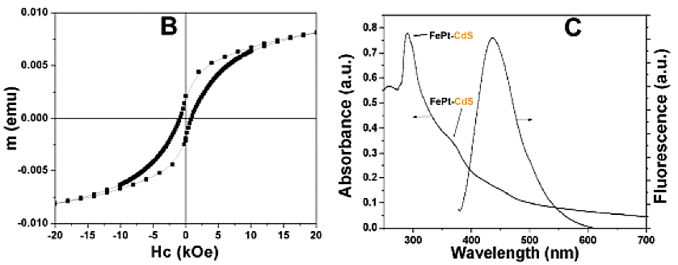
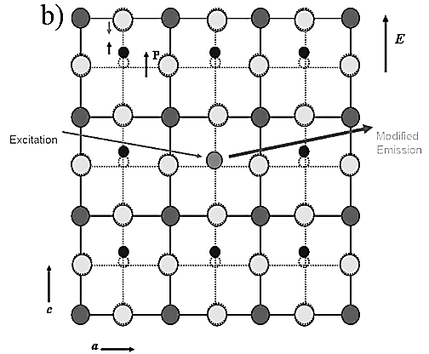
Concept of multifunctional solid luminophores – composite approach and single-phase but non-molecular approach
multiple phases (composite)
single phase but non-molecular
BaTiO₃:Er,Yb thin film exhibiting electric modulation of up-conversion (UCL) photoluminescence
J. Hao and co-workers, Angew. Chem. Int. Ed. 2011, 50, 6876
magneto-luminescent core-shell NPs of FePt and CdS
B. Xu and co-workers, J. Am. Chem. Soc. 2004, 126, 5664
Institute of Nuclear Physics PAS, Institute Seminar, Kraków, February 26, 2026

Slide 4
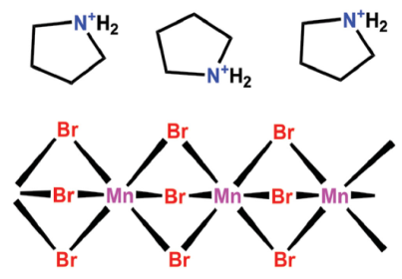
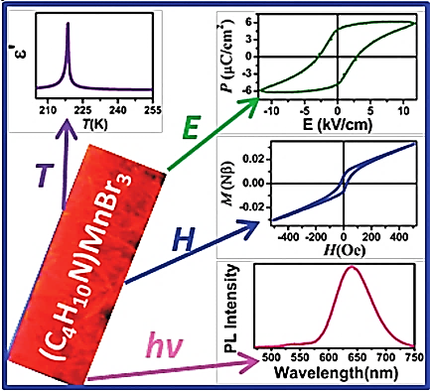
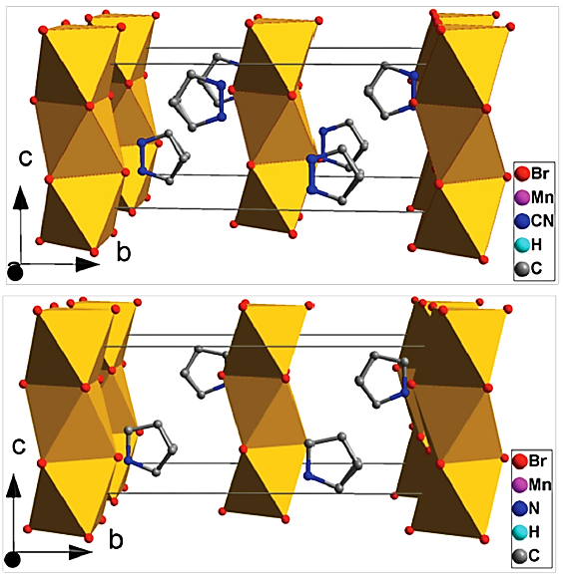
Concept of multifunctional solid luminophores – single-phase molecular approach
HT
(pyrrolidinium)[Mn^{II}Br₃] molecular hybrid serving as a luminescent multiferroic (ferroelectricity <219 K, ferromagnetism <2.4 K, RT emission)
R.-G. Xiong and co-workers, Adv. Mater. 2015, 27, 3942
LT
Institute of Nuclear Physics PAS, Institute Seminar, Kraków, February 26, 2026

Slide 5
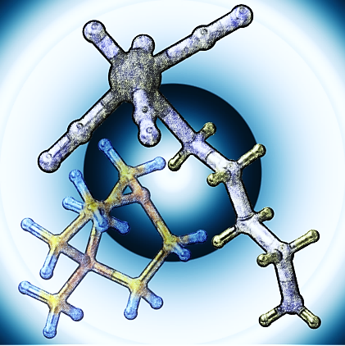
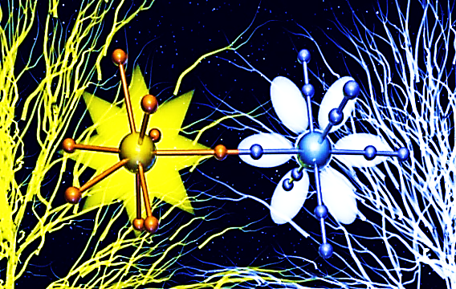
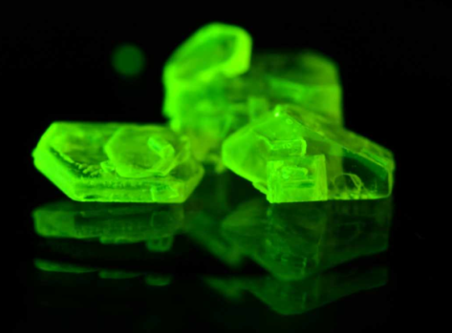
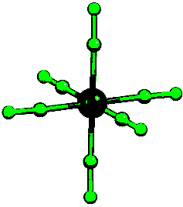
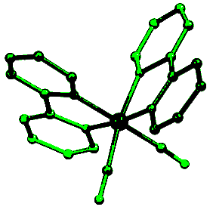
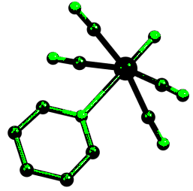
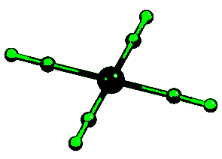
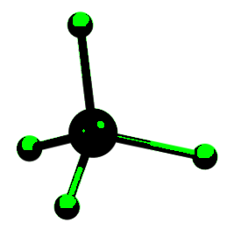

Synthetic approach – application of coordination chemistry
for the construction of multifunctional luminescent materials
Synthesis of functionalized solid luminophores
through linking of two (or more) molecular components towards
organic-inorganic molecular hybrids (I) and heterometallic
coordination systems (molecules, II, or CPs/MOFs, III)
organic counter-ions (I)
or
complexes of metal ions from s, p, d, and f blocks of periodic table (II/III)
(I)
(II/III)
+
hybrid salt with [Pt(CN)₄]²⁻, under UV
[M(CN)_{x}(L)_{y}]^{n-}
[M(X)₄]^{n-}
X = Cl, Br
Mn^{V}, Re^{V}
Ag^{I}, Au^{I}
Mn^{II}, Zn^{II}
Pd^{II}, Pt^{II}, Au^{III}
Co^{III}, Cr^{III}, Ru^{II}
Rh^{III}, Ir^{III}, Pt^{IV}
Fe^{II}, Ru^{II}
(…)
Institute of Nuclear Physics PAS, Institute Seminar, Kraków, February 26, 2026

Slide 6
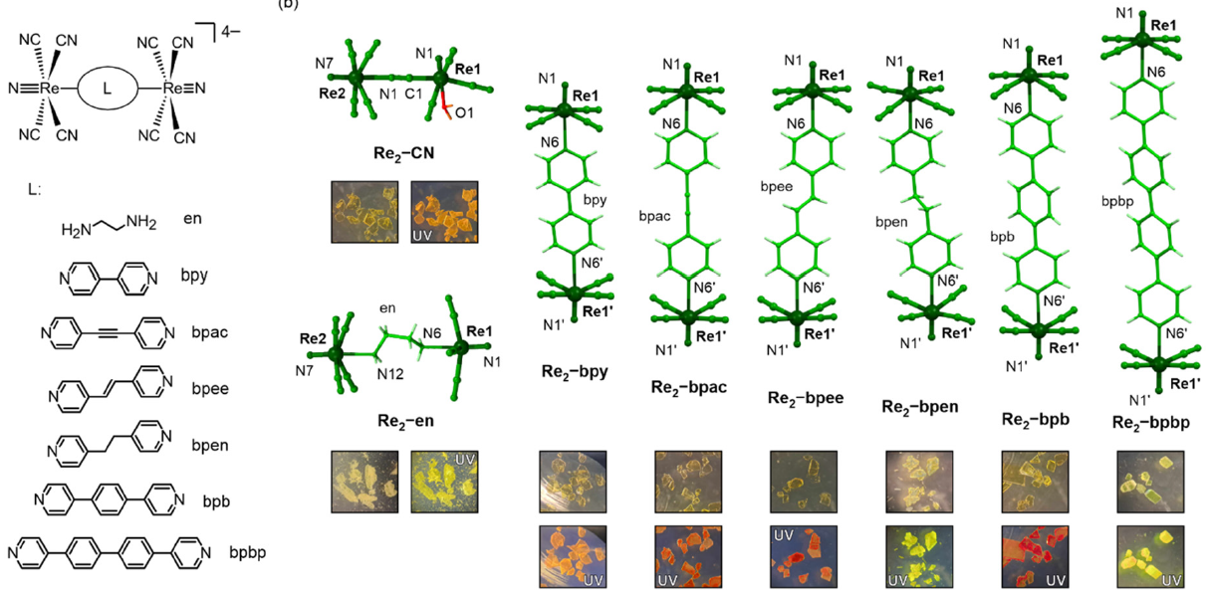
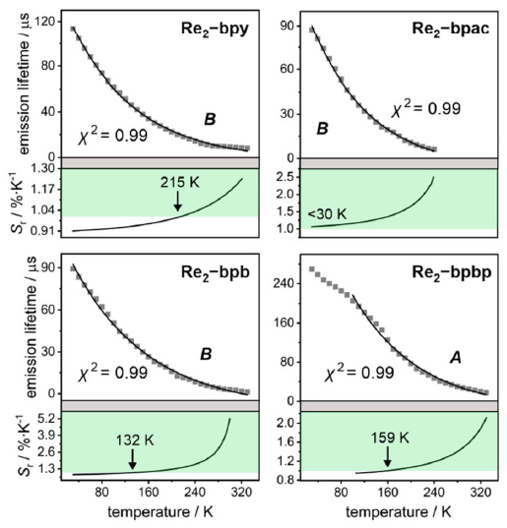
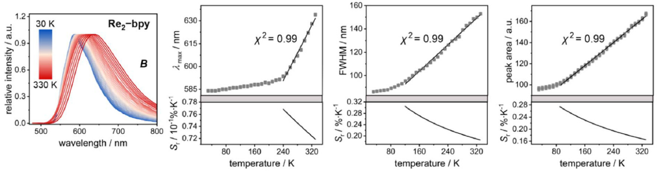
Hybrid molecular approach to multifunctional luminescent materials (I)
Tunable emission mechanism and various approaches for optical thermometry achievable in organic salts of dirhenium(V) molecular anions
M. Liberka et al.
Inorg. Chem. Front. 2024, 11, 8047
Institute of Nuclear Physics PAS, Institute Seminar, Kraków, February 26, 2026

Slide 7
Heterometallic molecular approach to multifunctional luminescent materials (molecules, II)
Unprecedented multifunctionality in a molecular solid: slow relaxation of magnetization (A), ratiometric luminescent thermometry (B), and super-ionic RH-dependent conductivity (C) related to water vapor sorption property (D)
A
B
D
C
J. Wang, J. J. Zakrzewski, et al.
J. Am. Chem. Soc. 2020, 142, 3970
Institute of Nuclear Physics PAS, Institute Seminar, Kraków, February 26, 2026

Slide 8
Heterometallic molecular approach to multifunctional luminescent materials (CPs/MOFs, III)
UCo
Similar effect for EtOH and MeCN (however, the sorption is different)
Efficient and reversible quenching of CT uranyl emission by dehydration and organic solvents. Photochromism induced by organic solvents.
J. J. Zakrzewski, et al.
Angew. Chem. Int. Ed. 2025, 64, e202517109
Institute of Nuclear Physics PAS, Institute Seminar, Kraków, February 26, 2026

Slide 9
Multifunctional solid luminophores based on metal complexes:
from luminescent molecular magnets to luminescent molecular ferroelectrics
Institute of Nuclear Physics PAS, Institute Seminar, Kraków, February 26, 2026

Slide 10
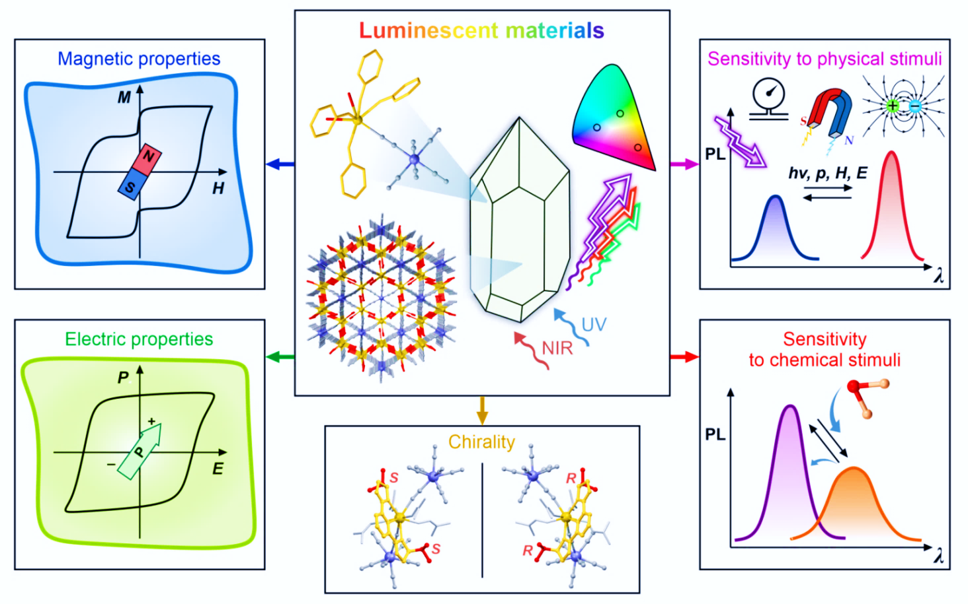
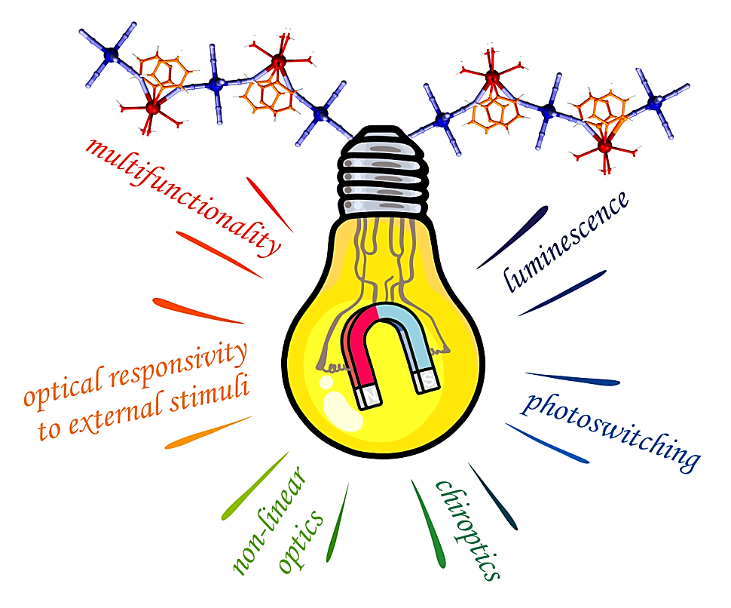
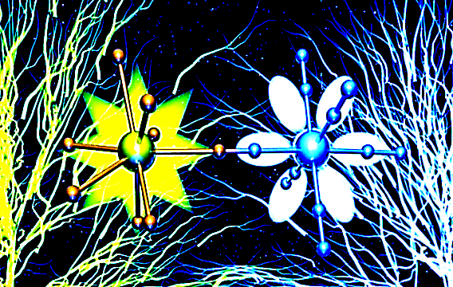
Two special research goals:
Linking molecular nanomagnetism with luminescent thermometry
(single-molecule magnets with optical self-monitoring of temperature)
Linking photomagnetism with luminescence
(photoluminescent detection of a photomagnetic effect)
Linking molecular nanomagnetism with luminescence and sensitivity to external stimuli
Strategy: lanthanide(III) – polycyanidometallate CPs
Broader context:
Optical phenomena in molecule-based magnetic materials
J. Zakrzewski, M. Liberka, J. Wang, S. Chorazy, S. Ohkoshi, Chem. Rev. 2024, 124, 5930
(III)
Institute of Nuclear Physics PAS, Institute Seminar, Kraków, February 26, 2026

Slide 11
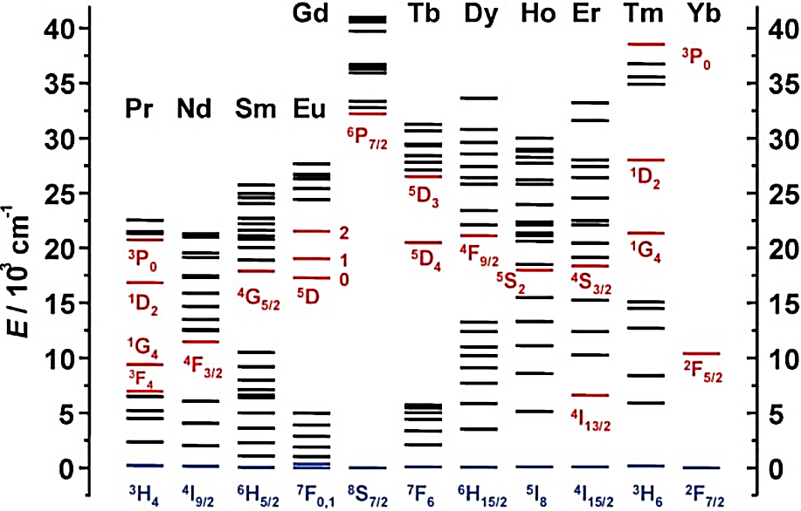
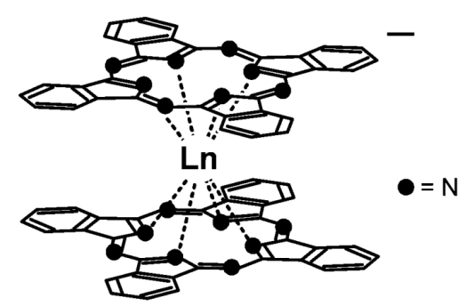
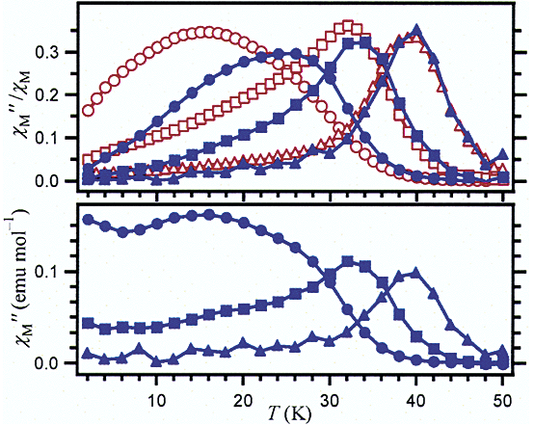
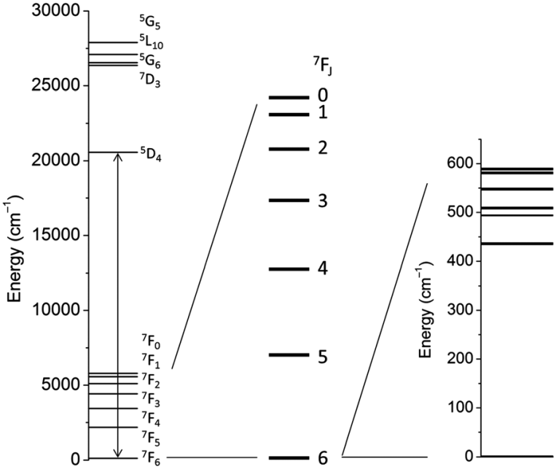
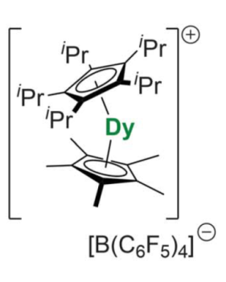
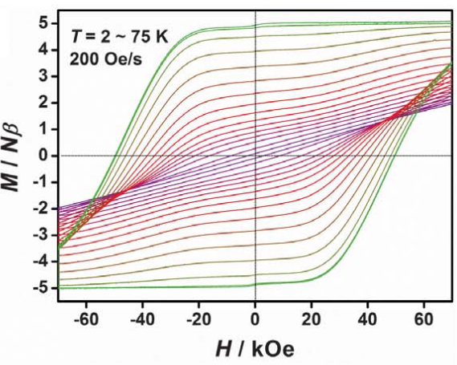
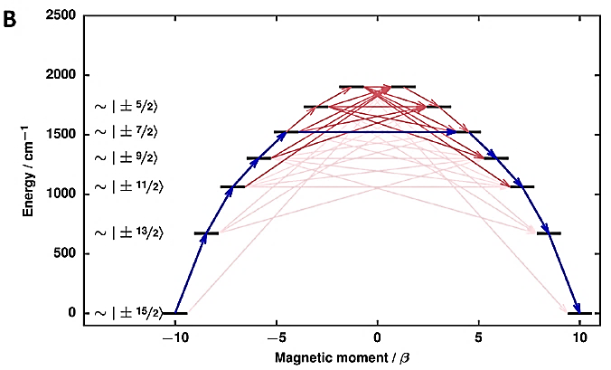
Linking molecular nanomagnetism with luminescent thermometry
(single-molecule magnets with optical self-monitoring of temperature) – ROLE OF LANTHANIDE IONS
large energy splitting of electronic ground multiplet in the crystal field of ligands together with magnetic axiality lead to Single-Molecule Magnet (SMM) behavior
Tb
Tb
TbY
N. Ishikawa, et al.
J. Am. Chem. Soc.
2003, 125, 8694
example of Tb(III)
SMMs as candidates for molecule-based magnetic memory devices
SOC
CF
F.-S. Guo, et al. Science 2018, 362, 1400
S. T. Liddle, et al. Chem. Soc. Rev. 2015, 44, 6655
Institute of Nuclear Physics PAS, Institute Seminar, Kraków, February 26, 2026

Slide 12
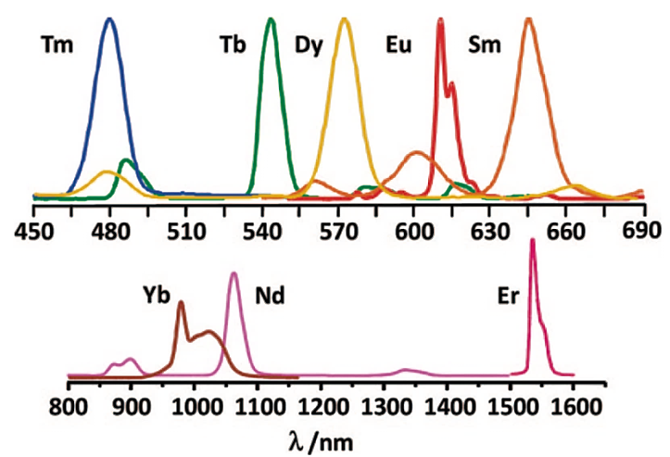
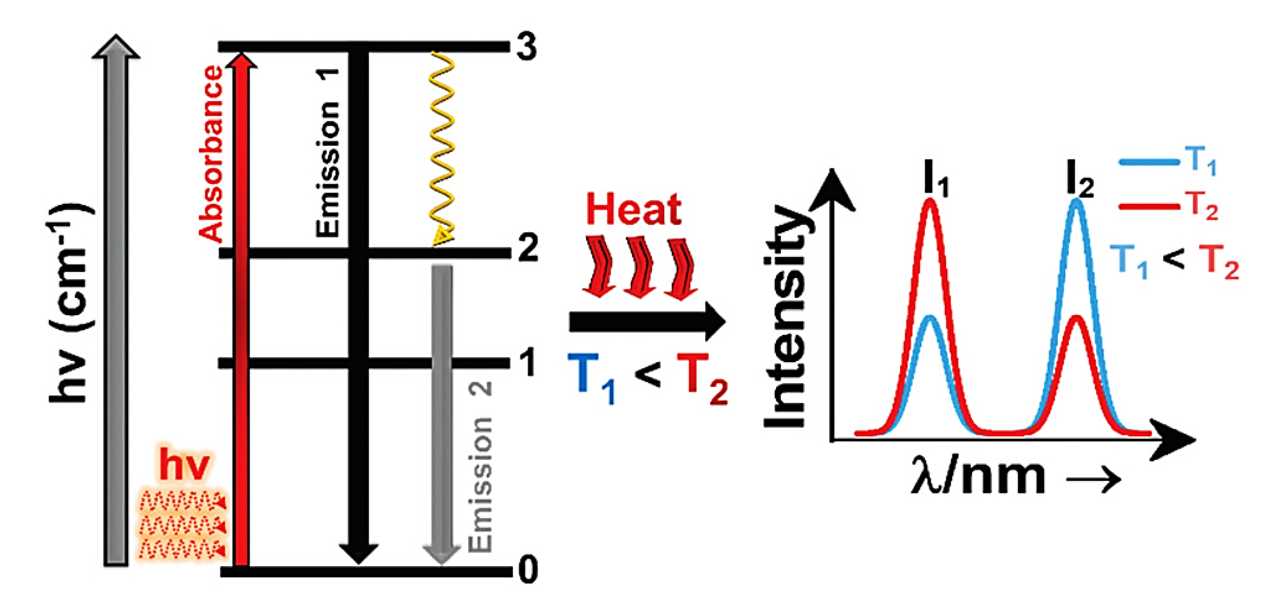
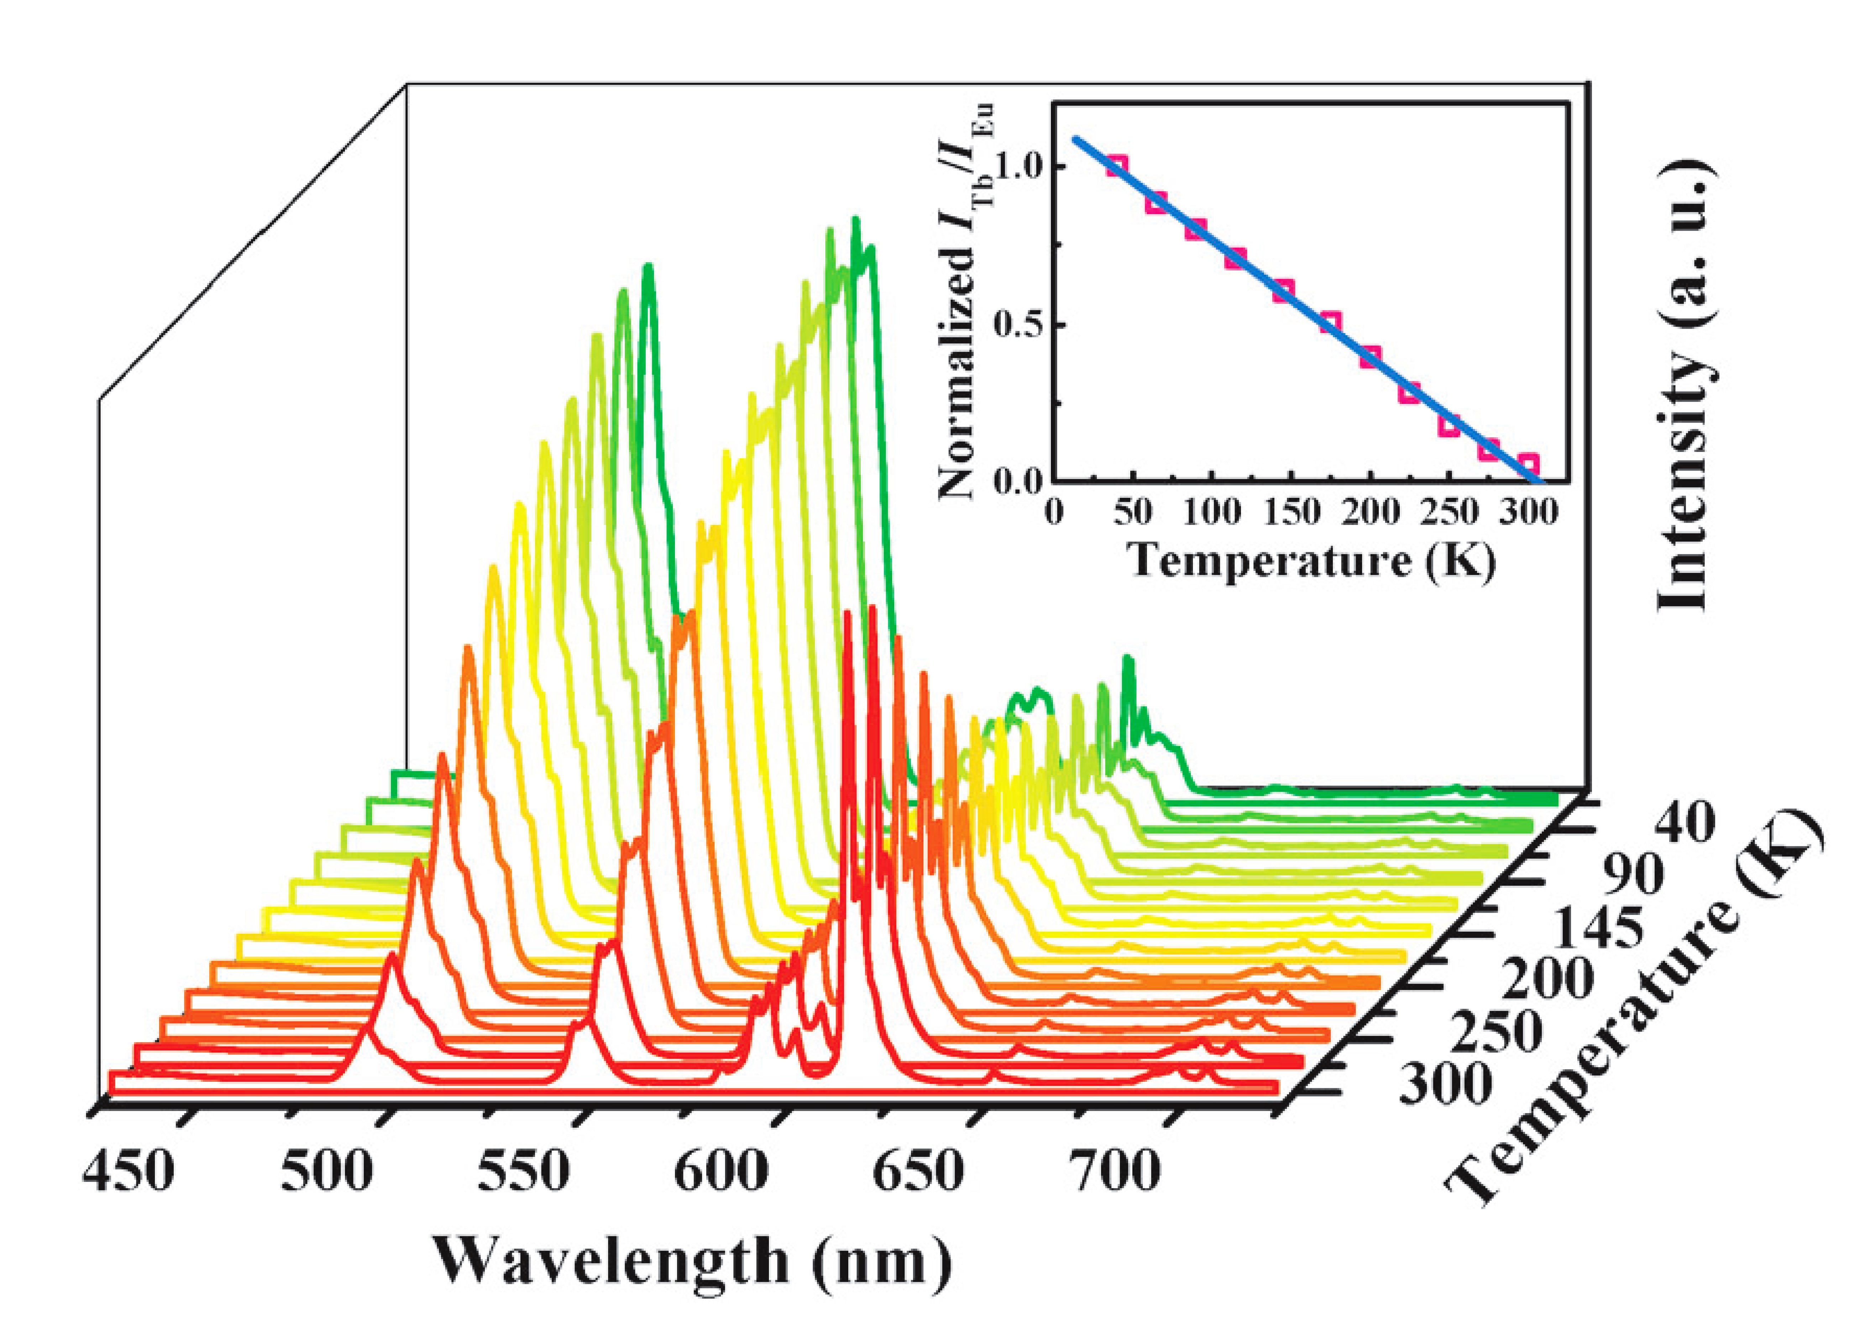
Linking molecular nanomagnetism with luminescent thermometry
(single-molecule magnets with optical self-monitoring of temperature) – ROLE OF LANTHANIDE IONS
photoluminescence related to f-f electronic transitions (down- or up-conversion, etc.)
multiple applications of lanthanide-based luminophores (lighting, lasers, sensors, security, displays, light conversion, bioimaging, cancer diagnosis, etc.)
J.-C. G. Bünzli, C. Piguet, Chem. Soc. Rev. 2005, 34, 1048
J.-C. G. Bünzli, K.-L. Wong, J. Lumin. 2025, 287, 121473
optical thermometry related to the temperature variation of luminescent spectra of lanthanide ions
contactless luminescent temperature sensing (medical diagnostics, catalytic reactors, microelectronics, etc.)
Tb
np. Eu/Tb
B. Chen, et al. J. Am. Chem. Soc. 2012, 134, 3979;
Y. Cui, et al. Chem. Commun. 2014, 50, 719;
A. Nexha, et al. Nanoscale 2021, 13, 7913;
C. D. S. Brites, et al. Adv. Opt. Mater. 2019, 7, 1801239
MLMG:
M. Wyczesany et al. J. Mater. Chem. C 2022, 10, 12054
Eu
Institute of Nuclear Physics PAS, Institute Seminar, Kraków, February 26, 2026

Slide 13
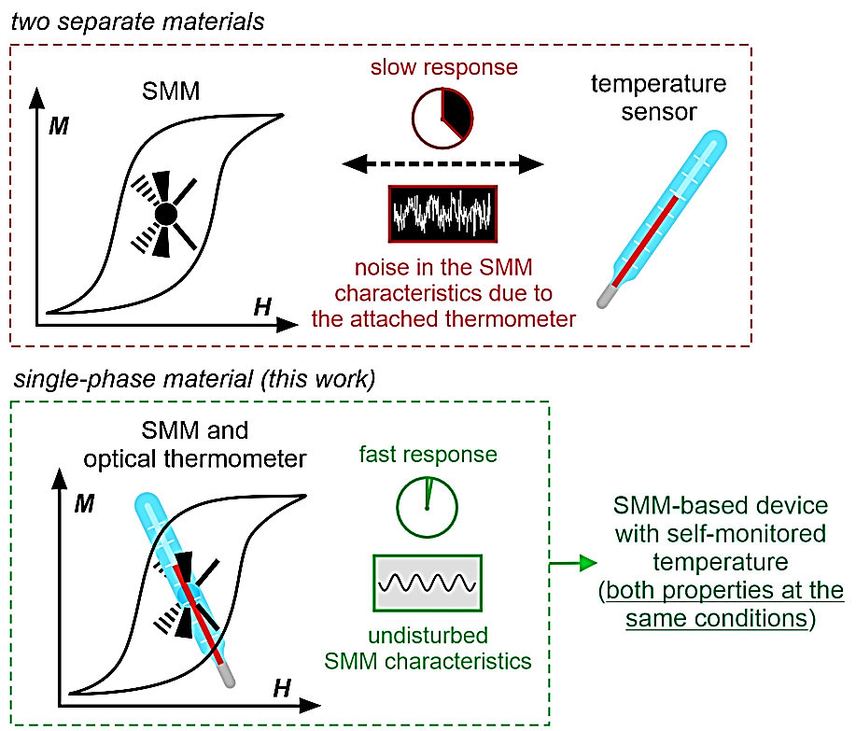
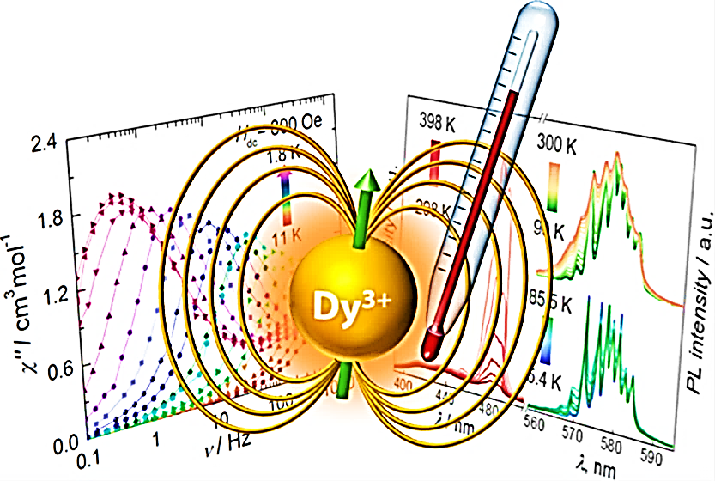
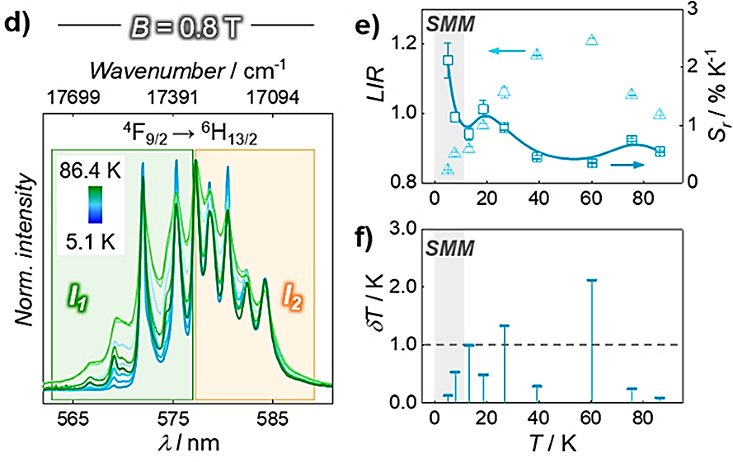
Linking molecular nanomagnetism with luminescent thermometry
(single-molecule magnets with optical self-monitoring of temperature)
Concept
Pioneering works
Research group of Prof. Muralee Murugesu
D. Errulat, et al. ACS Cent. Sci. 2019, 5, 1187
Using our approach:
YbCo: J. Am. Chem. Soc. 2020, 142, 3970
HoCo: Chem. Sci. 2021, 12, 730
Challenge
Simultaneous control of magnetic anisotropy and luminescent thermometry to achieve the wide overlap between high-performance SMM and efficient thermometric effects.
Institute of Nuclear Physics PAS, Institute Seminar, Kraków, February 26, 2026

Slide 14
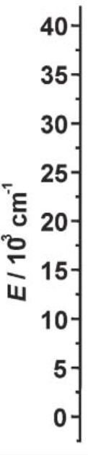


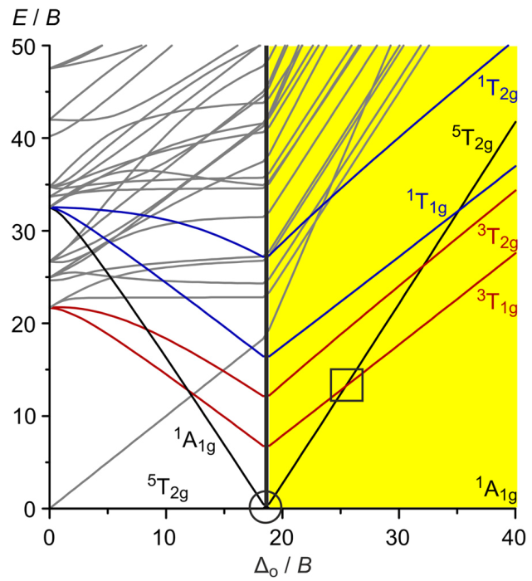

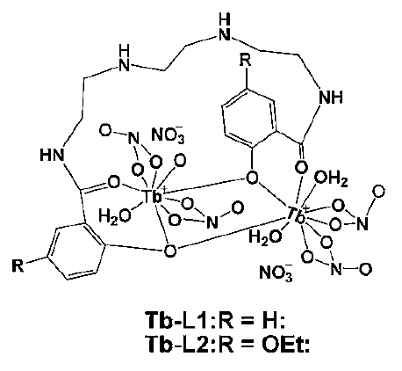
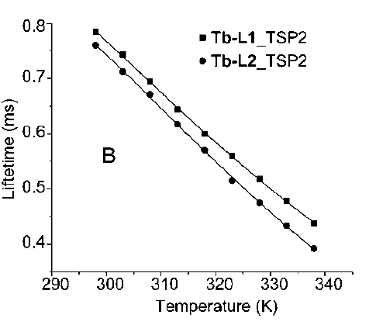
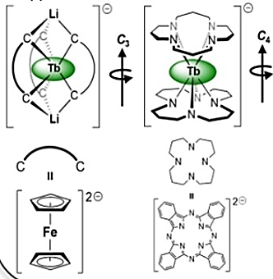
Linking molecular nanomagnetism with luminescent thermometry
(single-molecule magnets with optical self-monitoring of temperature)
terbium(3+) ion, Tb³⁺
hexacyanido-cobaltate(III) ion, [Co^{III}(CN)₆]³⁻
strong T-dependent green emission
S = 0
single-molecule magnetism
(magnetic axiality,
high symmetry)
large Stokes shift
(from abs. 350-450 nm to em. 600-800 nm)
emission
spectrum
J. Mater. Chem. 2010, 20, 6975
JACS 2003, 125, 8694
ACIE 2018, 57, 8164
ACIE 2022, 61, e202203285
Chem. Eur. J. 2016, 22, 7371
Institute of Nuclear Physics PAS, Institute Seminar, Kraków, February 26, 2026

Slide 15
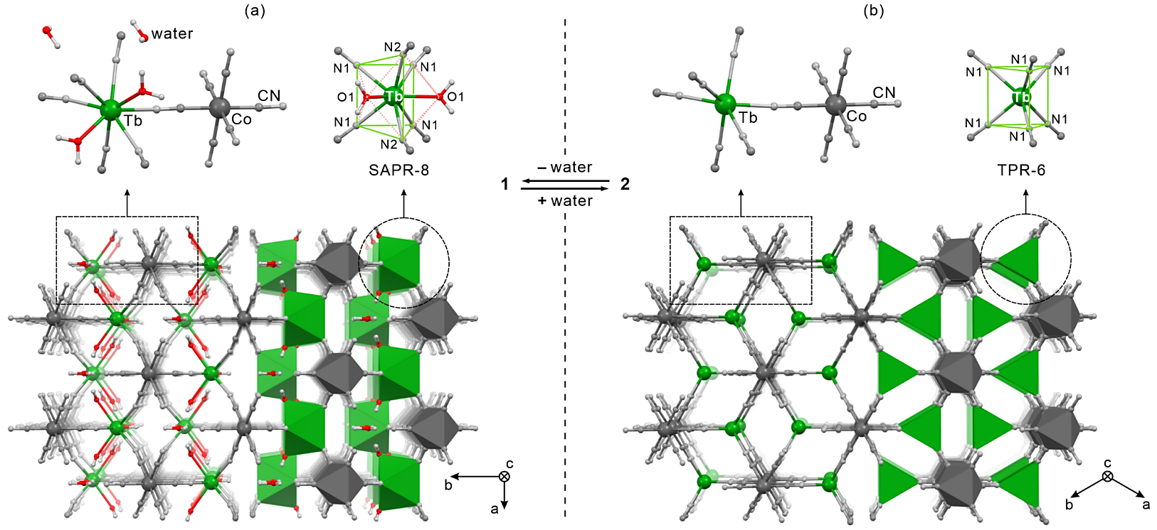
Linking molecular nanomagnetism with luminescent thermometry
(single-molecule magnets with optical self-monitoring of temperature)
Tb³⁺
[Co^{III}(CN)₆]³⁻
H₂O
{[Tb^{III}(H₂O)₂][Co^{III}(CN)₆]}∙2H₂O
3-D coordination network based on molecular cyanido bridges
hydrated phase (1)
dehydrated phase (2)
hydrated magnetically diluted phase (1md)
Tb_{0.026}Y_{0.974}[Co(CN)₆](H₂O)₄
dehydrated magnetically diluted phase (2md)
Tb_{0.026}Y_{0.974}[Co(CN)₆]
Institute of Nuclear Physics PAS, Institute Seminar, Kraków, February 26, 2026

Slide 16

Linking molecular nanomagnetism with luminescent thermometry
(single-molecule magnets with optical self-monitoring of temperature)
Orbach relaxation:
ΔE of 95(5) K (66(4) cm⁻¹) for 1md
ΔE of 855(26) K (594(18) cm⁻¹) for 2
ΔE of 879(39) K (611(27) cm⁻¹) for 2md
significant QTM and Raman contributions
Raman parameters (from CT^{n} approach):
n = 2.59(3)
for 1md at 2 kOe,
n = 4.81(6)
for 2 at 3 kOe,
n = 4.0(1)
for 2md at 0 Oe
n = 4.74(5)
for 2md at 3 kOe
(can be also described by C_{i} and ω_{i} of phonon modes)
Dehydration and magnetic dilution lead to the enhancement of SMM behaviour:
1 –the onset of field-induced SMM features; 1md – field-induced SMM
2 – the onset of zero-dc-field SMM; 2md – zero-dc-field SMM with large Orbach ΔE
Institute of Nuclear Physics PAS, Institute Seminar, Kraków, February 26, 2026

Slide 17

Linking molecular nanomagnetism with luminescent thermometry
(single-molecule magnets with optical self-monitoring of temperature)
thermometric
parameter
ratiometric luminescent thermometry utilizing the temperature-variable Tb(III)-centered emission pattern (exploration of hot and cold emission bands)
Institute of Nuclear Physics PAS, Institute Seminar, Kraków, February 26, 2026

Slide 18

Linking molecular nanomagnetism with luminescent thermometry
(single-molecule magnets with optical self-monitoring of temperature)
J. Wang, J. J. Zakrzewski, M. Zychowicz, Y. Xin, H. Tokoro, S. Chorazy, S. Ohkoshi, Angew. Chem. Int. Ed. 2023, 62, e202306372
The structural features (high symmetry, axially aligned negatively charged ligands) of [Tb^{III}(NC)₆]³⁻ are key both for SMM behaviour as well as optical thermometry:
(a) the large energy splitting combined with magnetic axiality lead to the SMM features
(b) the large energy splitting gives the good separation of cold and hot emission bands,
(c) the energy splitting is large for the ground state but much smaller for the emissive multiplet – as a result the hot bands are observed even below 50 K (overlapping with the SMM effect)
Institute of Nuclear Physics PAS, Institute Seminar, Kraków, February 26, 2026

Slide 19






Linking photomagnetism with luminescence
(photoluminescent detection of a photomagnetic effect)
Luminescent metal complex
Luminescent
photochromism
Photomagnetism
Photosensitive metal complex with photoswitchable magnetism
Photosensitive metal complex with photoswitchable magnetism
– octacyanidometallate(IV) anions, [M^{IV}(CN)₈]⁴⁻ (M = Mo, W)
400-430 nm
T
Photoinduced electron transfer between Mo(IV) and Cu(II) centers forming a pathway for ferromagnetic exchange and long-range spin ordering
S. Ohkoshi and co-workers, Synth. Met. 2001, 122, 523
S. Brossard and co-workers, J. Am. Chem. Soc. 2012, 134, 222
Institute of Nuclear Physics PAS, Institute Seminar, Kraków, February 26, 2026

Slide 20









Linking photomagnetism with luminescence
(photoluminescent detection of a photomagnetic effect)
Photosensitive metal complex with photoswitchable magnetism
– octacyanidometallate(IV) anions, [M^{IV}(CN)₈]⁴⁻ (M = Mo, W)
Photoinduced cyanide dissociation in the solid state containing [Mo^{IV}(CN)₈]⁴⁻ ions.
Change of magnetism and light absorption.
Photoinduced spin ordering in Mn(II)-W(IV) framework
D. Pinkowicz and co-workers,
J. Am. Chem. Soc. 2018, 59, 15876
D. Pinkowicz, C. Mathoniere, and co-workers,
Angew. Chem. Int. Ed. 2020, 59, 3117
Institute of Nuclear Physics PAS, Institute Seminar, Kraków, February 26, 2026

Slide 21

Linking photomagnetism with luminescence
(photoluminescent detection of a photomagnetic effect)
Luminescent metal complex
Luminescent
photochromism
Photomagnetism
Photosensitive metal complex with photoswitchable magnetism
NIR-emissive magnetic neodymium(III) were selected together with photoswitchable octacyanidotungstate(IV) for achieving photoluminescent photomagnets
Nd(III)-Mo(IV) and Nd(III)-W(IV) layered frameworks crystallizing in the C2 space group as the mixture of crystalline enantiomorphs. They reveal SHG activity, sensitized NIR emission, and slow magnetic relaxation effects.
S. Chorazy and co-workers, J. Mater. Chem. C 2021, 9, 10705
Institute of Nuclear Physics PAS, Institute Seminar, Kraków, February 26, 2026

Slide 22



Linking photomagnetism with luminescence
(photoluminescent detection of a photomagnetic effect)
Our candidate: (S,S/R,R-bmba){[Nd^{III}(MeOH)₄][W^{IV}(CN)₈]}∙n(solv) /(S,S)-1 and (R,R)-1/
(S,S/R,R-bmba = N-protonated (S,S)-(–)- or (R,R)-(+)-bis(α-methylbenzyl)-amine, solv = MeOH or H₂O)
Anionic Nd(III)-W(IV) coordination layers crystallizing with chiral organic cations (enantiopure crystals)
Institute of Nuclear Physics PAS, Institute Seminar, Kraków, February 26, 2026

Slide 23


Linking photomagnetism with luminescence
(photoluminescent detection of a photomagnetic effect)
(S,S/R,R-bmba){[Nd^{III}(MeOH)₄][W^{IV}(CN)₈]}∙n(solv) /(S,S)-1 and (R,R)-1/ - photoluminescence
(S,S)-1
NIR Nd(III) photoluminescence sensitized by the octacyanidotungstate(IV) triplet state.
The energy transfer is weak at room temperature (compared to the direct f-f excitation) but becomes efficient at LT.
Electronic transitions calculated ab initio (Nd) or TD-DFT (W).
Institute of Nuclear Physics PAS, Institute Seminar, Kraków, February 26, 2026

Slide 24



Linking photomagnetism with luminescence
(photoluminescent detection of a photomagnetic effect)
(S,S/R,R-bmba){[Nd^{III}(MeOH)₄][W^{IV}(CN)₈]}∙n(solv) /(S,S)-1 and (R,R)-1/ - photoluminescence
Theoretical prediction of the influence of photogenerated [W^{IV}(CN)₇]³⁻. Ab initio calculations for [W^{IV}(CN)₇]³⁻ ions from the published crystal structure (K. R. Dunbar and co-workers, Angew. Chem. Int. Ed. 2016, 55, 11368).
Expected quenching of NIR Nd(III) emission through the S₃ excited state of [W^{IV}(CN)₇]³⁻ ions.
Institute of Nuclear Physics PAS, Institute Seminar, Kraków, February 26, 2026

Slide 25


Linking photomagnetism with luminescence
(photoluminescent detection of a photomagnetic effect)
(S,S/R,R-bmba){[Nd^{III}(MeOH)₄][W^{IV}(CN)₈]}∙n(solv) – investigation of photochromism in NIR luminescence
10 K, irradiation by the 450 nm light (8 hours), tracing the excitation and emission spectra; then, heating to 290 K
T-dependence of the ratio between exc. peaks reveal the T = 180 K of thermal relaxation of a photoinduced state.
Fully thermally reversible photochromic luminescent effect (detectable in the excitation spectra) was observed.
Institute of Nuclear Physics PAS, Institute Seminar, Kraków, February 26, 2026

Slide 26



Linking photomagnetism with luminescence
(photoluminescent detection of a photomagnetic effect)
(S,S/R,R-bmba){[Nd^{III}(MeOH)₄][W^{IV}(CN)₈]}∙n(solv) – investigation of photochromism in NIR luminescence
Optical thermometric characteristics affected by the irradiation (an additional component added to the Mott-Seitz model).
Institute of Nuclear Physics PAS, Institute Seminar, Kraków, February 26, 2026

Slide 27


Linking photomagnetism with luminescence
(photoluminescent detection of a photomagnetic effect)
(S,S/R,R-bmba){[Nd^{III}(MeOH)₄][W^{IV}(CN)₈]}∙n(solv) – investigation of photochromism in NIR luminescence
(R,R)-1
Emission signal also changes (decreases) upon the 450 nm irradiation; the ratio between 893 and 1060 nm peaks is not changing upon the irradiation. The thermal reversibility can be postulated; however, the T-changes in background makes emission worse parameter for detection of the photoinduced effect than excitation peaks.
Institute of Nuclear Physics PAS, Institute Seminar, Kraków, February 26, 2026

Slide 28



Linking photomagnetism with luminescence
(photoluminescent detection of a photomagnetic effect)
(S,S/R,R-bmba){[Nd^{III}(MeOH)₄][W^{IV}(CN)₈]}∙n(solv) – investigation of photomagnetic effect
10 K, irradiation by the 405 nm light (24 hours); then, heating to 200 K/230 K
Lanthanide emission used to detect and follow the photomagnetic effect occurring due to the photo-sensitivity of cyanido metal complexes.
Fully thermally reversible photomagnetic effect. The thermal relaxation occurs at ca. 180 K which agrees with the result of thermal relaxation of a photoinduced state in the experiments of photochromism in photoluminescence.
J. J. Zakrzewski, R. Jankowski, M. Romanowska, J. Wang, D. Pinkowicz, B. Sieklucka, S. Ohkoshi, S. Chorazy, Angew. Chem. Int. Ed. 2025, e202424651
Institute of Nuclear Physics PAS, Institute Seminar, Kraków, February 26, 2026

Slide 29


Two special research goals:
Linking molecular nanomagnetism with luminescent thermometry
(single-molecule magnets with optical self-monitoring of temperature)
Linking photomagnetism with luminescence
(photoluminescent detection of a photomagnetic effect)
J. Wang, J. J. Zakrzewski, et al. Angew. Chem. Int. Ed. 2023, 62, e202306372
Strategy: lanthanide(III) – polycyanidometallate CPs
J. J. Zakrzewski et al. Angew. Chem. Int. Ed. 2025, e202424651
(III)
Institute of Nuclear Physics PAS, Institute Seminar, Kraków, February 26, 2026

Slide 30



Two special research goals:
Linking switchable
dielectric constant
with luminescence
(simultaneous switching of dielectric and luminescent effects)
Linking ferroelectricity with luminescent thermometry
(molecular ferroelectric with optical self-monitoring of temperature)
Linking molecular ferroelectrics (switchable dielectrics) with luminescence and sensitivity to external stimuli
Strategy: polar cations – polycyanidometallate hybrids
Context – molecular ferroelectrics:
R.-G. Xiong, et al.
J. Am. Chem. Soc. 2017, 139, 6369
(I)
Institute of Nuclear Physics PAS, Institute Seminar, Kraków, February 26, 2026

Slide 31





Context: Order-disorder phase transitions – the route to switching of luminescence
Two special research goals:
Linking switchable
dielectric constant
with luminescence
(simultaneous switching of dielectric and luminescent effects)
Linking ferroelectricity with luminescent thermometry
(molecular ferroelectric with optical self-monitoring of temperature)
0.94Bi_{0.5}Na_{0.5}TiO₃−0.06BaTiO₃ ceramics doped with 1 mol % Eu³⁺ (Eu-BNT6BT)
Ba
O
Ti
Switching the Eu(III)-centered emission
by an electric field in inorganic ferroelectric.
RT
Strategy: polar cations – polycyanidometallate hybrids
K. W. Kwok, et al. ACS Appl. Mater. Interfaces 2017, 9, 34042
(I)
Institute of Nuclear Physics PAS, Institute Seminar, Kraków, February 26, 2026

Slide 32


tetracyanidonitridorhenate(V) ion, [Re^{V}(CN)₄(nitrido)(L-N]²⁻ (L-N = amines, pyridine derivatives, etc.)
0-D (Me-dabco)₂[Re^{V}(CN)₄(nitrido)(L-diamine)]
Linking switchable
dielectric constant
with luminescence
(simultaneous switching of dielectric and
luminescent effects)
Ionic salts based on tetracyanidonitridorhenate(V) complexes with diamine-type ligands, further linked with polar organic cations of an N-dabconium-type (Me-dabco); Thermally-induced phase transitions of an order-disorder type, observed in structural, calorimetric, dielectric studies (thermal switching of dielectric constant)
Institute of Nuclear Physics PAS, Institute Seminar, Kraków, February 26, 2026

Slide 33



tetracyanidonitridorhenate(V) ion, [Re^{V}(CN)₄(nitrido)(L-N]²⁻ (L-N = amines, pyridine derivatives, etc.)
0-D (Me-dabco)₂[Re^{V}(CN)₄(nitrido)(L-diamine)]
Photoluminescence of a dominant d-d electronic transition character thermally switchable due to the order-disorder phase transition (a rarely observed synchronous switching of luminescence and dielectric constant)
M. Liberka, M. Zychowicz, J. Hooper, K. Nakabayashi, S. Ohkoshi, S. Chorazy, Angew. Chem. Int. Ed. 2023, 62, e202308284
Institute of Nuclear Physics PAS, Institute Seminar, Kraków, February 26, 2026

Slide 34


Linking ferroelectricity with luminescent thermometry
(molecular ferroelectric with optical self-monitoring of temperature)
cyclometalated dicyanidoplatinate(II) ion, [Pt^{II}(CN)₂(ppy)]²⁻
(ppy = carbanion of 2-phenylpyridine)
Spontaneous crystallization of cyclometalated dicyanidoplatinate(II) with N-methyl-quinuclidinium cations (Me-abco⁺) in a polar Ima2 space group, as confirmed by SC-XRD and SHG studies
Institute of Nuclear Physics PAS, Institute Seminar, Kraków, February 26, 2026

Slide 35



Efficient room-temperature charge-transfer photoluminescence related to phosphorescent electronic transitions within Pt(II) complexes
TD-DFT calculations indicate the dominant MLCT character of the emissive state (however; with the contribution of intraligand-CT)
Institute of Nuclear Physics PAS, Institute Seminar, Kraków, February 26, 2026

Slide 36

Ratiometric optical thermometry originating from the temperature-dependent energy splitting of the vibrationally coupled emission;
optical thermometry works the best below 100 K; however, it still operates in the around RT range (shown experimentally and theoretically)
Institute of Nuclear Physics PAS, Institute Seminar, Kraków, February 26, 2026

Slide 37



Room-temperature ferroelectricity confirmed by the single-crystal electrical (piezoresponse) studies using the piezoresponse force microscopy (PFM), indicating the reversible ferroelectric domain switching (proof for ferroelectricity at a single-crystalline level)
Institute of Nuclear Physics PAS, Institute Seminar, Kraków, February 26, 2026

Slide 38



Intermediate state
The ferroelectricity mechanism is expected to involve the electrically induced motion of Pt(II) complexes, as the cations are perpendicular to the polar axis.
At higher temperatures, additional dielectric relaxation processes appear; they are assignable to the simultaneous motion of cations and anions.
Institute of Nuclear Physics PAS, Institute Seminar, Kraków, February 26, 2026

Slide 39




Crystalline material can be conveniently transformed into a nanometric thin film by a spin-coating method;
photoluminescence of Pt(II) complexes is subtly amended, while ratiometric optical thermometry remains similar (at least for the LT range, where is accessible) to the crystalline sample
Institute of Nuclear Physics PAS, Institute Seminar, Kraków, February 26, 2026

Slide 40


Two special research goals:
Linking switchable
dielectric constant
with luminescence
(simultaneous switching of dielectric and luminescent effects)
Linking ferroelectricity with luminescent thermometry
(molecular ferroelectric with optical self-monitoring of temperature)
M. Liberka et al. Angew. Chem. Int. Ed. 2023, 62, e202308284
Strategy: polar cations – polycyanidometallate hybrids
P. Bonarek et al. manuscript under review
(preprint: 10.26434/chemrxiv-2025-70v85)
(I)
Institute of Nuclear Physics PAS, Institute Seminar, Kraków, February 26, 2026

Slide 41
(III)
(I)
Linking molecular nanomagnetism with optical thermometry
Linking photomagnetism with luminescence
Linking switchable dielectric constant with luminescence
Linking ferroelectricity with luminescent thermometry
Institute of Nuclear Physics PAS, Institute Seminar, Kraków, February 26, 2026

Slide 42







MLMG, October 2024
Dr. habil. Szymon Chorąży, JU prof.
Dr. Jakub Zakrzewski (research assistant)
Dr. Michal Liberka (research assistant)
Dr. Robert Jankowski (ERC lab manager)
M.Sc. Beata Tubek (ERC project manager)
M.Sc. Jan Rzepiela (research assistant)
Dr. Michał Heczko (guest researcher)
Ph.D. students:
Mikołaj Żychowicz
Aleksander Hoffman
Kseniia Boidachenko
Kinga Szczecińska
Paweł Bonarek
M.Sc./B.Sc. students
Dawid Kruczek
Marta Niemiec
Jan Sierżęga
Mikołaj Graff
Bogusława Smykla
Dominika Wolak
Maja Romanowska
Hubert Dziełak
Piotr Gas
Zofia Szymanowska
Paweł Porębski
Collaboration (presented research): Prof. F. Kagawa (RIKEN Institute, Wako, Japan); Prof. S. Ohkoshi (The University of Tokyo, Japan),
Prof. H. Tokoro (University of Tsukuba, Japan); Dr. habil. D. Pinkowicz, Dr. K. Wolski (Jagiellonian University)
Institute of Nuclear Physics PAS, Institute Seminar, Kraków, February 26, 2026

