Slide 1

Neutrons for AGH, research and perspectives
Łukasz Gondek
lgondek@agh.edu.pl
Faculty of Physics and Applied Computer Science
AGH University of Krakow

Slide 2
Research interest at AGH

Slide 3
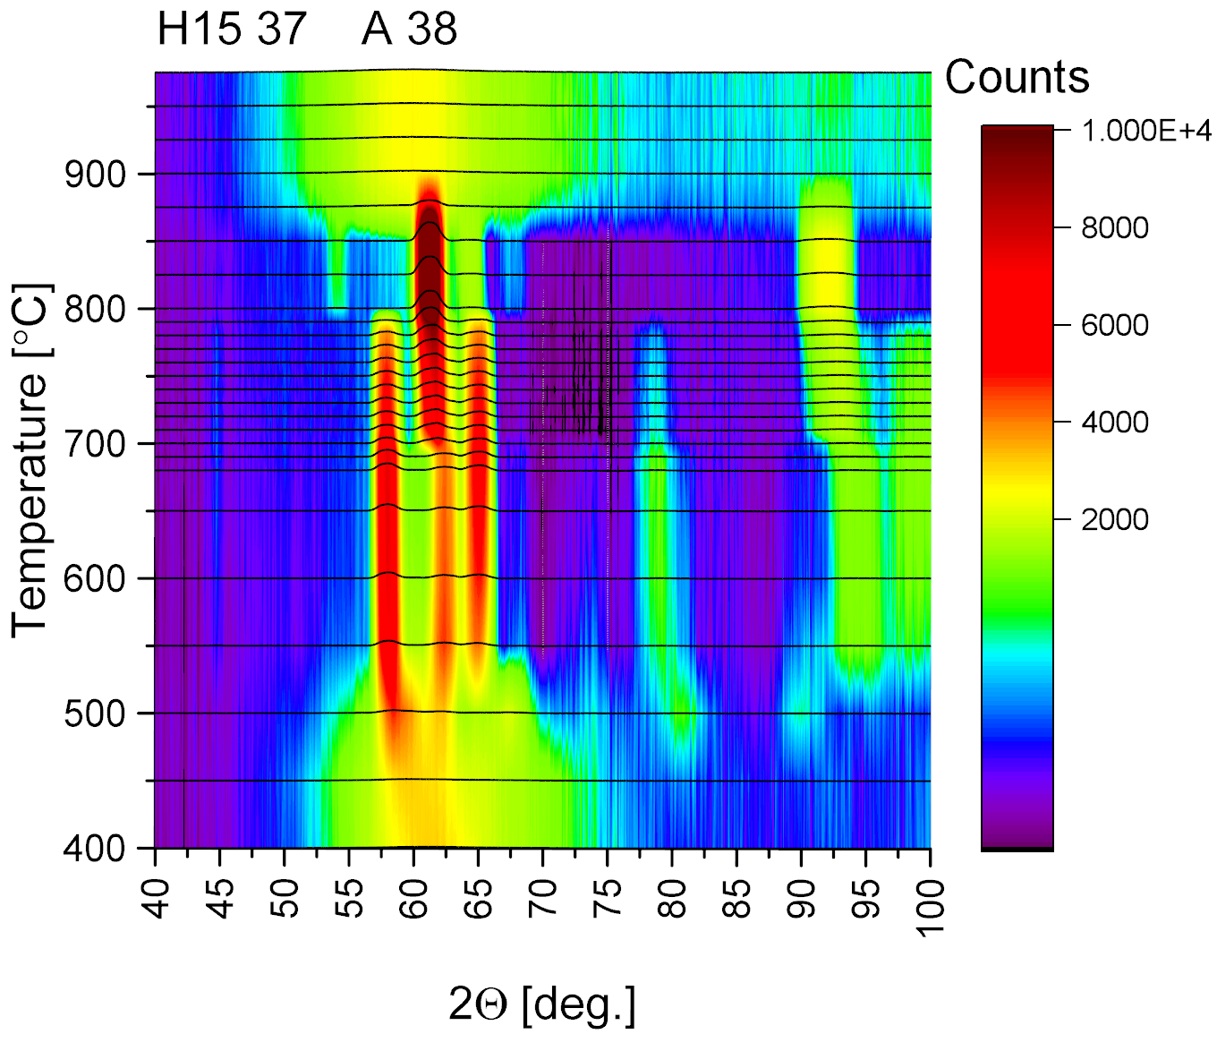
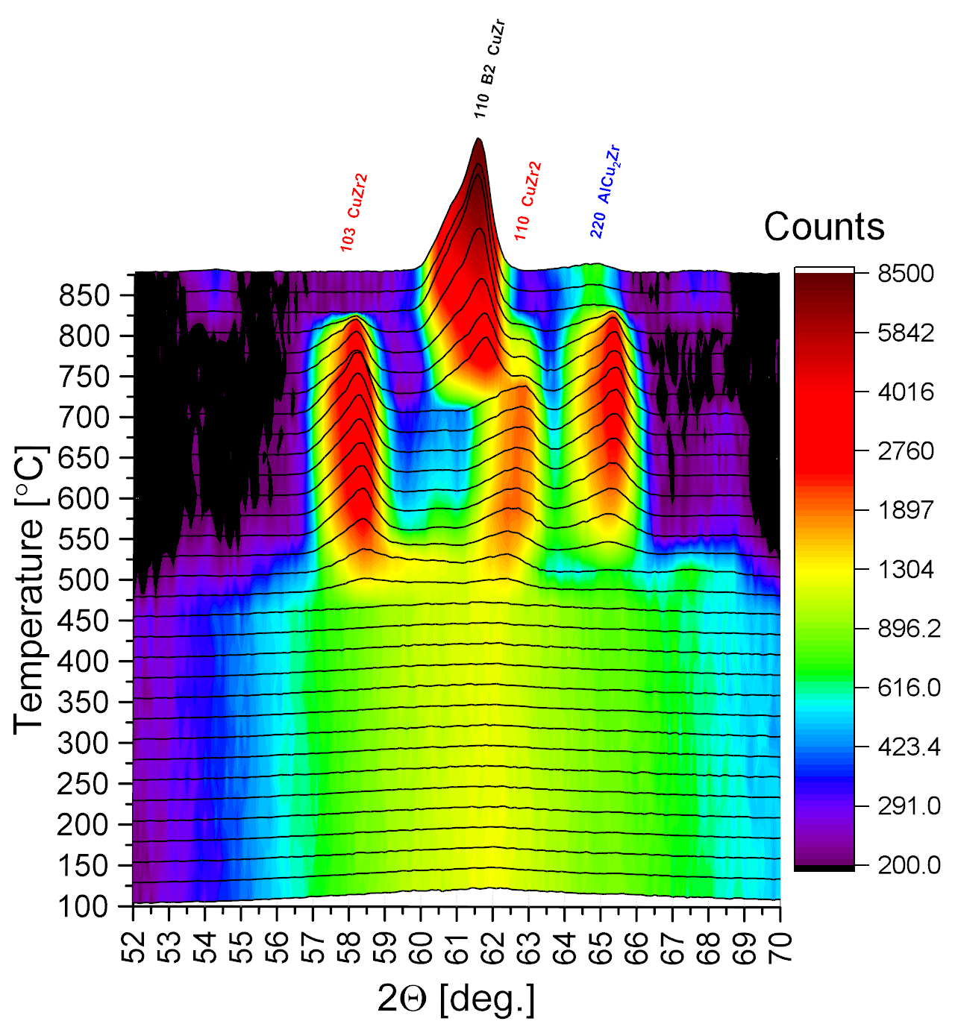
In-situ Neutron diffraction
High temperature diffraction

Slide 4
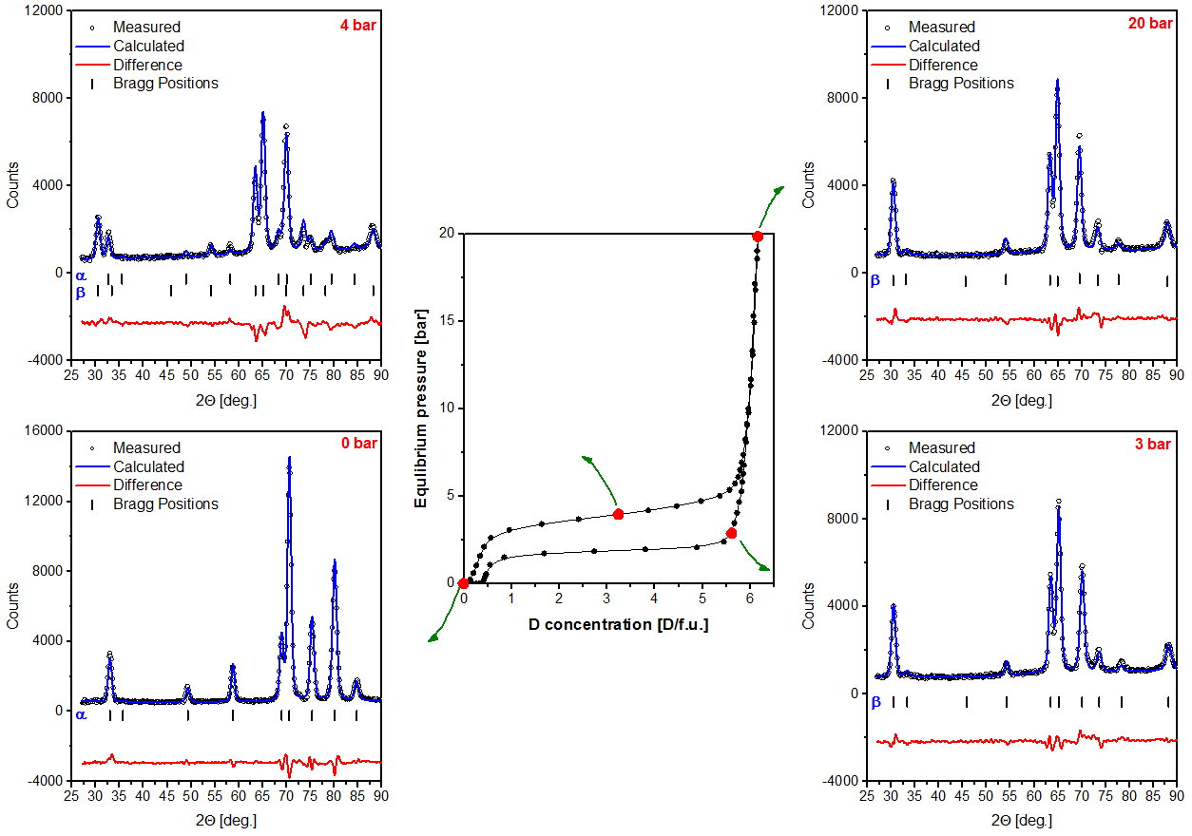
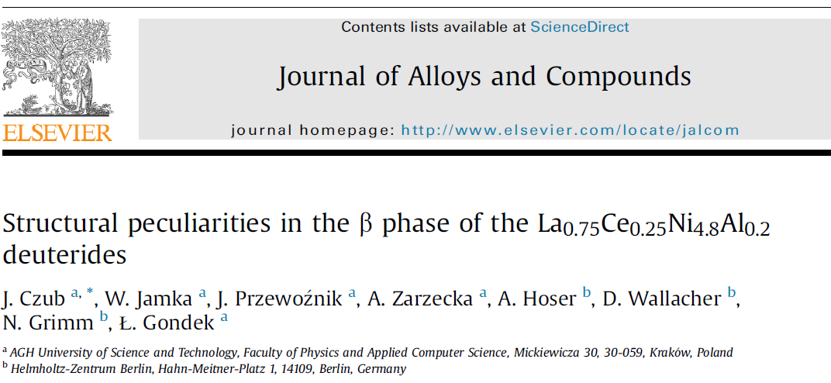
In-situ Neutron diffraction – Hydrides

Slide 5
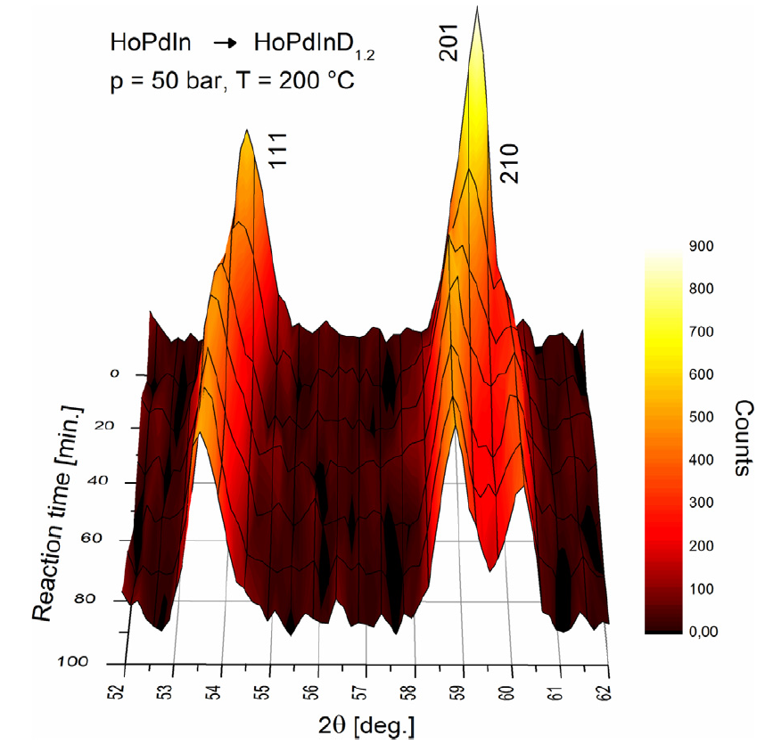
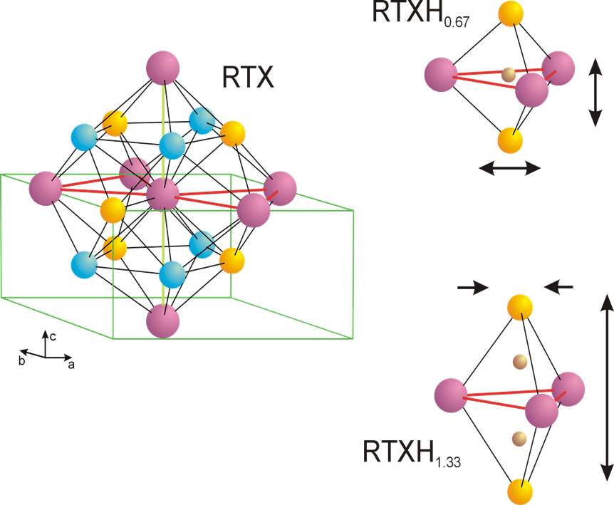
Time-resolved in-situ Neutron diffraction

Slide 6
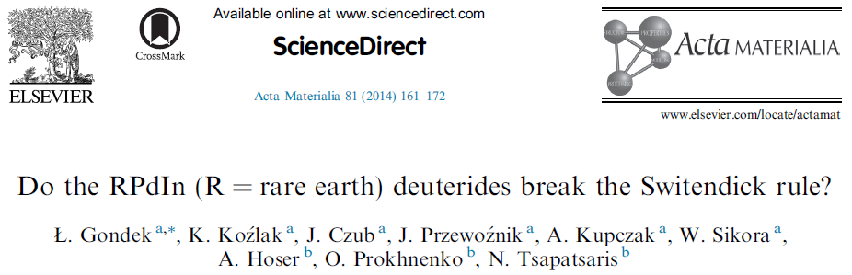
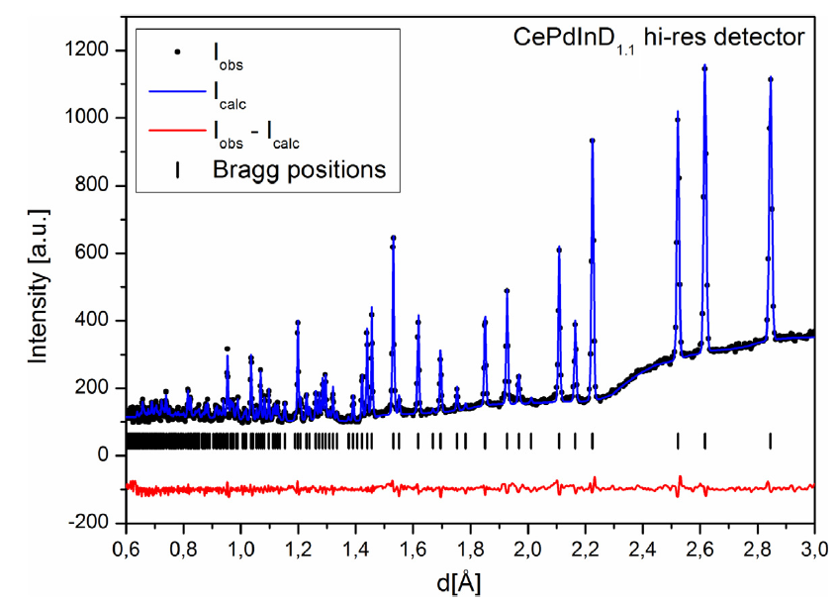
High-resolution TOF neutron diffraction

Slide 7
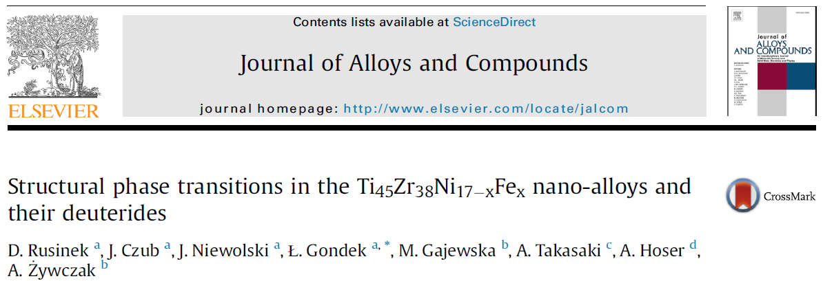
Neutron vs X-ray vs electron diffraction
X-ray, neutron and electron diffraction give complementary results!

Slide 8
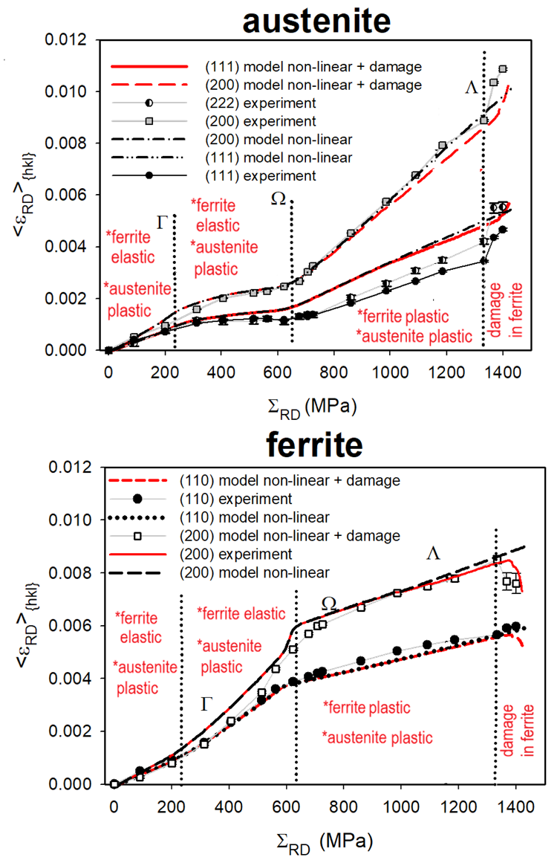
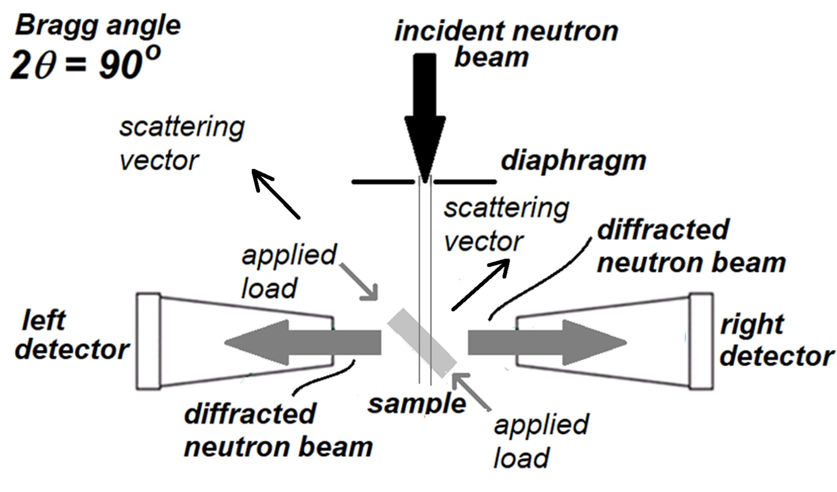
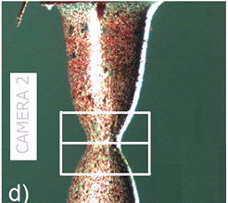
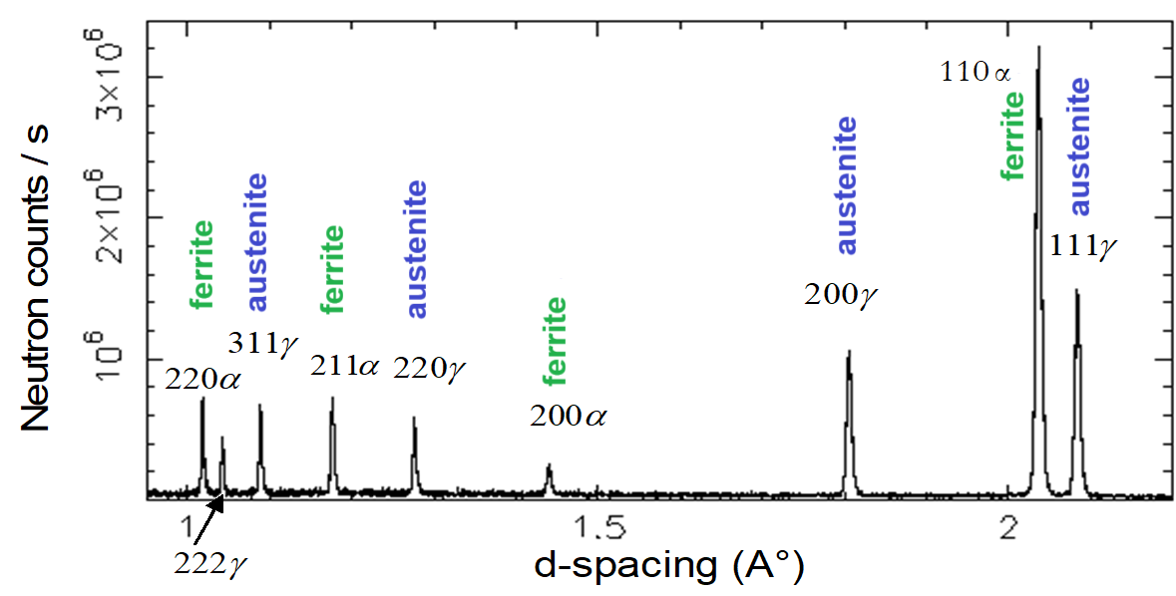
In-situ stress measurements under load
Broadening of reflections provides information about behavior of duplex steels under load.
Prof. Andrzej Baczmański: Andrzej.Baczmanski@fis.agh.edu.pl

Slide 9
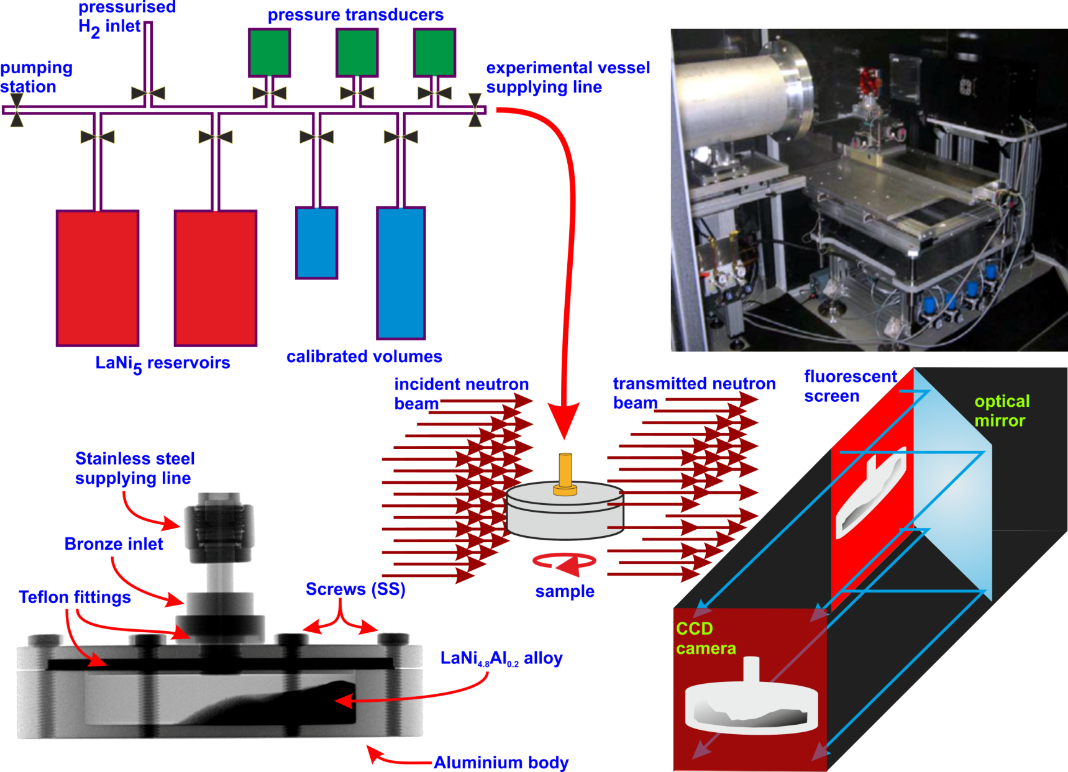
Neutron imaging

Slide 10
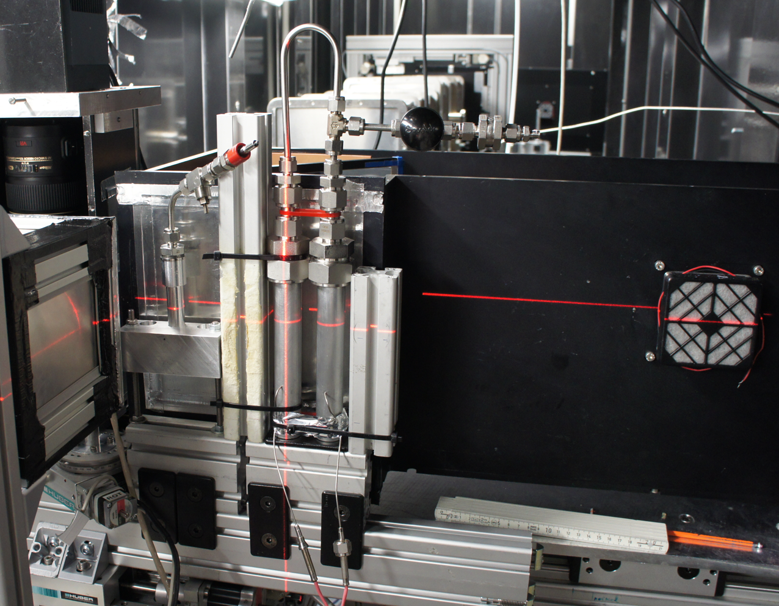
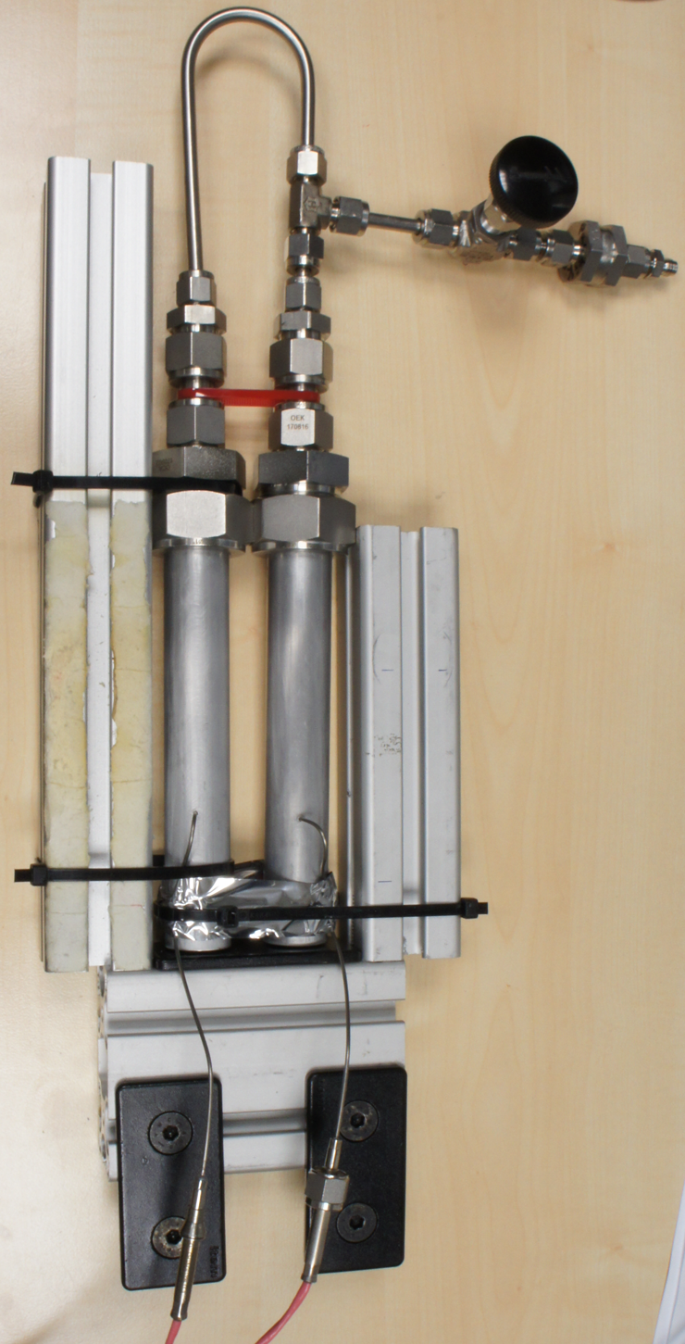
Neutron imaging

Slide 11
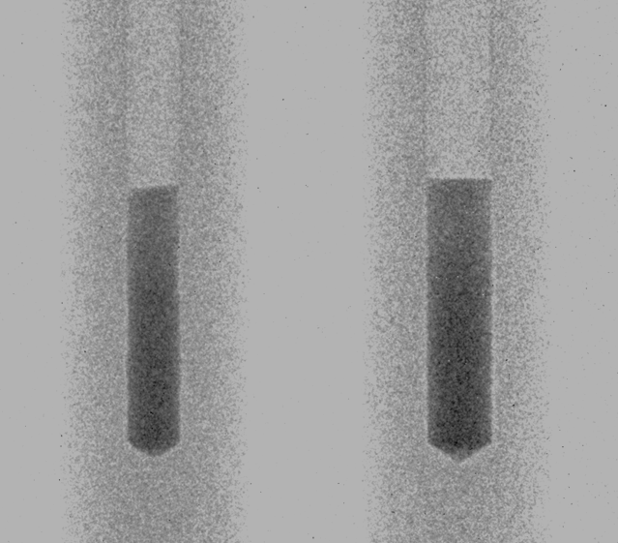
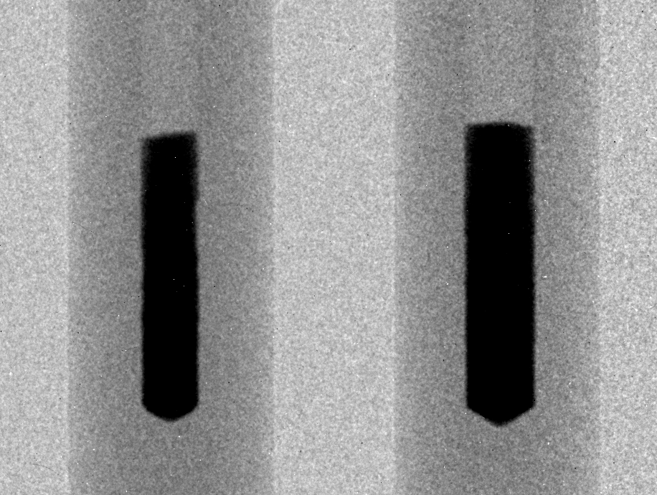
Neutron imaging

Slide 12
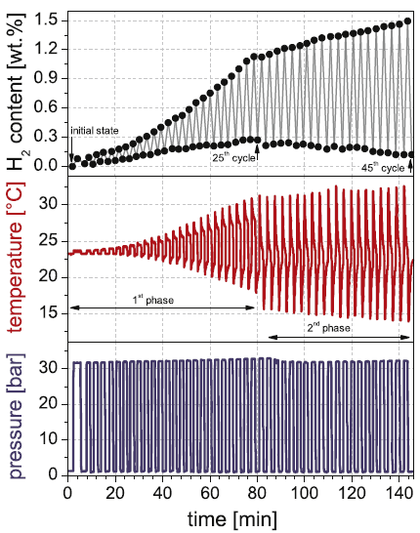
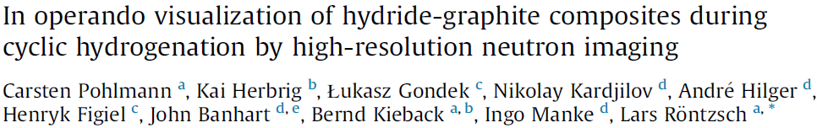
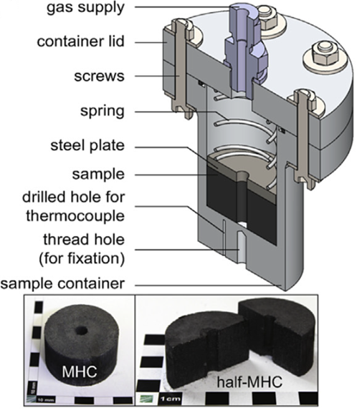
Neutron imaging

Slide 13
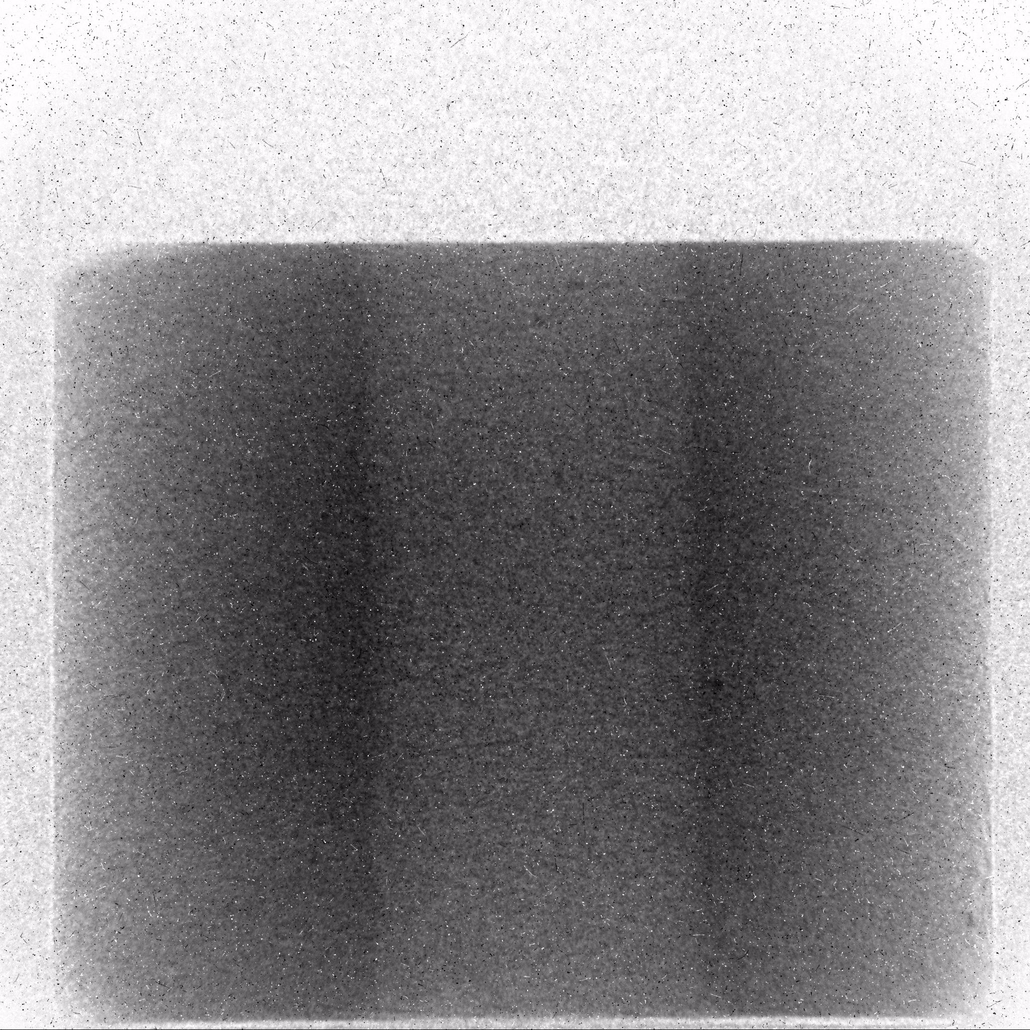
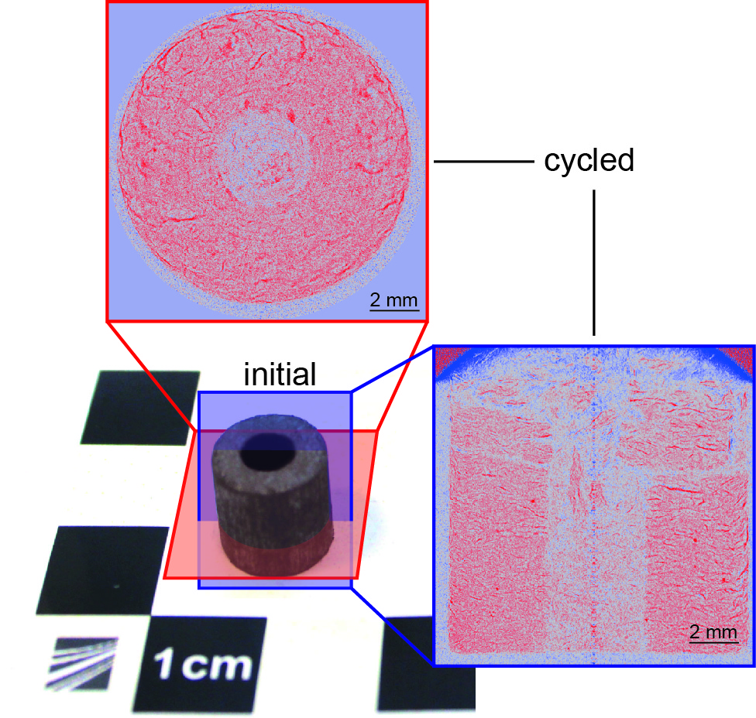
Neutron imaging

Slide 14
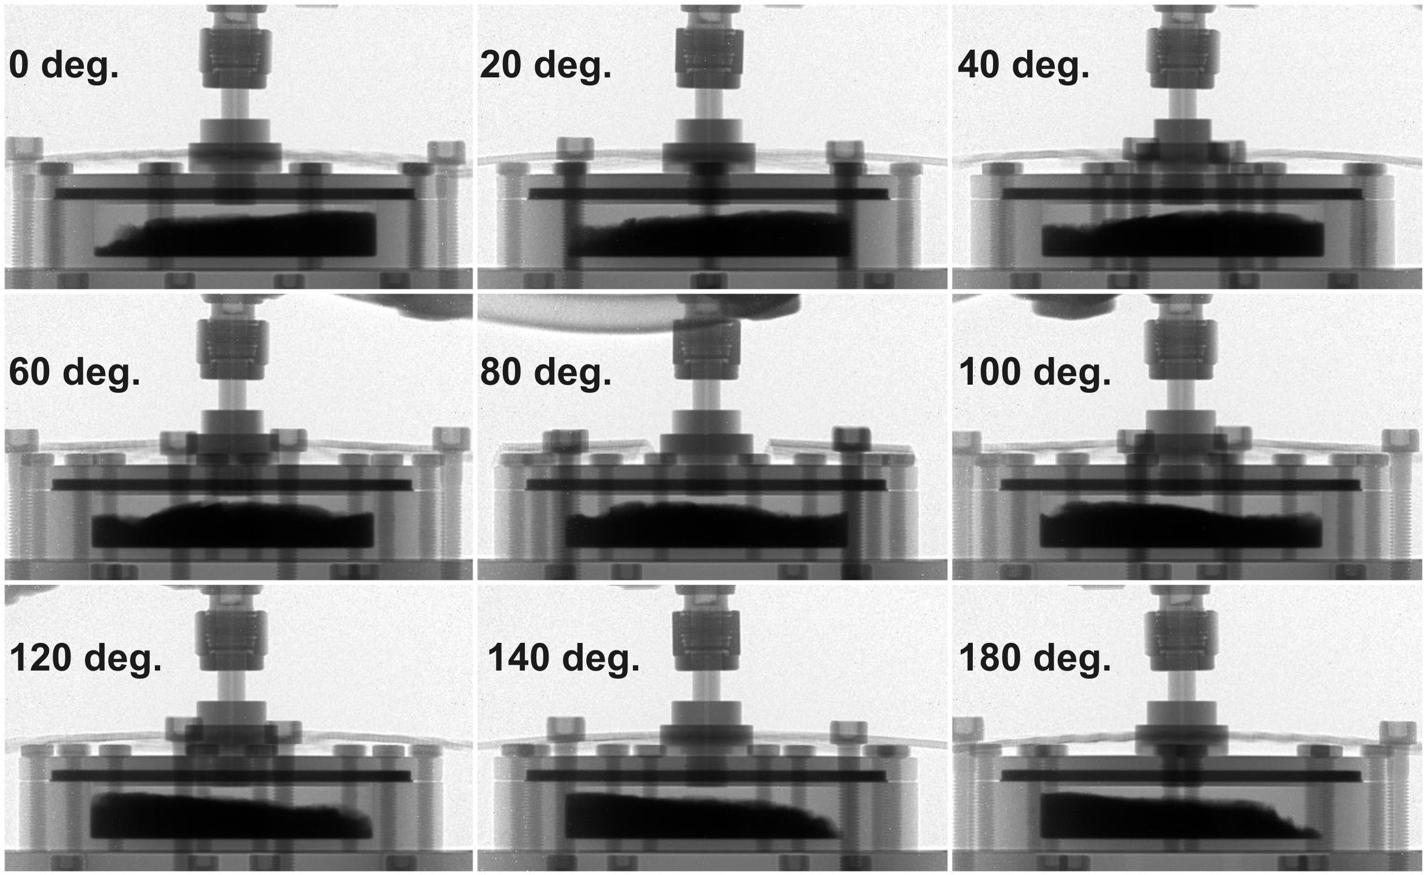
Neutron tomography
Data collected at different angles enable visualization of attenuation coefficient at any desired cross-section of our object using ‘parallel projection method’. Such a set of parallel cross-sections are called slices – in our case each of them integrates information from depth of 50 µm.

Slide 15
Summary
There are about 1o groups interested in research at ESS.
Neutron diffraciton is the most requested kind of experiment.
Single-crystal studies, as well as neutron imaging are also of some intrerest.
The non-ambient conditions are crucial for most of the groups:
Low and high temperatures 0.2 – 300 K, and up to 1200⁰C
Magnetic fields up to 14 T
High loads (stresses - 2000MPa)
High pressures of gases (O₂, H₂)

Slide 16
Thank you for your kind attention!

