Slide 1



Equilibration of Polymer Dynamics under Nanopore Confinement: Insights from Simultaneous Neutron and Dielectric Spectroscopy
Katarzyna Chat Karolina Adrjanowicz
Ewa Juszyńska-Gałązka
Department of Soft Matter Research
Markus Appel
Institut Laue-Langevin (ILL)

Slide 2
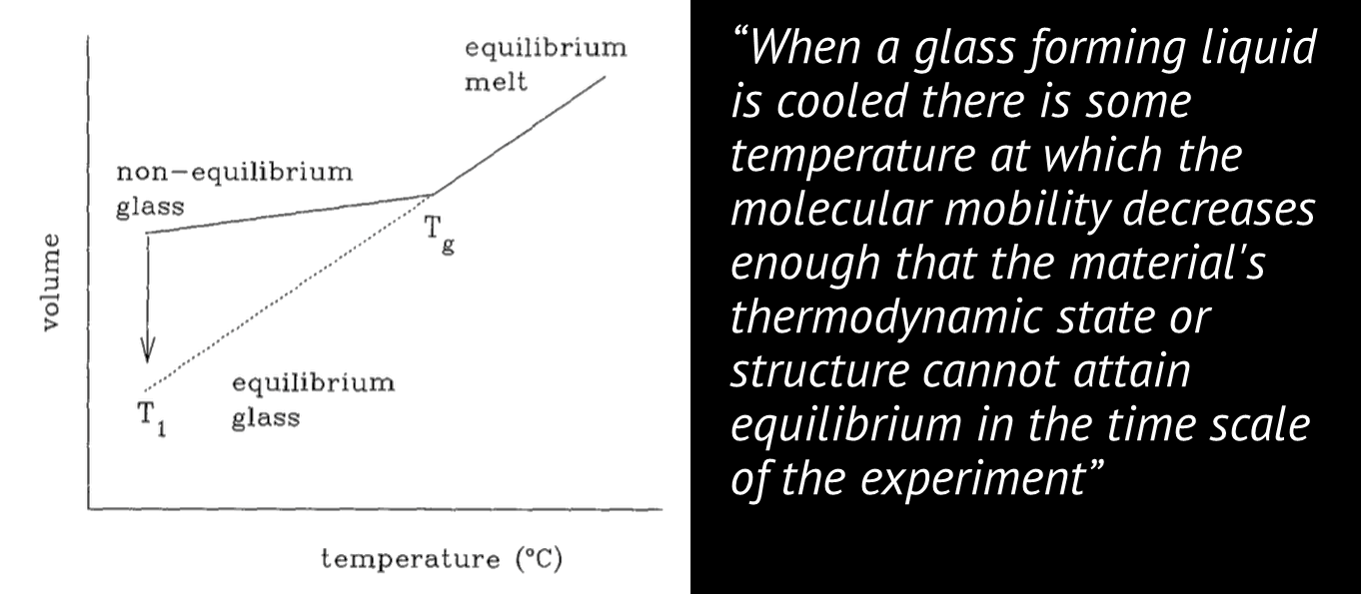
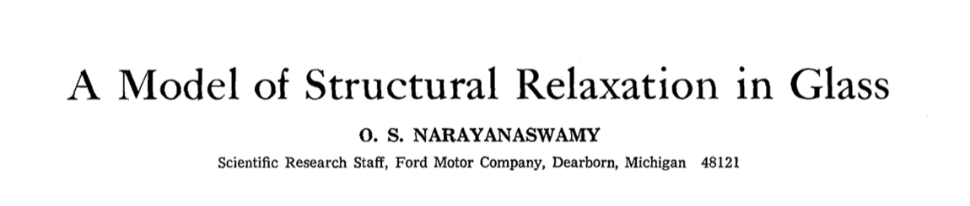
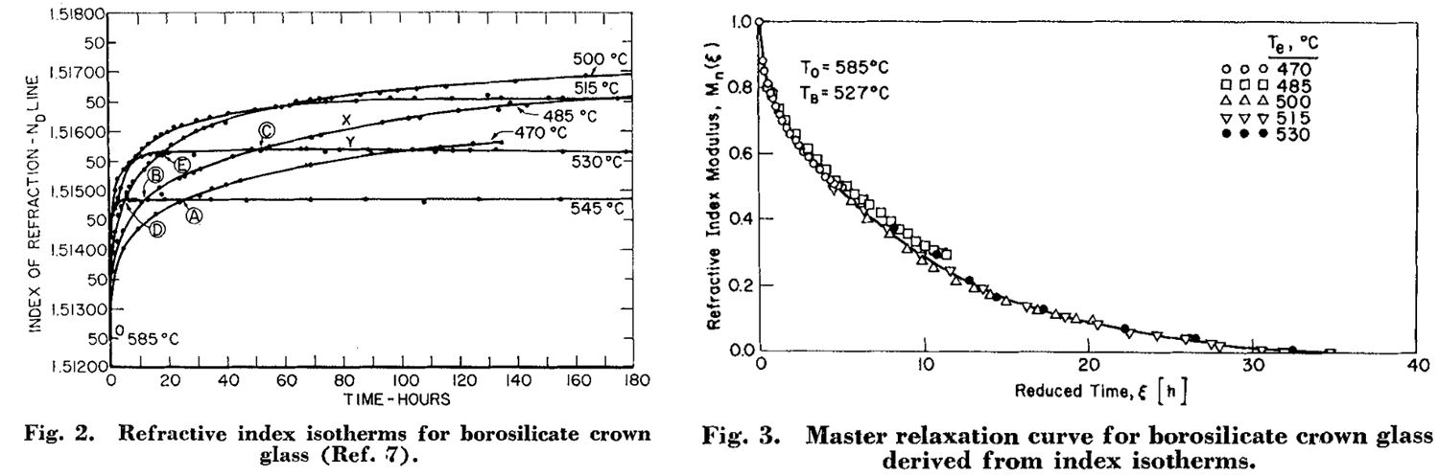
PHYSICAL AGING
“When a glass forming liquid is cooled is some t temperature at which the molecular mobility decreases enough that the material's thermodynamic state or structure cannot attain equilibrium in the time scale of the experiment”
Gregory B McKenna (1994) J. Res. NITS, 99(2), 169-189

Slide 3
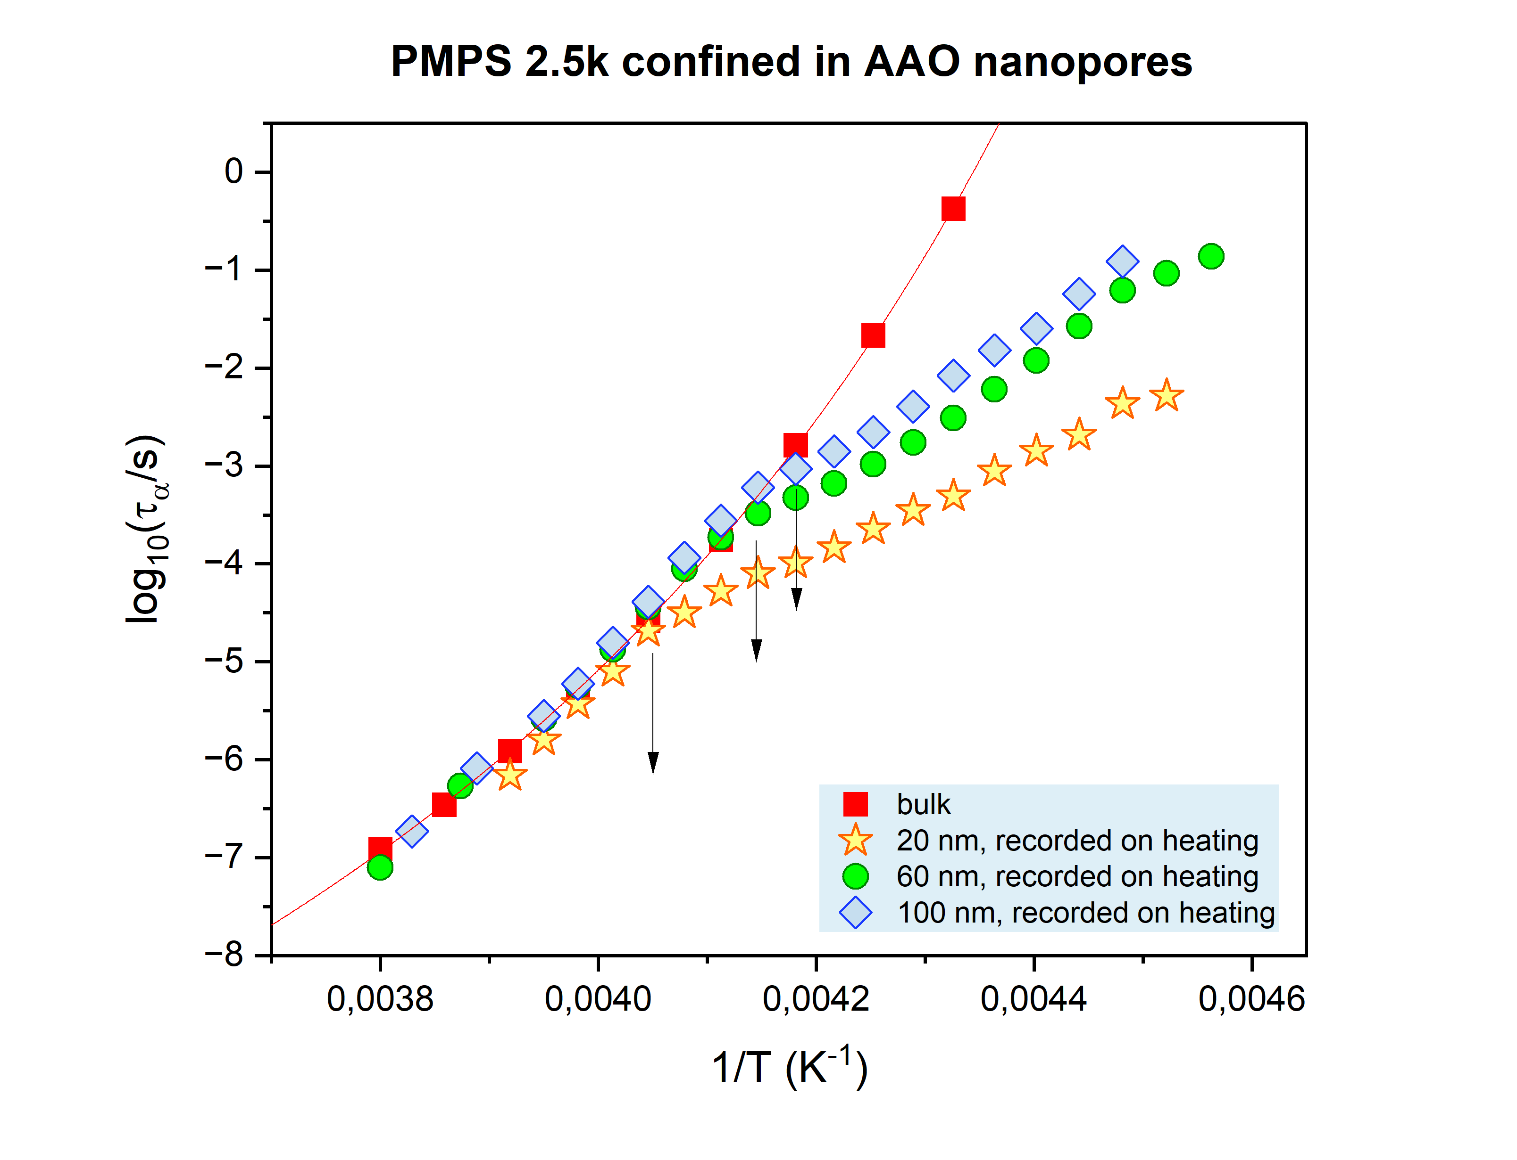
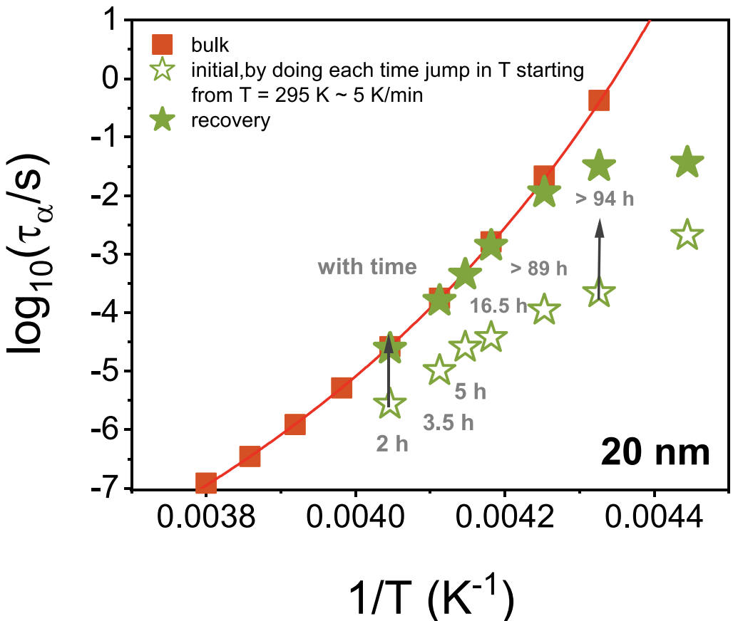
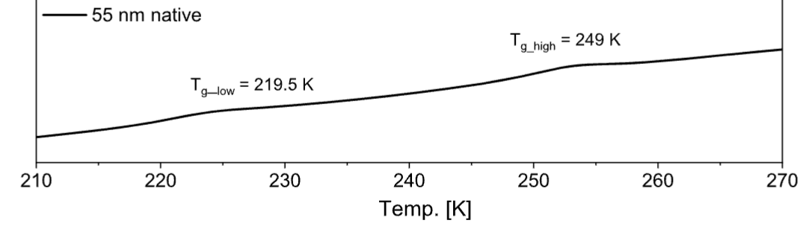
NANOPORE CONFINEMENT
Initially faster dynamics
Recovery of bulk τ_{α} with time
Interfacial layer
core
Two Tg’s
Two Tg’s

Slide 4
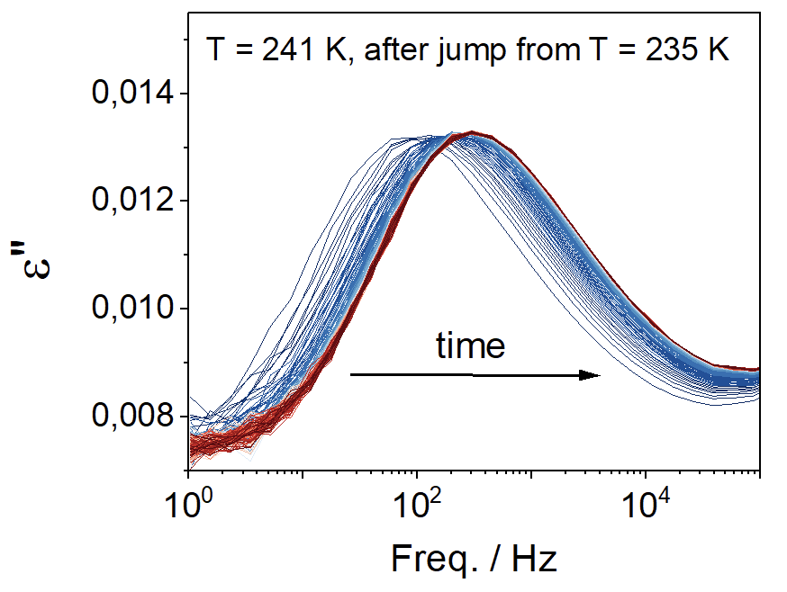
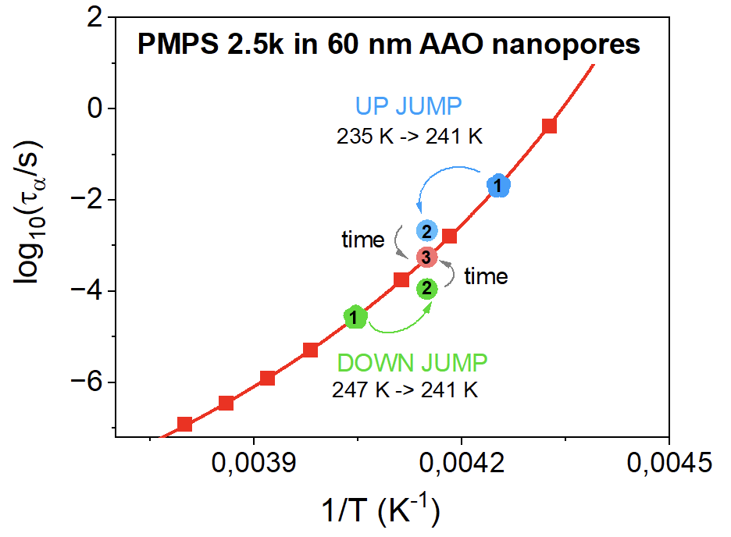
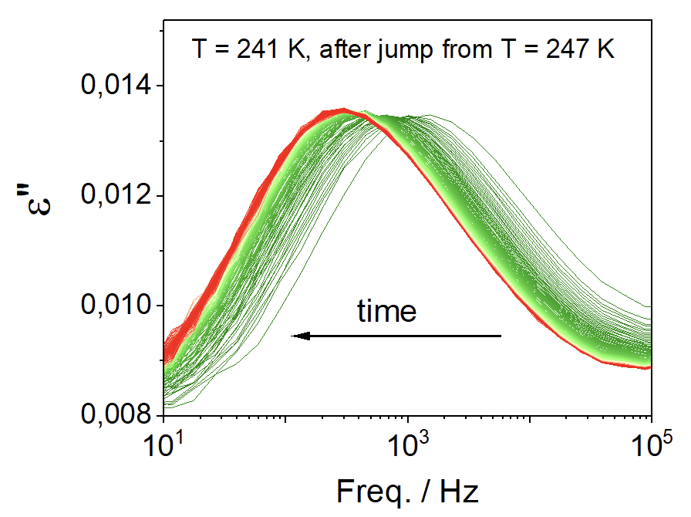
NON-EQUILIBRIUM PHENOMENA OBSERVED IN NANOPORE CONFINEMENT
Equilibration rates in confinement are always at least 6-7 decades slower compared to τ_{α}.
Two Tg’s

Slide 5
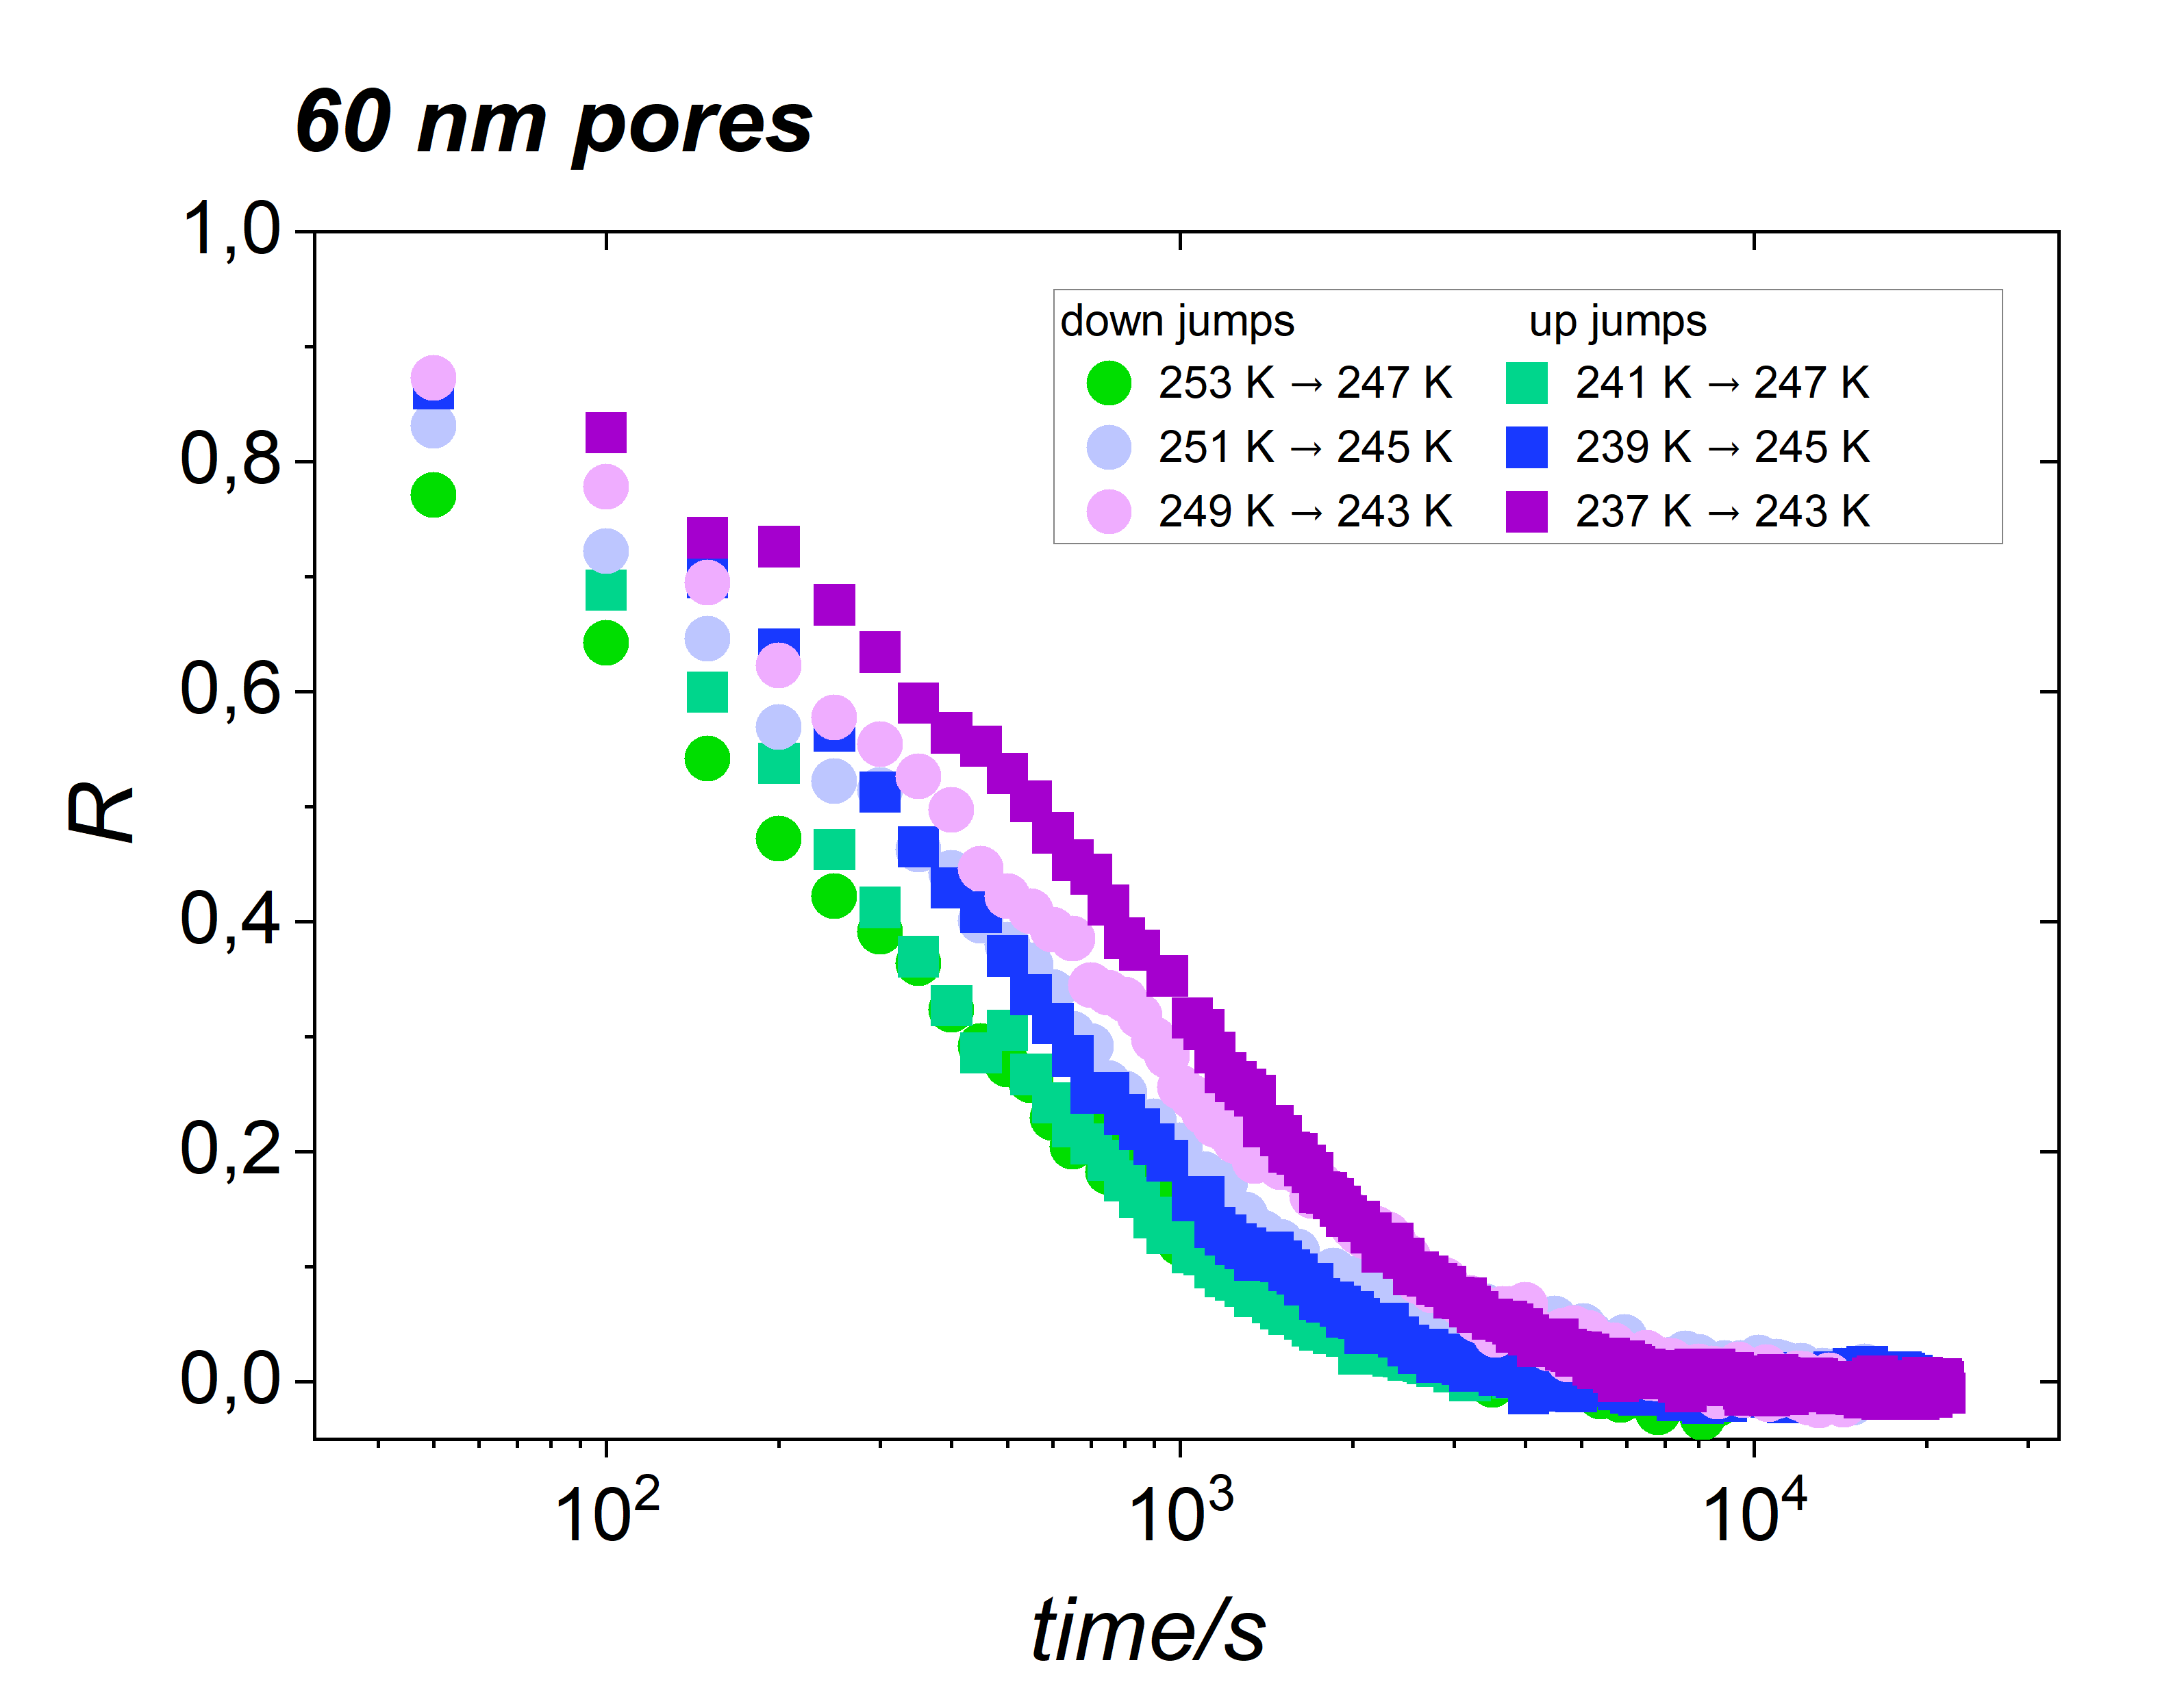
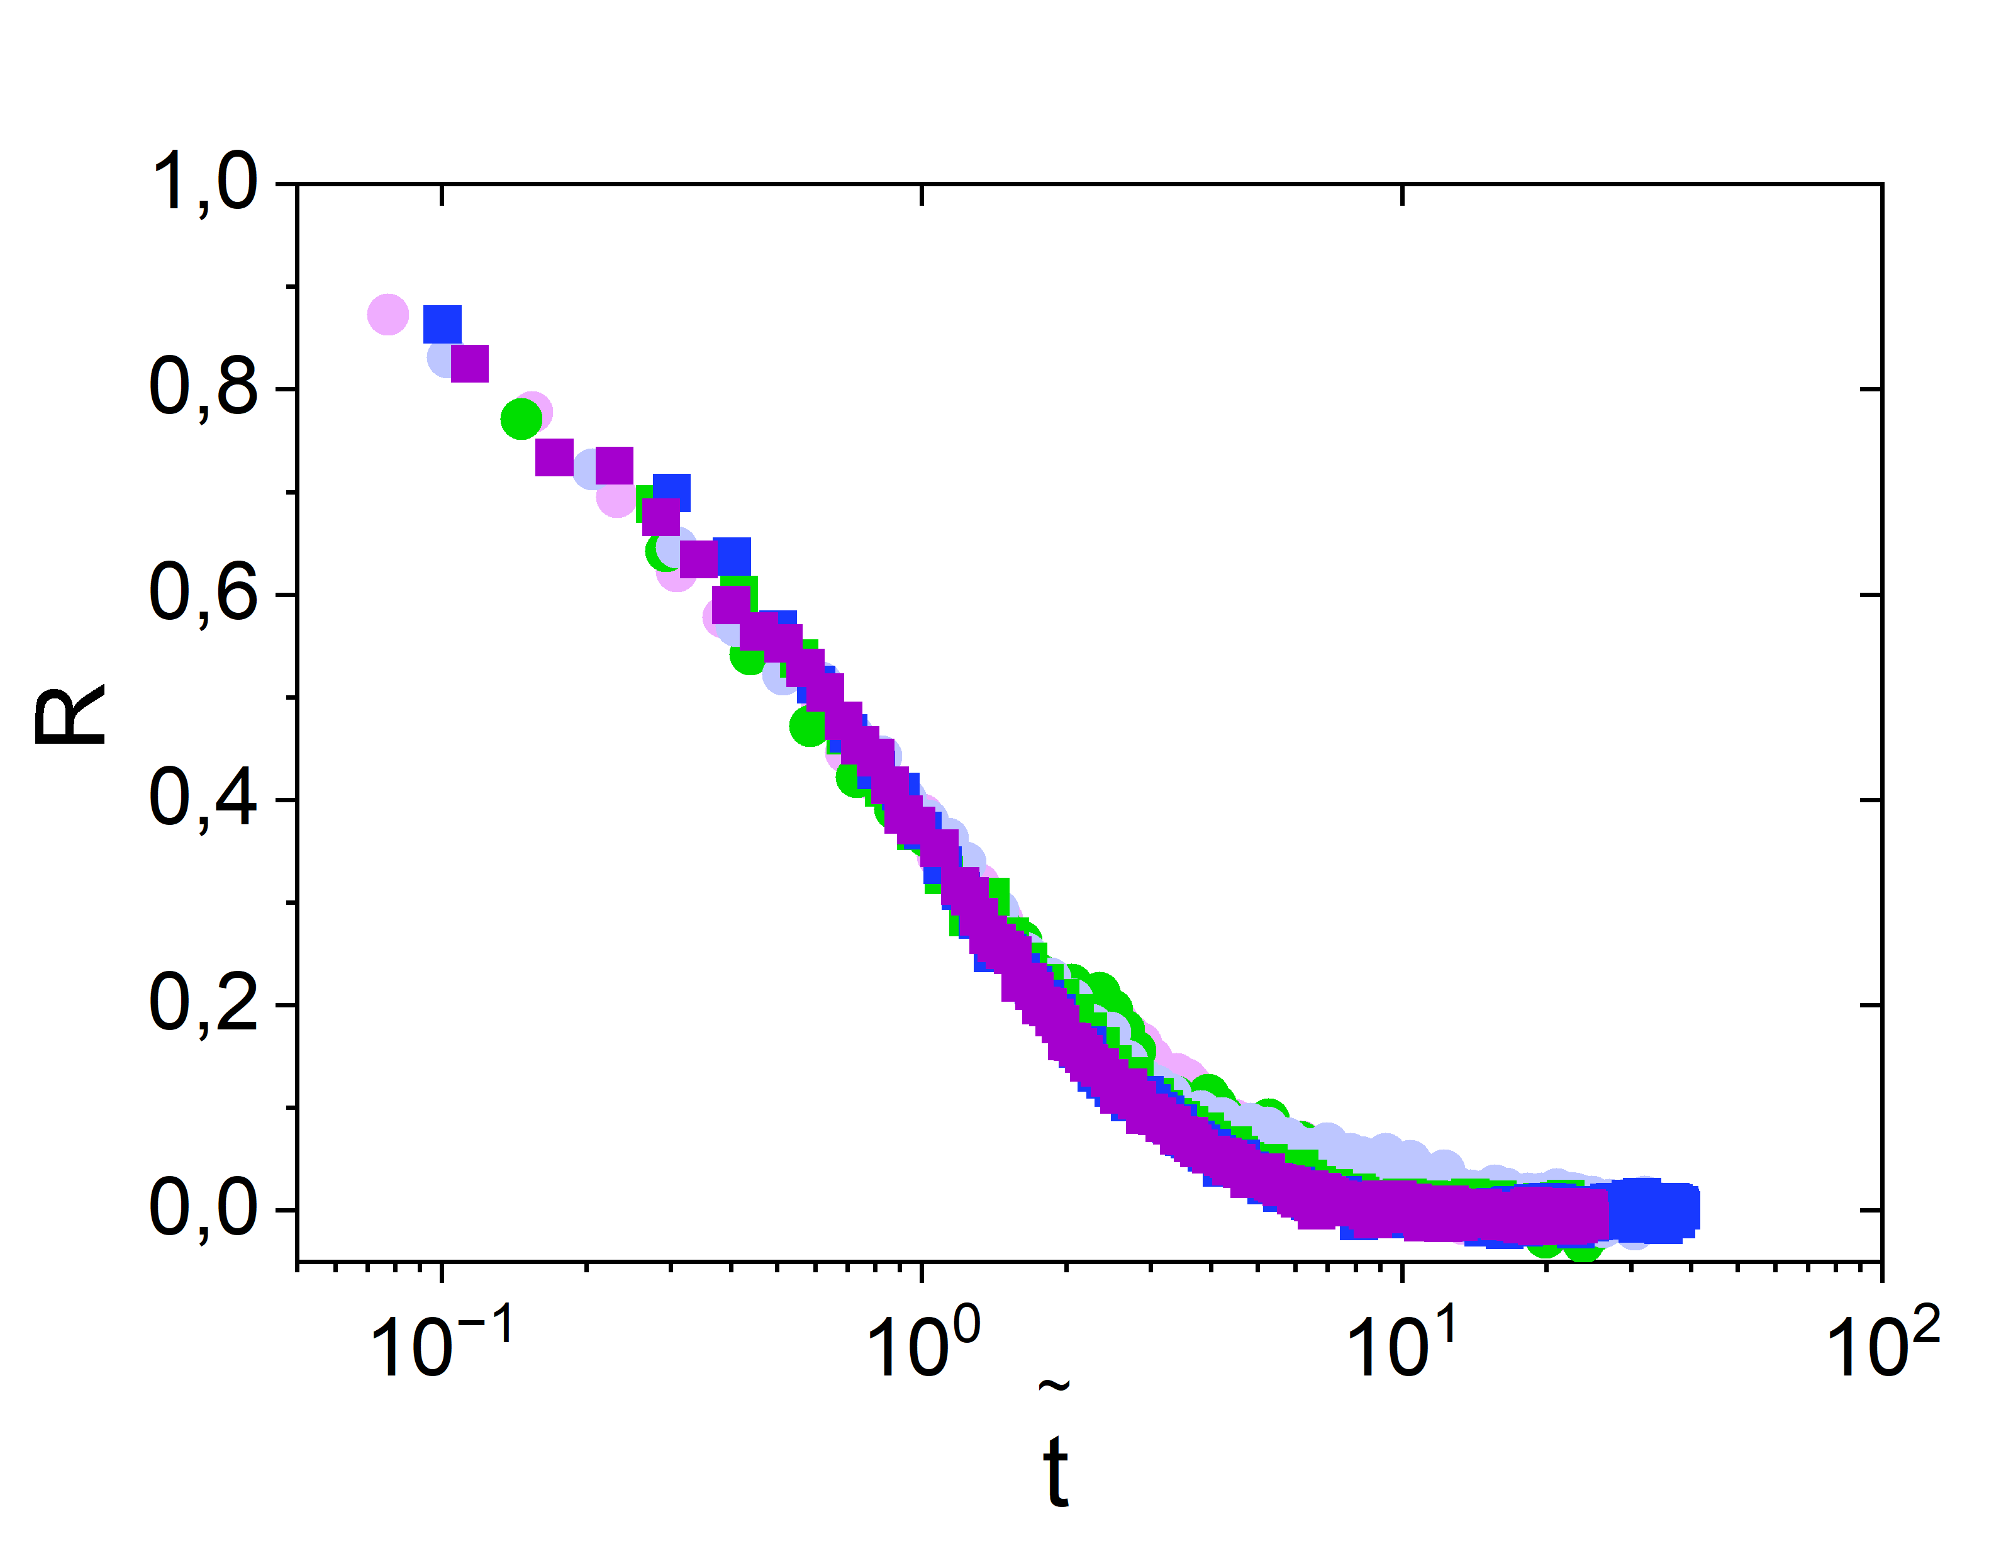
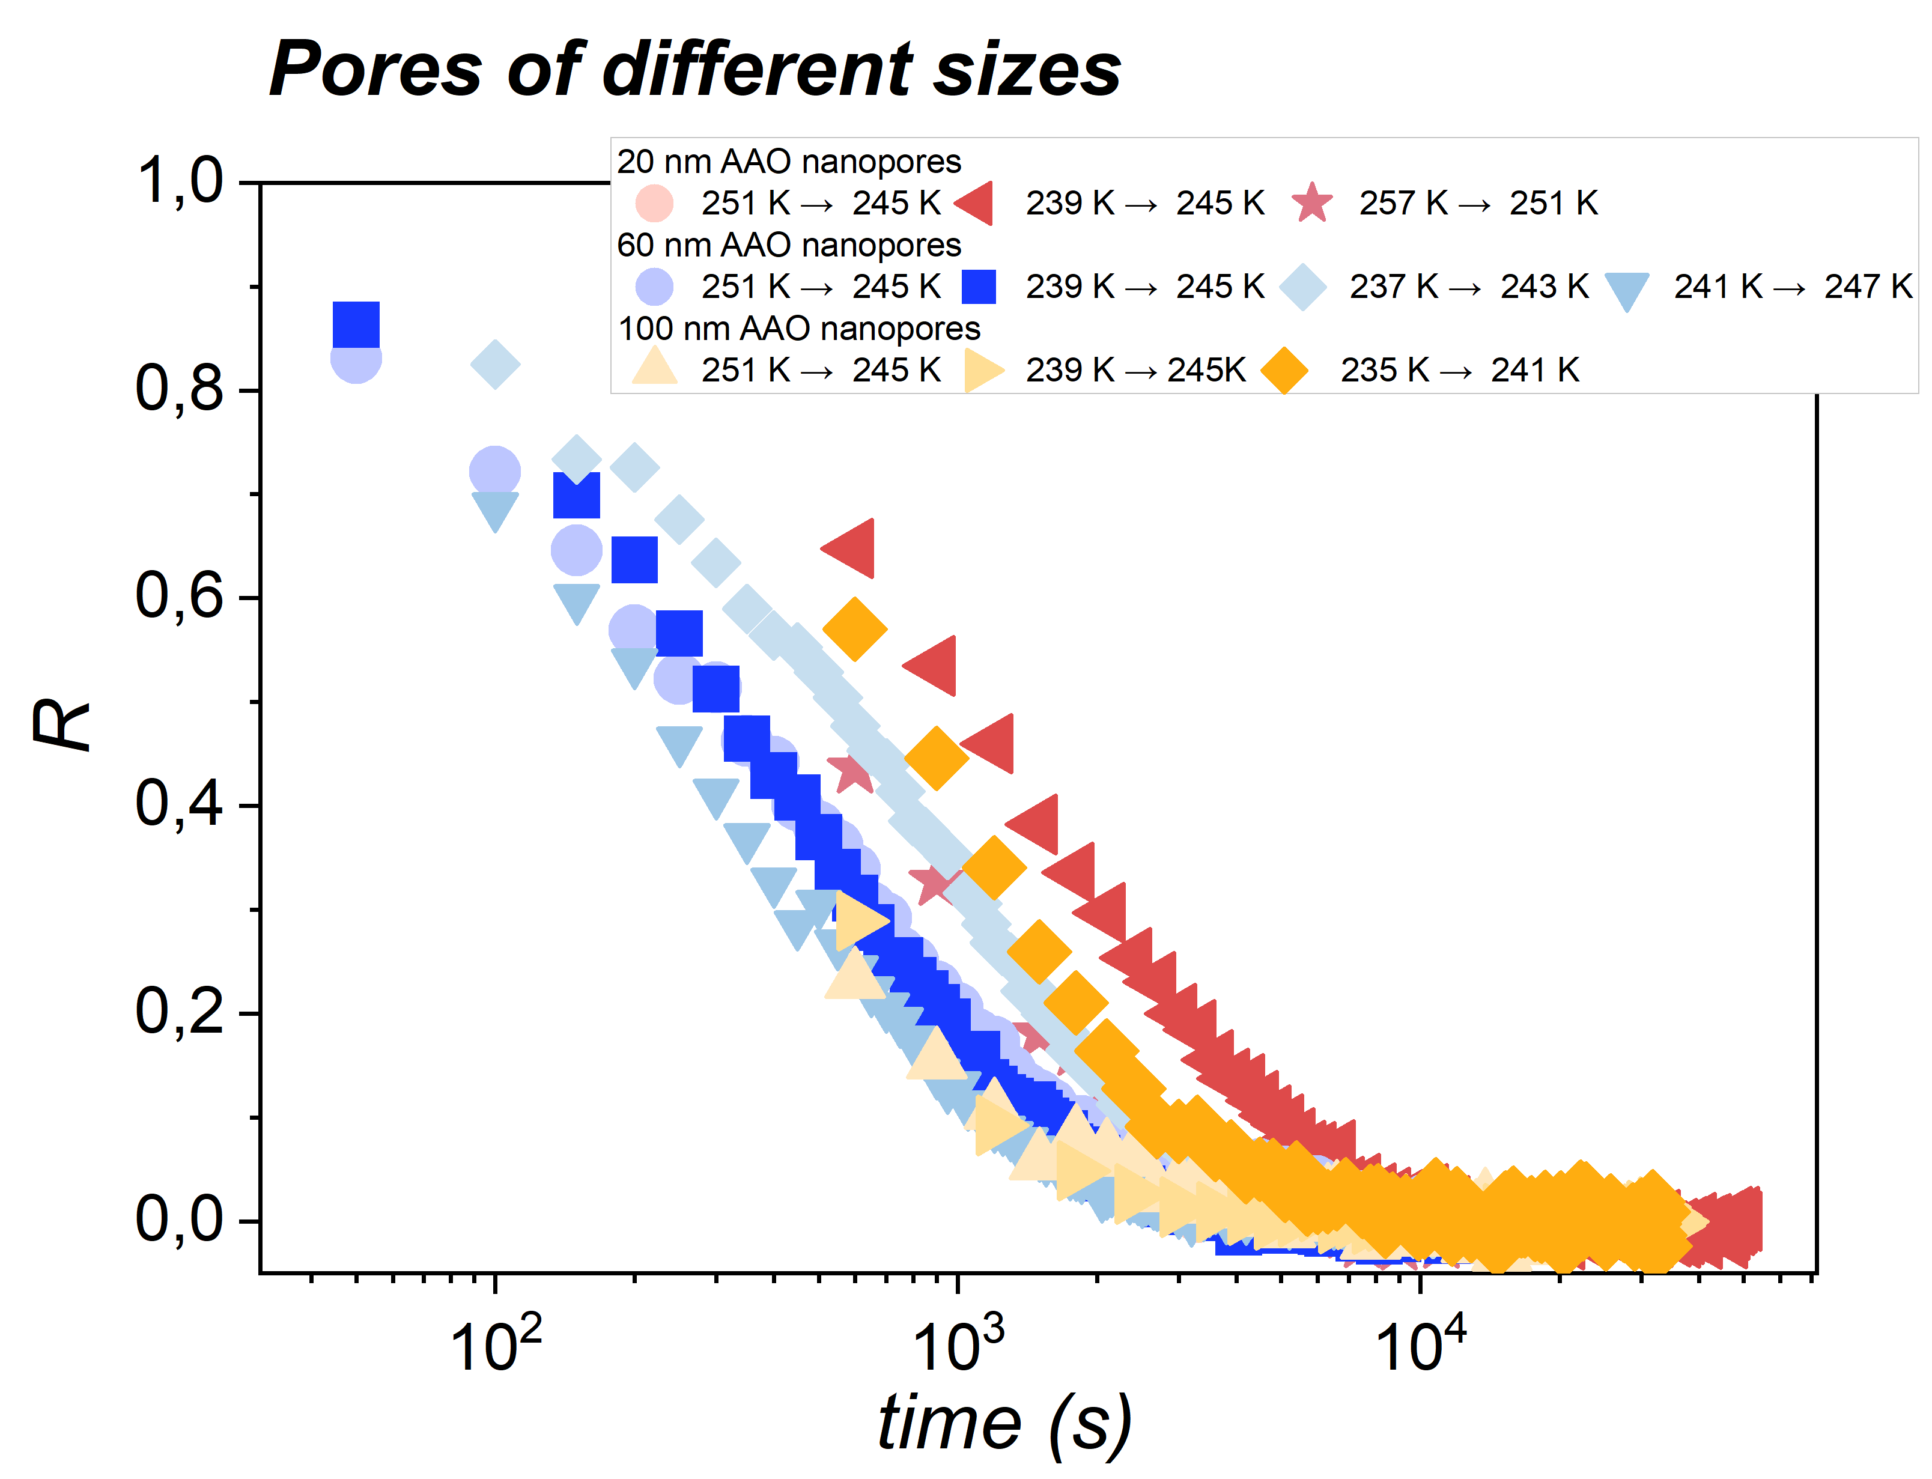
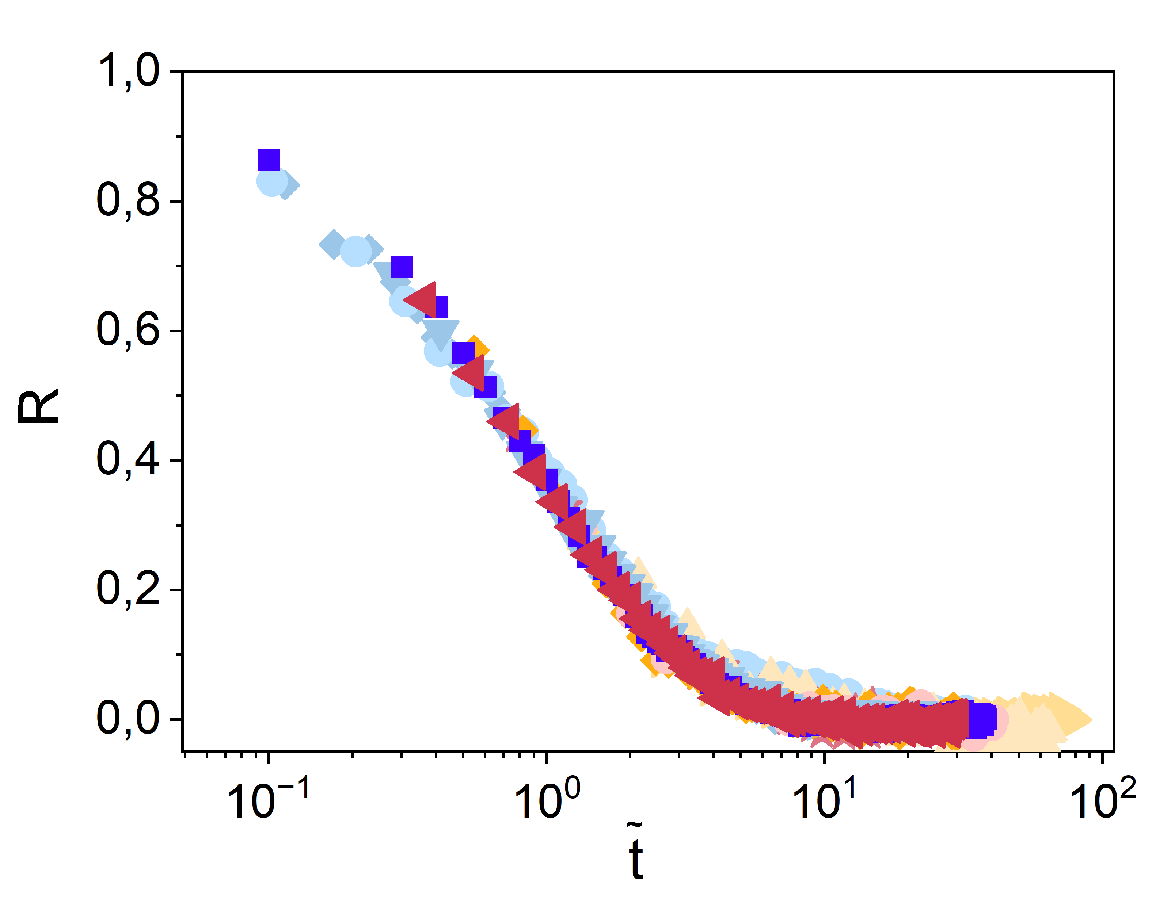
MATERIAL TIME IN NANOPORE CONFINEMENT
J. Phys. Chem. Lett. 2025, 16, 20, 5076–5081

Slide 6
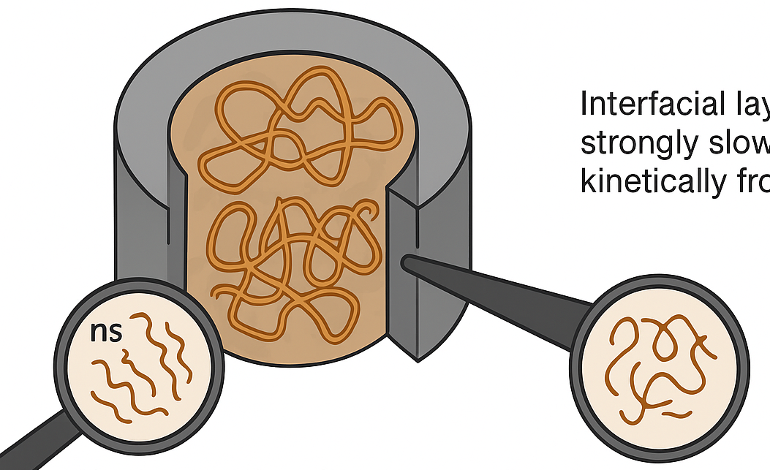
MOTIVATION
We want to understand how geometrical confinement changes polymer dynamics.
Confined polymers show changes on different time scales — from nanoseconds to seconds.
A key question is what happens to nanosecond motions when the polymer shows equilibration effects in the dielectric response.
This happens especially just below the kinetic freezing of the interfacial layer (chains close to the pore walls).
Dielectrics → cooperative
α-relaxation, equilibration (milliseconds – seconds)
Neutrons → local motions (fast, picoseconds – nanoseconds)

Slide 7
WHY COMBINE DIELECTRIC SPECTROSCOPY AND NEUTRON BACKSCATTERING?
Complementary Time Scales
Neutron backscattering → ps–ns, local mobility, MSD.
Dielectric spectroscopy → ms–s, α-relaxation and equilibration.
Different Motions, One System
Backscattering: fast, localized motions inside nanopores.
Dielectrics: slow, cooperative segmental dynamics.
Benefit of Combining Both
Tracks fast → slow dynamics under identical T and history.
Reveals how confinement affects both local mobility and structural relaxation.

Slide 8
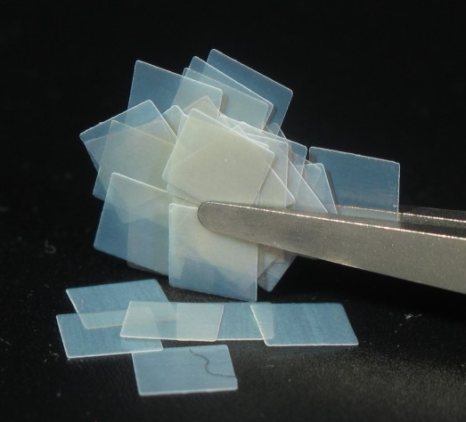
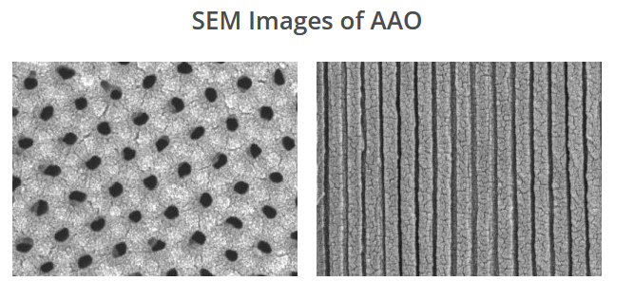
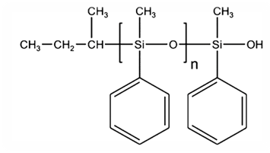
SAMPLES & EXPERIMENTAL SETUP
AAO Nanoporous Membranes
25×25 mm, 0.1 mm thick, ~25% porosity
Pore diameter: 200 nm
Polymer Sample (PMPS 2.5k)
Poly(phenyl-methyl-siloxane),
M_{w} = 2530 g/mol
AAO
SEM Images of AAO

Slide 9
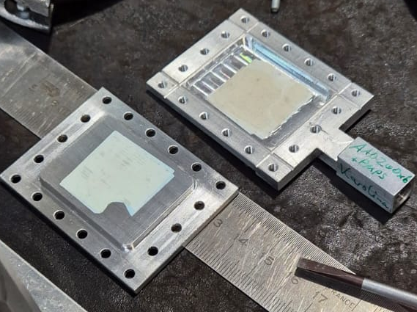
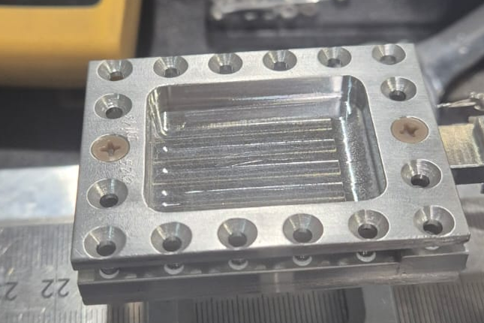
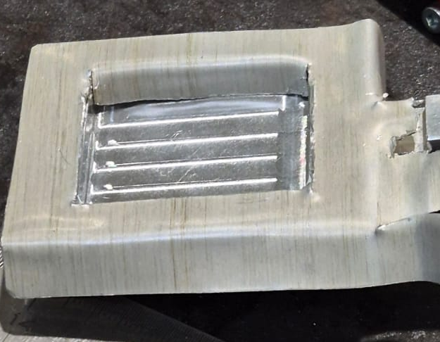

SAMPLES & EXPERIMENTAL SETUP
Sample Stack & Holder
One membrane for dielectric; 5 membranes for neutron-only.
Double-lid holder with cadmium frame to reduce background.
Instrumental Setup
Neutron spectroscopy: IN16B (HF mode) with cryofurnace, at ILL Grenoble.
Dielectric spectroscopy: Novocontrol Alpha Analyzer, 10 MHz–1 Hz.
Measurements simultaneous on same stack (unique IN16B capability).
a
b
c

Slide 10
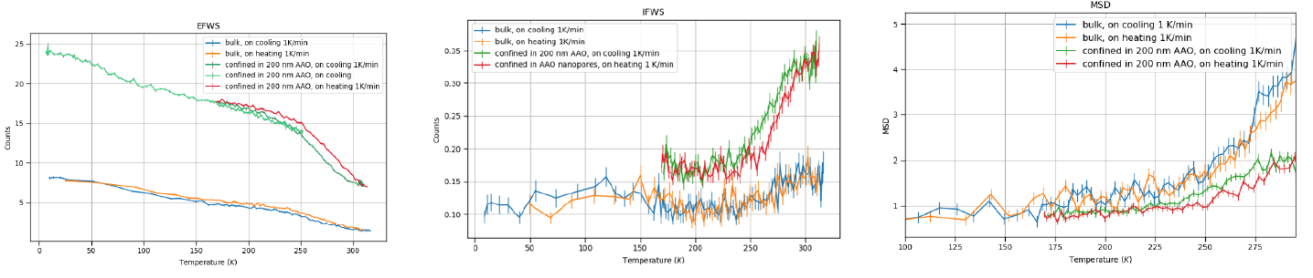
DIELECTRIC AND NEUTRON SIGNATURES
OF CONFINED DYNAMICS
MSD(T) reveals strong cooling/heating hysteresis in nanopores, absent in the bulk sample.
Confined polymer shows a lag in dynamic response to temperature changes around Tg.
EFWS/IFWS confirm that fast dynamics are modified by nanoconfinement.

Slide 11
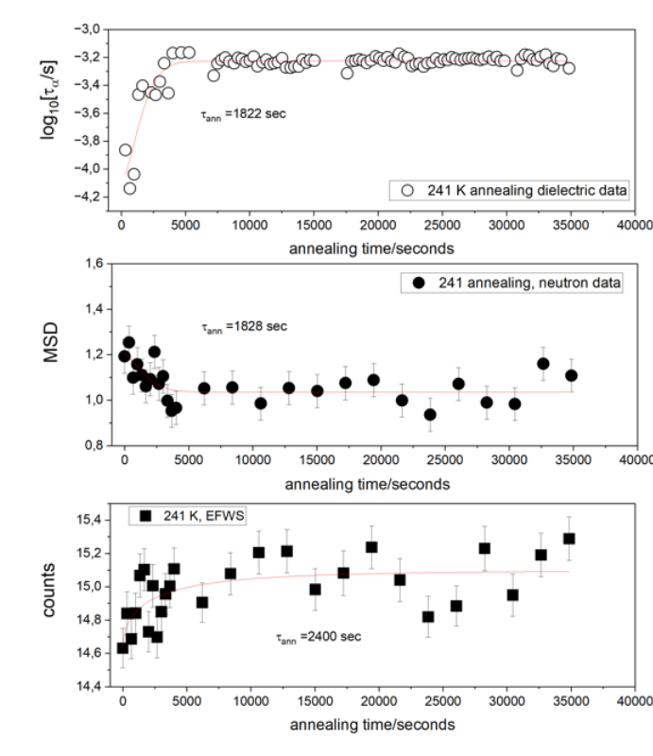
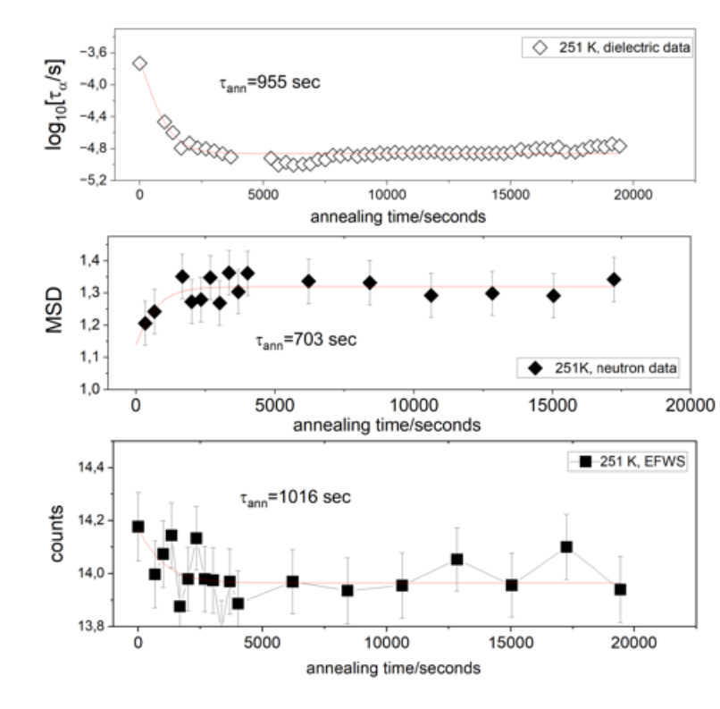
EQUILIBRATION DYNAMICS: TIME-DEPENDENT NEUTRON AND DIELECTRIC RESPONSES
down jump from room temperature
up jump from 241 K

Slide 12
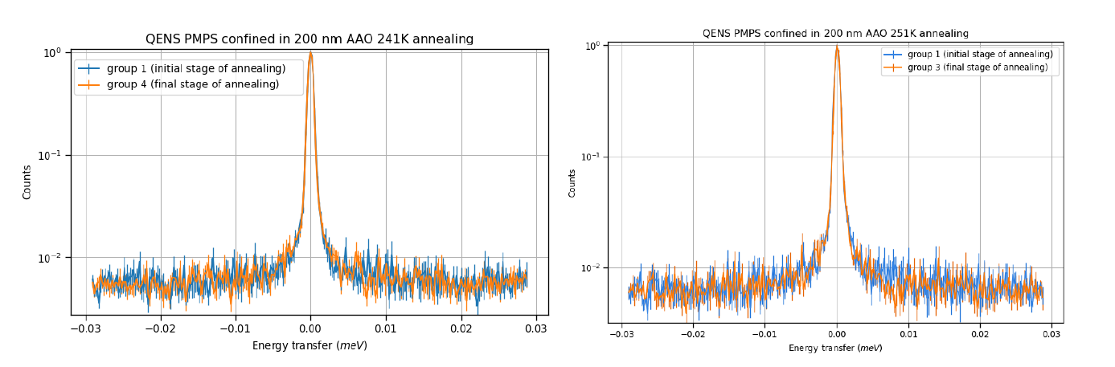
NANOSECOND DYNAMICS REVEALED BY QENS
Time-sliced spectra show small but systematic changes during equilibration (broadening at 241 K, narrowing at 251 K).
These changes follow the same trend as dielectric τₐ(T), linking ns dynamics with segmental relaxation.
Even with low statistics in 200 nm pores, QENS demonstrates that fast dynamics track the equilibration process.

Slide 13
CONCLUSIONS
Confinement affects segmental α-relaxation and modifies fast dynamics (MSD, QENS).
Annealing experiments reveal clear equilibration kinetics; both τₐ and MSD evolve consistently.
After full equilibration, confined PMPS recovers bulk-like relaxation times.
Results support the material time concept for confined polymers.
These studies have been and are being conducted at ILL Grenoble.
We are also interested in exploiting the neutron‑scattering infrastructure of the European Spallation Source (ESS) in Sweden, in particular the MIRACLES instrument for backscattering measurements.
FUTURE WORK & INFRASTRUCTURE NEEDS

Slide 14
FUTURE WORK
Continuation of Current Research
Smaller pores (50 & 20 nm) to enhance confinement effects
Equilibration at lower temperatures with longer annealing times to improve QENS statistics.
Chemical modification of nanopores to control polymer mobility profiles.
Study of other soft matter systems in bulk and under confinement — liquid crystals, molecular liquids, ionic liquids, and strongly hydrogen-bonded systems (diols).
Structural studies using SANS, INS and QENS.
New Research Direction
Ultra-stable glasses prepared by physical vapor deposition (PVD).
FUTURE WORK & INFRASTRUCTURE NEEDS

Slide 15


ACKNOWLEDGEMENTS
Support of the Polish Ministry of Science and Higher Education through the Neutrony dla Polskiej Nauki consortium, which enabled access and travel to the ILL facilities.

Slide 16
Thank you!

