Slide 1
MNL Maria Neutron Laboratory
Autor Autor
Dariusz Rusinek

Slide 2
Outline:
MARIA Reactor
Experimental hall
MNL MARIA NEUTRON LABORATORY
Instruments
Preparations for the creation of the MNL laboratory

Slide 3
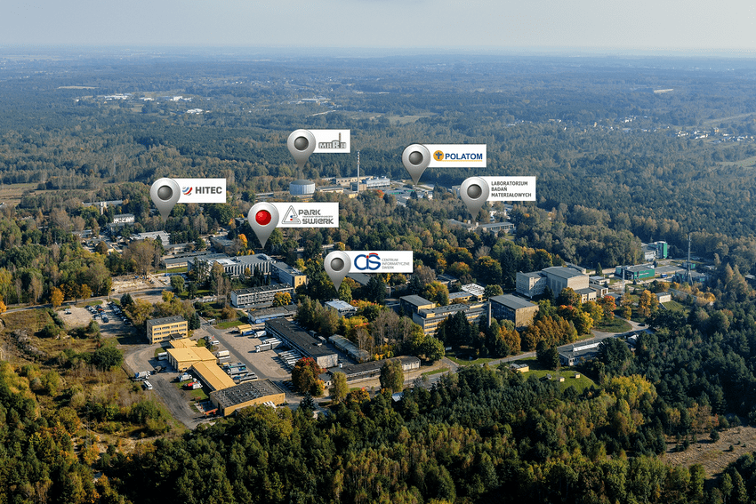
National Centre for Nuclear Research (NCBJ)

Slide 4
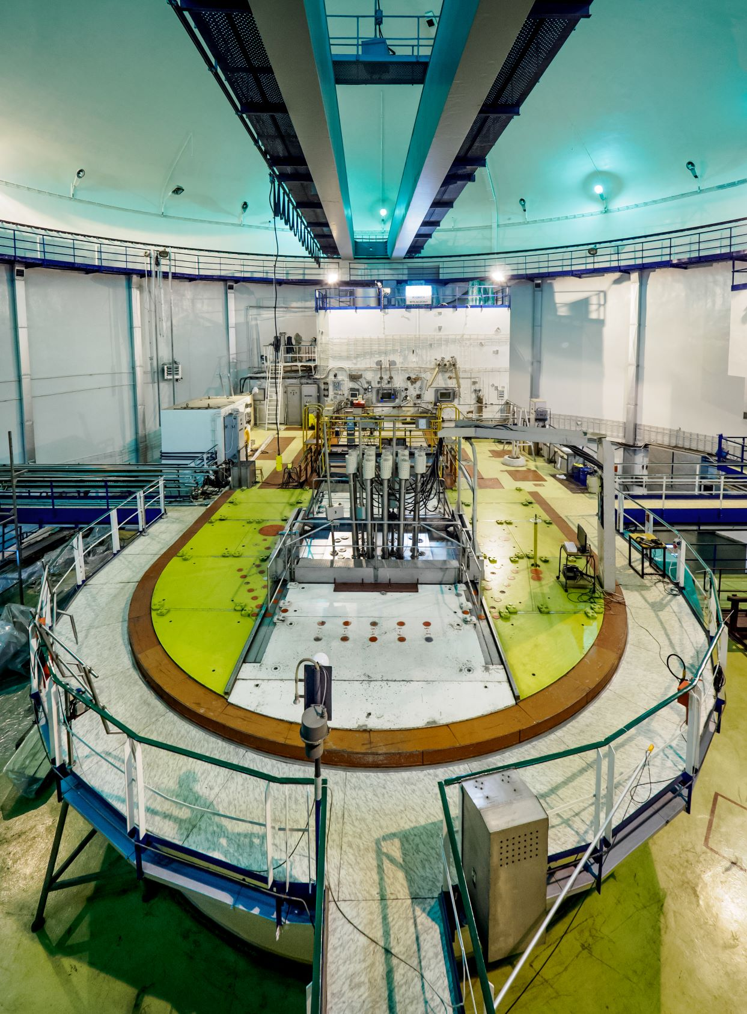
MARIA Reactor
Reactor type | pool-type reactor with pressurized fuel channels
Start operation | 1974
Thermal power | Max. 30 MW,
Nominal power | 19-26 MW
Fuel | MC-5 19,7 % 485 g U-235 U₃Si₂ MR-6 19,75 % 485 g U-235 UO₂-Al
Thermal neutron flux | 2,5 × 10¹⁴ n/cm²·s
Fast neutron flux | 2 x 10¹⁴ n/cm²·s
Moderator | H₂O; beryllium
Reflector | graphite
<numer>

Slide 5
Current main reactor applications:
production of radioisotopes,
testing of fuel and structural materials for nuclear power engineering,
neutron transmutation doping of silicon,
neutron modification of materials
research in neutron and condensed matter physics
neutron radiography,
neutron activation analysis,
neutron beams in medicine
training in the field of reactor physics & technology.

Slide 6
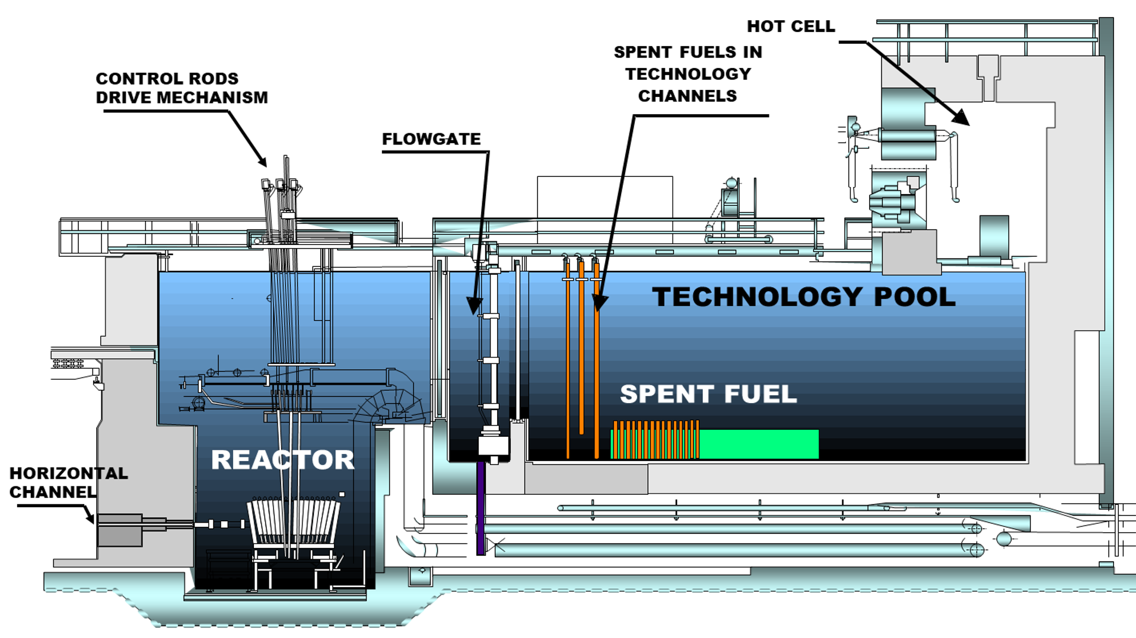
MARIA Reactor

Slide 7
NRR MARIA cross-section
Horizontal neutron beams
THERMAL NEUTRONS FLUX
AT HORIZONTAL NEUTRON BEAMS OUTLETS
4 x 10⁹ cm⁻² s⁻¹

Slide 8
Since 2021 the experimental hall @ MARIA NRR has been refurbished for
five HZB thermal neutron instruments
MARIA NEUTRON LABORATORY MNL
Open access on the application competition

Slide 9
HZB MACHINES
E2 - Flat Cone Diffractometer,
E3 – Residual Stress Analysis Diffractometer,
E4 – Two-Axis Diffractometer,
E5 - Four-Circle Diffractometer,
E6 – Focusing Diffractometer.

Slide 10
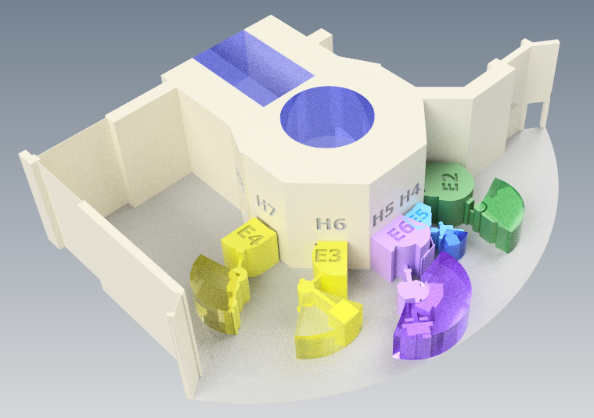
PLANNED ARRANGEMENT @ THE MARIA EXPERIMENTAL HALL

Slide 11
All diffractometers are equipped with 2-dimensional position sensitive
He³ neutron detectors and focusing monochromators
E2. Flat cone diffractometer
Monochromator, Cu (220), λ=0.91 Å Ge (311), λ=1.21 Å, PG (002), λ=2.41 Å;
4 x 2D PSD 30 x 30 cm
E3. Diffractometer for Microstructure and Residual Stress Analysis
Monochromator Si (400), Double focusing, λ = 1.48Å; 2D PSD 30 x 30 cm
E4. Two-Axis Diffractometer.
Monochromator PG (002): λ = 2.4Å or Ge (113): λ= 1.2Å; 2D PSD 20 x 20 cm
E5. Four-Circle Diffractometer.
Monochromator Cu(220); λ = 0.9Å or PG(002), λ=2.4Å, PSD 9 x 9 cm
E6. Focusing Diffractometer.
Monochromator PG (002) λ = 2.4Å double focusing, two 2D PSD each 30 x 30 cm

Slide 12
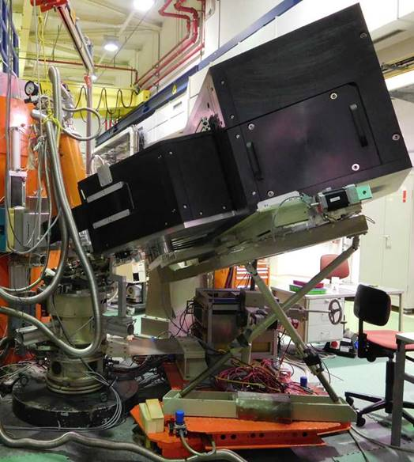
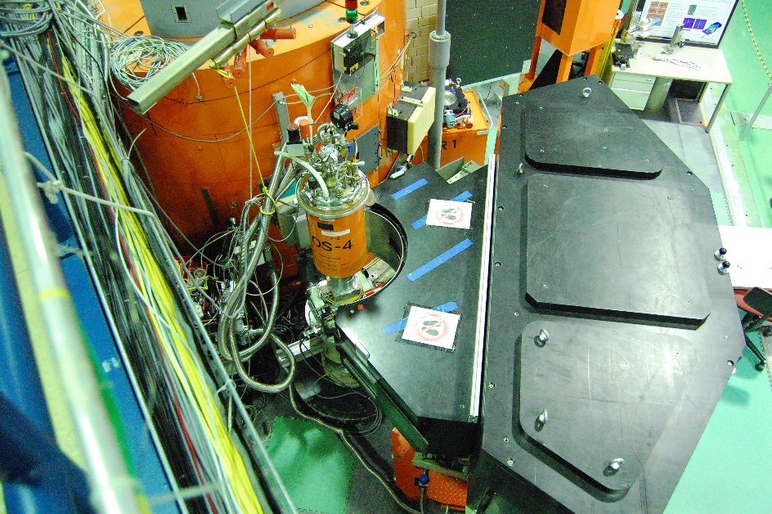
E2 diffractometer
Possiblity of tilting the detector from the horizontal scattering plane
A 3-dimensional part of the reciprocal space can be scanned in less than five steps by combining the “off-plane Bragg-scattering” and the flat-cone layer concept while tilting axis of the detector bank.
Parasitic scattering from cryostat or furnace walls is reduced by an oscillating „radial“ collimator.

Slide 13
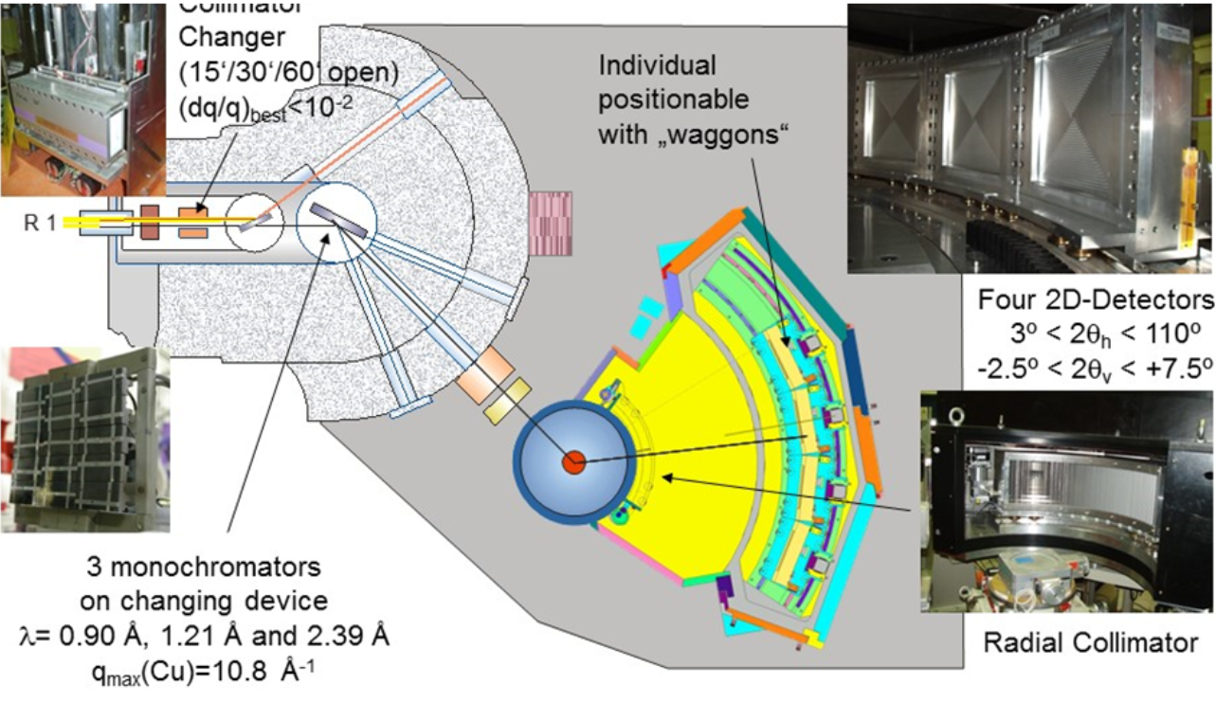
E2 diffractometer
Journal of large-scale research facilities, 4, A129 (2018)

Slide 14
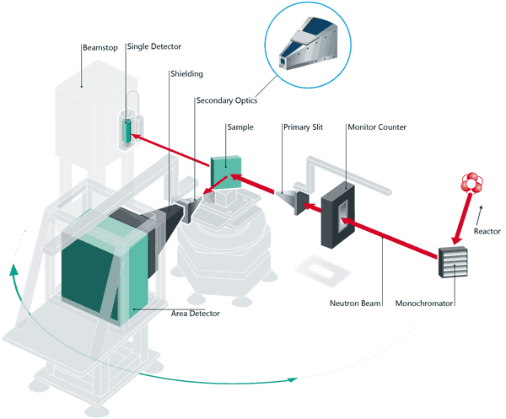
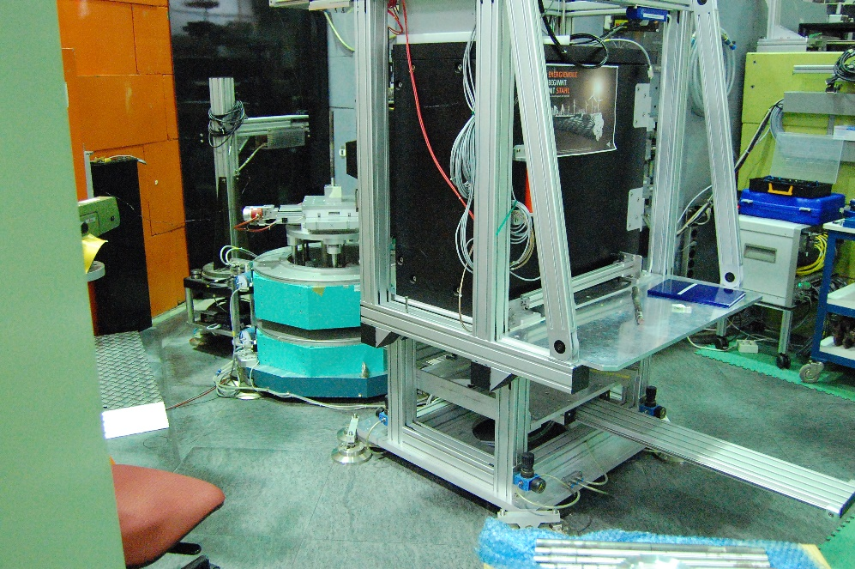
E3 diffractometer
for internal stress studies in macroscopic elements
The diffractometer is designed for strain and stress analysis for simple geometric samples as well as for industrial applications and heavy components of arbitrary shape.
The diffractometer itself consists of two big omega circles (Ω and 2Θ) with a diameter of 800 mm and upon a translation table (xyz-direction) for sample positioning in vertical and horizontal direction.
DOI: 10.17815/jlsrf-2-126

Slide 15
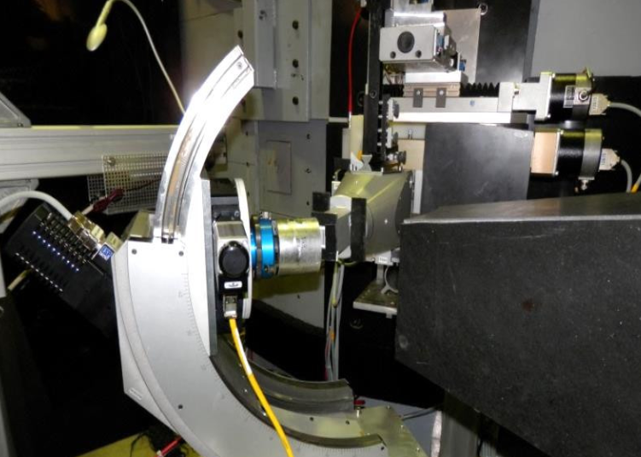
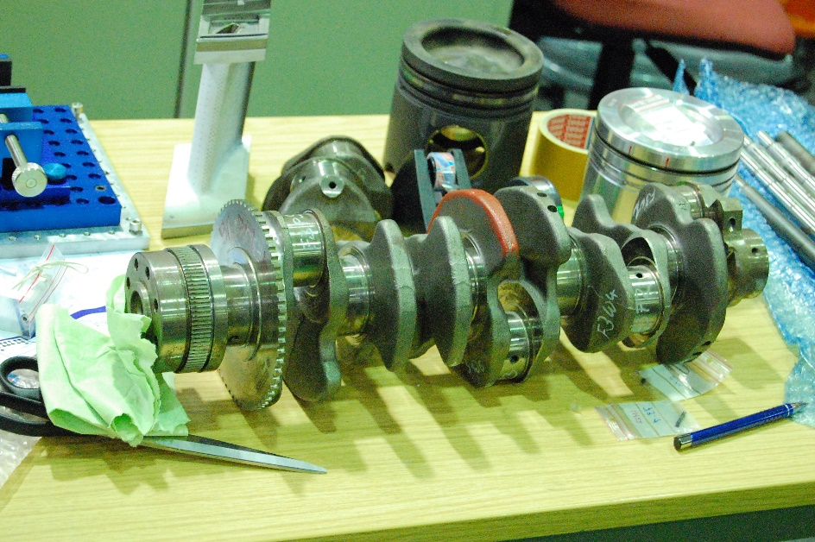
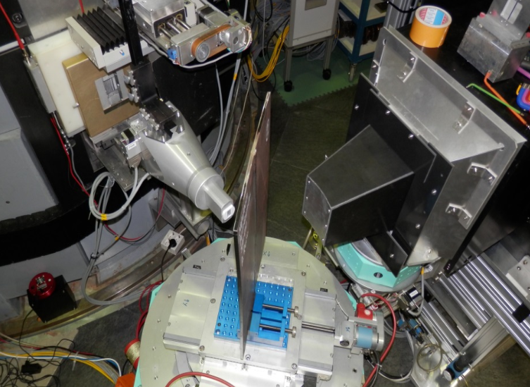
E3 diffractometer
DOI: 10.17815/jlsrf-2-126

Slide 16
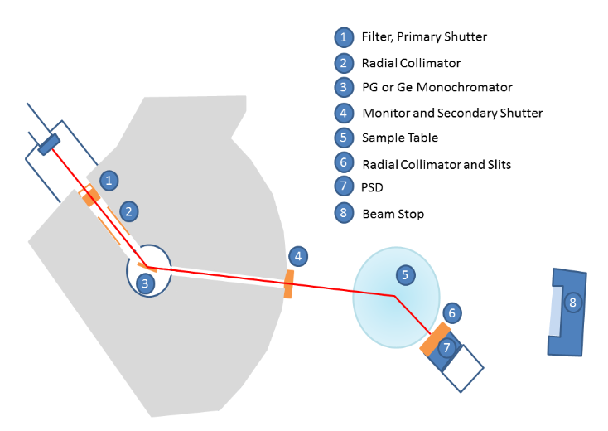
E4 diffractometer
The instrument is primarily suited for magnetic structure determination under various conditions, which includes:
magnetic fields,
low temperatures,
pressures.
The most common application is to reveal spatial arrangement ordered spin structures.

Slide 17
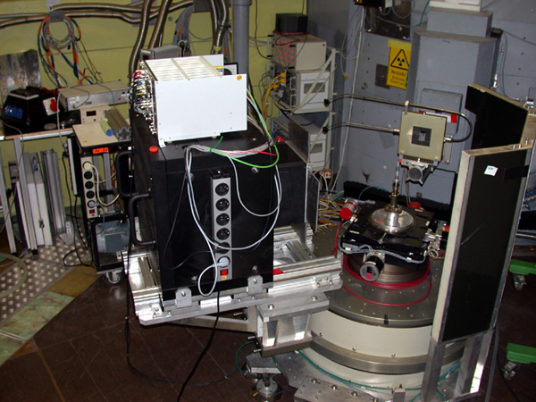
E4 diffractometer
Applications:
Magnetic structure determination
Study of magnetic and structural phase transitions
Determination of magnetic phase diagrams
Study of critical points as a function of magnetic field and temperature
Measurement of correlation functions above the ordering temperature

Slide 18
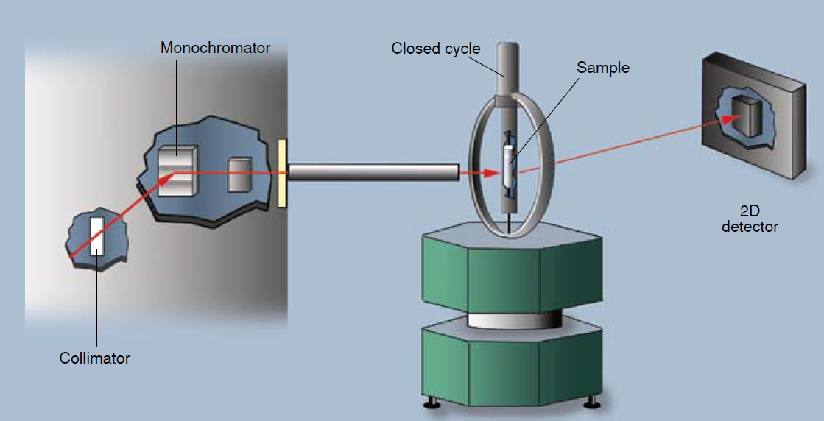
E5 diffractometer
E5 is a conventional four-circle diffractometer.
The instrument is equipped with a two-dimensional position sensitive 3He-detector.
The monochromator take-off angle is fixed at 42°.
The instrument setup is ideal for the determination of crystal and magnetic structures.

Slide 19
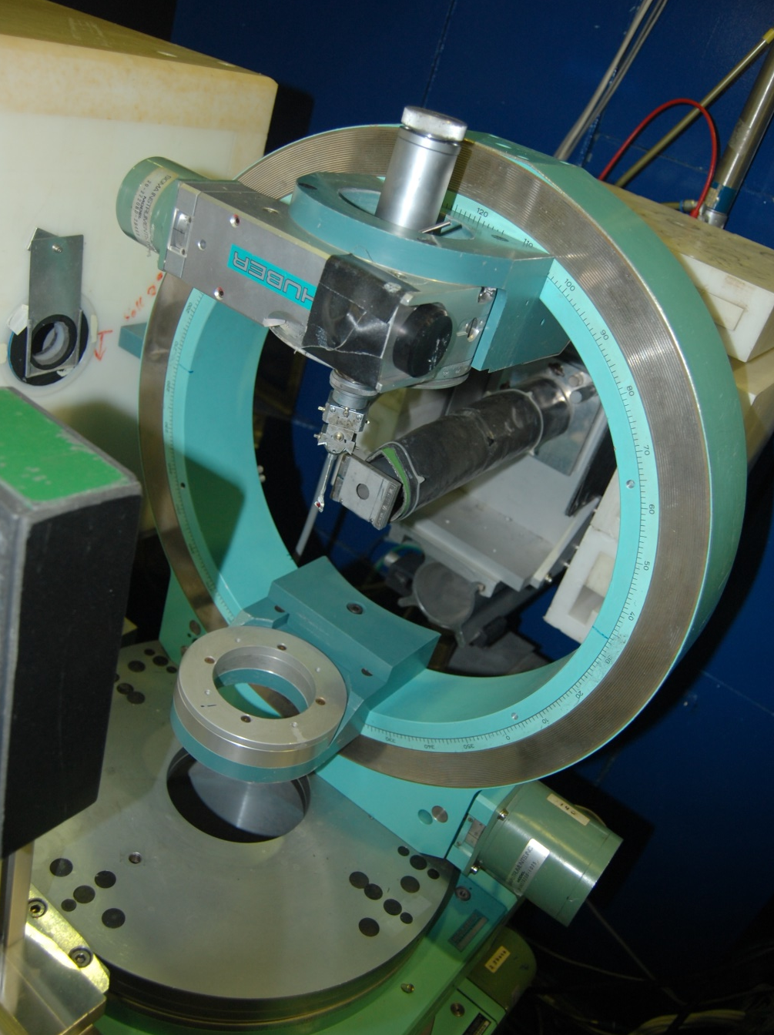
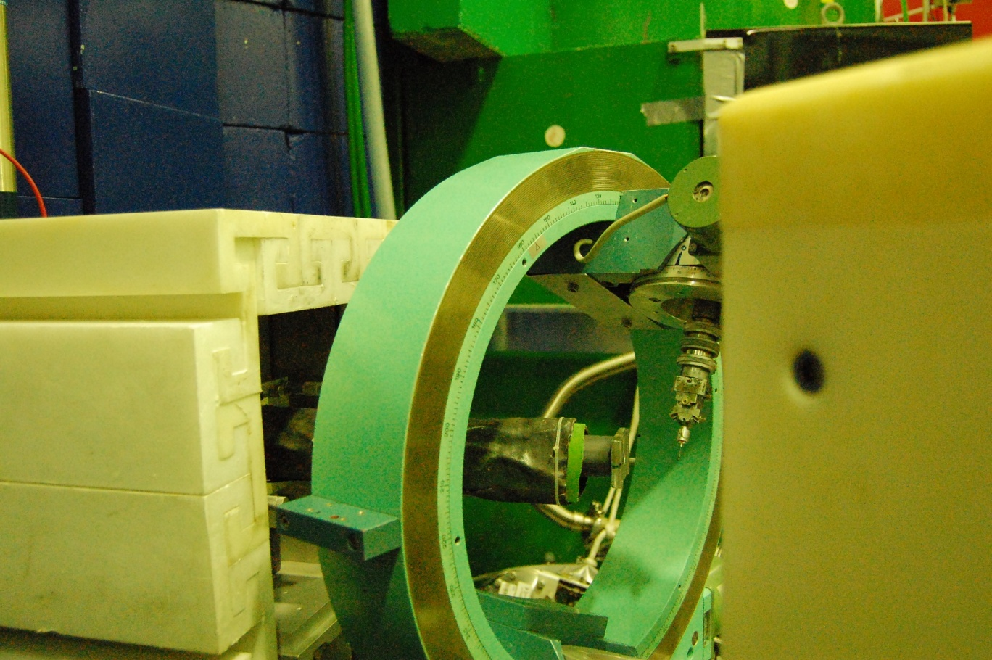
E5 diffractometer
Applications
investigation of crystal structures of molecular, ionic or intermetallic systems
determination of positional and thermal parameters of light atoms (H, D or Li)
complex magnetic structures (especially to deduce weak magnetic components)
structural and magnetic phase transitions (interplay between structural changes and physical properties)

Slide 20
E6 uses a horizontally and vertically bent monochromator and an in-pile fan collimator.
The fan collimator imitates a vertical slit with adjustable distance to the monochromator.
This diffraction geometry achieves a focusing in reciprocal space.
At medium resolution, the neutron flux is increased by a factor of two compared with diffractometers that use standard Soller collimators.

Slide 21
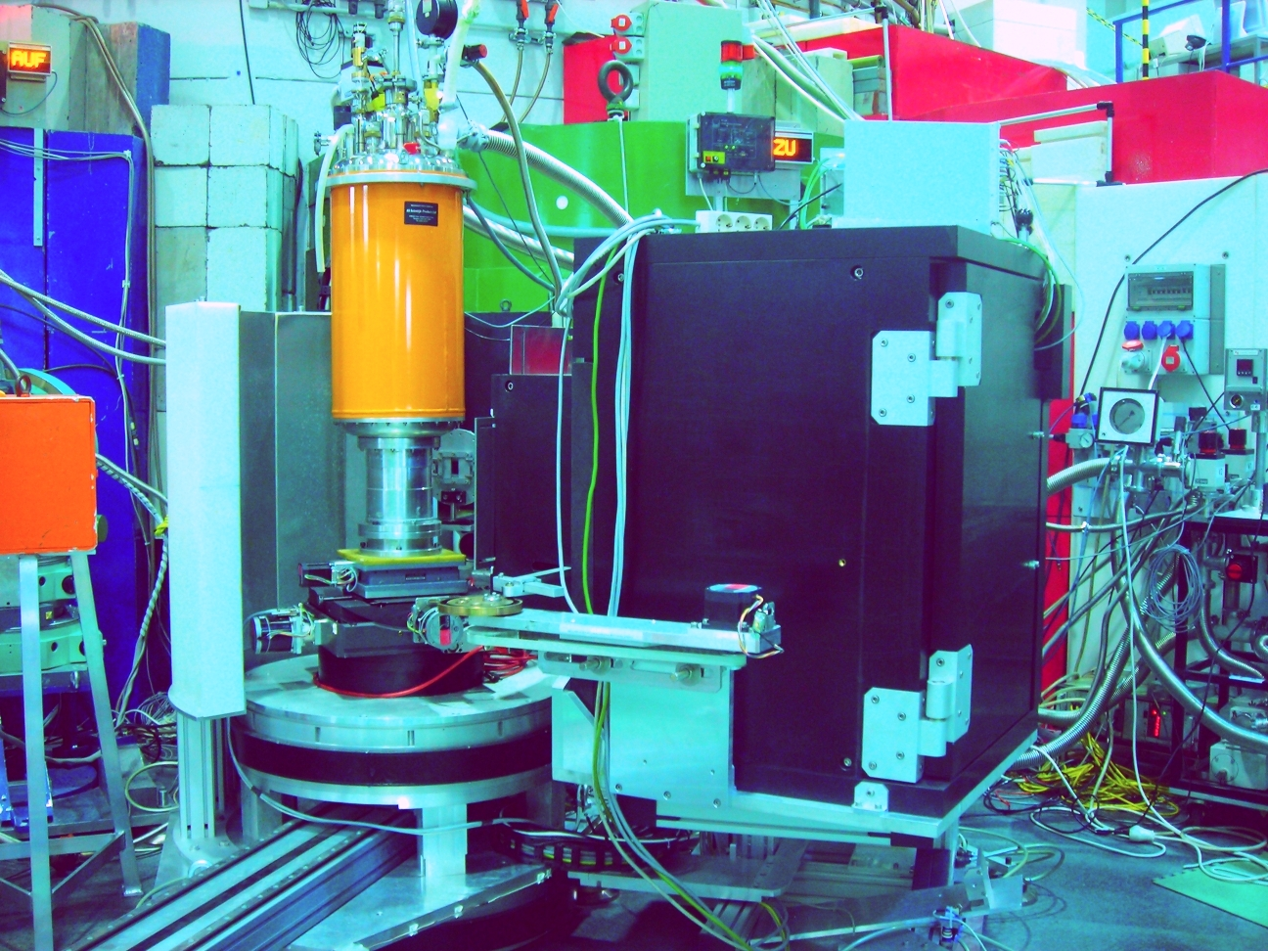
E6 diffractometer

Slide 22
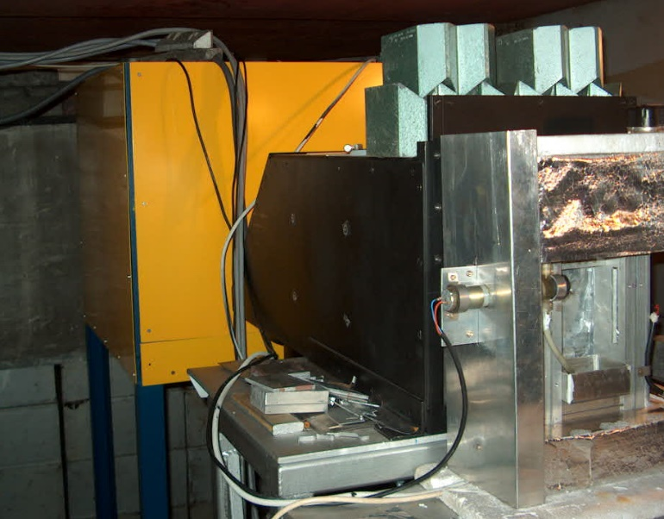
H8
neutron radiography station
Collimators

Slide 23
Neutron Radiography facility
main parameters
100 < L/D < 200
Cd ratio = 20
neutron flux density = 1.1 x 10⁷ n cm⁻² s⁻¹ (at L/D = 150)
ILL 2.9 x 10⁹ n cm⁻² s⁻¹ at L/D = 100
Converter screen size: 250 x 250 mm
Converters:
gamma : Gd₂ O₂ S: Tb
neutrons: ⁶Li:ZnS:Cu, Al, Au (green light)
Camera: CCD ORCA-ER (Hammamatsu)
Linear resolution: 0.1 mm, time resolution: 1 s
Objects: medium size technical devices
Processes: water migration in porous systems
self-diffusion in water

Slide 24
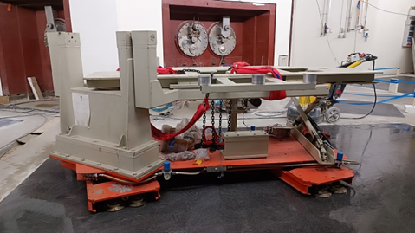
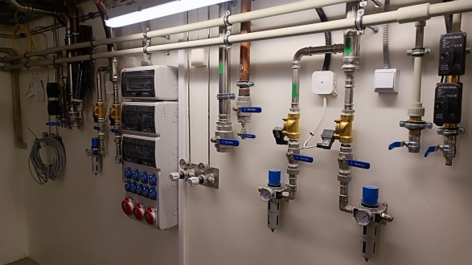
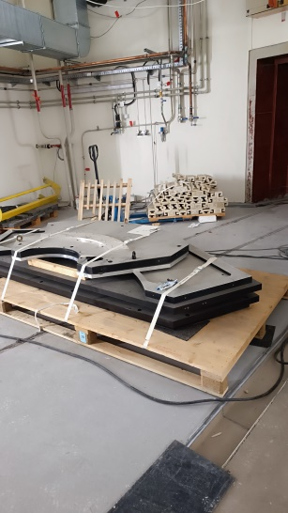
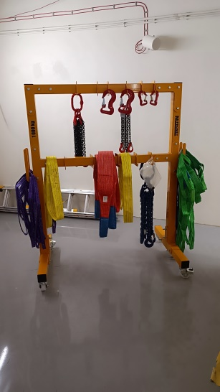
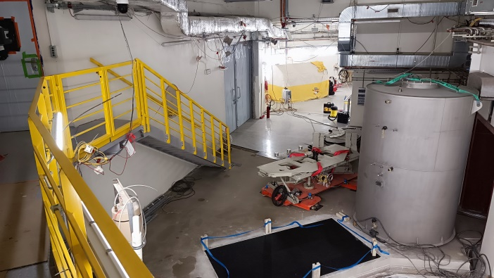
Pressurized air, He recovery, cooling water, N₂ and He installations

Slide 25
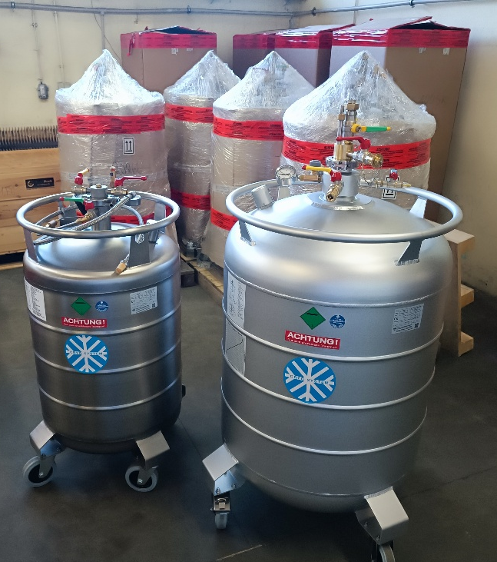
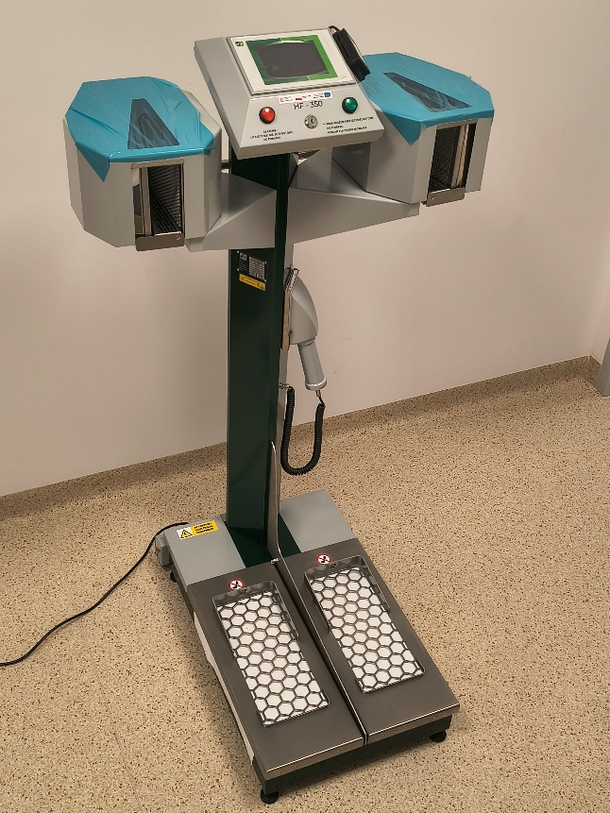
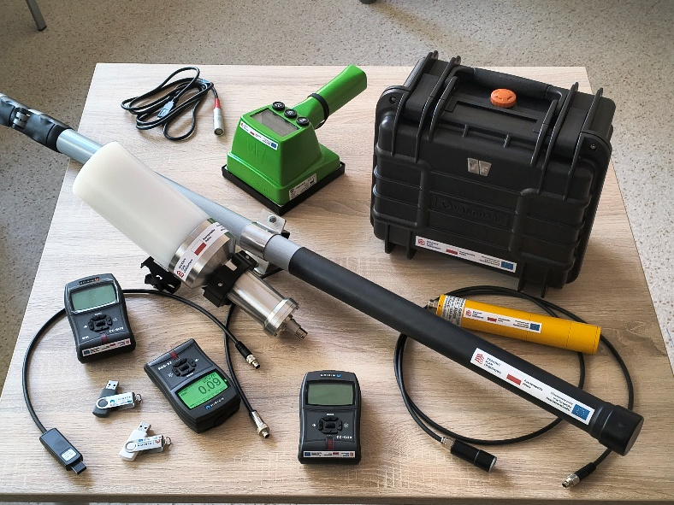
Equipment orders
pole pod posadzkę granitową

Slide 26
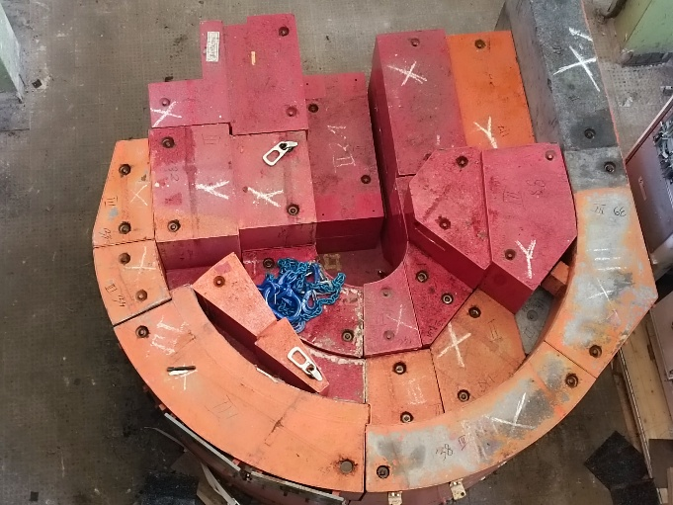
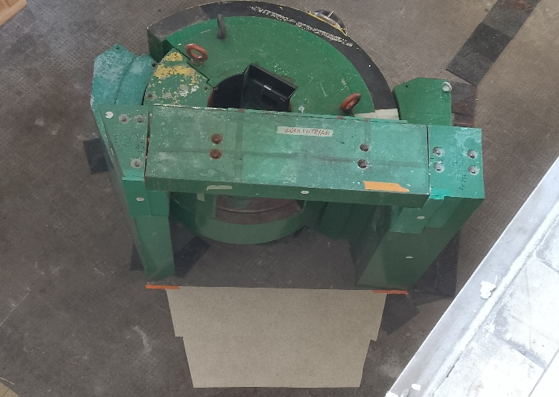
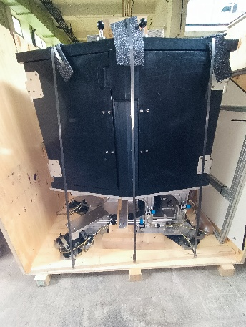
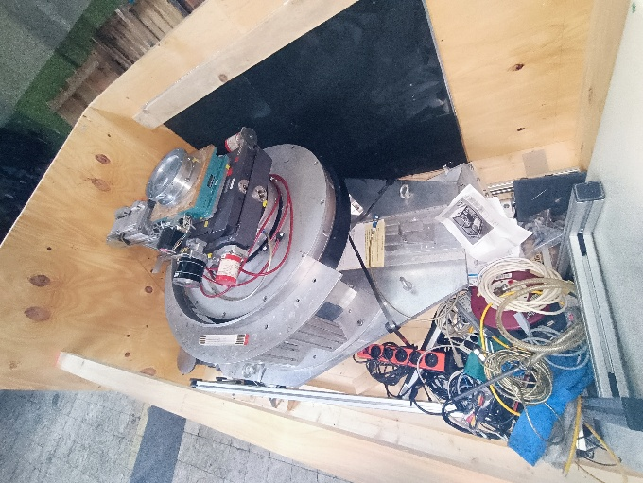
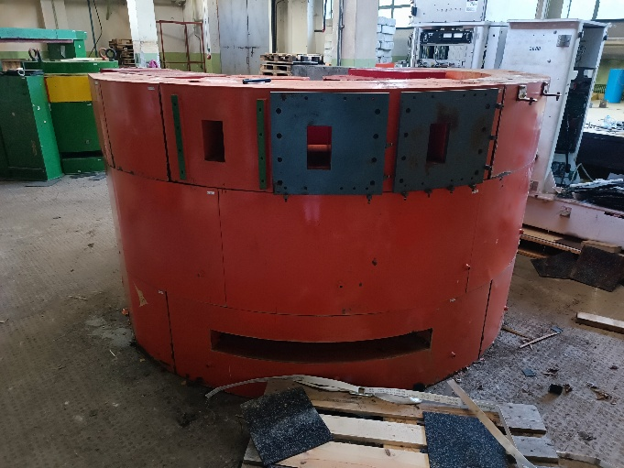
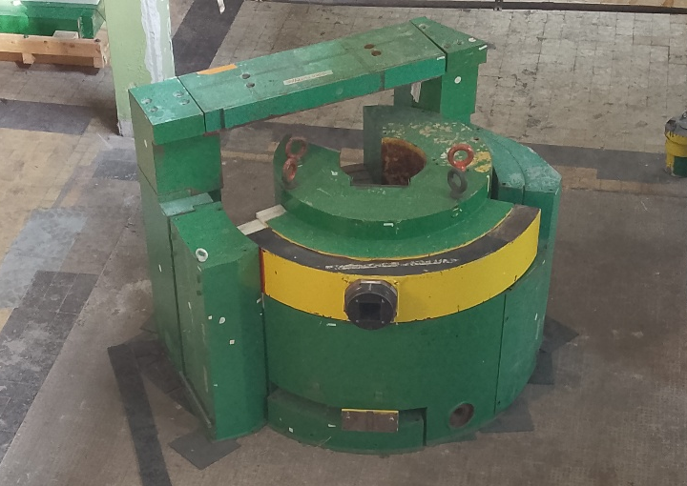
Dyfraktometry

Slide 27

National Recovery and Resilience Plan (KPO): MNL Maria Neutron Laboratory
Eligible expenses: 25 124 047,06 PLN
Funding: 19 830 000,00 PLN
Helium recovery and liquefaction station
Liquid helium and nitrogen dewars
Adaptation of shields
CEPH based reliability cluster for storing measurement data
Computers
Software
Modernization of the radiography station
Modernization of rooms for MNL in the LBM building

Slide 28
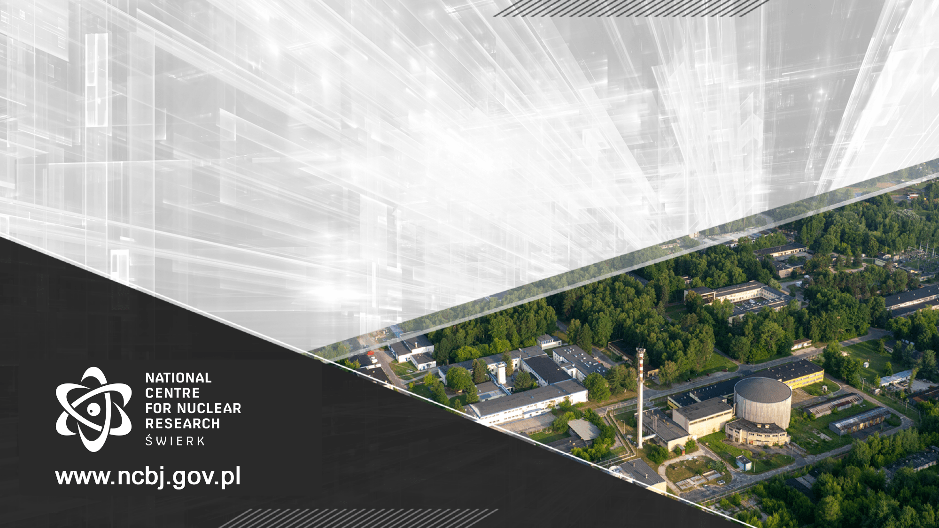
Thank you for your attention

