Slide 1
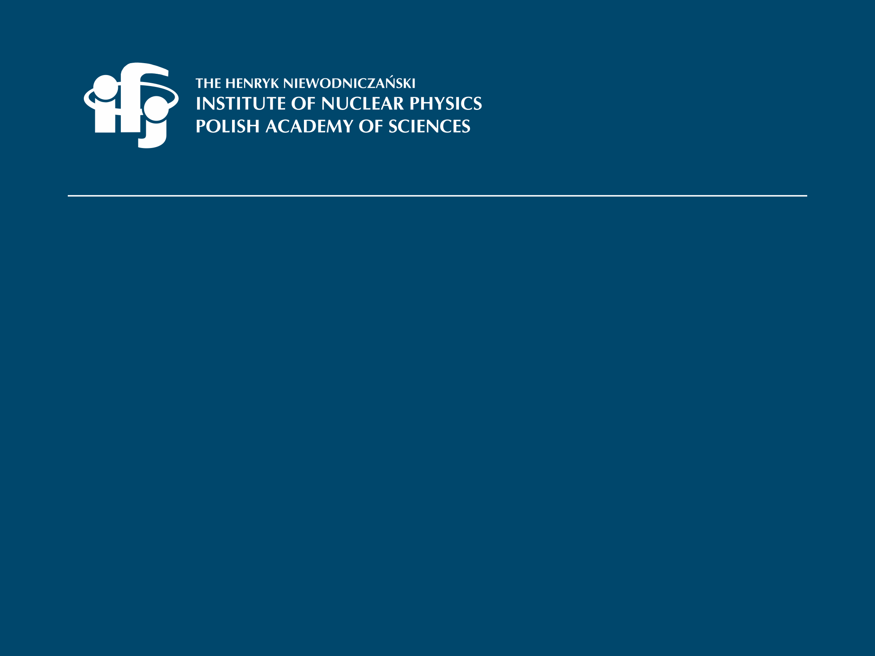
Division of Nuclear Physics and Strong Interactions (NO2)
Division Head: Prof. dr. hab. Adam Maj

Slide 2
Scientific Departments:
Division of Nuclar Physics and Strong Interactions
Theory of Strong Interactions and Many Body Systems (NZ21)
– head: Prof. dr hab. Antoni Szczurek
Structure of Atomic Nucleus (NZ22)
– head: Prof. dr hab. Piotr Bednarczyk
Ultrarelativistic Nuclear Physics and Hadron Interactions (NZ23)
– head: Prof. dr hab. Marek Kowalski
Nuclear Reactions and Hadronic Processes (NZ24)
– head: dr hab. Adam Kozela
Staff: 38; Researchers: 36; PhD Students:6

Slide 3
Division of Nuclar Physics and Strong Interactions
Main research activities
The Division investigates, theoretically and experimentally, a wide range of problems:
interactions between nucleons, including the so-called three-nucleon forces;
structure of atomic nuclei far from the valley of stability and their exotic excitations (e.g., pygmy and giant resonances, isomeric and high-spin states);
nuclear reaction mechanisms, including processes occurring at ultra-relativistic energies with open strangeness production;
the nuclear matter equation of state;
fundamental symmetries of interaction.
The Division is engaged mainly in basic research. R&D work performed on the construction of detectors in international experiments may contribute indirectly to applications.
Experiments in GSI/FAIR, GANIL/SPIRAL2, IJCLab, ILL, LNL Legnaro, IFIN-HH, CERN: ISOLDE, JYFL, RIKEN , RCNP, ANL, FRIB,…
and also in CCB Krakow and HIL Warsaw
Strong collaboration with many scientific partners in Poland, Europe and in the world.
RESULTS: ca. 120 papers yearly

Slide 4
Division of Nuclar Physics and Strong Interactions
Recent scientific achievements

Slide 5
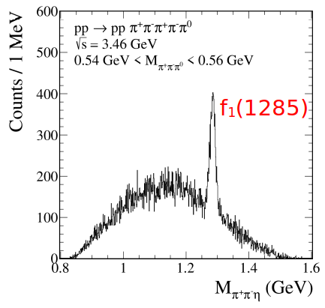
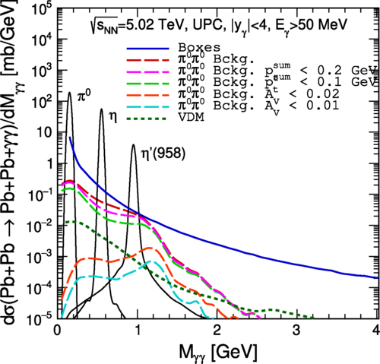
Department of the Theory of Strong Interactions and Many Body Systems (NZ21)
First theoretical evaluation of f₁(1285) meson production cross sections
For the first time the cross section for the pp-> ppf1(1285 reactions near threshold relevant for the HADES, CBM and PANDA experiments were evaluated. It was assumed that at energies close to the threshold the ωωf1(1285) and ρρ⁰f1(1285) fusion processes are the dominant production mechanisms. The possibility of a measurement by HADES@GSI has been presented and discussed. P. Lebiedowicz, O. Nachtmann, P. Salabura and A. Szczurek,
Phys. Rev. D104 034031 (2021)
Possible future studies of light-by-light scattering
Possible future studies of photon-photon (light-by-light) scattering using planned FoCal and ALICE 3 detectors were discussed. Different mechanisms of γγ→ γγ scattering, such as double-hadronic photon fluctuations, t/u-channel neutral pion exchange or resonance excitations (γγ→R ) and deexcitation (R→γγ). The PbPb→PbPb γγ cross section has been calculated within equivalent photon approximation in the impact parameter space. Several differential distributions have been presented and discussed and cross section in the (mb-b) range for typical ALICE 3 cuts (a few orders of magnitude larger than for the current ATLAS or CMS experiments) were predicted.
P. Jucha, M. Kłusek-Gawenda and A. Szczurek, Phys. Rev. D109 014004 (2024)

Slide 6
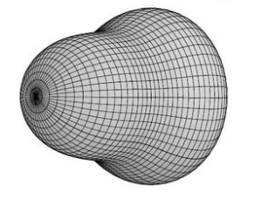
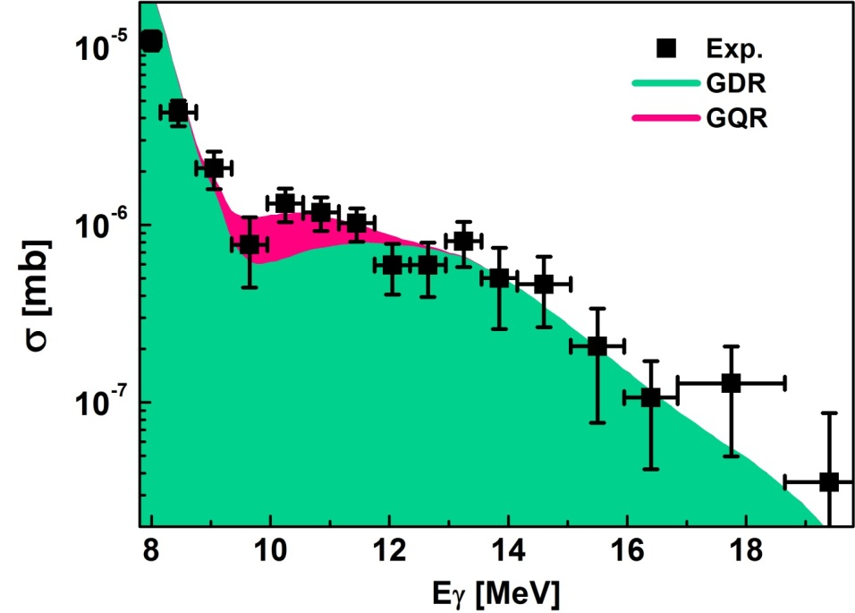
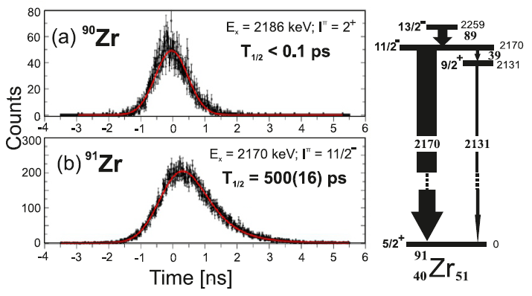
Department of the Structure
of Atomic Nucleus (NZ22
Gamma-Decay of the Giant Quadrupole Resonance (GQR) in ²⁰⁸Pb
(eperiment performed at CCB Krakow – inelastic scattering of high-energy protons)
The gamma decay of the GQR (very rare phenomenon) excited in the ²⁰⁸Pb nucleus was observed in a series of measurements performed at the Cyclotron Center Bronowice IFJ PAN, using a modern detection system for nuclear spectroscopy.. The result reported here fully confirms and refines findings from about 50 years ago, which was subject to great uncertainty and which could not be verified until now.
B. Wasilewska, M. Kmiecik, M. Ciemała,A. Maj et al., PRC105, 014310 (2022)
Study of octupole excitations
in neutron-rich Zr isotopes
Two fusion-evaporation experiments were
performed at IFIN-HH, Bucharest
(lifetime measurements)
In Zirconium isotopes ^{90,91}Zr, the lifetimes of states with spins 3- and 11/2, respectively, were measured using the “plunger” method. The corresponding reduced transition probabilities B(E3) were determined, which are 16 and 21 Weisskopf units, indicating a strong octupole vibration component of these excitations.
Ł.W. Iskra, B. Fornal et al., PRC 110, 0643127 (2024)

Slide 7
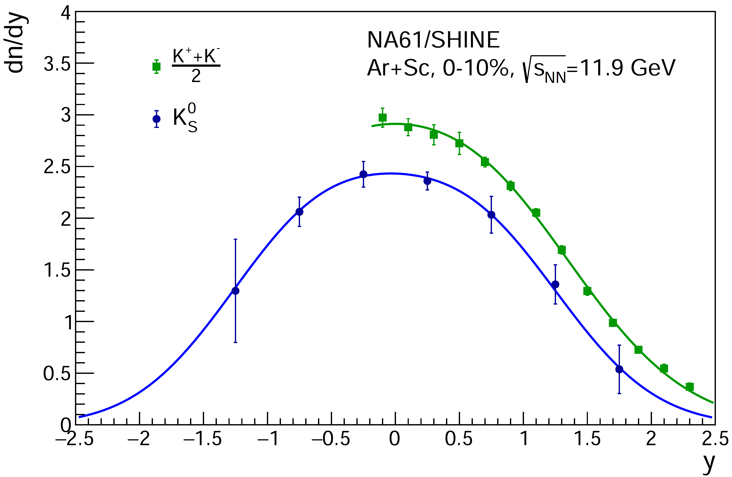
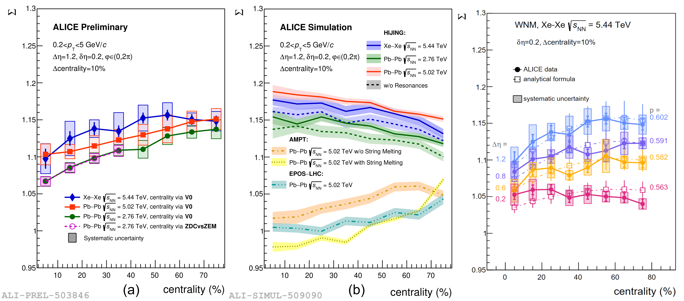
Department of the Ultrarelativistic Nuclear Physics and Hadron Interactions (NZ23)
The new measurement of electrically charged and neutral K mesons by the NA61/SHINE experiment at CERN reveals an unexpectedly large violation of isospin symmetry
Strong interactions preserve an approximate isospin symmetry between up (u) and down (d) quarks, part of the more general ﬂavor symmetry. The new measurement of electrically charged and neutral K mesons by the NA61/SHINE experiment at CERN reveals an unexpectedly large violation of isospin symmetry: in the mid-rapidity region, the excess of charged (K⁺ + K⁻) over neutral (K⁰ + anti-K⁰) mesons amounts to 18.4%+-6.1%. The observed effect cannot be explained by theoretical models including known sources of isospin symmetry violation.
NA61 Collaboration (IFJ PAN: N. Davis, M. Lewicki, A. Marcinek, V. Ozvenchuk, Ł. Rozpłochowski, A. Rybicki); Nature Communications (2025)16:2849 )
The first analysis of „Σ” within a two-component wounded-constituent mode
This work presents the first analysis of Σ (new correlation and fluctiation measure in heavy-ion physics) within a two-component wounded-constituent model, which successfully describes ALICE data from Xe–Xe and Pb–Pb collisions, outperforming standard Monte Carlo generators such as HIJING, AMPT, and EPOS. Although Σ no longer retains its strongly intensive character within this framework, it still preserves some of its desirable properties. Furthermore, the study demonstrates that Σ can, for the first time, be used as an experimental probe of the fragmentation function in symmetric nucleus-nucleus collisions
I. Sputowska “Forward-backward correlations with the quantity in the wounded-constituent framework at energies available at the CERN Large Hadron Collider”; Phys. C 108, 014903 (2023)

Slide 8
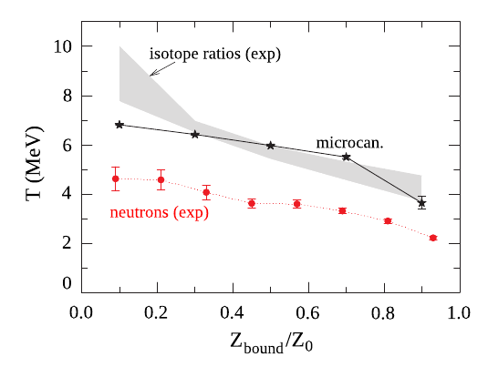
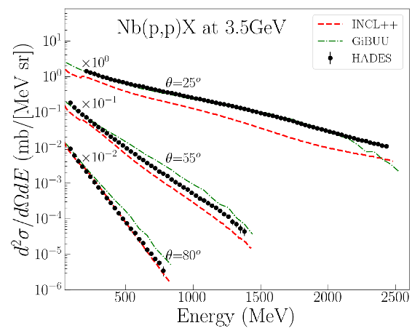
Department of the Nuclear Reactions
and Hadronic Processes (NZ24)
Neutron emission in projectile fragmentation at relativistic energies
A new method of neutron identification has been used for LAND detector data and resulted in average neutron multiplicities of about 11, depending strongly on projectile isotope composition. Effective source temperature has been estimated to 2–5 MeV, increasing monotonically with collision centrality. Measurred multiplicities peripheral collisions are well described by statistical multifragmentation model, while underestimation for more central collisions indicates at significant impact of non-equilibrium neutron emission from studied reactions.
P. Pawłowski, (J. Cibor, B. Czech, J. Łukasik) et al.,
Phys. Rev. C, 108 (2023) 044610
Production of hydrogen isotopes and charged pions in p (3.5 GeV) + ⁹³Nb reactions
Set of double-differential cross sections for production of p, d, t, p+, p+ in p+⁹³Nb at 3.5 GeV in the HADES acceptance (20º-80º) has been compared to GiBUU transport and INCL++ cascade models.
The discrepancies between the models and the data varies with the type of produced particle, its energy and emission angle. In general the models are able to reproduce the data within the factor of 2.
HADES Collab., R. Abou Yassine, (I. Ciepał, K. Pysz) et al., Phys. Rev. C 108, 064902 (2023)

Slide 9

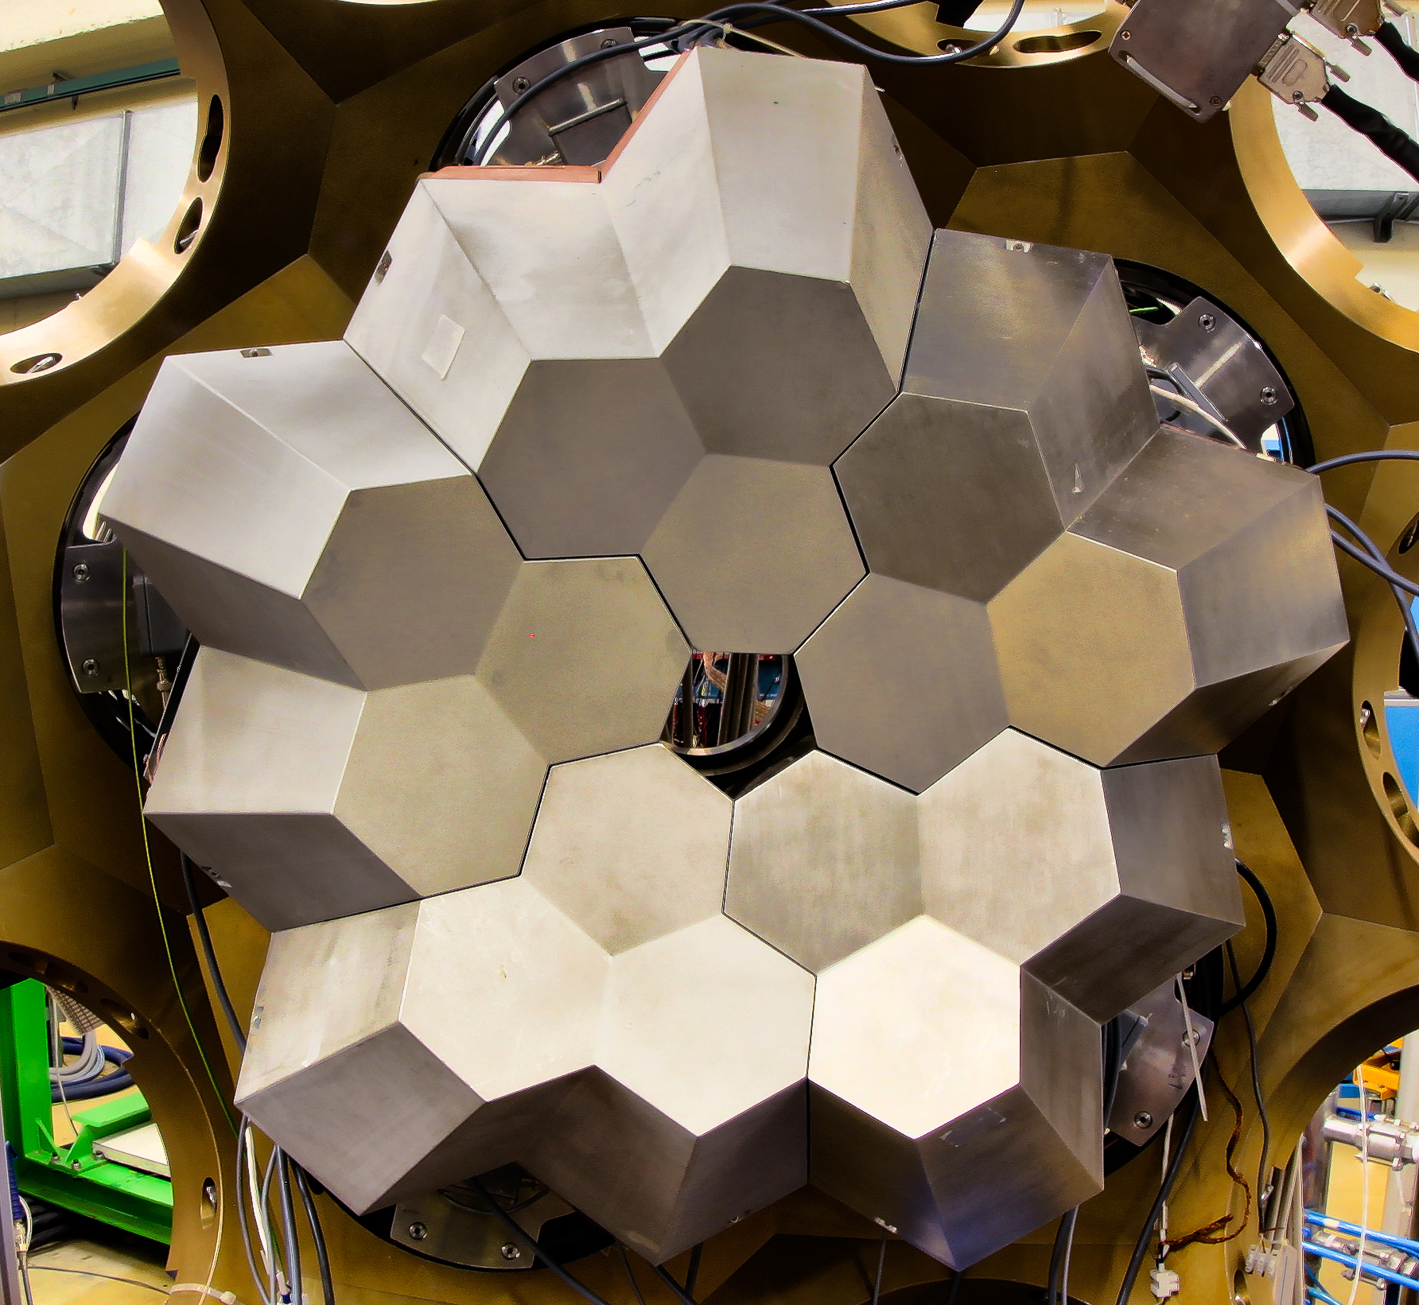
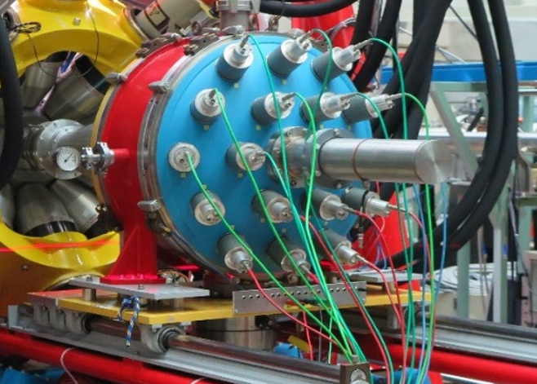
Division of Nuclar Physics and Strong Interactions
Other achievements – Scientific Equipment
PARIS array - a novel 4π gamma-ray calorimeter, being constructed by international collaboration coordinated by IFJ PAN. The basic module for the calorimeter is a phoswich 2 scintillator crystals: LaBr3 or CeBr3 and NaI.
AGATA - the next generation European gamma-ray tracking spectrometer based on segmented HPGe crystals, being developed by an international collaboration, including physicists of IFJ PAN.
RFD (Recoil Filter Detector), constructed in IFJ PAN, measures the time of flight of heavy ions emitted in nuclear reactions.
Other instrumentation: KRATTA, KATANA, KRAB (designed and constructed in IFJ PAN)

Slide 10


Division of Nuclar Physics and Strong Interactions
Other achievements – European Projects
EU FP7 EURO-LABS (2022-2026) – Participation and coordination of WP2: Access to European Nuclear Physics Facilities
DONES-ConP1 (2023-2025) DONES Consolidation Phase -
participation and coordination of the the „Non-Fusion experiments” task

Slide 11
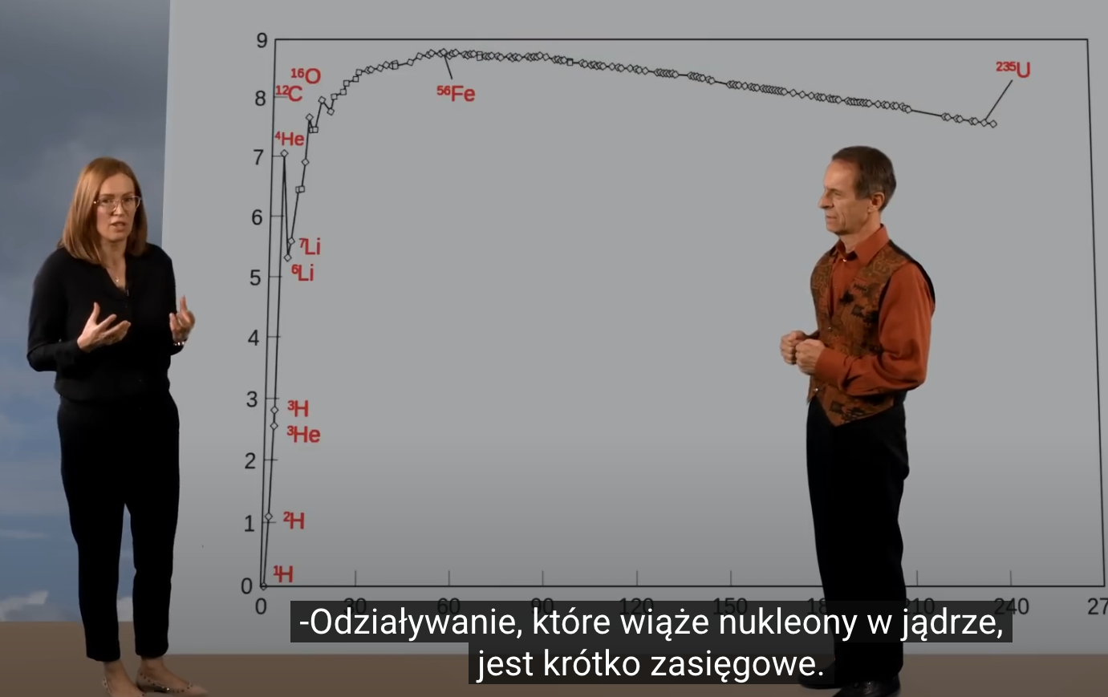
Division of Nuclar Physics and Strong Interactions
Other achievements – Outreach and Popularization of science
Members of the NO2 Division actively contribute to the Outreach and Popularization activities:
European Night of Researchers (every year in September)
Festival of Science (every year in June)
Popularization movies by dr hab. Jerzy Grębosz:
”Mysterious world of atomic nuclei” - https://www.youtube.com/watch?v=FG0oAaO-3XI
„Towards frontiers of knowledge” - https://www.youtube.com/watch?v=0w1HLggaZ24
„Cyclotron - accelerator of ions” - https://www.youtube.com/watch?v=miPTypH9Kf4
„Misterous Higgs particle - https://www.youtube.com/watch?v=__NFF7RJ9Dk
„Picnic in the Valley of Stability" - https://www.youtube.com/watch?v=Rqffasbzdks
„Land of Spectra” - https://www.youtube.com/watch?v=q6ORYazqcsk
„Studying the secrets of DNA” - https://www.youtube.com/watch?v=T1UA2_cTmiU

Slide 12
Division of Nuclar Physics and Strong Interactions
The main goals of nuclear physics and strong interactions at IFJ PAN for the coming years
(NZ21)
Theoretical investigations of:
exclusive di-jets and testing GPDs,
production of glueballs, tetraquarks and hybrids,
production of forward charm, charmed mesons and neutrinos at high energies,
intrinsic charm in the nucleon,
inelastic processes in ultraperipheral heavy ion collisions,
searches for odderon in different reactions,
testing models beyond Standard Model,
testing multiparton scattering,
modelling of exclusive reactions.
(NZ22)
Completion of the construction of the PARIS and AGATA spectrometers (in collaboration).
Commitments to large international infrastructures as FAIR and GANIL and contribution to the nuclear physics research programs (FAIR/NUSTAR, SPIRAL2).
Implementation of a detection setup dedicated to studies of fission processes at CCB.
Implementation of the Recoil Filter Detector as ancillary device for gamma spectroscopy experiments at HIL UW.
Development of the nuclear structure theory computer codes as part of virtual services for experimentalists at IFJ PAN.
Proposing and performing experiments at various international facilities.

Slide 13
Division of Nuclar Physics and Strong Interactions
The main goals of nuclear physics and strong interactions at IFJ PAN for the coming years
(NZ23)
Further activities on the development and modernization of the FIT detector in ALICE.
Further development of the support and cooling of the FoCal calorimeter in ALICE.
Commitments to further development of the software in NA61/SHINE and ALICE.
Further data analysis in NA61/SHINE and ALICE.
(NZ24)
First measurement of induced proton polarization in deuteron breakup reaction with BINA detector at CCB.
Study of relativistic heavy ion collisions at GSI and RIKEN with application of KRAB - more selective trigger detector constructed at IFJ PAN.
Implementation of a new trigger detector in HADES experiment.
Investigation of hyperons final state polarization (Λ⁰ and Σ⁰) in pion-proton interactions at energies above 1 GeV.
Development of cosmic ray veto detector for searches for baryon number violating processes at ESS.
Development of new methods for hadron beam diagnostics.

Slide 14
Final remarks:
In my opinion, as the Head of the NO2 Division for 5 last years, the scientific activities in all the Departments of NO2 are progressing very well and continuously developing, despite many external constrains.
And this is because of hard work and passion of all the scientists, technical stuff and Ph.D. students.
I would like to express my sincere thanks to all of them.
I am sure that this progress will continue in the future.
adam.maj@ifj.edu.pl

