Slide 1

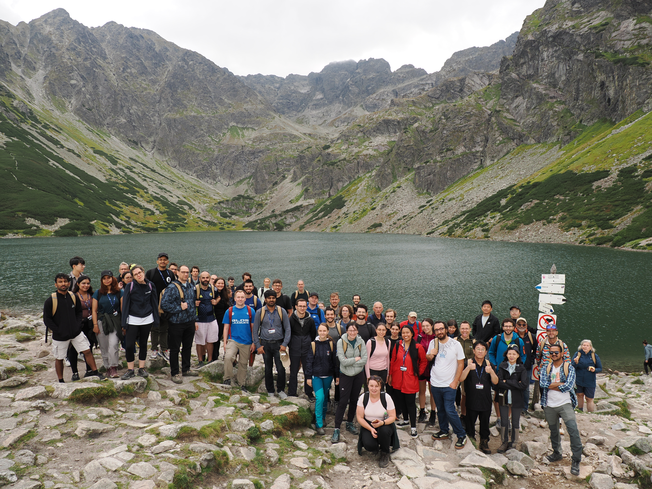



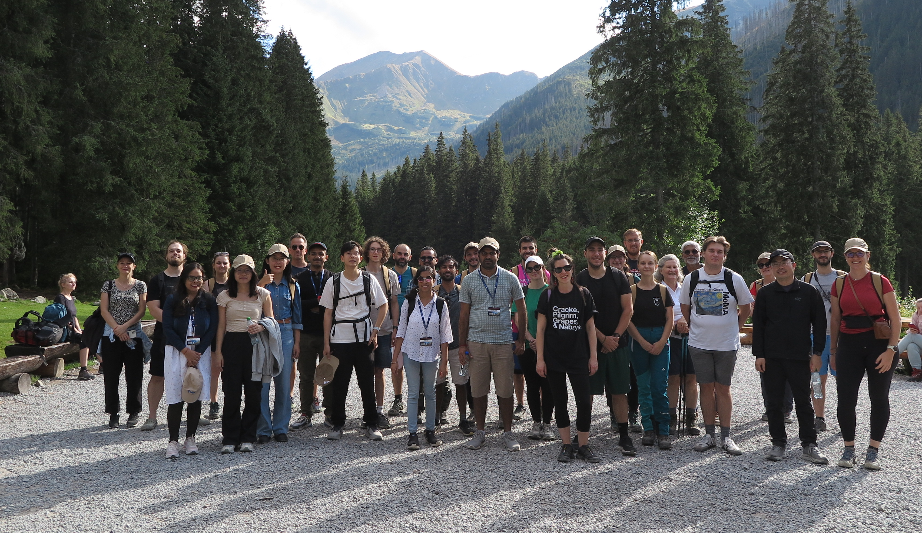


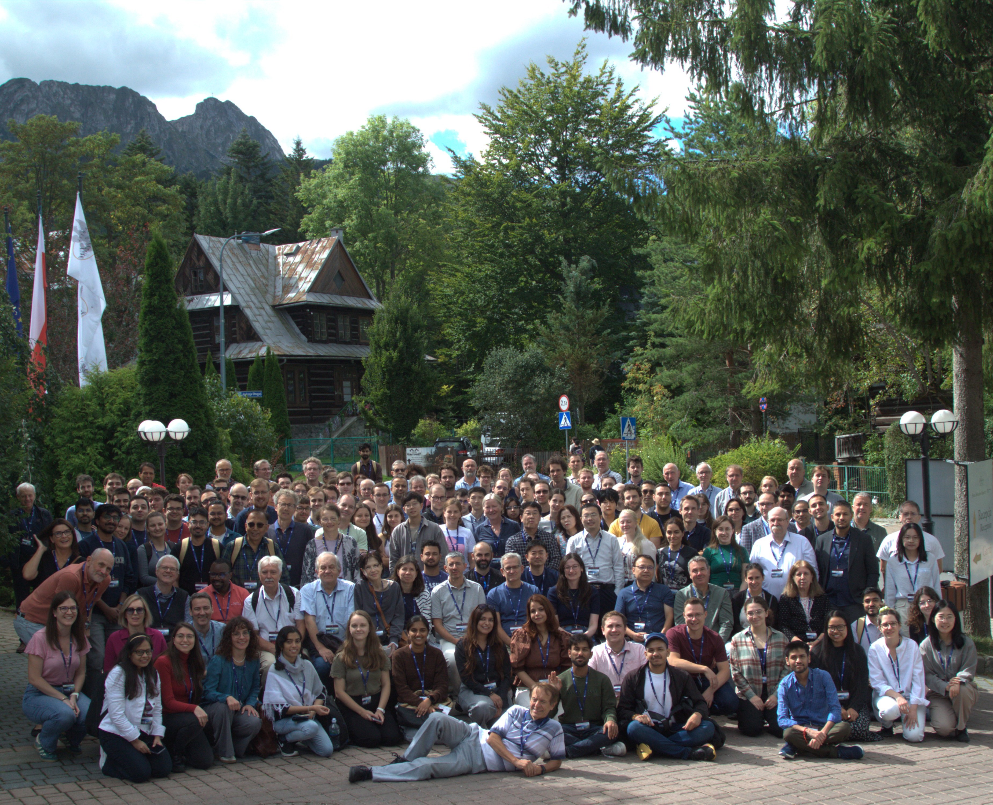
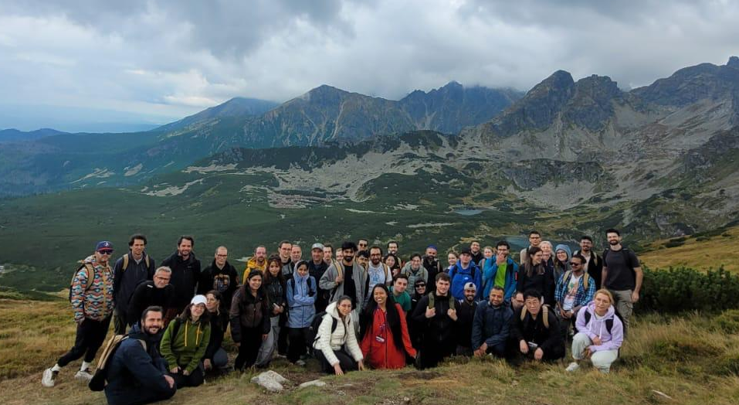
Organizers:

Slide 2
Conference Proceedings
Proceedings will be published as a dedicated volume of Acta Physica Polonica B Proceedings Supplement in Spring 2027
Submission deadline: Autumn 2026 (oral presentations and selected posters)
Detailed instructions will be provided on the conference website and via e-mails

Slide 3
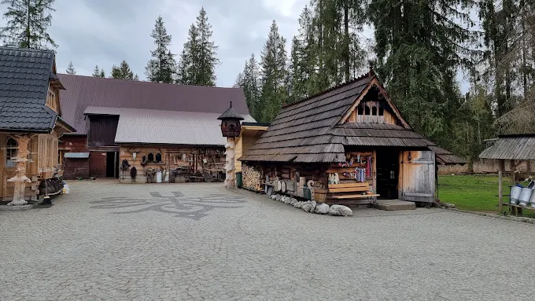
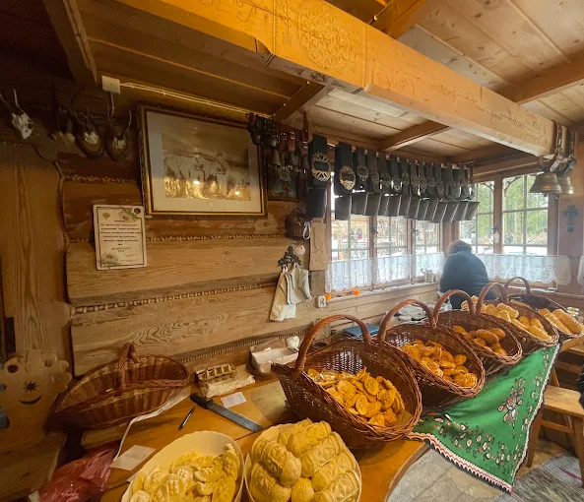
Excursion this afternoon
Cheese tasting

Slide 4


Conference Dinner
Karczma KULIG Krupówki 45
Announcement of the poster contest winners
Presentation of souvenirs
Folk dances
Regional dishes
Make sure to be there at 7pm !

Slide 5


