Slide 1
PARIS Detectors Status | PARIS Managing Board ZAKOPANE 2026
107 PARIS detectors are available 65 CeBr3 + 42 LaBr3 (29 B380 + B390)
11 clusters = 7 clusters CeBr3 (+2 spares) + 4 clusters LaBr3 (+ 6 spares)
5 detectors from BARC and Kolhanta are not taken into account
9 CeBr3 in Russia are not taken into account
Status PARIS Detectors - ZAKOPANE2026
Country/Funder |  | IN2P3 | GANIL | POLAND/GANIL | POLAND | ITALY | INDIA | ROMANIA | GREAT BRITAIN | TURKEY | Total
Detector type | LaBr3 | 19 | 7 | 3 | 6 | 4 | 2 |  | 2 |  | 43
 | CeBr3 | 6 | 13 | 3 | 11 | 13 | 9 | 8 |  | 1 | 64
TOTAL |  | 25 | 20 | 6 | 17 | 17 | 11 | 8 | 2 | 1 | 107

Slide 2
PARIS Detectors Status | PARIS Managing Board ZAKOPANE 2026
Location (beginning of 2026)
ALTO | IPHC | Krakow | Milano | Mumbai/India | Romania
40 | 4 | 38 | 11 | 11 | 3
Status | Status from experiments ALTO/GANIL (ALTO,VAMOS and NFS) : rather wide difference in resolution for the first stage crystal : from 3.2% to 7.2% @662 keV

Slide 3
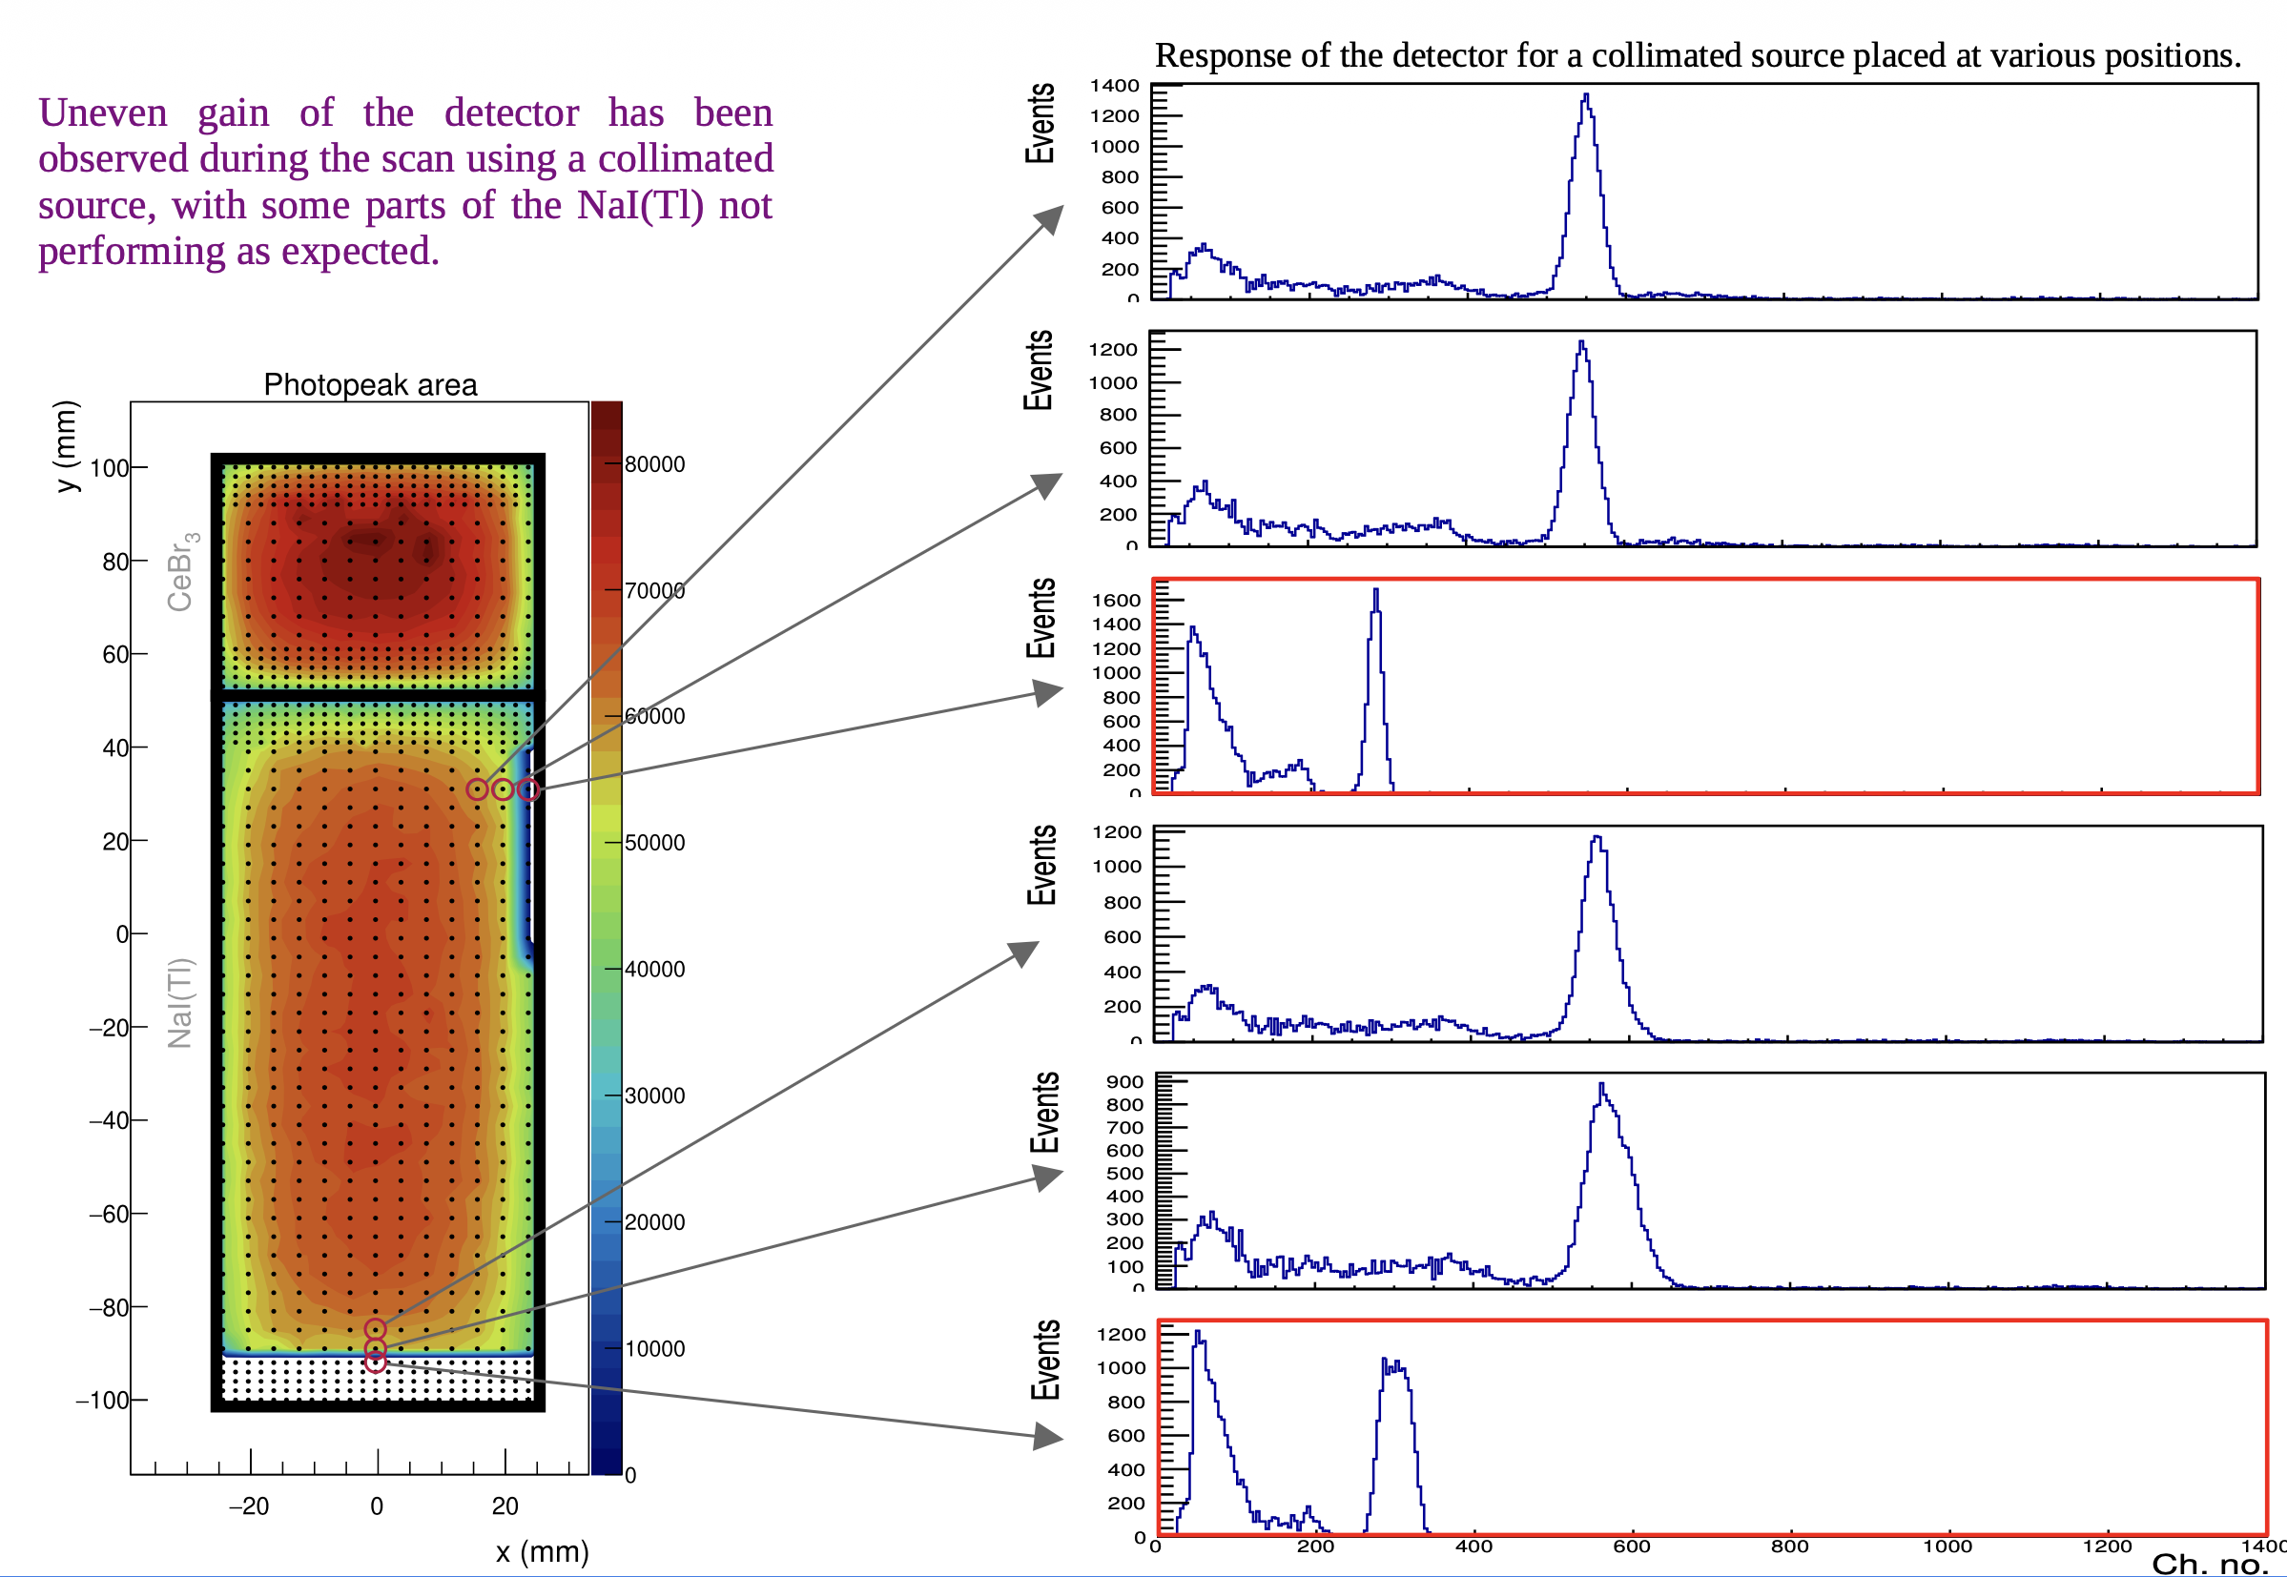
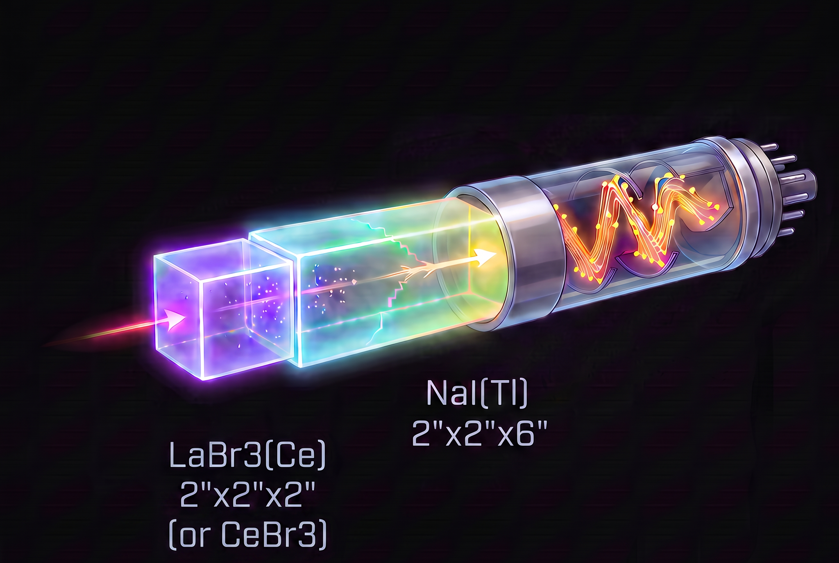
PARIS Detectors Status | PARIS Managing Board ZAKOPANE 2026
Performance differs from the interaction position

Slide 4
PARIS Detectors Status | PARIS Managing Board ZAKOPANE 2026
Status | Status from experiments ALTO/GANIL (ALTO,VAMOS and NFS) : rather wide difference in resolution for the first stage crystal : from 3.2% to 7.2% @662 keV
To be undertaken | a full characterisation of all detectors before a next campaign (LNL Legnaro, GANIL, …) for a selection of best detectors
To be completed | Neutron response efficiency

Slide 5
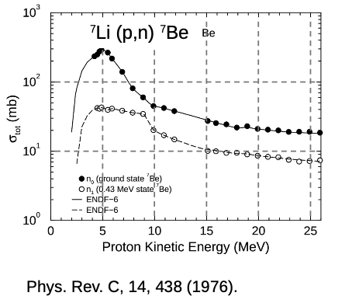
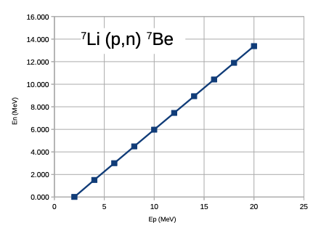
PARIS Detectors Status | PARIS Managing Board ZAKOPANE 2026
Test for Neutron response @Cyrcé facility - IPHC Strasbourg (Courtesy of Neeraj KUMAR)
p(@20MeV) + ⁷Li -> n + ⁷Be - beam intensity of ~500 pnA
Cross section
Neutron energy @ 90°

Slide 6
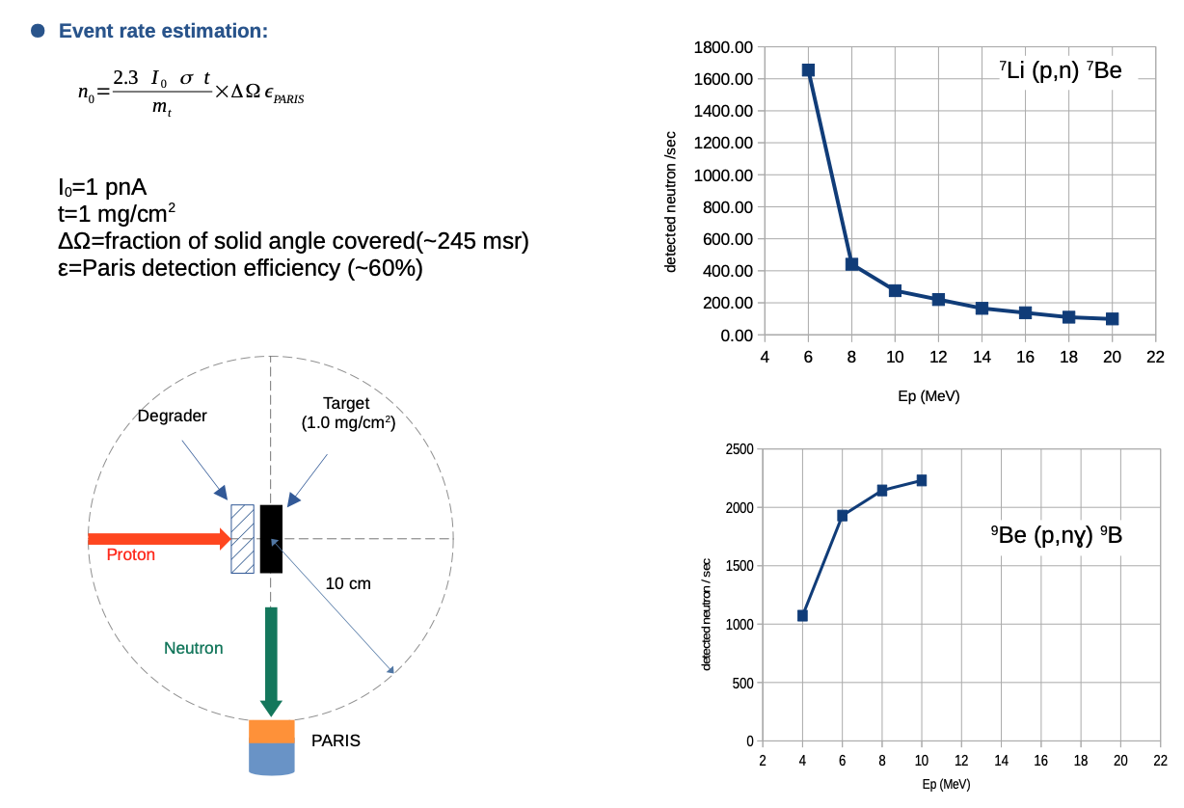
PARIS Detectors Status | PARIS Managing Board ZAKOPANE 2026
Test for Neutron response @Cyrcé facility - IPHC Strasbourg (Courtesy of Neeraj KUMAR)

Slide 7
PARIS Detectors Status | PARIS Managing Board ZAKOPANE 2026
Status | Status from experiments ALTO/GANIL (ALTO,VAMOS and NFS) : rather wide difference in resolution for the first stage crystal : from 3.2% to 7.2% @662 keV
To be undertaken | a full characterisation of all detectors before a next campaign (LNL Legnaro, GANIL, …) for a selection of best detectors
To be completed | Neutron response efficiency
Future | To fulfil the MoU
Buy some dedicated suitcase for transportation of clusters/detectors

