Slide 1

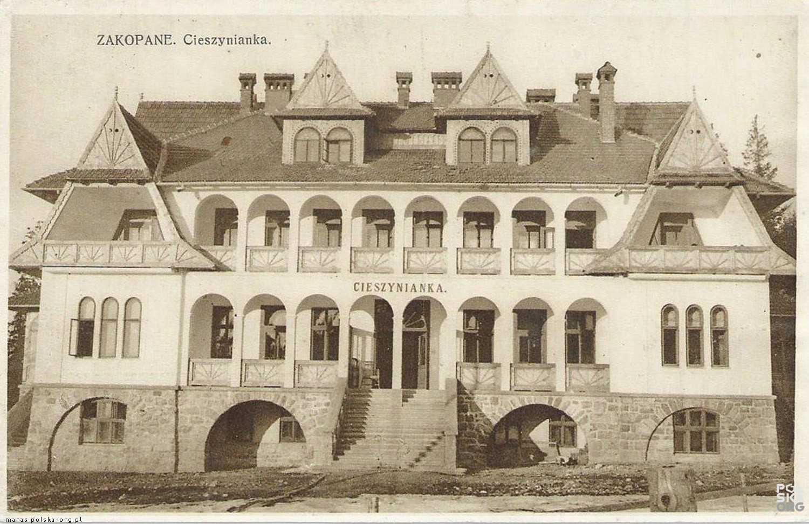
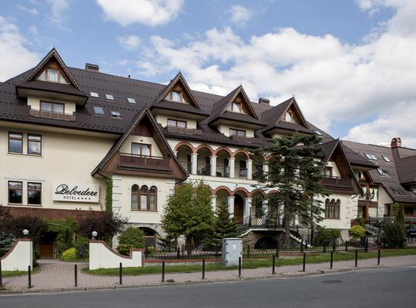
1930

Slide 2

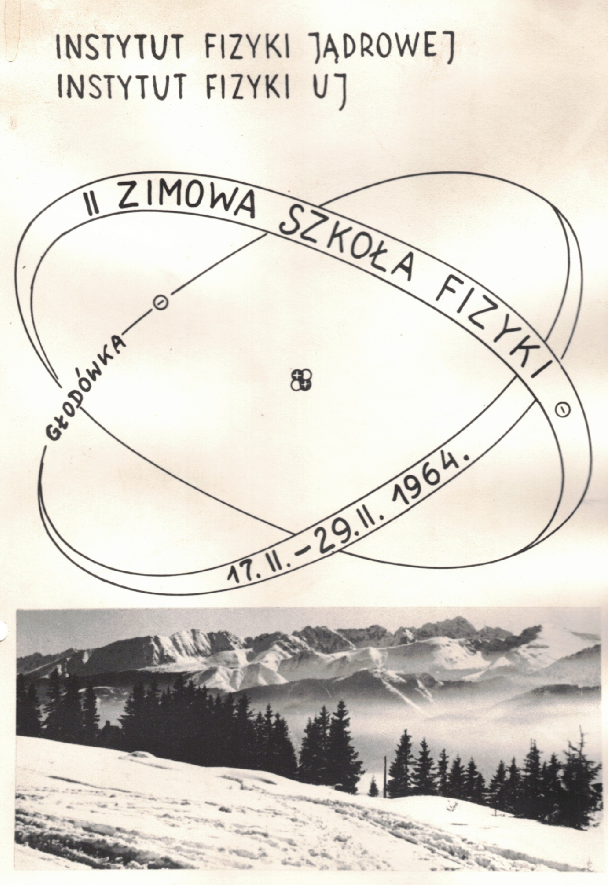




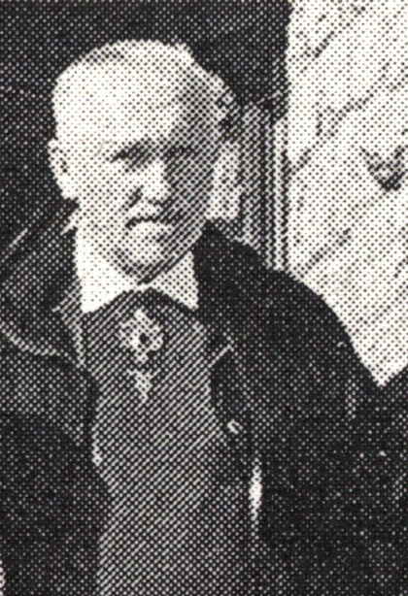
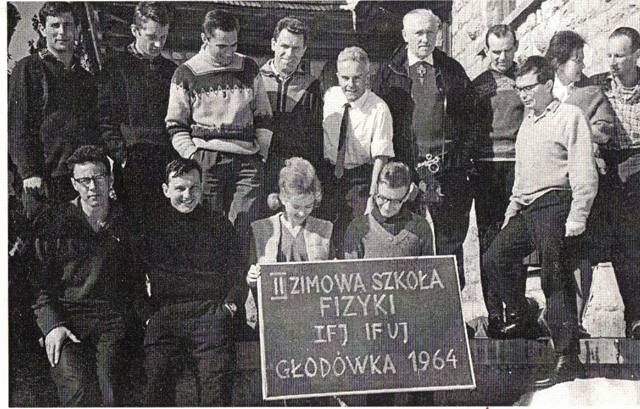
Organizers:
Sponsors:
Prof. Henryk Niewodniczański
(1900-1968)

Slide 3





Organizers:
Sponsors:
Chairman:
Piotr Bednarczyk
Scientific Secretaries:
Irene Dedes,
Magdalena Matejska-Minda
Conference Secretariat Manager:
Małgorzata Reś-Gunia
Members:
Michał Ciemała
Natalia Cieplicka-Oryńczak
Vratislav Chudoba
Dominik Duda
Katarzyna Gajewska
Jęrzy Grębosz
Łukasz Iskra
Maria Kmiecik
Paweł Kulessa
Bogdan Sowicki
Mirosław Ziębliński
Executive Manager:
Bożena Jakubiak

Slide 4

Organizers:
Sponsors:
Chairman:
Piotr Bednarczyk
Scientific Secretaries:
Irene Dedes,
Magdalena Matejska-Minda
Conference Secretariat Manager:
Małgorzata Reś-Gunia
Members:
Michał Ciemała
Natalia Cieplicka-Oryńczak
Vratislav Chudoba
Dominik Duda
Katarzyna Gajewska
Jęrzy Grębosz
Łukasz Iskra
Maria Kmiecik
Paweł Kulessa
Bogdan Sowicki
Mirosław Ziębliński
Executive Manager:
Bożena Jakubiak

Slide 5

Organizers:
Scientific support
Chairman:
Piotr Bednarczyk
Scientific Secretaries:
Irene Dedes,
Magdalena Matejska-Minda
Conference Secretariat Manager:
Małgorzata Reś-Gunia
Members:
Michał Ciemała
Natalia Cieplicka-Oryńczak
Vratislav Chudoba
Dominik Duda
Katarzyna Gajewska
Jęrzy Grębosz
Łukasz Iskra
Maria Kmiecik
Paweł Kulessa
Bogdan Sowicki
Mirosław Ziębliński
Executive Manager:
Bożena Jakubiak
Acknowledgements to:
Workshop Conveners
Members of the Advisory Committee
All Authors of submitted contributions

Slide 6
PROGRAM
SUNDAY 30/08 | MONDAY 31/08 |  | TUESDAY 1/09 | WEDNESDAY 2/09 |  | THURSDAY 3/09 |  | FRIDAY 4/09 |  | SATURDAY 5/09 | SUNDAY 6/09
 | Collective Modes of Nuclei 1 |  | Nuclear Structure Theory 1 | Plenary Session |  | Plenary Session |  | Nuclear Fission 1 |  | Plenary Session | Departure
 | coffee break |  | coffee break | coffee break |  | coffee break |  | coffee break |  | coffee break
 | Collective Modes of Nuclei 2 |  | Nuclear Structure Theory 2 | Parallel | Session | Parallel | Session | Nuclear Fission 2 |  | Plenary Session
 |  |  |  |  |  |  |  |  |  | Special lecture
 | Free/Walks | PARIS Meeting | Free | Free/Walks |  | Conference Excursion |  | Free |  | Closing
 |  |  |  |  |  |  |  |  |  | Free/Walks
 |  |  | Nuclear Structure Theory 3 |  |  |  |  | Nuclear Fission 3
Opening | dinner |  | dinner | dinner |  |  |  | dinner |  | Conference Dinner
Welcome Cocktail | Collective Modes of Nuclei 3 |  | Poster Session | Parallel | Session |  |  | Parallel | Session
 |  |  |  |  |  | dinner
 |  |  | Surprise!

Slide 7
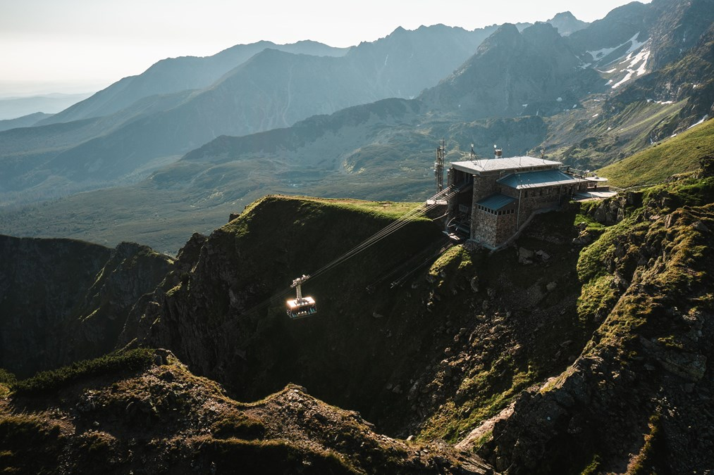
PROGRAM
SUNDAY 30/08 | MONDAY 31/08 |  | TUESDAY 1/09 | WEDNESDAY 2/09 |  | THURSDAY 3/09 |  | FRIDAY 4/09 |  | SATURDAY 5/09 | SUNDAY 6/09
 | Collective Modes of Nuclei 1 |  | Nuclear Structure Theory 1 | Plenary Session |  | Plenary Session |  | Nuclear Fission 1 |  | Plenary Session | Departure
 | coffee break |  | coffee break | coffee break |  | coffee break |  | coffee break |  | coffee break
 | Collective Modes of Nuclei 2 |  | Nuclear Structure Theory 2 | Parallel | Session | Parallel | Session | Nuclear Fission 2 |  | Plenary Session
 |  |  |  |  |  |  |  |  |  | Special lecture
 | Free/Walks | PARIS Meeting | Free | Free/Walks |  | Conference Excursion |  | Free |  | Closing
 |  |  |  |  |  |  |  |  |  | Free/Walks
 |  |  | Nuclear Structure Theory 3 |  |  |  |  | Nuclear Fission 3
Opening | dinner |  | dinner | dinner |  |  |  | dinner |  | Conference Dinner
Welcome Cocktail | Collective Modes of Nuclei 3 |  | Poster Session | Parallel | Session |  |  | Parallel | Session
 |  |  |  |  |  | dinner
 |  |  | Surprise!

Slide 8
PROGRAM
SUNDAY 30/08 | MONDAY 31/08 |  | TUESDAY 1/09 | WEDNESDAY 2/09 |  | THURSDAY 3/09 |  | FRIDAY 4/09 |  | SATURDAY 5/09 | SUNDAY 6/09
 | Collective Modes of Nuclei 1 |  | Nuclear Structure Theory 1 | Plenary Session |  | Plenary Session |  | Nuclear Fission 1 |  | Plenary Session | Departure
 | coffee break |  | coffee break | coffee break |  | coffee break |  | coffee break |  | coffee break
 | Collective Modes of Nuclei 2 |  | Nuclear Structure Theory 2 | Parallel | Session | Parallel | Session | Nuclear Fission 2 |  | Plenary Session
 |  |  |  |  |  |  |  |  |  | Special lecture
 | Free/Walks | PARIS Meeting | Free | Free/Walks |  | Conference Excursion |  | Free |  | Closing
 |  |  |  |  |  |  |  |  |  | Free/Walks
 |  |  | Nuclear Structure Theory 3 |  |  |  |  | Nuclear Fission 3
Opening | dinner |  | dinner | dinner |  |  |  | dinner |  | Conference Dinner
Welcome Cocktail | Collective Modes of Nuclei 3 |  | Poster Session | Parallel | Session |  |  | Parallel | Session
 |  |  |  |  |  | dinner
 |  |  | Surprise!

Slide 9
PROGRAM
SUNDAY 30/08 | MONDAY 31/08 |  | TUESDAY 1/09 | WEDNESDAY 2/09 |  | THURSDAY 3/09 |  | FRIDAY 4/09 |  | SATURDAY 5/09 | SUNDAY 6/09
 | Collective Modes of Nuclei 1 |  | Nuclear Structure Theory 1 | Plenary Session |  | Plenary Session |  | Nuclear Fission 1 |  | Plenary Session | Departure
 | coffee break |  | coffee break | coffee break |  | coffee break |  | coffee break |  | coffee break
 | Collective Modes of Nuclei 2 |  | Nuclear Structure Theory 2 | Parallel | Session | Parallel | Session | Nuclear Fission 2 |  | Plenary Session
 |  |  |  |  |  |  |  |  |  | Special lecture
 | Free/Walks | PARIS Meeting | Free | Free/Walks |  | Conference Excursion |  | Free |  | Closing
 |  |  |  |  |  |  |  |  |  | Free/Walks
 |  |  | Nuclear Structure Theory 3 |  |  |  |  | Nuclear Fission 3
Opening | dinner |  | dinner | dinner |  |  |  | dinner |  | Conference Dinner
Welcome Cocktail | Collective Modes of Nuclei 3 |  | Poster Session | Parallel | Session |  |  | Parallel | Session
 |  |  |  |  |  | dinner
 |  |  | Surprise!
Special Session on Nuclear Mean-Field:
Mark Riley, Shapes and Symmetries at the Extremes in Atomic Nuclei: Reflections on the Seminal Contributions of Jerzy Dudek
Adam Maj, Jacobi and Poincare Instabilities in Hot Rotating Nuclei: Experimental Studies Inspired by Jerzy Dudek
Nicolas Schunck, Pyramids, Diamonds, and Where to Find Them
Jerzy Dudek, Universal Mean-Field in the Service of Nuclear Structure: From GDR and Super-Deformation to Exotic Symmetries
Special Lecture
chaired by Adam Maj
Mark Riley
Shapes and Symmetries at the Extremes in Atomic Nuclei: Reflections on the Seminal Contributions of Jerzy Dudek

Slide 10
IMPORTANT
PROCEEDINGS
Proceedings will be published as a dedicated volume of Acta Physica Polonica B Proceedings Supplement in Spring 2027
Submission deadline: Autumn 2026
Detailed instructions will be given after the conference
EXTRA INFORMATION
Upload presentations to indico or bring them with USB before
Certificates of participation on demand, until Wednesday 2/09
WIFI-name: Belvedere-Konferencje Password: Belvedere!2023
Most updated program version on indico website (not BoA)!

Slide 11


Program for tonight
Tadeusz Lesiak | IFJ PAN’s Director Welcome
Thomas Nilsson | Status and perspectives for science at FAIR (Facility for Antiproton and Ion Research)
Welcome Cocktail

