Slide 1

Nuclear structure
with polarised unstable nuclei at ISOLDE
Magdalena Kowalska, CERN, UNIGE

Slide 2
Principle and setup

Slide 3

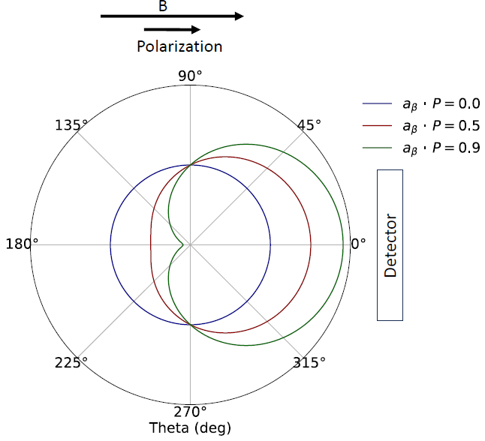
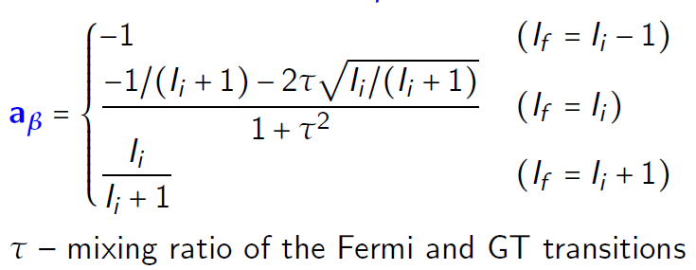

Beta decay of spin-polarized nuclei
Parity non-conservation of weak interaction, Mme Wu experiment
Spatial asymmetry in β emission:
Asymmetry depends on:
  P: degree of spin polarization
  a_{β}: β-asymmetry parameter
  For allowed transitions:

Slide 4
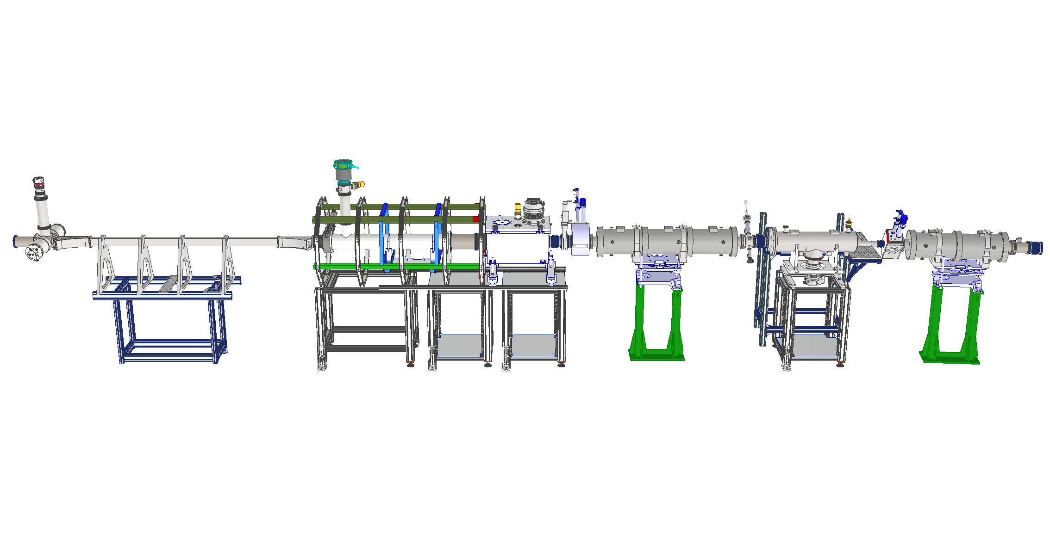
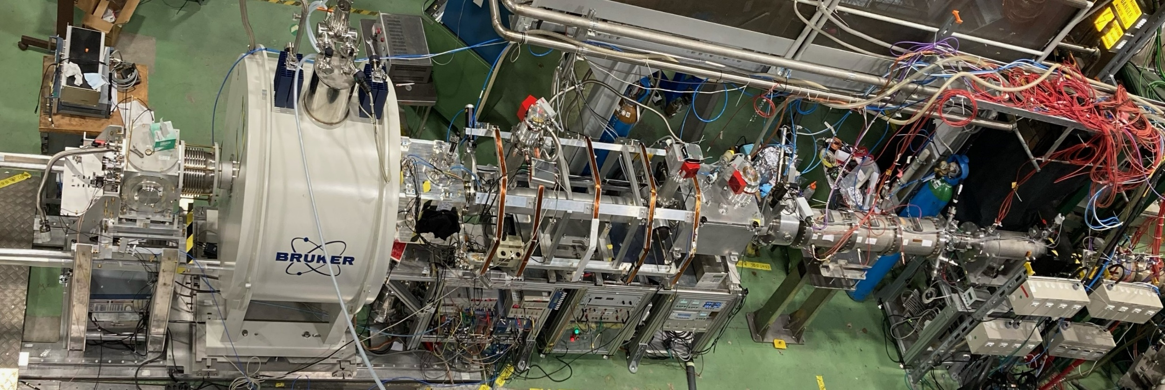
VITO: laser-polarisation beamline at CERN-ISOLDE
Low-energy (30- 60 keV) radioactive ion beam
In-beam atom/ions polarization via collinear laser beam (optical pumping)
Electron and nuclear spin decoupling in strong magnetic field
Optional: beam neutralisation
Optical pumping
Collinear laser light
Polarised beam to
end-station
containing a magnet
Ion beam from ISOLDE
M. Kowalska et al., J. Phys. G: Nucl. Part. Phys. 44 (2017) 084005
W. Gins et al., Nucl. Instrum. Meth. A 925 (2019) 24

Slide 5
Spins of excited states

Slide 6

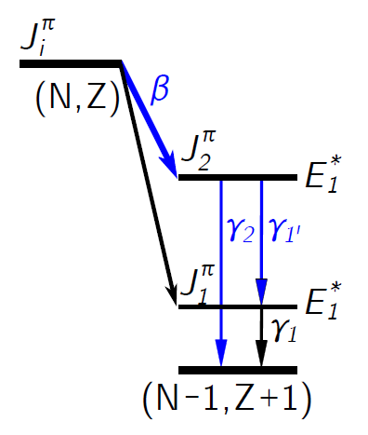
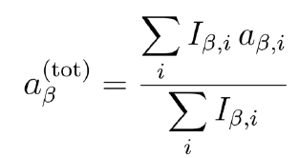
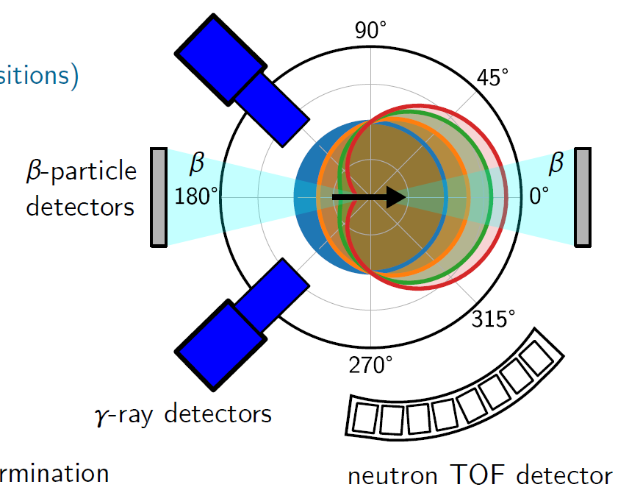
Spin value from angular β−γ coincidences
  For allowed (β-)transitions:
  Selection of β transition with γ rays:
-
spin
B₀
Pioneered by Osaka team at TRIUMF
See e.g. H. Nishibata et al., Phys. Rev. C 99, 024322 (2019)
From M. Piersa-Siłkowska

Slide 7
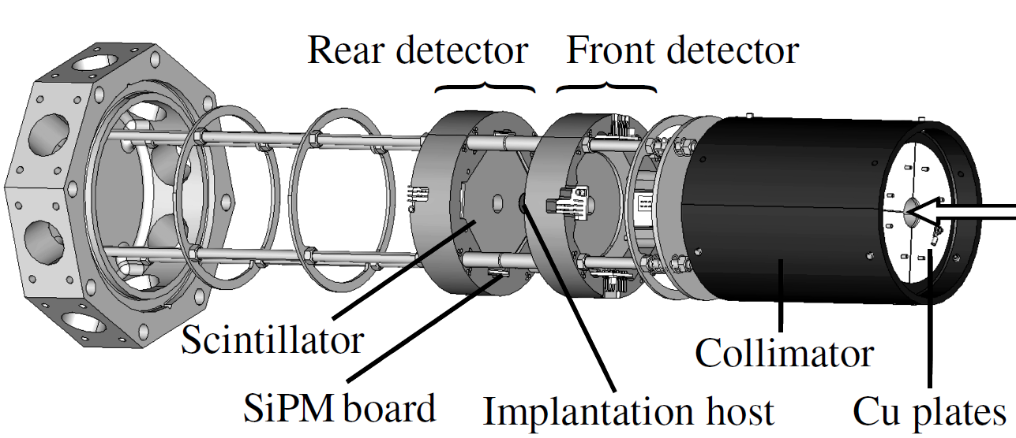
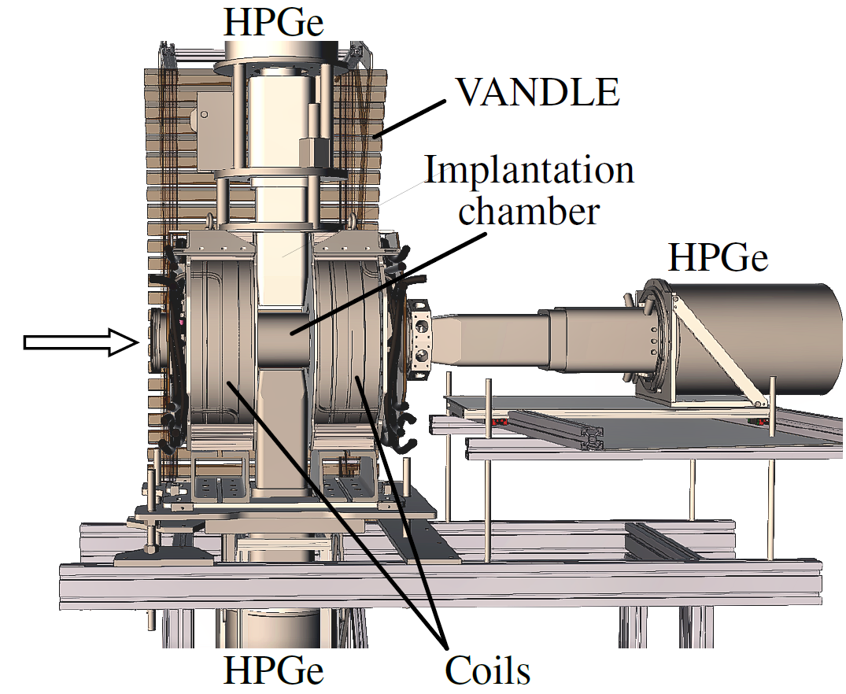
DeVITO: decay spectroscopy end-station at VITO
From M. Piersa-Siłkowska

Slide 8
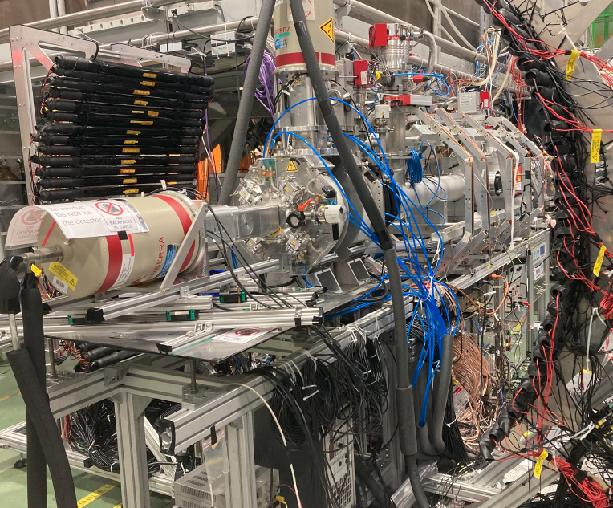
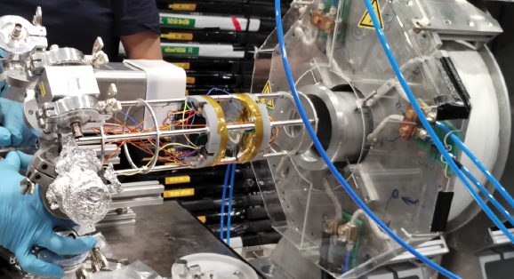

DeVITO: decay spectroscopy end-station at VITO
Laser polarisation
0.1 T magnet for spin decoupling
Implantation crystal
thin beta detectors
HPGe clovers
VANDLE n detectors
CERN: M. Piersa-Siłkowska (MSC Fellowship),
N. Azaryan, I. Michelon
+ groups of:
M. Madurga, R. Grzywacz
A. Korgul
R. Lica

Slide 9
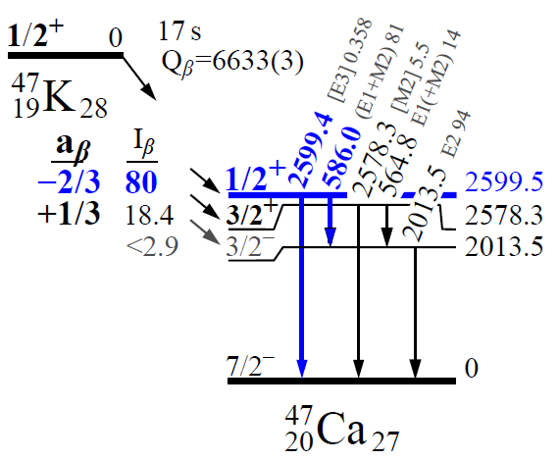
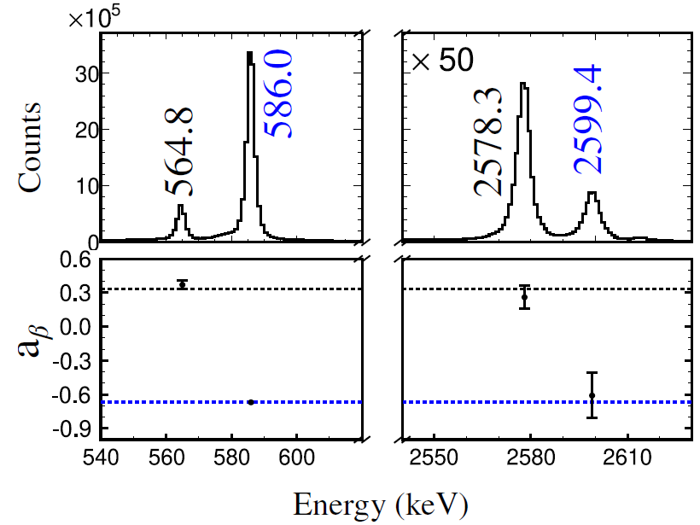
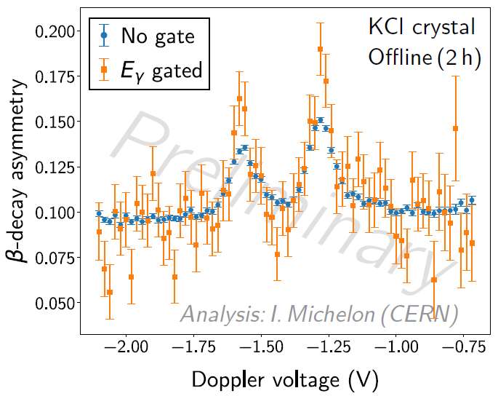
Proof of principle: Spins of excited states in ⁴⁷K
Reference
From I. Michelon and M. Piersa-Siłkowska
Beta-gamma coincidences work
Based on known spins in one transition, correct a_{β} determined in another
=> ready to tackle unknown spins and neutrons
M. Piersa-Siłkowska, M. Madurga et al.,
CERN-INTC-2023-026/INTC-P-662

Slide 10
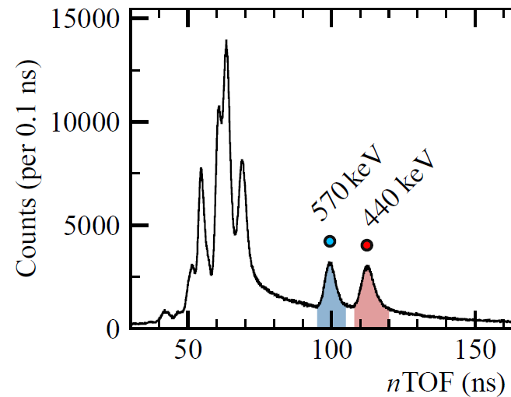
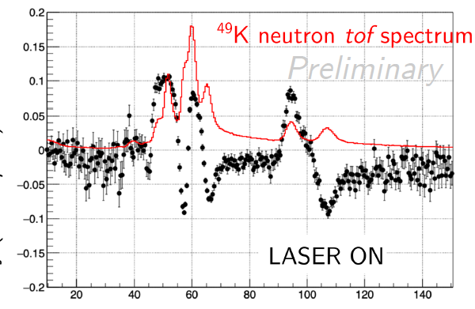
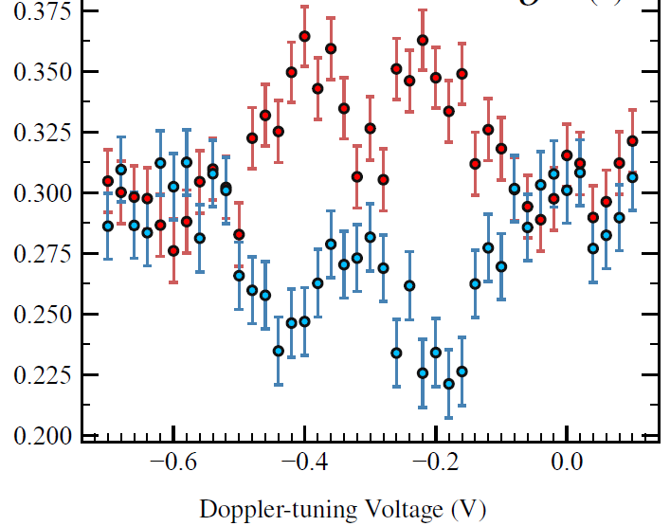
^{49,51}K: spins of states in β-delayed neutron emission
⁴⁹K
Intensity of emitted neutrons
β-decay asymmetry
Asymmetry for β-emission in coincidence with neutrons
HFS
Neutron ToF (ns)
Neutron-data analysis ongoing
Determination of spins for n-emitting states
=> Insight into β-decayed n emission mechanism
β decay asymmetry
neutron-gated betas
M. Piersa-Siłkowska

Slide 11
Precise magnetic moments and distribution of magnetisation in unstable nuclei

Slide 12
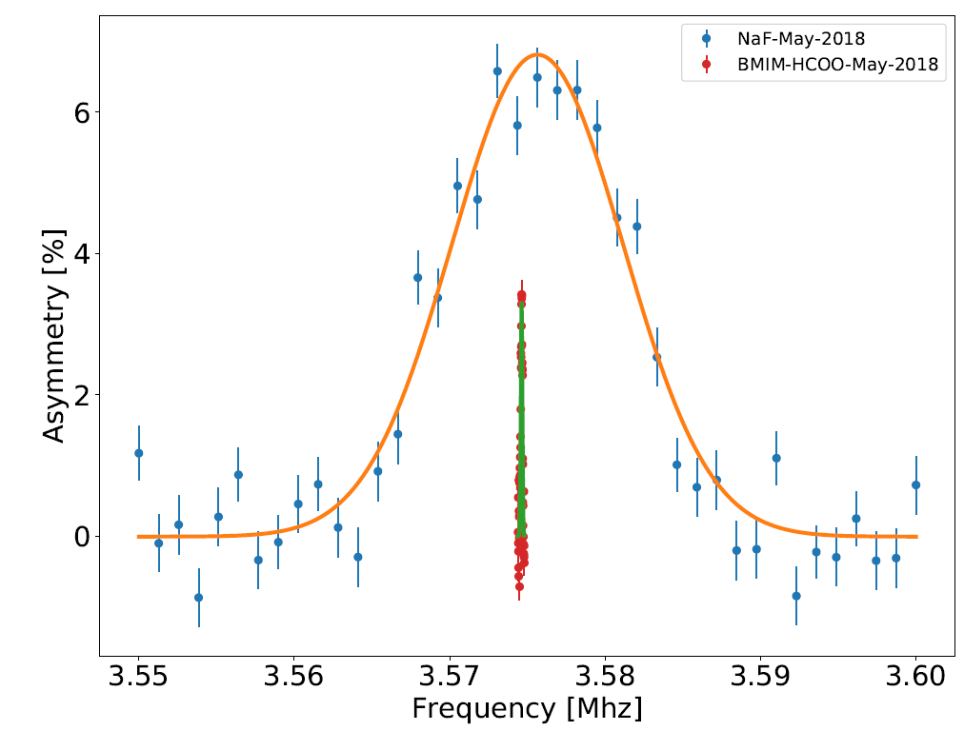
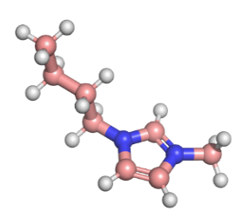
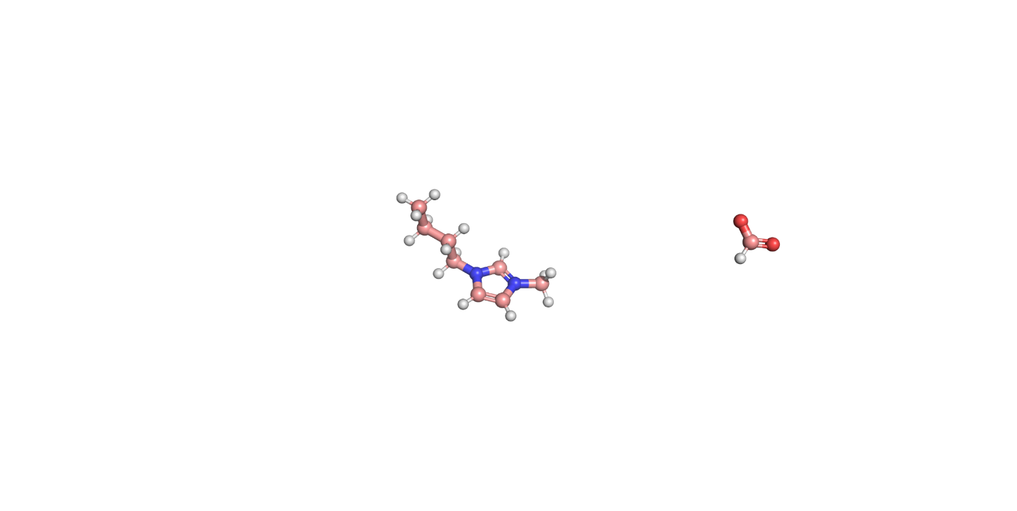



Magnetic moments from NMR
NMR = spin-flip in external magnetic field
$$ν_{L}=\frac{μ_{I}B_{0}}{h I}$$
β-detected NMR:
spin polarisation for unstable nuclei + NMR detection via β-decay asymmetry:
- rf excitation of polarized nuclei in host
- β-asymmetry disappears when ν_{rf}=ν_{L}
Liquid host: 100 narrower resonances than in solids
β-detectors
²⁶Na (t_{1/2} = 1.6 s)
about 10⁸ nuclei
RF Coil
β-decay asymmetry
β particles
β decay
RF
B₀
[MHz]
=> magnetic moments of unstable nuclei with ppm precision
R. Harding et al., Phys. Rev. X 10, 041061 (2020)
betaDropNMR
J. Croese et al., Nucl. Inst. Meth. A, 1020, 165862 (2021)

Slide 13

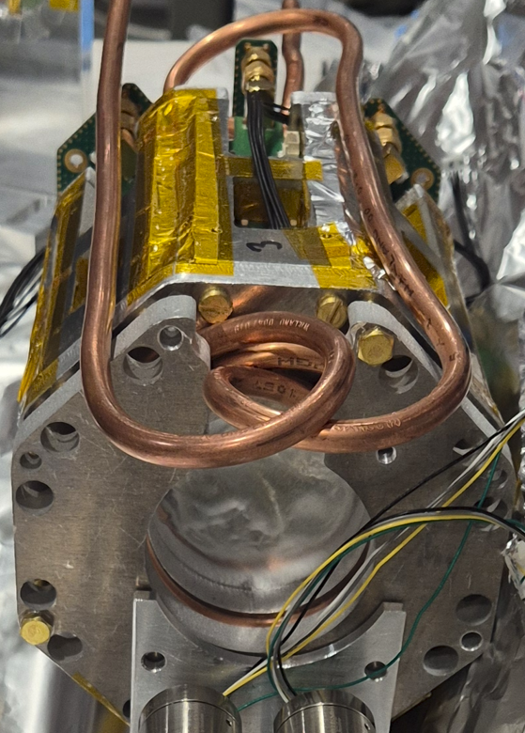
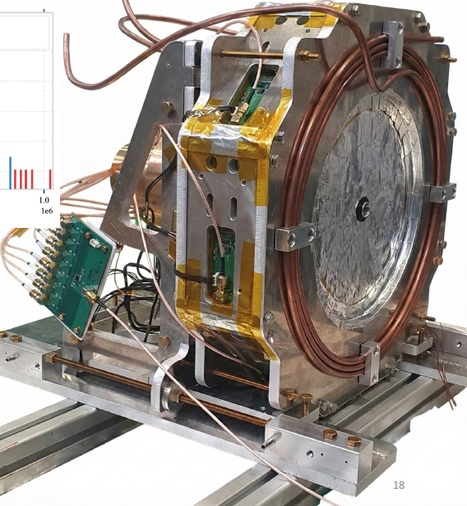
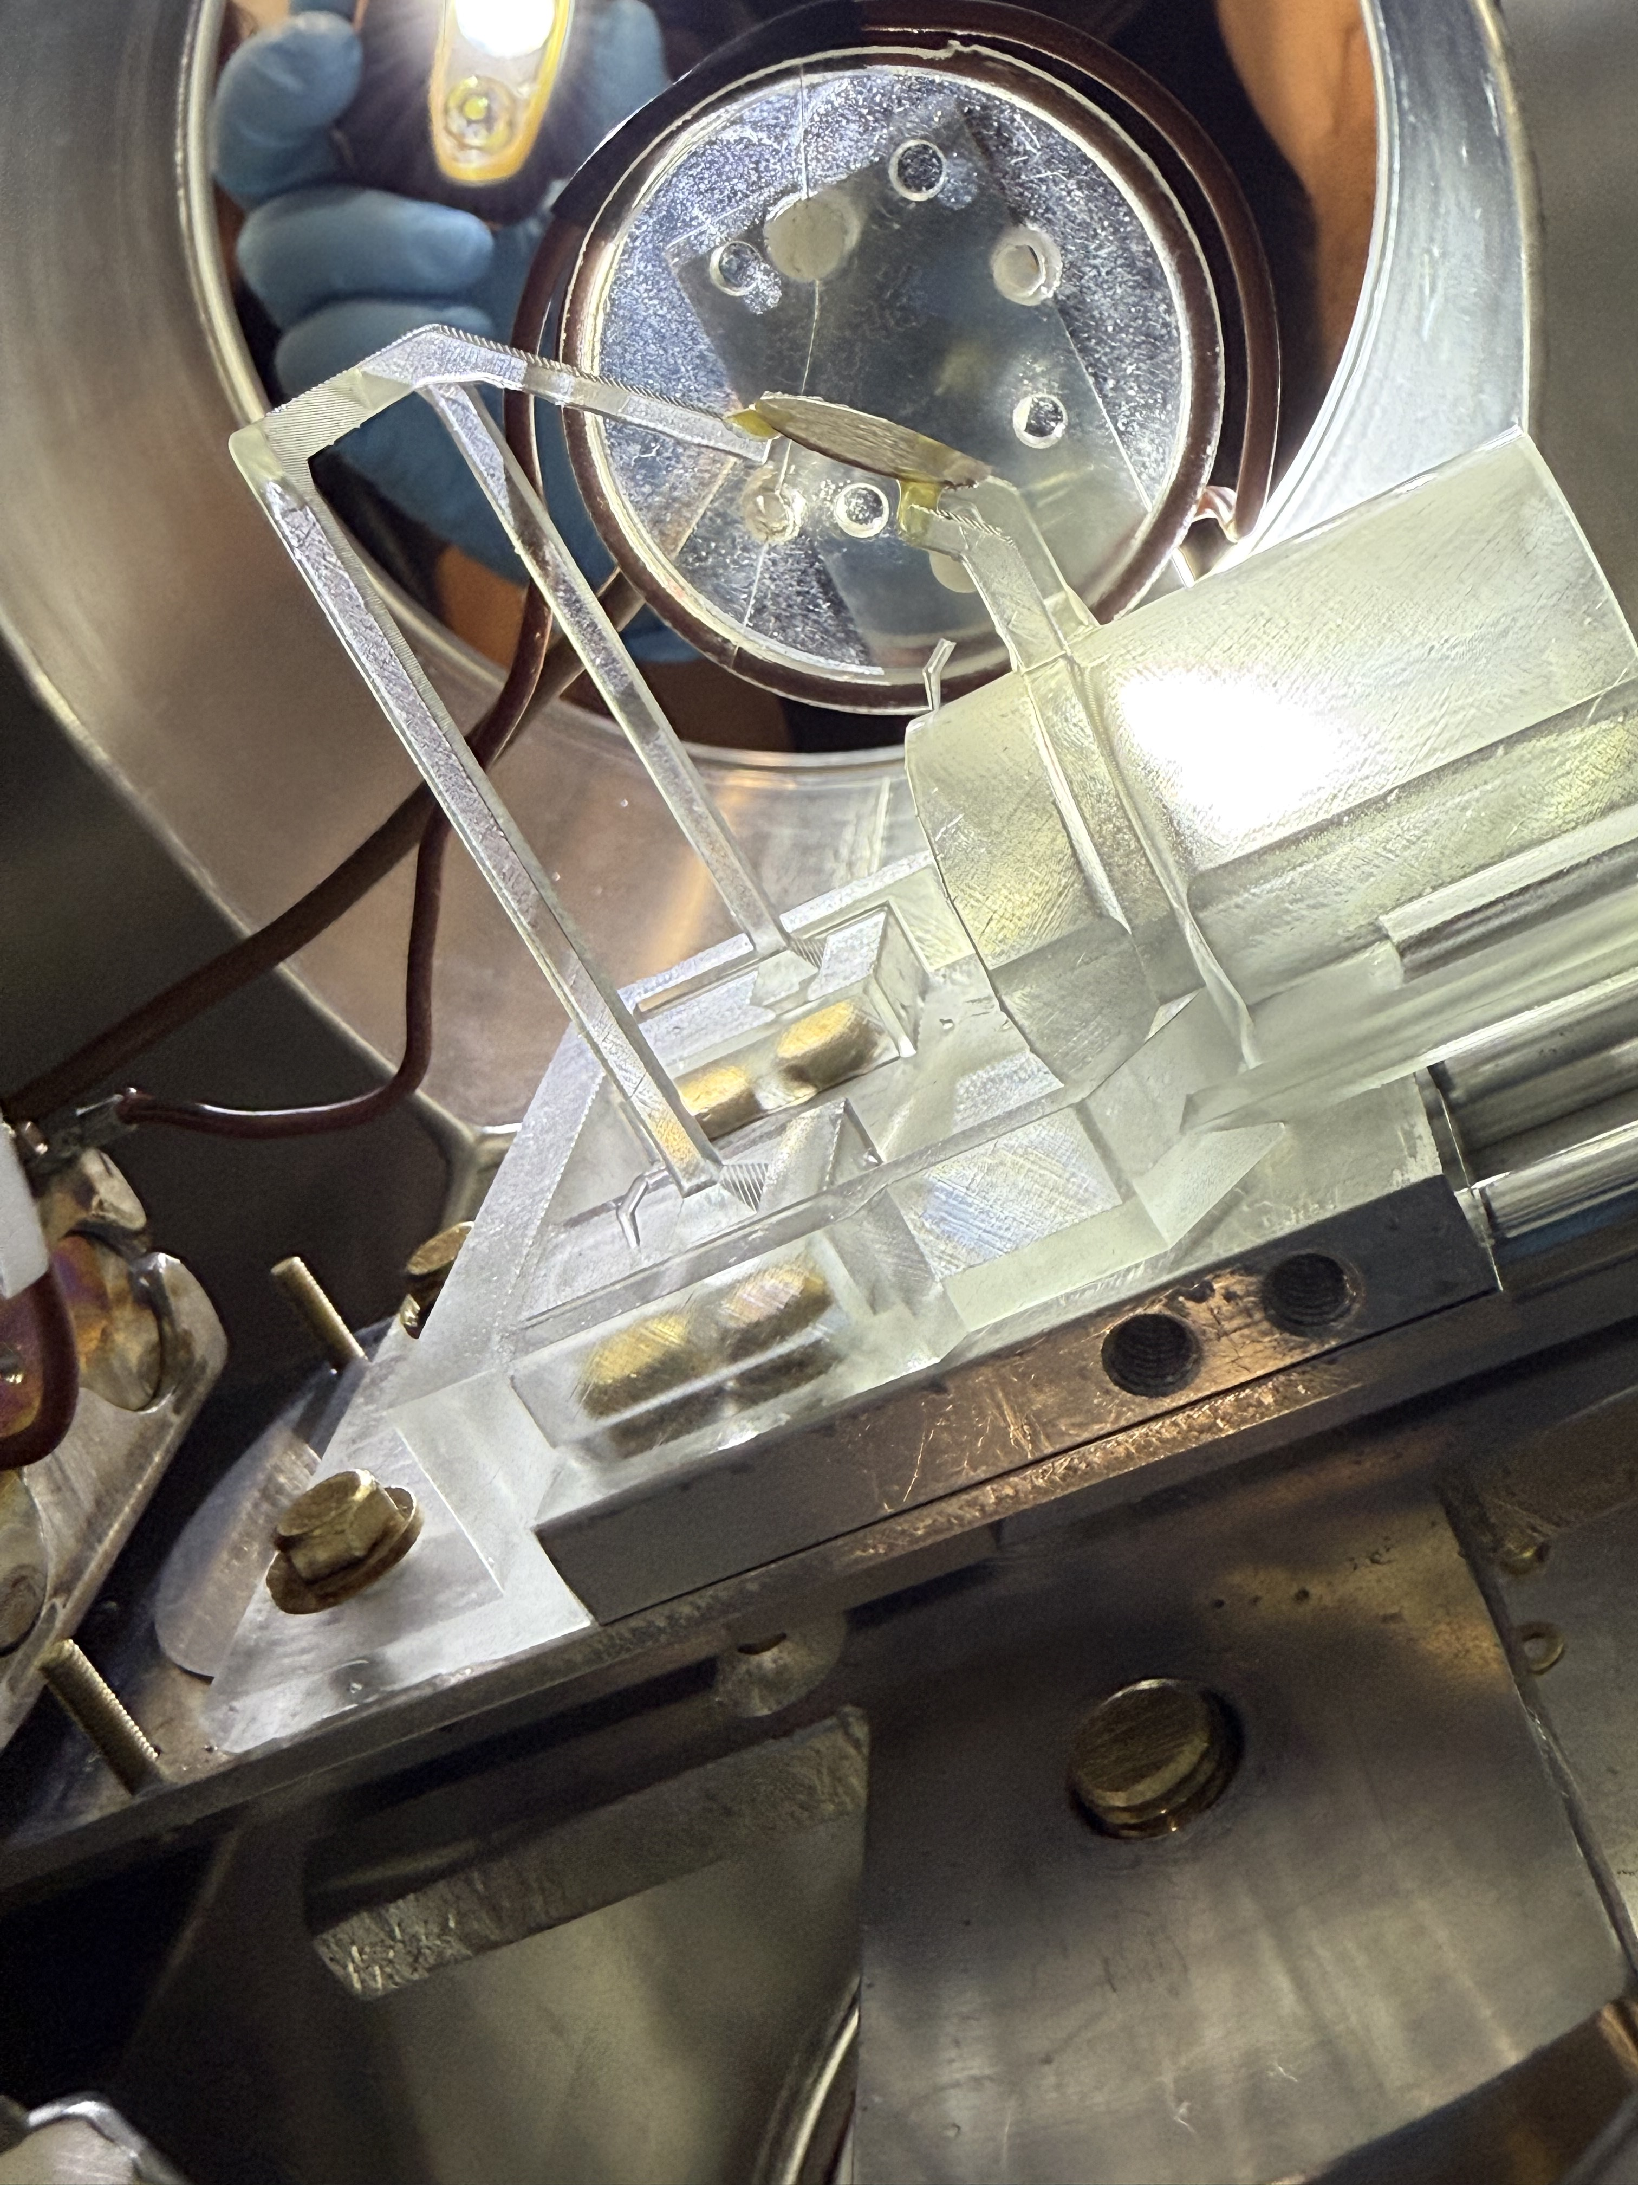
Upgraded β-NMR end-station at VITO
4.7 T magnet, sub-ppm homogeneity at sample position
Sample loading area
B₀
Polarised beam from VITO
Beta detector
Beta detector
β-NMR sample and rf coil
D. Paulitsch, in preparation
A. Sparks, in preparation

Slide 14
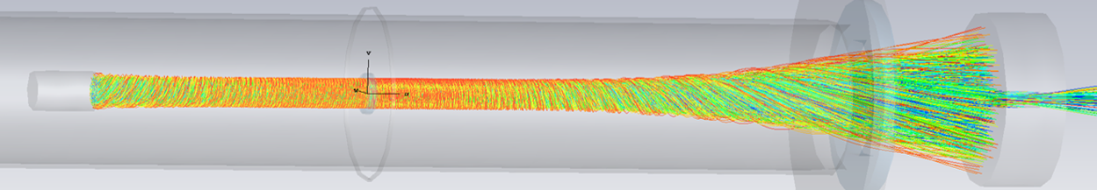
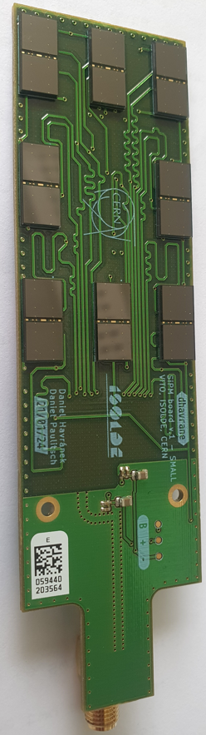
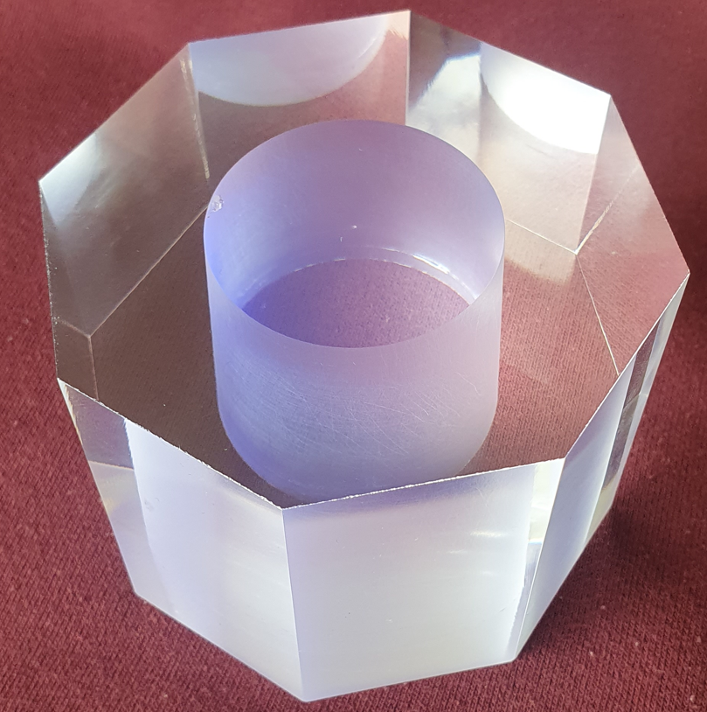
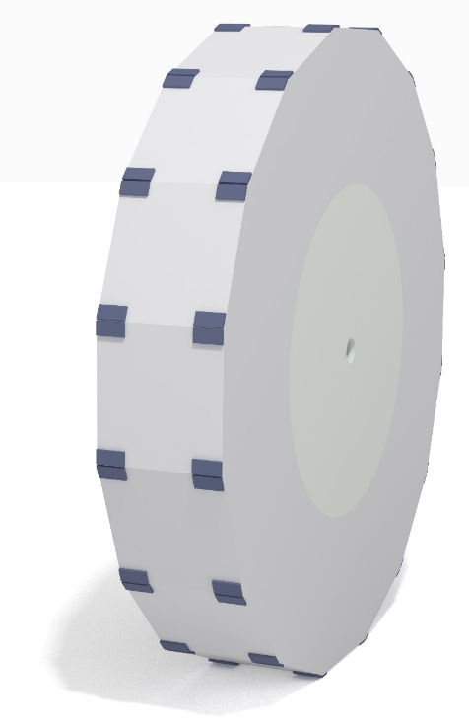
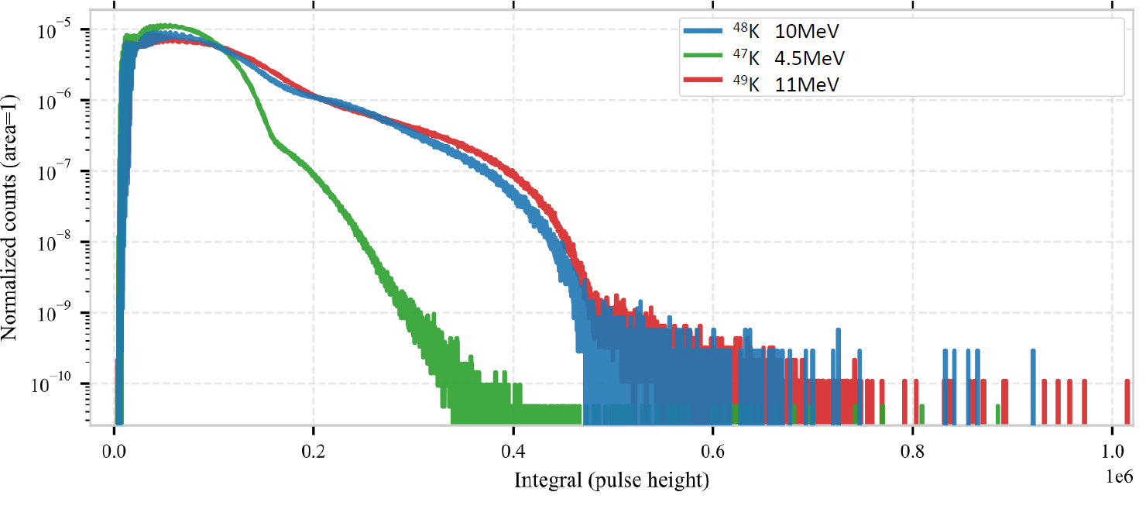
Energy-resolving B-field compatible β detectors
B= 4.7T
Beam
direction
magnet bore, 1m long
Back detector
Implantation site
Thick plastic scintillator + plastic diffuser + many SiPMs
Front detector
SiPM
7 cm
PhD: D. Paulitsch
M. Bissell

Slide 15
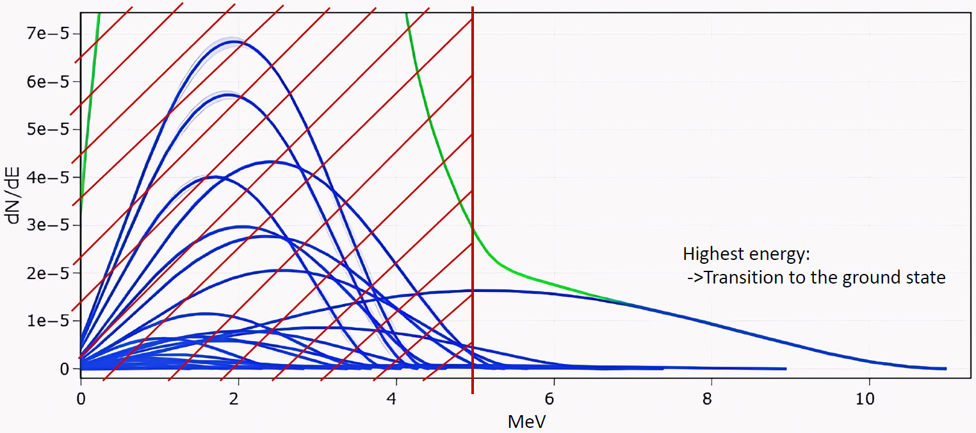
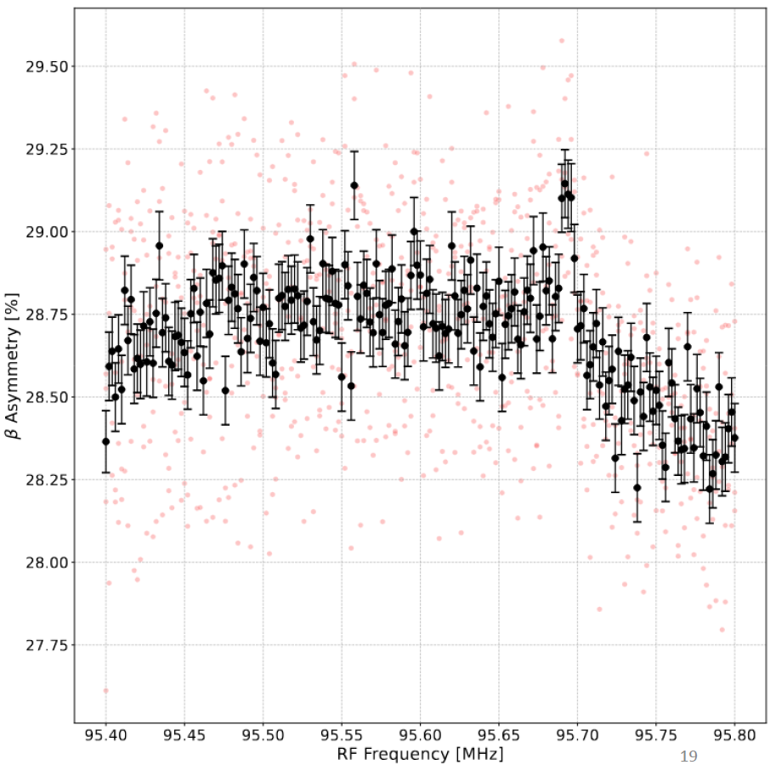
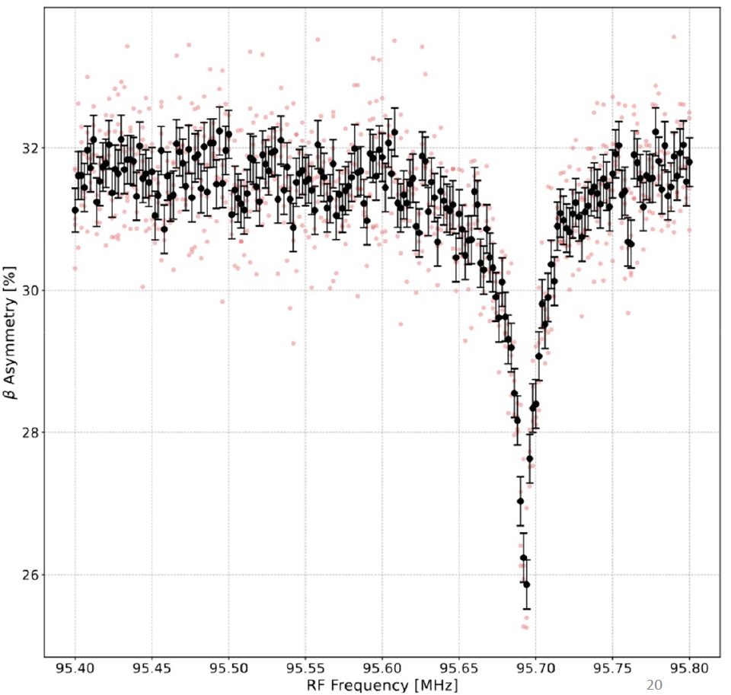
Selection in transitions via β energy: example of ⁴⁹K
0.75%
β events above 5 MeV
-> Mostly β’s to lowest-lying state
-> a_{β} for 1 state
6%
All beta events
-> Averaged a_{β}

Slide 16




Magnetisation distribution via Bohr-Weisskopf effect
Bohr-Weisskopf effect: correction to magnetic moment derived from HFS A-factor:
  Due to inhomogeneity of B field generated by atomic electrons
Required: correction to HFS formula to account for distributed nuclear charge (Breit-Rosenthal effect) and magnetisation (Bohr-Weisskopf effect)
Bohr-Weisskopf effect:
  Very small, down to 10⁻⁵
  Until now: smaller than experimental precision for unstable nuclei -> neglected
B
PreSOBEN
HFS
$$μ$$
$$μ$$
NMR
To use Bohr-Weisskopf effect to derive magnetisation distribution in unstable nuclei:
Compare very precise μ from NMR and HFS constant A from HFS
+ state-of-the-art nuclear and atomic theory
Bohr, Weisskopf, Phys Rev76, 678 (1950)

Slide 17

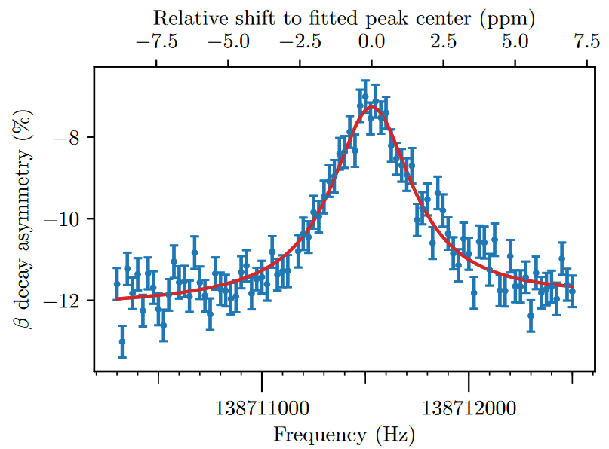


⁴⁷K: Bohr-Weisskopf effect in short-lived nuclei
Differential effect to ³⁹K
due to uncertainties in atomic theory
⁴⁷K in
EMIM-DCA
Ionic liquid
+
Laser spectroscopy at ISOLDE
J. Papuga, M. Bissell, et. al.,
Phys. Rev. C 90, 034321 (2014)
Liquid β-NMR at VITO
NMR data
HFS
NMR correction
Most precise Bohr-Weisskopf effect for a short-lived nucleus
M. Bissell et al., https://arxiv.org/abs/2603.20090

Slide 18


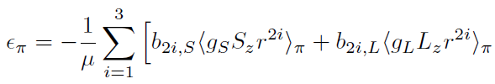

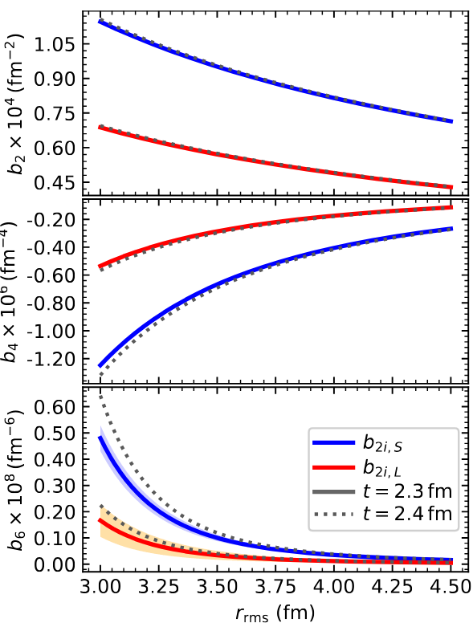
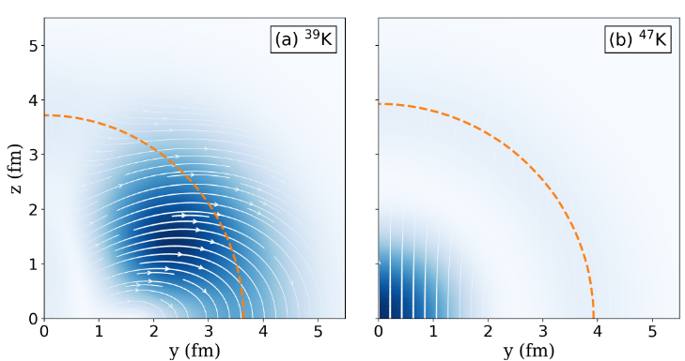
⁴⁷K: theoretical value of Bohr-Weisskopf effect
Theoretical Bohr Weisskopf effect:
Nuclear theory (J. Dobaczewski, M. Kortelainen)
Atomic theory (J. Ginges, B. Roberts)
Intrinsic magnetisation distributions from DFT
³⁹K
⁴⁷K
I=3/2
I=1/2
M. Bissell et al., https://arxiv.org/abs/2603.20090

Slide 19
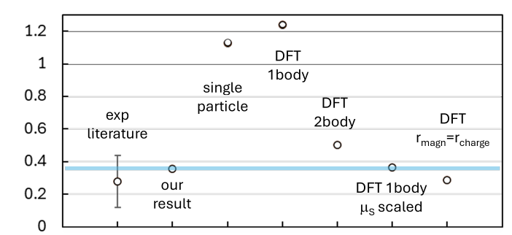
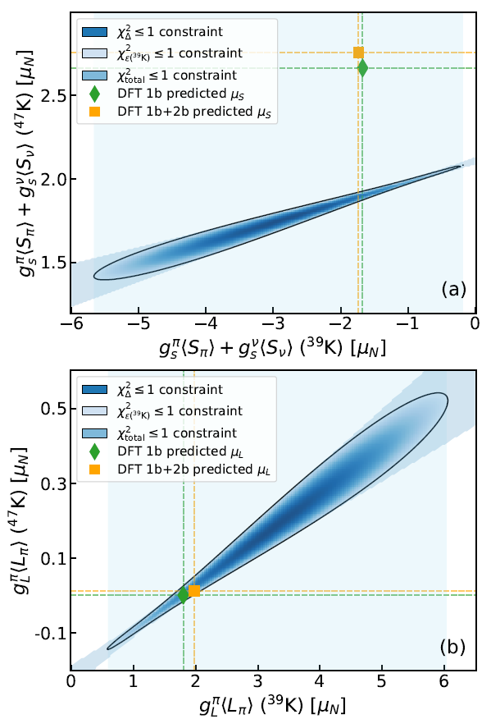
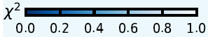
Composition & distribution of magnetization in ^{39,47}K
Combined experiment-theory comparison of hyperfine anomaly + magnetic moments
Bohr-Weisskopf effect ³⁹K-⁴⁷K (%)
Orbital contributions to magnetic moments correct
Spin contributions overestimated
2-body currents not enough to resolve discrepancy
Only realistic magnetization distribution reproduces experimental BW effect
BW effect as a new way to look at nucleus
Sensitive to unpaired p/n -> valence-neutron radii
Benchmark for nuclear and atomic theory

Slide 20
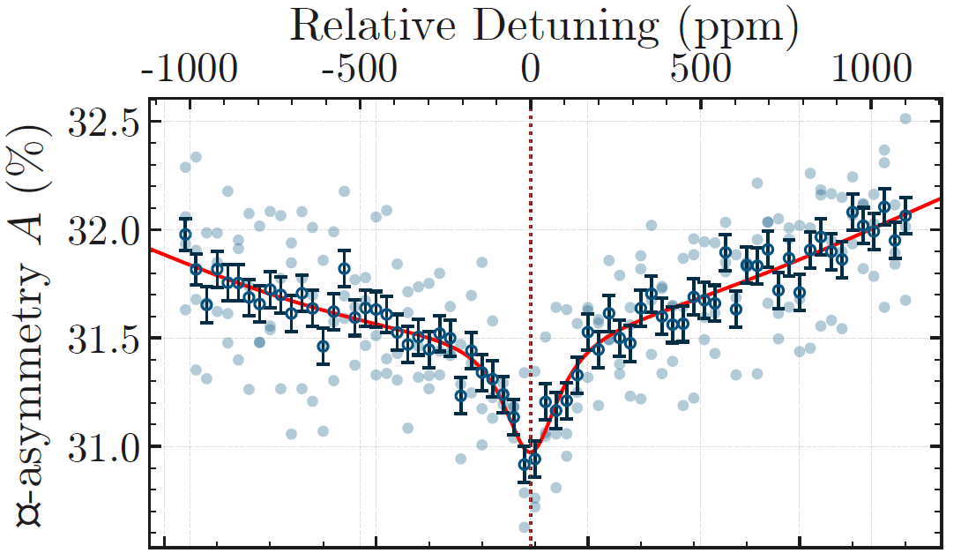
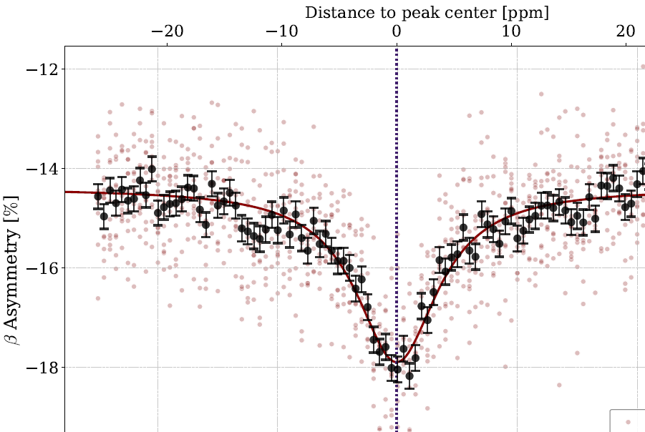


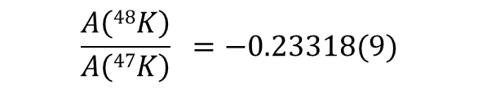
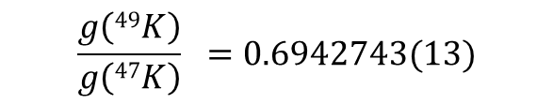
^{47,48,49}K: origin of kink in charge radii at N=28
Kink due to deformation or extended neutron orbits?
=> magnetisation radii can judge
β-NMR experiment in October 2025
J. Bonnard, S. M. Lenzi, and A. P. Zuker, Phys. Rev. Lett. 116, 212501 (2016)
⁴⁹K, I = 1/2⁺
⁴⁸K, I = 1⁻
A. Nagpal
β
D. Paulitsch
$$\frac{A\left(48K\right)}{A\left(47K\right)} =−0.23318(9)$$
$$\frac{A\left(49K\right)}{A\left(47K\right)} =0.6938(6)$$
J. Papuga, M. Bissell, et. al.,
Phys. Rev. C 90, 034321 (2014)
+ this work (preliminary):
$$\frac{g\left(49K\right)}{g\left(47K\right)} =\text{0.6942743}(13)$$
HFS A factor precision not sufficient
⁴⁹Δ⁴⁷ = -0.06(1)(6)%

Slide 21
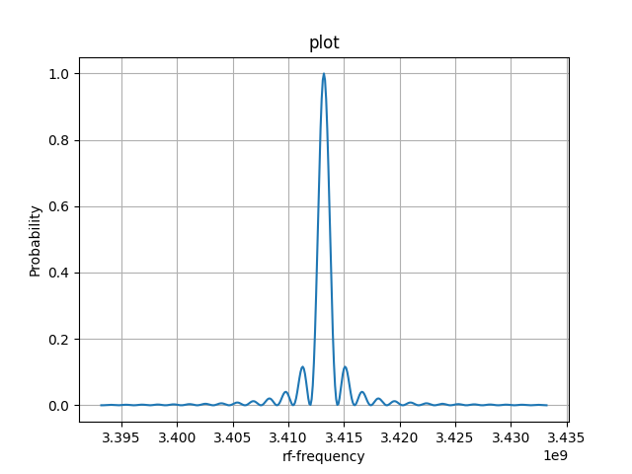
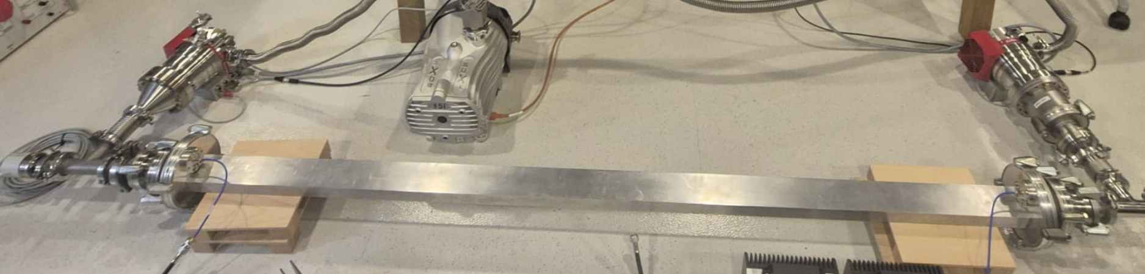




Outlook: rf-laser double resonance spectroscopy
Precise determination of HFS A factor ratios for unstable nuclei
$${2p}_{3/2}$$
Simulated HFS of ⁴⁷K
$F^{′}$=2
$F^{′}$=1
$${2s}_{1/2}$$
F=1
=1.1 MHz
rf
F=0
Hz
beam direction
rf excitation
Optical Detection
Optical pumping
Design: P, Rak, H. Kulik, N. Azaryan

Slide 22



Outlook: magnetisation distribution in light nuclei
Stable ^{6,7}Li as benchmarks
Distribution of magnetisation and halo neutron in ¹¹Be:
  HFS A factor already measured with high precision
  Magnetic moment from β-NMR in a liquid missing (energy-resolving b detectors crucial)
Theory:
  Atomic, QED: M. Puchalski, M. Siłkowski
  Nuclear, ab initio: S. Pastori, G. King, G. Chambers Wall
Approach:
  Theoretical absolute Bohr-Weisskopft effect – accurate atomic theory
  Direct product of nuclear vector potential (1 and 2 body) and electronic current density
1st results, preliminary:
Experiment:
-368(3) ppm
-261(3) ppm

Slide 23
Summary
Polarised unstable nuclei useful for nuclear-structure studies
  Signal from transition-specific beta-decay asymmetry
VITO laser-polarisation beamline at CERN-ISOLDE
Spins of excited states:
  DeVITO decay-spectroscopy end station
  Beta-gamma-neutron correlations for ^{47,49,51}K
Very precise magnetic moments:
  Upgraded β-NMR end-station
  Composition and distribution of nuclear magnetization in ^{47,48,49}K
Outlook:
  Decay spectroscopy studies in r-process path
  Precise HFS constant via rf-laser double resonance end station
  Bohr-Weisskopf effect used to probe nuclear models and improve atomic calculations
  Halo-neutron radius in ¹¹Be

Slide 24
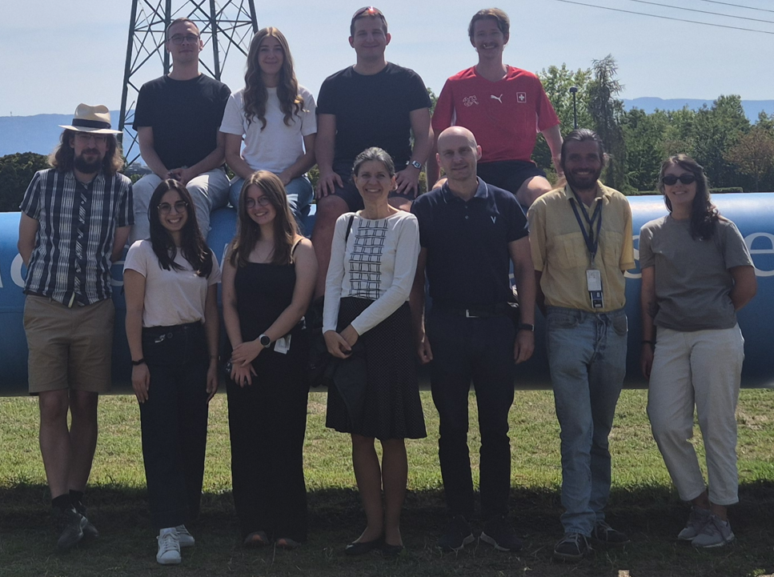


Acknowledgements
Polarised-nuclei team at ISOLDE:
M. Baranowski, M. Bissell, H. Kulik, I. Michelon, M. Pesek, M. Rutkowska, A. Sparks
Alumni:
N. Azaryan, D. Paulitsch, P. Rak, J. Kaszowski, M. Dvorak, O. Novak ,M. Lupinski, M. Sojka, J. Jaluvka, M. Piersa-Silkowska, M. Chojnacki, A. Nagpal, M. Becvar, M. Jankowski, D. Havranek, M. Sienkiel, L. Budzinski,
Collaborating experimental teams:
L. Vazquez, MPIK; M. Baranowski, Poznan; M. Madurga, R. Grzywacz, Knoxville; A. Korgul, A. Fijalkowska, Warsaw; D. Zakoucky, Rez; J. Cubiss, Z. Yue, York; R. Lica, Bucharest
Theory:
nuclear: J. Dobaczewski, York; M. Kortelainen, Jyvaskyla, S. Pastore, St Louis;
atomic: J. Ginges, Brisbane; M. Puchalski, Poznan
chemistry: A. Antusek, Bratislava
Funding:
Thank you for your attention

Slide 25
How to polarise spins of radio-nuclei?
Optical pumping:
laser
Capture of polarised neutrons
Spin Exchange Optical pumping
(SEOP): laser + atomic collisions
Short-lived nuclei
(t1/2 = ms to s):
In-beam polarisation at production side
Long-lived nuclei (t1/2 = min to day):
polarisation decoupled from production
Low temperature nuclear orientation
Production mechanism
(heavy-ion reactions)
To be explored:
‘Chemical’ methods
(pH₂, DNP)

Slide 26
Nuclear spin-polarization via optical pumping
Polarisation of coupled electron-nuclear spins with circularly-polarized laser light
4p ²P_{3/2}
3
-3
-2
-1
0
1
2
3
2
1
49
0
K
F
I =3/2
D2-line
σ+ light
2
-2
-1
0
1
2
4s ²S_{1/2}
1
frequency
Decoupling of electron and nuclear spins in strong magnetic field
=> nuclear polarization above 10% level => beta-decay asymmetry

Slide 27
How do we use polarised radio-nuclei?
Atomic Parity Violation studies
  Nuclear astrophysics
Material science
Life sciences
Chemistry
improved atomic calculations
Bohr-Weisskopf effect
  Nuclear structure
Beta-detected
Nuclear Magnetic Resonance
(beta-NMR)
Spin and parity of
excited nuclear states
Polarised
radioactive
nuclei
β decay
γ decay
  Asymmetry parameter:
  V_{ud} matrix element of
  CKM quark mixing matrix
Gamma-detected
Nuclear Magnetic Imaging
(gamma-MRI)
  Weak interaction studies
Medical diagnosis

Slide 28
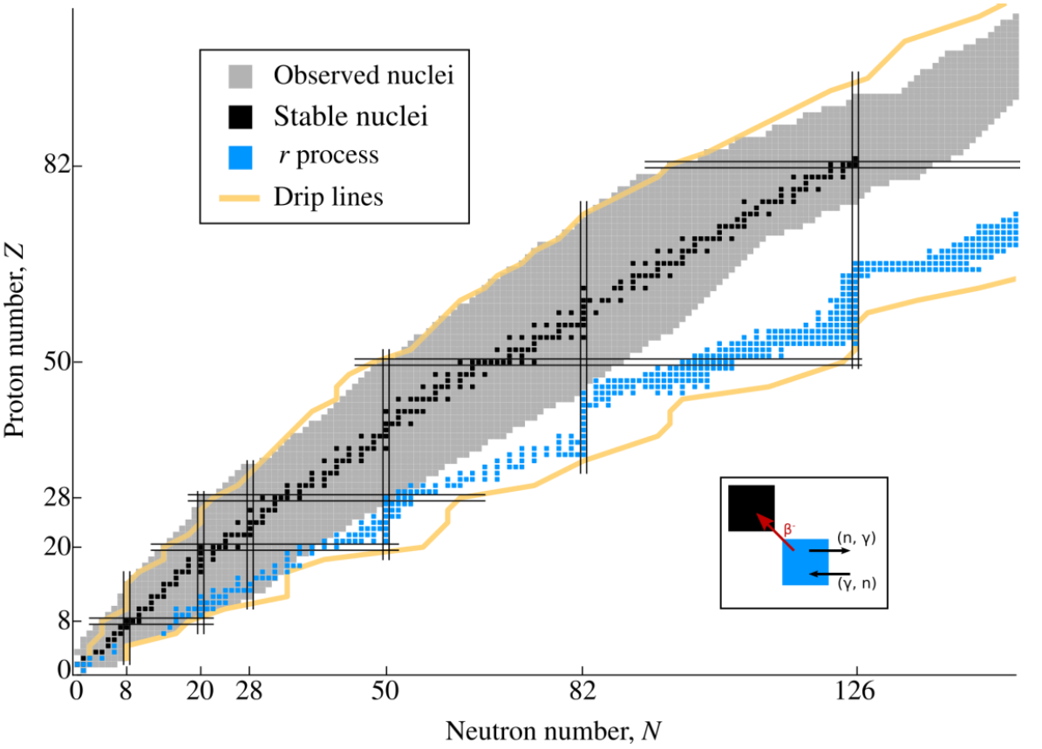
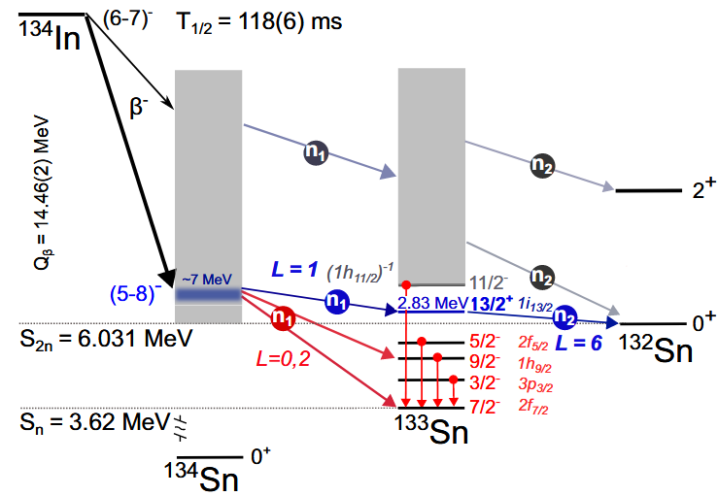
Spins and β-delayed neutron emission for r-process
Rapid neutron-capture drives production of heavy elements
Participating nuclei created in extreme cosmic environments, can’t be measured
=> Calculations rely on predictions
𝛽 decay (and delayed neutron emission) compete with r-process and affect final elemental abundance
=> Required: spins of excited nuclear states to estimate β transition probabilities and mechanism of β delayed neutron emission
Progr. in Part. and Nucl. Phys. 86 (2016) 86
Adapted from T. L. Tang et al., PRL 124, 062502 (2020)
P. Dyszel, R. Grzywacz, et. Al, Phys. Rev. Lett 135, 152501 (2025)
From I. Michelon

Slide 29
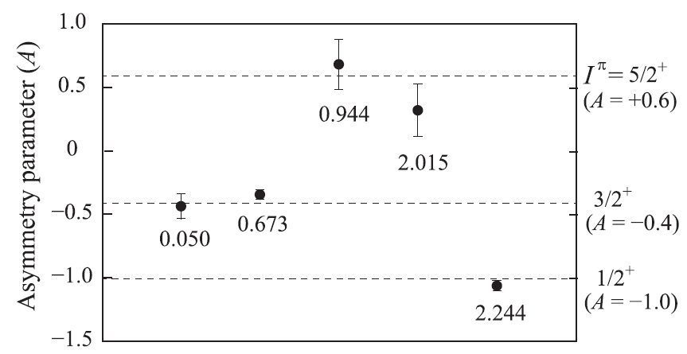
Spin determination by β−γ coincidences
  For allowed (β-)transitions:
-
  Selection of β transition with γ rays:
Pioneered by Osaka team at TRIUMF:
a_{β} for β’s in coincidence with different γ’s
(a_{β})
³¹Na (I^{π}=3/2⁺)
-> ³¹Mg
spin
B₀
a_{β}=+0.6
a_{β}=−0.4
γ energy (MeV)
a_{β}=−1.0
From M. Piersa-Siłkowska
Adopted from H. Nishibata et al., Phys. Rev. C 99, 024322 (2019)

Slide 30
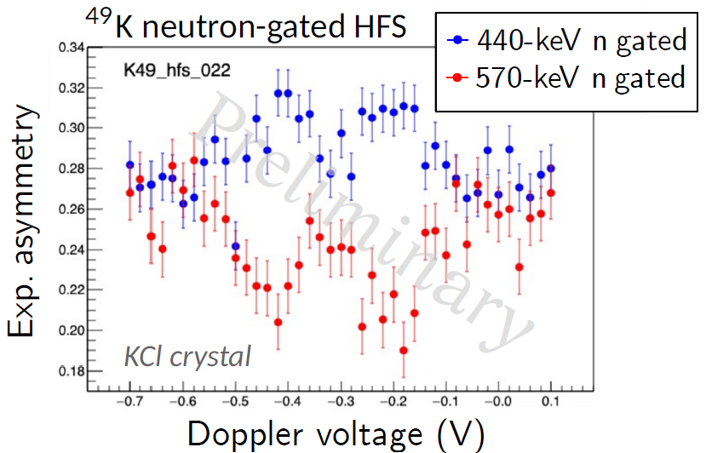
^{49,51}K: spins of states in β-delayed neutron emission
⁴⁹K
Intensity of emitted neutrons
β-decay asymmetry
Asymmetry for β-emission in coincidence with neutrons
Neutron ToF (ns)
Neutron-data analysis ongoing
=> Insight into β-decayed n emission mechanism
M. Piersa-Siłkowska

Slide 31

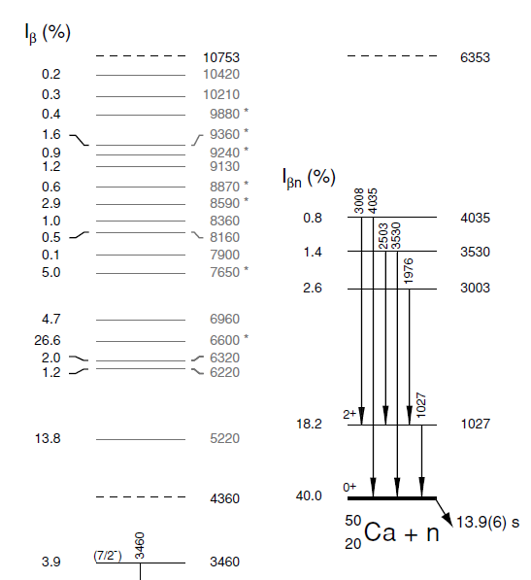


^{49,51}K: spins of states in β-delayed neutron emission
Intensity of emitted neutrons
Asymmetry for β-emission in coincidence with neutrons
Neutron ToF (ns)
M. Piersa-Silkowska

Slide 32




⁴⁷K: Bohr-Weisskopf effect in short-lived nuclei
K NMR shielding
(A. Hurajt, A. Antusek, Bratislava)
⁴⁷K in
EMIM-DCA
EMIM-DCA
water
Liquid β-NMR at VITO
+
+
Laser spectroscopy at ISOLDE
J. Papuga, M. Bissell, et. al., Phys. Rev. C 90, 034321 (2014)
Most precise hyperfine anomaly for short-lived nucleus
M. Bissell et al., with coauthors

Slide 33



47K

