Slide 1
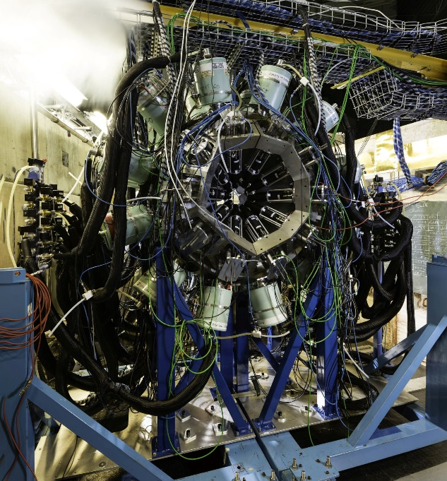
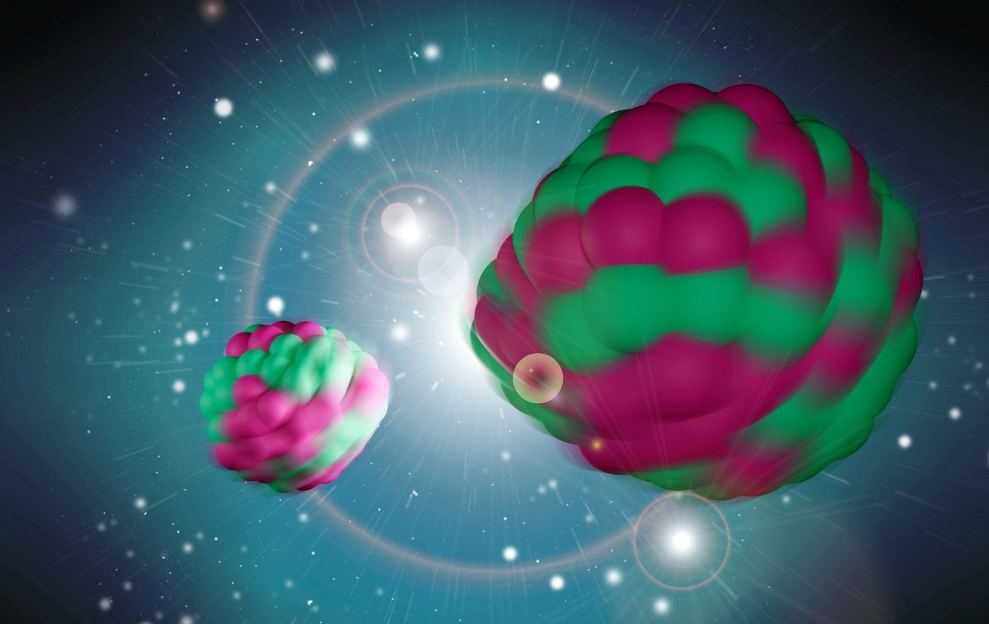
Probe of the fission mechanism via gamma ray coincidence spectroscopy
J.N. Wilson, IJC Lab
Jonathan Wilson, Giorgia Pasqualato, Corentin Hiver, IJC Lab, Orsay
Dorthea Gjestvang, Henrich Haug, Sunniva Siem, University of Oslo
Carole Chatel, GSI
Natalia Dzysiuk, University of Kyiv
Julia Fischer, University of Köln
Gamma-ray spectroscopy of fission fragments with state-of-the-art techniques
S. Leoni, C. Michelagnoli, J. N. Wilson La Rivista del Nuovo Cimento 45 461–547 (2022)

Slide 2
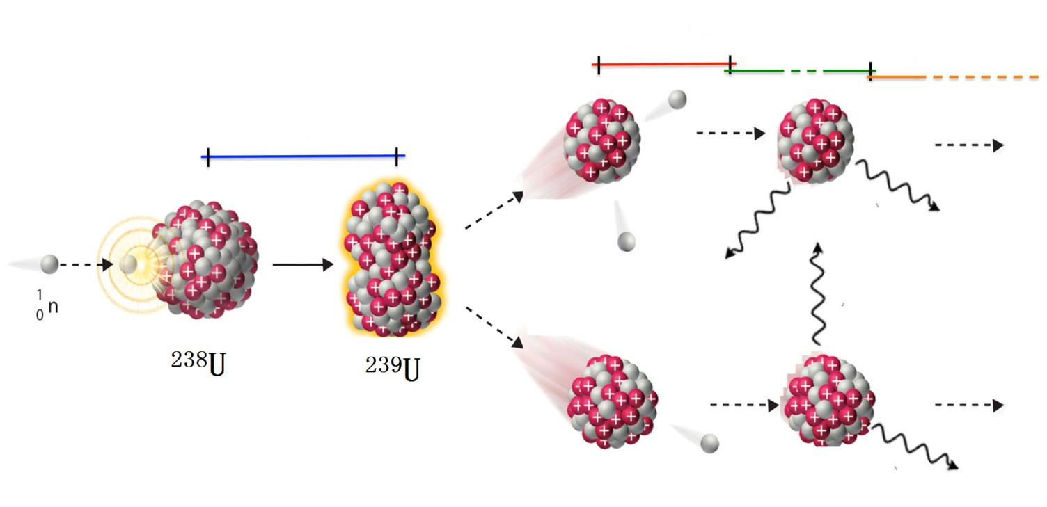
The de-excitation process in fission
10⁻¹⁸ – 10⁻¹⁴ s
10⁻¹⁴ – 10⁻⁹ s
10⁻³ – ∞ s
10⁻²¹ – 10⁻²⁰ s
Post scission
Beta decay
Pre-scission
_
Fragment
Kinetic Energy
Prompt
neutrons
Prompt
gamma rays
β, ν, γ
decay
~160 MeV
~6 MeV
~8 MeV
~20 MeV

Slide 3
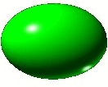

What can we investigate using high resolution gamma ray spectroscopy of fission?
Fragment nuclear structure
Fragment spin distributions and average spins
Isomeric yield ratios
Independent fission yields
Correlated fission yields
Spin correlations with emitted neutrons
Fragment partner correlations
Gamma ray angular distributions
One fragment
measurements
Partner fragment
measurements

Slide 4
What can we investigate using high resolution gamma ray spectroscopy of fission?
Fragment nuclear structure
Fragment spin distributions and average spins
Isomeric yield ratios
Independent fission yields
Correlated fission yields
Spin correlations with emitted neutrons
Fragment partner correlations
Gamma ray angular distributions
One fragment
measurements
Partner fragment
measurements

Slide 5
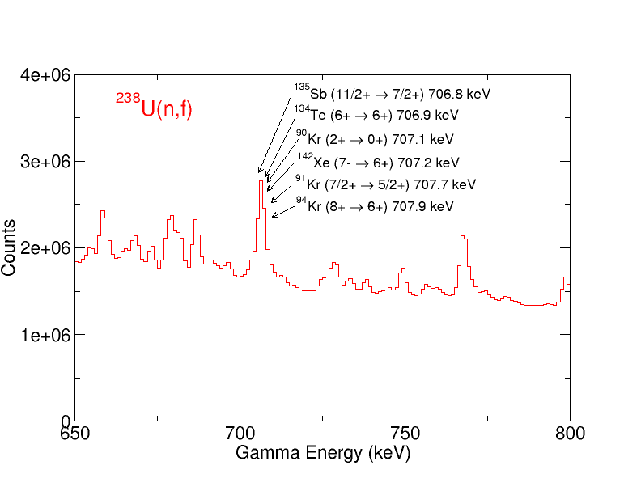
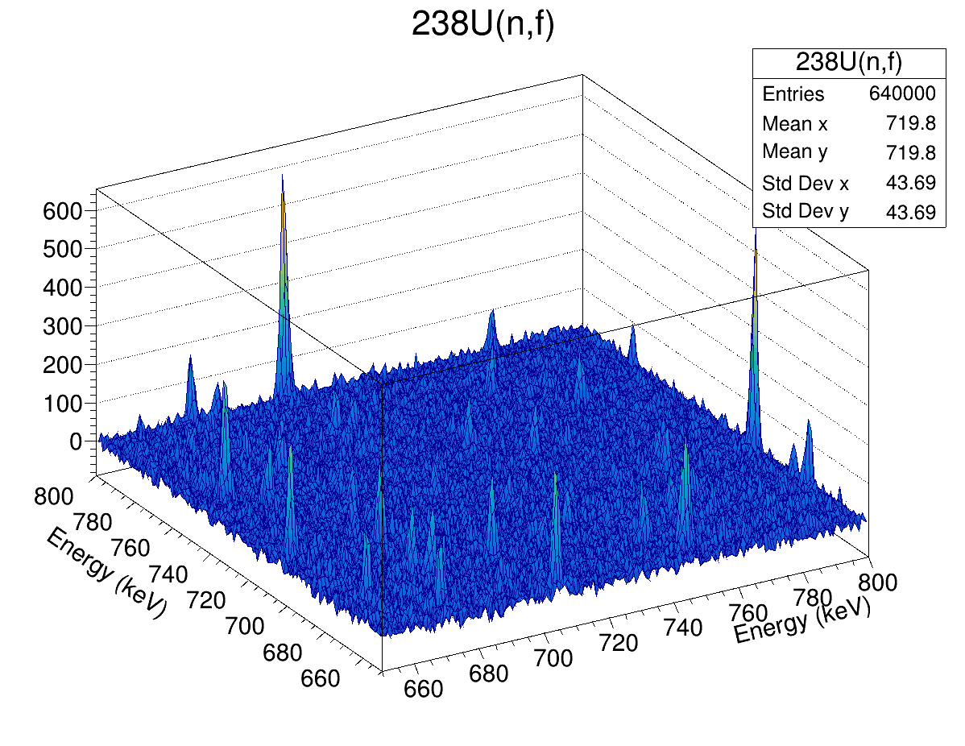
High resolution gamma-ray coincidence analysis
Complex prompt fission γ spectra: Hundreds of fragments, thousands of discrete γ transitions
1D spectrum

Slide 6
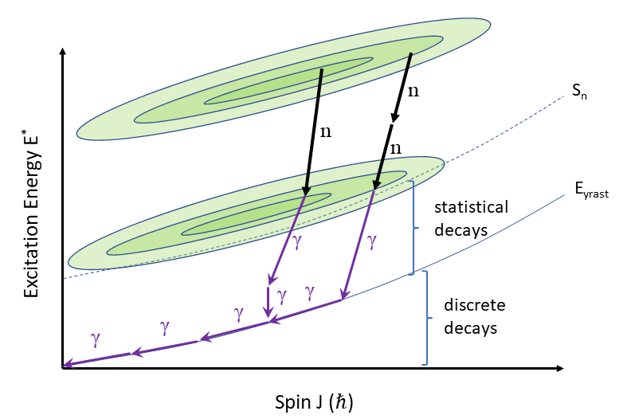
Fission fragment decay
Primary fragment entry
distribution
Secondary fragment entry
distribution
Excitation energy evacuated by neutrons
Angular momentum evacuated by gammas
(mostly!)
<M_{γ}> (one fragment) ~ 3.5 - 4
<ν> (one fragment) ~ 1 - 2

Slide 7
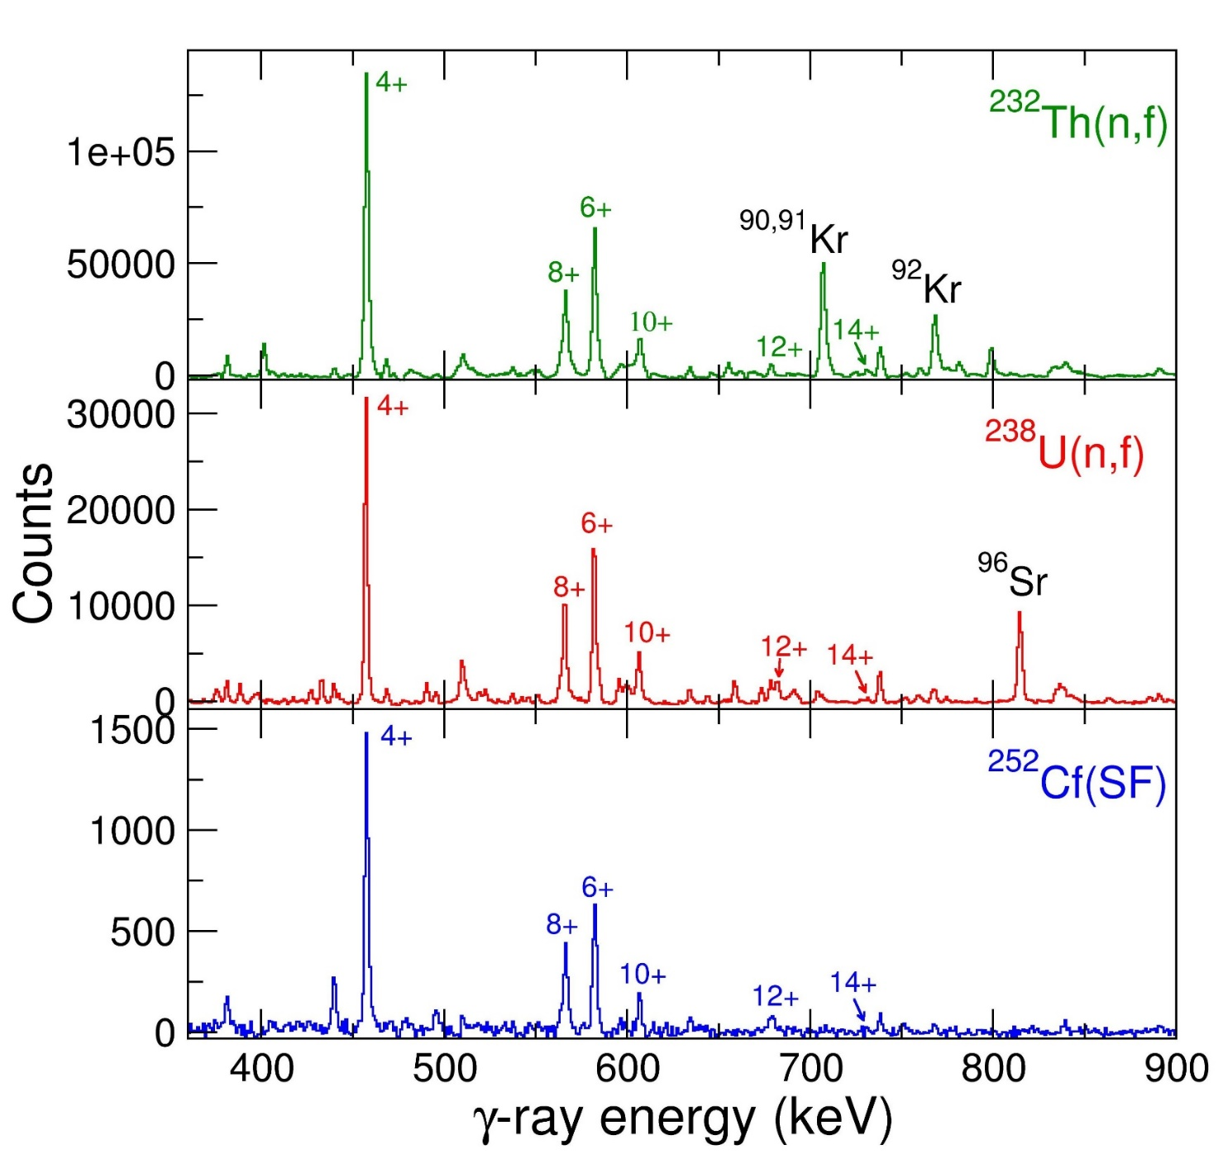
nu-Ball1 results: Gates on the 2⁺ → 0⁺ transition in ¹⁴⁰Xe
Study of 3 different systems with the same device
Prompt decay only
Separation of prompt fission decay and beta feeding is essential
¹⁴⁰Xe
⁹⁰Kr
(separation with pulsed neutron beam)
¹⁴⁰Xe shows invariant intensity pattern
Does the partner nucleus not matter?
¹⁴⁰Xe
⁹⁶Ru
(With ionisation chamber tagging one
Fragment in flight and stopping the other)
¹⁴⁰Xe
¹¹⁰Ru

Slide 8
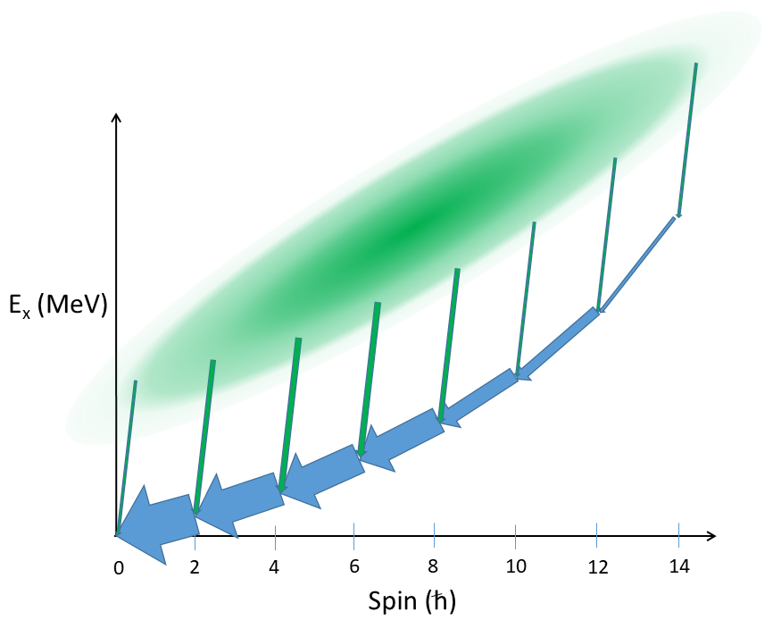
The Manchester Spin Method (MSM)
.
Fit feeding distributions with 1 parameter fit.
Spin cutoff parameter σ² from statistical theory
Be careful with:
Isomeric states
Error propagation
Treatmetnt of odd spins
Extrapolation to ground state
S₁₄
S₁₂
S₁₀
S₈
S₆
P(I)
S₄
S₀
S₂
0
2
4
6
8
10
12
14
Y. Abdelrahman et al. Phys. Lett. B 199 4 504 (1987)
Spin (ħ)

Slide 9
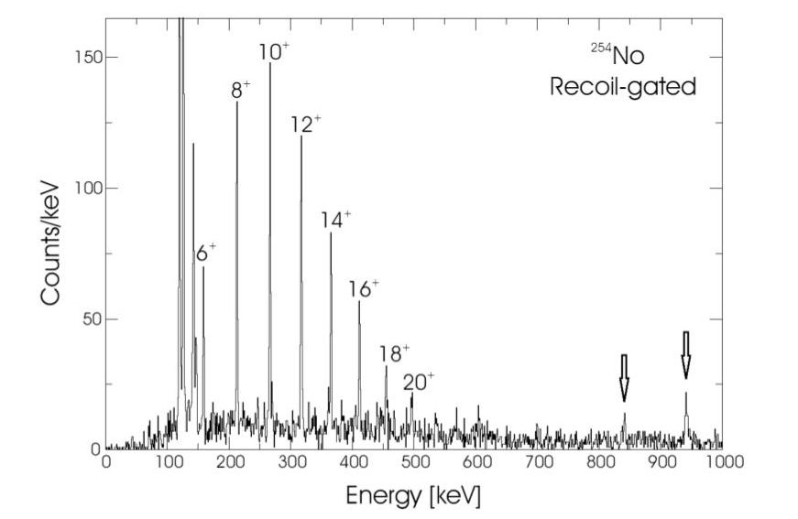
Spin distribution extraction from level scheme intensity data is a GENERAL technique
Can be used for any nuclear reaction:
Coulomb excitation
Transfer Reactions
Fission
Multi-nucleon transfer
Fusion-evaporation, etc.
P. Greenlees et al.
P(I)
0
2
4
6
8
10
12
14
Spin (ħ)

Slide 10
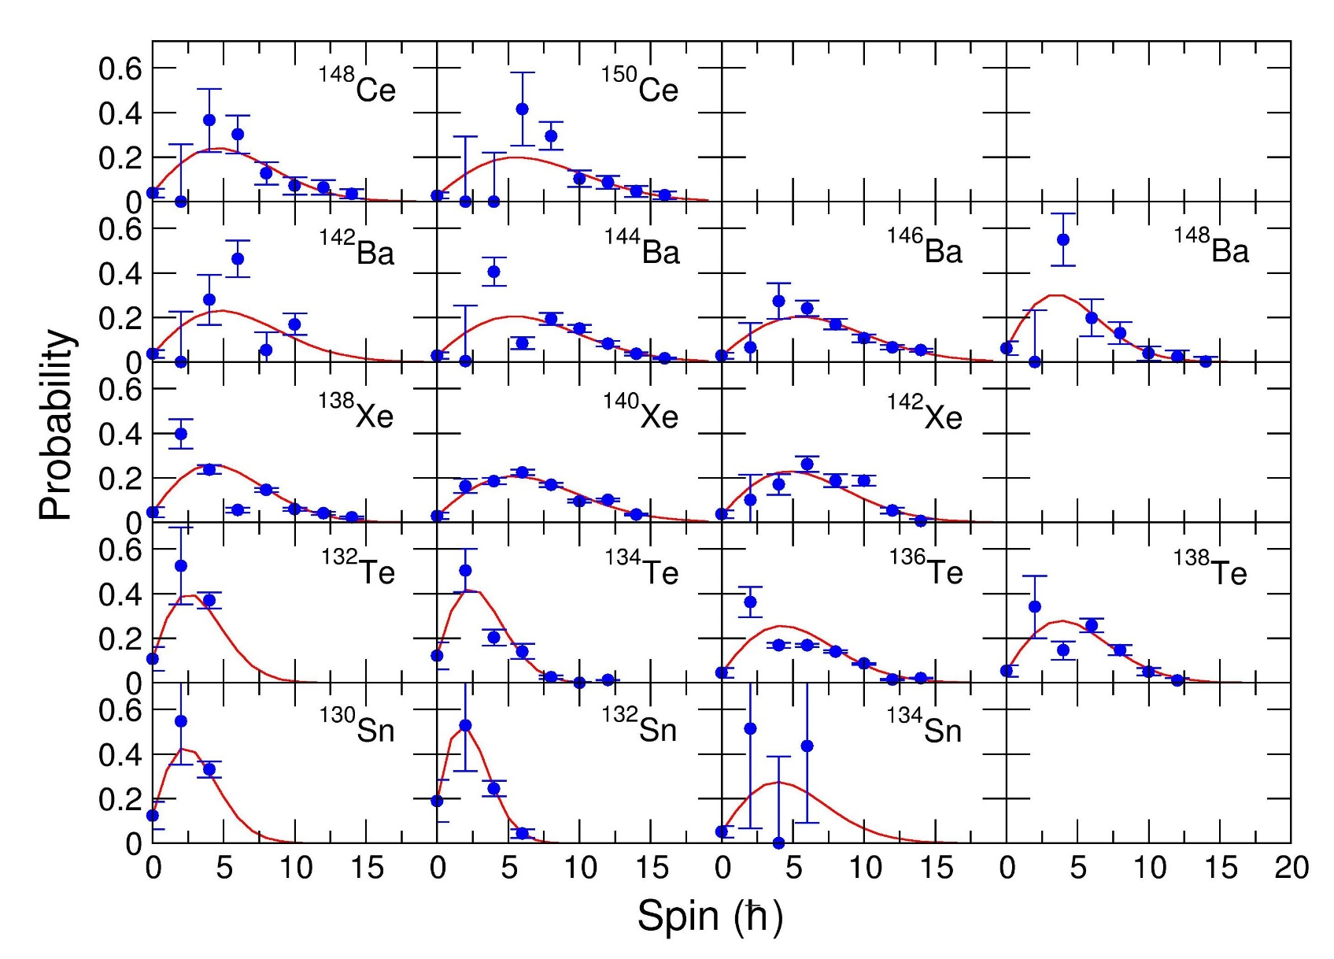
Examples of measured side-feeding distributions
Fit distributions with 1 parameter
Spin cutoff parameter σ²
²³⁸U(n,f) heavy fragments
“An Attempt to Calculate the Number of Energy Levels of a Heavy Nucleus”, H. A. Bethe Phys. Rev. 50, 332 (1936)

Slide 11
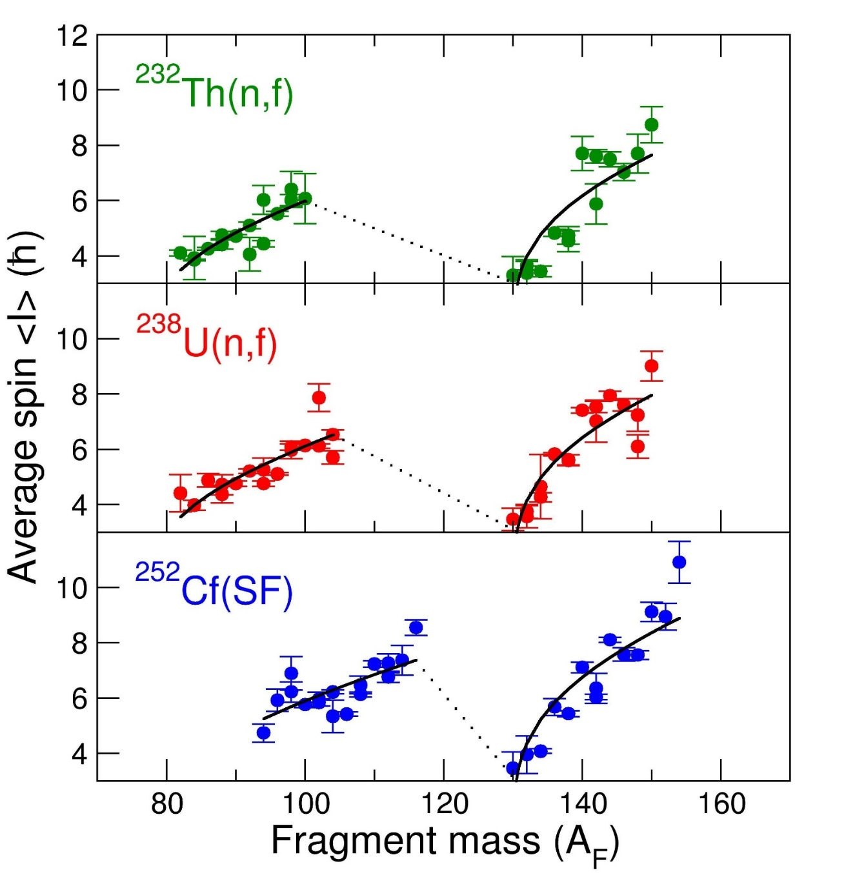
Average spin <I> vs fragment mass (A)
30 even-even nuclei measured for each system
Definitive saw-tooth patterns
Slope and curvature. Heavy peak has higher spins
Fit based on statistical theory
<I> α E_{x}^{1/4}
Remarks
No notable dependence on the partner nucleus
e.g.
¹⁴⁰Xe + ⁹⁰Kr
¹⁴⁰Xe + ⁹⁶Sr
¹⁴⁰Xe + ¹¹²Ru
Each nucleus does not care who it emerged with!
25% difference in mass
ΔθΔI=ℏ
Certain partners have large asymmetries in <I>
e.g. ¹⁵⁰Ce has double the <I> of ⁸⁶Se
Highly asymmetric distribution
J.N. Wilson et al. Nature 590 566 (2021)

Slide 12
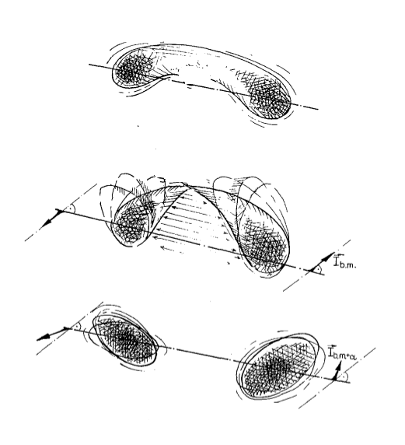
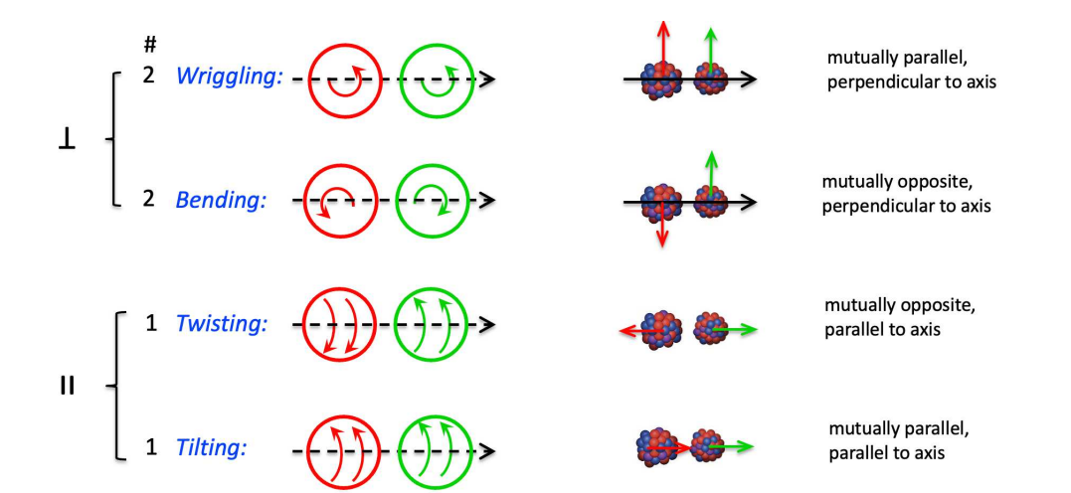
Angular momentum “modes”
Confusion from the multiple uses of the word « mode » in fission!!
1) A decay mode (spontaneous fission)
2) Reference to the shell effects governing the mass partition (e.g. S1 mode, S2 mode, Super-long mode, etc.)
3) A zoology of fragment spin directions after scission (bending mode, wriggling mode, etc.)
4) A collective mechanism via which fragment spin is generated
Adapted from W. Pilz et al. Z. Phys. A 338, 75-87 (1991)

Slide 13
Orientation pumping mechanism
(See talk of Guillaume Scamps)
ΔθΔL=ℏ
Large deformation at scission
θ
Δθ
ΔL
Small deformation at scission
θ
Δθ
ΔL

Slide 14
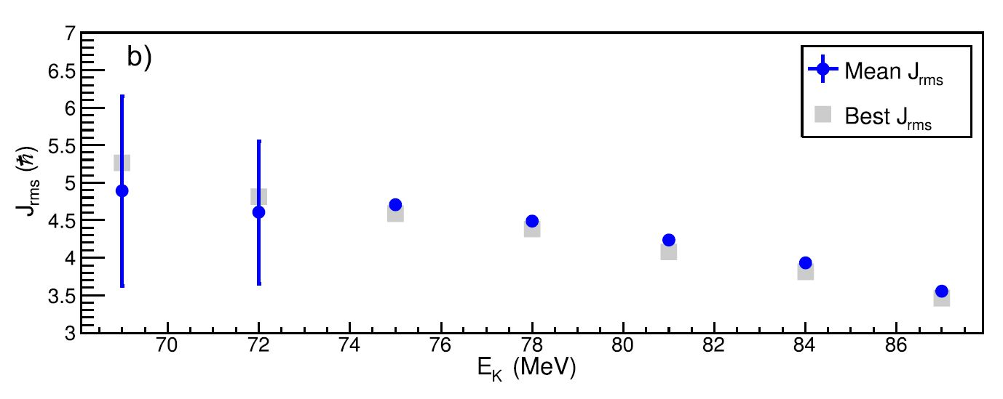

Relationship between spin and fragment kinetic energy
Kinetic energy dependence of fission fragment isomeric ratios for spherical nuclei ¹³²Sn. Chebboubi et al. Phys. Lett. B775 190–195 (2017)
Small p, small L
Large p, large L
Elongated rupture. Low TKE
Compact rupture. High TKE

Slide 15
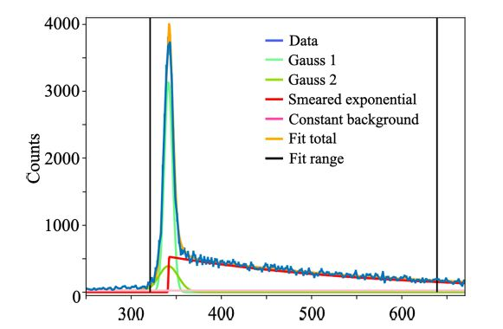
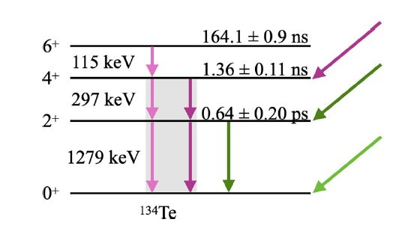
Variation of ¹³⁴Te Isomeric Yield Ratio (IYR) with other observables
Using the IYR of ¹³⁴Te as a highly sensitive probe to small changes in fragment angular momentum
D. Gjestvang, J. N. Wilson, et al. Phys. Rev. C 108, 064602 (2023)
¹³⁴Te 6⁺(163 ns)
IYR is defined as isomer feeding/total feeding
Measured by fits to the time distribution (prompt and delayed componnents)
IYR is sensitive to small changes in spin
Time (ns)
Time distribution of 1279 keV/297 keV coincidence in nu-Ball

Slide 16
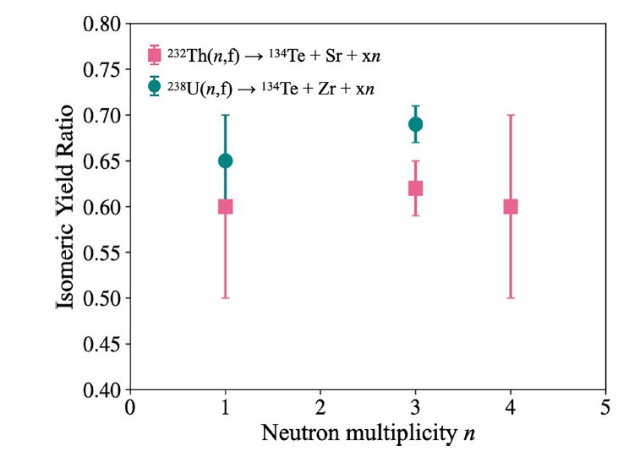
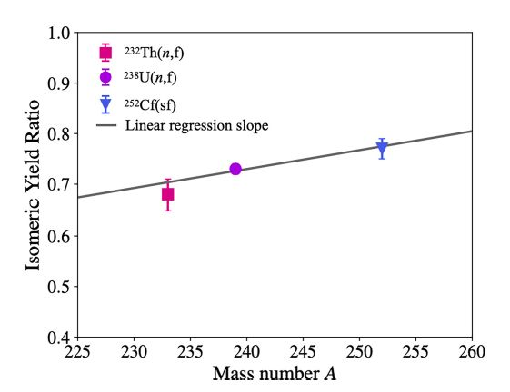
Results
Dependence of IYR on neutron multiplicity
Dependence of IYR on mass of fissioning system
No significant dependence on number of emitted neutrons
Weak dependence on fissioning A_{system} (~2σ significance)

Slide 17
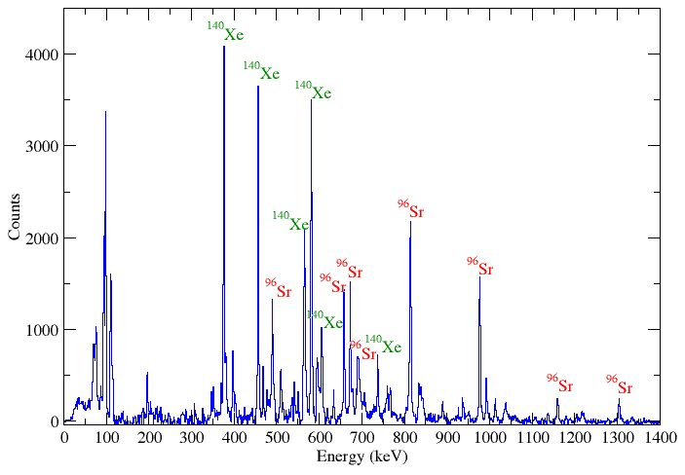
ν-Ball2/FATIMA/LICORNE: ²³⁸U(n,f) data quality
Triple gamma coincidences: Double gate on transitions from fragments
Ge-Ge-Ge, Ge-LaBr3-LaBr3, Ge-Ge-BGO
Double gate on
376 keV/814 keV
Selects ¹⁴⁰Xe/⁹⁶Sr
pair
Indirect measurement of neutron multiplicities
Control for the number of neutrons emitted
Study of the angular momentum carried by neutrons
D. Gjestvang, H. Haug, J.N. Wilson, J. Randrup et al.,
Accepted PRC, Aug. 2026
1.6 x 10⁹
Ge-Ge-Ge
coincidences

Slide 18
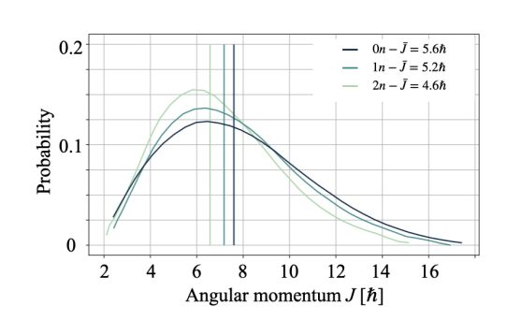
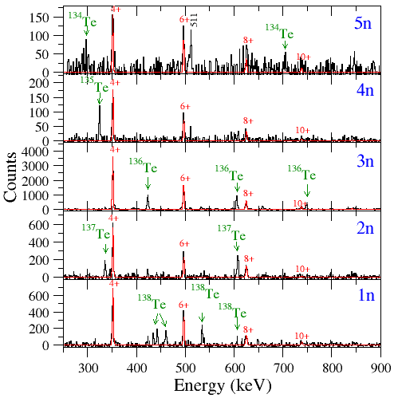
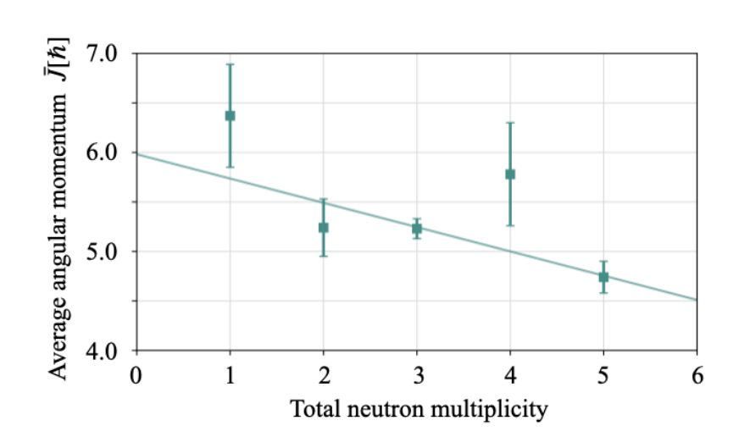
¹⁰²Zr
¹⁴⁰Xe

Slide 19
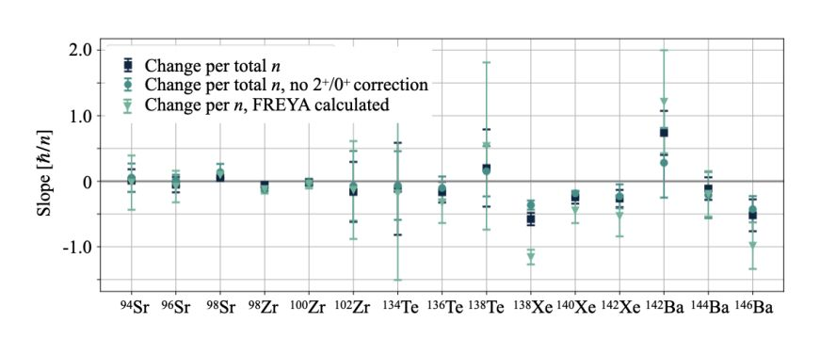
Average angular momentum removal per neutron vs fragment
D. Gjestvang, H. Haug et al., Accepted Phys. Rev. C, Aug. 12 2026
Conclusion: Fragment average spins at yrast are only very weakly dependent on number of neutrons emitted

Slide 20
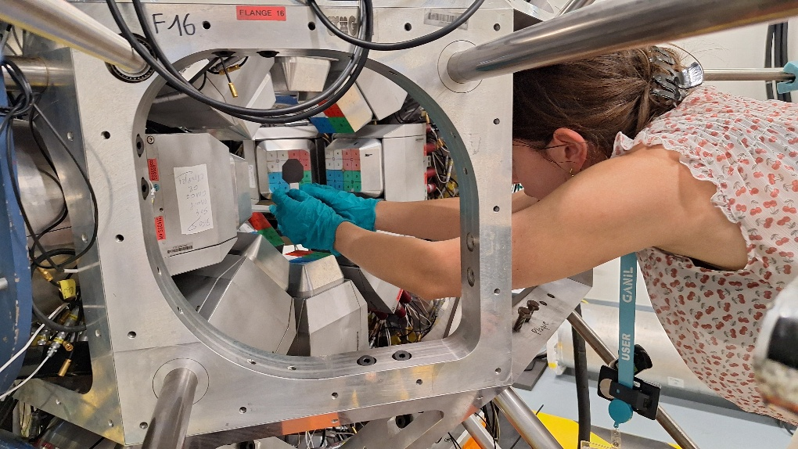
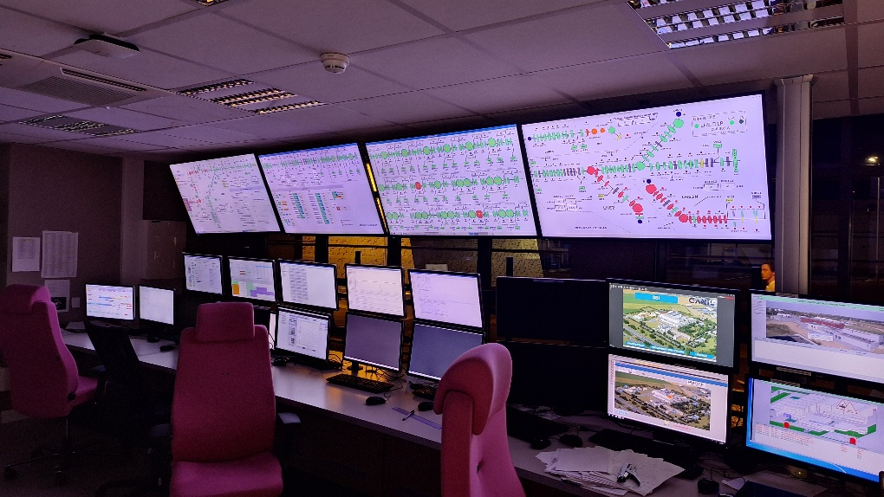
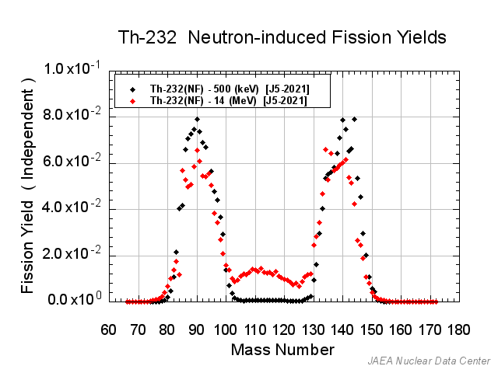
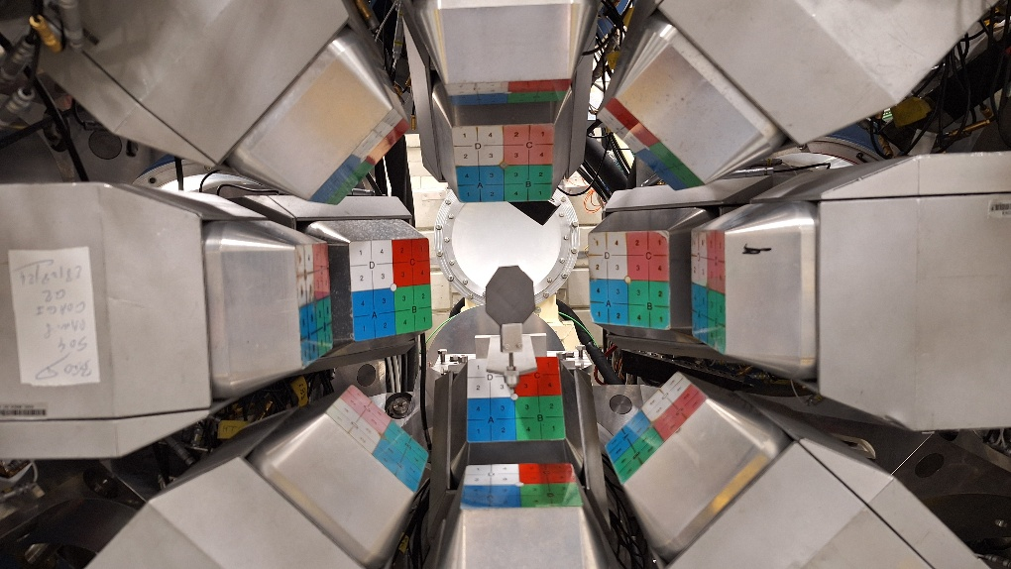
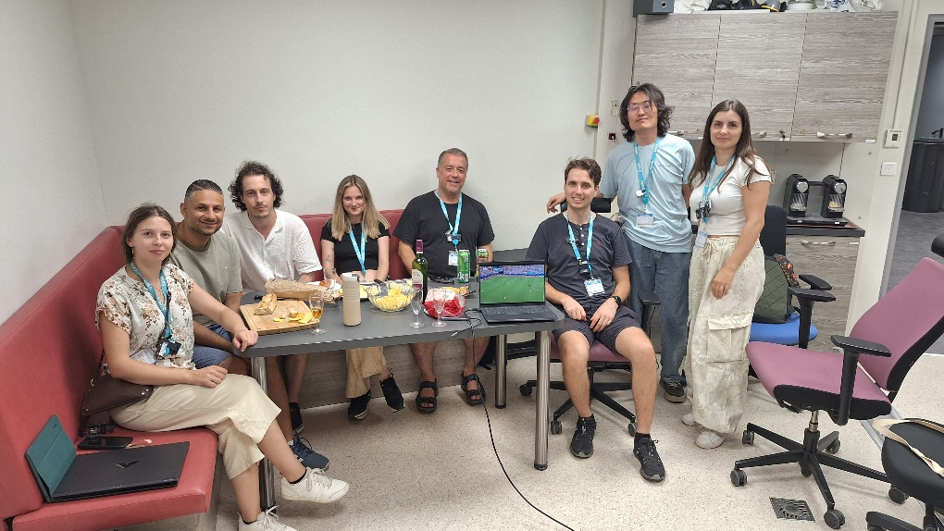
²³²Th(n,f) expmeriment at GANIL/NFS – July 2026
SL mode

Slide 21

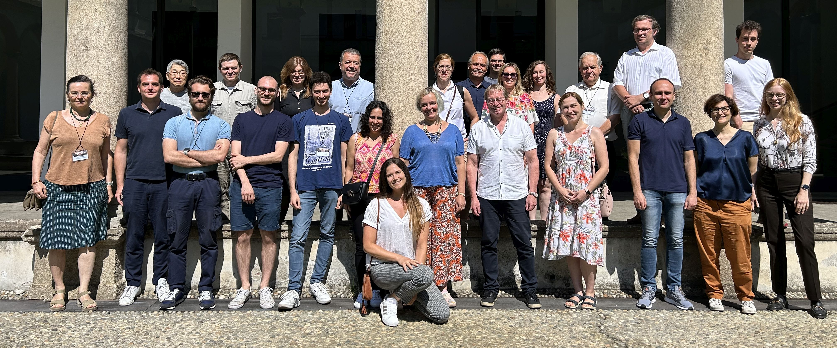












The nu-Ball2 collaboration, July (2024)
IJC Lab, CEA DAM
Subatech, CENBG, IPHC,
GANIL, LPC Caen
University of Milano
INFN Legnaro
IFJ-PAN Krakow
University of Warsaw
University of Oslo
JRC-Geel
Leuven
University of Surrey, NPL
University of Manchester
TU Darmstadt
IFK- Koln
University of Novi Sad
University of Madrid
IFIC Valencia
ELI-NP, Bucharest
University of Sofia
Riken

Slide 22
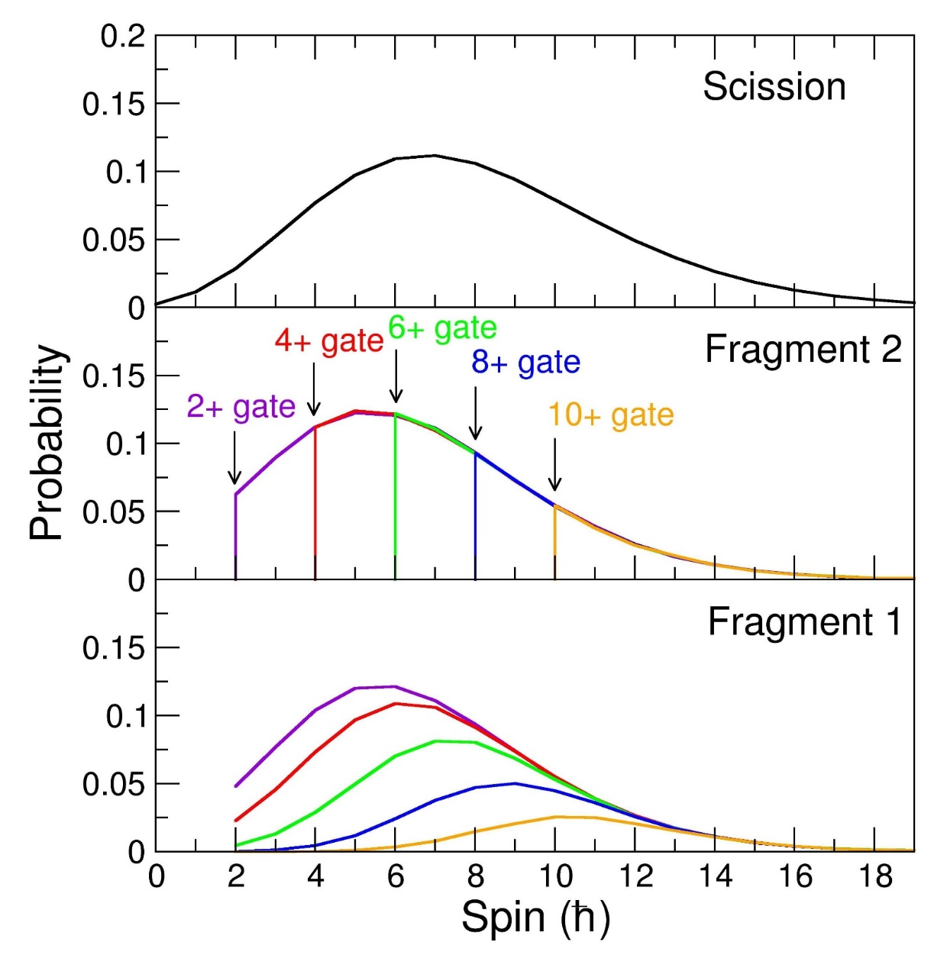
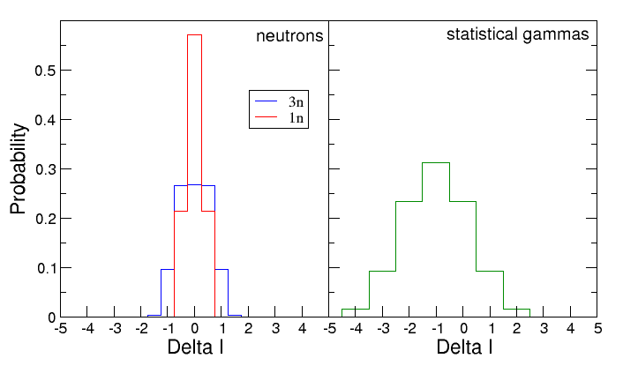
Monte-Carlo code: scission to yrast spin propagation
Spin dispersions from scission to yrast
Conclusion: dispersions can slightly weaken spin correlations at scission but do not destroy them

