Slide 1
Progress in Microscopic Fission Theory
Zakopane Conference on Nuclear Physics 2026
September 4th, 2026
Nicolas Schunck | NACS

Slide 2
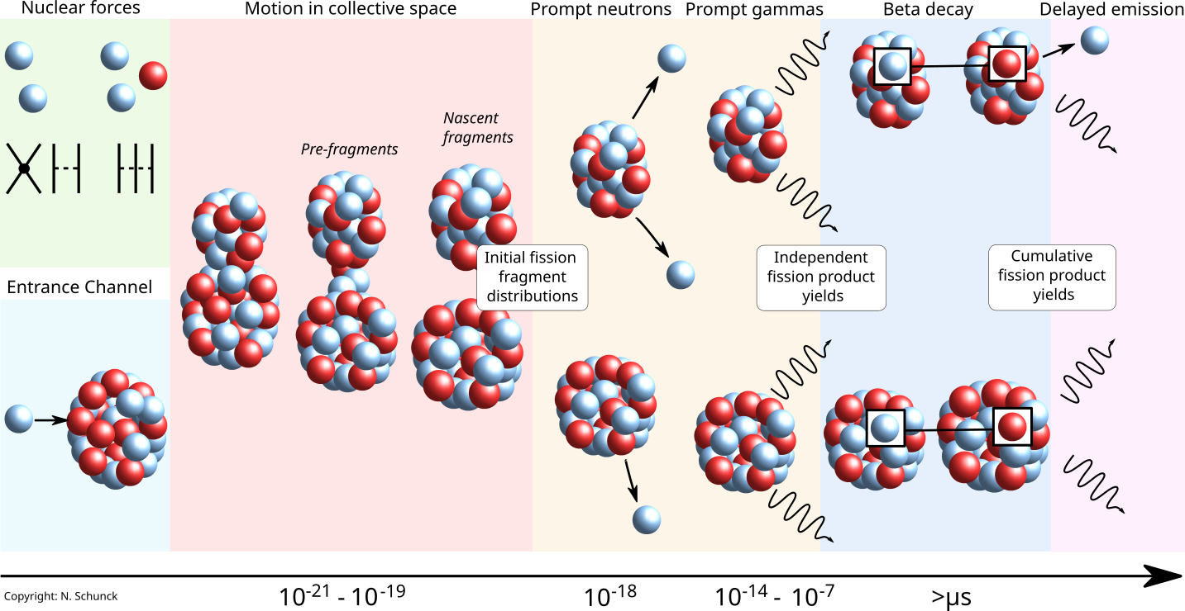


Nuclear fission is one of the most challenging scientific problems
PNPP 125,103963 (2022)
Notes:
2

Slide 3
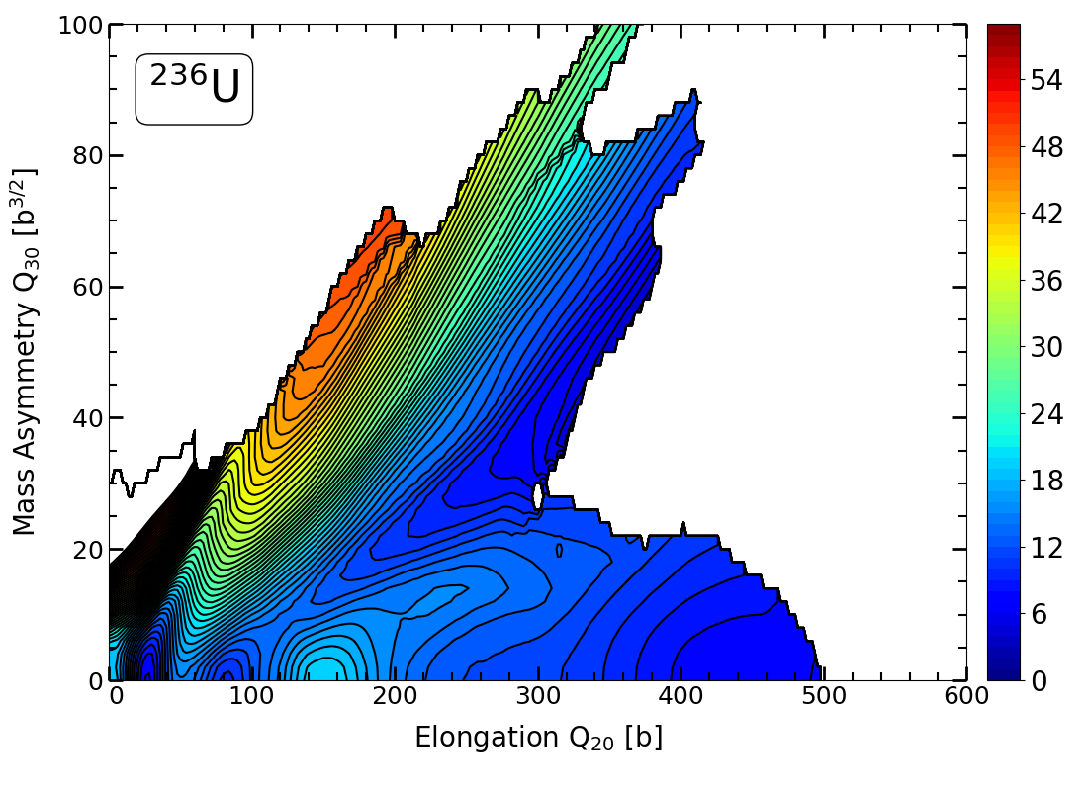
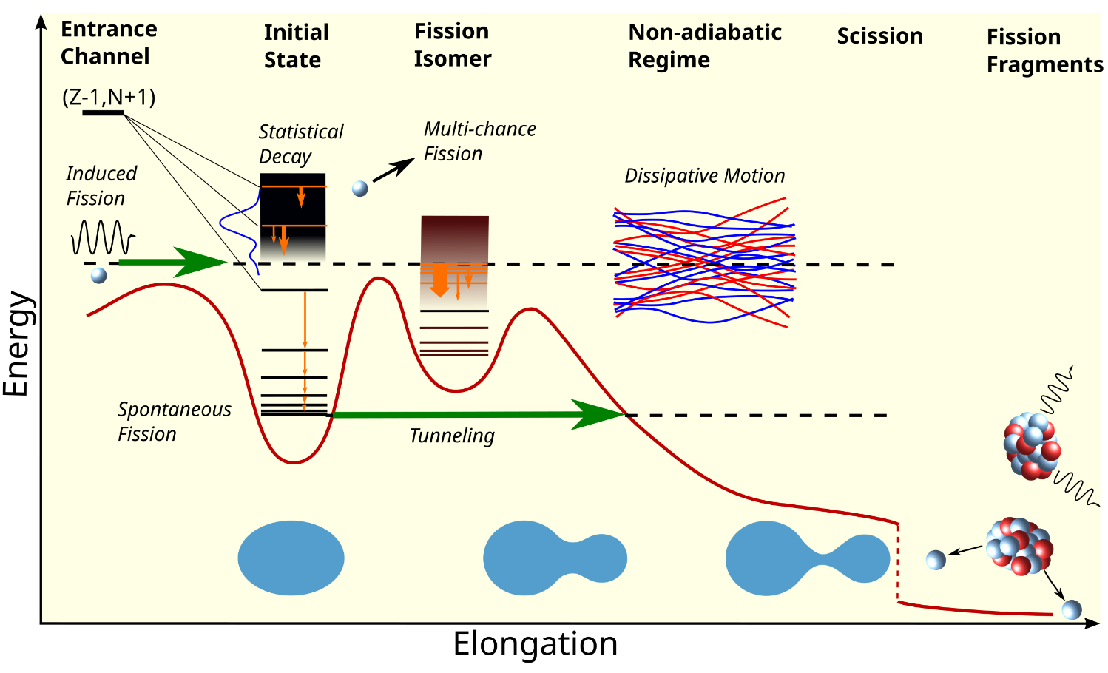
Fission can be thought of as a quantum-mechanical system moving through a multi-dimensional potential energy surface
Probability of fission related to height and width of the “barriers”
JPG 47, 113002 (2020)
Properties of fission fragments related to “shape” of the fissioning nucleus at scission
Potential energy surfaces encode a lot of information about the fission process

Slide 4
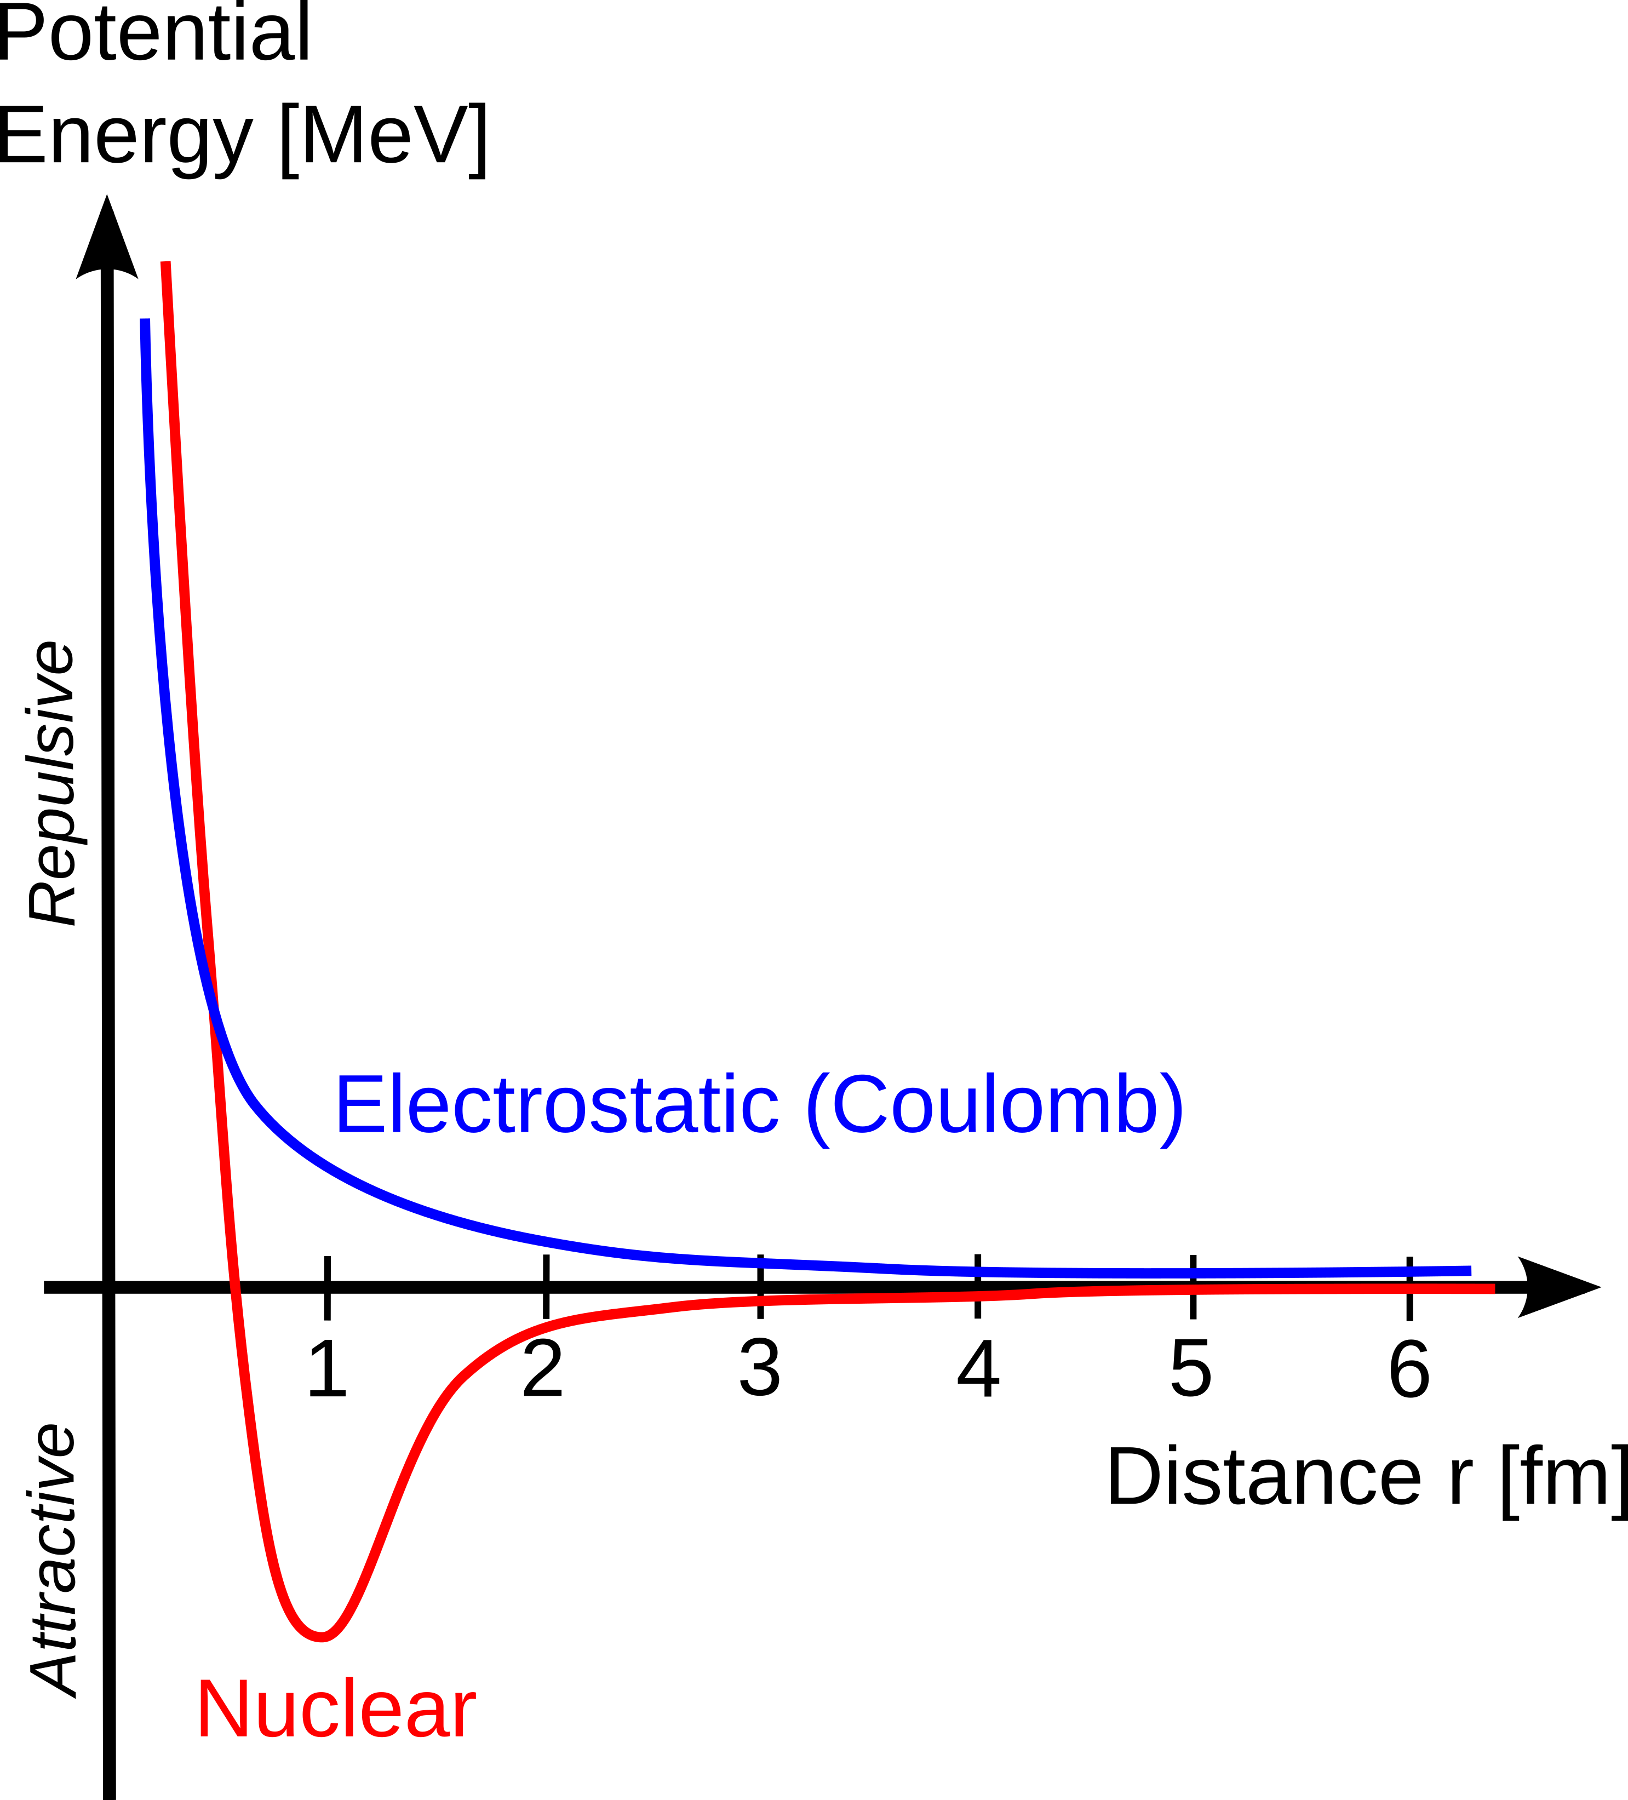
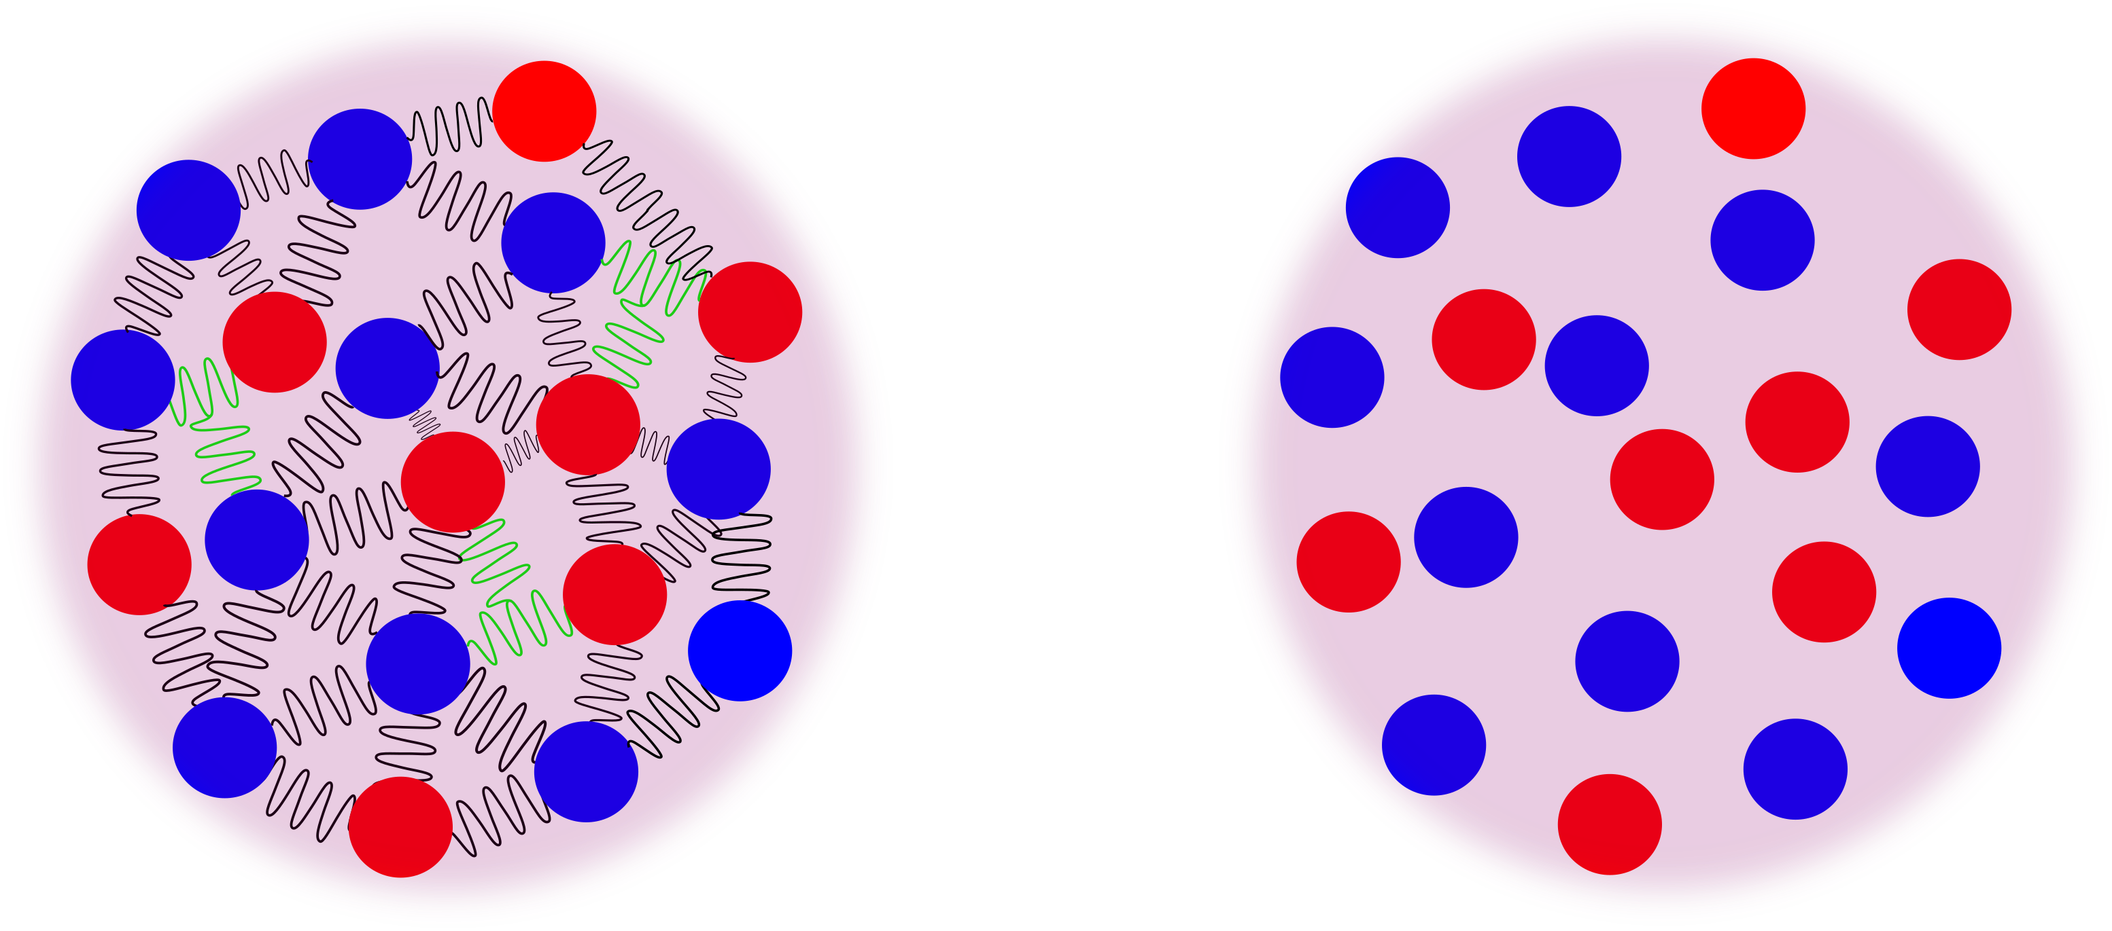
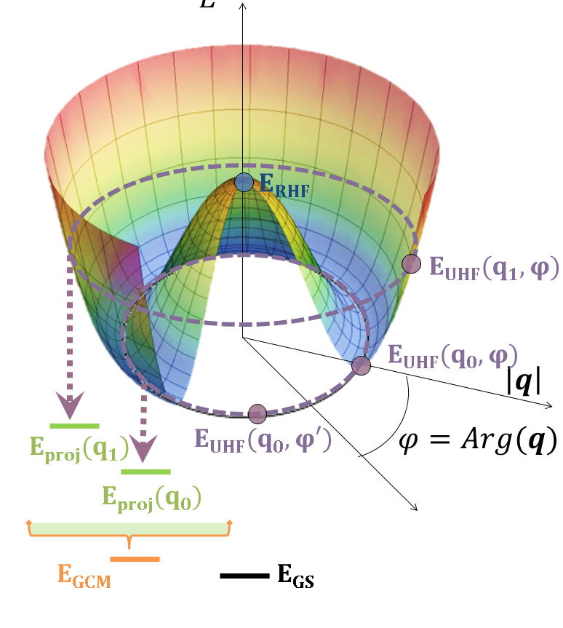
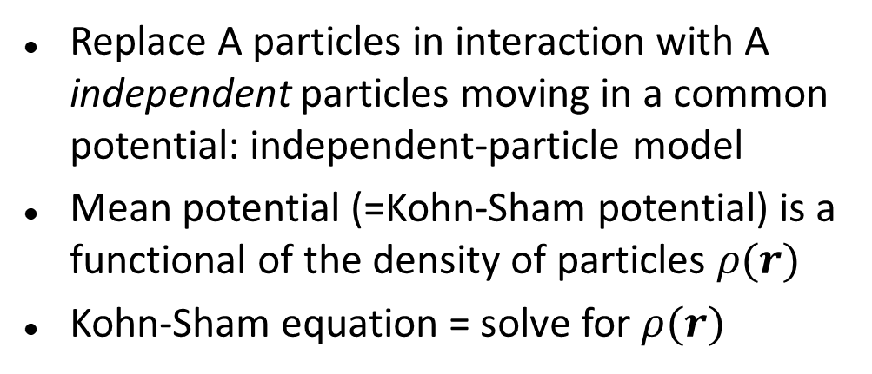
Nuclear density functional theory is a computationally efficient remapping of the quantum many-body problem
Nuclear forces
Contrary to, e.g., coulomb or gravity, nuclear forces are 2-, 3-, …, A-body, i.e., involve simultaneously 2, 3, …, A nucleons
Replace A particles in interaction with A independent particles moving in a common potential: independent-particle model
Mean potential (=Kohn-Sham potential) is a functional of the density of particles $ρ(r)$
Kohn-Sham equation = solve for $ρ(r)$
Spontaneous symmetry breaking
If the nucleus is deformed, symmetries of nuclear forces are broken: this is an example of spontaneous symmetry breaking – a cornerstone of modern physics

Slide 5
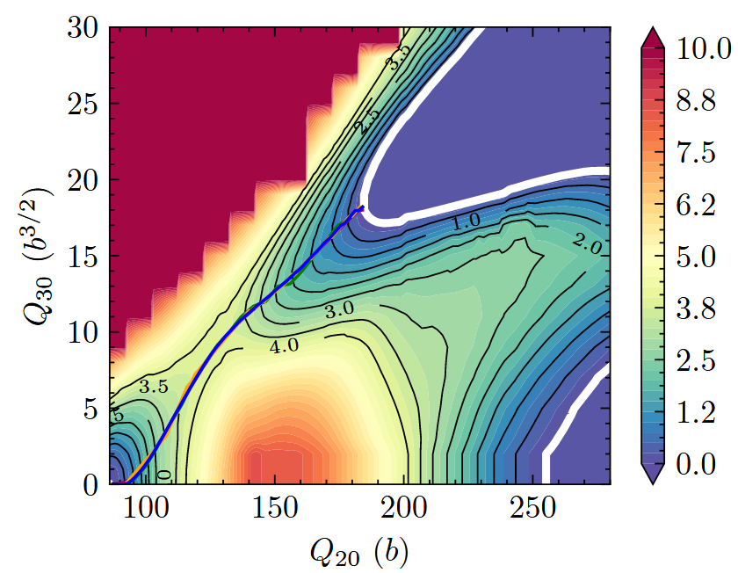
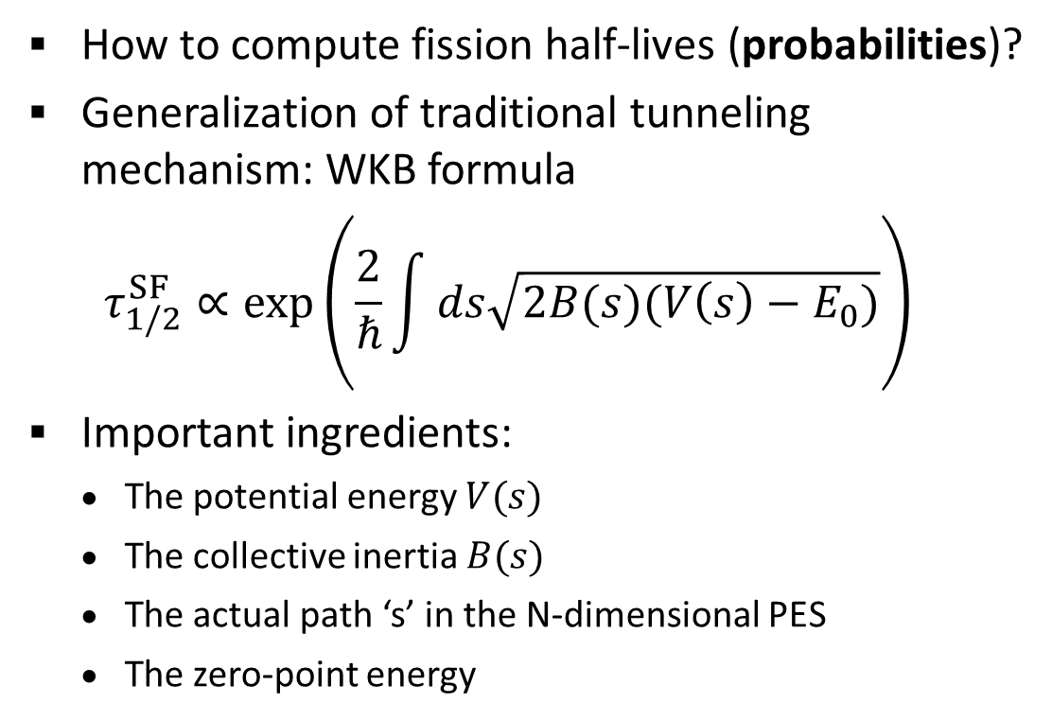
Spontaneous fission half lives can be predicted by computing the tunneling probability in multi-dimensional potential energy surfaces
How to compute fission half-lives (probabilities)?
Generalization of traditional tunneling mechanism: WKB formula
$$τ_{1/2}^{SF}∝exp\left(\frac{2}{ℏ}\int{ds\sqrt{2B(s)(V\left(s\right)−E_{0})}}\right)$$
Important ingredients:
  The potential energy $V(s)$
  The collective inertia $B(s)$
  The actual path ‘s’ in the N-dimensional PES
  The zero-point energy
Outer turning points (or line)
Ground state = starting point
PRC 105, 054302 (2022)

Slide 6
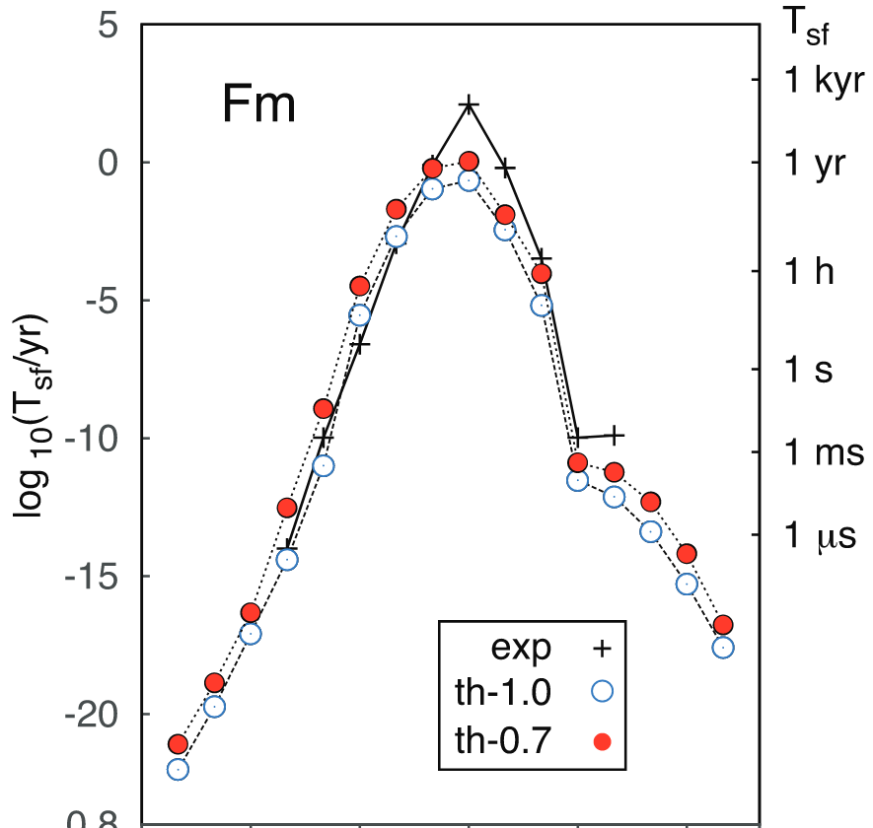
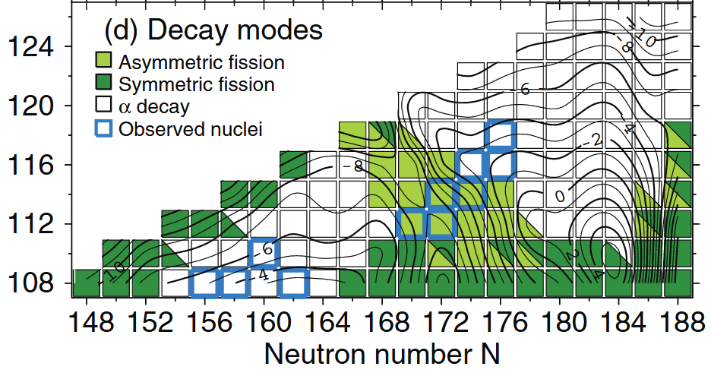
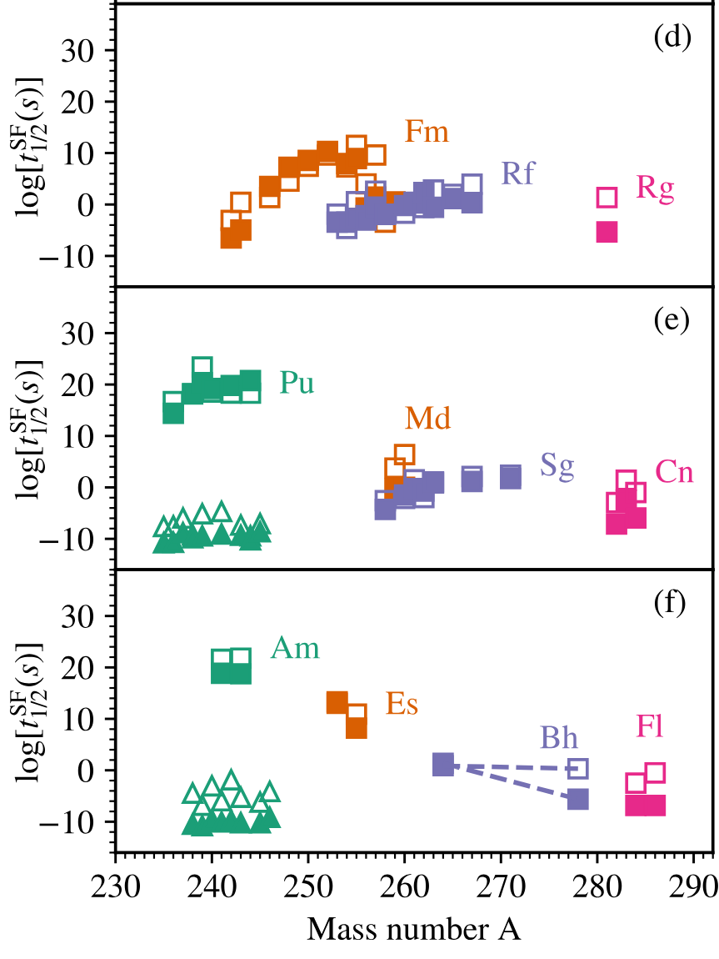
Spontaneous fission is a main driver of the stability of superheavy elements
PRC 87, 024320 (2013)
PLB 874, 140287 (2026)
As expected, fission half-lives are extremely sensitive to details of the potential energy surface and collective inertia
Same hold for fission cross sections – the analogue of half-lives in induced fission

Slide 7


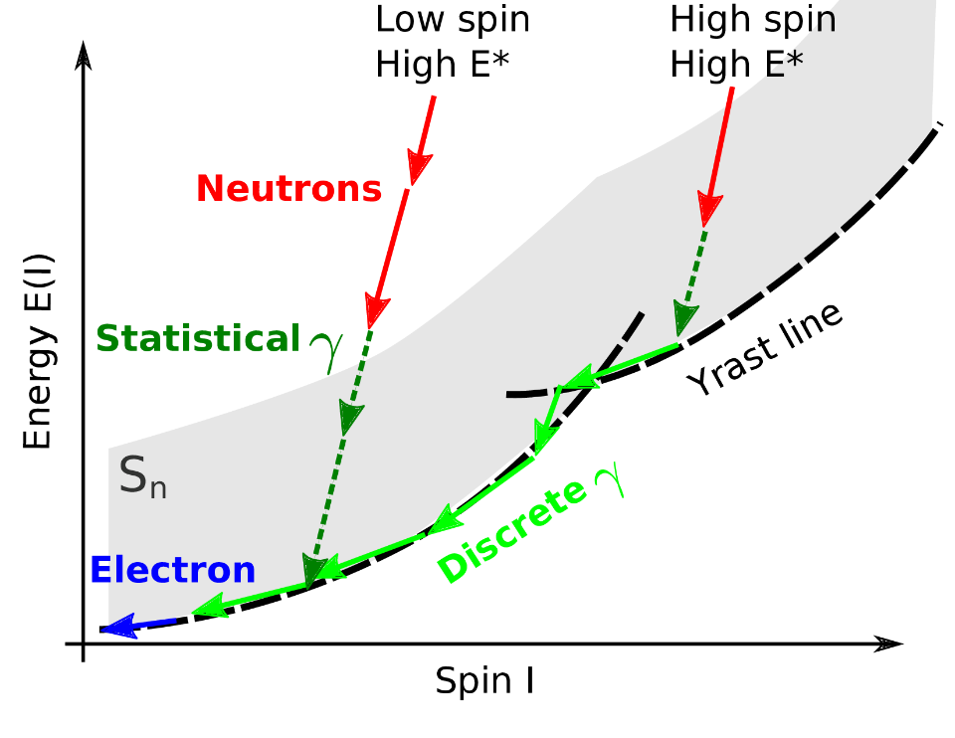
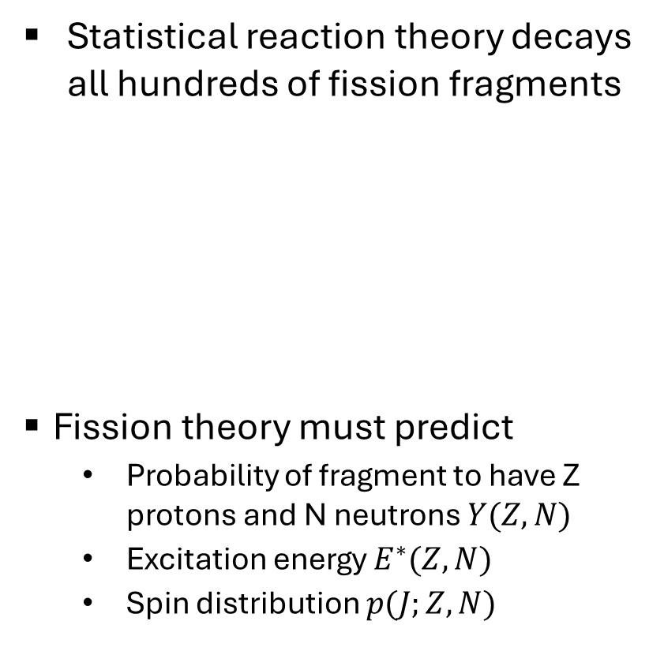
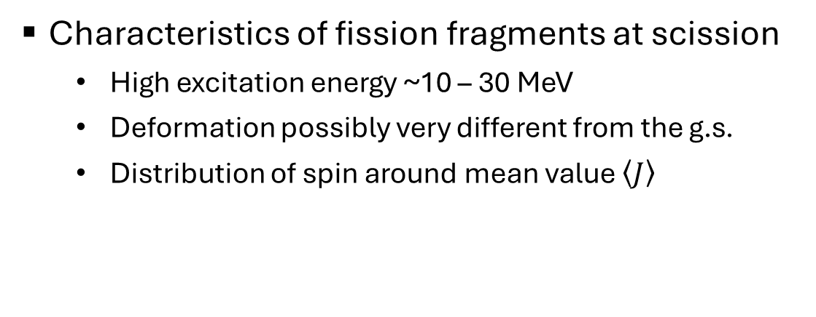
Microscopic theory can provide the initial conditions of excited fission fragments upon their formation
Statistical reaction theory decays all hundreds of fission fragments
Fission theory must predict
  Probability of fragment to have Z protons and N neutrons $Y(Z,N)$
  Excitation energy $E^{∗}(Z,N)$
  Spin distribution $p(J;Z,N)$
Characteristics of fission fragments at scission
  High excitation energy ~10 – 30 MeV
  Deformation possibly very different from the g.s.
  Distribution of spin around mean value $\left\langle J\right\rangle$
Notes:
7

Slide 8
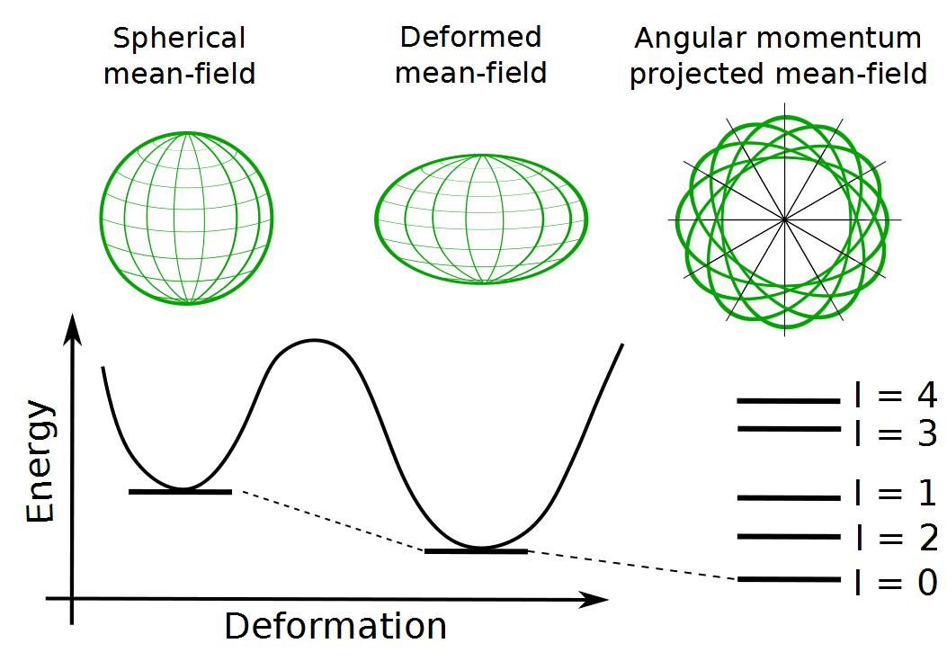
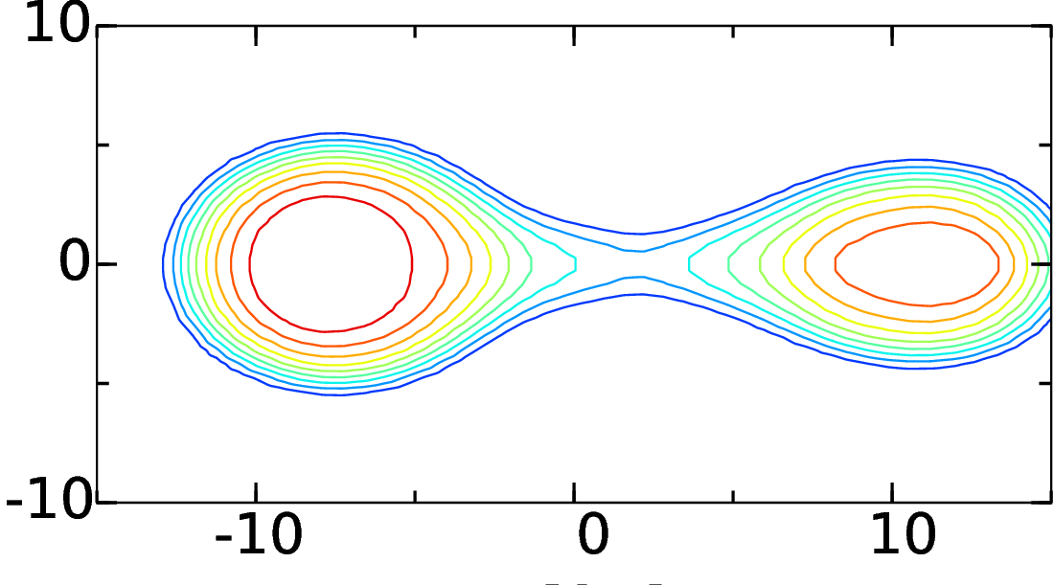
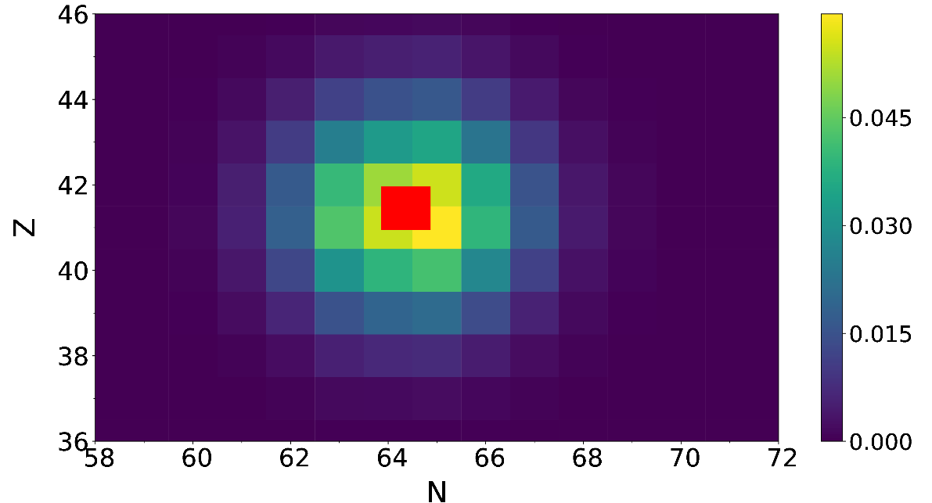
Symmetry restoration techniques were extended to extract quantum numbers associated with fission fragments
Identify position of the neck z_{N} between the prefragments
Define operators (particle number, angular momentum) acting in ½ of the space only
PNP: PRL 105, 192701 (2010); PRC 87, 014605 (2013); PRC 100, 024612 (2019)
AMP: PRC 96, 014615 (2017); PRC 104, L021601 (2021); PRL 126, 142502 (2021)
Notes:
8

Slide 9
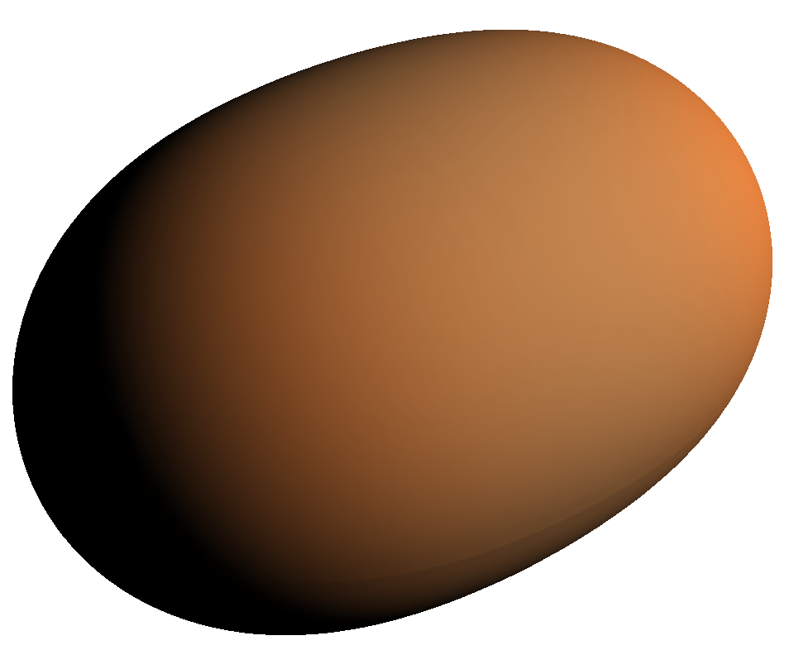
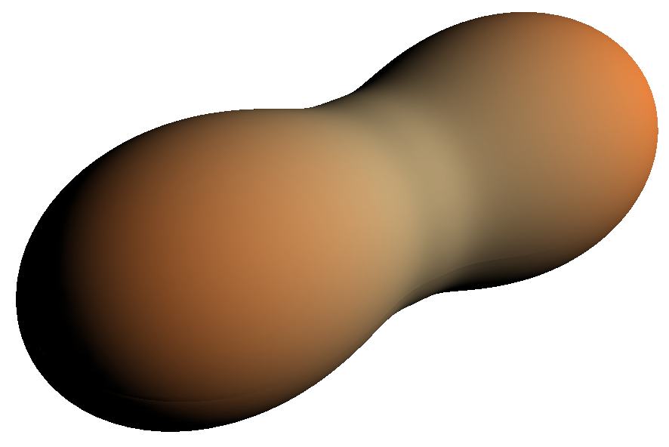
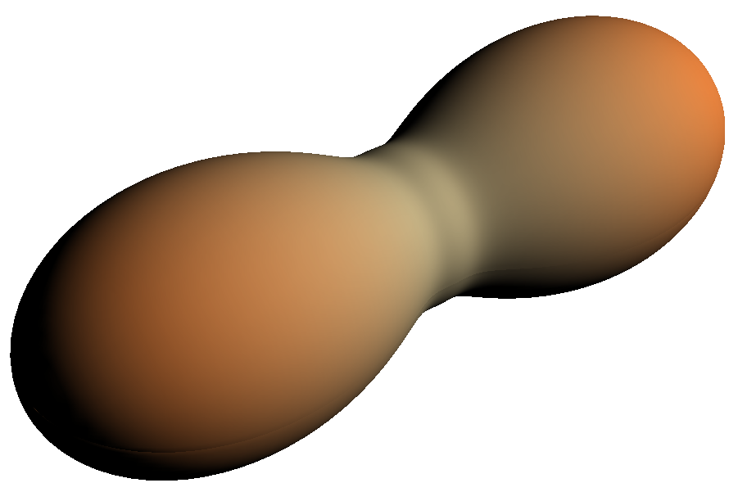
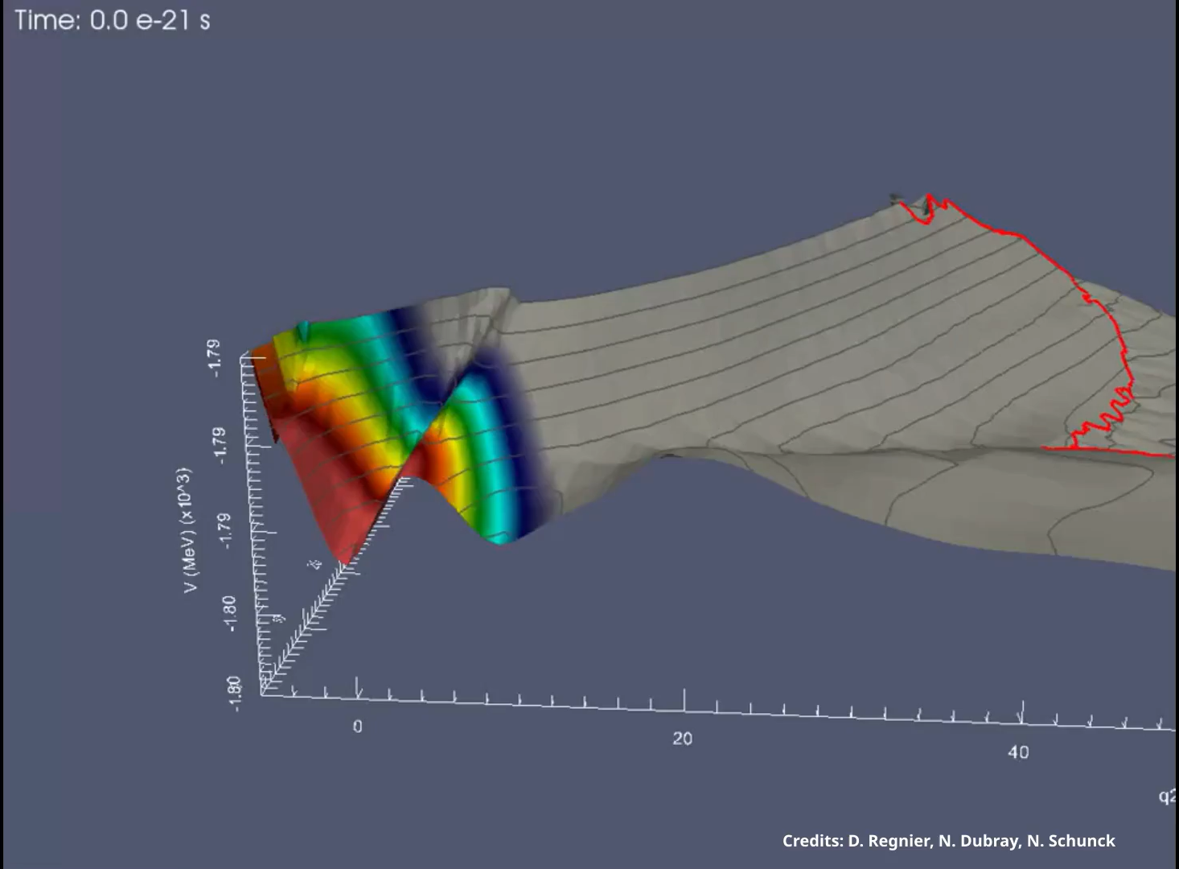
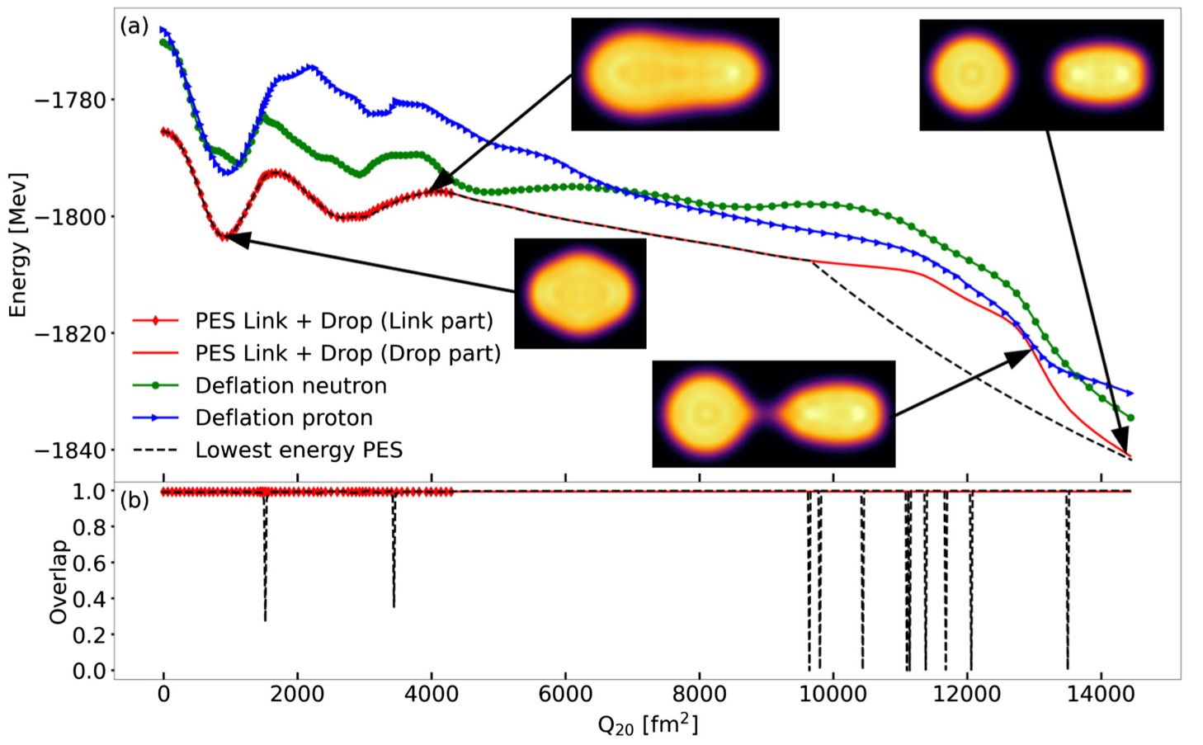
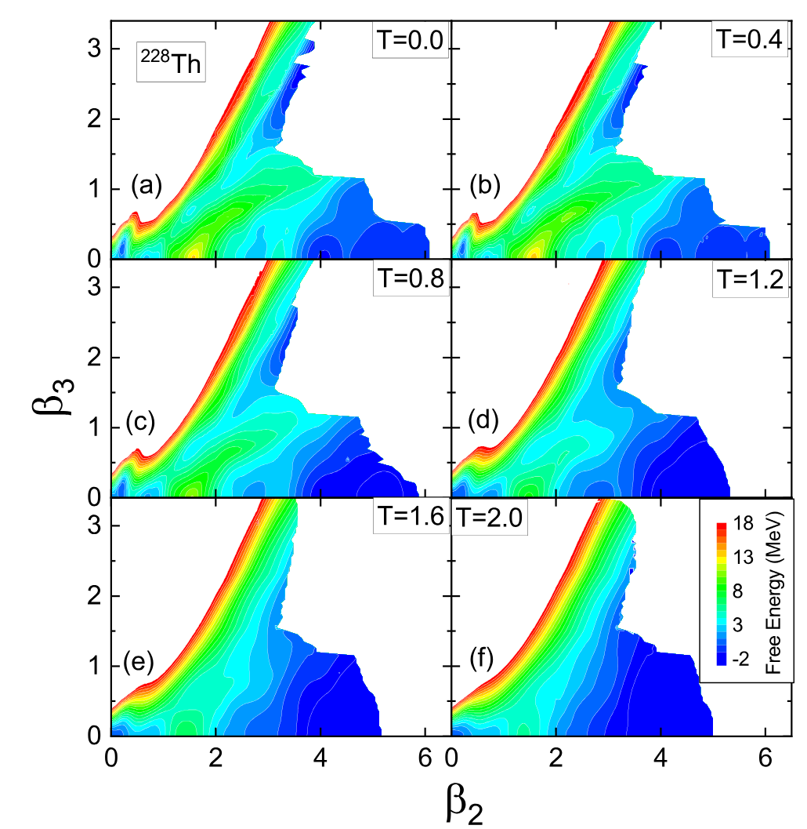
Fission fragment distributions are obtained from collective time-dependent dynamics
Time-dependent generator coordinate method (TDGCM):
Key inputs: precalculated PES, PNP in scission configurations
Technicalities: continuity, E*
PRL 133, 152501(2024)
PRC 105, 054604 (2022)
Notes:
9

Slide 10
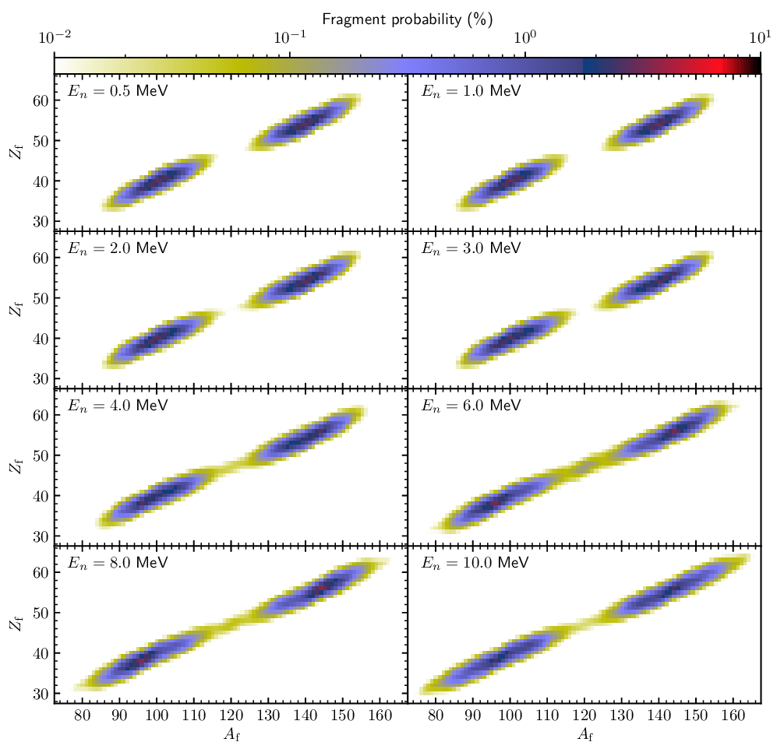
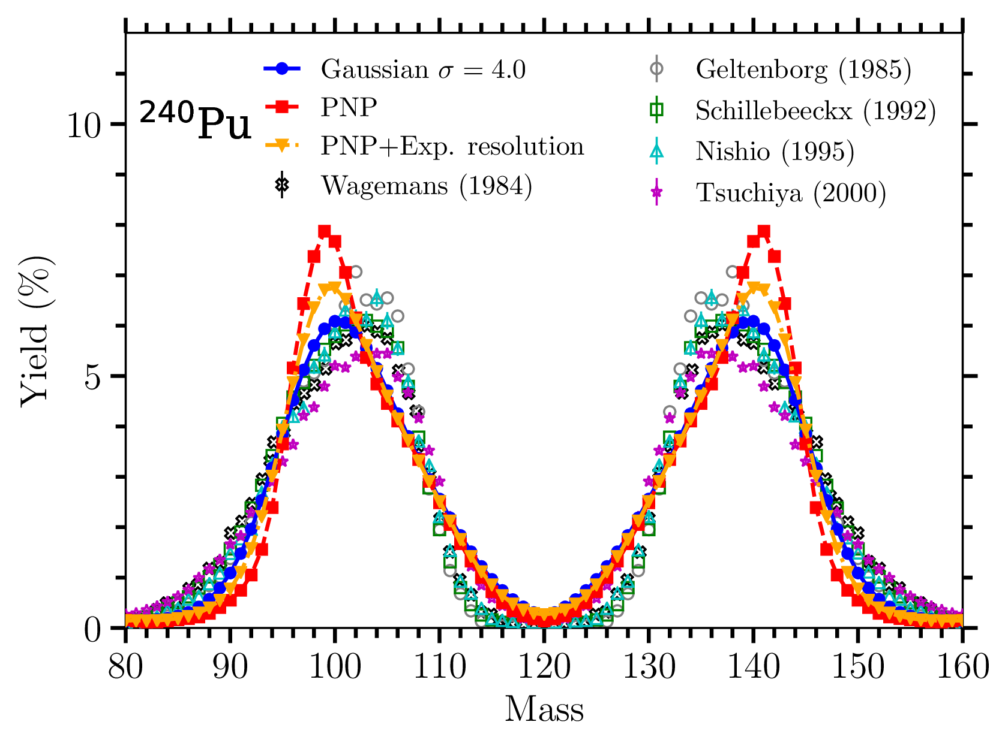
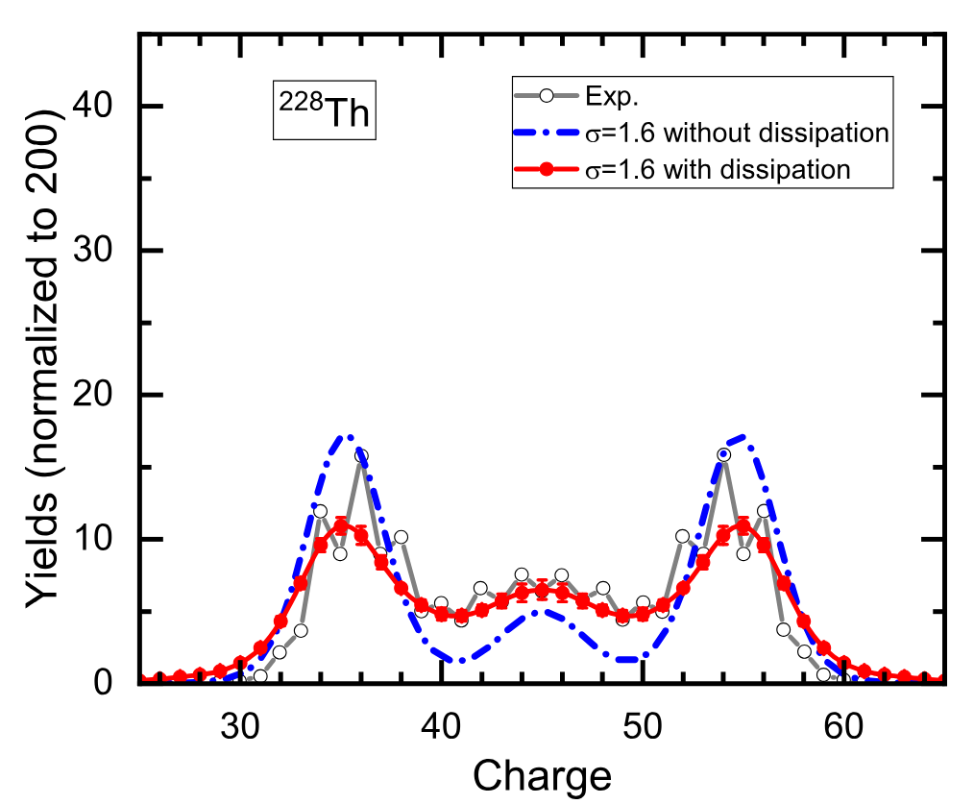
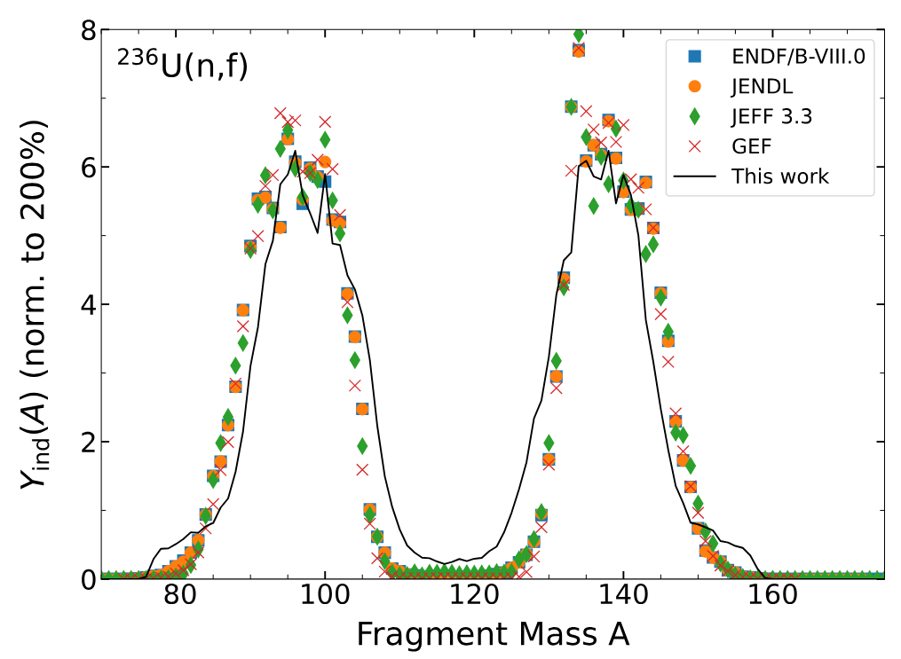
State-of-the-art simulations of fission fragment distributions agree with experiment to within 20% at best
PRC 103, 054602 (2021)
PRC 105, 054604 (2022)
Extensions of TDGCM
  Coupled-channel for entrance channel probabilities
  Finite-temperature effects
PRC 107, 044312 (2023)
Notes:
10

Slide 11
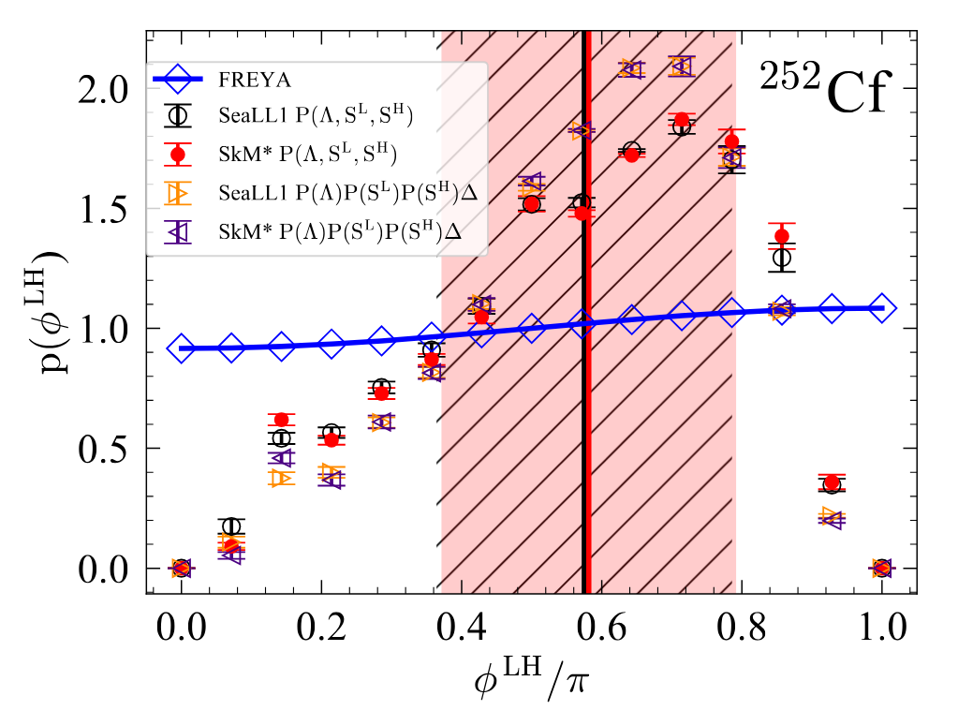
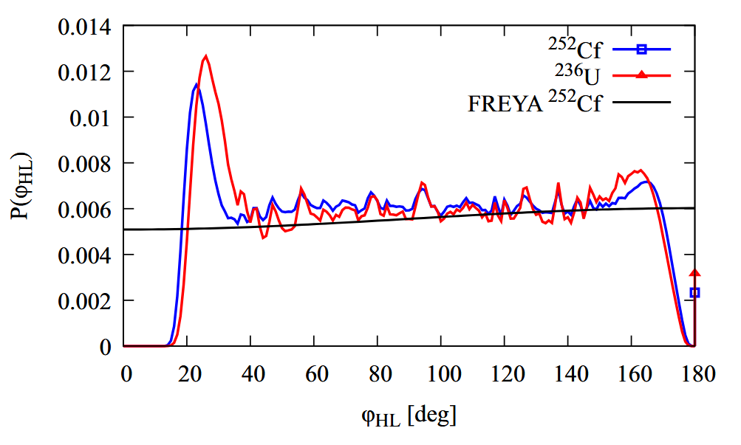
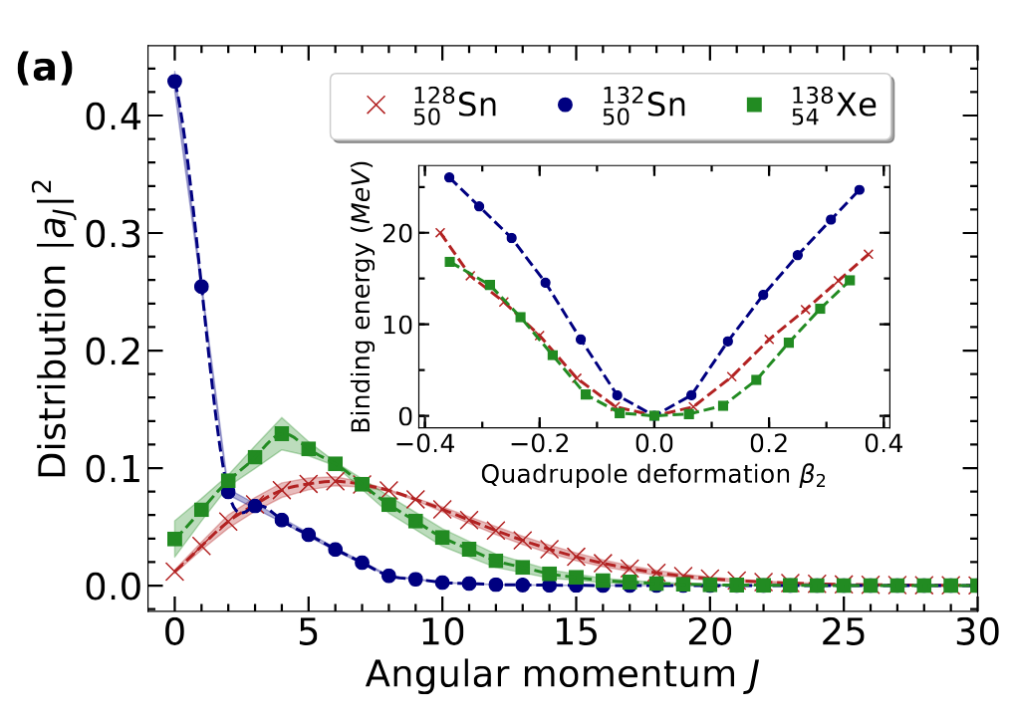
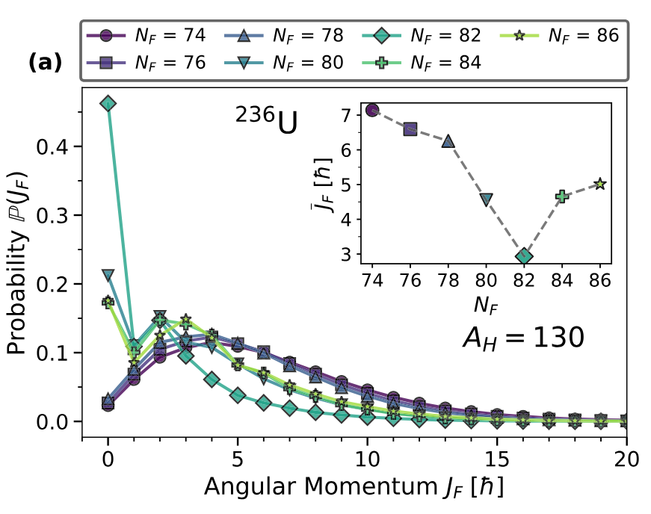
Angular momentum projection techniques predict angular momentum (and parity) content of fission fragments
PRL 128, 022501 (2022)
PRC 108, L061602 (2023)
PRC 104, L021601 (2021)
PRC 113, 034602 (2026)
FFs have preferred relative orientation that were predicted by TDDFT+AMP…
… but these predictions were later corrected after performing a full 3D projection
Deformations at scission are a key driver of the spin distributions – and they are very different from g.s. deformations
Spin distributions along an isobaric chain of FFs can be very different
Physics insights into how spin is generated in fission fragments
Constraints on phenomenological models

Slide 12
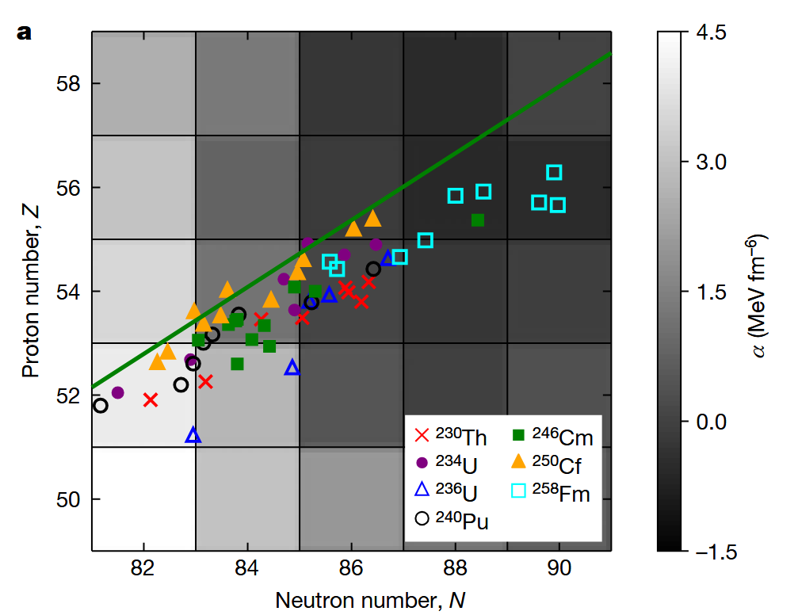
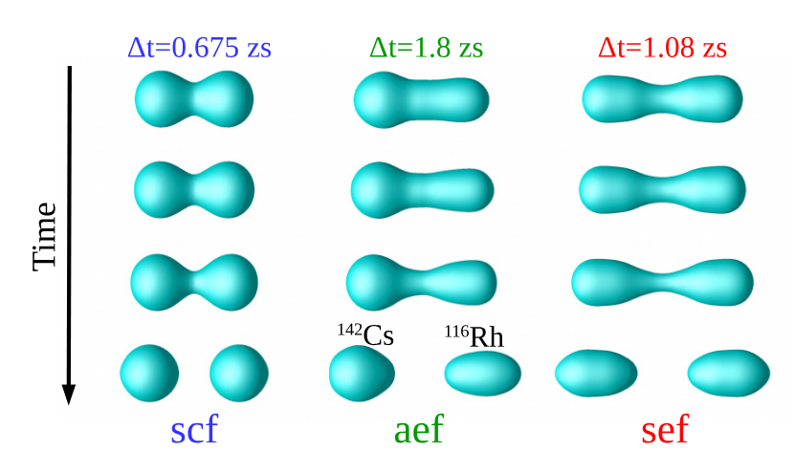
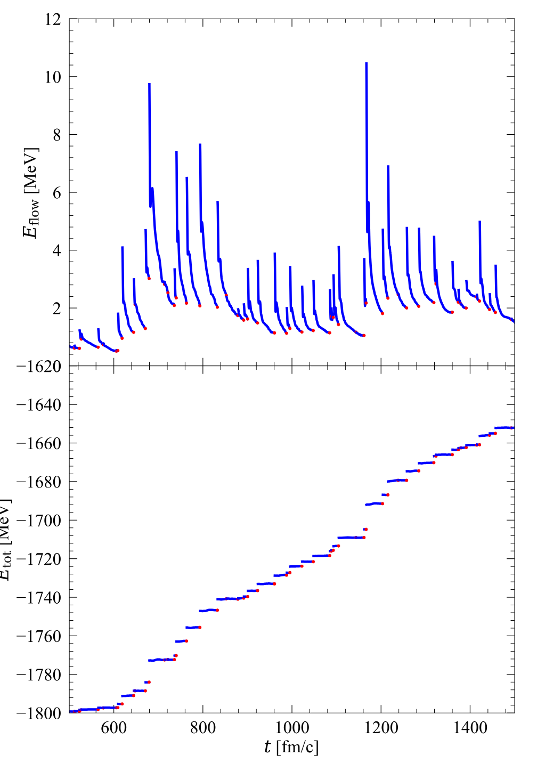
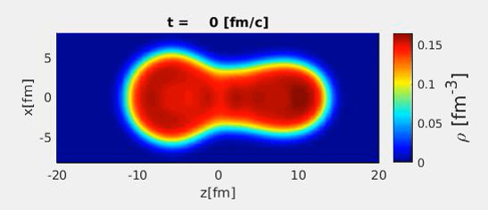
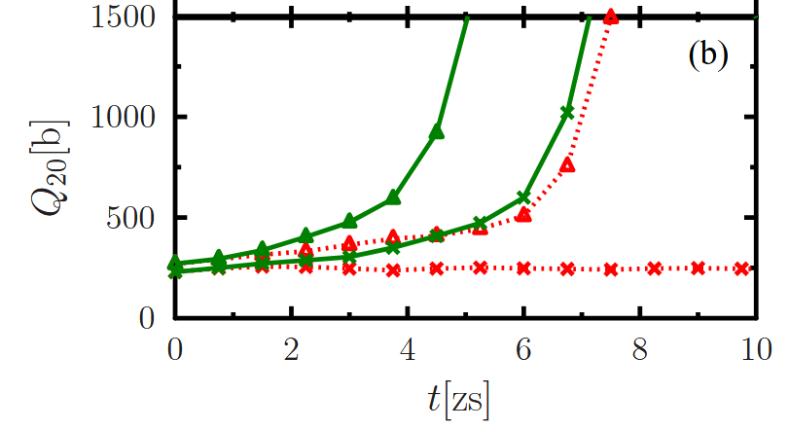
Real-time simulations of fission events with time-dependent density functional theory provided new insights
Nature 564, 382 (2018)
PRC 92, 011602(R) (2015)
PRC 100, 034615 (2019)
Competition spherical/octupole shell closure explains the peaks of fission fragment distributions
Critical role of pairing to trigger fission
Dissipative nature of the fission process

Slide 13
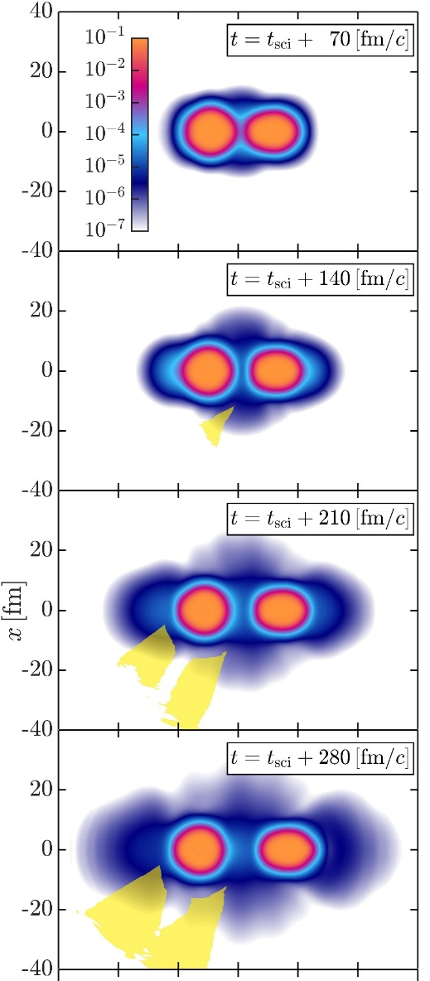
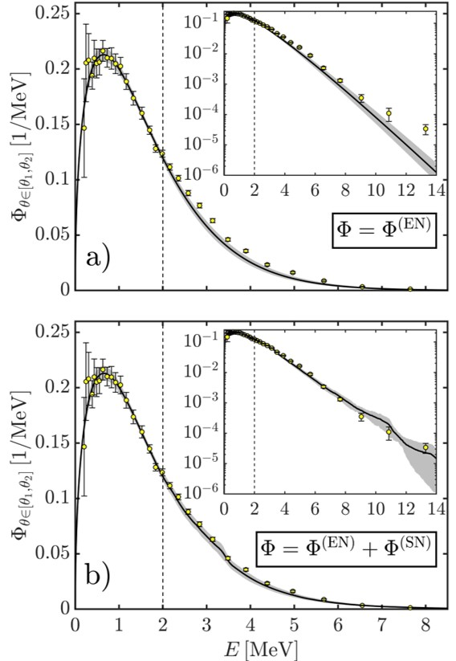
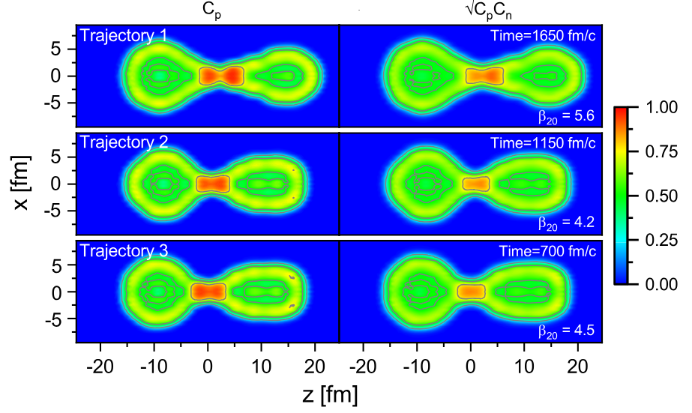
TDDFT can help tackle long-standing problems in fission such as ternary fission or scission neutrons…
PRL 128, 172501 (2022)
PRL 132, 242501 (2024)
Ternary fission most often involves an α particle
Scission neutrons
  Conjectured to be emitted by the fissioning nucleus just before it splits
  Very difficult to disentangle from prompt neutrons
arXiv:2606.09656

Slide 14
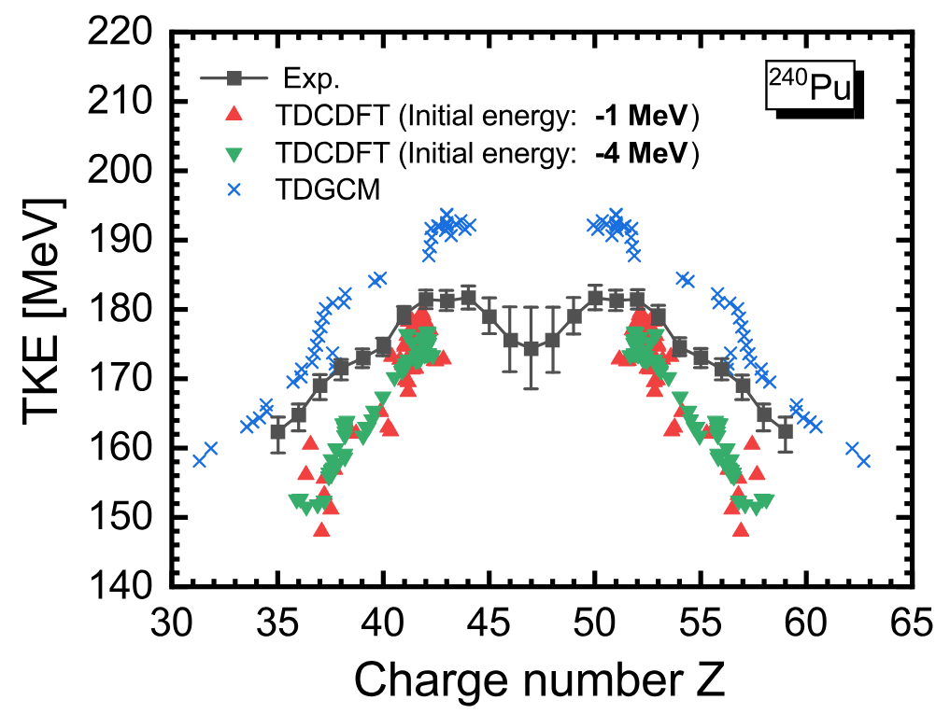
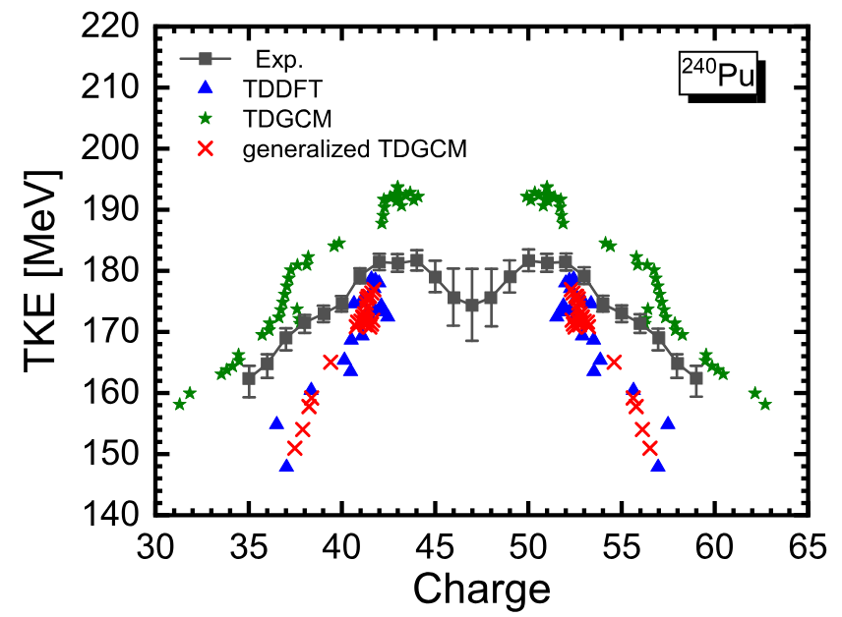
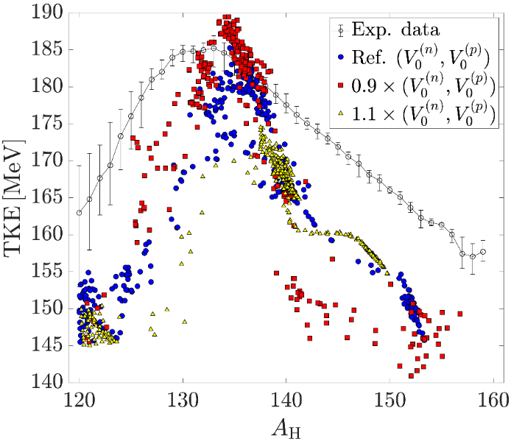
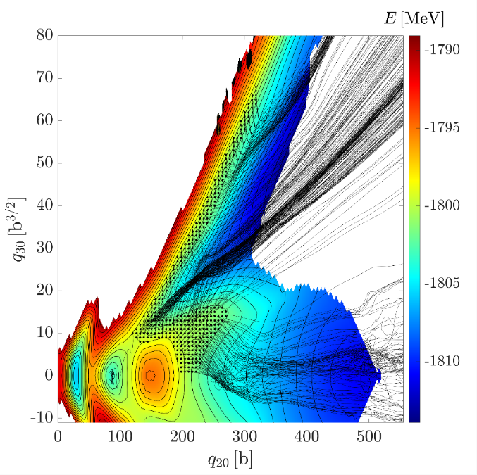
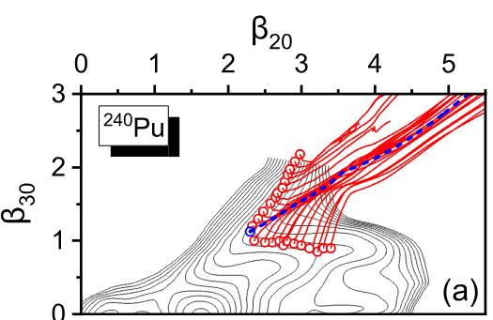
… but it still fails to reproduce TKE and excitation energies outside most likely fission
PRC 105, 044313 (2022)
PRC 111, L051302 (2025)
PRC 113, 034602 (2026)
TKE of fragments can be computed directly and compared with data
  “Standard” TDDFT fails to reproduce experimental data for all fragments
  TDGCM built out of TDDFT trajectories also fails
Initializations far from first potential well may be to blame?

Slide 15
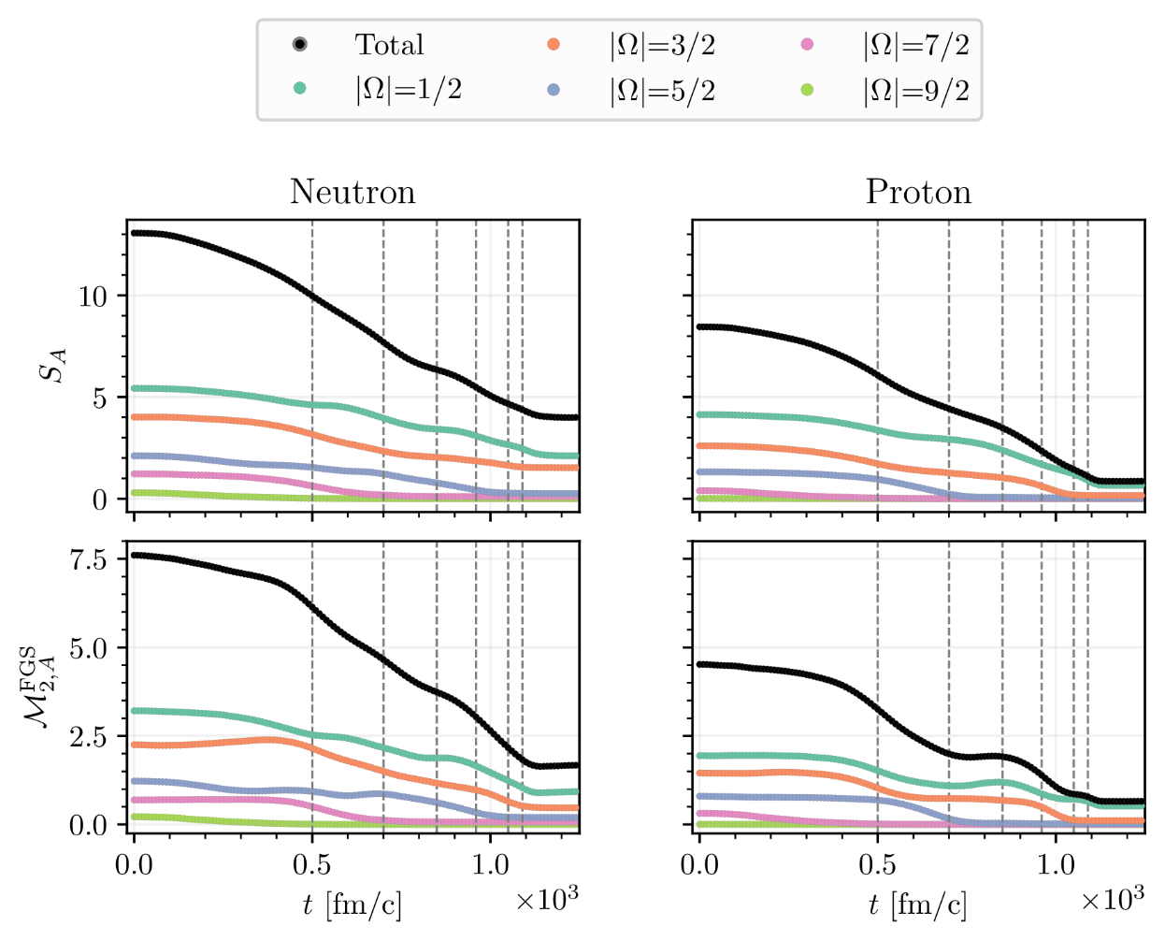
What can we learn about fission with techniques from quantum information science?
arXiv:2608.12120
arXiv:2609.03240
Entanglement entropy and non-local magic capture complexity of nuclear wave function
Initial findings suggest the two fragments remain entangled because of the neutrons, but the type of fragmentation matters

Slide 16
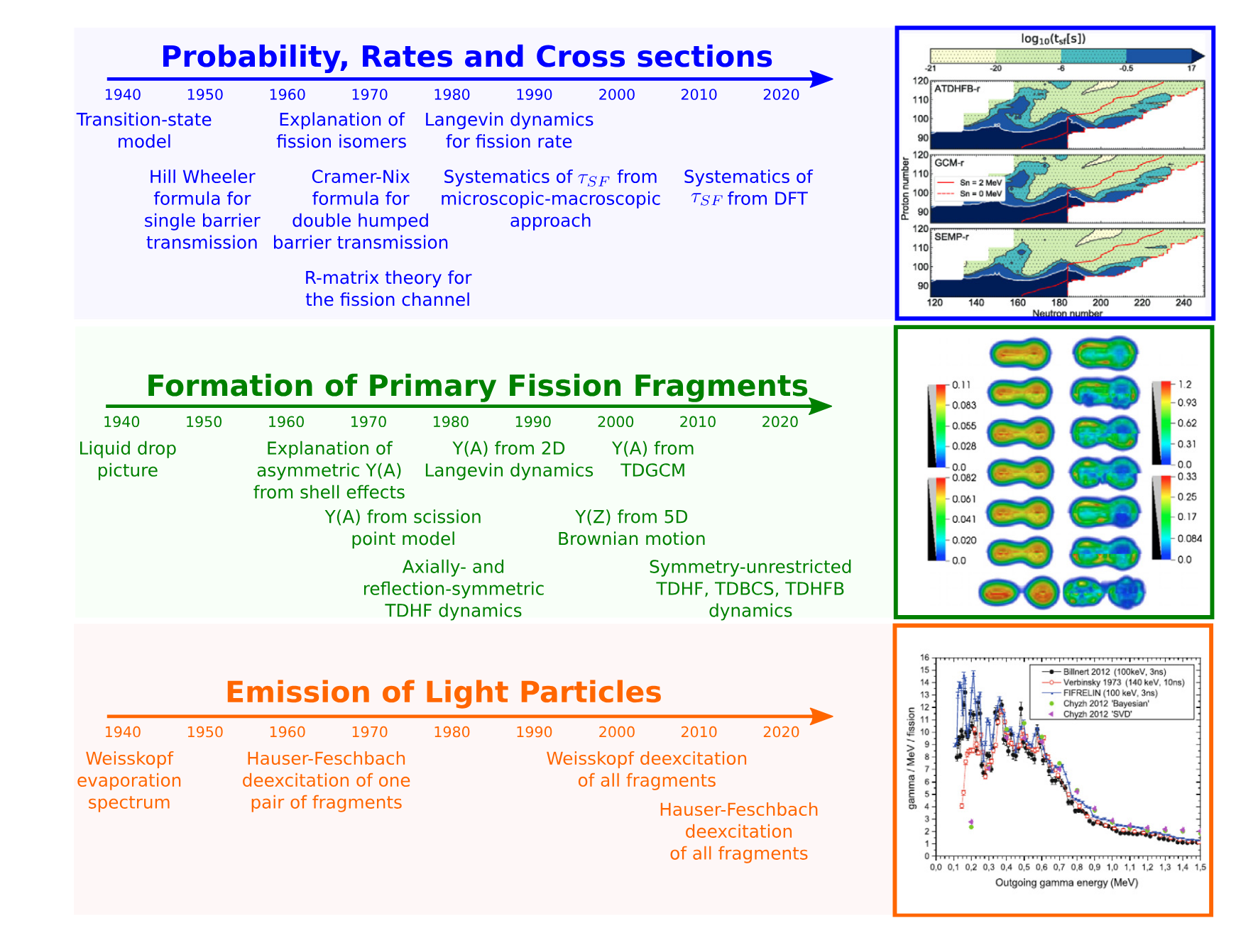
Conclusions
Renaissance of fission theory
  High-performance computing
  Symmetry restoration techniques
  TDDFT
Microscopic methods provide
  new insights on the physics of fission
  new constraints on phenomenological models
Short-term progress hinges on
  better structure models
  beyond TDDFT or TDGCM for time-dependent dynamics
Longer-term: QC for fission?
PNPP 125,103963 (2022)

