Slide 1
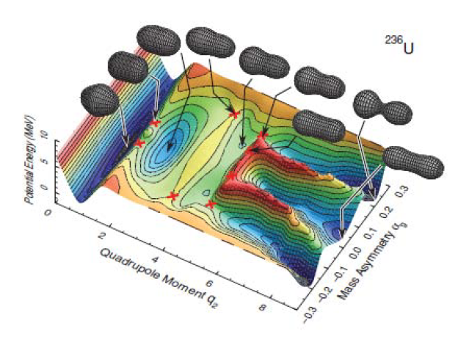


Advances in
Experimental Nuclear Fission:
Fission with New Observables
and Correlations
Zakopane Conference on Nuclear Physics
Extreme of the Nuclear Landscape !
Session : « When one nucleus becomes two !»
Antoine Lemasson, GANIL, Caen, France

Slide 2
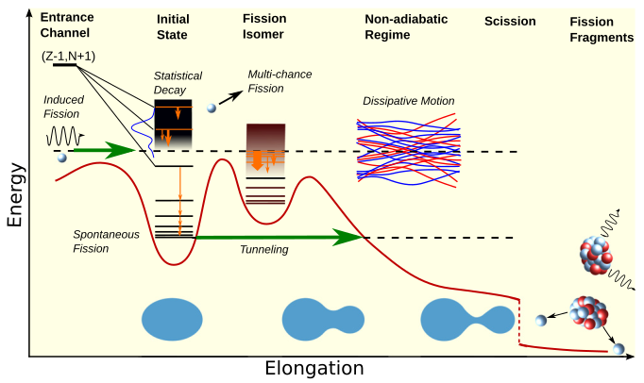
Challenging Fission
Large-amplitude collective motion
coupled to quantum/shell effects
Non-equilibrium, dissipative many-body dynamics
Predictive theory struggles with
fragment distributions, Kinetic Energies, prompt emission
A comprehensive, universal, microscopic description across the nuclear chart is missing
Sensitive to (so) many
nuclear physics aspects
Experimentally challenging !
Wide range of objects to detect and identify
  slow and heavy fission fragments
  neutrons, gamma-rays, ...
  short and long time scales
  (prompt n-emission, isomers, decay)
Complex coupled observables
Impressive progress in the last decade
J. Phys. G: Nucl. Part. Phys. 47 113002

Slide 3
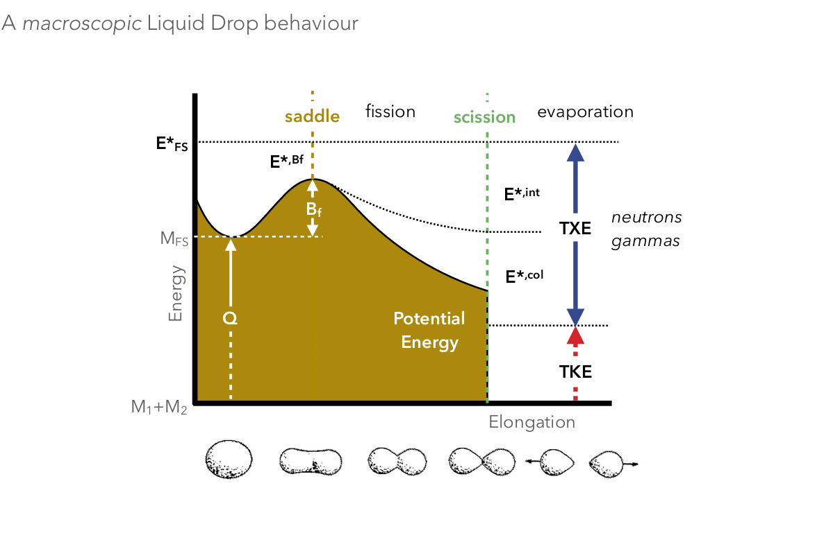

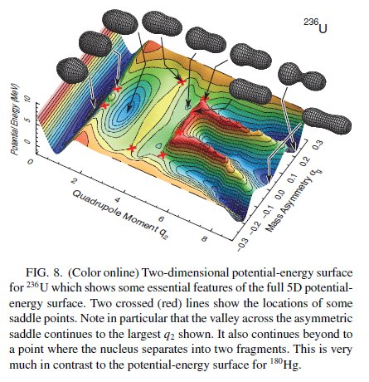
Fission Process
Fission: a “definition”
Large scale collective motion
Static forces (nuclear, Coulomb)
Dynamics of the nuclear medium
Shell-Structure + Dynamics
Favoured paths + Energy sharing
Fragment properties (A, Z, E*, TKE)
Ichikawa et al., PRC (2012)

Slide 4
Intertwinned Theories and Expriments
Back-tracing, theory-aided :
from initial and final observables to the fundamental fission driving laws
Entrance Channel (A,Z,E*,J)
Fission
Scission
Observables
Fragment
De-excitation
PRIMARY (pre-n)
SECONDARY (post-n)
A*_{1,2}, Z*_{1,2} , E* _{1,2 kin}
n,g
A_{1,2}, Z_{1,}
E_{1,2 kin}, E*_{1,2}
L_{1,2}
n,g
A*_{1,2}, Z*_{1,2} , E* _{1,2 kin}
A_{1,2}, Z_{1,2}
E_{1,2 kin}, E*_{1,2} L_{1,2}
Ichikawa et al., PRC (2012)
conservation laws & kinematics

Slide 5
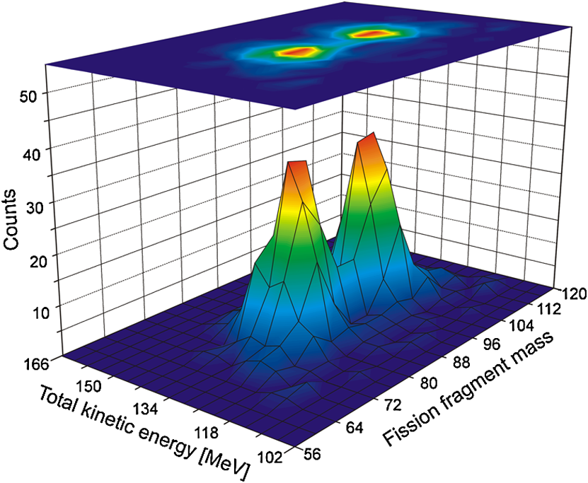
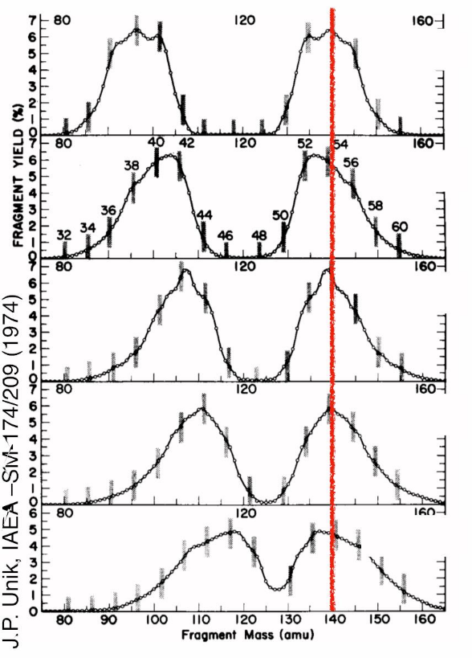
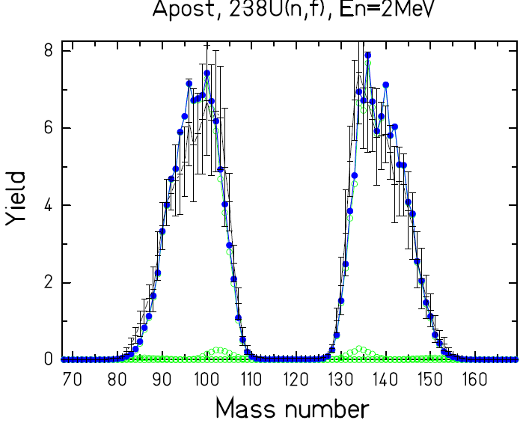
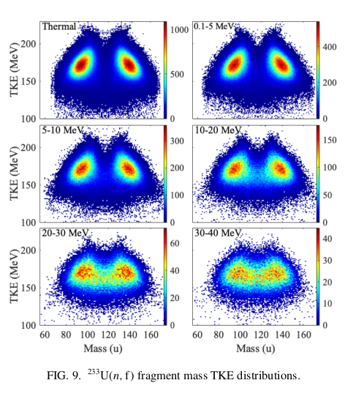
Correlations give insight to the fission process
Fissioning system-E*
and
Fission Fragment Mass-TKE correlations
Fission Fragment Mass Distributions
²³⁵U
²³⁹Pu
¹⁸⁰Hg (Andreyev et al PRL (2010) )
²⁴⁵Cm
Symmetric / Assymetric distributions
Multimodal distributions
Evolution as function of :
  Excitation Energy (E*)
  Fissionning system (A,Z)
²⁴⁹Cf
²⁵⁴Es
Shell Stabilization
Competition
Microscopic / Macroscopic properties
²³³U(n,f) Higgins et al,
PRC 101, 014601 (2020)
Unik et al. (1973)
Spontaneaous / beat-- Neutron induced – Fusion

Slide 6
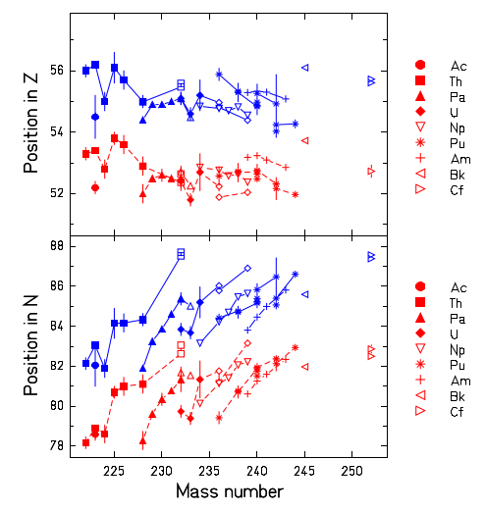
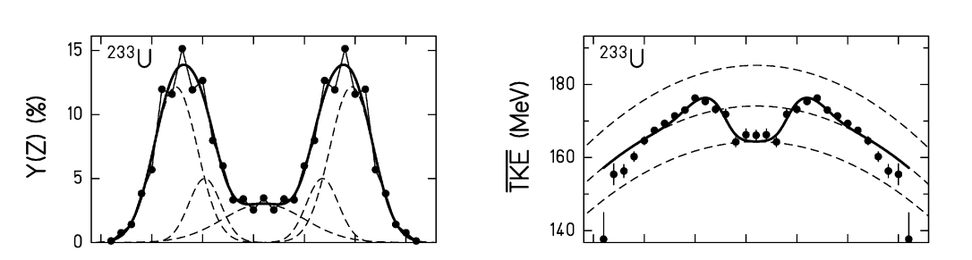
Correlations give insight to the fission process
Fissioning system
and
Fission Fragment Z-TKE correlation
Wide range of fissioning systems (Ac-Cf)
Asymetric distributions
Multimodal distributions
Evolution as function of fissionning system
Heavy fragment located at :
  Z~52 in S1
  Z~55 in S2
Proton Shells stabilization
Competition between modes
Schmidt et al., NPA (2000)
Bockstiegel et al., NPA (2008)

Slide 7
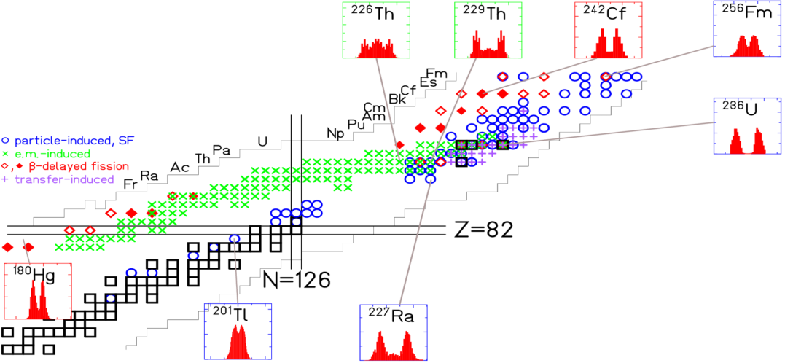
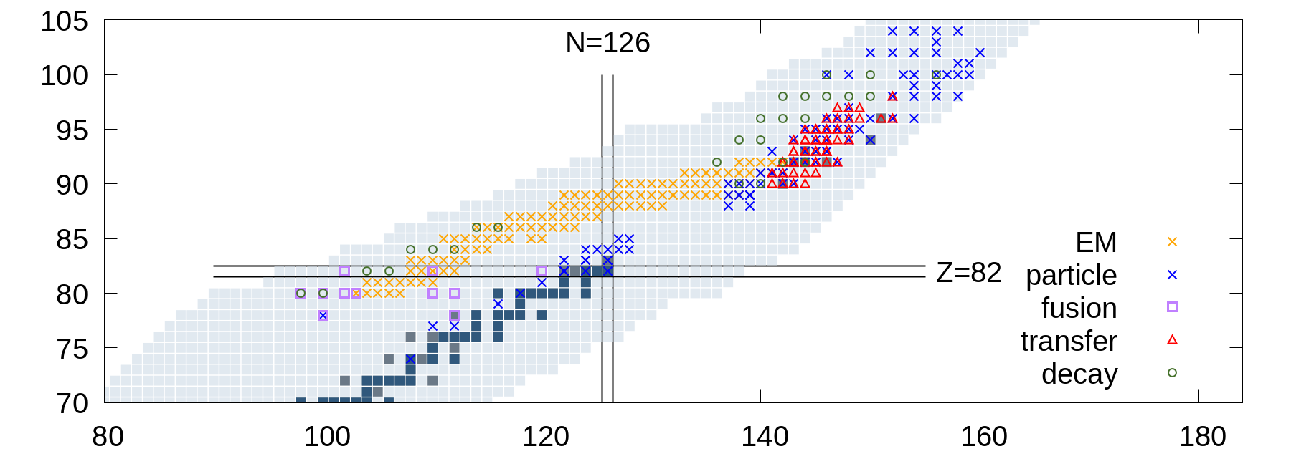
« Universality » of shell effects across fission landscape
Pre-Actinides N/Z ~ 1.2
Unexpected Assymetric fission
in ¹⁸⁰Hg (Andreiev et al PRL (2010) )
=> New stabilizing effects
at Z ~ 36 deformed
Actinides N/Z ~ 1.5
Identified shell effects
(Z= 52, 56, N=82,88)
Competition between modes
Open questions on the pairing and the damping of shell effects with E*
Isotopic scission observables
Looking for a coherent picture across the landscape

Slide 8
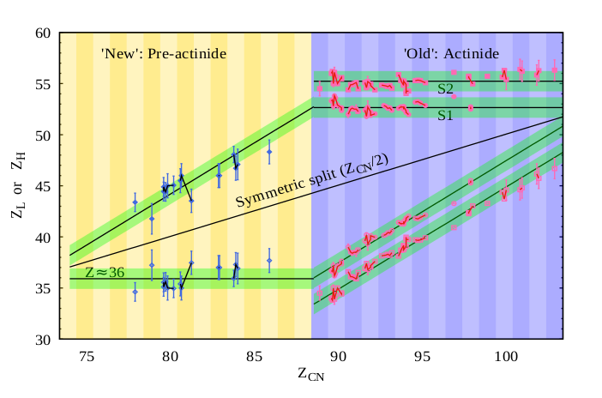
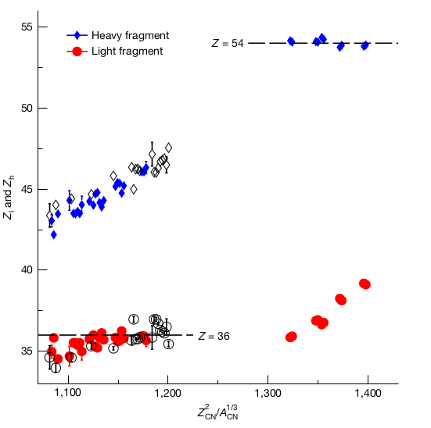
Universality of shell effects: proton configurations steer fission
Pre-actinide Fusion Fission / β-delayed
Z_{heavy} and Z_{Light} inferred
EM Fission Induced
Z_{heavy} and Z_{Light} measured
K. Mahata et al. PLB (2022)
Protons emerge as dominant drivers
accros the fission landscape
C. Schmitt et al., Phys. Rev. Lett. 126, 132502 (2021);
K. Mahata et al., Phys. Lett. B 825, 136859 (2022);
P. Morfouace et al., Nature 641, 339 (2025);
J. Buete et al., arXiv:2503.23681 (2025).
P. Morfouace et al. Nature (2025)
Talks : P. Morfouace for recent
results on n-deficient systems
Notes:
For decades, asymmetric fission was largely discussed in terms of fragment masses and neutron shell closures, most famously the accumulation of heavy fragments around $A∼140$.
But when we extend measurements over nuclei with very different $N/Z$, the mass of the preferred fragment is no longer constant. What remains surprisingly stable is its charge.
“So the emerging universal quantity may not be a preferred fragment mass, or even one particular shell. It is the tendency of the evolving fissioning system to exploit a small number of energetically favoured proton configurations.”
Shell effects are a universal ingredient of the fission landscape, and fragment proton number emerges as a remarkably robust coordinate organizing the final partition.
G. Scamps and C. Simenel, Impact of pear-shaped fission fragments on mass-asymmetric fission in actinides, Nature 564, 382–385 (2018). DOI: 10.1038/s41586-018-0780-0.
G. Scamps and C. Simenel, Effect of shell structure on the fission of sub-lead nuclei, Phys. Rev. C 100, 041602(R) (2019). DOI: 10.1103/PhysRevC.100.041602.
For the conclusion of your universality slide, I would use:
Across actinides and sub-lead nuclei, fission asymmetry emerges from the same mechanism: shell-stabilized, octupole-deformed proton configurations steer the fragments toward preferred $Z$.
Or, even shorter and more punchy:
A universal mechanism emerges: fission exploits octupole-stabilized proton shells to select preferred fragment charges.

Slide 9
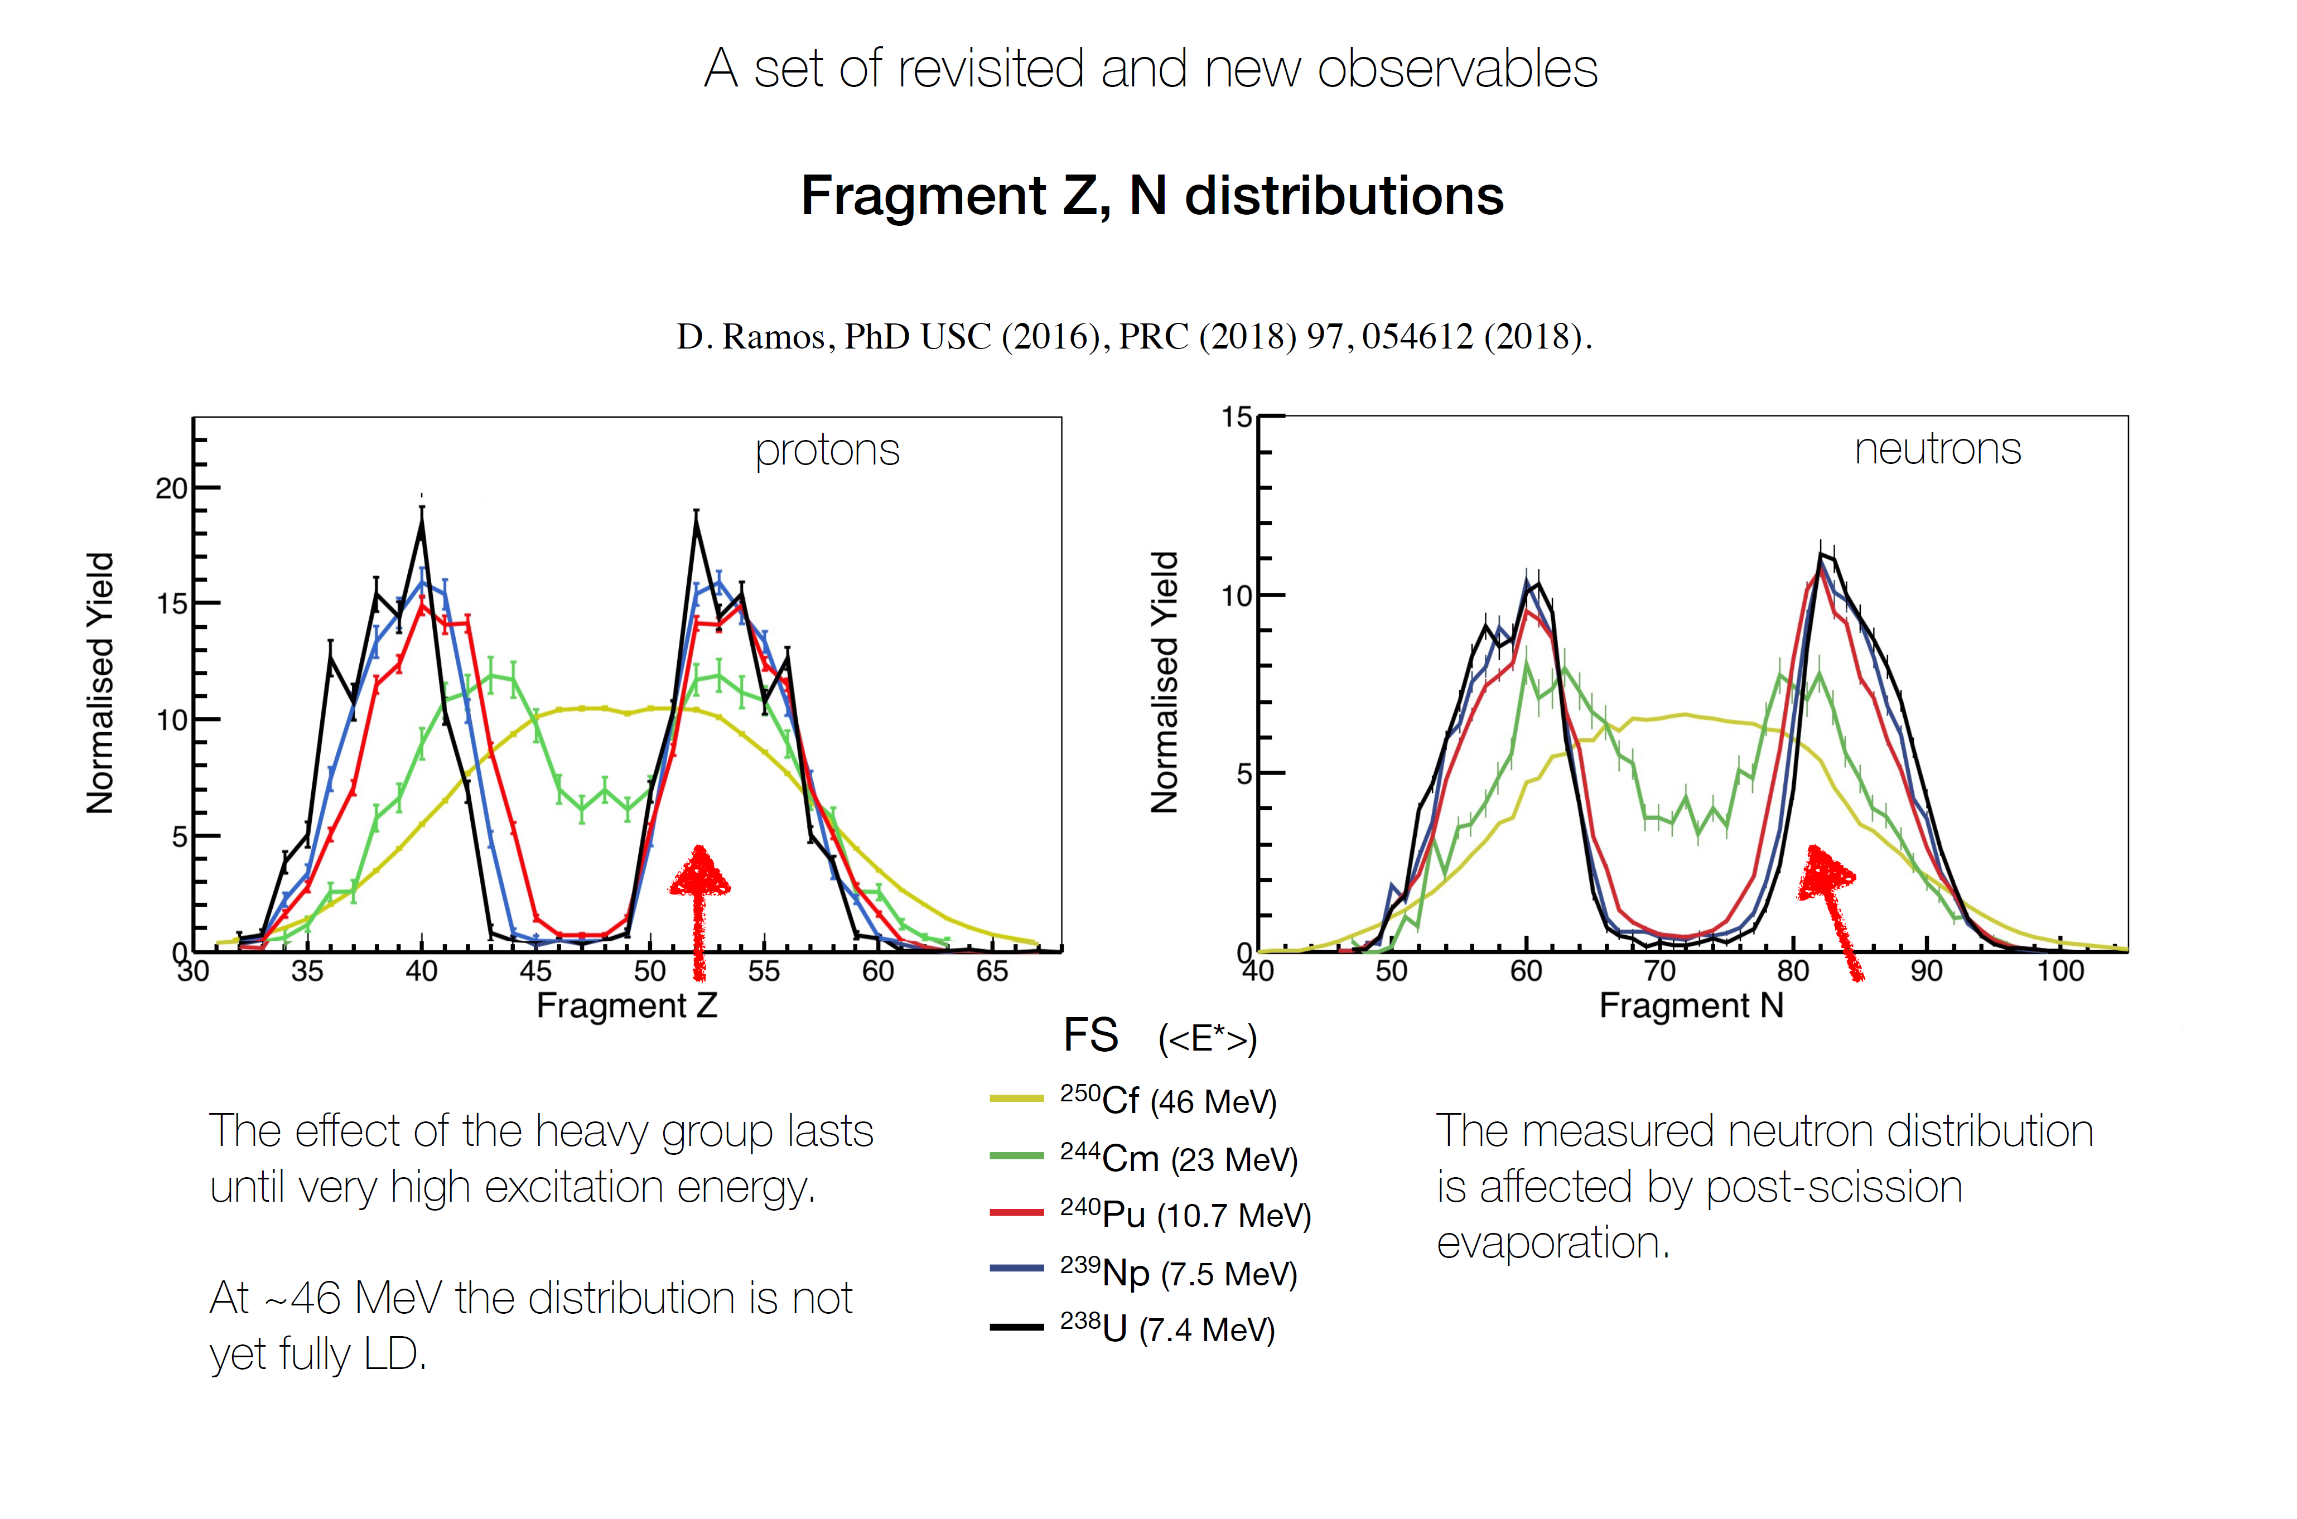
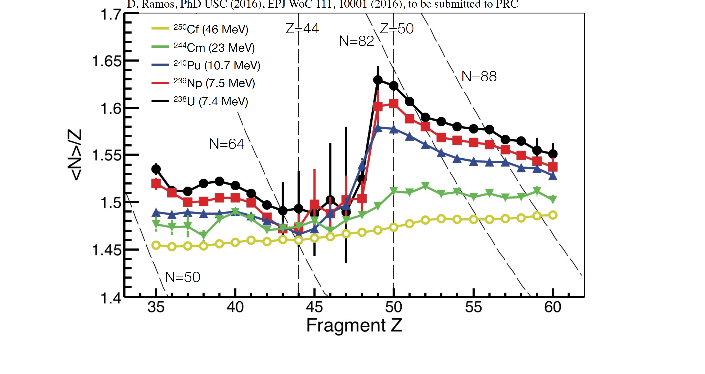
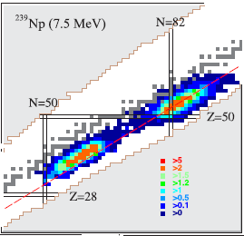
Correlations give insight to the fission process
Fissioning system-E*
and
Fission Fragment A-Z correlations
0.01 in N/Z
=> Sensitivity better
than 1 neutrons
M. Caamano et al. PRC (2015)
D. Ramos et al. PRC(2019)
Post
Reveals fine structural effects otherwise unknown

Slide 10
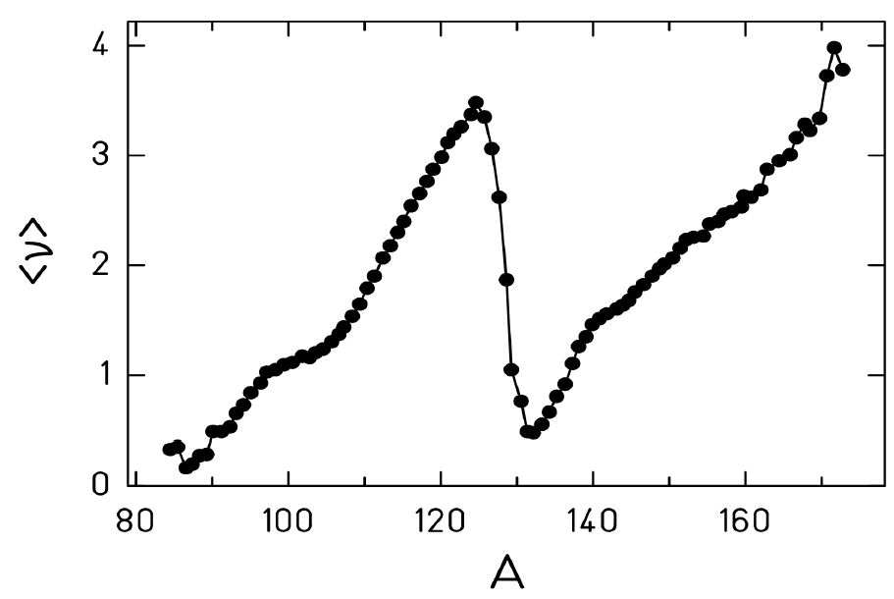
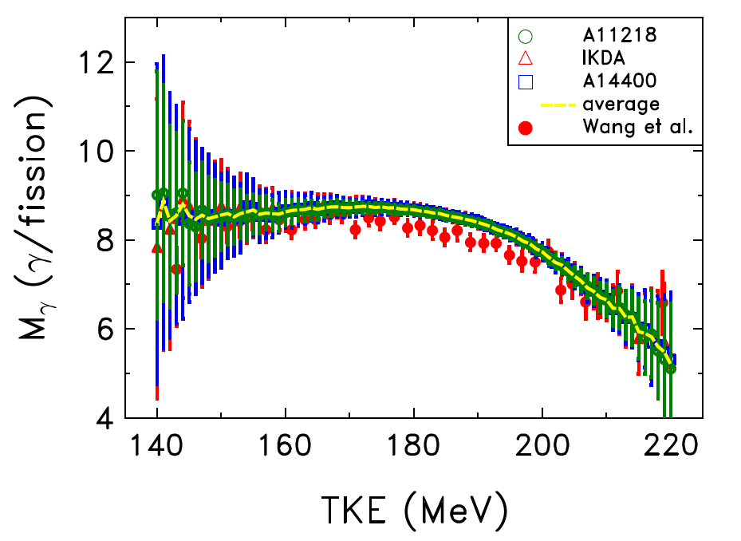
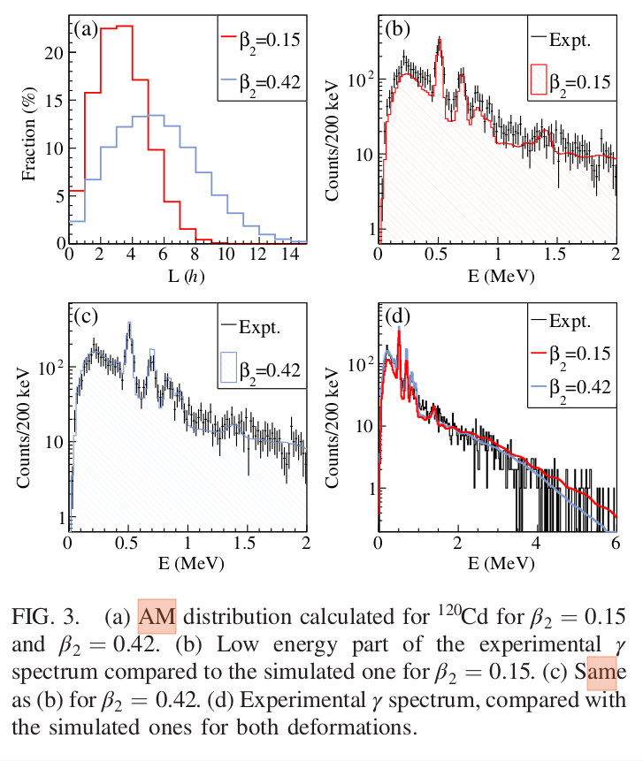
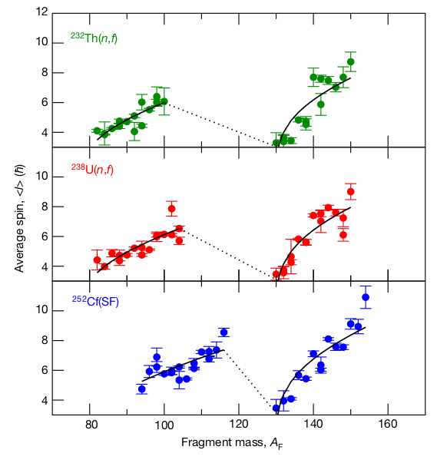
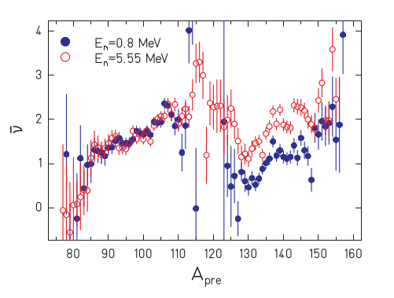
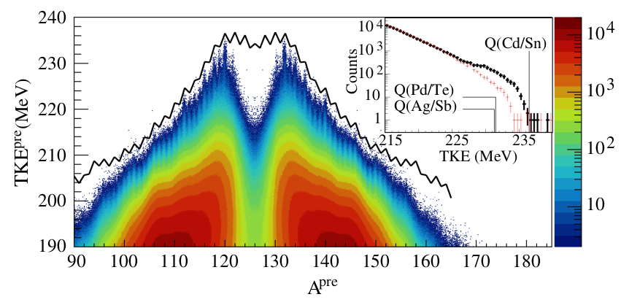
Correlations give insight to the fission process
neutron multiplicty & gamma-rays
²⁵²Cf
²⁵²Cf
Fissioning system-E*
and
Fission Fragment Mass-neutron/γ-ray correlations
Average spin <J> of FF
A-TKE-γ-rays
<ν> (A,E*)
Francheteau et al. PRL 132, 142501 (2024)
K-H Schmidt and B. Jurado
PRL 104, 212501 (2010)
Compettion between Shell Effects
Energy sharing among fragments
Energy Sorting (Level Densities)
De-excitation of FF
Angular momentum generation
Wilson et al, Nature 590, 566 (2021)
Talks by
A. Al-Adili, M. Ciemala,
J. Wilson, B. Mauss

Slide 11
The Experimental Fission Landscape Today
Many complementary experimental routes:
direct kinematics, inverse kinematics, storage rings, spontaneous fission, ISOL beams, in-flight fission, ...
Different facilities reach different regions of the nuclear chart and different observables
This session reflects that diversity : GANIL, GSI, ISOLDE, IGISOL, OSLO, LANL, ...
In the following, I will further exemplify
insight on the fission process
gained from correlations measured at VAMOS

Slide 12
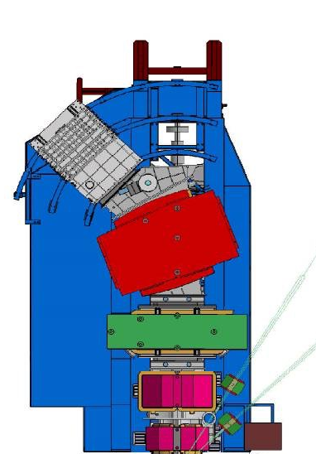
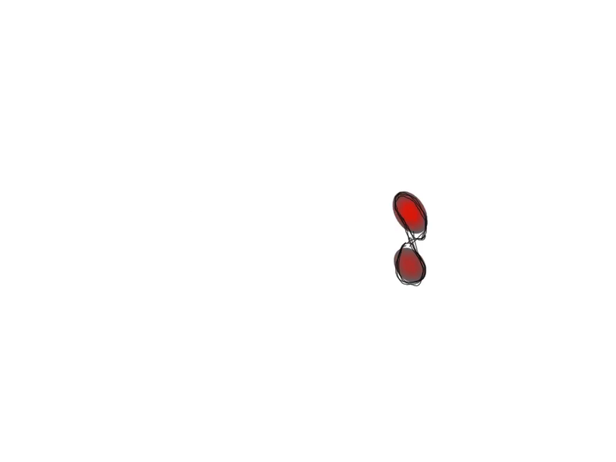

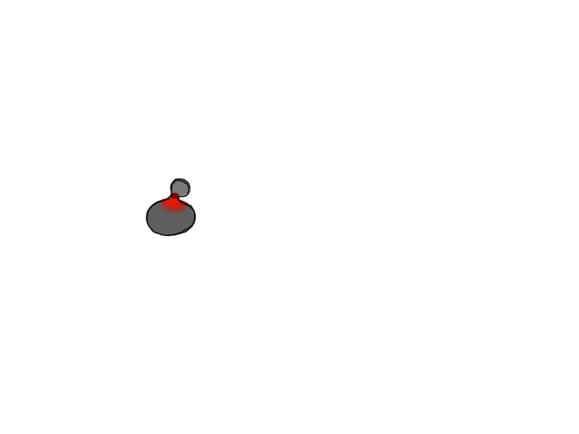
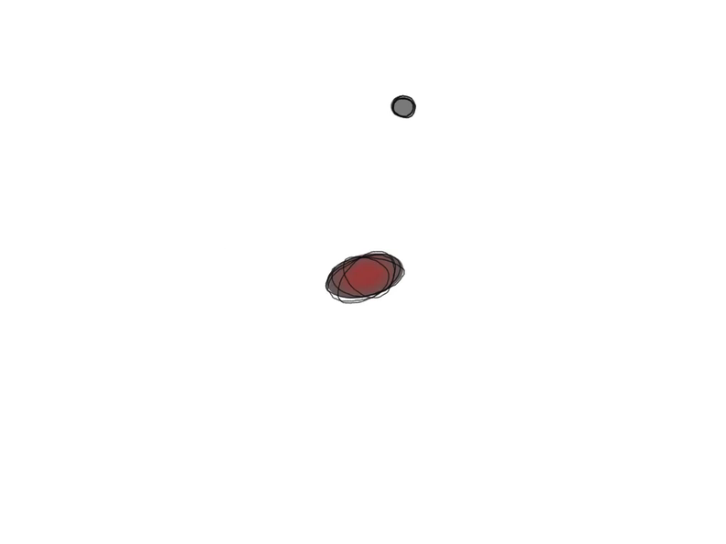
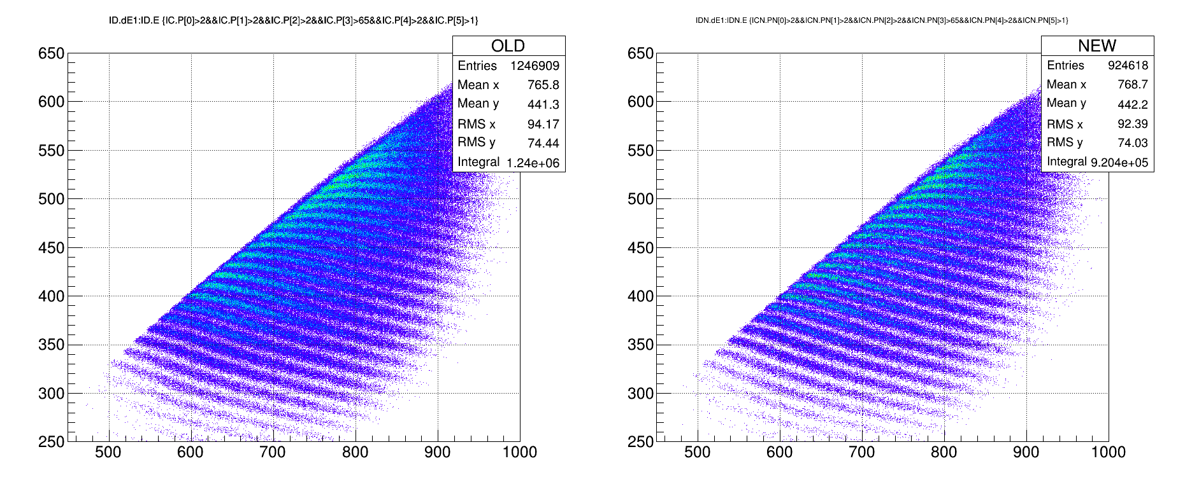
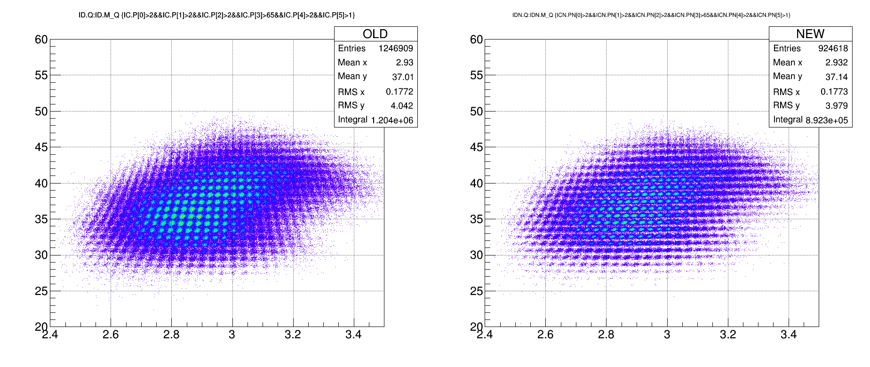

Fission in inverse kinematics at VAMOS++
Inverse Kinematics using beams of ²³⁸U/²³²Th around Coulomb Barrier
Access to a range of exotic fissioning systems heavier than ²³⁸U
VAMOS++
Fission Fragments
(A,Z,q)
evaporation
fission
VAMOS Magnetic Spectrometer
Direct and Complete isotopic identification of fission fragments
Precise center-of-mass fission fragment velocities
²³⁸U
@ 6 AMeV
transfer
reaction
¹²C
target
Atomic
Charge
(Z)
Mass (A)
recoil
SPIDER → PISTA:
Recoil
A, Z, E, angle
M. Rejmund et al., NIM A (2011)
Y-H Kim et al., EPJA (2018)
A. Lemasson et al,. EPJA (2023)
ΔE (MeV)
Q
Inverse KinematicsTalks :
A. Cobo Zarzuelo, B. Errandonea
P. Morfouace, B. Jurado
E (MeV)
M/Q
12
observables:
Fissioning System:
- A, Z, E*, angle, velocity
Fission Fragments:
- A^{post}, Z, q, angle, velocity

Slide 13
VAMOS++ and PISTA/SPIDER
Inverse Kinematics using beams of ²³⁸U/²³²Th around Coulomb Barrier
Access to a range of exotic fissioning systems heavier than ²³⁸U
VAMOS++
Fission Fragments
(A,Z,q)
evaporation
fission
²³⁸U
@ 6 AMeV
transfer
reaction
¹²C
target
recoil
SPIDER/PISTA
Recoil
(A, Z, E, angle)
Surrogate reactions
(transfer induced fission)
Identification of the fissionning system
Measurement of the fissionning system excitation energy
13
observables:
Fissioning System:
- A, Z, E*, angle, velocity
Fission Fragments:
- A^{post}, Z, q, angle, velocity

Slide 14
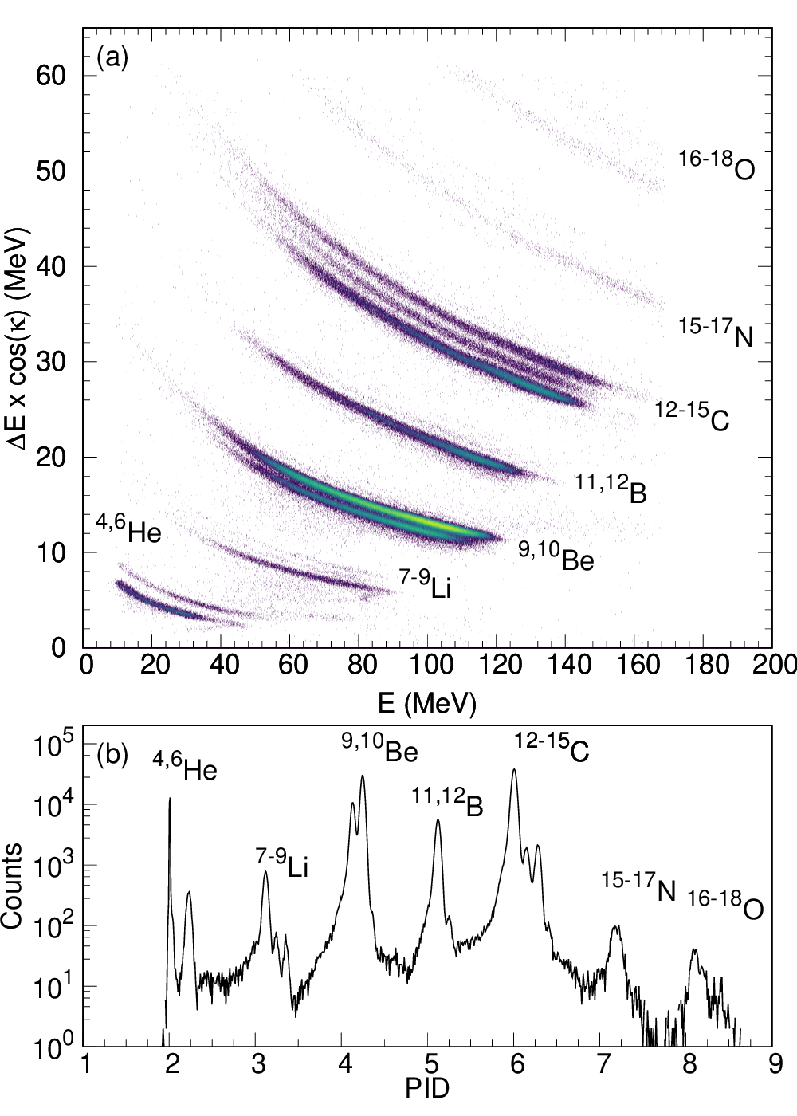

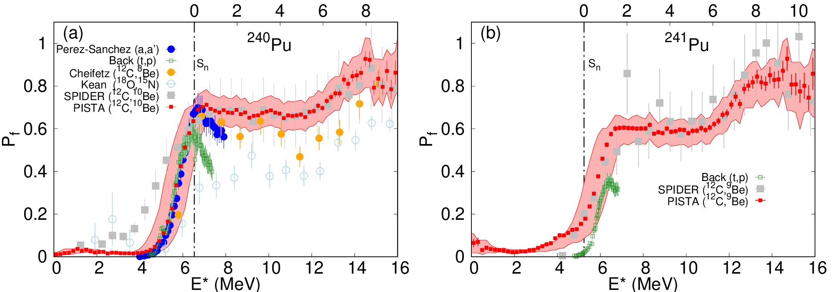
VAMOS++ and PISTA/SPIDER
PISTA
Fissioning System Identification
GANIL-CEA/DAM collaboration
ΔE
100 µm thickness
0.5 mm strips (θ)
10 cm from target
E
1 mm thickness
1.2 mm strips (ɸ)
¹⁰Be
FF
²³⁸U
FF
¹²C
High granularity
(0.5 mm strips)
High homogeneity
Precise Excitation Energy, Fission Probability
  ∆E_{x}∼800 keV (FWHM)
L. Begué—Guillou et al. NIM A 1090, 171671 (2026) 10.1016/j.nima.2026.171671
Talk by B. Jurado (P_{f},P_{n},P_{g} at Storage Rings / Surrogate Methods)

Slide 15
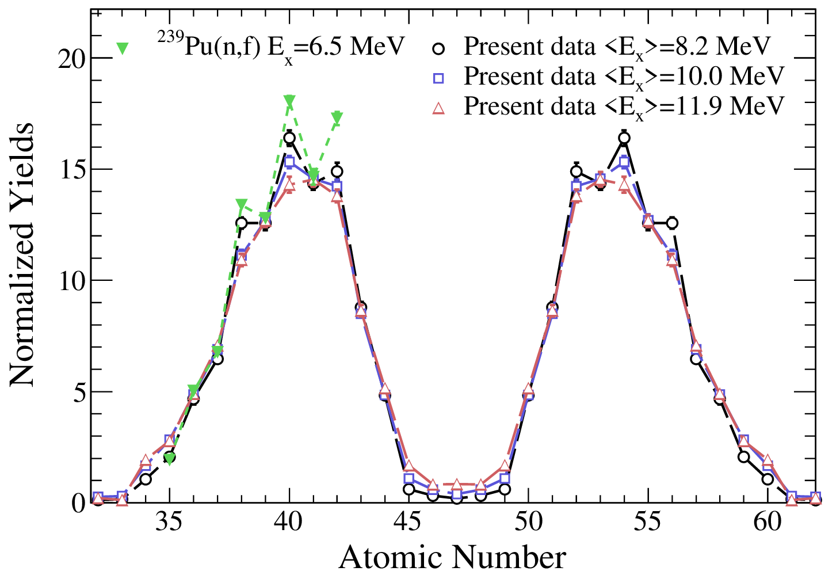
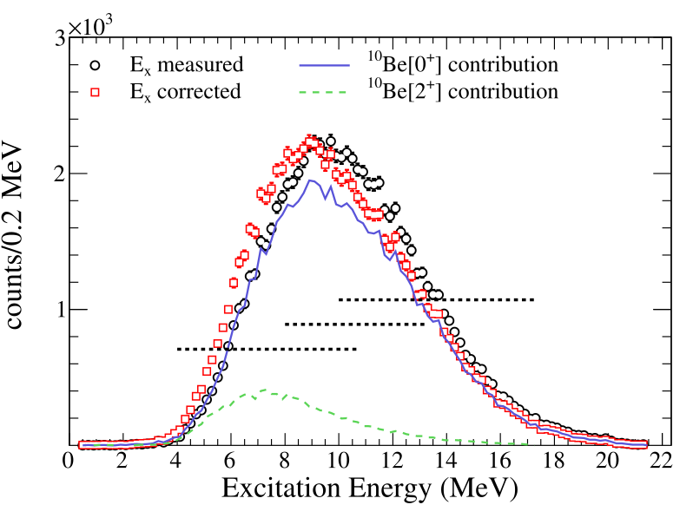
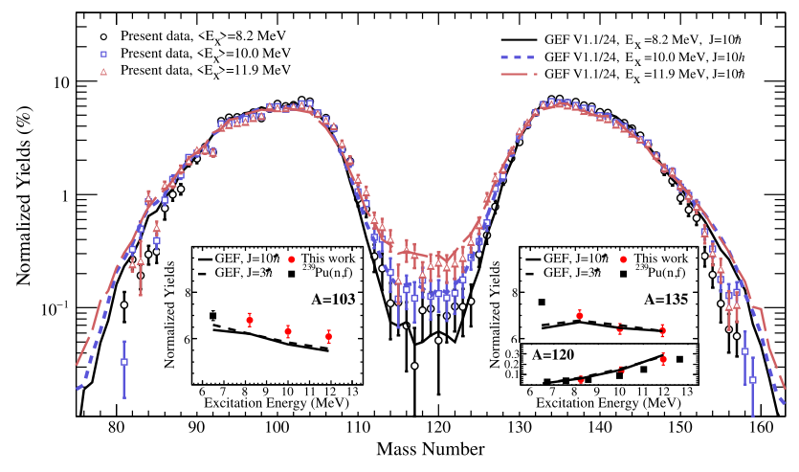
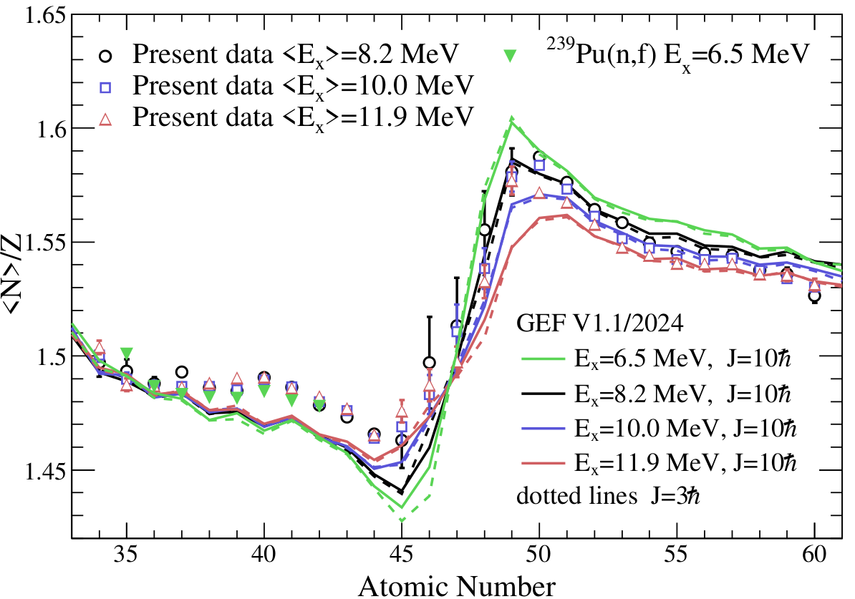
VAMOS++ and PISTA/SPIDER
E* and Isotopic Yields
²⁴⁰Pu
Progressive damping of shell effects.
Damping of even-odd staggering
Reduction of neutron richness of fnal heavy fragment with increasing E*
=> energy is mainly dissipated through neutron evaporation from the heavy fragment.
Talks by :
B. Errandonea and A. Cobo-Zarzuelo
D. Ramos et al. Phys. Rev. C 113, 054611 (2026)
Excitation-energy sharing is asymmetric: with increasing E*, the heavy fragments become less neutron rich while the light-fragment <N>/Z remains nearly unchanged → additional energy is mainly dissipated through neutron evaporation from the heavy fragment.
Correlated observables reveal physics hidden in yields alone: the Z=50 region shows a strong shell-related signature and provides stringent constraints on fission models; GEF reproduces the global trends but misses details of the fragment neutron content.
Y(A_{post},Z,E*), <N>/Z(Z,E*)

Slide 16
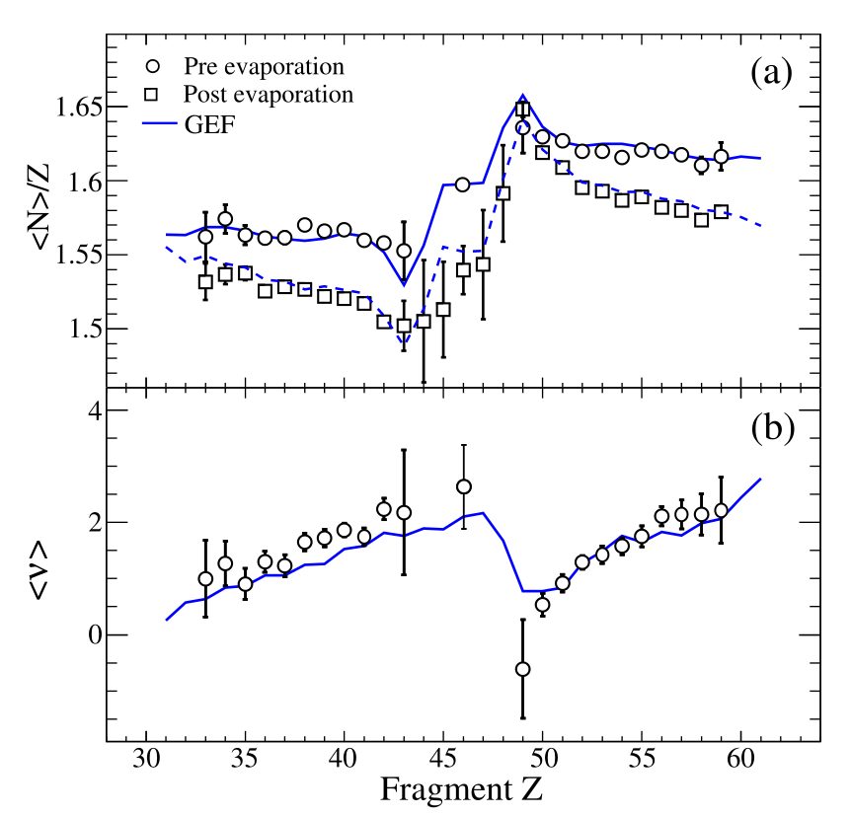
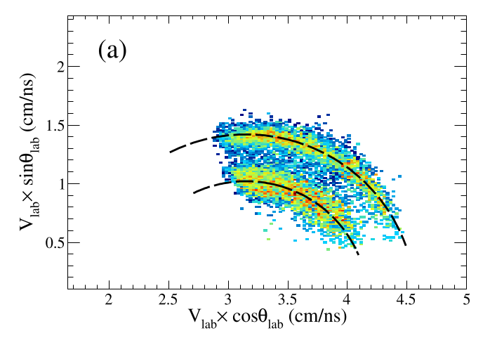
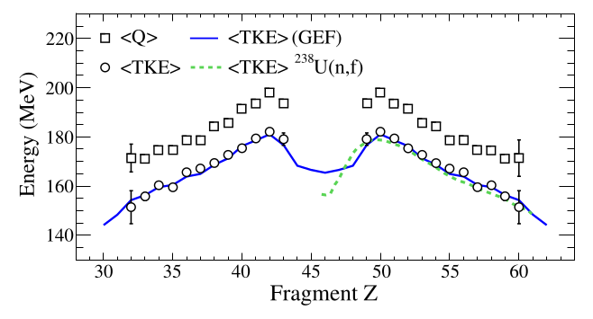
Tracing back to scission
(Z,A)-neutron multiplicity-TKE
²³⁹U
²³⁹U
Tracing back to scission quantities vs Z
  <N_{pre}>/Z (Z)
  <ν> (Z)
  <TKE> (Z)
  <TXE> (Z)
²³⁹U
using one fragment velocity
+ conservation laws
at Coulomb barrier energies
D. Ramos et al.,
Phys. Rev. C 101, 034609 (2020)
Y(A_{pre},Z), <N_{pre}>/Z(Z), <ν>(Ζ)

Slide 17
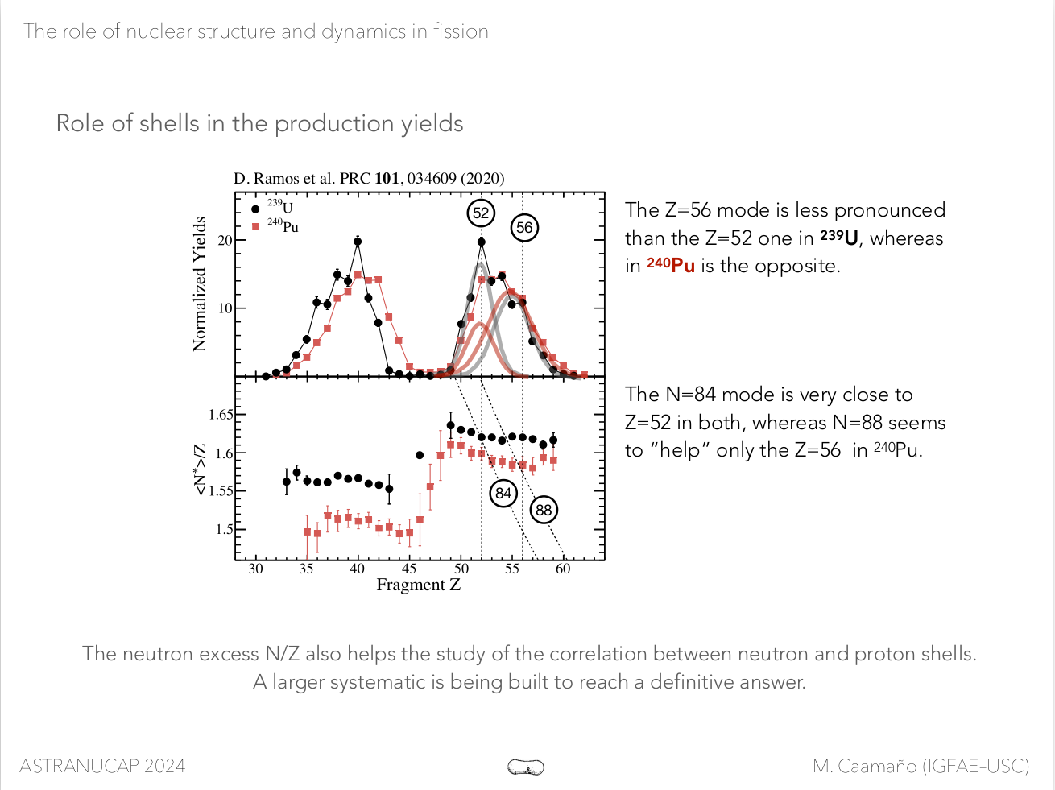
Tracing back to scission
The neutron excess (N/Z) at scission allows to study the correlation between neutron and proton shells.
By combining several systems the role of proton- and neutron- octupole deformed shells [G. Scamps, C Simenel, Nature 564, 382 (2018)] is revealed :
The enhanced yields of Te in ²³⁹U can be explained by the combined effect of the octupole shells in Z=52 and N=84
The enhanced yields of Ba can be explained by combined effect of the N=88 and Z=56
D. Ramos et al.,
Phys. Rev. C 101, 034609 (2020)

Slide 18
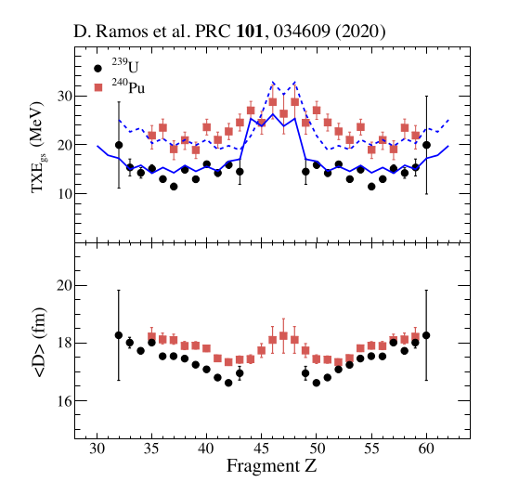
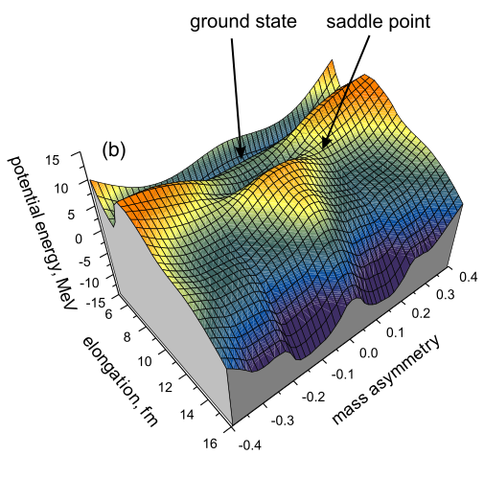
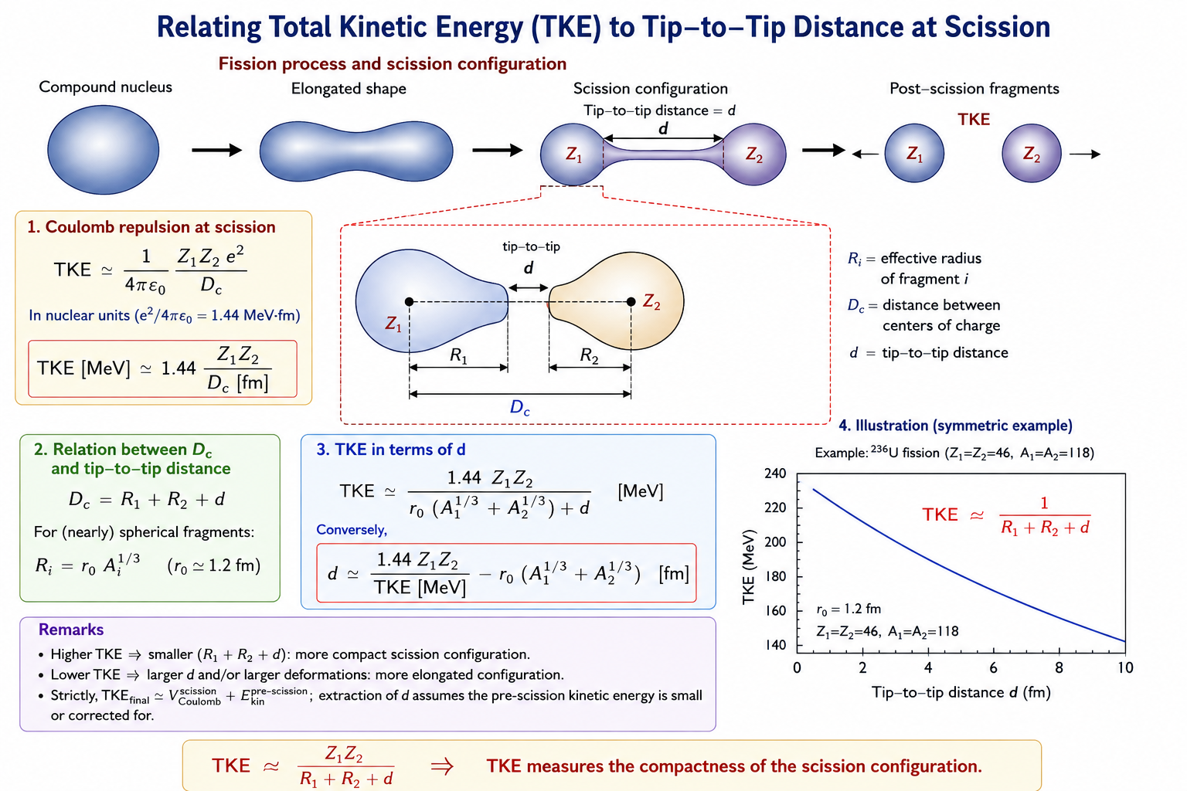
Tracing back to scission
(Z,A)-TXE-Distance
TXE = Q-TKE
The excitation energy of the fission fragments and their relative distance at scission are related to the dynamics and shape of the potential surface
D. Ramos et al., Phys. Rev. C 101, 034609 (2020)
Y(A_{pre},Z), <N_{pre}>/Z(Z), <ν>(Ζ)

Slide 19
Where are we heading today ?
Towards complete measurements at VAMOS++
  Done : Isotopic distribution of FF (VAMOS++) (A,Z,q)
  Done : Entrance Channel control (A,Z,E*) (PISTA)
  On way to Scission : 2v method
  => Second Fragment as precisely as possible
    Pre-neutron evaporation fission yields
    Kinetic Energies
    Isotopic neutron evaporation multiplicities
  Future (and past !) : Gamma-rays
    Multiplicties, Spin Distributions, Angular Distributions and Correlations
Efficient AI-driven instrument
for reliable high quality and precision results
    Precision / Reproducibility
    Speed
    Scalability

Slide 20

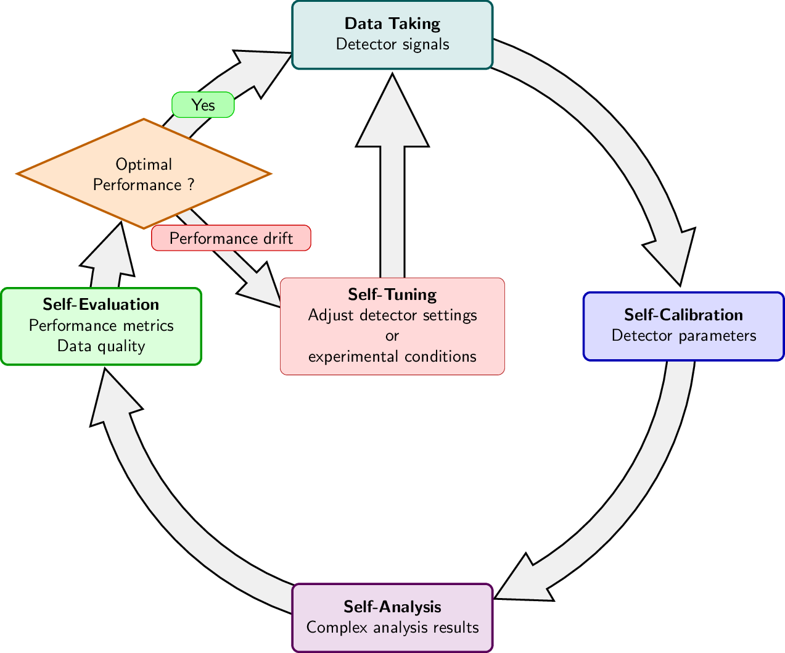
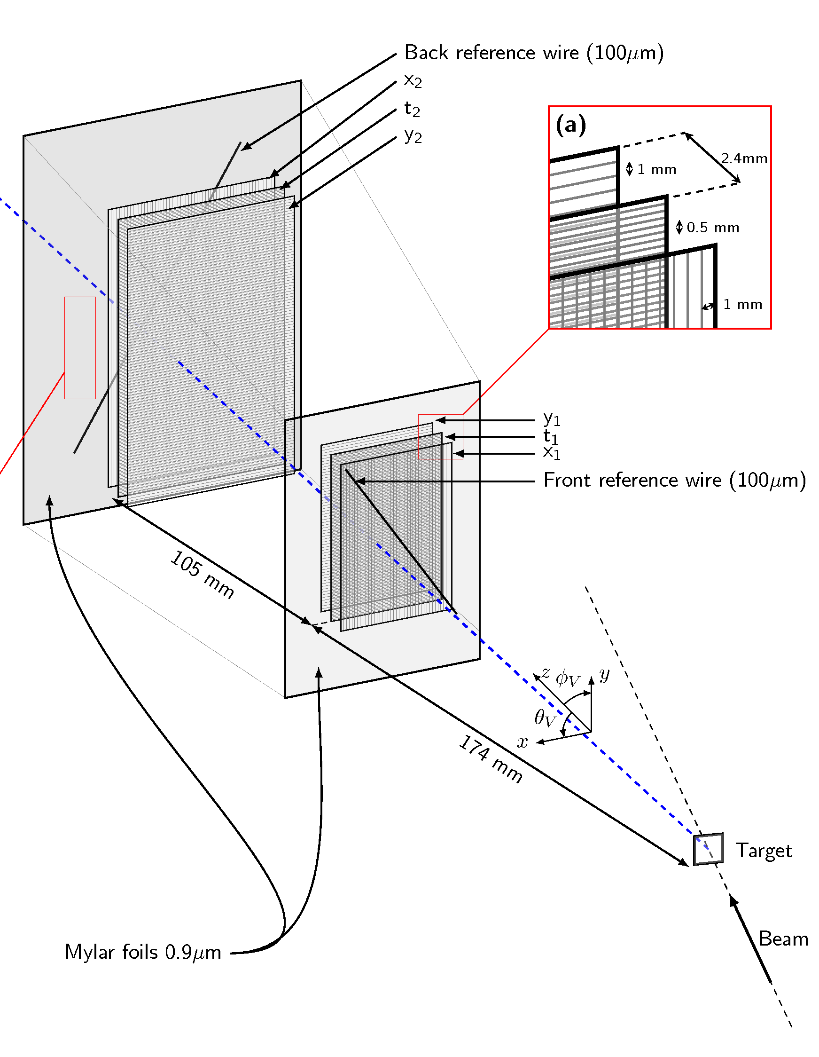
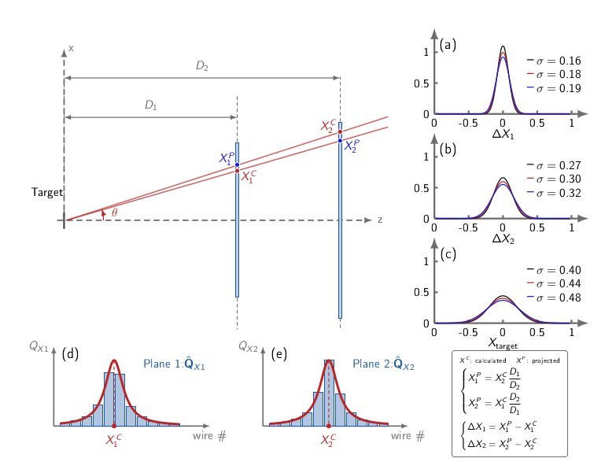
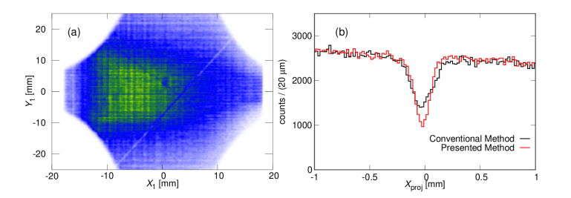
AI’s perception of the instrument
Dual Position MW
M. Vandebrouck et al
NIM A (2016)
Self-Calibration (no labels !)
Learning from the production data :
Calibration of all wires
Charge Profile
Fast process (minutes)
Improved position resolution um->um
Online circular/repetitive process
Online optimization of detector
σ = 60 (2) µm
A. Lemasson, M. Rejmund, In Prep. (2026)
σ = 92 (2) µm

Slide 21
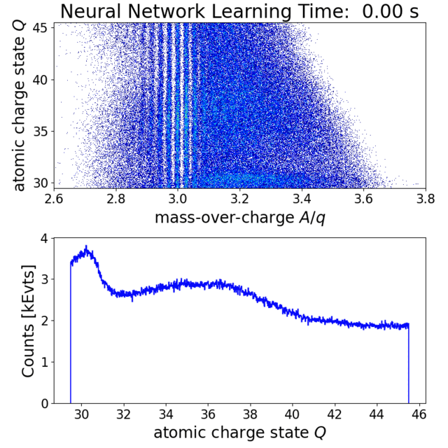
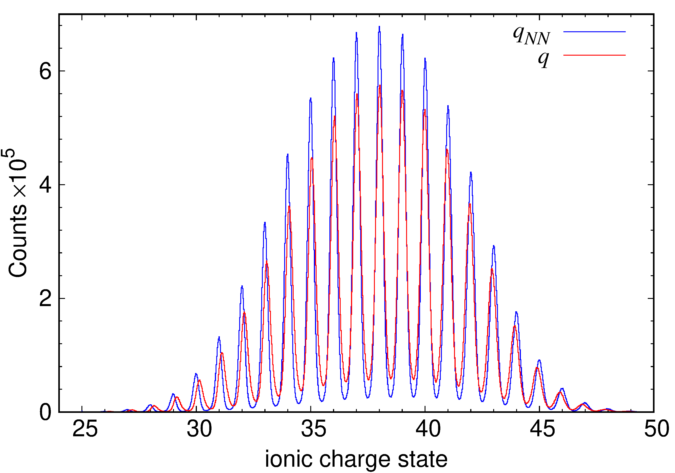
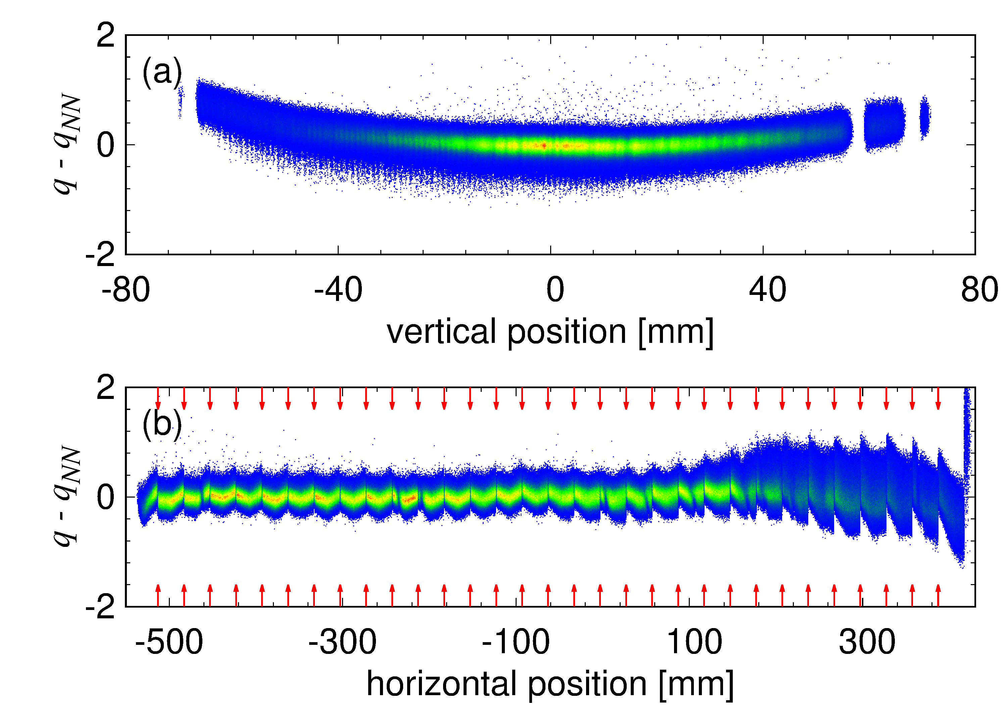
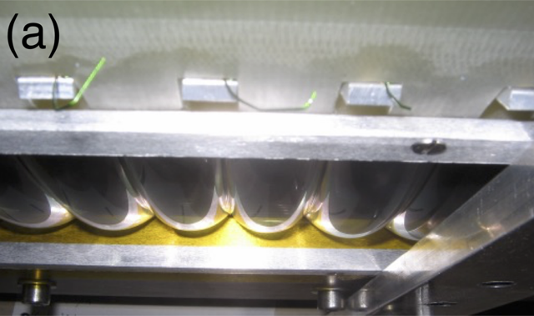
AI’s perception of the instrument
How it happens
Self-Calibration
=> Specialized Model
Self-Calibration + Self Analysis
Learning from the production data :
  Calibration of all IC Pads
  detector imperfections
  (downstream specialized model accounting for it)
Fast process (minutes)
Improved resolution (ion charge state [q] and atomic number [Z])
Online cicular/repetitive process
Online optimization of detector
Spatial detector imperfection tracking

Slide 22
AI’s perception of the instrument
AI’s perception of the instrument
VAMOS++ Large Acceptance Spectrometer :
  7D Ion Trajectory Reconstruction in Spectrometer
  M. Rejmund, A. Lemasson, NIMA 1076 170445 (2025)
  Self-Calibration : Ion Trackers
  A. Lemasson, M. Rejmund (In prep., 2026)
  Self-Calibration and Self-Analysis : Ion Identification (Z, A, q)
  M. Rejmund, A. Lemasson, submitted / arxiv : 2606.29466v1 (2026)
PISTA :
  Self-Calibration : Highly segmented Silicon Detectors
  Ion Identification (Z, A)
  M. Rejmund et al., submitted (2026)
Gains :
  Labelling-less + Human-Bias-less
    Precision
    Reproducibility
    Speed
    Scalability
  Detection Optimizability
  Detection Imperfection Tracking
Upcoming :
  Self-Tunning : Machine Learning Optimization
  Full Online Implementation
VAMOS is now
an Intelligent Instrument to provide even higher quality data

Slide 23
Almost twenty years of Fission at VAMOS++
We learned to experimentally trace fission fragments back toward scission, revealing the deformation, energy and proton/neutron structure of the nascent fragments.
We showed that the proton structure of the emerging fragments is a major driver of asymmetric fission, with common fingerprints extending from neutron-deficient Hg
to the actinides.
We showed that nuclear shells influence not only the yields but the dynamics itself, modifying dissipation and potentially the saddle-to-scission time.
+ Fission Fragments Spectroscpy program
already discussed this week !
M. Caamaño et al., PRC 92, 034606 (2015);
M. Caamaño & F. Farget, PLB 770, 72 (2017);
D. Ramos et al., PRC 101, 034609 (2020).
D. Ramos et al., PRC 97, 054612 (2018);
D. Ramos et al., PRL 123, 092503 (2019) ;
D. Ramos et al., PRC 113, 054611 (2026).
C. Schmitt et al., PRL 126, 132502 (2021);
A. Jhingan et al., PRC 106, 044607 (2022),
D. Ramos et al., PRC 97, 054612 (2018);
D. Ramos et al., PRC 107, L021601 (2023).
A. Navin and M. Rejmund, Yearbook of Science & Technology (2018),
A. Lemasson et al, EPJA (2023)
….
We $≡$ Long Standing Fission (Dynamics) Collaboration around VAMOS
Path followed :
Continuous improvement of fission products measurement →
reconstructing scission quantities →
identifying the microscopic structures controlling the path →
experimentally probing the dissipation along that path

Slide 24

Nuclear fission has entered a new era of precision and correlation
Hunting for high-quality, unique datasets :
New experimental setups provide simultaneous access to multiple correlated observables
Increasingly complete kinematics allow us to trace the system back toward scission using isotopic information on fragments
ML/AI offers new opportunities to push resolution, identification and reconstruction beyond traditional limits
Unprecedented experimental information available :
Multi-dimensional observables: $Y(A,Z,E^{∗})$, $ν(A,Z,E^{∗})$, $M_{γ}(A,Z?)$, $S(A,Z?)$, $TKE(A,Z,E^{∗})$,
Measurements across an increasingly broad range of fissioning systems, excitation energies and angular momenta
We entered an exciting period for nuclear-fission research:
richer experiments, more complete correlations and rapidly advancing theory
towards a deeper understanding the fission dynamics universal drivers

Slide 26








Fusion-Fission in n-deficient pre-Actinides
¹²⁴Xe (4.3 MeV/u) + ⁵⁴Fe → ¹⁷⁸Hg (E_{x}=34 MeV)
2 arms at 64° (folding angle)
Complete-Kinematics Measurement
2V method
First isotopic FF measurement in n-defficient pre-actinides
Confirmed presence of asymetric fission in ¹⁷⁸Hg
Pre-evaporation mass, TKE, neutron multiplicity
C. Schmitt et al. PRL 126, 132502 (2021)
10

Slide 27



From a proton content perspective
neutrons
M_{n} = M_{post} – M_{pre} ~ Shape relaxation after scission
Same microscopic contribution to N/Z at given Z for different N’s
Same magnitude of shape relaxation
at given Z for different N’s
deformed fragments with
28 < Z < 50 favored
Shell effect Z~34-36 (quadrupole + octupole)
Single isotopic experiment so far…
Additional experimental data needed
protons
Scamps and Simenel, PRC 100 (2019)

Slide 28

Continuous improvements of VAMOS
Improvements :
High Pressure
Ionisation chambers
Target MWPC
Focal Plane MWPC
Reconstruction methods
Software Standardisation
Machine Learning / AI

Slide 29

And much more at VAMOS
D. Ramos et al., PRC 107, L021601 (2023).

Slide 30

Detecting two fission fragments
Inverse Kinematics using beams of ²³⁸U/²³²Th around Coulomb Barrier
Access to a range of exotic fissioning systems heavier than ²³⁸U
VAMOS
Fission Fragments
(A,Z,q)
evaporation
fission
²³⁸U
@ 6 AMeV
transfer
reaction
VAMOS Magnetic Spectrometer
Direct and Complete isotopic identification of fission fragments
Precise center-of-mass fission fragment velocities
¹²C
target
Second Arm
recoil
Distribution of FF
Ongoing :
Second Fragment as precisely measured as possible
  Pre-neutron evaporation fission yields
  Isotopic distribution of FF Kinetic Energy
  Isotopic neutron evaporation multiplicities
Vlab1
θ₁
Vcm1
Boost
θ₂
Vcm2
Vlab2
observables:
Fissioning System:
- A, Z, E*, angle, velocity
Fission Fragments:
- A^{post}, Z, q, angle, velocity

Slide 31

Towards Complete Measurements
Inverse Kinematics using beams of ²³⁸U/²³²Th around Coulomb Barrier
Access to a range of exotic fissioning systems heavier than ²³⁸U
VAMOS
Fission Fragments
(A,Z,q)
evaporation
fission
VAMOS Magnetic Spectrometer
Direct and Complete isotopic identification of fission fragments
Precise center-of-mass fission fragment velocities
²³⁸U
@ 6 AMeV
transfer
reaction
¹²C
target
Second Arm
recoil
PISTA
Recoil
(A, Z, E*, angle)
Distribution of FF
Gamma-rays
Gamma-ray multiplicities
Spin distributions
Angular correlations wrt Fission Plane
Vlab1
θ₁
¹⁰Be
Vcm1
FF
Boost
θ₂
²³⁸U
Vcm2
FF
Vlab2
¹²C
observables:
Fissioning System:
- A, Z, E*, angle, velocity
Fission Fragments:
- A^{post}, Z, q, angle, velocity

Slide 33
Tracing back to scission
(Z,A)-neutron multiplicity-TKE
The neutron excess N/Z also helps the study of the correlation between neutron and proton shells.
²³⁹U
²³⁹U
By combining several systems the role of proton- and neutron- octupole deformed shells [G. Scamps, C Simenel, Nature 564, 382 (2018)] are reflected
The large production of Te in ²³⁹U can be explained by the combined effect of the octupole shells in Z=52 and N=84
The production of Ba is explained by the effect of N=88 in ²⁴⁰Pu and N=56 in ²³⁹U
²³⁹U
2v method
Y(A_{pre},Z), <N_{pre}>/Z(Z), <ν>(Ζ)
D. Ramos et al., Phys. Rev. C 101, 034609 (2020)

Slide 35
A set of revisited and new observables
Fragments N excess (<N>/Z)
D. Ramos et al. (2019)
Post
Reveals fine structural effects otherwise unnoticed
N=82 (~spherical) and N=88 (deformed / Octupolar)

Slide 36



PISTA : Improving fissioning system identification
Fissioning System Identification
SPIDER
PISTA
GANIL-CEA/DAM collaboration
ΔE
100 µm thickness
0.5 mm strips (θ)
10 cm from target
E
1 mm thickness
1.2 mm strips (ɸ)
2023
¹⁰Be
FF
²³⁸U
FF
¹²C
High granularity
(0.5 mm strips)
High homogeneity
  ∆E_{x}∼800 keV (FWHM)
²³⁹Np
²³⁸⁻²³⁶U
²⁴⁰⁻²⁴¹Pu
L. Begué—Guillou et al. NIM A 1090, 171671 (2026) 10.1016/j.nima.2026.171671

Slide 37


Fission in inverse kinematics at VAMOS/GANIL
Inverse Kinematic using beams of ²³⁸U/²³²Th around Coulomb Barrier
Access to « exotic » fissioning systems heavier than ²³⁸U
evaporation
transfer
reaction
fission
²³⁸U
@ 6 AMeV
¹²C
target
recoil
SPIDER/PISTA
Recoil
(A, Z, E, angle)
L. Begué—Guillou et al. NIM A 1090, 171671 (2026) 10.1016/j.nima.2026.171671
L. Begué—Guillou et al. (PhD GANIL/CEA-DAM)
Surrogate reactions
(transfer induced fission)
Selection of the fissionning system
Measurement of the excitation energy
The reconstruction of the binary reaction also provides information on the fission barrier
37
observables:
Fissioning System:
- A, Z, E*, angle, velocity
Fission Fragments:
- A^{post}, Z, q, angle, velocity

Slide 38

Scission Observables - Detection of both fragments
2v method
²³⁹U
²³⁹U
²³⁹U
56
The neutron excess N/Z also helps the study of the correlation between neutron and proton shells.
50
52
By combining several systems the role of proton- and neutron- octupole deformed shells [G. Scamps, C Simenel, Nature 564, 382 (2018)] are reflected
The large production of Te in ²³⁹U can be explained by the combined effect of the octupole shells in Z=52 and N=84
88
82
84
The production of Ba is explained by the effect of N=88 in ²⁴⁰Pu and N=56 in ²³⁹U
D. Ramos et al., Phys. Rev. C 101, 034609 (2020)
16

Slide 39
Exploring further the fission landscape
Pre-Actinides N/Z ~ 1.2
Unexpected Assymetric fission
in ¹⁸⁰Hg (Andreiev et al PRL (2010) )
=> New stabilizing effects
at Z ~ 36 deformed (octupole) configuration
Ongoing programs :
- Fusion Fission GANIL / JAEA
- Electromagnetic probe @ GSI
Actinides N/Z ~ 1.5
Identified shell effects
(Z= 52, 56, N=82,88)
Competition between modes
Open questions on the pairing and the damping of shell effects with E*
Isotopic scission observables
Looking for a coherent picture across the landscape

Slide 40

Rich ongoing and future studies at VAMOS
Actinides : precision measurements
  PISTA : unprecedent precision on
  the entrance channel (A,Z,E*)
      shell effect damping with E*
      even-odd effect
  ²³²Th beams : new systems available
  Two velocities measurements
  γ-rays : Calorimetry and Angular Momentum
  Towards nuclear data standards
Pre-Actinides : uncharted territory
  Exploring the island of asymmetry ¹⁸⁴Pb
  (E851 , June 2024)
  ²¹⁰Po : Fusion fission on ⁴He cooled gaz target
  (E882, March 2025), at the crossroads
Unified view of fission
Actinides : precision measurements
  PISTA : unprecedent precision on
  the entrance channel (A,Z,E*)
      shell effect damping with E*
      even-odd effect
  ²³²Th beams : new systems available
  Two velocities measurements
  γ-rays : Calorimetry and Angular Momentum
  Towards nuclear data standards

Slide 41


Rich ongoing and future studies at VAMOS
Actinides : precision measurements
  PISTA : unprecedent precision on
  the entrance channel (A,Z,E*)
      shell effect damping with E*
      even-odd effect
  ²³²Th beams : new systems available
  Two velocities measurements
  γ-rays : Calorimetry and Angular Momentum
  Towards nuclear data standards
Pre-Actinides : uncharted territory
  Exploring the island of asymmetry ¹⁸⁴Pb
  (E851 , June 2024)
  ²¹⁰Po : Fusion fission on ⁴He cooled gaz target
  (E882, March 2025), at the crossroads
Unified view of fission

Slide 42

Fission studies at VAMOS/GANIL
Key Open Questions (Not all addressed here !):
  Dynamical evolution of complex quantum system
  At the crossroad of many research topics of nuclear physics with
  essential interplay between structural and dynamical properties of nuclei.
  Fully microscopic description of the whole fission process (fissioning system, fission dynamics and fission fragment distributions and properties) is not yet available
  What is the importance of dissipation in the process ?
Relevant observables for what ?
  Direct isotopic (A,Z) fission fragments data
  Complete fission yields
  => Probing the role of shell effect in fission and dissipation
  Kinetic energies and excitation energies of the fission fragments
  => Probing the scission configurations (A, Z, Energy sharing)
  Fission Barriers (evolution as function of excitation energy):
  => Probing the the potential energy surface as function of E*
  => Exploring the fission paths (different modes of fission)

Slide 43
Why fission still matters ?
How does the nucleus evolve from saddle to scission?
What are the relevant collective coordinates, timescales, dissipation and fluctuations along the fission pathway?
How do nuclear structure effects shape the fragment distribution?
When and how do shell effects, pairing and deformation select preferred mass/charge splits and scission configurations?
How are excitation energy and angular momentum shared between fragments?
What determines fragment \(N/Z\), intrinsic excitation, deformation energy, neutron/\(\gamma\) emission and spin?
How does the fission mechanism change with the initial conditions?
How do excitation energy, angular momentum and entrance channel modify shell damping, fission modes, multichance fission and fragment observables?
Test nuclear many-body dynamics in extreme conditions
Fission probes the interplay of collective motion, shell structure, pairing, dissipation and fluctuations far from equilibrium.
Constrain nuclear models and fundamental properties
Fragment yields, TKE, neutron/\(\gamma\) emission and correlations constrain potential-energy surfaces, level densities, barriers, energy sharing and scission dynamics.
Improve nuclear data for reactors and the fuel cycle
Accurate fission yields, prompt-neutron multiplicities and decay properties are essential for reactor calculations, decay heat, inventories, safety and transmutation.
Enable applications from astrophysics to safeguards
Fission data impact r-process nucleosynthesis and fission recycling, while also supporting nuclear forensics, safeguards, waste management and evaluated nuclear-data libraries.
Fission connects fundamental many-body physics to applications.
From shell effects and quantum dynamics → to fragment yields, neutrons and nuclear data.
But experimentally, we limted number of observabkes…

Slide 44


The richness of fission observables
The richness of fission observables
Formation :
Capture cross sections
Barrier to well after scission:
Fission fragment yields
Ground-state to barrier :
Fission probability (P_{f}), P_{n}, P_{g}
Prompt neutrons & gammas
²⁵²Cf
²⁵²Cf
neutron capture cross sections
Fission Barrier (Fission probability)
Fission Fragment Yields (A , (N,Z))
Kinetic Energies
Neutron multiplicities
Gamma-ray Emission
Cummulative yields
...

Slide 45
The richness of fission observables
The richness of fission observables
Formation :
Capture cross sections
Barrier to well after scission:
Fission fragment yields
Ground-state to barrier :
Fission probability (P_{f}), P_{n}, P_{g}
Prompt neutrons & gammas
²⁵²Cf
²⁵²Cf
Scientific Questions :
Large Collective motion
Microscopic effects (shell effects, paring, )
Dynamics : Dissipation, Energy Sharing

Slide 46


